Slide 1
and all that I can see is just another … AARC TREE!
a preliminary insight in potential developments in the AARC Community
David Groep
AARC Policy Area Coordinator
Nikhef Physics Data Processing programme and UM Dept. Advanced Computing Sciences
TNC23 Workshop Standing on the shoulders of giants
June 2023

Slide 2
Arguably the best remembered picture from our AARC community

Slide 3
Beyond a single BPA proxy – complexities in composite infrastructure
EOSC AAI was one of the triggers to extend the BPA
but is and will not be the only one!
2019 “BPA Reloaded” (AARC-G045) lead us
to composite proxy architectures
and as we see the need grow for
multiple instances of community and e-Infra proxies
to work together, we end up with …
… a federation of proxies ?! ☺
AARC G045 https://aarc-community.org/guidelines/aarc-g045/
and EOSC AAI Task Force report – ISBN 978-92-76-28113-9, DOI:10.2777/8702

Slide 4
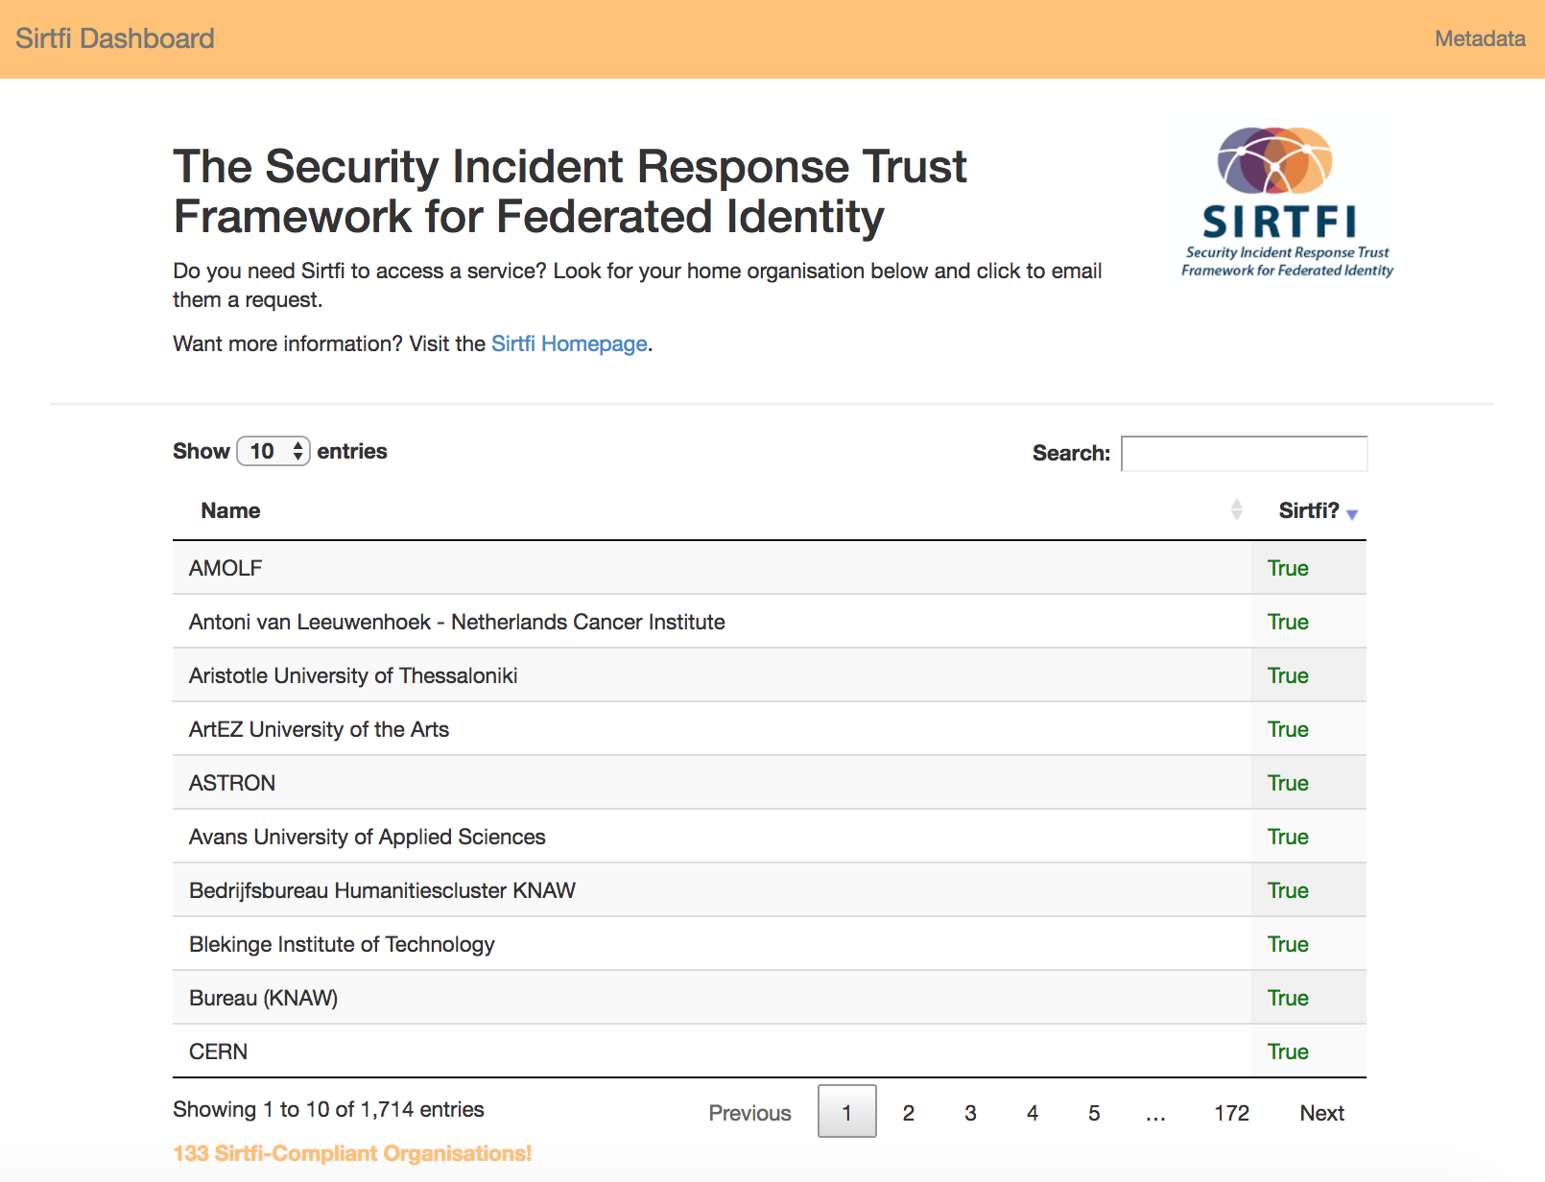
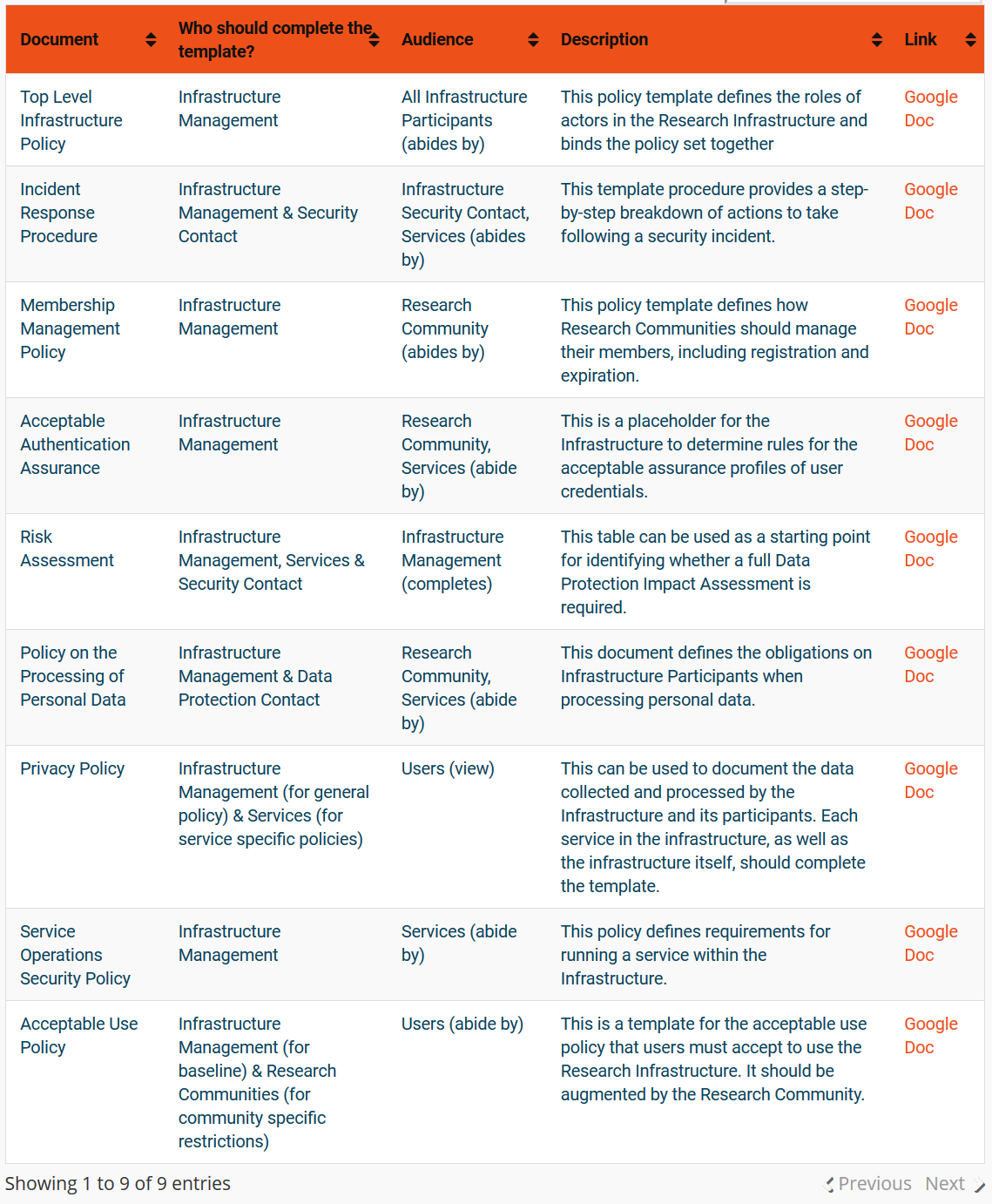
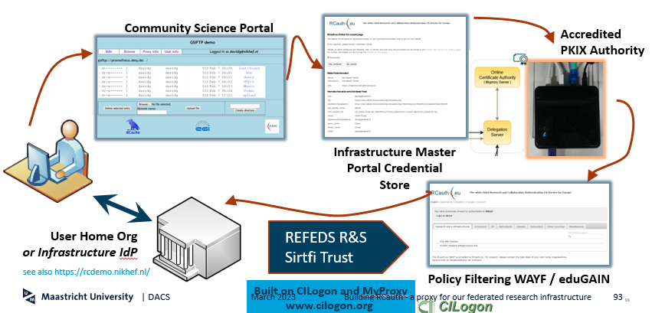
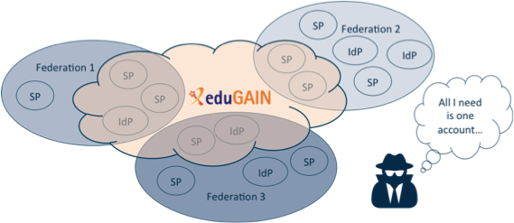

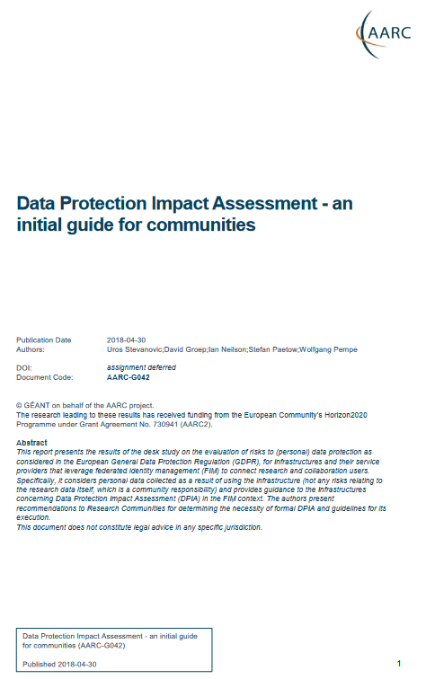


And an AARC beyond Sirtfi, RCauth, and the Policy Development Kit?
https://aarc-community.org/policy

Slide 5
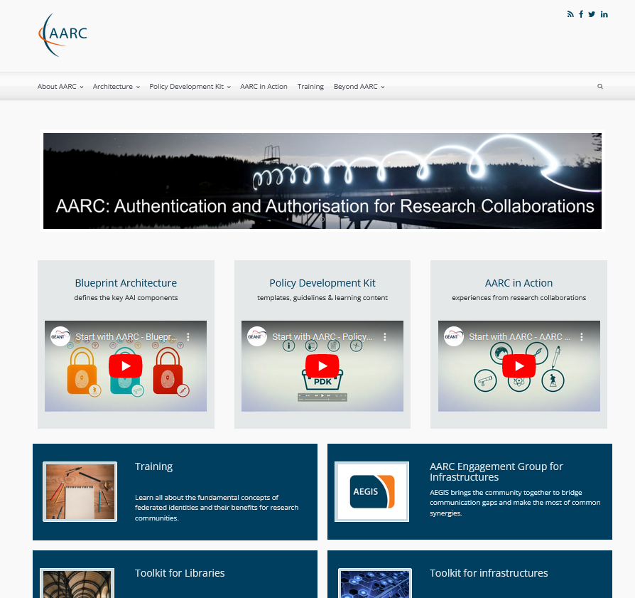
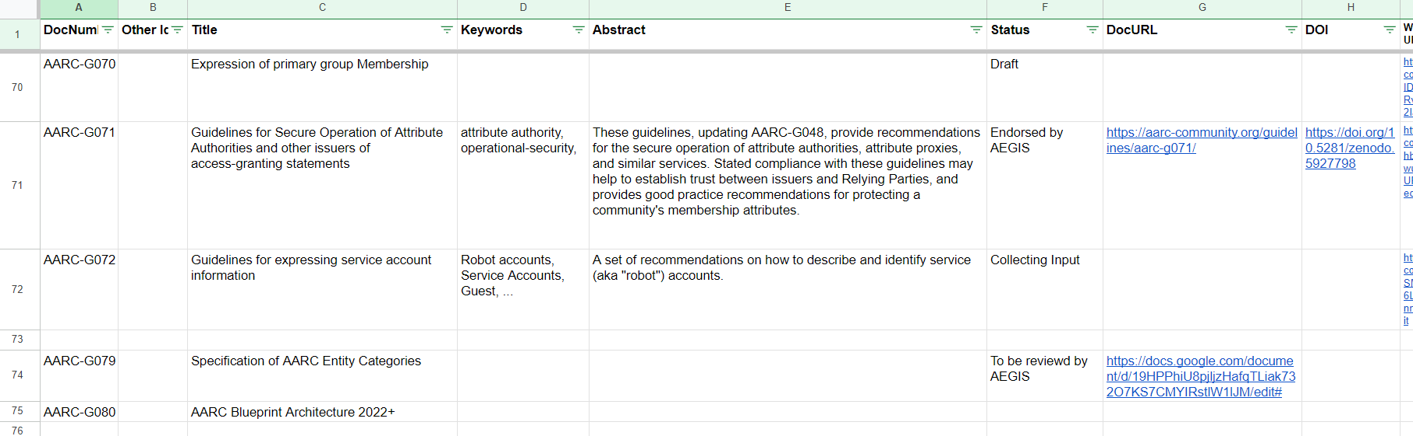
Our AARC Community
Work on structuring AAI is far from over – and the AARC community & AEGIS provide the framework:
architecture guidelines: primary group membership, service account information, entity categories, composite BPA proxy models
policy developments: ‘AAOPS’, trust federation
‘across proxies’, assurance, and community formation in the Policy Development Kit
Today supported by a range of
(inter)national infrastructures and
projects (like ‘GN51 EnCo’ & ‘EOSC’)
Using WISE, IGTF, REFEDS,
as open venues to convene and work
https://aarc-community.org/

Slide 6
So what are we facing now?!
meta-federations of research infrastructures and horizontal providers
interoperability with broader provider base, and not limited to just EU Wallets or SSI
need better uptake and integration of the BPA, and in more Research Infrastructures
a need for assurance (in FIM4R and beyond),
without a ubiquitous source in R&E … but with govt. eID capabilities for some
plus all the things we just heard about before!
It’s time to enhance the effectiveness of the AARC BPA and PDK
leverage AARC’s structuring effect to ease interoperation across thematic areas, and
increase impact of the BPA in new communities (within and outside of EOSC)

Slide 7
Who should sit under the AARC TREE … and who do we need on board
Research Infrastructures and e-Infrastructures, both national and international facilities
providers of resources and services for research communities, ERICs, ESFRIs, and other (data) sources
Research Communities
scientific communities, collaborations and individual researchers, (so including our mid-sized groups)
EU and global initiatives
International Data Spaces Association (IDSA), GAIA-X, EU ID Wallets, FIM for Research (FIM4R), &c
Service and resource providers:
AAI and other providers interested in offering their services and resources to researchers
EOSC Ecosystem
EOSC related initiatives like EOSC Association Task Forces and other EOSC projects

Slide 8
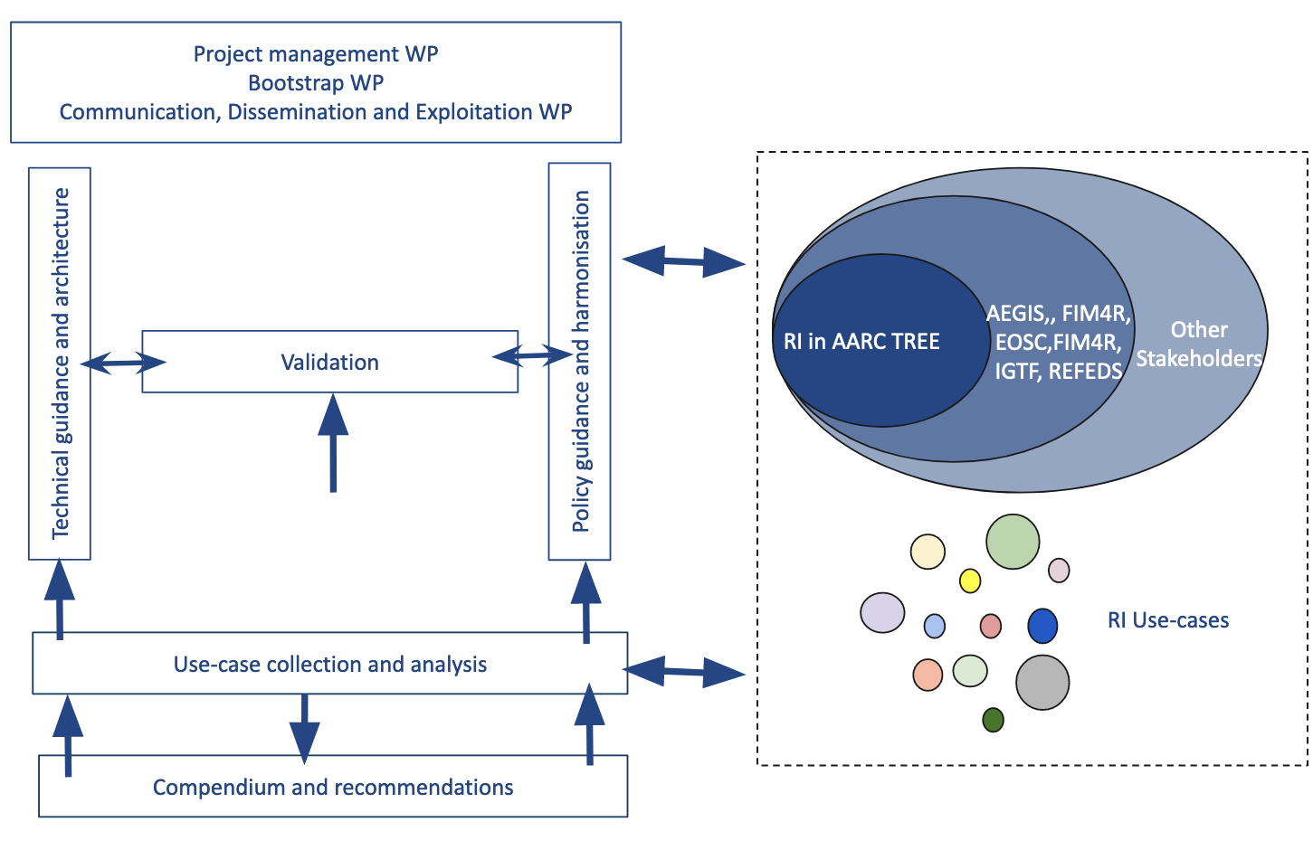
Growing an AARC TREE

Slide 9
sprouting an evolved architecture
Evolution of the AARC Blueprint Architecture
including a more prominent role for OpenID Connect federation
federated authorization mechanisms
Harmonisation of community user attributes
application integration across different protocols
OpenID Connect Federations
deployment profile of the specification
addressing the challenges we face now in the heterogeneous EOSC AAI ecosystem
Authorisation for Federated Resources
authorization policy interoperability
Decentralised Identities
EU Digital Identity Wallet, distributed Identifiers, verifiable creds & presentations, decentralised storage

Slide 10
and evolved AARC policy development
Research-infrastructure alignment and policy harmonisation
Operational Trust for Community and Infrastructure BPA Proxies
Snctfi - increasing acceptance of research infrastructure proxies with R&E identity providers and sources of authentication
Review infrastructure models for coordinated AUP, T&C, and privacy notices, improving
cross-infrastructure user experience
User-centric trust alignment and policy harmonisation
Lightweight community management policy template
Guideline on cross-sectoral trust in novel federated access models
Assurance in research services through (eIDAS) public identity assertion
FIM4R policy workshop series on validation of the restructured policy framework
(together with the new ‘BPA’)

Slide 11
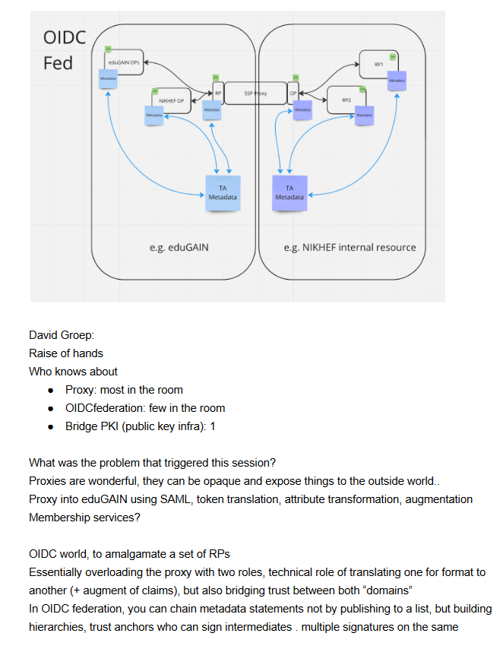
Just one of the many topics to try …
In today’s BPA, the proxy links both sides by being opaque, both for attributes as well as for trust
does it have to be that way?
separate claims/attribute transformation from trust bridging?
can OIDCfed structures convey trust transparently?
can we do more that way? or would it just confuse everyone?
easier to bridge trust across sectors this way?
edu, gov, and private?

Slide 12
A proven methodology
Provide guidance based on a
broad and open community process:
FIM4R, EOSC, AEGIS, WISE, REFEDS, IGTF, AppInt, …
Experts gather in open, dedicated teams
Iterative stakeholder engagement
practical validation in use cases of
the research and e-infras, e.g. through AEGIS

Slide 13










We need our collaborators and stakeholders … and thus: you!
Use Cases Collection and Analysis
with the large ESFRI RIs, clusters, and national nodes to
validate BPA effectiveness and
act as a flywheel to increase its application
followed by adoption and validation
Compendium & Recommendations
have the validators and use cases have a broader impact by promoting them as ‘community good practice’ examples – and telling the world about it.
The ‘Compendium’ model helped us before ☺
just some of the RIs that are looking for a BPA with enhanced effectiveness

Slide 14
What would be the presents under a (funded) AARC Tree?
Updated AARC Blueprint architecture for emerging technologies and
services in pan-European research infrastructures
  Up-to-date guidance on implementing the architecture of their Authentication and Authorisation Infrastructure service components, incorporating new requirements, use cases and new technologies.
Recommendations for a common long-term strategy for AAI services and best practices
  AARC TREE best practices and recommendations with new technical approaches and collaboration in its implementation across scientific domains
Updated interoperability framework
  Framework to harmonise AAI policies to empower identity providers, service providers and user communities to identify interoperable policies for the open science vision.

Slide 15
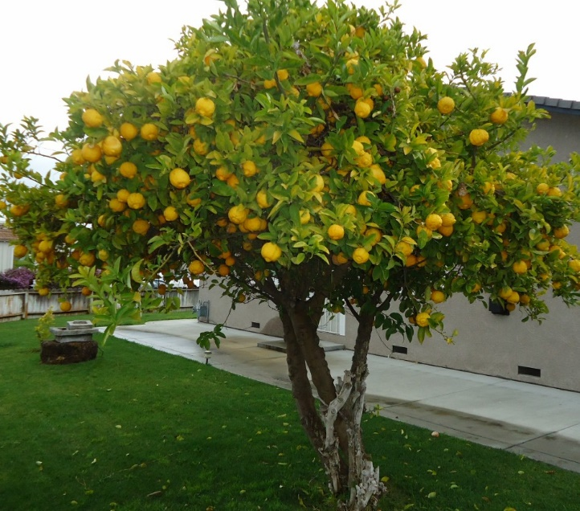
davidg@nikhef.nl
Any and all information in this document SHOULD NOT be construed as an endorsement of any particular organisation or plan.
All information subject to change without notice. Information presented here MUST NOT be quoted out of context. (RFC 2119)
Lemon tree image: Tomwsulcer, https://commons.wikimedia.org/wiki/File:Lemon_Tree_in_Santa_Clara_California.jpg

