Slide 1
When Software Enters the Stage
Roel Aaij
November 30rd, 2023

Slide 2
1
Version Control
It’s very easy to forget what you did even a few days ago
When working on multiple projects, it’s worse
When writing your thesis, you’ll need to remake plots
You want to keep track of the history of what you’re doing
Data
Code
Documentation
The answer is: version control
A very popular tool: git
https://swcarpentry.github.io/git-novice/

Slide 3
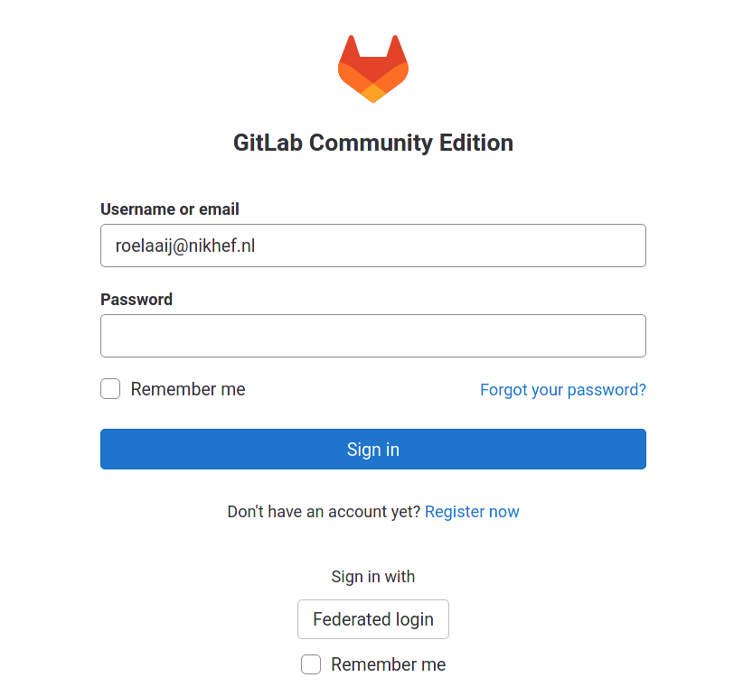
1
GitLab
We now have a repository somewhere on stoomboot, let’s make that more useful
go to https://gitlab.nikhef.nl and hit “Federated login”

Slide 4
1
GitLab SSH Keys
Intermezzo: add your SSH key to gitlab
https://www.nikhef.nl/pdp/computing-course/work/ssh.html
cat ~/.ssh/id_rsa.pub
Click on your profile and select “Preferences”

Slide 5
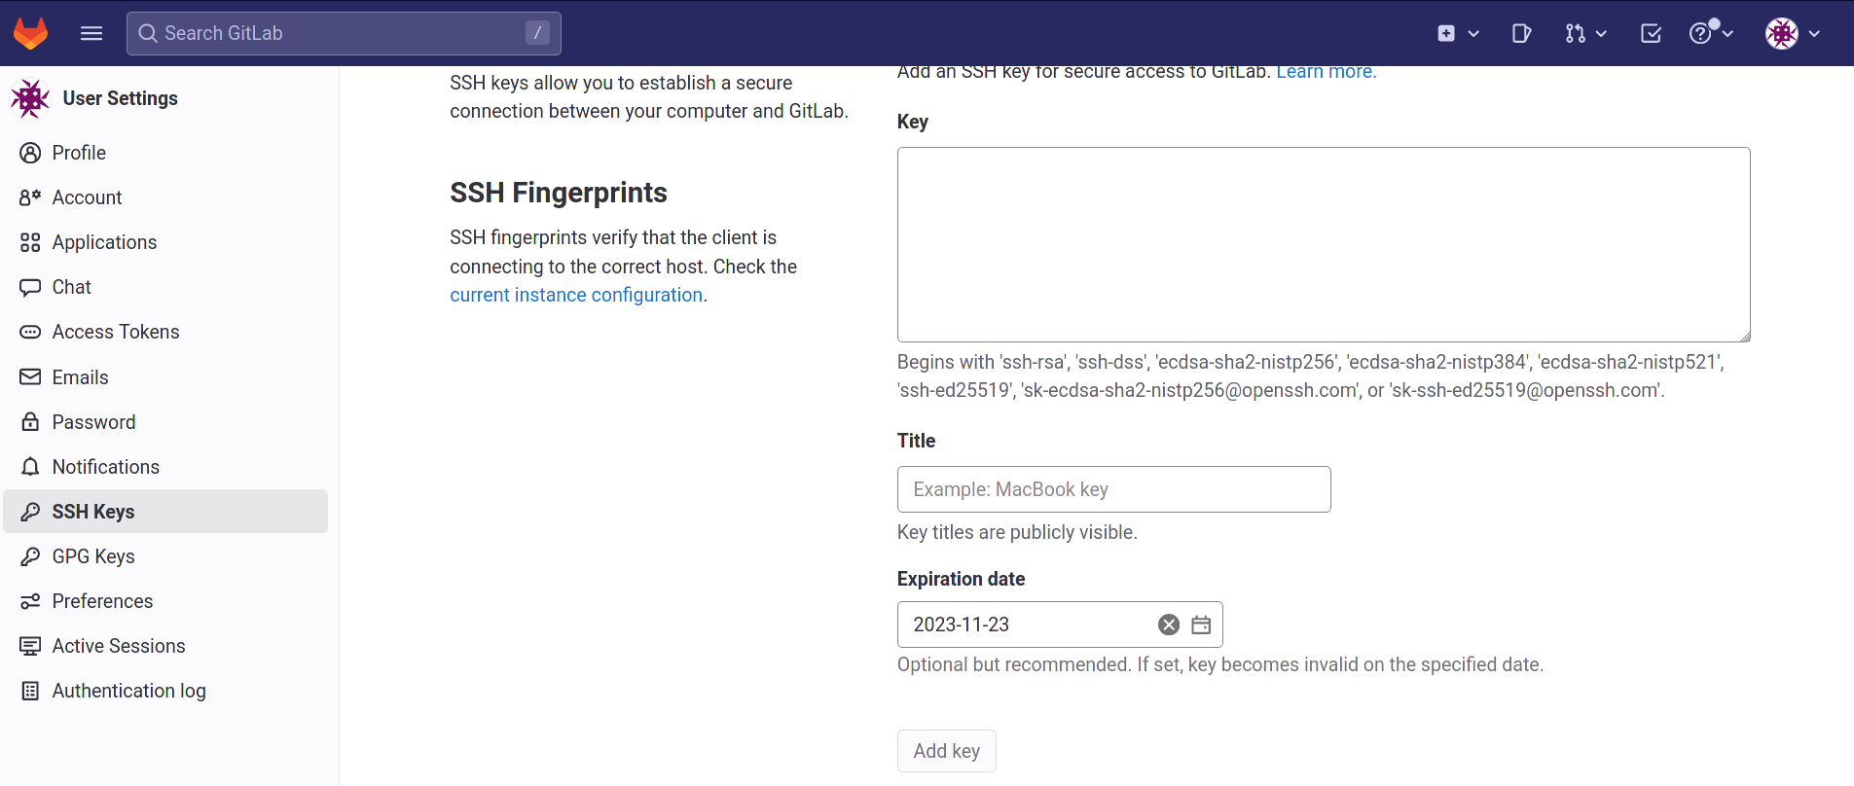
1
GitLab SSH Keys
Select “SSH Keys” from the menu on the left
Copy paste your public key into the box and add it with a title

Slide 6
1
New GitLab project

Slide 7
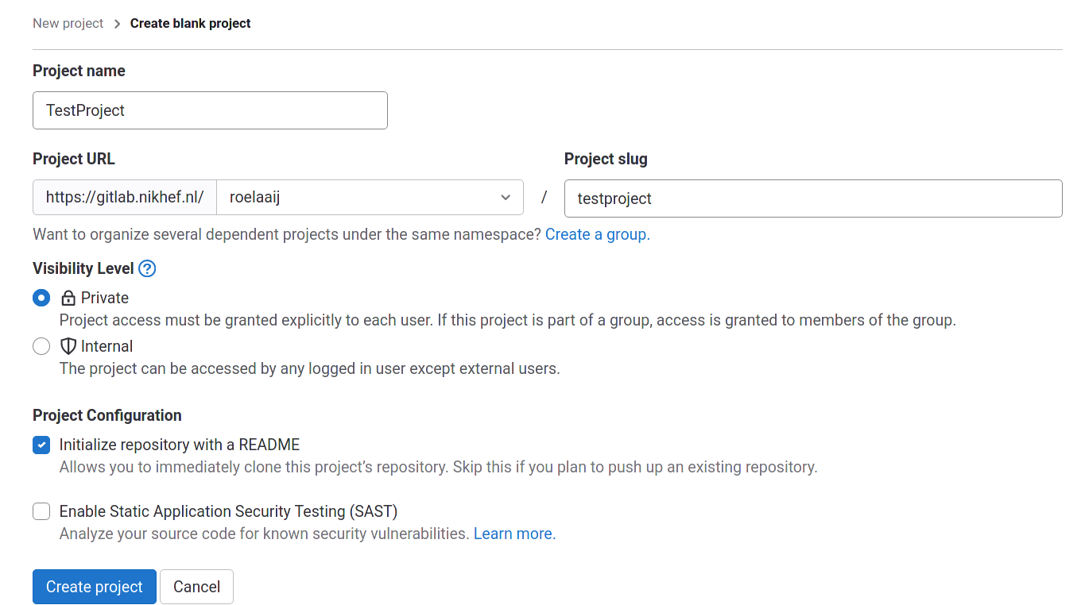
1
New GitLab project

Slide 8
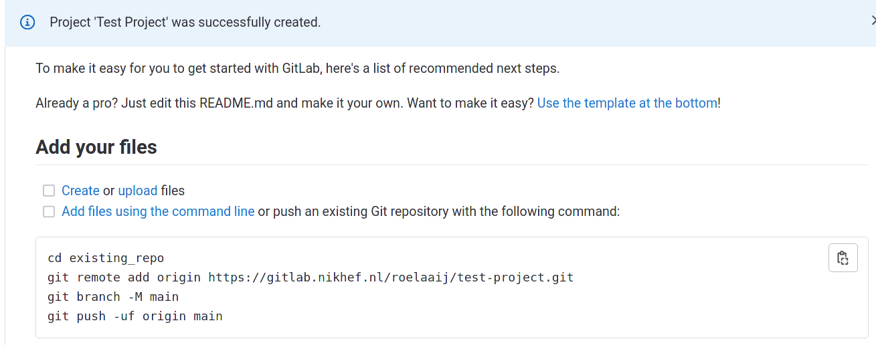
1
New GitLab project
Copy the commands, but instead of https, we need ssh

Slide 9
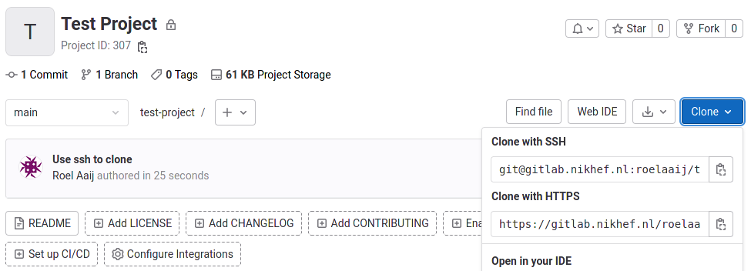
1
New GitLab project
Copy the ssh URL

Slide 10
1
What about data?
You should keep track of your data too
Git is great for ASCII encoded files, not so much for binary
Do it in the same repository, with symlinks
Create folders for various types of files
Work in progress
Plot created from this data
Data used for thesis or publication
etc.
Use the symlinks in your code and notebooks
Commit them as part of the rest

Slide 11
1
What about software?
Create a conda environment https://www.nikhef.nl/pdp/computing-course/software/where-to-get.html
Create conda spec file, and store it in your repository: $> conda list --explicit > spec-file.txt
Create environment from spec file: $> conda create --name myenv --file spec-file.txt
This relies on the availability of packages in conda
For experiment software: include the version(s) of the release
For software you develop:
Create a repository for your software
Create a release
Upload it to zenodo
cite the DOI
For those who want more: build containers

Slide 12
1
Zenodo
Zenodo is a general purpose repository for scientific documents and data
Hosted by CERN
For each submission, a digital object identifier (DOI) is created, which allow citation of the submission
Let’s go and upload something:
$> tar jcf my_repo.tar.bz2 my_repo
https://sandbox.zenodo.org/
sign up (easiest with ORCID)
log in
upload

Slide 13
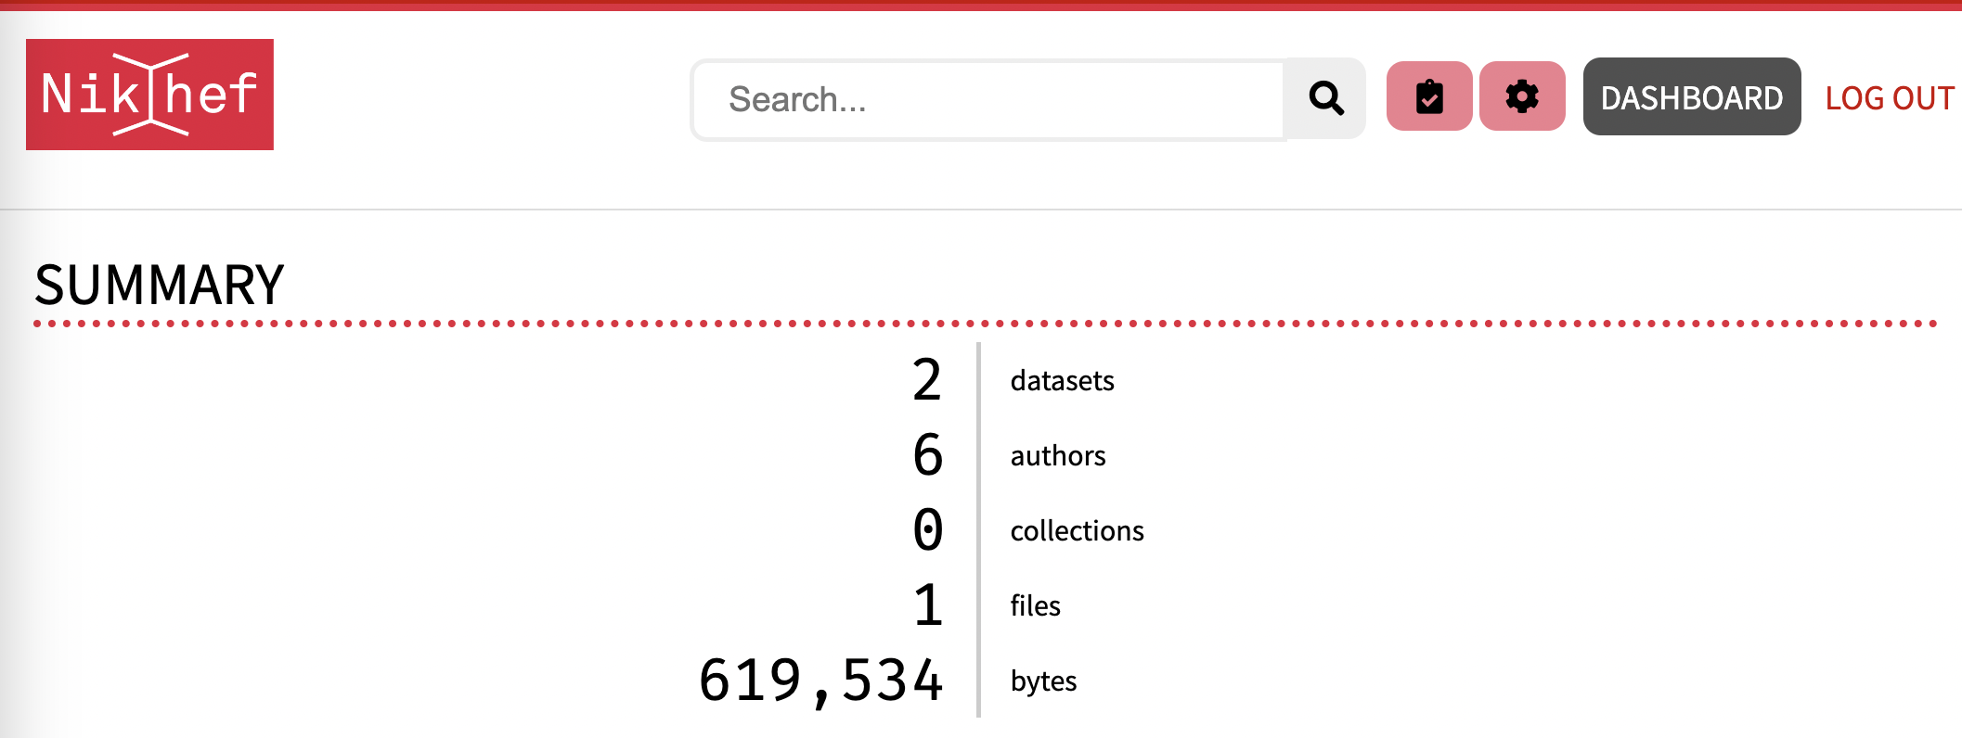
1
Djehuty
Djehuty is Nikhef’s institutional repository for scientific documents, software and data (pre-published and published)
Hosted by Nikhef, created together with 4TU/TU Delft
At the moment Beta, production will be live in 2024
Accessible at archive.nikhef.nl

Slide 14
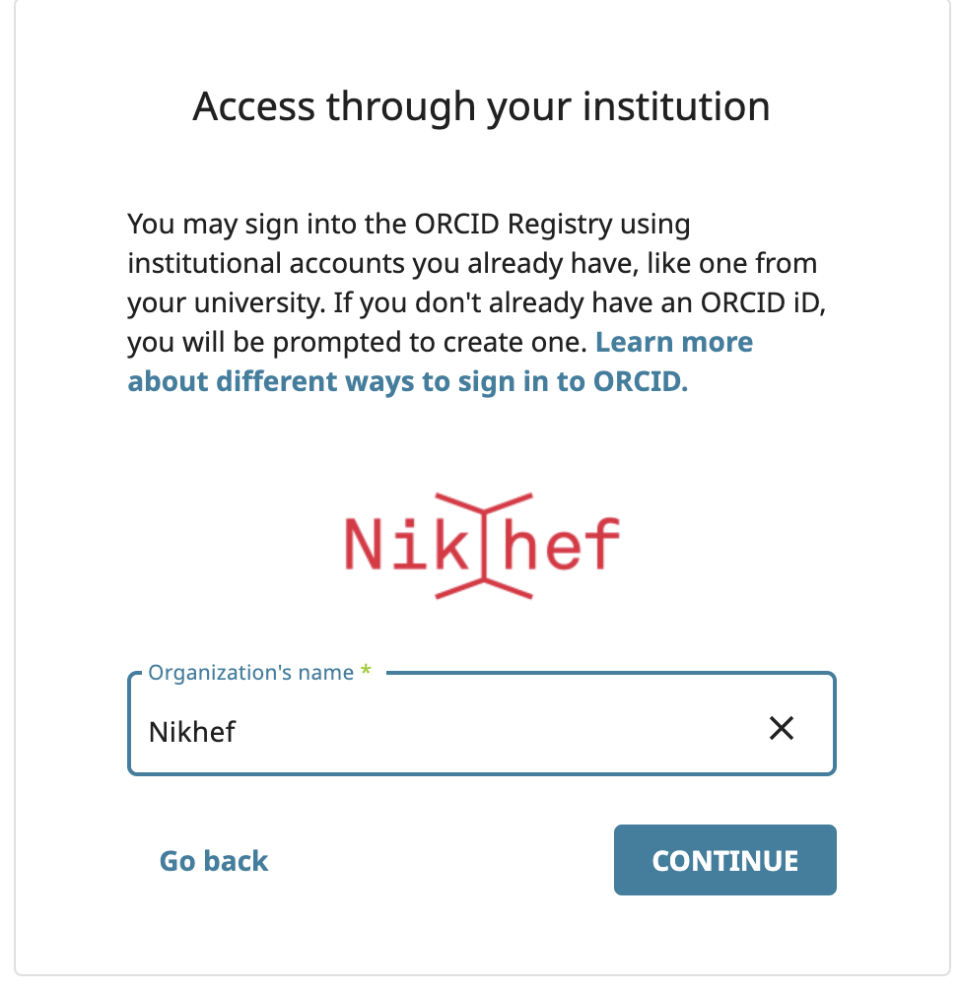
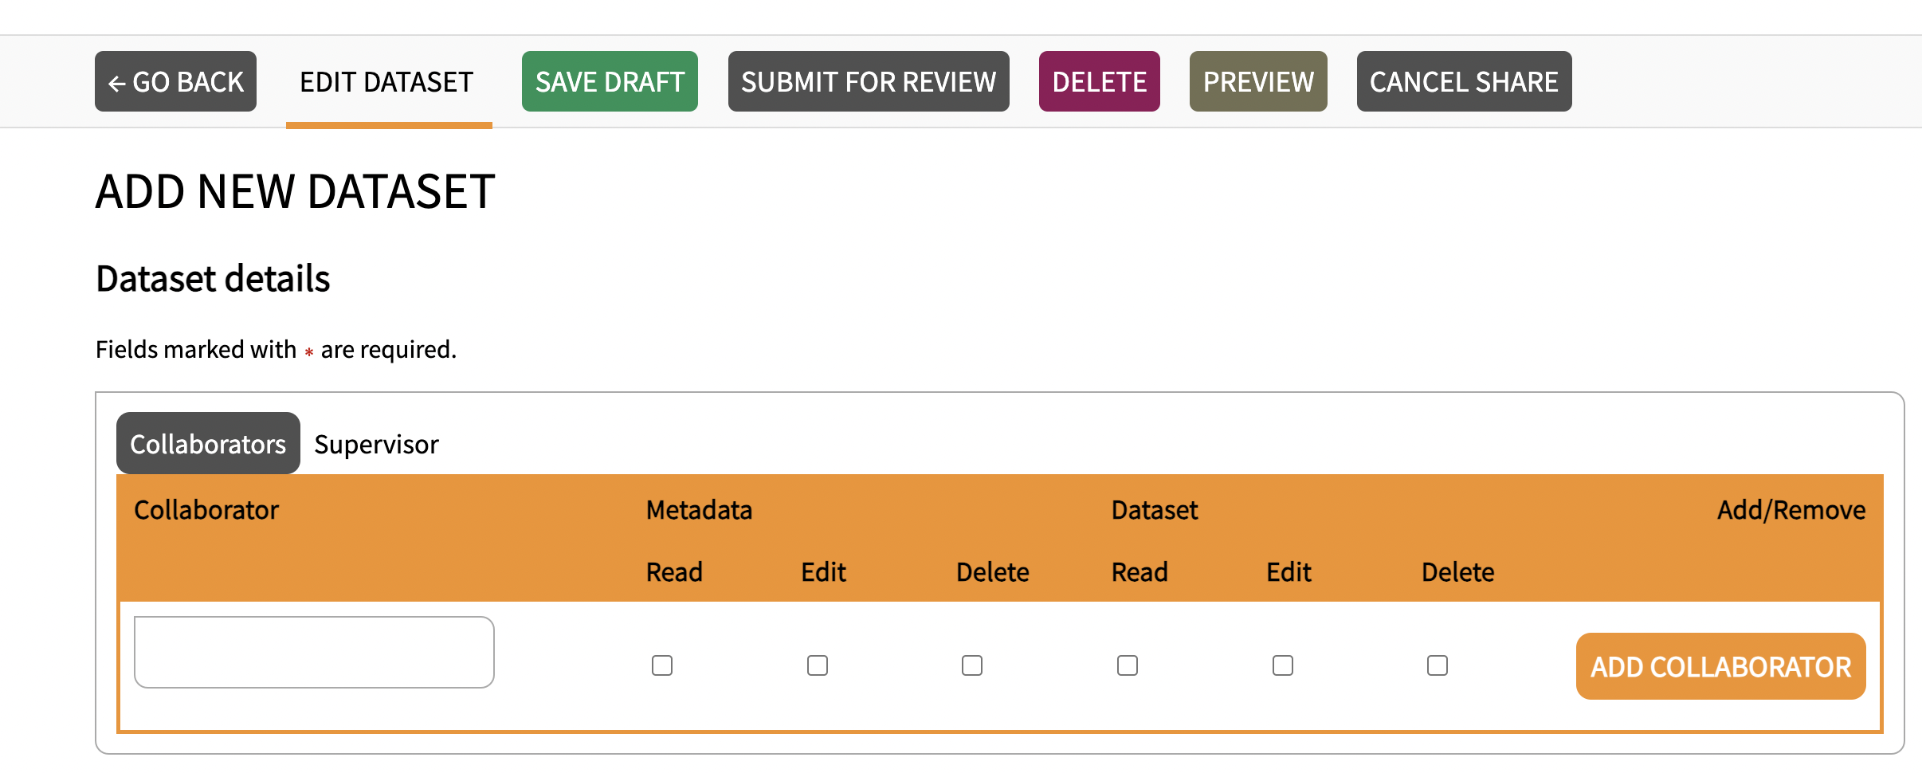
1
Djehuty
Login via SSO – Orcid
Private links to share (read-only) datasets with others
Add collaborators to your dataset (WIP)
Upload different versions of your dataset (WIP)
Categories will be based on (nested) tags, to grow with new research (future feature)
We need more users to optimize this tool, please talk to Catharina (cvaendel@nikhef.nl) or join our Mattermost to join our user-panel. (https://mattermost.nikhef.nl/nikhef-members/channels/nikhefs-institutional-repository)

Slide 15
1
arXiv
arXiv is a preprint server
The majority of papers in our fields are put on arXiv
No peer-review, also many “interesting” papers
A DOI is generated for each submission
arXiv publications can be cited
Don’t forget to update the citation once a journal publication is available
Many categories available:
https://arxiv.org
https://arxiv.org/archive/hep-ex
https://arxiv.org/archive/hep-ph
https://arxiv.org/archive/hep-th
https://arxiv.org/archive/cs.LG

Slide 16
1
Journal
In addition to what you create, you may also want to keep track of what you do
A research journal
You can do it on old-fashioned paper
Or use a digital one and store it using git (with a remote on gitlab.nikhef.nl)
Emacs + org-mode: https://orgmode.org/worg/org-tutorials/org4beginners.html
Markdown in your editor of choice
LaTeX
Jupyter notebooks: https://nextjournal.com/schmudde/how-to-version-control-jupyter

