Slide 1




Pixel TPC testbeam results
Yevgen Bilevych, Klaus Desch, Harry van der Graaf, Fred Hartjes, Jochen Kaminski, Peter Kluit, Naomi van der Kolk,
Cornelis Ligtenberg,
Gerhard Raven, and
Jan Timmermans
8 Quad Module
Lepton Collider 26 June 2023

Slide 2
DESY testbeam Module Analysis
Towards a paper
Results on diffusion for B=0 and 1T data
Results on deformations and tracking precision for B=0 and 1 T data
- In the pipeline dE/dx and particle identification B=0 and B=1 T data

Slide 3

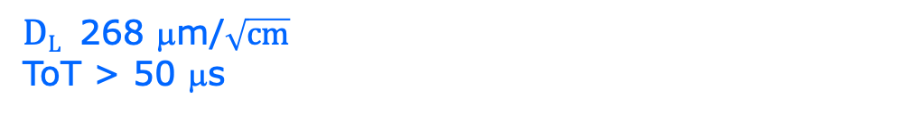
DESY testbeam Module Analysis
Study of the B = 0 T field data set
runs 6916 6917 6918 p=6 GeV
Fit quality χ²/ndf = 124/137 χ²/ndf = 96/121
$DT$ 287 μm/$\sqrt{cm}$
$DL$ 268 μm/$\sqrt{cm}$
ToT > 50 μs
Preliminary
E_{d}=280 V/cm
B=0 T
T2K*
T2K* = T2K gas with O₂ and H₂O

Slide 4
DESY testbeam Module Analysis
Study of the B = 0 T field data set
runs 6916 6917 6918 p=6 GeV
Some numbers: 6854 TPX3 Telescope tracks mean nr TPX3 hits 964.3
Fitted drift velocity per run in mm/ns
run 6916 vdrift 0.0630034
run 6917 vdrift 0.0630206
run 6918 vdrift 0.0616319

Slide 5

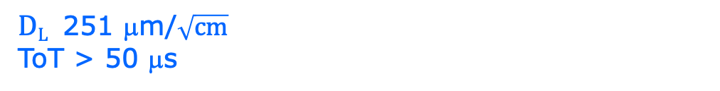
DESY testbeam Module Analysis
Study of the B = 1 T field data set
runs 6983 6986 6989 6990 p=5 GeV
Fit quality χ²/ndf = 19/35 χ²/ndf = 21/34
$DT$ 120 μm/$\sqrt{cm}$
$DL$ 251 μm/$\sqrt{cm}$
ToT > 50 μs
Preliminary
E_{d}=280 V/cm
B=1 T
T2K*
T2K* = T2K gas with O₂ and H₂O

Slide 6
DESY testbeam Module Analysis
Study of the B = 1 T field data set
runs 6983 6986 6989 6990 p=5 GeV
Some numbers: 7605 TPX3 Telescope tracks mean nr TPX3 hits 714.6
Fitted drift velocity per run in mm/ns
run 6983 vdrift 0.0587502
run 6986 vdrift 0.0582876
run 6989 vdrift 0.0590797
run 6990 vdrift 0.0571644

Slide 7
DESY testbeam Module Analysis
Runs 6909,16-18,34,35 B=0 T p = 5,6 GeV
Remove/exclude
- 4 corner chips
- chips around 11
- chip 16
B=0 T
situation
Preliminary

Slide 8
DESY testbeam Module Analysis
Study of the B = 0 T field data set
Runs 6909,16-18,34,35 B=0 T p = 5,6 GeV
Here the Telescope tracks are used and residuals in xy calculated wrt to the Telescope track. In z the Telescope track is shifted (1 free parameter refit of T track wrt TPX3 hits) to account for the trigger jitter; and the z residuals are calculated.
Telescope track 5 out of 6 planes and χ²_{z,xy} < 100 TPX3 hits > 200
A selection is applied on the difference between the Telescope track and the TPX3 track parameters (in xy, z and angles dxdy and dzdy).
Some numbers: 21789 Telescope tracks mean nr TPX3 hits 860.3

Slide 9
DESY testbeam Module Analysis
Runs 6981-6988 B=1 T p=5 GeV
Mean residuals
Remove/exclude
- 4 corner chips
- chips around 11
- chip 16
Deformations in xy for excluded chips are smaller than for B=0 and have often a different shape.
This is due to the fact that electrons follow the B field lines @ 1T
xy
z
B=1 T
situation
Preliminary

Slide 10
DESY testbeam Module Analysis
Study of the B = 1 T field data set
runs 6981-6988 p=5,6 GeV
Here the TPX3 tracks are used and residuals in xy and z calculated wrt to the TPX3 track. The curvature is fitted. TPX3 tracks are selected with more than 200 hits and within the acceptance (position xy, z and angles dxdy, dzdy and curvature).
In the final fit the momentum is fixed and residuals in xy are calculated.
Some numbers: 74447 TPX3 tracks mean nr TPX3 hits 663.5

Slide 11
DESY testbeam Module Analysis
Runs 6909,16-18,34,35 B=0 T p = 5,6 GeV
Mean residuals regrouped the row and column planes
xy
z
B=0 T
situation
Preliminary

Slide 12
DESY testbeam Module Analysis
Runs 6981-6988 B=1T p=5 GeV
Mean residuals regrouped the row and column planes
xy
z
xy
z
B=1 T
situation
Preliminary

Slide 13
DESY testbeam Module Analysis
Runs 6909,16-18,34,35 B=0 T p = 5,6 GeV
B=0 T situation
method | rms (stat) xy | bins xy | rms (stat) z | bins z
row | 10 (5) μm | 1280 | 12 (5) μm | 638
column | 11 (5) μm | 1280 | 11 (5) μm | 636
Preliminary
The 4 corner chips, the chips around chip 11 and chip 16 were excluded.

Slide 14
DESY testbeam Module Analysis
Runs 6983-6988 B=1T p=5 GeV
B=1 T situation
method | rms (stat) xy | bins xy | rms (stat) z | bins z
row | 14 (2) μm | 3322 | 22 (5) μm | 640
column | 12 (2) μm | 3266 | 19 (5) μm | 639
Preliminary
The rms for z is larger than the value of 12 μm obtained for the B=0 run for the module and quad.
The rms in xy is excellent!
The 4 corner chips, the chips around chip 11 and chip 16 were excluded.

Slide 15
DESY testbeam Module Analysis
Performance of dEdx
Use the B=0 an 1 T runs select the central chips (same runs as for deformation studies).
Remove 2 chips per row (deformations and low performance)
Calibrate the number of electrons to be equal for the different chips. Correct for slight z dependence (in B=1T data).
We have 6 chips on the track
B=0 T number of tracks 14534
mean number of electrons for 848 with rms 245
B=1 number of tracks 19860
mean number of electrons 632 with rms 119

Slide 16
DESY testbeam Module Analysis
Performance of dEdx
B=0 T has a large Landau tail
B=1 T tiny Landau tail and a more gaussian distribution
Very large difference
NB our single chip dEdx results has B=0 and had a large Landau tail. This degrades the performance…

Slide 17
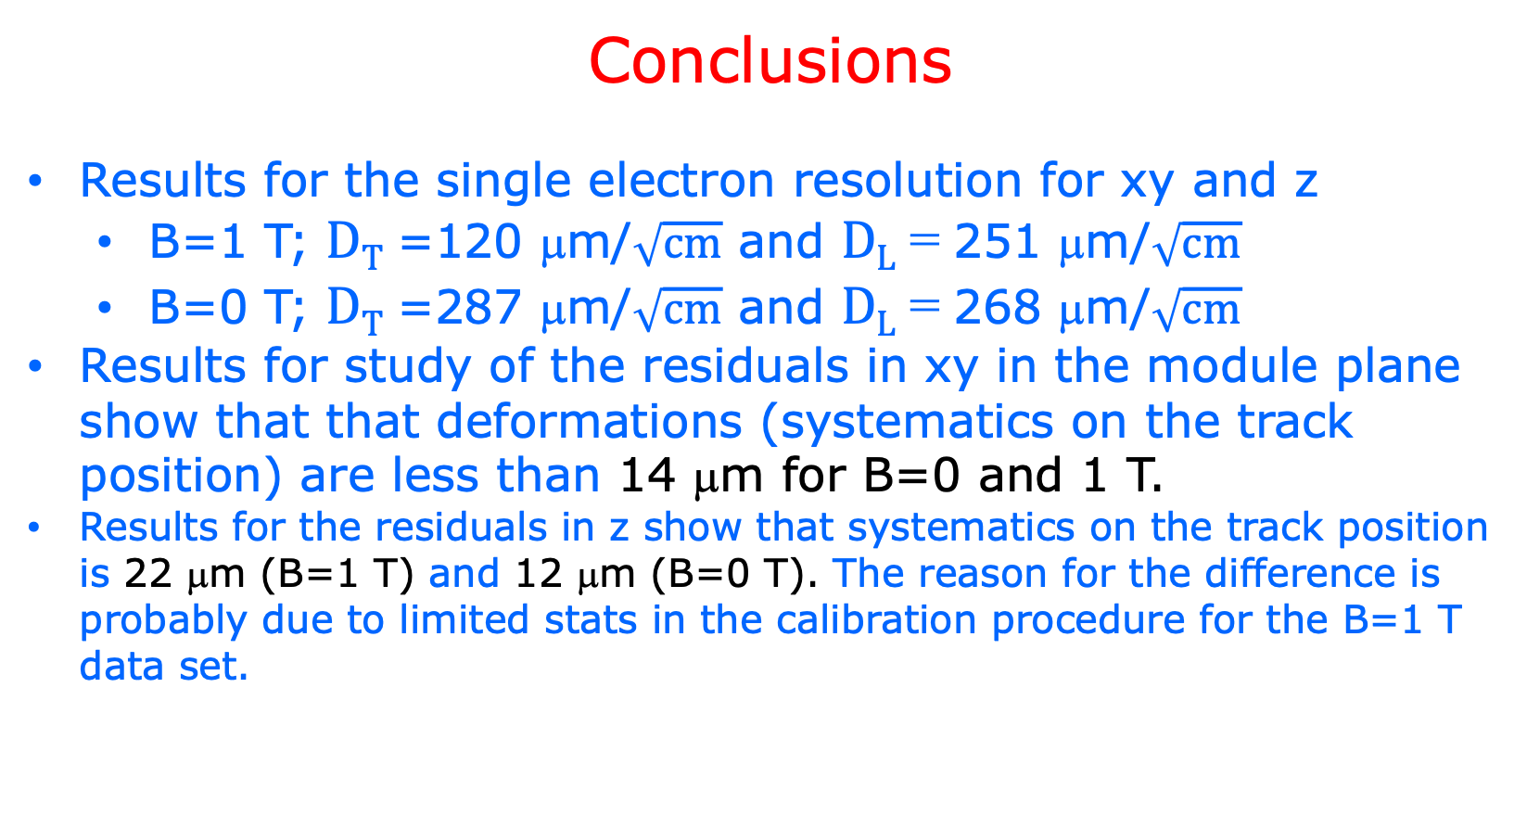
DESY testbeam Module Analysis
Conclusions
Results for the single electron resolution for xy and z
  B=1 T; $DT$ =120 μm/$\sqrt{cm}$ and $DL$ = 251 μm/$\sqrt{cm}$
  B=0 T; $DT$ =287 μm/$\sqrt{cm}$ and $DL$ = 268 μm/$\sqrt{cm}$
Results for study of the residuals in xy in the module plane show that that deformations (systematics on the track position) are less than 14 μm for B=0 and 1 T.
Results for the residuals in z show that systematics on the track position is 22 μm (B=1 T) and 12 μm (B=0 T). The reason for the difference is probably due to limited stats in the calibration procedure for the B=1 T data set.

