Slide 1
Permanent Magnet Particle Traps Design of a Ioffe trap using Permanent Magnets
Supervisor: dr. S.A. Jones
Second Examiner: dr. K.A.M. de Bruyn
Student: Sam Herz
2023

Slide 2
Introduction
Goal: Trapping (anti-)hydrogen
Purpose: For use in a precision test of nature’s fundamental symmetries.

Slide 3
Introduction
Goal: Trapping anti-hydrogen
Purpose: For use in a precision test of nature’s fundamental symmetries.
Model-independent test of charge conjugation/parity/time reversal (CPT) theorem
Study the gravitational behaviour of antimatter

Slide 4
How to trap (anti-)hydrogen?

Slide 5
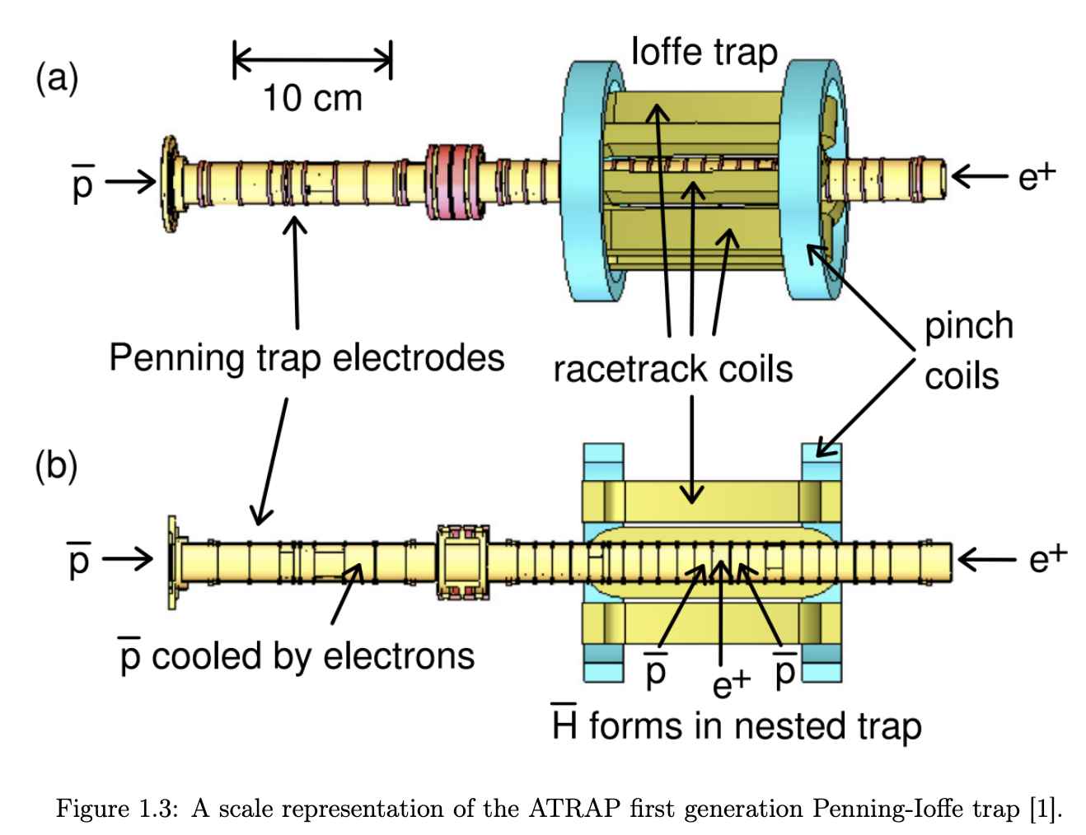
How to trap (anti-)hydrogen?
Source: E. Tardiff, X. Fan, G. Gabrielse, et al., “Two-symmetry penning-ioffe trap for antihydrogen cooling and spectroscopy,”

Slide 6
How to trap (anti-)hydrogen?
Source: E. Tardiff, X. Fan, G. Gabrielse, et al., “Two-symmetry penning-ioffe trap for antihydrogen cooling and spectroscopy,”
Source: S.A. Jones, “Observation of the 1s-2s transition in trapped antihydrogen,”

Slide 7
How to trap (anti-)hydrogen?
Source: E. Tardiff, X. Fan, G. Gabrielse, et al., “Two-symmetry penning-ioffe trap for antihydrogen cooling and spectroscopy,”

Slide 8
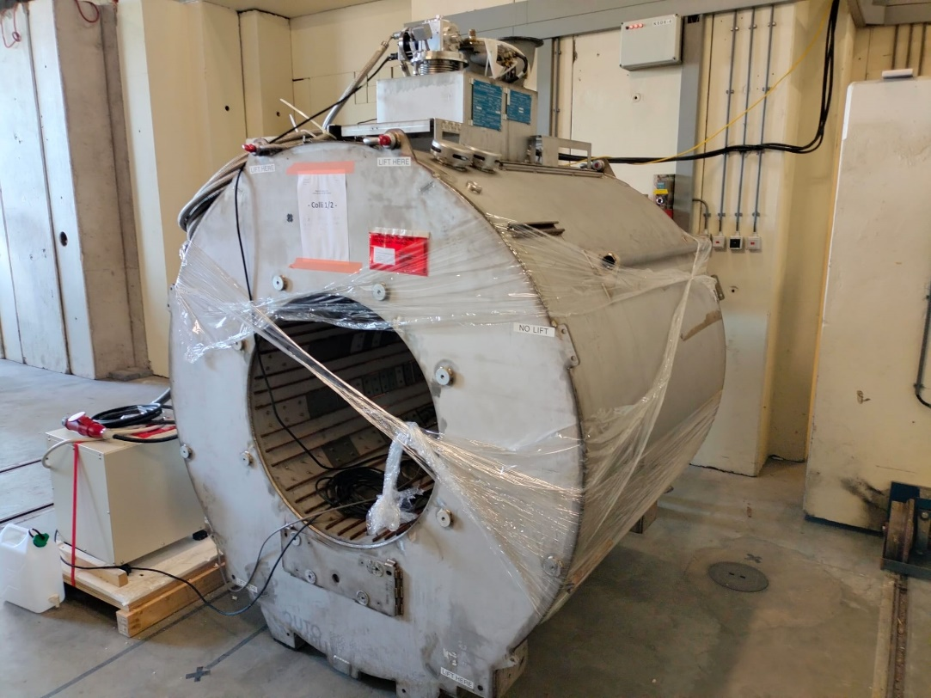
Disadvantages
- Superconducting wires only operate at low temperatures
(placed in liquid helium at 4.2 Kelvin)
High inductance due to the large number of windings caused significant experimental limitations
Expensive

Slide 9
Motivation
Goal:
Is it possible to design a Ioffe trap exclusively out of permanent magnets which is strong enough to trap (anti-)hydrogen particles?
Methods:
COMSOL Multiphysics 6.0 software
1. Modelling
2. Magnetic flux density studies to identify 3D magnetic field minimum
3. Simulating (anti-)hydrogen particle trajectory

Slide 10
Design 1: Ring magnets as mirror coils

Slide 11
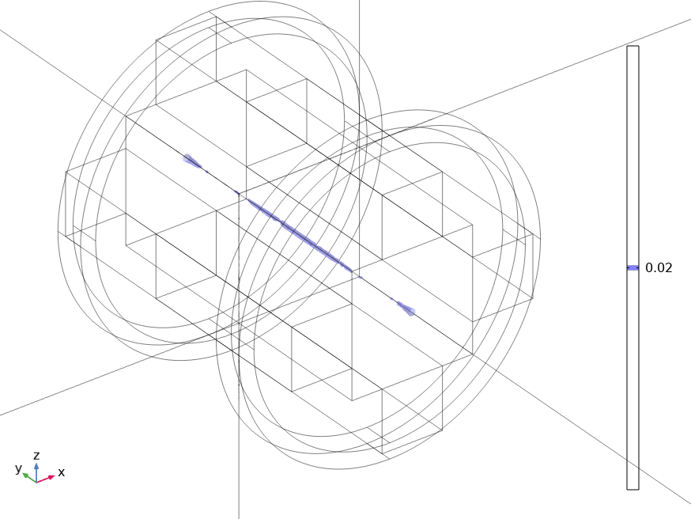
0.02 T
cm
cm

Slide 12
with

Slide 13
with
Trap depth of around 0.009K

Slide 14
W ≈ 0.009 K
W ≈ 0.012 K
W ≈ 0.013 K

Slide 15
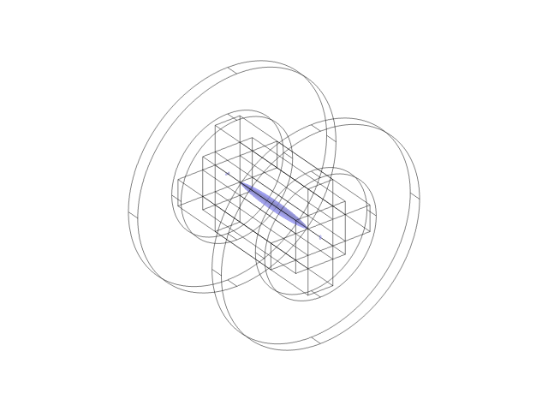
4
0.1 T
2
cm
0
-2
-4
-2
0
2
cm

Slide 16
W ≈ 0.02 K
W ≈ 0.03 K
W ≈ 0.04 K

Slide 17
Design 2: Changing shape of Quadrupole

Slide 18
cm
cm

Slide 19
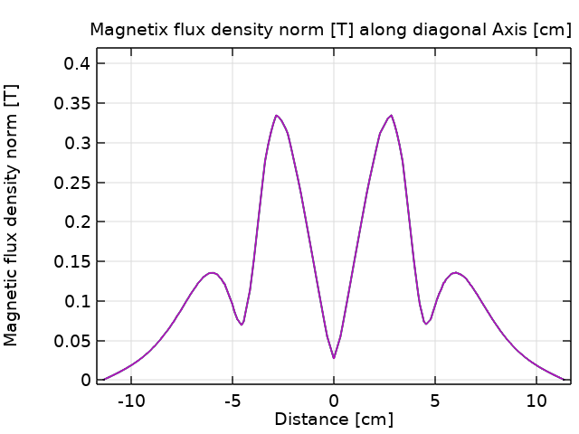

Slide 20
Trap depth of around 0.21K

Slide 21
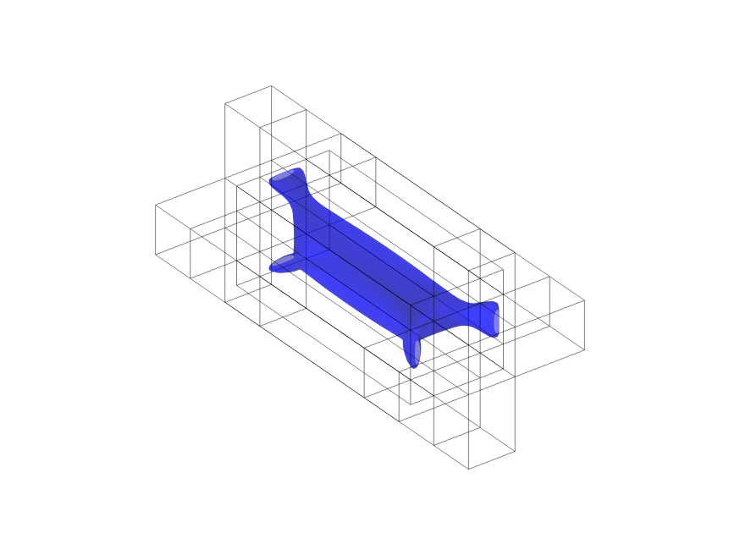
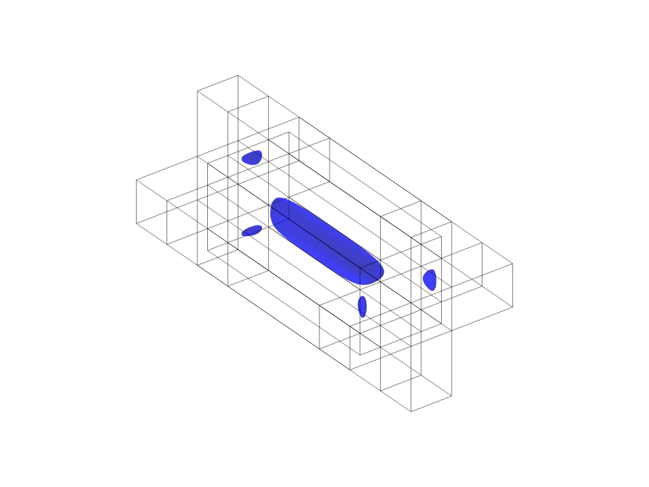
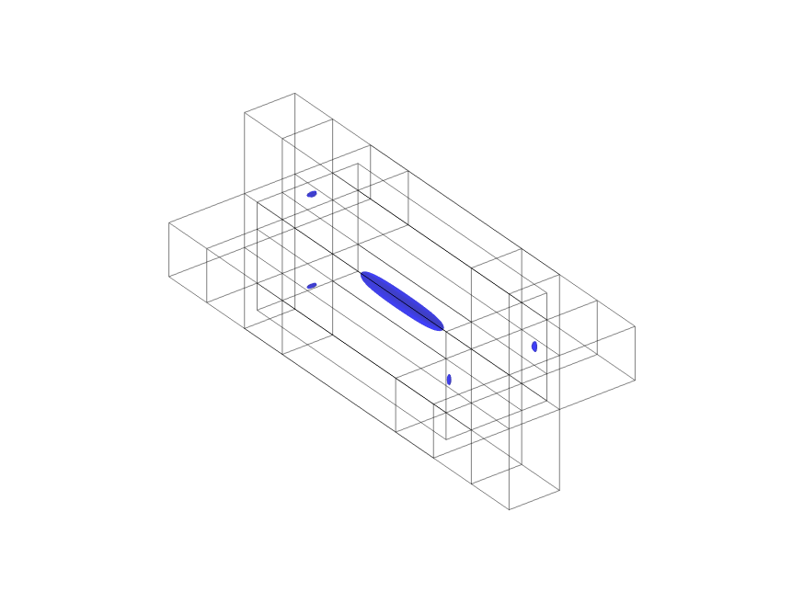
0.27 T
0.17 T
0.07 T
0.18 K
0.11 K
0.04 K

Slide 22
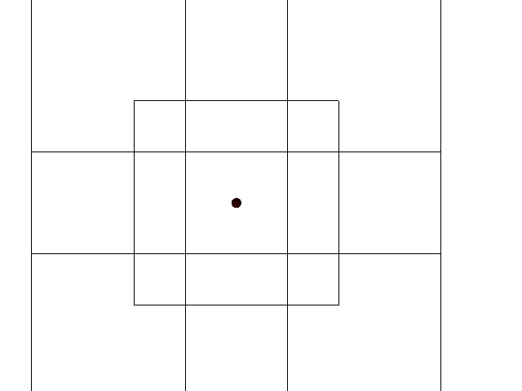
Particle with kinetic energy of 0.24K.

Slide 23
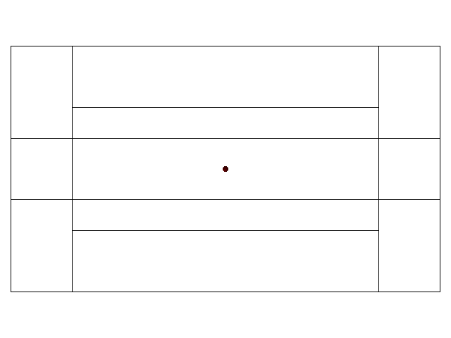
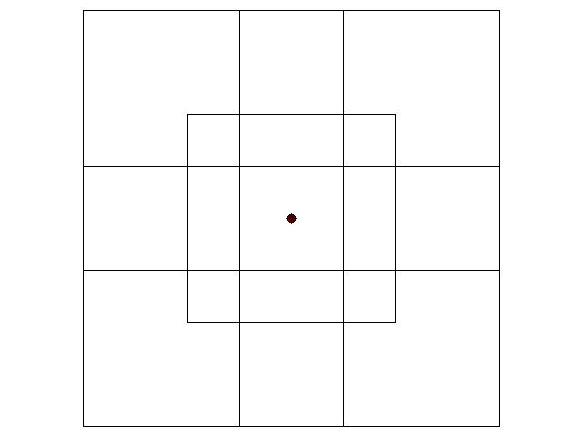
Particle with kinetic energy of 0.22K.

Slide 24
Design 3: Closing the trap using permanent magnets

Slide 25
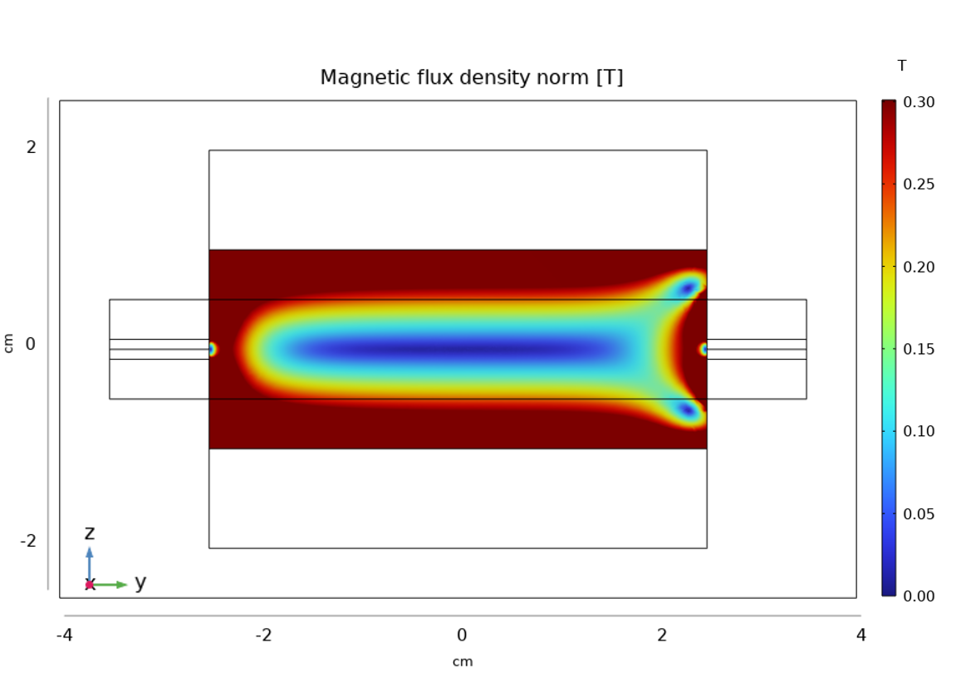
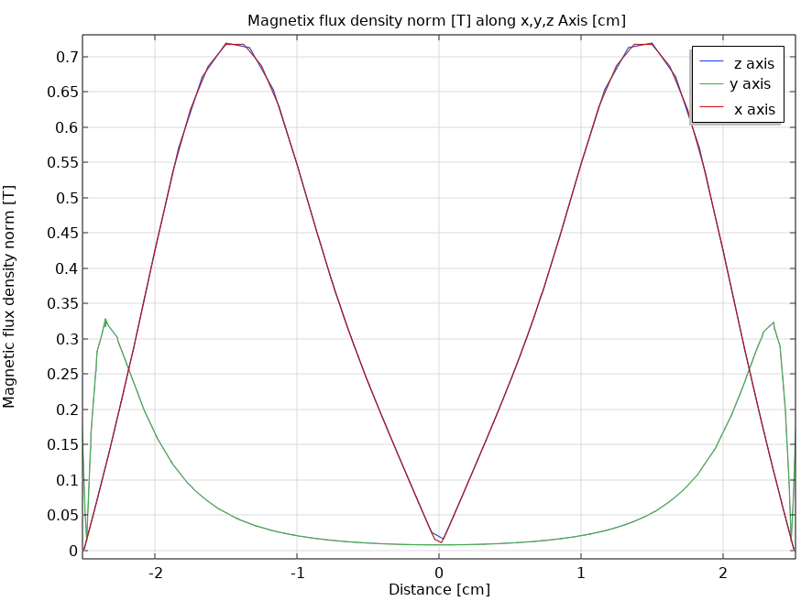
cm
cm

Slide 26
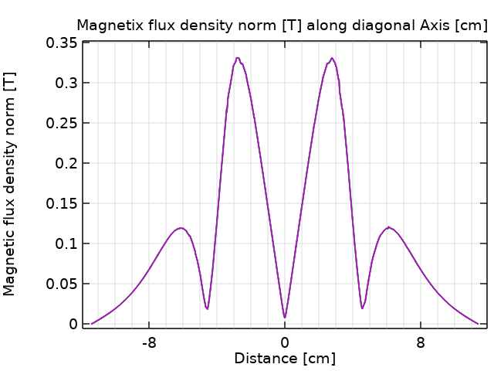

Slide 27
Trap depth of around 0.21K

Slide 28
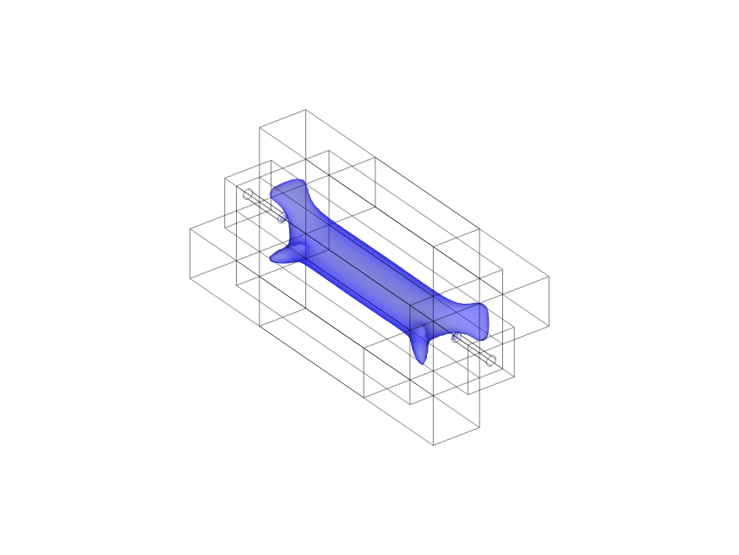
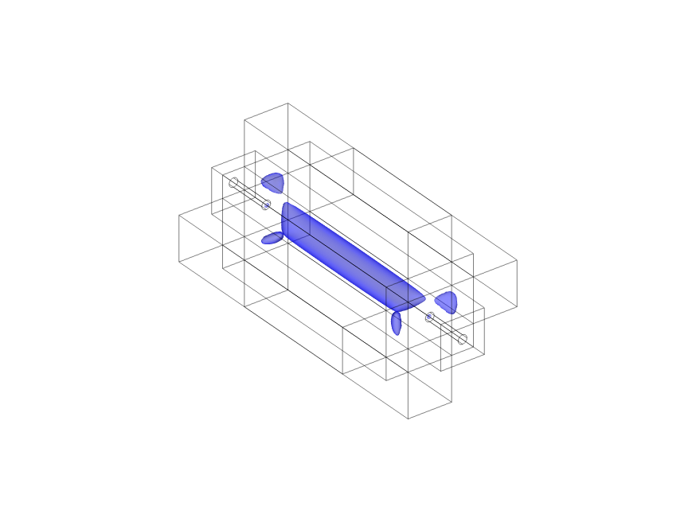
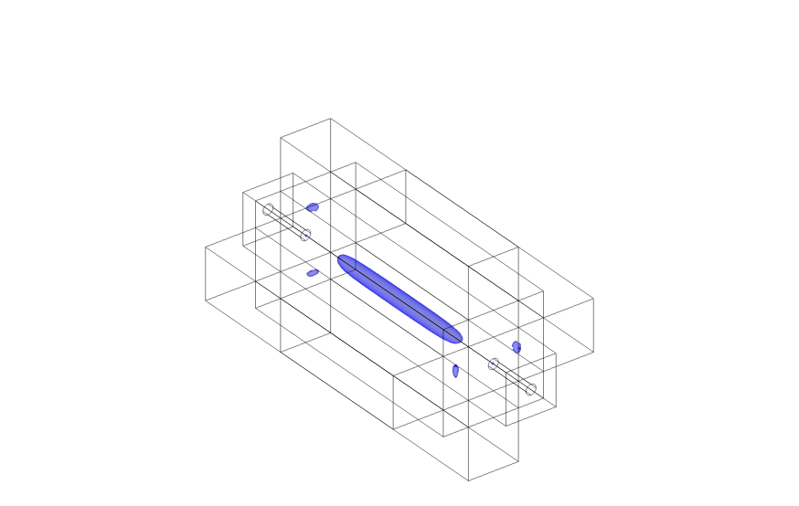
0.21 T
0.14 T
0.07 T
0.14 K
0.09 K
0.04 K

Slide 29
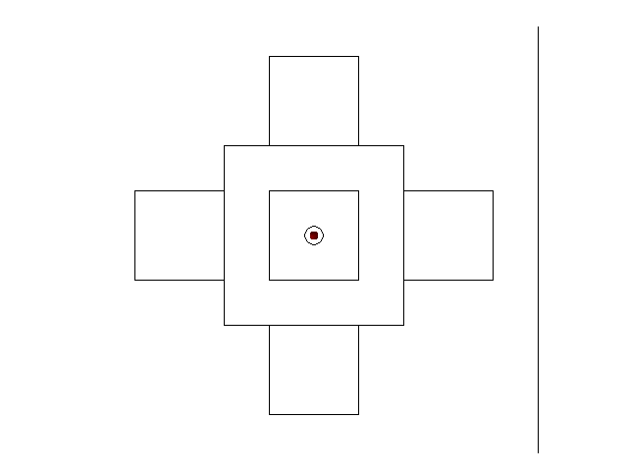
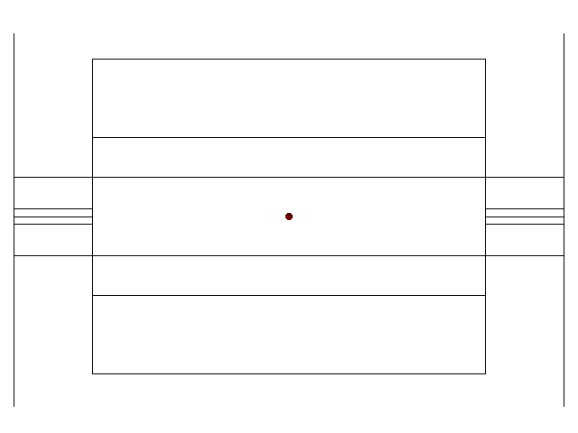
Particle with kinetic energy of 0.24K.

Slide 30
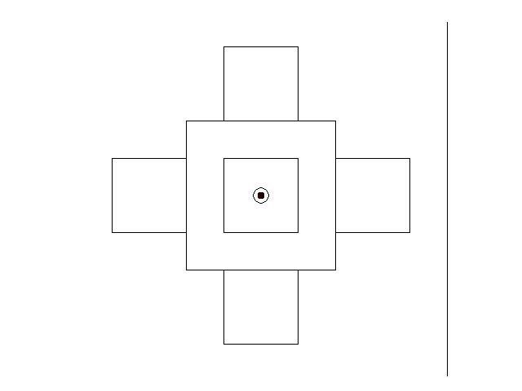
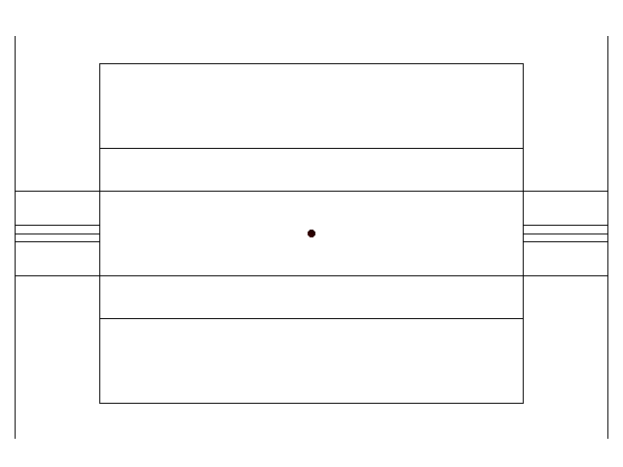
Particle with kinetic energy of 0.22K.

Slide 31
Conclusion
+ Prove of multiple designs of a Ioffe trap, exclusively made out of
permanent magnets, for trapping (anti-)hydrogen
+ No need of cryogenic cooling
+ Cheaper and smaller alternative to conventional Ioffe traps
+ Use of Quadrupole facilitate access for lasers
- Functional limitation (static magnetic field)
- Limited trap depth

Slide 32
Acknowledgement
dr. S.A. Jones
Nikos
Joël
Tom

Slide 33
Backup
Second generation Penning-Ioffe trap has
80 A in each pinch coil and 68 A in the racetrack coil produced a 0.56 T deep trap 1 T bias field was applied along the central axis of the trap. This corresponds to a 380 mK trap depth for an H¯atom in a low-field-seeking ground state.

Slide 34
N52 (sintered NdFeB) magnets
Remanent flux density norm Br for this material is 1.44T
Maximum Energy Product (BH)max of 50-53 MGOe ((mega-gauss-oersted)

Slide 35
Earnshaw’s theorem
E = −∇ϕ
Illustration of the electrostatic potential saddle created inside a Penning trap, in absence of a magnetic field B0, where z is along the axial axis and ρ along the radial axis. Image taken from !!!!!

Slide 36
Breit-Rabi diagram

Slide 37
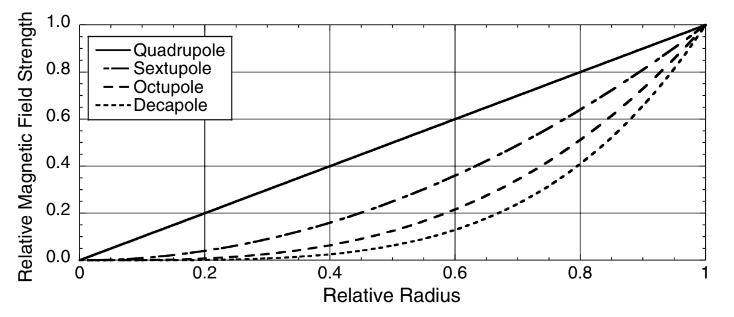

Slide 38
