Slide 1
Constraints from a $B_{c}→τν_{τ}$ Measurement on the New Physics Parameter Space
Anna Esselink
Supervisor:
dr. K.A.M. de Bruyn

Slide 2
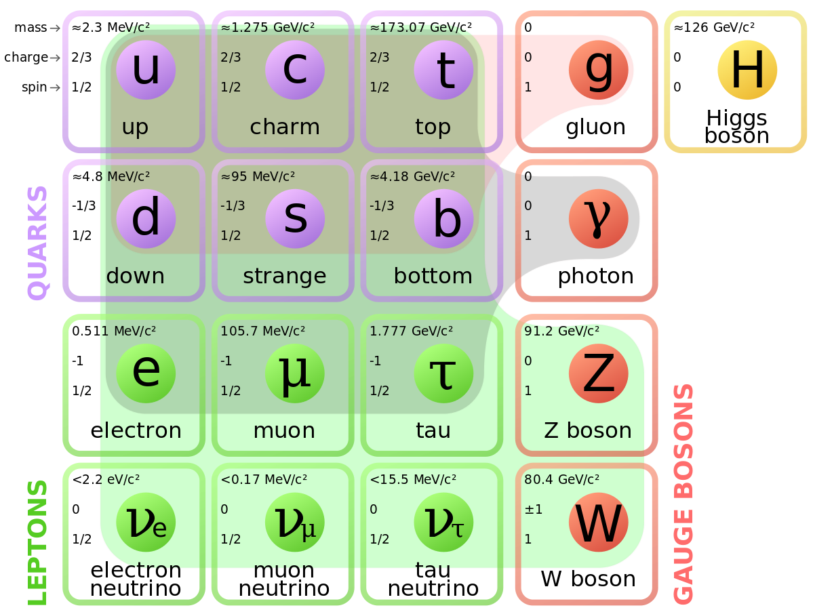
Standard model
?
?
?
?
?
?

Slide 3
Shortcomings of the Standard Model (SM)
Does not consider gravity
Matter-antimatter asymmetry
Nature of dark matter and dark energy
Neutrino masses
… and much more
Physconomics [2]
Notes:
Maybe highlight flavour physics more instead of only general stuff

Slide 4
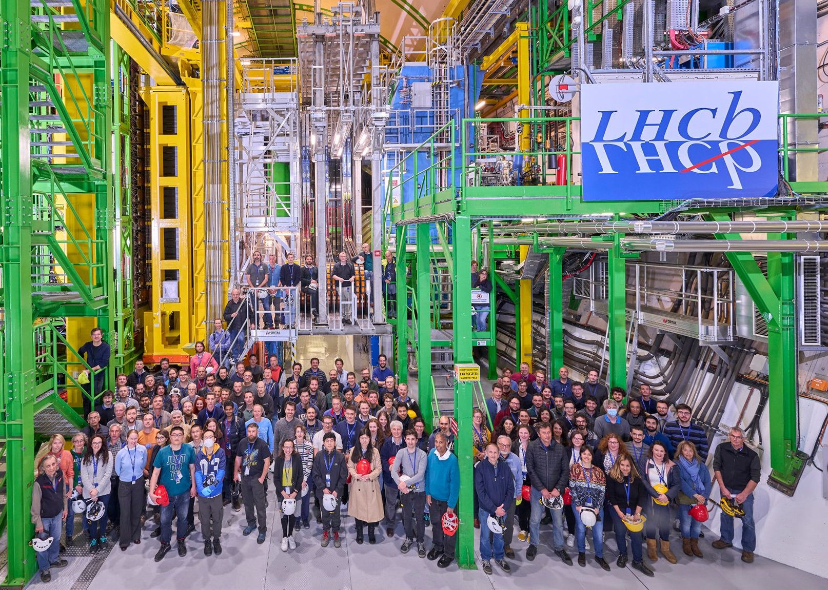
Search for physics beyond the Standard Model
No proof beyond 5$σ$ threshold
Strong indications of “New Physics” NP
Direct: search for new particles
Indirect: disagreement experimental data & SM prediction
@LHCb experiment at CERN [3]
Notes:
Strength of flavour physics: many observables, many measurements

Slide 5
B meson decays

Slide 6
Full theory to weak effective theory
Full SM theory of weak interactions
Very complex & computationally challenging
Effective Field Theory:
Removes dependence on higher energy scales

Slide 7
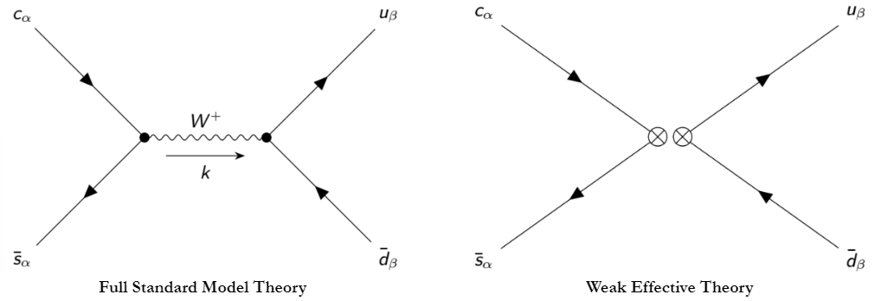
Full theory to weak effective theory
Full SM theory
Weak effective theory
W boson exchange
Local 4-fermion interaction

Slide 8
Full theory to weak effective theory
Operator Product Expansion
Separation of :
long-distance/low energy physics ( Operators)
short-distance/high energy physics ( Wilson coefficients)
Search for New Physics → constrain

Slide 9
Theoretical Framework & Method
By Fleischer et. al. [4]
For $b→cτ{\overline{ν}}_{τ}$ transitions:
$V_{L}$ Left-handed vector
$V_{R}$ Right-handed vector
$S$ Scalar
$P$ Pseudoscalar
$T$ Tensor
$$C_{V_{L}}^{(SM)c,e}=1$$
$$C_{V_{R}}^{(SM)c,e}=0$$
$$C_{S}^{(SM)c,e}=0$$
$$C_{P}^{(SM)c,e}=0$$
$$C_{T}^{(SM)c,e}=0$$
$$C_{a}^{c,e}=0.1 C_{a}^{c,μ}$$
$$C_{a}^{c,e}=1 C_{a}^{c,μ}$$
$$C_{a}^{c,e}=10 C_{a}^{c,μ}$$

Slide 10
Constraining $C_{j}^{NP}$using OPE
Advantages
Combines experimental data
Show allowed interactions
Model independent
Disadvantages
Many coefficients → selection required
Determining significance of components difficult
Underlying theory remains unknown

Slide 11
Observables

Slide 12
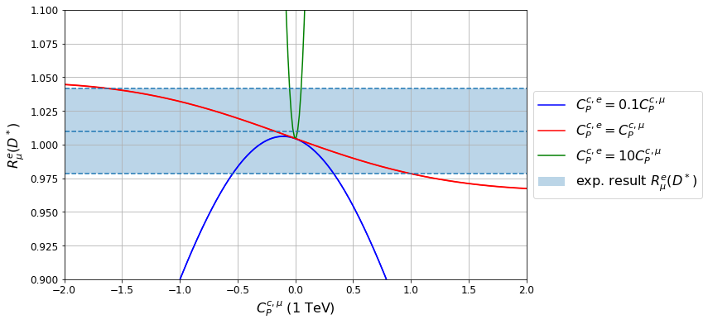
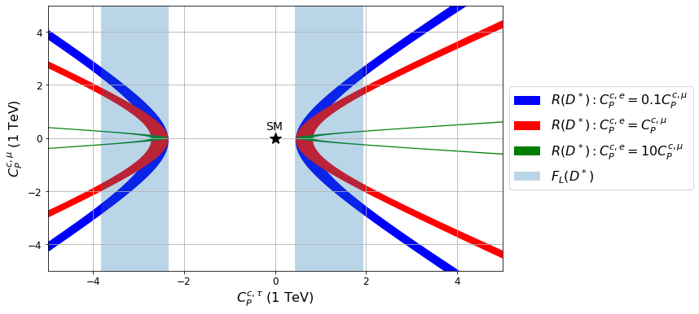
Constraints on NP Pseudoscalar Coefficients

Slide 13
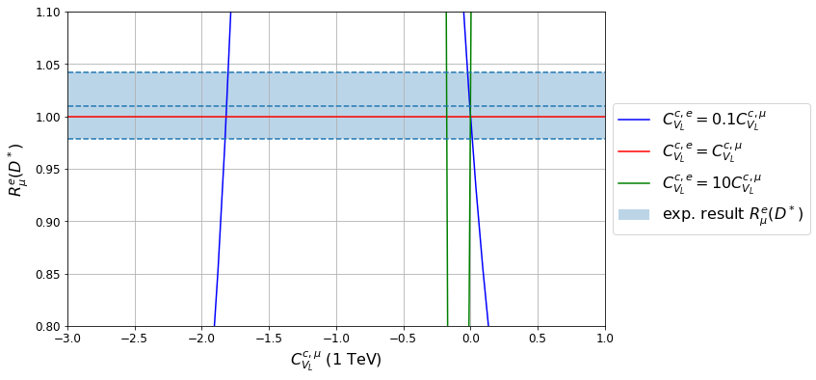
Constraints on NP LH-vector Coefficients

Slide 14
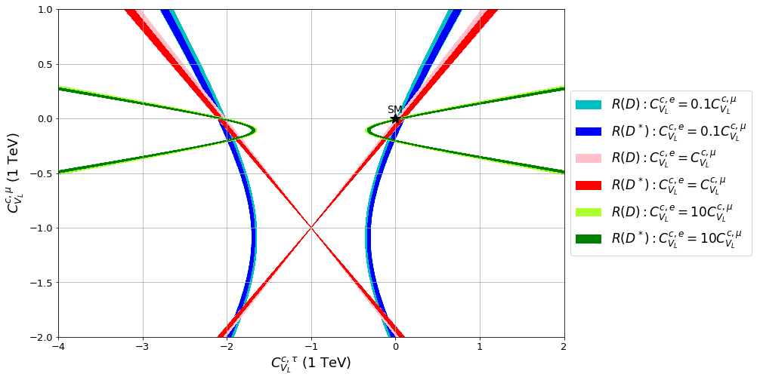
Constraints on NP LH-vector Coefficients

Slide 15
Impact of $B_{c}→τν_{τ}$
Branching Fraction:
$V_{cb}$ dependent

Slide 16
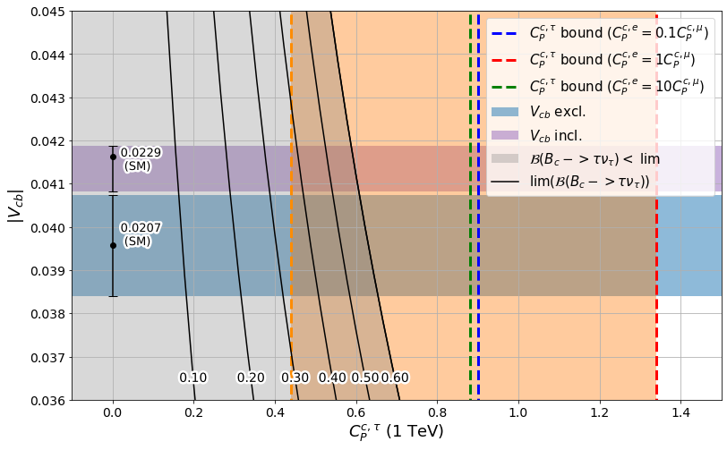
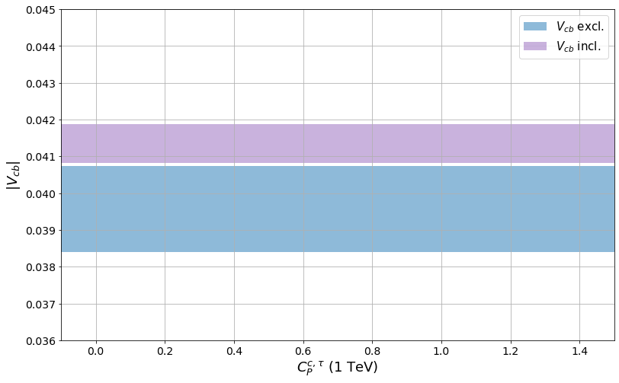
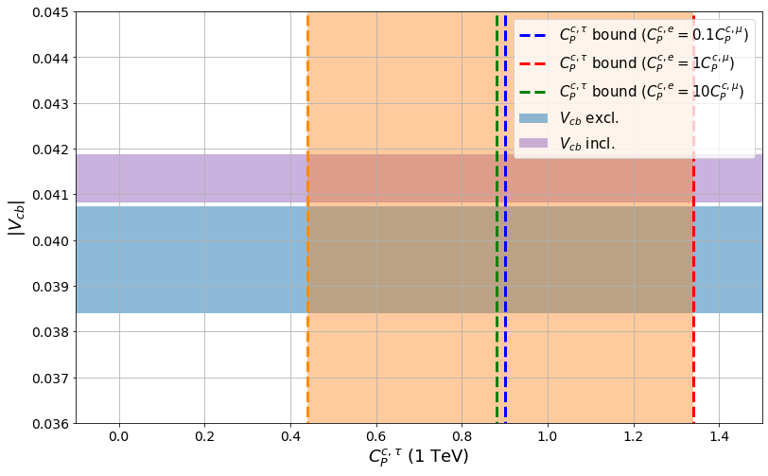
Impact of $B_{c}→τν_{τ}$ - Pseudoscalar

Slide 17
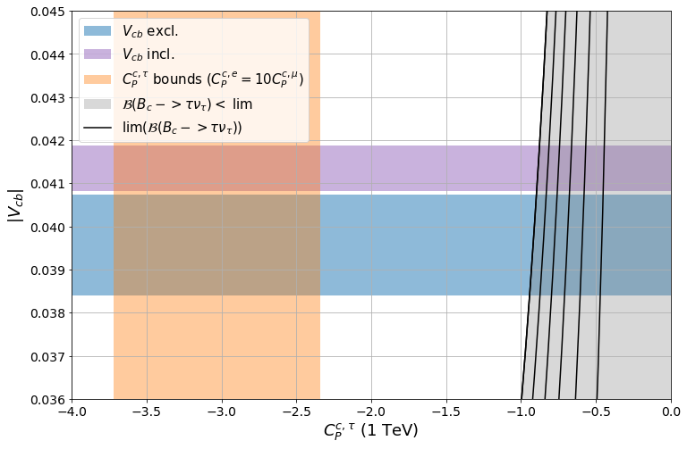
Impact of $B_{c}→τν_{τ}$ - Pseudoscalar

Slide 18
Impact of $B_{c}→τν_{τ}$ - Pseudoscalar
Disagreement with experimental data ($V_{cb}$ excl., 1σ) when:
$C_{P}^{c,τ}>0.614$

Slide 19
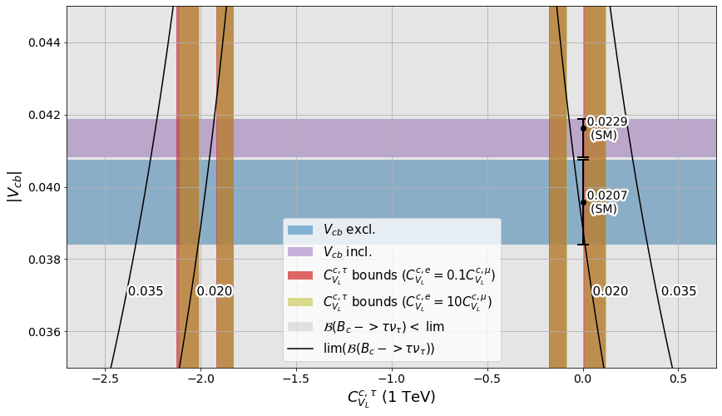
Impact of $B_{c}→τν_{τ}$ - LH vector

Slide 20
Summary
Search for physics beyond the Standard Model
Methodology: Operator Product Expansion
Constraints on NP Wilson coefficients using experimental measurements
Measurement $B_{c}→τν_{τ}$ could improve:
Constraints on NP coefficients & remove ambiguity
Accuracy & precision of tension with SM

Slide 21
References
[1] M. Cush, “Standard model of elementary particles,” Wikimedia Commons, Sep. 17, 2019. https://commons.wikimedia.org/wiki/File:Standard_Model_of_Elementary_Particles.svg#/media/File:Standard_Model_of_Elementary_Particles_modified_version.svg (accessed Jun. 28, 2023).
[2] physconomics, “What is Dark Energy and Dark Matter?,” physconomics, Jun. 10, 2018. https://physconomic.wordpress.com/2018/06/10/what-is-dark-energy-and-dark-matter/
[3] L. Shchutska and O. Schneider, “Lepton universality restored,” actu.epfl.ch, Dec. 20, 2022. https://actu.epfl.ch/news/lepton-universality-restored/ (accessed Jun. 28, 2023).
[4] R. C. Fleischer, R. Jaarsma, and G. Tetlalmatzi-Xolocotzi, “Mapping out the space for new physics with leptonic and semileptonic $$B_{(c)}$$ decays,” Eur. Phys. J. C, vol. 81, no. 7, Jul. 2021, doi: https://doi.org/10.1140/epjc/s10052-021-09419-8.

Slide 22
Full theory to weak effective theory
Hamiltonian:
$$k≪m_{W}$$
Operator Product Expansion
: Operator
: Wilson Coefficient

Slide 23
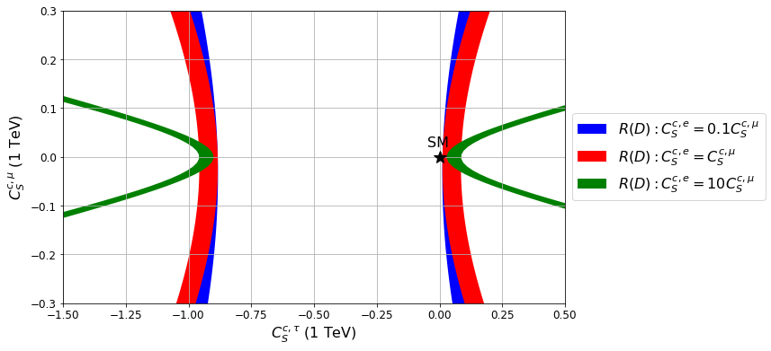
Constraints on NP Scalar Coefficients

Slide 24
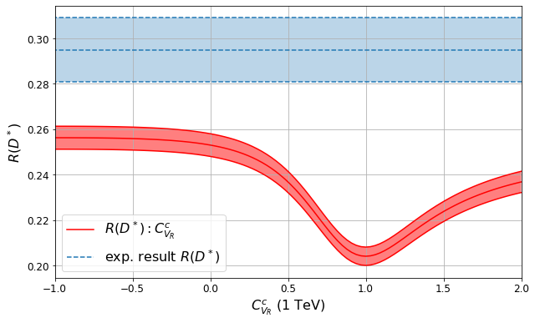
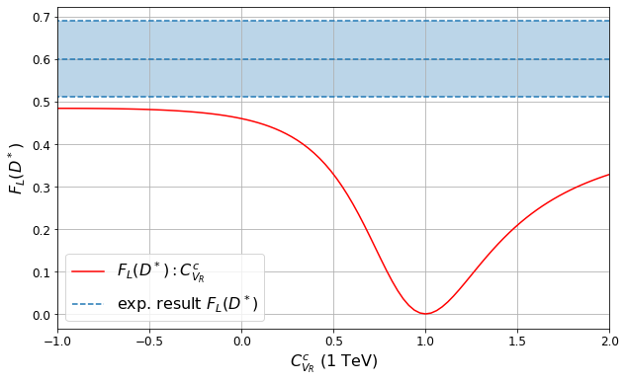
Constraints on NP RH-vector Coefficients
No agreement (at 1σ) with experimental data

Slide 25
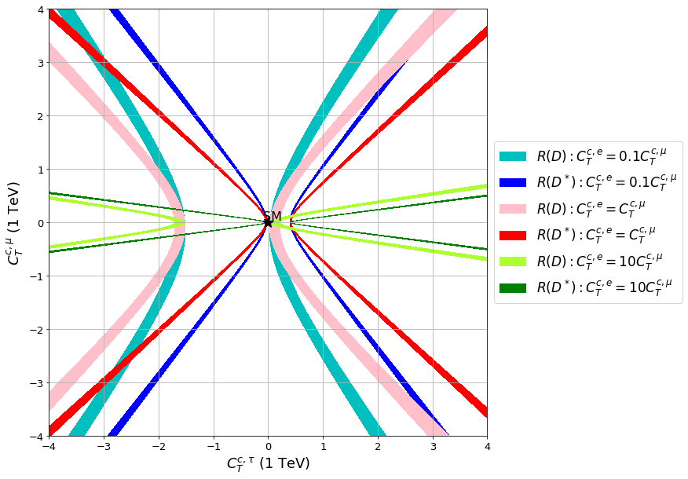
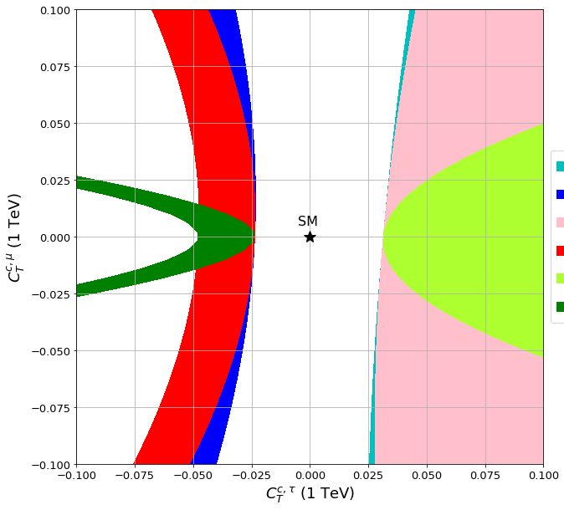
Constraints on NP Tensor Coefficients

Slide 26
Impact of $B_{c}→τν_{τ}$ - Pseudoscalar
Updated constraints

Slide 27
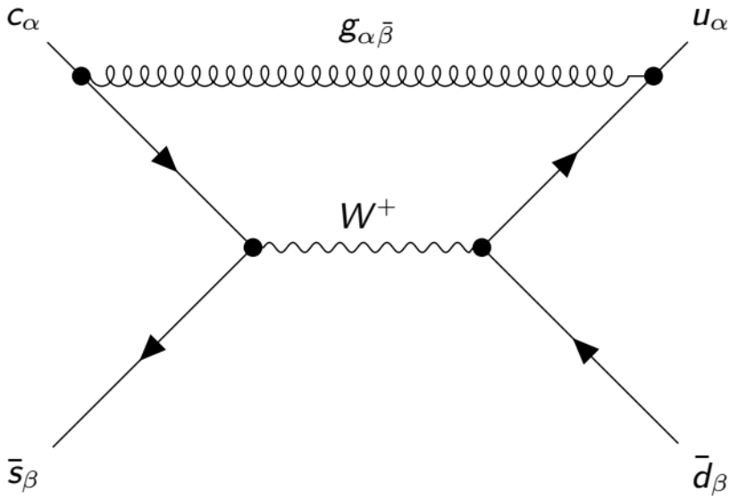
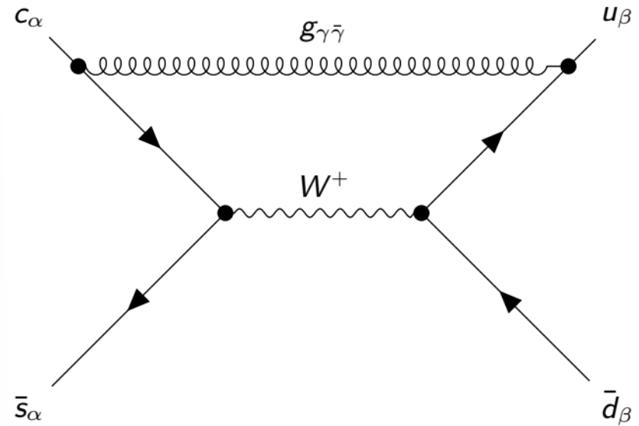
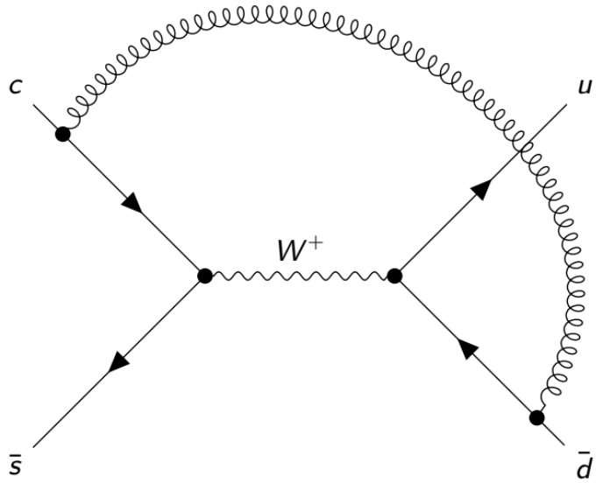
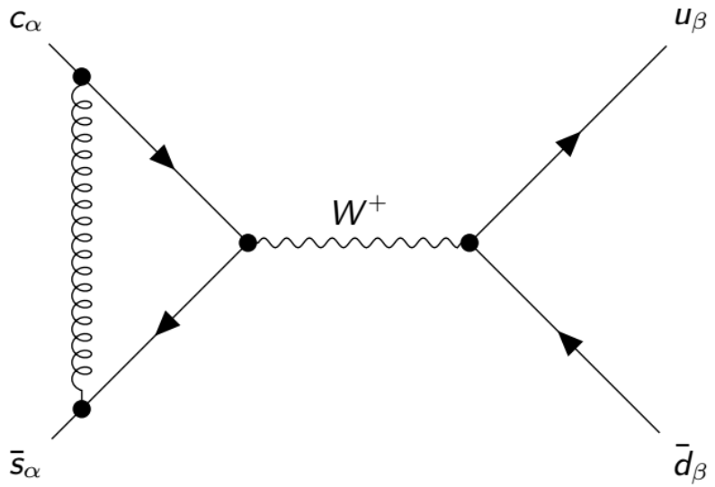

Slide 28
Renormalisation group equation

