Slide 1
PhD lunch
Topical Lectures Dark Matter
November 2023
phdcouncil@nikhef.nl

Slide 2
PhD Council at Nikhef
Your representation at Nikhef
Lots of useful information on our website
Please contact us or chat to one of us if you have ideas, questions, complaints or anything you’d like to say
Ideas for social events welcome. We have a budget(!)
You can contact us anonymously at: https://barm.nikhef.nl/phdcouncil/anonymous-feedback-form/
phdcouncil@nikhef.nl

Slide 3
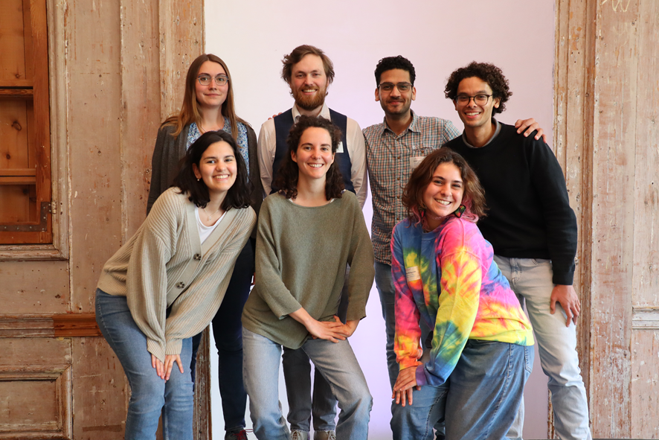
The old PhD Council
The new PhD Council?
phdcouncil@nikhef.nl

Slide 4
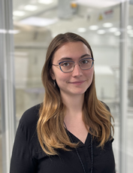
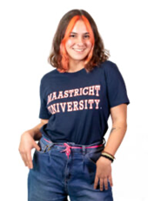
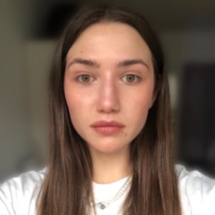
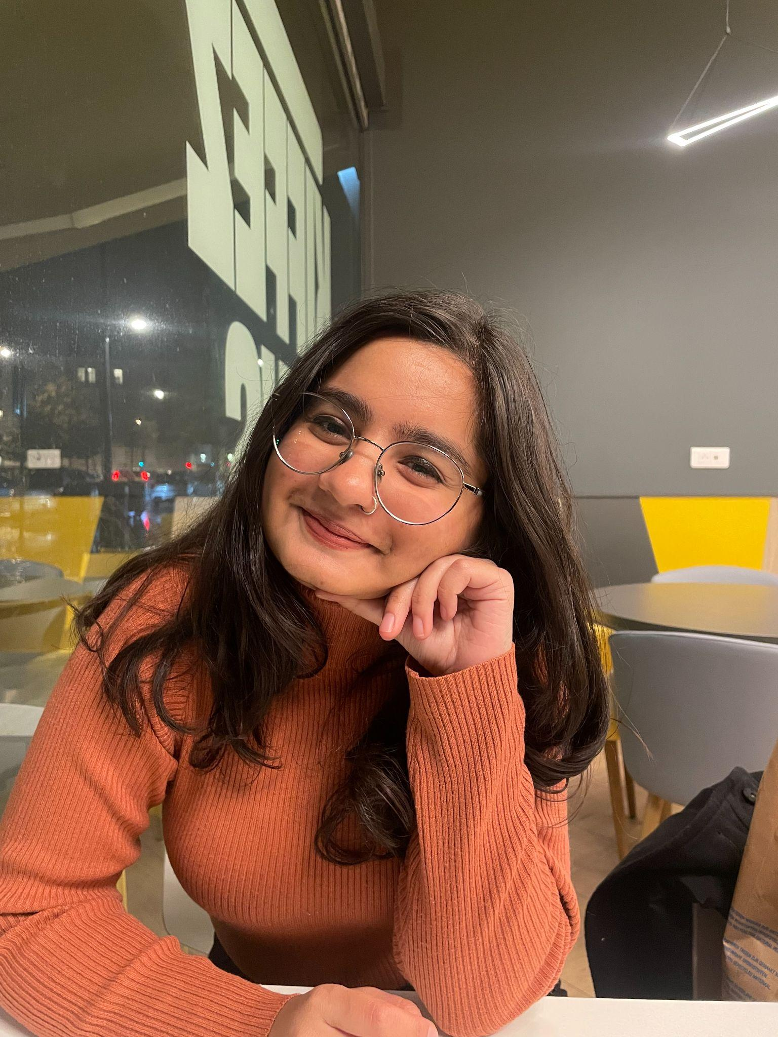
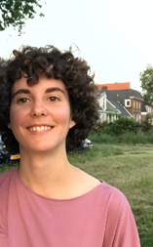
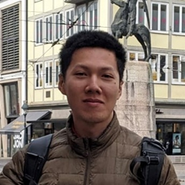
Introducing the PhD Council members
Luise, Virgo/ET
Maastricht
Carolina, LHCb
Maastricht
Mariia, ALICE
Amsterdam
Pranati, Dark Matter
Amsterdam
Clara, KM3NeT
Amsterdam
Vu, Theory
Nijmegen
phdcouncil@nikhef.nl

Slide 5
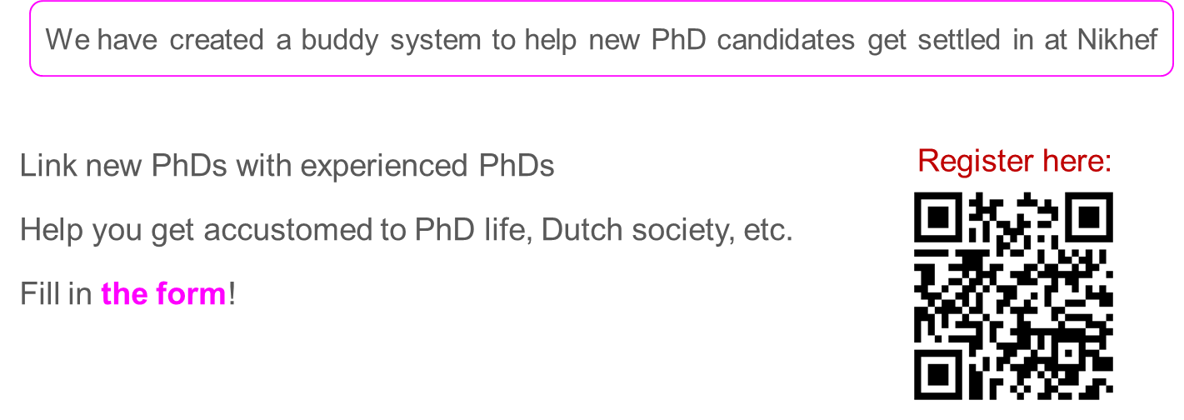
The Nikhef buddy system
phdcouncil@nikhef.nl

Slide 6
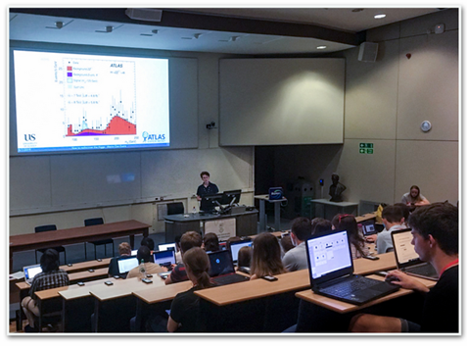
Junior Colloquium
organised by a group of post-docs in collaboration with the PhD Council
opportunity for PhD candidates and young post-docs to practice conference-style talks in front of peers
learn about other PhD’s research
first one was on October 24th
Keep your eyes peeled for the next one!
phdcouncil@nikhef.nl

Slide 7
Become a writer/editor for “Quantum Universe”
Popular science website, has to be in Dutch
Contact PhD Council if you are interested
the Quantum Universe | Natuurkunde voor iedereen
phdcouncil@nikhef.nl

Slide 8
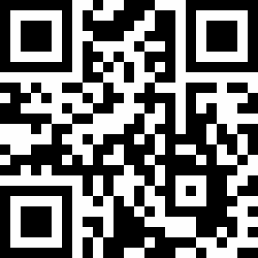
Diversity and Inclusion Training
Exploring possibility of implementing diversity and inclusion training
Aim to enhance awareness and sensitivity towards these topics
Please fill the form to express your views
Example of such trainings : ECHO
Scan here :
phdcouncil@nikhef.nl

Slide 9
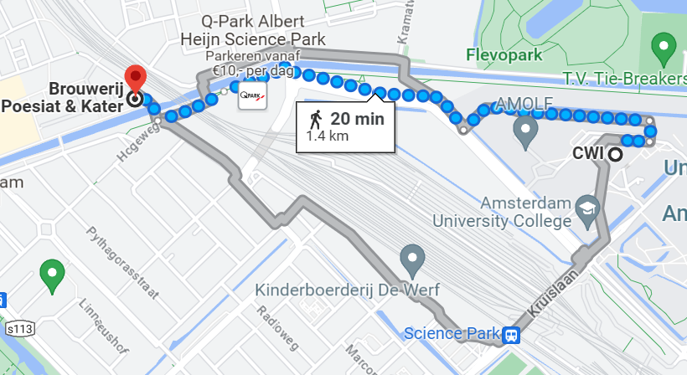
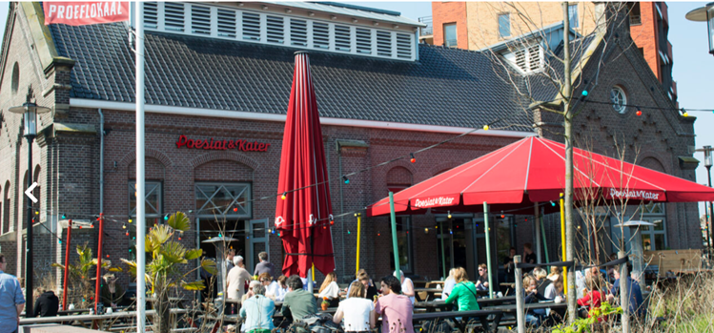
Social Event on Tuesday
18:30 | Indian buffet (drinks exclusive)
20:00 | Board game night
Poesiat & Kater Polderweg 648 1093KP Amsterdam
See you there! :)

