Slide 1
Quad TPX3 chipboard PCB
Concentrator board connector
Flex PCB
Bond pad pedestal
POWER Regulator + connector
+ ADC
2cm?
20cm?
TPX3
TPX3
Cooling block
Cooling block
Cooling block
Tpx3 IO signals
DC POWER 2V

Slide 2
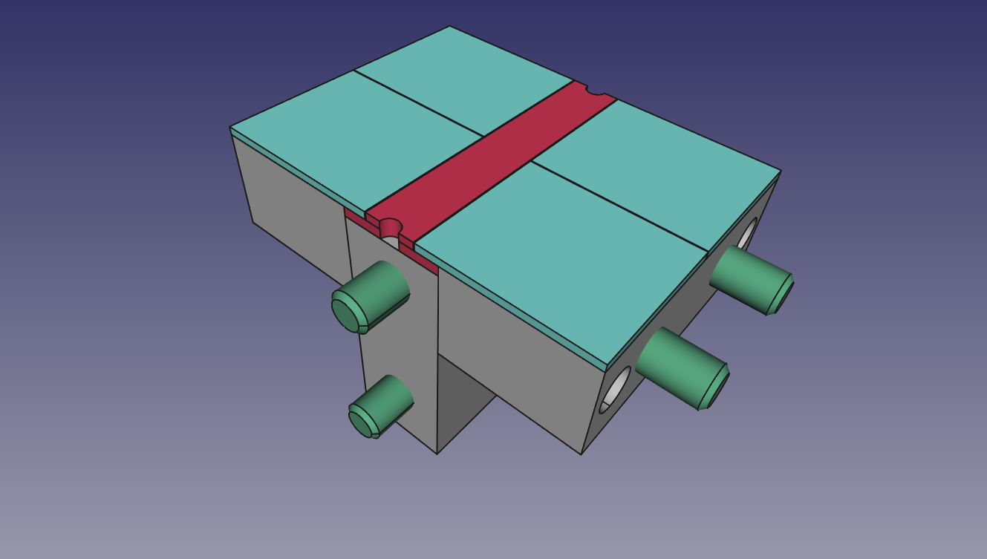
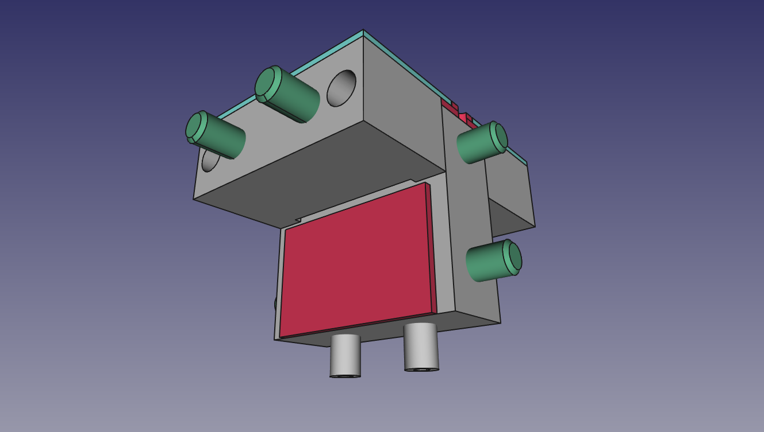
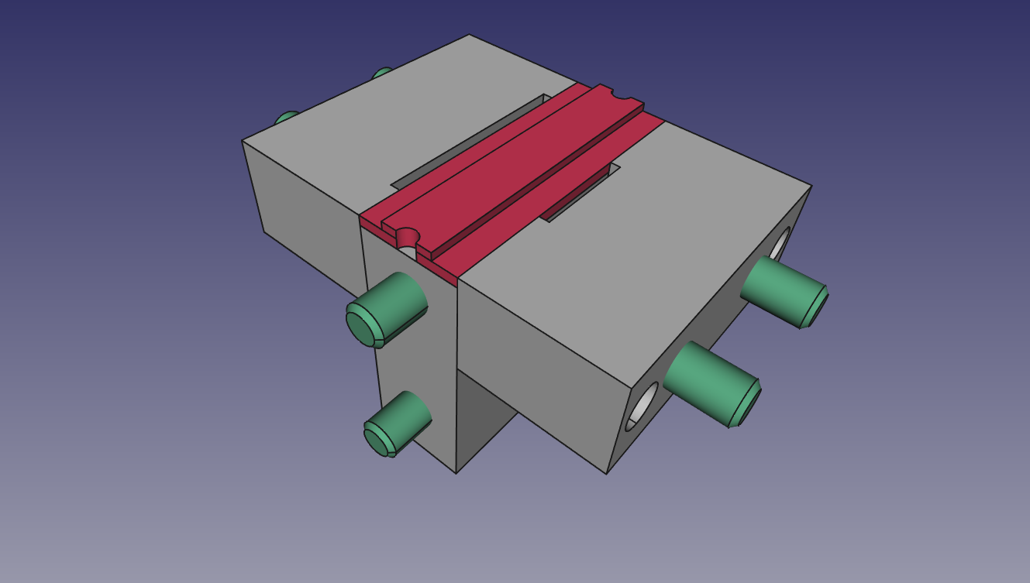
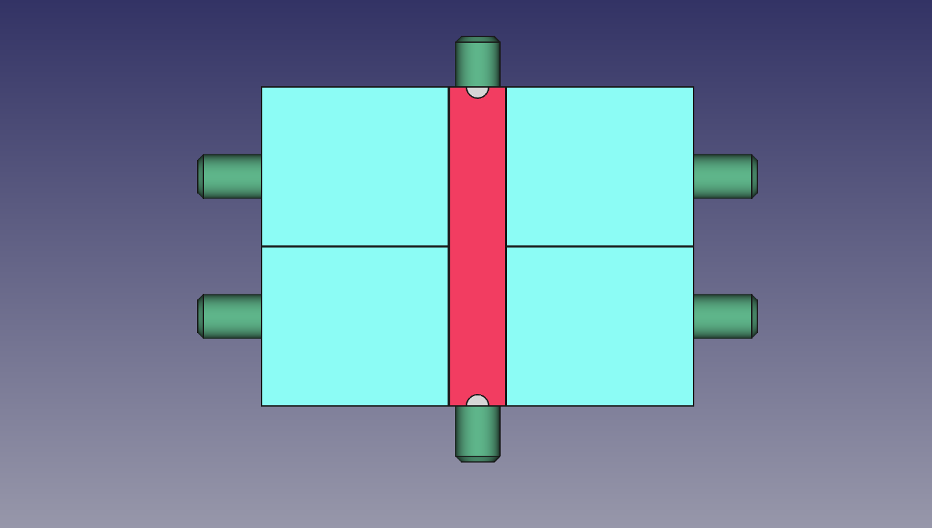
Quad tile “dowel pin“ mockup

Slide 3
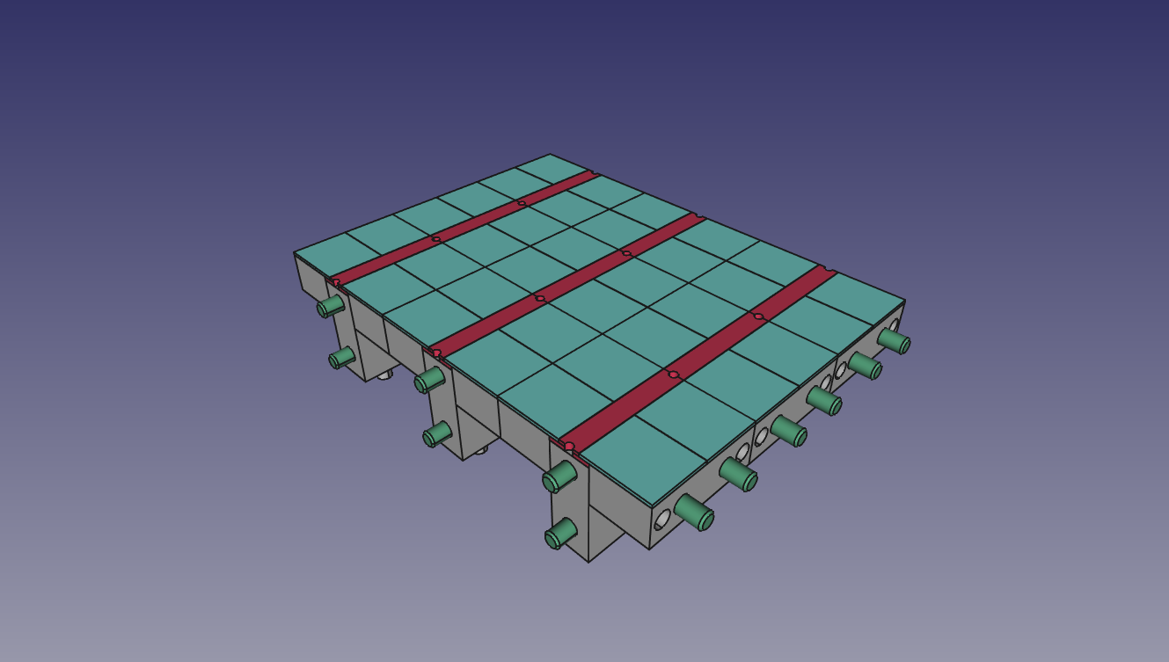
3x3 frame

Slide 4
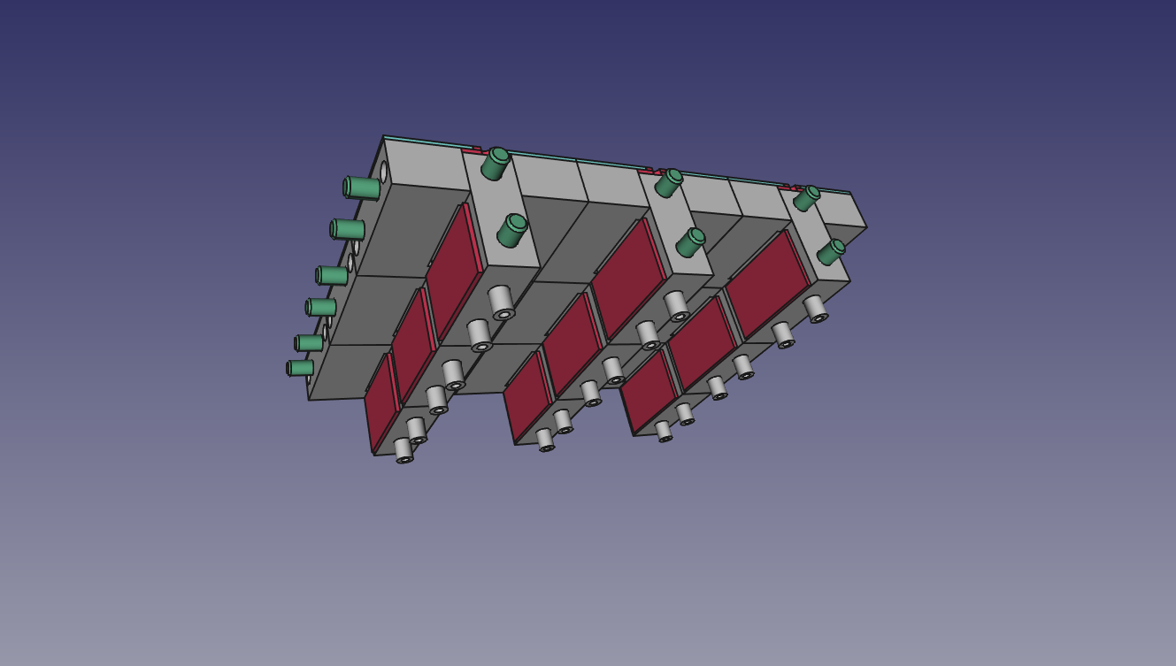
3x3 frame

Slide 5
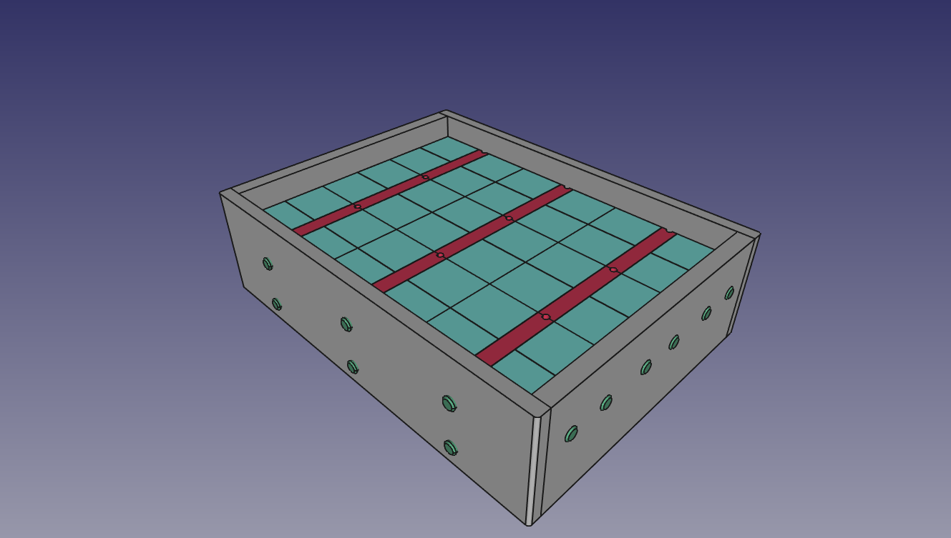
3x3 frame

Slide 6
LEPCol readout scheme proposal
TPX3 @ 160Mb readout speed ≈ 2Mhit/s
8x4x4=128 TPX3 chips per readout system
KU040 devkit = 1K€
Link concentrator uses cheap (20€) Microsemi FPGA
Option for magnetic field tolerant DC/DC converter
Quad
TPX3 Module
Quad
TPX3 Module
8x
3.125Gb 8b10b
1x
10Gb Ethernet
2x
Link
Concentrator
(rad hard+ magnetic field tolerant)
SPIDR
(KU040 FPGA Development Kit?)
Quad
TPX3 Module
DAQ PC
Quad
TPX3 Module

