Slide 1
Octopuce Field Distortions
Peter Kluit, Jan Timmermans
Lepton Collider meeting 12 July 2016

Slide 2
Introduction
Compare the B = 1 data with the B = 0 data
Look for distortions between the chips (not at the edge of the Octopuce)

Slide 3
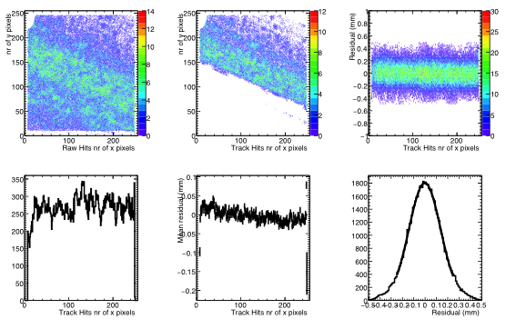
Chip 3 B = 1 T 300 V

Slide 4
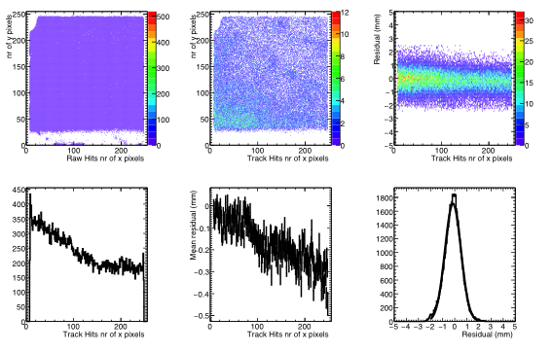
Chip 3 B = 0 T 300 V
Note larger uncerainties (scales)
Explanation: edge effects not taken into account

Slide 5
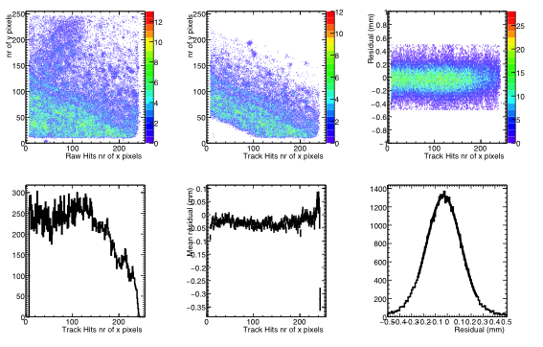
Chip 4 B = 1 T 300 V

Slide 6
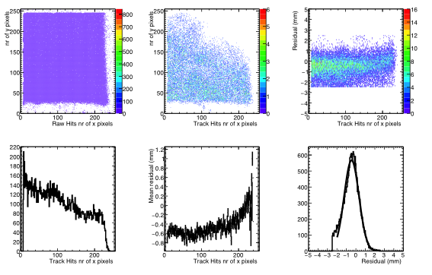
Chip 4 B = 0 T 300 V
Observed deformation and shift vs x probably edge effect

Slide 7
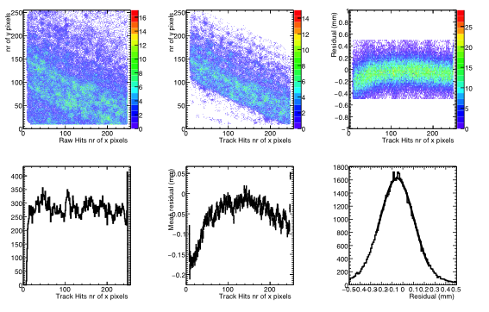
Chip 5 B = 1 T 300 V
Deformation at low x -0.2 mm

Slide 8
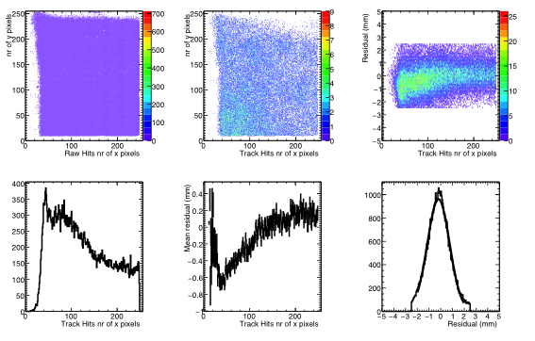
Chip 5 B = 0 T 300 V
Deformation at low x -0.6 mm

Slide 9
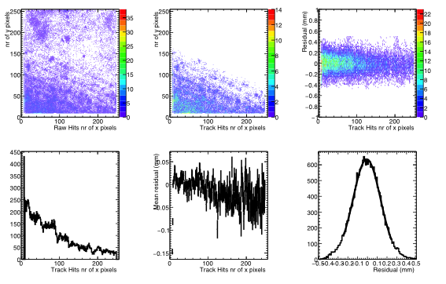
Chip 6 B = 1 T 300 V

Slide 10
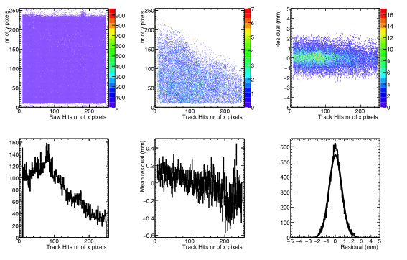
Chip 6 B = 0 T 300 V

Slide 11
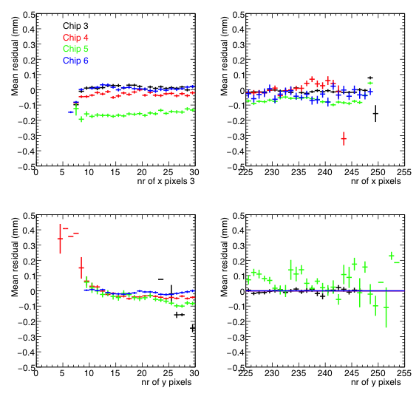
Edge effects 1 T 300 V
Low x pixel
3,4,6 in between chips
NB chip 5 has deformations
See a small deviation -100 microns x 8-9
At high x
See in chip 3 and 5
Nothing seen in y pixel

