Slide 1




Pixel TPC testbeam results
Yevgen Bilevych, Klaus Desch, Harry van der Graaf, Fred Hartjes, Jochen Kaminski, Peter Kluit, Naomi van der Kolk,
Cornelis Ligtenberg,
Gerhard Raven, and
Jan Timmermans
8 Quad Module
Lepton Collider 22 May 2023

Slide 2
DESY testbeam Module Analysis
How to extract results for the B field data sets?
1) If one requires a Telescope track one has a quite bad coverage of the module plane due to the telescope track selection (geometrical coverage)
2) For extracting a single electrons resolution as a function of z one needs the Telescope track (to have a precise z estimate)
3) For studying the deformations in the detector plane one can use the TPX3 tracks without requiring a Telescope track
Calibration and alignment procedure is based on starting with the TPX3 track and determining the shifts and rotations of the chips (three groups of runs). In a second step the residuals wrt the Telescope track are fitted allowing per chip row a shift and rotation (4 rows times 2 times 2 (xy,z) constants per run ).
Using the telescope track and the z residuals, the t0 offset per chip and common drift velocity is calibrated per run.

Slide 3
DESY testbeam Module Analysis
Study of the B = 1 T field data set
First, the results for single electron resolution as a function of z are presented: fitting the diffusion coefficient.
Runs 6983, 6986, 6989 and 6990 with p=5 GeV/c are used.
The first two runs have a low z setting; runs 6898 and 6990 a larger one.
The results are based on Telescope tracks. Only the central chips will be used. For the z residuals the TPX3 track is refitted to take out the event by event trigger time jitter. For xy the residuals wrt the Telescope track are shown. The measured drift distance was corrected for time slewing using the measured time over threshold.

Slide 4
DESY testbeam Module Analysis
Study of the B = 1 T field data set
runs 6983 6986 6989 6990 p=5 GeV
Preliminary

Slide 5
DESY testbeam Module Analysis
Study of the B = 1 T field data set
runs 6983 6986 6989 6990 p=5 GeV
Only the central chips with sufficient statistics will be used.
So remove the chips in the box
Preliminary

Slide 6
DESY testbeam Module Analysis
Study of the B = 1 T field data set
runs 6983 6986 6989 6990 p=5 GeV
Comparison of TPX3 track and the Telescope track.
Cuts on these parameters are made to select good matched tracks.
Telescope track 5/6 planes and χ²_{z,xy} < 100
TPX3 hits > 200
Preliminary

Slide 7
DESY testbeam Module Analysis
Study of the B = 1 T field data set
runs 6983 6986 6989 6990 p=5 GeV
Mean residuals wrt Telescope track
Looks fine. It has too low statistics to measure deformations
Preliminary

Slide 8

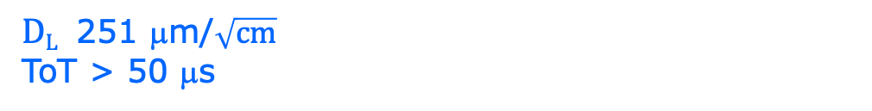
DESY testbeam Module Analysis
Study of the B = 1 T field data set
runs 6983 6986 6989 6990 p=5 GeV
Fit quality χ²/ndf = 17/35 χ²/ndf = 26/34
$DT$ 118 μm/$\sqrt{cm}$
$DL$ 251 μm/$\sqrt{cm}$
ToT > 50 μs
Preliminary
E_{d}=280 V/cm
B=1 T
T2K*
T2K* = T2K gas with O₂ and H₂O

Slide 9
DESY testbeam Module Analysis
Study of the B = 1 T field data set
runs 6983 6986 6989 6990 p=5 GeV
Some numbers: 7459 TPX3 Telescope tracks mean nr TPX3 hits 716.676
Fitted drift velocity per run in mm /ns
run 6983 vdrift 0.0587502
run 6986 vdrift 0.0582876
run 6989 vdrift 0.0590797
run 6990 vdrift 0.0571644

Slide 10
DESY testbeam Module Analysis
Study of the B = 1 T field data set
Now we will study the deformations in the module plane with a large data set based on TPX3 tracks. Only runs with z close to the grid were used.
Runs 6981, 6983, 6984, 6985, 6986 and 6987 with p=5 GeV/c are analysed.
The results are based on TPX3 tracks. As said, Telescope tracks have too partial coverage and too low statistics.

Slide 11
DESY testbeam Module Analysis
Runs 6981-6988 B=1T p=5 GeV
Preliminary
Increase coverage by using all selected TPX3 tracks for deformation plots
Here the number of hits on track for the selected tracks
Total of TPX3 tracks 76535
mean nr TPX3 hits 662.652

Slide 12
DESY testbeam Module Analysis
Runs 6981-6988 B=1T p=5 GeV
Preliminary
Residuals are calculated refitting the TPX3 hits with a fixed 5 GeV momentum constrained.

Slide 13
DESY testbeam Module Analysis
Runs 6981-6988 B=1T p=5 GeV
In case a Telescope track is found comparison of the fitted track parameters in xy and z
Total 10807 tracks

Slide 14
DESY testbeam Module Analysis
Runs 6981-6988 B=1 T p=5 GeV
Mean residuals
Remove/exclude
- 4 corner chips
- chips around 11
- chip 16
Deformations in xy for excluded chips are smaller than for B=0 and have often a different shape.
This is due to the fact that electrons follow the B field lines @ 1T
xy
z
B=1 T
situation
Preliminary

Slide 15
DESY testbeam Module Analysis
Runs 6909,16-18,34,35 B=0 T p = 5,6 GeV
Remove/exclude
- 4 corner chips
- chips around 11
- chip 16
B=0 T
situation
Preliminary

Slide 16
DESY testbeam Module Analysis
Runs 6981-6988 B=1T p=5 GeV
Mean residuals regrouped the row and column planes
xy
z
xy
z
B=1 T
situation
Preliminary

Slide 17
DESY testbeam Module Analysis
Runs 6909,16-18,34,35 B=0 T p = 5,6 GeV
xy
z
B=0 T
situation
Preliminary

Slide 18
DESY testbeam Module Analysis
Runs 6983-6988 B=1T p=5 GeV
method | rms (stat) xy | bins xy | rms (stat) z | bins z
row | 13 (2) μm | 3318 | 24 (5) μm | 864
column | 11 (2) μm | 2859 | 26 (5) μm | 729
Preliminary
In order to reduce the statistical error the bins in z were reduced.
The rms for z is larger than the value of 15 μm obtained for the B=0 run for the module and quad.
The rms in xy is excellent!

Slide 19
DESY testbeam Module Analysis
Runs 6909,16-18,34,35 B=0 T p = 5,6 GeV
B=0 T
situation
method | rms (stat) xy | bins xy | rms (stat) z | bins z
row | 10 (6) μm | 2881 | 14 (8) μm | 2850
column | 12 (7) μm | 2901 | 13 (8) μm | 2843
Preliminary

Slide 20
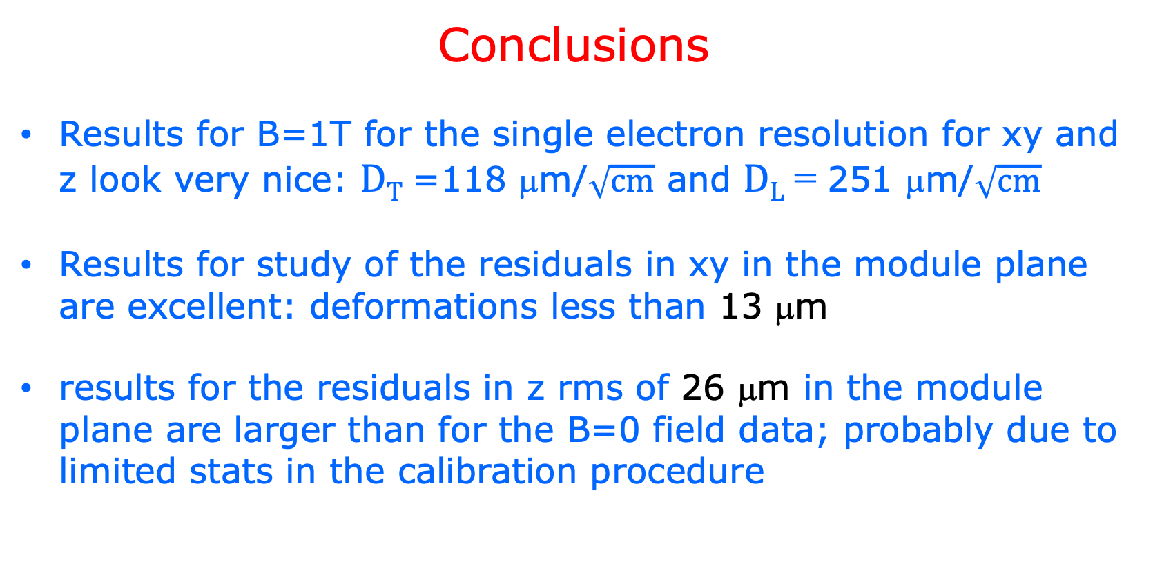
DESY testbeam Module Analysis
Conclusions
Results for B=1T for the single electron resolution for xy and z look very nice: $DT$ =118 μm/$\sqrt{cm}$ and $DL$ = 251 μm/$\sqrt{cm}$
Results for study of the residuals in xy in the module plane are excellent: deformations less than 13 μm
results for the residuals in z rms of 26 μm in the module plane are larger than for the B=0 field data; probably due to limited stats in the calibration procedure

