Slide 1
SUSTAINABILITY
28 June 2023
Arjen van Rijn, Catharina Vaendel, Maria Haney, Karin Matthesius, Jan Visser, Patrick Koppenburg.

Slide 2
SUSTAINabLE BUSINESS travel
The topic of this session: an inventory of building blocks for sustainable travel policy, tailored to the needs of Nikhef.
In other words: formulate Nikhef’s updated business travel policy!
So it is NOT about commute travel (woon-werk-verkeer).
Agenda (14:00 – 16:00):
Nikhef’s Sustainability Roadmap (Arjen)
Experiences from the PhD Council (Gijs van Weelden, Clara Gatius);
Further introduction to the topic (Arjen)
Working session (all)

Slide 3
1. SUSTAINABILITY @ nikhef
Roadmap Sustainable Nikhef. Goal: climate neutral in 2030.
Reduce energy consumption: building and primary process e.g. computing;
After the renovation the Nikhef building (‘SP105’) is ‘van het gas af’;
Mobility, in particular less business travel by plane;
The topic of this session
Waste and circular economy; a.o. joining initiatives on the Science Park;
We work together with Science Park a.o. partners to realise a ‘milieuplein’ (centralized separate waste collection);
Attitude and behaviour;
We discuss with each other about sustainable behaviour; e.g. plant based catering of events;
Primary process: sustainable (astro)particle physics;
We discuss sustainability during our (scientific) meetings, such as the Jamboree and VISTA30.
See: https://www.nikhef.nl/duurzaamheid-onze-ambitie/
And: https://intranet.nikhef.nl/duurzaamheid/

Slide 4
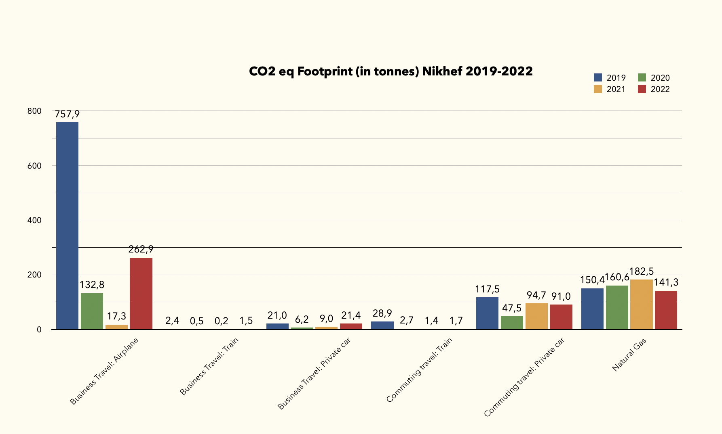
Nikhef’s carbon footprint

Slide 5
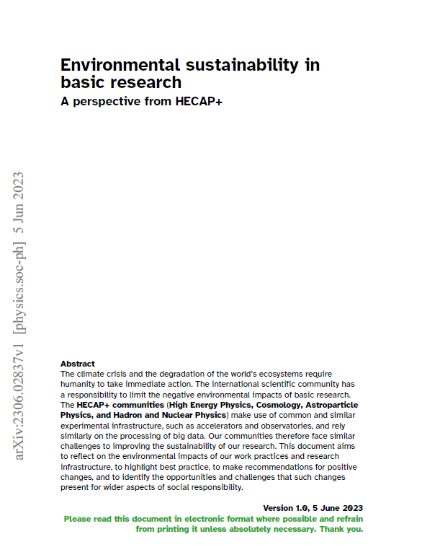
HECAP+ report
A comprehensive report on sustainability issues in the field of High Energy Physics, Cosmology, Astroparticle Physics and Hadron and Nuclear Physics (https://arxiv.org/abs/2306.02837).
Treats topics such as:
Computing
Energy
Food
Mobility
Research Infrastructure and Mobility
Resources and Waste

Slide 6
2. Experiences from the phd council
Clara Gatius
Gijs van Weelden

Slide 7
3. Sustainable business travel @ nikhef
Recommendations HECAP+ report
Implementing regulations NWO (Nikhef/NWO-I)
Travel requests @ Nikhef

Slide 8
HECAP+ report – Recommendations (1)
Individual actions:
• Re-assess business travel needs, using remote technologies wherever practicable.
• Choose environmentally sustainable means of transport for (daily commutes as well as) unavoidable business travel, amalgamating long-distance trips where possible.
Further group actions:
• Define mobility requirements and travel policies that minimise emissions, while accounting for the differing needs of particular groups, such as early-career researchers or those who are geographically isolated.
• Re-assess needs for in-person meetings, and prioritise formats that minimise travel emissions and diversify participation by making use of hybrid, virtual or local hub participation, and optimising the meeting location(s).

Slide 9
HECAP+ report – Recommendations (2)
Further institutional actions:
• Support environmentally sustainable commuting by improving on-site bicycle infrastructure, subsidising public transport and providing shuttle services.
• Disincentivise car travel where viable alternatives exist, facilitate car pooling, and provide on-site charging stations.
• Incentivise the reduction of business travel, e.g., by implementing carbon budgets with appropriate concessions.
• Ensure unavoidable travel is made via environmentally sustainable means through flexible travel policies and budgets, and the use of travel agents that offer multi-modal itineraries. Employ carbon offsetting only as a last resort.
• Remove any requirement on past mobility as an indication of quality in hiring decisions.
• Lobby for improved and environmentally sustainable local and regional transport infrastructure.

Slide 10
NWO implementing regulations 2023-2025
Article 10 – Allowance and mode of transport
1 In the case of business trips to and within foreign countries, the same provisions apply as
for domestic business trips in Article 2.
2 Travel by air is allowed if the travel time by public transport would exceed 8 hours or if it
saves an overnight stay.
3 Flying is only permitted when the manager judges that attendance abroad is necessary.
4 In the case of flights, the least environmentally damaging option must be chosen. In
particular, this means opting for a direct flight.
5 If travelling by air, NWO also reimburses the cost of CO2 compensation.
6 The employee is not permitted to use air miles received for private use.
7 In special situations, the employer may give an allowance tailored to the situation, if use is
made of car rental.

Slide 11
A Travel request within nikhef…
Needs to be entered in advance in the Nikhef financial system (UBW – travel & expenses).
Needs approval of the budget holder (can be a program leader or a PI of a project).
Budget holder can never approve his/her own travel.
Has the travel secretariat in the workflow, but you can also arrange the travel bookings yourself (which is what more than half of Nikhef travellers do).
Currently Nikhef does NOT advocate to include CO2-compensation when purchasing your plane ticket.

Slide 12
4. Working session

Slide 13
SUSTAINability
Reaching sustainability goals will require dedicated, consistent and long term attention. It will certainly mean changes in the way we work.
We appreciate your feedback! Send it to the sustainability ambassadors: duurzaamheid@nikhef.nl.

