Slide 1
Measurement of jet quenching cone-size dependence in pp and Pb–Pb collisions with ALICE
Presentation by Christos Pliatskas Stylianidis, NNV meeting
November 3rd 2023,Lunteren

Slide 2
Heavy Ion collisions and Quark Gluon Plasma (QGP)
arXiv:2208.05290 [nucl-ex]

Slide 3
Jets as witnesses of QGP evolution
Heavy ion collisions produce:
Hot and dense medium of deconfined matter
High energy partons as a result of hard scattering
Parton energy loss due to its interaction with the medium
Through collisions
Through gluon radiation
Cluster parton shower products → jets
Jet of radius R

Slide 4
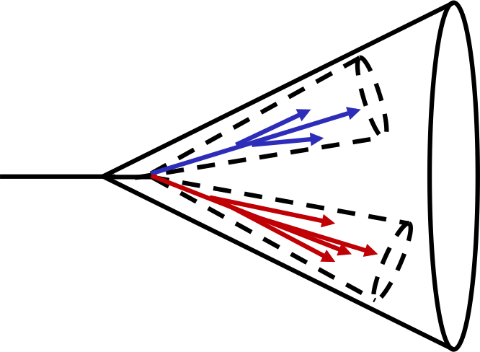
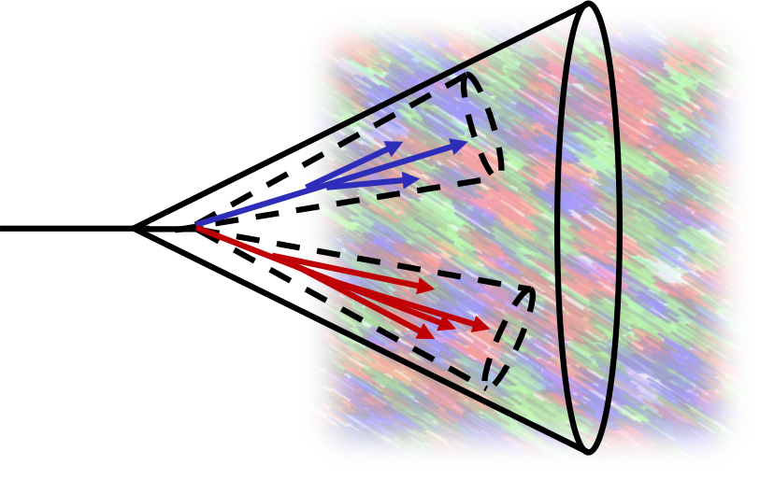
What is “jet quenching”?
Vacuum
Medium

Slide 5
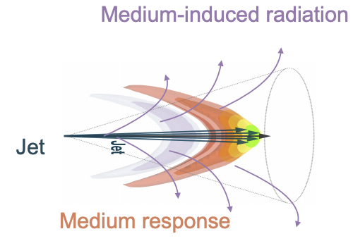
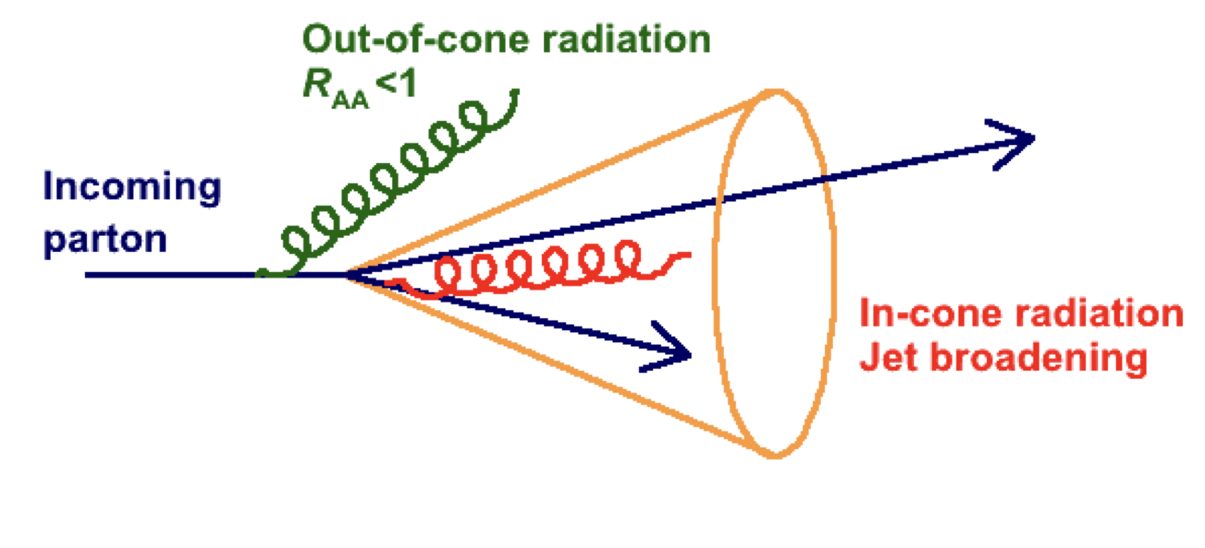
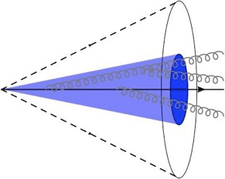
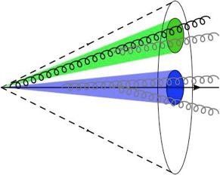
“Jet quenching” can have many aspects…
Medium-induced energy loss
Coherence effects
Medium recoil

Slide 6
Let’s quantify this …
Nuclear modification factor R_{AA}
$R_{AA}$=$\frac{1}{\left\langle T_{AA}\right\rangle }$ $\frac{d^{2}N/{dp}_{T}dη}{d^{2}σ_{pp}/{dp}_{T}dη}$
$R_{AA}$=

Slide 7
Measurement of R_{AA} with ALICE
$R_{AA}$=$\frac{1}{\left\langle T_{AA}\right\rangle }$ $\frac{d^{2}N/{dp}_{T}dη}{d^{2}σ_{pp}/{dp}_{T}dη}$
ALICE: https://arxiv.org/abs/2303.00592

Slide 8
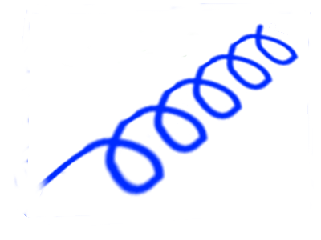
Are large jets more quenched?
Large angle recapture
R_{AA} / R_{AA, 0.2}
R_{jet}
Wider jet suppression
Sketch: QM19, Yi Chen

Slide 9
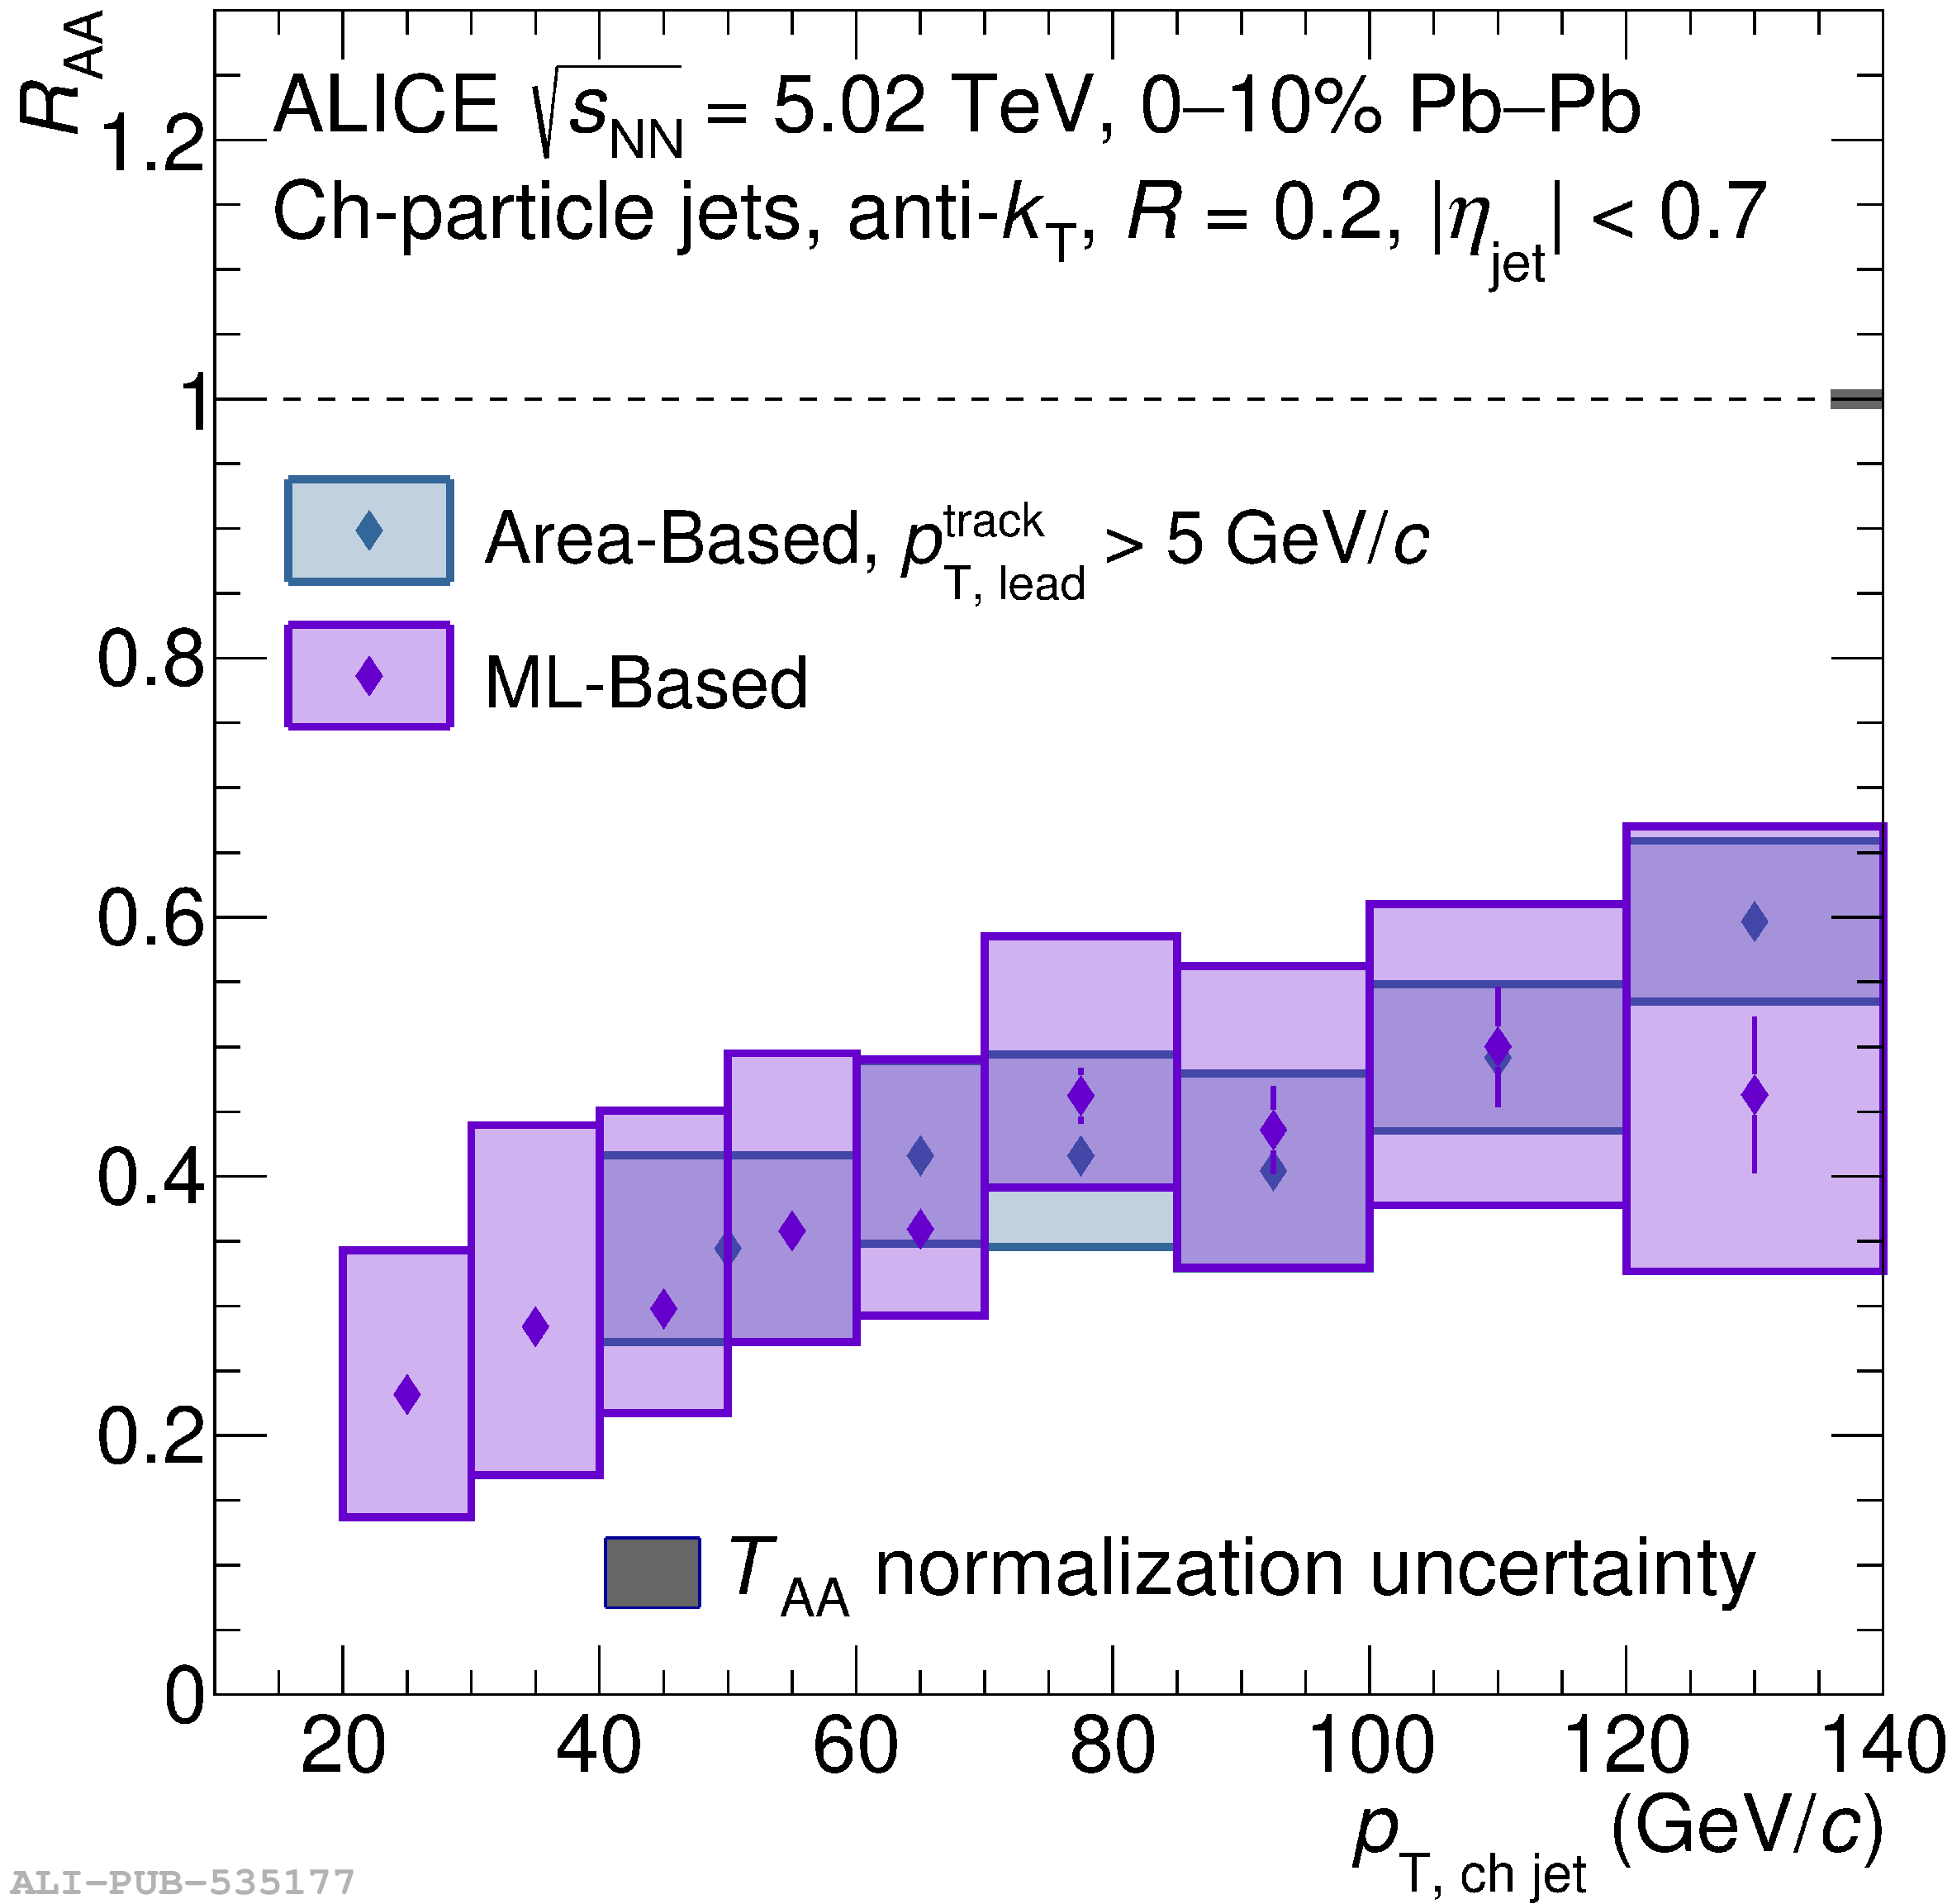
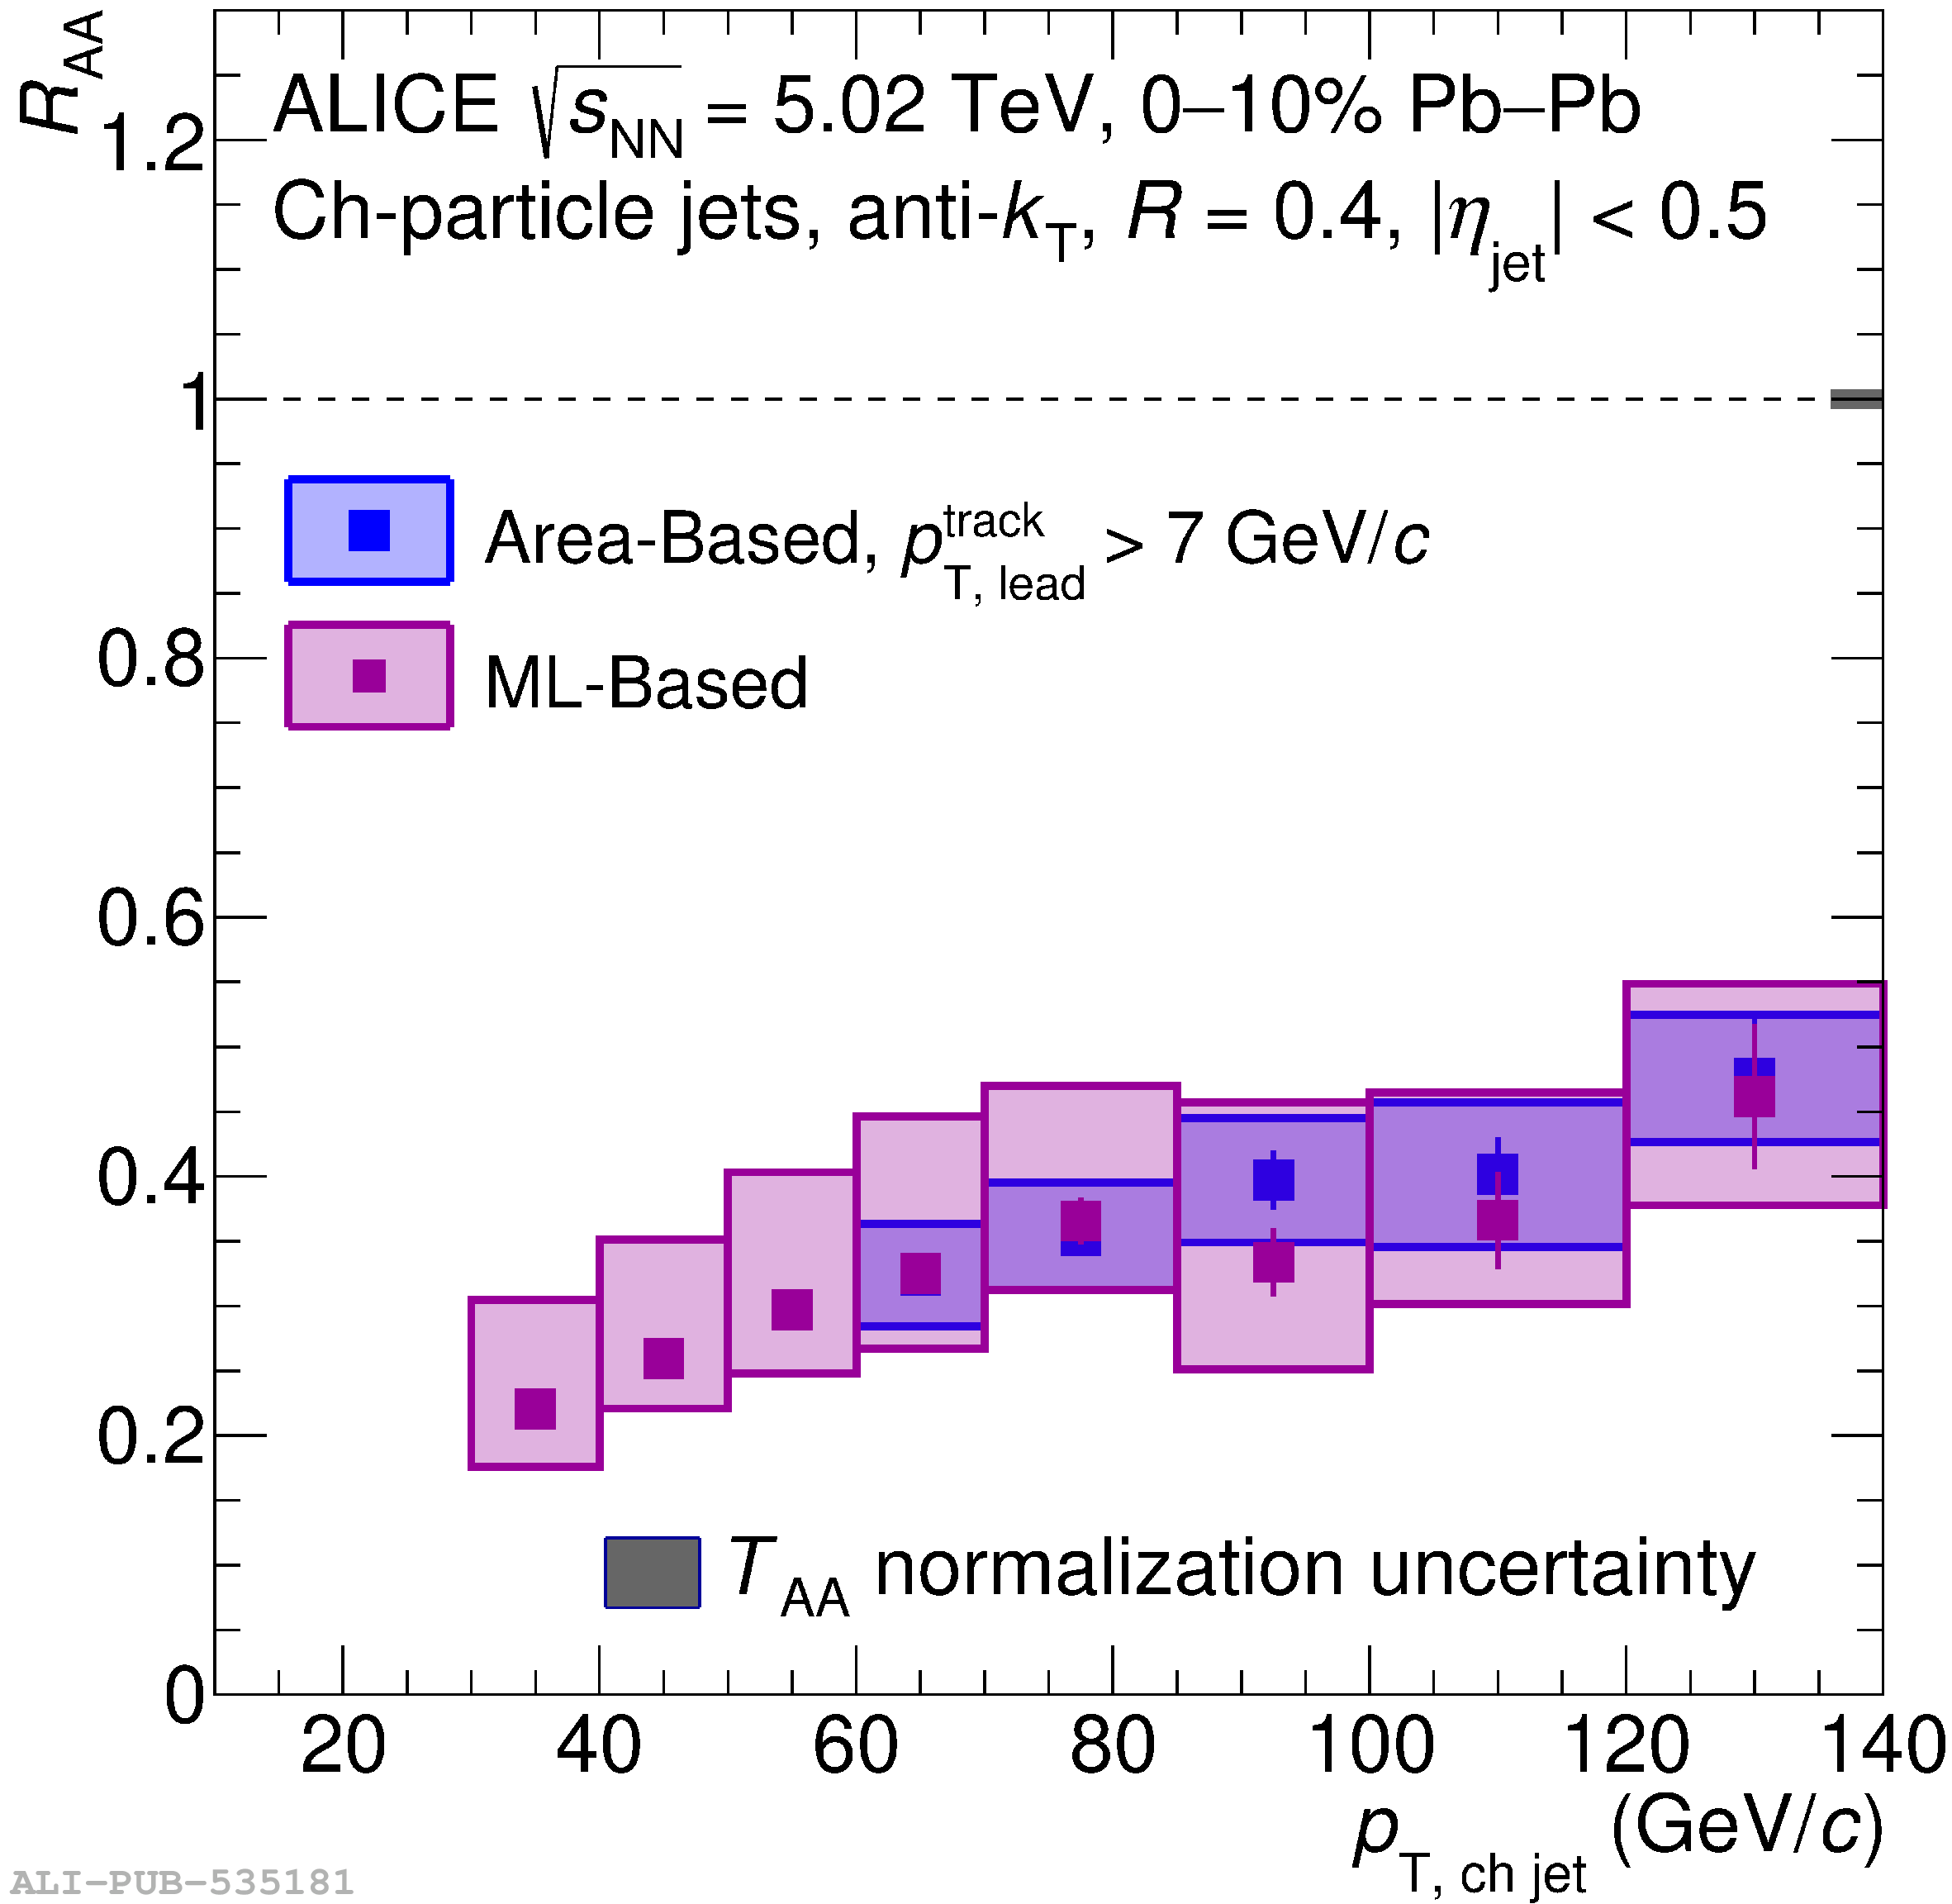
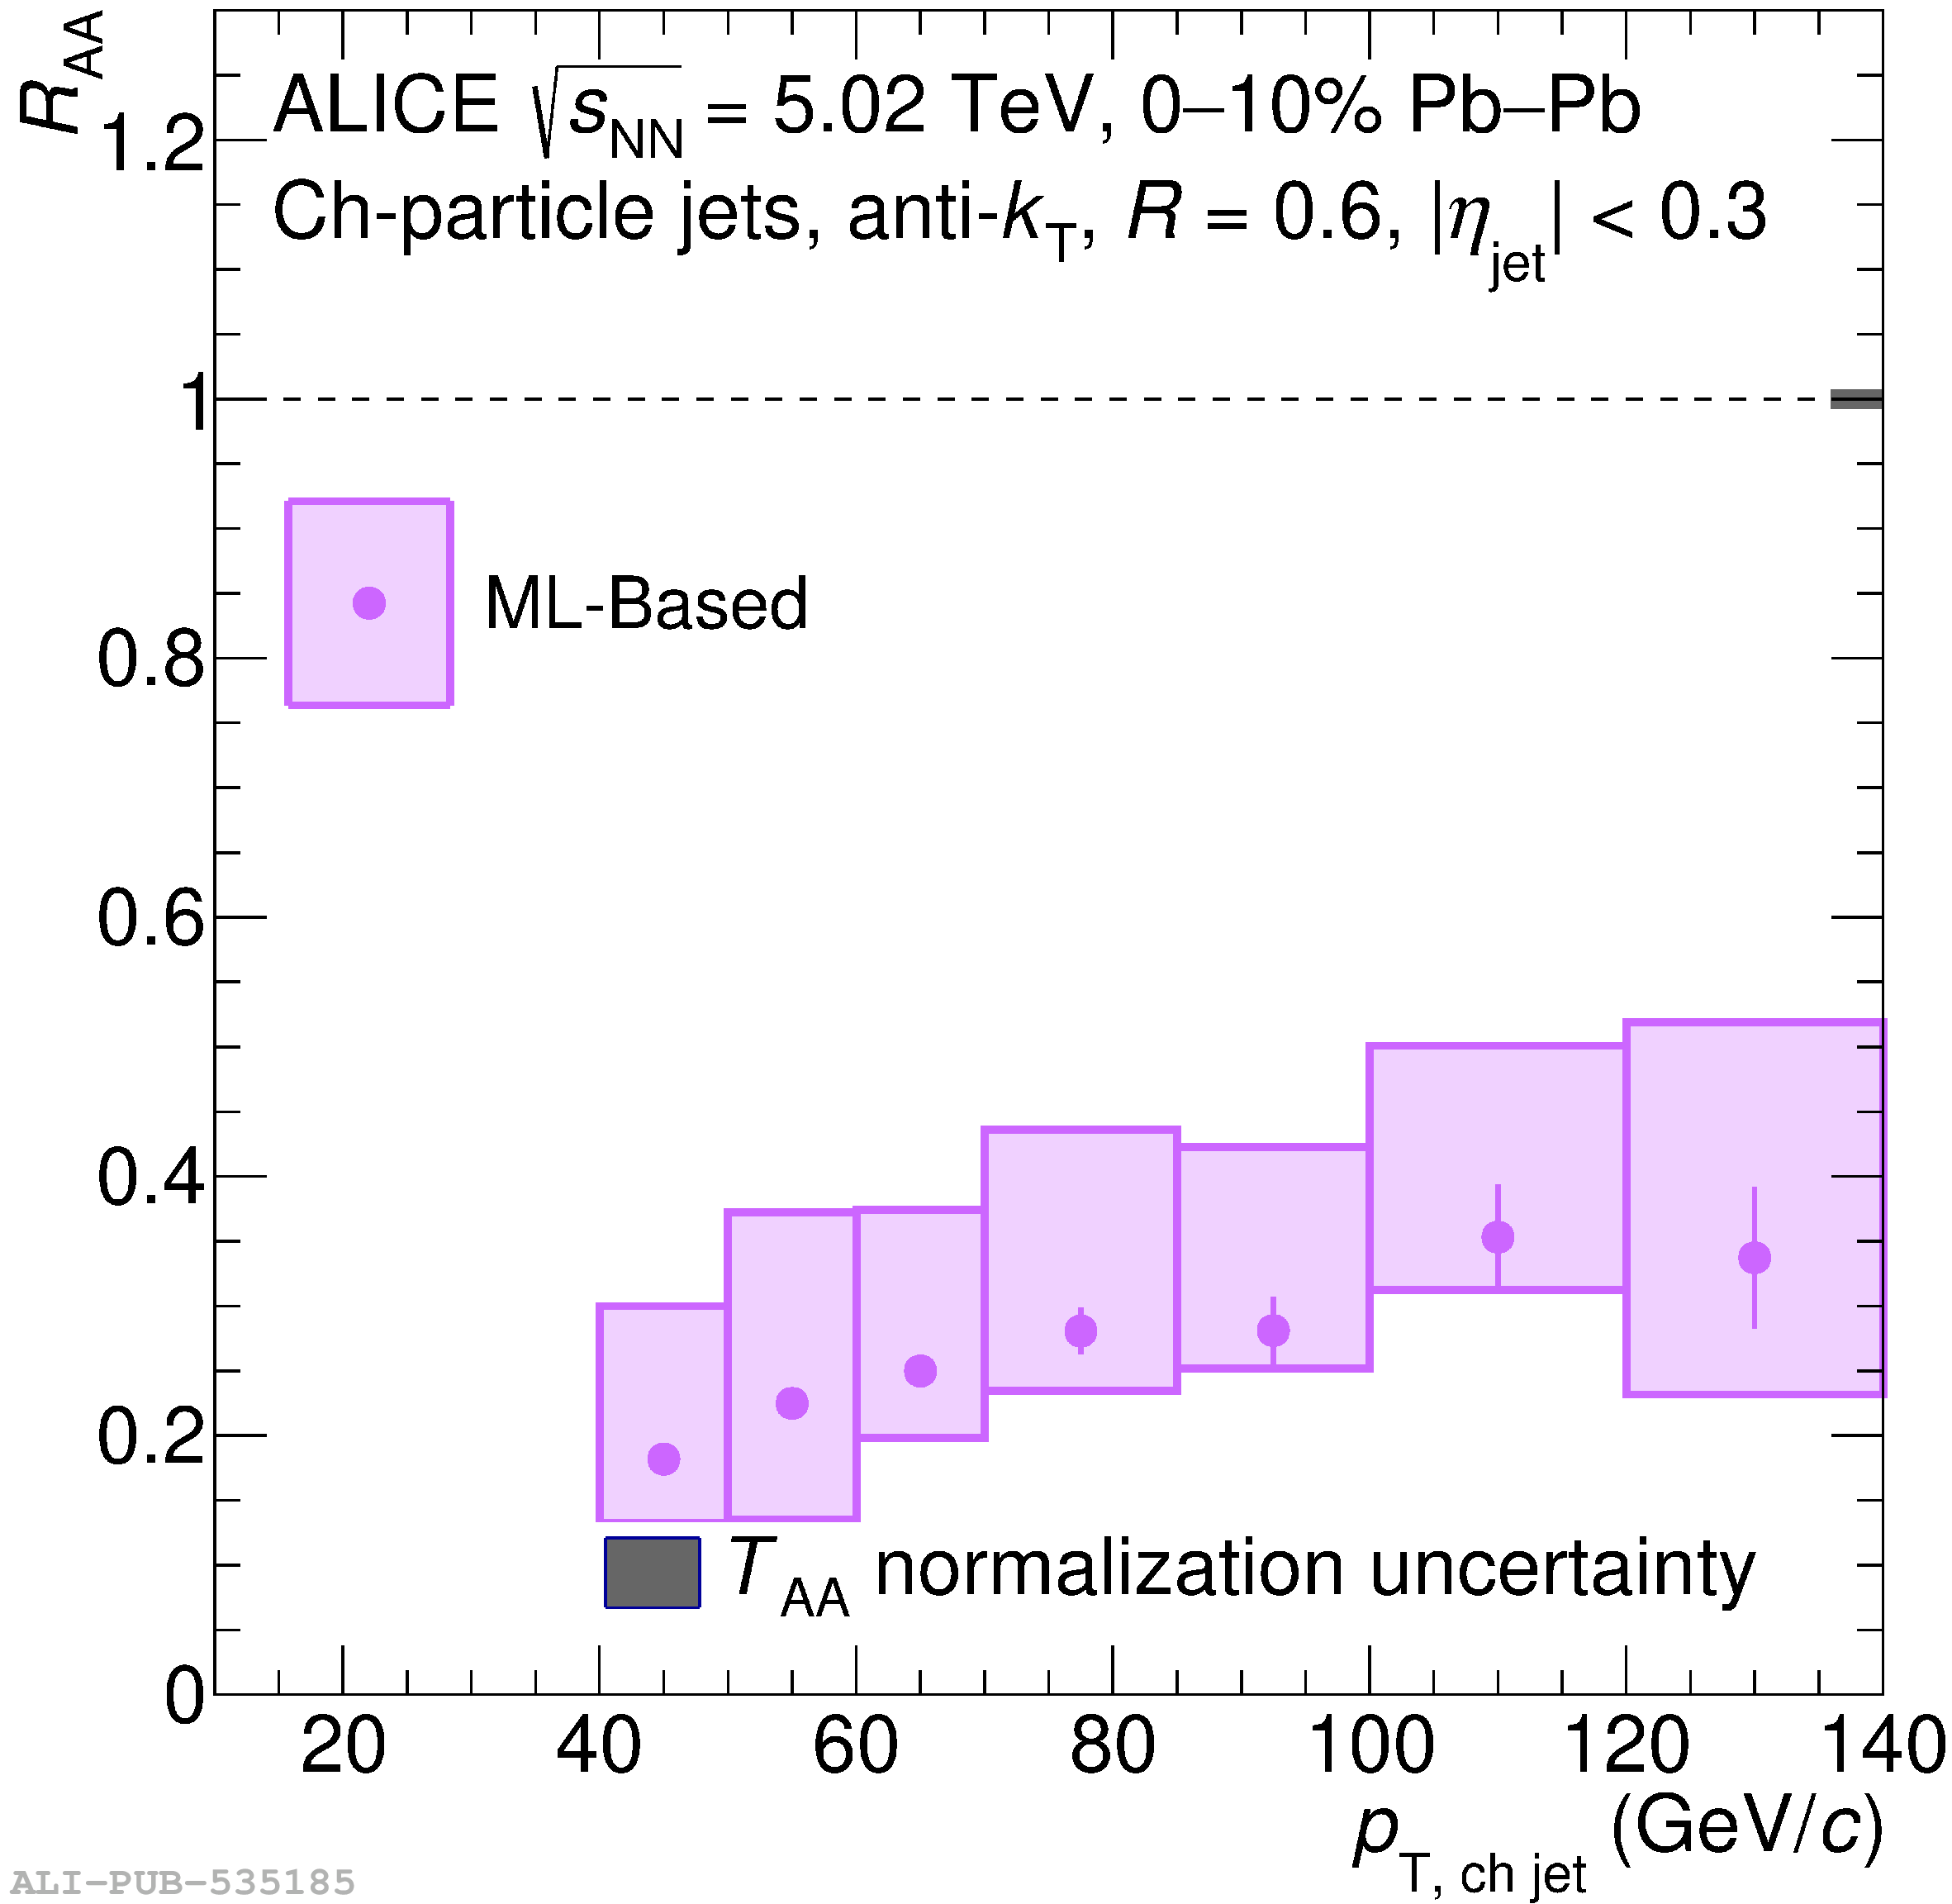
R-dependence of jet nuclear modification factor
R increases
ALICE: https://arxiv.org/abs/2303.00592
R=0.2
R=0.4
R=0.6

Slide 10
R-dependence of jet nuclear modification factor
Hint of decrease of R_{AA} for large R at low p_{T} values
Comparison with models shows sensitivity to recoil effects
Large angle recapture
R_{AA} / R_{AA, 0.2}
R_{jet}
Wider jet suppression
R=0.4/R=0.2
R=0.6/R=0.2
ALICE: https://arxiv.org/abs/2303.00592

Slide 11
An alternative approach to the question
Large angle recapture
Energy flow definition:
Δp_{T} = p_{T} (R_{i+1}) - p_{T} (R_{i})
Δp_{T,AA} > Δp_{T,pp}
R= R_{i+1}
R_{AA} / R_{AA, 0.2}
R=R_{i}
R_{jet}
Wider jet suppression
Using a measurement in pp as baseline, study the effect of the energy loss mechanisms in Pb‒Pb
Δp_{T,AA} < Δp_{T,pp}
Sketch: QM19, Yi Chen

Slide 12
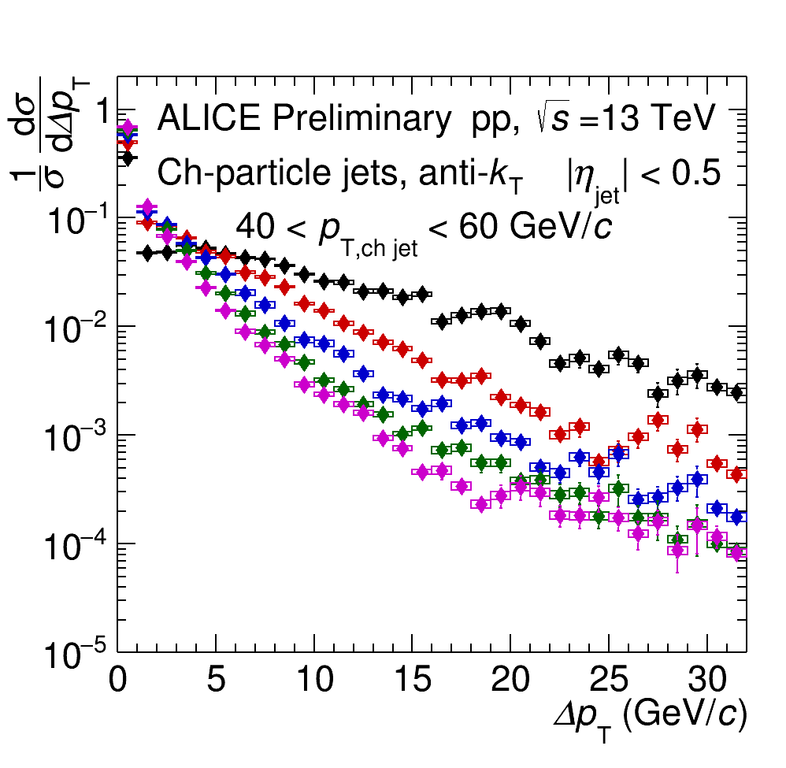
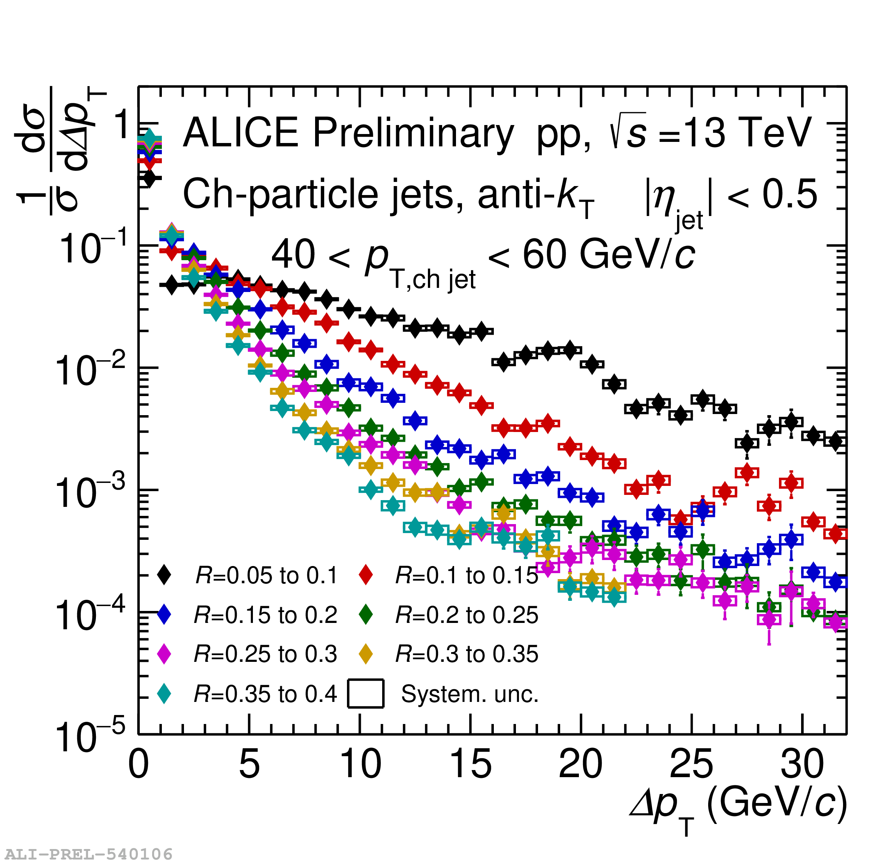
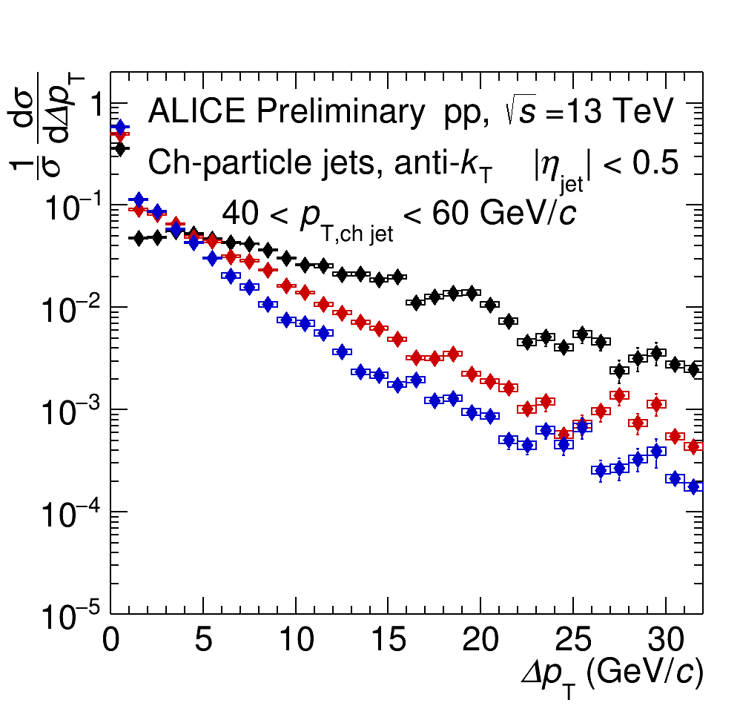
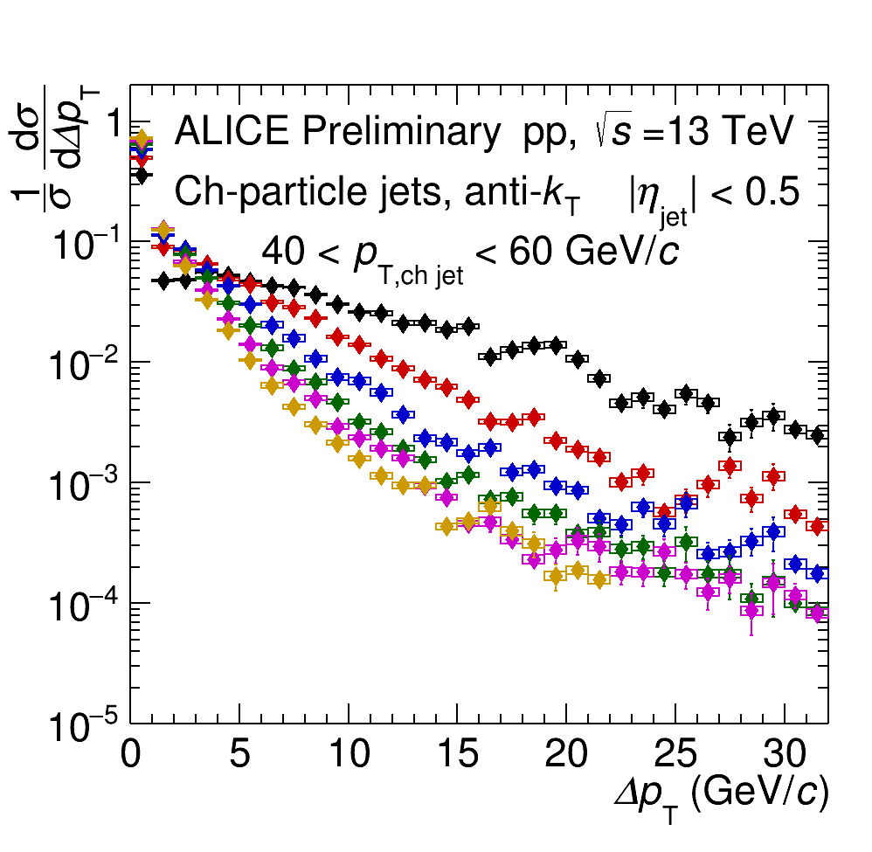
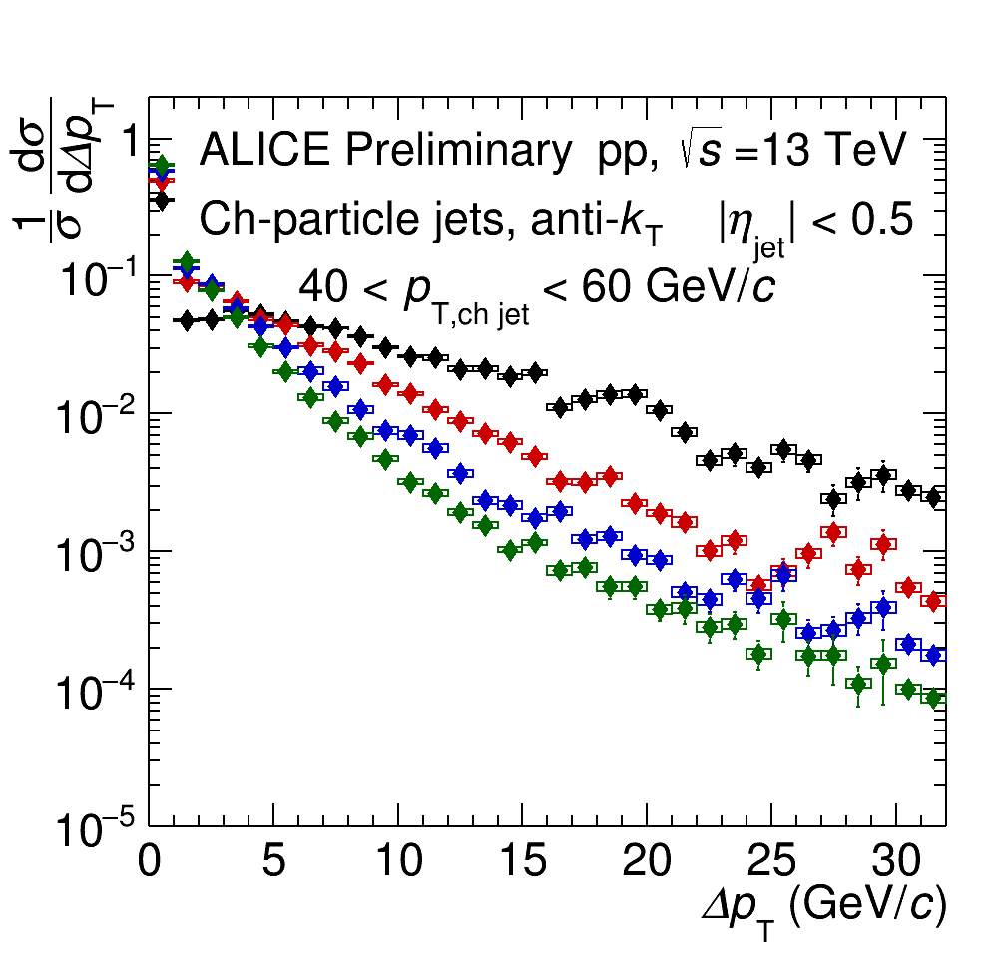
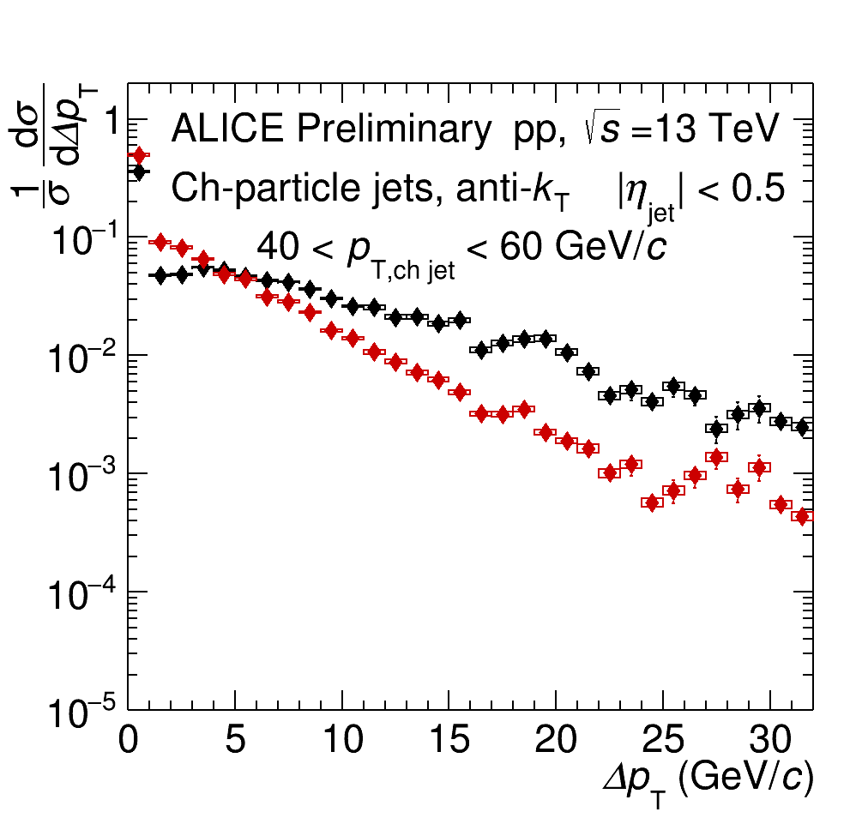
Jet energy flow measurement in pp collisions
Distinct peak at Δp_{T} =0.
Larger R → Steeper distributions
Smooth transition from narrow to wide jet cone radii.
R increases
Distribution mean
Mean energy flow rapidly decreases as function of R

Slide 13
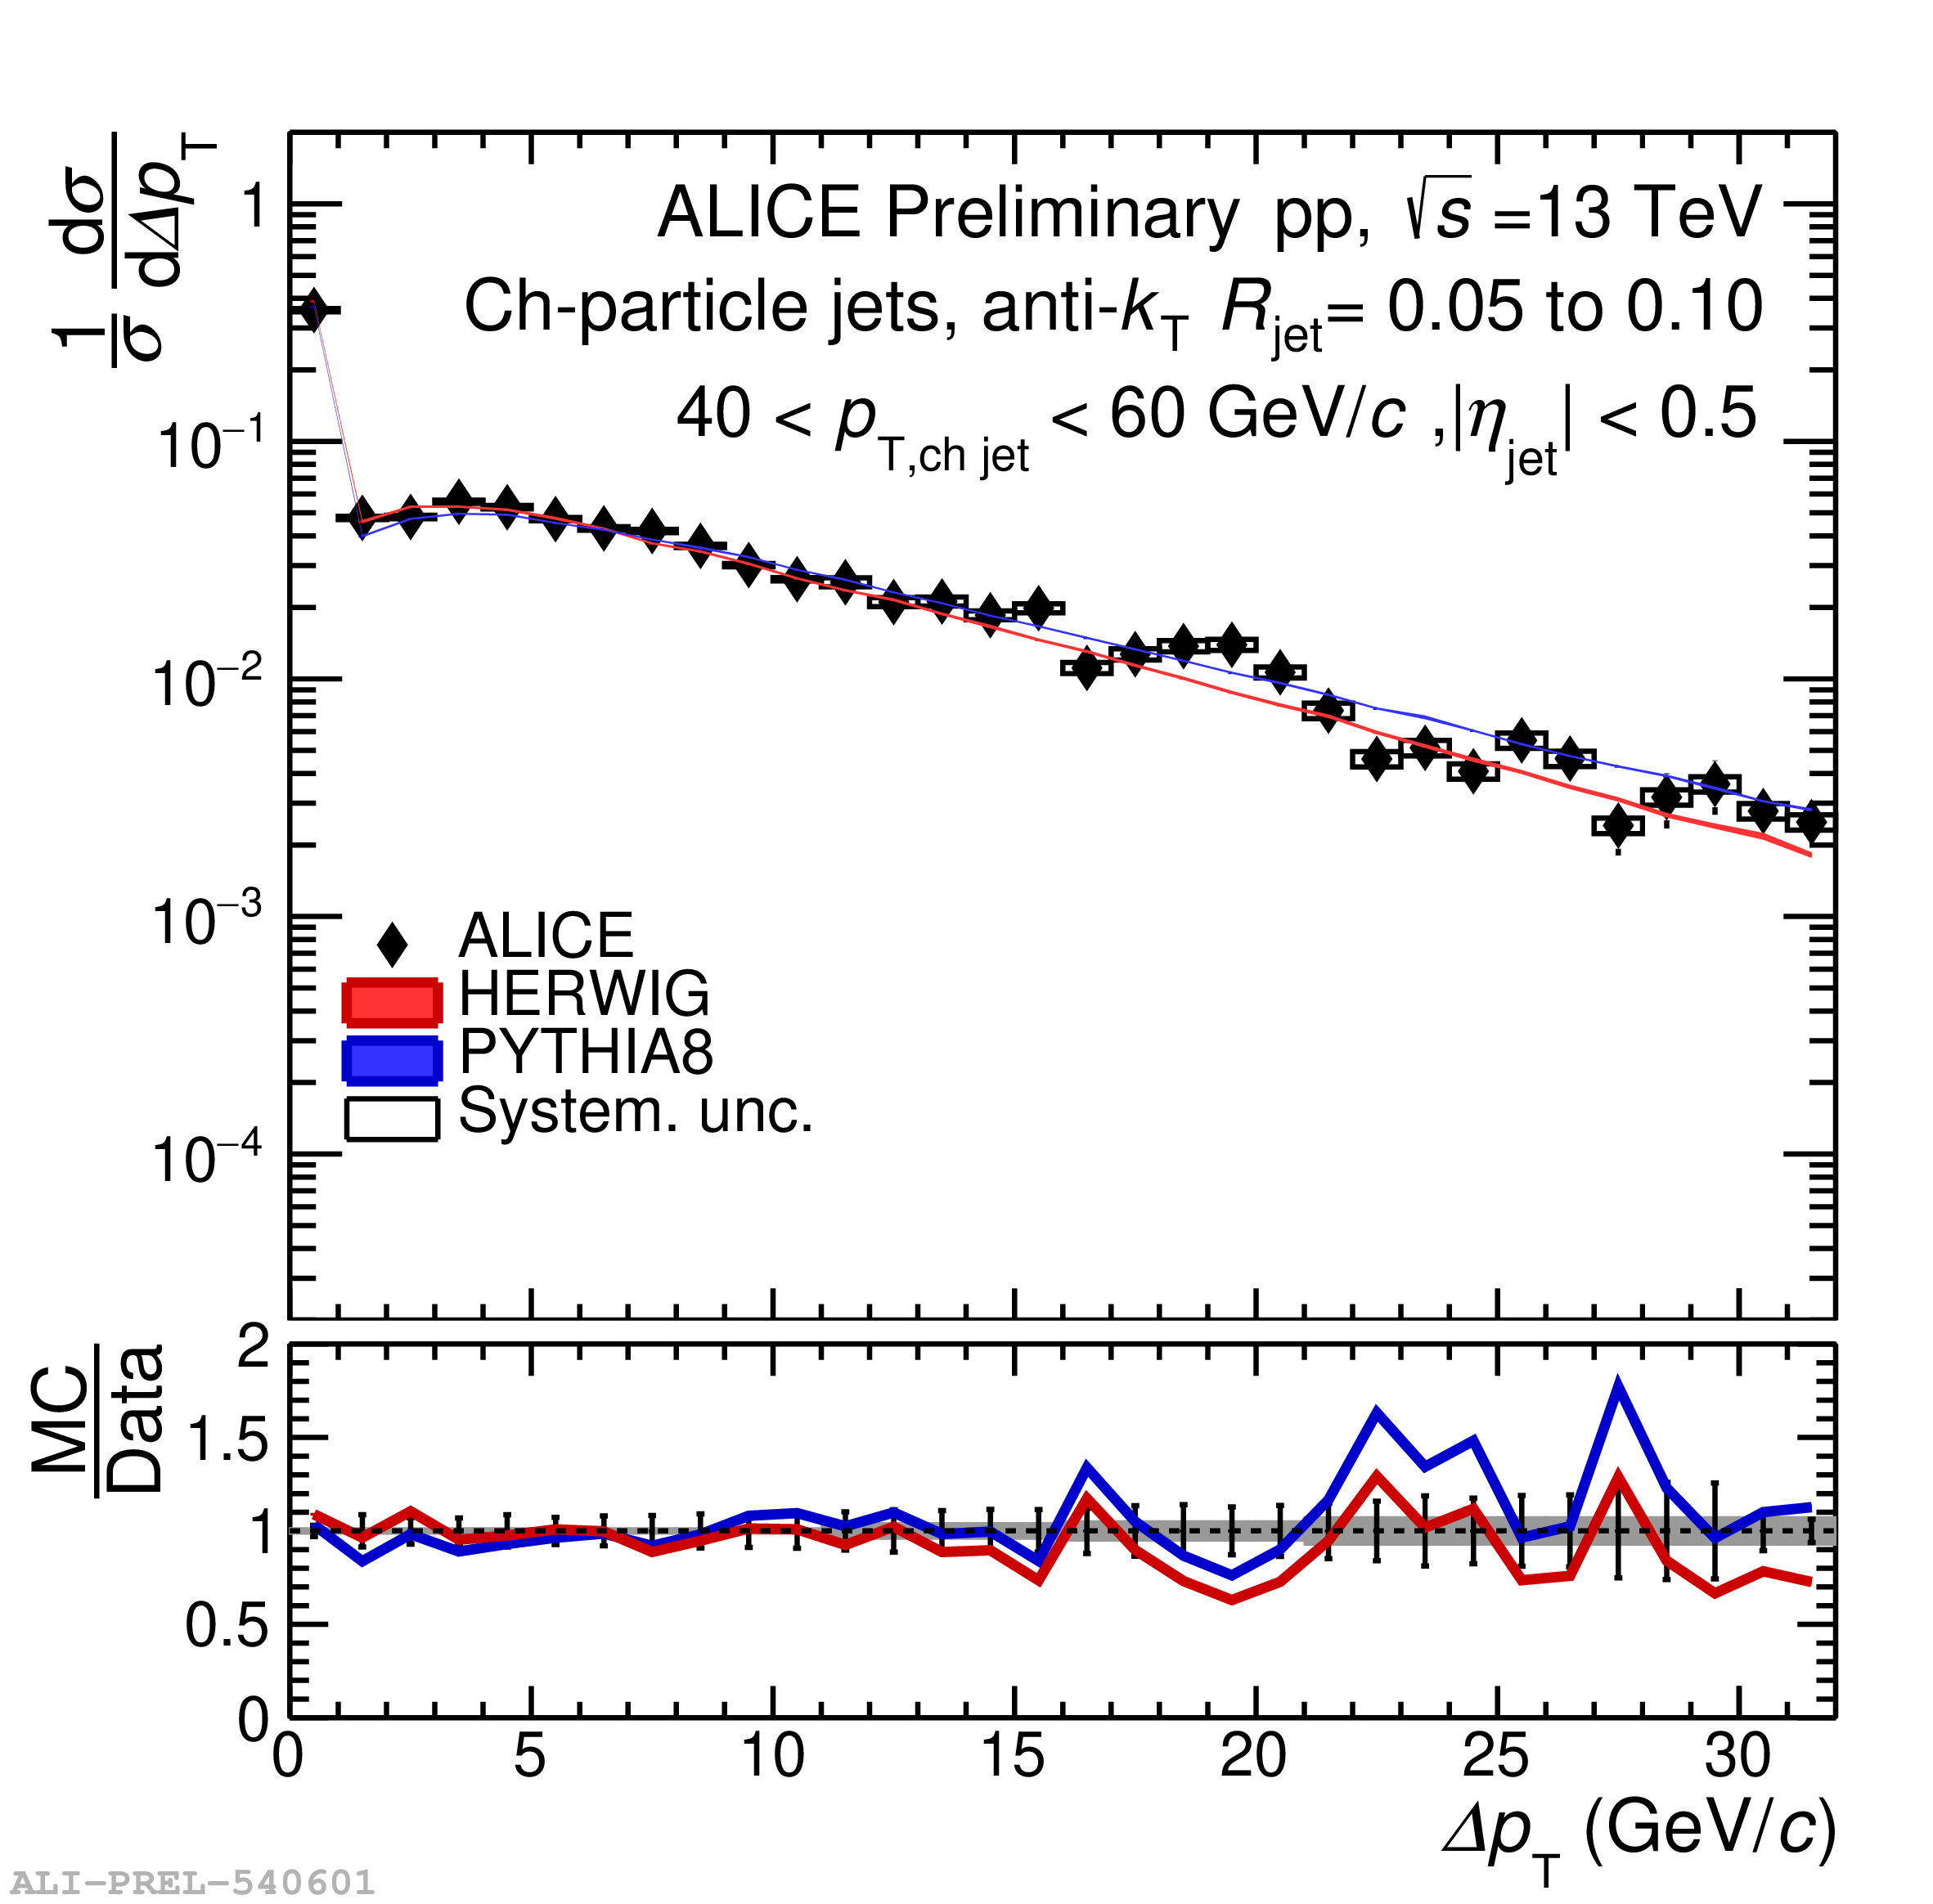
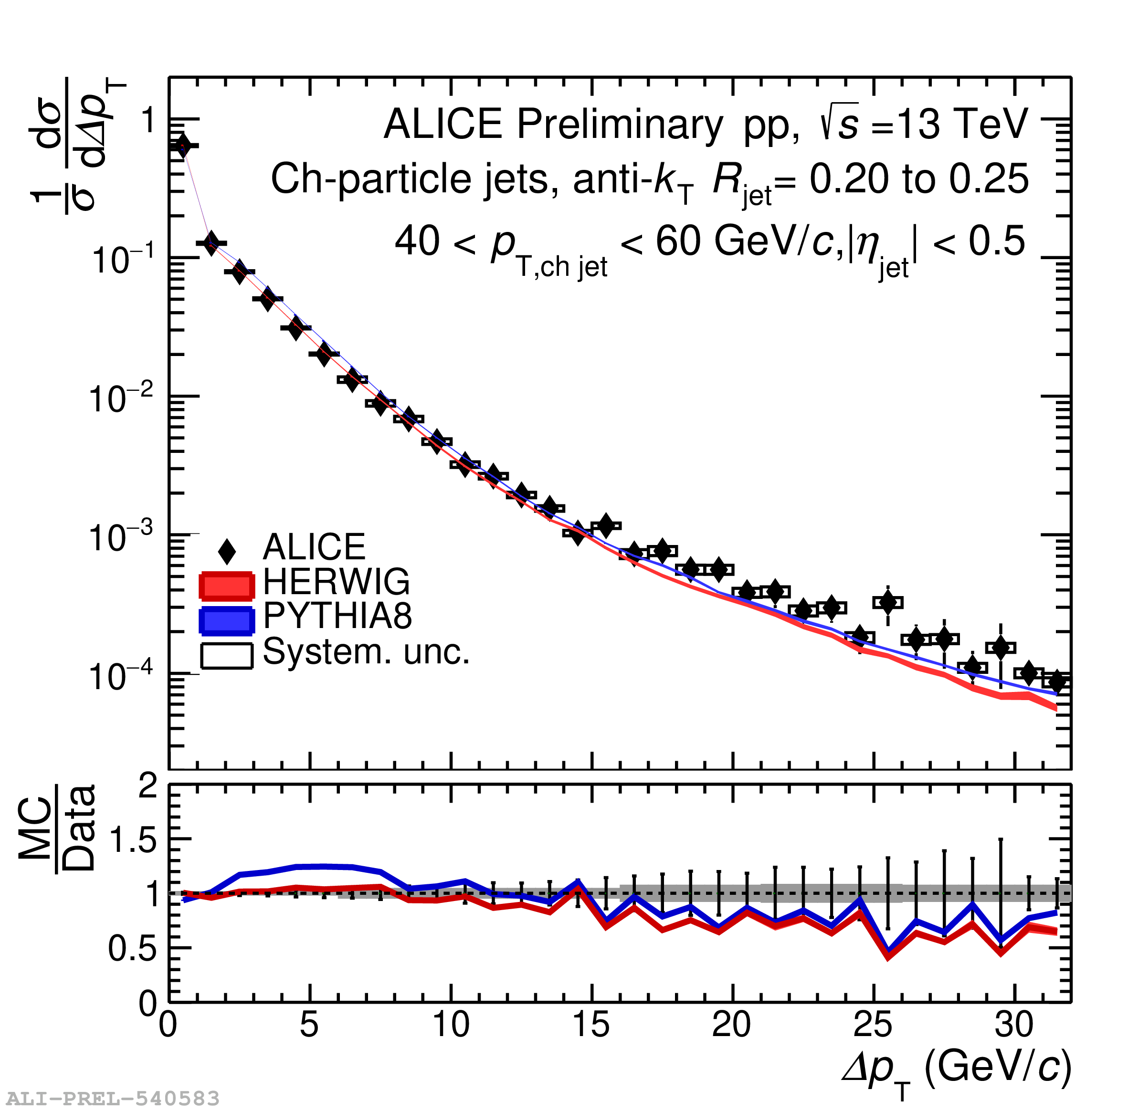
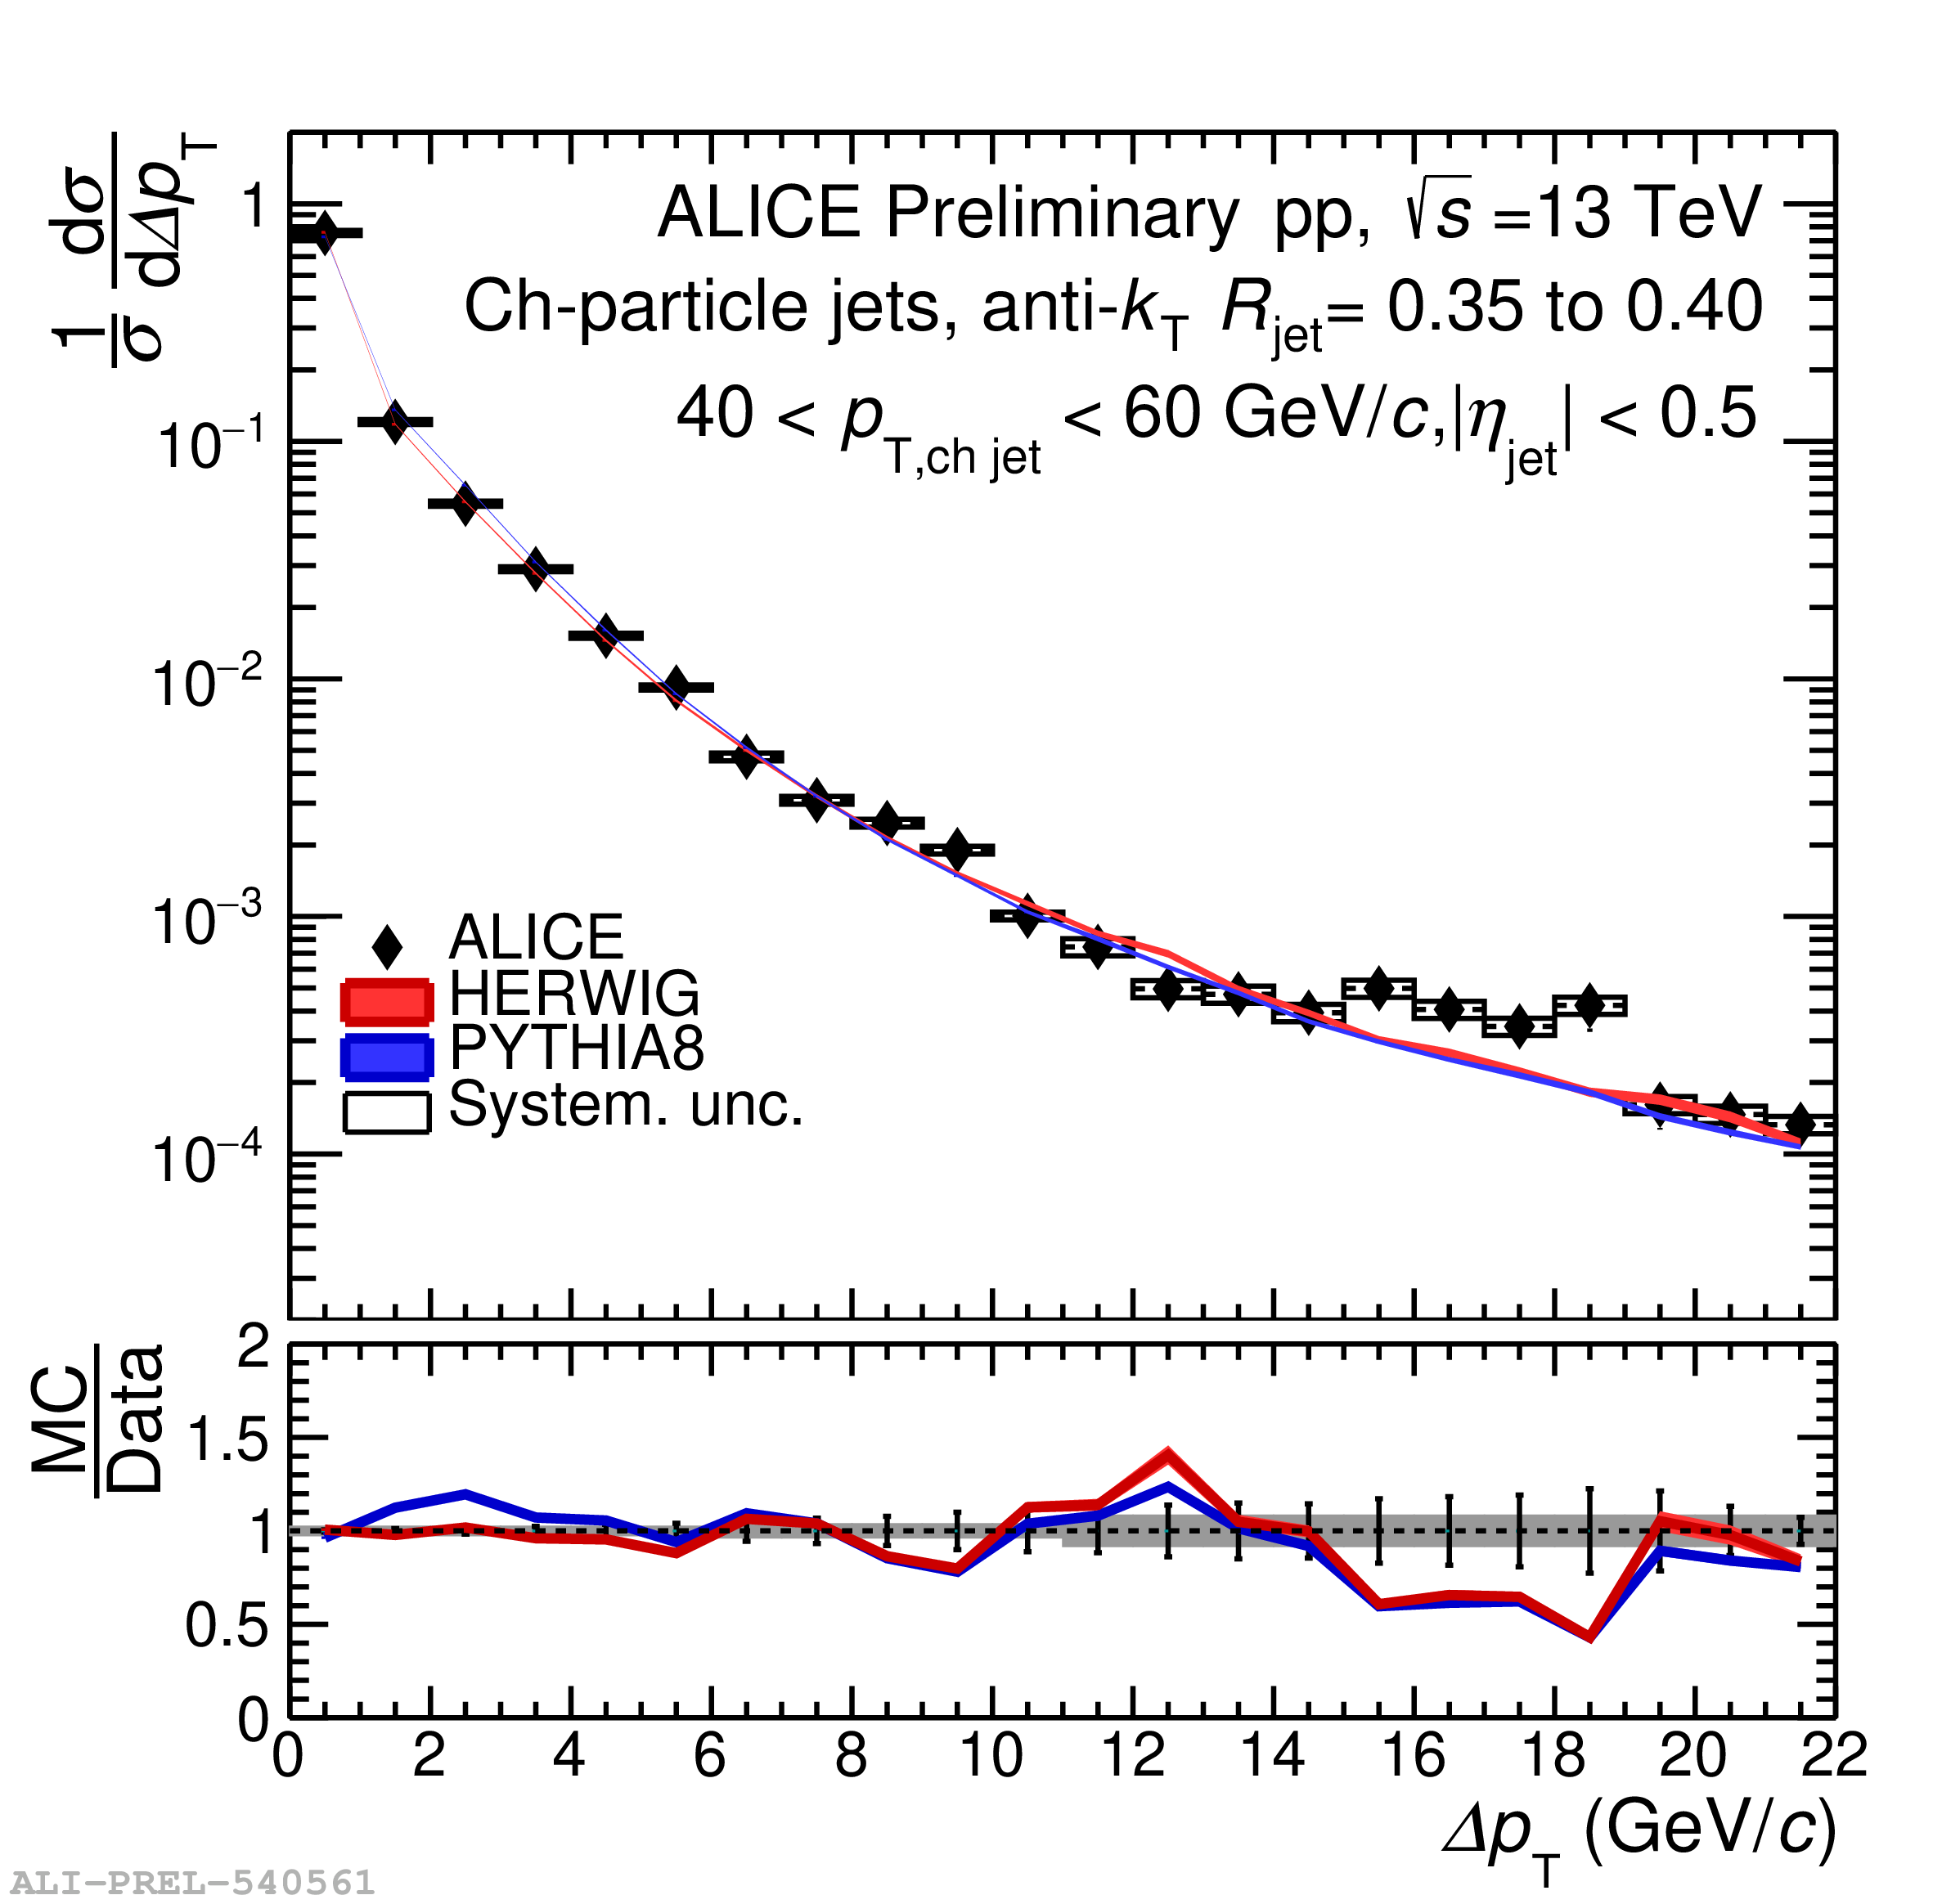
Jet energy flow measurement: Model comparison
Good description of the measurement by both HERWIG and PYTHIA
Jet p_{T} increases
R=0.05 to R=0.1
R=0.2 to R=0.25
R=0.35 to R=0.4

Slide 14
Model predictions for HI measurement
Observable is sensitive to recoil effects.
JEWEL Δp_{T} prediction in vacuum >> ALICE pp measurement.
Disagreement in vacuum predictions impedes interpretation for JEWEL AA simulations.

Slide 15
Model predictions for HI measurement
JEWEL predictions for jet quenching:
Recoil effects → Recovery of energy at large R.
No recoil effects → Narrower jet energy profile

Slide 16
Summary & Outlook
Jets serve as excellent probes for the study of the QGP medium dynamics.
R_{AA} measurements clearly demonstrate jet quenching in HI collisions.
Cone-size dependence of jet quenching is sensitive to competing effects.
Measurements of R_{AA} show hints of decrease at large jets in low momenta.
Novel jet energy flow observable and its measurement in pp collisions presented.
Mean jet energy flow monotonically decreases as a function of R
Model predictions showcase the sensitivity of the observable to recoil effects in the medium.
Jet energy flow measurement in ALICE Pb-Pb data is on the way.

Slide 17
Backup

Slide 18
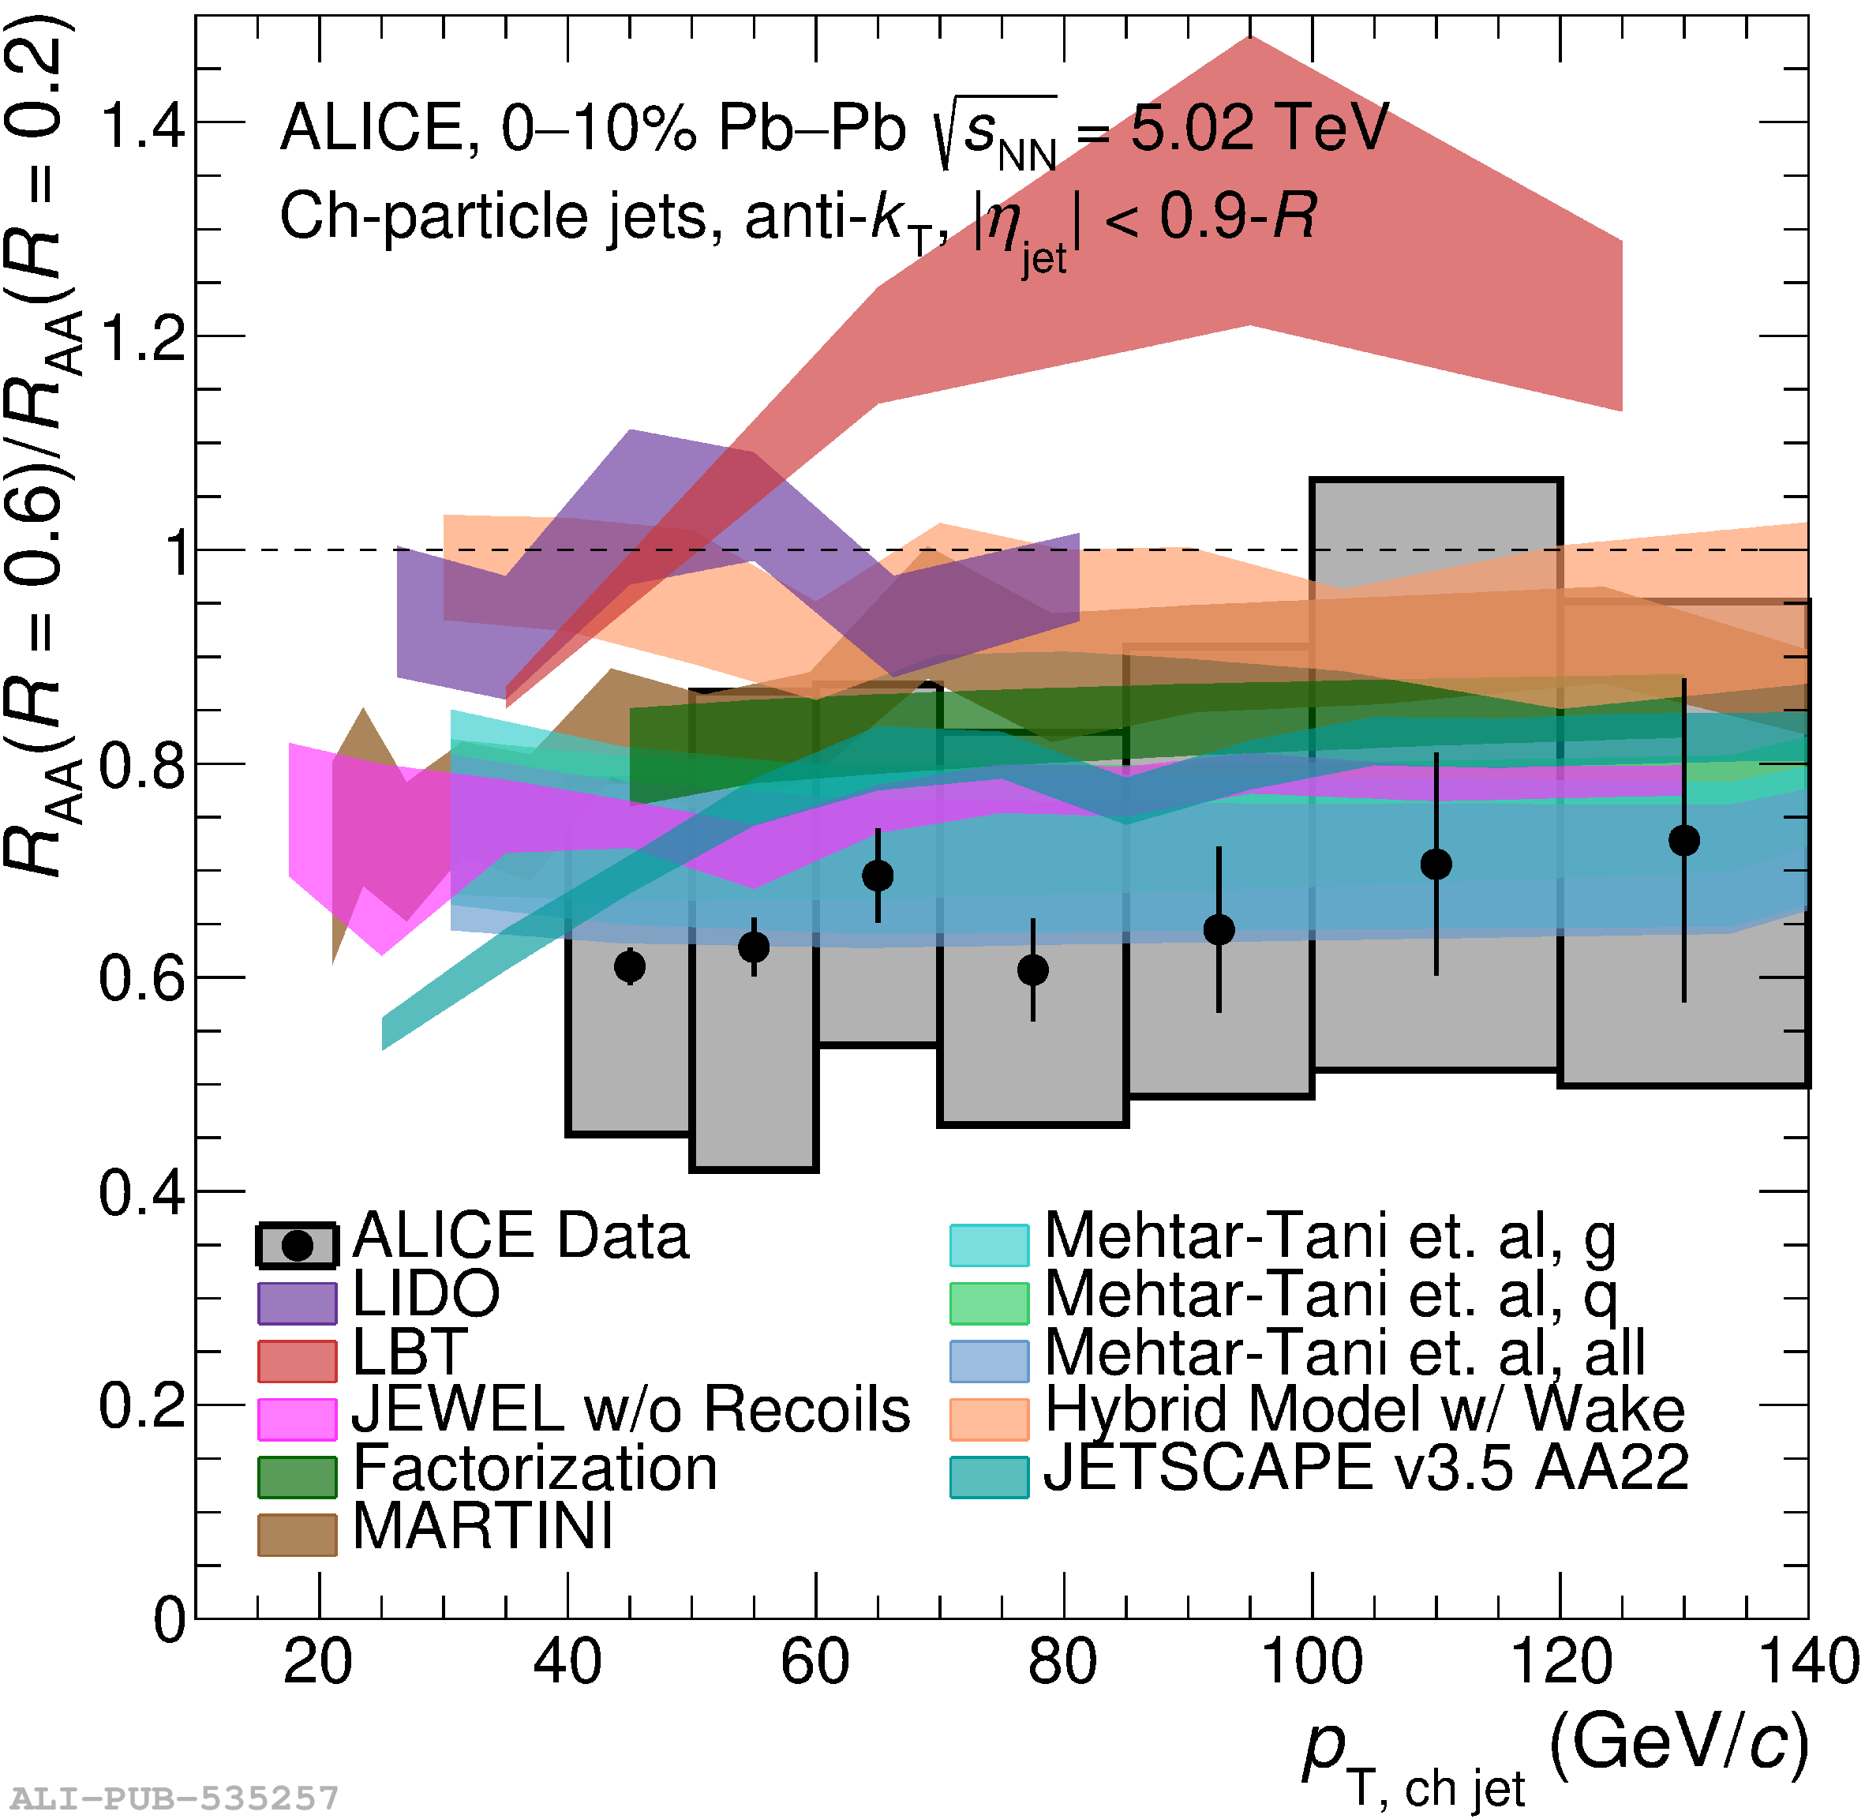
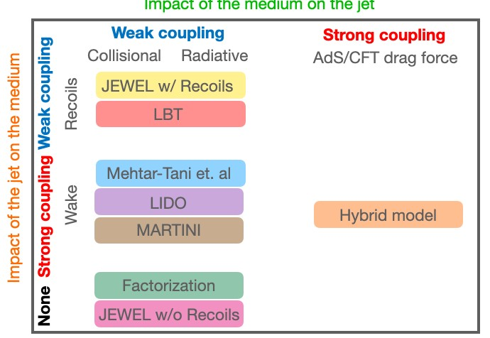
R dependence of jet nuclear modification factor – Models
ALICE: https://arxiv.org/abs/2303.00592

Slide 19
Matching/Tagging procedure
R_{jet} | PYTHIA Truth /Generator/ Particle level | PYTHIA Hybrid/Detector/ Reconstructed level
R=0.2
R=0.25
MC tagging
Closest match
Closest match

Slide 20
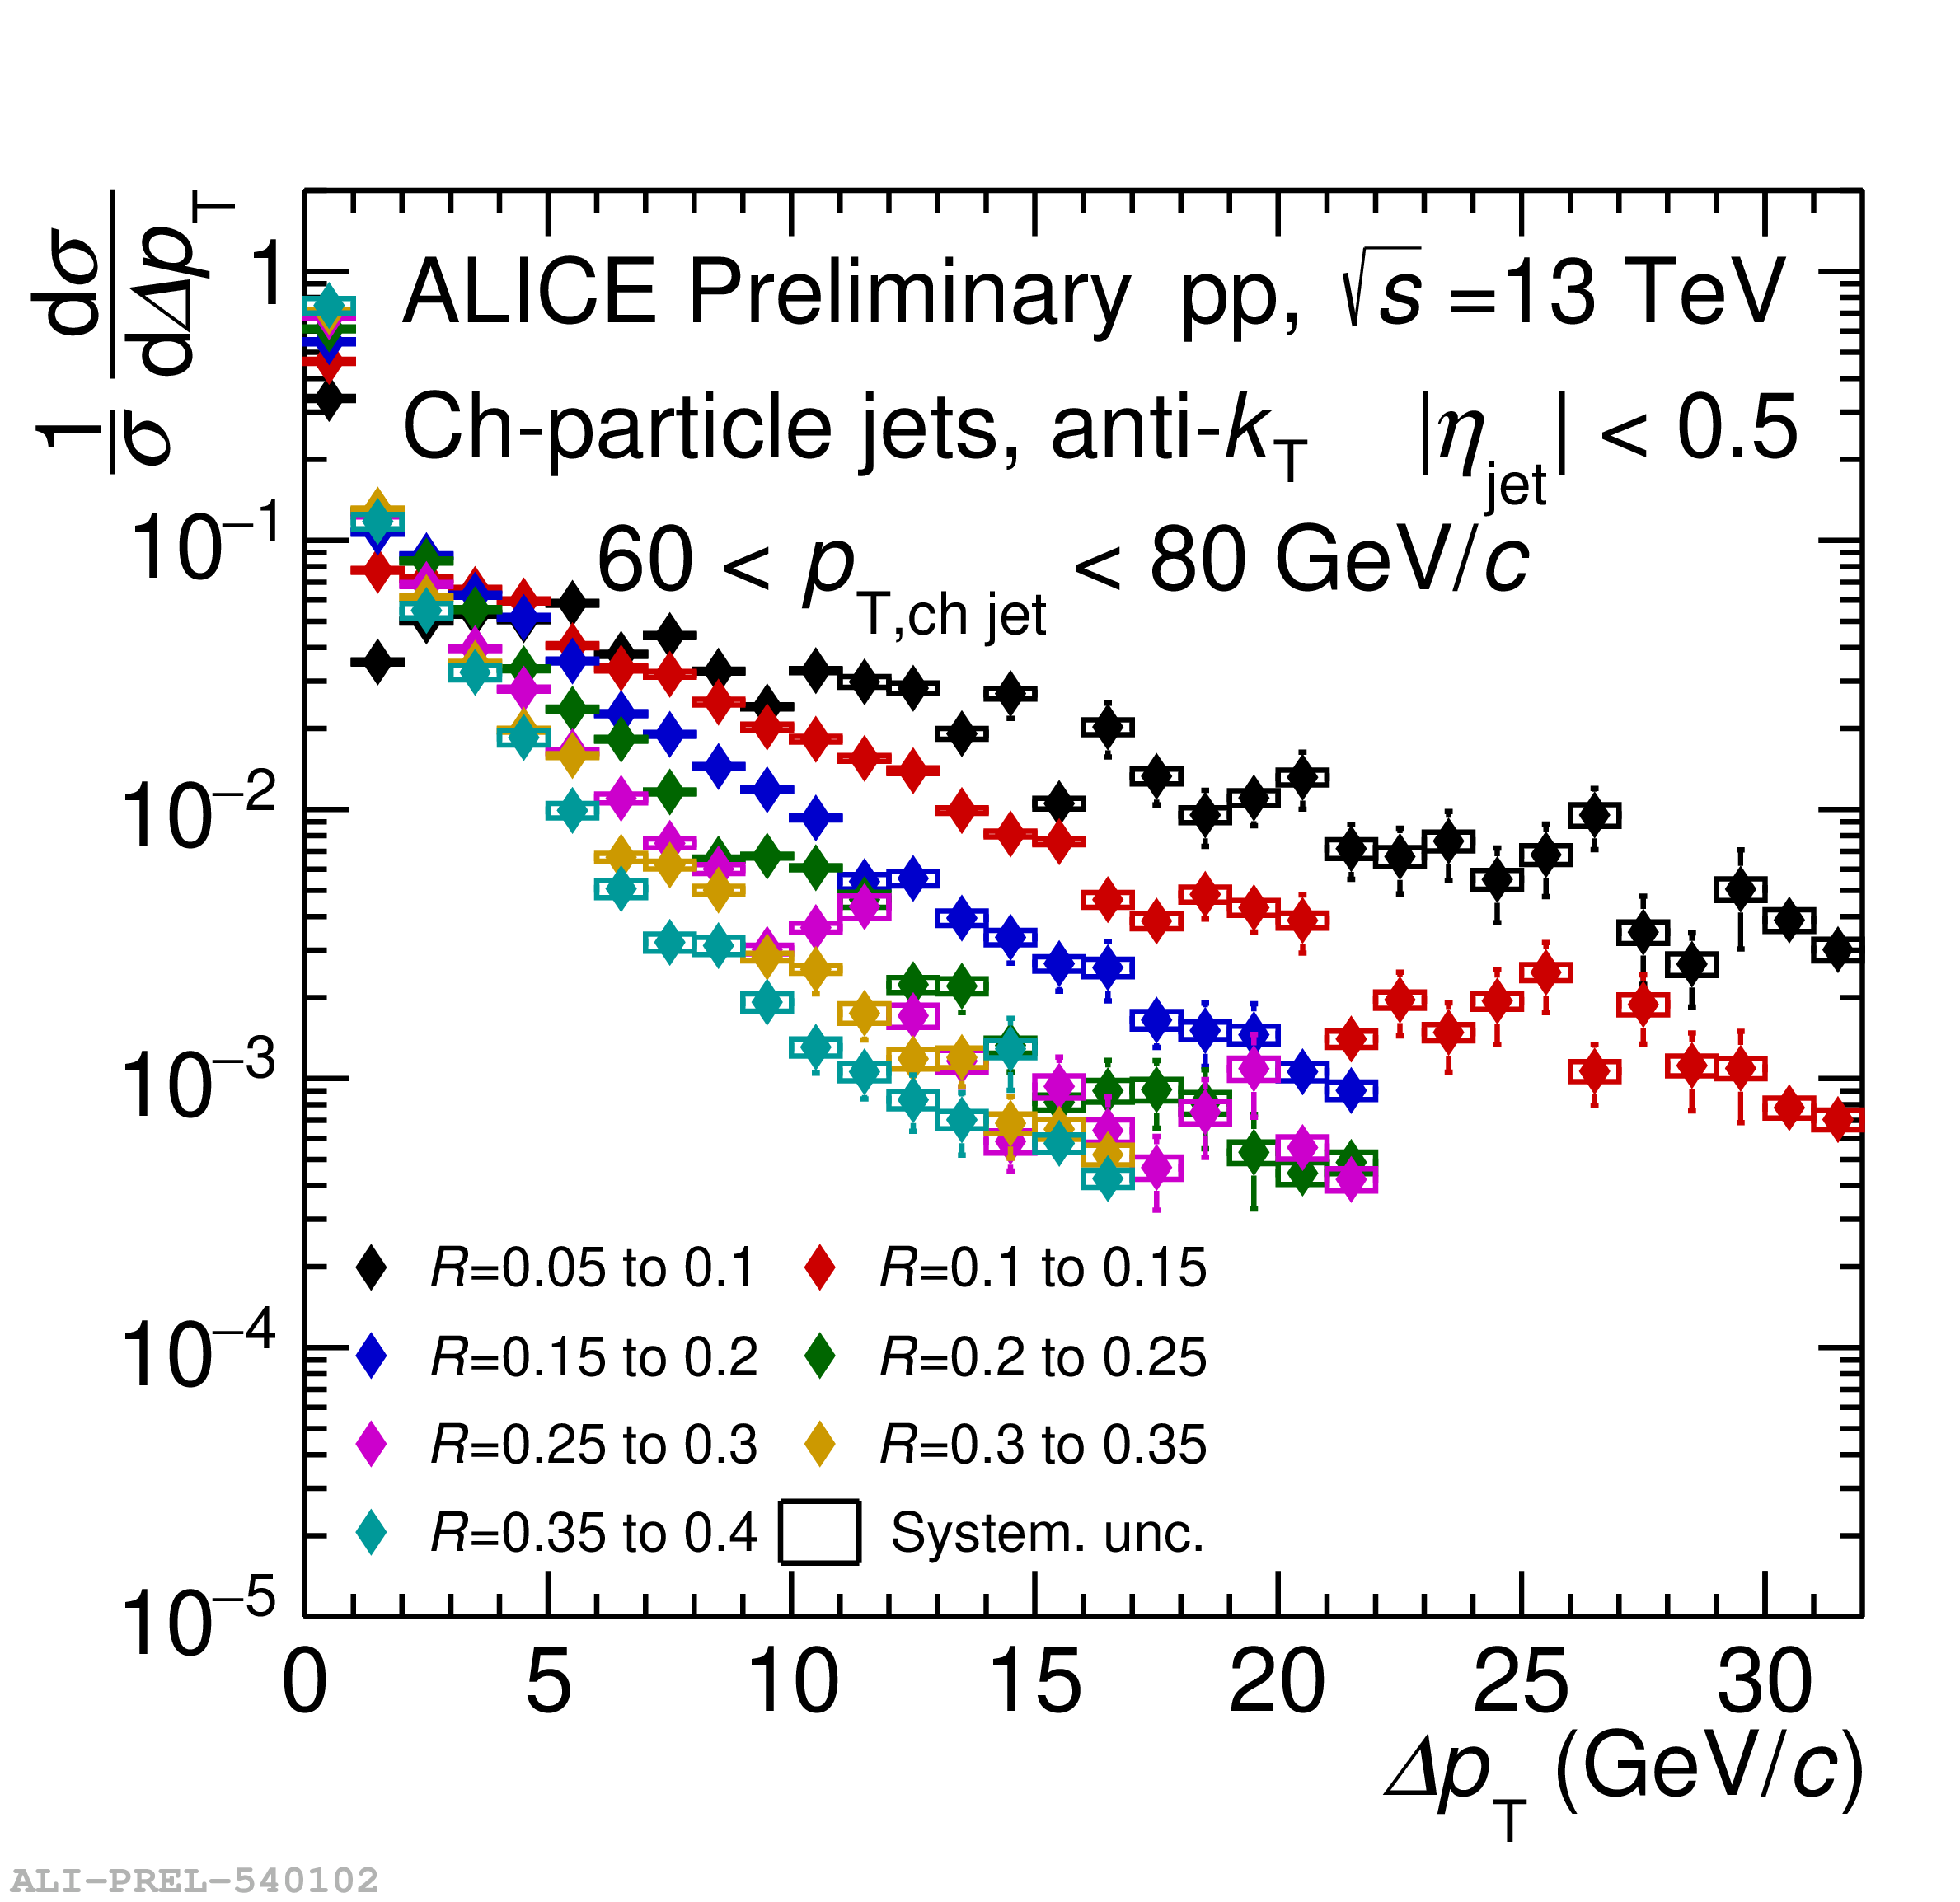
Jet energy flow distributions: jet p_{T} dependence
40 < p_{T} < 60 GeV/c
60 < p_{T} < 80 GeV/c

Slide 21
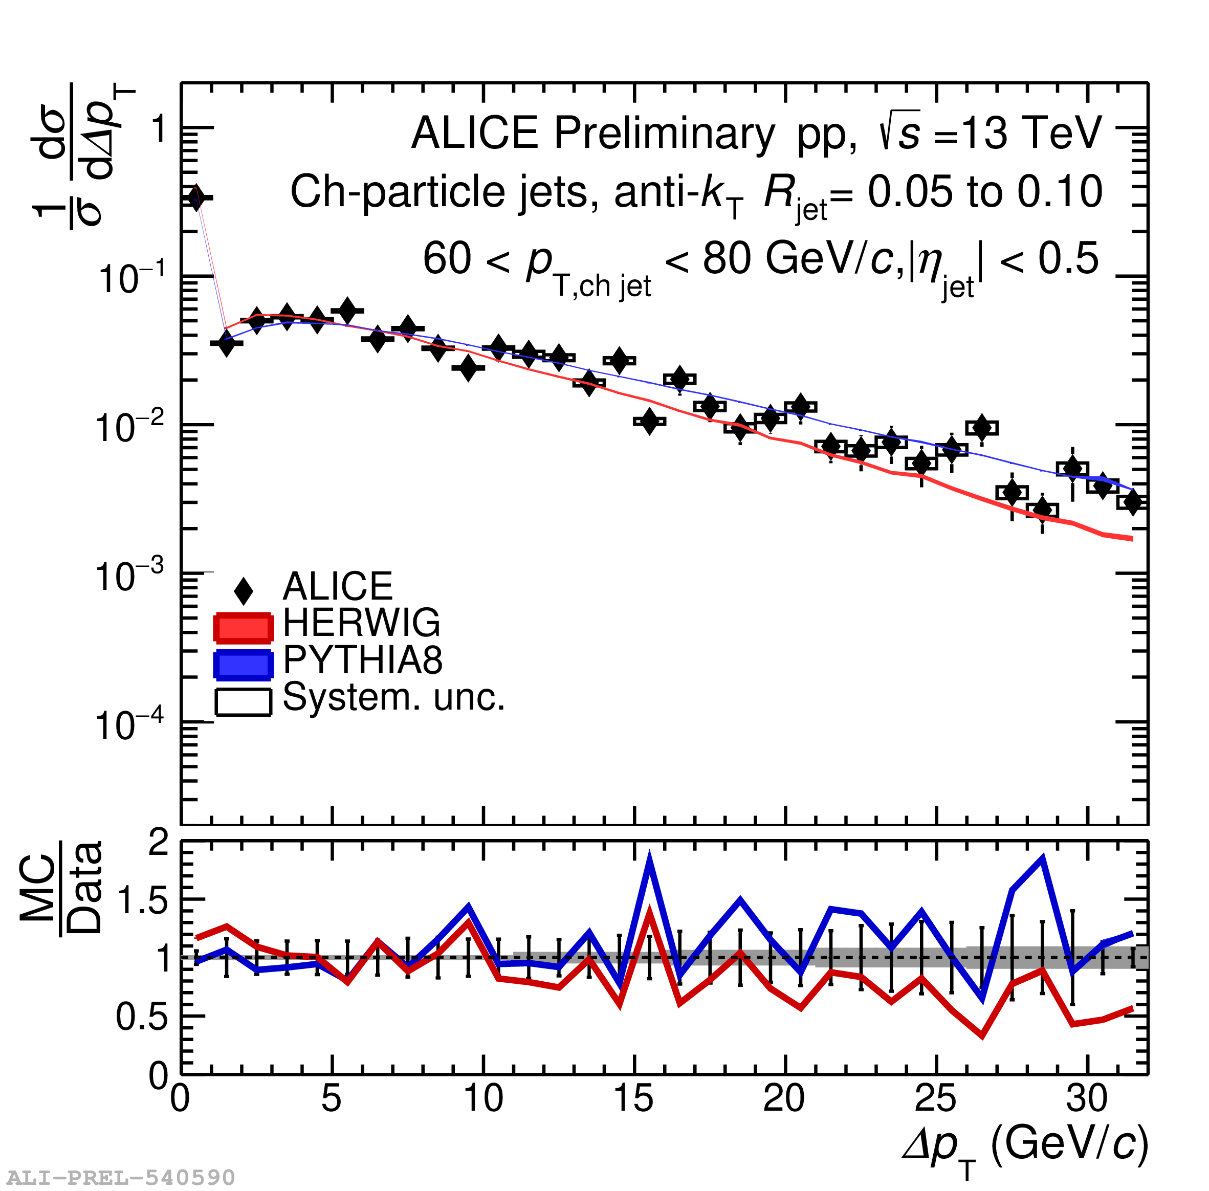
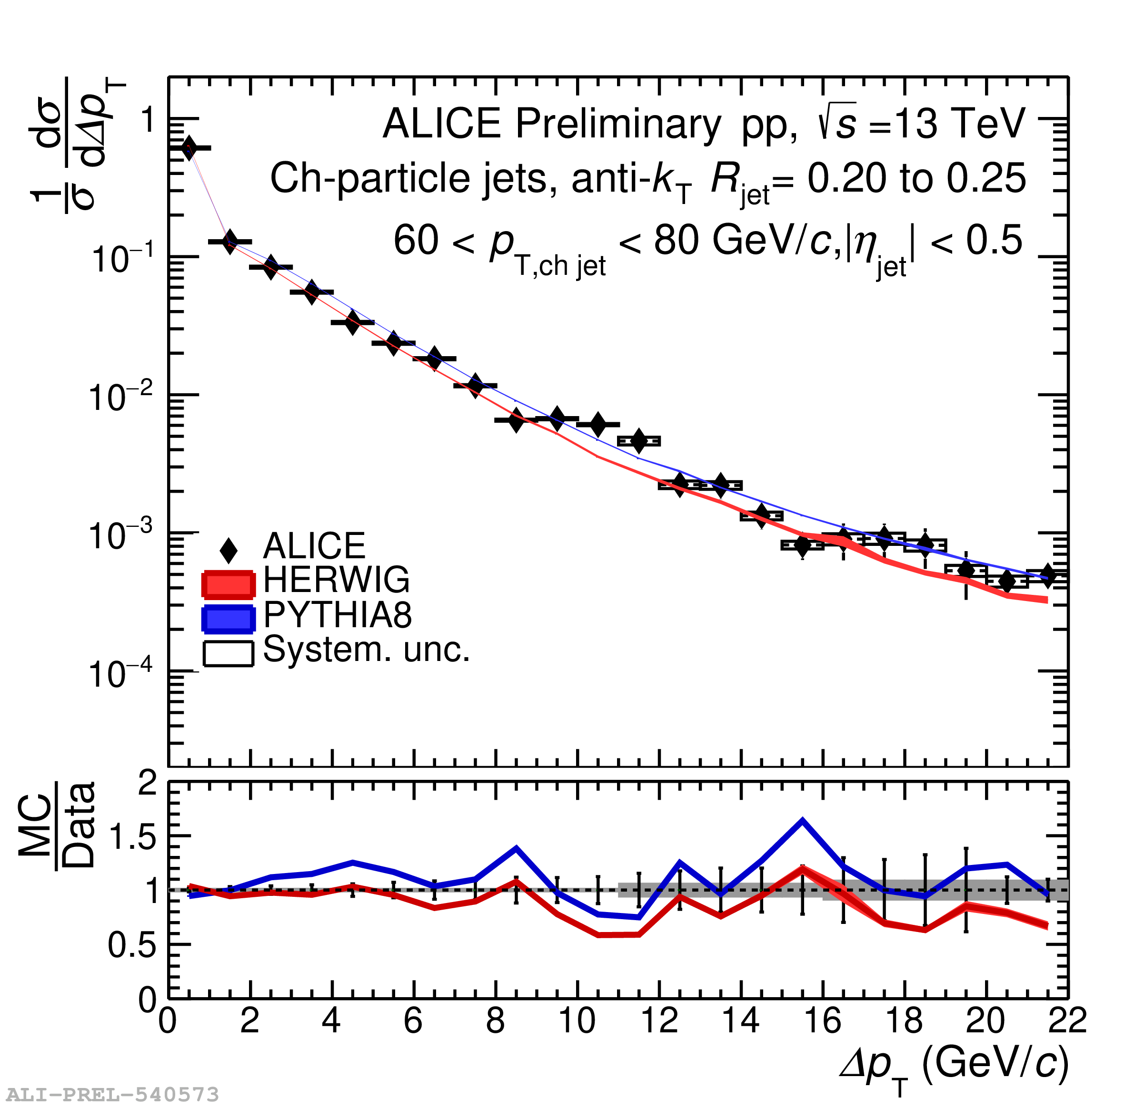
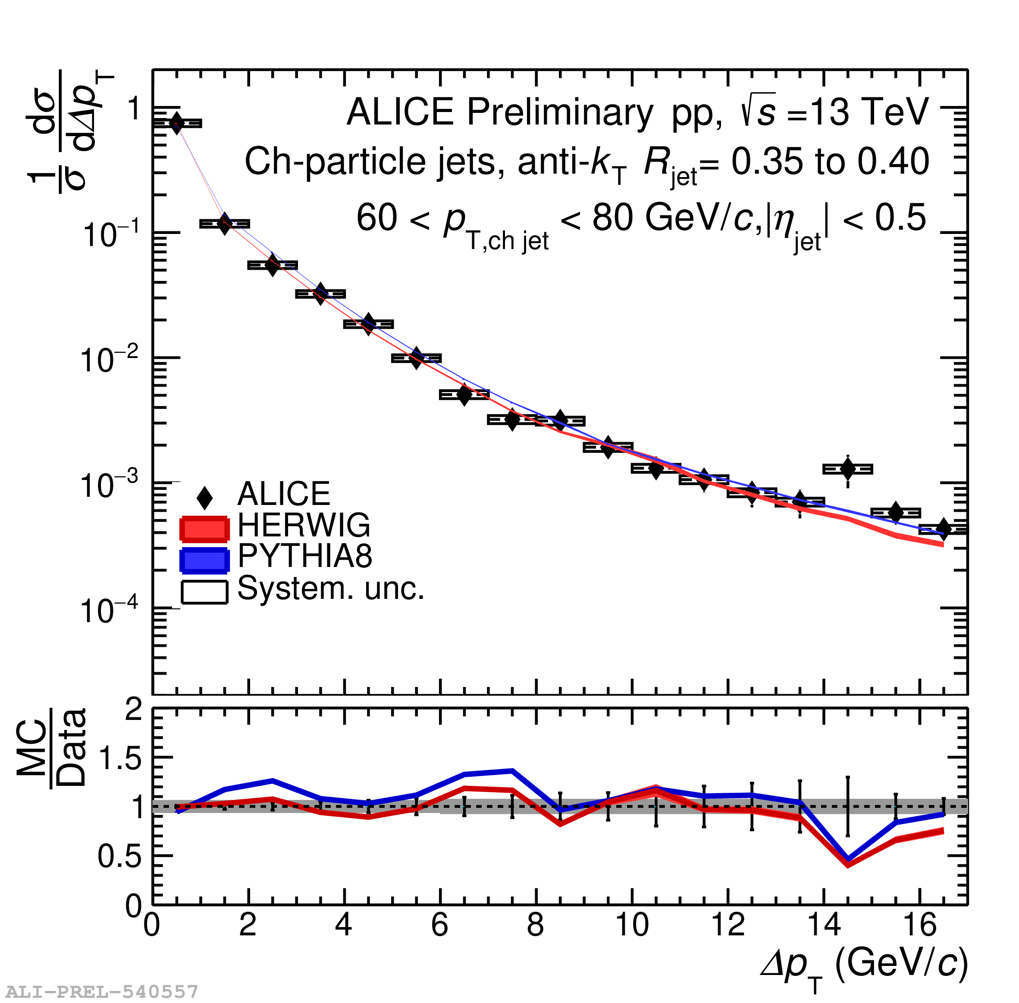
Jet energy flow measurement: Model comparison
Good description of the measurement by both HERWIG and PYTHIA
R=0.05 to R=0.1
R=0.2 to R=0.25
R=0.35 to R=0.4

