Slide 1
TCAD Simulations on Monolithic Pixel Sensors
Improving Timing Performance for MAPS at high-luminosity LHC
Mariia Selina 3.10.23

Slide 2
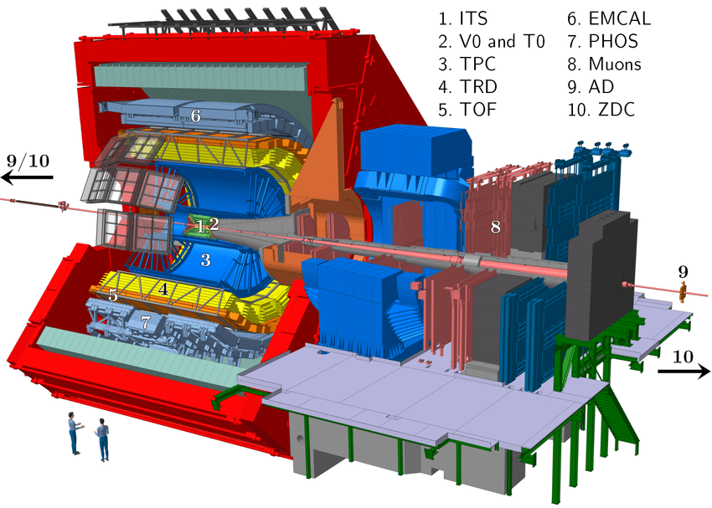
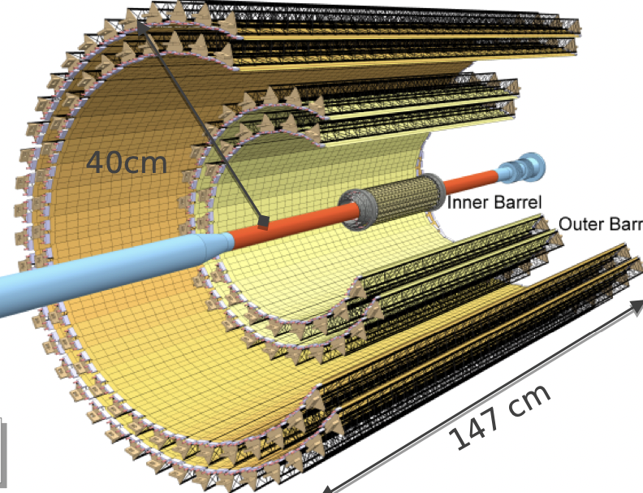
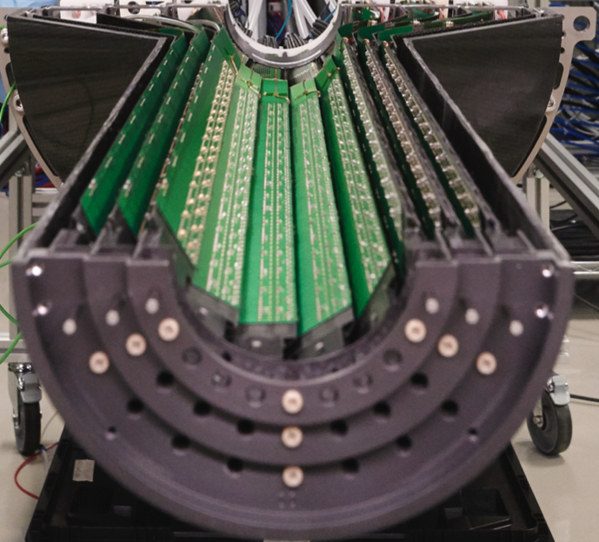

ALICE experiment
ALICE (A Large Ion Collider Experiment) is a detector at the Larger Hadron Collider (LHC), CERN. Aimed on a study of quark-gluon plasma (QGP) in heavy-ion collisions.
First CERN experiment that adopt the MAPS technology
Contain around 10 m² of MAPS.
First layer is at 22 mm from the pipe
Taking data since September 2021
27 cm
147 cm
Reconstruction of charm and beauty hadrons
Precise vertexing and tracking capabilities needed
Interest in low momentum particles
Minimum amount of material in use

Slide 3
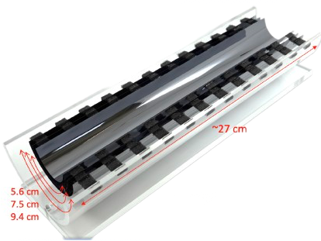
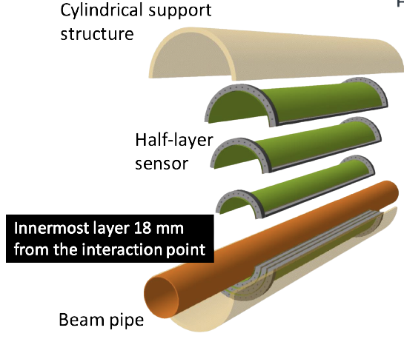
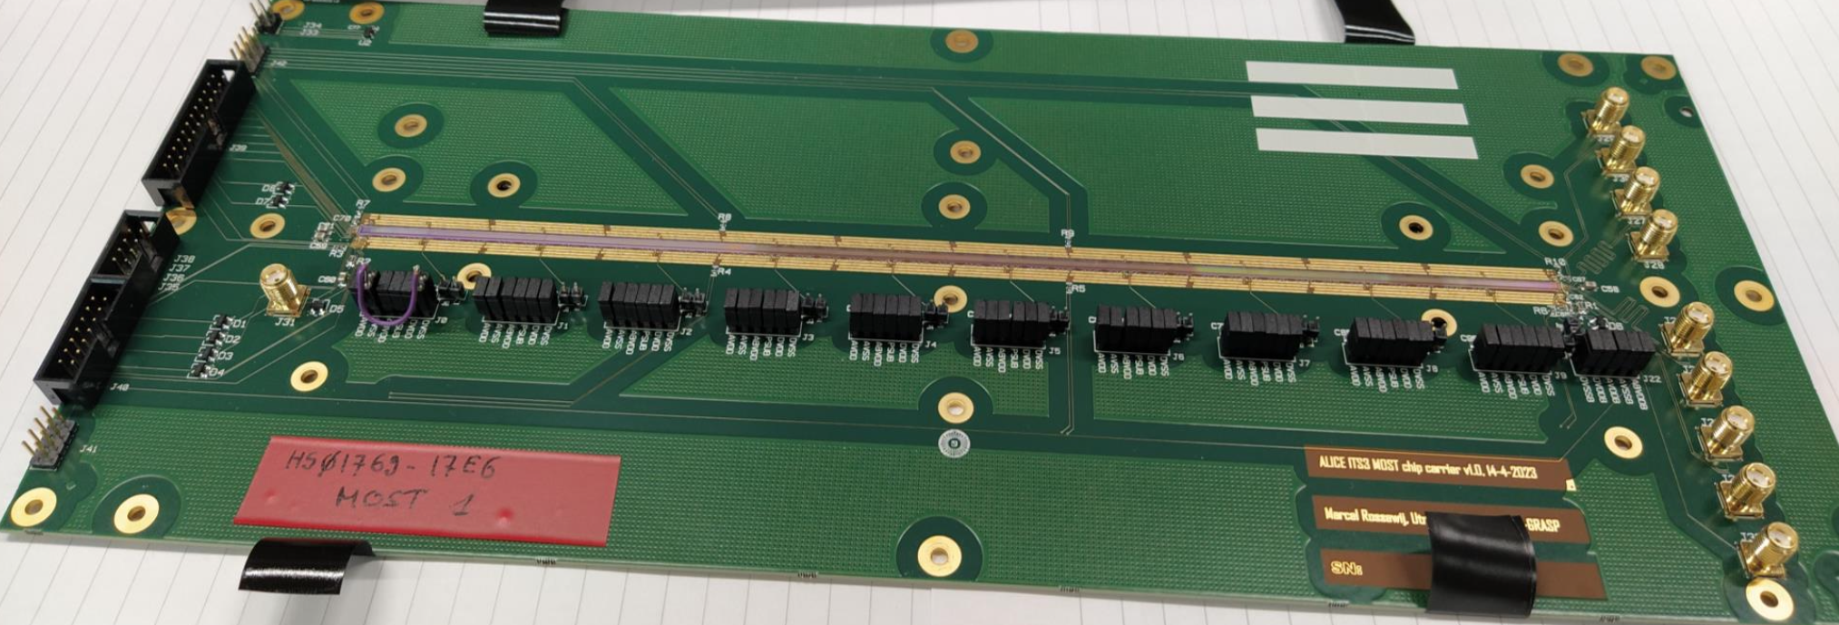
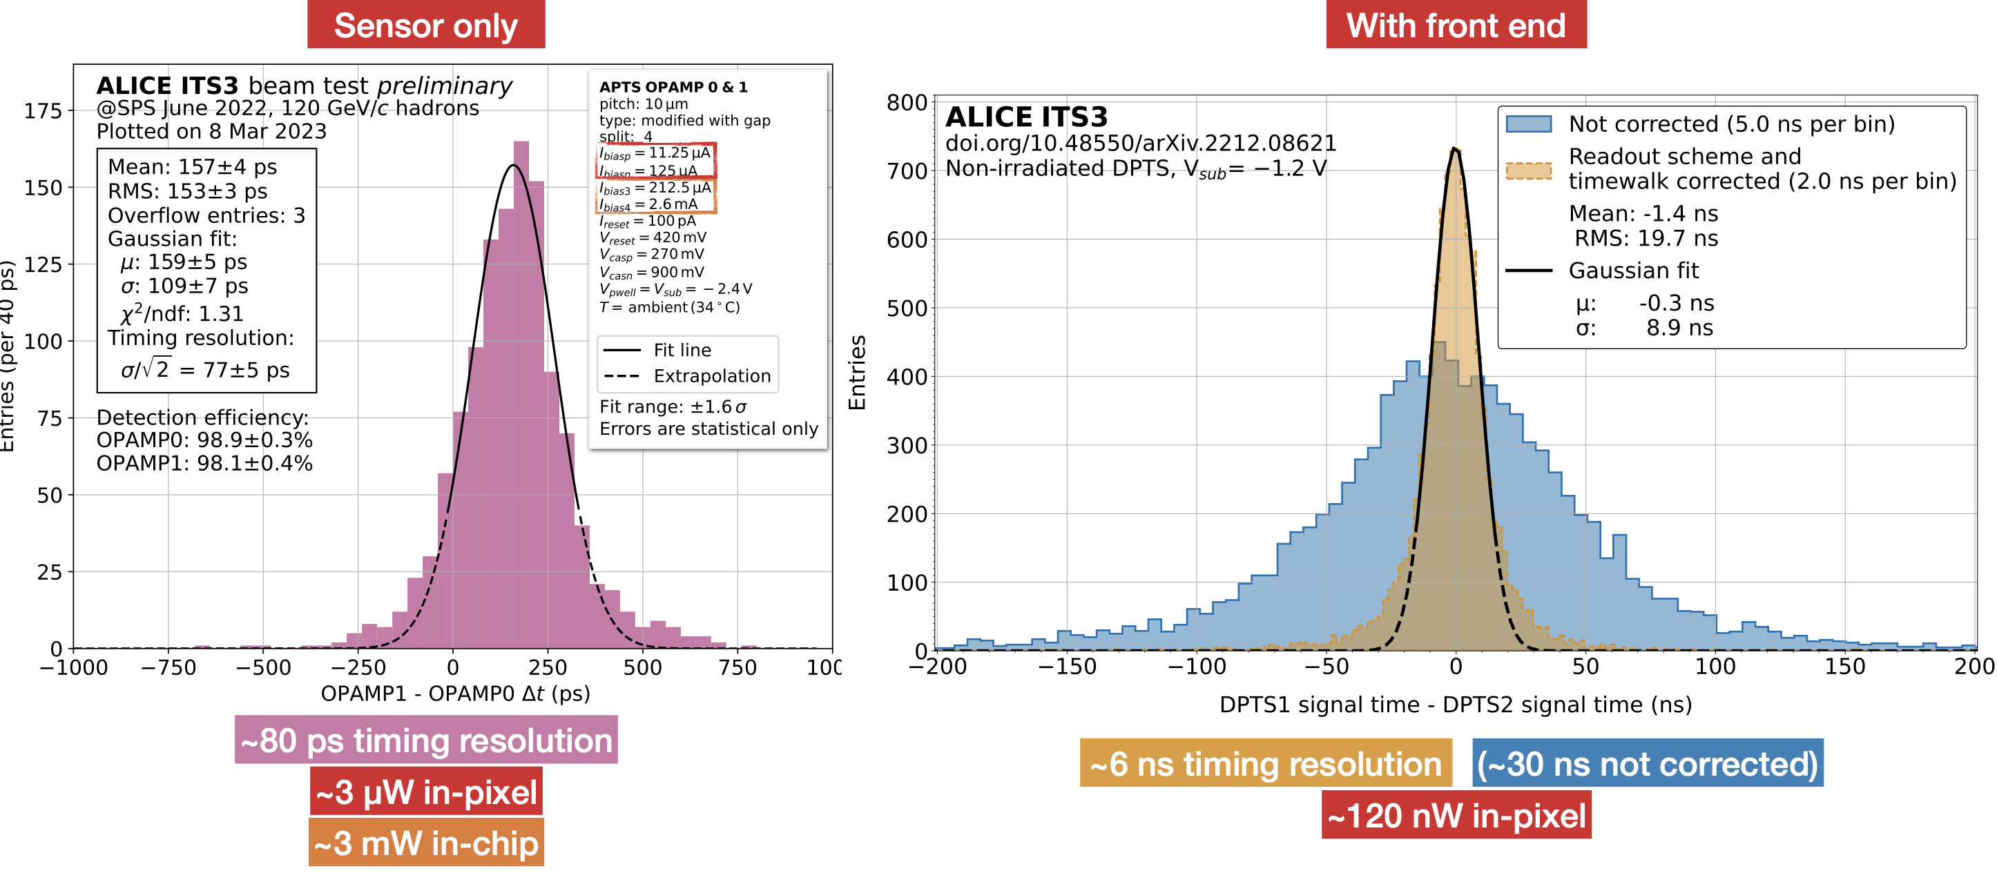
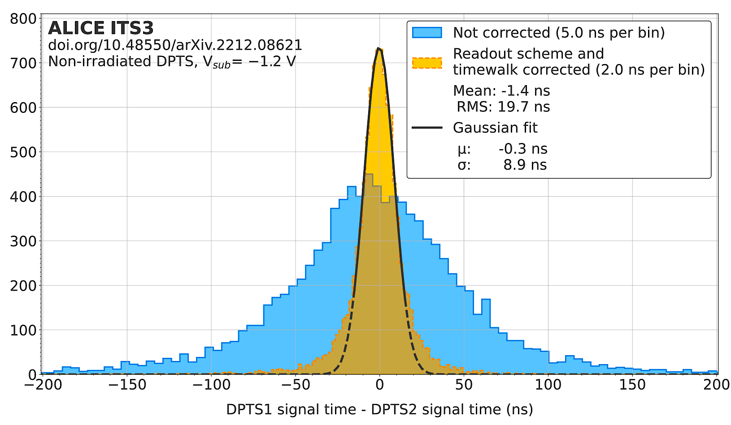
ITS3 - 2026 Upgrade
Improvements
Replacement of the Inner barrel silicon sensors bended in cylindrical layers
MAPS in new TPSCo 65 nm imaging process
In tests since 09.21
259 mm
Stitching used for connecting power distribution and interconnect busses for control and data readout
Already produced and bonded, now under tests

Slide 4
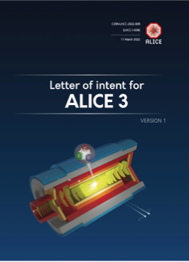
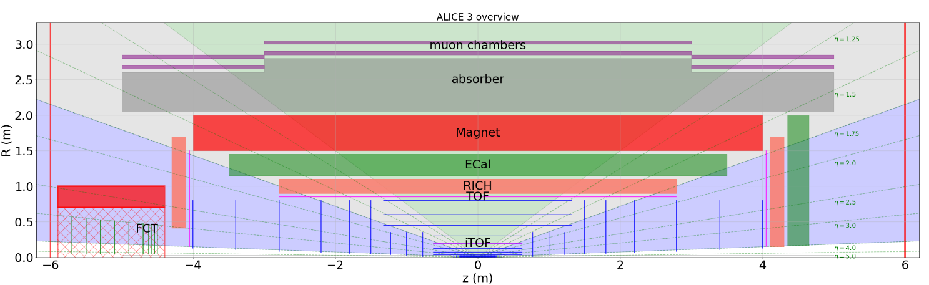
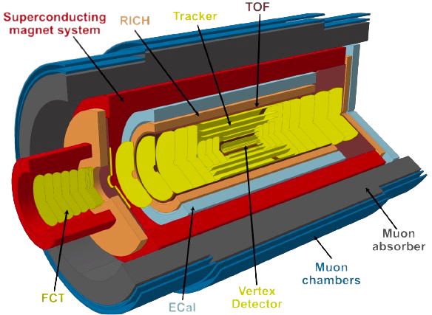
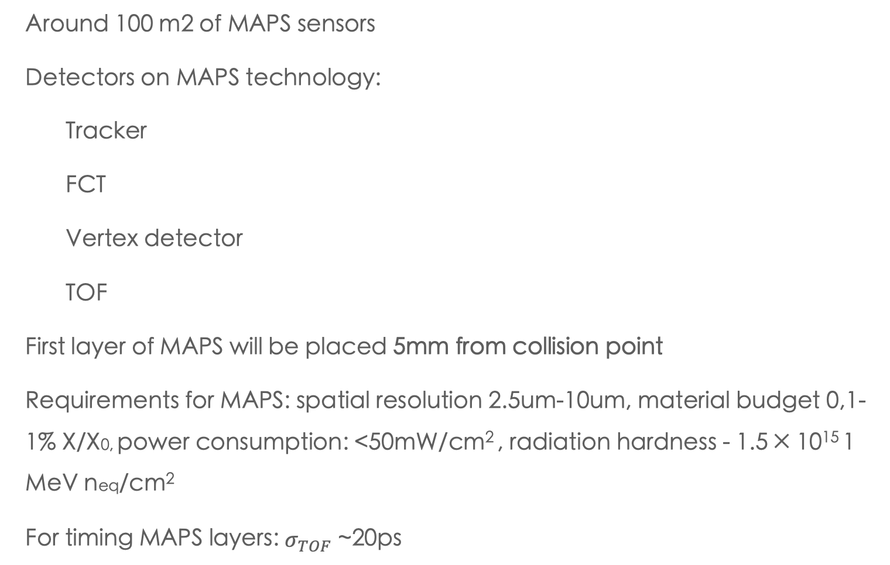
ALICE - new detector in 2033
Around 100 m2 of MAPS sensors
Detectors on MAPS technology:
  Tracker
  FCT
  Vertex detector
  TOF
First layer of MAPS will be placed 5mm from collision point
Requirements for MAPS: spatial resolution 2.5um-10um, material budget 0,1-1% X/X0, power consumption: <50mW/cm² , radiation hardness - 1.5 × 10¹⁵ 1 MeV neq/cm²
For timing MAPS layers: $σ_{TOF}$ ~20ps
Source: LOI, arXiv:2211.02491
How we can improve timing in MAPS?

Slide 5
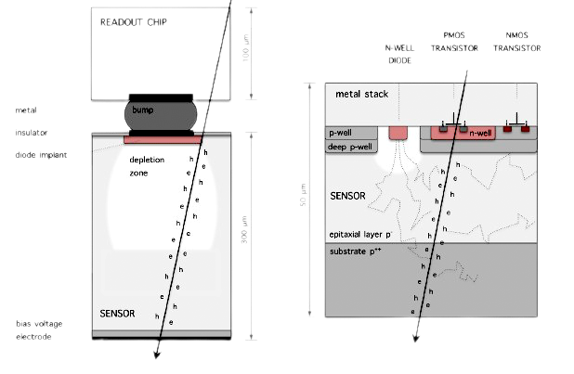
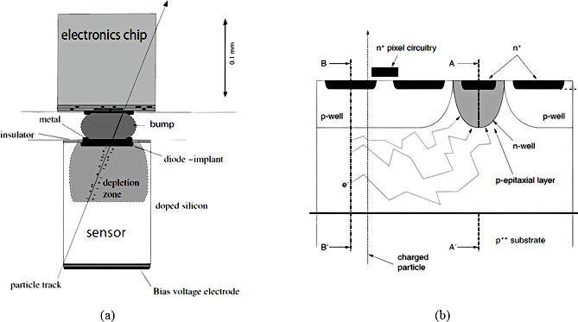

Why MAPS?
Difference between hybrid and monolithic sensors
100 um
50 $μm$
<300 um
Charged particle
Hybrid
Monolithic
Default technology in High Energy Physics
Expensive hybridisation process
Reduced material budget
Low noise figure and power consumption
reachable
Lower cost

Slide 6
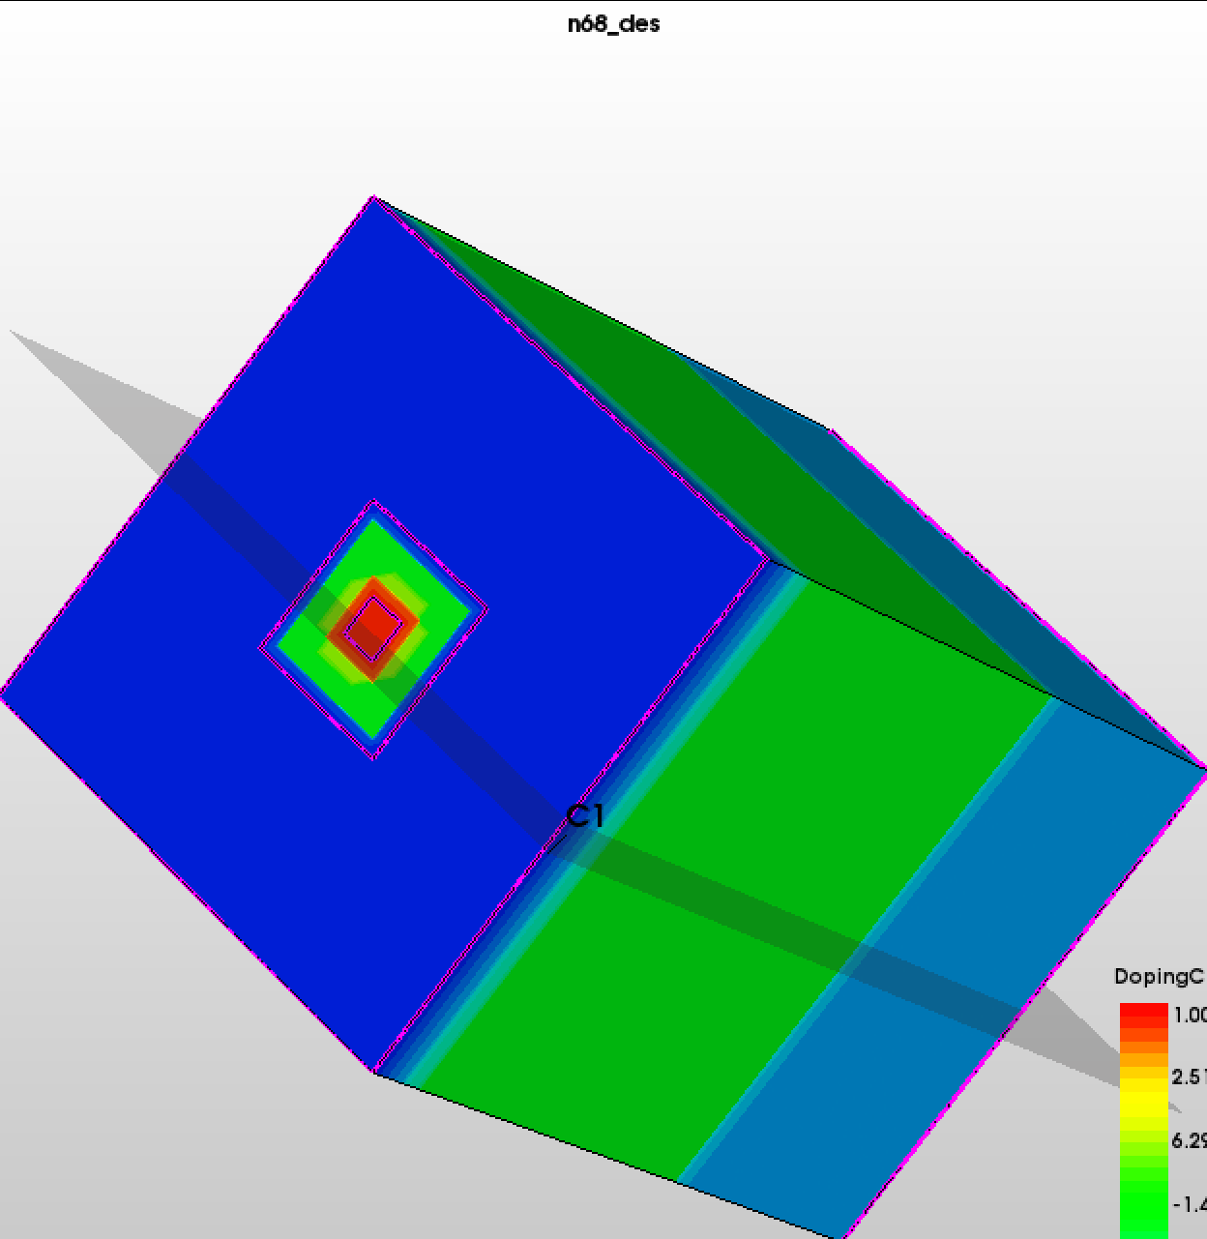
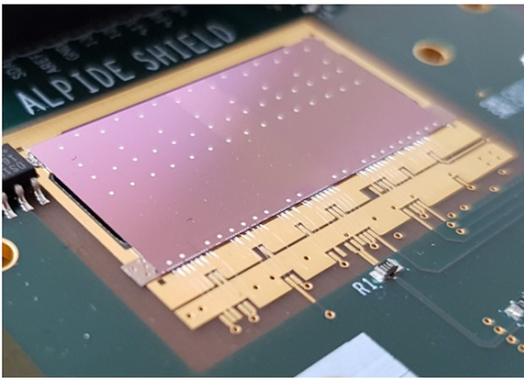
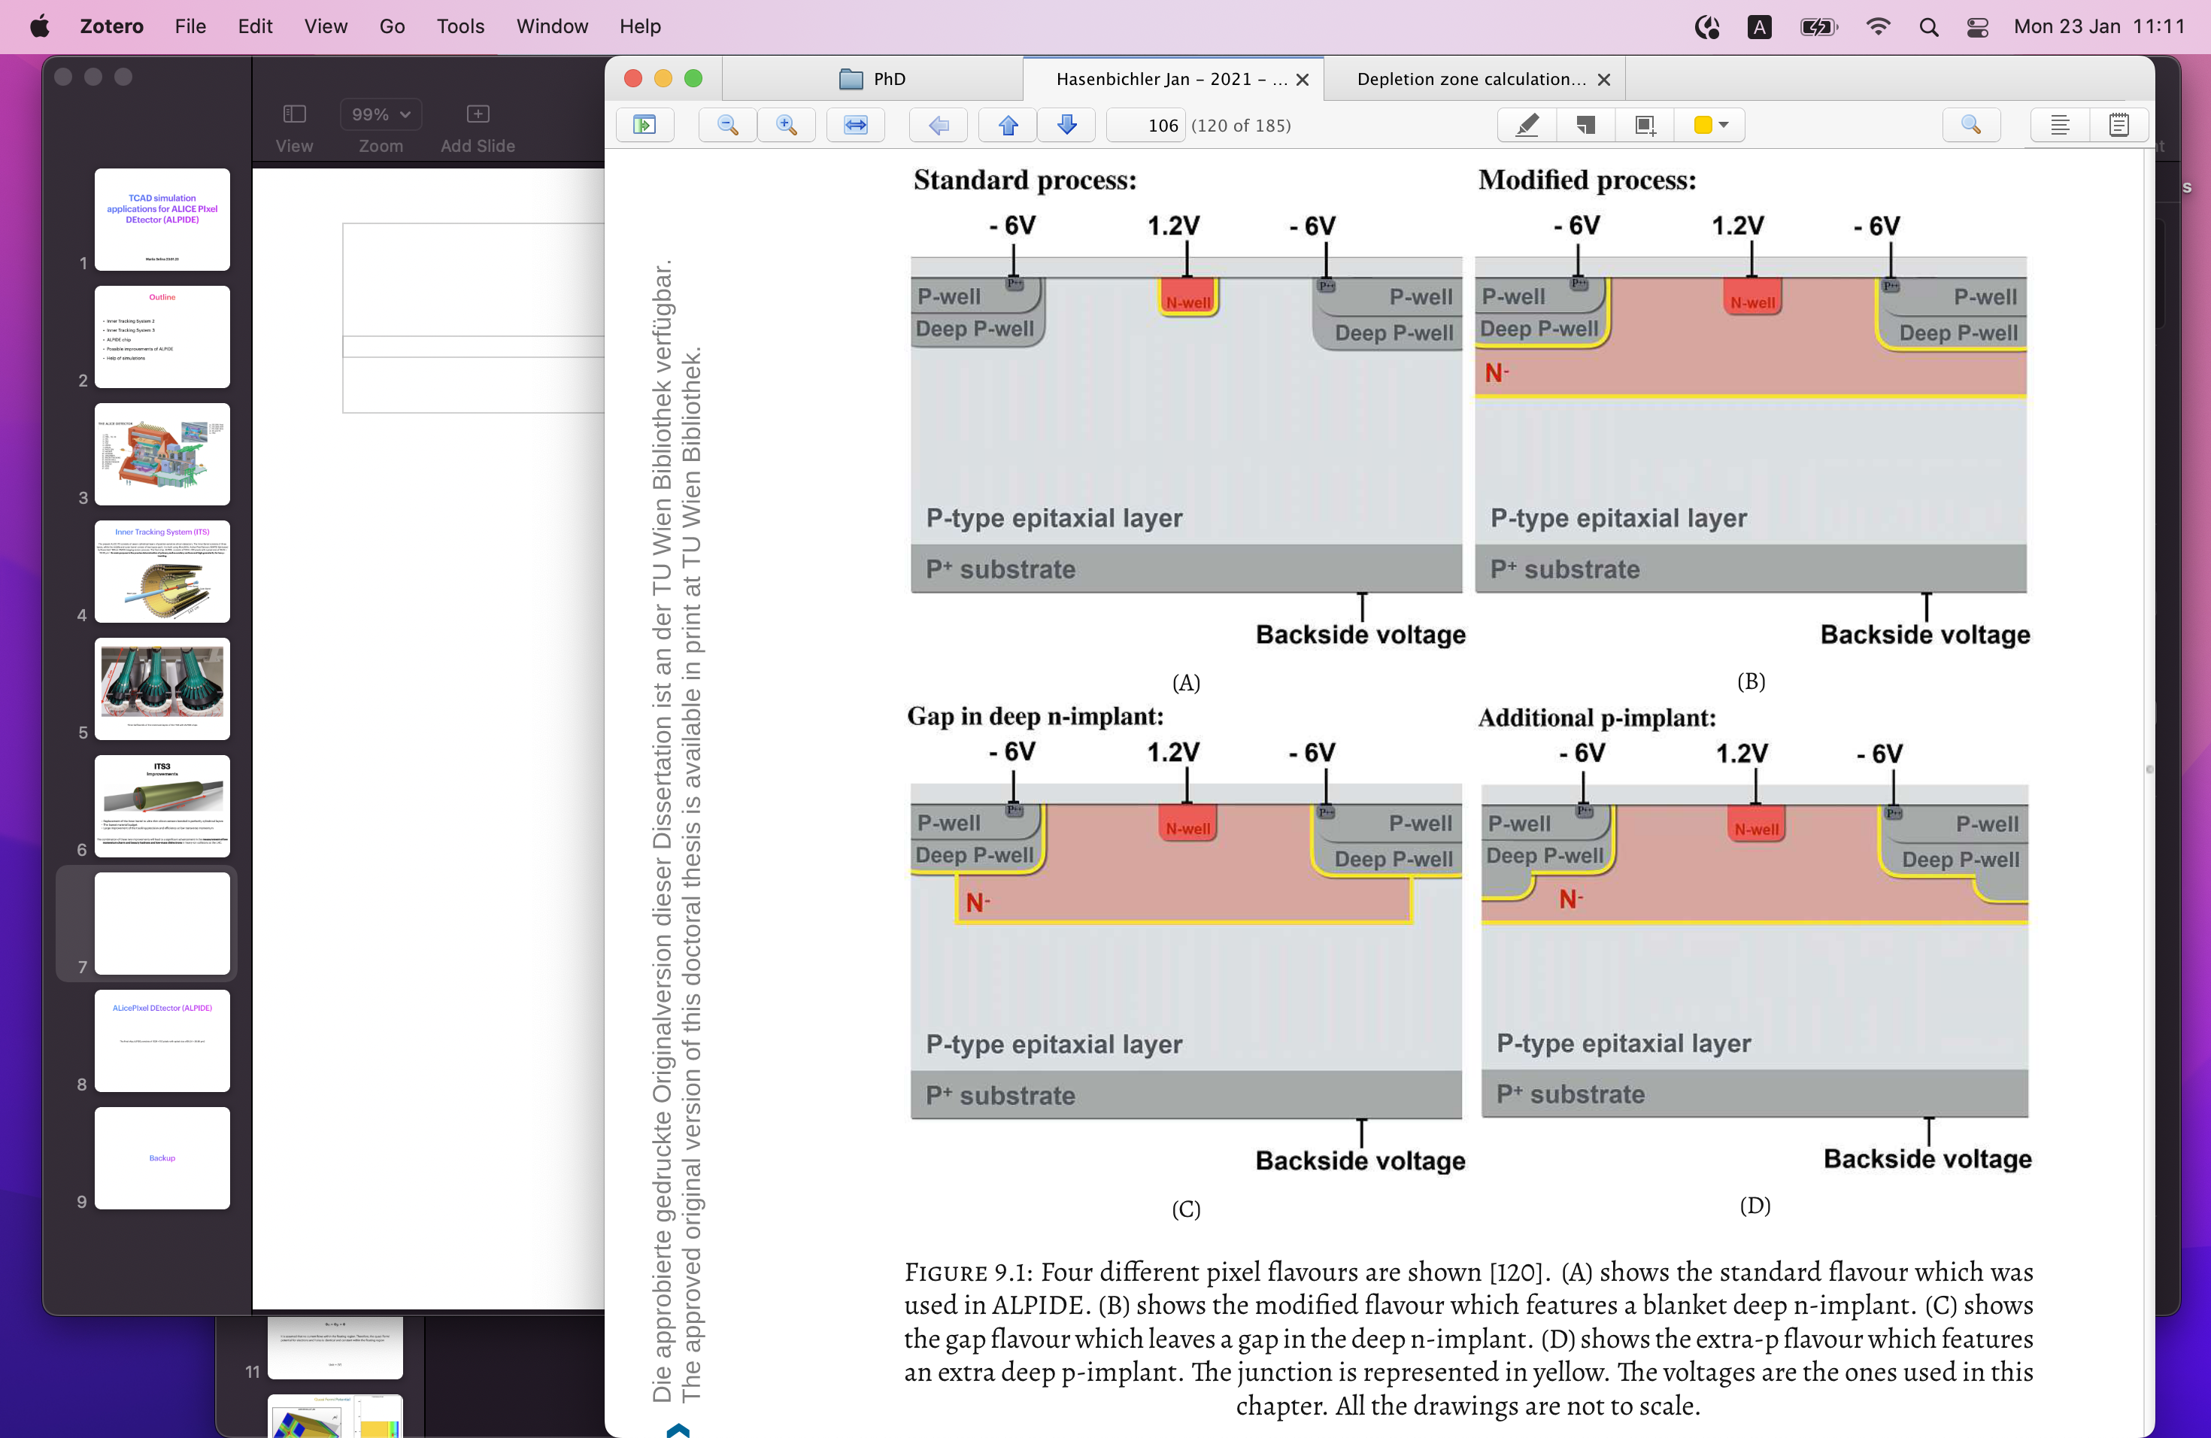
Sensor flavours
~ 20 um
30 mm
3.
1.
2.
Standard process:
Timing resolution ~ 5 ns
Modified process:
~ 2 ns
High charge sharing probability
Gap in deep n-implant:
~ 70 ps
Less charge sharing

Slide 7
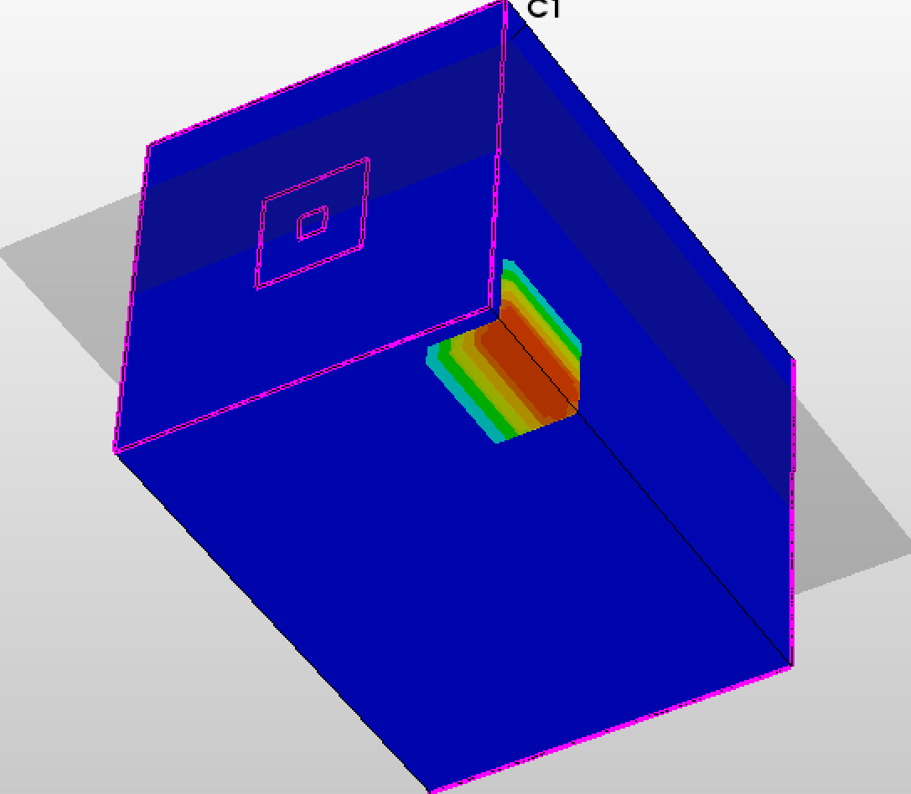
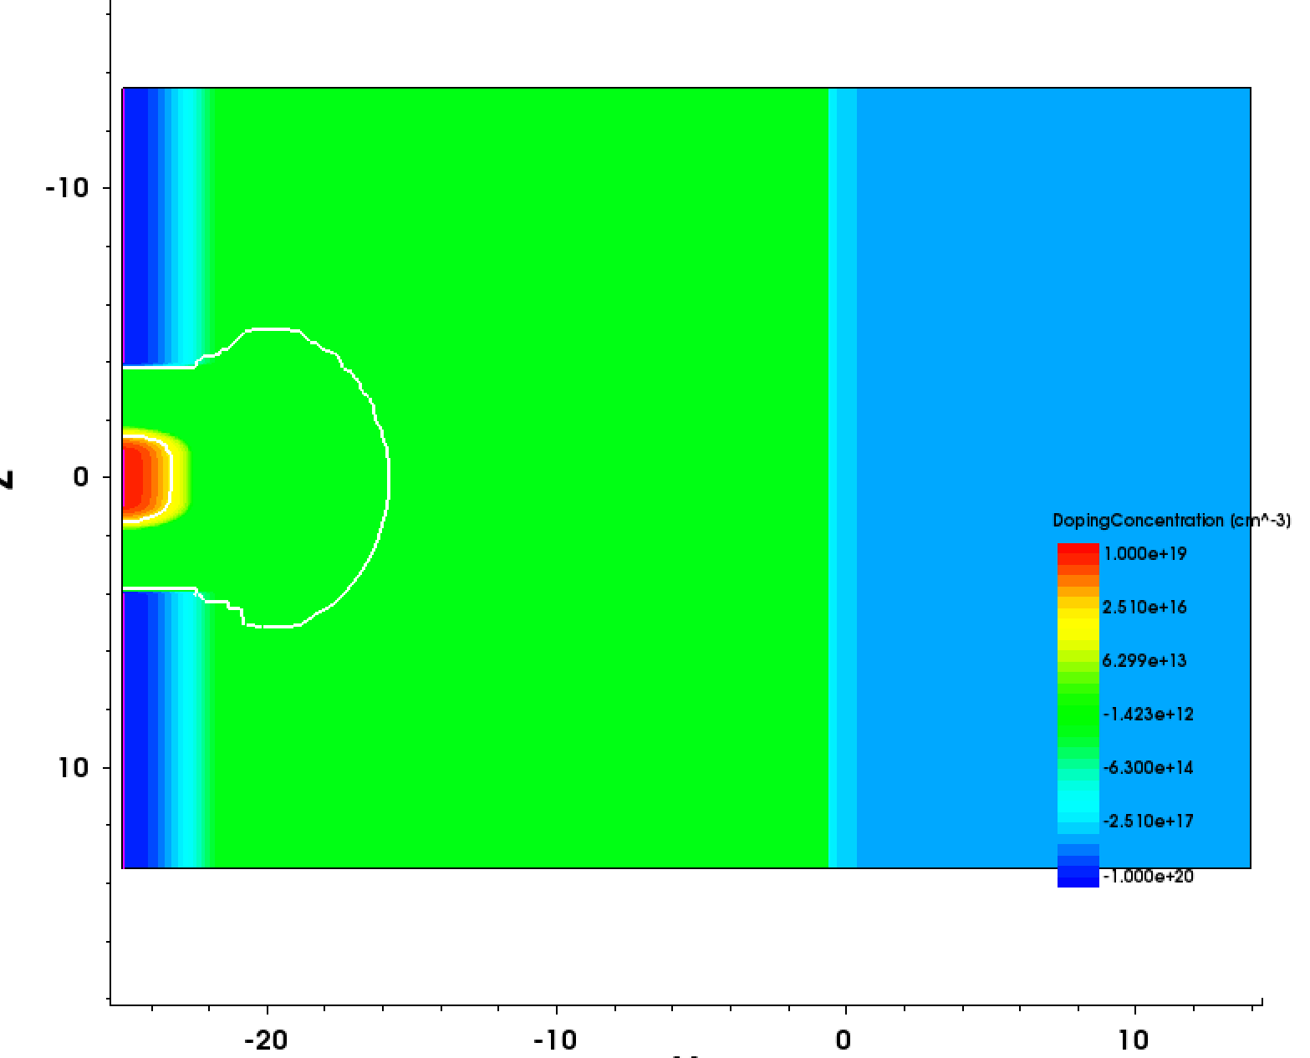

Technology Computer-Aided Design (TCAD) Simulations
Development and optimisation of semiconductor process technologies and devices
TCAD is a very powerful tool for simulating the semiconductors sensor performance:
Electric and weighting field and electrostatic potential
Charge collection time
Total collected current
Path of charge travel
Charge sharing
Capacitance
Radiation damage
Performance in MAPS is contingent on numerous parameters:
Pixel geometry
Sensor flavours
Pitch size
Reverse bias voltage
Doping concentrations

Slide 8
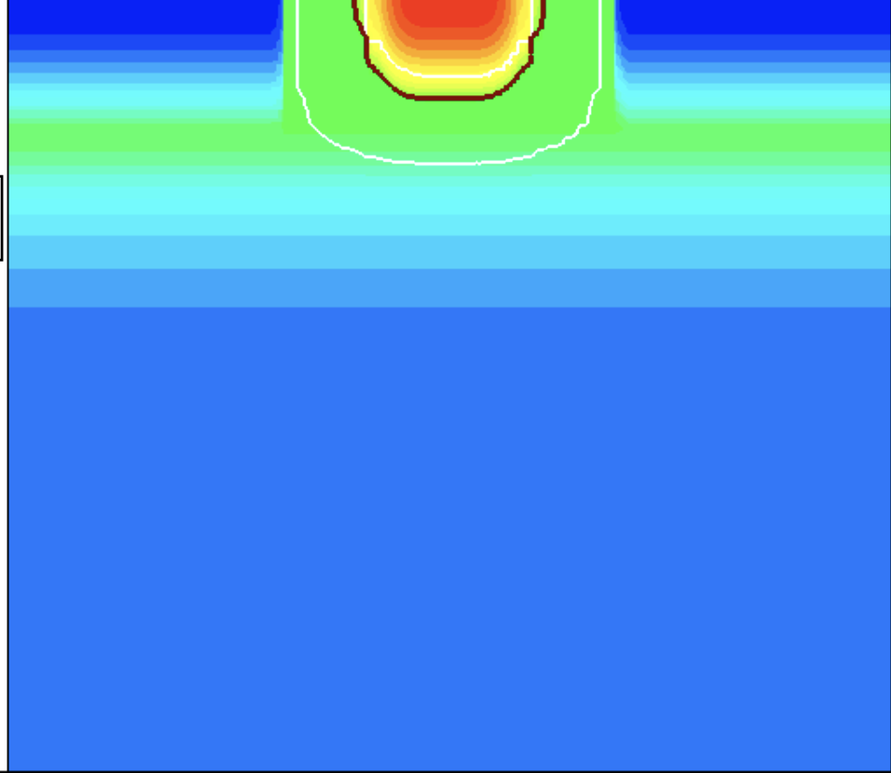
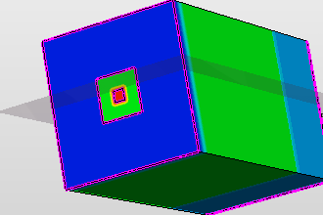
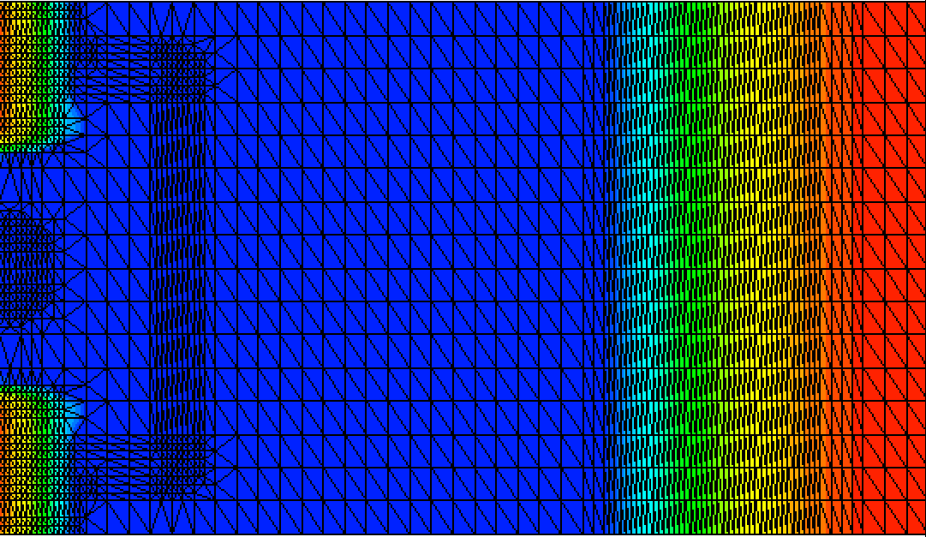
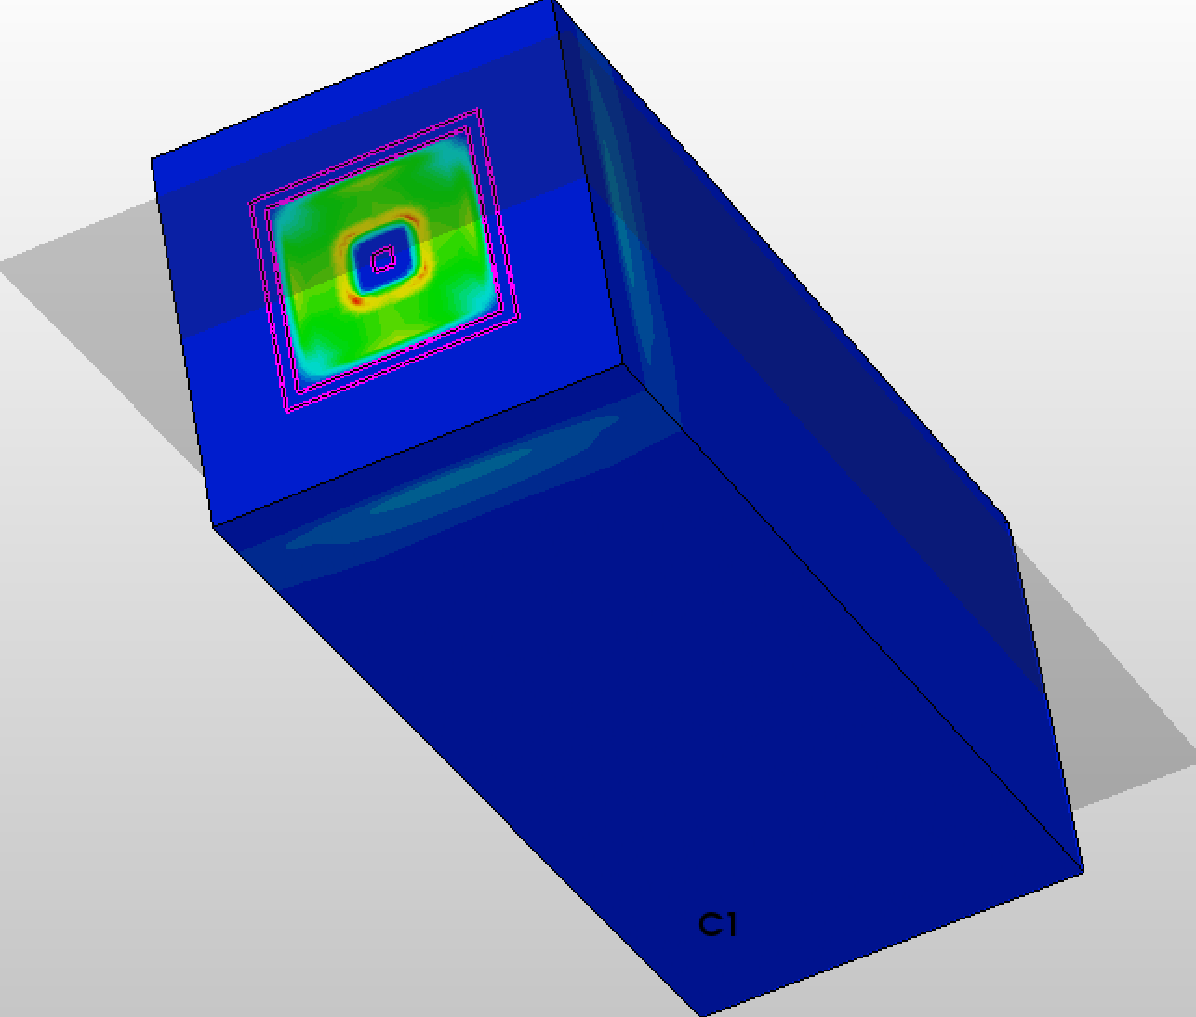
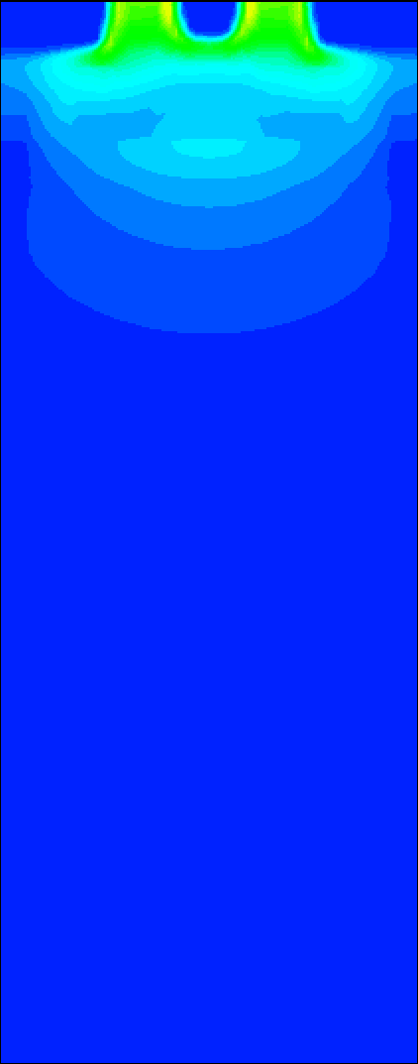
TCAD
Basic principles
The first step of a simulation of a simple semiconductor device is modelling of geometry and filling it with doping
In the next step, the meshing of the constructed device should be done. Meshing is dividing the model into small elements that could be considered homogenous for calculation
The last step is a calculation of parameters that we are interested in, such as electrostatic potential, electric field, charge distribution and etc. in quasi-stationary or transient types of simulations.

Slide 9
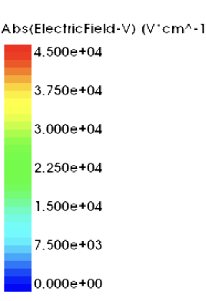
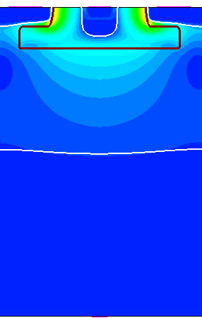
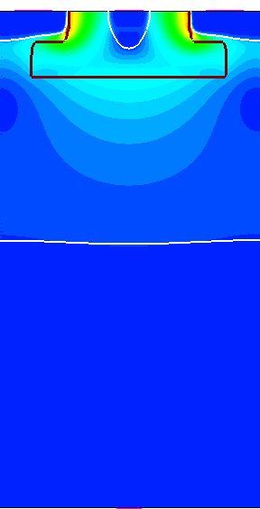
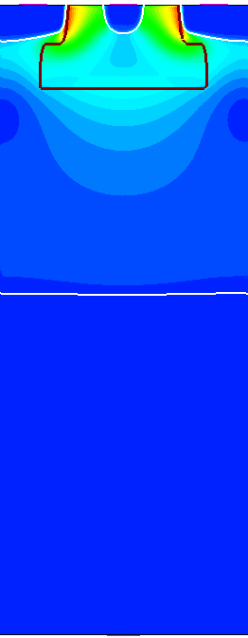
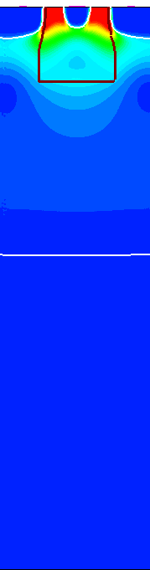
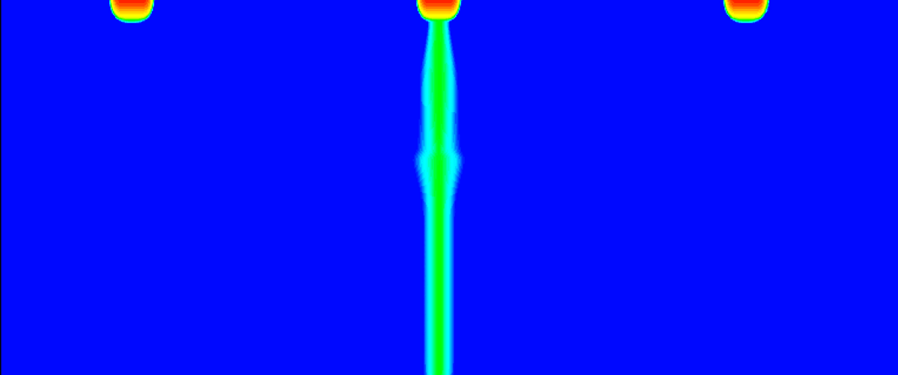
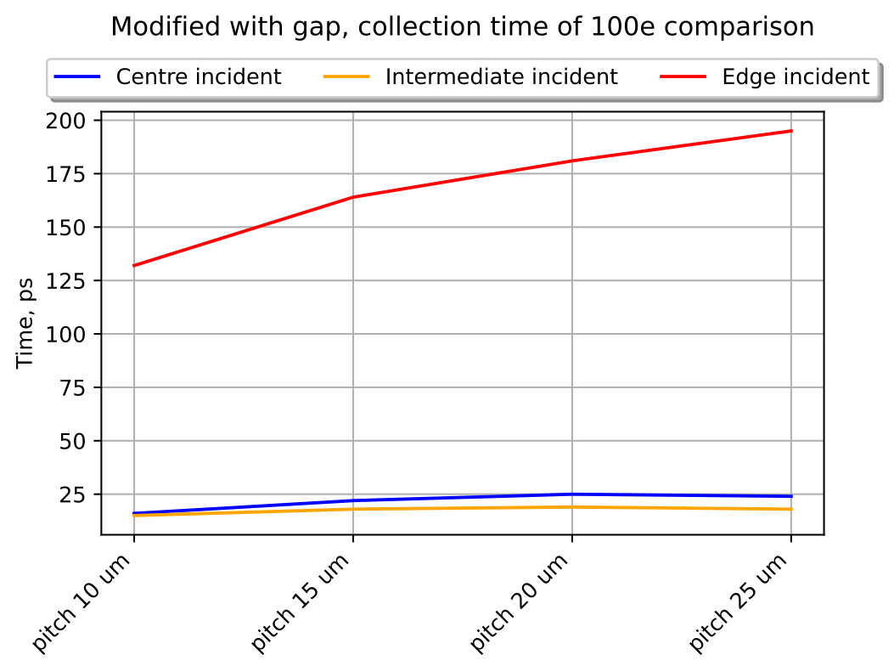
TCAD Simulations
Electrode
Pwell
pitch
Charge collection time
Epitaxial layer
Junction line (deep n-implant contour)
Depletion region
Substrate layer
Intermediate
Edge
Centre
Modified with gap process
Comparison of collection time of 100e in the edge position on different pitches:
Pitch, [um] | 10 | 15 | 20 | 25
Collection time of 100e, [ps] | 132 | 164 | 181 | 195

Slide 10
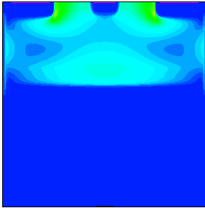
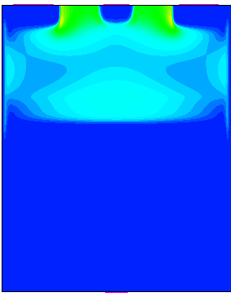
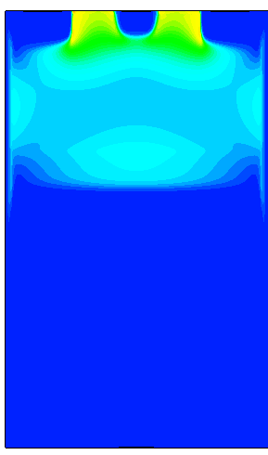
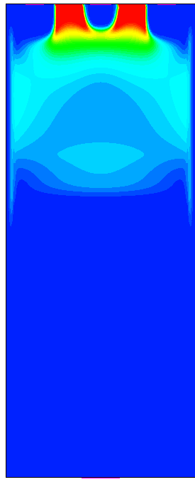
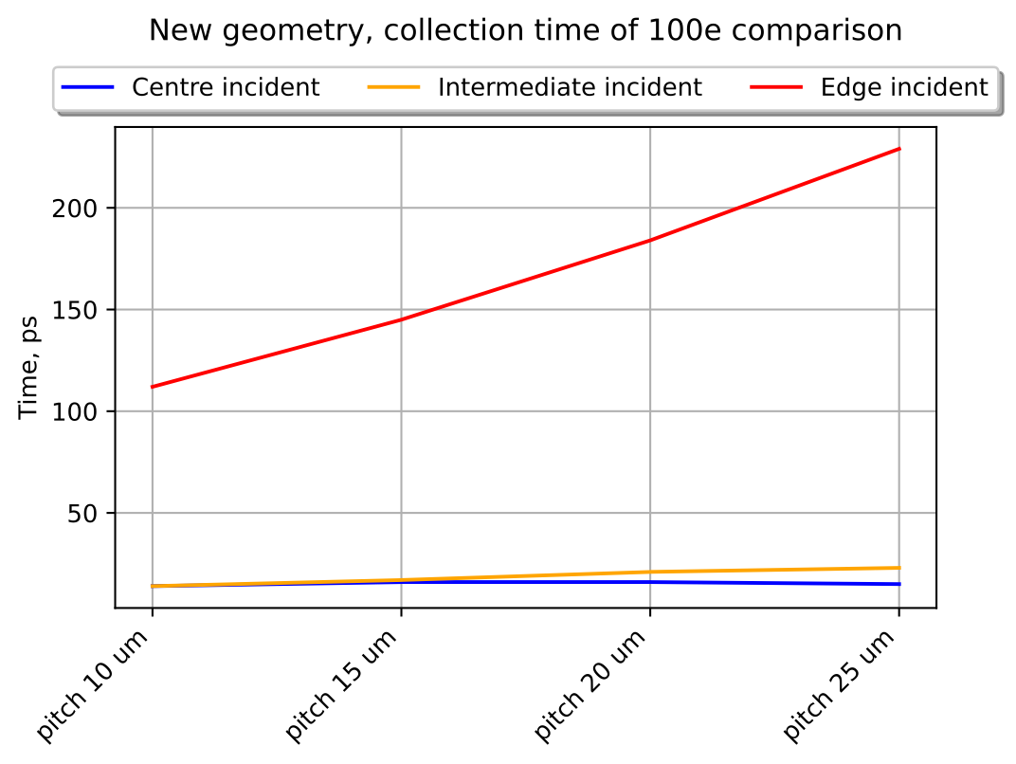
TCAD Simulations
Charge collection time
New process
Comparison of time when 100 e was collected in the edge position on different pitches:
Pitch, [um] | 10 | 15 | 20 | 25
Collection time of 100e, [ps] | 112 | 145 | 184 | 229

Slide 11
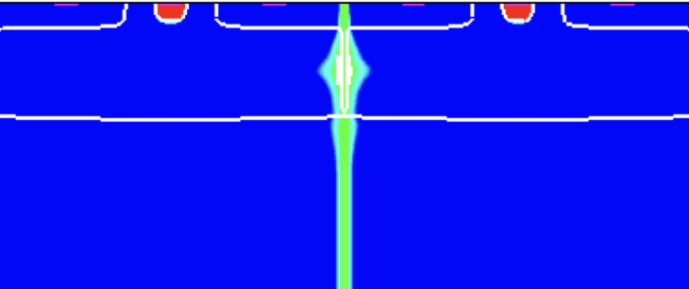
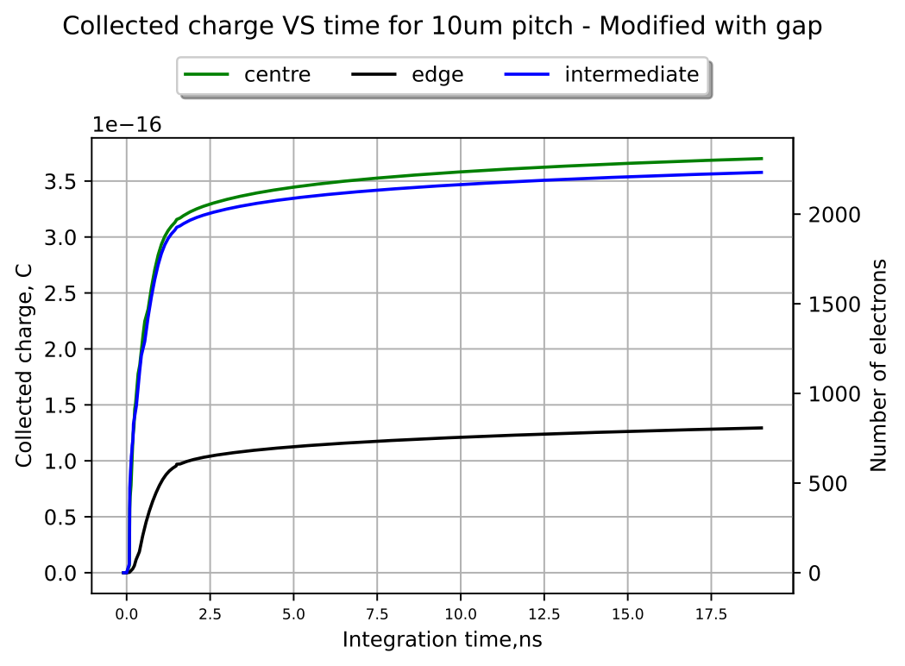
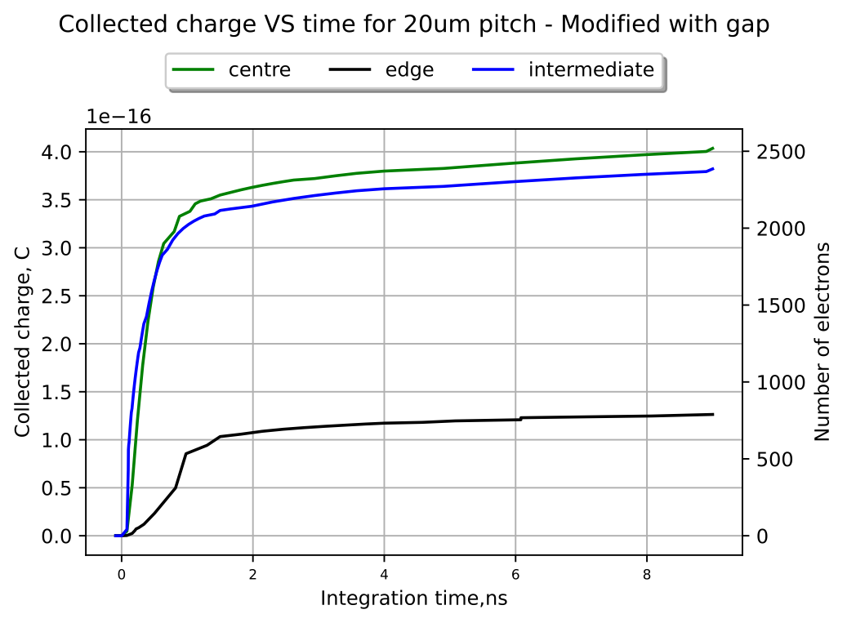
TCAD Simulations
Charge sharing
Charge sharing decreases time resolution
For timing purposes we need to collect all charge in one pixel
The deposited charge in both cases is the same, but the collected charge that is shown on the graph with the same electrode differ

Slide 12
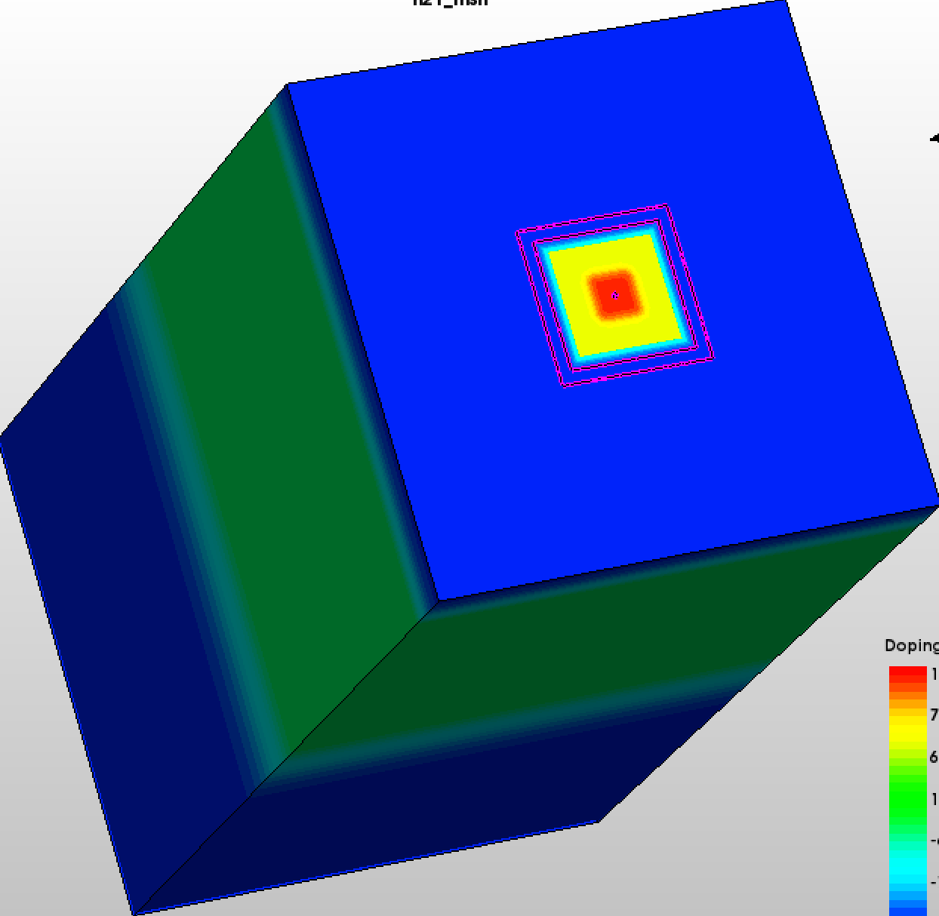
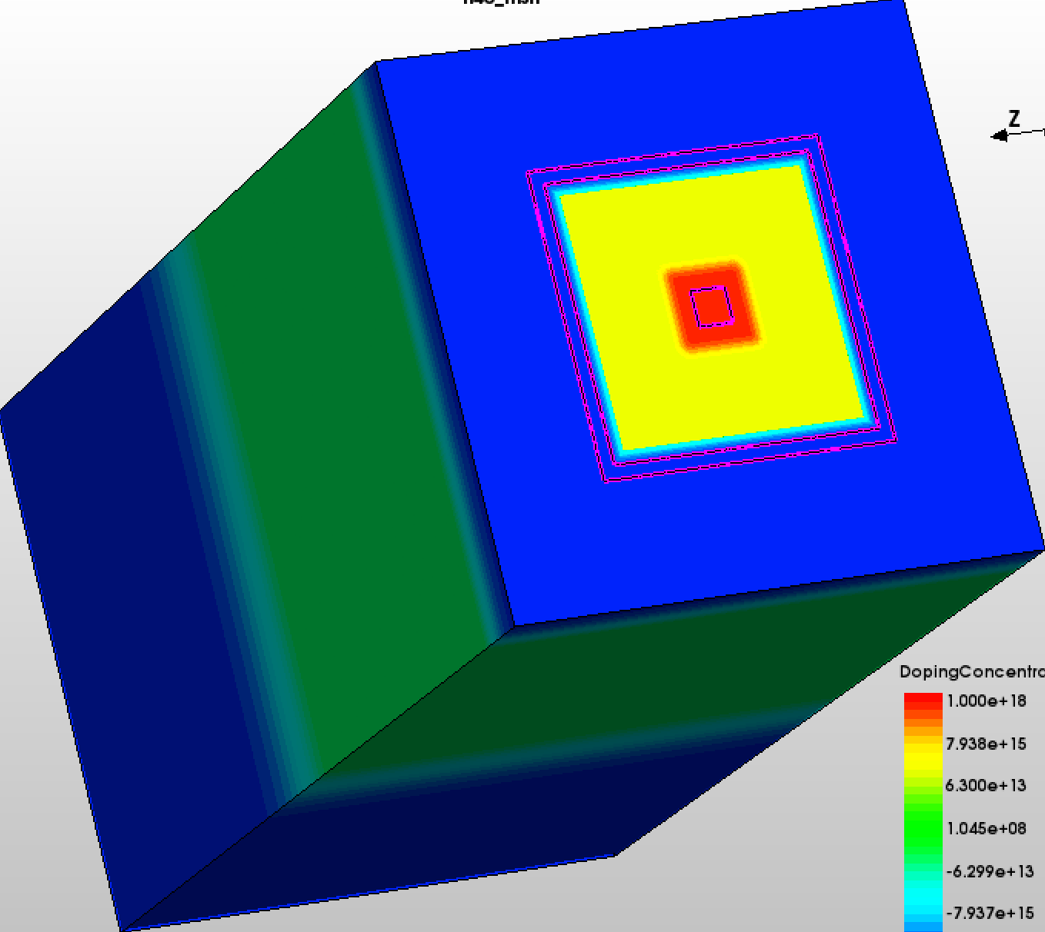
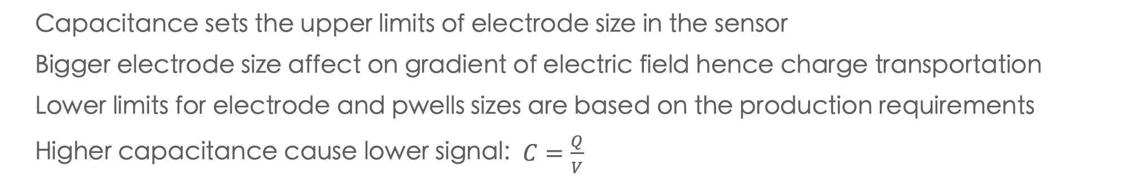
Capacitance
 | 10um pitch | 15um pitch | 20um pitch | 25um pitch
linear scale up 3D, [fF] | 1.0378 | 1.2687 | 1.5160 | 1.9736
Only pwell change size 3D, [fF] | 1.0378 | 1.0135 | 1.0455 | 1.0364
And its effect on power consumption
Capacitance sets the upper limits of electrode size in the sensor
Bigger electrode size affect on gradient of electric field hence charge transportation
Lower limits for electrode and pwells sizes are based on the production requirements
Higher capacitance cause lower signal: $C=\frac{Q}{V}$
Spacing
P-well
Electrode
Pwell size increase only
Linear scale up of the components
In the case of high capacitance more power will be consumed in order to get the same signal
Low capacitance will allow us to use lower power consumption electronics
Pitch, [um] | 10 | 15 | 20 | 25
Nwell, [um] | 1.14 | 1.14 | 1.14 | 1.14
Pwell, [um] | 2.5 | 5 | 7.5 | 10
Spacing, [um] | 2.5 | 2.5 | 2.5 | 2.5
Pitch, [um] | 10 | 15 | 20 | 25
Nwell, [um] | 1.14 | 1.71 | 2.28 | 2.85
Pwell, [um] | 2.5 | 3.75 | 5 | 6.25
Spacing, [um] | 2.5 | 3.75 | 5 | 6.25

Slide 13
Summary
In 2033, ALICE will incorporate a new, advanced detector
Necessitating improved detectors for enhanced time resolution and reduced power consumption
Recent results confirm a 70 ps resolution with minimal power use
Further enhancements involve TCAD simulations for sensor optimisation and front-end electronics improvements
Outlook
Investigation of capacitance impact on power consumption
Further characterisation of new geometry
Optimisation of the existing technology
Generating more statistics with the usage of Monte-Carlo simulation technics
Research of radiation impact on the pixel

Slide 14
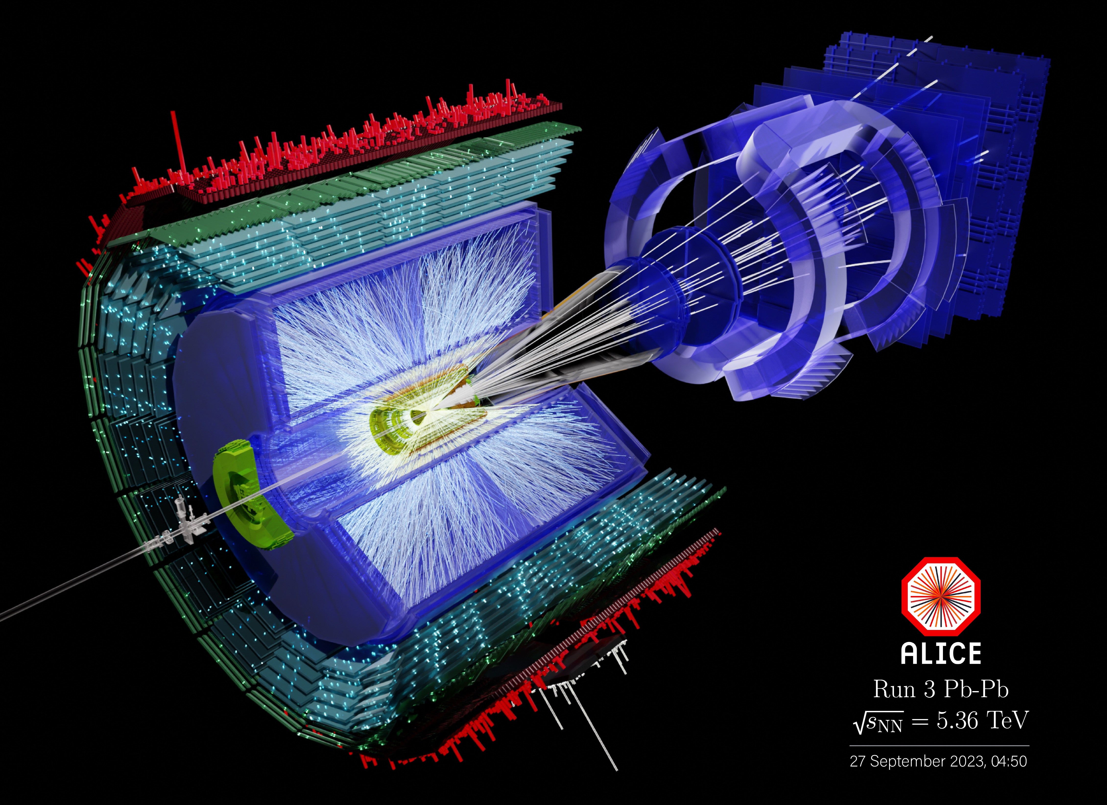
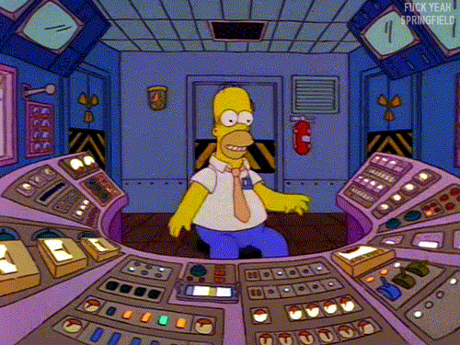
Thank you for your attention!
Mariia Selina

Slide 15
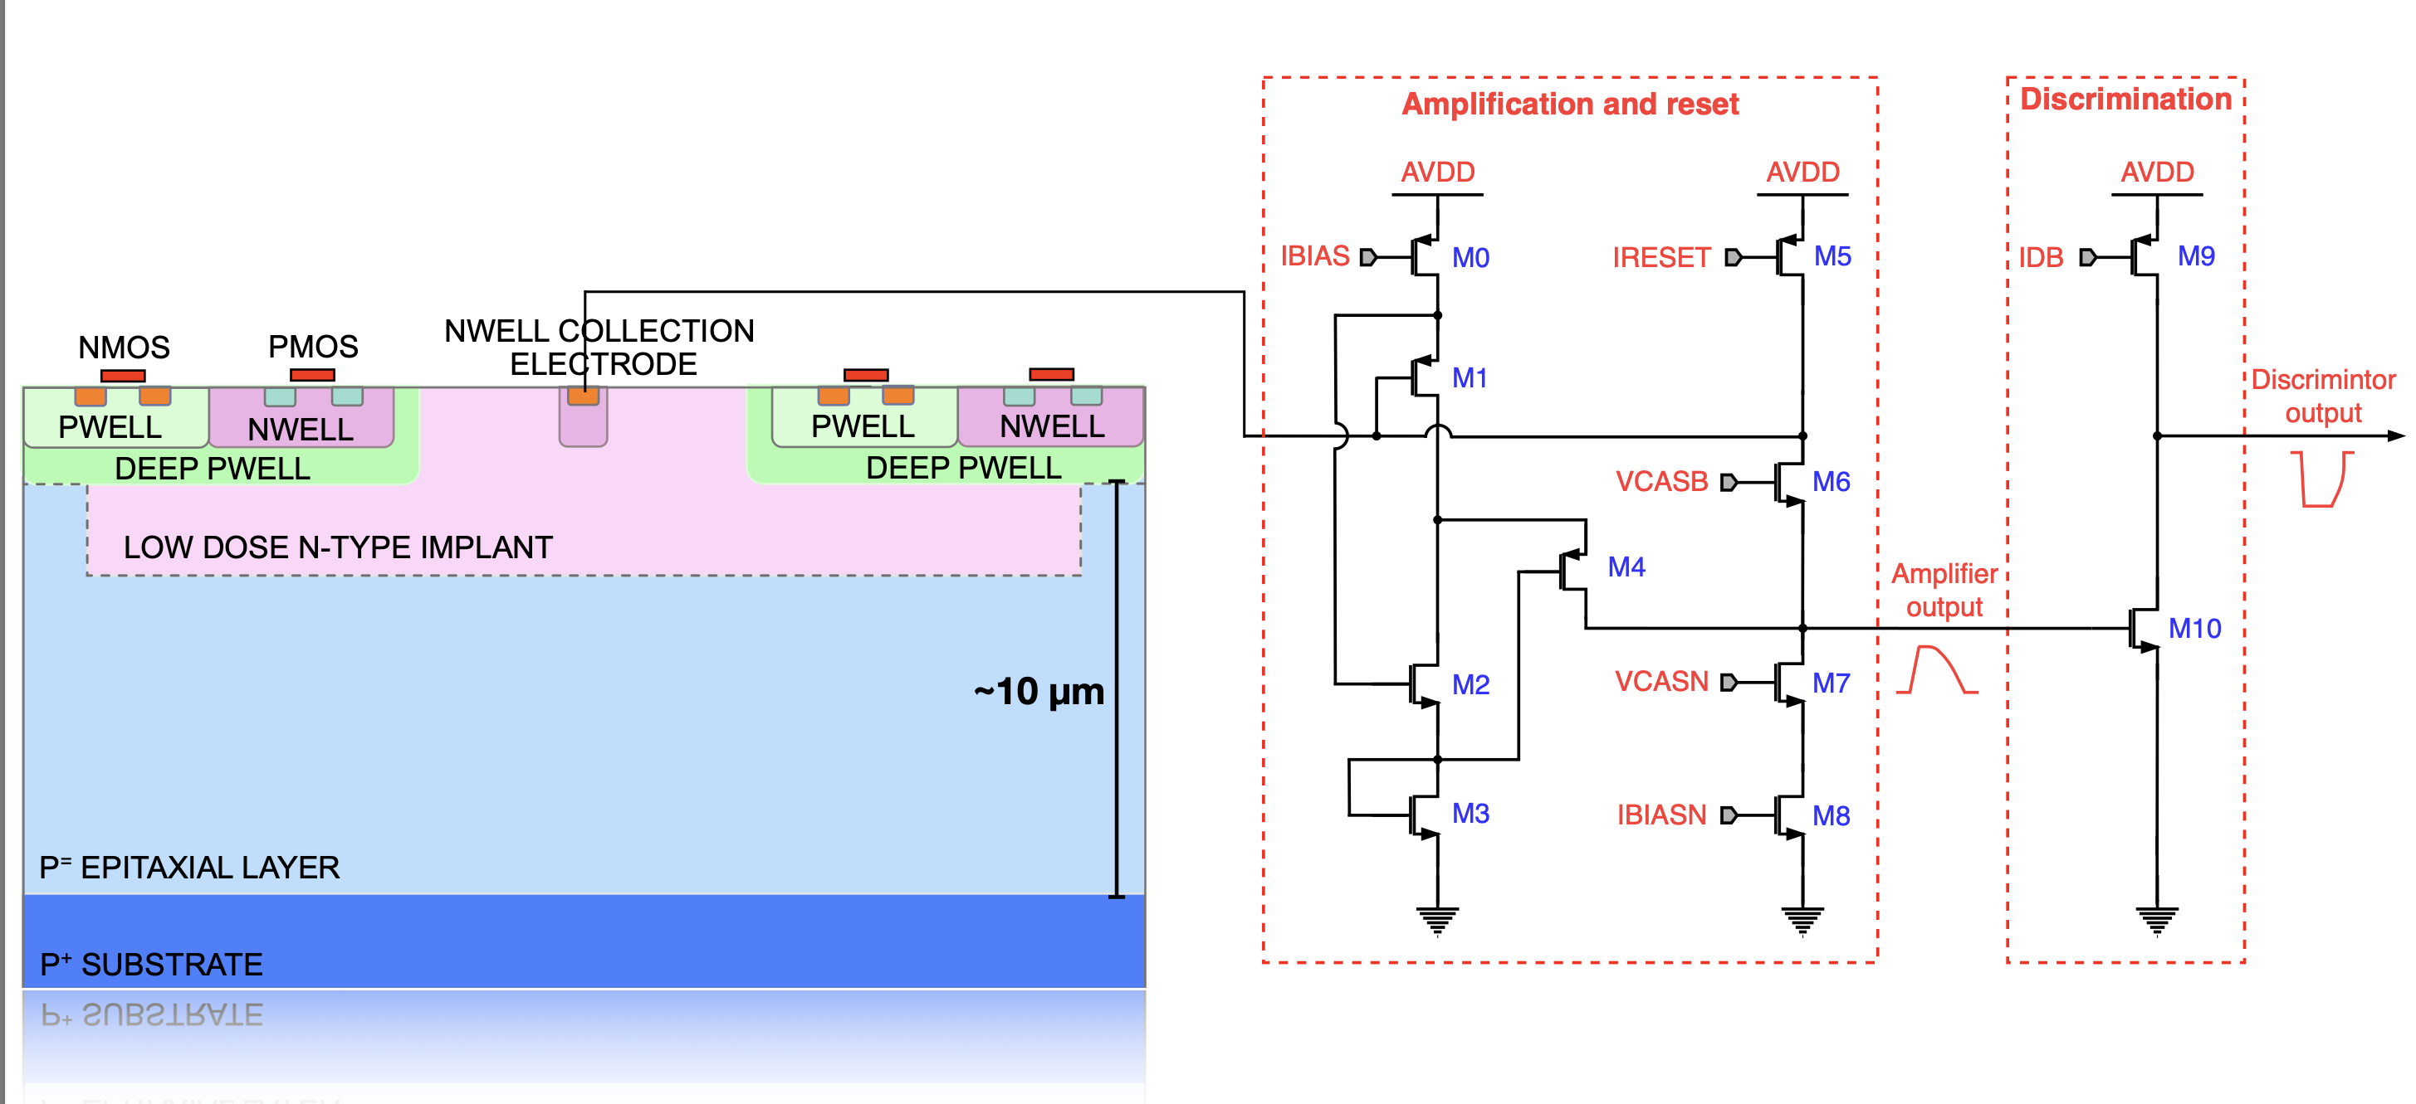
Backup
Monolithic = sensor+front end
Credits: Miljenko Šuljić — ALICE Upgrade week

Slide 16
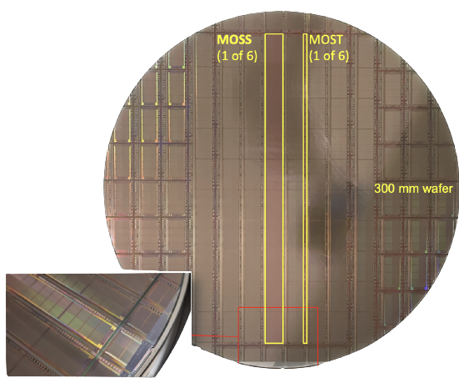

MOnolithic Stitched Sensor (MOST)
Stitched chip development
Stitching used to connect metal traces for power distribution and long range on-chip interconnect busses for control and data readout
MOSS and MOST: Different approaches for resilience to manufacturing faults
Stitched sensors for large-scale sensors in the ITS3 and ALICE3 projects
Already been manufactured
Presently undergoing thorough characterisation processes
259 mm
Stitched chip wafer with MOSS, MOST and babyMOST
MOST structure at Nikhef
Credit: G. A. Rinella on TWEPP 2023

