Slide 1
Detecting the Cosmic Neutrino Background with PTOLEMY
26 October 2023
Inge van Rens

Slide 2
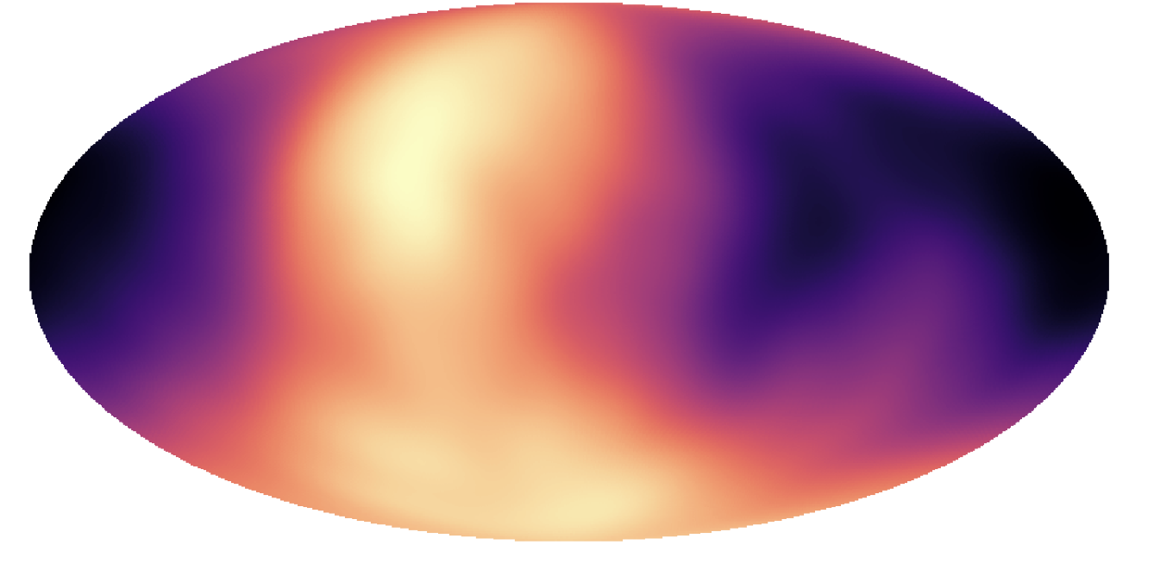
Cosmic Neutrino Background
Notes:
1 second after the Big Bang
2 Kelvin
56 cm⁻³
Clustering

Slide 3
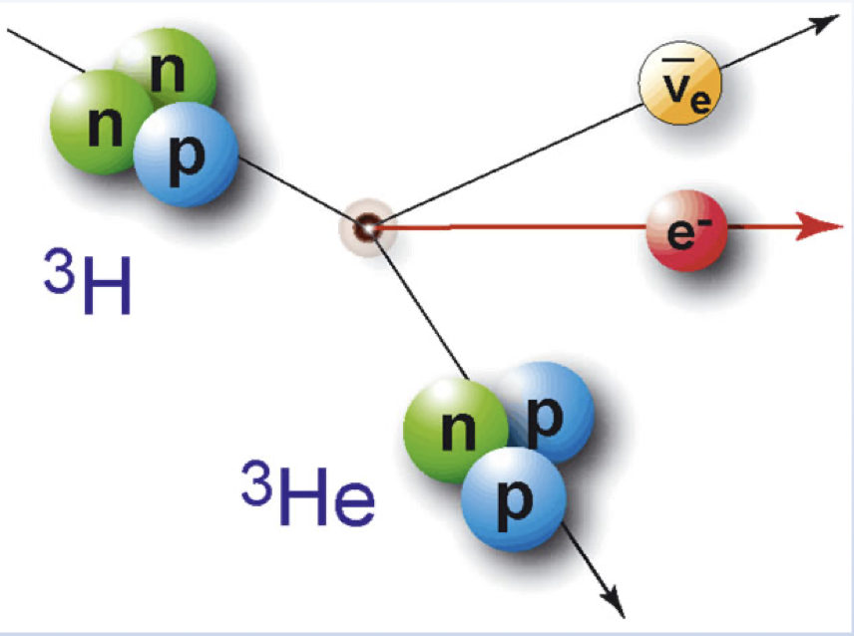
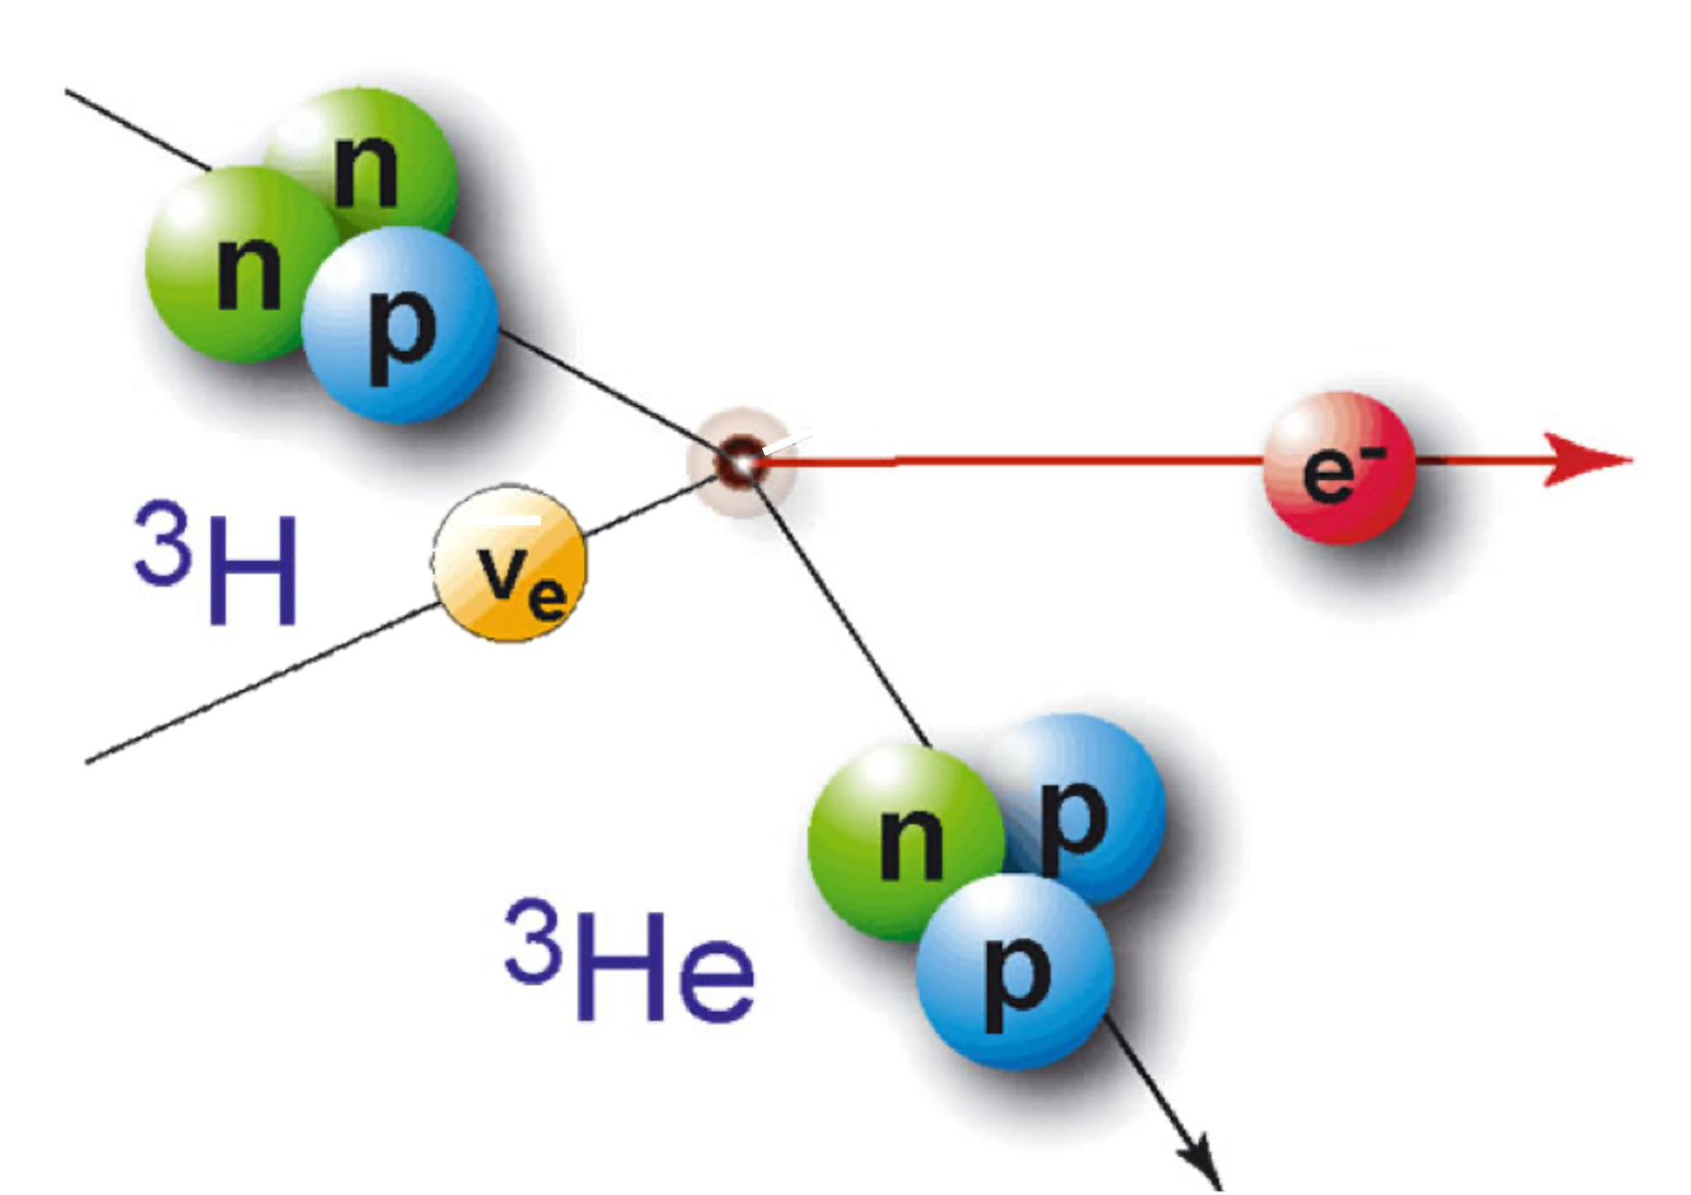
Neutrino capture

Slide 4
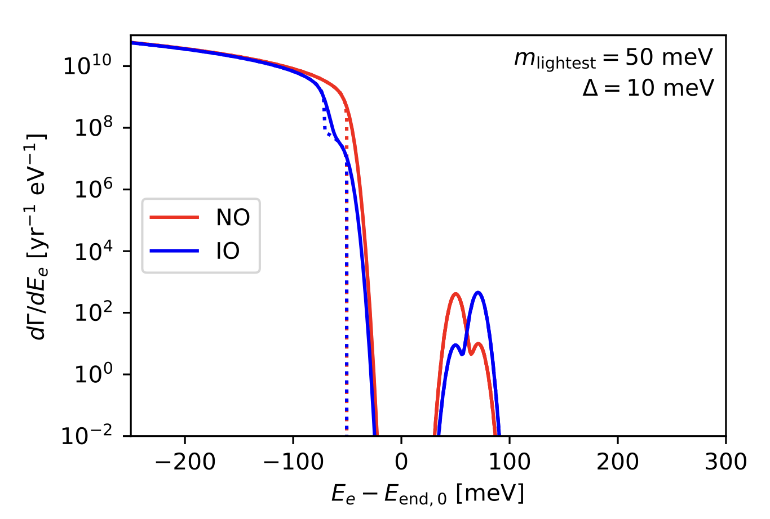
Neutrino capture

Slide 5
The experiment
Nij

Slide 6
The experiment
Notes:
Amsterdam group, James Mead

Slide 7
The experiment

Slide 8
The experiment

Slide 9
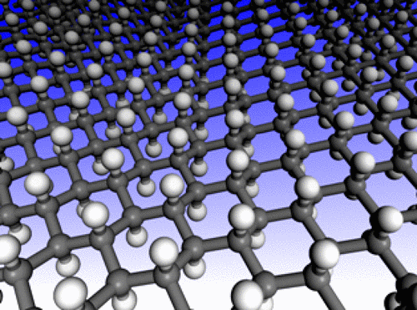
The target
Tritium on graphene

Slide 10
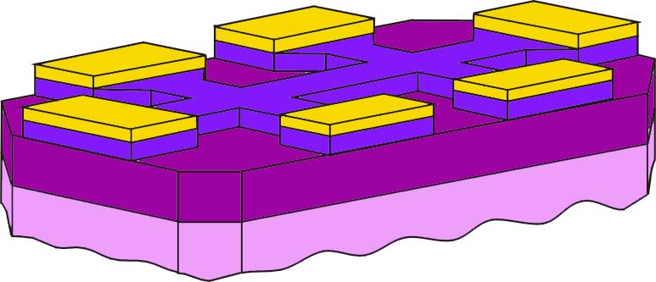
Graphene Field Effect Transistor
graphene
Au contacts
SiO₂
gate insulator
Si backgate

Slide 11
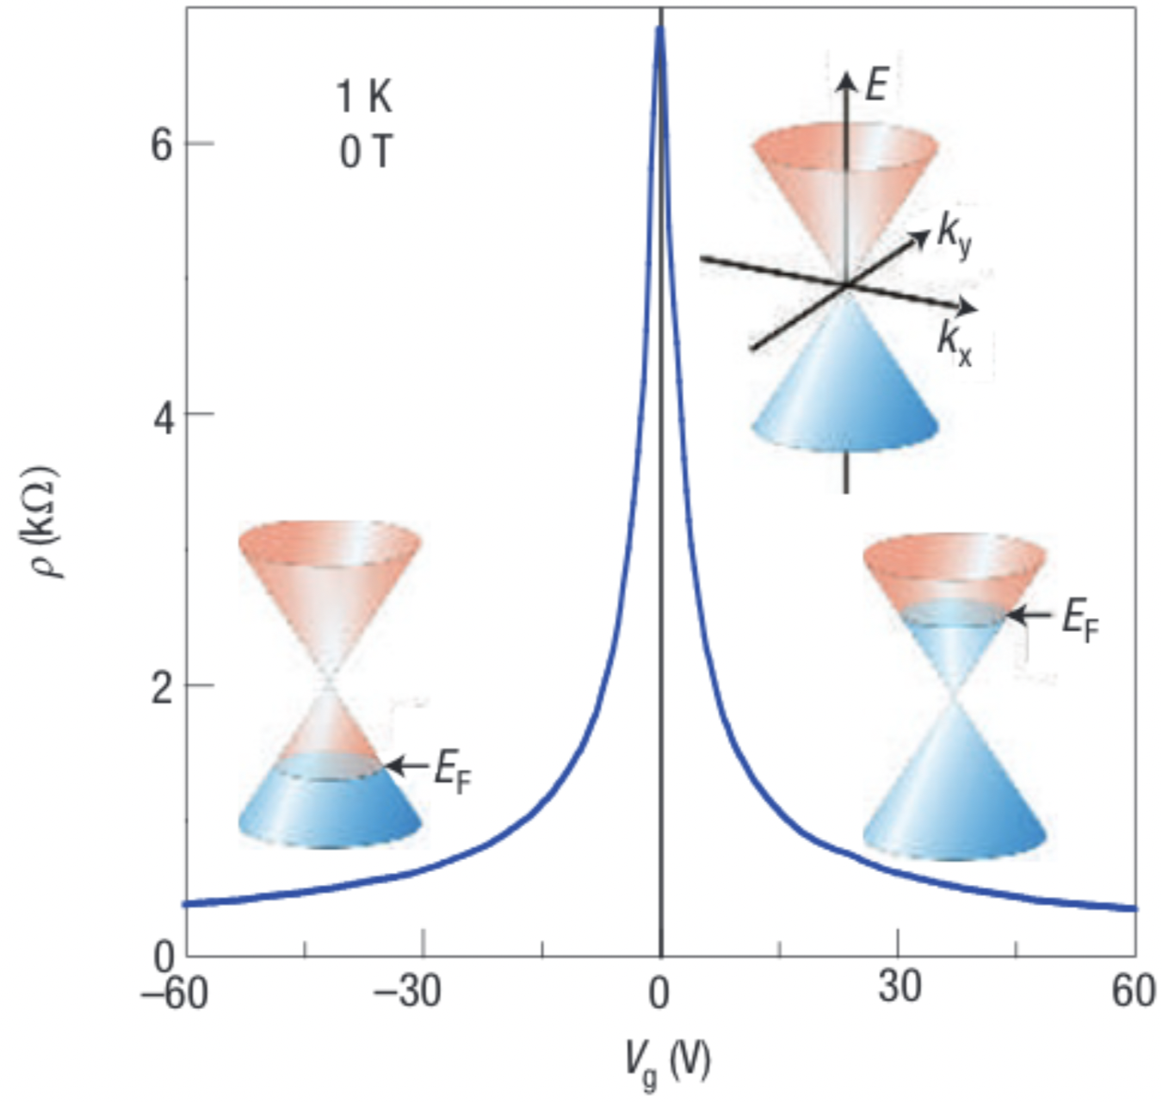
Transfer curve
Graphenea, GFET-S10 data sheet
Geim, A. K. & Novoselov, K. S. The rise of graphene. In Nanoscience and technology: a collection of reviews from nature journals, 11–19 (World Scientific, 2010)

Slide 12
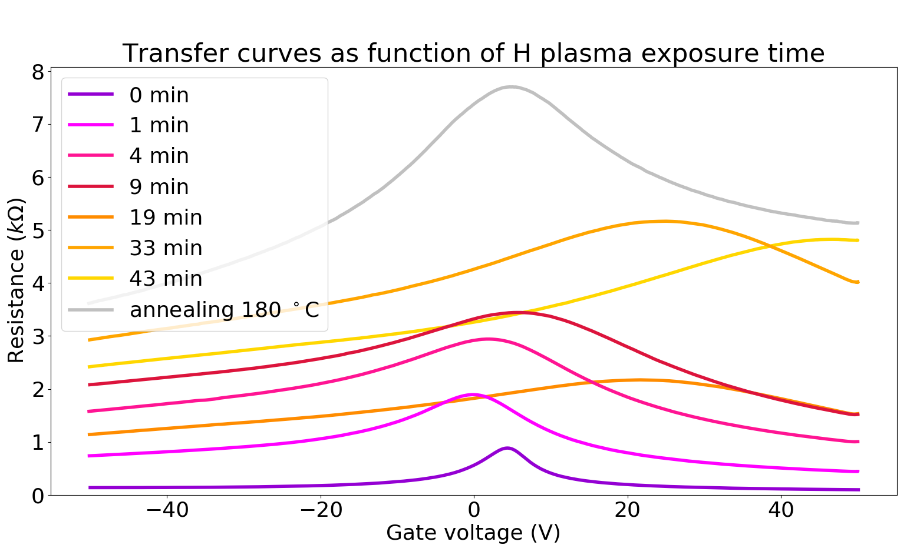
Measurements

Slide 13
Summary
Cosmic Neutrino Background
PTOLEMY experiment
Graphene hydrogenation

Slide 14
Backup slides

Slide 15
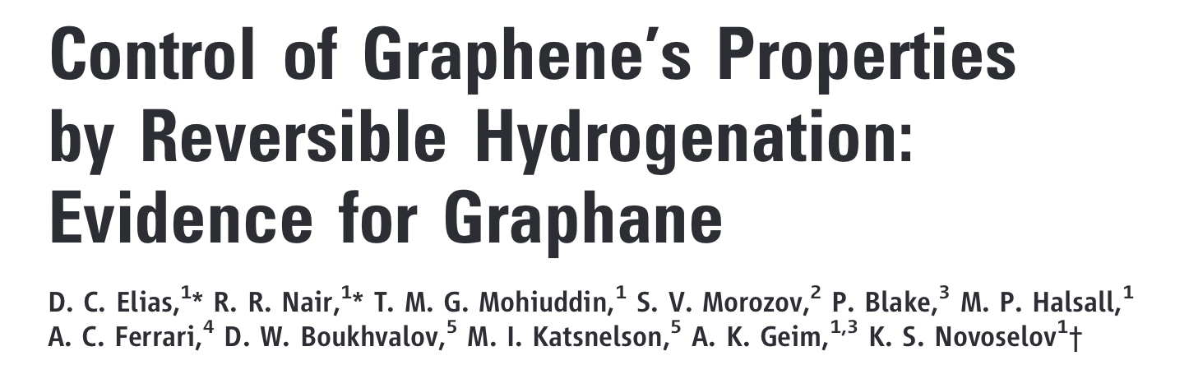
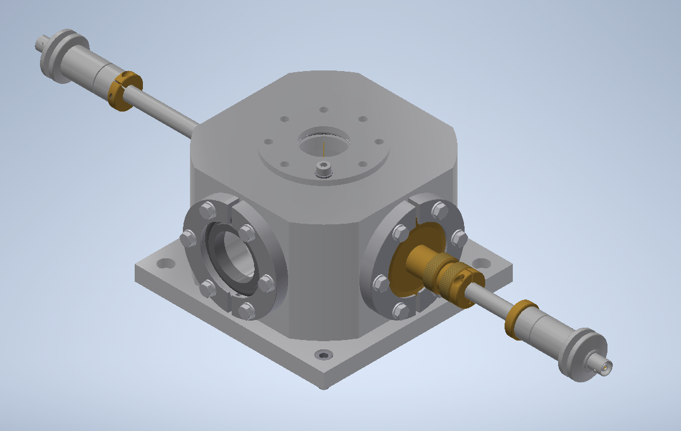
Hydrogen plasma

Slide 16
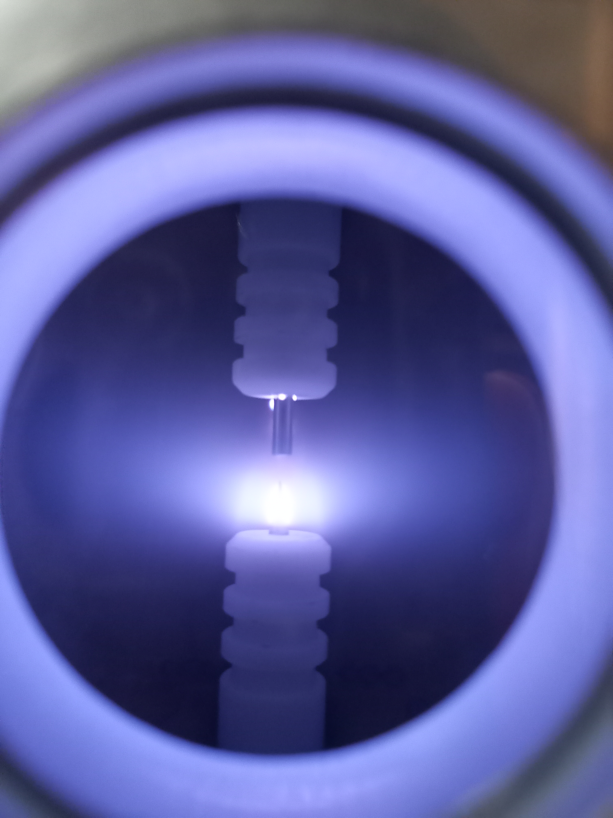
Hydrogen plasma

Slide 17
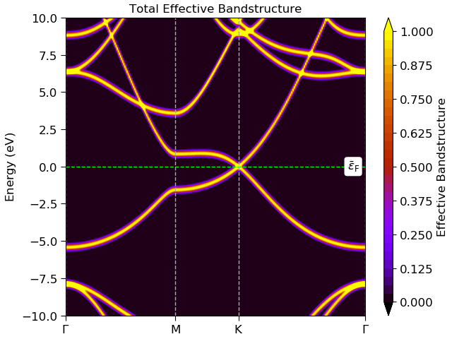
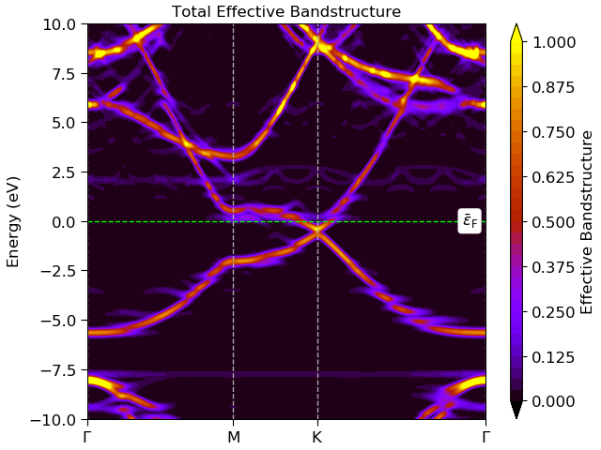
Organised simulations

Slide 18
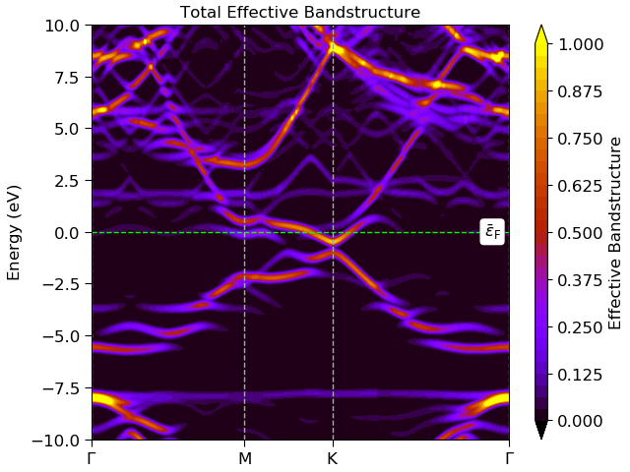
Organised simulations

Slide 19
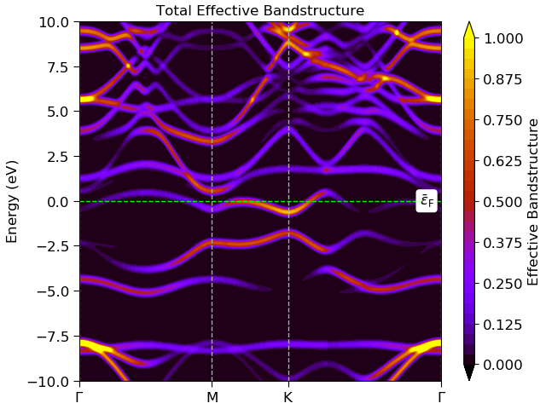
Organised simulations

Slide 20
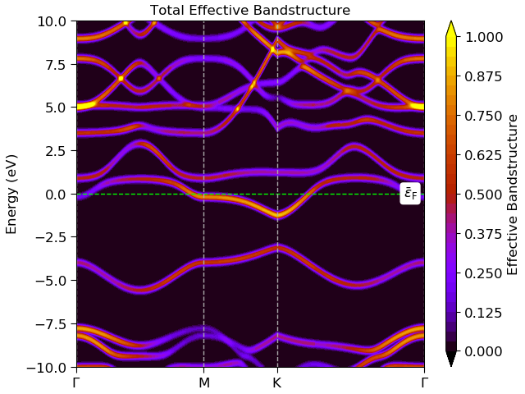
Organised simulations

Slide 21
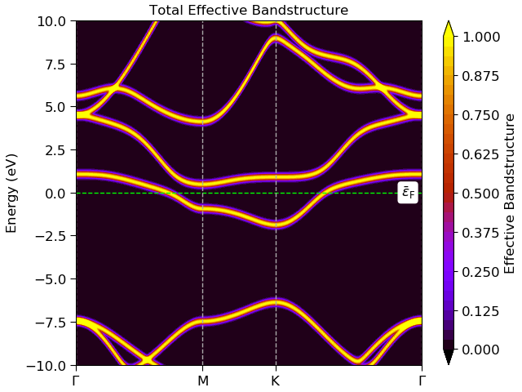
Organised simulations

