Slide 1
Quantum algorithm for track reconstruction in the LHCb vertex locator
Davide Nicotra
Notes:
- Reduce the text to 1/2

Slide 2
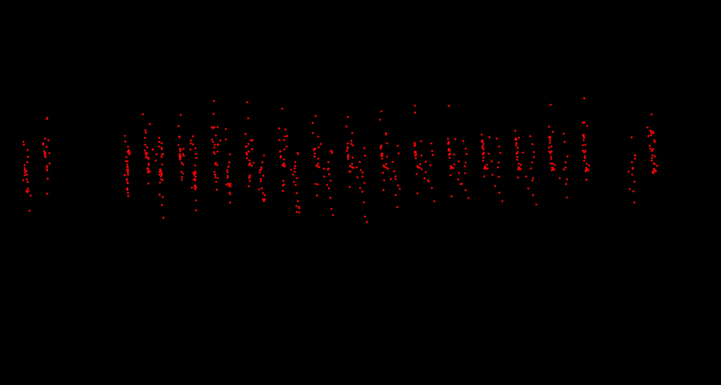
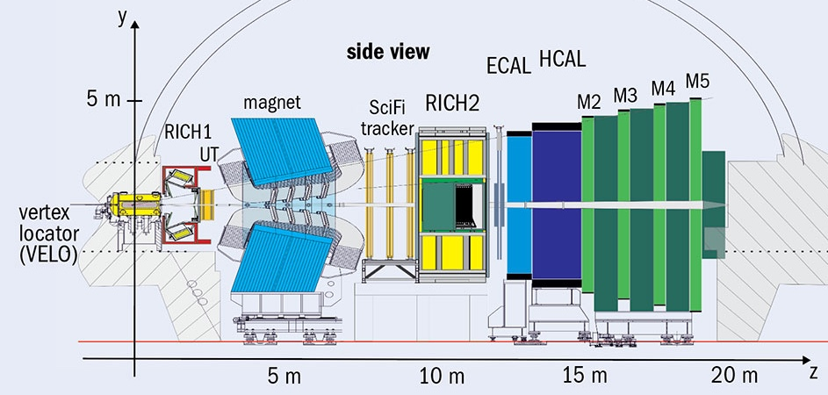
Connecting dots in the LHCb VELO
Charged particles leave hits in the VELO.
Reconstruction of the tracks crucial step of the LHCb pipeline.
The most computationally expensive algorithm at trigger level.
Here
Notes:
Make picture bottom larger
Straight tracks only say it
Animation larger (full page)
Say it quick

Slide 3
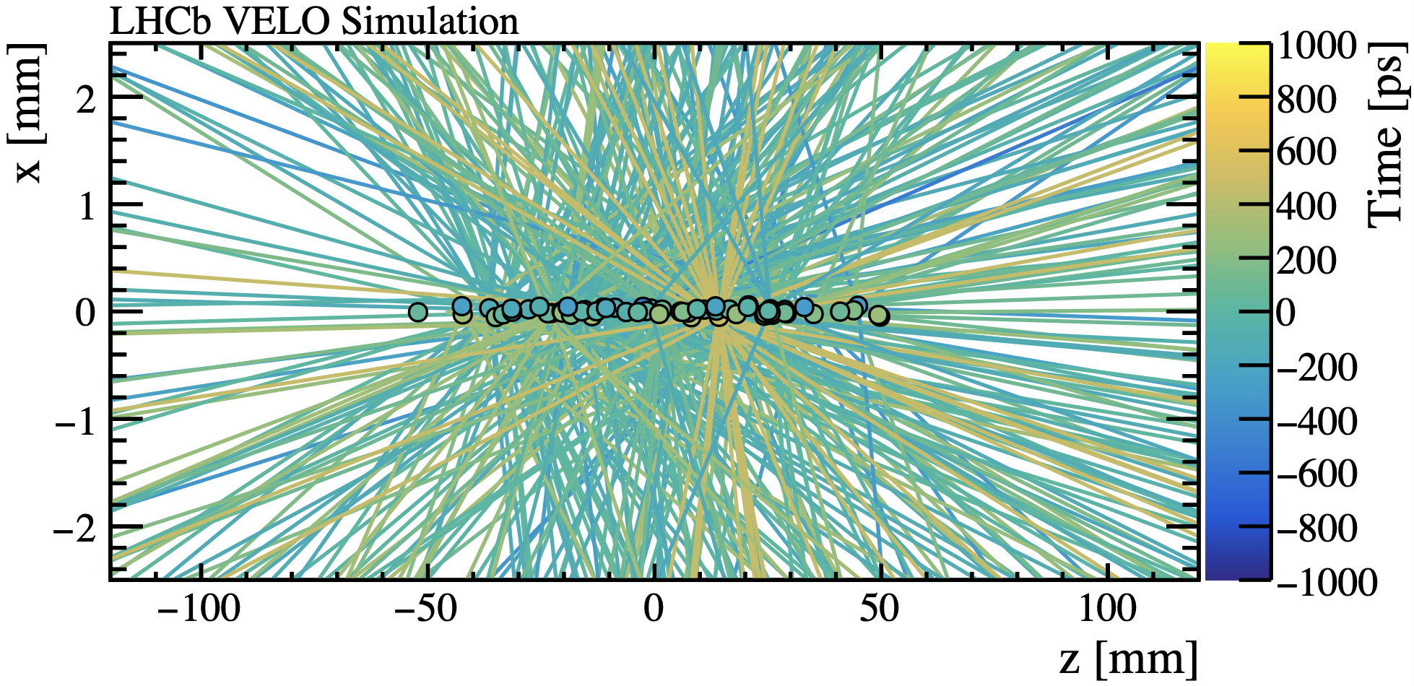
Tracking challenges in HL-LHC
Number of collisions per crossing: ~7
Substantial boost in luminosity in the future
10x more collisions
10x more particles
New algorithms will be required to deal with the new operating conditions
Can quantum computing play a role?
Courtesy of Robbert Geertsema
Notes:
Simplify the bunch crossing concept
1.6 run1
7 run 3
10xrun3 hl
Maybe get rid of first 2 bulll

Slide 4
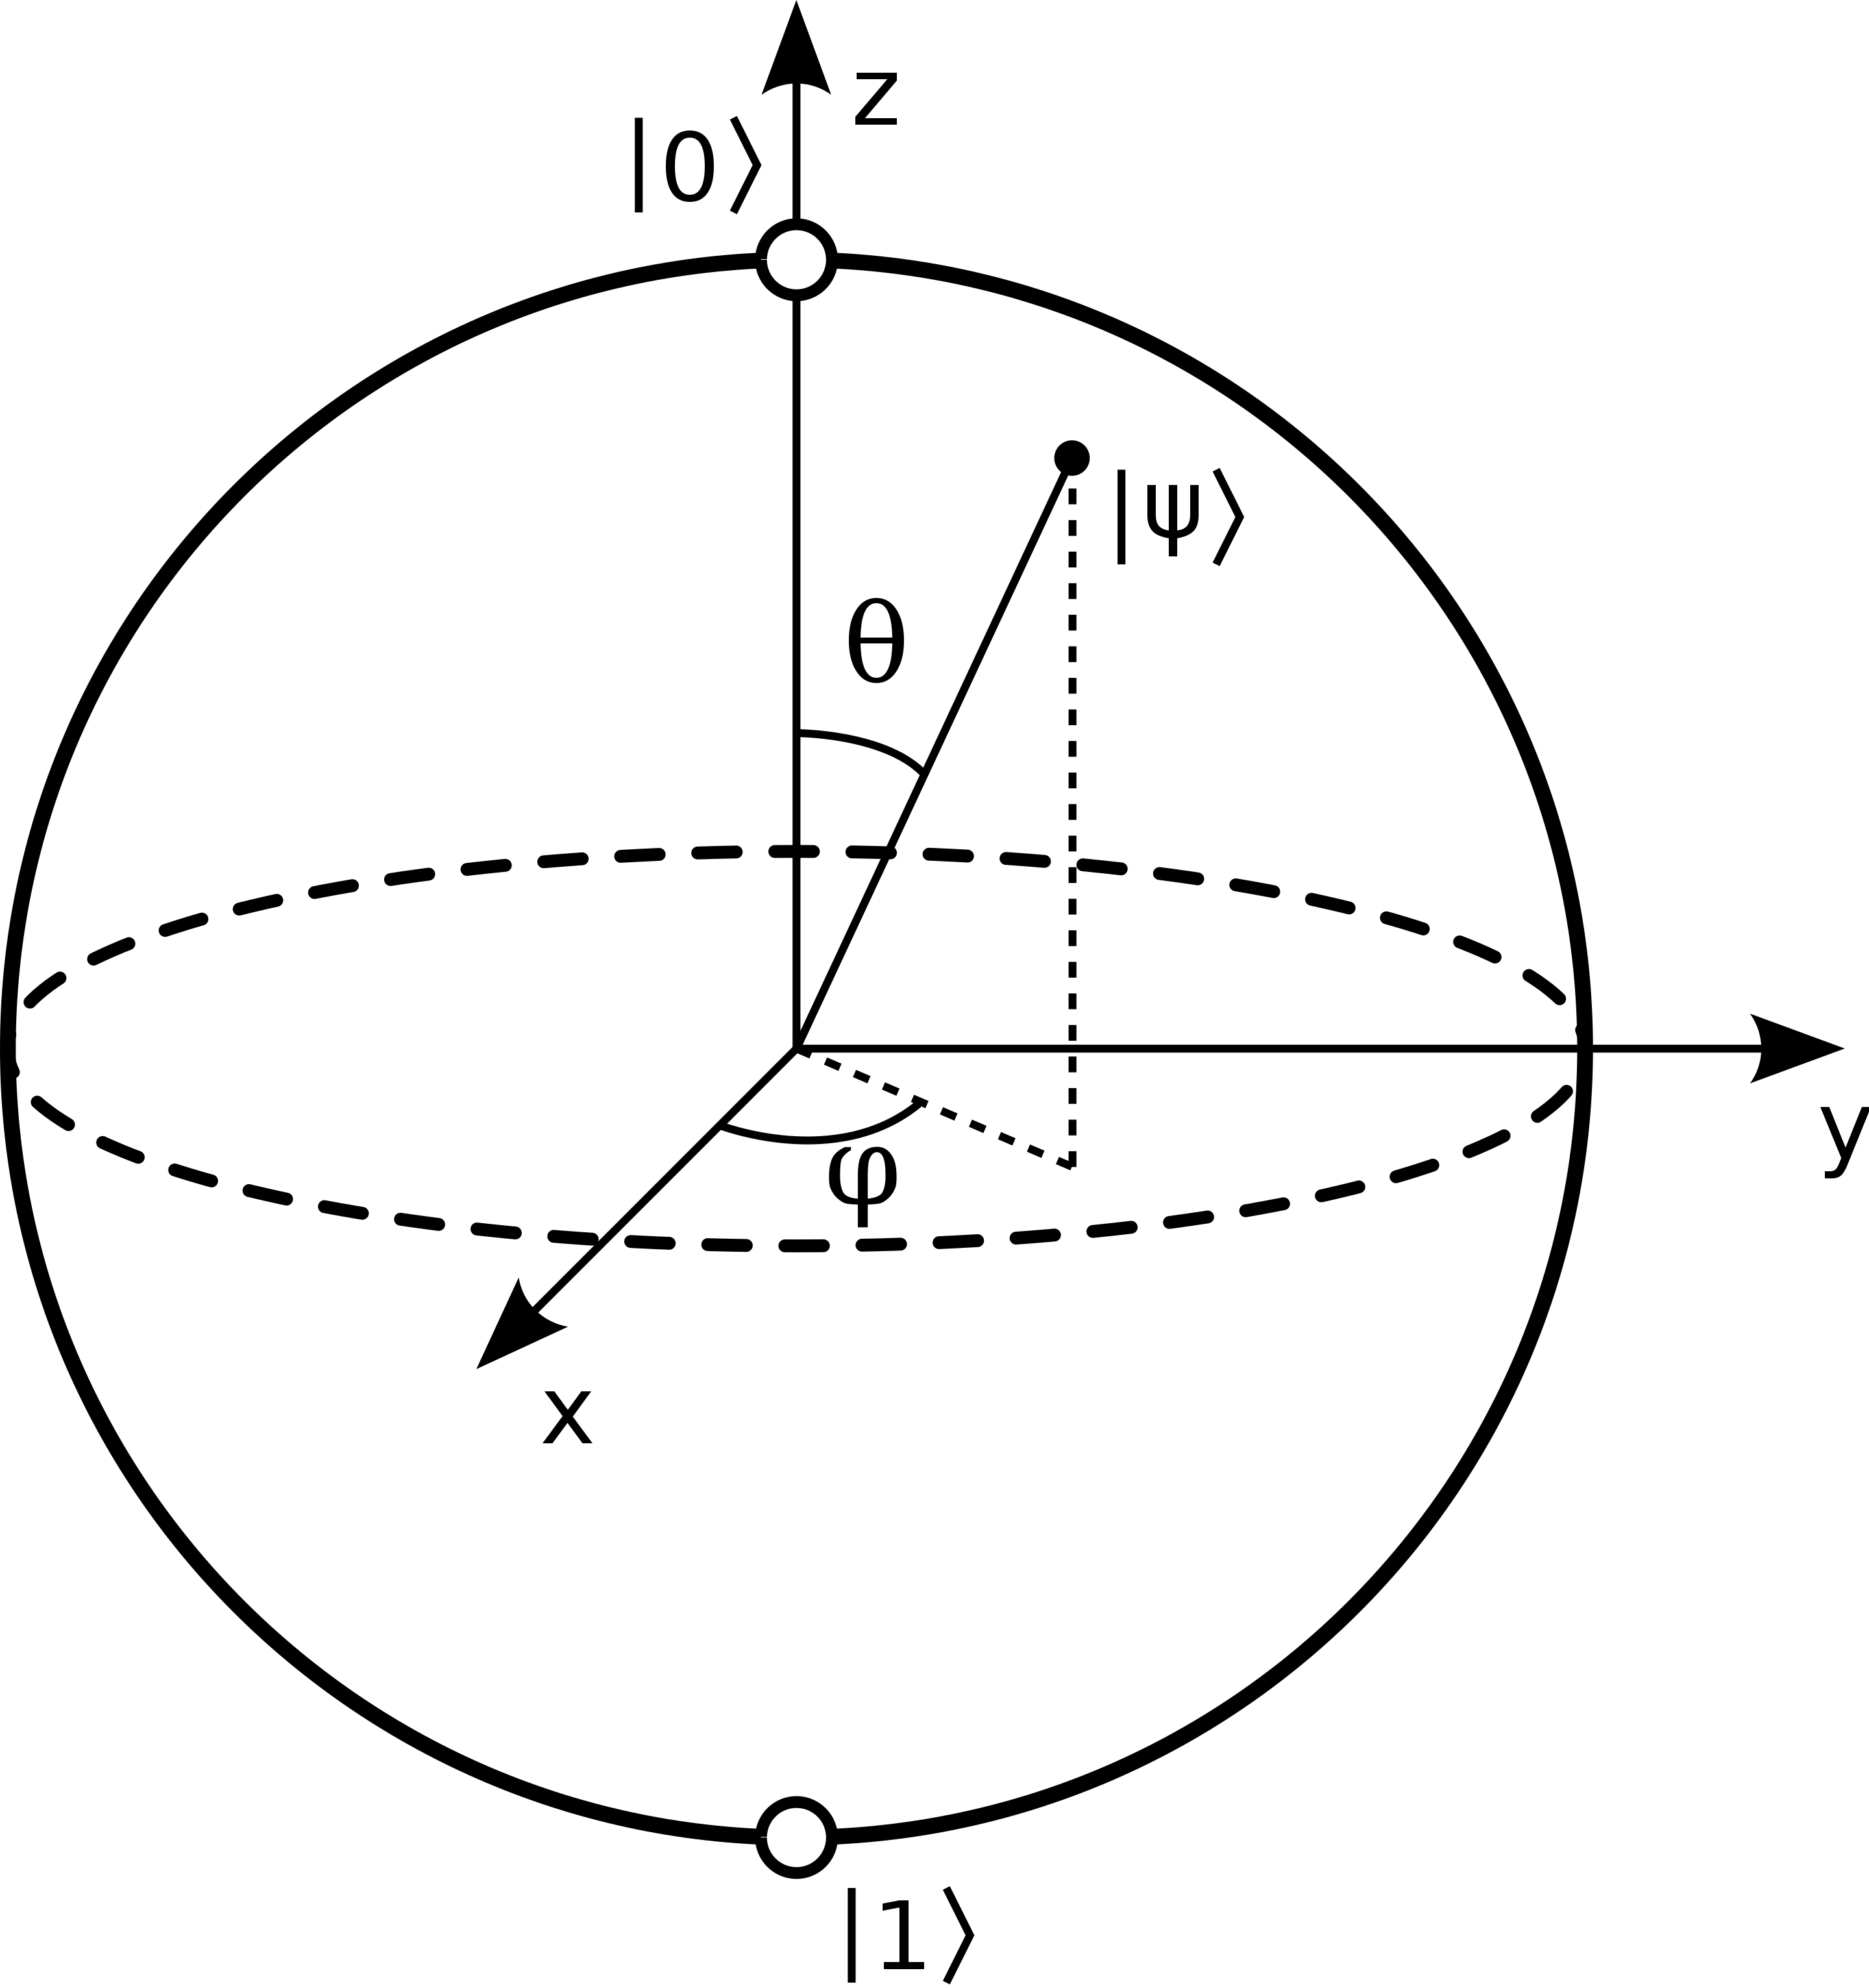
Quantum Computing
Using a system of qubits to perform calculations A $n$-qubit state lives in a $2^{n}$-dim Hilbert space
1-qubit state
2-qubit state
Translate the tracking problem to something compatible with a quantum computer
$$\left|ψ\right\rangle =α_{0}\left|0\right\rangle +α_{1}|1⟩$$
$$\left|ψ\right\rangle =α_{00}\left|00\right\rangle +α_{01}\left|01\right\rangle +α_{10}\left|10\right\rangle +α_{11}|11⟩$$
Initialisation
The initial state is created with each qubit initialised to the $|0⟩$ state.
$$\left|Ψ\right\rangle =|00…00⟩$$
Computing
Unitary operators $U_{i}$ are applied to $\left|Ψ\right\rangle$ implementing an algorithm
$$\left|Ψ\right\rangle →U_{i}\left|Ψ\right\rangle →U_{j}U_{i}\left|Ψ\right\rangle → …$$
Measurement
The probability distribution of the final state is measured
$$P\left(00\right)={\left|\left\langle Ψ | 00\right\rangle \right|}^{2}={\left|α_{00}\right|}^{2}$$
Depth

Slide 5
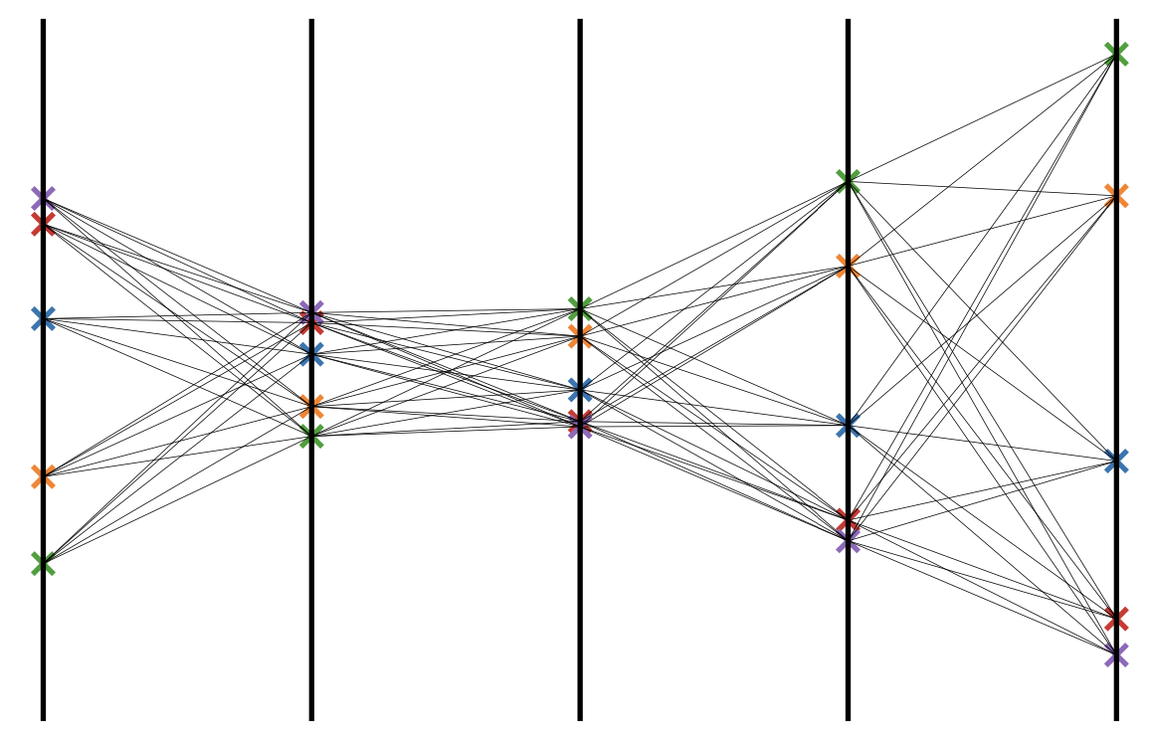
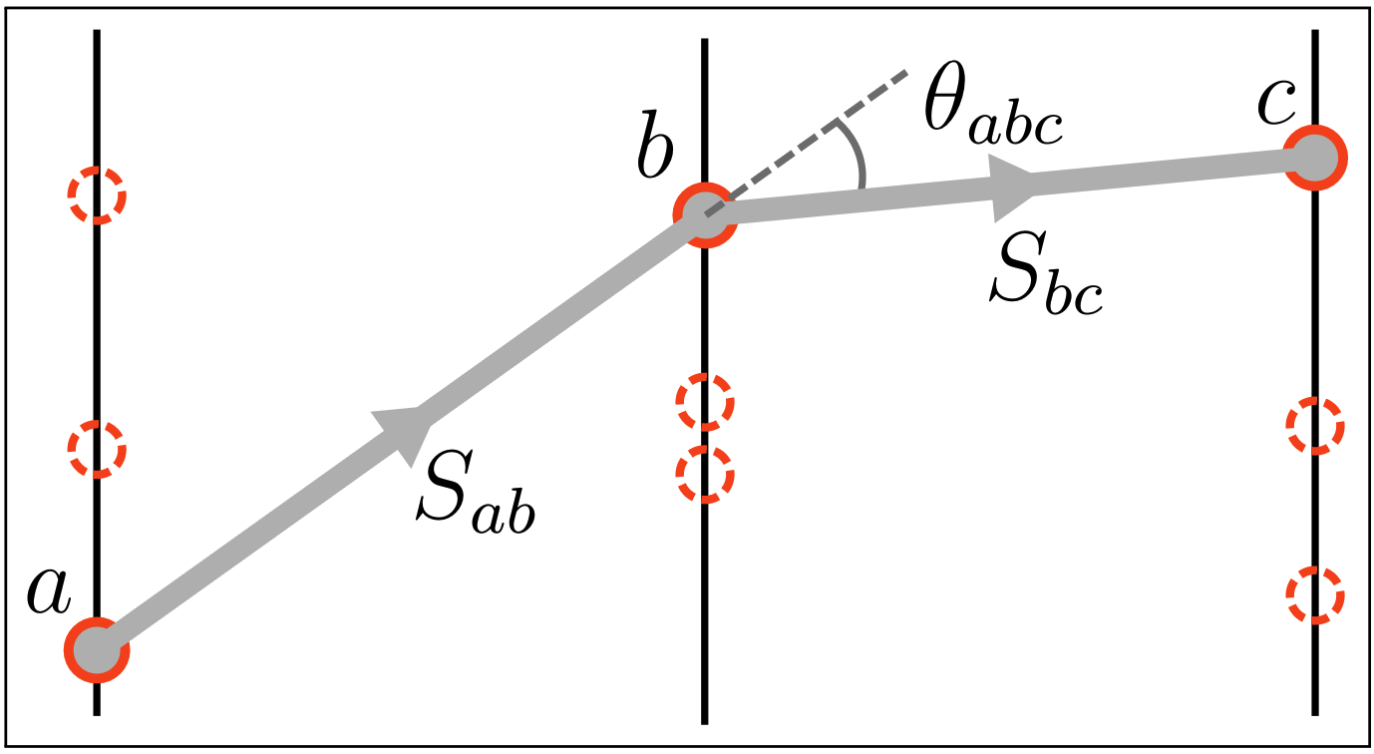
A quantum algorithm for tracking
From Hits to an Ising-like Hamiltonian
Inspired by Denby-Peterson^{[1]} model
Candidate doublets constructed $N=(\#Layers−1) × \#Particles^{2}$
Initialise the Hamiltonian
Only linear and quadratic terms. It’s Ising!
$$S_{j}$$
$$S_{i}$$
[1] R Mankel. “Pattern Recognition and Event Reconstruction in Particle Physics Experiments.” Reports on Progress in Physics 67, no. 4 (March 25, 2004): 553. https://doi.org/10.1088/0034-4885/67/4/R03.
Notes:
Picture larger, less text
Formula bigger
- Add the formula for number of doublts here

Slide 6
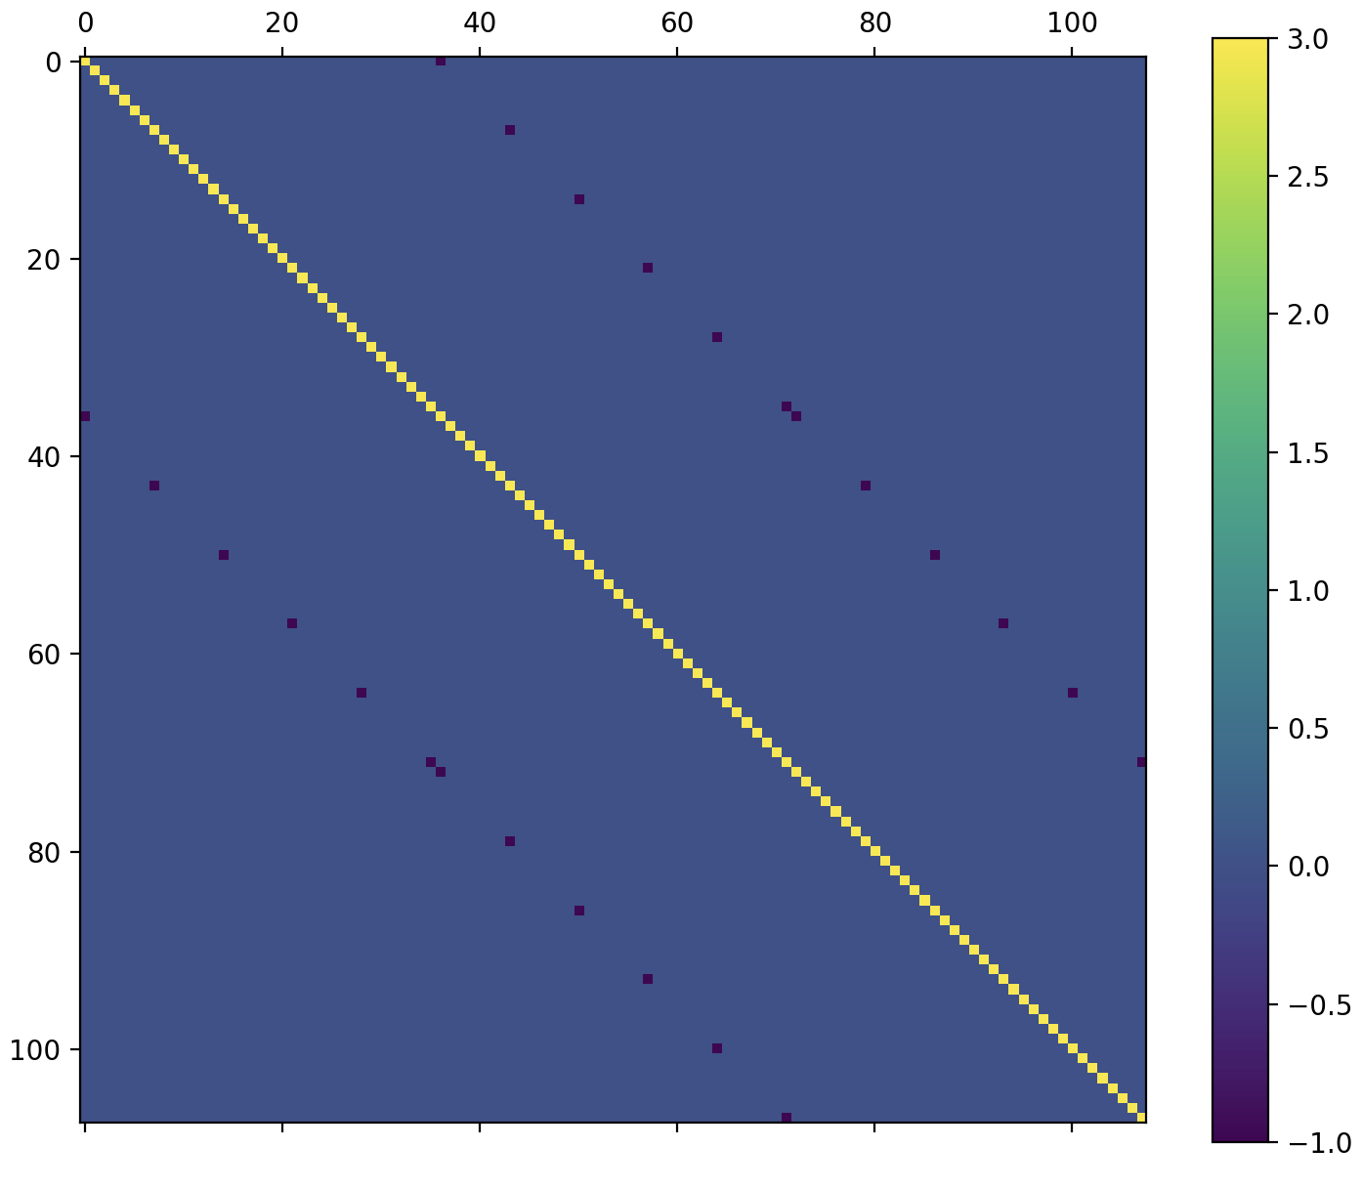
A quantum algorithm for tracking
From Ising to an Linear Algebra
$$S_{j}$$
Segments take discrete values: on or off
Relaxation of the problem promoting
Hamiltonian is a differentiable
Solve this huge $N×N$ system
Discretize back the solution
$$S_{i}$$
$$N=\#Layers × \#Particles^{2}$$
$$N$$
$$N$$
Notes:
Add the scaling
Add picture matrix
Maybe remove matrix and put the same picture of previous slide

Slide 7
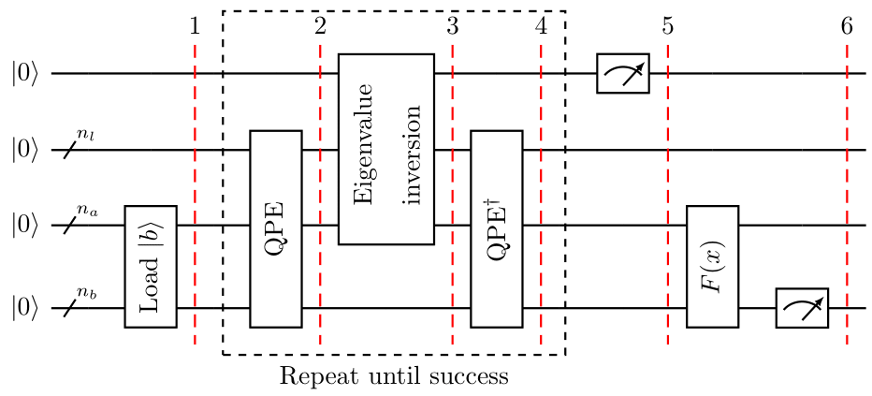
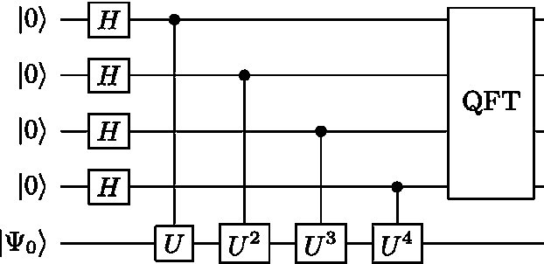
A quantum algorithm for tracking
The Harrow-Hassadim-Lloyd quantum algorithm
$$AS=b→S=A^{−1}b$$
We are are going to solve this HUGE system of linear equations with HHL
It exploits Quantum Phase Estimation to perform efficient matrix inversion
QPE works by applying conditional Hamiltonian evolution multiple times
Under certain conditions
Classical $O\left(N\right)$
Quantum $O\left(\log{N}\right)$
Exponential speed-up!
Conditions
Efficient State Preparation ✅
b is easy to prepare!
Efficient QPE 🚧 Structure of A
High sparsity helps
Extremely deep circuits
Efficient Read-out 🚧
Structure of S
Amplitudes not accessible by measurements
QPE
$$U=e^{iA}$$
Notes:
Reduce QPE explaination

Slide 8
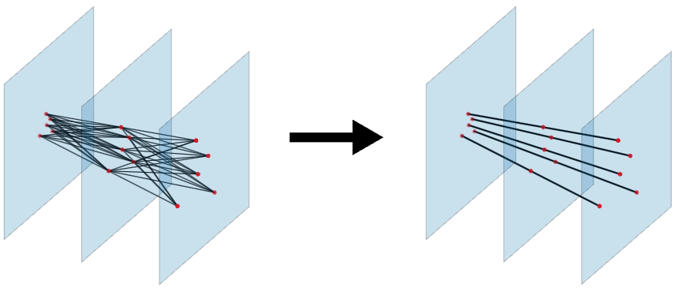
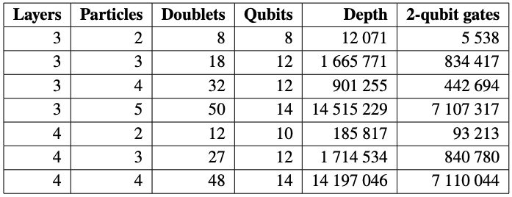
Quantum implementation
5 particles – 3 layers detector
quantum simulation
Test the algorithm using the Qiskit implementation of HHL
Smaller toy model events
Transpiled to IBM target device
Estimated depth and 2-qubit gates
Correct solution always retrieved
Depth extremely high
Effectively unfeasible today
Expected: HHL implementation ignores the sparsity structure
Took 2 days to complete
Notes:
2 main messages
- We cannot test on actual event because too big
we tested smaller event on simulators and it works
Hardwere testing is not possible because of Hamiltonian simulations
Thicker points and lines
Remove first 2 bullets say it in previous slide. Simply say that on hardware is not possible yet.
Put a huge circuit in backup
Make point 2 very clear

Slide 9
Will it work on real-world LHCb data?

Slide 10
Animation
LHCb Simulated Event 1 collision event
Half of the VELO
$$B_{s}→φφ$$
To validate our new Hamiltonian approach, HHL has been replaced with a classical linear solver
LHCb events on quantum simulator/hardware is not possible yet.
Circuit too deep
Hardware too noisy
Notes:
Say that we have 1 collision event

Slide 11
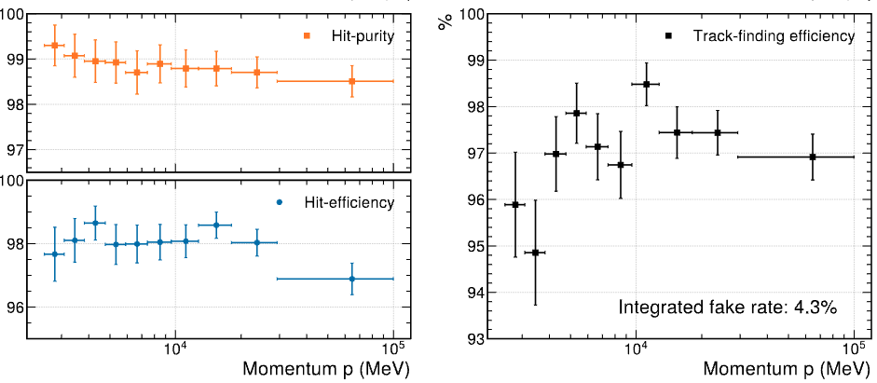
Validation on LHCb events
LHCb simulated events with a classical solver to assess track reconstruction performance
Precision
Great performance!
Recall
Notes:
Only as a function of momentum
Make clear that this is not quantum implementation
Start the plot form 1gev
Just show efficiency

Slide 12
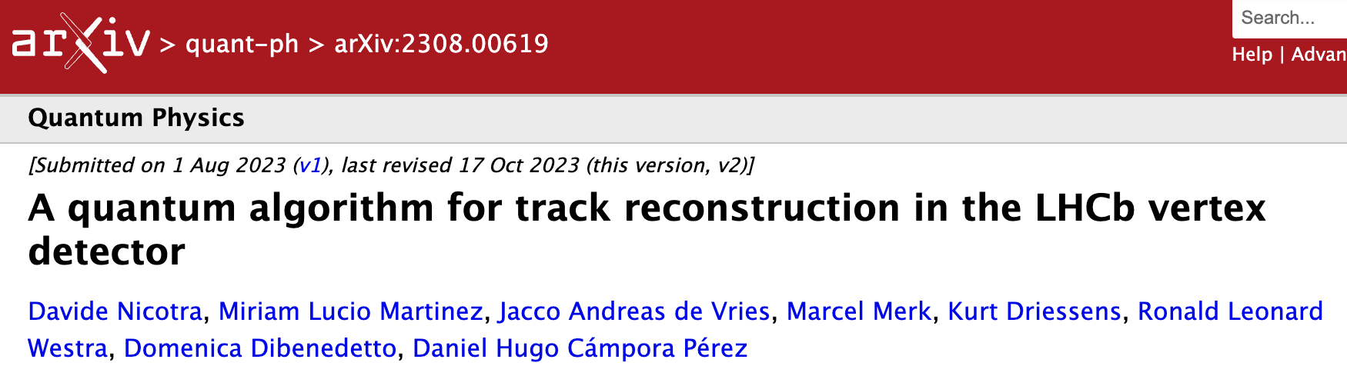
Conclusions
New track reco algorithm based on Ising-like Hamiltonian
Tested and validated classically on LHCb simulated events
Good performance!
First track reco algorithm based on the HHL quantum algorithm
Tested on smaller events
🚧 Hamiltonian simulation and read-out are still inefficient.
Preprint on the ArXiv. Accepted for publication on JINST.
Notes:
Split the results on classical and the actual quantum implementation

Slide 13
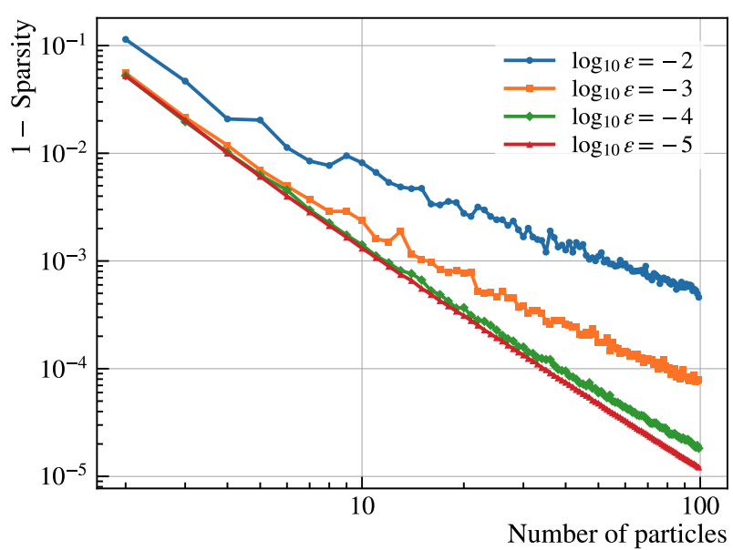
Questions for the future
Is it possible to perform efficient QPE of the operator $e^{iA}$?
$A$ is very sparse
Can we efficiently extract information about the reconstructed tracks from the final state?
No need for the full vector. We just need tracks.

Slide 14
Thank you

