Slide 1
Track Reconstruction Using Transformers
Nadezhda Dobreva
nadezhda.dobreva@ru.nl
ICIS, Radboud University
MSc student in Data Science and Artificial Intelligence
NNV Annual meeting 2023 03/11/2023

Slide 2
Team
The project collaborates:
Radboud University (Nadezhda Dobreva)
Nikhef (Sascha Caron, Zef Wolffs, Uraz Odyurt)
SURF (Yue Zhao)
Via IMAPP, ELLIS and Radboud AI
Notes:
KF finds all possible combinations of hits and makes candidate clusters from those that form a sufficiently long track, so multiple combinations of hit patterns must be explored and compared in order to find the best one. due to its combinatorial nature, it scales quadratically with increasing occupancy. Especially with the High-Luminosity LHC being introduced soon, the number of interactions and generated secondary particles per collision will be increased tenfold [9], motivating the need to move away from combinatorial algorithms and work on a solution that can run faster and in parallel
there’s a lot of exploration into alterantive methods, some involving paralelizing kalman filters, and some focusing on machine and deep learning. we look at the latter and in particular, transformers

Slide 3
The Problem

Slide 4
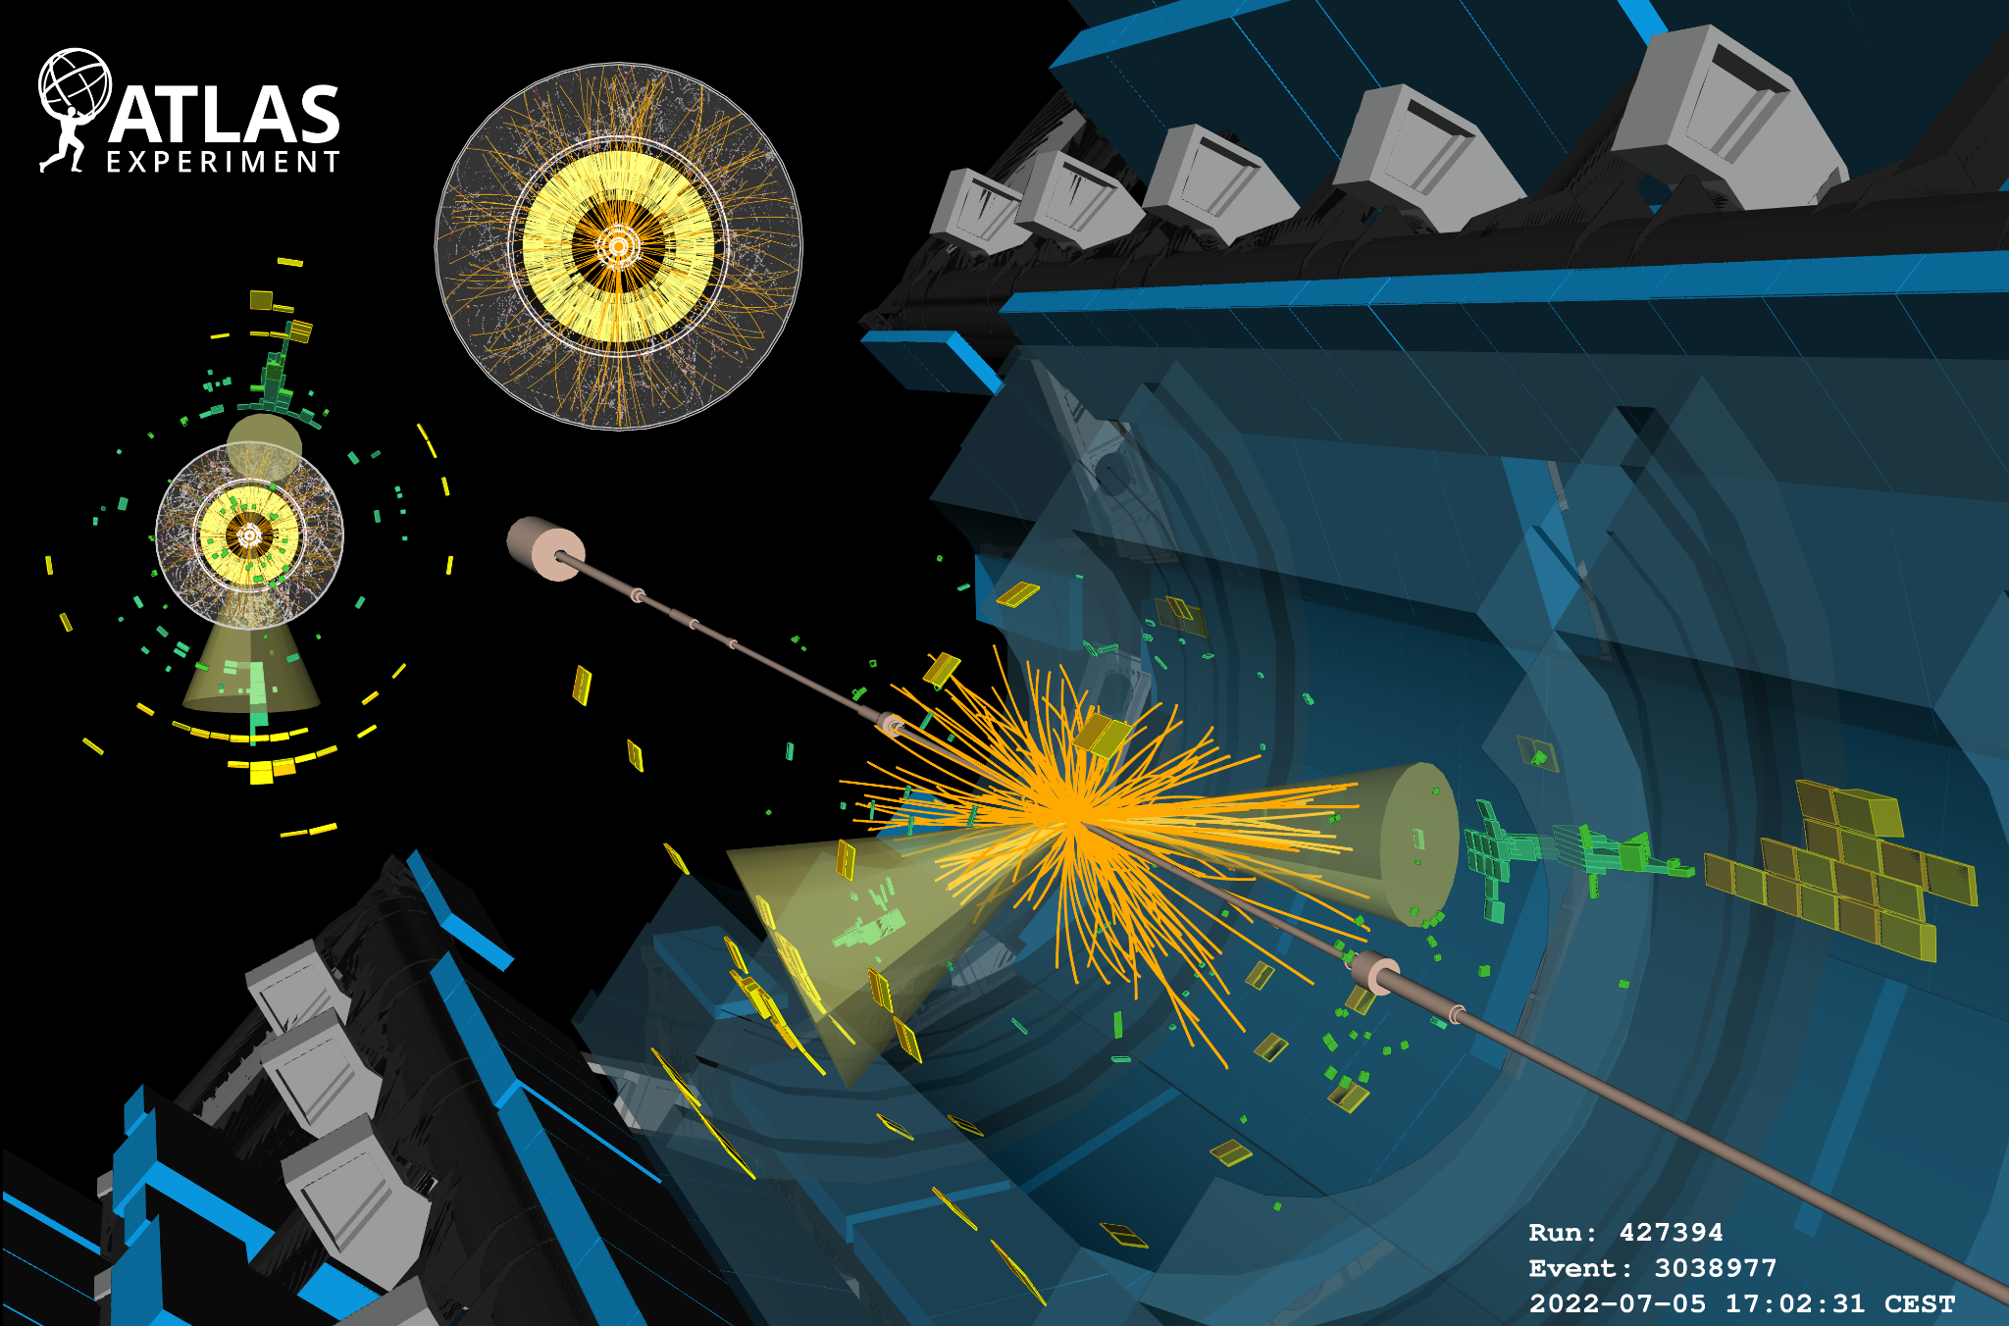
Image credit: ATLAS Collaboration, CERN

Slide 5
Scalability Issue
Kalman filters: scaling quadratically, inherently sequential [1, 2]
High Luminosity LHC: detector occupancy scales up [3]
[1] Lantz, Steven, et al. "Speeding up particle track reconstruction using a parallel Kalman filter algorithm." Journal of Instrumentation 15.09 (2020): P09030.
[2] Tsaris, Aristeidis, et al. "The HEP. TrkX project: deep learning for particle tracking." Journal of Physics: Conference Series. Vol. 1085. IOP Publishing, 2018.
[3] Apollinari, Giorgio, Lucio Rossi, and Oliver Brüning. High luminosity LHC project description. No. CERN-ACC-2014-0321. 2014.
Notes:
KF finds all possible combinations of hits and makes candidate clusters from those that form a sufficiently long track, so multiple combinations of hit patterns must be explored and compared in order to find the best one. due to its combinatorial nature, it scales quadratically with increasing occupancy. Especially with the High-Luminosity LHC being introduced soon, the number of interactions and generated secondary particles per collision will be increased tenfold [9], motivating the need to move away from combinatorial algorithms and work on a solution that can run faster and in parallel
there’s a lot of exploration into alterantive methods, some involving paralelizing kalman filters, and some focusing on machine and deep learning. we look at the latter and in particular, transformers

Slide 6
Alternatives
An active field of research
TrackML challenge [4]
GNN tracking - graph-based solutions [5]
Other deep learning approaches
[4] https://www.kaggle.com/competitions/trackml-particle-identification/
[5] Caillou, Sylvain, et al. ATLAS ITk Track Reconstruction with a GNN-based pipeline. No. ATL-ITK-PROC-2022-006. ATL-COM-ITK-2022-057, 2022.

Slide 7
The Transformer

Slide 8
What is a Transformer?
Deep learning architecture
Success in NLP
“The butterfly “Пеперудата
is beautiful.” е красива.”
hits tracks
transformer
Notes:
deep learning architecture that excels at modeling sequential data
wide application in natural language processing, so generation of text and also text translation; has been used for other purposes too incl comp vision
translating is a typical task for transformer models. we utilize them for precisely this type of task, but where the translation doesn’t happen from one language to another, but from hits to tracks

Slide 9
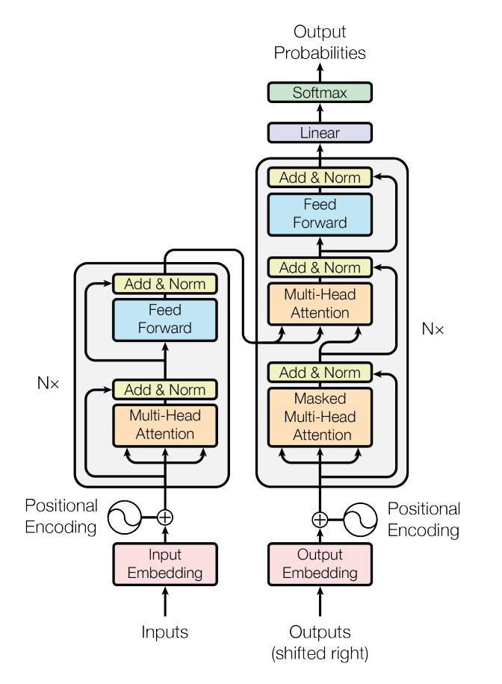
Transformer Architecture [6]
Encoder
Decoder
Multi-head attention mechanism
[6] Vaswani, Ashish, et al. "Attention is all you need." Advances in neural information processing systems, 30 (2017).
Image credit: [6]
Notes:
The Transformer starts by generating initial representations, or embeddings, for each word... Then, using self-attention, it aggregates information from all of the other words, generating a new representation per word informed by the entire context. This is repeated for all words, in parallel. A decoder then generates the output sentence word by word while consulting the representation generated by the encoder.

Slide 10
Motivation
Runs in parallel
Transformer pipeline can be trained end-to-end
Can handle variable length input
Equivariant to input order
Good at capturing complex non-linear dynamics in data
Good at sequential data
Notes:
parallelizable - makes them efficient to run on gpus
why is the training point good? todo

Slide 11
The Data

Slide 12
Complexity-Reduced Datasets
REDuced VIrtual Detector (REDVID) for simulation of events [7, 8]
Iterative increase of complexity
[7] Reduced Simulations for High-Energy Physics, a Middle Ground for Data-Driven Physics Research, Uraz Odyurt, Stephen Nicholas Swatman, Ana-Lucia Varbanescu, Sascha Caron, 2023
[8] https://virtualdetector.com/redvid/
Notes:
in our search for the optimal architecture and hyperparameters, we make use of simplified data. the idea behind starting off simple and gradually increasing the complexity is to facilitate the exploration and model design process.
we use the reduced virtual detector to simulate data in 2d and 3d, with linear and helical particle tracks, and of varying number of tracks per event: starting with 3 and going up to 50

Slide 13
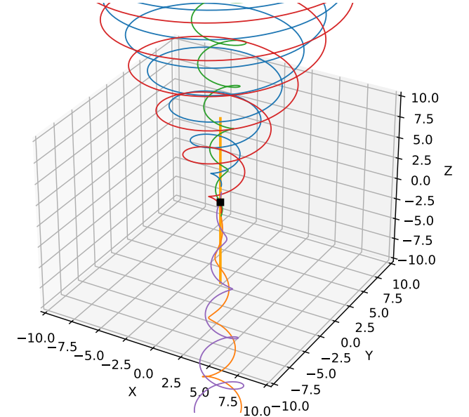
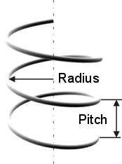
Example
3D Helical Data
Images: https://www.to-calculate.com/geometry/evolute-helix.php, [7]
Notes:
only 5 tracks in this case
noisy hits and origin smearing (i..e they dont start perfectly fom the origin) but
azimuthal coefficiet is always 1

Slide 14
Proposed Approaches

Slide 15
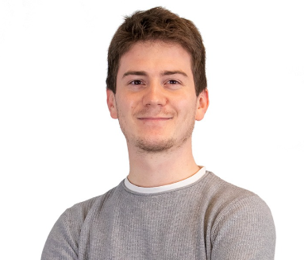
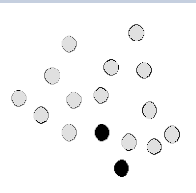
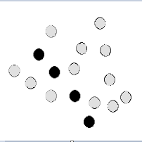
Encoder-Decoder Model
Encoder: Encodes event hits
Decoder: Predicts next hit in track. Autoregressively builds the full track, starting from a given seed
Notes:
does it take the hits of a single event?
does it take a seed per track?

Slide 16
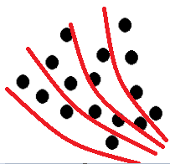
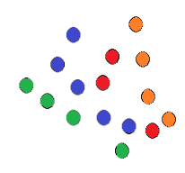
Encoder-only Classifier
Track defining parameters placed in equally sized bins (i.e. classes)
Transformer predicts the class of each hit
Notes:
A second approach is using the transformer as a classifier model, so a network which, given certain input, decides which class the input belongs to from a set of classes. The class labels are generated by splitting the track parameter space into chunks, so essentially we create equally sized “bins” or “roads” of the track parameters and whenever a hit falls within a certain bin, it is given that label. for the 3d helical data that i showed earlier, for example., the 2 track parameters are pitch coefficient and radial coefficient, each of which we divide into 20 bins, so there is a total of 400 bins. However, some combinations of pitch coeff and radial coeff do not occur in the data, which is why there are only actually 209 classes. So we split the parameter space into 209 parts and essentially the model takes in the hits from a single event and distributes each of them between the 209 classes based on where in the parameter space they fall in. at this resolution, for the 10 to 50 track data, for all events in the dataset, there are no classes that contain more than 1 track - all tracks are uniquely identified

Slide 17
Encoder-only Regressor
Used for regressing track-defining parameters
Clustering hits based on regressed parameters
Notes:
ASK SASCHA: are track parameters a known thing? how do i explain them in general?

Slide 18
Preliminary Results

Slide 19
Performance Evaluation
TrackML score
A reconstructed track is scored as “correct” if more than 50% of its hits originate from the same truth particle [9]
Used for all state-of-the-art models
Reported results on 3D helical noisy data with 10 - 50 tracks per event
[9] Kiehn, Moritz, et al. "The TrackML high-energy physics tracking challenge on Kaggle." EPJ Web of Conferences. Vol. 214. EDP Sciences, 2019.
Notes:
we dont need penalty for incorrectly assigning hits to tracks, since a wrongly associated hit will automatically reduce the score for the track it should hvae been associated with

Slide 20
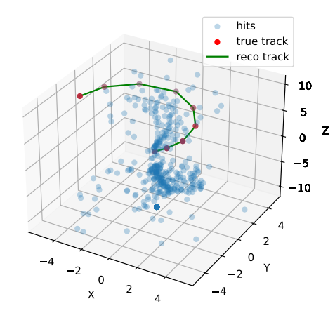
Encoder-Decoder Model: 85%
Example event
Green: the reconstructed track
Red: the hits from the true track

Slide 21
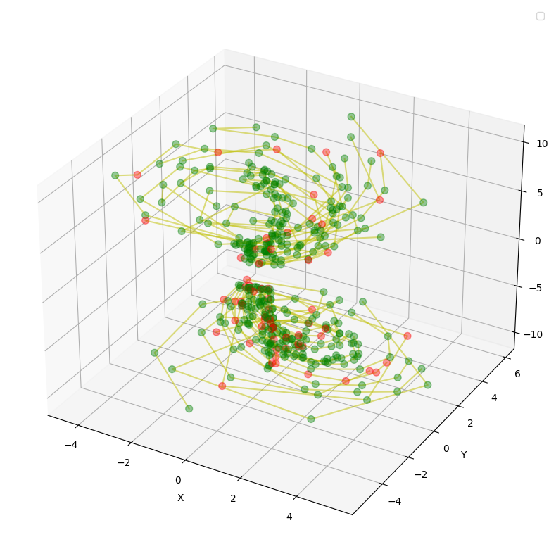
Encoder-only Classifier: 98%
Example event
Green: correctly classified hits
Red: incorrectly classified hits
Notes:
The classifier is trained for 30 epochs. It has a very high trackML score of 98% and also additionally, accuracy of 88% (so the percentage of hits that are correctly classified). This is a plot of 1 example event; the lines
o Green: correctly predicted hits
o Red: wrongly predicted hits
o Lines connect hits that belong to the same track

Slide 22
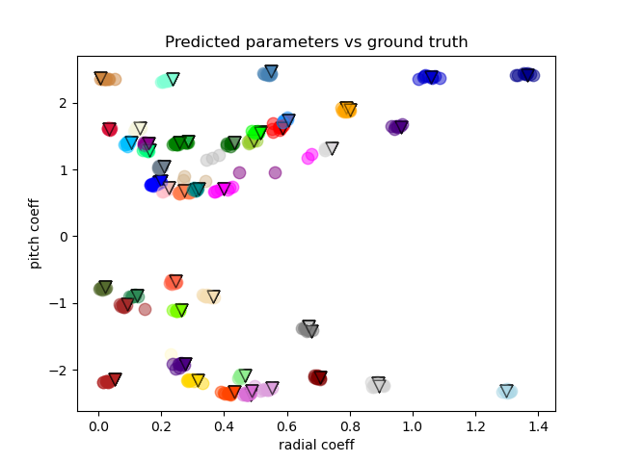
Encoder-only Regressor: 87%
Example event
Circles: regressed track parameters
Triangles: actual track parameters

Slide 23
Conclusion

Slide 24
Questions?
Thank you.

