Slide 1
Top of the ALPs
Direct probes of the axion coupling to tops
Anh Vu Phan (Vu), Susanne Westhoff
NNV meeting, Lunteren, 03 Nov 2023

Slide 2
Dark matter
MotivationS
Standard Model
Dark matter
Notes:
There are a lot of evidences for DM.
Fail to find it

Slide 3
Dark matter
More on portals to dark sector:
Batell, Pospelov, and Ritz (2009)
Batell, Blinov, Hearty, and McGehee (2022)
MotivationS
Have no SM charge
Standard Model
Portal particles
Dark matter
Vector portal
Neutrino portal
Higgs portal
Axion portal
our focus
Notes:
Expand search strategy: find the mediator between SM and DM instead.
Portal: a class of mediator without SM charge.

Slide 4
Strong CP problem $→$ axion
MotivationS
$ℒ_{θ}=−θ_{QCD}\frac{α_{s}}{8π}G^{A,μν}{\tilde{G}}_{μν}^{A}$ is allowed $⇒$ must include
neutron electric dipole moment $d_{n}=5.2×{10}^{−16}e⋅cm \overline{θ}$
Abel et al. (2020) $⇒\left|d_{n}\right|<1.8×{10}^{−26}e⋅cm⇒\left|\overline{θ}\right|<3.5×{10}^{−11}$
$$\overline{θ}=θ_{QCD}−\arg{\det\left(Y_{d}Y_{u}\right)}$$
Strong CP problem: why $\overline{θ}$ so small?
Notes:
So, what is an axion? I need to explain the strong CP problem
Why called CP? This term breaks CP, CP is broken in the SM -> it is allowed.
Why is it so small? Or better yet, why theta_QCD so close to Yukawa angle?

Slide 5
Strong CP problem $→$ axion
Peccei and Quinn (1977)
MotivationS
$$V_{eff}\left[a\right]$$
Solution: make $θ$ dynamical
$$ℒ_{θ}=−θ_{QCD}\frac{α_{s}}{8π}G^{A,μν}{\tilde{G}}_{μν}^{A}$$
$$−\left[\frac{a}{f_{a}}+θ_{QCD}\right]\frac{α_{s}}{8π}G^{A,μν}{\tilde{G}}_{μν}^{A}$$
$$a$$
$$\frac{a}{f_{a}}+\overline{θ}=0$$
$⇒a$ naturally relaxes to $d_{n}∝\frac{a}{f_{a}}+\overline{θ}=0$
axion
(pseudoscalar)

Slide 6
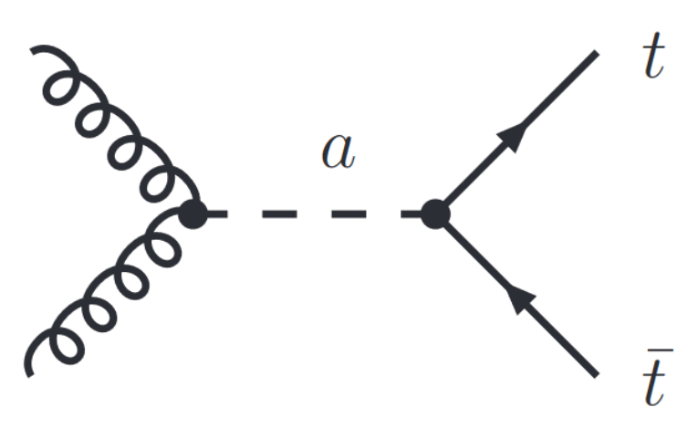
Axion-like particle (ALP)
Georgi, Kaplan, and Randall (1986)
model
Energy
Generalization of the axion (a pseudo-scalar)
$$ℒ_{eff}\left(μ\right)⊃\frac{1}{2}∂_{μ}a ∂^{μ}a−\frac{m_{a}^{2}}{2}a^{2}−\sum_{q}{m_{q}c_{qq}\frac{a}{f_{a}}\overline{q}iγ^{5}q}+{\tilde{c}}_{GG}\frac{a}{f_{a}}\frac{α_{s}}{4π}G_{μν}^{A}{\tilde{G}}^{A,μν}$$
New physics
$$Λ=4πf_{a}$$
$$μ$$
top is most sensitive to ALP!
Goal: study ALP effects on top observables
EW
Notes:
Pseudo-Goldstone bosons (or pseudoscalar)
Interaction respect shift symmetry
Here is the simplified Lagrangian (where I have hidden the non-important stuff)
There are 2 interactions of relevance: alp-quark and alp gluon
Alp-quark coupling is proportional to quark mass, top is most massive -> TOP
Note:
“i \bar{psi} \gamma^5 psi” is CPT even.

Slide 7
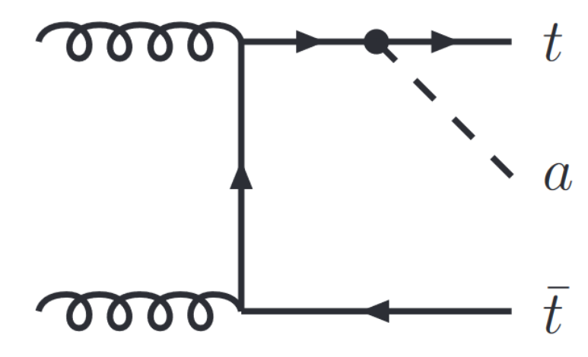
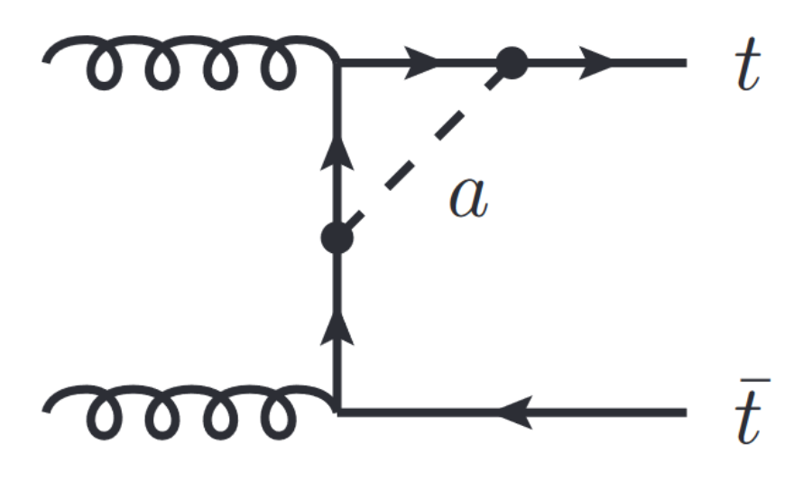
Axion-like particle (ALP)
model
Leading contributions
Tree-level
Real ALP radiation
Virtual corrections
Notes:
We look at processes where tops are produced onshell, specifically ttbar production because they are precisely predicted and measured -> direct probe to alp-top coupling

Slide 8
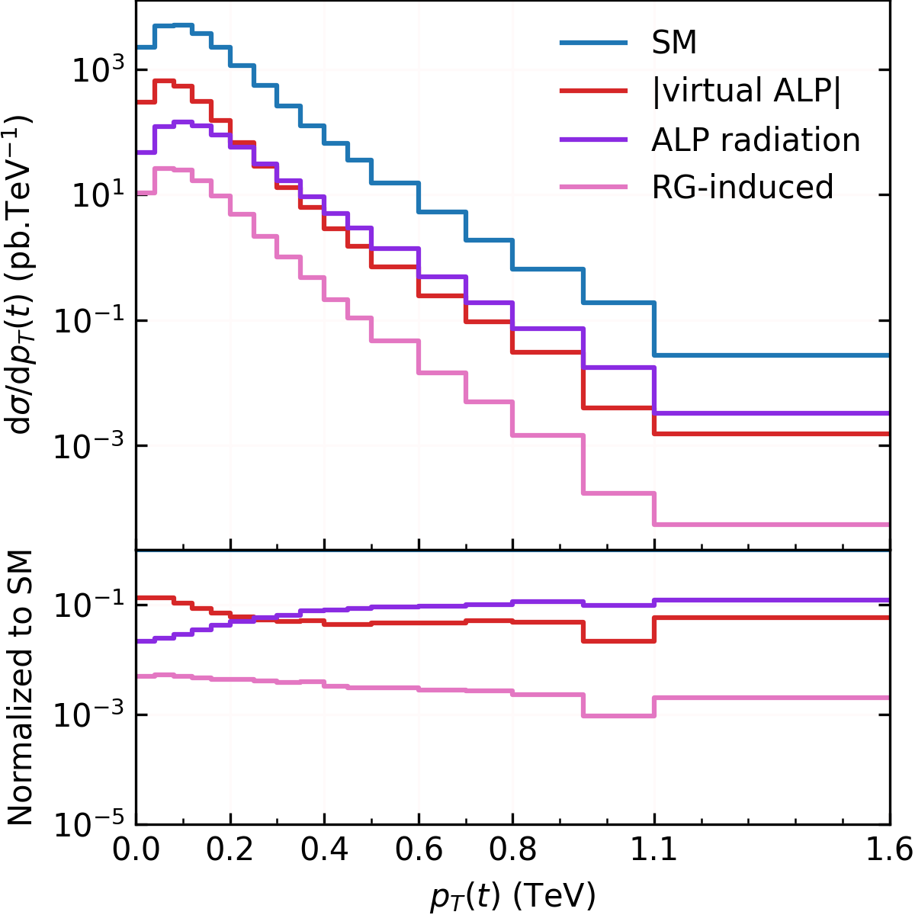
results
INDIVIDUal contributionS
SM: PRD 104 (2021) 092013
Virtual ALP contribution is negative
Preliminary
$$\frac{c_{tt}\left(Λ\right)}{f_{a}}=20 TeV^{−1} ;{\tilde{c}}_{GG}\left(Λ\right)=0 ;m_{a}=10 GeV$$
New Physics scale $Λ=4πf_{a}$
Notes:
virtual ALP contribution is negative.
Virtual ALP dominates low rapidity/pT regime. Also total xsection
Alp radiation favors high pT regime
RG induced effect != 0 because of RG.
RG is small because gluon-alp coupling is turned off at high scale.

Slide 9
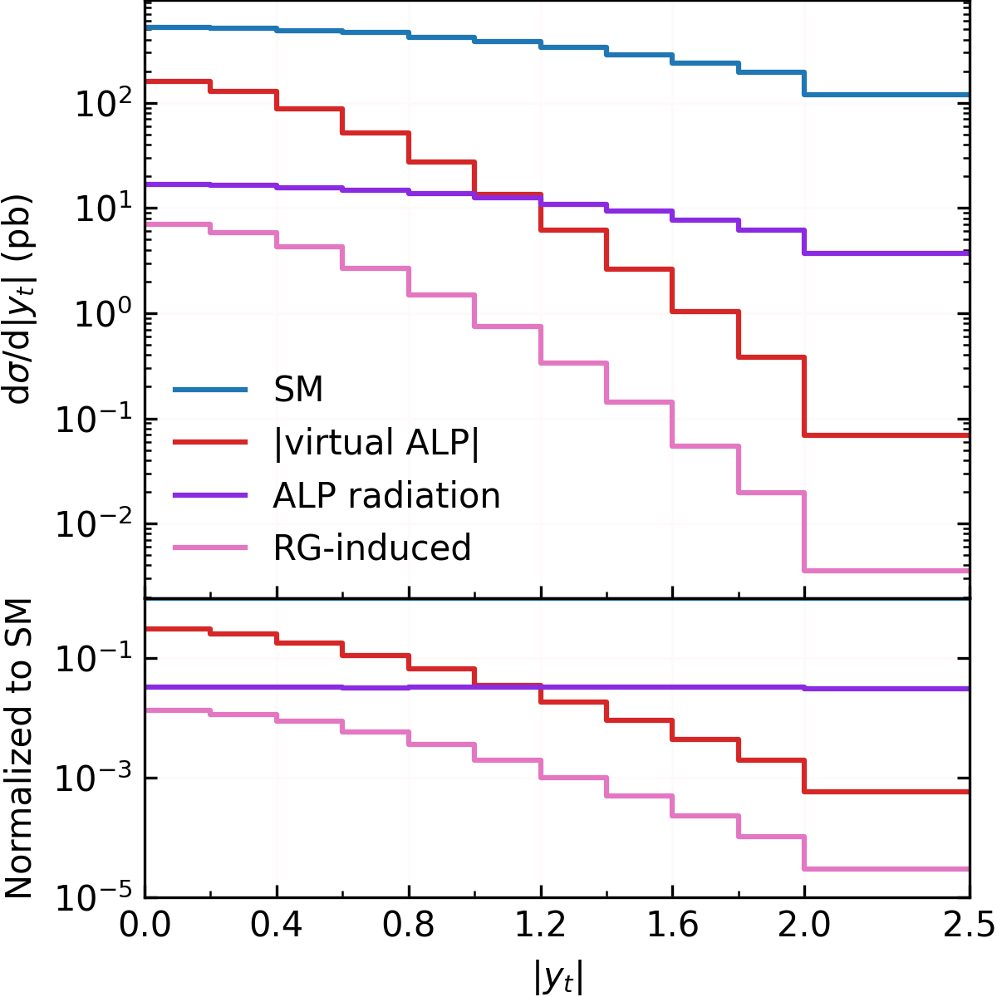
results
INDIVIDUal contributionS
SM: PRD 104 (2021) 092013
Virtual ALP contribution is negative
Preliminary
$$\frac{c_{tt}\left(Λ\right)}{f_{a}}=20 TeV^{−1} ;{\tilde{c}}_{GG}\left(Λ\right)=0 ;m_{a}=10 GeV$$
New Physics scale $Λ=4πf_{a}$
Notes:
virtual ALP contribution is negative.
Virtual ALP dominates low rapidity/pT regime. Also total xsection
Alp radiation favors forward direction
RG induced effect != 0 because of RG.

Slide 10
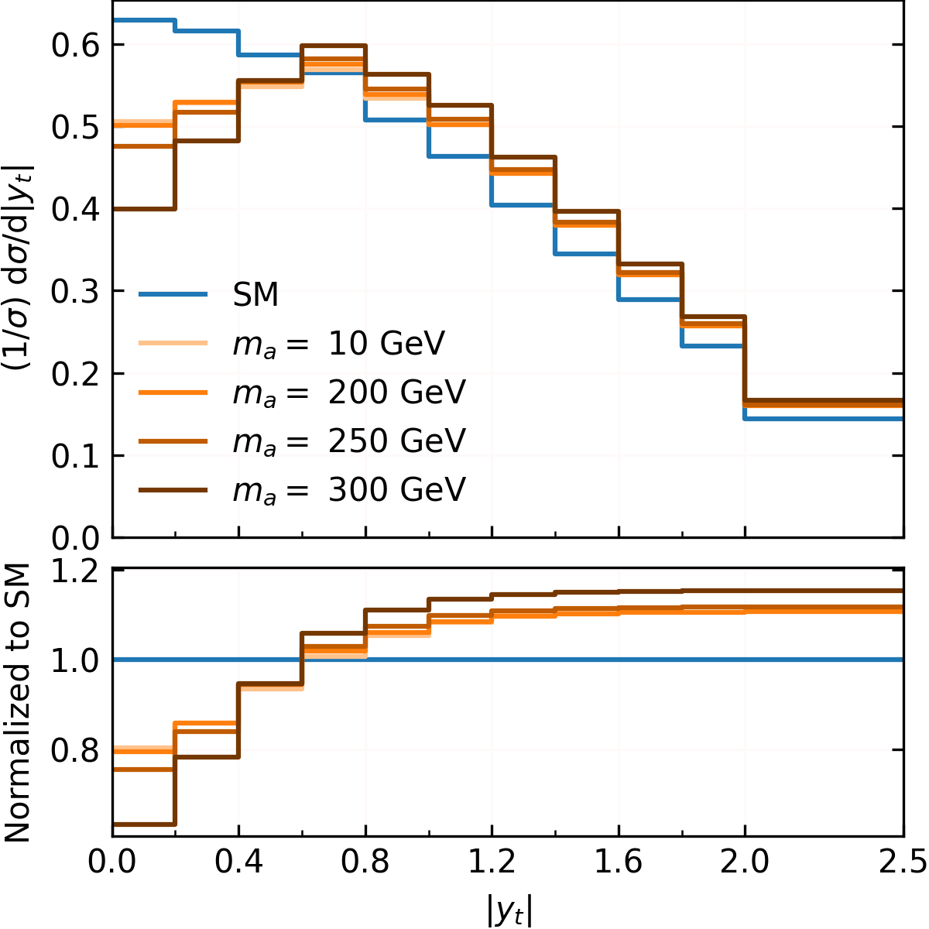
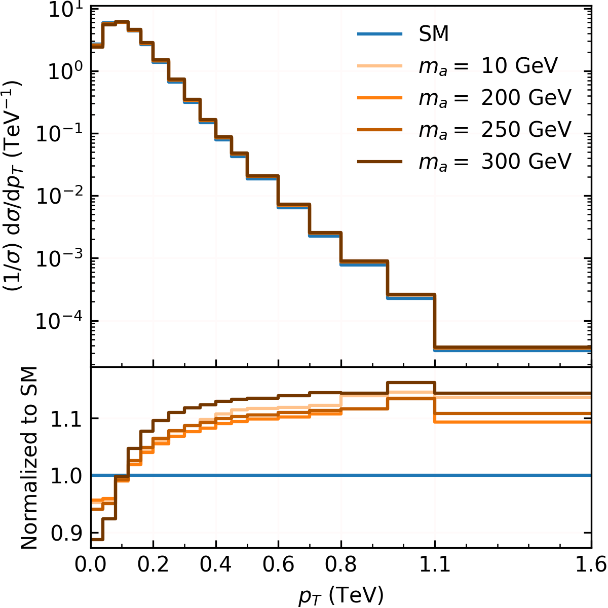
$$\frac{c_{tt}\left(Λ\right)}{f_{a}}=20 TeV^{−1} ;{\tilde{c}}_{GG}\left(Λ\right)=0$$
results
ALP MASS dependence
Preliminary
Preliminary
Notes:
Note: The difference between 10 and 200 GeV may be too small to see
The effect is mass independence below ~ 200 GeV.
The effect grows as we approach 2*mt due to near resonance production

Slide 11
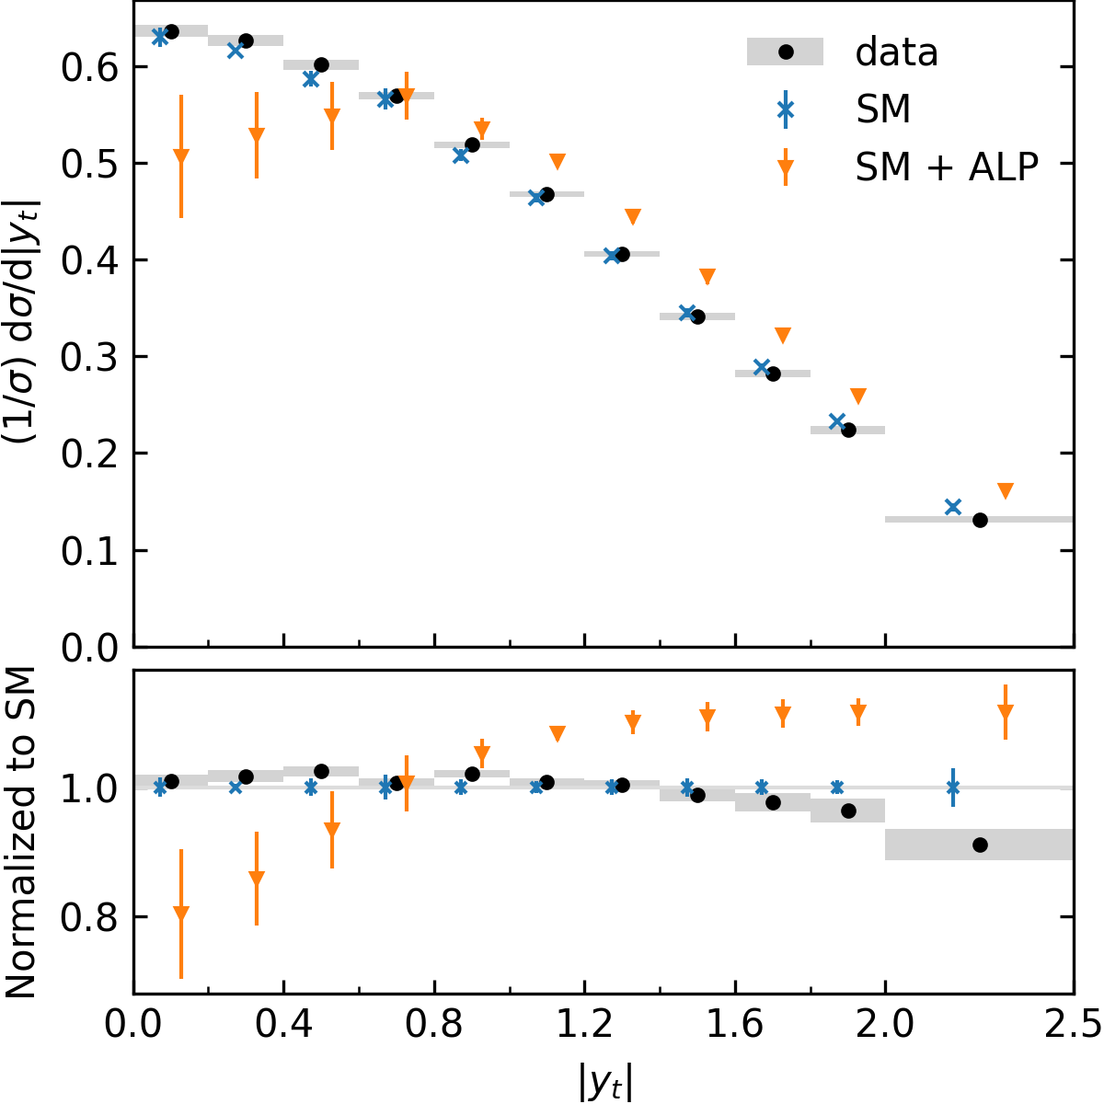
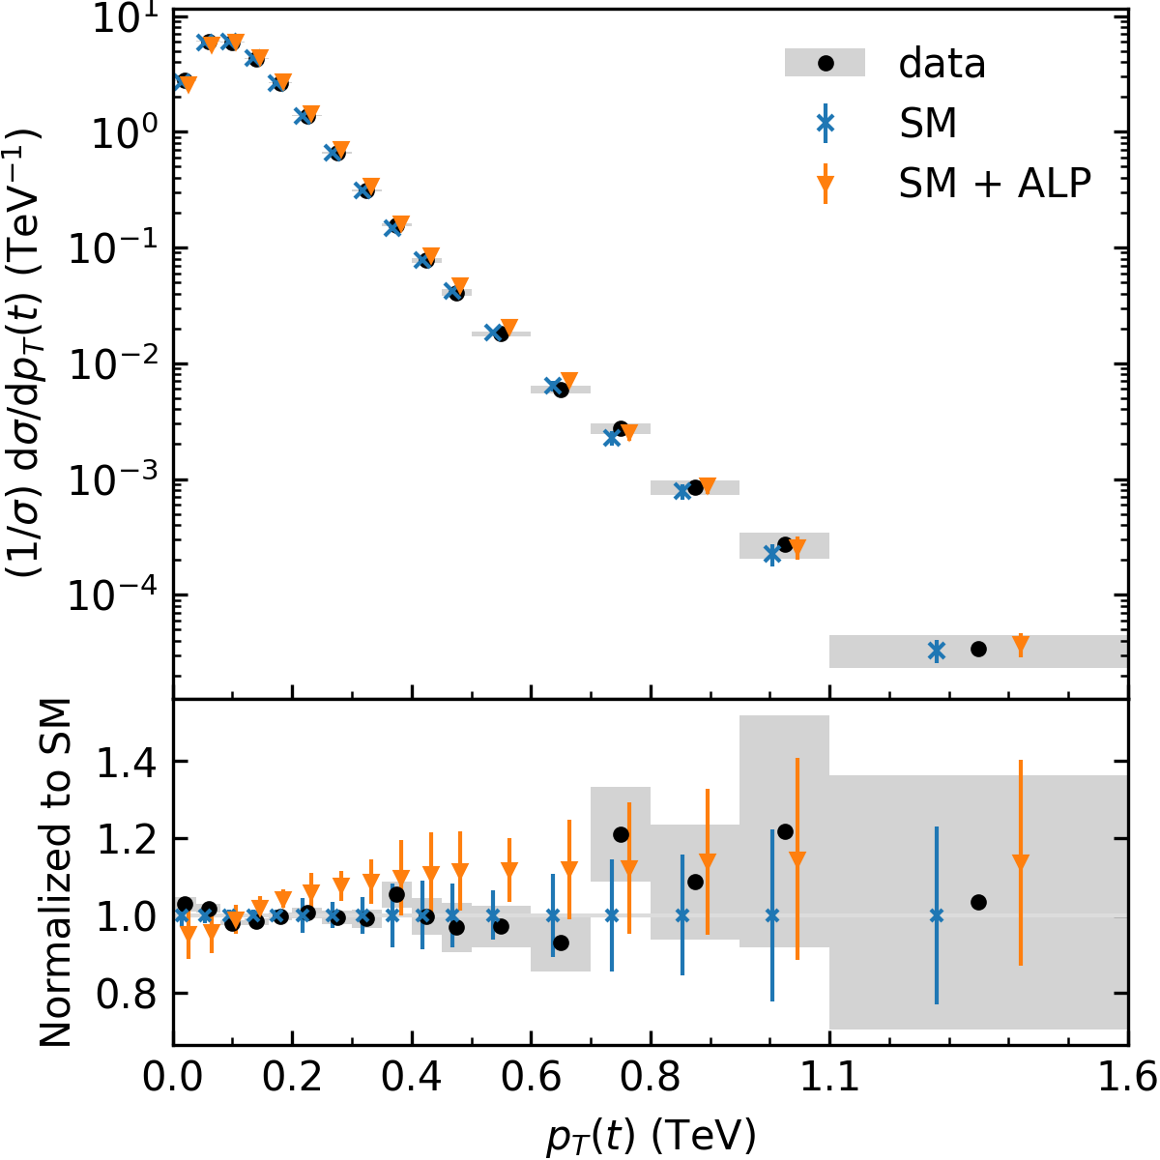
Data: PRD 104 (2021) 092013
$$\frac{c_{tt}\left(Λ\right)}{f_{a}}=20 TeV^{−1} ;{\tilde{c}}_{GG}\left(Λ\right)=0 ;m_{a}=10 GeV$$
ALP uncertainty: 30%
Preliminary
Preliminary
Notes:
Data: CMS (LHC run 2) data
Changes the shape of distributions
Rapidity has lowest uncertainties -> Most sensitive
If we try to fit the distributions to data, to obtain a 95% C.L. region for ctt allowed by experiment

Slide 12
Bounds on $c_{tt}$
results
$${\tilde{c}}_{GG}\left(Λ\right)=0$$
Shaded = excluded at 95% C.L.
Ref:
Bauer et al. (2021),
PDG (2023),
CMS-BPH-21-006,
DESY-14-026
Preliminary
Notes:
EXPLAIN h->aa and Bs -> mu mu
We fit the distributions we have with CMS data to obtain allowed range for ctt. Report best bound by best distribution
The region m_a > m_h/2 is relatively unexplored.
The blue shaded region is excluded at 95% C.L.

Slide 13
Bounds on $c_{tt}$ and $c_{GG}$
results
Preliminary
$$m_{a}=10 GeV$$
Notes:
If ctt and cgg have same sign -> enhance the effect
If ctt and cgg have opposite sign -> cancel out -> worse bound
I stops at 10 to ensure perturbativity (prevents the couplings from getting too large), since ALP-top coupling is roughly ctt*mt/fa = 1 for ctt/fa = 10/TeV.

Slide 14
Conclusions
Among the SM fermions, top is most sensitive to ALPs.
We constrain ALP-top coupling using top kinematic distributions.
From a fit to LHC data Run II, we obtain $\left|\frac{c_{tt}}{f_{a}}\right|≤6.4 TeV^{−1}$ for $m_{a}≲200$ GeV and ${\tilde{c}}_{GG}=0$. This bound gets stricter as $m_{a}$ approaches $2m_{t}$.
ALP-gluon coupling can either enhance or suppress the ALP’s effects, depending on its sign.
Thank you for listening!
Notes:
Potential questions:
Why ALP contribution < 0?
Why is there divergence below resonance? Is it caused by inverse propagator?
For simplicity, I mixed up the results for different bases.

Slide 15
Backup slides

Slide 16
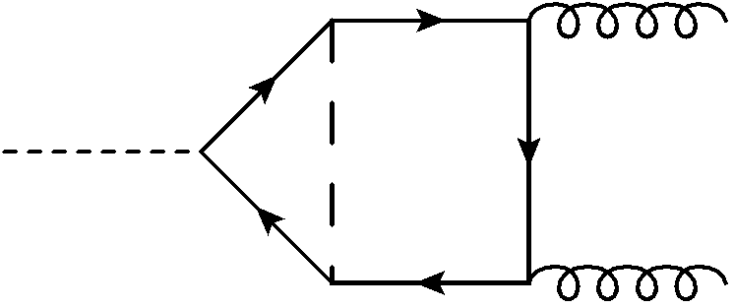
INDUCED alp-GLUON COUPLING
Bauer, Neubert, Renner, Schnubel, and Thamm (2021)
ALPs in $t\overline{t}$ production
$$t$$
$$⇒ \frac{d c_{tt}}{d\ln{μ}}=\frac{9y_{t}^{2}}{16π^{2}}c_{tt}$$
$$a$$
$$h$$
, etc.
$⇒$ need counterterm
$$δc_{tt}$$
$$\overline{t}$$
$$⇒ \frac{d {\tilde{c}}_{GG}}{d\ln{μ}}=\frac{y_{t}^{2}}{8π^{2}}c_{tt}$$
$$a$$
$$h$$
, etc.
$⇒$ need counterterm
$$δ{\tilde{c}}_{GG}$$
UV-divergent
$$⇒$$
${\tilde{c}}_{GG}$ and $c_{tt}$ are scale-dependent.

Slide 17
INDUCED alp-GLUON COUPLING
ALPs in $t\overline{t}$ production
Energy
New physics
E.g., $\left.\begin{aligned}{\tilde{c}}_{GG}\left(Λ\right)=0 \\ c_{tt}\left(Λ\right)=1\end{aligned}\right\}$
$$Λ=4πf_{a}$$
$$\left.\begin{aligned}{\tilde{c}}_{GG}\left(m_{t}\right)=−0.04 \\ c_{tt}\left(m_{t}\right)=0.81\end{aligned}\right\}$$
$$m_{t}$$
Contributes due to the running of ${\tilde{c}}_{GG}$
EW

Slide 18
Real alp radiation
ALPs in $t\overline{t}$ production
We consider top observables are inclusive with respect to the ALP $⇒$ We also need these diagrams

Slide 19
Virtual corrections
ALPs in $t\overline{t}$ production
UV-finite
UV-divergent
$$⇓$$
Need renormalization
Only SM counterterms
SMEFT counterterms
(if we have time)

Slide 20
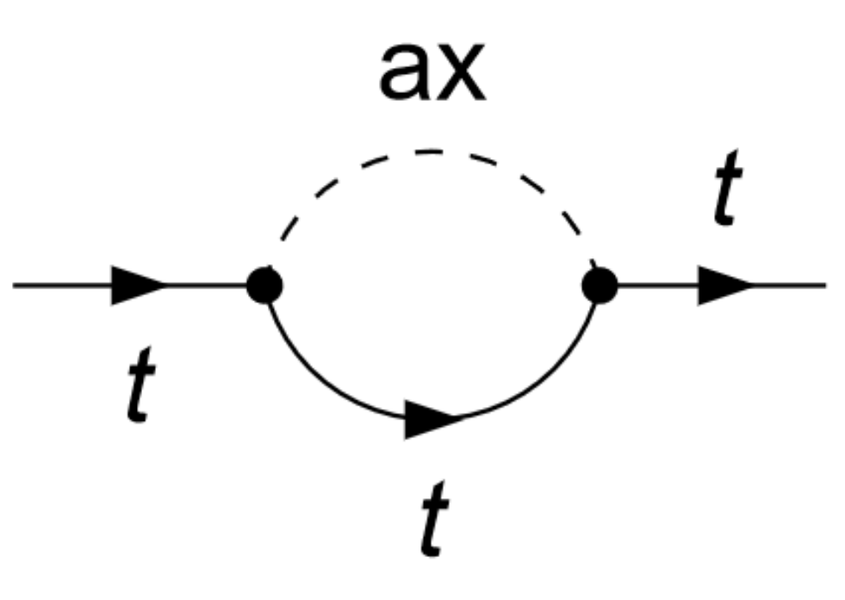
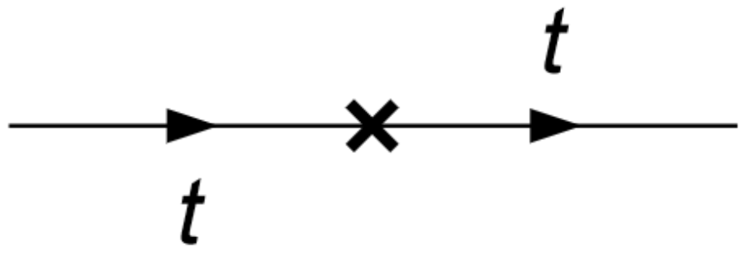
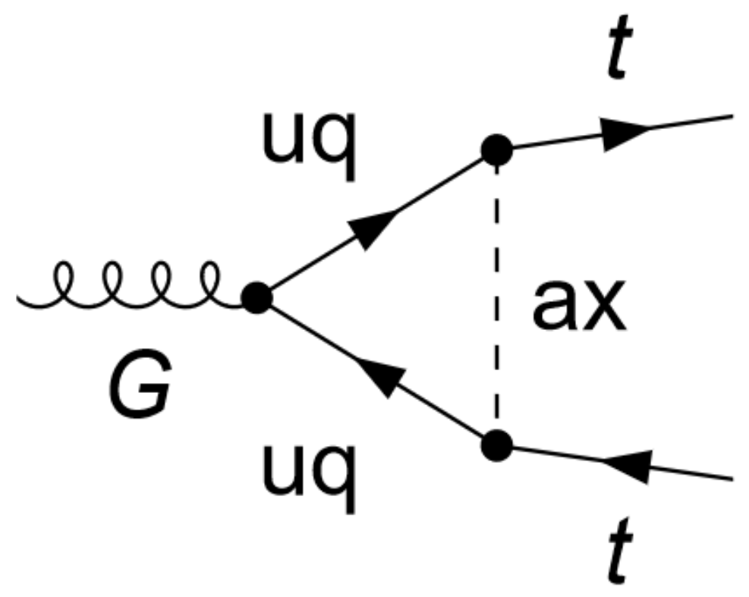
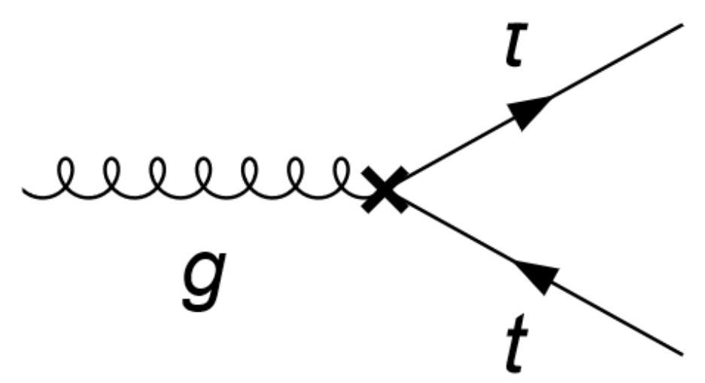
Virtual corrections
ALPs in $t\overline{t}$ production
Renormalization – only SM counterterms
$$ℒ_{eff}\left(μ\right)⊃Z_{2}\overline{t}i∂_{μ}γ^{μ}t−Z_{2}Z_{m}m_{t}\overline{t}t+Z_{1}g_{s}G_{μ}^{a}\overline{t}γ^{μ}T^{a}t$$
$$i\left[p^{μ}γ_{μ}δ_{2}−\left(δ_{m}+δ_{2}\right)m_{t}\right]$$
$$ig_{s}T_{ij}^{a}γ^{μ}δ_{1}$$
UV-divergent
counterterms

Slide 21
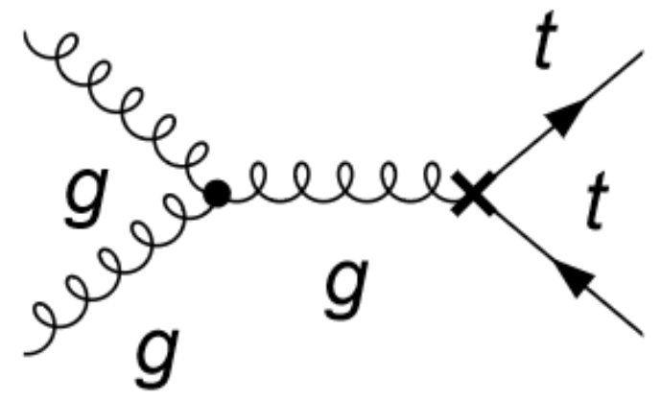
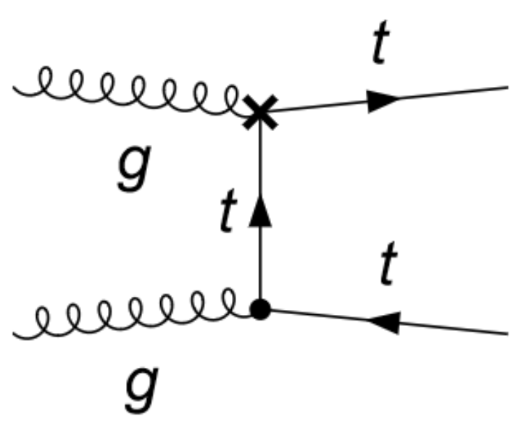
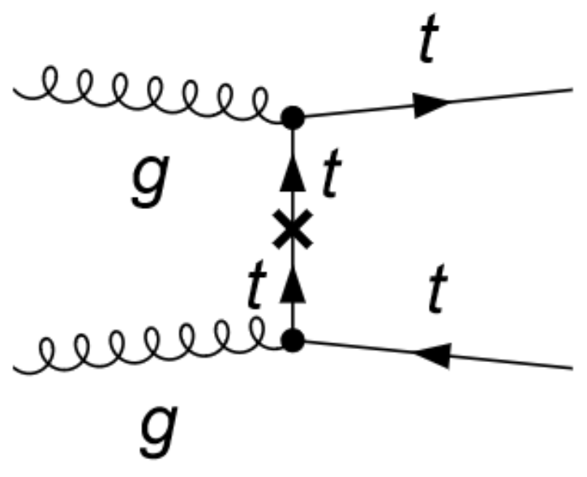
Virtual corrections
ALPs in $t\overline{t}$ production
Renormalization – only SM counterterms
$$ℒ_{eff}\left(μ\right)⊃Z_{2}\overline{t}i∂_{μ}γ^{μ}t−Z_{2}Z_{m}m_{t}\overline{t}t+Z_{1}g_{s}G_{μ}^{a}\overline{t}γ^{μ}T^{a}t$$
$$δ_{1}$$
$$i\left[p^{μ}γ_{μ}δ_{2}−\left(δ_{m}+δ_{2}\right)m_{t}\right]$$
$$δ_{1}$$
$$ig_{s}T_{ij}^{a}γ^{μ}δ_{1}$$
$$δ_{2},δ_{m}$$
UV-divergent
counterterms
UV-finite
UV-finite

Slide 22
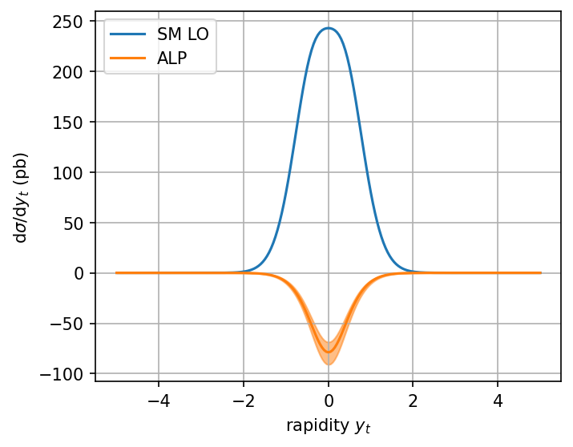
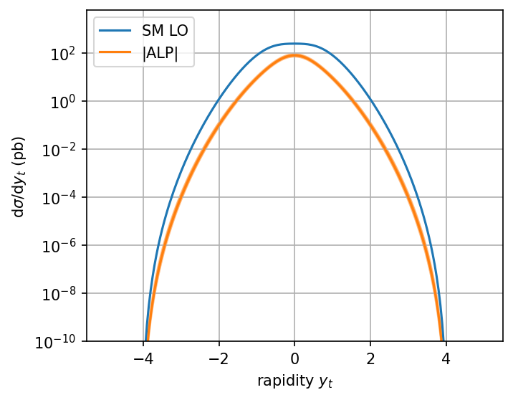
TOP Kinematic distributions
Reminder: $c_{tt}\frac{m_{t}}{f_{a}}$ is the ALP-top coupling
results
$$\frac{c_{tt}\left(Λ\right)}{f_{a}}=20 TeV^{−1}$$

Slide 23
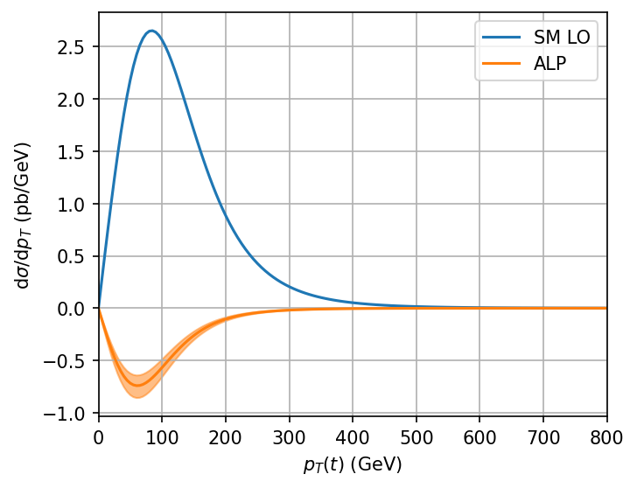
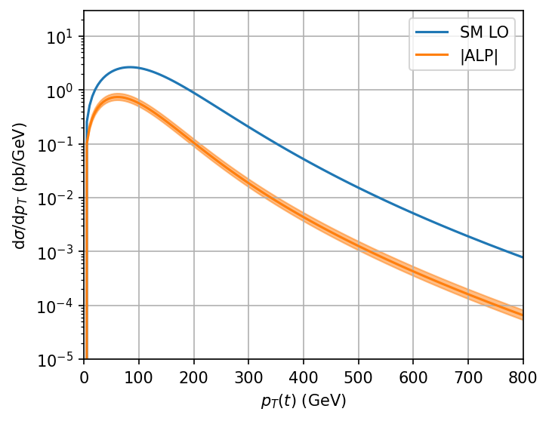
TOP Kinematic distributions
Reminder: $c_{tt}\frac{m_{t}}{f_{a}}$ is the ALP-top coupling
results
$$\frac{c_{tt}\left(Λ\right)}{f_{a}}=20 TeV^{−1}$$

Slide 24
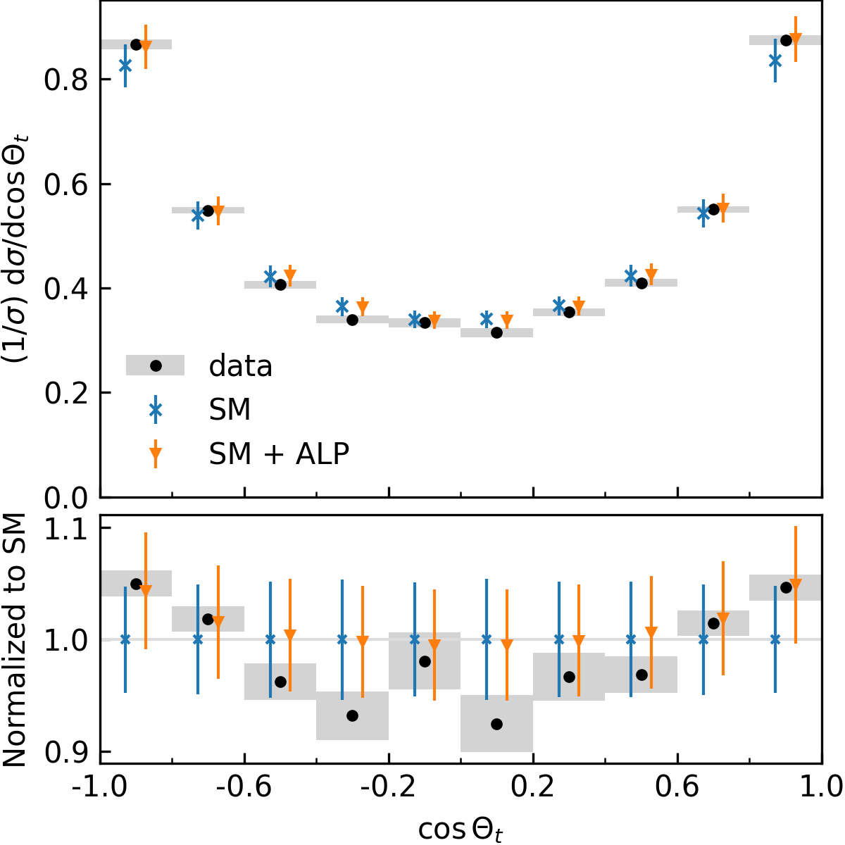
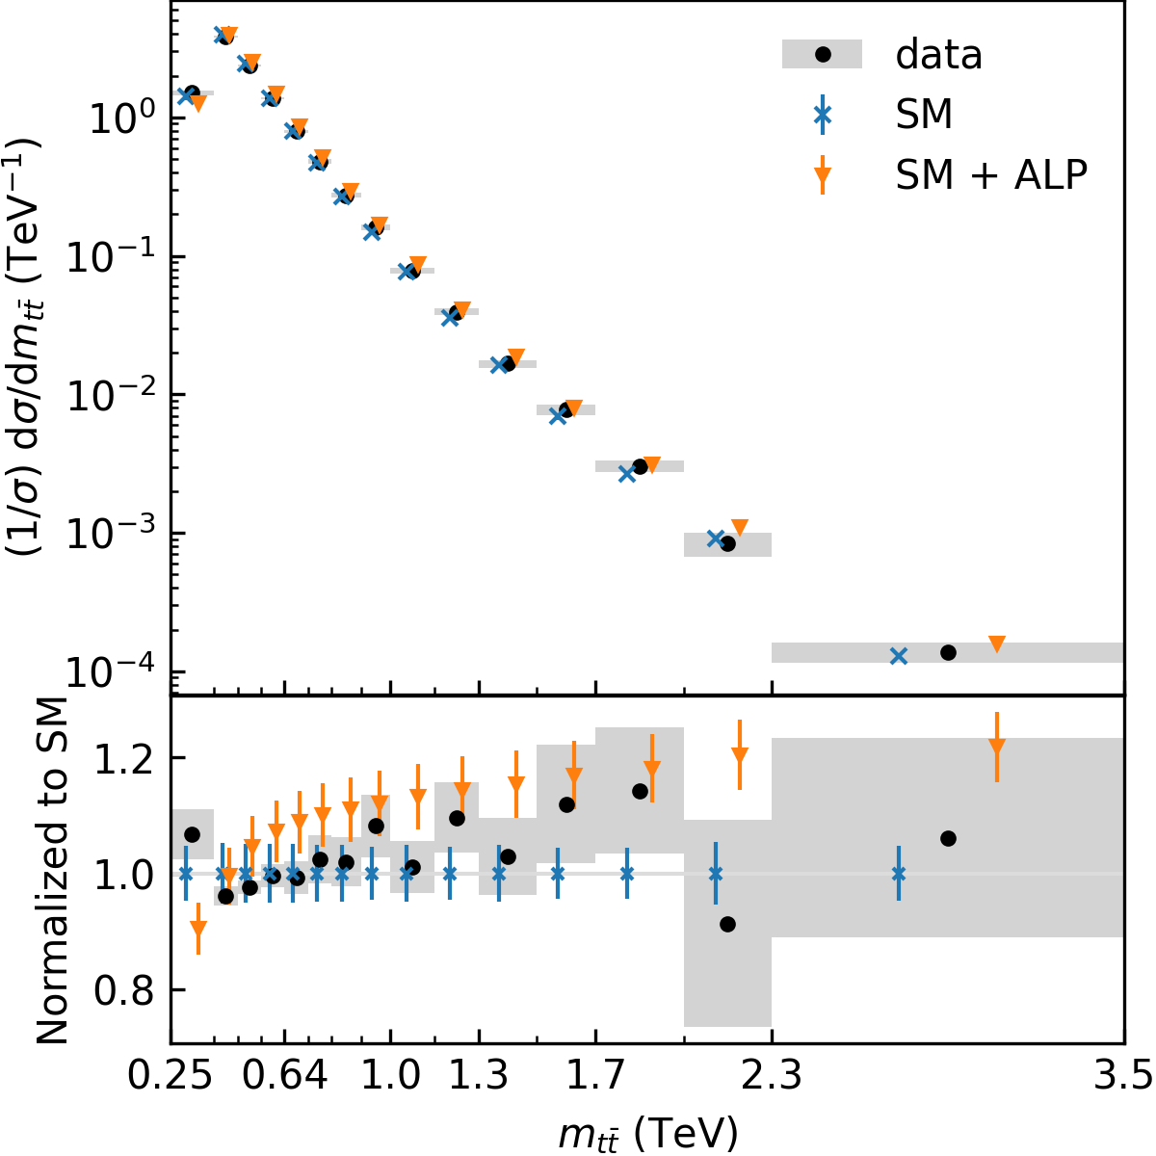
Kinematic distributions
results
$$\frac{c_{tt}\left(Λ\right)}{f_{a}}=20 TeV^{−1}$$
Data: CMS-TOP-20-001
Theoretical uncertainty: 5%

Slide 25
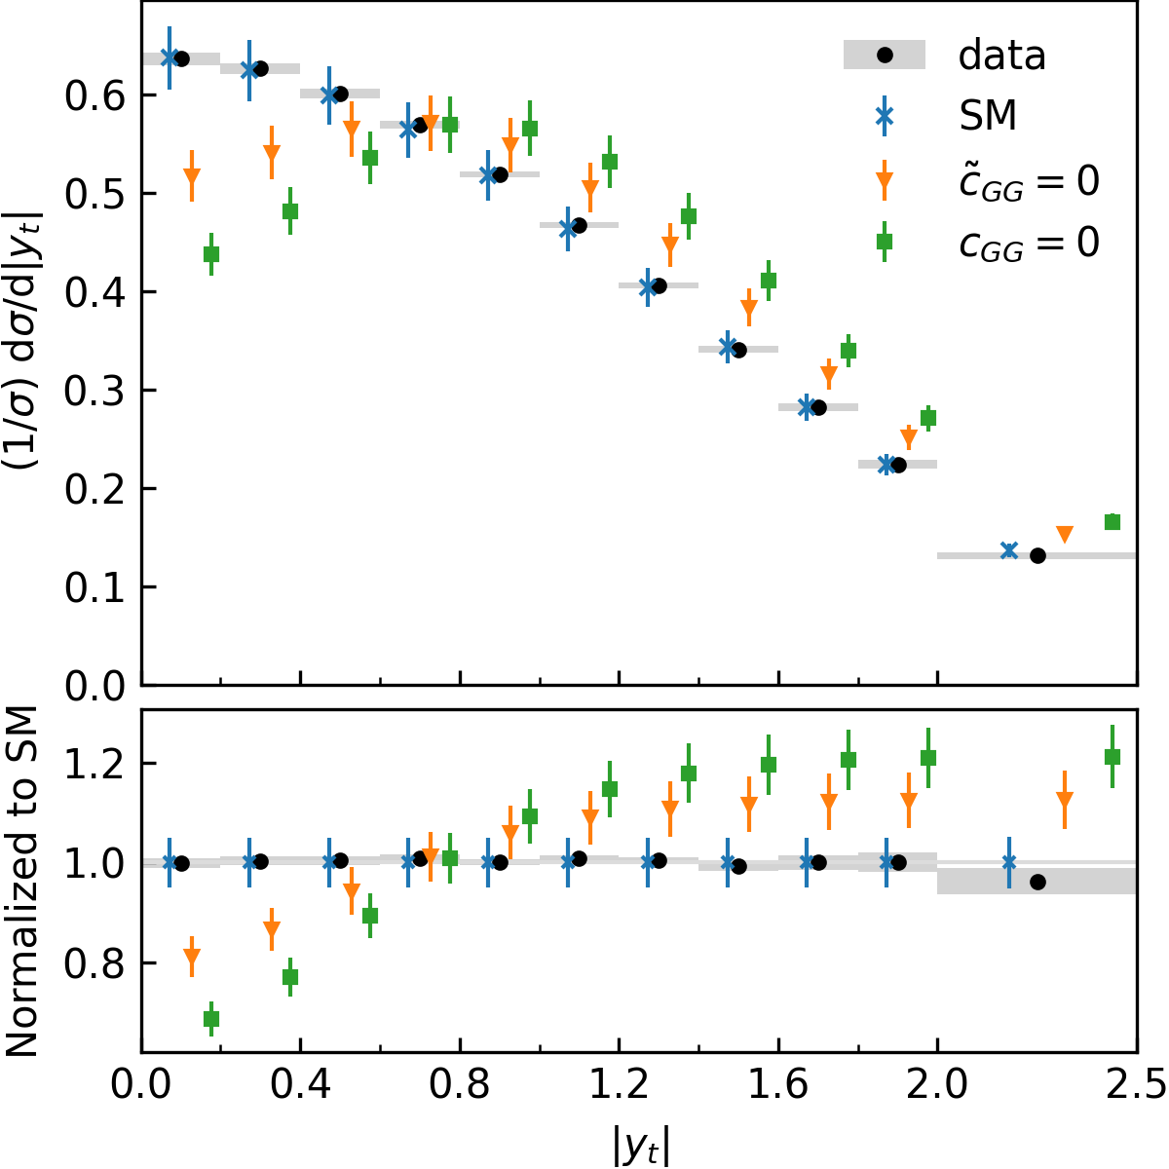
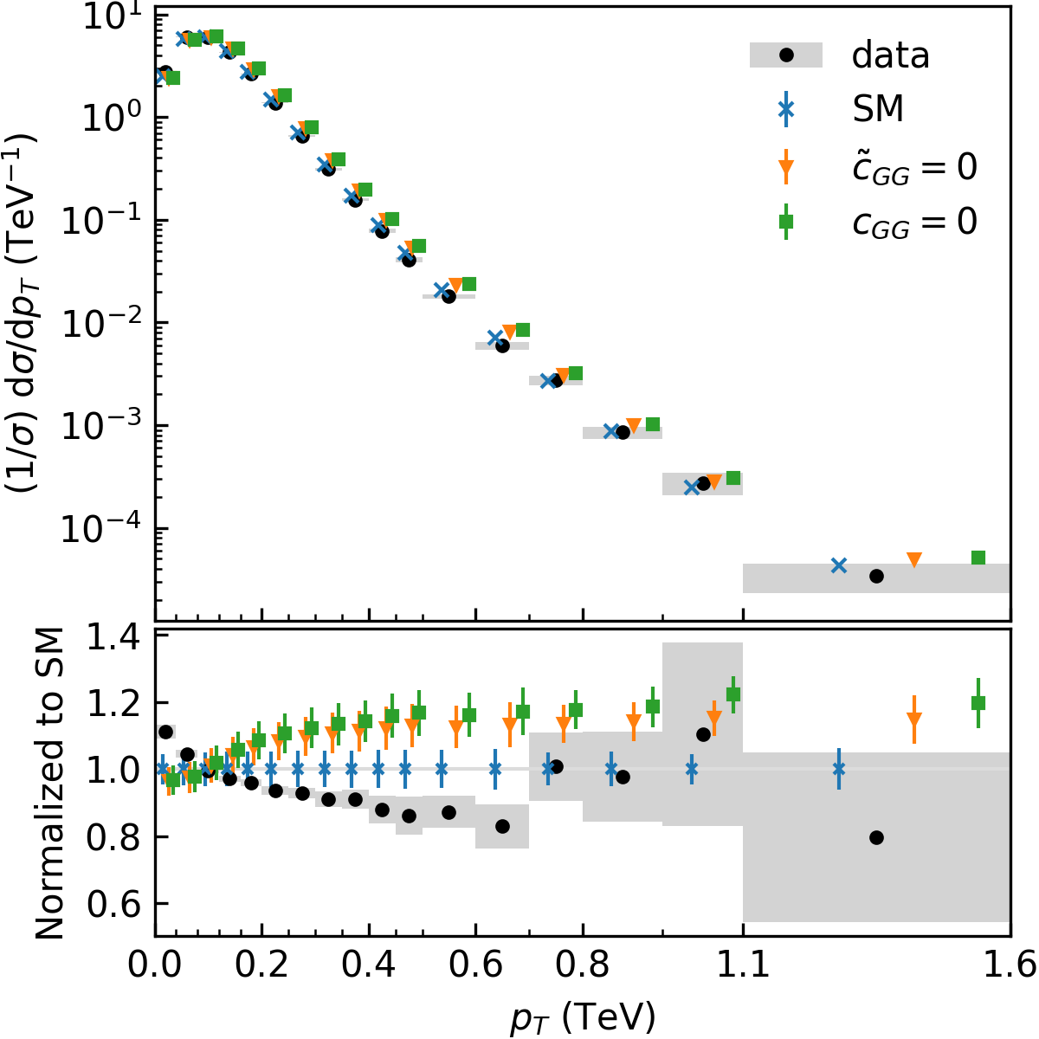
ALP-gluon: $c_{GG}=0$ vs ${\tilde{c}}_{GG}=0$
$$\frac{c_{tt}\left(Λ\right)}{f_{a}}=20 TeV^{−1}$$
results
Data: CMS-TOP-20-001
Theoretical uncertainty: 5%

Slide 26
Effective coupling approximation
discussions
Only consider RG-induced tree level diagram

Slide 27
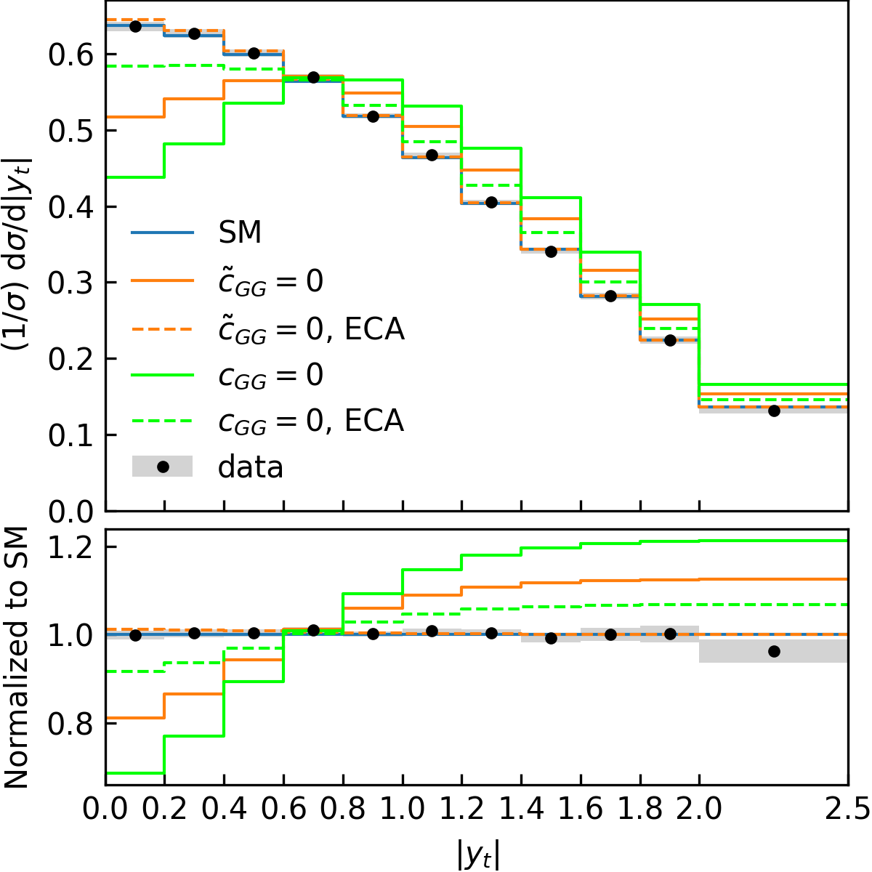
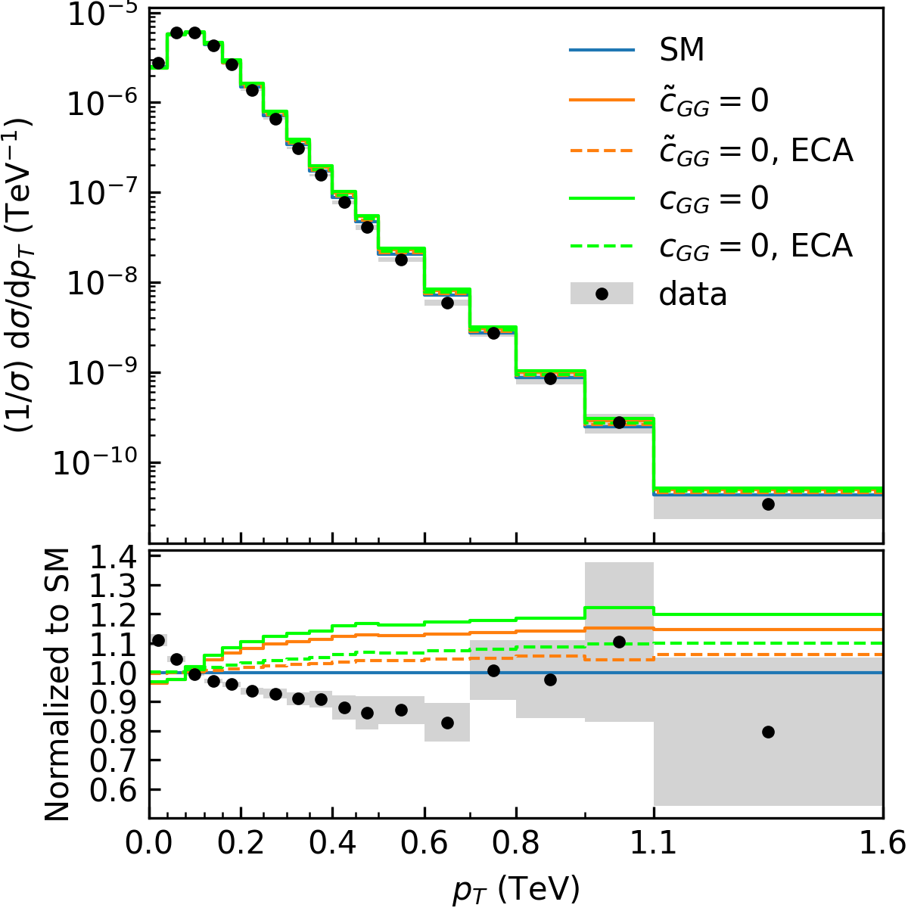
Kinematic distributions
results
$$\frac{c_{tt}\left(Λ\right)}{f_{a}}=20 TeV^{−1}$$
Data: CMS-TOP-20-001
Theoretical uncertainty: 5%

Slide 28
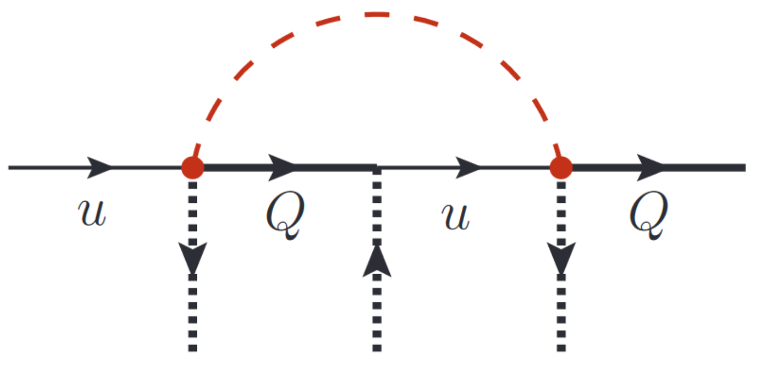
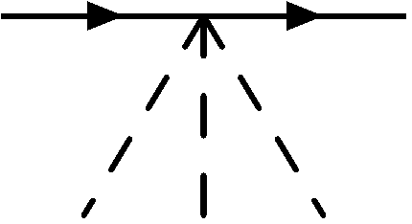
Renormalization revisited
discussions
$$a$$
UV-diverges
$⇒$ need SMEFT counterterms
For example, from$H^{†}H\left(\overline{Q}Hu\right)+h.c.$
$$h$$
$$h$$
$$h$$
In the SM, no counterterm of the form $HHHQu$

Slide 29
Renormalization revisited
discussions
$$a$$
UV-diverges
$⇒$ need SMEFT counterterms
For example, from$H^{†}H\left(\overline{Q}Hu\right)+h.c.$
$$h$$
$$h$$
$$h$$
In the SM, no counterterm of the form $HHHQu$
$$a$$
But,
$$⊃$$
$$⇒$$
is renormalized by
$$\left\langle H\right\rangle$$
$$\left\langle H\right\rangle$$
$$\left\langle H\right\rangle$$
$$⇒$$
is not needed
$$\left\langle H\right\rangle$$
$$\left\langle H\right\rangle$$
$$\left\langle H\right\rangle$$
$$δ_{m}$$

Slide 30
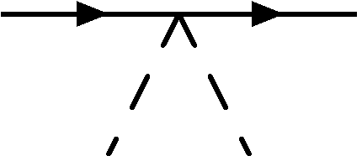
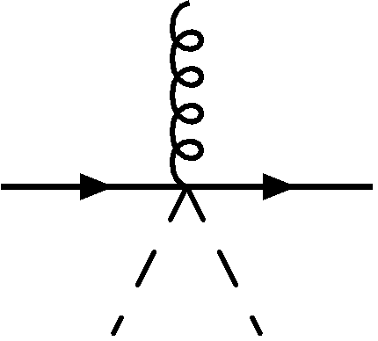
Renormalization revisited
discussions
The complete story
Dim-6 operators
“$m_{t}$”
$$H^{†}H\left(\overline{Q}Hu\right)+h.c.$$
$$p$$
$$\left\langle H\right\rangle$$
$$\left\langle H\right\rangle$$
$$\left\langle H\right\rangle$$
All divergences are cured
$$\left\langle H\right\rangle$$
$$\left\langle H\right\rangle$$
$$H^{†}H\left(\overline{Q}i\overset{⃡}{D_{μ}}γ^{μ}Q\right),$$
$$H^{†}H\left(\overline{u}i\overset{⃡}{D_{μ}}γ^{μ}u\right),$$
$$H^{†}σ^{I}H\left(\overline{Q}i\overset{⃡}{D_{μ}}γ^{μ}σ^{I}Q\right)$$
$δ_{1},δ_{2},δ_{m}$ are not needed
$$\left\langle H\right\rangle$$
$$\left\langle H\right\rangle$$
UV-divergent
Counterterms

Slide 31
Renormalization in the warsaw basis?
discussions
$$H^{†}H\left(\overline{Q}Hu\right)+h.c.,$$
$$H^{†}H\left(\overline{Q}i\overset{⃡}{D_{μ}}γ^{μ}Q\right),$$
$$H^{†}H\left(\overline{u}i\overset{⃡}{D_{μ}}γ^{μ}u\right),$$
$$H^{†}σ^{I}H\left(\overline{Q}i\overset{⃡}{D_{μ}}γ^{μ}σ^{I}Q\right)$$
Field transformation
$$H^{†}H\left(\overline{Q}Hu\right)+h.c.$$
$$Q→Q−{\tilde{C}}_{Hq}^{\left(1\right)}Q\left(H^{†}H\right)−{\tilde{C}}_{Hq}^{\left(3\right)}σ^{I}Q\left(H^{†}σ^{I}H\right)$$
$$u→u−{\tilde{C}}_{Hu}u\left(H^{†}H\right)$$
Green basis
Warsaw basis
Redundant
Simple

Slide 32
Renormalization in the warsaw basis?
discussions
$$H^{†}H\left(\overline{Q}Hu\right)+h.c.$$
$$\left\langle H\right\rangle$$
$$\left\langle H\right\rangle$$
$$\left\langle H\right\rangle$$
$$\left\langle H\right\rangle$$
$$\left\langle H\right\rangle$$
$$H^{†}H\left(\overline{Q}i\overset{⃡}{D_{μ}}γ^{μ}Q\right),$$
$$H^{†}H\left(\overline{u}i\overset{⃡}{D_{μ}}γ^{μ}u\right),$$
$$H^{†}σ^{I}H\left(\overline{Q}i\overset{⃡}{D_{μ}}γ^{μ}σ^{I}Q\right)$$
Without these operators,
how do we cancel the divergences?
$$\left\langle H\right\rangle$$
$$\left\langle H\right\rangle$$
UV-divergent
Counterterms

Slide 33
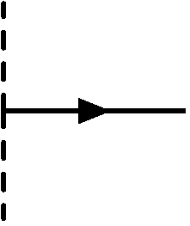
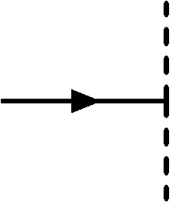
Renormalization in the warsaw basis?
Kallosh and Tyutin (1973)
discussions
$$H^{†}H\left(\overline{Q}Hu\right)+h.c.,$$
$$H^{†}H\left(\overline{Q}i\overset{⃡}{D_{μ}}γ^{μ}Q\right),$$
$$H^{†}H\left(\overline{u}i\overset{⃡}{D_{μ}}γ^{μ}u\right),$$
$$H^{†}σ^{I}H\left(\overline{Q}i\overset{⃡}{D_{μ}}γ^{μ}σ^{I}Q\right)$$
$$H^{†}H\left(\overline{Q}Hu\right)+h.c.$$
$$Q→Q−{\tilde{C}}_{Hq}^{\left(1\right)}Q\left(H^{†}H\right)−{\tilde{C}}_{Hq}^{\left(3\right)}σ^{I}Q\left(H^{†}σ^{I}H\right)$$
$$u→u−{\tilde{C}}_{Hu}u\left(H^{†}H\right)$$
Green basis
Warsaw basis
$${\left\langle \overline{u}u\right\rangle }_{G}$$
$${\left\langle \overline{u}u\right\rangle }_{W}$$
$$+$$
$${\tilde{C}}_{Hu} {\left\langle H^{†}H\overline{u}u\right\rangle }_{W}$$
$$+$$
$${\tilde{C}}_{Hu} {\left\langle \overline{u}uH^{†}H\right\rangle }_{W}$$
$$+$$
$$+$$

Slide 34
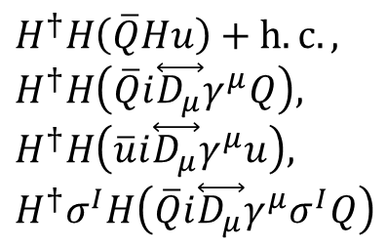
Renormalization in the warsaw basis?
Kallosh and Tyutin (1973)
discussions
$$H^{†}H\left(\overline{Q}Hu\right)+h.c.,$$
$$H^{†}H\left(\overline{Q}i\overset{⃡}{D_{μ}}γ^{μ}Q\right),$$
$$H^{†}H\left(\overline{u}i\overset{⃡}{D_{μ}}γ^{μ}u\right),$$
$$H^{†}σ^{I}H\left(\overline{Q}i\overset{⃡}{D_{μ}}γ^{μ}σ^{I}Q\right)$$
$$H^{†}H\left(\overline{Q}Hu\right)+h.c.$$
$$Q→Q−{\tilde{C}}_{Hq}^{\left(1\right)}Q\left(H^{†}H\right)−{\tilde{C}}_{Hq}^{\left(3\right)}σ^{I}Q\left(H^{†}σ^{I}H\right)$$
$$u→u−{\tilde{C}}_{Hu}u\left(H^{†}H\right)$$
Green basis
Warsaw basis
$${\left\langle \overline{u}u\right\rangle }_{G}$$
$${\left\langle \overline{u}u\right\rangle }_{W}$$
$$+$$
$${\tilde{C}}_{Hu} {\left\langle H^{†}H\overline{u}u\right\rangle }_{W}$$
$$+$$
$${\tilde{C}}_{Hu} {\left\langle \overline{u}uH^{†}H\right\rangle }_{W}$$
$$+$$
$$+$$
$$2$$
$$=$$
$$1+$$
$$×$$
$$2$$
We need $Z_{u}$, or
We need to include reducible diagrams
$$⟹Z_{u}^{Green}= ×Z_{u}^{Warsaw}$$
$$1+$$

Slide 35
Renormalization in the warsaw basis
discussions
$$ℒ_{eff}\left(μ\right)⊃Z_{2}\overline{t}i∂_{μ}γ^{μ}t−Z_{2}m_{t}\overline{t}t+Z_{2}g_{s}G_{μ}^{a}\overline{t}γ^{μ}T^{a}t+\left(C_{uH}^{(0)}H^{†}H\left(\overline{Q}Hu\right)+h.c.\right)$$
$$i\frac{v^{2}}{2\sqrt{2}}δC_{uH}$$
$$\left\langle H\right\rangle$$
$$\left\langle H\right\rangle$$
$$\left\langle H\right\rangle$$
All divergences are cured
$$i\left(p^{μ}γ_{μ}δ_{2}−δ_{2}m_{t}\right)$$
$$ig_{s}T_{ij}^{a}γ^{μ}δ_{2}$$
UV-divergent
counterterms

Slide 36
Fitting method
Backup slides
Höcker et al. (2001); Charles et al. (2017 )
RFit
Minimize the log-likelihood function
$$χ^{2}\left(c_{tt}\right)={\vec{χ}}_{d}^{T}C^{−1}{\vec{χ}}_{d}$$
For each value of $c_{tt}$
Let all ${prediction}_{i}$ vary within their theoretical uncertainty range
Find $χ_{min}^{2}\left(c_{tt}\right)$, the minimum of $χ^{2}\left(c_{tt}\right)$ w.r.t all possible values of ${prediction}_{i}$
Find $χ_{min}^{2}=\min_{c_{tt}} χ_{min}^{2}\left(c_{tt}\right)$
A value of $c_{tt}$ is excluded at 95% C.L. if $Δχ^{2}\left(c_{tt}\right)=χ_{min}^{2}\left(c_{tt}\right)−χ_{min}^{2}≥3.84$. That is, we assume $Δχ^{2}\left(c_{tt}\right)$ follows the $χ^{2}$-distribution with 1 degree of freedom
Best bound of all distributions is selected
Experimental covariance matrix
$$χ_{d,i}=\left|{data}_{i}−{prediction}_{i}\right|$$

