Slide 1

58th EUGridPMA, IGTF,
GN5 EnCo, EOSC ISM, EGI ISM
Amsterdam meeting
hosted by SURF, the collaborative organisation for IT in Dutch education and research
February 2023
David Groep

Slide 2
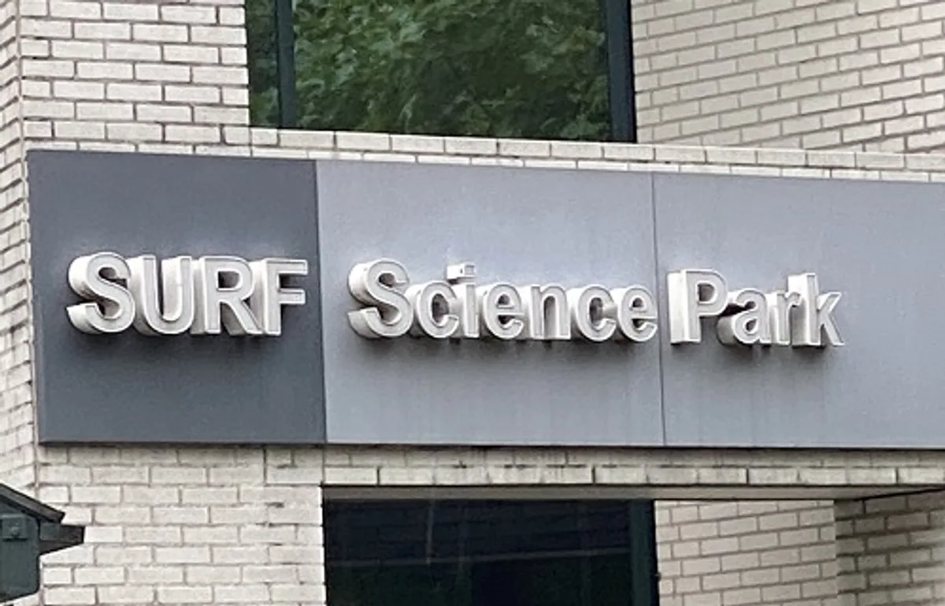
Great to be here in-person – or remote
Thanks to Maarten Kremers!

Slide 3
Two + two days
Today (Monday): membership, self-assessments, PKIX fabric issues
  RCauth.eu and TCS CA updates
  S/MIME BR requirements and email vs authentication trust
  discussions on continuity and catch-all retail services
  WLCG trust evolution – splitting host-based and client-based trust (without using keyUsage…)
  + updates from the APGridPMA and TAGPMA
Tuesday: Enabling Communities with AARC & WISE
  GN5-1 ‘EnCo’
  AARC-G071 "AAOPS" self assessment
  OIDC Federation and the T&I Incubator
  WISE
and although some of you are still remote …
let it not be a series of presentations, but raise your (virtual) hand, engage, comment,
engage in violent agreement, add or shorten, &c!

Slide 4
Logistics
Upload presentations to the agenda page
https://eugridpma.org/agenda/58
you should have a login, or invite email
For the benefit of those on-line-only, also connect to zoom (without audio please!), and share your screen when presenting/editing
https://eugridpma.org/z/58

Slide 5
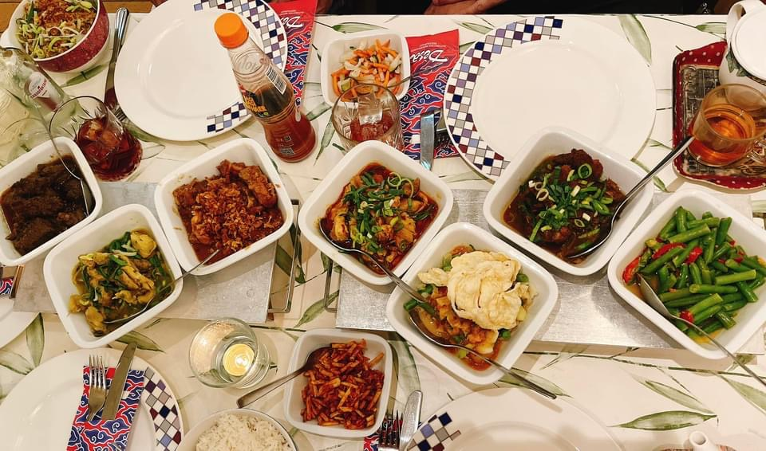
For this evening
We have 12 spots at the Desa Indonesian restaurant Ceintuurbaan 103
Unique ‘rijsttafel’ experience – with many, many dishes &
many options for
vegetarian, vegan,
no-eggs, …
We need a count, so if
you clicked ‘dinner’
by accident, tell us
Start at 19.00

Slide 6
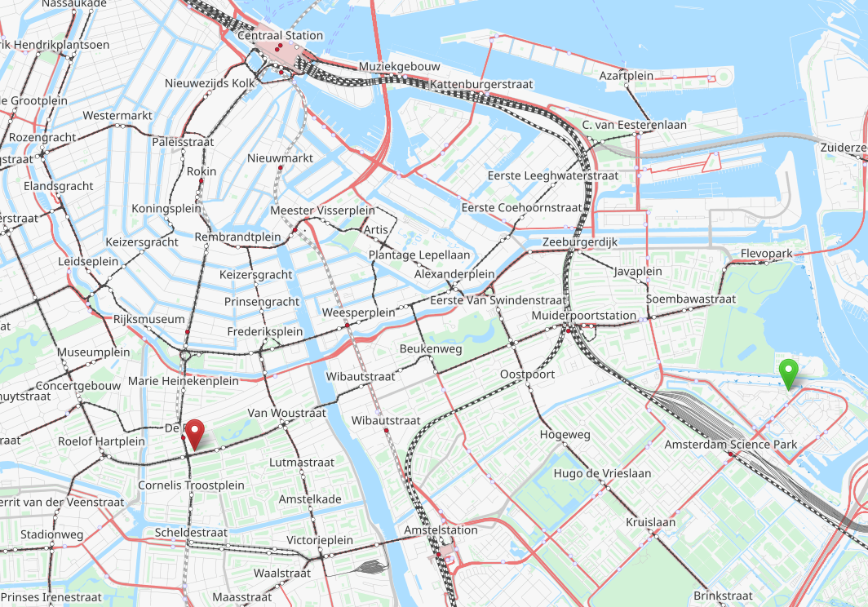
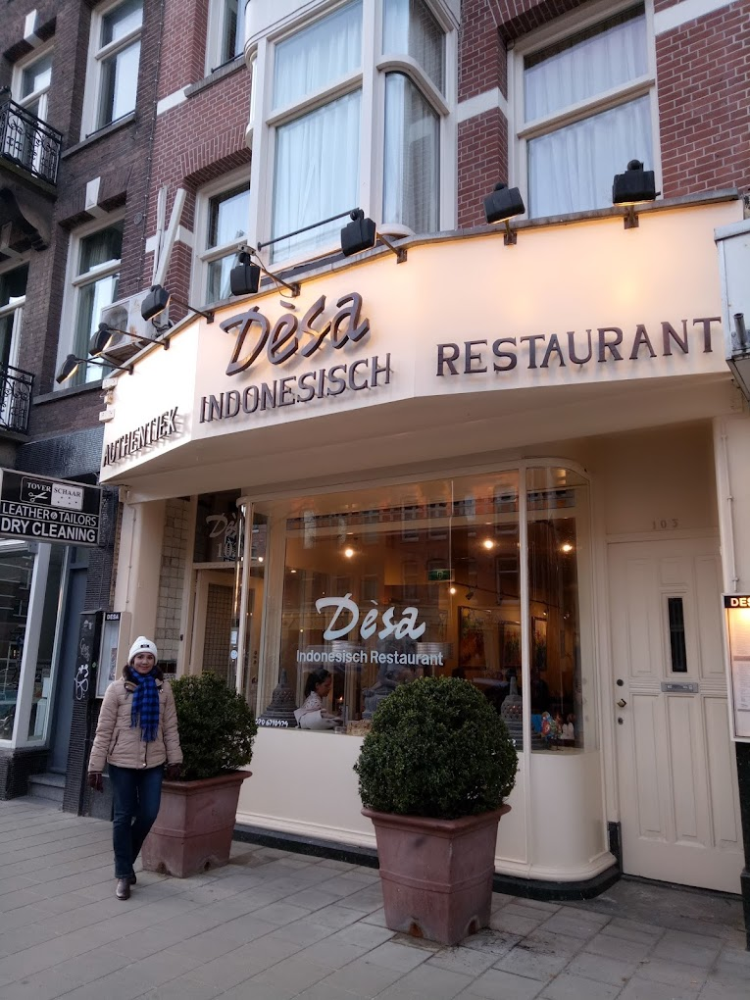
Where you should be at 1900

Slide 7
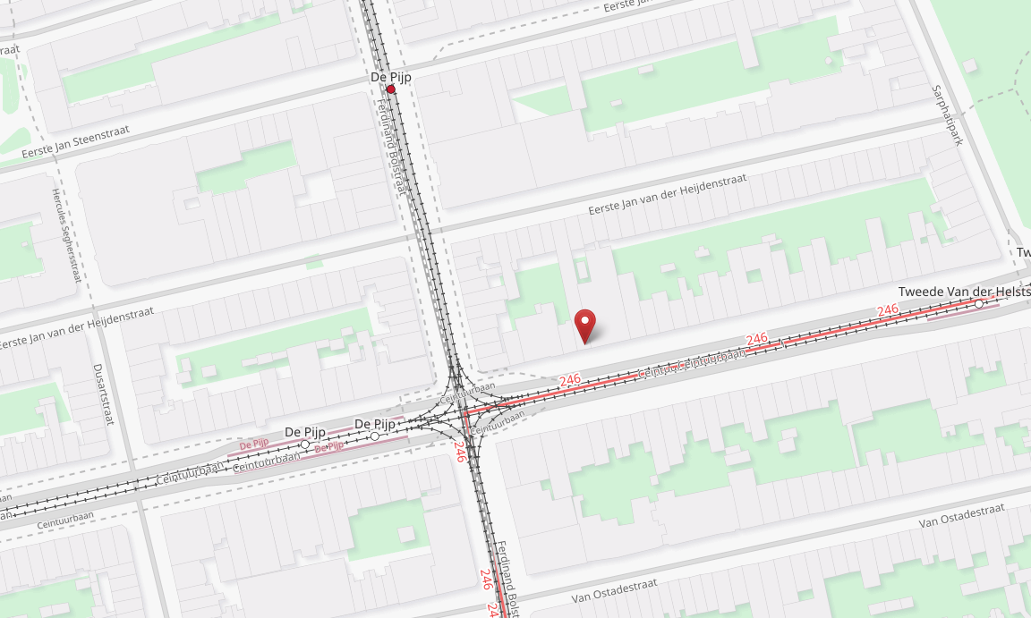
Getting there ‘from here’
Walk 17 min to Soembawa street, then one tramride with #3 to “De Pijp”.
Bus #40 from here to Muiderpoort, then #3 to Desa
Bus #40 from here to Amstel station, then tram #12 to Centraal: stop at “De Pijp”

Slide 8
Building a global trust fabric
Questions?

