Slide 1
Module building
Peter Kluit, Gerhard Raven
Prepared 17 June 2016

Slide 2
Introduction: email from Stan
De productie van de gasgevulde detectoren is bedoeld om Nikhef te positioneren voor de pixel TPC bij ILC. Dit is een project met een looptijd van enkele jaren.
De LEPCOL groep wil hiervoor een grote module bouwen met rond de 100 chips. Dat is ondoenlijk om op dit moment te beheersen en daarvoor is (nog) geen akkoord.
Er is wel akkoord aan de eerste milestone te werken: de productie van een quad submodule binnen de periode van grofweg een jaar. Dan zien we daarna verder. Deze quad is ook interessant voor de R&D groep.
De quadmodule wordt ontworpen met oog op de grotere pixel TPC. Dus met aandacht voor Spidr r/o, cooling plate, voldoende nauwkeurige onderlinge positionering van de chips, optimalisatie van effectief oppervlak.
De LEPCOL maakt een uitgebreid projectplan voor de bouw van deze quad en legt dat voor aan het OPP. Ook samenwerking met Bonn hoort hierbij.
Dus als acties zou ik graag zien dat Peter een projectplan voor de fabricage vandeze quad in elkaar zet - dat wordt gedragen door R&D en actieve personen.

Slide 3
Introduction
The Lepton Collider meeting is the forum to discuss and reach consensus for building a TPC module. Inputs of all people involved are important to converge to a concrete work plan.
The context:
It is important that we realize that the ultimate goal is the production and test of a module of 96-100 chips.
This will be realized in steps.
One important intermediate step and milestone is the design and test of a smaller size sub-module (n board n = 4-8 chips).
The design of the sub-module should allow “copying/tiling” into a larger module.

Slide 4
Milestones and deliverables
Our email reply to the management
Concerning milestones and a project plan. There will (be at least) the following deliverables:
the electronics DAQ read-out of a module (can be tested with bare chips)
the design of the cold plate
test of the chips with INGRIDs (delivered by Bonn)
the design, production and test of a submodule (quad,octoboard,sixtoboard) and design of the electro-mechanics
the production and test of a module (96-100 chips) integrating read-out, cooling, submodules and electro-mechanics
Items (1 to 4) will be worked on in parallel. To develop
these deliverables into a full project plan (with more
details) and a precise time line, we will need to continue
discussions with the TGLs (on hold now) and our
colleagues in Bonn.
Go ahead for items 1-4

Slide 5
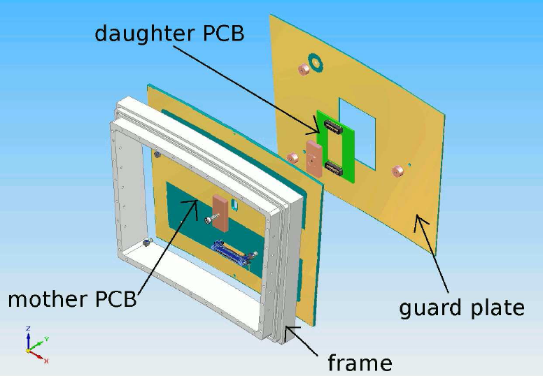
Module size
The sub-module must fit into a module so that it can be tested in the DESY TPC.
the module size is ~ 17 x 22 cm²
here below a sketch of the existing module to hold an octopuce sub-module
- It is important to make an integrated design of cooling, electronics and mechanics
.

Slide 6
Cooling aspects
In the current design of the LCTPC CO2 will be used. It is therefore important to test this on the full module (mile 5).
The TimePix III chip produces max about 3 W and this heat should be carried away
In ILC power pulsing will be used
Another aspect is the material budget. In the design we want to minimize the material.The overall budget is:
Readout modules+electronics 7% X₀
Power cables 10% X₀
For ease of use water cooling has been proposed.
This has to looked into: possibly thicker (more) material has to be used and we will need a redesign of the sub-module if we build a module (mile 5) later. To be decided in discussion with TGLs.
.

Slide 7
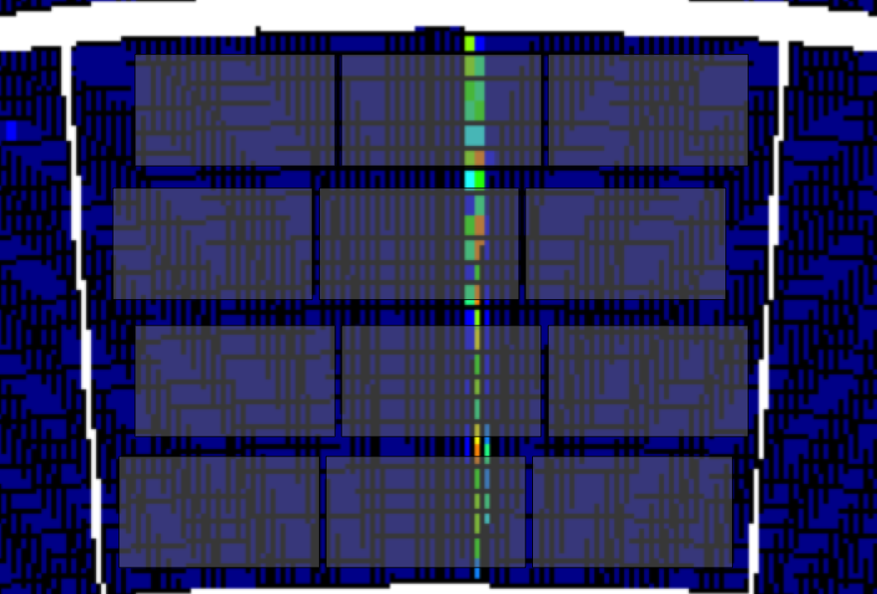
Sub-module size
There is a proposal from Fred and Harry to use 4 chips for a sub-module. One can think however of other options:
2 x 3 six module, 2 x 4 octo module (as was done for TimePix I in Nikhef and Bonn) or 1 x 6 and 1 x 7
- Concerning the last item this would be quite ideal for tiling the full detector (two types allow to cover optimally the wedge shaped surface).
- Advantages of using more chips per module is the reduced amount of connectors. Ideally one would even think of one module with all chips and no sub-tiling.
One clear advantage of the octo sub-module is the reduced deformations. The chips in the middle are less affected by deformations and allow for an undistorted measurement.
.
12 octoboards Bonn

Slide 8

Guard and electro-mechanics
From the performance studies it is clear that the difficulties for a module is the minimization of the E field distortions by applying a guard or specially designed T or long T structure to define the field.
What counts here is the mechanical precision: the distance of the grid for several chips. From the octopuce board we know that Joop did an amazing job, by controlling the height to about 20 microns and putting the chips side by side with similar precision. We know that this is what we need and will result in a detector with minimal E field distortions that meets the ILC design specifications.
The applied voltages also have to be regulated at the Volt level.
In the design we have to make sure that we come up with a procedure/technique that meets these specifications.

Slide 9
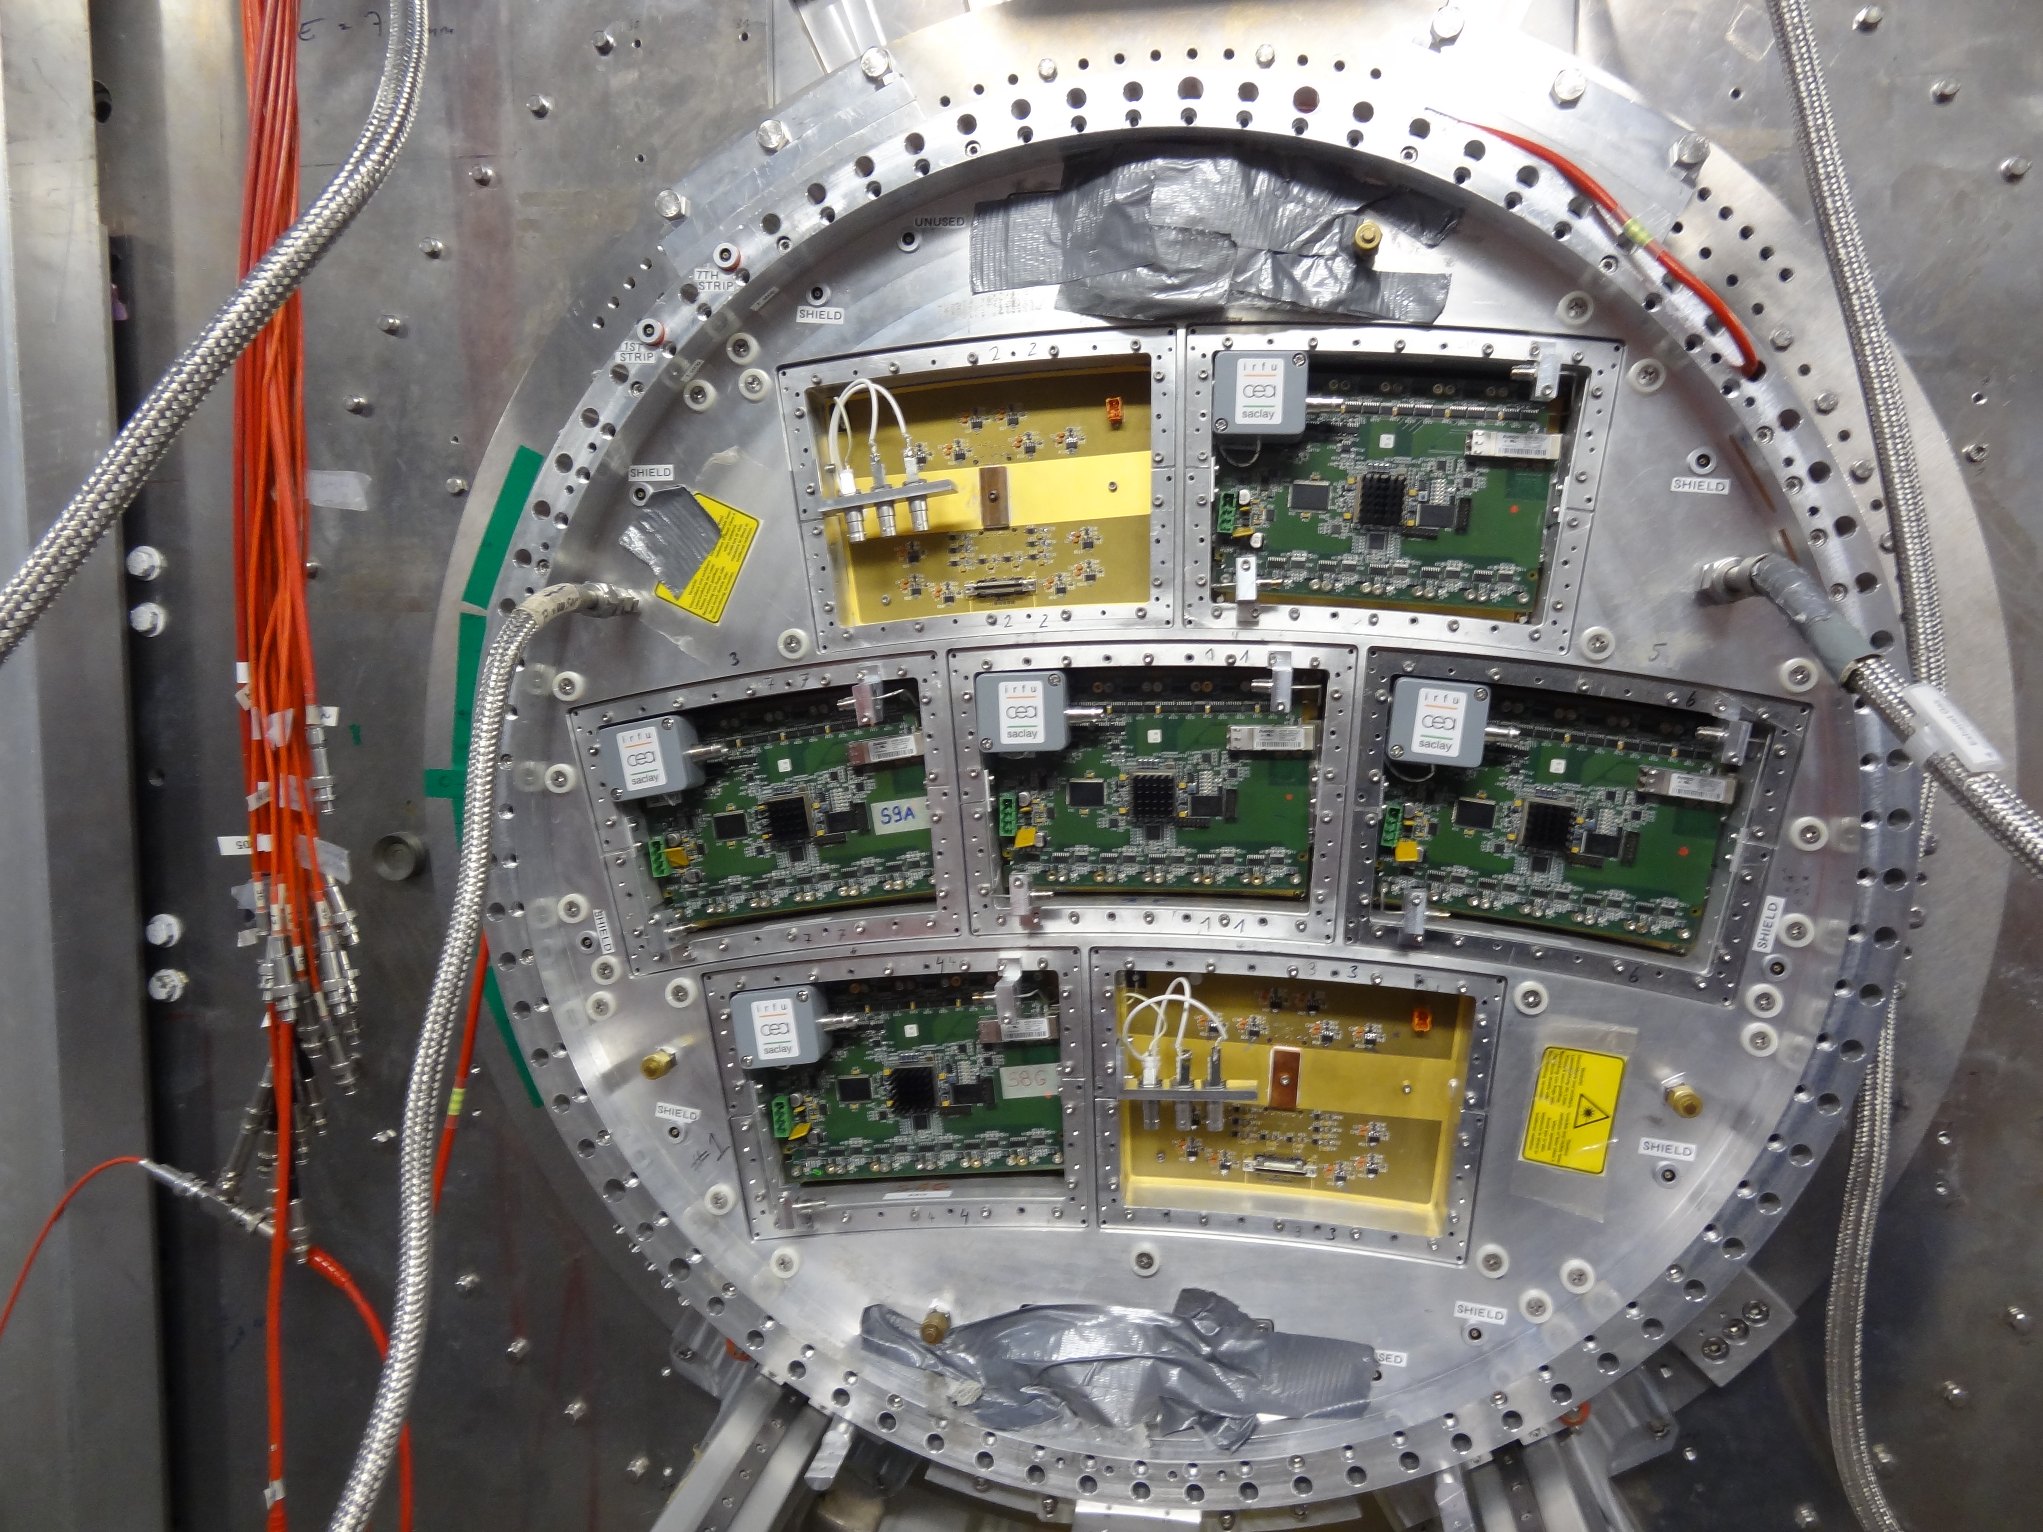
Read-out electronics
The baseline for the read-out is SPIDR.
For the full module it is important that we can read out more chips. In the ET a proposal to read out a 100 chip module using a multiplexing scheme has been suggested.
This sounds promising and needs to be worked out.
Another aspect is the fact that bonding of the chips needs space. We will have to maximize the sensitive area. Current proposal has an active area of only 63%. This needs to be looked into more detail.
In this area there are good (MicroMegas Saclay/Octoboards Bonn) and less optimal (Pads Desy) examples of how the read out can be organized. Clearly here we have to come up with an elegant, compact solution that can be scaled up to a full module.

Slide 10
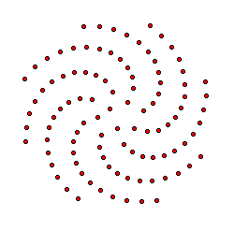
Simulations
Several optimization studies using simulations have to be performed.
One question is the optimal filling/tiling of the full TPC another using of a module
Second point is the optimal tiling of a module using a certain sub-module (2x2, 3x2, 4x2 etc.)
Other aspects are electrical field calculations for an optimal design of the mechanical structures
Also simulations have to be performed in the context of ILD such as:
  Implementation of the geometry for a Pixel TPC
  Implement the digitization
  Develop the pattern recognition for the pixel TPC
  Geant4 simulations to evaluate tracking and dE/dx performance

Slide 11
Email reply to management
Backup
the duration of the project. What is ready when the project is completed? We foresee a duration of the project of 3 to 4 years for building and fully testing a pixel TPC module. This is in line with the planning of the ILC and ILD where a technology choice is still at least 3 years away.
the outlook: do you see a next phase or follow up that you already need to prepare? We can enter a next phase if a technology choice for a pixel TPC is made by ILD. In that case we will have to reoptimize the pixel TPC design: the cooling, material, chip and electro-mechanics. In case pixel technology would not be selected by ILD, NIKHEF should be ready to participate in other (major) parts and/or technologies for construction of the final ILD. If the ILC is not approved we have to reconsider the options.

Slide 12
Email reply to management
3) partners: how is the sharing of the work with Bonn. In view of the discussions with the management at Nikhef, we didnot make definitive agreements with the Bonn group yet. A kind of natural division would be that Bonn takes care of the INGRID chip production at IZM and we provide the Timepix 3 wafers and help testing the chips. We could share the work on the cooling. Bonn wants to use the SPIDER read-out and will buy this system. A PhD student from Bonn will work on the read-out. One shared PhD student Kevin Heijhoff is appointed (50%/50% Bonn/Nikhef) who will work on the module building. The module frame is fully designed and will be made at Nikhef. The sharing of the work on the electro-mechanics and the basic submodule (quad/octopuce/sixtoboard) has not been discussed.
4) Who will be the Nikhef project leader? We discussed this in the meeting of 23 May and there was consensus that this will be Peter Kluit. He will be responsable and gather a team of experts to decide on the details of the project and look whether other persons (e.g. Bob van Eijk) are willing to take part in the construction.

Slide 13
Email reply to management
Some are more more technical:
Cooling. What are the cooling specs. Do you need CO2 now or later? What (MT)expertise is needed for the projec?t We propose to use the existing CO2 plant at Nikhef without further R&D on CO2 cooling. For the testbeam: at DESY and CERN (AIDA) there are CO2 plants available that have sufficient power (300 W) to cool a few modules. The basic work is the design of a cold plate with an optimized tube diameter. The expertise is available in the MT. For submodule testing we could use water cooling.
2) SPIDR. Do you plan to make minor changes or a completely new/differentversion of SPIDR readout system? If you make a new version is it usefull for.other projects too. We use the SPIDR read-out system as it is. The ET is very interested in our project and has proposed a solution to read-out all 96-100 the chips of a module with one SPIDR system using a multiplexer. This will need some additional work and might be usefull for other projects.
3) the module size/layout. If the main goal is to show large scale operationwith homogeneous drift suited for ILC operation how many chips/quads do you need to operate in this module?

Slide 14
Email reply to management
We propose to build modules consisting of 96 to 100 chips. Nikhef wants to build at least two modules, Bonn one or more. This will allow for a detailed redundant test of the performance of a pixel TPC.
Concerning milestones and a project plan. There will (be at least) the following deliverables: 1. the electronics DAQ read-out of a module (can be tested with bare chips) 2. the design of the cool plate 3. test of the chips withs INGRIDs (delivered by Bonn) 4. the design, production and test of a submodule (quad,octoboard,sixtoboard) and design of the electro-mechanics 5. the production and test of a module (96-100 chips) integrating read-out, cooling, submodules and electro-mechanics Some items (1 to 4) will be worked on in parallel. To develop these deliverables into a full project plan (with more details) and a precise time line, we will need to continue discussions with the TGLs (on hold now) and our colleagues in Bonn.

