Slide 1


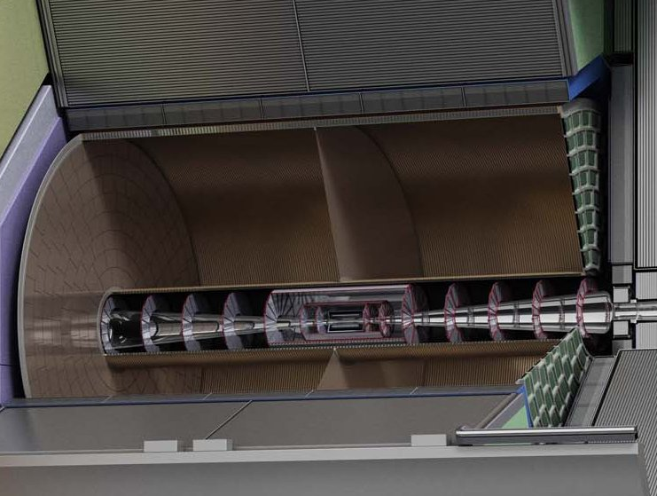



TPC Development for the ILD Detector at ILC
Peter Kluit,
On behalf of the LCTPC Collaboration
LCWS 2023 at SLAC May 2023

Slide 2
ILD TPC requirements
The R&D on a TPC for a Linear Collider is done in the LCTPC collaboration
Requirements for a TPC ILC TDR

Slide 3
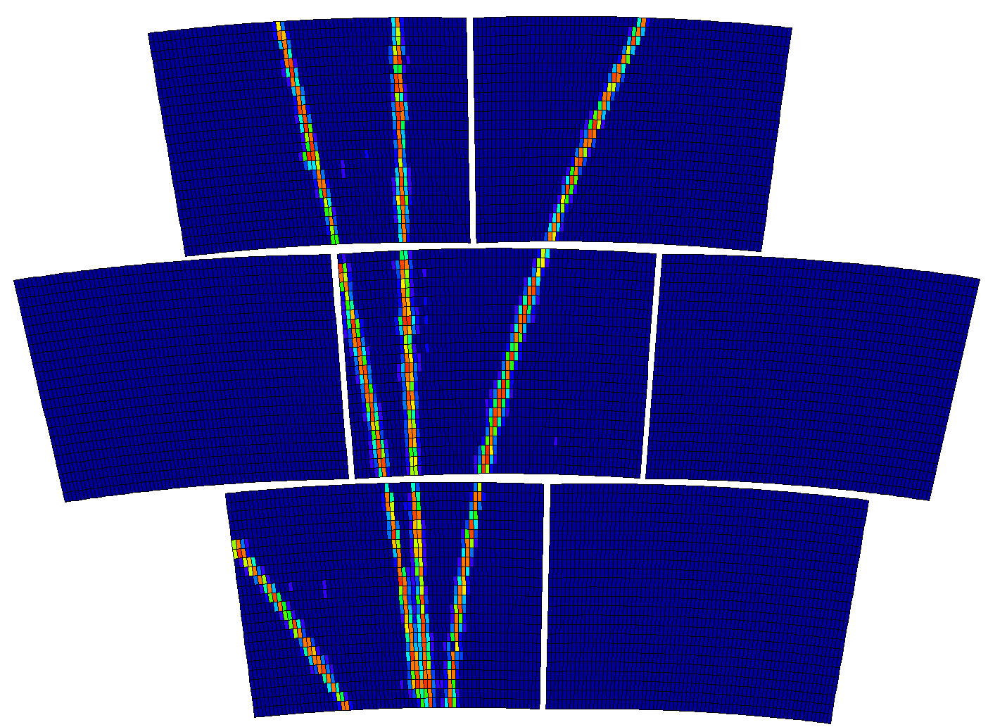
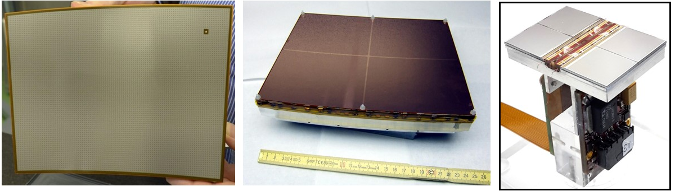
ILD TPC read out technologies
There are 3 main options for the readout :
Micromegas with a resistive anode (ERAM), GEM, and Gridpix.
Feasibility and performance has been demonstrated in ILC conditions.
New ILD strategic goal is to adapt to conditions at high luminosity colliders.
Micromegas GEM GridPix

Slide 4
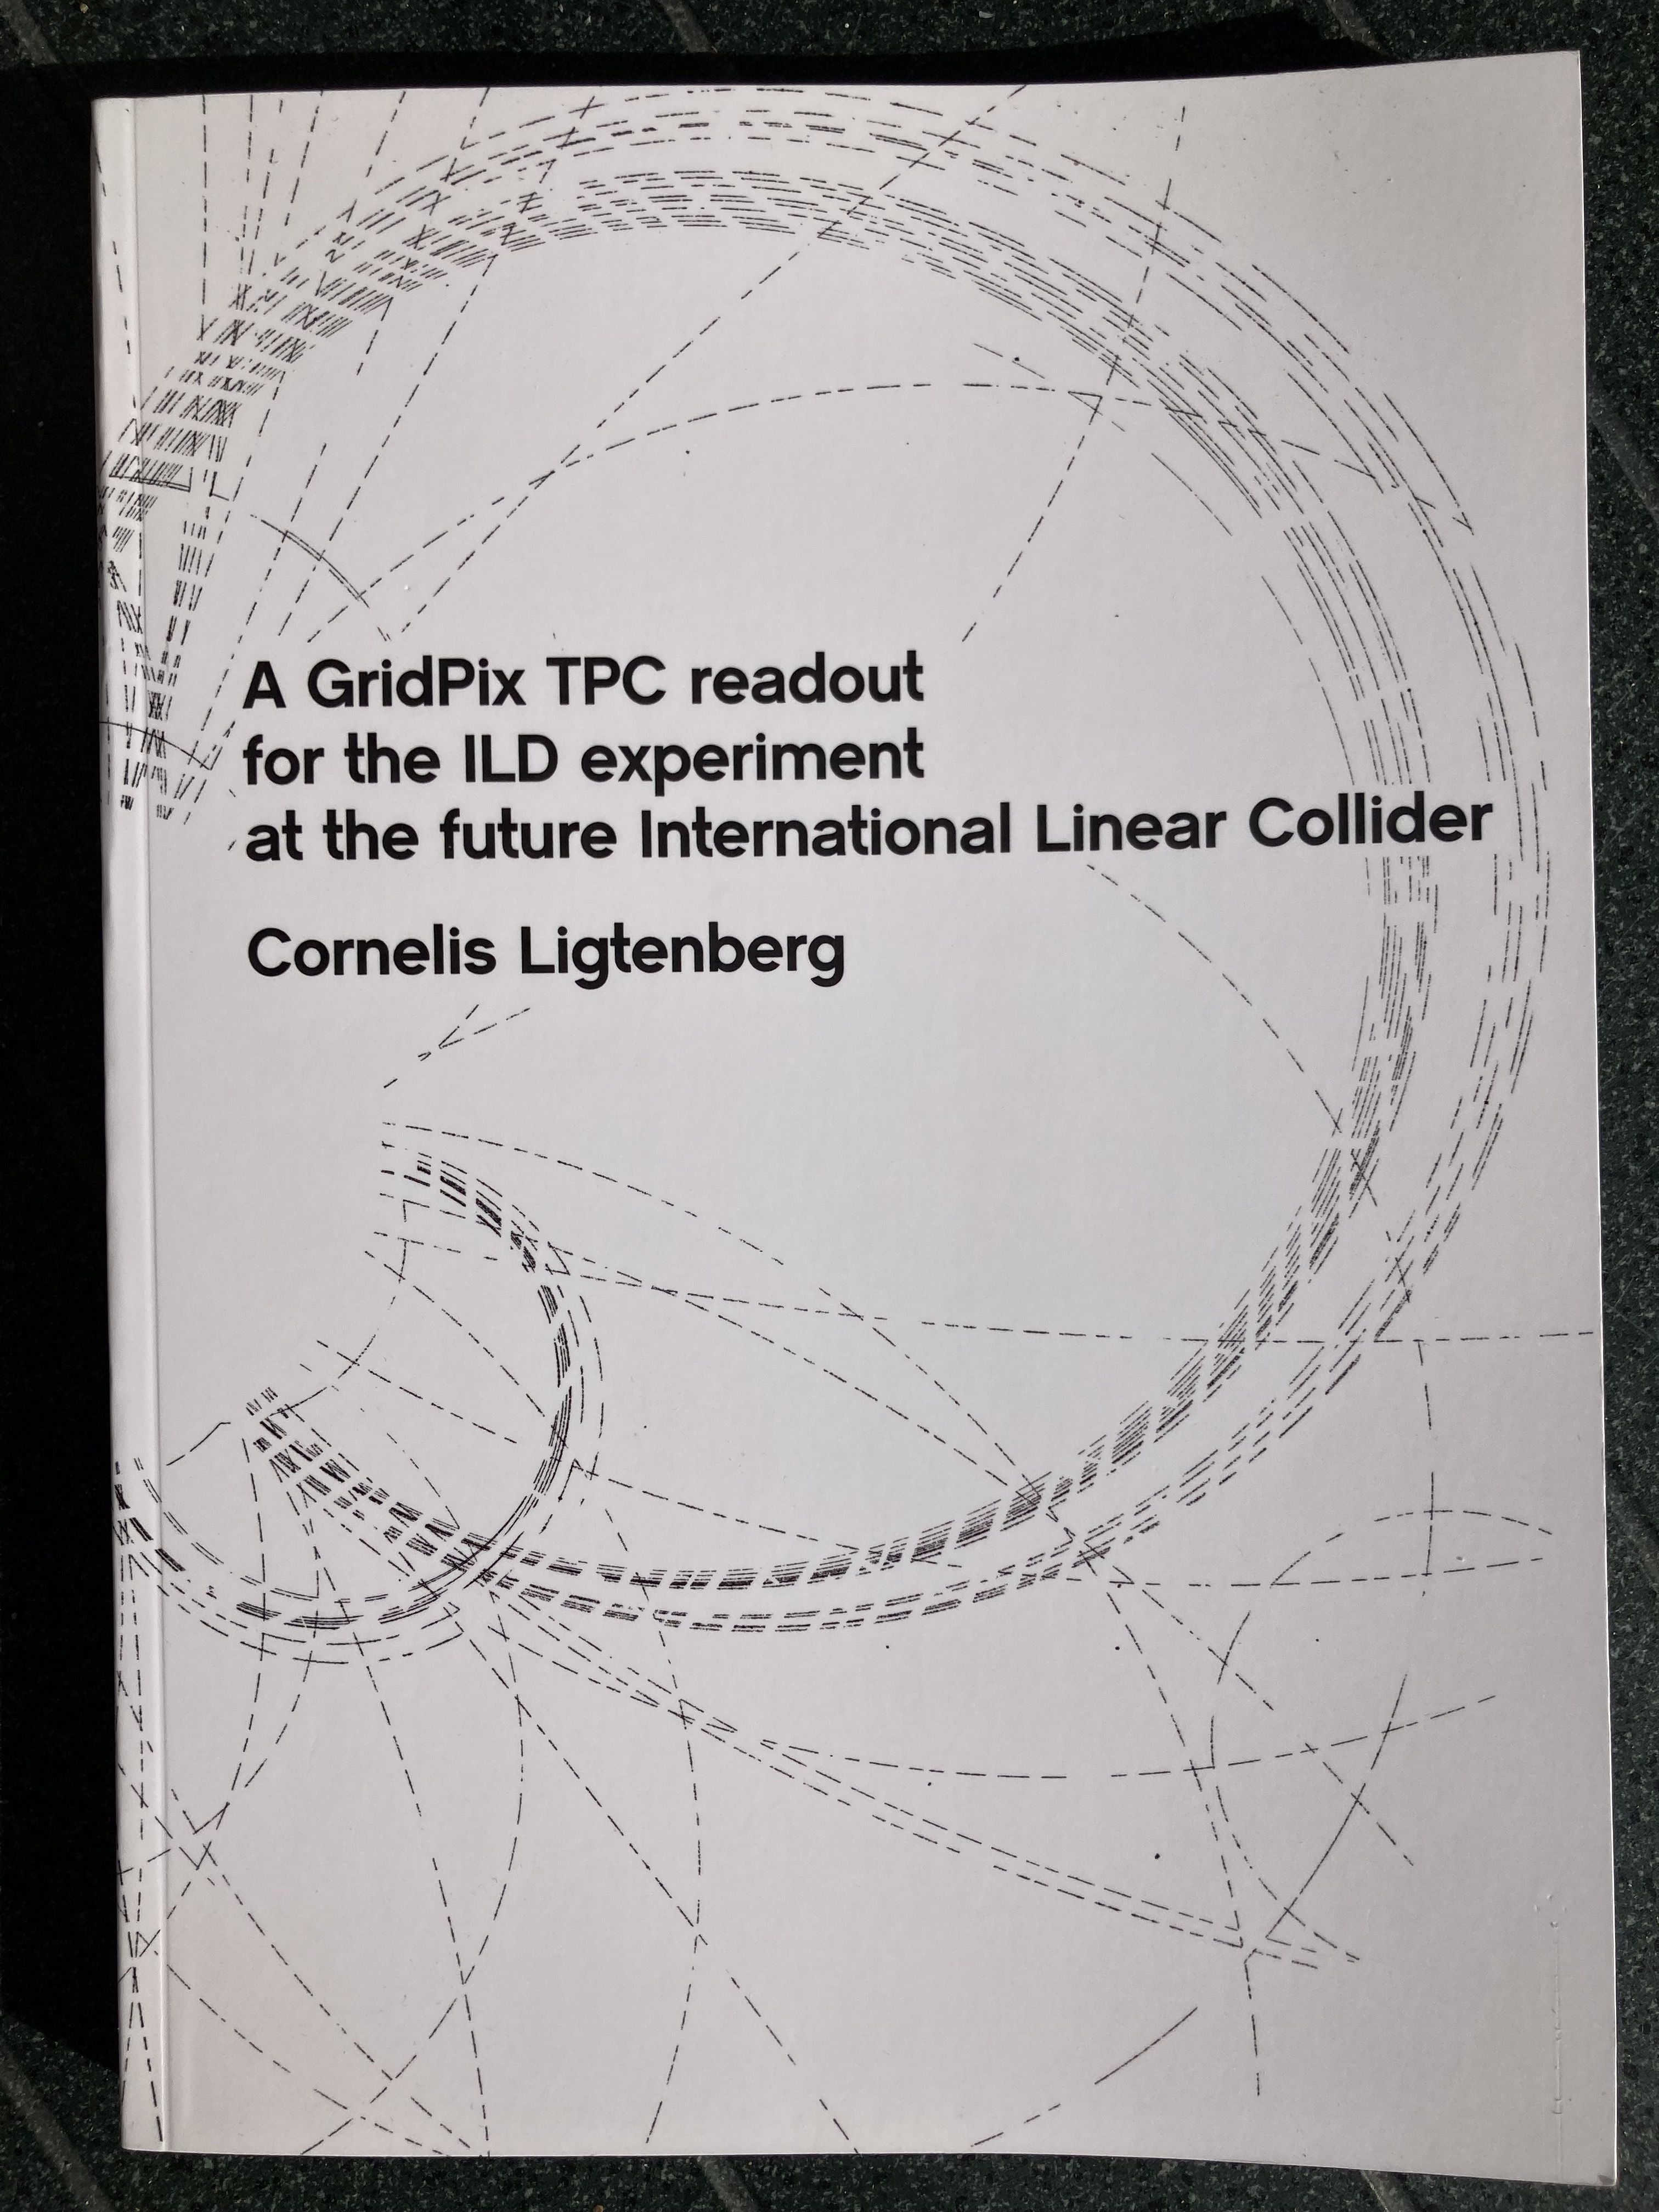
ILD TPC particle identification and material
M. Hauschild: dE/dx and Particle ID Performance with Cluster Counting;
ILC Workshop Valencia 2006
Excellent tracking device with low material budget
  0.01 X₀ TPC gas
  0.01 X₀ inner cylinder
  0.03 X₀ outer cylinder
  < 0.25 X₀ endplates (incl readout)
Material budget can be respected by different technologies like GEM, MicroMegas and Pixels
TPC between silicon detectors VTX, SIT and SET
Excellent particle identification
Pixel readout is a serious option for the TPC readout plane @ ILC or other colliders. Thesis Ligtenberg on a Pixel TPC.

Slide 5




Pixel TPC
(Octopuce)
(TimePix1) TPX3 chip Quad Module TPC plane
(2007-14) 2017 2018 2019

Slide 6
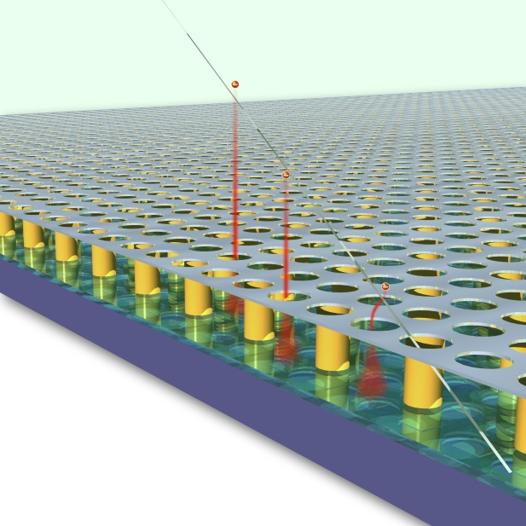
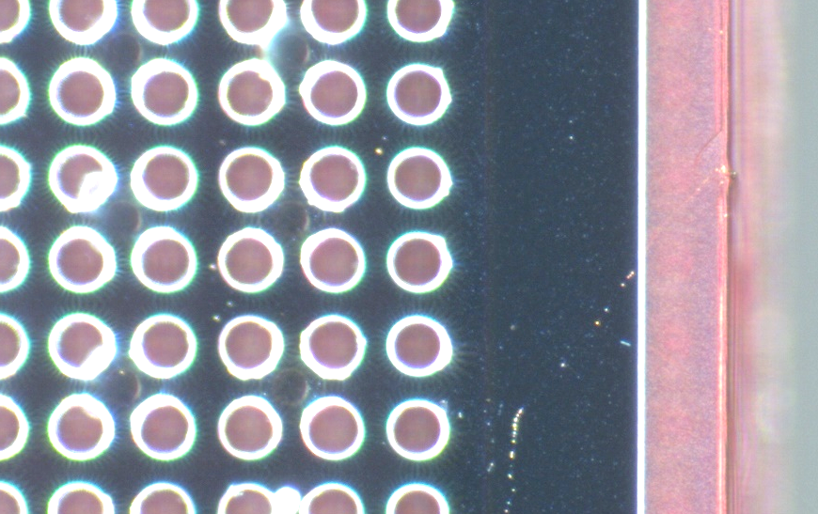
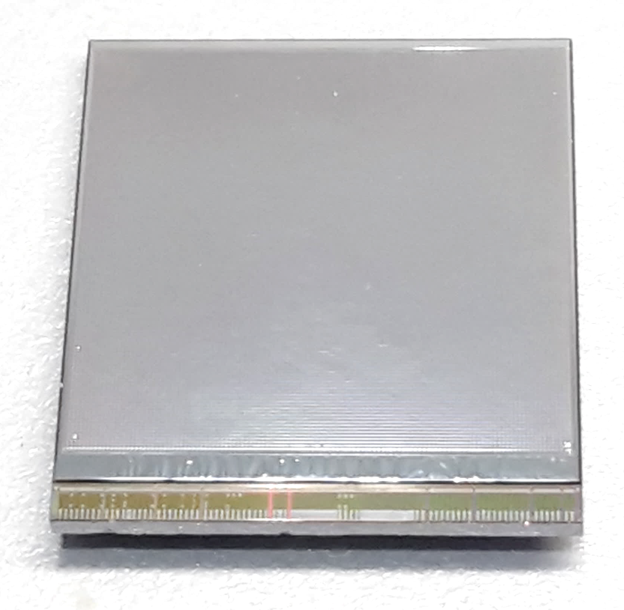
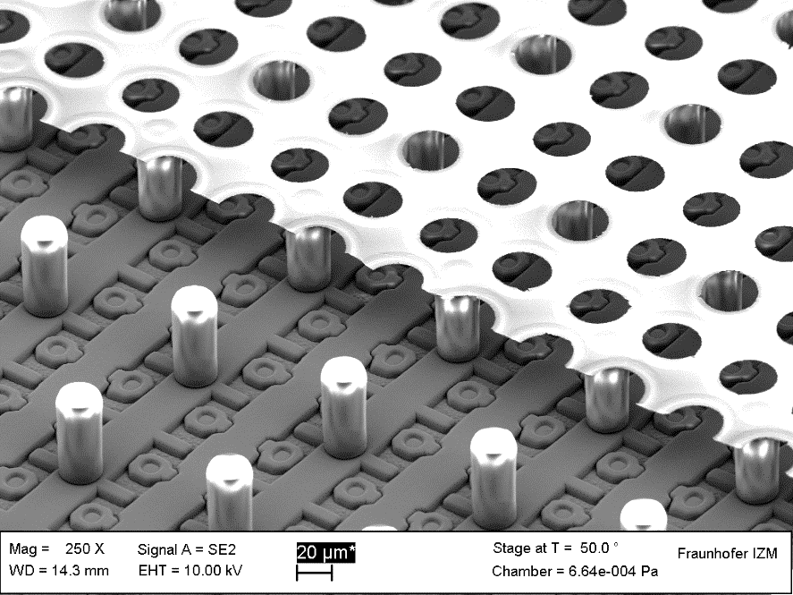
GridPix technology
Pixel chip with integrated Grid (Micromegas-like)
InGrid post-processed @ IZM
Grid set at negative voltage (300 – 600 V) to provide gas amplification
Very small pixel size (55 µm)
detecting individual electrons
dyke
55 µm
Aluminium grid (1 µm thick)
35 µm wide holes, 55 µm pitch
Supported by SU8 pillars 50 µm high
Grid surrounded by SU8 dyke (150 µm wide solid strip) for mechanical and HV stability
50 µm

Slide 7
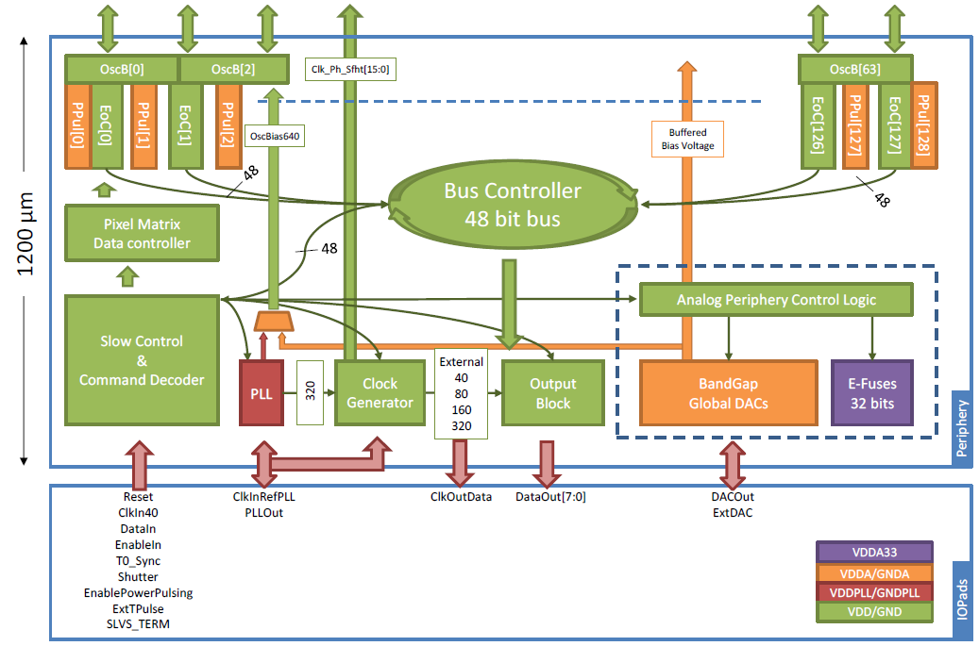
Pixel chip: TimePix3
256 x 256 pixels
55 x 55 µm pitch
14.1 x 14.1 mm sensitive area
TDC with 640 MHz clock (1.56 ns)
Used in the data driven mode
  Each hit consists of the pixel address and time stamp of arrival time (ToA)
  Time over threshold (ToT) is added to register the signal amplitude
  compensation for time walk
  Trigger (for t₀) added to the data stream as an additional time stamp
Power consumption
  ~1 A @ 2 V (2W) depending on hit rate
  power pulsing possible
  good cooling is important
Sensitive area
14.1 mm
2+3 mm

Slide 8
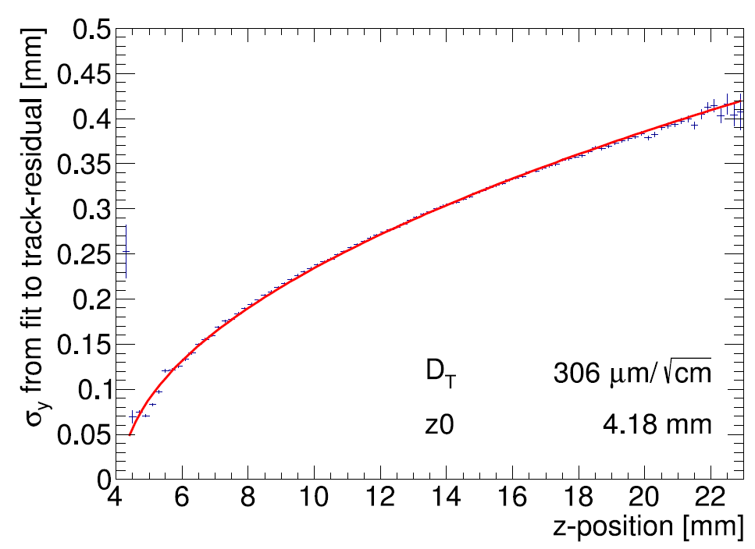
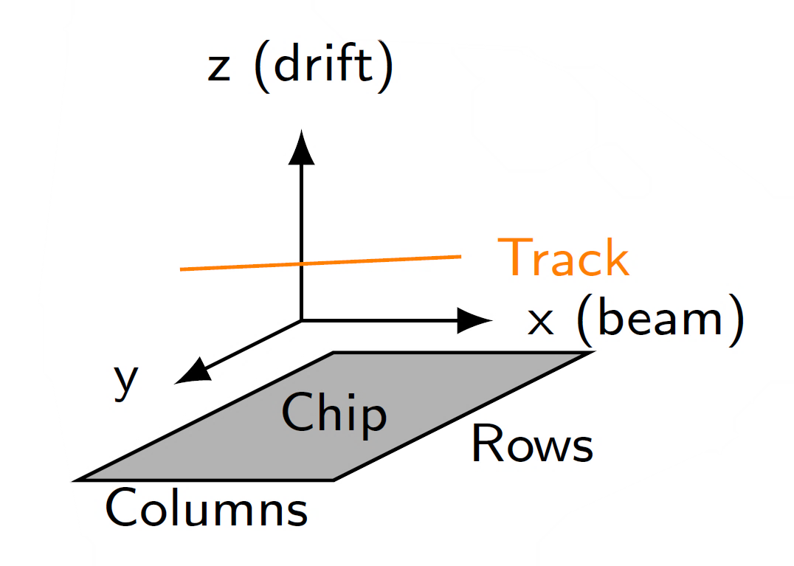
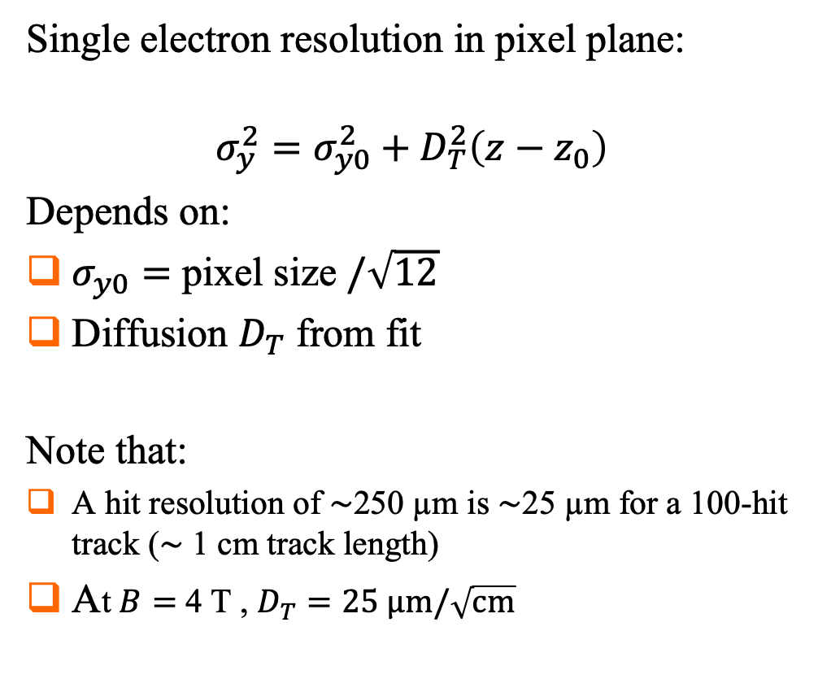
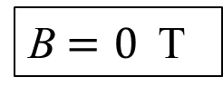
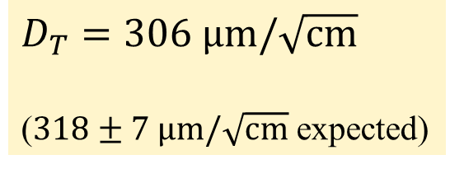
Single hit resolution in transverse direction
Results from Bonn-Elsa testbeam in 2017
https://doi.org/10.1016/j.nima.2018.08.012
B$=0$ T
Single electron resolution in pixel plane:
$$σ_{y}^{2}=σ_{y0}^{2}+D_{T}^{2}\left(z−z_{0}\right)$$
Depends on:
$σ_{y0}=$ pixel size $/\sqrt{12}$
Diffusion $D_{T}$ from fit
Note that:
A hit resolution of $\sim$250 µm is $\sim$25 µm for a 100-hit track ($\sim$ 1 cm track length)
At $B=$ 4 T , $D_{T}=25 \text{μm}/\sqrt{\text{cm}}$
T2K gas
$D_{T}=306 \text{μm}/\sqrt{\text{cm}}$
($318±7 \text{μm}/\sqrt{\text{cm}}$ expected)

Slide 9
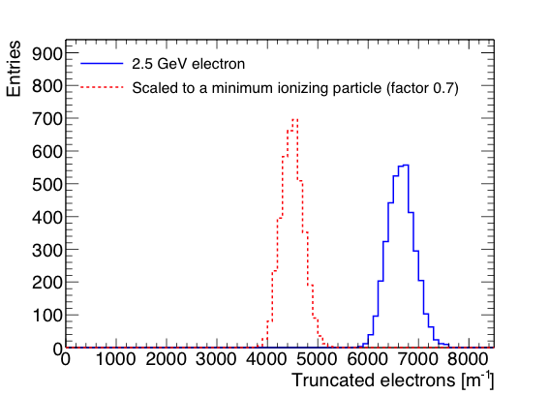
Pixel dE/dx performance
dE/dx resolution measured with truncated mean technique
  From the single chip tracks; 1 m long tracks are made;
  nr of electrons counted in slices of 20 pixel and reject 10% highest slices
  Track-lentgh scaled by 1/0.7 to get an estimation for the dE/dx of a MIP
  Resolution is 4.1% for a 2.5 GeV electron and 4.9% for a MIP
Separation S = (N_{e} − N_{MIP})/σ_{e}
8σ MIP-e separation for a 1 meter track
A pixel readout can in principle within the resolution (diffusion) separate primary from secondary clusters. dE/dx can be measured by cluster counting and performance separation enhanced.

Slide 10
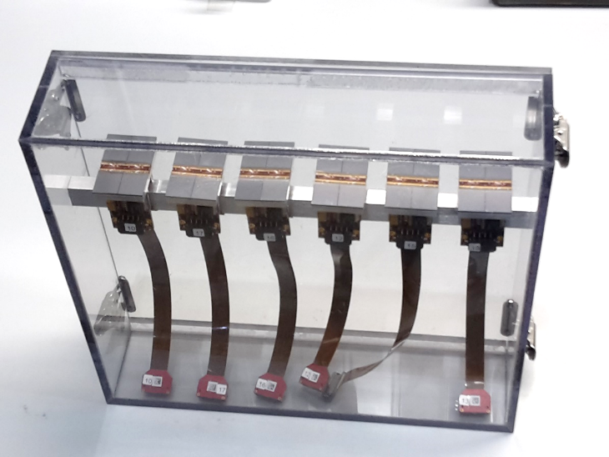
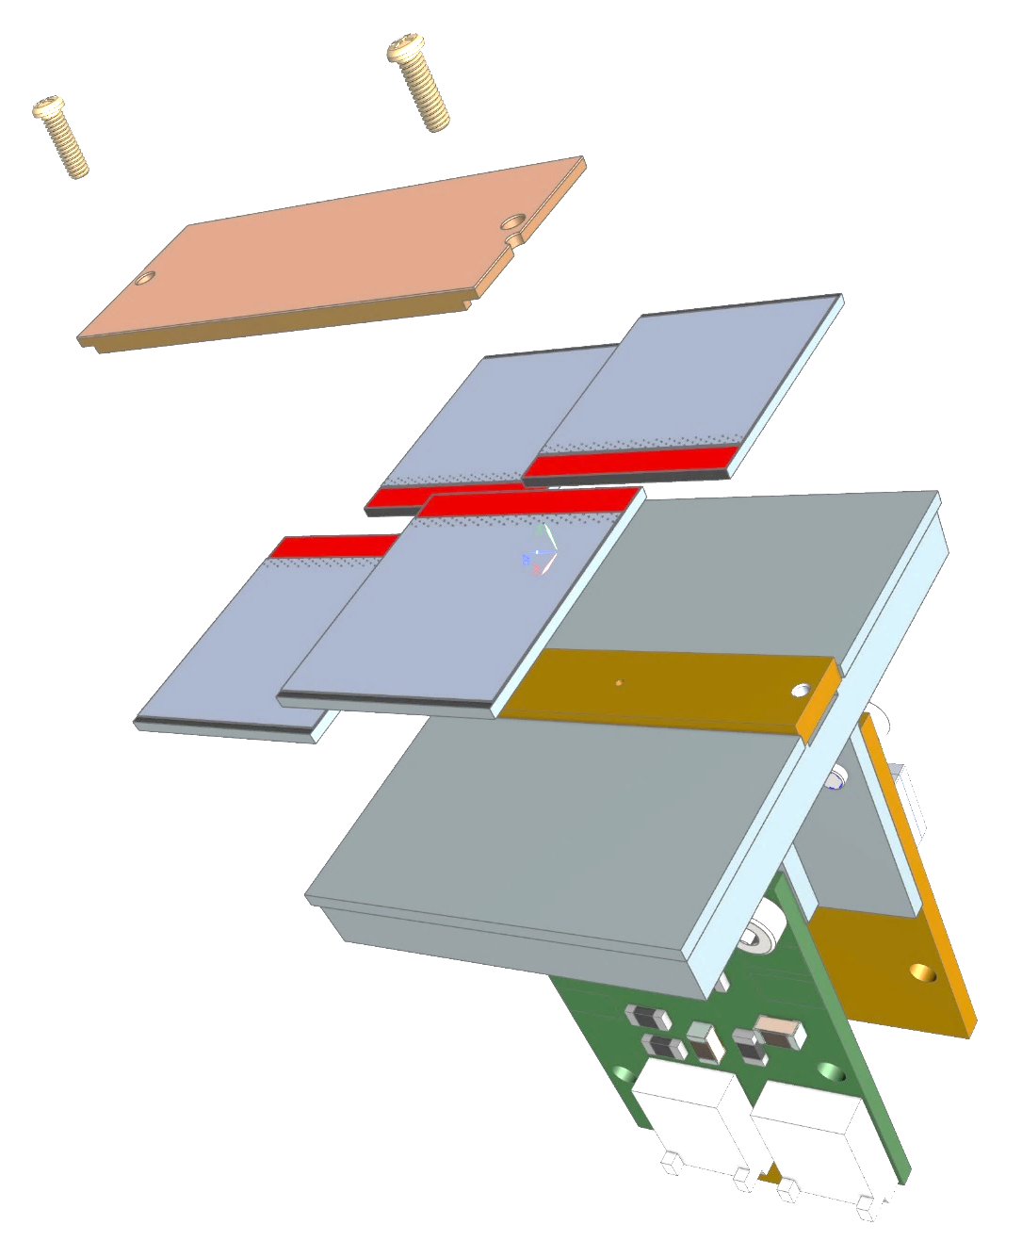
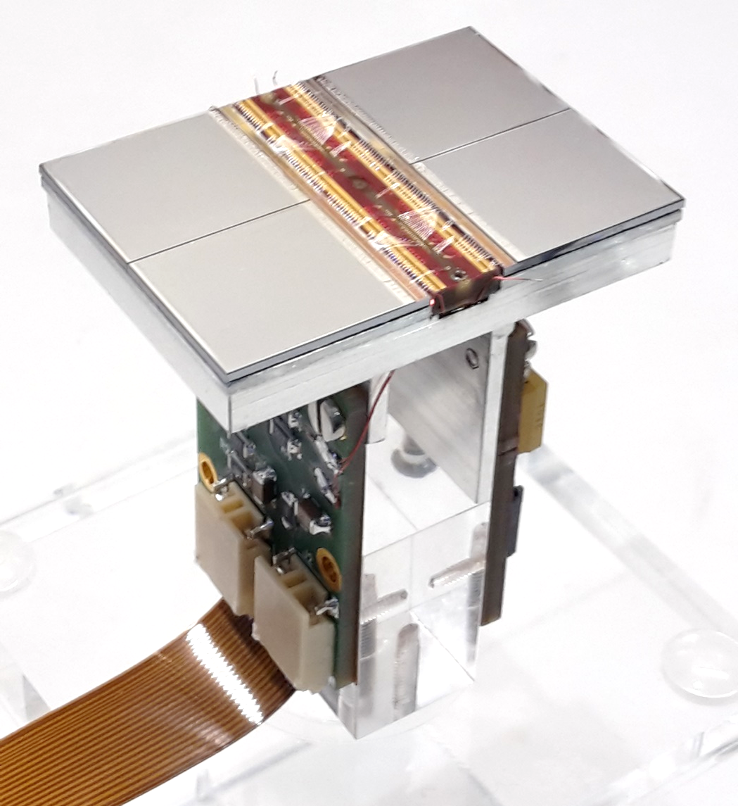
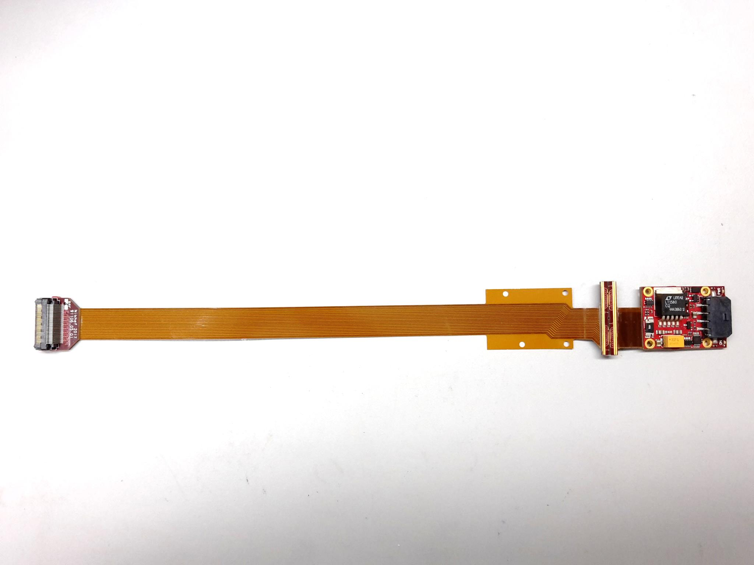
QUAD design and realization
Four-TimePix3 chips
All services (signal IO, LV power) are located under the detection surface
The area for connections was squeezed to the minimum
High precision 10 μm mounting of the chips and guard
QUAD has a sensitive area of 68.9%
DAQ by SPIDR
39.6 x 28.38 mm
series of QUADs
Guard
TPX3
TPX3
TPX3
TPX3
COld
CArrier

Slide 11
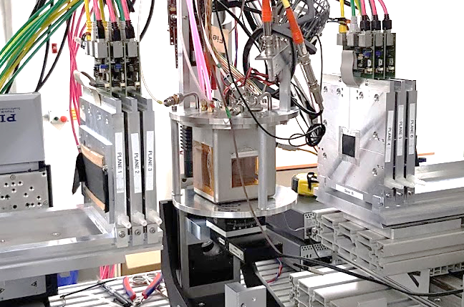
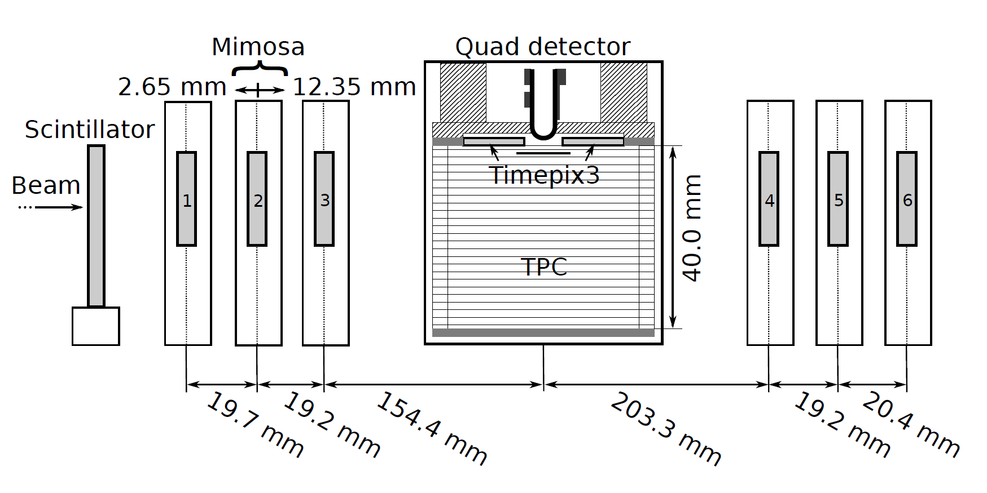

QUAD test beam in Bonn (October 2018)
ELSA: 2.5 GeV electrons
Tracks referenced by Mimosa telescope
QUAD sandwiched between Mimosa planes
  Largely improved track definition
  6 planes with 18.4 μm × 18.4 μm sized pixels
Gas: Ar/CF₄/iC₄H₁₀ 95/3/2 (T2K)
E_{d} = 400 V/cm, V_{grid} = -330 V
Typical beam height above the chip: ~1 cm
Published NIMA https://doi.org/10.1016/j.nima.2019.163331
@Bonn
Field cage

Slide 12
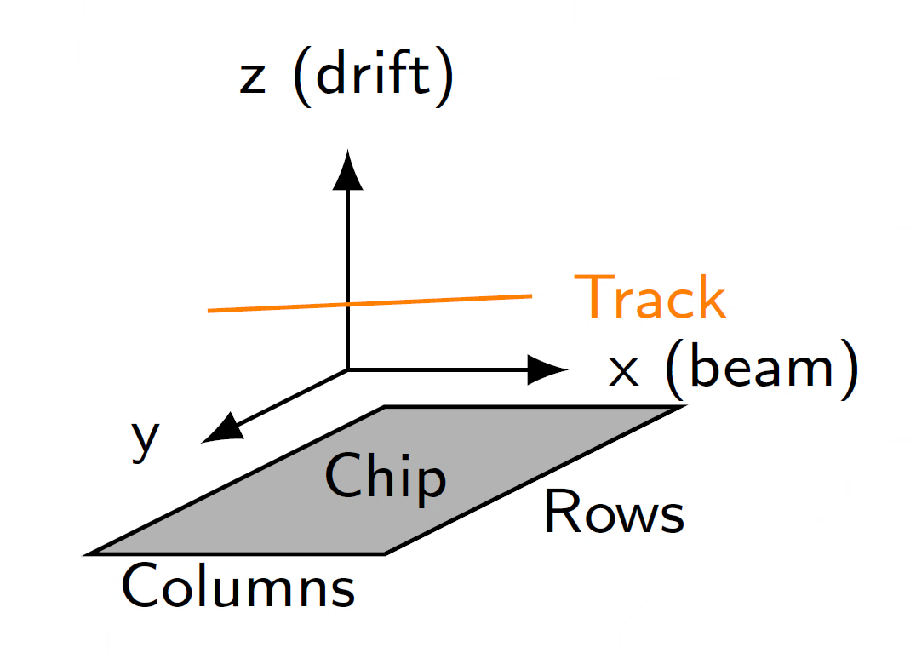
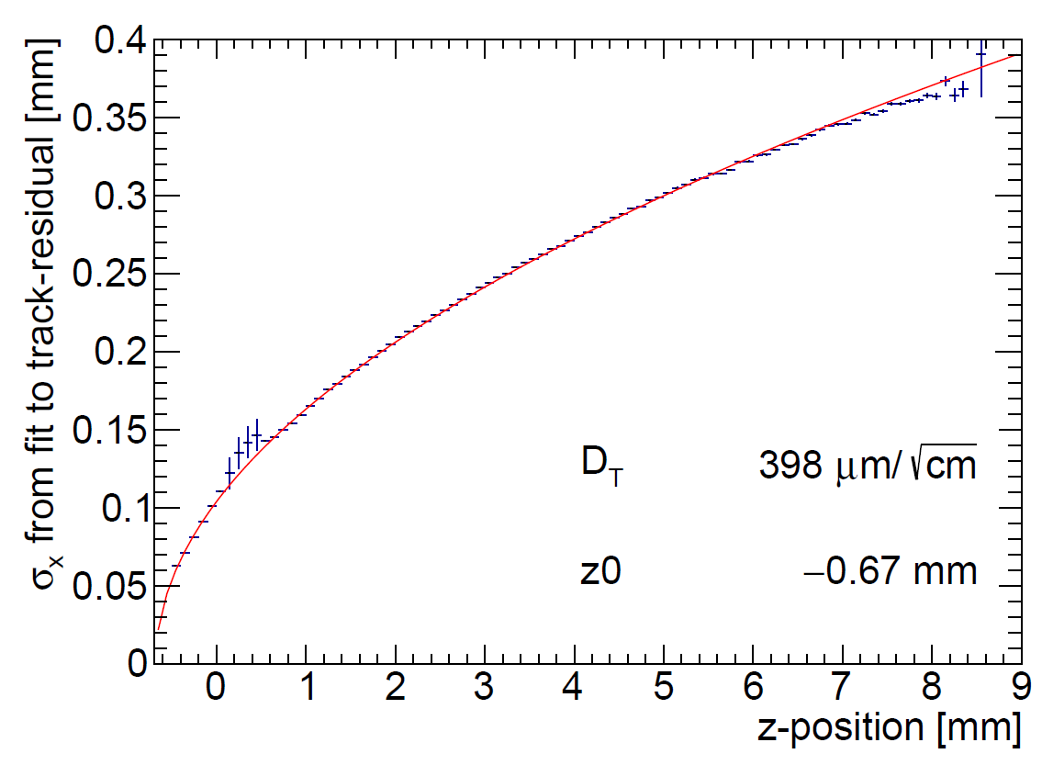
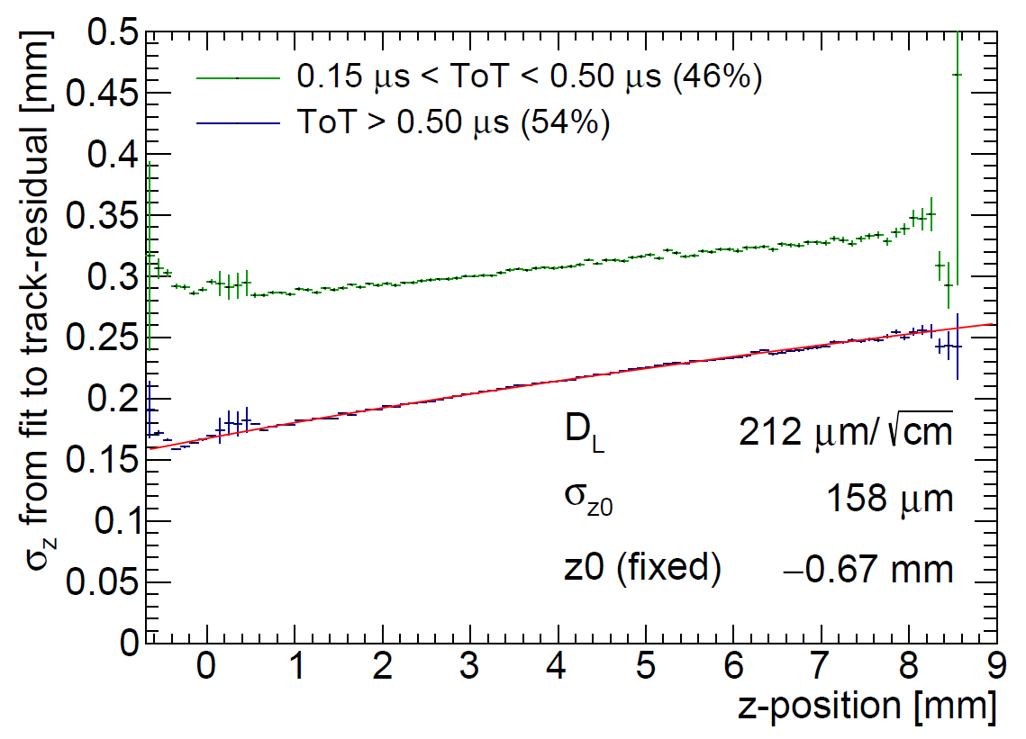
QUAD single hit resolution
Transverse
Longitudinal
D_{T} = 398 μm/√cm
D_{L} = 212 μm/√cm
The D_{T} value is rather high due to an error in the gas mixing (too low CF4)

Slide 13
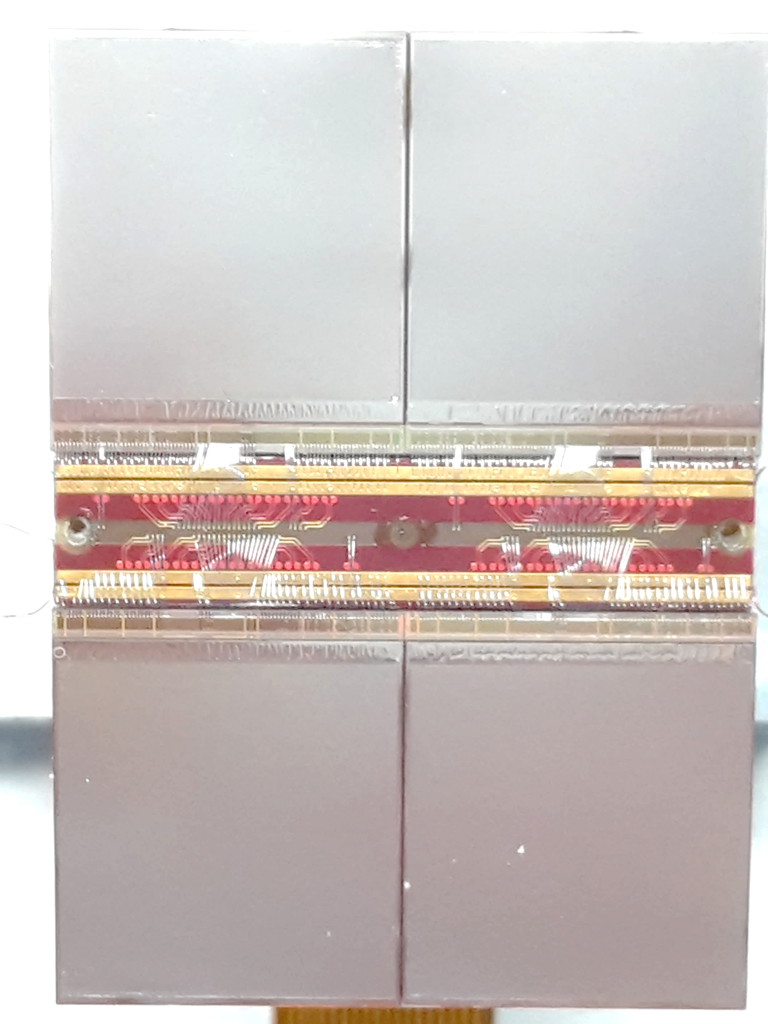
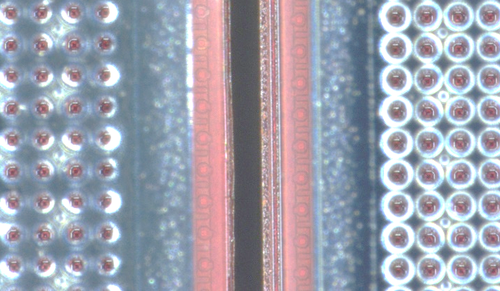
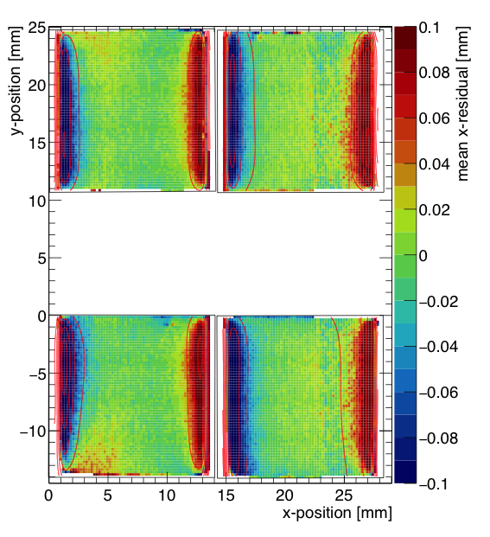
QUAD edge deformations (XY)
Small deformations due to
  Dead zone between chips
  Grounded region between chips
Are corrected by:
  fitted correction function
  adding proper guard wire electrode
Grounded region

Slide 14
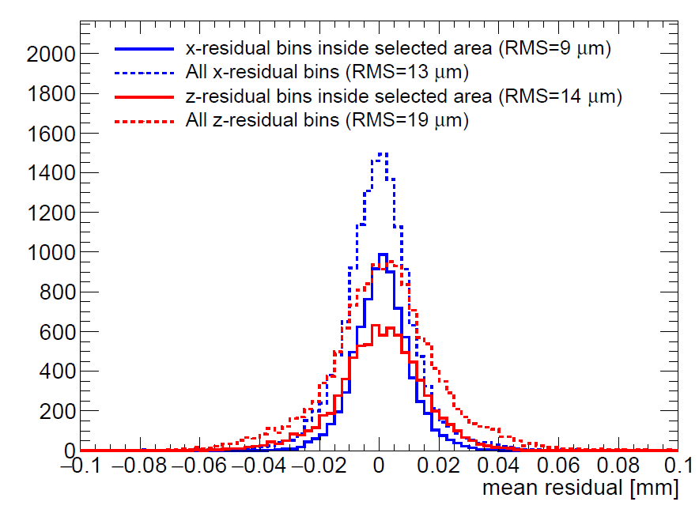
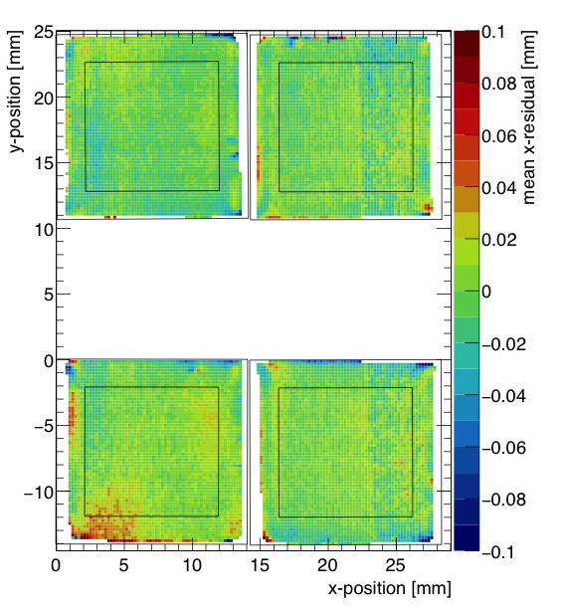
QUAD deformations in transverse plane (XY)
After applying fitted edge corrections
RMS of the mean residuals are 13 μm over the whole QUAD
XY

Slide 15
Next: QUAD as a building block
8-QUAD module (2x4) with field cage
in red guard wires

Slide 16
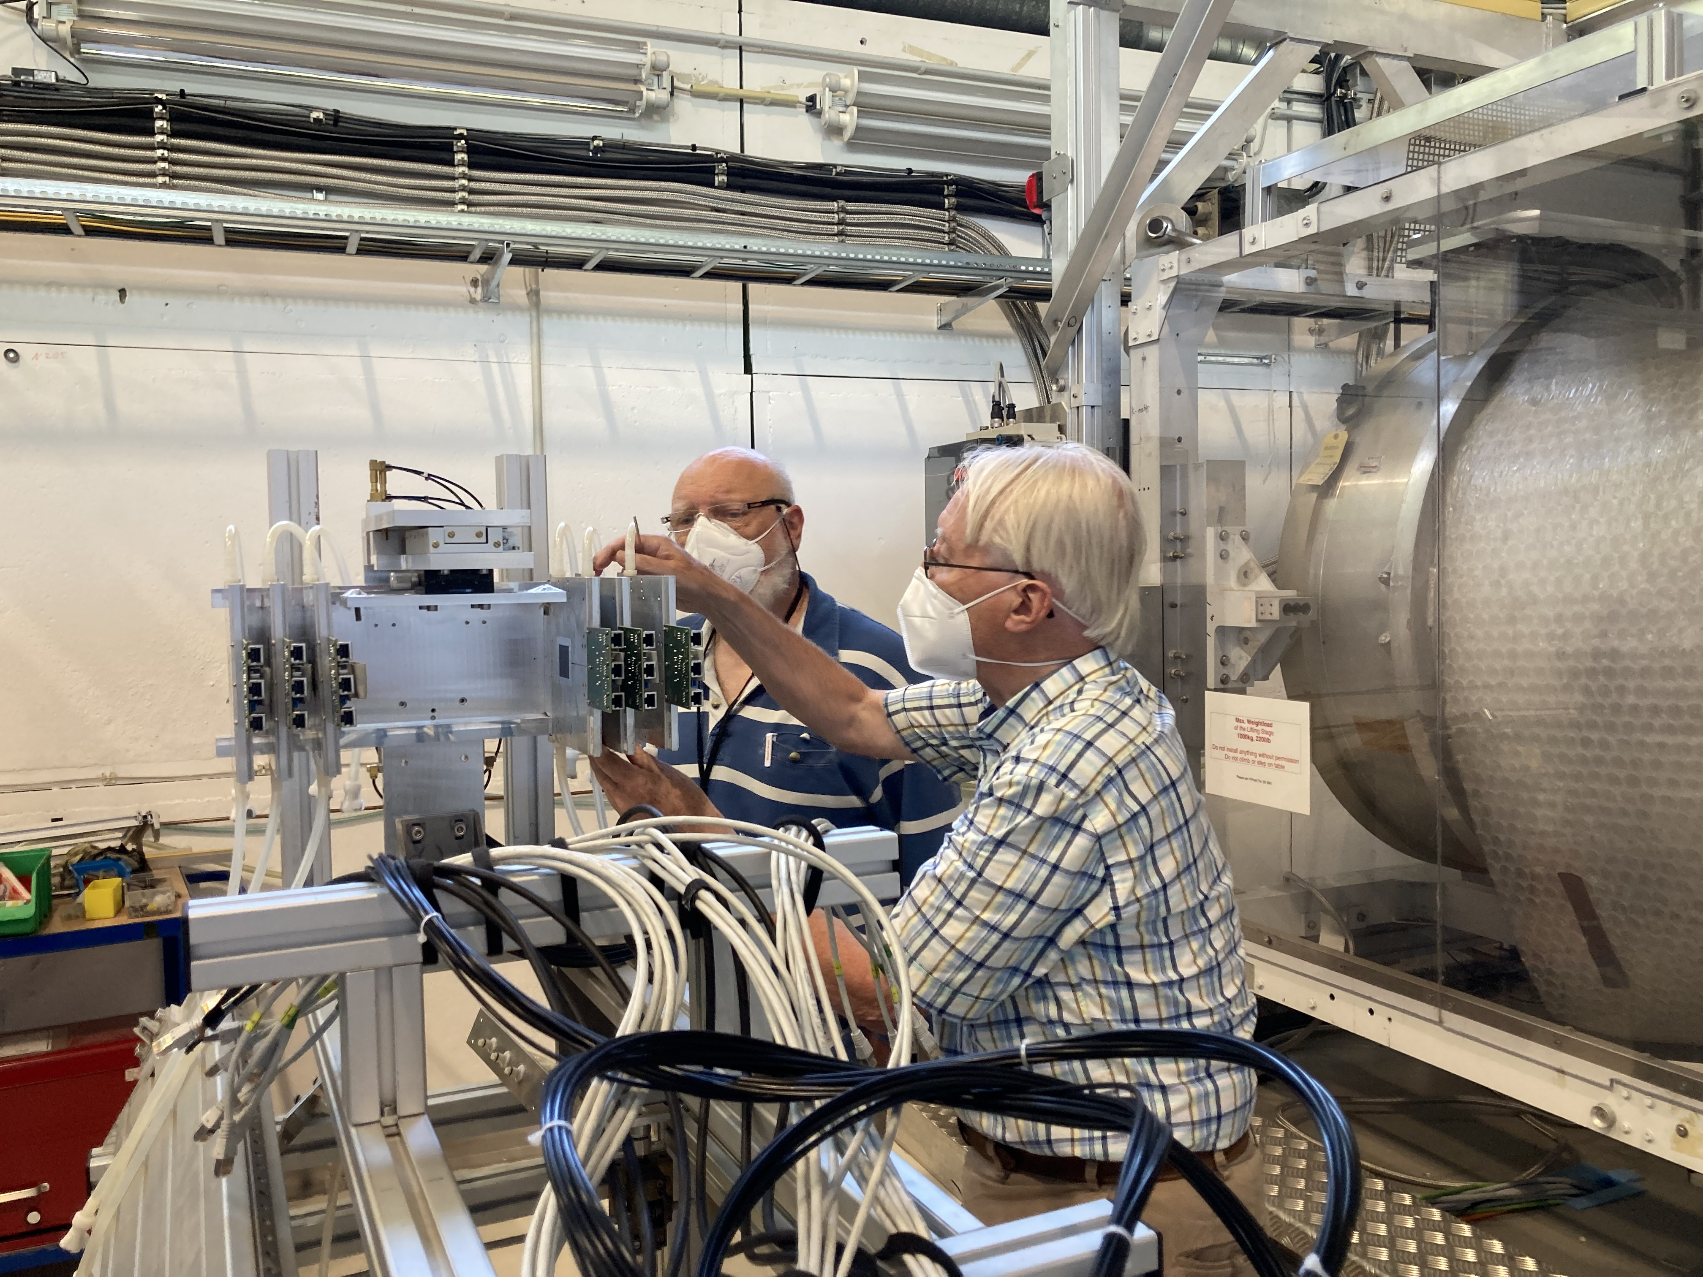
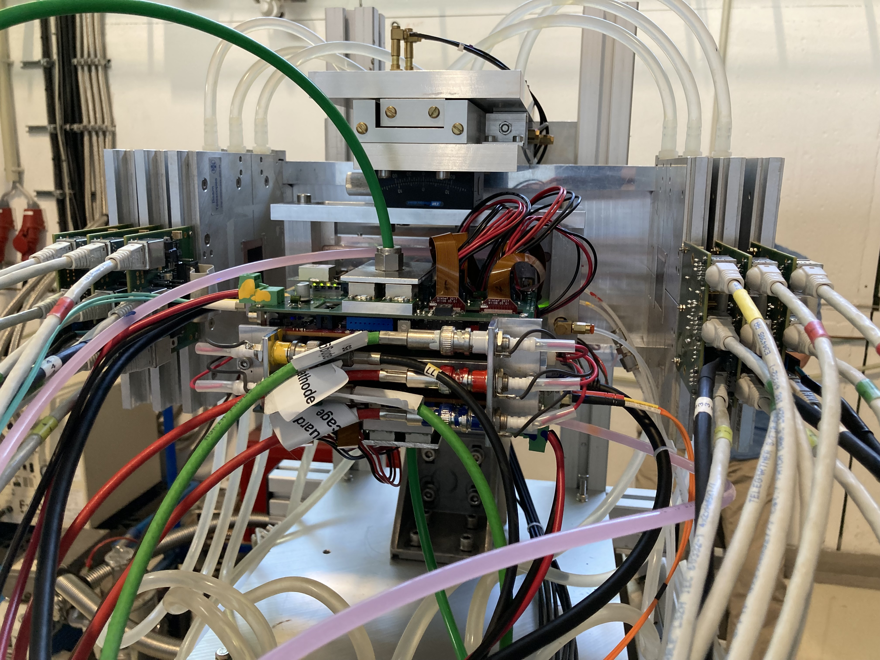
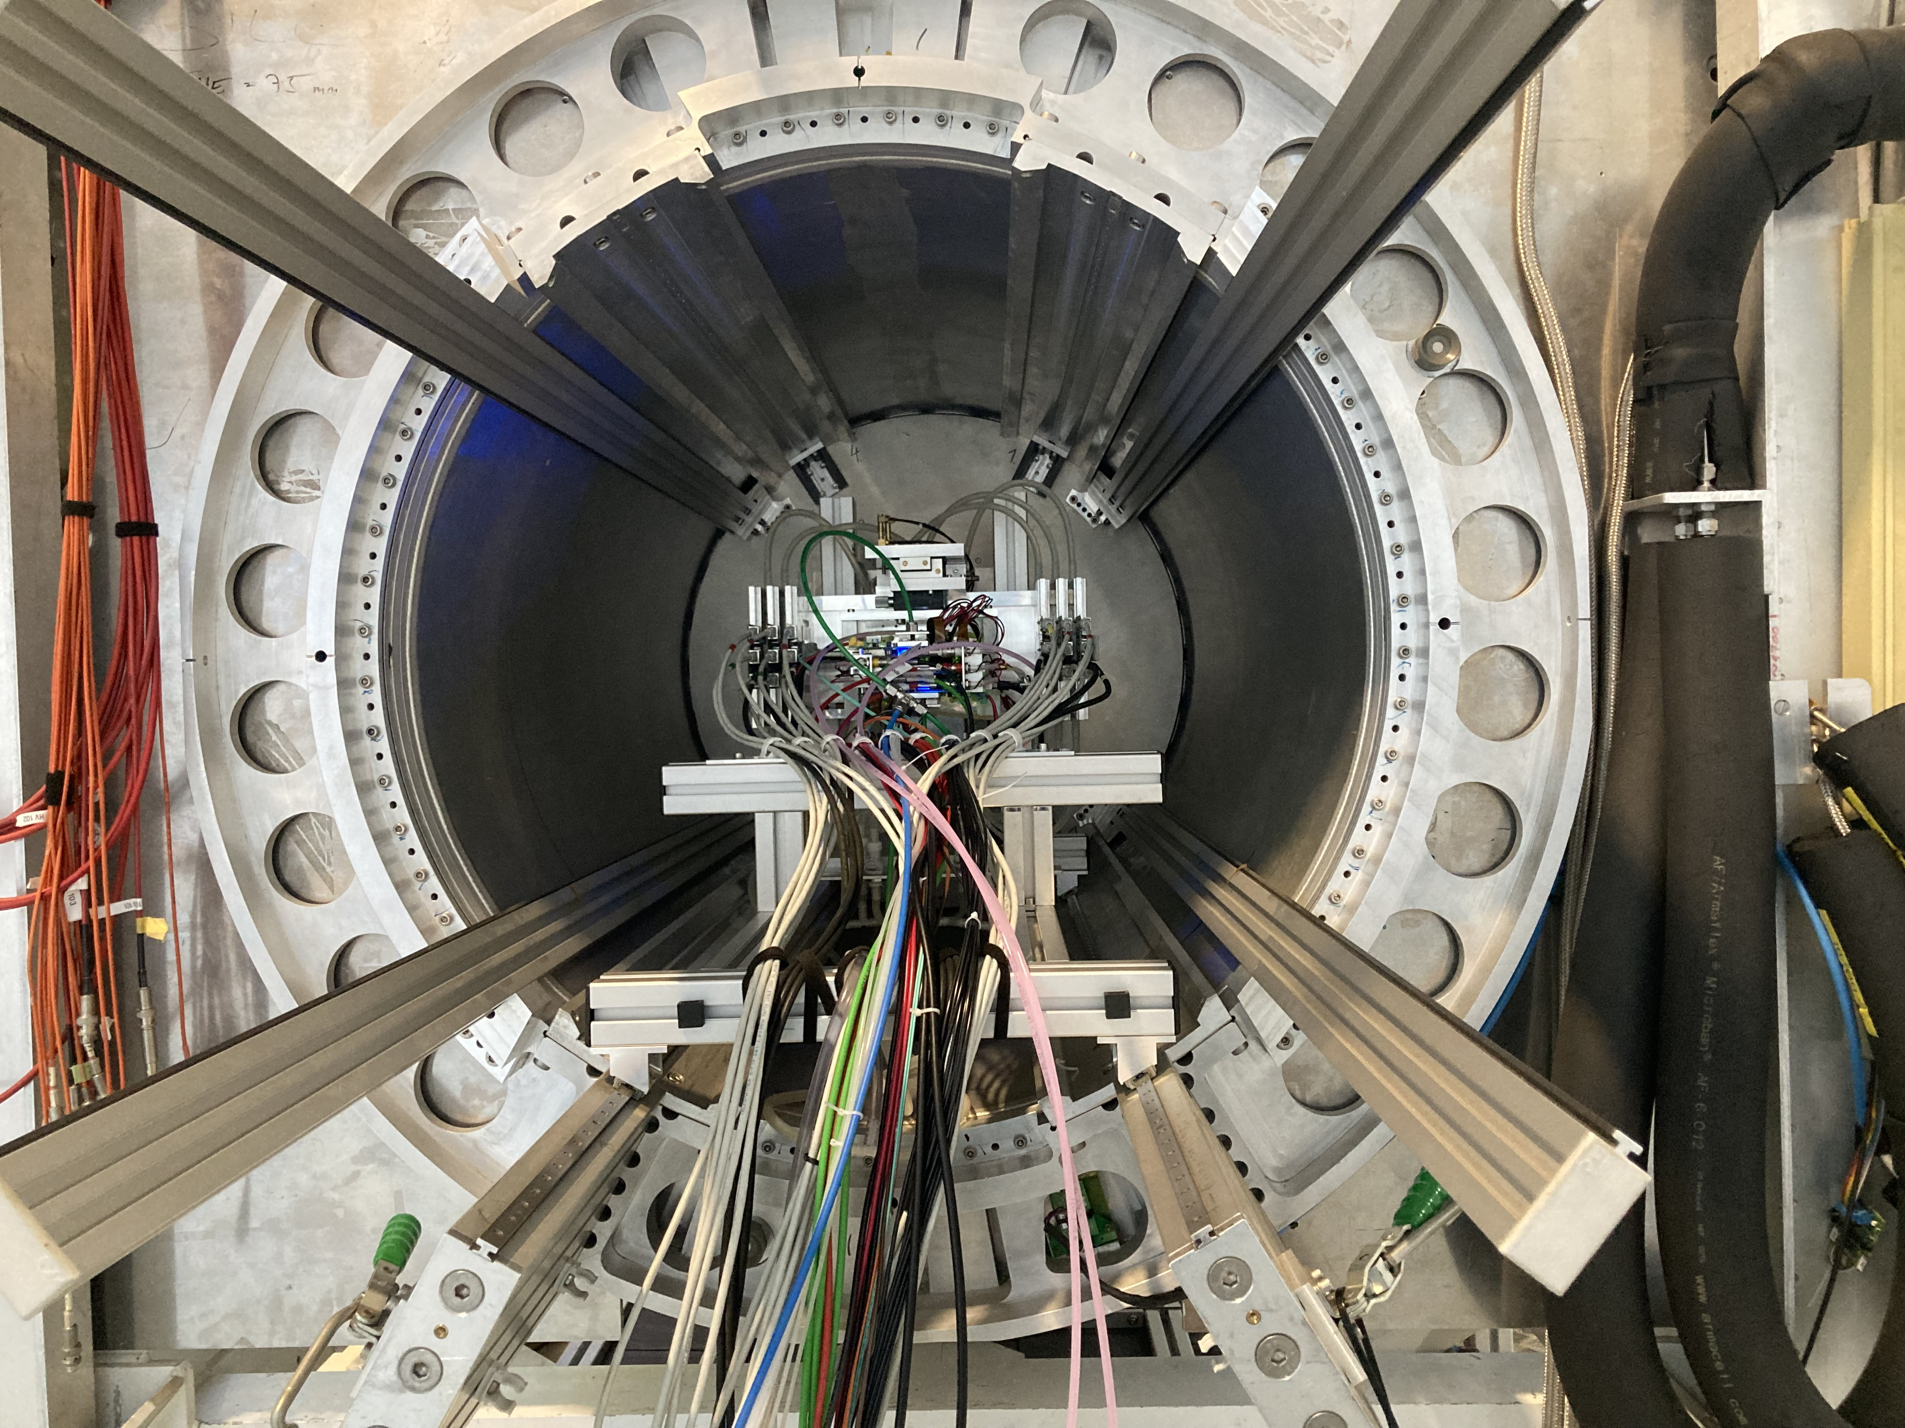
DESY testbeam June 2021
Mounting the 8 quad module between the silicon planes
sliding it into the 1 T PCMAG solenoid

Slide 17
DESY testbeam June 2021

Slide 18
DESY testbeam Module Analysis
Event display with module and telescope
TPX3 track 1130 hits
χ²_{xy} = 677.5/1128
χ²_{z} = 775.9/1069
Asymmetric tail outlier removal applied 1071 hits in z kept.
TPX3 track hits
Telescope track hits (off track green)
Preliminary
x global
x local
z global
y local
z global
y global
z local drift
y local

Slide 19
DESY testbeam Module Analysis
Run 6916 B=0 T p =6 GeV
Preliminary
8-quad module tracking precision:
position 9 μm (xy) 13 μm (z)
angle 0.19 mrad (dx/dy) 0.25 (dz/dy) mrad
module tracklength = 157.96 mm
Note that in a B field because of the reduced diffusion the tracking precision will improve substantially
964 selected tracks
Impressive 1009 hits / track

Slide 20
DESY testbeam Module Analysis
Run 6916-6918 B=0 T p=6 GeV
Three runs at different drift distances
Preliminary

Slide 21
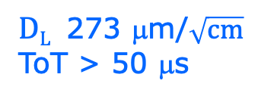

DESY testbeam Module Analysis
Run 6916-6918 B=0 T p=6 GeV
Fitted hit resolution
$$σxy,z2=σ2xy0,z0+D2xy,z \left(z−z0\right)$$
σ² _{xy0}= σ²_{pixel} + σ²_{xy tele} σ²_{pixel}= 55²/12 μm²
σ_{xy tele}=35 μm
$DT$ 287 μm/$\sqrt{cm}$
$DL$ 273 μm/$\sqrt{cm}$
ToT > 50 μs
Preliminary
In red the curve published single chip results
T2K* = T2K gas with admixture of O₂ and H₂O
B=0 T
T2K*
E_{d}=280 V/cm

Slide 22
DESY testbeam Module Analysis
Runs 6909, 6916-17, 6934-35 B=0 T p =6,5 GeV
Mean residuals in the module plane with acceptance cuts
There are clear deformations in xy for the chips in the 4 corners.
The field around chip 11 (no grid HV) is affected.
The Efield defined by the field cage is in these areas not homogenous enough
Preliminary
xy
Vertical white bands guards
z

Slide 23
DESY testbeam Module Analysis
Runs 6909, 6916-17, 6934-35 B=0 T p =6,5 GeV
Mean residuals xy in the quad plane no acceptance cut
Columns horizontal
Granularity 8x8 pixels
Only small deformations at the chip column edges.
This means that the guard and guard wires are well tuned.
At the column edges the efficiency drops and introduces a bias (in local x).
Preliminary

Slide 24
DESY testbeam Module Analysis
Runs 6909, 6916-17, 6934-35 B=0 T p =6,5 GeV
Distribution of mean residuals in the plane
Method row
z
Two methods (row/column) that group the module plane were used
xy
method | rms (stat) xy | bins xy | rms (stat) z | bins z
row | 10 (6) μm | 2881 | 14 (8) μm | 2850
column | 12 (7) μm | 2901 | 13 (8) μm | 2843
Preliminary
Method column
We did not include the 4 corner chips and (11), 14, 8, 13 and 19.
These are affected by the field cage and the short in chip 11.

Slide 25
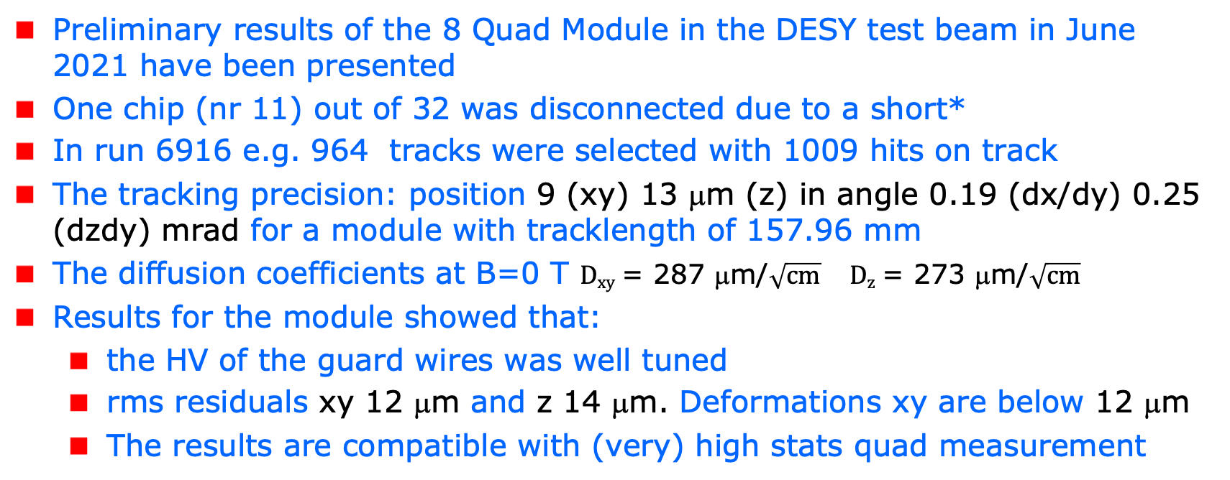
Preliminary Conclusions
Preliminary results of the 8 Quad Module in the DESY test beam in June 2021 have been presented
One chip (nr 11) out of 32 was disconnected due to a short*
In run 6916 e.g. 964 tracks were selected with 1009 hits on track
The tracking precision: position 9 (xy) 13 μm (z) in angle 0.19 (dx/dy) 0.25 (dzdy) mrad for a module with tracklength of 157.96 mm
The diffusion coefficients at B=0 T $Dxy$ = 287 μm/$\sqrt{cm}$ $Dz$ = 273 μm/$\sqrt{cm}$
Results for the module showed that:
  the HV of the guard wires was well tuned
  rms residuals xy 12 μm and z 14 μm. Deformations xy are below 12 μm
  The results are compatible with (very) high stats quad measurement
*Chip 11 was successfully repaired in 2023 in Bonn

Slide 26
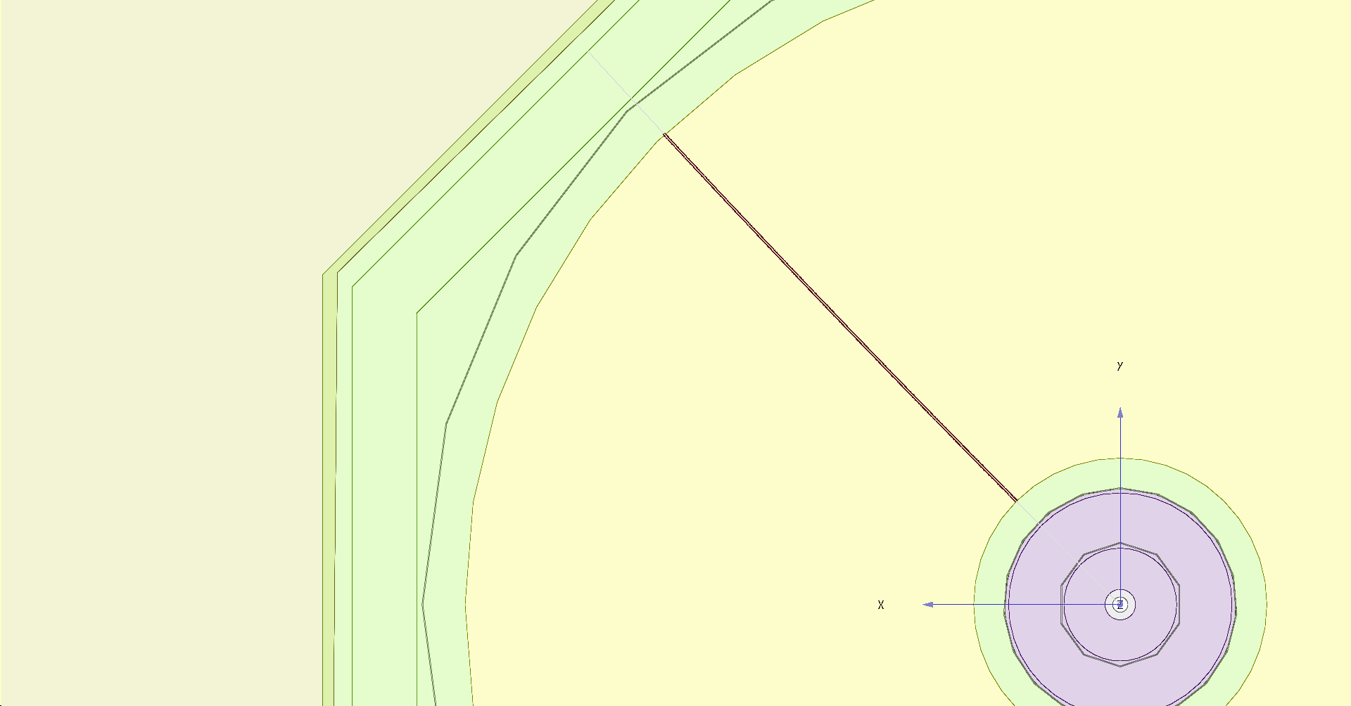
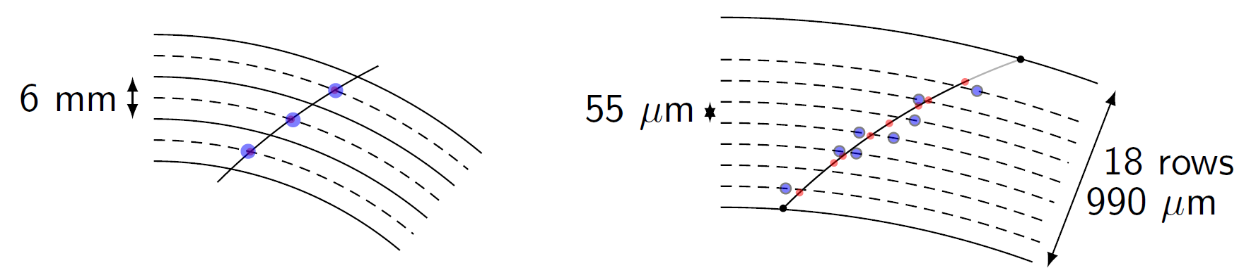
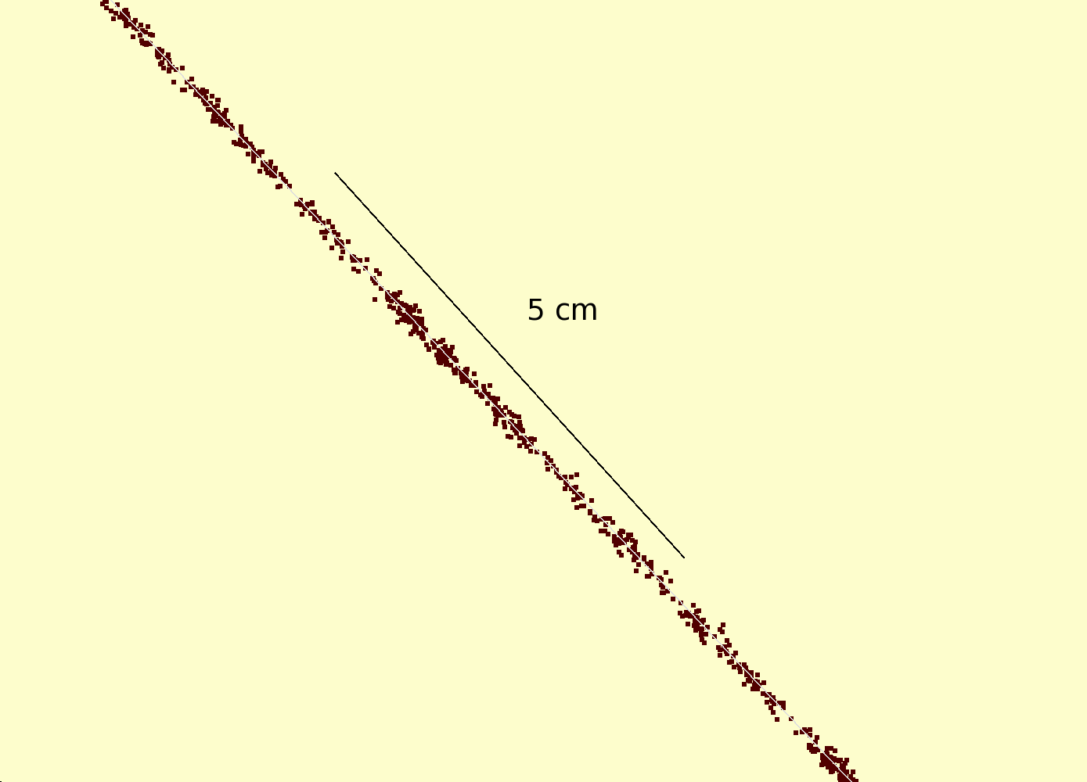
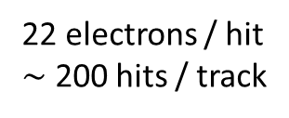
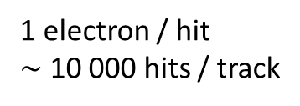
Simulation of ILD TPC with pixel readout
To study the performance of a large pixelized TPC, the pixel readout was implemented in the full ILD DD4HEP (Geant4) simulation
Changed the existing TPC pad readout to a pixel readout
Adapted Kalman filter track reconstruction to pixels
details: PhD thesis Kees Ligtenberg
pixels
pads
50 GeV muon track with
pixel readout

Slide 27
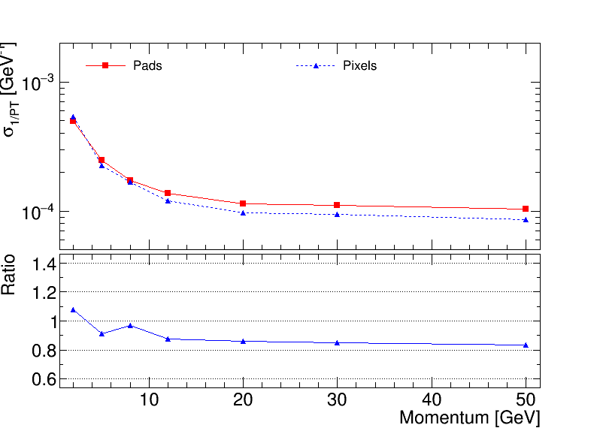
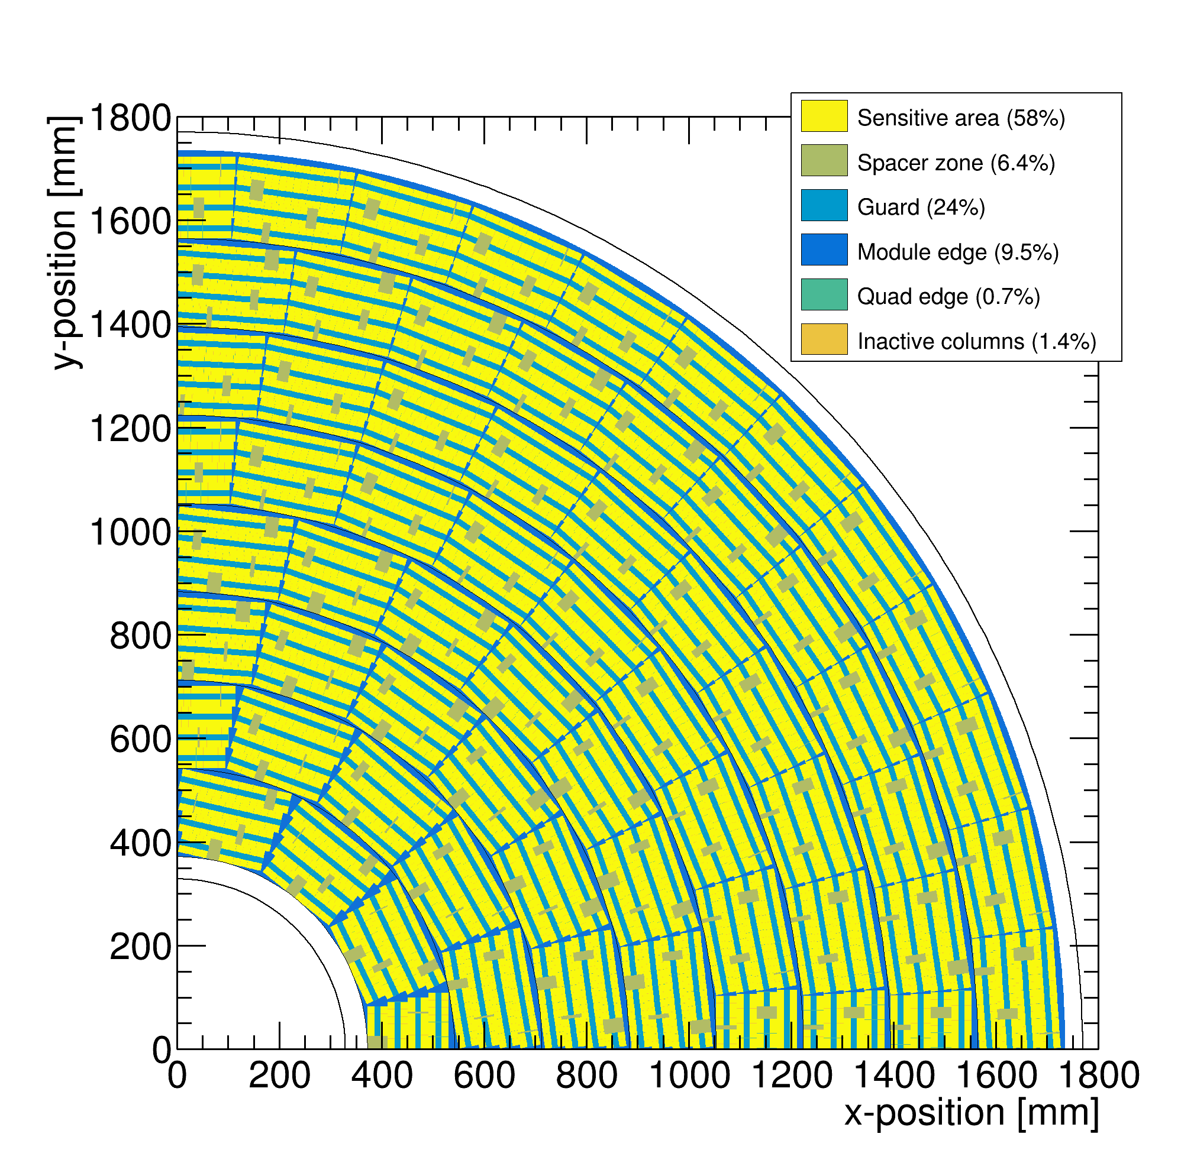
Performance of a GridPix TPC at ILC
From full simulation the momentum resolution can be determined
Momentum resolution is about 15% better for the pixels with realistic coverage (with the quads arranged in modules coverage 59%) and deltas.

Slide 28
Power consumption and cooling
The power consumption of the TPX3 chip is ~1 W/cm².
At the ILC – due to the beam structure - the chip can be ran in power pulsing mode. Reducing the power consumption by more than a factor of 10.
The power consumption of the TPX3 chip can be reduced by
a factor of 5-10 by using different DAC settings.
Cooling remains important.
A test of the CO2 cooling of Micro Megas integrated modules showed it works fine.

Slide 29
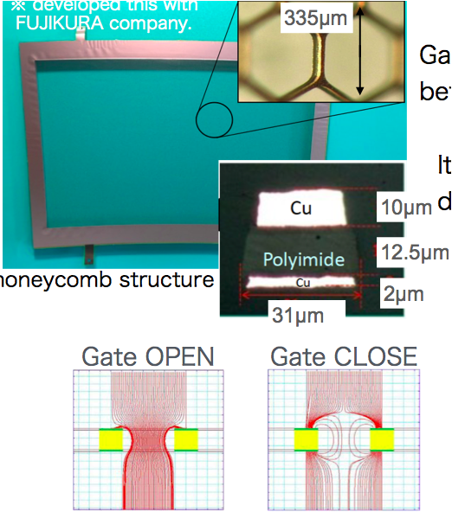
Reducing the Ion back flow in a TPC
Part of the ions created in the avalanche drift back in the TPC drift volume will cause (limited) distortions.
The Ion back flow can be reduced at ILC by using a gating GEM gating device placed above the read out module. The gate is opened and closed based on the beam structure.
For a Pixel TPC a double grid structure will be developed (see backup slide ) that reduces the ion back flow without the need of gating.
This will also allow operation with a more continuous beam (FCC-ee/CEPC).
LCWS19 by Yumi Aoki (KEK))

Slide 30
Summary of the Pixel TPC performance
A single chip GridPix detector was reliably operated in a test beam in 2017
  Single electron detection => the resolution is primarily limited by diffusion
  Systematic uncertainties are low: < 10 µm in the pixel xy plane
  dE/dx resolution for a 1 m track is 4.1%
  A Quad detector was designed and the results from the 2018 test beam shown
  Small edge deformations at the boundary between two chips are observed
    added guard wires to the module to obtain a homogeneous field
    After correcting the edges, deformations in the transverse plane shown to be < 15 µm
An 8-Quad module has been designed with guard wires
Preliminary 2021 test beam results are excelllent deformations (in xy or z) < 15 µm
A test beam @ FermiLab with the module in a TPC is planned (US Grant EIC)
A pixel TPC has become a realistic viable option for experiments
  High precision tracking like ILD@ILC in the transverse and longitudinal planes, dE/dx by electron and cluster counting, excellent two track resolution, digital readout that can deal with high rates

Slide 31
Back up slides follow

Slide 32
Reducing the Ion back flow in a Pixel TPC
The Ion back flow can be reduced by adding a second grid to the device.
It is important that the holes of the grids are aligned. The Ion back flow is a function of the geometry and electric fields. Detailed simulations – validated by data - have been presented in LCTPC WP #326.
With a hole size of 25 μm an IBF of 3 10⁻⁴ can be achieved and the value for IBF*Gain (2000) would be 0.6.
Ion backflow | Hole 30 μm | Hole 25 μm | Hole 20 μm
Top grid | 2.2% | 1.2% | 0.7%
GridPix | 5.5% | 2.8% | 1.7%
Total | 12 10⁻⁴ | 3 10⁻⁴ | 1 10⁻⁴
transparancy | 100% | 99.4% | 91.7%

