Slide 1





R&D for a Pixelated Time Projection Chamber
Yevgen Bilevych, Klaus Desch, Harry van der Graaf, Fred Hartjes, Jochen Kaminski, Peter Kluit, Naomi van der Kolk,
Cornelis Ligtenberg,
Gerhard Raven, and
Jan Timmermans
LCTPC workshop follow up

Slide 2
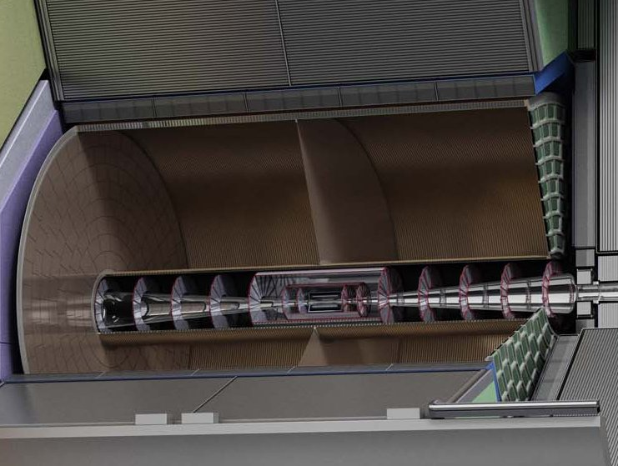



Pixel TPC
(Octopuce)
(TimePix1) TPX3 chip Quad Module TPC plane
(2007-14) 2017 2018 2019

Slide 3
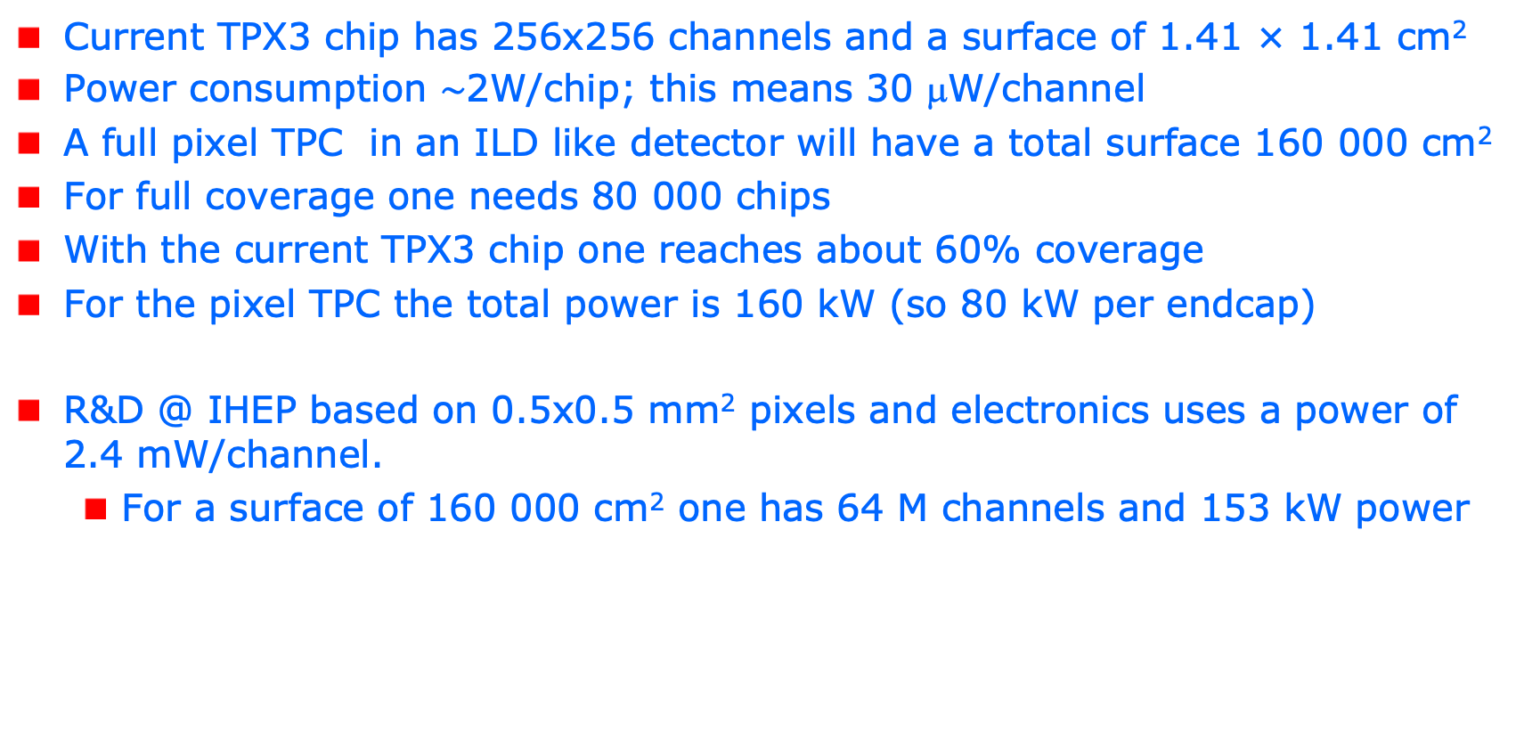
R&D topics: power consumption
Current TPX3 chip has 256x256 channels and a surface of 1.41 × 1.41 cm²
Power consumption $\sim$2W/chip; this means 30 μW/channel
A full pixel TPC in an ILD like detector will have a total surface 160 000 cm²
For full coverage one needs 80 000 chips
With the current TPX3 chip one reaches about 60% coverage
For the pixel TPC the total power is 160 kW (so 80 kW per endcap)
R&D @ IHEP based on 0.5x0.5 mm² pixels and electronics uses a power of 2.4 mW/channel.
  For a surface of 160 000 cm² one has 64 M channels and 153 kW power

Slide 4
power consumption for TPX4
The most elegant solution to reduce the power consumption is - according to Nikhef electronics engineer V. Gromov - by
  reducing the currents (gain) in the pre-amplifier and discriminator; this will affect (worsen) the time resolution. An option to reduce the digital power is to lower the clock frequency to e.g. 10-25 Mhz
  Unfortunately, reducing the nr of channels does not help; increasing the nr of channels does help, because of the noise reduction (smaller pixels less noise).
For the TPX4 chip the power in standard operation is 1 W/chip (0.5 W/cm²)
A special setting “low power mode” has been prepared for TPX4 reducing the power consumption by a factor of 5 (see next slide for the TPX4 settings).

Slide 5
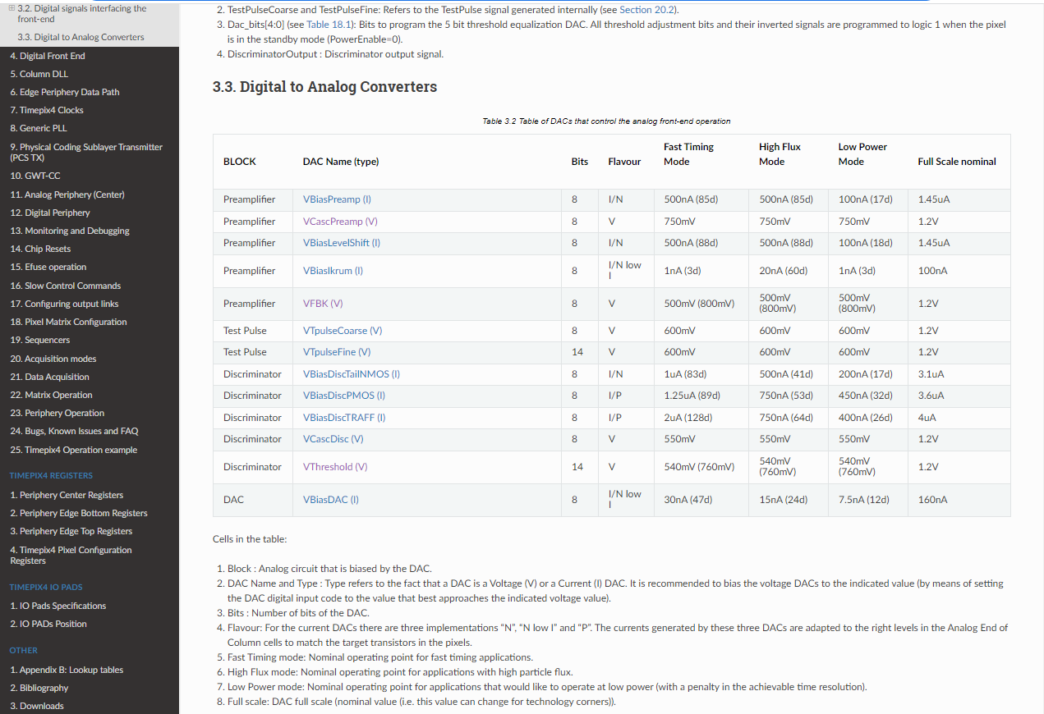
R&D: low power mode TPX4
VBiasPreamp I
VBiasLevelShift (I)
VBiasIkrum
VBiasDiscTailNMOS
VBiasDiscPMOS
VBiasDAC

Slide 6
R&D: TPX3 power consumption
The Medipix collaboration (CERN and Czech groups) carefully investigated the possibilities of the reduction of the power consumption for the TPX3 chip
The results can be found at
  Ref1 https://iopscience.iop.org/article/10.1088/1748-0221/14/01/C01024
  Ref2 https://iopscience.iop.org/article/10.1088/1748-0221/14/01/C01001
The analog power consumption can be reduced by a factor 10 [Ref1]
If also the digital power consumption is reduced by lowering the clock frequency from 40MHz to 10 MHz, the total power consumption was show to be 0.216 W per chip [ref2]
Standard settings uses 25 nsec bins and ‘low power’ 100 ns bins.
So running at lower power will worsen the time resolution
Note that this will bring down the power per endcap to 8 kW
The low power dac settings can be found on slide 7

Slide 7
TPX3 power

Slide 9
Low power dacs for TPX3
# TPX3 DAC settings
# lines starting with # are skipped
#
# reg_nr reg_value
#
1 8 # TPX3_IBIAS_PREAMP_ON [0-255]
2 8 # TPX3_IBIAS_PREAMP_OFF [0-15]
3 128 # TPX3_VPREAMP_NCAS [0-255]
4 10 # TPX3_IBIAS_IKRUM [0-255]
5 128 # TPX3_VFBK [0-255]
6 420 # TPX3_VTHRESH_FINE [0-512]
7 6 # TPX3_VTHRESH_COARSE [0-15]
8 8 # TPX3_IBIAS_DISCS1_ON [0-255]
9 8 # TPX3_IBIAS_DISCS1_OFF [0- 15]
10 8 # TPX3_IBIAS_DISCS2_ON [0-255]
11 8 # TPX3_IBIAS_DISCS2_OFF [0-15]
12 20 # TPX3_IBIAS_PIXELDAC [0-255]
13 128 # TPX3_IBIAS_TPBUFIN [0-255]
14 128 # TPX3_IBIAS_TPBUFOUT [0-255]
15 128 # TPX3_VTP_COARSE [0-255]
16 256 # TPX3_VTP_FINE [0-512]
17 128 # TPX3_IBIAS_CP_PLL [0-255]
18 128 # TPX3_PLL_VCNTRL [0-255]

Slide 10
R&D: TPX3 power consumption
For the GridPix it is possible to test the
  Single chip new DAC settings plus lower clock frequency
  Quad new DAC settings plus lower clock frequency
  Module new DAC settings only
The current design of the concentrators in the 32 chip module is based on a 40 MHz clock. This cannot be changed. So this will need a re-design of the concentrators. The concentrator combines the data streams and controls of 16 chips.
For EIC I have prepared a set of low power dac settings
Main conclusion is that running the TPX3 Gridpixes in low power mode reduces the power consumption for a pixel TPC to say 8 kW per endcap. Pretty good.

