Slide 1
EIC information
The DAQ computer Arawana has login gastpx and pwd Gastpx
The Slow Controls Computer Levaard uses Labview
login pwd @dministrat0r (so zero r)
We took data in DESY with E_{d}=280 V/cm
The grid was put at V_{grid} = 340 V
The surrounding guard (yellow) 355 V
The guard (white) was put at 359 V
The guard wires were put at 380 V
Guard and Guard wires
The guard (white area) sits about 1 mm above the grid. The guard wires (red) 50 μm CuBe are not connected to the guard; about 200 μm above it. The layout can be seen on the next slide.

Slide 2
8-QUAD module with field cage
in red guard wires
in white guard
In yellow surround guard

Slide 3
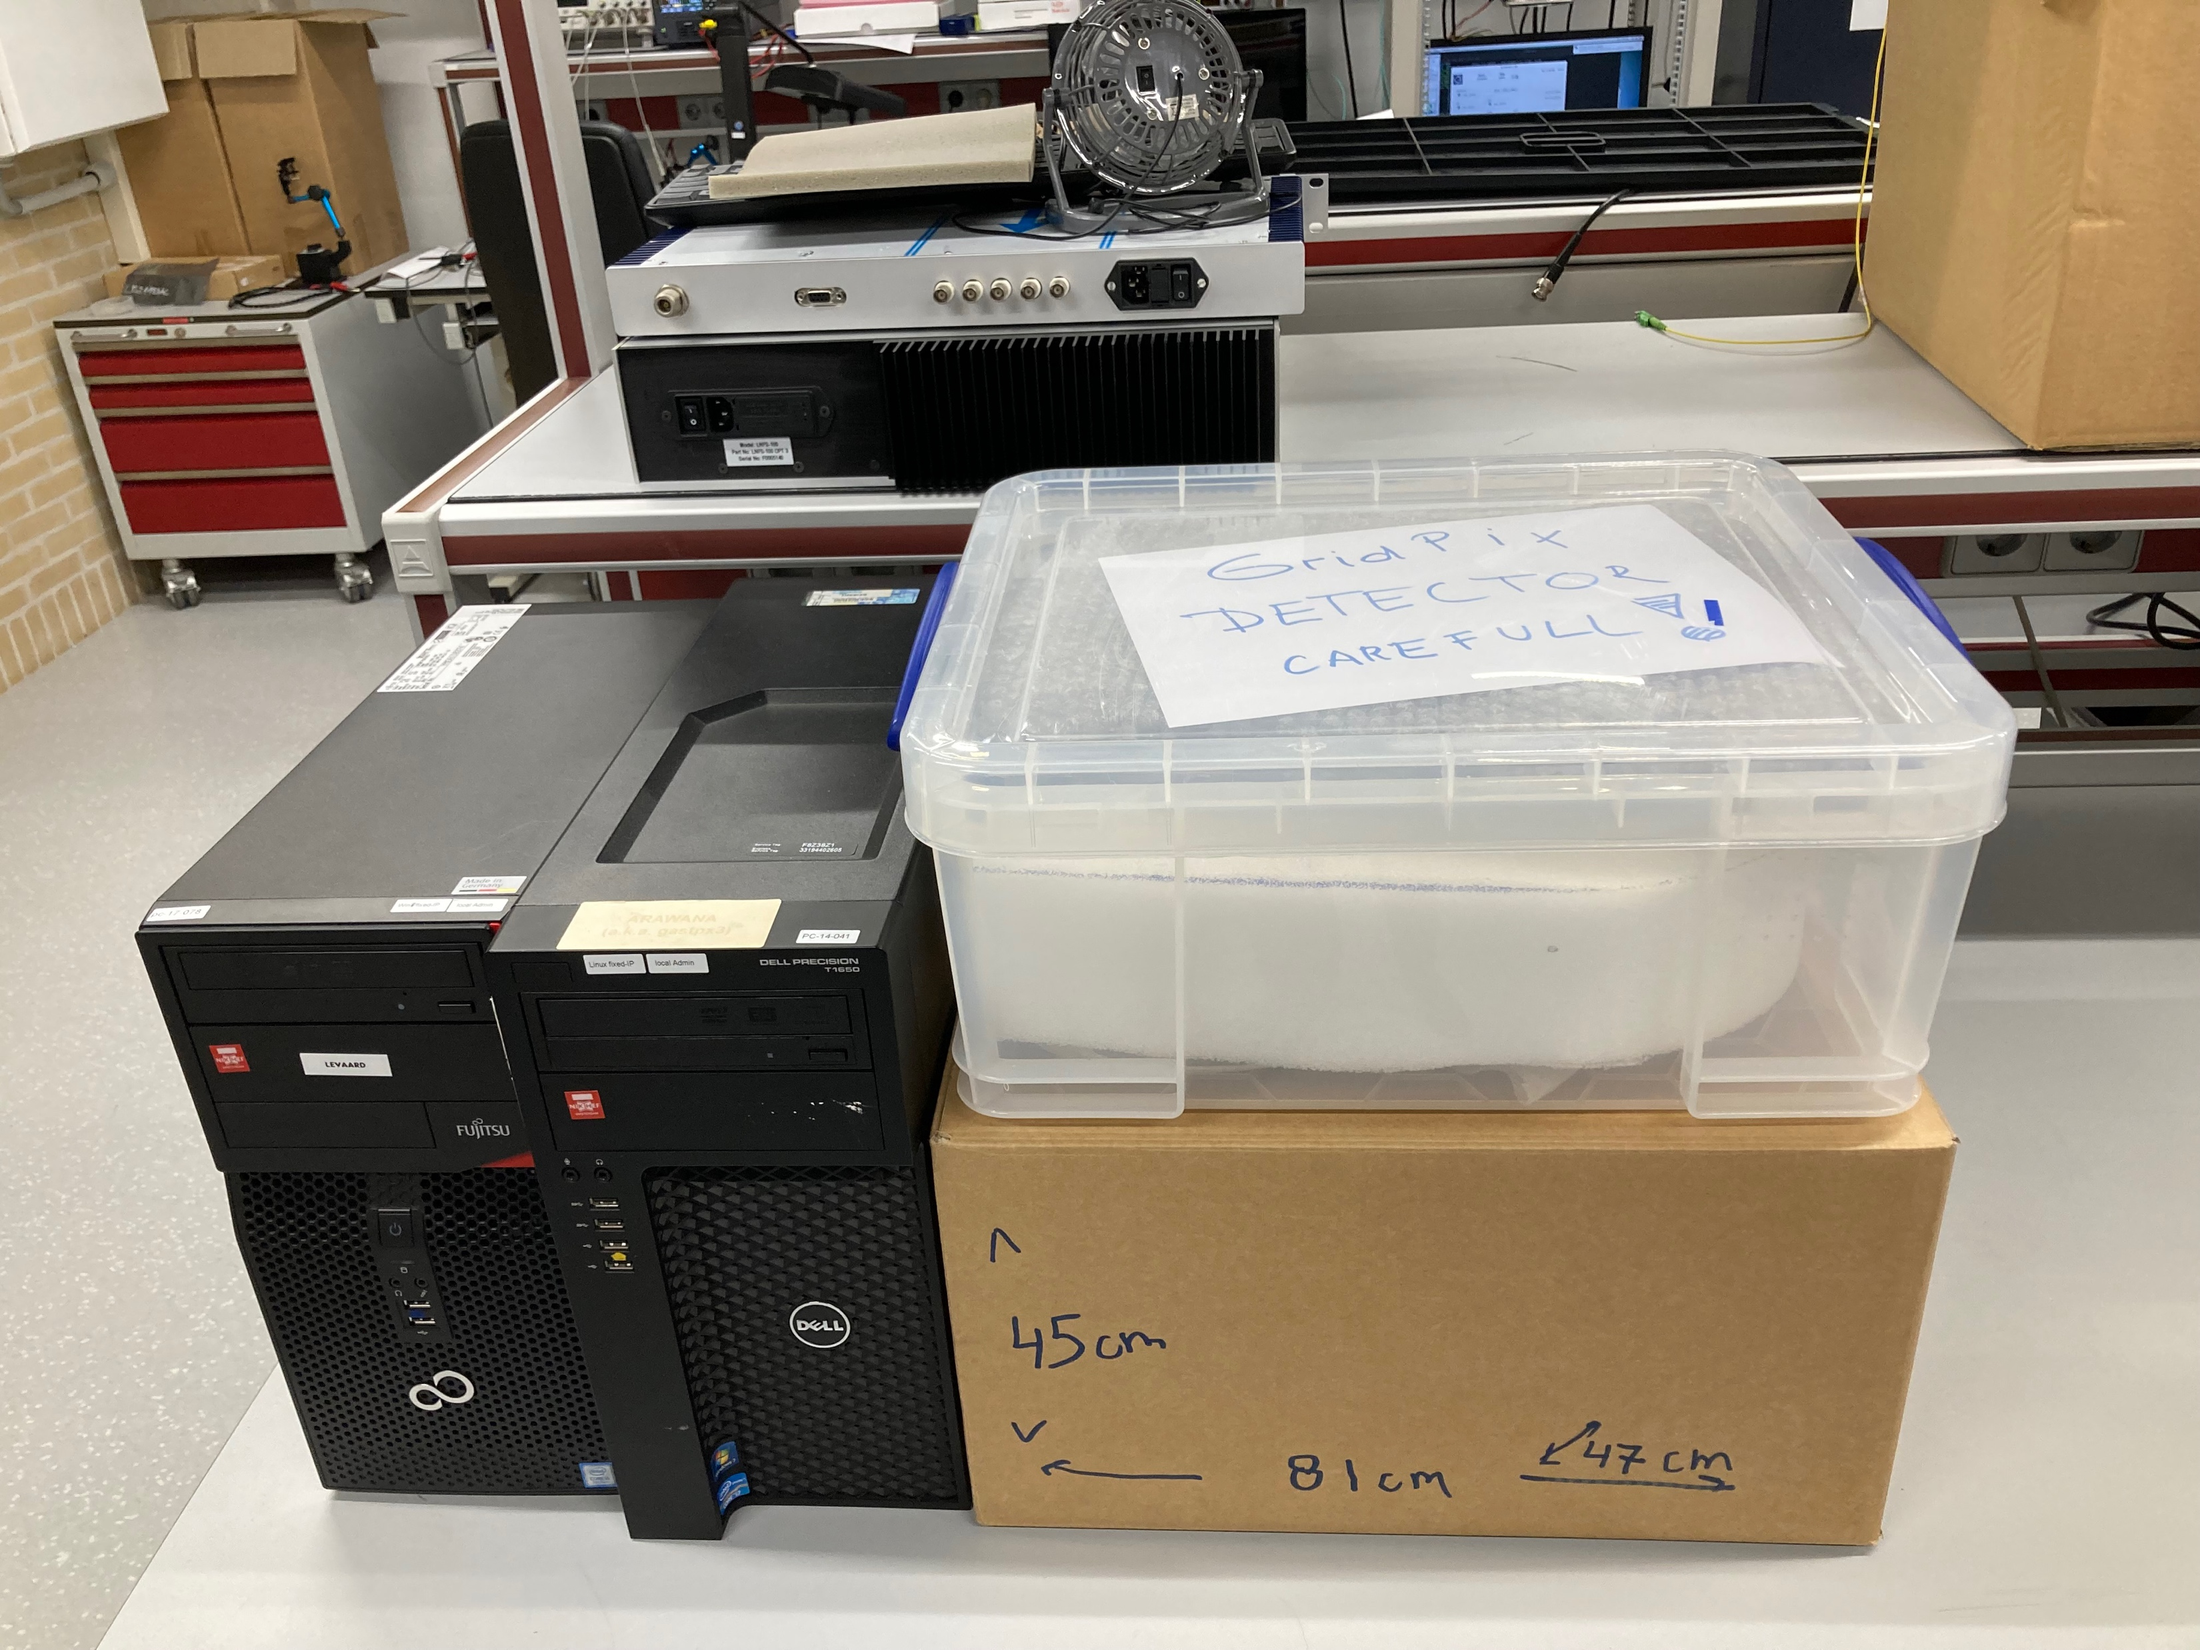
Prepared boxes
Dimensions in cm (no margin)
length depth height
45 47 81
Wooden box should be
50 x 50 x 85 cm³

Slide 4
List of items to be transported to US
- 32 chip detector with protection box and concentrators
- main SPIDR with adaptor
- trigger SPIDR with adaptor
- computer DAQ Arawana (linux)
- cables to connect detector/trigger/DAQ system
- Mini HVs
- controllers
- computer Slow Controls Levaard (windows)
- cables to connect slow controls

