Slide 1
Equalization
Goal of equalization is to measure and adjust (trimming) the noise level of all chips and channels in the module and apply masking to reduce the noise tail.
- The results are stored for running (later) in
/localstore/TPX3/localCONFIGS/Module/W*_dacs.txt
/localstore/TPX3/localCONFIGS/Module/W*_trimdacs.txt
- W* is the chipid the dacs contains the general setting of TPX3
the trimdacs the per channel value and the masked bit
As a starting point the DESY equalisation was taken
The equalisation was excellent (see next slides) and a test run was done to (re)determine the mean noise level and mask pixels with a too high noise level.

Slide 2
Equalization
cd /localstore2/TPX3/user/cligtenb/equalise_conc/
Equalise_concentrator -t all
the program asks for spacing put in 4 and chips put in -1 (all)
it produces files: all_spacing_4_chip_-1_link0_equalised.root
all_spacing_4_chip_-1_link1_equalised.root LOGFILE outall.log
(here I don’t discuss full (-f) equalization starting from scratch)
With the *equalised.root files one can plot see the result per chip (and channel).. There are .C macros to compare *_trimdac.txt files and look at the mean noise.
The final plots and values are extracted by running maskTrim.C.
Note that the trim dac values are kept as in the DESY run.
There is masking applied to channels with a too high noise level
The code contains code to extract the mean noise level also in case of side peaks etc.
Root > .L maskTrim.C Root > maskTrim(-1)
LOGFILE output_maskTrim.log

Slide 3
Checking the noise level of the chips
DESY NEW DESY NEW
W0030_F06 (1e66) chipnr 0 289 286
W0030_E07 (1e75) chipnr 1 318 316
W0030_F07 (1e76) chipnr 2 294 291
W0030_M05 (1e5d) chipnr 3 296 295
W0023_H09 (1798) chipnr 4 304 301
W0023_I09 (1799) chipnr 5 287 285
W0023_I06 (1769) chipnr 6 275 275
W0023_F09 (1796) chipnr 7 288 289
W0030_C07 (1e73) chipnr 8 260 261
W0030_C08 (1e83) chipnr 9 268 267
W0030_C09 (1e93) chipnr 10 300 301
W0030_K05 (1e5b) chipnr 11 311 314
W0023_E09 (1795) chipnr 12 316 317
W0023_D08 (1784) chipnr 13 319 319
W0023_E08 (1785) chipnr 14 289 288
W0023_H08 (1788) chipnr 15 306 306
W0030_G03 (1e37) chipnr 16 312 312
W0030_I04 (1e49) chipnr 17 307 307
W0030_A05 (1e51) chipnr 18 257 256
W0030_H02 (1e28) chipnr 19 292 291
W0023_E04 (1745) chipnr 20 301 299
W0023_F04 (1746) chipnr 21 279 277
W0023_G04 (1747) chipnr 22 267 267
W0023_H03 (1738) chipnr 23 270 269
W0023_I04 (1749) chipnr 24 323 320
W0023_D05 (1754) chipnr 25 238 235
W0023_E05 (1755) chipnr 26 274 273
W0023_H04 (1748) chipnr 27 246 244
W0023_D06 (1764) chipnr 28 258 261
W0023_H06 (1768) chipnr 29 308 312
W0023_J06 (176a) chipnr 30 260 265
W0023_J05 (175a) chipnr 31 371 380

Slide 4
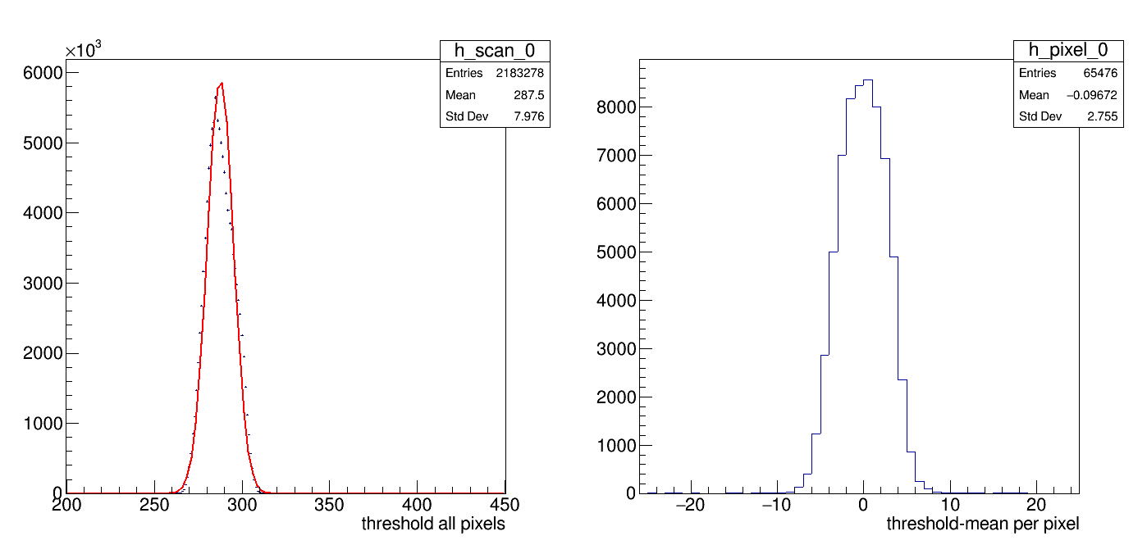
Equalisation results chip 0
ThresholdFinalChip0.gif
One has sigma noise is 7.9 counts and the tune per pixel is 2.8 counts
One trim dac unit corresponds to 12 counts . So one expects 12/sqrt(12.)

Slide 5
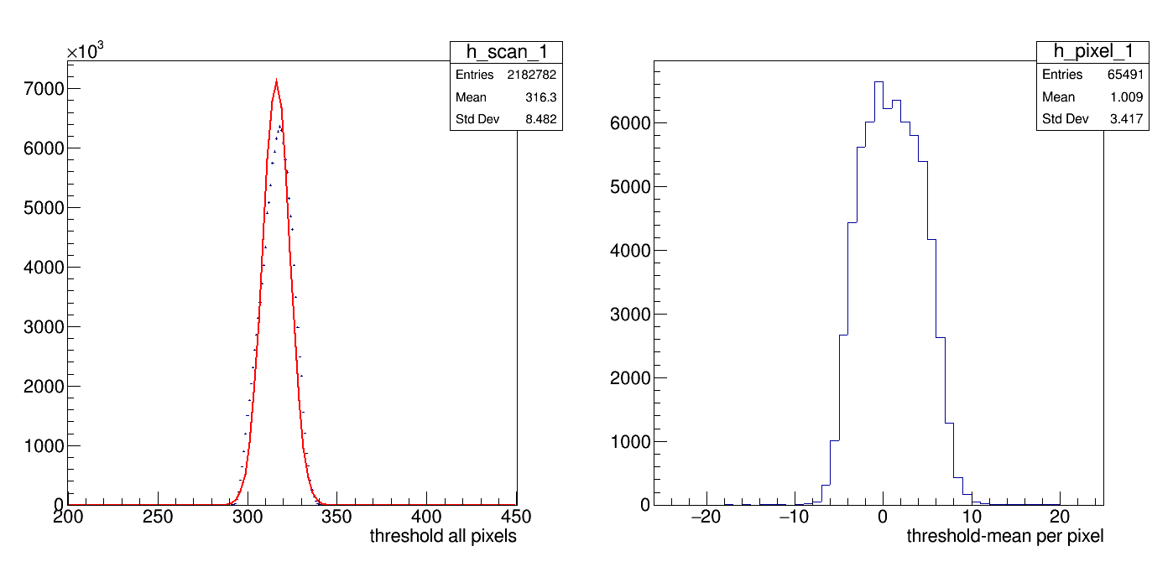
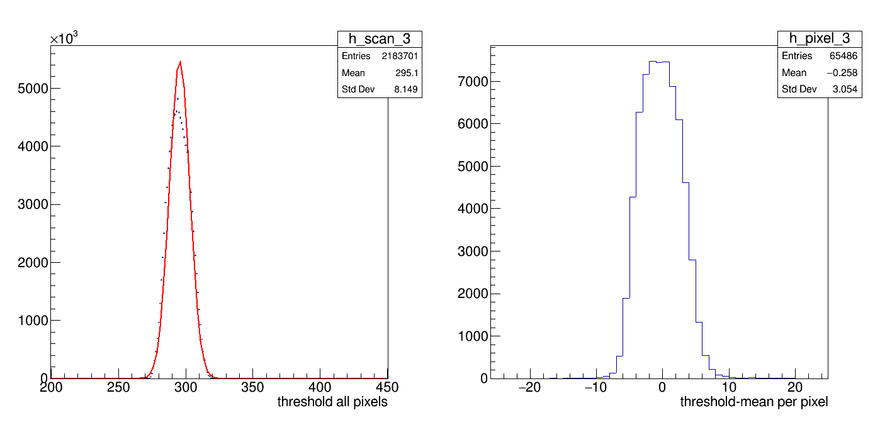
Equalisation results chip 1-3
Chip 0 see previous slide

Slide 6
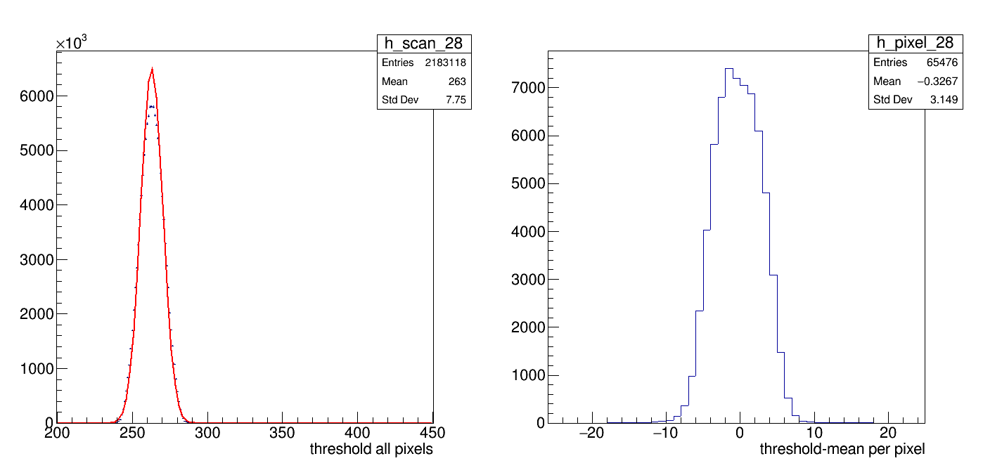
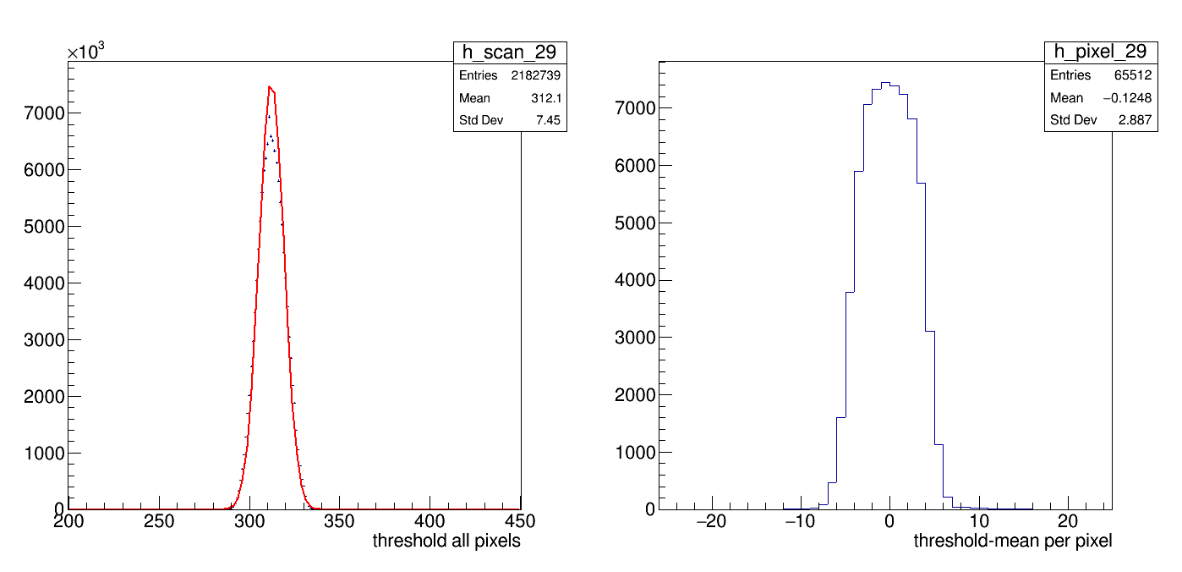
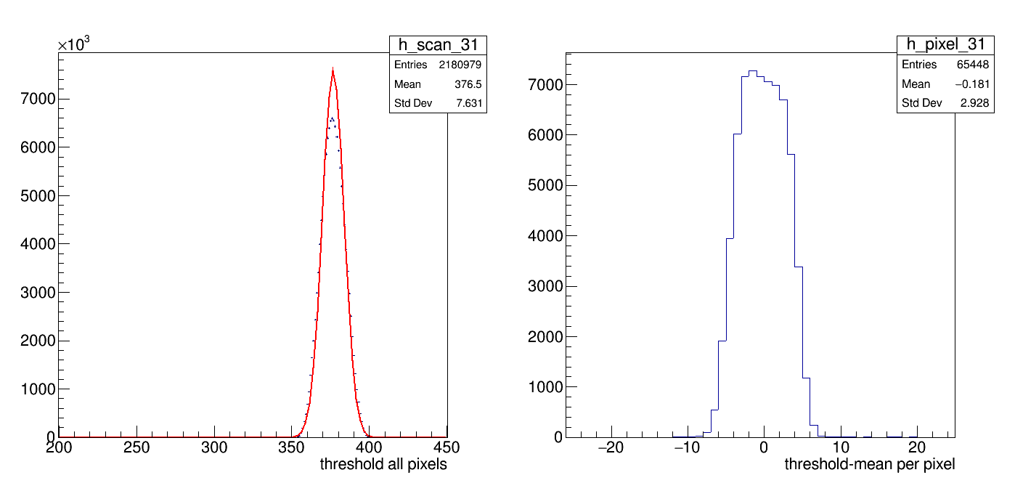
Equalisation results chip 28-31
Chip 30 not in read out

Slide 7
Conclusions (February) on equalisation
As a baseline the trim dac values for the DESY run were taken. They are excellent. The masking of pixels helps to get rid of the upper tail of the noise spectrum.
Also the chips 28-31 that had lower efficiencies in the DESY run look well tuned. The mean dac values is slightly adjusted. NB one can observe 5 counts changed wrt DESY.
The equalization is well done and doesnot have to redone for EIC, but the procedure/principle should be understood
The new EIC dacs and trimdacs can be found on:
/localstore/TPX3/localCONFIGS/Module/EIC/W*_dacs.txt
/localstore/TPX3/localCONFIGS/Module/EIC/W*_trimdacs.txt

Slide 8
Situation after the new disk
Unfortunately the situation changed after the loss of the disk on arawana and regrounding of the power distribution. See the remarks about instabilities and hurray events.
In April we tries to chase the instabilities and checked that the power distribution on the chips is fine.
What can happen is that the trimdacs are not correctly loaded WITHOUT that we get a LOG message with a problem…
The chip then has wrong trimdac settings and “odd” thresholds. This results in e.g. large noise rates. Chips 2 18 and 19 can more often get in this state at the start of a run.
The way to diagnose this situation is to do a quick short scan on chips 2 or 18 and check the thresholds
Usually rerunning (reconfiguring) helps or eventually reset the SPIDR

Slide 9
Software on arawana for equalisation
// Equalize is in PC (event counter) and iTOT mode
// event counter 10 bit LFSR ( iTOT not used but 14 bit LFSR)
// change and compile code:
/localstore/TPX3/spidr3-software/Telescope/Equalisation_Concentrator/Lib
// main code SpidrEqualisation.h SpidrEqualisation.cpp
make -B
/localstore/TPX3/spidr3-software/Telescope/Equalisation_Concentrator/App
// main app Equalise.cpp
make -B
// run code
cd /localstore2/TPX3/user/cligtenb/equalise_conc/
Equalise_concentrator -t all
the program asks for spacing put in 4 and chips put in -1 (all)
(For just running on chip 4 and 16+4 put in 4)
the program does 4*4 = 16 scans masking pixels 1/16

Slide 10
Quick scan for equalisation
Equalise_concentrator -t chip2Quick
the program asks for spacing put in -4 and chips put in 2
Due to the negative -4 only 1/16 pixels is scanned.
Open the root file and plot hthrscan_2_py.

