Slide 1
How to get the DAQ prepared
See also slides Nikhef_Noise_EIC.pptx
Create minicoms that spy on the SPIDERs
ls /dev/ttyUS*
// try them all and find the TriggerSPIDER and main SPIDER
sudo minicom -D /dev/ttyUSB0 (or 1 or 2)
Just press d to get the information
// some times we need to restart arawana to reach the TriggerSPIDER because d doesnot show information
How to get all chips in the DAQ?
// List the chips in the readout (should be 2x16)
/localstore/TPX3/spidr3-software/Release/spidrchipids 192.168.1.10

Slide 2
How to get the DAQ prepared
Procedure if not all chips are in the DAQ
a) we need to restart the system thus that it finds the missing chips
b) this can be done remotely by
/localstore/TPX3/spidr3-software/Release/spidrreset 192.168.1.10
if no improvement use microswitch on main SPDIR
c) push microswitch(es)
SPIDER will restart
if not OK
d) switch off and put macro switch SPIDR
if not OK
e) switch off power LV of concentators
switch off SPIDER macro switch
switch on LV, SPIDER

Slide 3
How to get the DAQ prepared
If still not OK?
if not OK push microswitch SPIDER (several trials) eventually redo e) - not OK (time-out in logfile or in minicom)
a time-out can occur (e.g. after stopping the run) and the SPIDER has to be restarted usually the spidrreset b) does not work
- Usefull command for finding problems for a particular chip
// One can also dump spidrtpxinfo for chip=1 etc.
/localstore/TPX3/spidr3-software/Release/spidrtpxinfo 192.168.1.10 1
spidrtpxinfo 192.168.1.10 1
- If all chips are in the readout
do a noise run: see slides Nikhef_Noise_EIC.pptx

Slide 4
Remote desktop and data taking
SLOW CONTROLS
Windows
DAQ TPX3
Linux
DAQ Si
Linux
In hall
outside magnet
Si telescope
Levaard
arawana
Switch
Control room
Remote hut
Windows
Linux
HV, Gas and
run control (tunnel to arawana)
SPDR controls (2)
DAQ running
root file production

Slide 5
Data and Software on arawana
Data structure on arawana:
/localstore2/TPX3/DATA/LOGFILES/arawana*.log
TPX3/DATA/LINK0/Runxxxx/*.dat
TPX3/DATA/LINK1/Runxxxx/*.dat
TPX3/DATA/TIMESTAMP/Runxxxx/*.dat
DAQ program on arawana:
/localstore/TPX3/spidr3-software/Telescope/DAQ_Concentrator
Note that disk space is not infinite and files from localstore2 have to be transferred.
It is also important to produce (root) ntuples on another machine.
In particular arawana runs the DAQ and should be kept as free as possible.

Slide 6
Levaard Slow controls
Gas system: Measures and controls gas flow temperature of the 8-quad and O2 meter
HV system: controls the HV on the grid, guard etc. measures currents
The run was started @ DESY from Levaard starting PUTTY and tunneling to arawana. The procedure is explained in the next slide.
It is likely that for EIC this will be changed.
One can also start a run from arawna, as explained a bit further on.

Slide 7
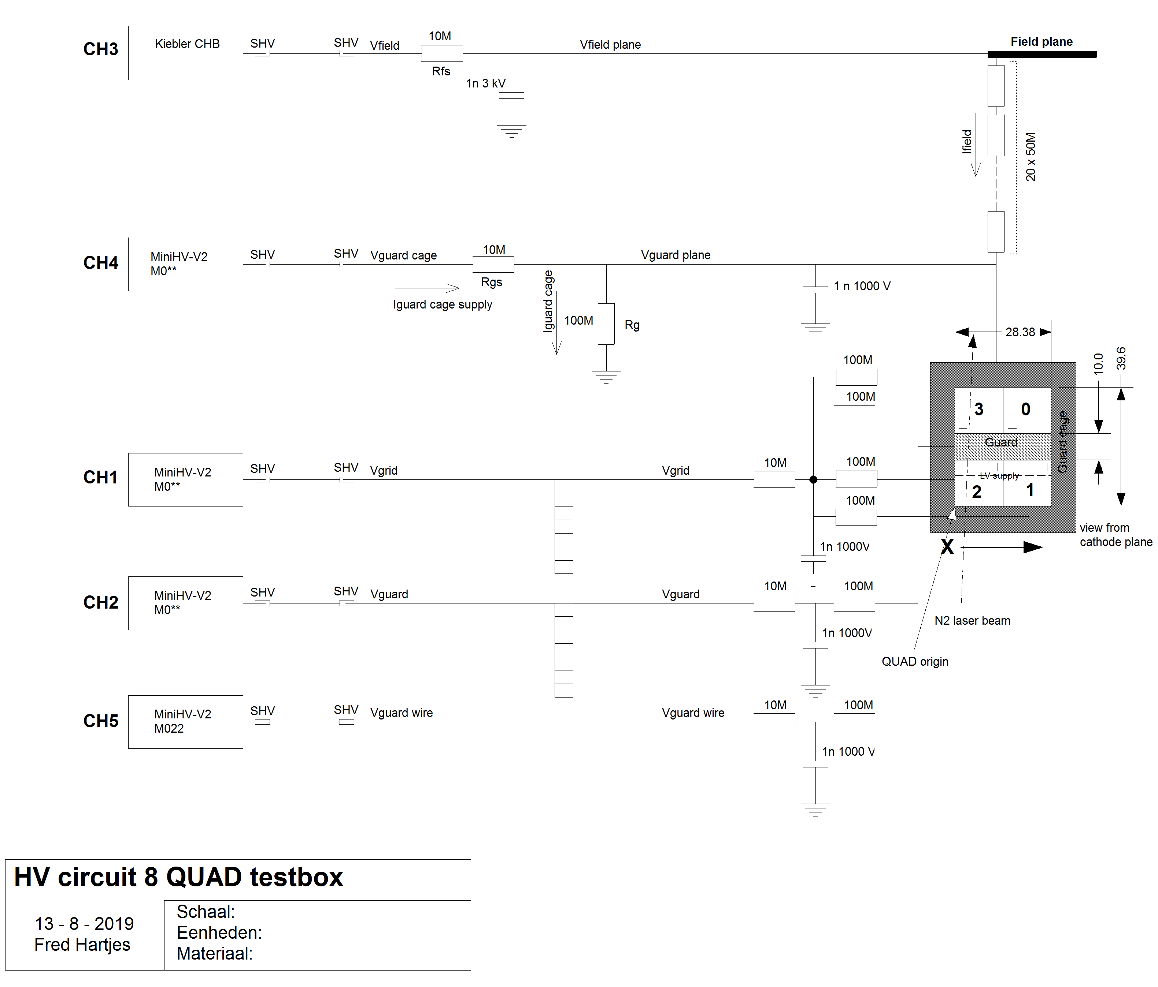
Levaard Slow controls HV block scheme

Slide 8
Levaard start of run
Run control mode is used to start a run
- first start PUTTY on Levaard and tunnel to arawana
- on arawana ./rundaq.sh (starts the daq in run control mode)
it should give a binding socket (if not ˆC and redo)
check on arawana chips: spidrchipids 192.168.1.10
if not 32 chips do: spidrreset 192.168.1.10
- from the panel Connect (to arawana) and then Configure
check the arawana PUTTY window to check that you are connected
after configure still have 32 chips in the readout
- if OK give run number and Start run
- After (e.g.) 60 s Stop run
- the bytestream is now closed and we can decode it
rundaq.sh ping -c5 -i0.2 192.168.1.10
Tpx3daq_concentrator -i 1 -p 2 -m -r 2358
so port 2358 is used to listen to

Slide 9
arawana start of run
Run control mode is used to start a run:
cd /localstore2/TPX3/DATA/LOGFILES
Tpx3daq_concentrator -i 1 -p 2 -m -r 4001
will listen to port 4001
Open other terminal with port 4001 on arawana:
> telnet arawana 4001
configure <ret>
start_run 3001 <ret>
stop_run <ret>
Important for running is the dac off set (Tpx3daq_concentrator.cpp) now put to 55 counts based on noise runs.
Dac_offset == how many counts the threshold is put above the mean noise level. The lower the better. At DESY it was 60 and 65 counts.
Example DESY run 32 chips /localstore2/TPX3/DATA/LOGFILES arawana_daqlog_20210616_152353.txt

Slide 10
Data and Software on arawana
Production of the ntuple is similar as for a noise run:
// open terminal setup command
/home/gastpx/source init_laser_setup_software.sh
Produce root file for run 3001 and link (concentrator) 0
cd /localstore/TPX3/laser_setup_software
./make_concentrator_tree -r 3001 -l 0 >&1 | tee out_3001_0.log
// root file: /localstore2/TPX3/ROOT/run3001_0.root
Similar for link 1
./make_concentrator_tree -r 3001 -l 1 >&1 | tee out_3001_1.log
For monitoring usually 1000 triggers are enough. NB modify make_concentrator_tree.cpp to run 1000 trigger; Too many triggers takes too long. The root files should be transferred to another computer, where it can be further analysed.

Slide 11
Analysis of root files
Analysis of root files on other computer:
- open root file root –l ../ROOT/filename
- one can browse the histograms TBrowser t
- or analyse the ntuple hits and make selections
- note that in the ntuple production code one can put cuts around the trigger time and reduce the ntuple size and backgrounds
One can also run the event analysis and display code like was done at DESY: https://indico.nikhef.nl/event/3158/DESY_testbeam_Events.pptx
code (now) on /localstore/TPX3/laser_setup_software
- PlotOnline.C (and .h) // in .h the two _0 _1.root files are specified
> root –l
> .L PlotOnline.C++
> PlotOnline p
> p.Loop(-1) // runs all events makes plots
> p.Loop(0) // runs and displays trigger/event 0

Slide 12
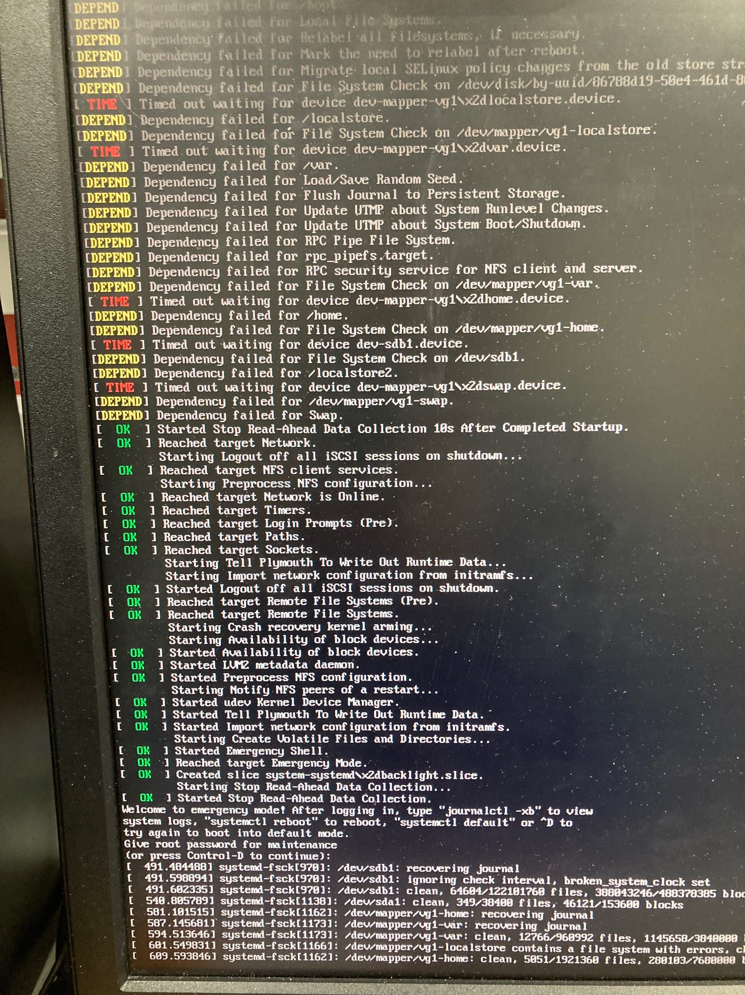
Problems with arawana
Unfortunately, just before dismantling the Nikhef test setup …. one of the disks with the operator system and the module software has gone crazy (see picture). The files on /localstore are affected (not reachable).
The repair of the disk with software tools was not succesfull. The Nikhef computer department has tried to clone the disk.
The data could not be recovered.
NB copying took several days for 500 Gb.

Slide 13
Recovered arawana
Arawana has two 2T disk; one contains/localstore/
That disk houses the operating system plus all the TPX3 specific programs.
The other 2T disk /localstore2/ houses the data and user directories. On /localstore2/ there is a zipped tar file with all the TPX3 specific programs plus visibile part of /home/gastpx3
The disk /localstore could NOT be recovered/cloned. So a new disk was put in the machine and CENTOS 7 was installed.
The code from the zipped tar file was used to get back the TPX3 software programs.
The standard user is now gastpx (not gastpx3 anymore)

Slide 14
Recovered arawana
Some code was lost and e.g. some setup scripts (pathes) for the software were written again (like .bashrc).
The we needed to install root 6.22 with missing libzdst
the missing lib was added with the Epel version
sudo yum search / sudo yum install were used to add missing libraries. These were: qt4 (qt5 is standard in Centos7) telnet wireshark screen
With wireshark the different ports of the computers were reconfigured properly. In the end the Centos7 firewall had to be switched off, to allow the data streams to be accepted. sudo systemctl disable firewalld

Slide 15
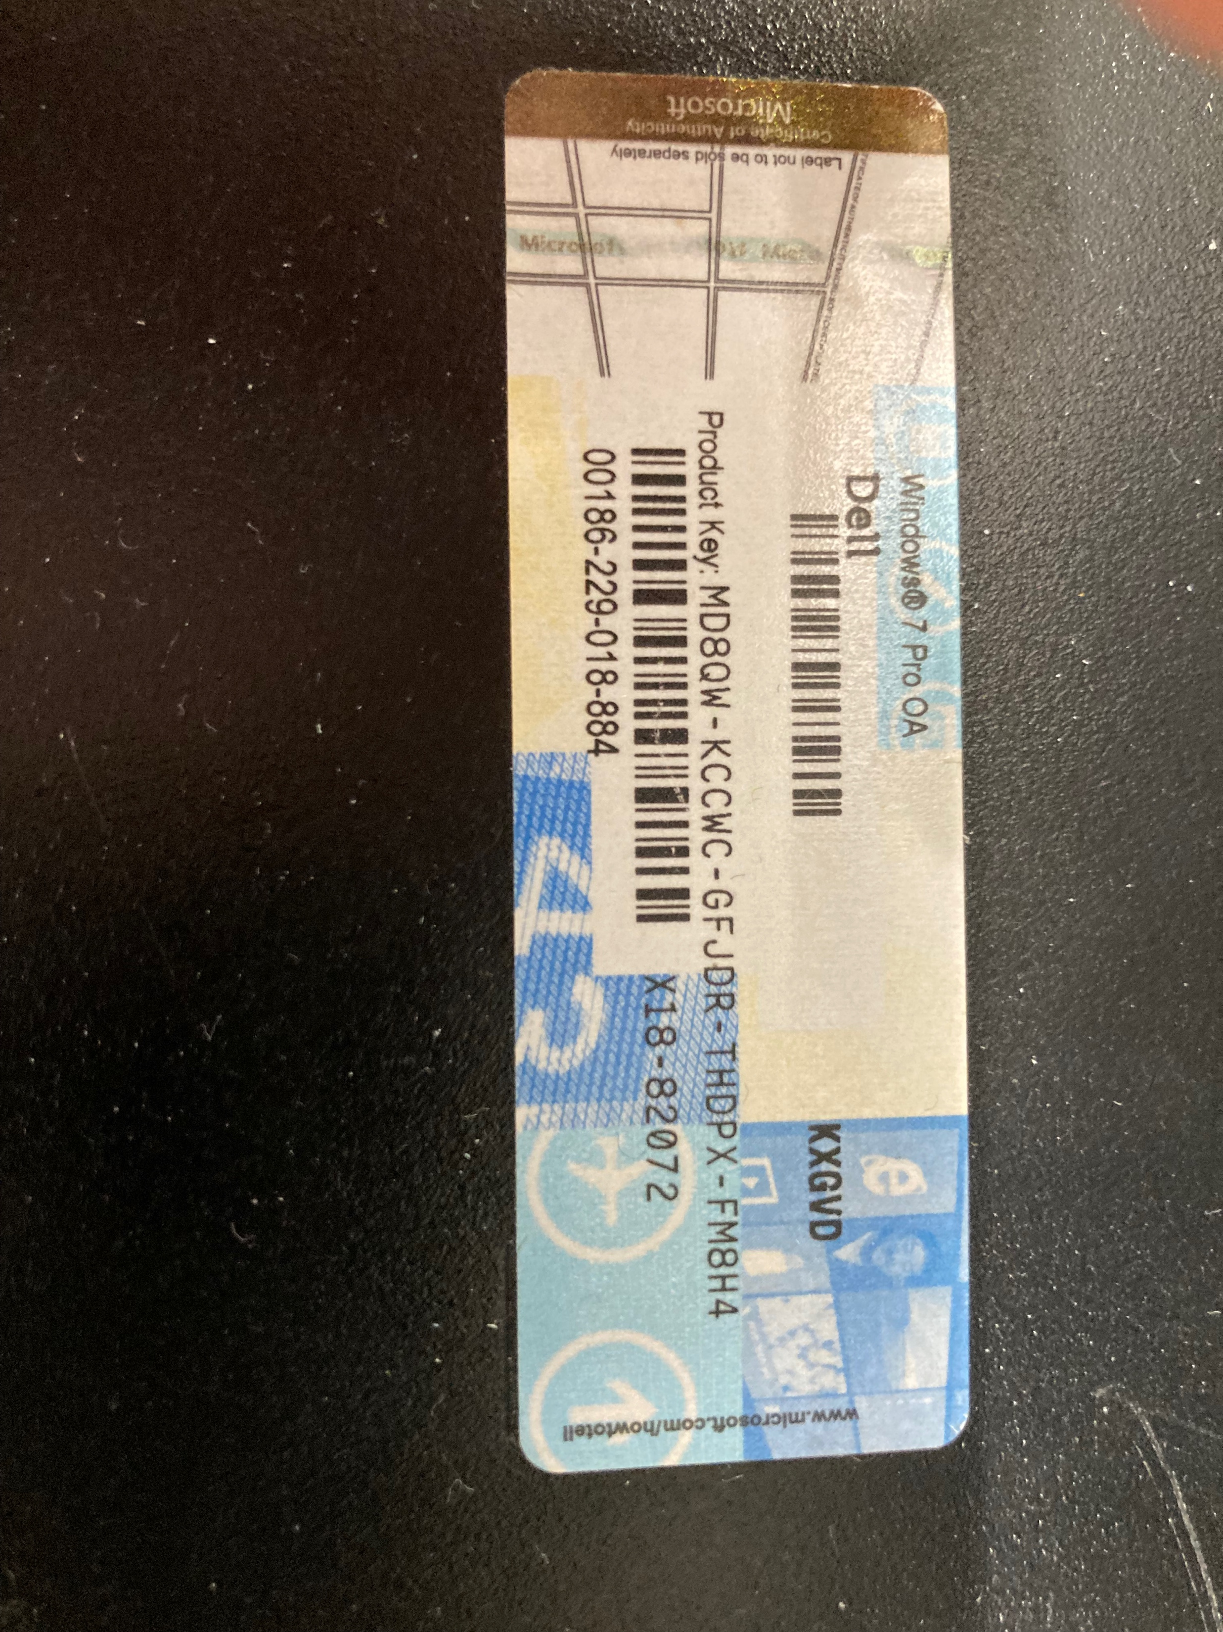
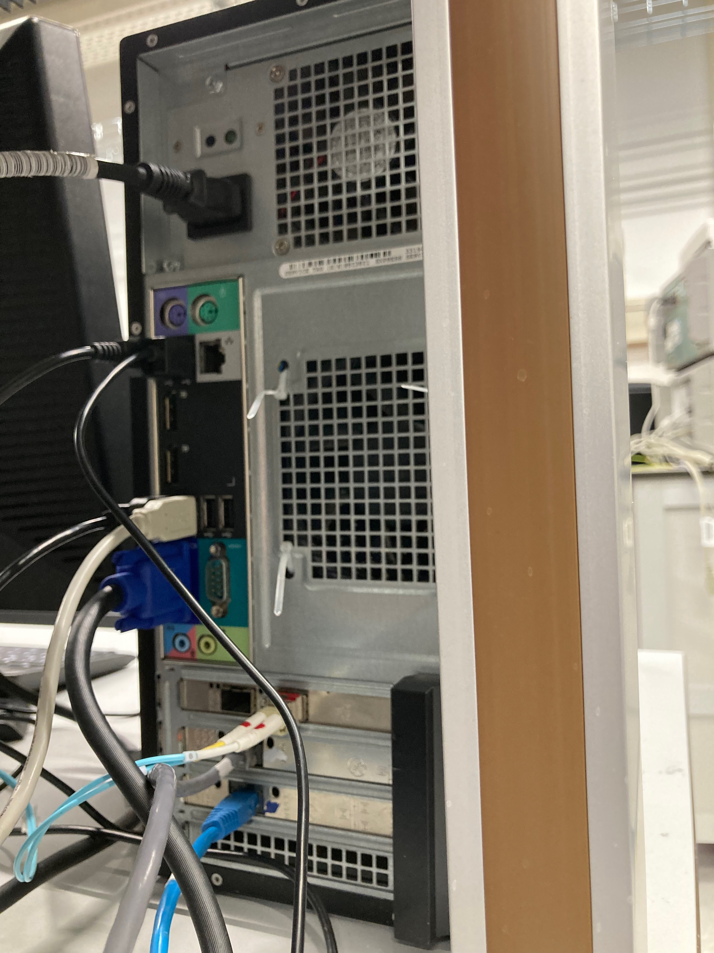
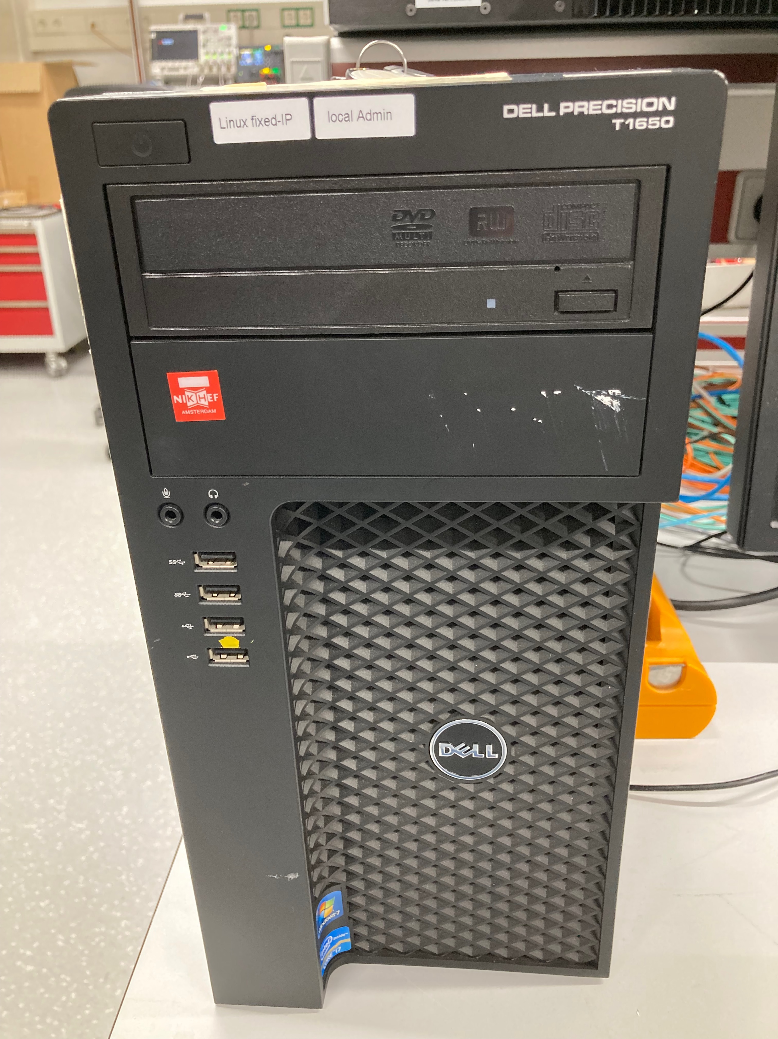
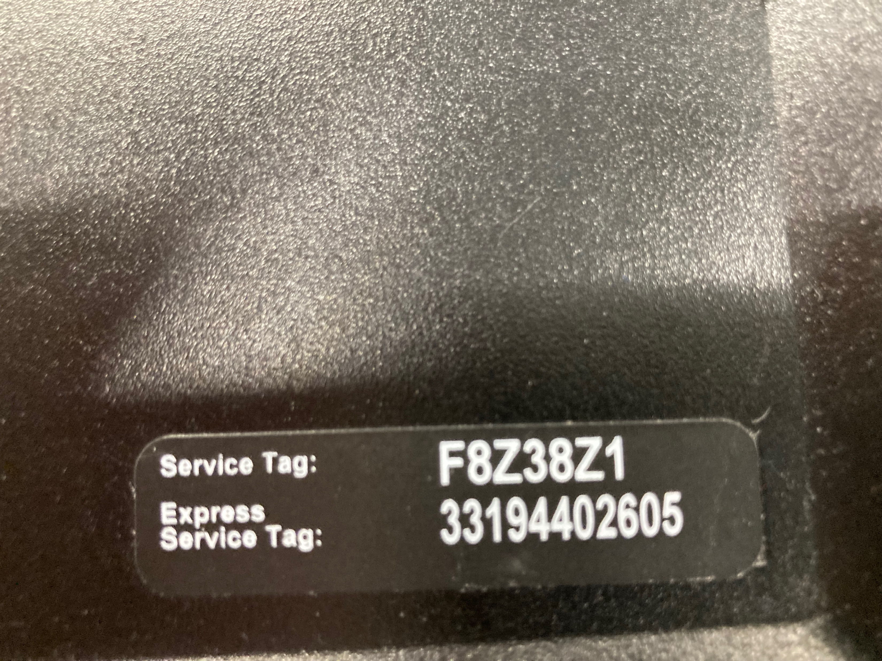
Photo’s arawana

Slide 16
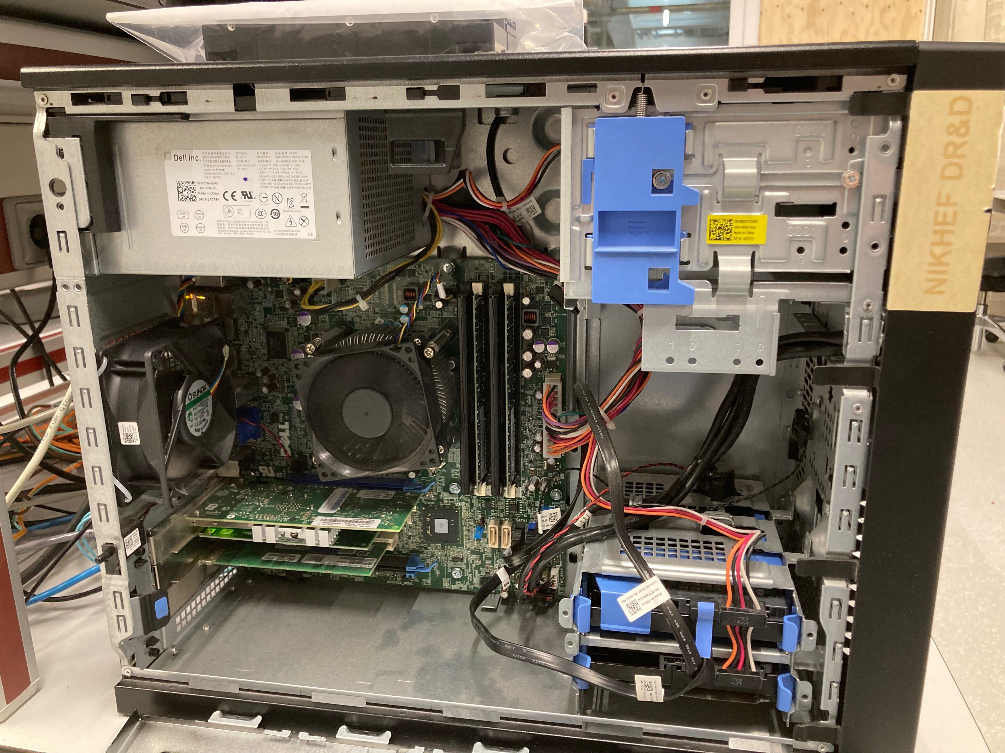
Photo’s inside arawana

Slide 17
Testing arawana with Noise runs
As described in the other presentation, the best way to test the detector is to perform a noise run. The Nikhef_Noise_EIC.pptx are updated.
The files for the trimdacs for EIC are pretty similar to the DESY ones. The dacs have just update fine thresholds. They are kept under /localstore/TPX3/localCONFIGS/Module/EIC/.
A copy is keep under ../EIC/keep
For EIC also a low power setting of the dacs was made that could also be tested: /localstore/TPX3/localCONFIGS/Module/EIC/low_power

