Slide 1
Noise runs
The goal of the noise run is to verify the stability of the DAQ and to mask new noisy channels before data taking.
Noise runs have run number 1111.
A Run procedure:
cd /localstore2/TPX3/DATA/LOGFILES
// first remove old noise run always 1111
rm -f /localstore2/TPX3/DATA/*I*/Run1111/*
// run command for 10 secs data (is enough)
Tpx3daq_concentrator -s "" -i 1 -p 2 -m -t 10
// produces arawana_daqlog_*.txt
// and .dat files in /localstore2/TPX3/DATA/LINK0 LINK1/ TIMESTAMP/
Details in the log file show that right thresholds were put and at the end of the run read back. See e.g. arawana*EIC55.log

Slide 2
Noise runs
B Ntuple production start a new terminal (cannot mix the setups for ntuple production and A run/ B analysis):
cd /home/gastpx
source init_laser_setup_software.sh
you are in /localstore/TPX3/laser_setup_software
// run the ntuple production
./make_concentrator_tree -r 1111 -l 0 > testNoise_0.l &
./make_concentrator_tree -r 1111 -l 1 > testNoise_1.l &
// produces /localstore2/TPX3/ROOT/run1111_0.root and run1111_1.root
// note that there is an unstable startup period at the beginning of the run when the voltage is ramped up. That period (high ToT noise shots) is rejected
//main code
// make_concentrator_tree.cpp make_concentrator_tree.h
// you can redo make make_concentrator_tree
//

Slide 3
Noise runs
C Analyse Ntuple start a new terminal (cannot mix the setups for ntuple production and A run/ B analysis):
cd /home/gastpx
cd /localstore/TPX3/laser_setup_software
root -l
> .L MaskAndTrim.C++
> MaskAndTrim t
> t.LoopM()
edit MaskAndTrim.h to run on both concentrators
name = "/localstore2/TPX3/ROOT/run1111_0.root";
name = "/localstore2/TPX3/ROOT/run1111_1.root";
// this code masks pixels and updates all the 32 W*_trimdacs.txt files
In order to use the new trimdacs: cp -rf W*.txt /localstore/TPX3/localCONFIGS/Module/EIC/.
Then redo A take noise data, B make ntuple, C analyse and mask pixels
NB: for DESY we did not have to update trimdacs anymore.

Slide 4
Diagnostics from Noise runs
Often one needs several iterations for masking after the equalisation procedure.
It is likely that the current setting of the masks is fine
B) One can see DAQ problems in the running (e.g. time outs etc.)
C) The analysis can show not so apparent problems
High ToT values indicate a badly running chip
A high rate 200 hits/ pixel with almost all channels firing
The most likely cause is that some some dacs were not loaded properly. In the LOGFILE of the run this could be indicated that some problems occurred for this chip.
HOWEVER it happens that everything looks OK (stored values are OK), but still the dac data is corrupted. SOLUTION: First just rerun again (up to say three times) if not working do a spidr reset and take a new noise run

Slide 5
Diagnostics from Noise runs
Example of noise runs with dac offset of 55 counts
/localstore2/TPX3/DATA/LOGFILES/arawana*EIC55.txt
B) Corresponding ntuples
/localstore2/TPX3/ROOT/EIC/run1111_0_EIC55.root
/localstore2/TPX3/ROOT/EIC/run1111_1_EIC55.root
Logfiles /localstore/TPX3/laser_setup_software/make_conc*55_10s.log
C) Output of the mask and trim
Outputfiles /localstore/TPX3/laser_setup_software/conc*_EIC55.log
** also outputs *last* are there that show some problems that are basically fine
Typically we have 1-20 hits per pixel in a run of 10 seconds.
For a window of 1 μs it means 0.1-20 hits per event. This is a very acceptable noise rate. The noise can be easily removed offline by at ToT cut at 8 counts (time 25 nsec).

Slide 6
Diagnostics from Noise runs
The last months it was very rare that I succeeded to get chip 30 in the readout. In the DESY test beam we did after many retries.
More details on how to get 32 chips are in the slides DAQ_Stability_EIC.pptx.
*** Often chip 31 had (e.g. high ToT) problems. After a restarts of the SPIDRs it worked fine. Or it gets problems in the coarse of the run and drops out.
**** Sometimes the trimdacs or dacs are not properly loaded and e.g. chip 2, 18, 19 or 31 have a large rate. Just rerun a few times (to get the right trimdacs in the chip). If this doesnot help reset the SPIDR and start all over.

Slide 7
Diagnostics from Noise/source run
C) In case the detector is fully on with gas and HV one can take a source and take a noise run for a 10-100 seconds
One can measure the ToT per chip and this is VERY revealing. It shows the full functioning of the detector
The mean ToT should be similar for all chips
see next slides from May 2021
The recipe is simple: take a noise run and make the ntuple and use the tree for making plots of the mean ToT (in units of 25 ns).

Slide 8
New Gas envelop
Old gas box
New gas box
May 2021: https://indico.nikhef.nl/event/3124/
Mean ToT
Concentrator 0 chip nr

Slide 9
New Gas envelop
Old gas box
New gas box
May 2021: https://indico.nikhef.nl/event/3124/
Mean ToT
Concentrator 1 chip nr

Slide 10
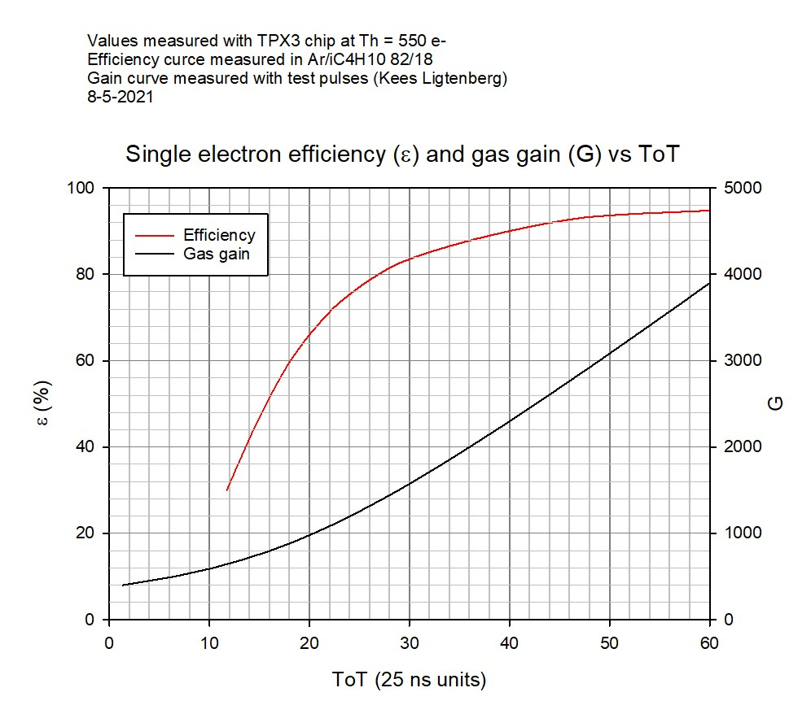
Calibration curve ToT gas gain

