Slide 1
DAQ stability
Arawana is now full up and running so that issue has been resolved.
Next step was the running of the DAQ and in particular the taking of noise runs.
Known DAQ instability issues.
What works relatively fine is the preparing of the DAQ, most of the time we get 30-32 chips in one go, after a few C commands we can get 32 chips (see slides further on) in the readout by the SPIDR. On the 17 of March I also got 32 chips connected to the SPIDR. This is a well known ‘struggle’ also needed for the DESY testbeam preparations.

Slide 2
DAQ stability
The cause of this communication problem lies in the concentrator design: all the communication traffic goes through concentrator 0 or 1. Concentrator 0 is usually OK, however concentrator 1 the packet that is sent by chip to tell that it is there is not always timed properly and is corrupted or lost. This has to do (i.e. 100% correlated) with the location of the chip on the concentrator board. Our electronics engineer thinks that the FPGA that was selected has a too small memory. Anyway we have to live with this: we need a few trials, patience and a bit of luck/magic.
We found out that the cooling of the concentrator is very important to
get the chips on board.

Slide 3
DAQ stability
B) There is another issue that is relevant to know. This has to do with the occurrence of what we call ‘hurray’ events. At the start up of the chip and the quad all the pixels start to fire and the chip lights up. This is very likely related to the fact that the digital and analog power of the TPX3 chips was connected in the quad design. In retrospect we think it is better to keep them separate.
What happens is that the chips are configured and the analog part is powered. Then the runs start and the digital part draws a current, the voltage to chip dips (seen on an oscilloscope) and the pixels start to fire. The voltage regulator then reaches a plateau and the thresholds are at nominal value and the chip calms down. This was the situation for the DESY testbeam. Sometimes in rare cases one chip kept firing but this has another cause see next slide..

Slide 4
DAQ stability improved
Interventions in March/April: checking the grounding of the setup. Now the ground of the Low Voltage PS is connected to the cold plate. Sander van Doesburg also redid the connectors on the concentrator boards putting sockets. The actual voltage on problematic chips was checked and found to be stable.
On the software side there were always issues with the communication with the chips. In order to get it right, idle time had to be introduced to allow the system to settle. Small changes in the software were now introduced allowing for more time for chips 30 and 31, to retry more times checking the stored value etc. In the preparation of the streams/threads and files, the pixel configuration will not be stored in the header anymore, additional ‘usleeps’ were introduced to allow the system to settle before starting the run.
With these changes the situation is now similar to the DESY testbeam.

Slide 5
How to get 32 chips in the readout?
This can be done by starting the system and checking the devices it finds and verifying the correct naming: type d on the USB for the concentrator SPIDR.
If not 32 chips then type C if not 32 type C again.
It will reshuffle/reinitialize the devices.
If 32 chips then type d and check that the names make sense. Often one of names is odd/corrupted. If this is the case type C again etc. See next slides for the right names.
It can happen that you get a time-out or the bad chip name stays. In that case repower the concentrator and main SPIDR etc…
If 32 correct names are connected a run can be started. And one should verify that all the chip noises rate are low (take a noise run) and no ‘hurray’ chips are present. If needed some pixels can be masked.

Slide 6
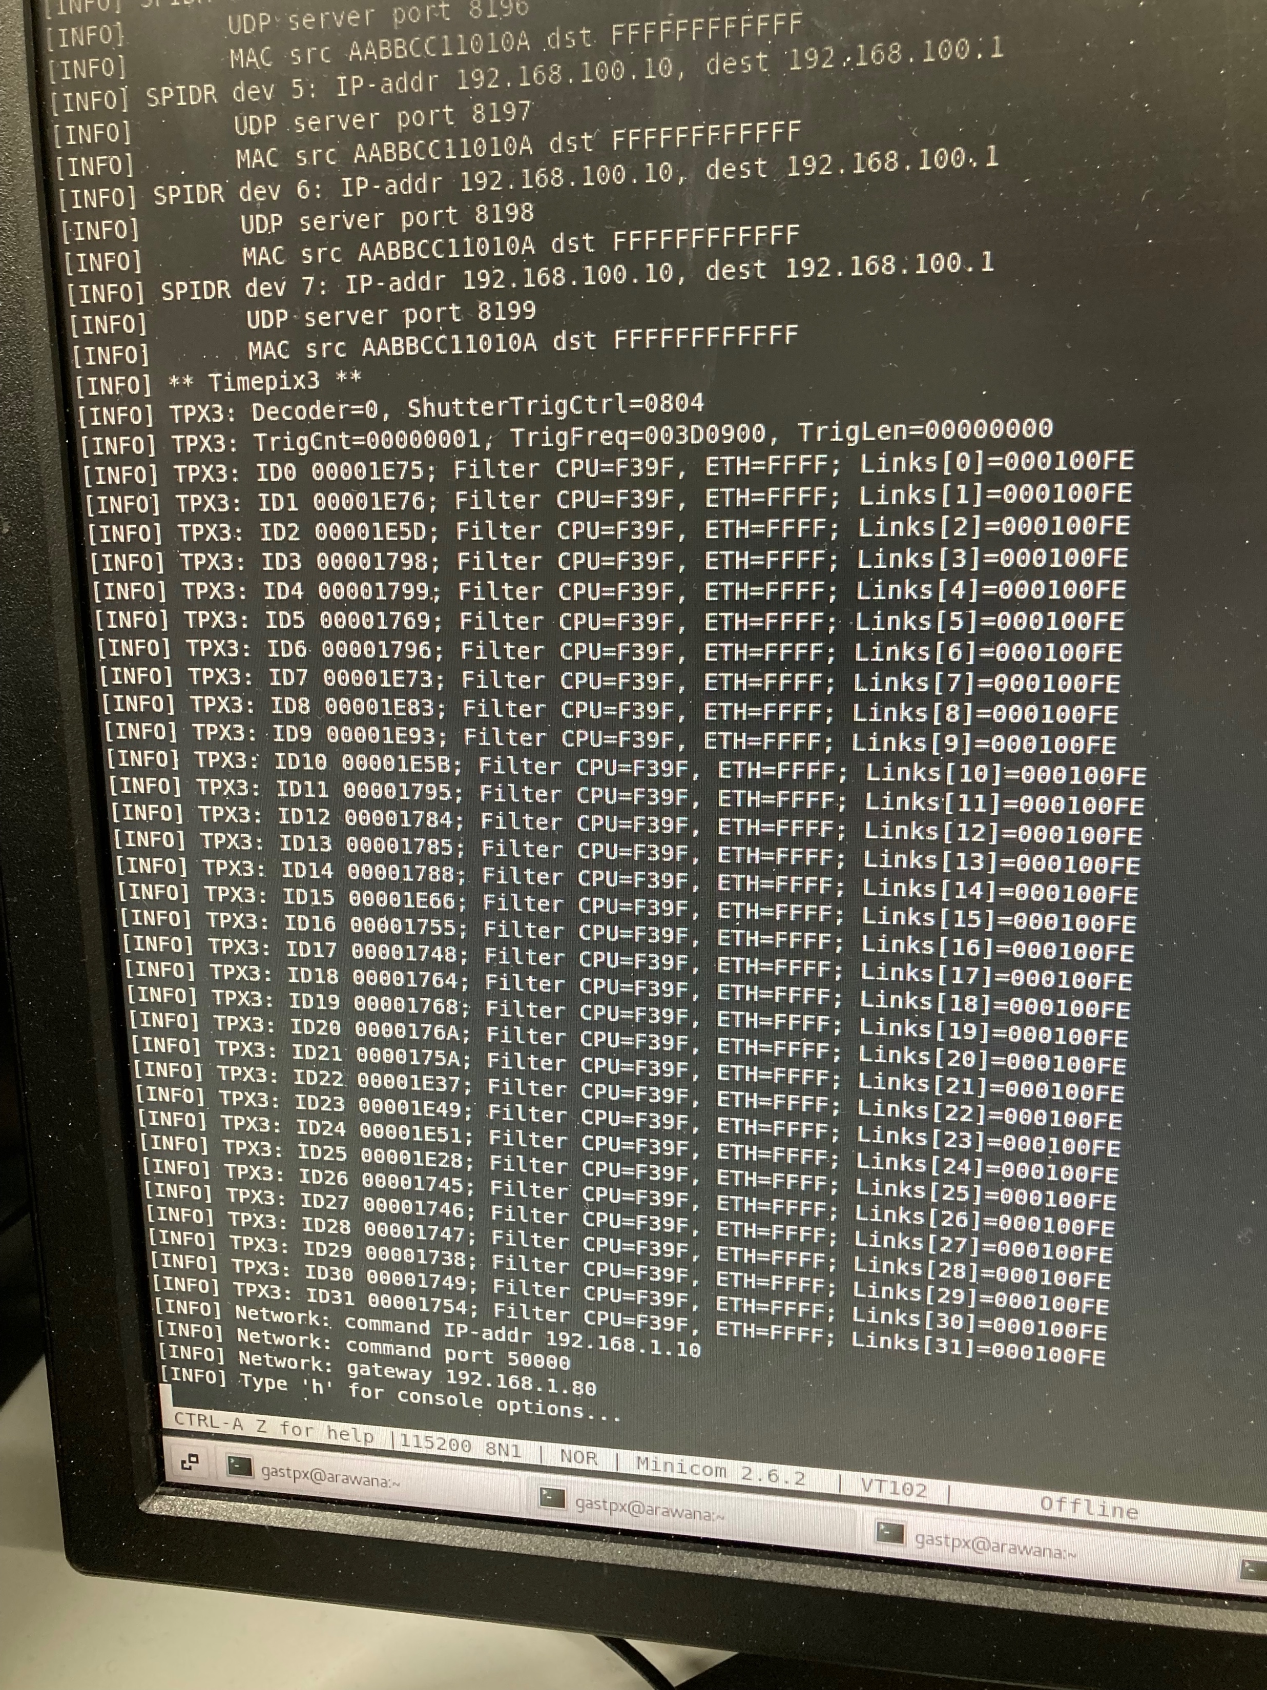
How to get 32 chips in the readout?
Here a photo the USB SPIDR output with 32 connected chips all with correct names 1E75 etc.
One cause of hurray events is a wrong Chip id; in that case the chip cannot be addressed and configured properly and very often ends up in a bad state. The chip can also not be masked …
Usually one has to use the C command, eventually reset the SPIDR or repower the concentrator.

Slide 7
How to get 32 chips in the readout?
Step-step procedure.
- Next step is to look at the file size. If too large then check the arawana log file. If OK one can make root files for the concentrators.
- Next step is to analyze the data file MaskAndTrim, check the noise rates of the chips in particular of chips 2, 18, 19 and 31 and do another noise
- The situation in April is stable (after this procedure) and one doesnot need additional pixel masking
Try to avoid to use the C command and reset SPIDR. These commands reset all the (carefully loaded) dacs and trimdacs. If you do need to reset the SPIDR (e.g. because of a time out) or repower the concentrator, the whole step by step procedure should be restarted.
If all succesful one can make the root files and mask additional noisy channel.
E.g. in DESY we never we took the masks from Nikhef and applied them. At the beginning of the run we made a small adjustment and ran the whole two weeks with it. NB you do need to keep the detector and concentrator cooled.

