Slide 1
Seismic Isolation for ET-LF
(or why seismic isolation is hard)
Conor Mow-Lowry
…On behalf of the OmniSens team and many others

Slide 2
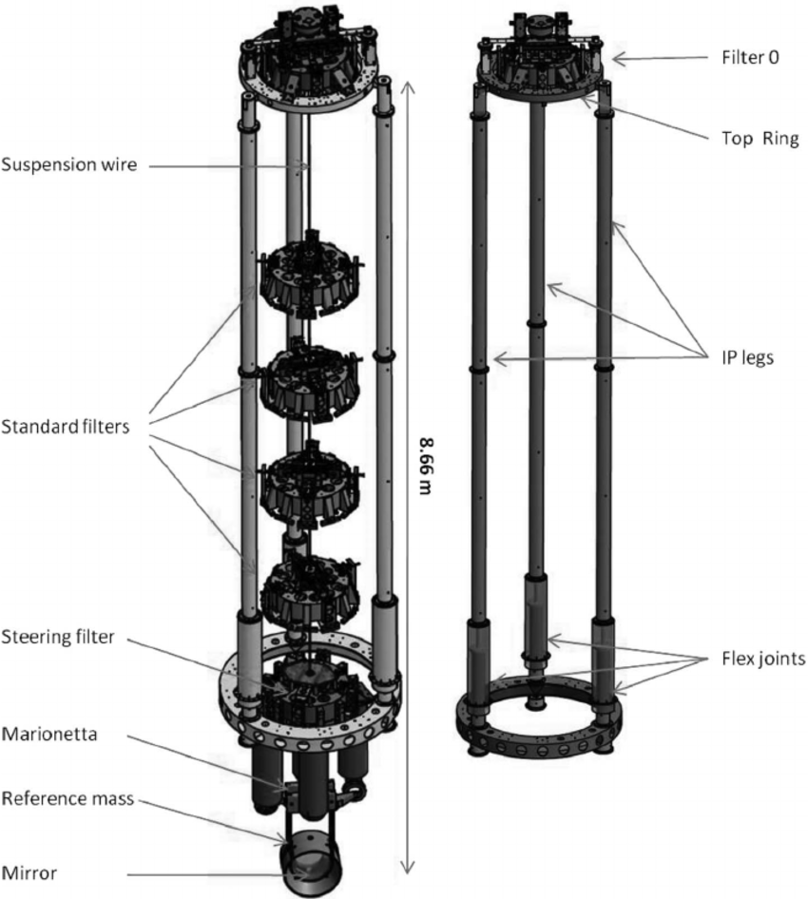
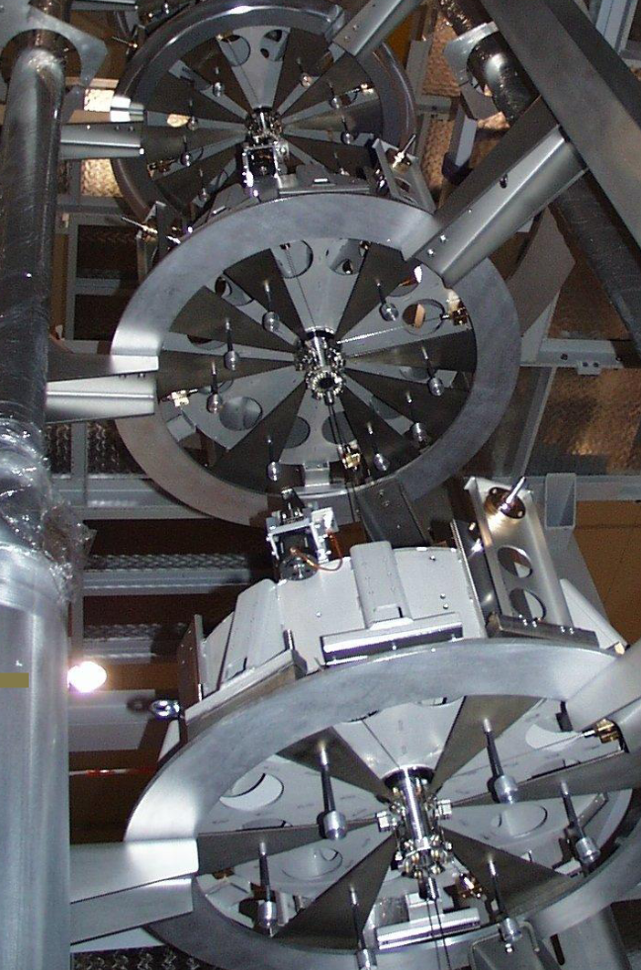
ET-LF isolation at CDR

Slide 3
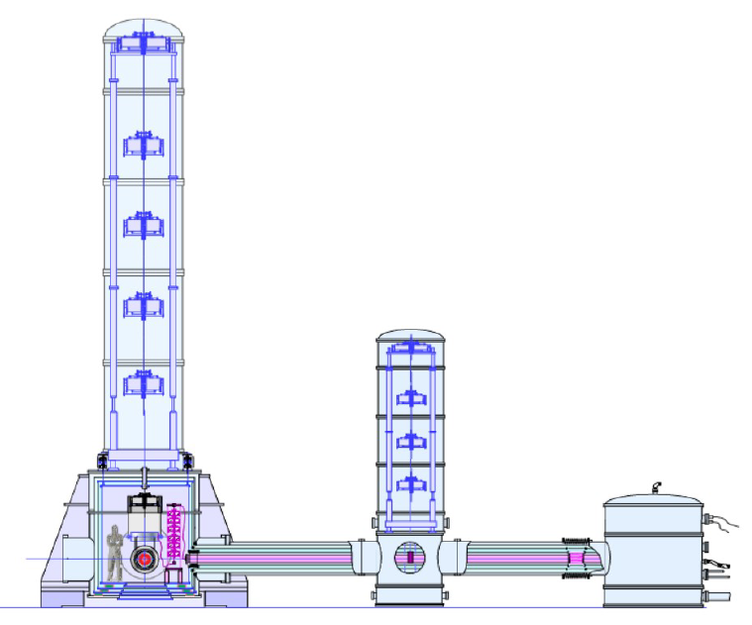
17m tall!
No seismic platform
Needs substantial work
– design, interfaces, and requirements all uncertain

Slide 4
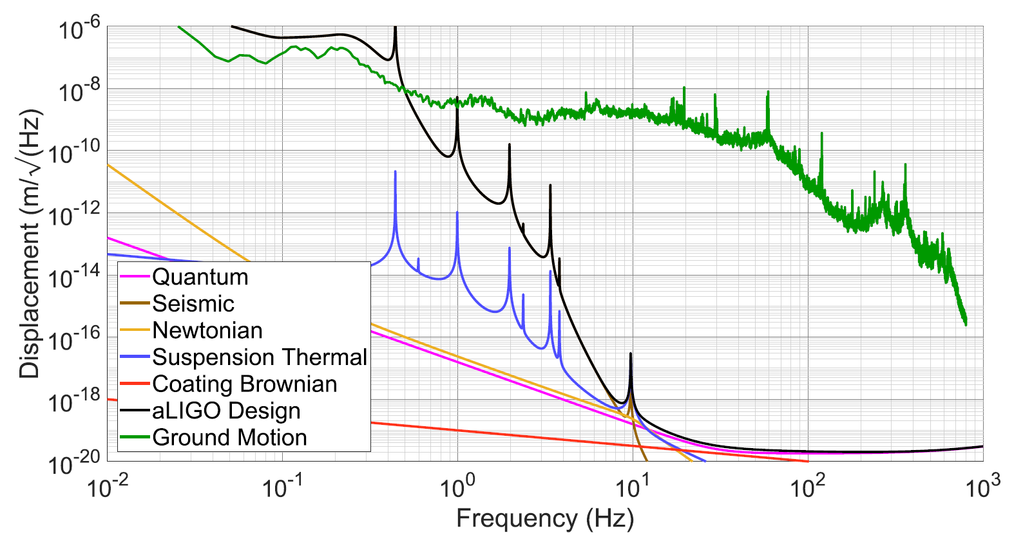
Factor of 10¹⁰!

Slide 5
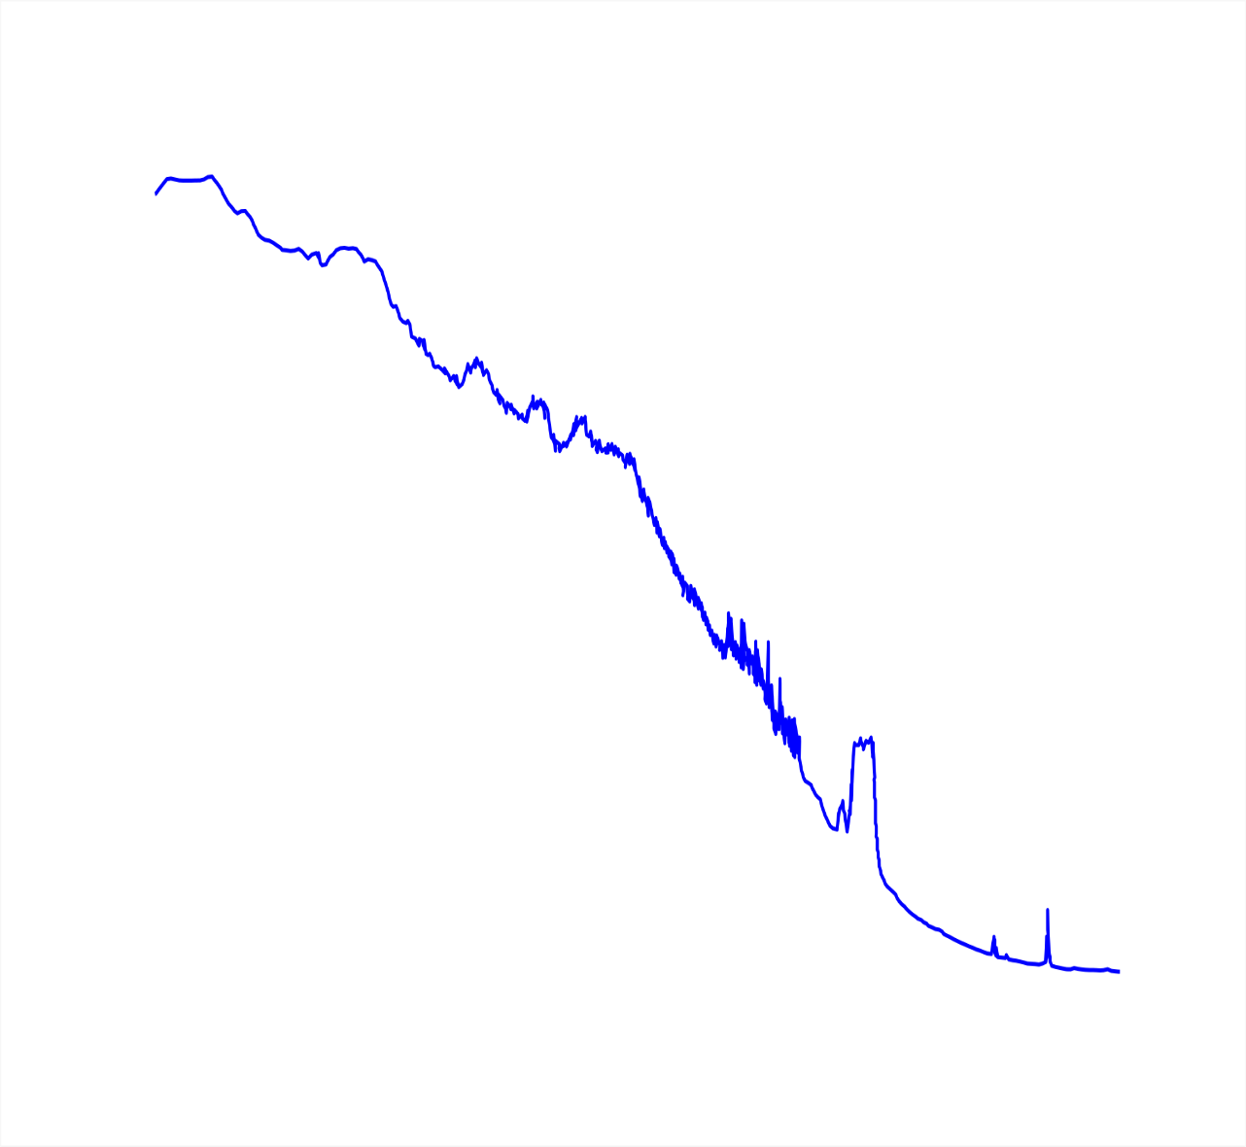
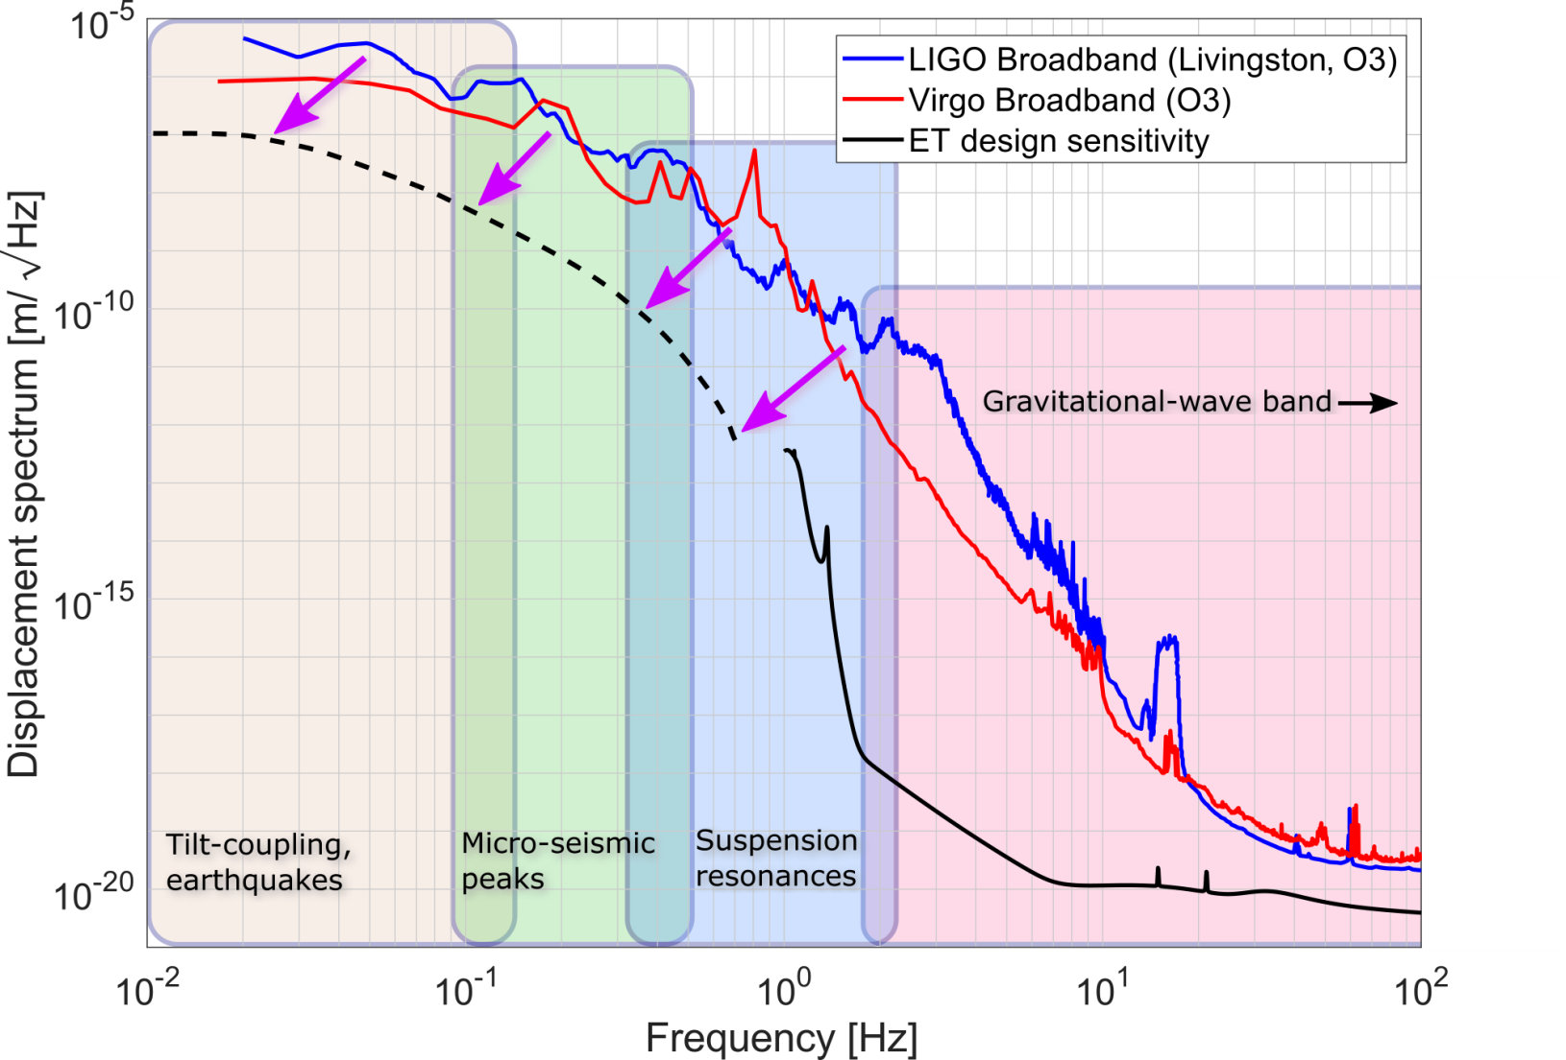

Slide 6
How do we keep something still?
Some examples…
  Seismometers (funny that we isolate them)
  Heavy machinery
  Cars (or trains etc)
  Optical lab experiments
→ Common-mode rejection
(big slabs of granite)

Slide 7
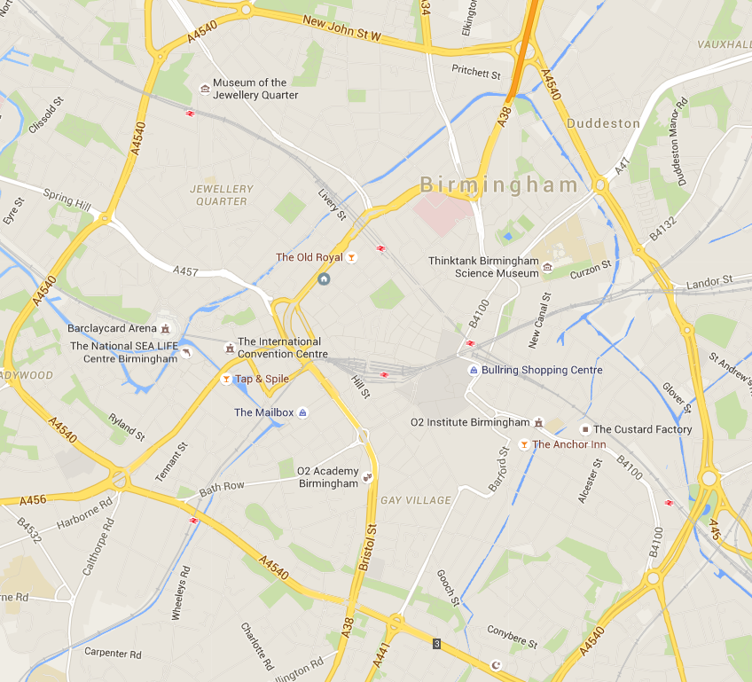
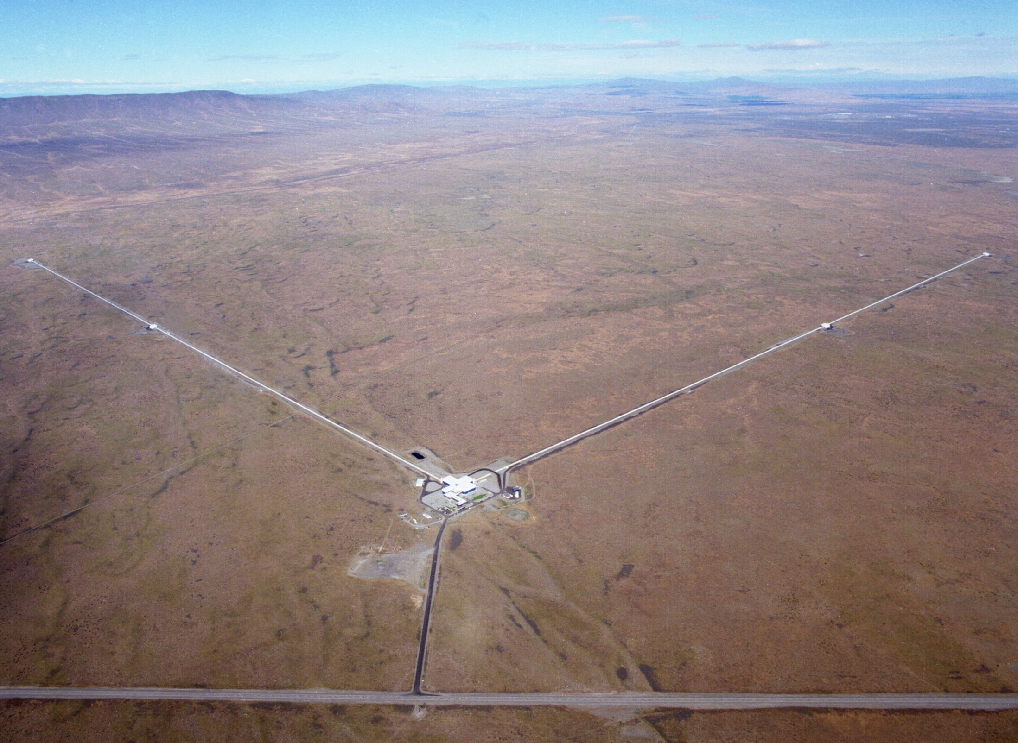
Images: LIGO Laboratory and Google Maps

Slide 8
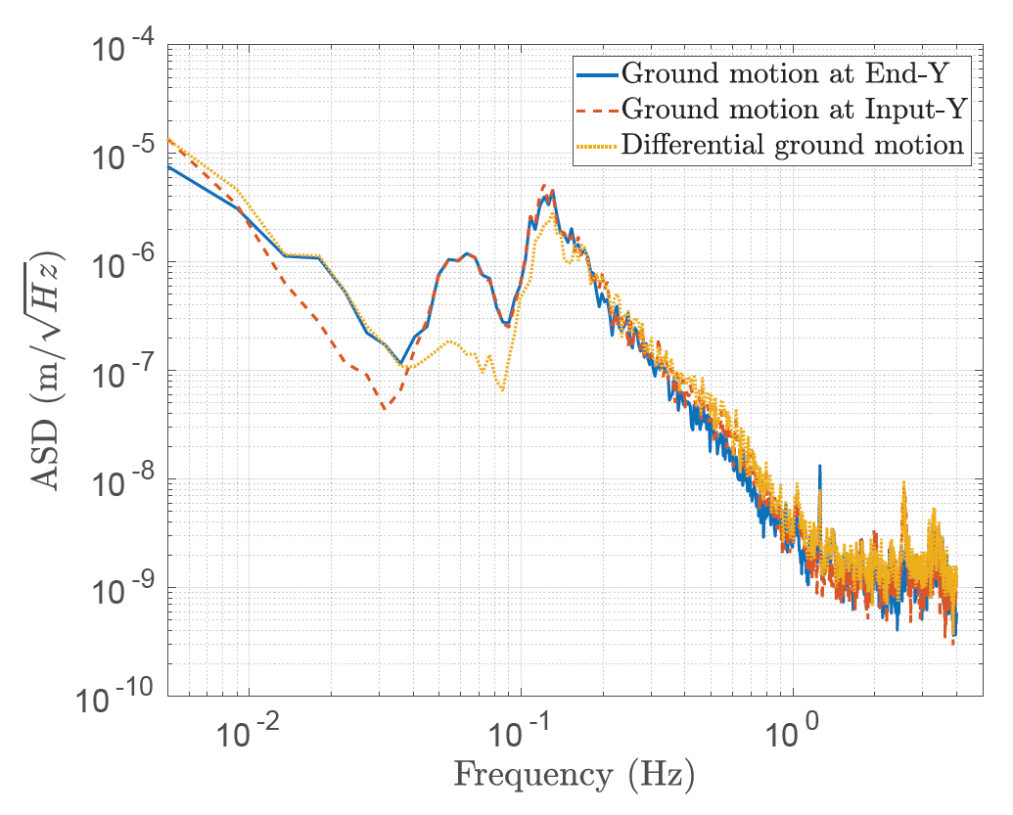
GW detectors are big
The ground is not rigid enough!
Granite might have been stiff enough for LIGO… but next gen detectors will be longer.

Slide 9
Time-scale conspiracy #1
Detectors are ~3-4km and wave-speed means seismic waves at f>0.1Hz are differential…
And the dominant RMS comes at ~0.1-0.3Hz.

Slide 10
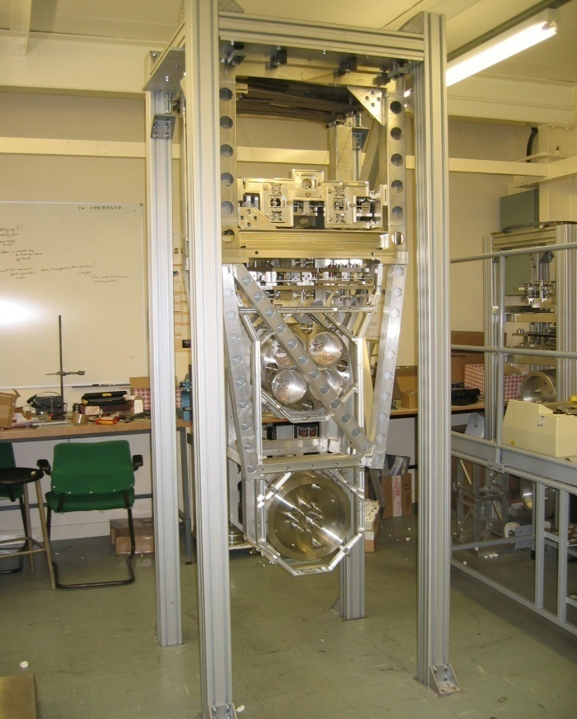
So we need an isolator
Prototype quadruple-pendulum for Advanced LIGO
K1
K1
L1
0.5M
K2
K2
L2
≈2 m
0.5M
K3
K3
L3
M
Test Mass
M = 40 kg
K4
L4
K4
M
Credit: Brett Shapiro

Slide 11

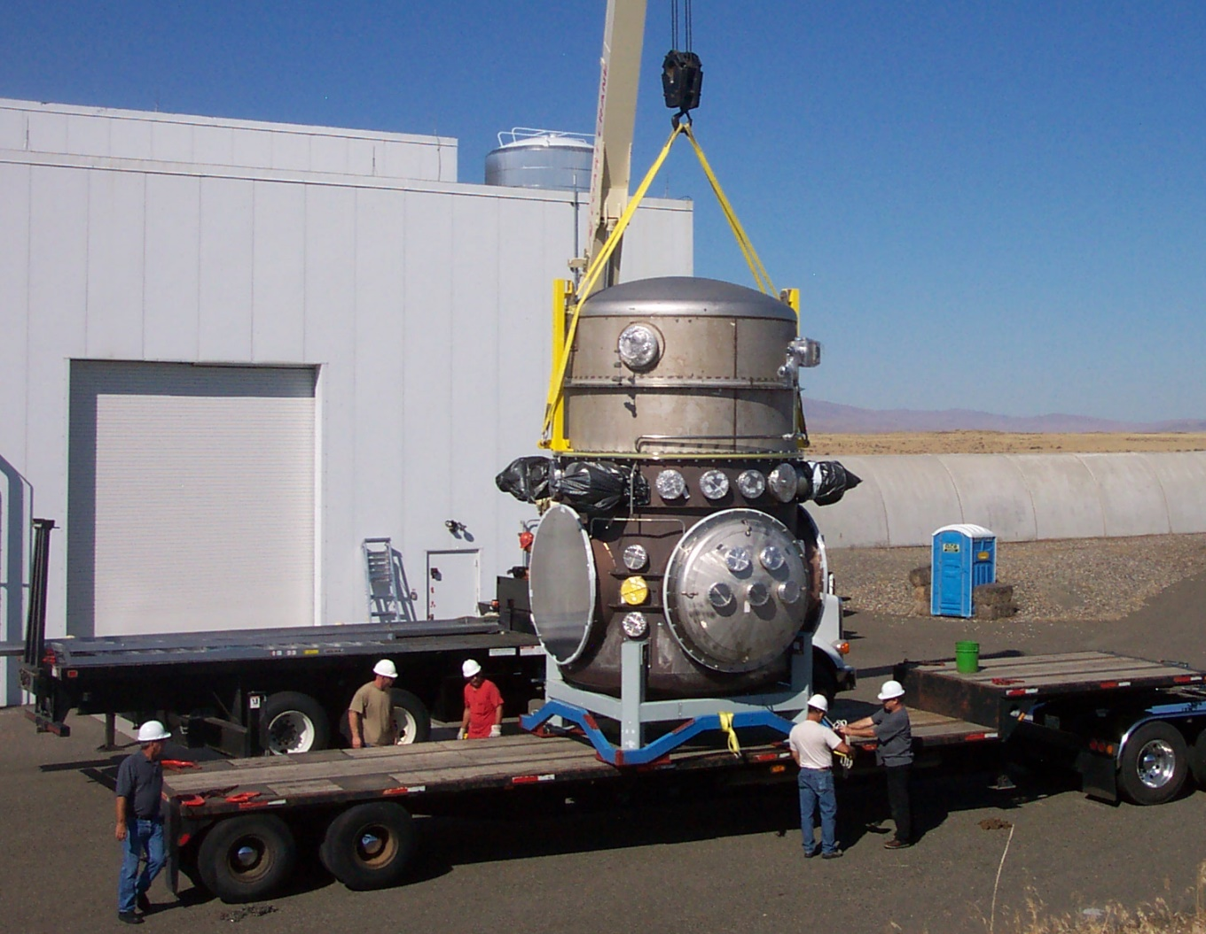
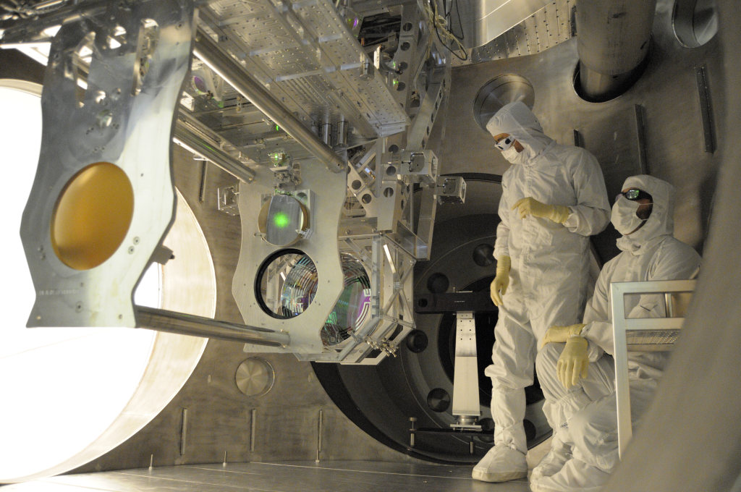
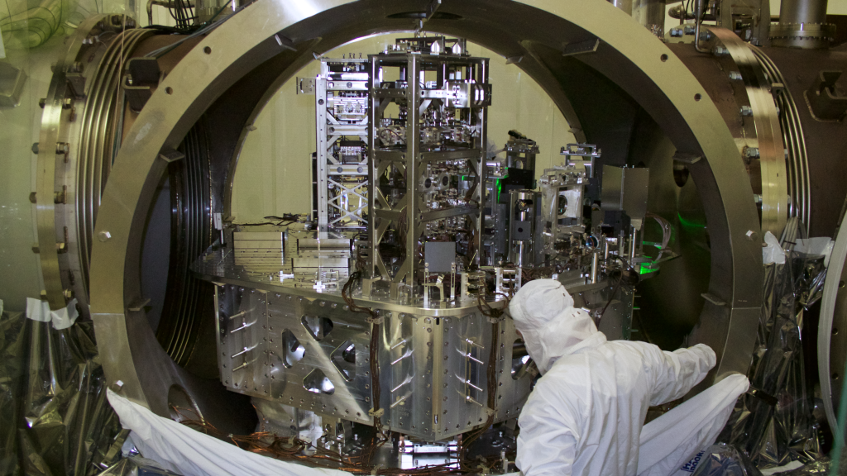
Images: LIGO Laboratory

Slide 12
Response of the ‘Quadruple Pendulum’
Cascaded resonators produce a steep filter.
We needed 10¹⁰ at 10Hz in LIGO.
steep roll off!
1/f⁸
Isolation at 10Hz
-140db = 10^{-140/20}
= 10⁻⁷
We need more
GWs this way
Credit: Brett Shapiro

Slide 13
Time-scale conspiracy #2
Detectors are ~3-4km and wave-speed means seismic waves at f>0.1Hz are differential…
The dominant RMS comes at ~0.1-0.3Hz…
And the passive suspensions have resonances at ~0.5Hz.

Slide 14


isolator
$$f_{0}=\frac{1}{2π}\sqrt{\frac{g}{L}}$$

Slide 15
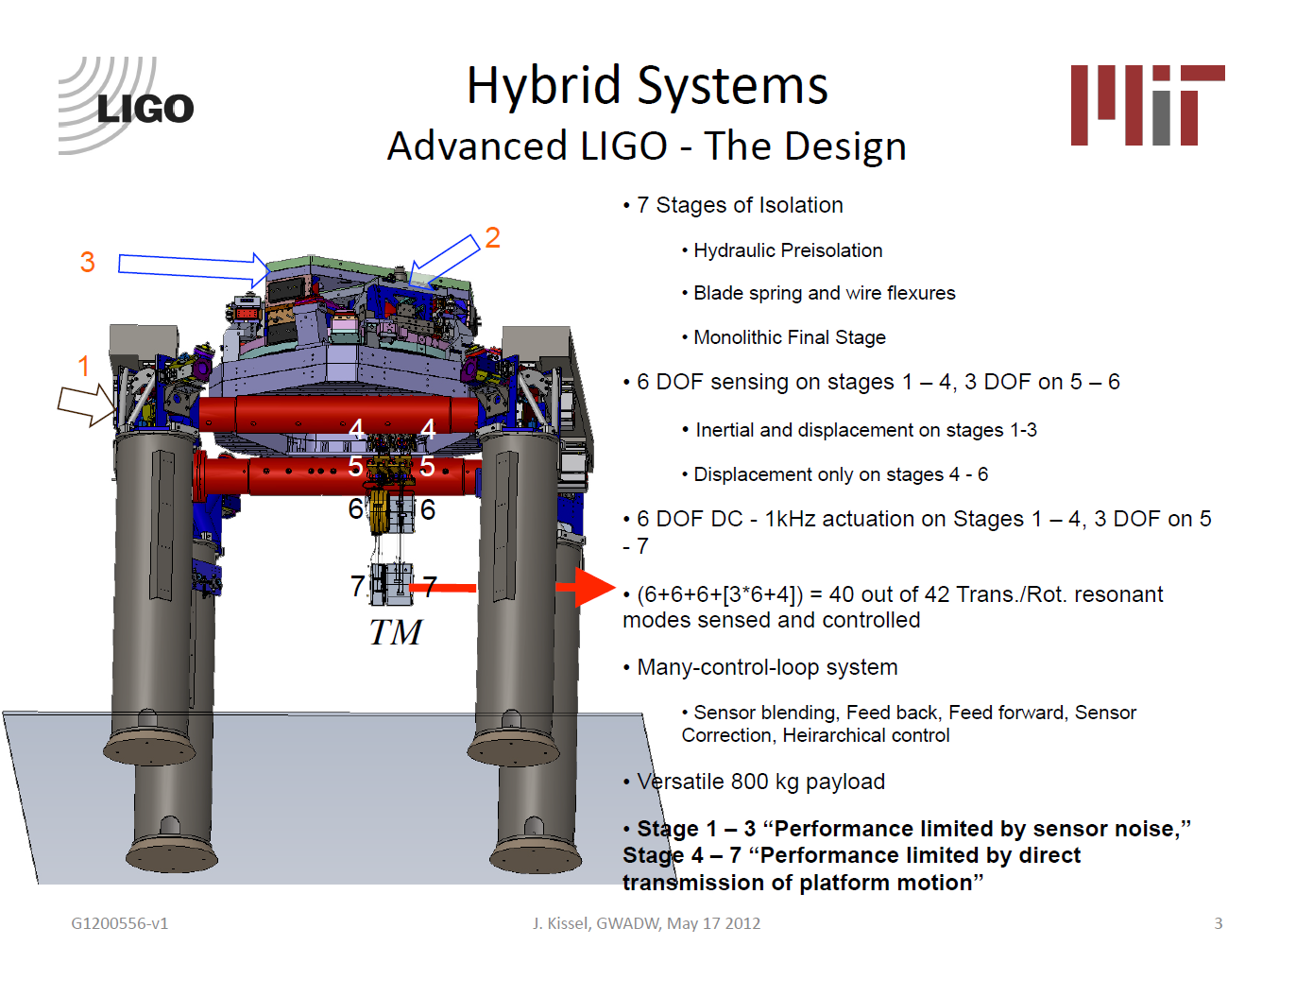
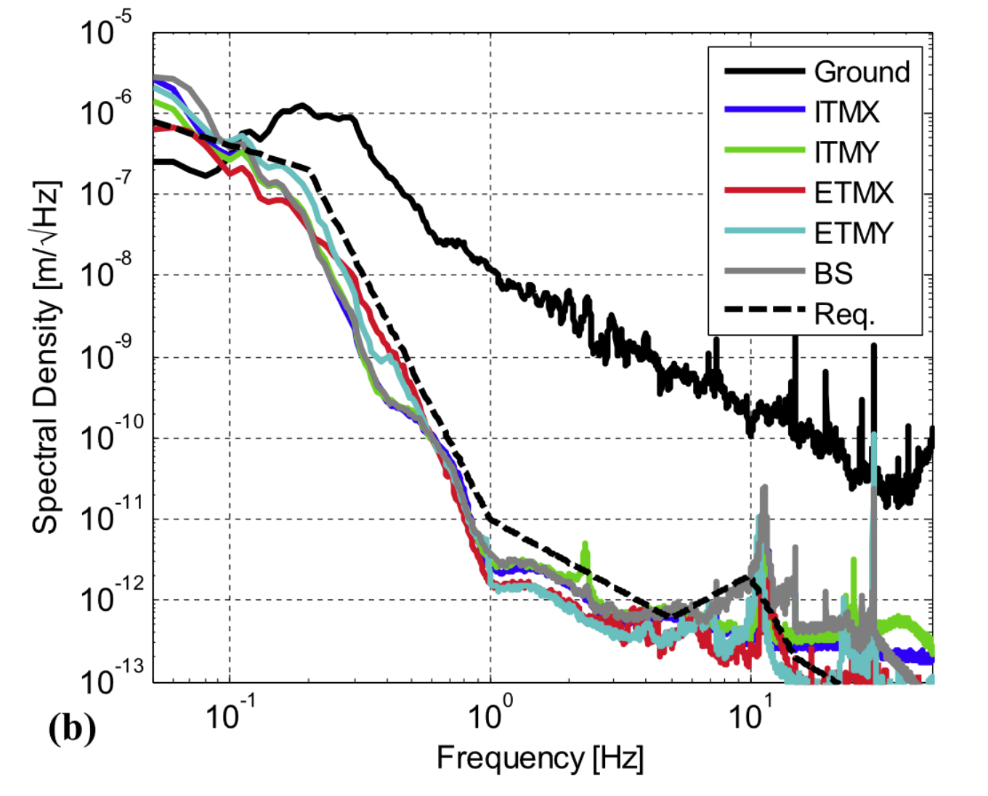
Matichard et al 2015 Class. Quantum Grav. 32 185003
https://doi.org/10.1088/0264-9381/32/18/185003

Slide 16
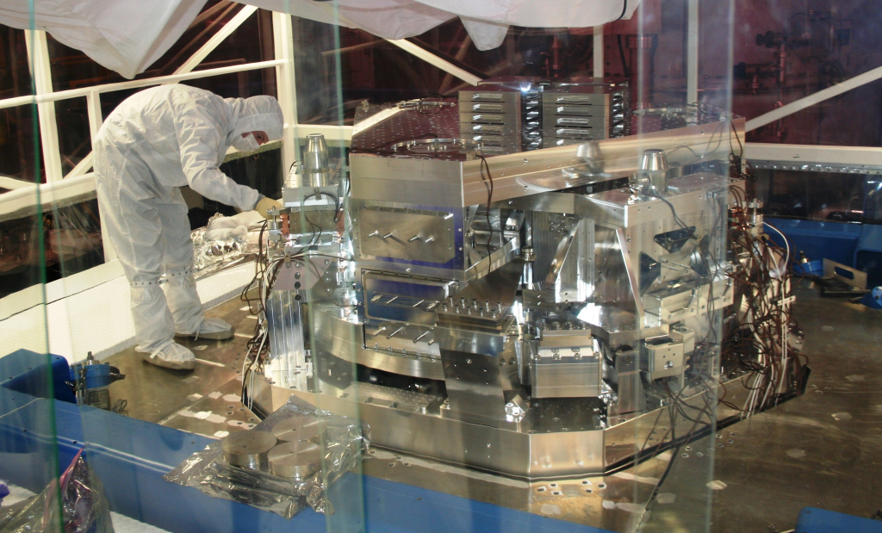
Images: LIGO Laboratory

Slide 17
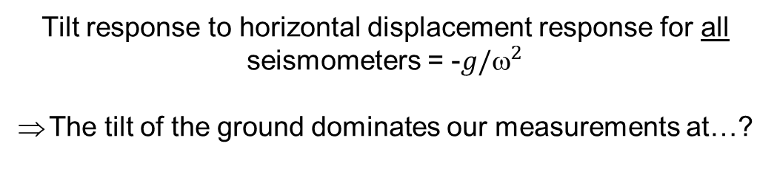
Tilt versus Horizontal displacement
Conventional seismometers and tiltmeters cannot differentiate between horizontal displacement and ground tilt.
δx ∝ ax
δx ∝ gθ
Tilt response to horizontal displacement response for all seismometers = -$g/^{2}$
The tilt of the ground dominates our measurements at…?

Slide 18
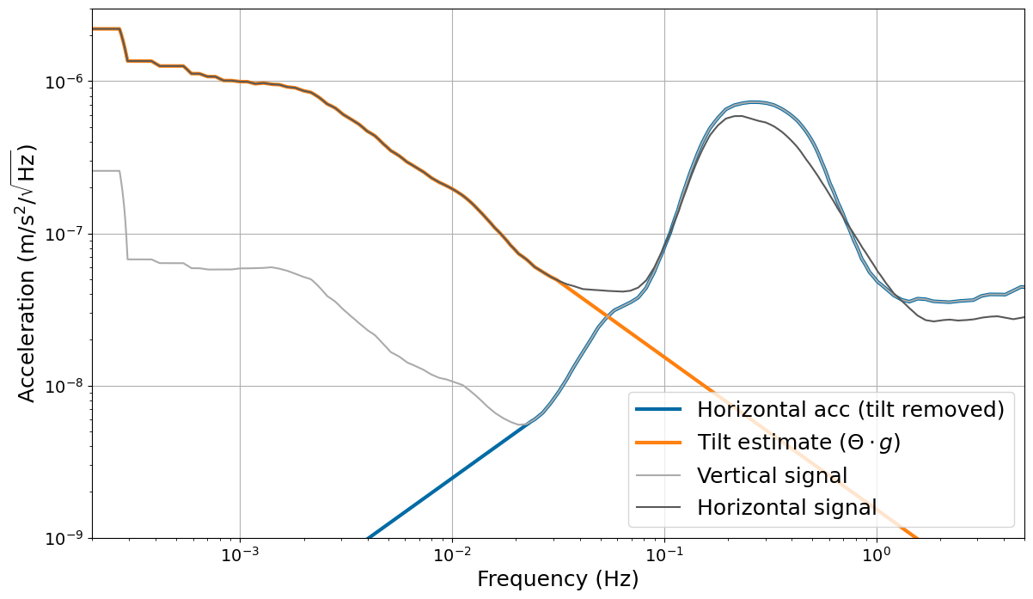
Estimating true tilt and translation (LNGS)
50mHz
Extrapolating tilt
Estimating
translation

Slide 19
Time-scale conspiracy #3
Detectors are ~3-4km and wave-speed means seismic waves at f>0.1Hz are differential…
The dominant RMS comes at ~0.1-0.3Hz.
Passive suspensions have resonances at ~0.5Hz…
And ground tilt ruins isolation at ~0.05Hz.

Slide 20
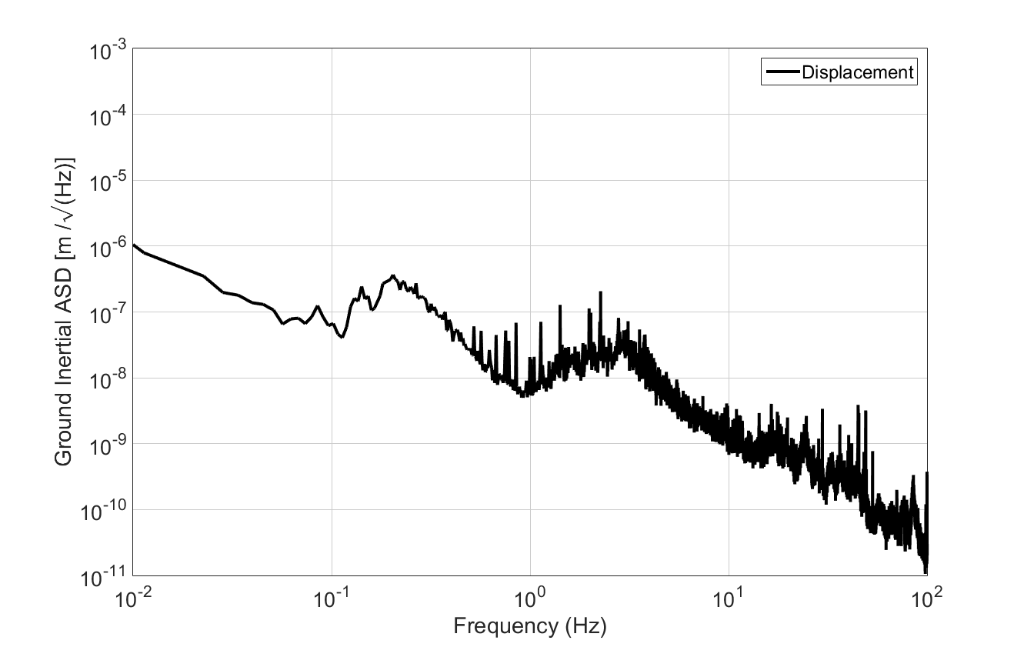
The bridge from 10mHz to 10Hz
Low-frequency noise
and tilt-to-length coupling
Principle suspension modes
and ‘Auxilliary’ control signals
μ-Seismic motion,
Principle ground RMS
Sensitive region
for GW detectors

Slide 21
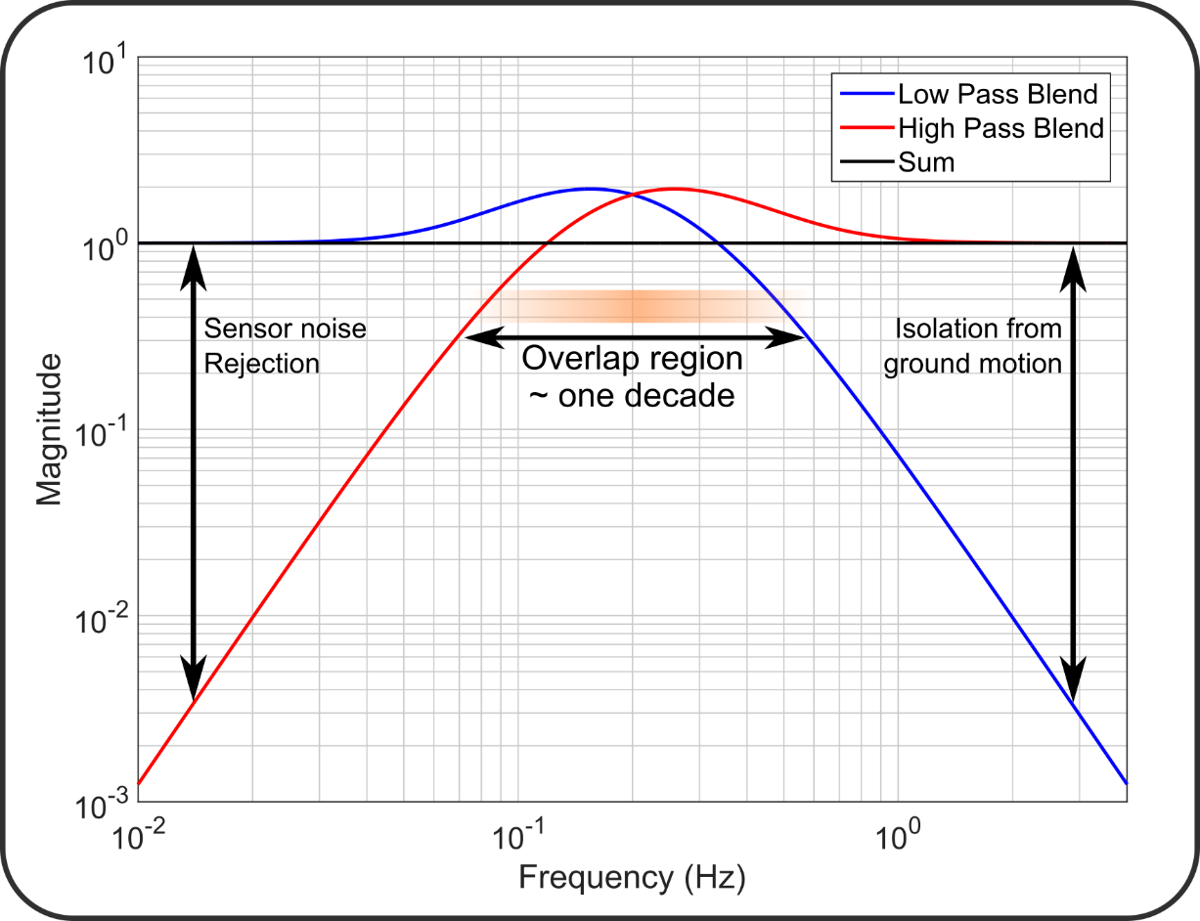
Blending filters

Slide 22
Conclusion: the axioms of isolation
GW Observatories require extreme levels of seismic isolation in-band, 3+ Hz for ET
Both active and passive isolation are required
Active isolation is most critical below 0.5Hz
Inertial sensors and passive isolators are affected by tilt
We need better inertial rotation sensors.
Seismic isolation is far from solved for ET-LF.

Slide 23
… but isn’t ET’s underground site awesome?

Slide 24
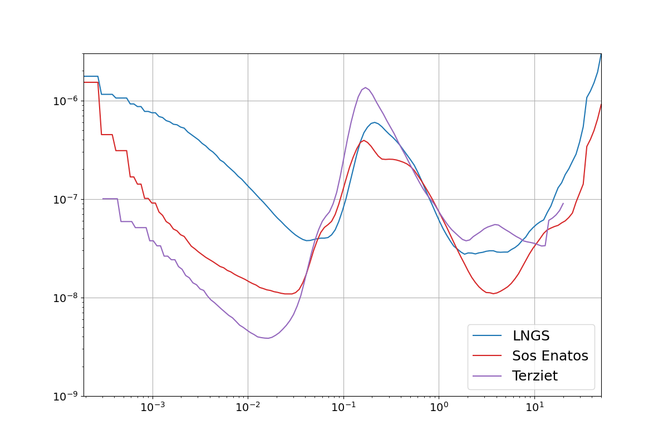
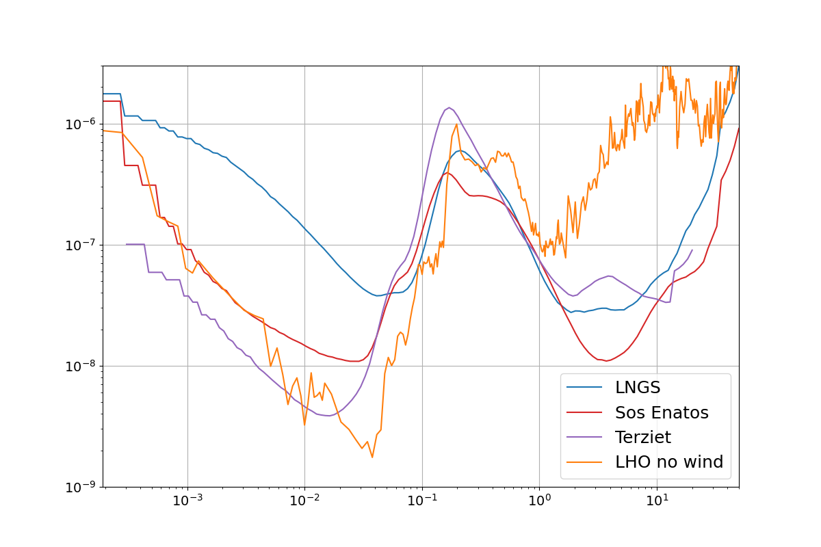
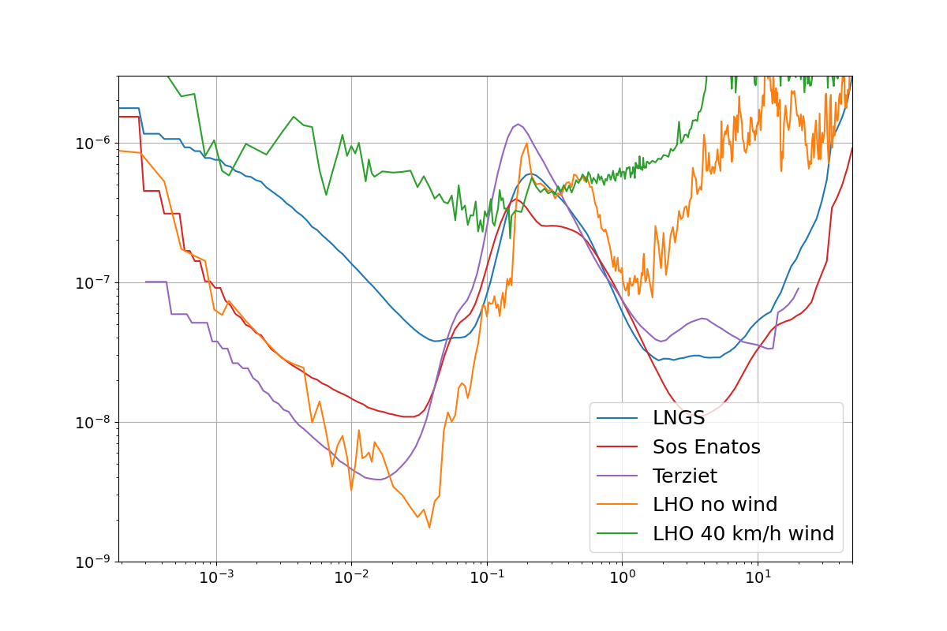
Comparison with LIGO Hanford site
Acceleration spectrum (m/s^2/sqrt(Hz))
Frequency (Hz)

Slide 25
… but isn’t ET’s underground site awesome?
No…
not at the frequencies where we struggle the most

Slide 27
ET-LF isolation requirements
How can we compute requirements when current instruments fail at low-f and our needs are a million times harder?
Workshop in Amsterdam, Tuesday 18 April
Wiki page: https://wiki.nikhef.nl/gravwav/ET-LF_requirements_workshop
Git repo: https://gitlab.nikhef.nl/gw/et-lf-requirements-workshop

Slide 28
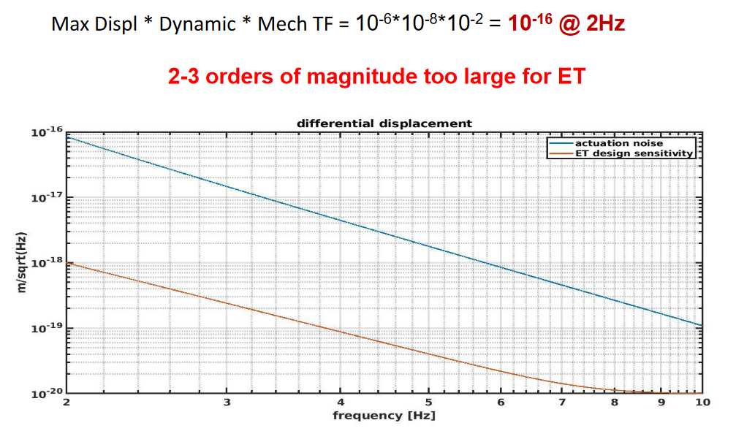
First target: actuation noise
There is a simple recipe for actuation noise. Using Virgo numbers:
This is the focus
for OmniSens
Requires payload
and controls models
Ruggi, ET-ISB workshop
actuation noise does not seem less ‘fundamental’ then thermal noise

Slide 29
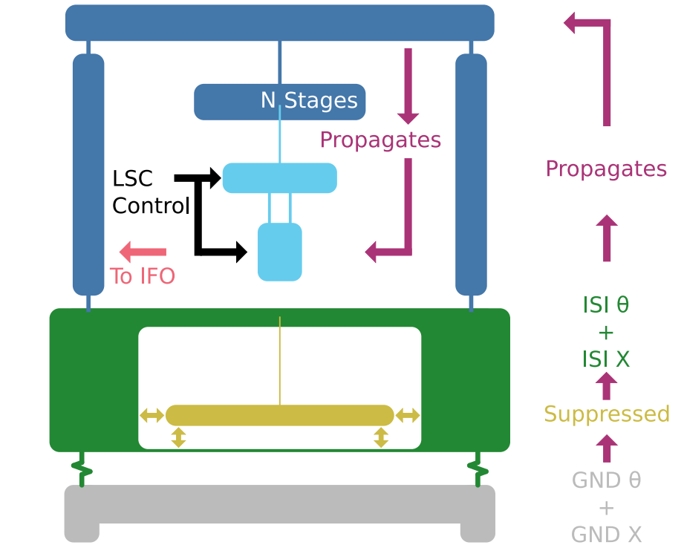


System model
LNGS input spectra
OmniSens isolation
2 Stage payload
3 SAT options:
  9m Virgo
  12m ET
  17m ET-LF
GWADW 2023-05-24
N. A. Holland, et. al.
29
ET-0198A-23
of
19

Slide 30
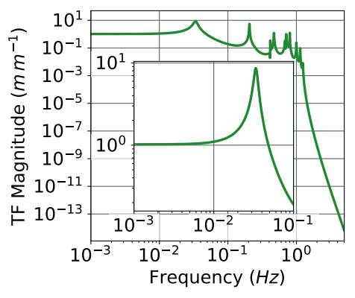
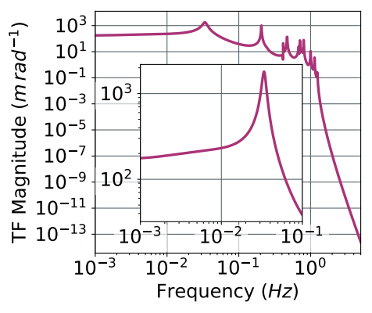
SAT TF – 17m ET-LF Baseline
GWADW 2023-05-24
N. A. Holland, et. al.
30
ET-0198A-23
of
19

Slide 31
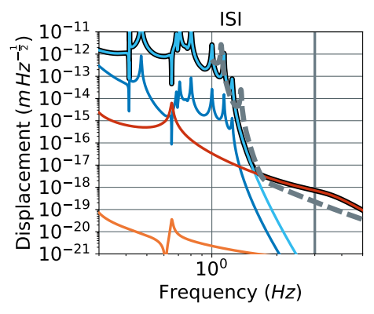
Pulling it all together – ET-LF
ET-LF sensitivity
Total actuation noise
Actuation noise is 8 times higher than the design curve
With a safety margin and realistic statistics, this more like 300x too large.
These models are already aggressive and optimistic.
8⨉
too high
GWADW 2023-05-24
N. A. Holland, et. al.
31
ET-0198A-23
of
19

Slide 32
Where do we go from here?
We projected design solutions into noise, we need to reflect them back into design requirements
Low-frequency motion in real underground laboratories requires further study (different locations, history, statistics)
We need more detailed mechanical models that more accurately reflect real motion
It is clear we need better instrumentation and controls distributed through the

Slide 34
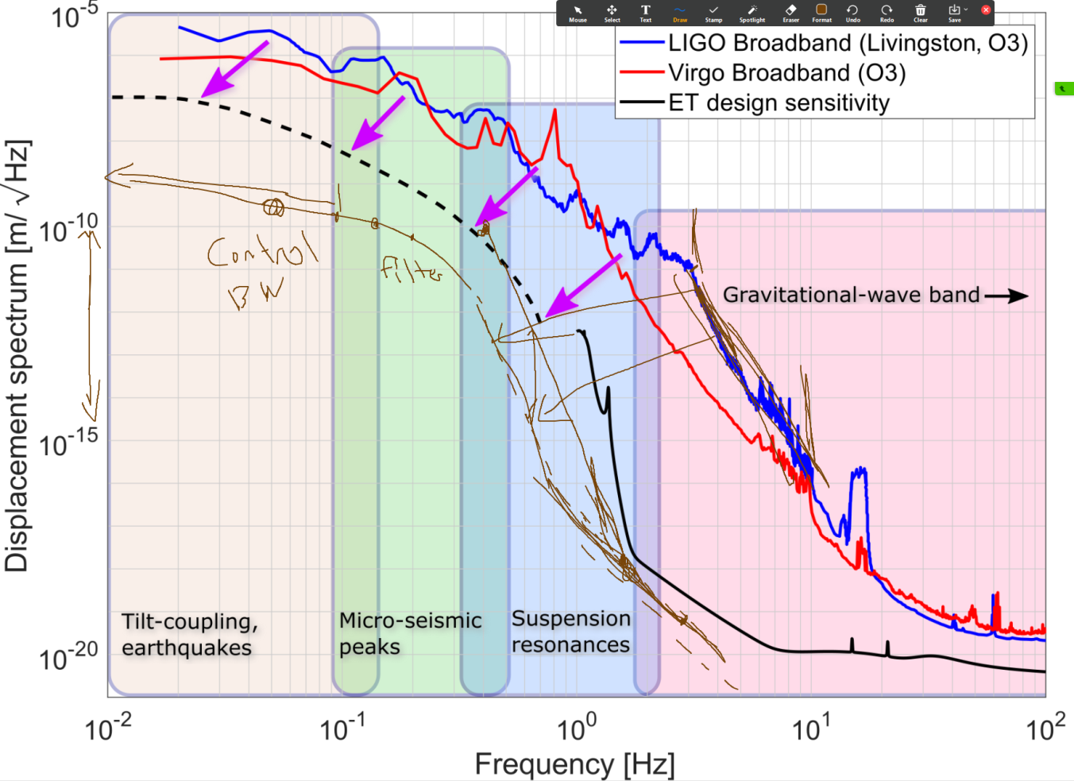
ET requirements?

Slide 35
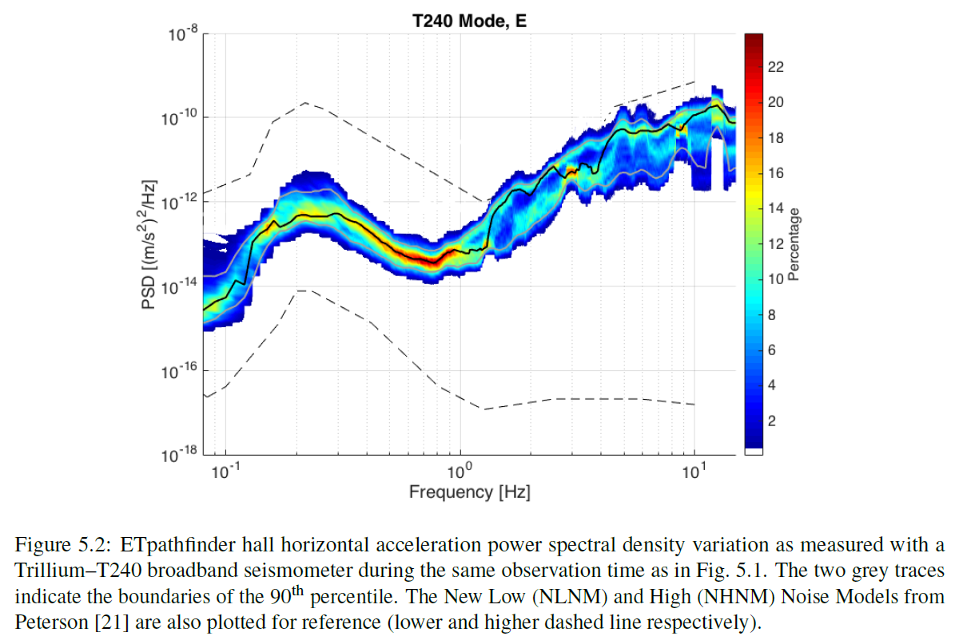
ET Pathfinder

