Slide 1
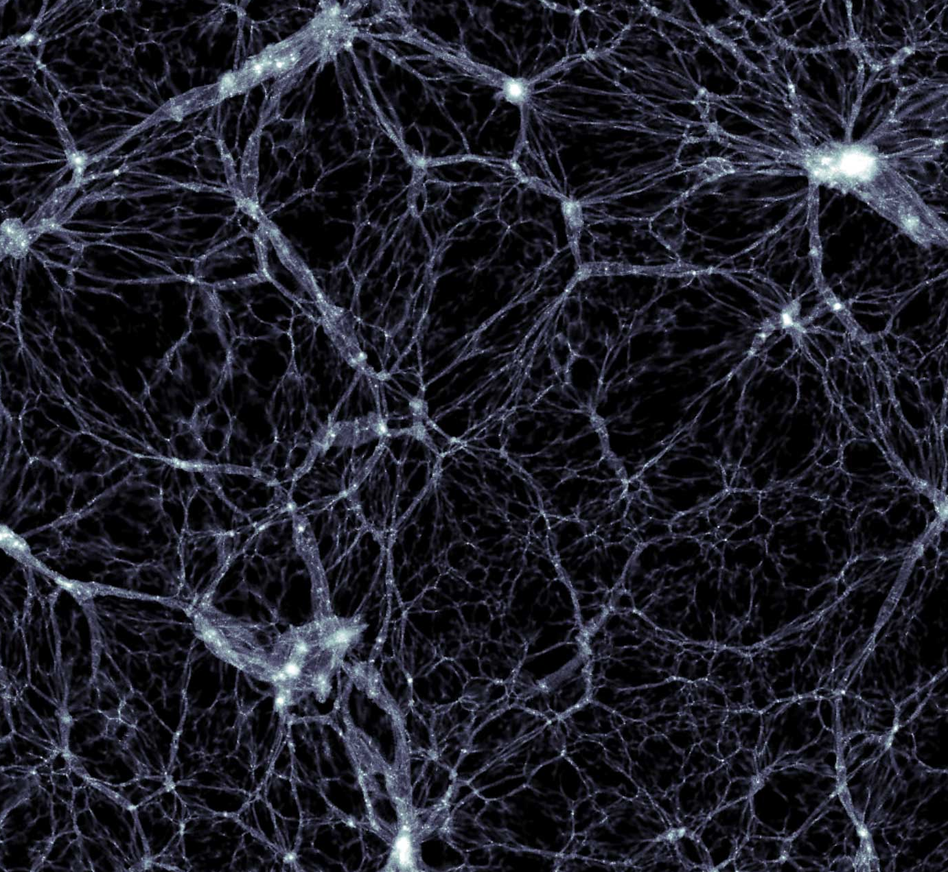




Number counts of GW
in ΛCDM and
Scalar-Tensor Theories
Anna Balaudo
In collaboration with:
Mattia Pantiri
Alessandra Silvestri
Credit: Markus Haider, Illustris Collaboration.

Slide 2
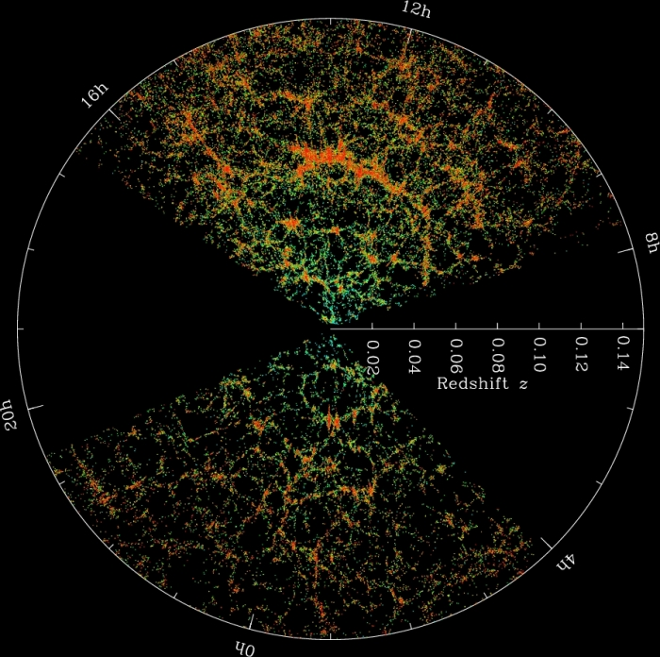
Is the Universe homogeneous
and isotropic?

Slide 3
Is the Universe homogeneous
and isotropic?

Slide 4
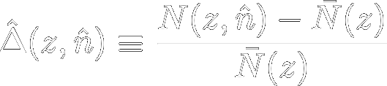
Is the Universe homogeneous
and isotropic?
Data

Slide 5
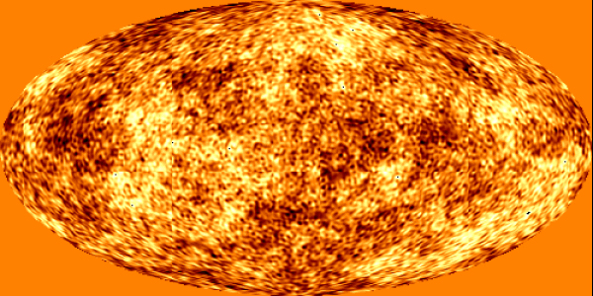
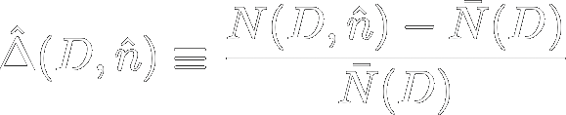
Is the Universe homogeneous
and isotropic?
Primordial perturbations
Cosmological model
Theory ?
Data

Slide 6
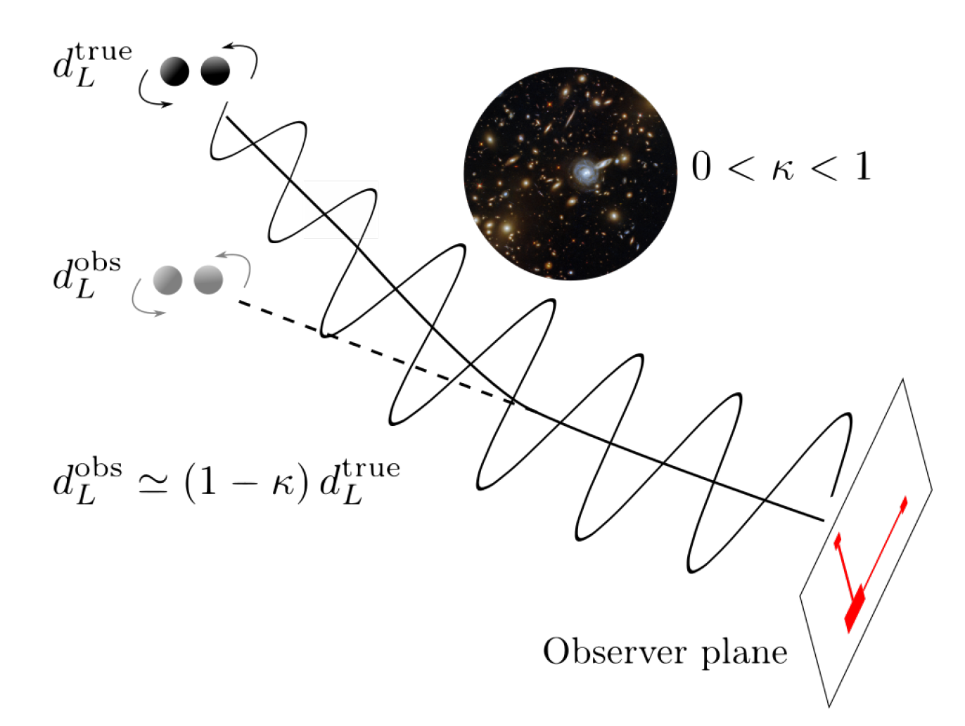


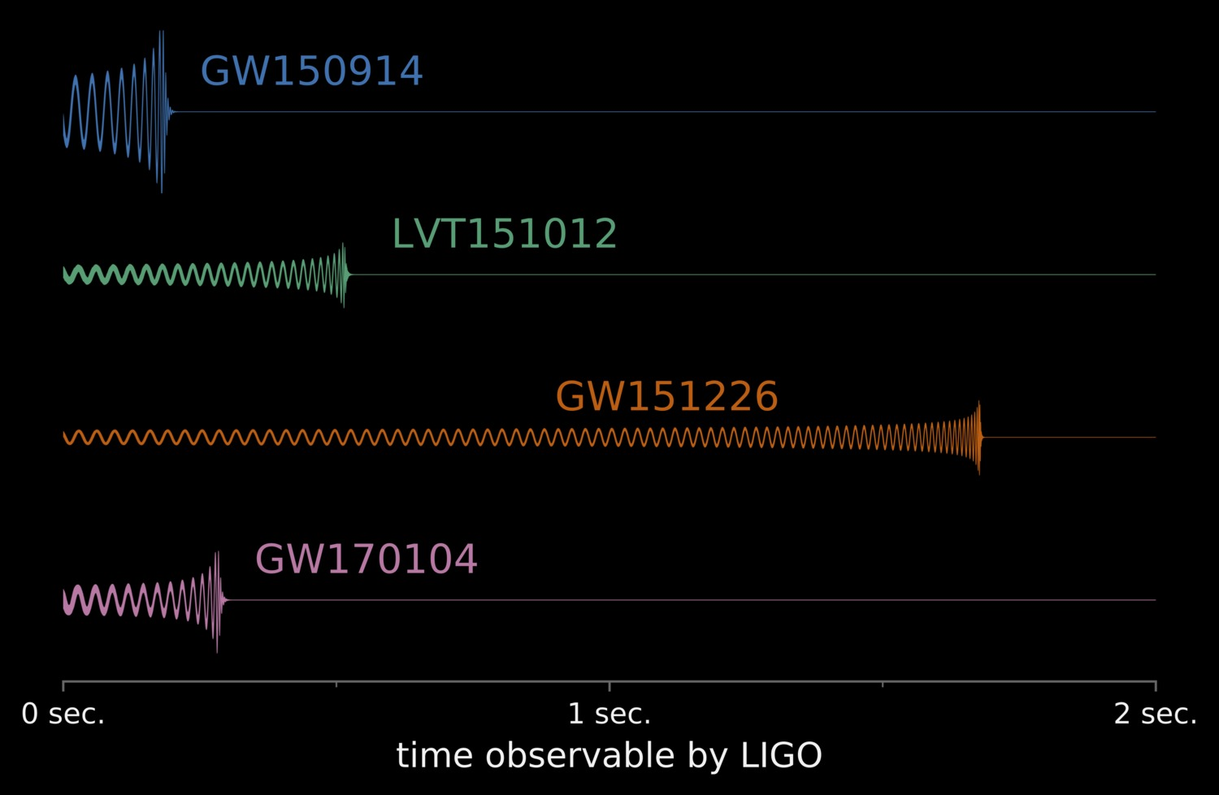
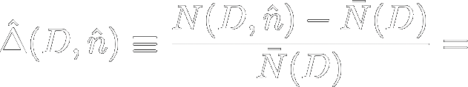

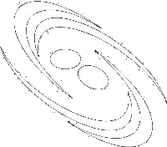
Mpetha, Congedo and Taylor (2022)
GW propagate in an expanding FRW Universe following
From the strain, we can measure the luminosity distance of the binary
Background
Perturbations:
Bertacca et al. (2019)
Bonvin & Durrer (2009)
density
fluctuations
relativistic
effects
+
Density
Volume

Slide 7


Mpetha, Congedo and Taylor (2022)
GW propagate in an expanding FRW Universe following
From the strain, we can measure the luminosity distance of the binary
Background
Perturbations :
Garoffolo et al. (2020)
MG models: ST Horndeski with c_{T} =1
Bonvin & Durrer (2009)
density
fluctuations
relativistic
effects
+
Density
Volume

Slide 8
GW number counts in Scalar-Tensor theories of Gravity
Doppler
Luminosity Space Distortions
Peculiar velocity effects

Slide 9
GW number counts in Scalar-Tensor theories of Gravity
Doppler
Luminosity Space Distortions
Lensing
Time delay
Integrated Sachs-Wölfe
Peculiar velocity effects
Integrated relativistic effects during propagation

Slide 10
GW number counts in Scalar-Tensor theories of Gravity
Doppler
Luminosity Space Distortions
Lensing
Time delay
Integrated Sachs-Wölfe
Local potentials
Peculiar velocity effects
Integrated relativistic effects during propagation
Local potentials at the wave emission

Slide 11
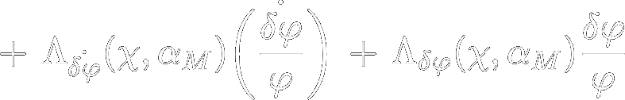
GW number counts in Scalar-Tensor theories of Gravity
Doppler
Luminosity Space Distortions
Lensing
Time delay
Integrated Sachs-Wölfe
Local potentials
Peculiar velocity effects
Integrated relativistic effects during propagation
Local potentials at the wave emission
Interaction of the GW with the DE scalar field
Scalar field

Slide 12
Number counts signal in standard GR

Slide 13
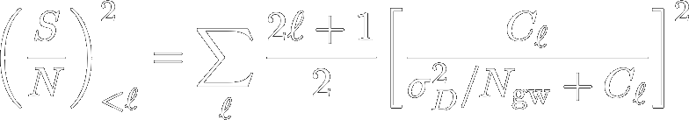
Observability
We define a cumulative
signal to noise
The signal is observable in both detectors!

Slide 14
Number counts in Scalar-Tensor theories
200
400
600 - 700

Slide 15
GW number counts is
potentially observable by next generation detectors
The GW signal can be cross-correlated with LSS to give even more information.
Key
Takeaways
Deviations from ΛCDM can only be measured effectively probing the smallest scales.
Crucial improvement needed is accuracy on the measure of D_{L} and on sky-locations
Thank you!
And thanks to Mattia Pantiri and Alessandra Silvestri

Slide 16
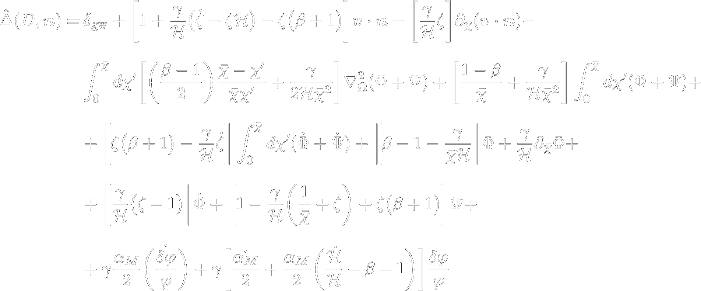
GW number counts in Scalar-Tensor theories of Gravity

