Slide 1
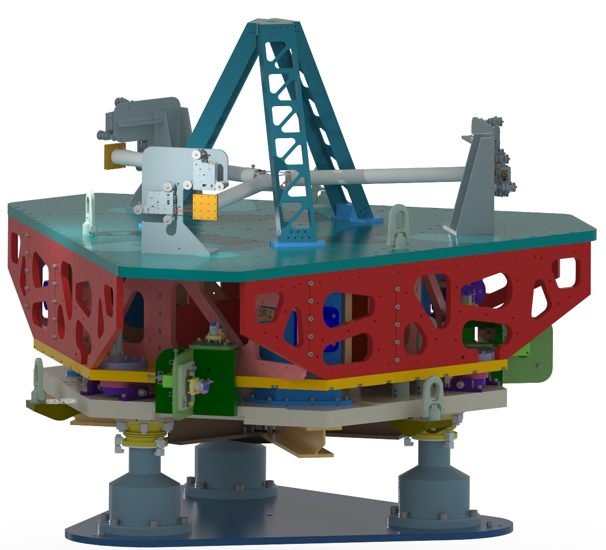
Updates from the Omnisense project
Jesse van dongen
On behalf of: Nathan A. Holland, Alexandra L. Mitchell ,
Armin Numic, Pooya Saffarieh, Michele Valentini,
Conor M. Mow-Lowry and Others

Slide 2
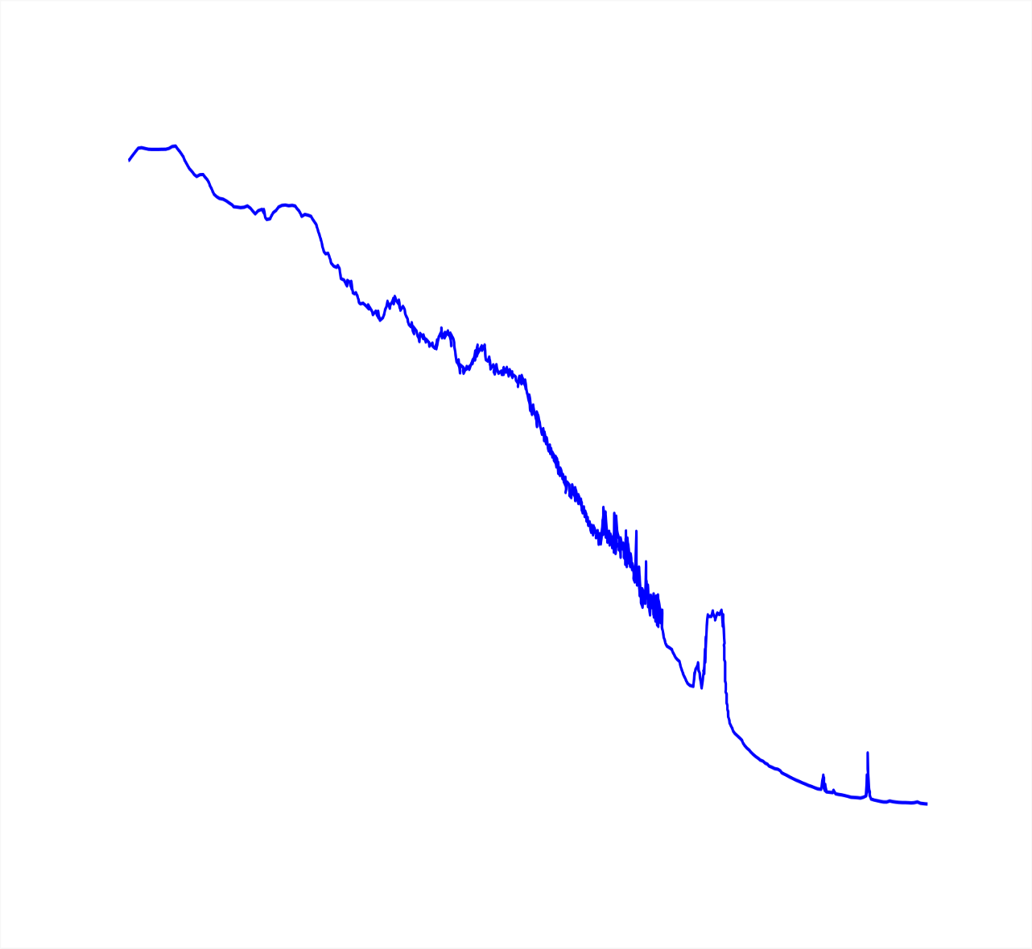
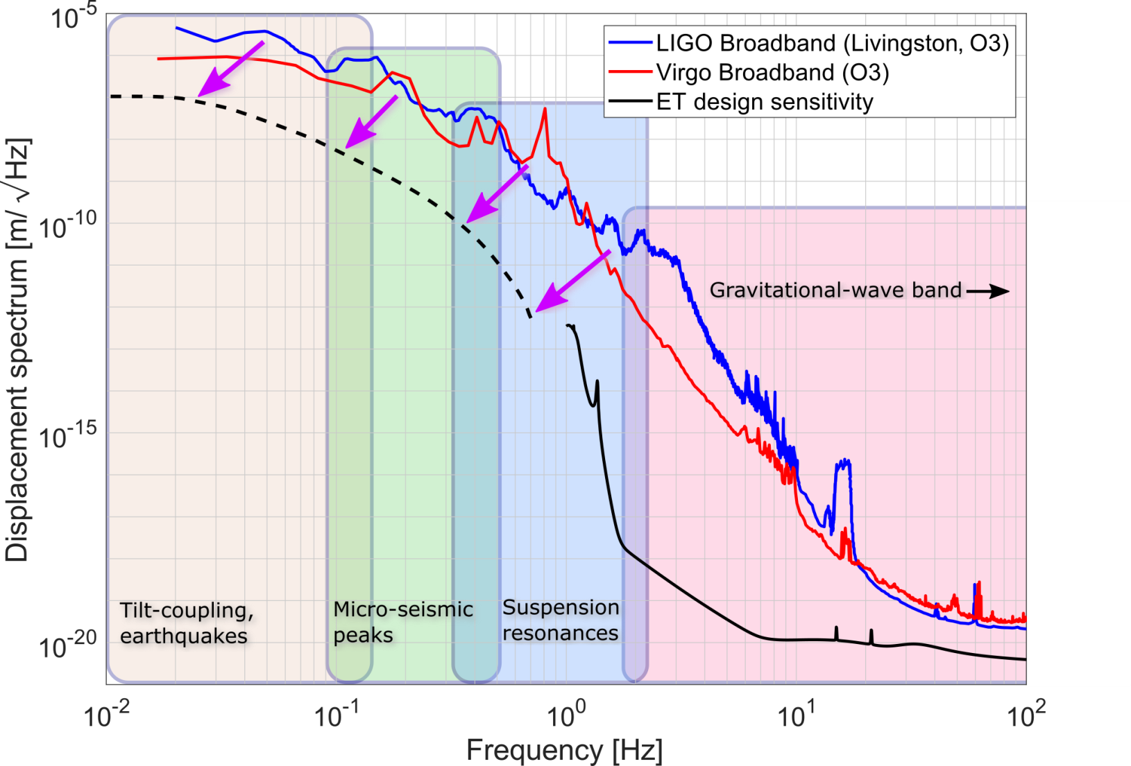
Credit: Conor Mow-Lowry
ET Desire: Low Frequency Sensitivity

Slide 3
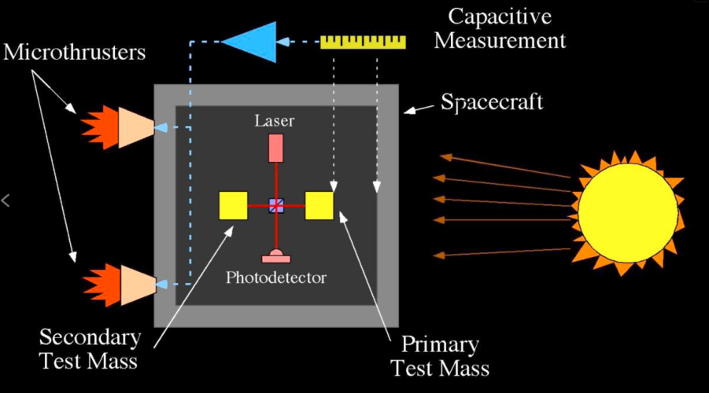
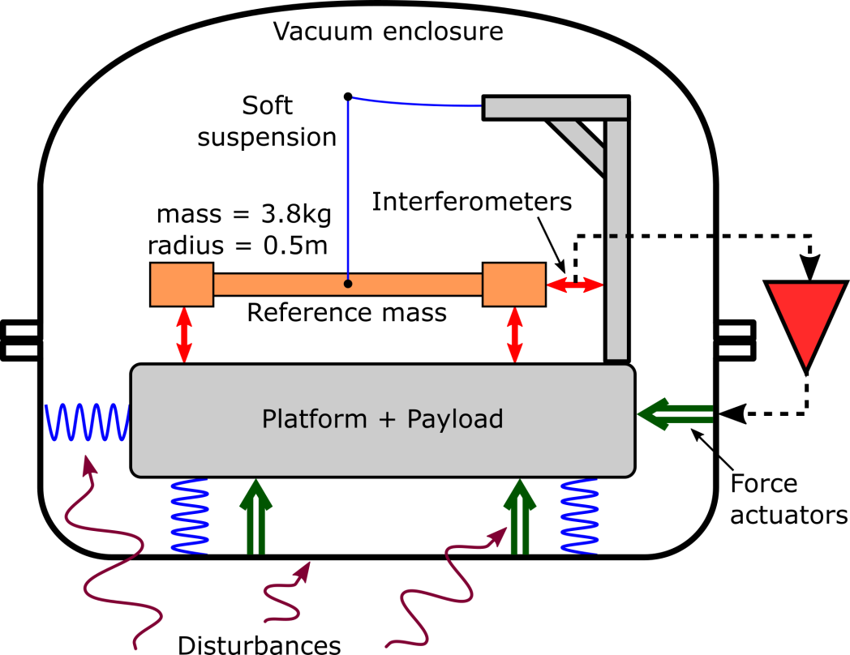
Seismic isolation for Einstein Telescope
Credit: Conor MOW-Lowry
OmniSens concept
…a sort of terrestrial drag-free control
DRS Working Principle – Image: NASA/JPL

Slide 4
Image Credit: Armin Numic

Slide 5
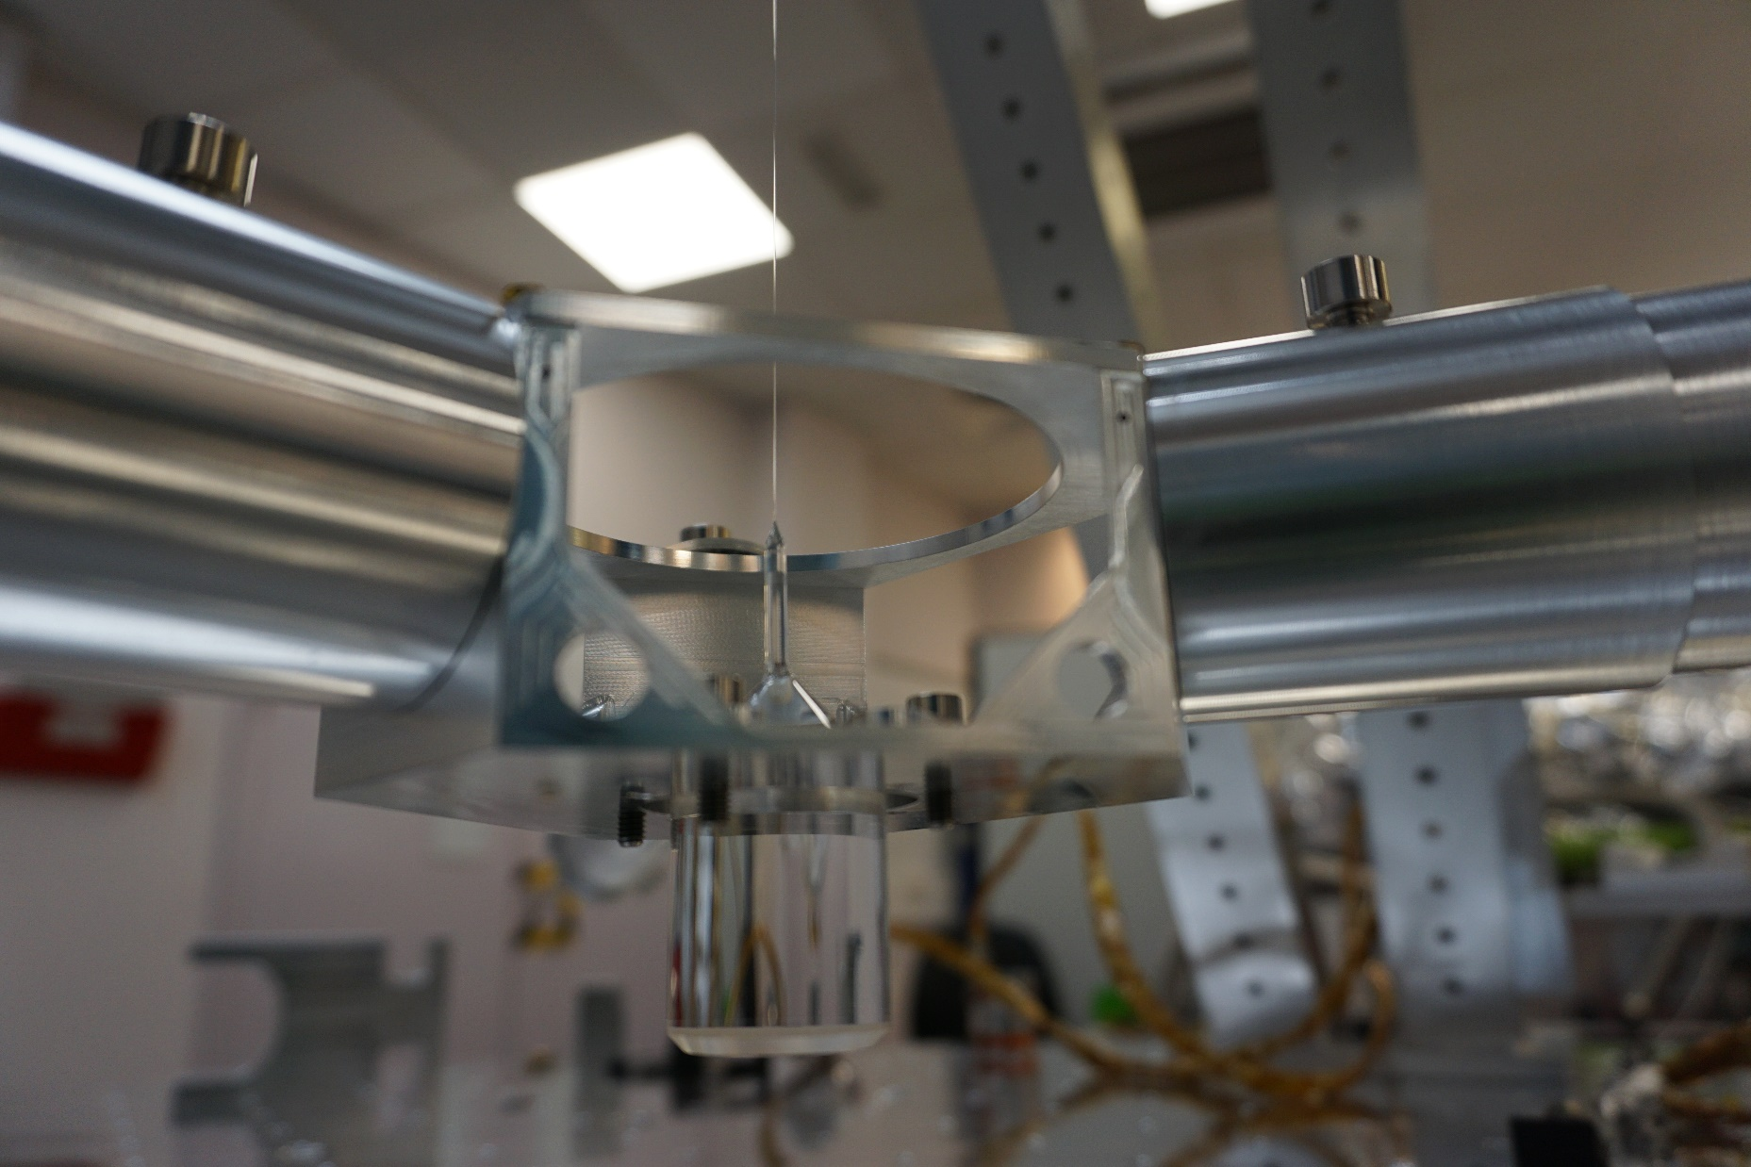
Credit: University of Birmingham

Slide 6
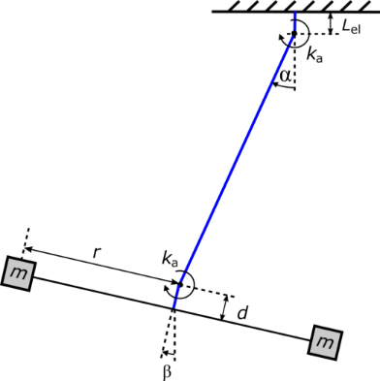
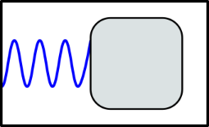
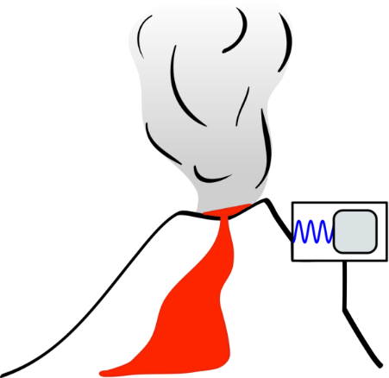
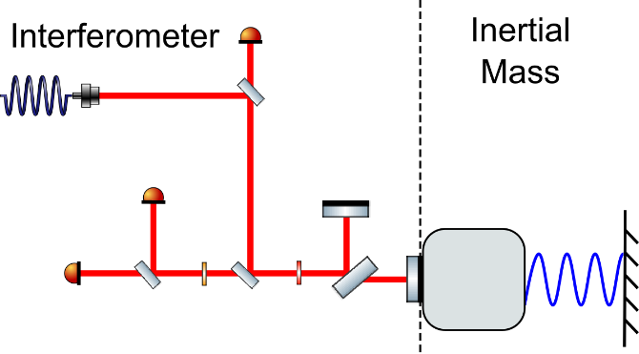
Credit: Conor Mow-Lowry
Tilt-to-Horizontal coupling
Mechanical cross-coupling
δx ∝ ax
δx ∝ gθ
Sensor/actuator noise
Dynamic range
Notes:
There are 4 Hard problems that limit low-frequency seismic isolation. The first shown here is the most fundamental and challenging: When an inertial sensor is tilted, there is now a component of gravitational acceleration pushing ‘horizontally’ against the proof mass.
This tilt-to-horizontal coupling obscures low-frequency translation, and it is the dominant problem.
Many low-force experiments use torsion balances because they show low cross-coupling to other degrees of freedom. However there is a limit to what is possible in reducing these couplings, and it is easy to construct over-constrained systems where large forces leak into a sensitive direction.
All current commercial instruments are limited by a combination of sensor and actuator noise. Employing large-range interferometry can ‘solve’ this problem.
LIGO employs world-best commercial devices, but they are designed to work in extreme environments, and cope with the full motion spectrum of the Earth. We are only interested in operating in an extremely quiet, temperature-stable vacuum environment.
It became clear after my years working on active isolation in Germany that these problems could not be solved by incremental improvements or a new commercial sensor; we needed some fundamentally new ideas for reducing low-frequency motion.

Slide 7
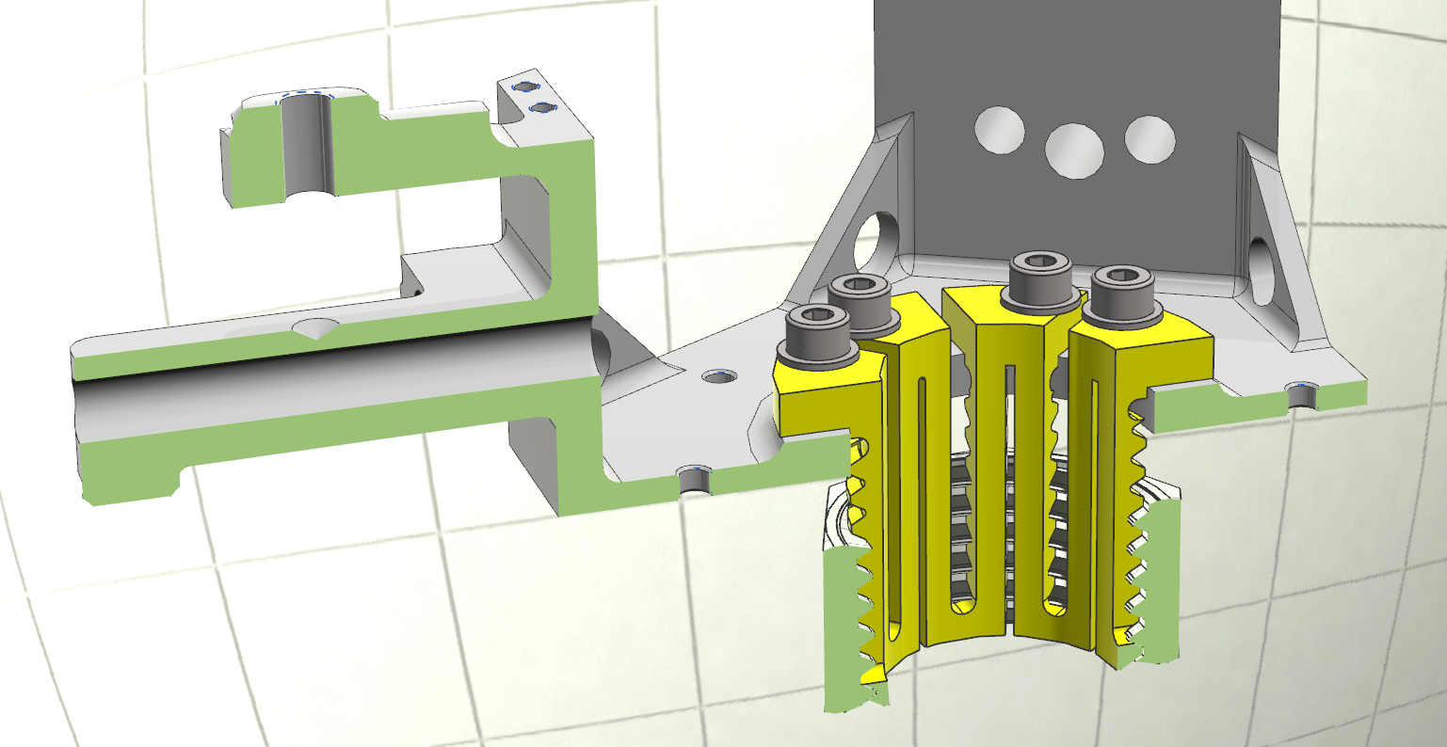
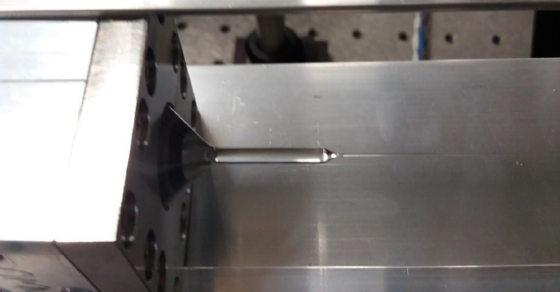
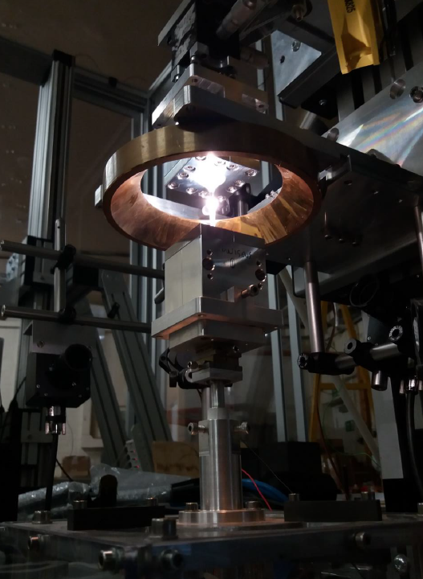
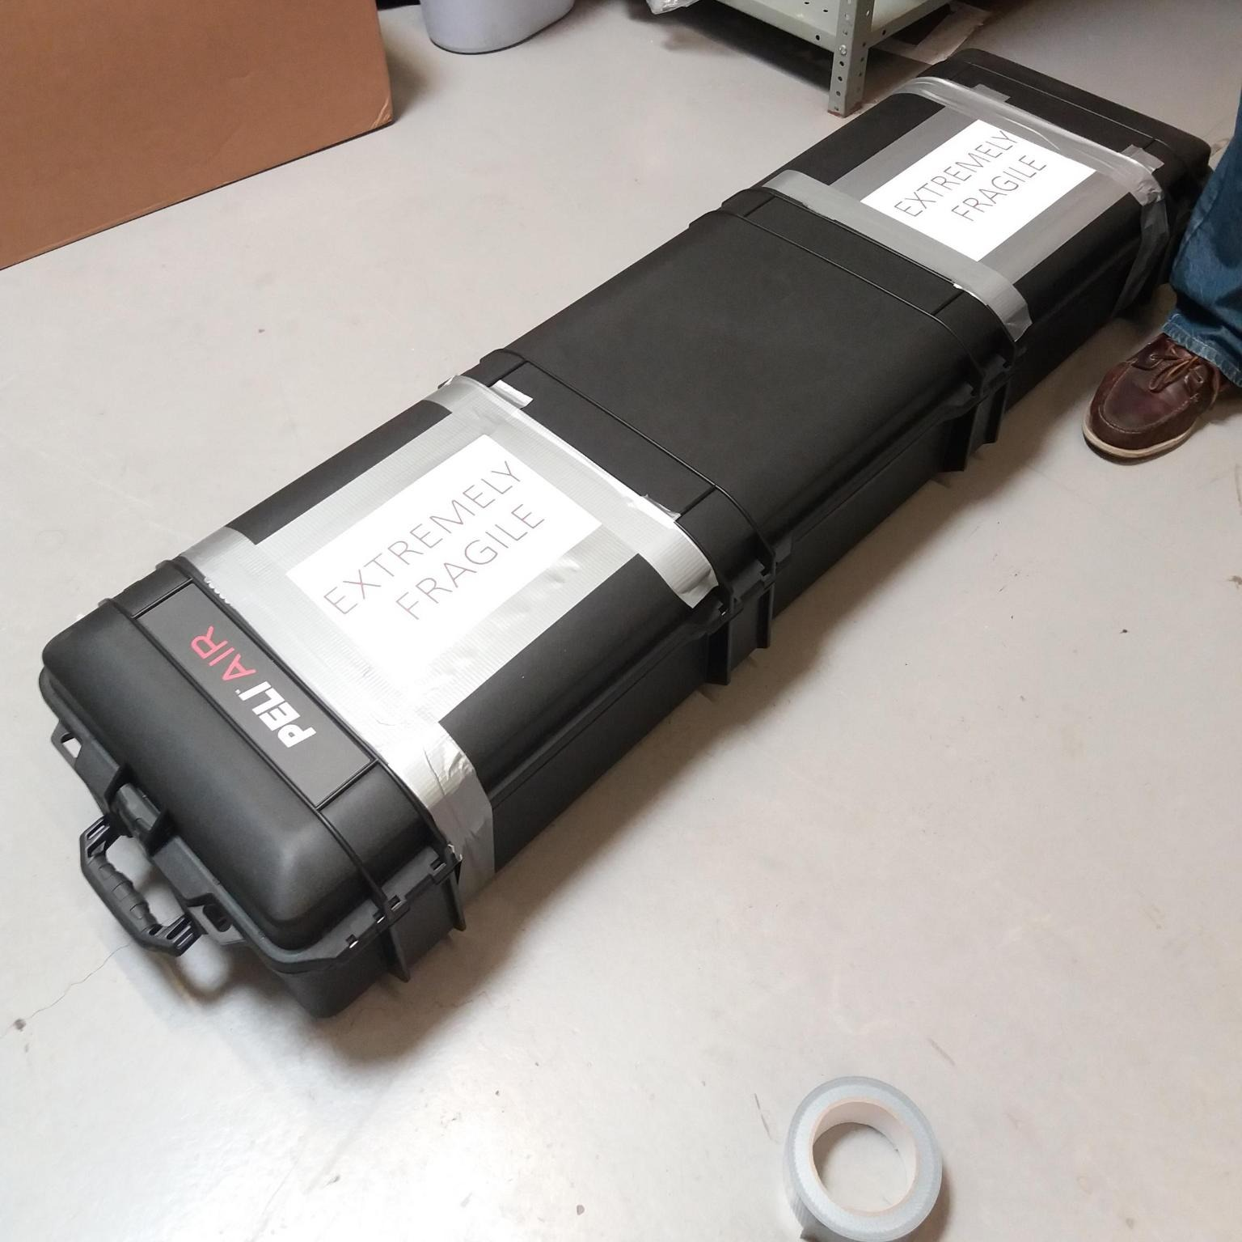
Glass Metal Interface
Credit: Alan Cumming
Credit: Martin Adams
Fibers Pulled @ Glasgow

Slide 8
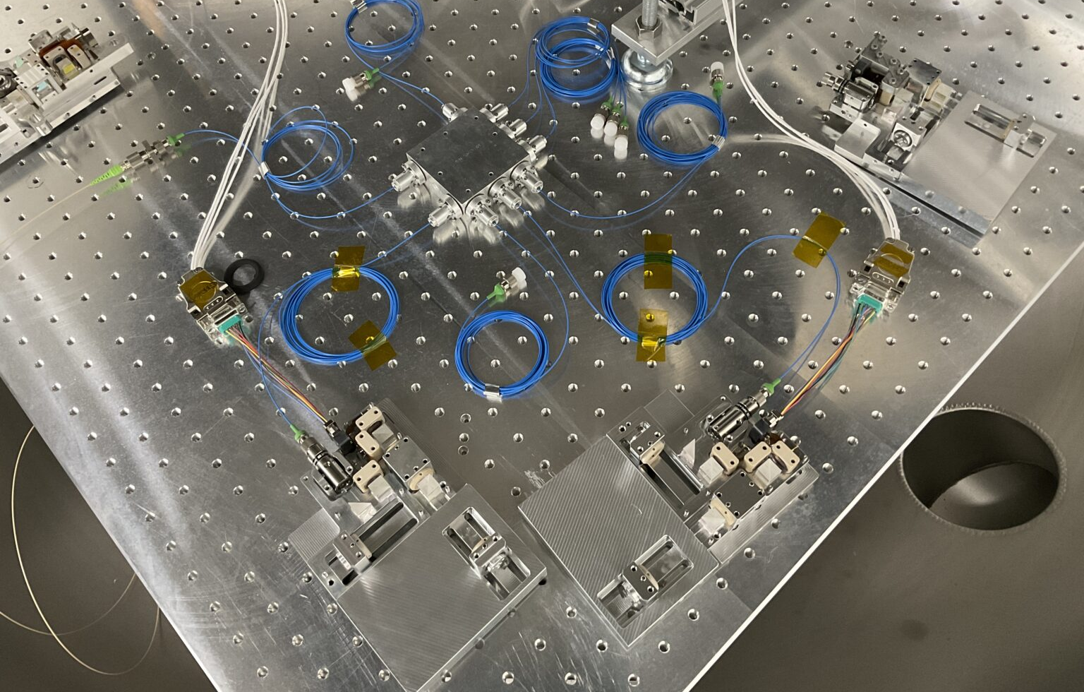
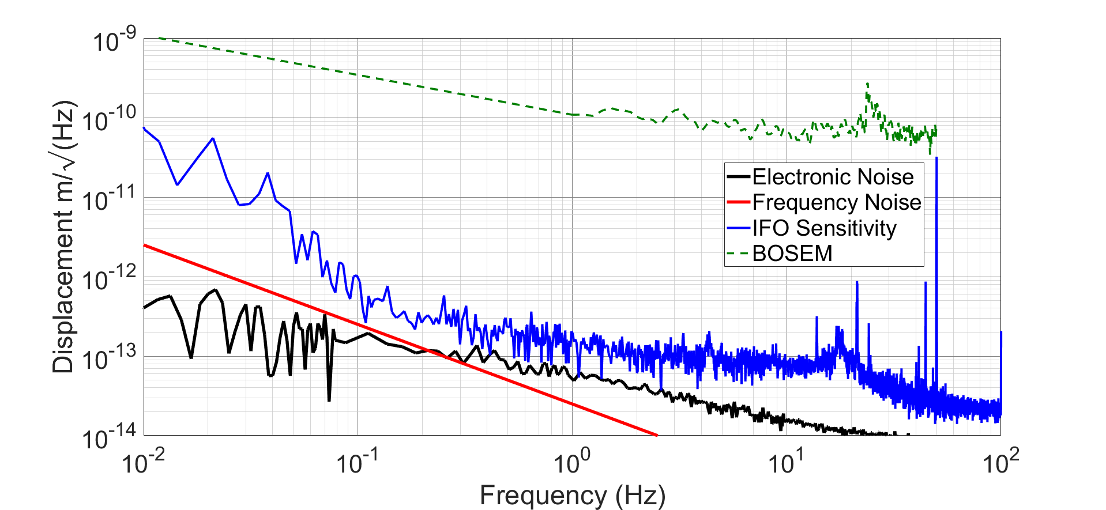
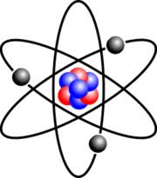
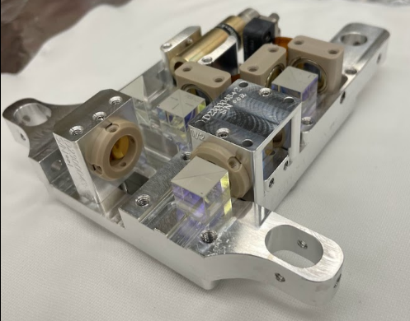
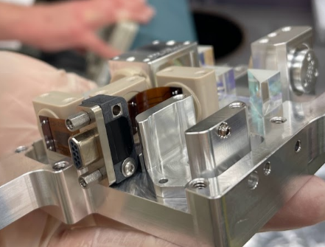
Credit pictures: Alexandra Mitchell
HoQI for Readout
Homodyne Quadrature Interferometers
noise hunting / optimizing the performance
10⁻¹⁰ m
Cooper et al., CQG 35 095007 (2018)
http://iopscience.iop.org/article/10.1088/1361-6382/aab2e9/meta

Slide 9
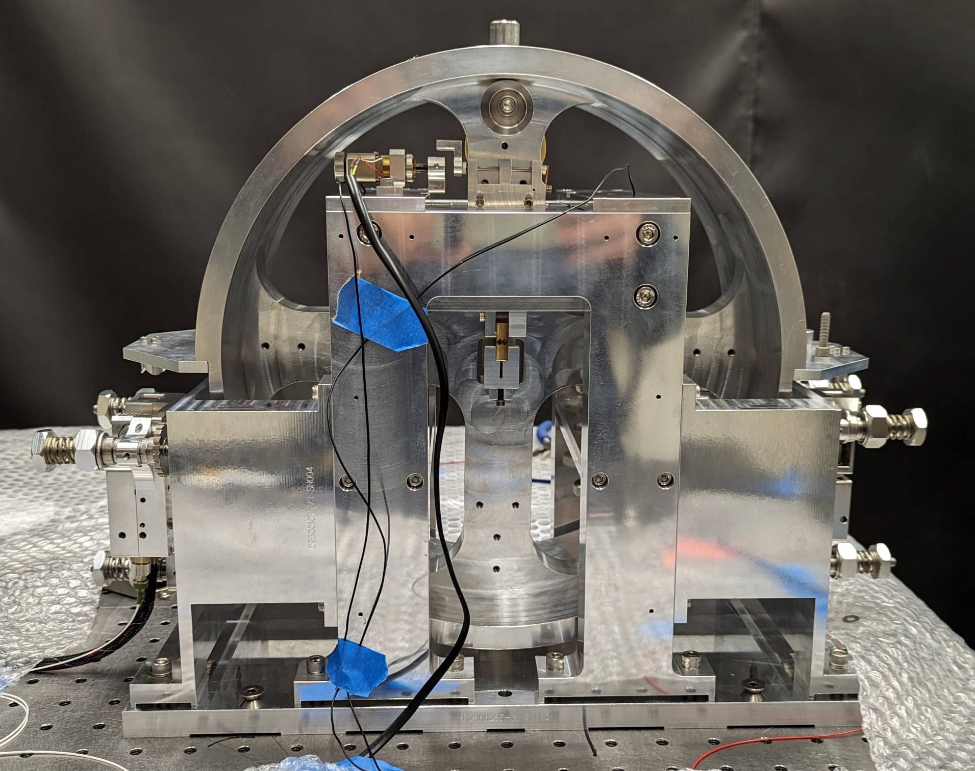
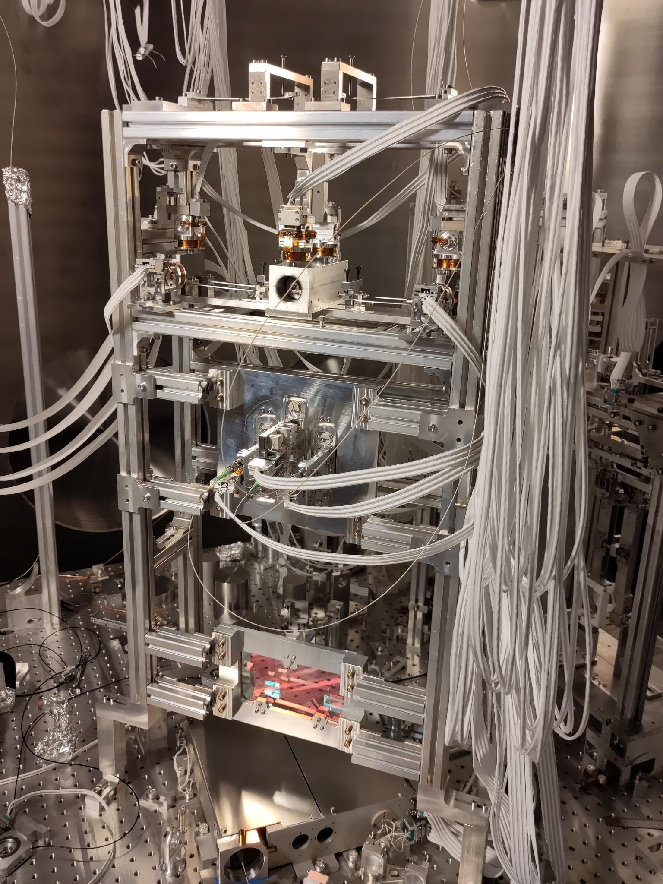
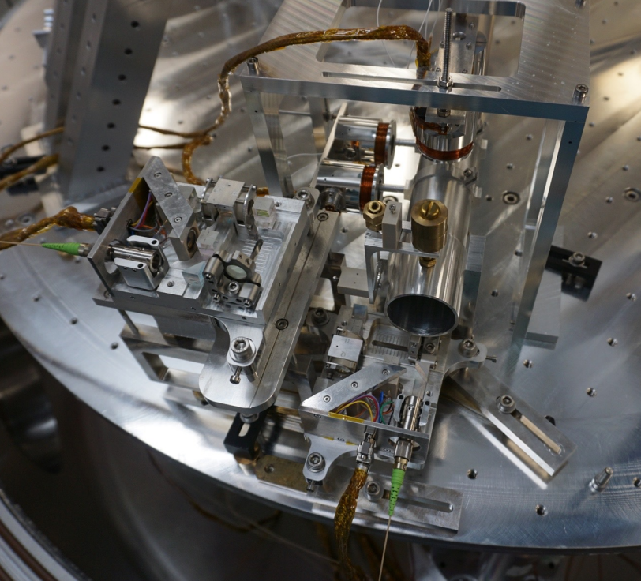
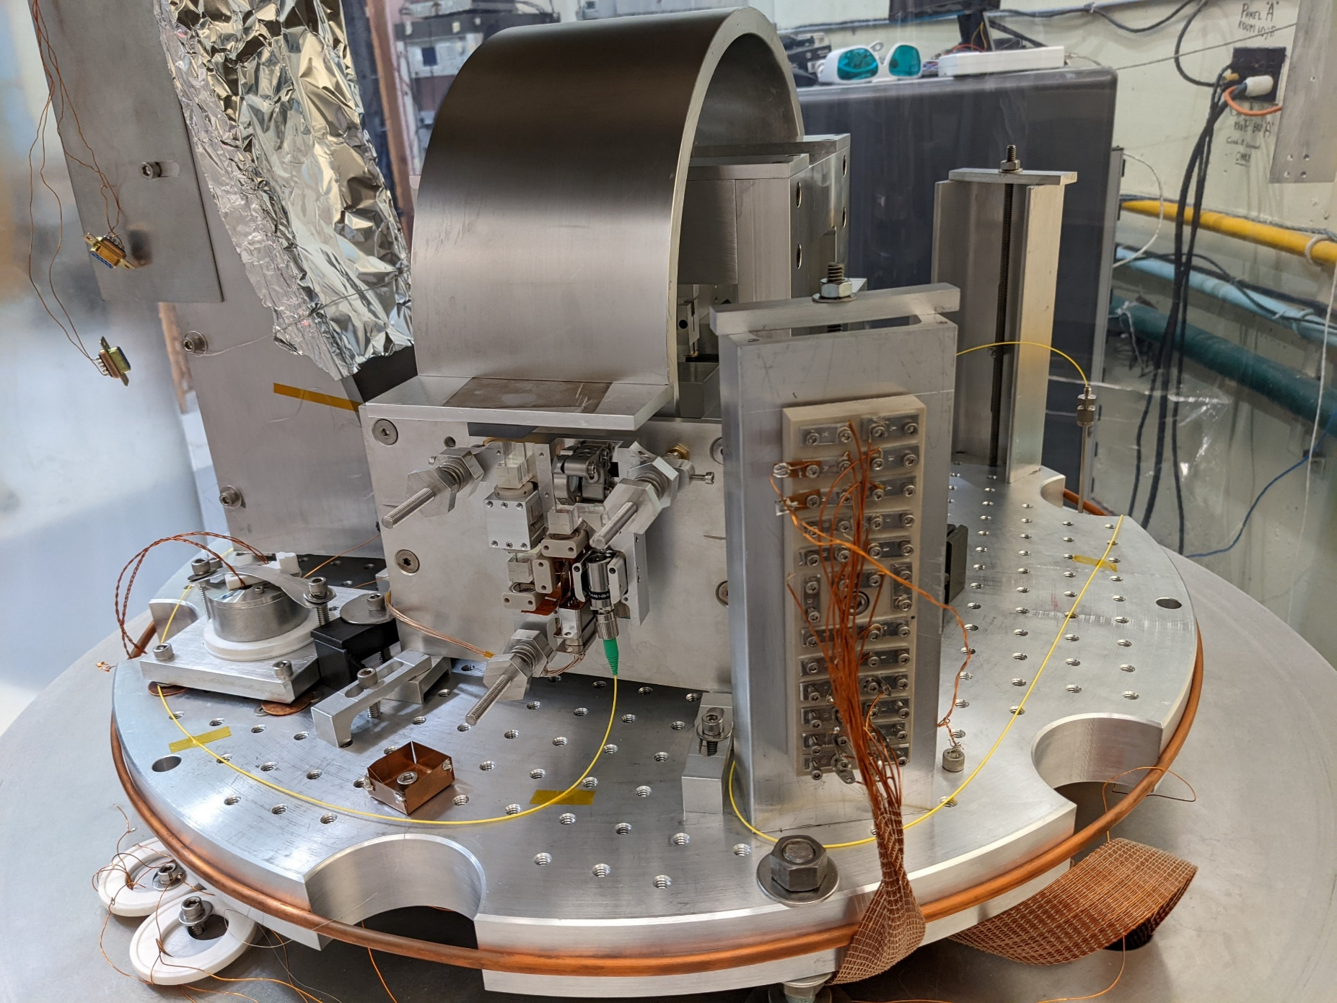
HoQIs around the world …
Credit: Alexandra Mitchell
Cylindrical rotation sensor readout at CALtech
Readout of Birmingham 6D experiment
https://dcc.ligo.org/LIGO-G2300542
Measuring IM in AEI 10m prototype beamsplitter suspension
Cylindrical rotation sensor readout at UW
9

Slide 10
Image Credit: Armin Numic
Seismic Isolation platform ordered,
Expecting first parts to arrive late january

Slide 11
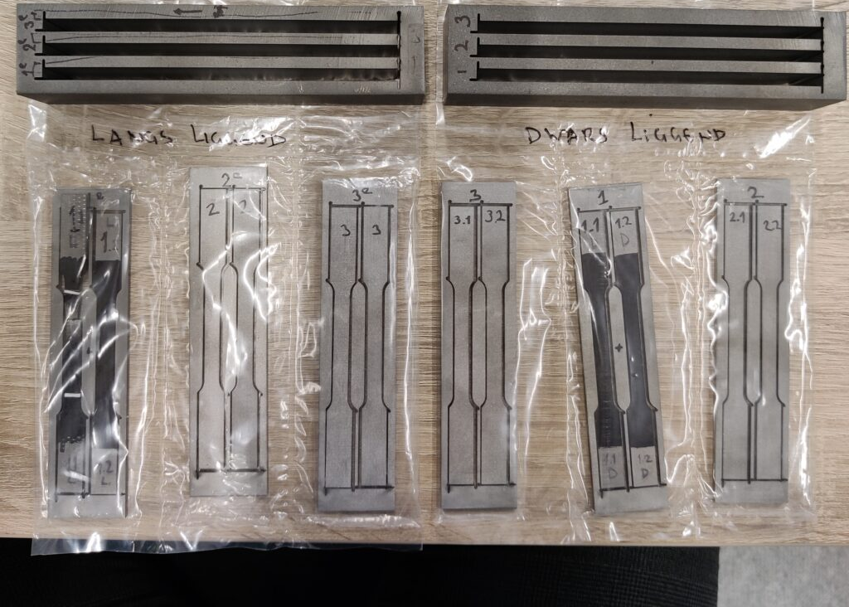
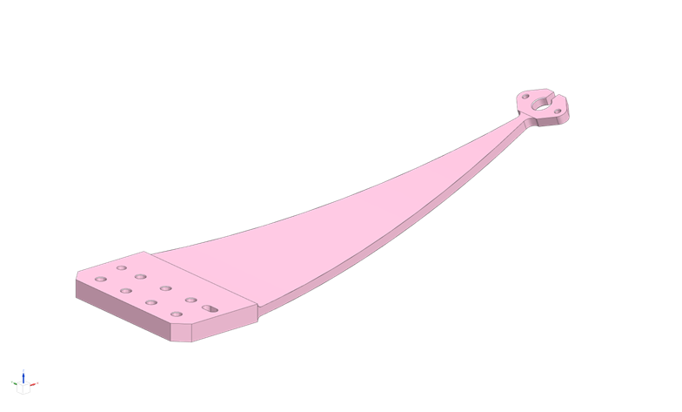
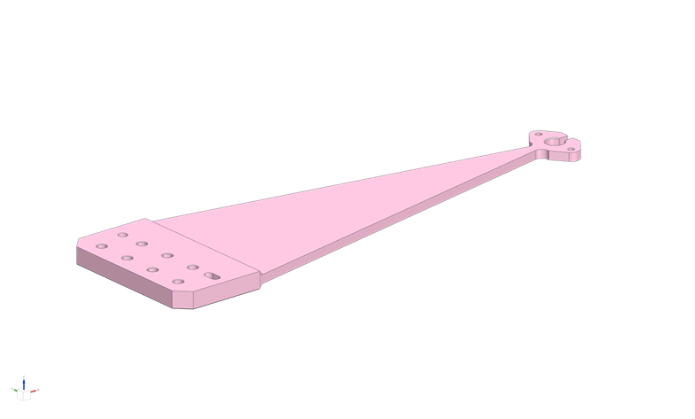
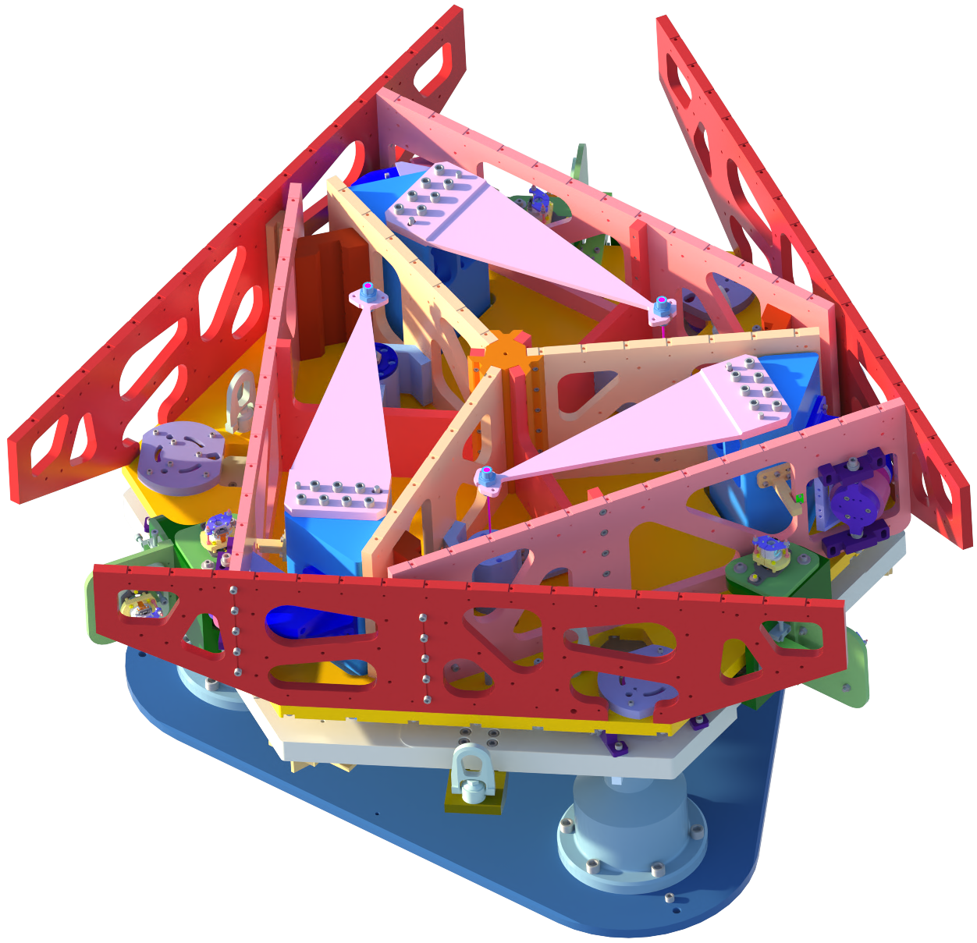
Seismic isolation for Einstein Telescope
Credit: Armin Numic
OmniSens prototype
Titanium grade 19 Beta-C
Material arrived: - tested without heat treatment
- will test after heat treatment
discussions ongoing for bending

Slide 12
Image Credit: Armin Numic
Do we need active isolation for
The Einstein Telescope?

Slide 13
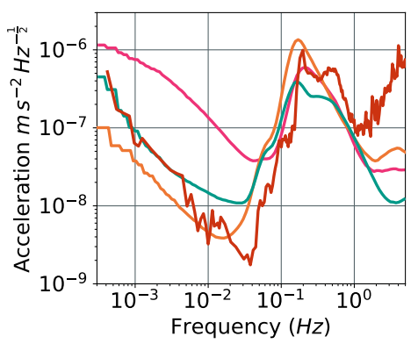
From; C. M. Mow-Lowry, et. al., 13 ET Symposium, May 2023.
Seismic motion at boreholes
LNGS Terziet Sos Enattos Hanford (no wind)
Boreholes/seismic vaults are NOT representative of Seismic spectra for large ventilated caverns.
For analysis worst case LNGS spectrum is used.

Slide 14
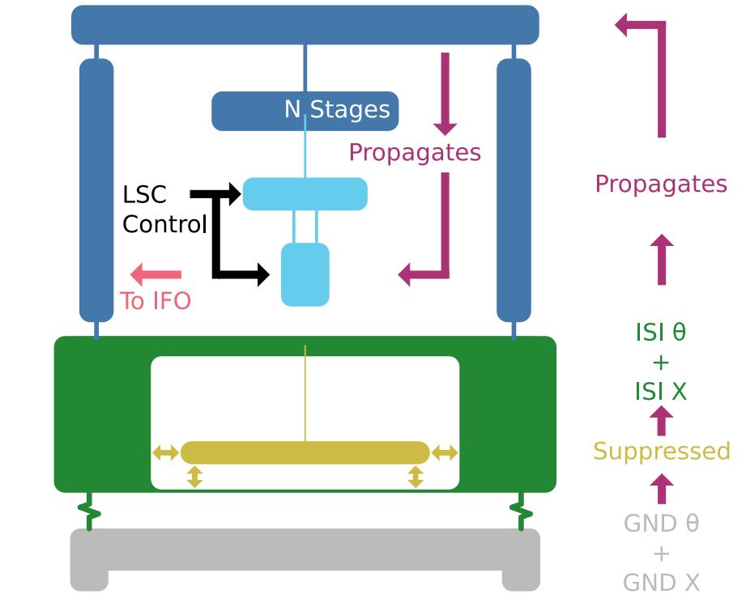
Credit: Nathan A. Holland GWADW 2023
Modelled system
LNGS ground spectra.
6D ISI pre-isolation.
Suspension model used:
9m Virgo.
12m ET.
17m ET-LF.

Slide 15
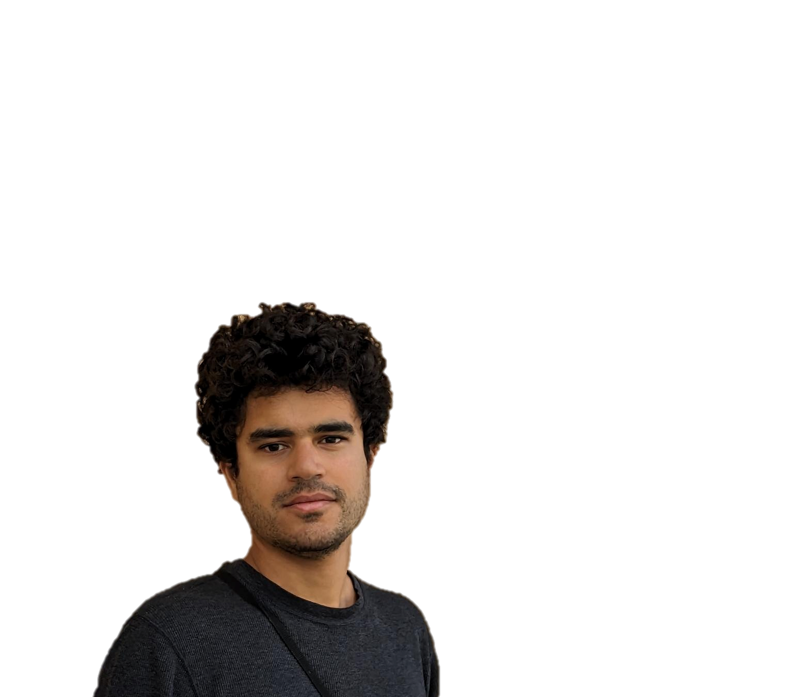
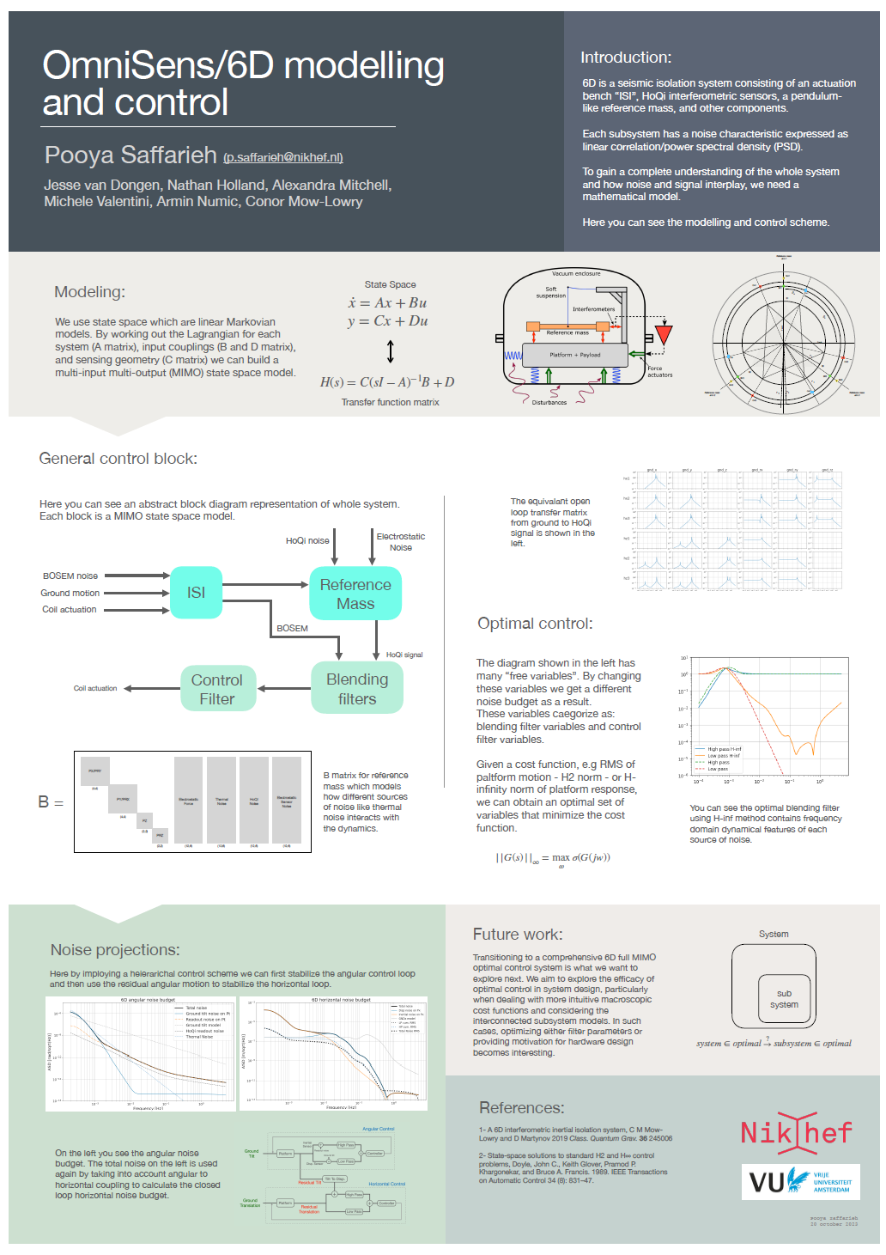
Poster on modelling
& Control of Omnisense / 6D
By Pooya Saffarieh

Slide 16
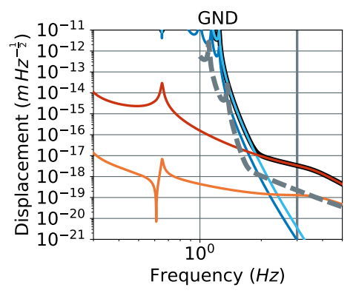
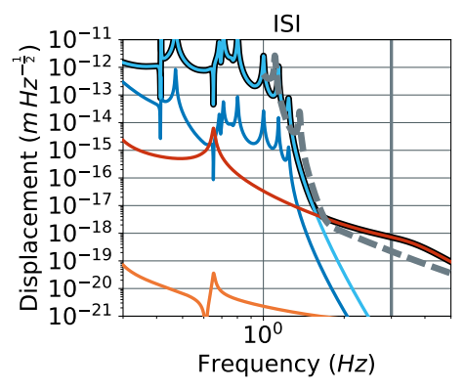
Credit: Nathan A. Holland GWADW 2023
Modelled results
No Active Isolation Noise 35x too high at 3 HZ
With Active Isolation Noise 8x too high at 3 HZ
ET-LF Total x (SAT) θ(SAT) ACT (STG0) ACT (STG1)

Slide 17
Image Credit: Armin Numic
Take home message
The 6D experiment at Amsterdam is becoming reality soon.
Initial extremely optimistic modelling of ET suspensions including actuation noise is not yet good enough.
An active platform is probably needed for ET

