Slide 1






Cryogenic Coating Thermal Noise direct measurement
Koen Lotze, Enrico Porcelli, Enzo N. Tapia S. Martin,
Alessandro Bertolini, Marcel ter Brake, Rogier Elsinga, Eric Hennes, Stefan Hild, Michiel van Limbeek, Fabian Meylahn, Matteo Tacca, Cris Vermeer, Benno Wilke

Slide 2
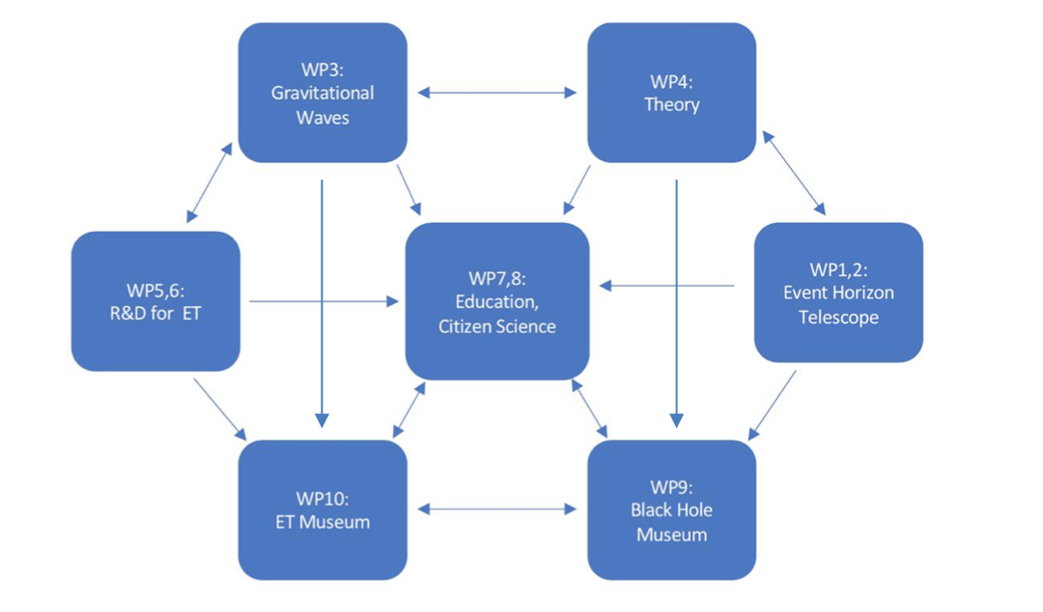
Dutch Black Hole Consortium
A group of 30+ scientists, carrying out an interdisciplinary black hole research program throughout the Netherlands: https://www.dbhc.nl/

Slide 3
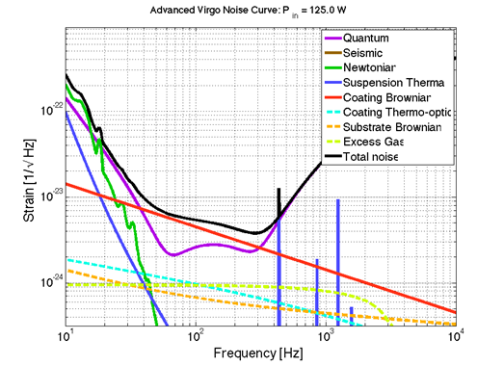

Sensitivity of Gravitational Wave Detectors
Mid-range Frequencies:
Sensitivity limited by mirror coating thermal noise
directly proportional to material properties (E₀, σ, φ_{eff,c})
inversely proportional to the beam spot size on the mirror (w)
directly proportional to temperature (T)
Different technique to reduce the thermal noise impact -> decrease the working temperature -> new material needed for coating

Slide 4
Motivations & Goals
TN of new coatings directly measured using an interferometric method in a cryogenic environment to select the material to be used in the third-generation detectors;
A low noise fast turnaround cryogenic test bench essential to characterize new sensors and actuators compatible with low temperature environment.
R&D on new low noise technology is of wide interest -> Liquid free low noise cryogenics more and more required in many fields of fundamental physics.
Cryogenic test bench with ~ 10⁻¹³ m / sqrt (Hz) residual motion above 30 Hz

Slide 5
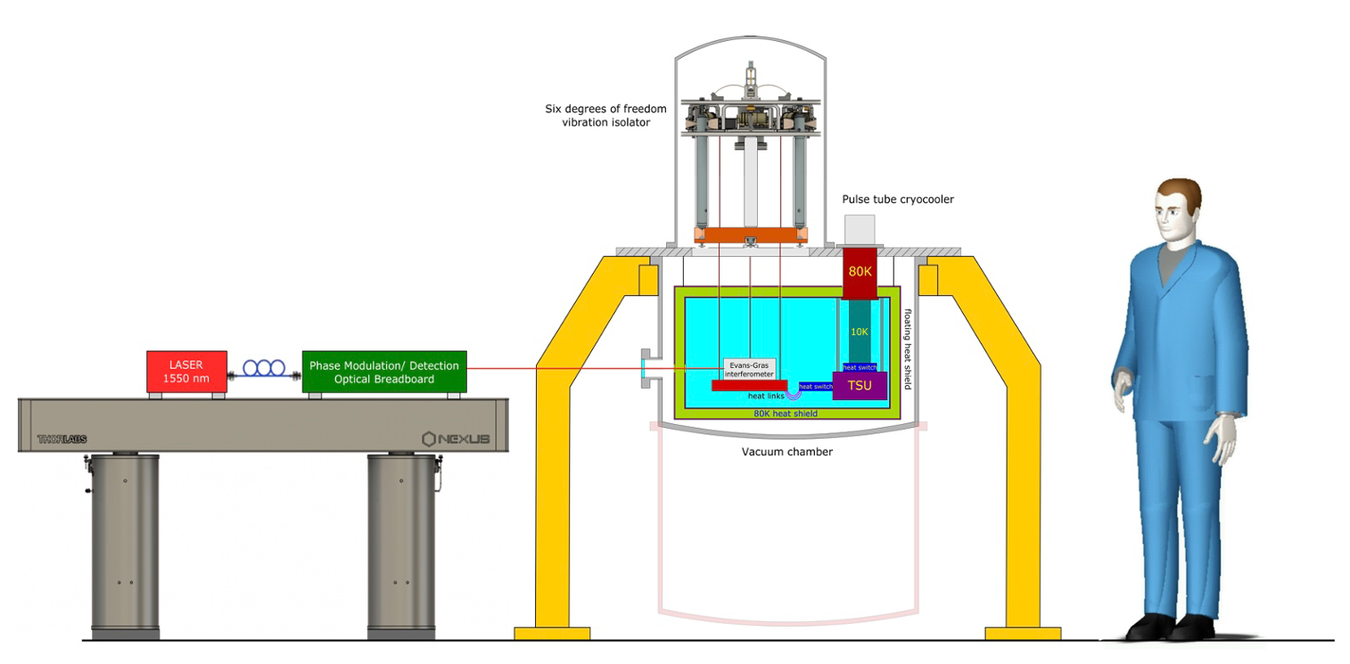
Motivations & Goals
Mechanics
Cryogenics
Optics
A flexible test facility available to anyone (not just in the GW collaboration) who needs it

Slide 6
Three main work packages
Cryogenic Technology (Koen)
Seismic Attenuation System (Enrico)
Optical setup (Enzo)

Slide 7
Three main work packages
Cryogenic Technology (Koen)
Seismic Attenuation System (Enrico)
Optical setup (Enzo)

Slide 8
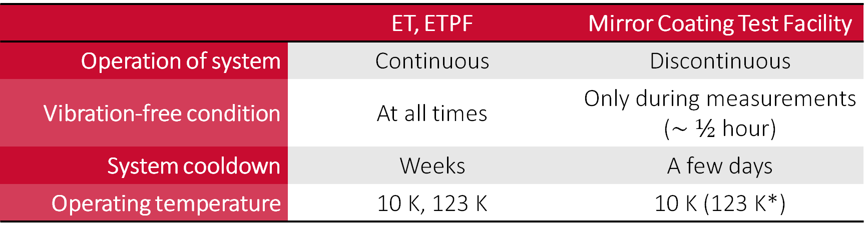
Cryogenic system requirements
 | ET, ETPF | Mirror Coating Test Facility
Operation of system | Continuous | Discontinuous
Vibration-free condition | At all times | Only during measurements ($\sim ½$ hour)
System cooldown | Weeks | A few days
Operating temperature | 10 K, 123 K | 10 K (123 K*)

Slide 9
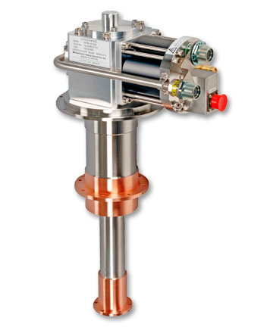
Core concept
Cold storage (battery)
Mechanical cryocooler (charging battery)
Cooler on, cool down cold storage
Cooler off, measure using stored cold
Cryocooler
cold tip
½ m
Cold storage
Sumitomo RDK 415D
1.5 W at 4 K
4 K
5 K
10 K
Optical bench

Slide 10
Operation
Other heat loads (radiative, supports/suspension) not drawn
Cryocooler
cold tip
Cryocooler
cold tip
Heat flows during cooldown
Cold storage
Heat flows during measurement
Cold storage
Heat switches
Cooldown: on
Measurement: off
Optical bench
Optical bench
Temperature control heater
Temperature control heater
(fine tuning)
Conducting links
Heat switches

Slide 11

Cold storage
High heat capacity at $T<10$K
Phase change material:
latent heat
  Helium (4.2 K, 1 bar)
  Lanthanides (magnetic)
Ordinary heat capacity
  Lead
  Helium gas

Slide 12
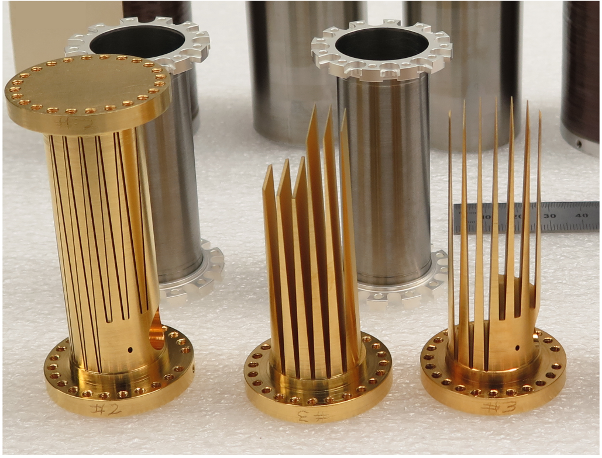
Heat switches
Mechanical
Gas-gap
off state
transition regime
on state
M.O. Kimball et al., NASA

Slide 13
Simulation: cyclic operation
2 hours of regeneration (cooldown)
½ hour of measurement time
regeneration
measurement
regeneration
measurement

Slide 14
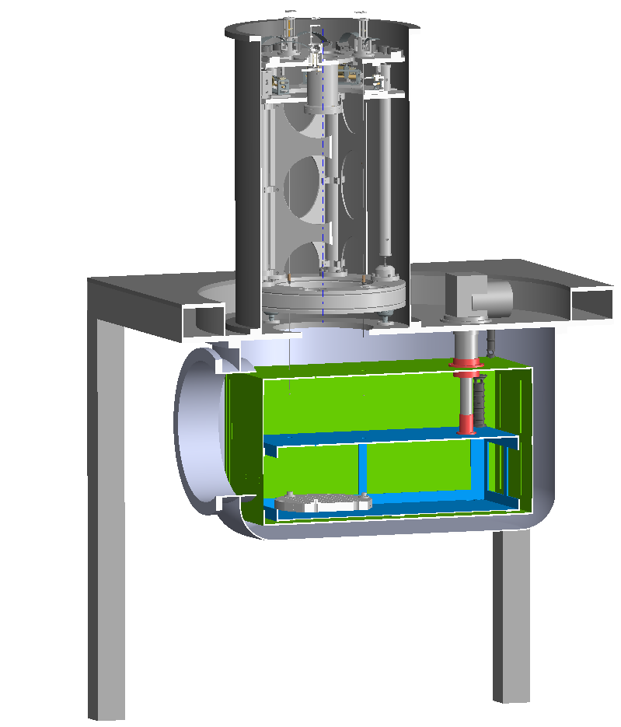
Phased approach
Modular system, replace components over time
Lead cold storage, conducting links
(no heat switches)
  System testing
  Will not meet ½ hour measurement
  criterium
  Target cryogenic assembly: end of 2024
Replace links by heat switches
Replace cold storage by helium gas or
magnetic phase change material
Rogier Elsinga, Nikhef

Slide 15
Three main work packages
Cryogenic Technology (Koen)
Seismic Attenuation System (Enrico)
Optical setup (Enzo)

Slide 16
Why a vibration-isolation system?
GAS filters
Measuring the vibration injection due to heat-links by avoiding direct contribution from the ground.
Testing sensors/actuators at cryogenic temperature (≥10 K).
IP
The whole system is supported by a Frame and is composed by:
3 legs Inverted Pendulum (IP) - Longitudinal vibration.
1 stage with 3 pairs of Geometrical Anti Springs (GAS) - Vertical vibration.
3 Titanium alloy suspending wires hanging the optical bench.
Heat-Links (HL) for thermal conduction from the Cryocooler to the bench.
HL
Suspending Wires

Slide 17
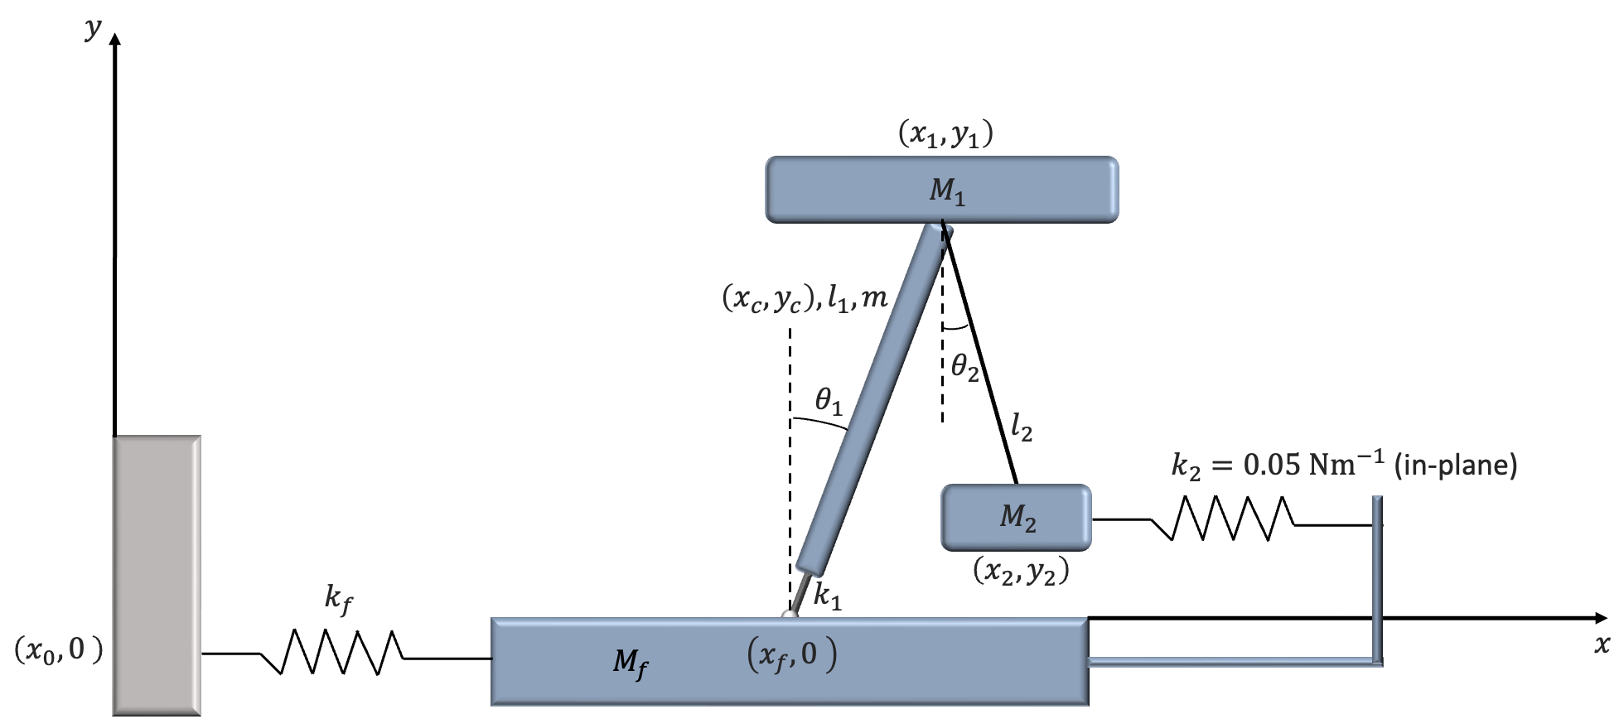
Lagrangian model of the mechanics in a longitudinal DoF
The suspension system is composed by an Inverted Pendulum (IP) anchored to the Frame and a pendulum hanging the bench.
IP, the bench, and the cooling system share the same reference frame.
Cold finger and single wire Heat-Link (HL) with linear elastic constant k_2.
The Frame is anchored to the ground.
Its elastic movement is simulated by a spring with linear elastic constant k_f.
Ground

Slide 18
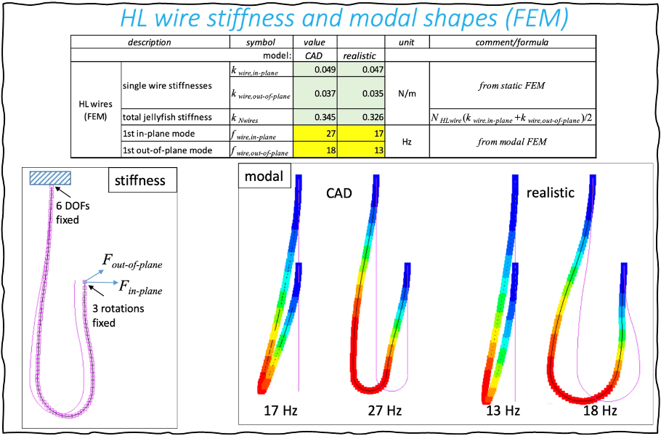
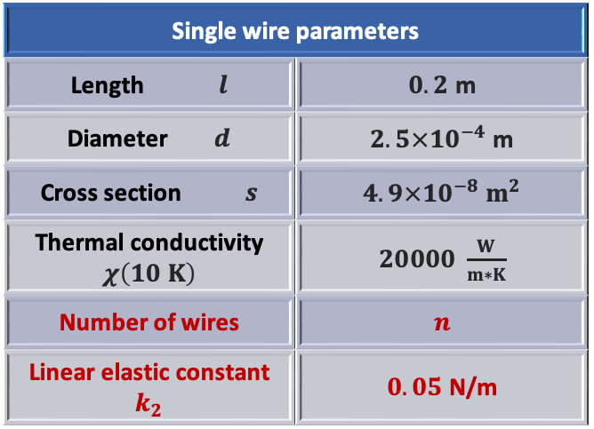
Stiffness of a single wire HL
For a fixed geometrical model
k = n∗k_2 Total stiffness for a HL
T_R = l/χsn Thermal resistance
(Eric Hennes and Andrei Utina)
How many wires do we need in order to have a good cooling down without affecting the seismic isolation?

Slide 19
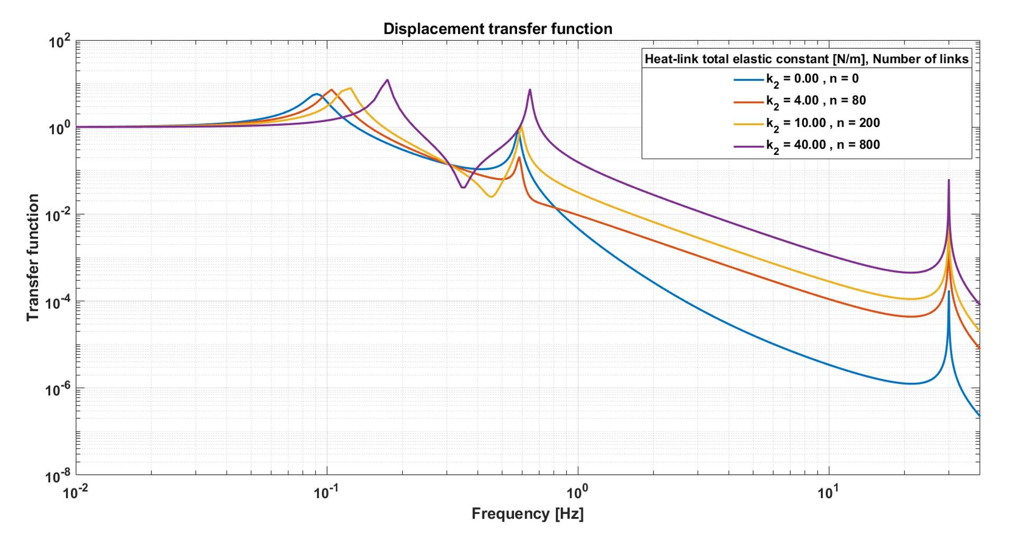
Displacement transfer function (tf) of the mechanics at the bench level
k = n∗k_2 is the total stiffness for a HL
tf reaches about 10⁻³ of amplitude at 10 Hz by using 800 wires wrt residual ground motion.
Frame freq. resonance! The frequency resonance of the Frame can affect the measurement.

Slide 20
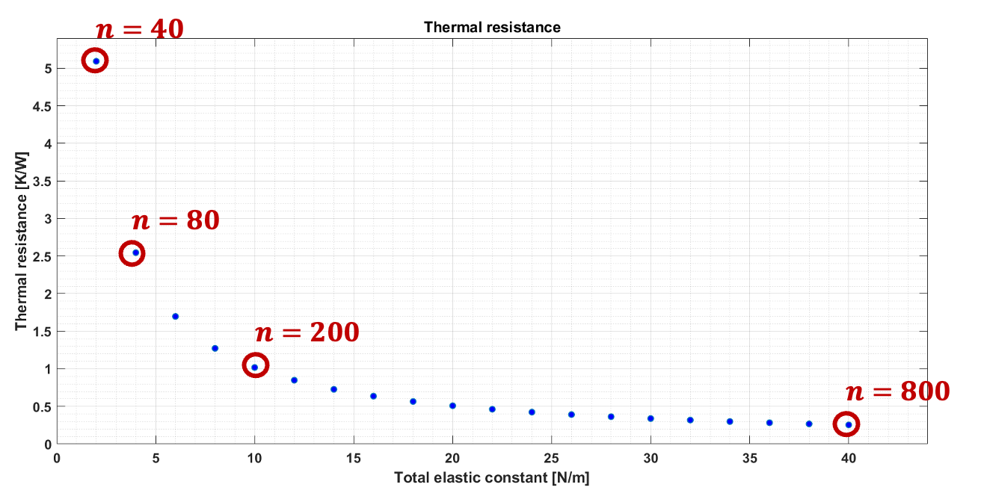
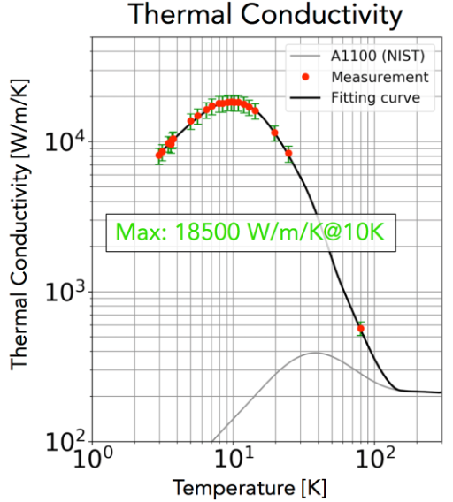
HL Thermal Resistance
T_R = l/χsn
Taking advantage from KAGRA experience
Thermal conductivity χ = 2×10^4 W/(m∗K)
s = 4.9×10^(-8) m^2
l = 0.2 m
According with the model, it is possible to obtain an attenuation of ~3×10⁻⁴ wrt ground motion at 10 Hz by using ~200 wires per HL while maintaining the temperature stable inside the cryostat within 1 K even with 1 W loaded.
T_R = l/χsn =
n=800 à 0.25 K/W
n=200 à 1.02 K/W
n=80 à 2.55 K/W
Attenuation at 10 Hz:
  ~10^(-3)
  ~3×10^(-4)
  ~10^(-4)

Slide 21
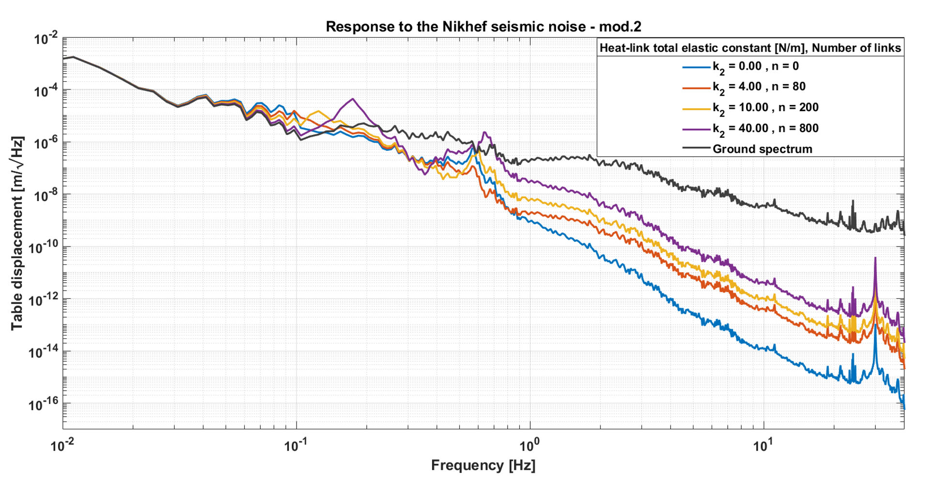
Expected noise level of the bench
n=200 wires per HL is the best compromise to have a good ground isolation and Thermal Resistance at the same time.
A tuned damper can be applied in order to smooth the peak due to the Frame.

Slide 22
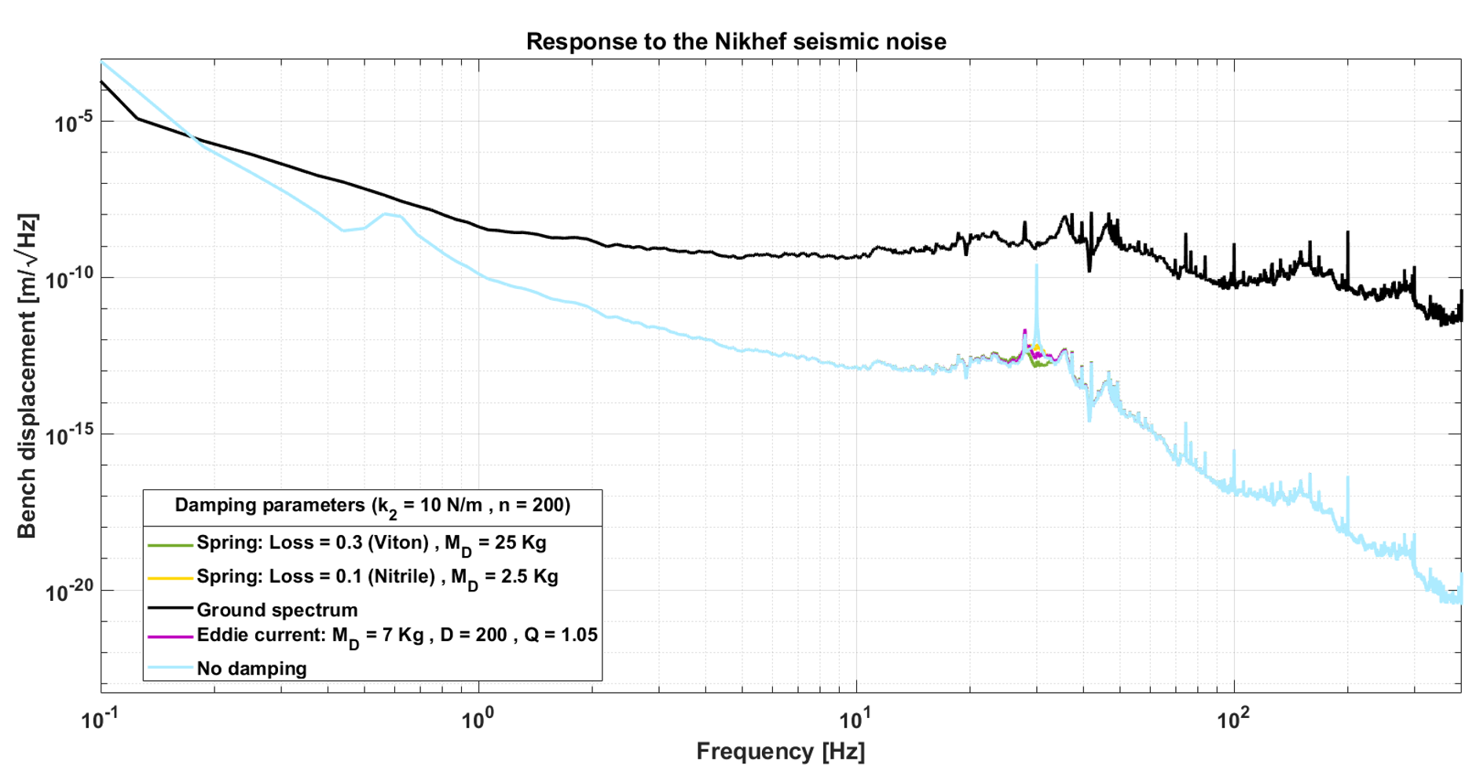
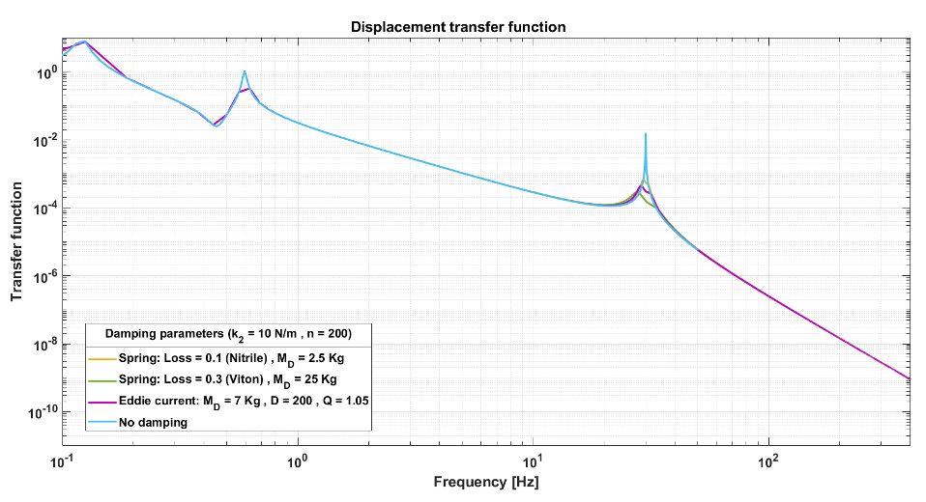
Bench displacement after applying a tuned damper
The bench at 10 Hz:
Displacement from ~3×10⁻⁹ down to ~10⁻¹³
Thermal Resistance = 1.02 K/W
∆T~1 K even by applying 1 W of power.
~10³ m/√Hz recovered
Next steps :
Finite Element Analysis on the HL geometrical model to look for the minimum stiffness and minimum thermal resistance.
HL analytical model.

Slide 23
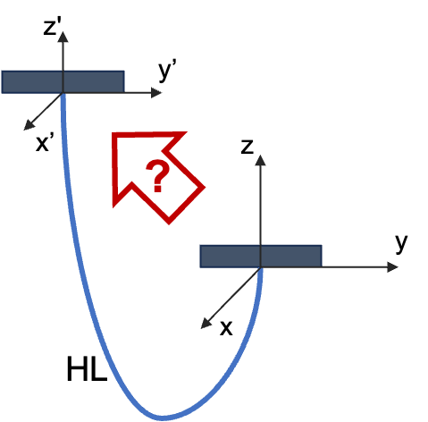
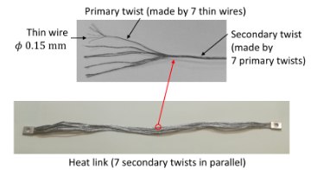
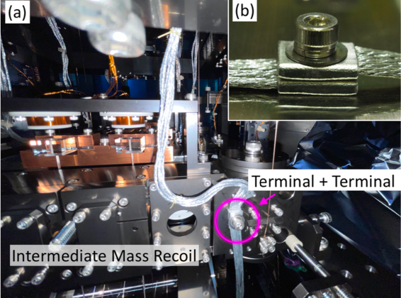
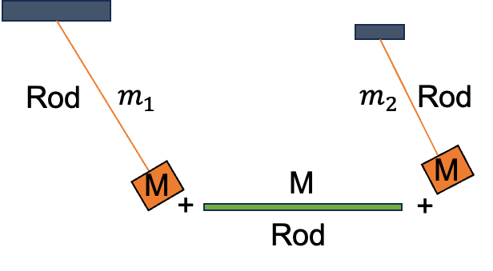
Heat Link analytical study
Where:
E à Young Modulus
I à Second moment of area
T à Tension
ρ à Mass per unit length
To solve in frequency domain for:
Rod+mass pendulum
Simply supported rod
-EIy(z,t)′′′′+Ty(z,t)′′=ρÿ(z,t)
In both pictures: Heat-Links used at KAGRA

Slide 24
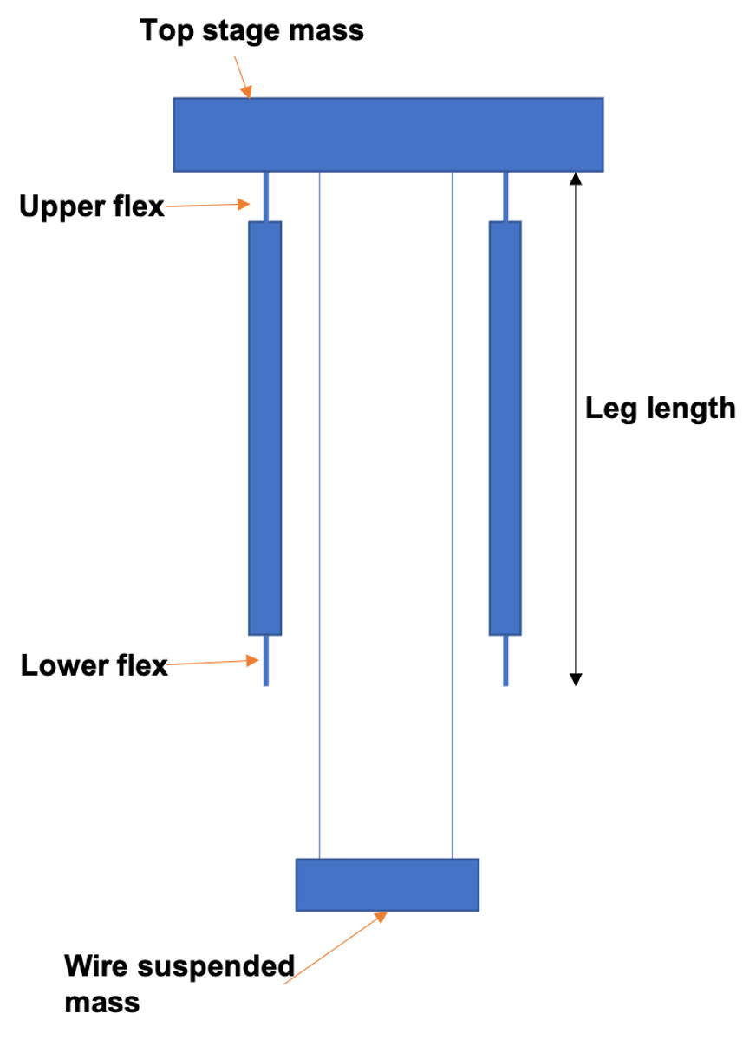
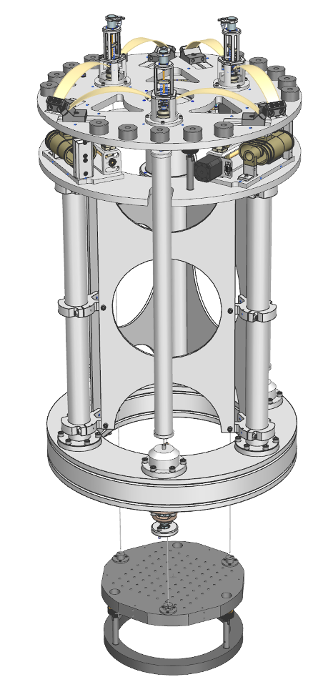
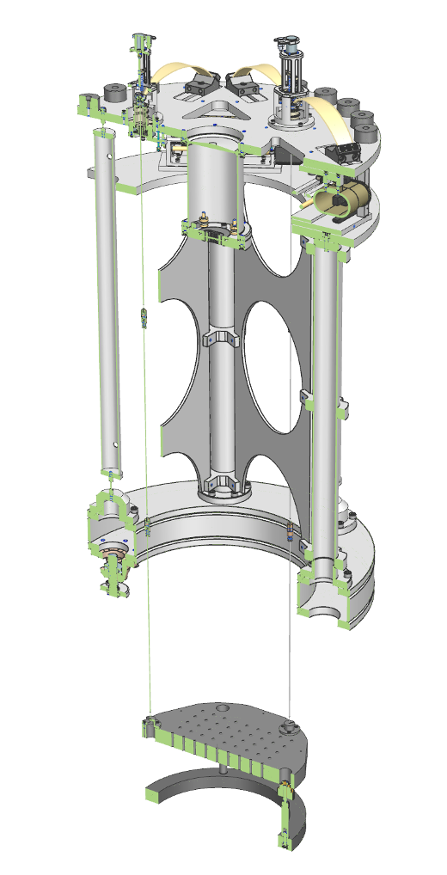
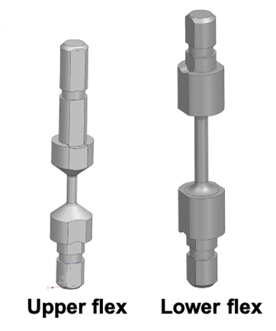
Vibration Isolation System Overview
Geometrical Anti-Spring (GAS)

Slide 25
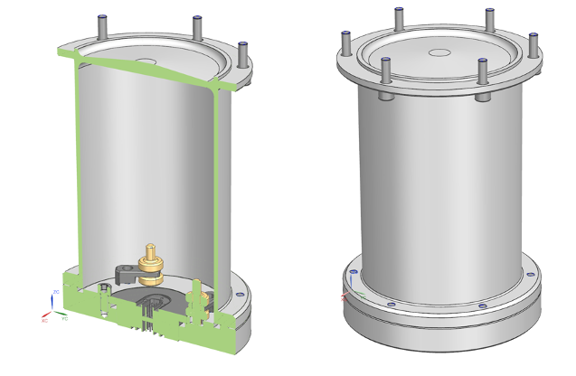
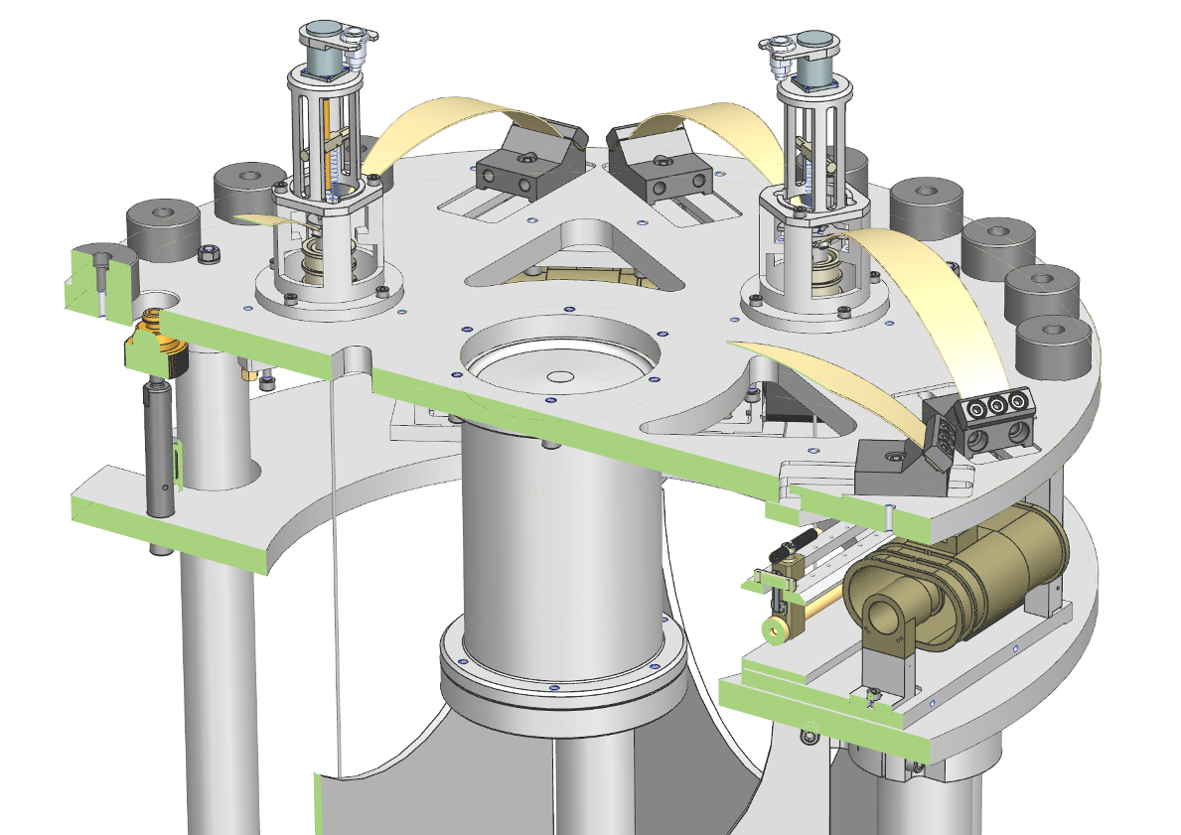
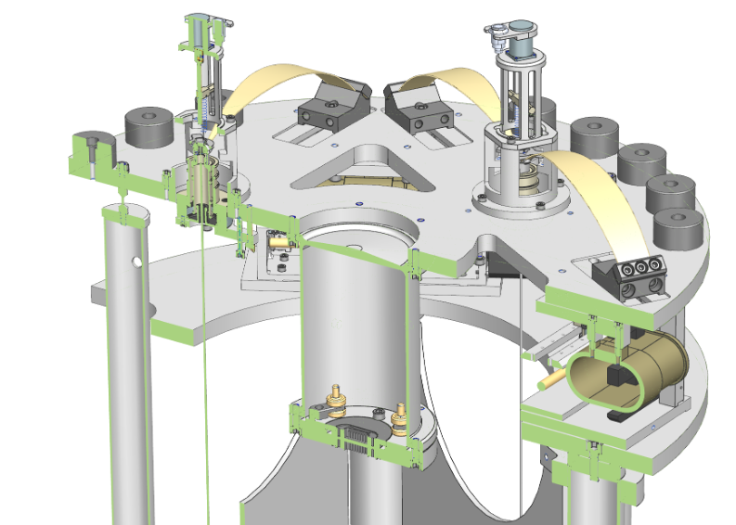
Top Stage: GAS blades+Seismometer
Nanometrics Trillium 120
3 pairs of GASs for vertical seismic attenuation + vertical LVDTs.
A triaxial seismometer is hanged at the Top Stage from the bottom:
  It is used to sense the xy-inertial motion of the IP.
  The z-channel is used to subtract the ground from the vertical LVDTs.

Slide 26
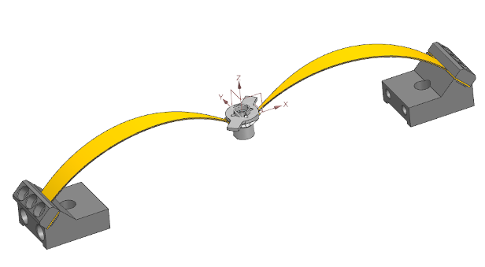
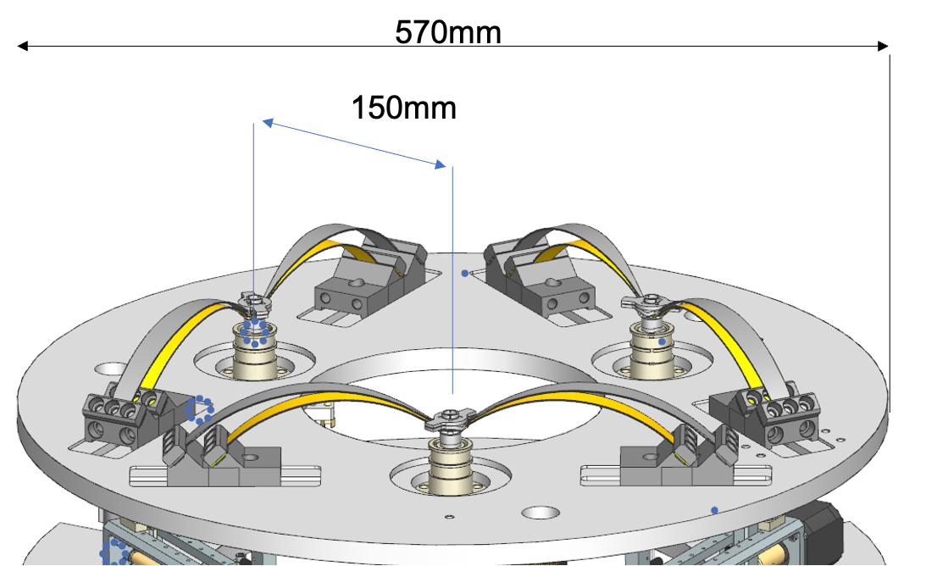
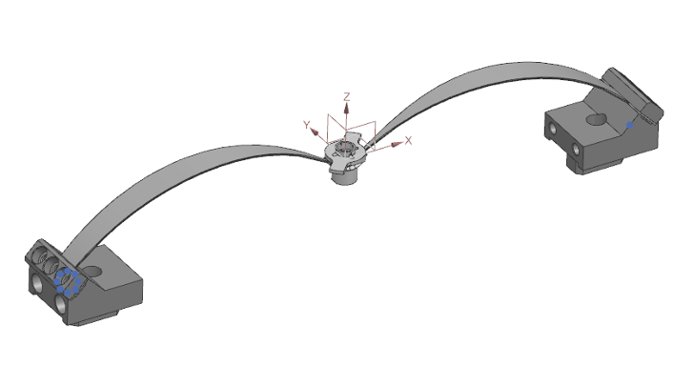
GAS filters
CuBe2 configuration
Both configurations are equally valid.
They will fit on a 570mm round plate with Pendulum wires on a radial position of 15cm.
-> CuBe2 blades have been chosen for practical reasons.
Maraging Steel configuration

Slide 27
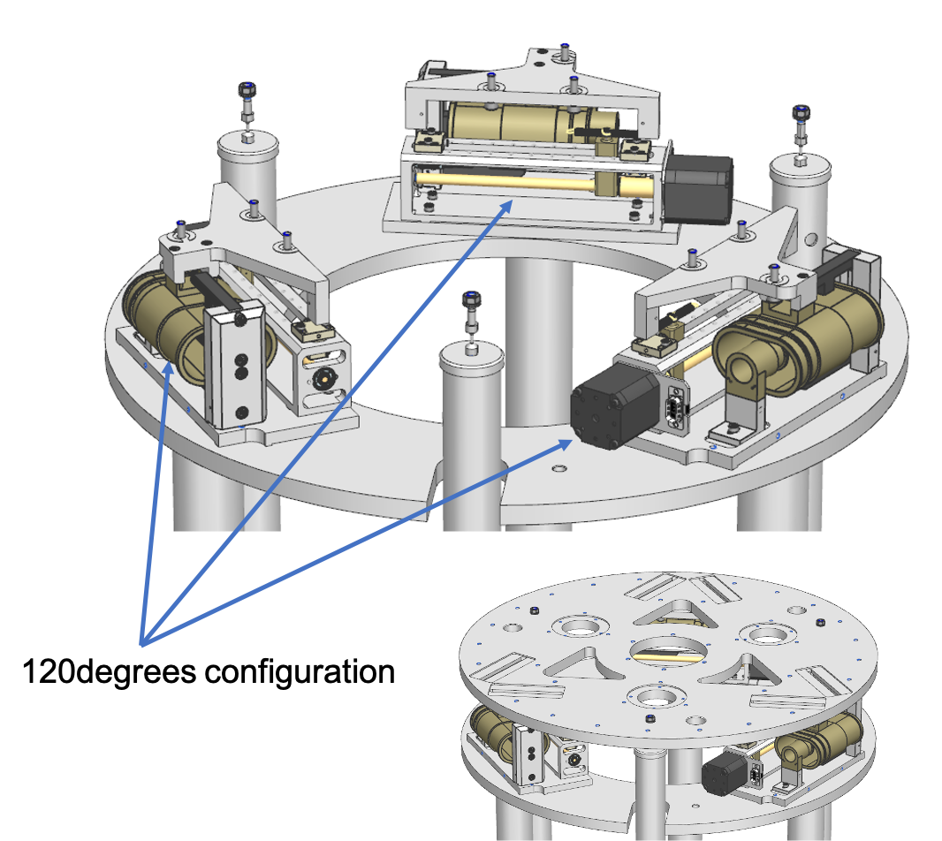
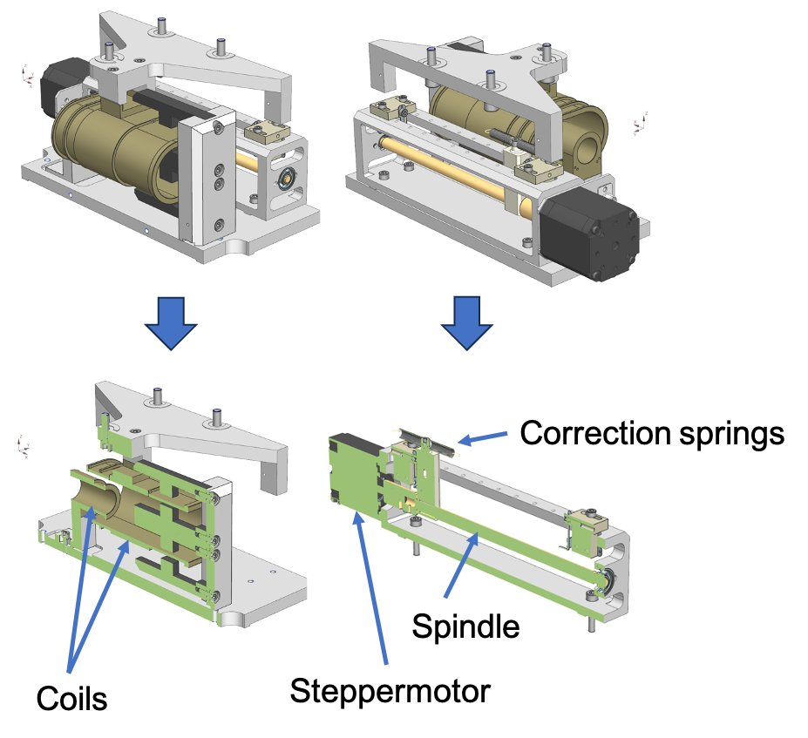
Top Ring: IP Correction Spring Assembly
LVDTs are used to sense the position of the IP with respect to the Frame/Ground.
Voice-coils are used for correction.
StepMotors are used for static positioning.
120 degrees configuration

Slide 28
Next Steps
Short term:
Finalization of the analytical model of the heat-links
Procurement of the mechanical components of the vibration-isolation system in progress;
Mid term:
Implementation and checks of the vibration-isolation system in stand-alone;
Long term:
Integration of the vibration-isolation system with the optical bread-board and the cryogenic system in the vacuum tank;

Slide 29
Three main parts
Cryogenic Technology (Koen)
Seismic Attenuation System (Enrico)
Optical setup (Enzo)

Slide 30
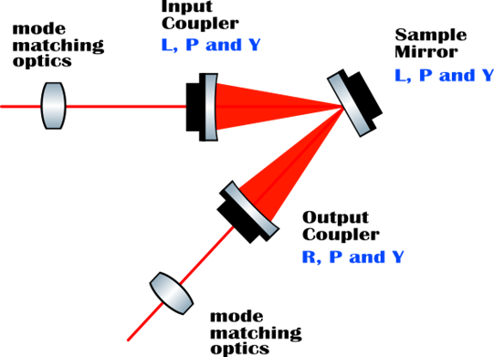

Working Principle
Fluctuations of the longitudinal motion of the optical axis can be caused by the internal thermal noise of a mirror in an optical cavity.
Fluctuations are produced by the internal damping inside the test mass.
Measurement of the longitudinal displacement of the sample mirror by direct application of the fluctuation-dissipation theorem to the readout of the setup.
First implementation at MIT:
S. Gras and M. Evans
Phys. Rev. D 98, 122001

Slide 31
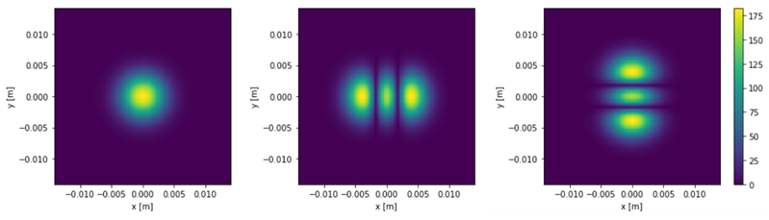
Working Principle
Folded cavity must allow co-resonance for the fundamental mode and two higher order modes (HoMs).
Thermal noise that is sensed by the TEM02 mode is different from the thermal noise sensed by the TEM20 mode, since they do not explore the same area of the sample mirror.
​
​In the readout, for the HOMs, common noises such as length noise, frequency noise and thermal noise of the mirror can be decoupled from the Coating Thermal Noise (CTN). CTN is obtained from the beat note of the resonant frequencies of TEM02 and TEM20.

Slide 32
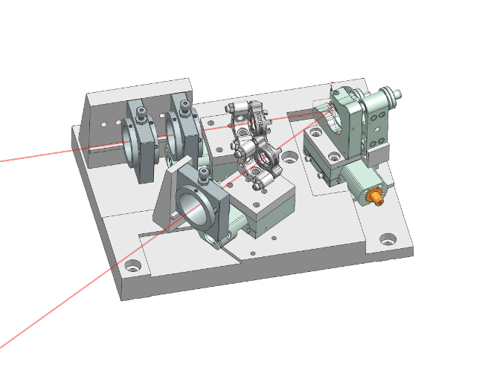

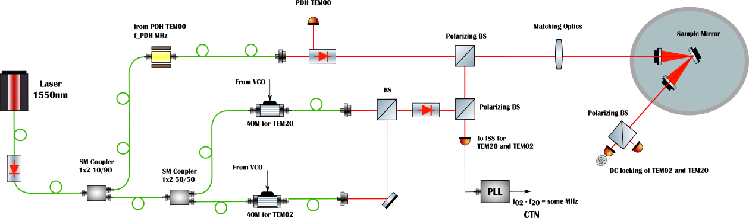
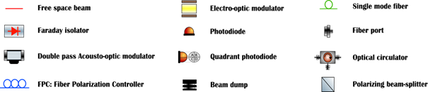
Optical Setup: Overview
1550 nm laser beam split into three beams: one is used to lock the cavity with the TEM00 mode, the two of others are shifted in frequency with Acousto-optic Modulators (AOMs) to have TEM02 and TEM20 resonant in the cavity.
In-vacuum high Finesse multi resonant folded cavity.
*Cavity design based on a similar AEI cavity design

Slide 33

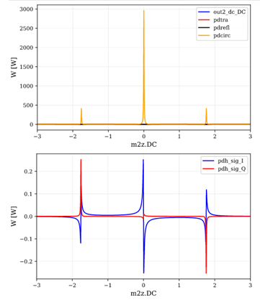
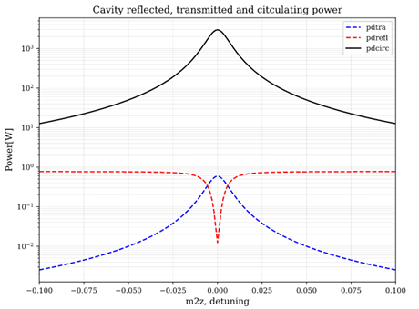
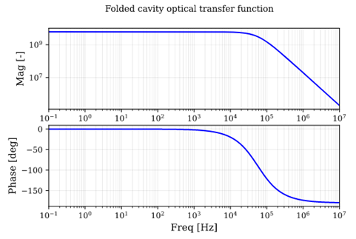
Optical Setup: Simulations
Fundamental (TEM00) is locked using a Pound-Drever-Hall (PDH) loop in reflection.
Sample mirror inside a folded high-Finesse optical cavity.
RoC Input mirror: 50 mm
RoC Output mirror: 50 mm
Pole of the cavity @ 56kHz
Cavity Finesse: ~13000

Slide 34
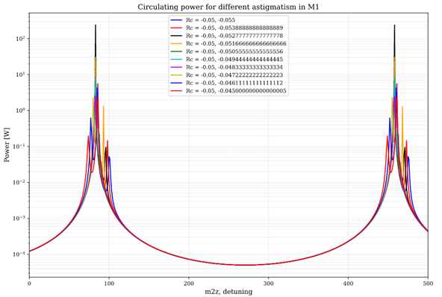
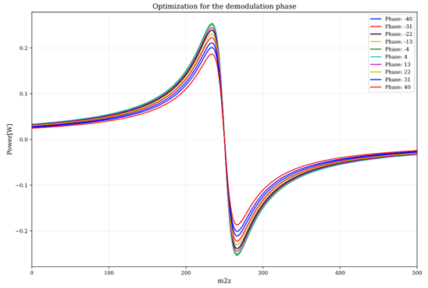
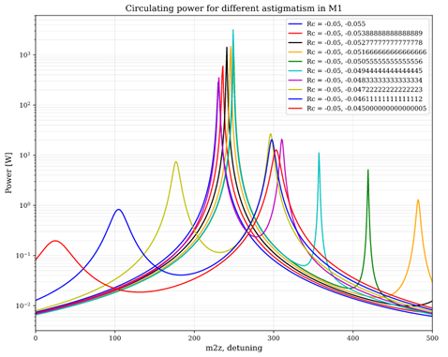
Optical Setup: Simulations
TEM00, TEM02 and TEM20 can co-resonate inside the folded cavity by tuning the orientation of the input mirror.
The error signal to lock the fundamental mode can/must be optimized.

Slide 35
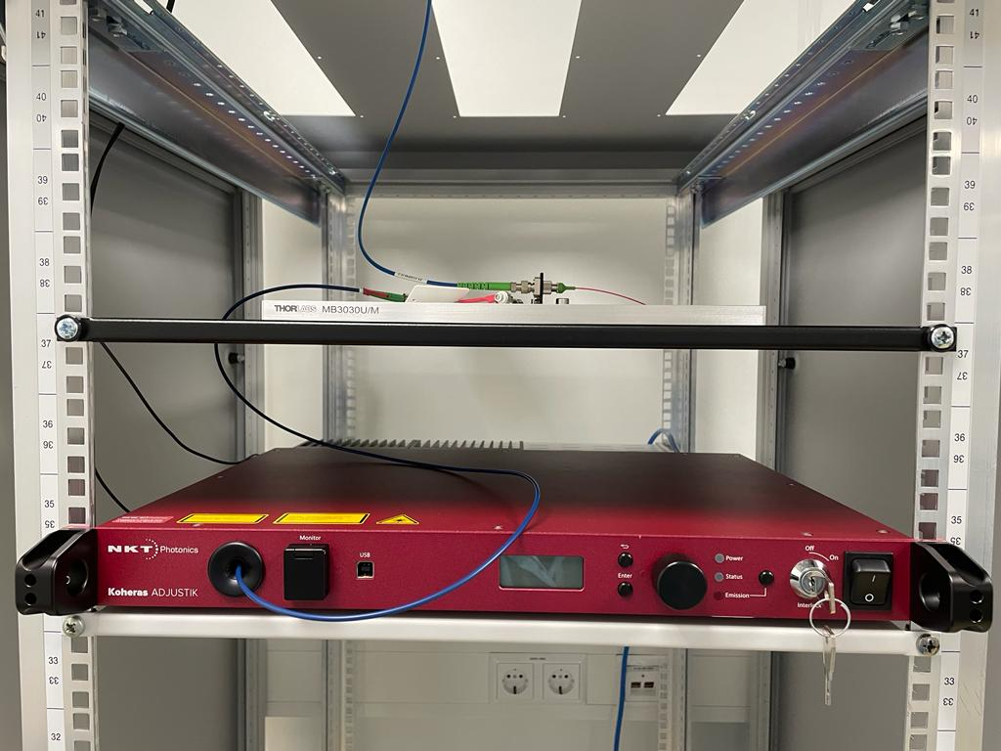
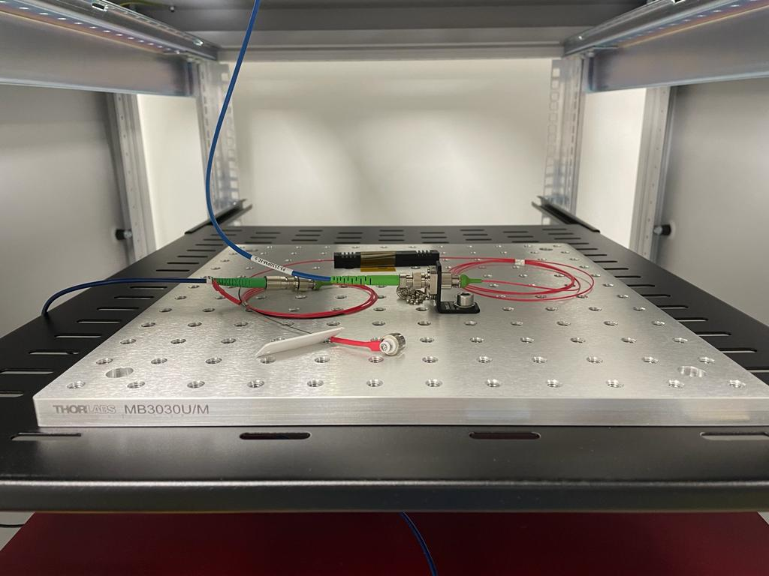
Optical Setup at Nikhef Lab
Main Laser and Faraday Isolator:
1550nm Main laser with 0.1-2W Output Power.

Slide 36
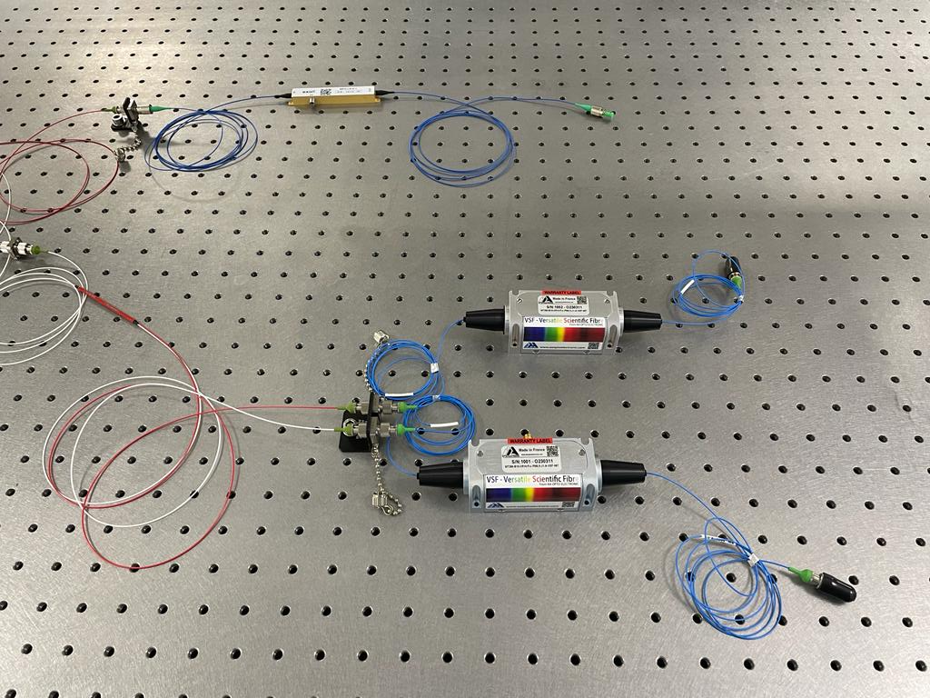
Optical Setup at Nikhef Lab
Electro-optic Modulator (EOM) and Acousto-optic Modulators (AOMs) installed in lab:
EOM modulation frequency ~ 15 MHz
AOM modulation frequency ~280MHz
From here towards and in the folded cavity the laser is in-air.
Collimator and matching optics to be installed.

Slide 37
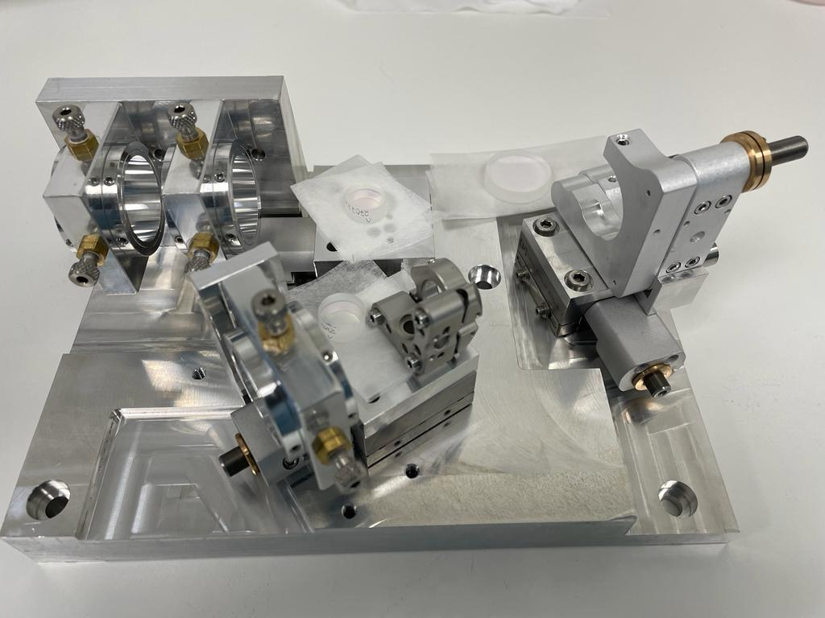
Optical Setup at Nikhef Lab
Mount of input coupler under test at cryogenic temperatures in Perugia.
Input coupler mirror.​​
Folded cavity:
Mount for coating sample under test
Sample size: 1 inch.
Matching optics
(TBC)
Output coupler mirror.​
Mount of output coupler.

Slide 38
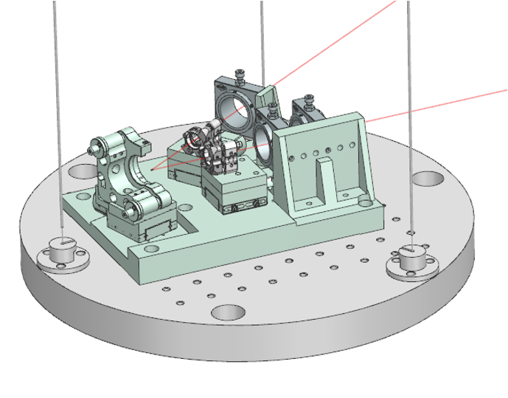
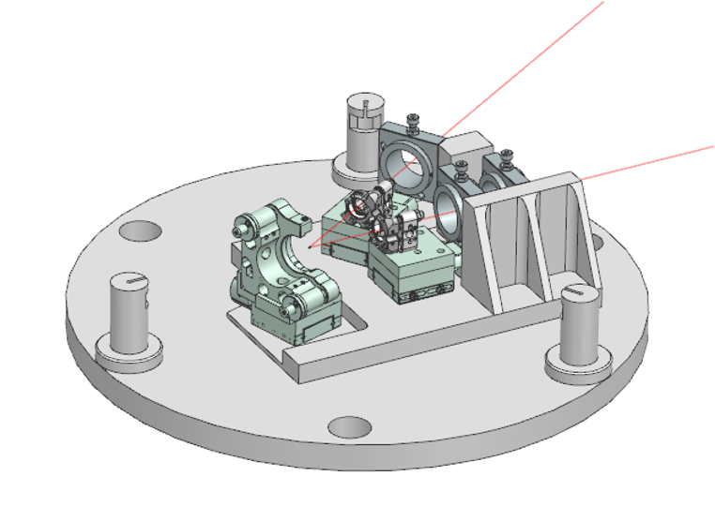
Integration of the optical breadboard
Two possible solutions:
Removable breadboard to allow the cavity pre-alignment outside the vacuum tank.
Monolithic cavity to reduce the residual motions.

Slide 39
Next Steps
Short term:
Characterization of the optical beams in the lab;
Design and procurement of the mode-matching telescope;
Procurement of some electronics in progress;
Mid term:
Have the 3 beams co-resonant in the cavity in lab;
Lock the cavity in-air;
Long term:
Integration of the optics in the full experiment;
Measurements and characterization of the full system at room temperature;
Measurements and characterization of the full system at cryogenic temperature

Slide 40
Backup: simulation

