Slide 1
Tidal oscillations of neutron stars in eccentric binary systems
János Takátsy ELTE Institute of Physics Wigner RCP
PhD Advisor:
Péter Kovács Wigner RCP
Collaborator: Prof. Bence Kocsis University of Oxford
Multi-messenger Continuous Gravitational Waves Workshop, 11-13 July 2023
Supported by the ÚNKP-22-3 New National Excellence Program of the Ministry for Culture and Innovation from the source of the National Research, Development and Innovation Fund.

Slide 2
Motivation
Tidal effects are important in binary NS inspiral evolution
Measurements of tides constrain the equation of state of NSs
Tides evolve adiabatically in circular binaries, following the frequency evolution of the orbit
Regular close encounters in eccentric binaries → dynamical tides might be important
Source: N. Yunes, et al., Nature Rev. Phys. 4, 237 (2022)

Slide 3
Model for binary evolution
Start with simple Keplerian model with tidal interactions:
Approximations: only f-mode contributes, only quadrupole tides
Include radiation terms: 2.5PN terms for orbital evolution, exponential decay of tidal modes
Approximations: viscosities are negligible, no cross-terms between orbit and tide
Analytical formulas for leading order effects (compared to numerical results)

Slide 4
Eccentric evolution with tides
No tidal forces for most of the orbit
Sharp “kick” at pericenter passage
NSs continue to oscillate

Slide 5
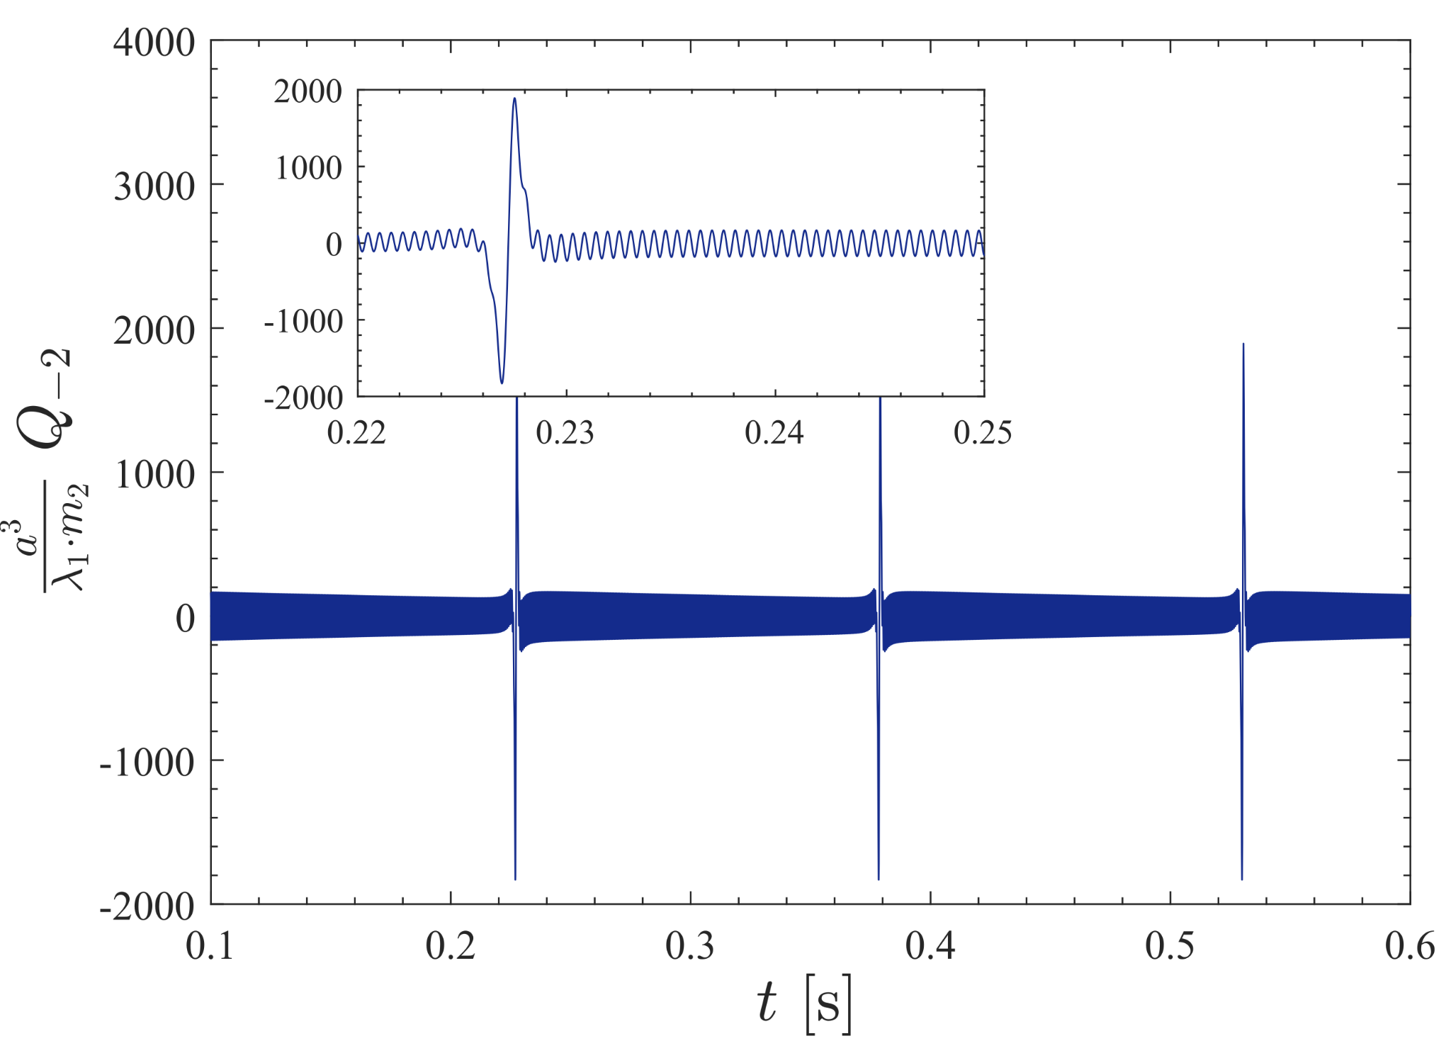
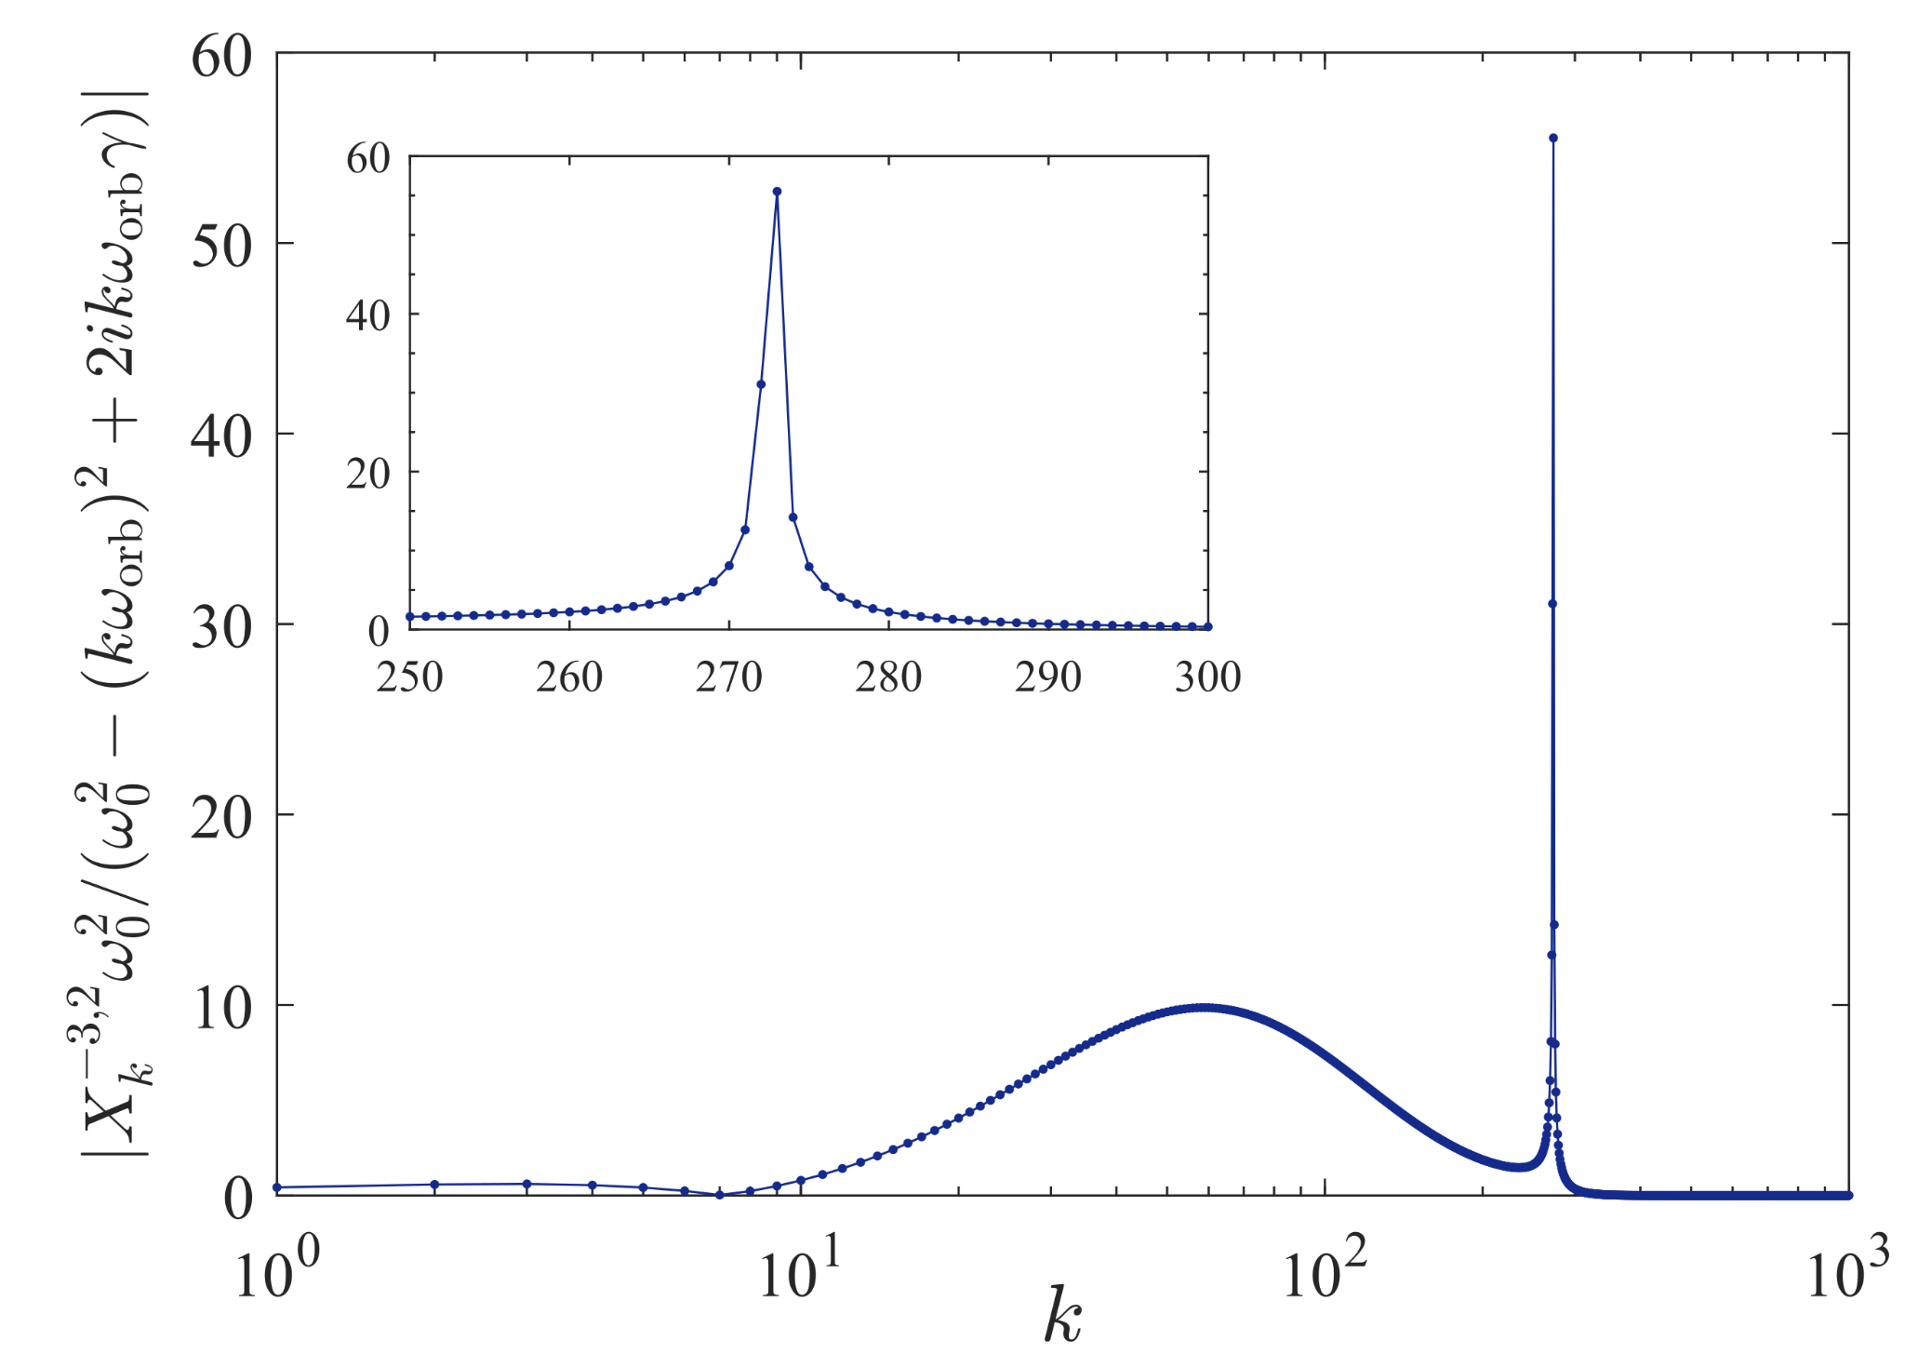
Eccentric evolution with tides
→ transmitted energy strongly depends on the f-mode frequency (~exponential)

Slide 6
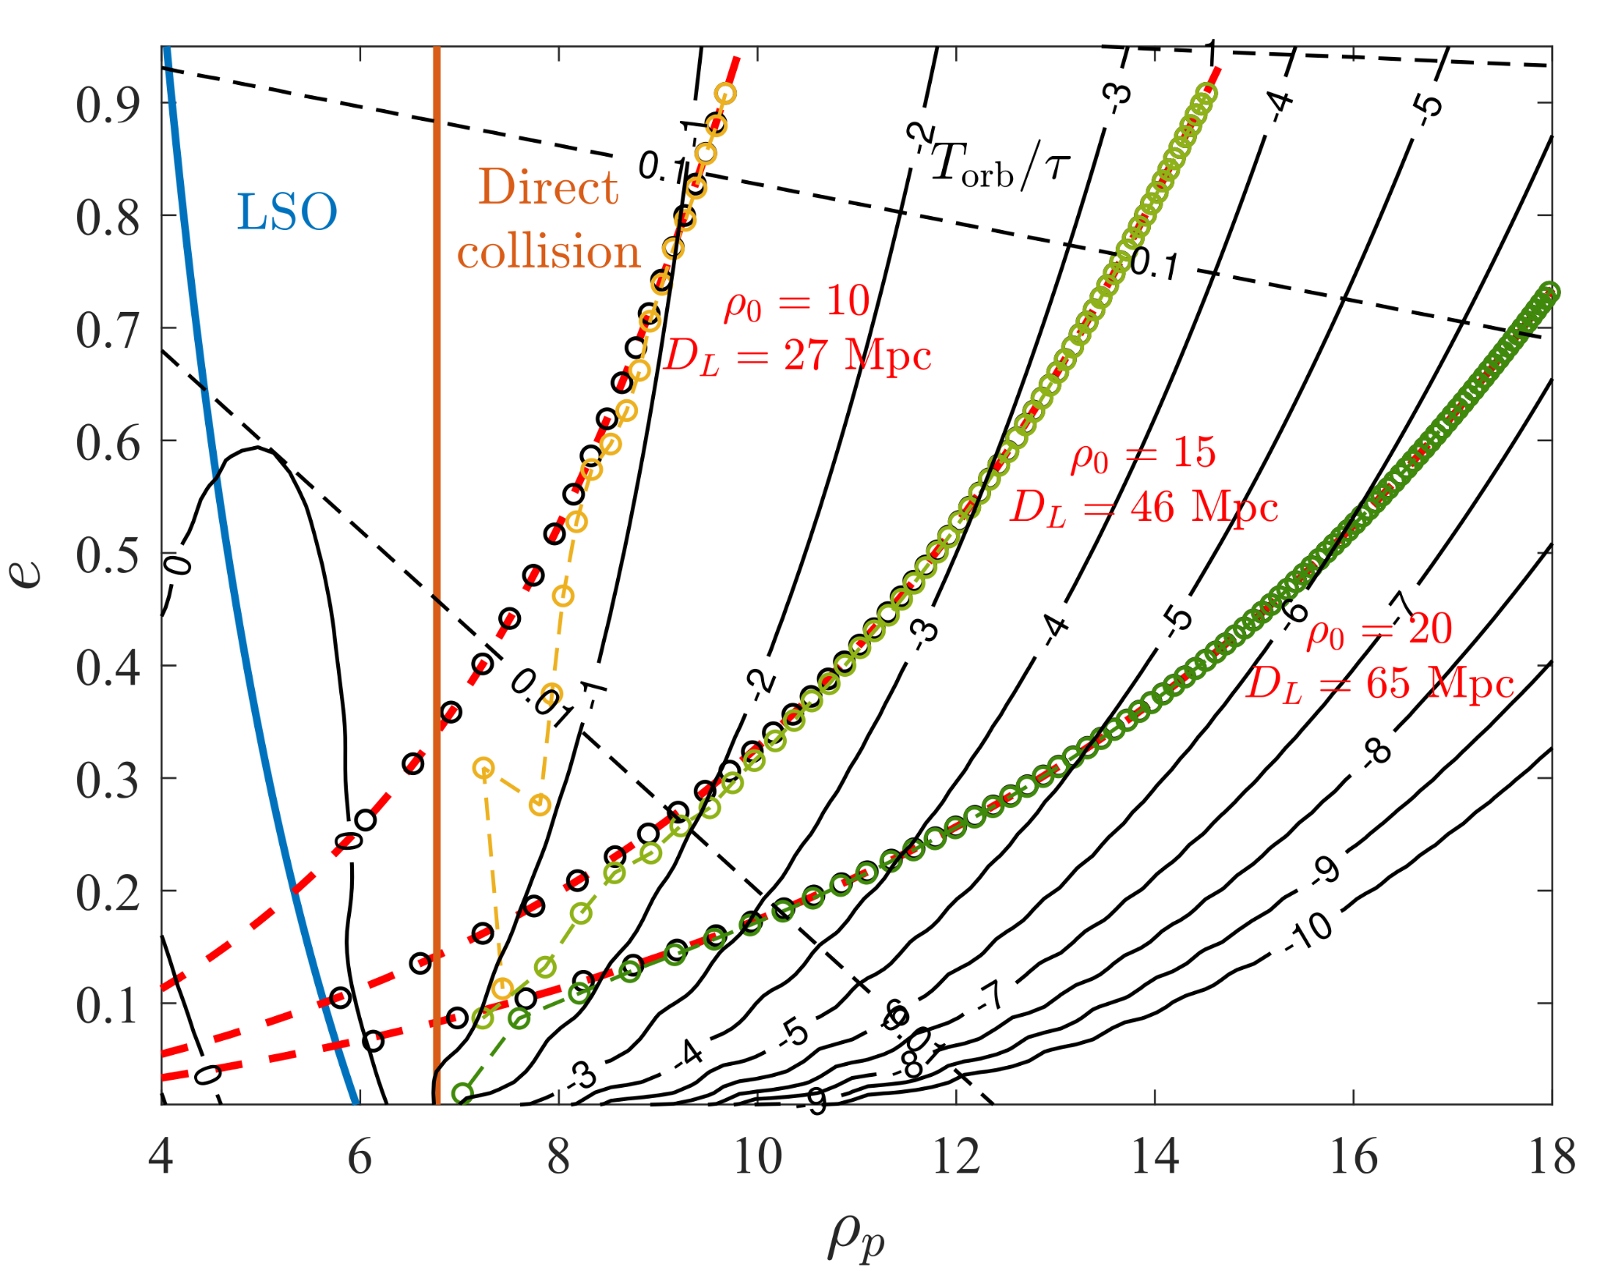
The energy transmitted to tidal oscillations
Transmitted energy can be estimated using the formula by Press & Teukolsky (1977):
Orbital radiation is determined from Peters & Mathews (1963)
Decay timescale of oscillations is much longer than orbital period
Random walk of amplitudes

Slide 7
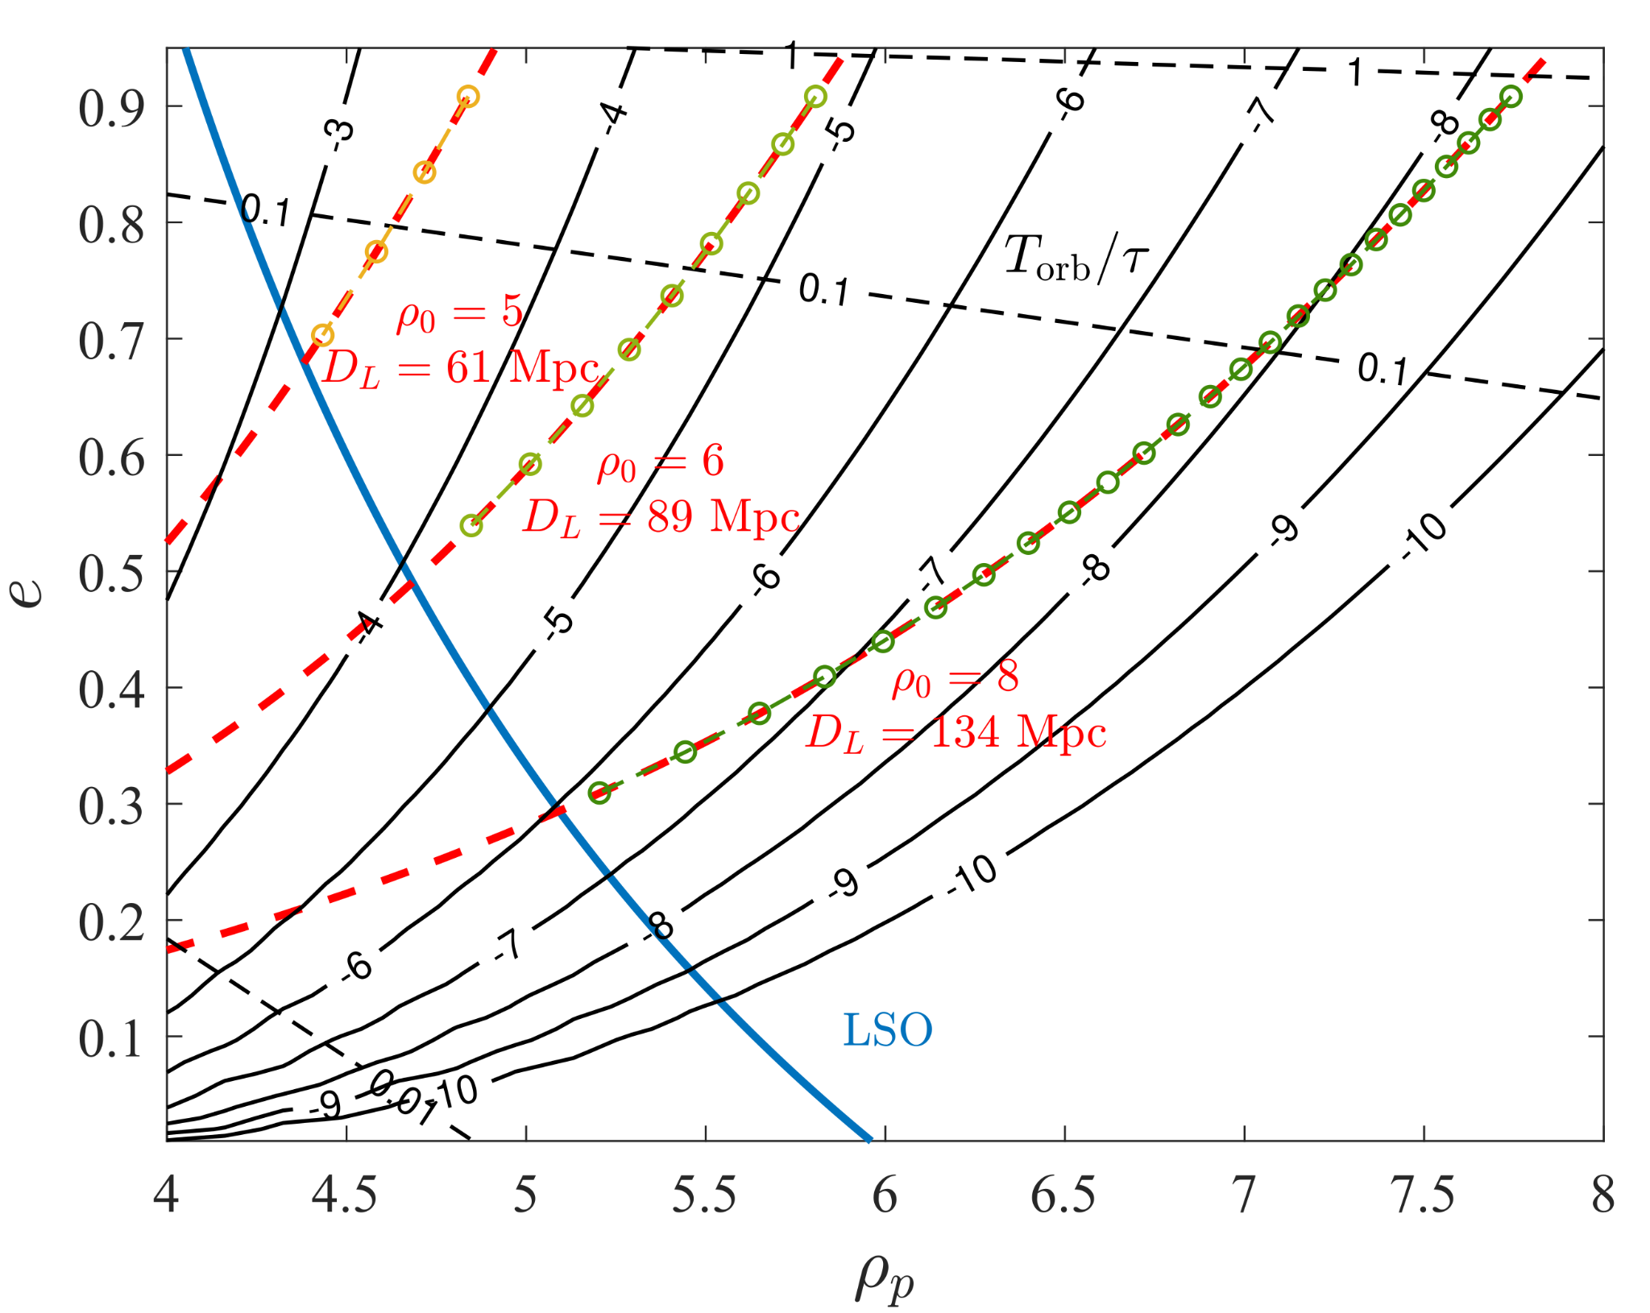
The energy transmitted to tidal oscillations
→ tidal effects are much smaller for BH-NS binaries

Slide 8
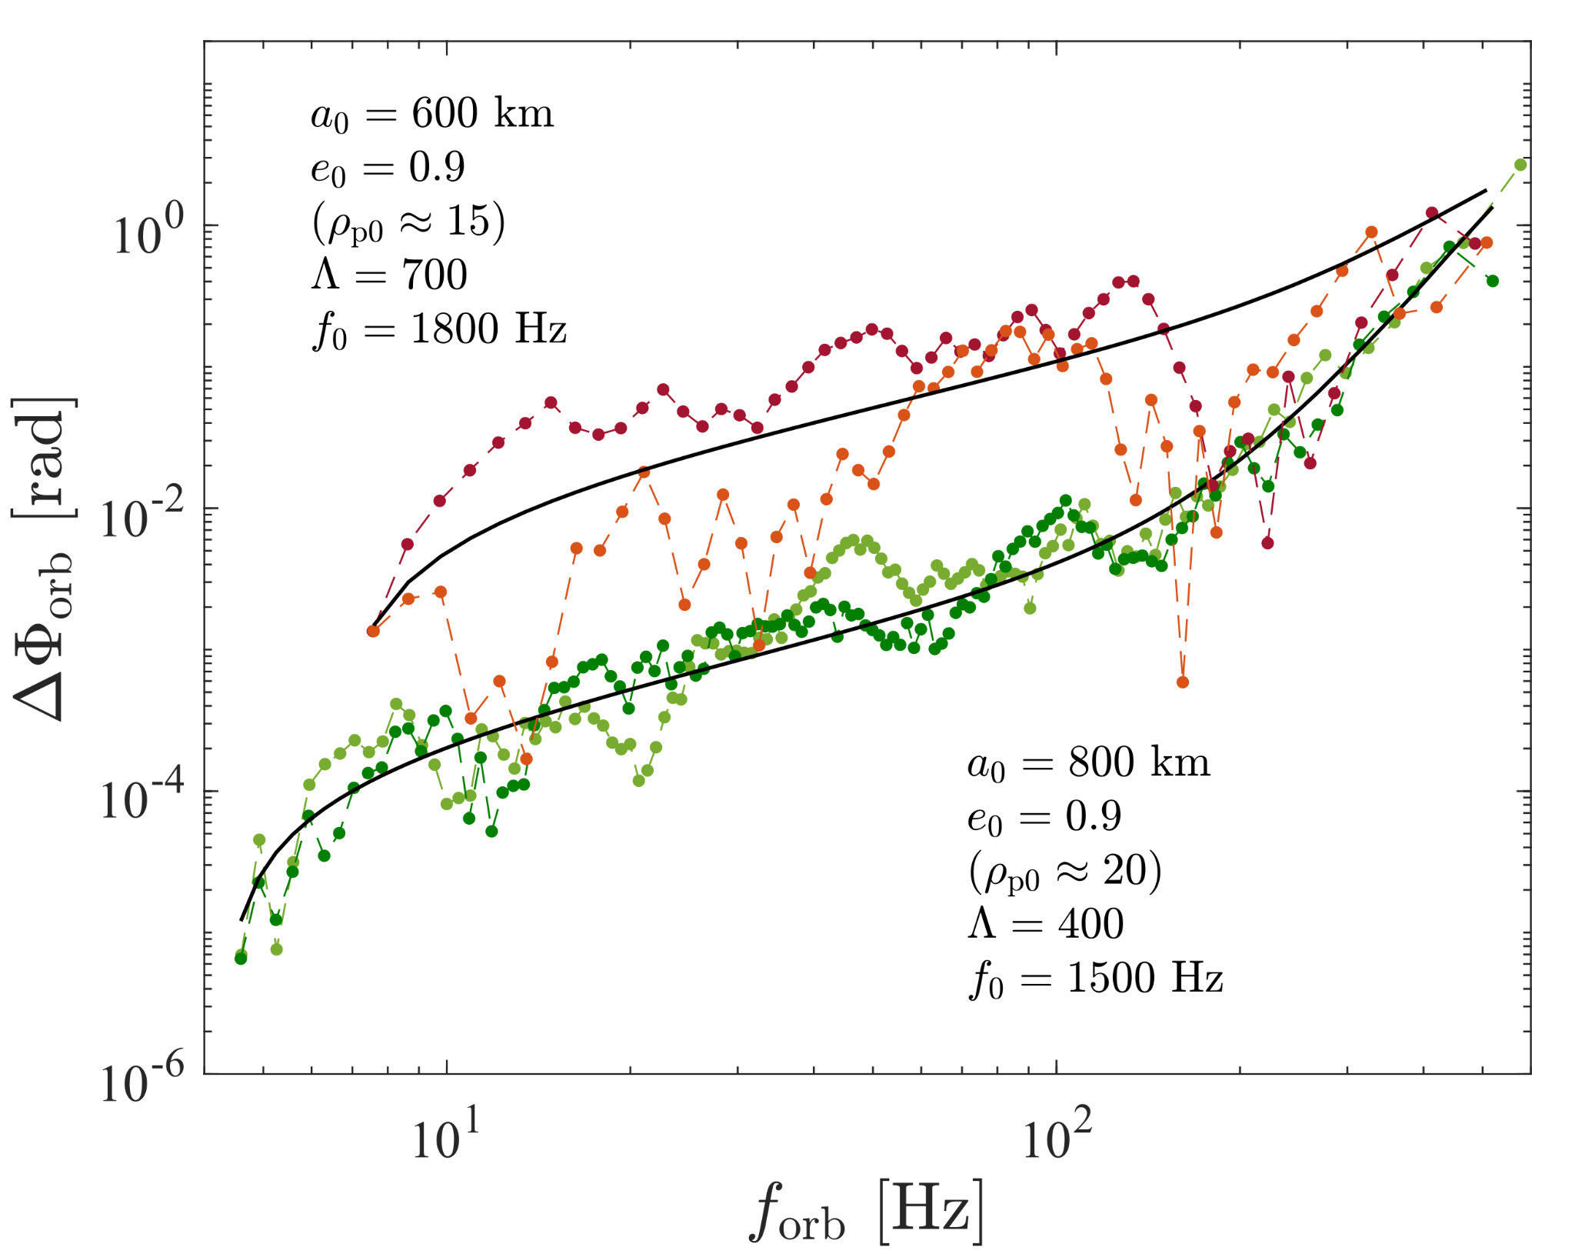
Observable effect: phase shift
Gravitational wave from oscillation is below threshold for detection with LIGO/Virgo
The orbital phase is shifted, similarly to the circular case
Phase shift is proportional to the fraction of energy transmitted and radiated:

Slide 9
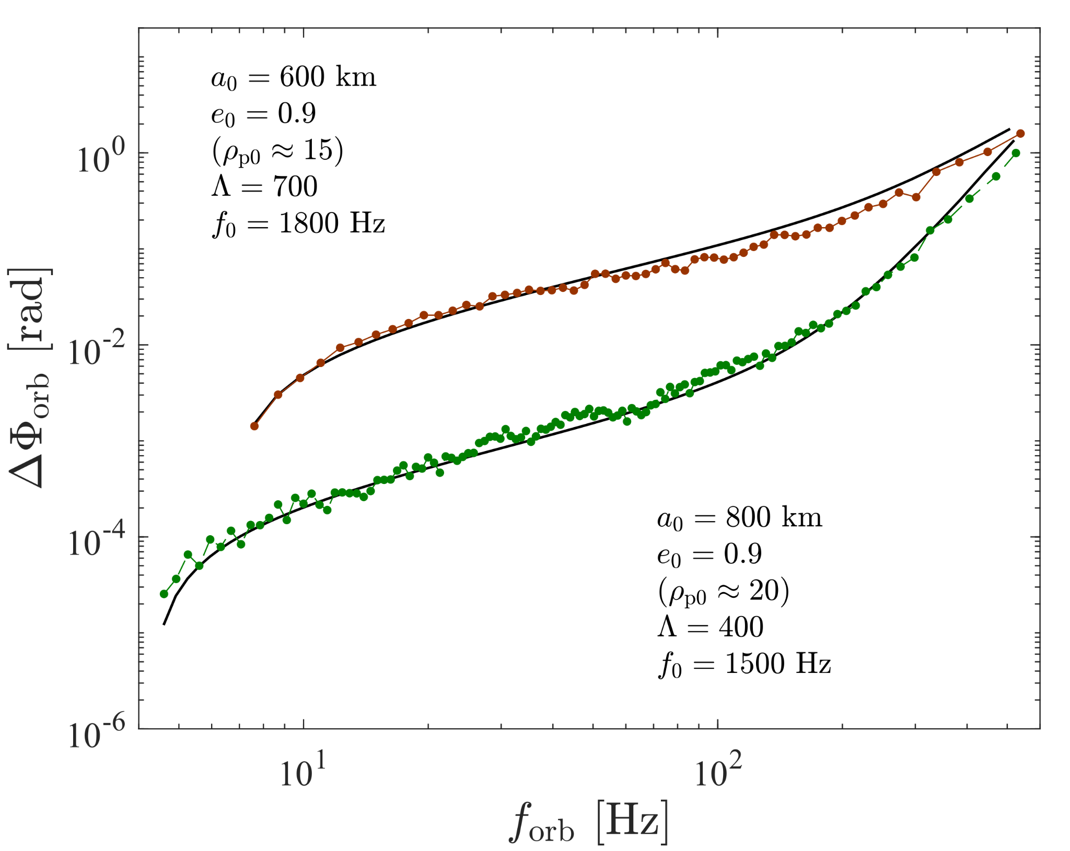
Observable effect: phase shift
Gravitational wave from oscillation is below threshold for detection with LIGO/Virgo
The orbital phase is shifted, similarly to the circular case
Phase shift is proportional to the fraction of energy transmitted and radiated:

Slide 10
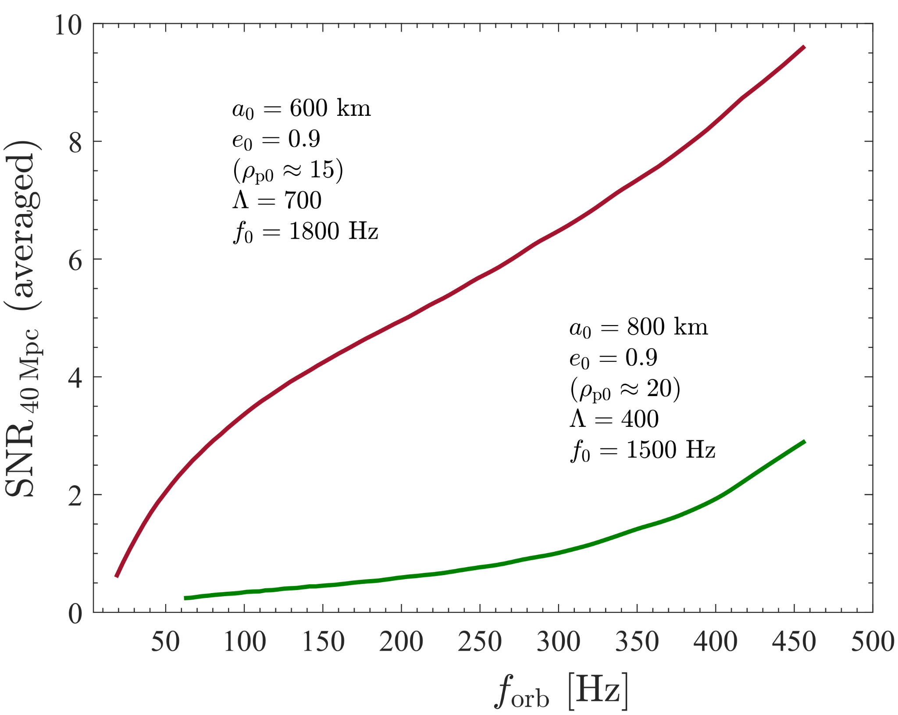
Direct SNR calculation
Conclusions
Dynamical tides might have an observable effect in eccentric binaries through the phase shift
Phase shift strongly depends on f-mode frequency → equation of state might be constrained
PN and other effects still need to be taken into account

Slide 11
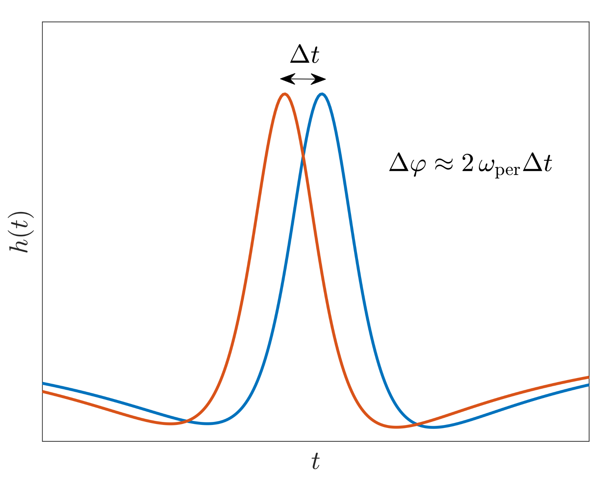
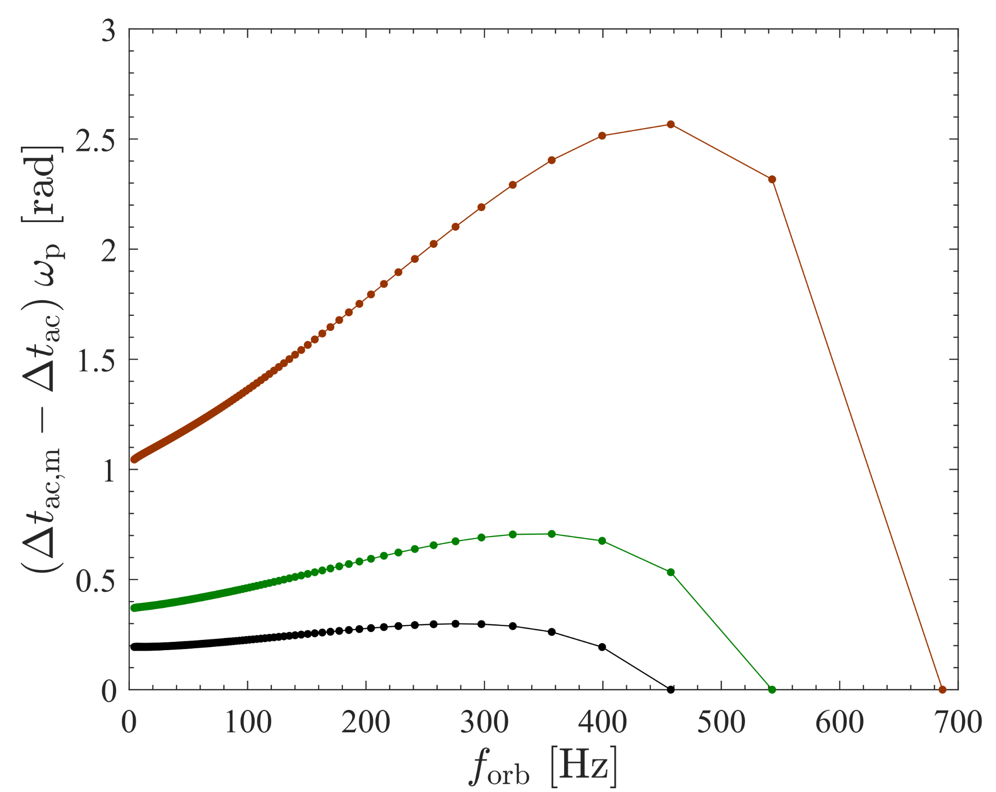
SNR estimation with phase shift
→ highly depends on the last observed orbit

