Slide 1

Detectability of continuous gravitational waves with future interferometers
(see also Evans+ arXiv:2306.13745, Owen+ arXiv:soon)
Benjamin J. Owen

Slide 2
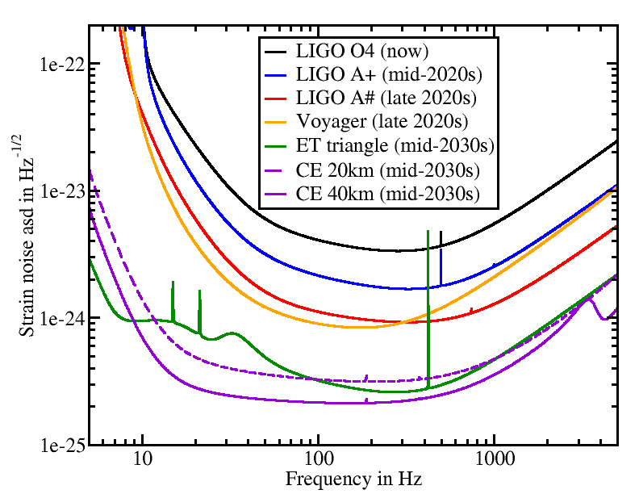
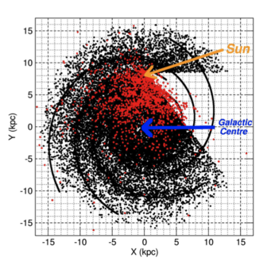
GW and EM instrumentation
LIGO-T1500293 and T2300041 and CE-T2000017
Square Km Array: 20,000 pulsars
ngVLA, eXTP, ATHENA, …
Also supernova remnants, pulsar wind nebulae, central compact objects…
Credit: M. Kramer
Cosmic Explorer: 10x LIGO (I am Head of Observational Analysis)

Slide 3
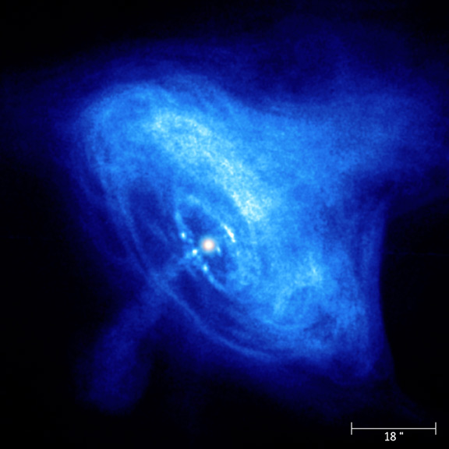
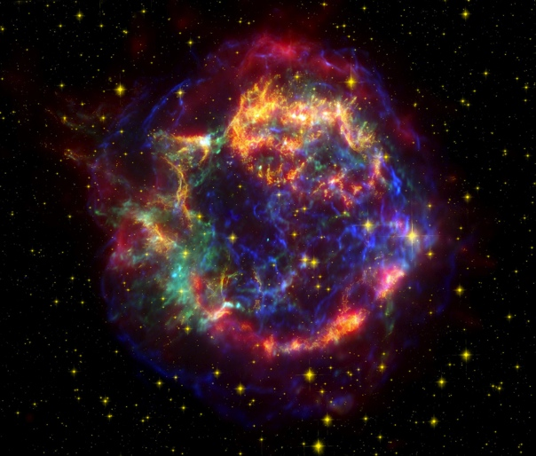
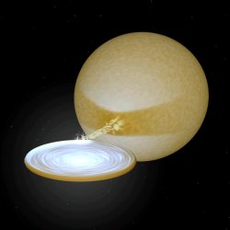
3/4 types of CW searches are MM
Sco X-1 type directed
Known position
No timing
Variable accretion rate
Search broad band
Credit: NASA
Pulsars (Crab)
Known position
Known timing
Follow timing or narrow band around it
Credit: NASA
Cas A type directed
Known position
No timing
Search broad band
Credit: M. van der Sluys

Slide 4
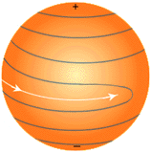

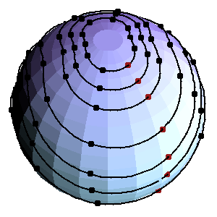

Emission mechanisms
Glampedakis & Gualtieri, arXiv:1709.07049
“Mountains” - elastically supported mass quadrupoles (ellipticity)
Max. height is known Real height depends on history of crust
Magnetically supported ellipticity
Internal B-dipole *must* make mass quadrupole
Credit: K. Hokusai
Credit: Eric Priest
R-modes: rotational modes = current quadrupoles
Prograde/retrograde (CFS) instability grows even w/ viscosity
Also free precession, like a tumbling football
I’ll skip over axion clouds around black holes etc.
Credit: C. Hanna & B. Owen

Slide 5
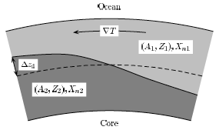
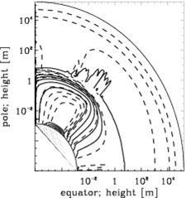
Accreting neutron stars
Spins should go to ~2kHz, seem to stop at ~700Hz
GW torque balance is natural reason (steep f-dependence)
Electron capture, r-mode instability, magnetic bottling
Best GW emitters are brightest in x-rays (Sco X-1)
These have unknown, jittery spin frequencies
Sco X-1
Credit: M. van der Sluys
Ushomirsky+, MNRAS 319, 902 (2000)
Melatos & Payne, ApJ
623, 1044 (2005)
Credit: C. Hanna & B. Owen

Slide 6
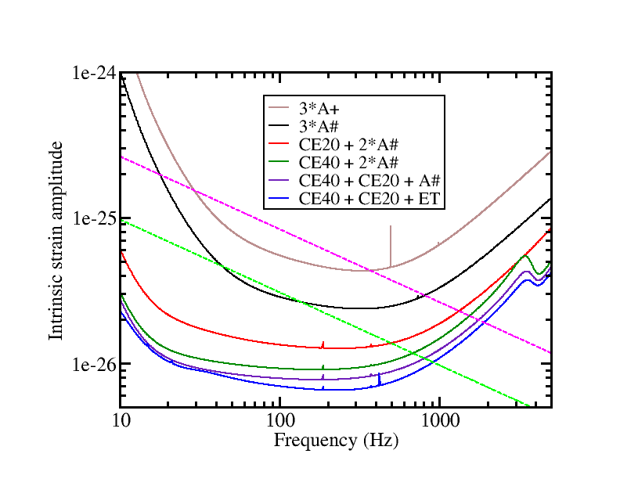
Detectability of Sco X-1 type sources
GW emission in torque balance? [Papaloizou & Pringle, MNRAS 184:501 (1978); Bildsten, ApJL 501:L89 (1998)]
Sco X-1 is the brightest, maybe detectable soon, surely by era of Cosmic Explorer
GX 5-1 and several others next
Non-detection confronts torque balance
Improved orbital elements help search
X-ray detection of pulsations?
  Would improve strain sensitivity ~10x, likely immediate GW detection!
Owen+ in prep.
Sco X-1
GX 5-1

Slide 7
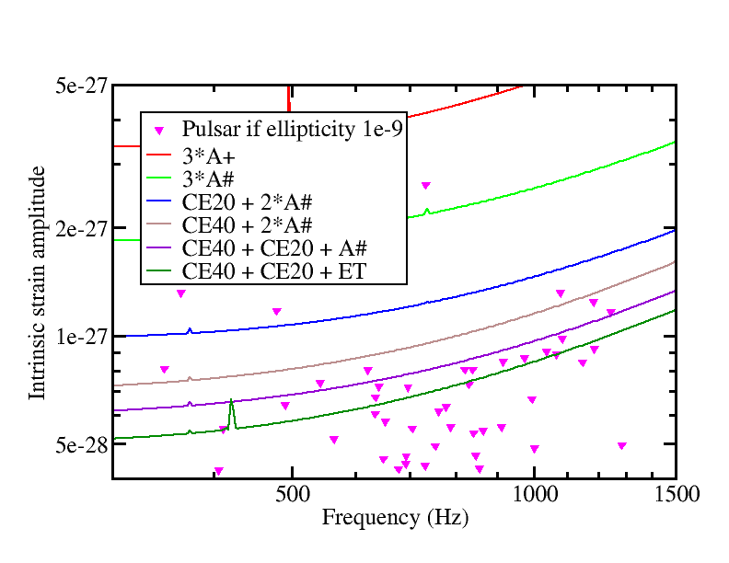
Detectability of millisecond pulsars
Quadrupolar “death line” in millisecond pulsars argues for minimum ellipticity ~1e-9
Fits decades of B-burial predictions
Best CE should detect >20 millisecond pulsars at ellipticity 1e-9
A# should detect ~1
Keep timing these! Best is a PhD thesis
Owen+ in prep.
Woan+, ApJ 863, L40 (2018)

Slide 8
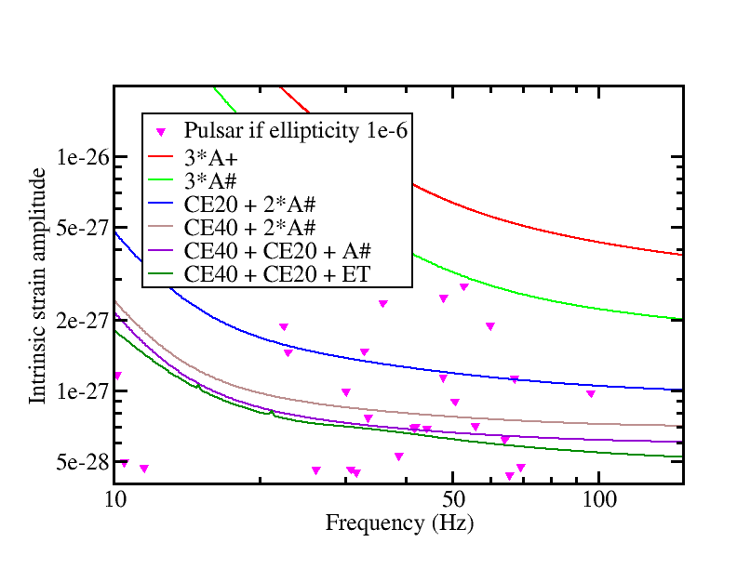
Detectability of young pulsars
Dall’Osso & Perna, MNRAS 472, 2142 (2017)
  Crab radio timing suggests magnetic axis ~60º+0.006º/yr
  Fits 1970s predictions of crust-B-core instability limited by dissipation
  Model-dependent prediction of ellipticity 3e-6, strong enough to detect with A+, also ~max. elastic quadrupole predictions
J0537-6910 (the great glitcher)
  R-modes? [Andersson+, ApJ 864:137 (2018)]
  May be detectable in O4 or O5, extrapolating from O3 [Abbott+, ApJ 922:71 (2021)]
  But needs huge r-mode amplitude
These also beat the spin-down limits – those are higher for young pulsars, CE will beat them for thousands
CE could detect ~20 other young pulsars at quadrupole 1e-6
A#/Vger could detect ~1-few
Owen+ in prep.

Slide 9
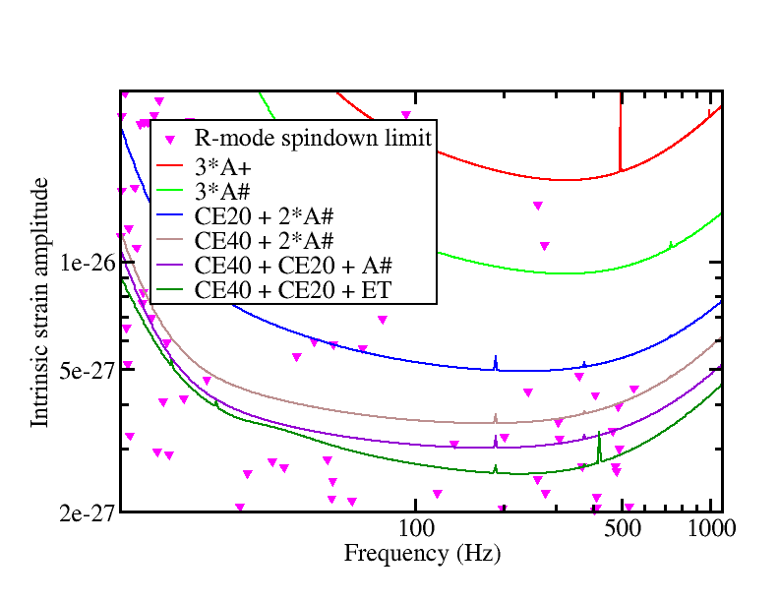
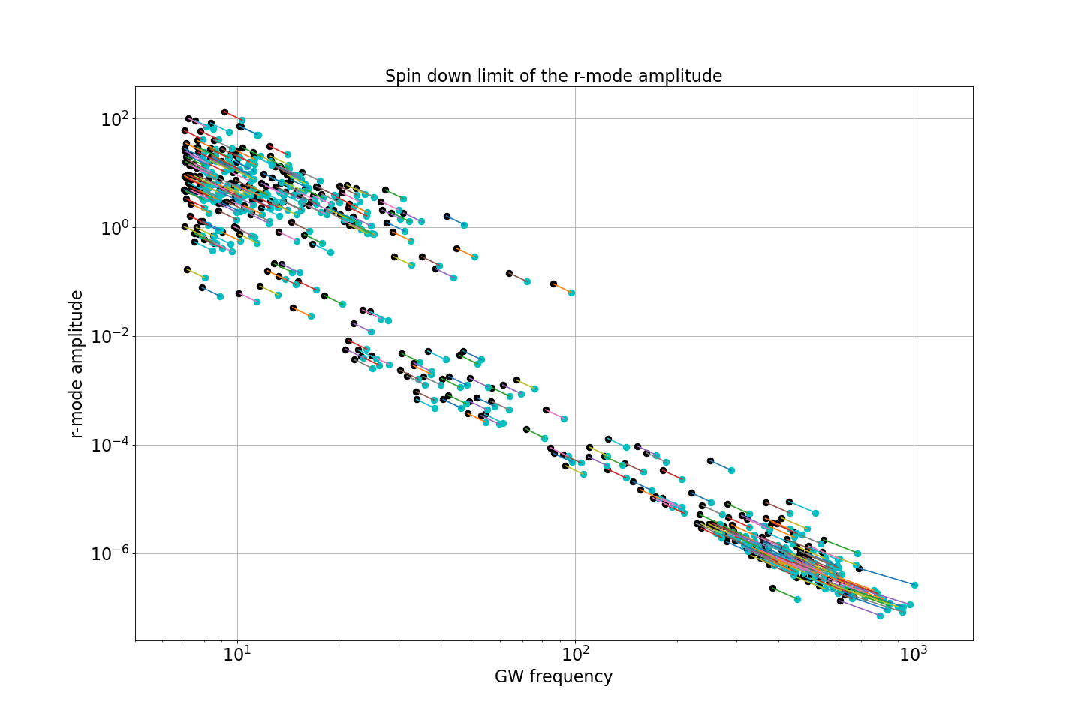
Detectability of r-modes
Spin-down limits look good, especially J0537-6910
But r-mode amplitude says only millisecond pulsars: J0437-4715 etc.

Slide 10
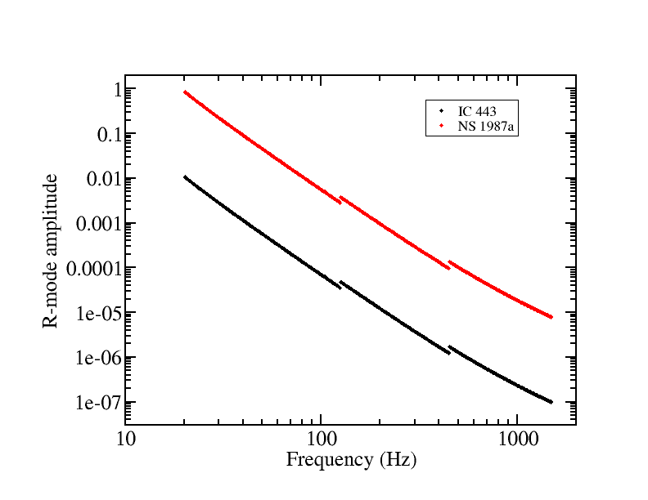
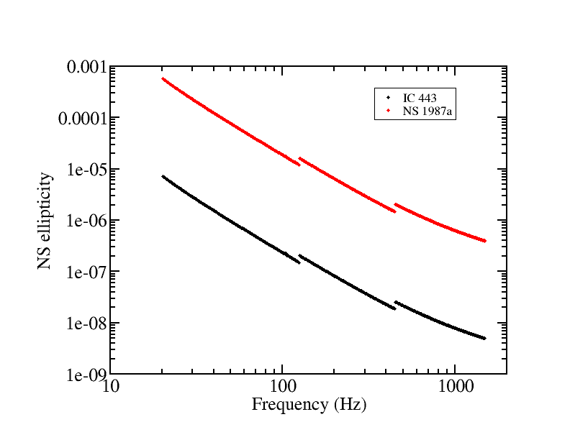
Detectability in supernova remnants etc.
Like Sco X-1, depends on the frequency of GW emission – also age & distance
IC 443 was relatively easy to search, 1987a was harder than Cas A
Extrapolating a recent 1987a search [Owen+, ApJ 935:L7 (2022)] to CE says easier sources are detectable at normal ellipticity and r-mode amptitudes above 10s of Hz, 1987a above few hundred Hz
Owen+ in prep.
Owen+ in prep.
▼ Normal NS
▼ Saturation?

Slide 11
Detectability in all sky surveys
Population synthesis models have improved a lot since Blandford’s unpublished argument (1980s)
Maybe >100 detectable by CE/ET
One or so in the A#/Vger era?
Bad news: Purely magnetic quadrupoles are likely undetectable in pulsars not “recycled” to millisecond periods
Pagliaro+, arXiv:2303.04714

Slide 12

The take-away
Continuous gravitational waves are a different type of multi-messenger astronomy, more precise than binary mergers and coupling to different physics
A few might be detected soon, next generation detectors should detect many (or confront popular theories)

