Slide 1
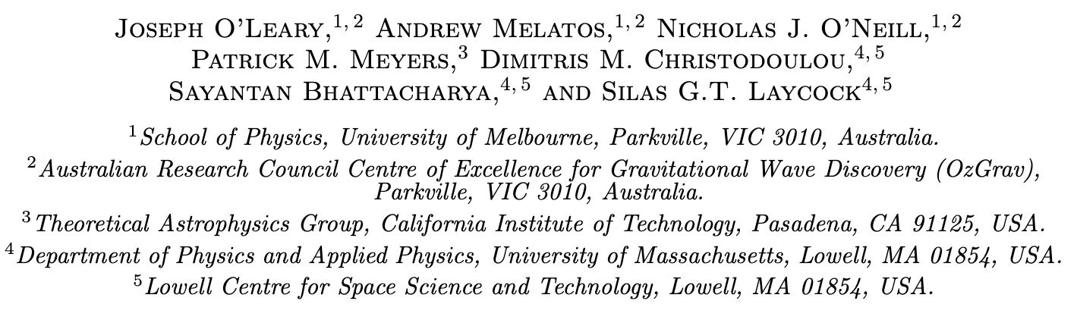


Measuring the magnetic dipole moment and magnetospheric fluctuations of SXP 18.3 with a Kalman filter

Slide 2
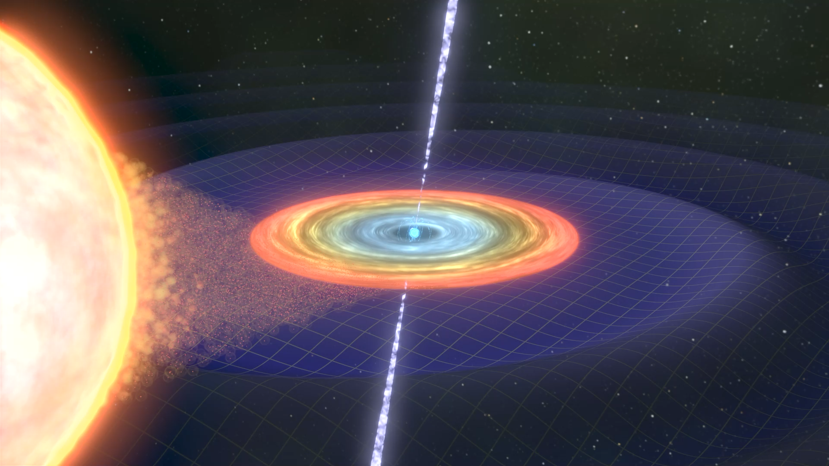
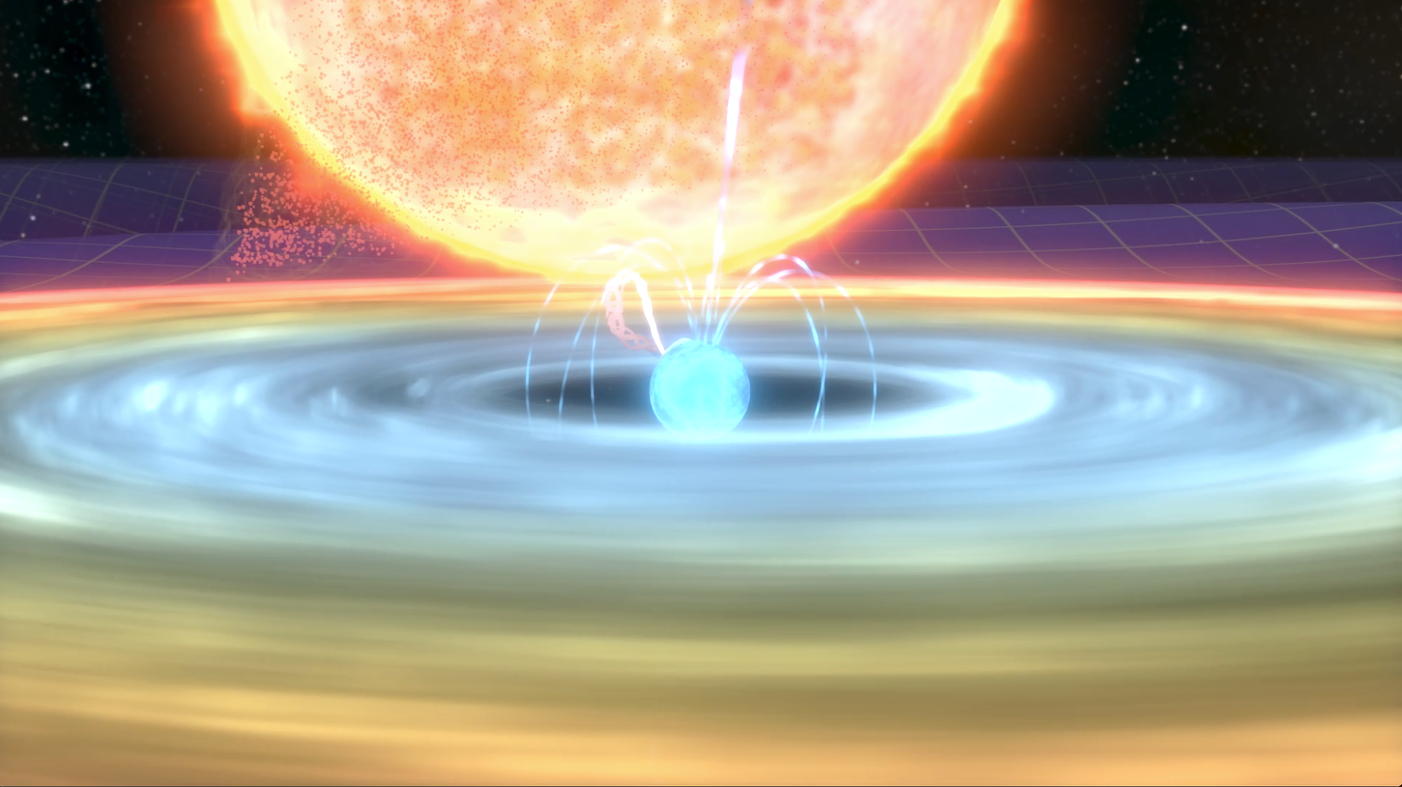
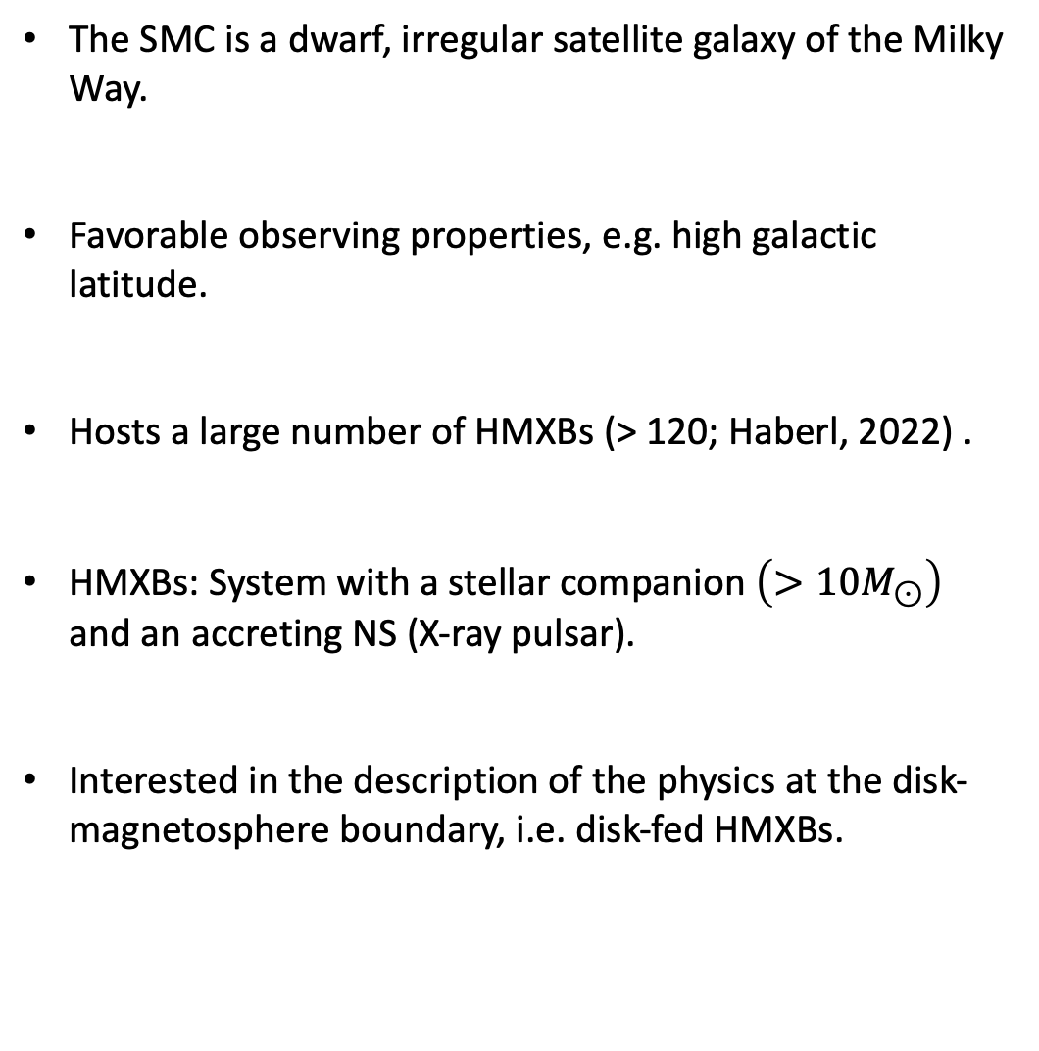
High Mass X-ray Binaries (HMXBs) in the SMC
The SMC is a dwarf, irregular satellite galaxy of the Milky Way.
Favorable observing properties, e.g. high galactic latitude.
Hosts a large number of HMXBs (> 120; Haberl, 2022) .
HMXBs: System with a stellar companion $\left(>10M_{⊙}\right)$ and an accreting NS (X-ray pulsar).
Interested in the description of the physics at the disk-magnetosphere boundary, i.e. disk-fed HMXBs.

Slide 3
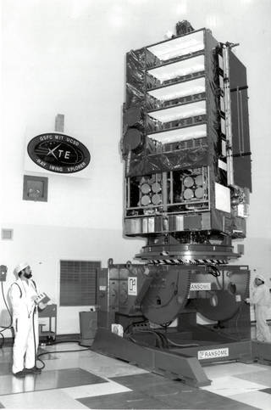
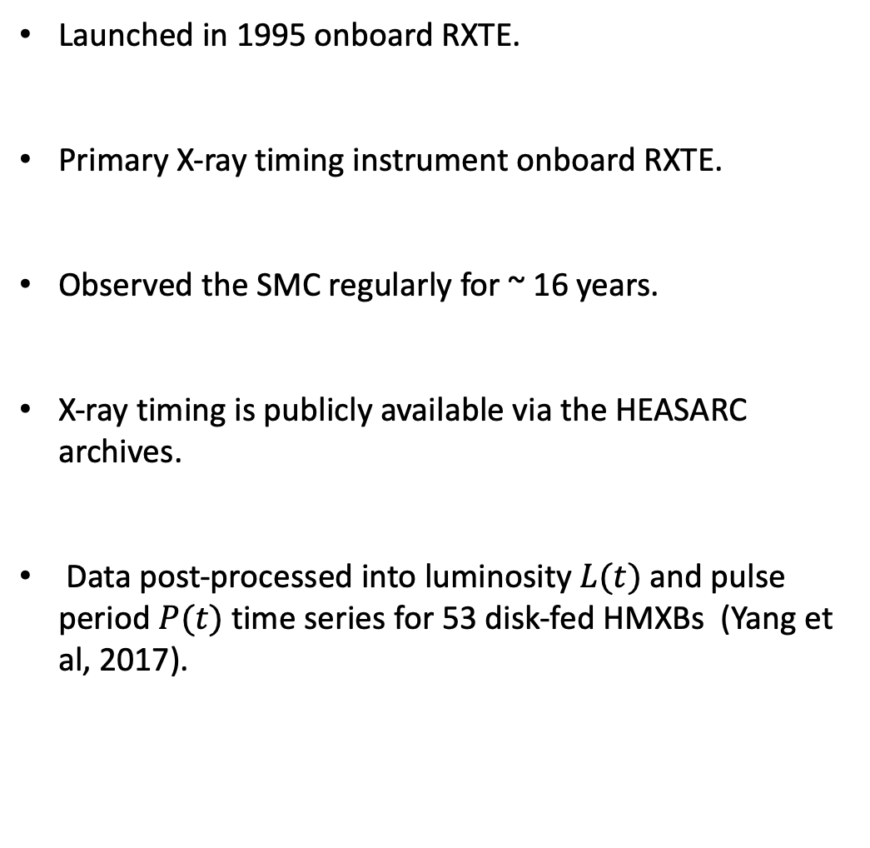
Proportional Counter Array
Launched in 1995 onboard RXTE.
Primary X-ray timing instrument onboard RXTE.
Observed the SMC regularly for ~ 16 years.
X-ray timing is publicly available via the HEASARC archives.
Data post-processed into luminosity $L(t)$ and pulse period $P(t)$ time series for 53 disk-fed HMXBs (Yang et al, 2017).

Slide 4
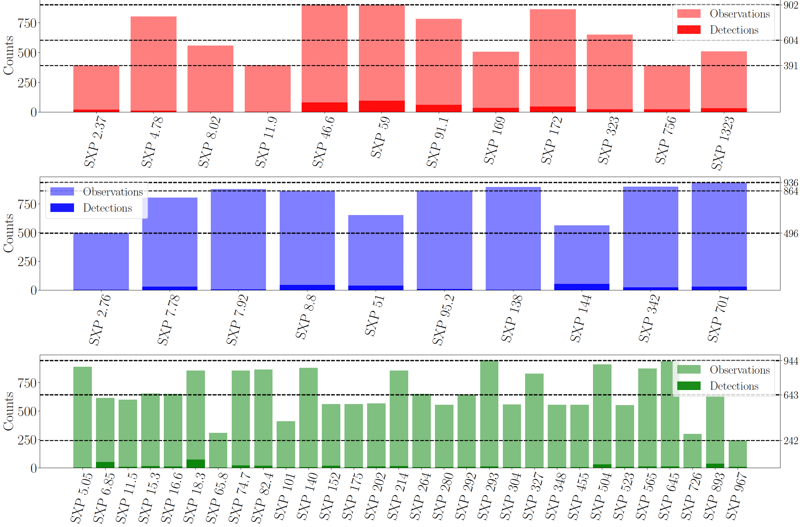
RXTE Observations (Yang et al, 2017)
Spinning up
Spinning down
Rotational equilibrium

Slide 5
Accretion dynamics
State variables

Slide 6
Accretion dynamics
Accretion torque (Ghosh et al, 1977, Ghosh & Lamb, 1979)
Characteristic radii

Slide 7
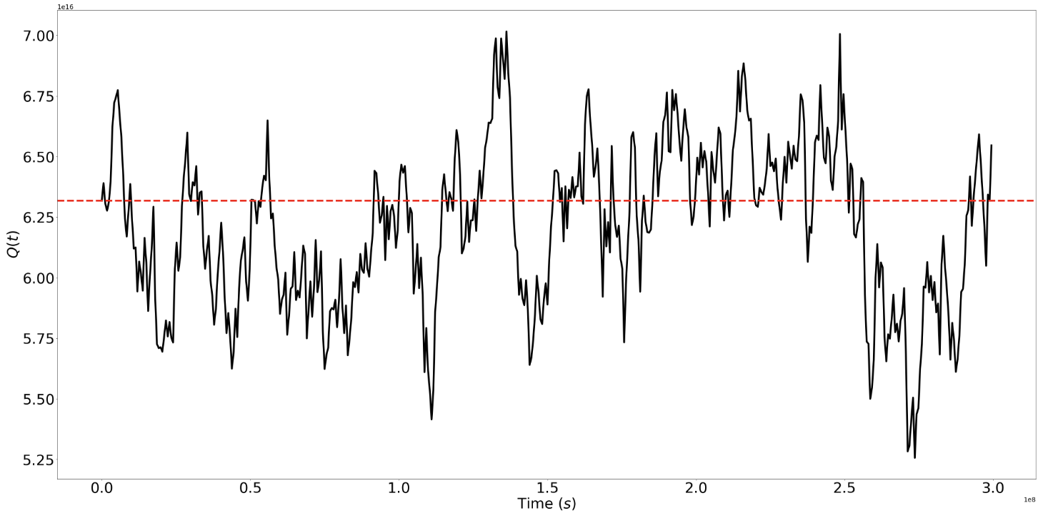
Accretion dynamics
Langevin equations (Melatos, 2023)

Slide 8
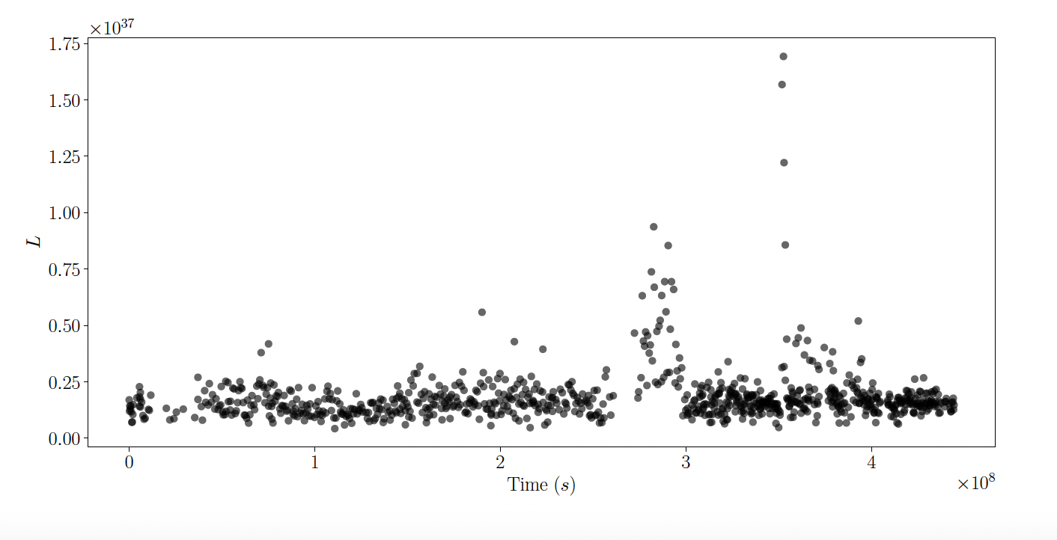
Observation models
Observables

Slide 9
Accretion dynamics recap
Accretion physics described by noise-driven system of stochastic differential equations
Noisy observations collected by the RXTE PCA

Slide 10
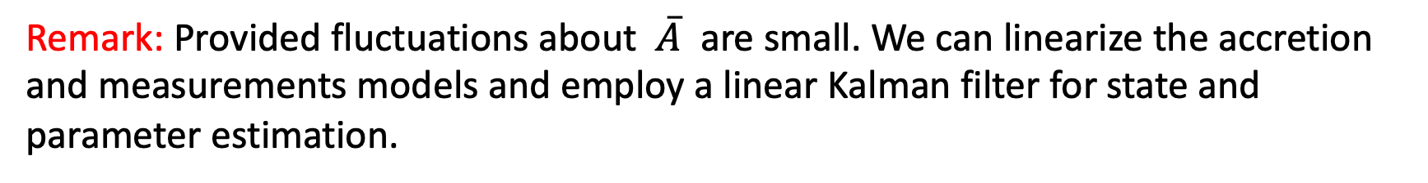
Paper overview
Goal: infer accretion parameters and magnetic dipole moment of HMXBs in the SMC by tracking fluctuations in P(t) and L(t) RXTE PCA measurements with a Kalman filter.
Assumptions: we restrict attention to disk-fed HMXBs classified as being near rotational equilibrium, i.e.
Remark: Provided fluctuations about $\overline{A}$ are small. We can linearize the accretion and measurements models and employ a linear Kalman filter for state and parameter estimation.

Slide 11
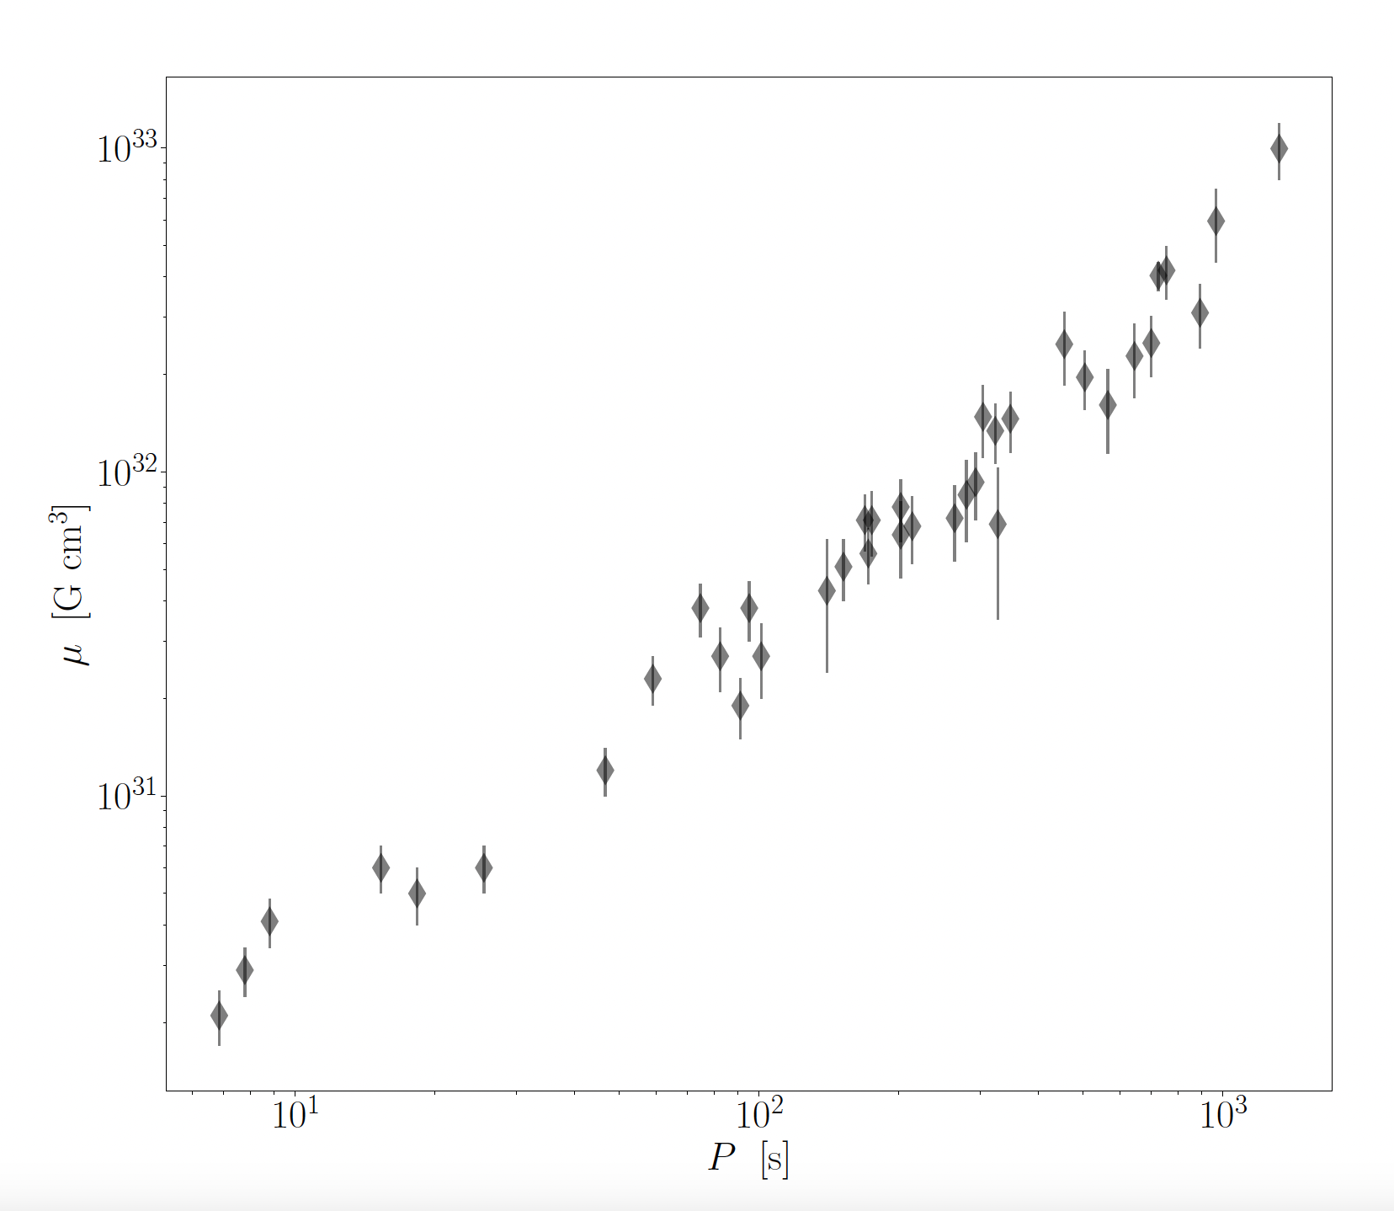
Traditional approach to estimate
Standard technique: Employ time-averaged P(t) and L(t) statistics with various physical theories of accretion.
A common approach is to combine the rotational equilibrium condition, i.e.
with
to estimate the magnetic dipole moment, viz.
by assuming
Results summarized from Klus et al (2014)

Slide 12
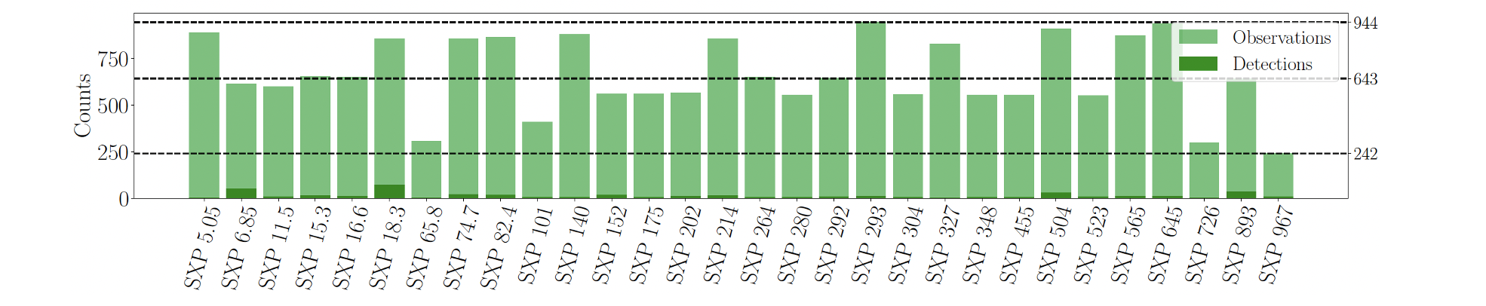
Linearized (state-space) accretion dynamics
State dynamics:
Measurement model:

Slide 13
Linearized (state-space) accretion dynamics
State dynamics:
Measurement model:
Parameters:

Slide 14
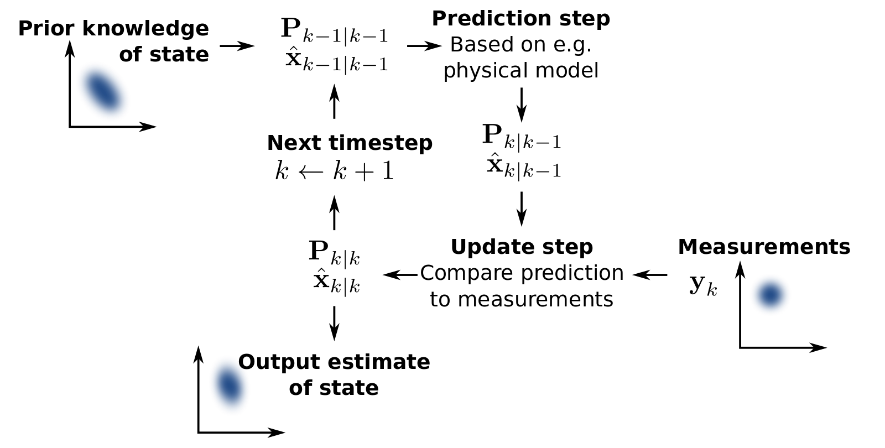
State estimation with a Kalman filter
Kalman filter state estimation: Represents each state variable as a Gaussian random variable with mean and covariance.
Kalman filter parameter estimation: Maximize likelihood using Bayesian inference.

Slide 15
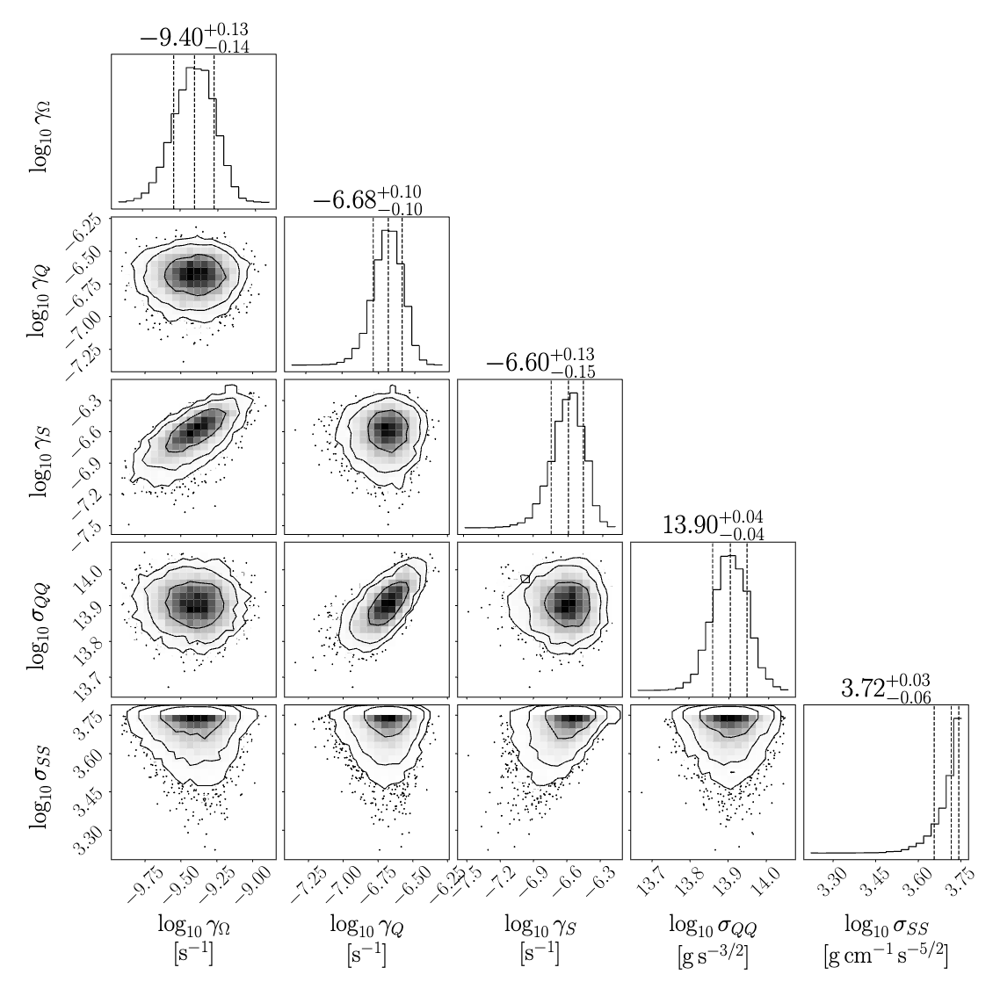
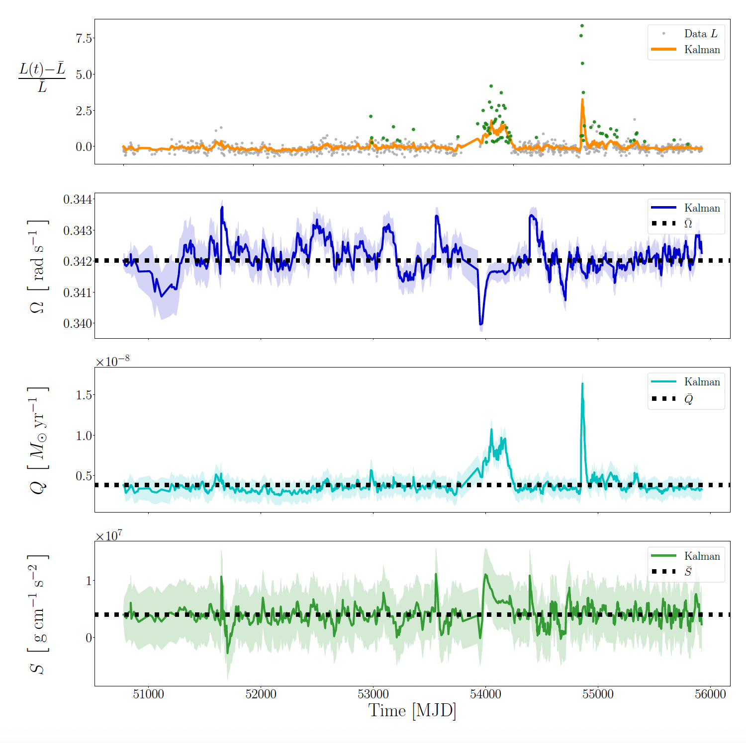
Results for SXP 18.3

Slide 16
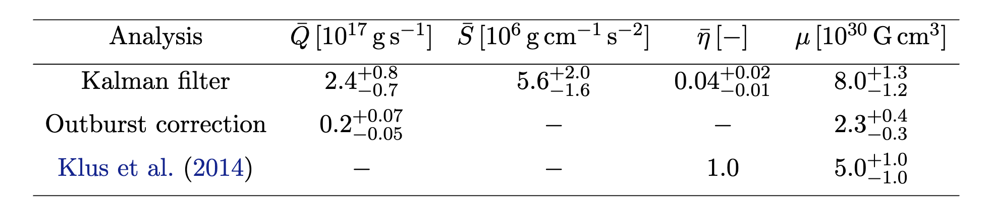
Results for SXP 18.3
As well as state and parameter estimation, the Kalman filter framework also returns posteriors for and hence

Slide 17
Parameter estimation with a (nonlinear) Kalman filter
The standard Kalman filter is an optimal estimator when the state-space model [i.e. the dynamic and measurement equations] is linear with Gaussian noise.
Yet, many of the objects in our catalogue are in rotational disequilibrium, i.e. they are spinning up or down. How do we accommodate for this?
Two options: Either assume that most sources are well represented as being close to rotational equilibrium (common in the literature) or use an unscented Kalman filter on the full, nonlinear accretion model.

Slide 18
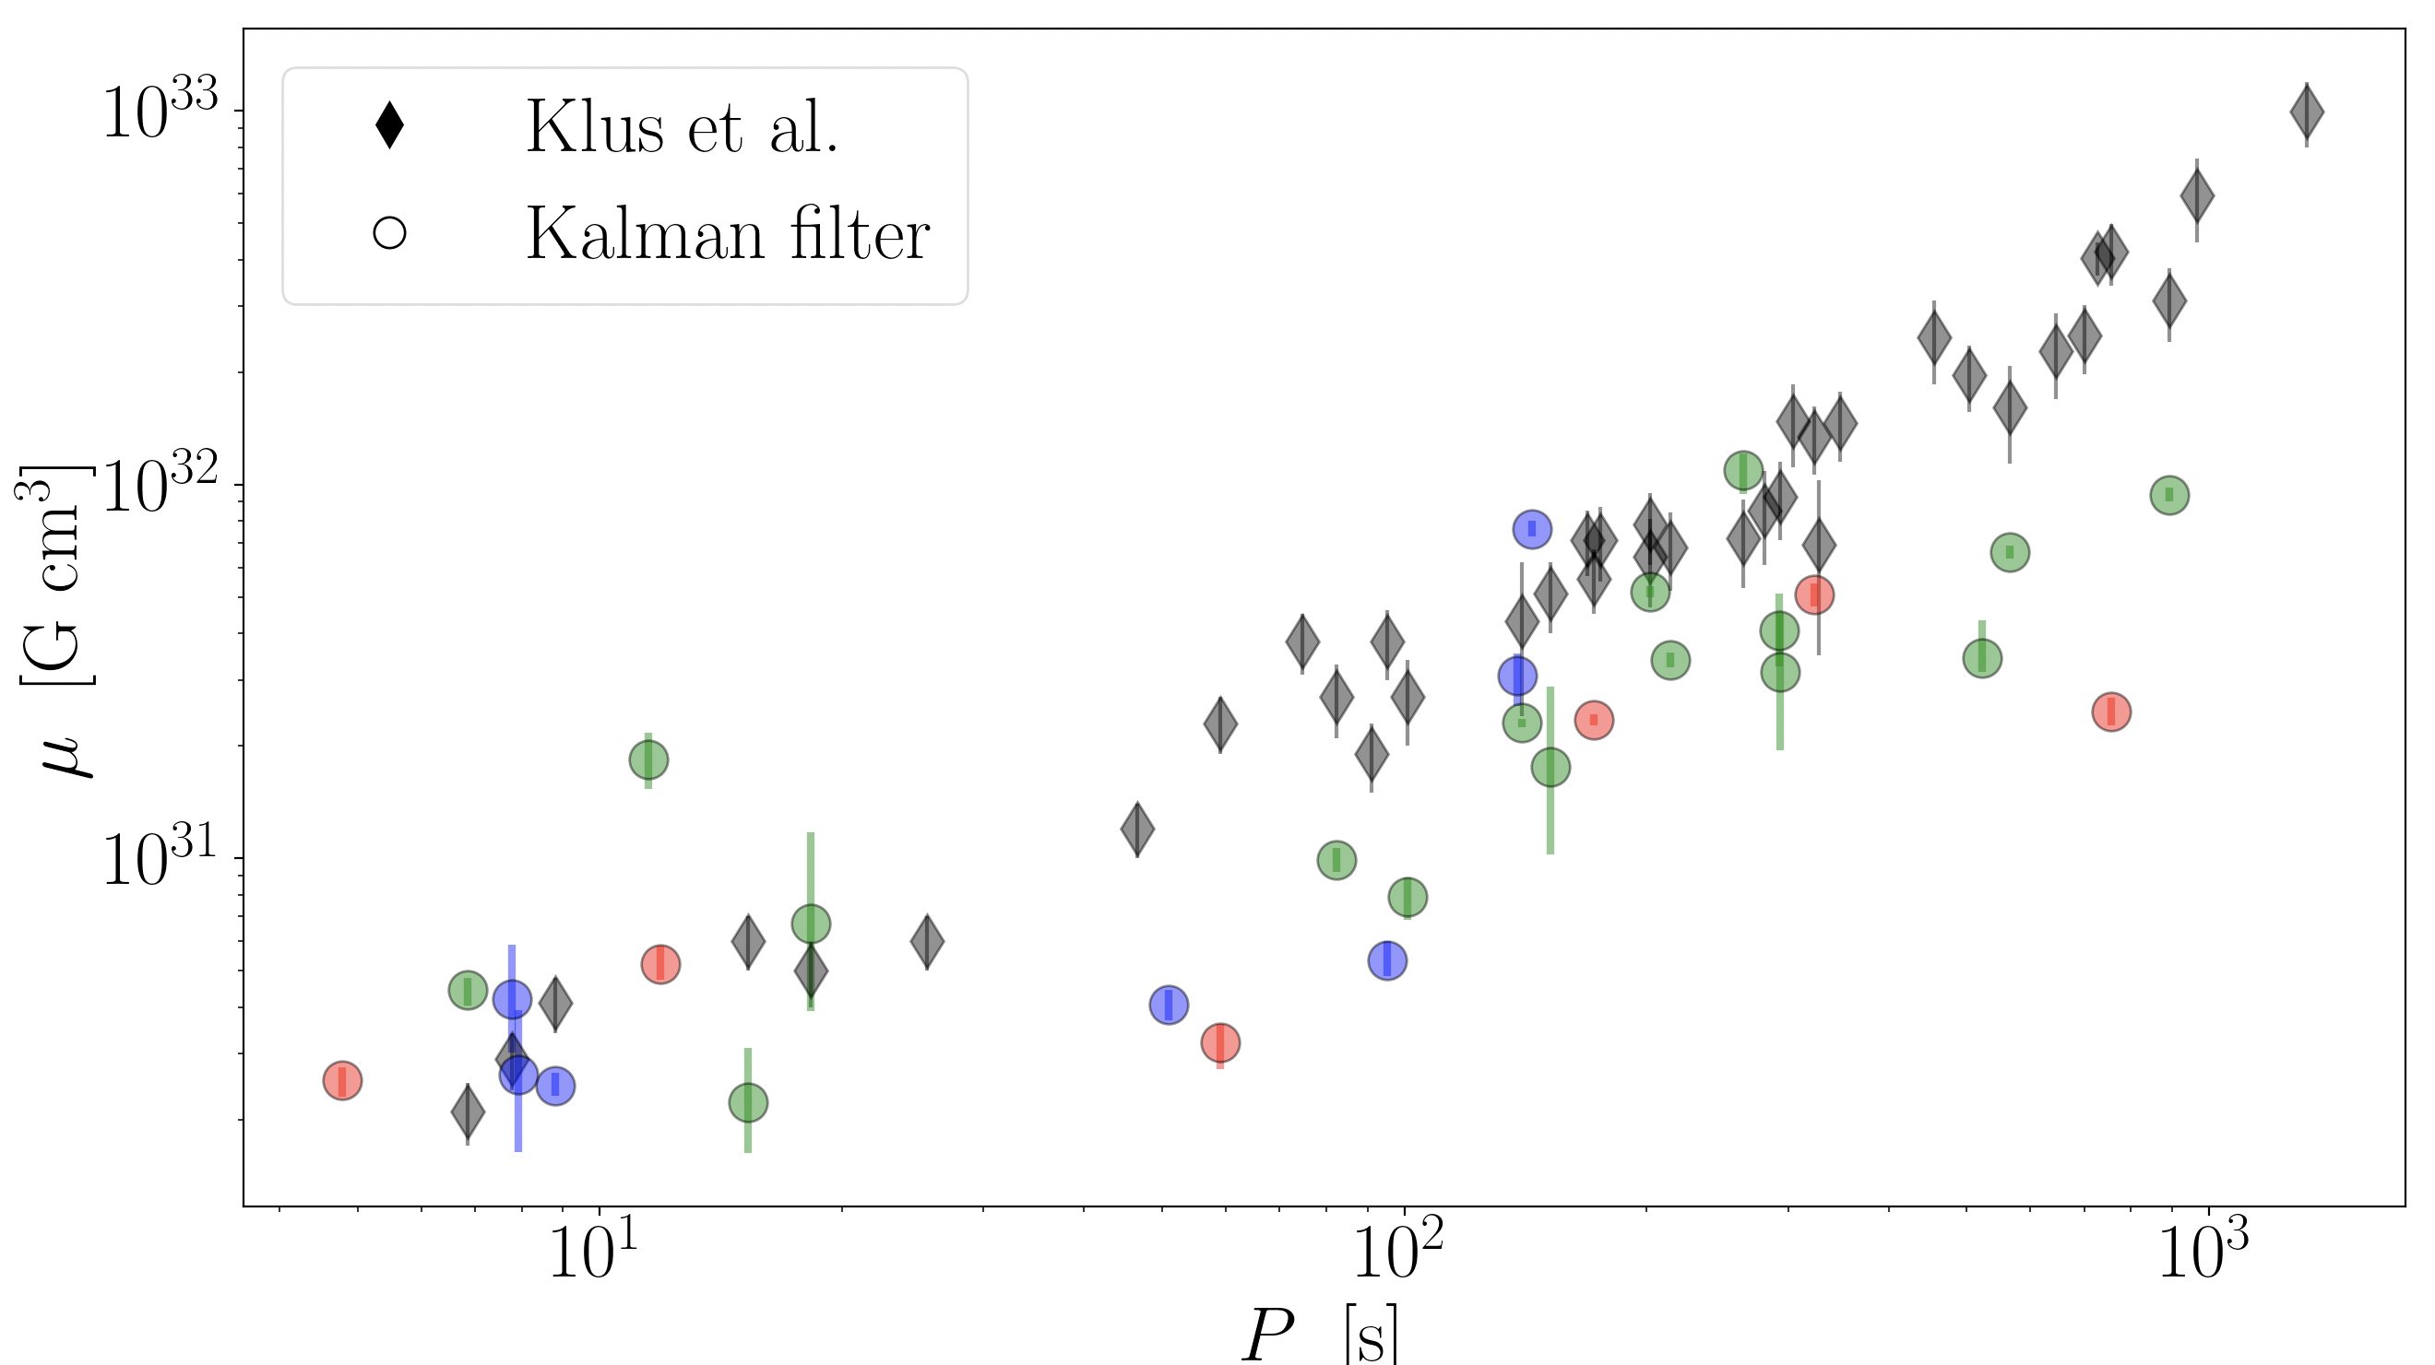
Parameter estimation with a (nonlinear) Kalman filter

Slide 19
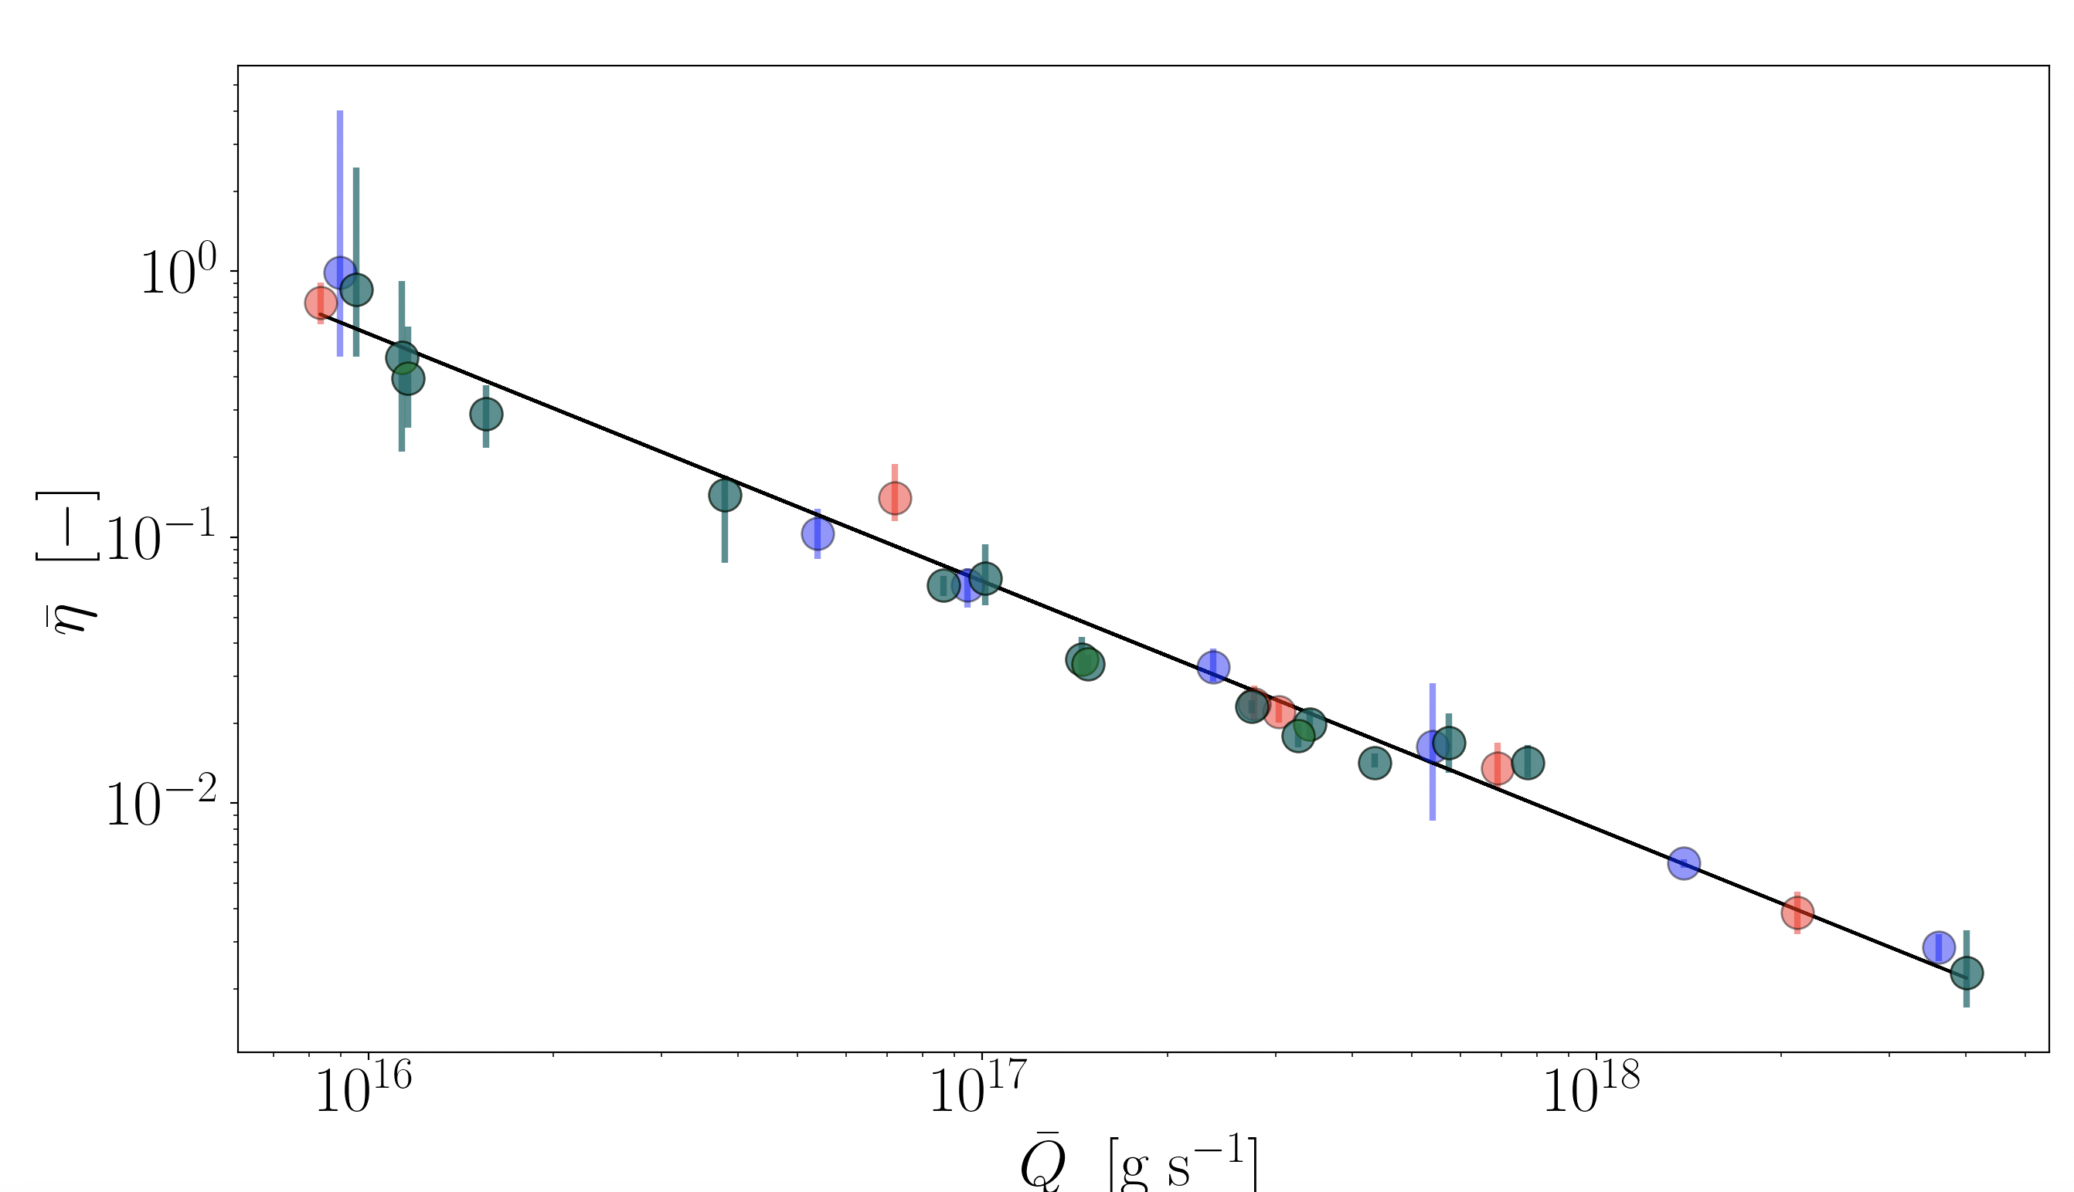
Parameter estimation with a (nonlinear) Kalman filter

Slide 20
Some comments and conclusions
The Kalman filter/parameter estimation framework introduced here is new in the context of accretion-powered pulsars.
The framework yields the first independent estimate of and hence without assuming an a priori radiative efficiency.
Next step: calibration tests on galactic sources whose magnetic field strengths are estimated via CRSF.

Slide 21
State estimation with a Kalman filter (back-up slide)
Kalman filter predict step:
Kalman filter update step:
Kalman (optimal) gain:

