Slide 1
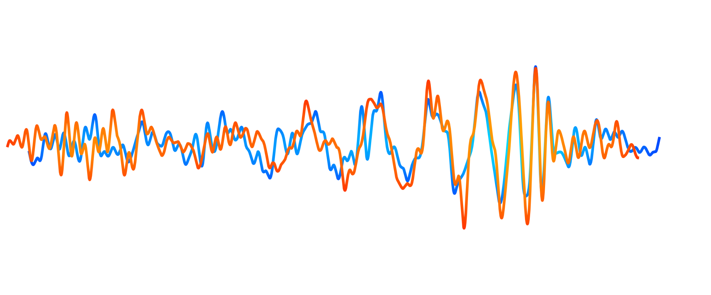
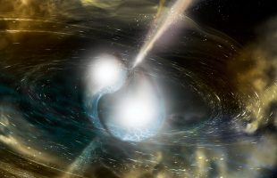
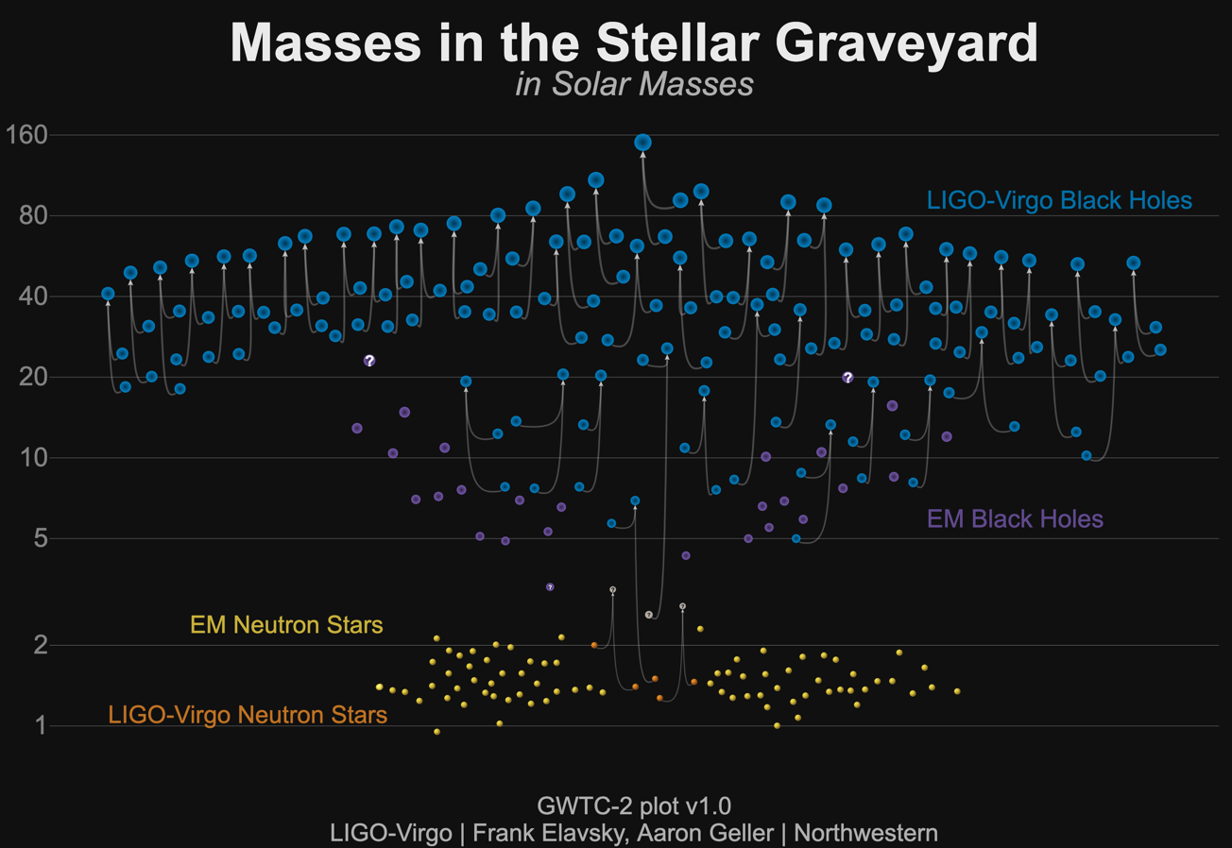
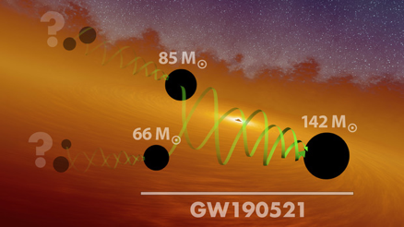
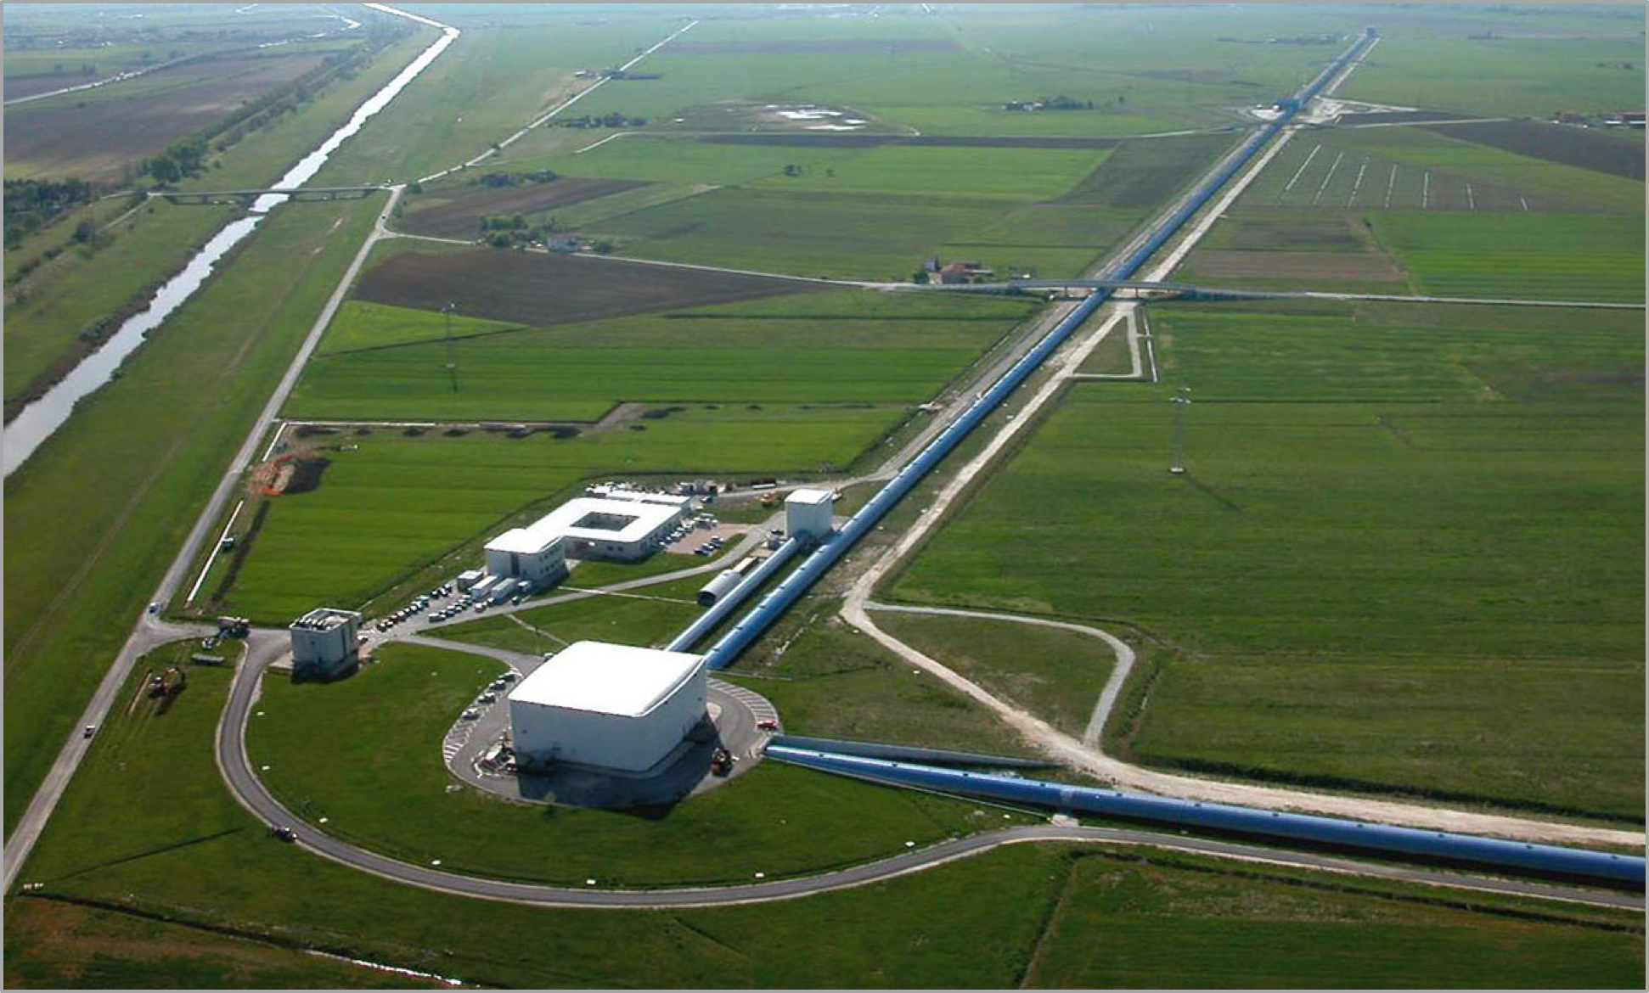
Nikhef GW programme

Slide 2
The Mission: Detecting and studying Gravitational Waves that are produced by cataclysmic events in the universe
Upgrade Advanced Virgo and run jointly with Advanced LIGO providing observational data of unprecedented reach and pointing accuracy.
Study gravitational waves from compact binary mergers, and extract knowledge about black-hole and neutron star populations, their formation channels, the equation of state of neutron stars and the expansion rate of the universe.
Develop strategies to probe the nature of black holes and the fundamental physics of gravity and shed light on the nature of dark matter and dark energy.
Develop new data-analysis techniques and consolidate innovative instrumentation R&D for Virgo, ETpathfinder, ET and LISA.
Consolidate the Dutch co-leadership of the Einstein Telescope and prepare a strong bid for hosting the Einstein Telescope in Euregio Meuse-Rhine.

Slide 3
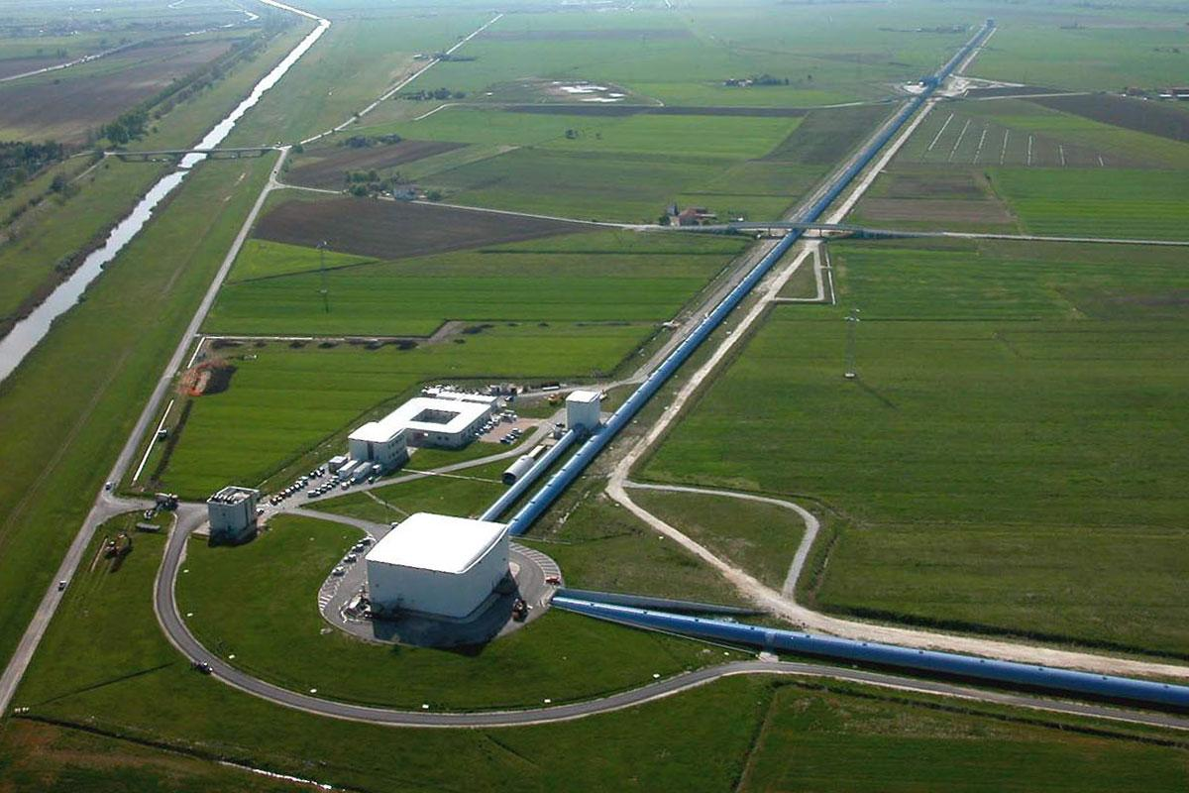
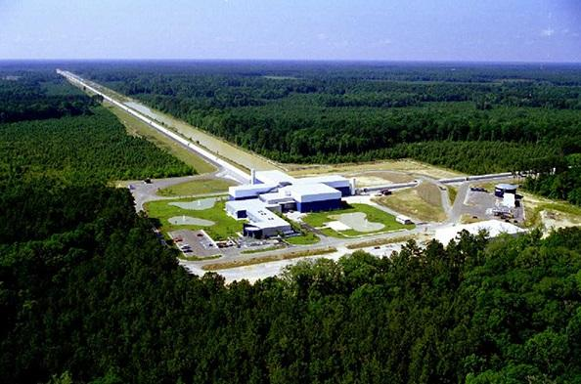
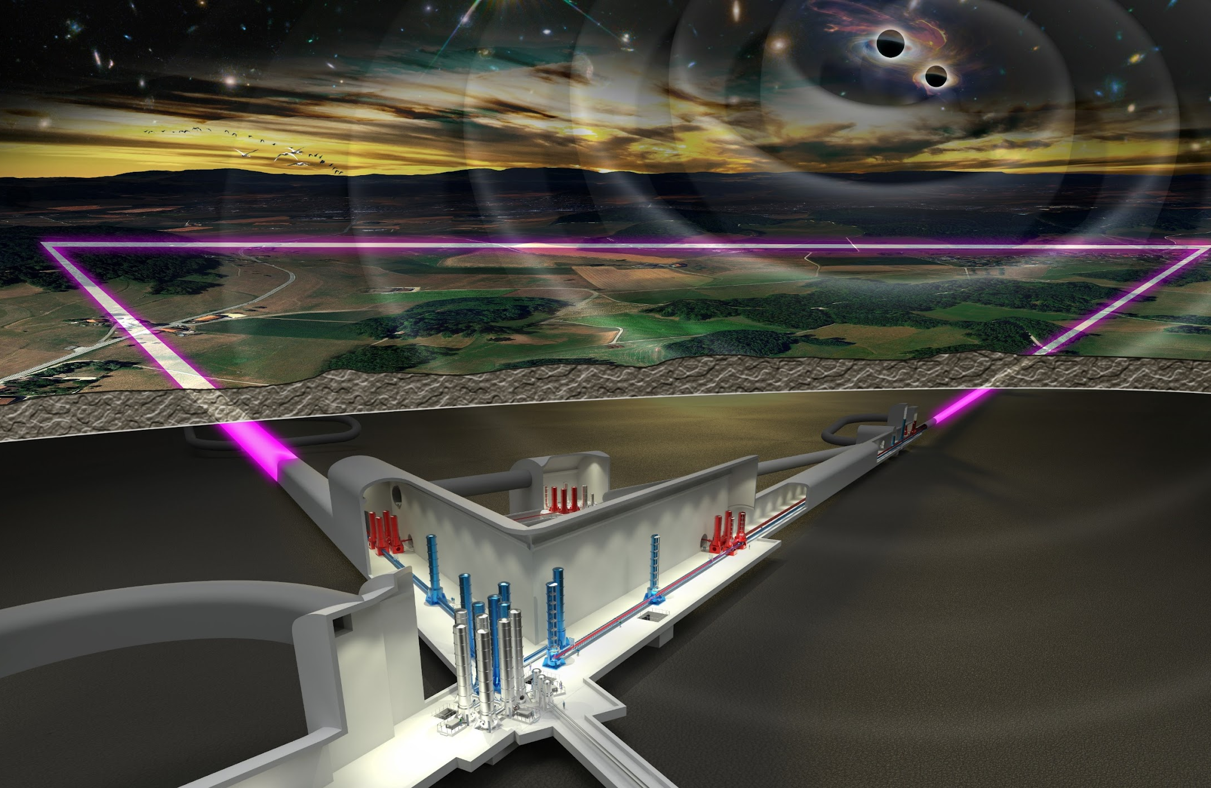
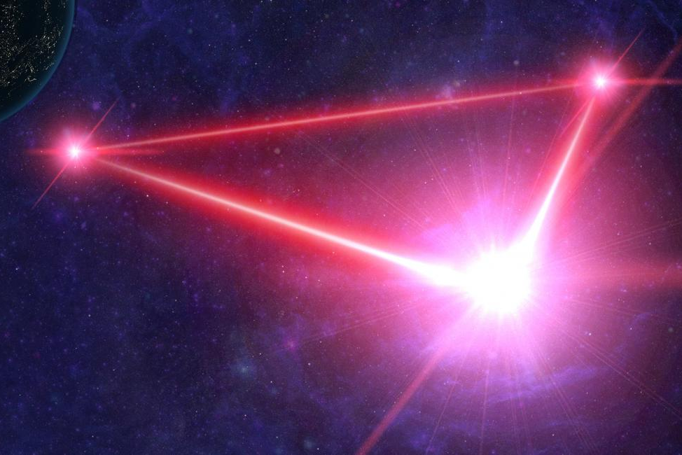
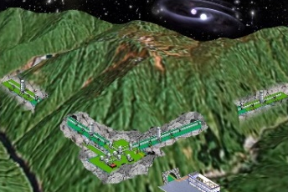
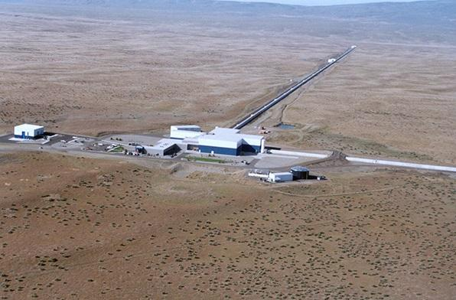
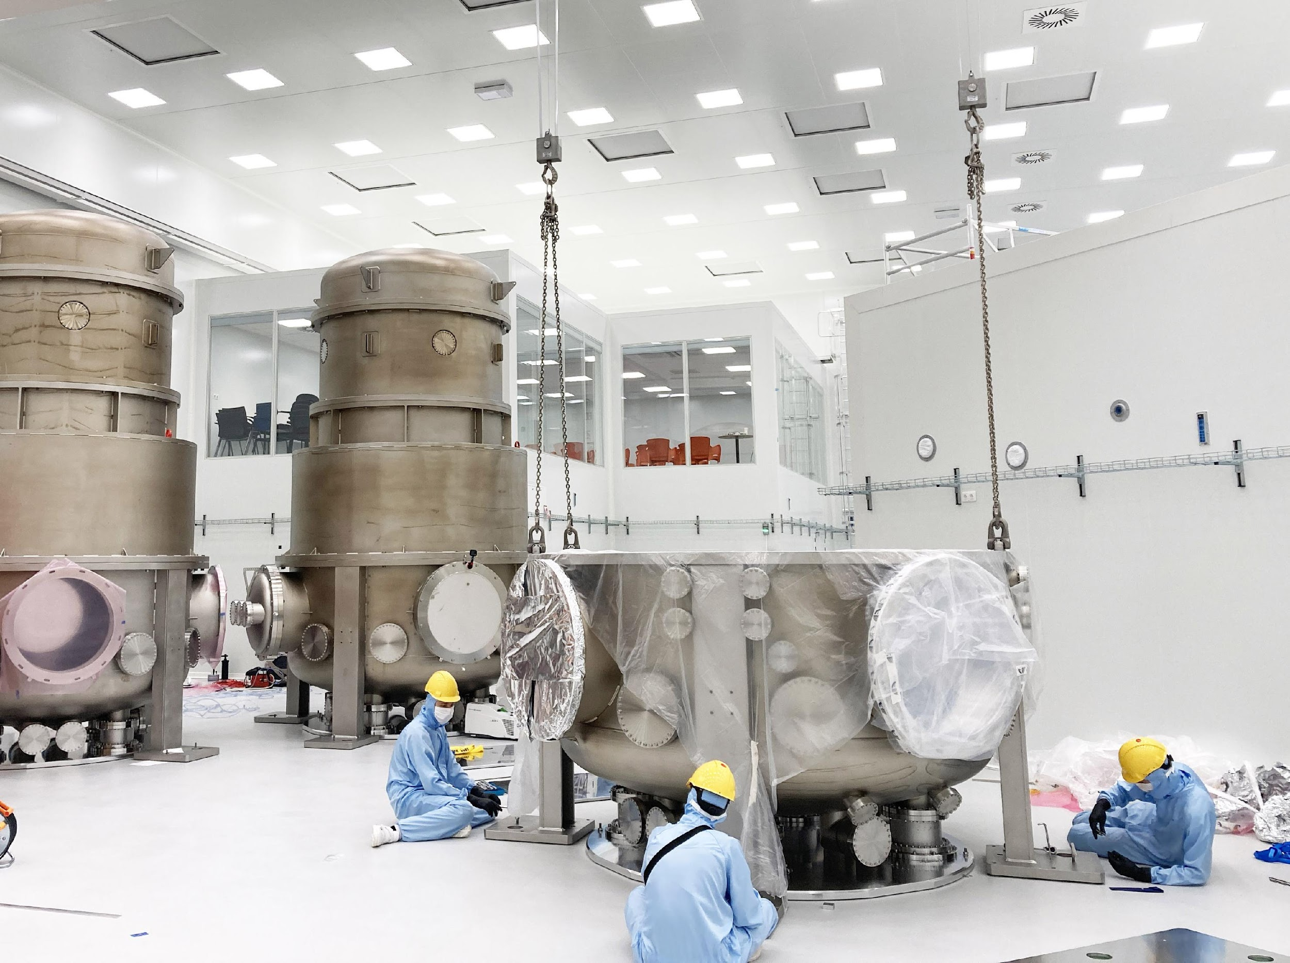
Nikhef GW programme
More than one experiment/collaboration:
Einstein Telescope
LISA
Virgo, Cascina, Italy
LIGO, Livingston, LA
ETpathfinder
KAGRA, Japan
LIGO, Hanford, WA
Present …..
….. Future

Slide 4
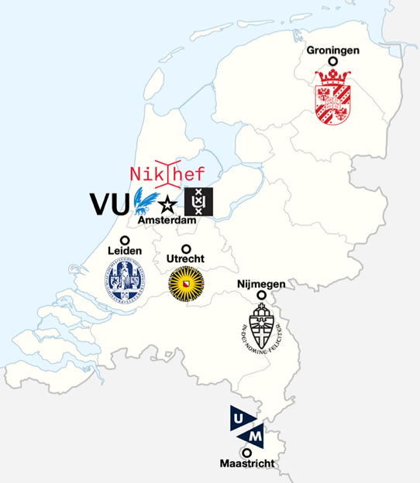
The Team
Part of the GW group at a recent Nikhef ET day
Reminder GW is one of the younger Nikhef programs (started around 15 years ago.)
GW related research carried out at all Nikhef partners (Nikhef NWO-I, VU, UvA, UU, UM, Radboud and UG).
In total about 60-70 people (excluding bachelor and master students).

Slide 5
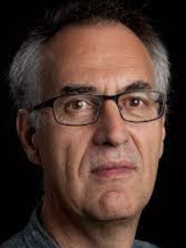
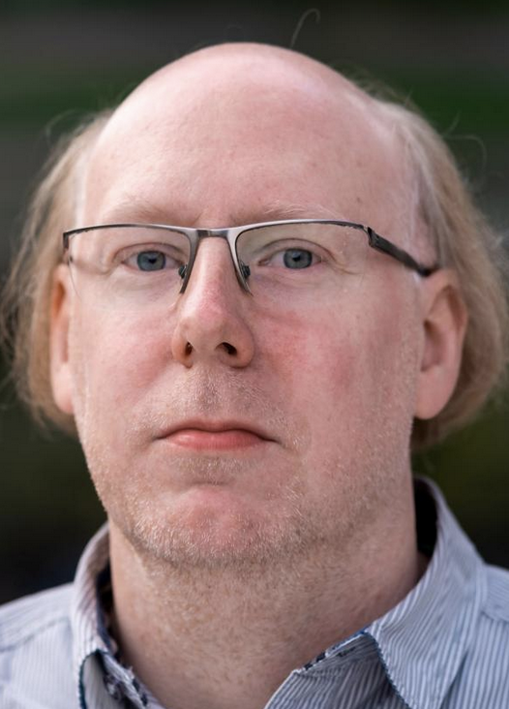
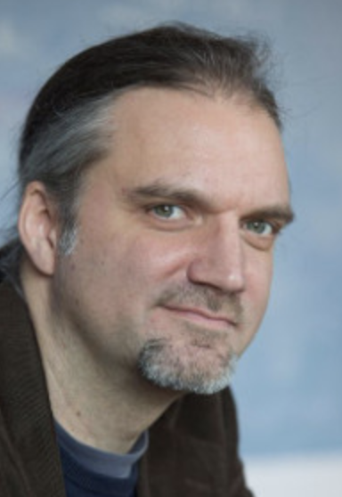
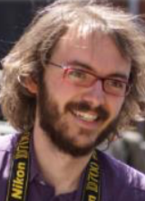
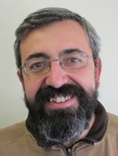
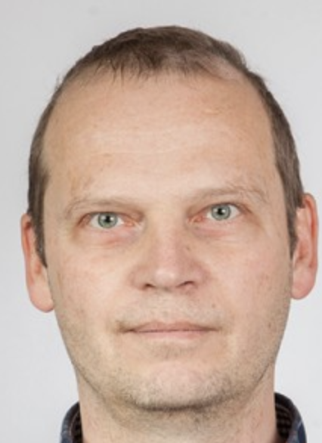
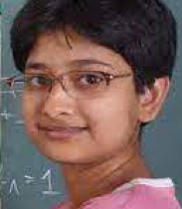
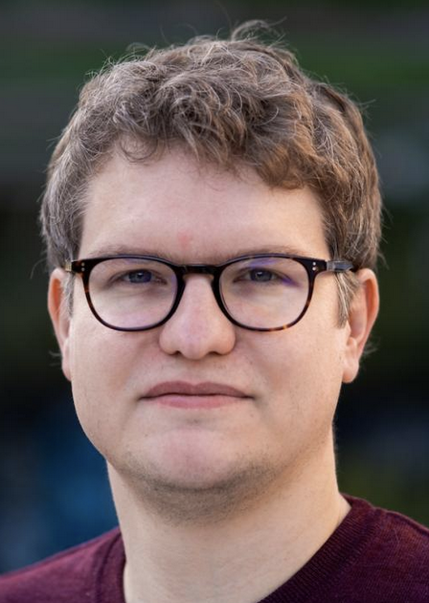
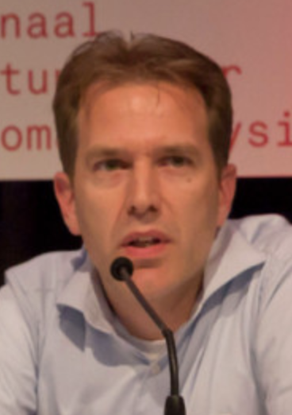
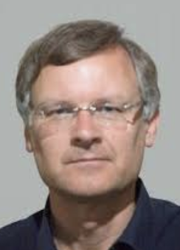
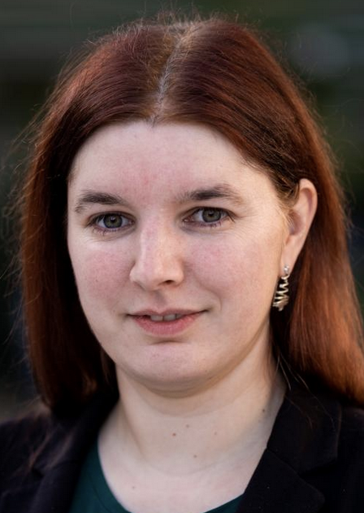
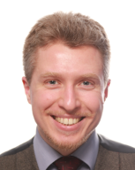
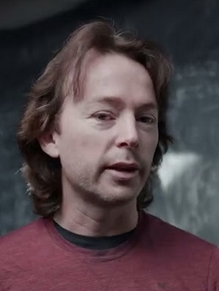
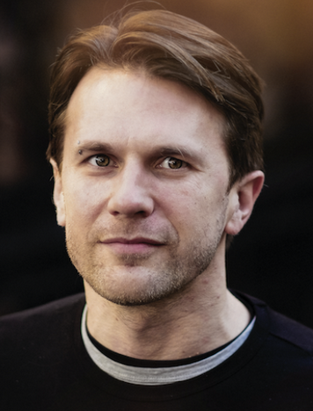
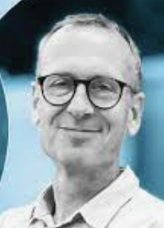
The GW Staff
Will start 5/2023
Left summer 2022
F.Linde, UvA
former program lead
S.Hild, UM
program leader
A.Freise, VU
deputy program leader
M. Tacca, Nikhef
A.Bertollini, Nikhef
H.J.Bulten, Nikhef
C.v.d.Broeck, UU
deputy program leader
A.Samajdar, UU
S.Caudill, UU
New 2022
S.Steinlechner, UM
B.Swinkels, Nikhef
P.Kuijer, Nikhef
J.Steinlechner, UM
S.Danilishin, UM
C.Mow-Lowry, VU
G.Koekoek, UM
P.Wernecke, Nikhef
S. Nissanke, UvA
M. Haney, Nikhef

Slide 6
The GW Staff
Will start 5/2023
Left summer 2022
Vidi
F.Linde, UvA
former program lead
S.Hild, UM
program leader
A.Freise, VU
deputy program leader
M. Tacca, Nikhef
A.Bertollini, Nikhef
H.J.Bulten, Nikhef
C.v.d.Broeck, UU
deputy program leader
A.Samajdar, UU
S.Caudill, UU
ET ISB co-chair
ETpathfinder PL
ET-TEchnology PI
Virgo Commissioning coordinator (until 2022)
Virgo FC manager
ET Suspension Division co-chair
ETPF, WP5 co-chair
E-TEST WP1 chair
Virgo SBmanager
ETPF, WP4 co-chair
ET director
ET OSB Division 1 co-chair
ET OSB Division 10 co-chair
Vidi
Vidi
New 2022
S.Steinlechner, UM
B.Swinkels, Nikhef
P.Kuijer, Nikhef
J.Steinlechner, UM
S.Danilishin, UM
C.Mow-Lowry, VU
G.Koekoek, UM
P.Wernecke, Nikhef
S. Nissanke, UvA
M. Haney, Nikhef
Virgo OSD manager,
ETPF, WP6 lead
ETPF, WP7 lead
ET DAQ co-chair
ETPF, WP3 lead
LIGO Optics Chair
ET Test mass co-chair
ET Interferometer Division co-chair
ET-AMN co-chair
DBHC outreach lead
Head of ET Engineering
ET OSB Division 5 co-chair
LVK waveforms co-chair

Slide 7
Diverse Activities
Program covers a wide variety of ‘traditional’ activities:
Instrumentation science (Seismic isolation, Sensors, Mirrors, Coatings, Interferometry, Controls, Vacuum, Cryogenics …)
Observational science (Data analysis, Parameter estimation, Tests of GR, Multimessenger …)
Outreach and Education

Slide 8
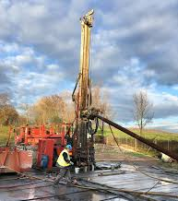
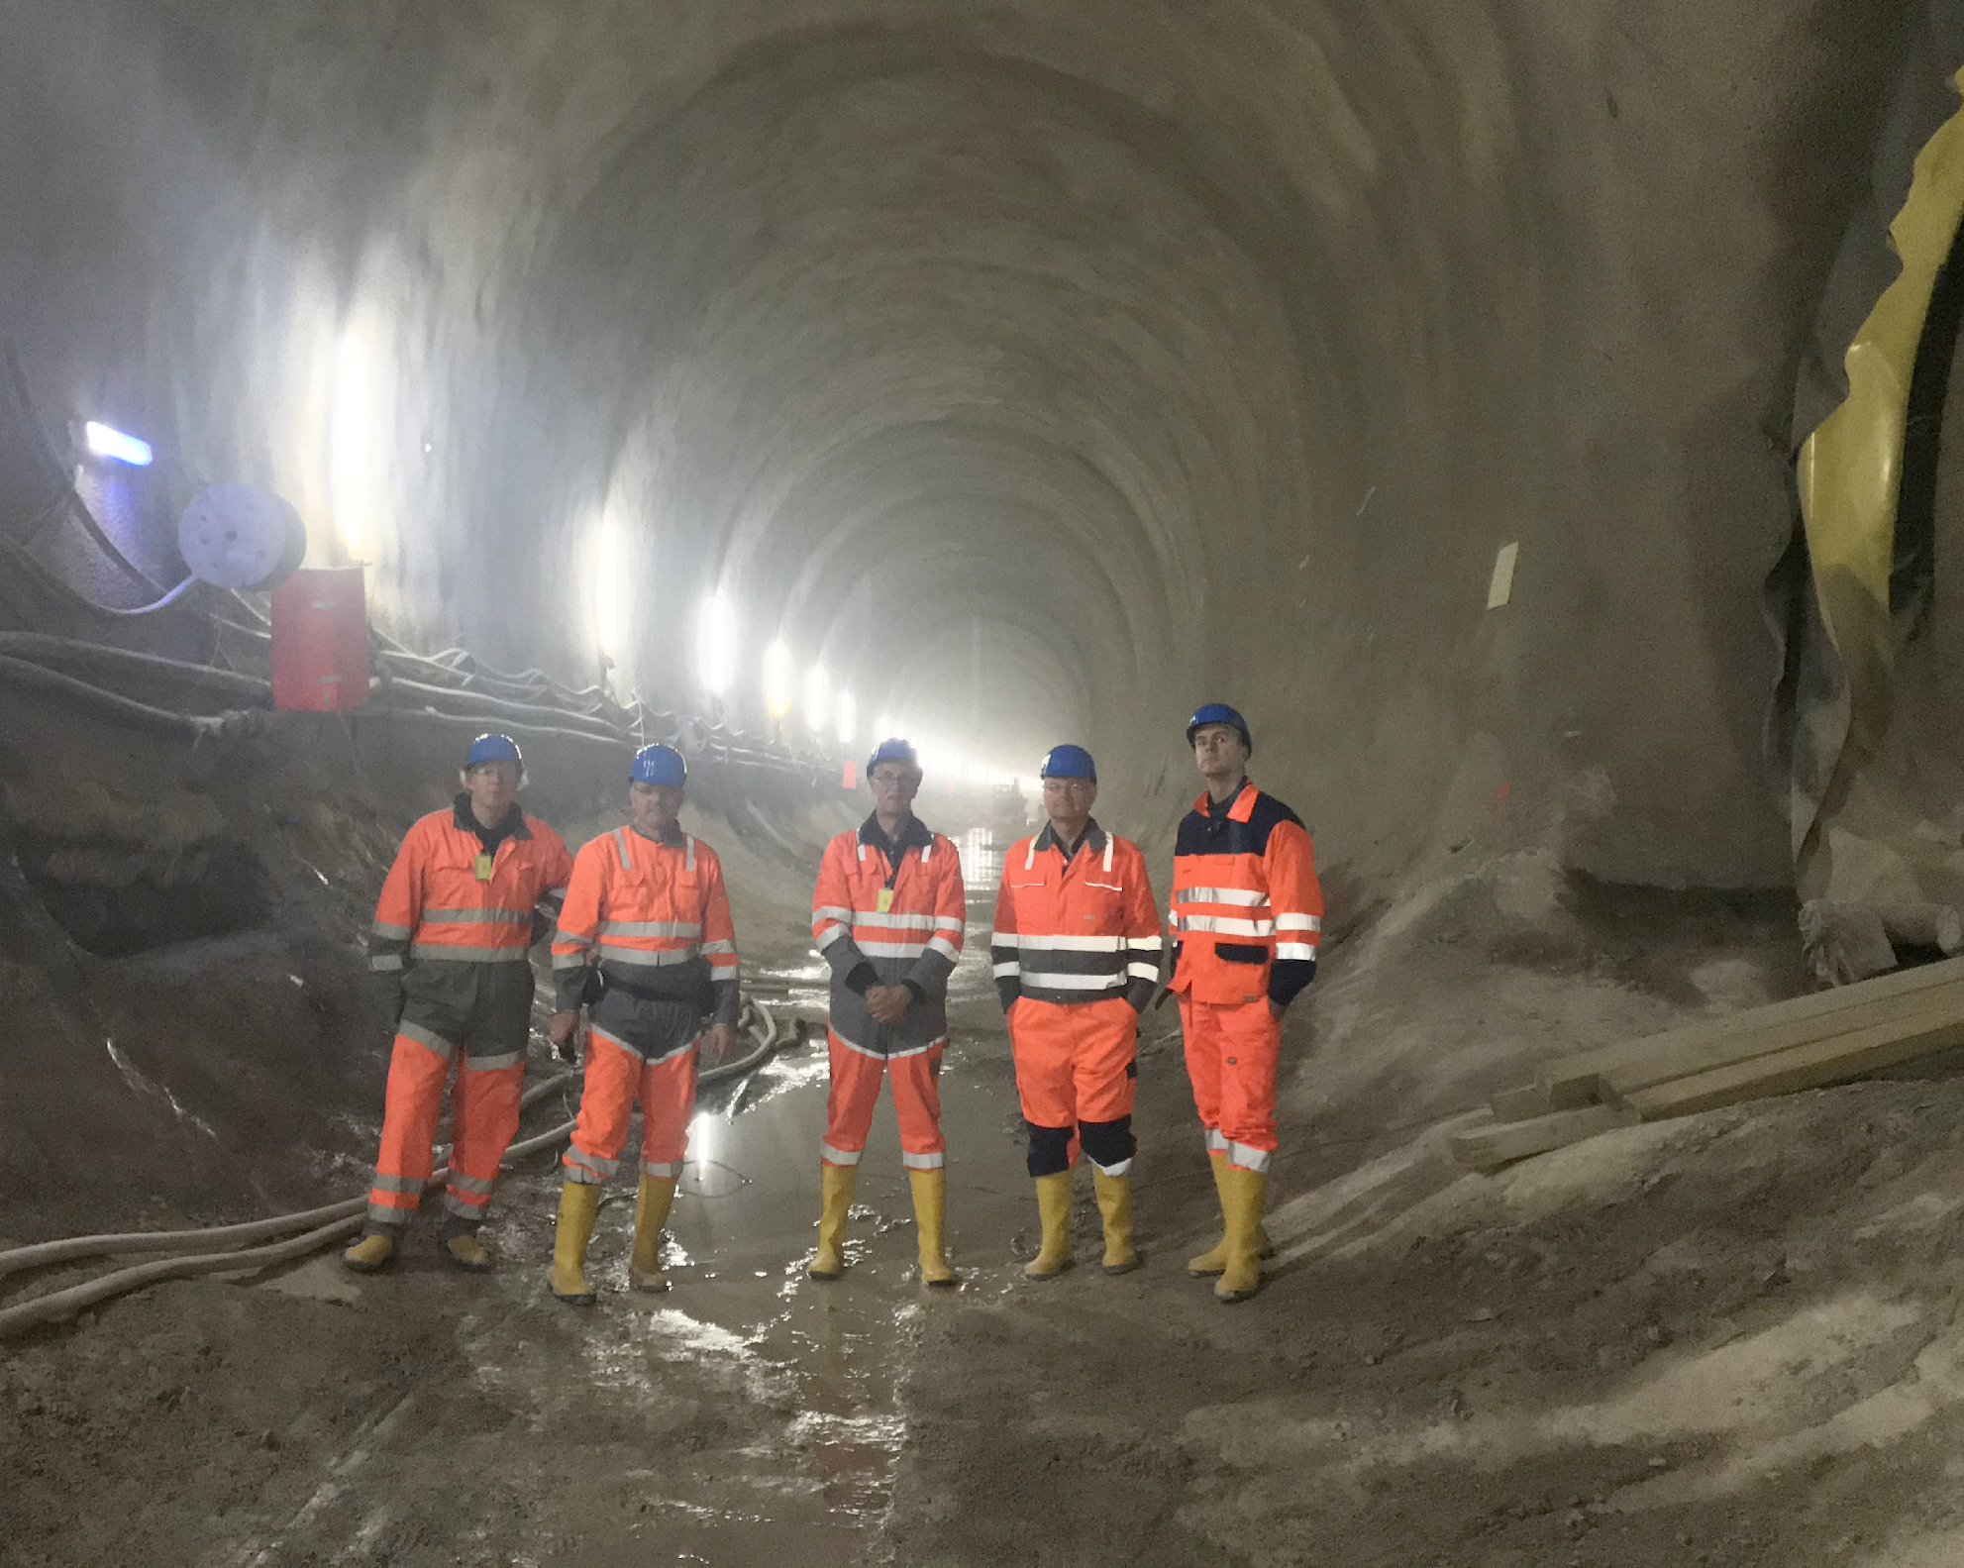
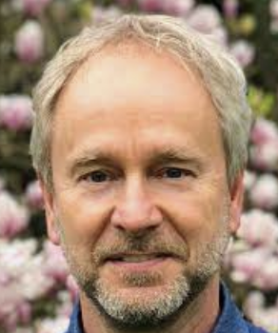
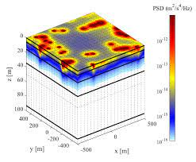
Diverse Activities
Program covers a wide variety of ‘traditional’ activities:
Instrumentation science (Seismic isolation, Sensors, Mirrors, Coatings, Interferometry, Controls, Vacuum, Cryogenics …)
Observational science (Data analysis, Parameter estimation, Tests of GR, Multimessenger …)
Outreach and Education
as well as a variety of less traditional activities:
Seismic studies, site studies, some aspects of geology, sustainability, planning/permissions, windturbines, civil engineering studies …
W.Walk, Nikhef
ET Site preparation division co-chair

Slide 10
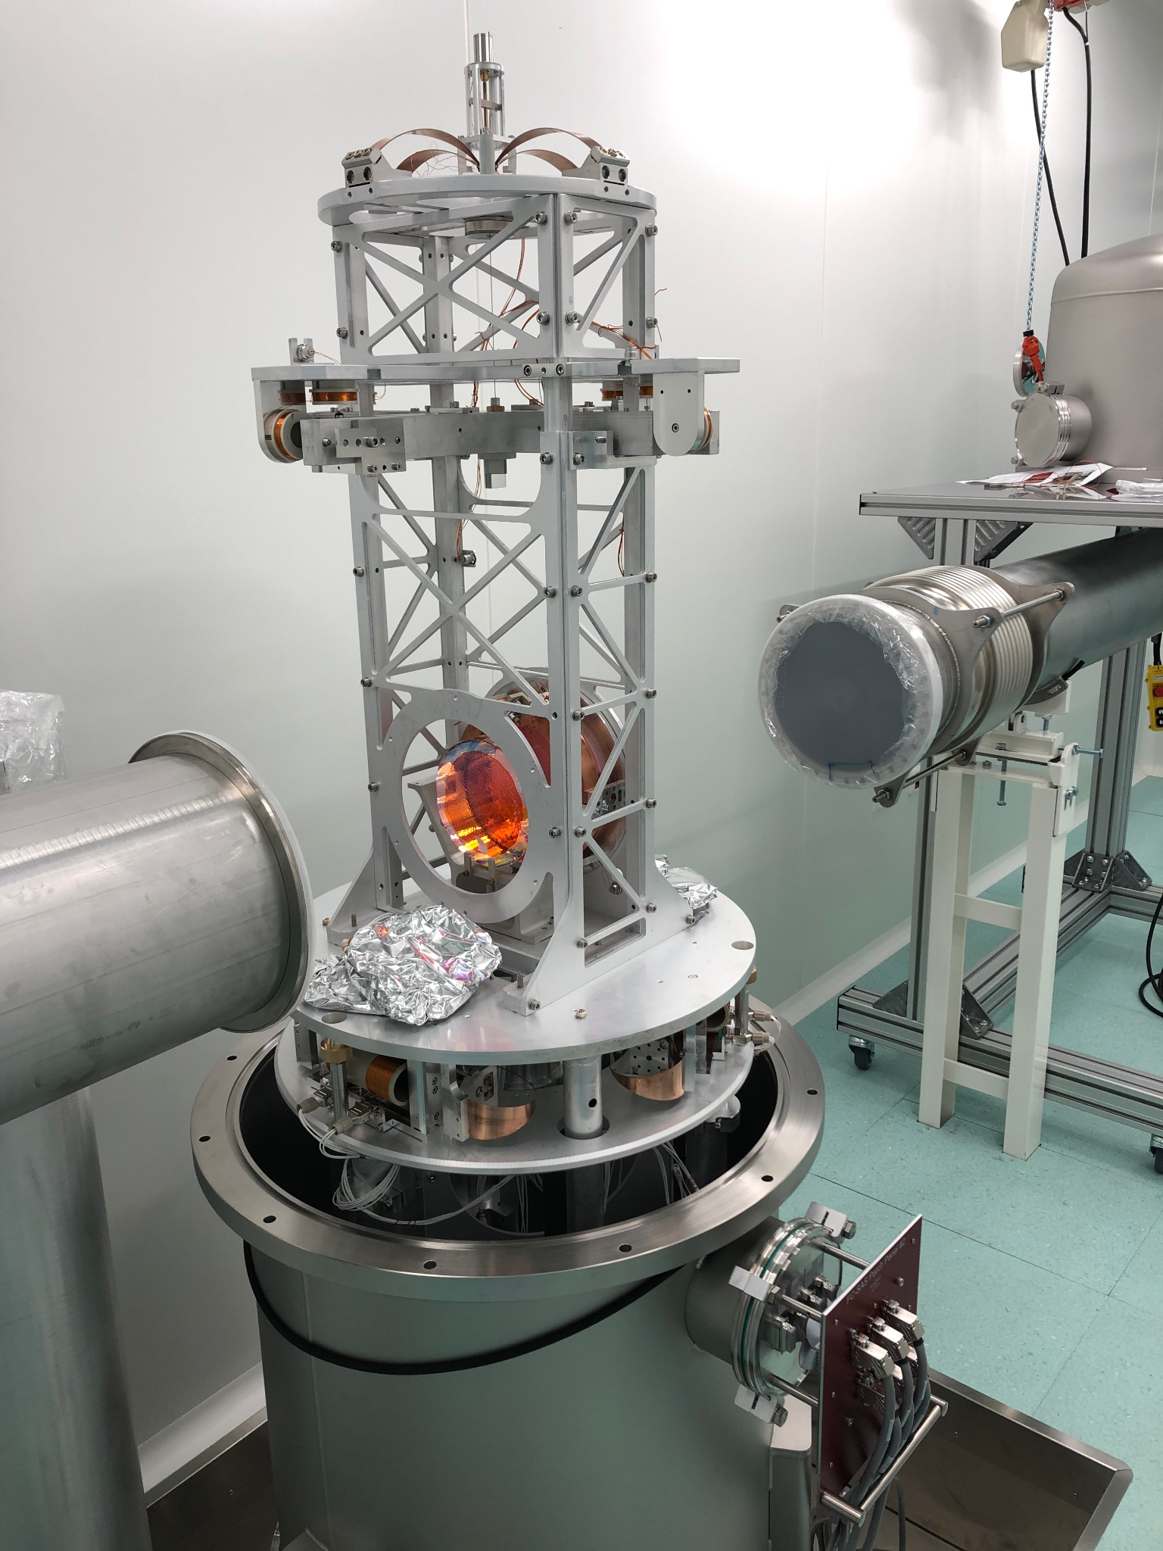
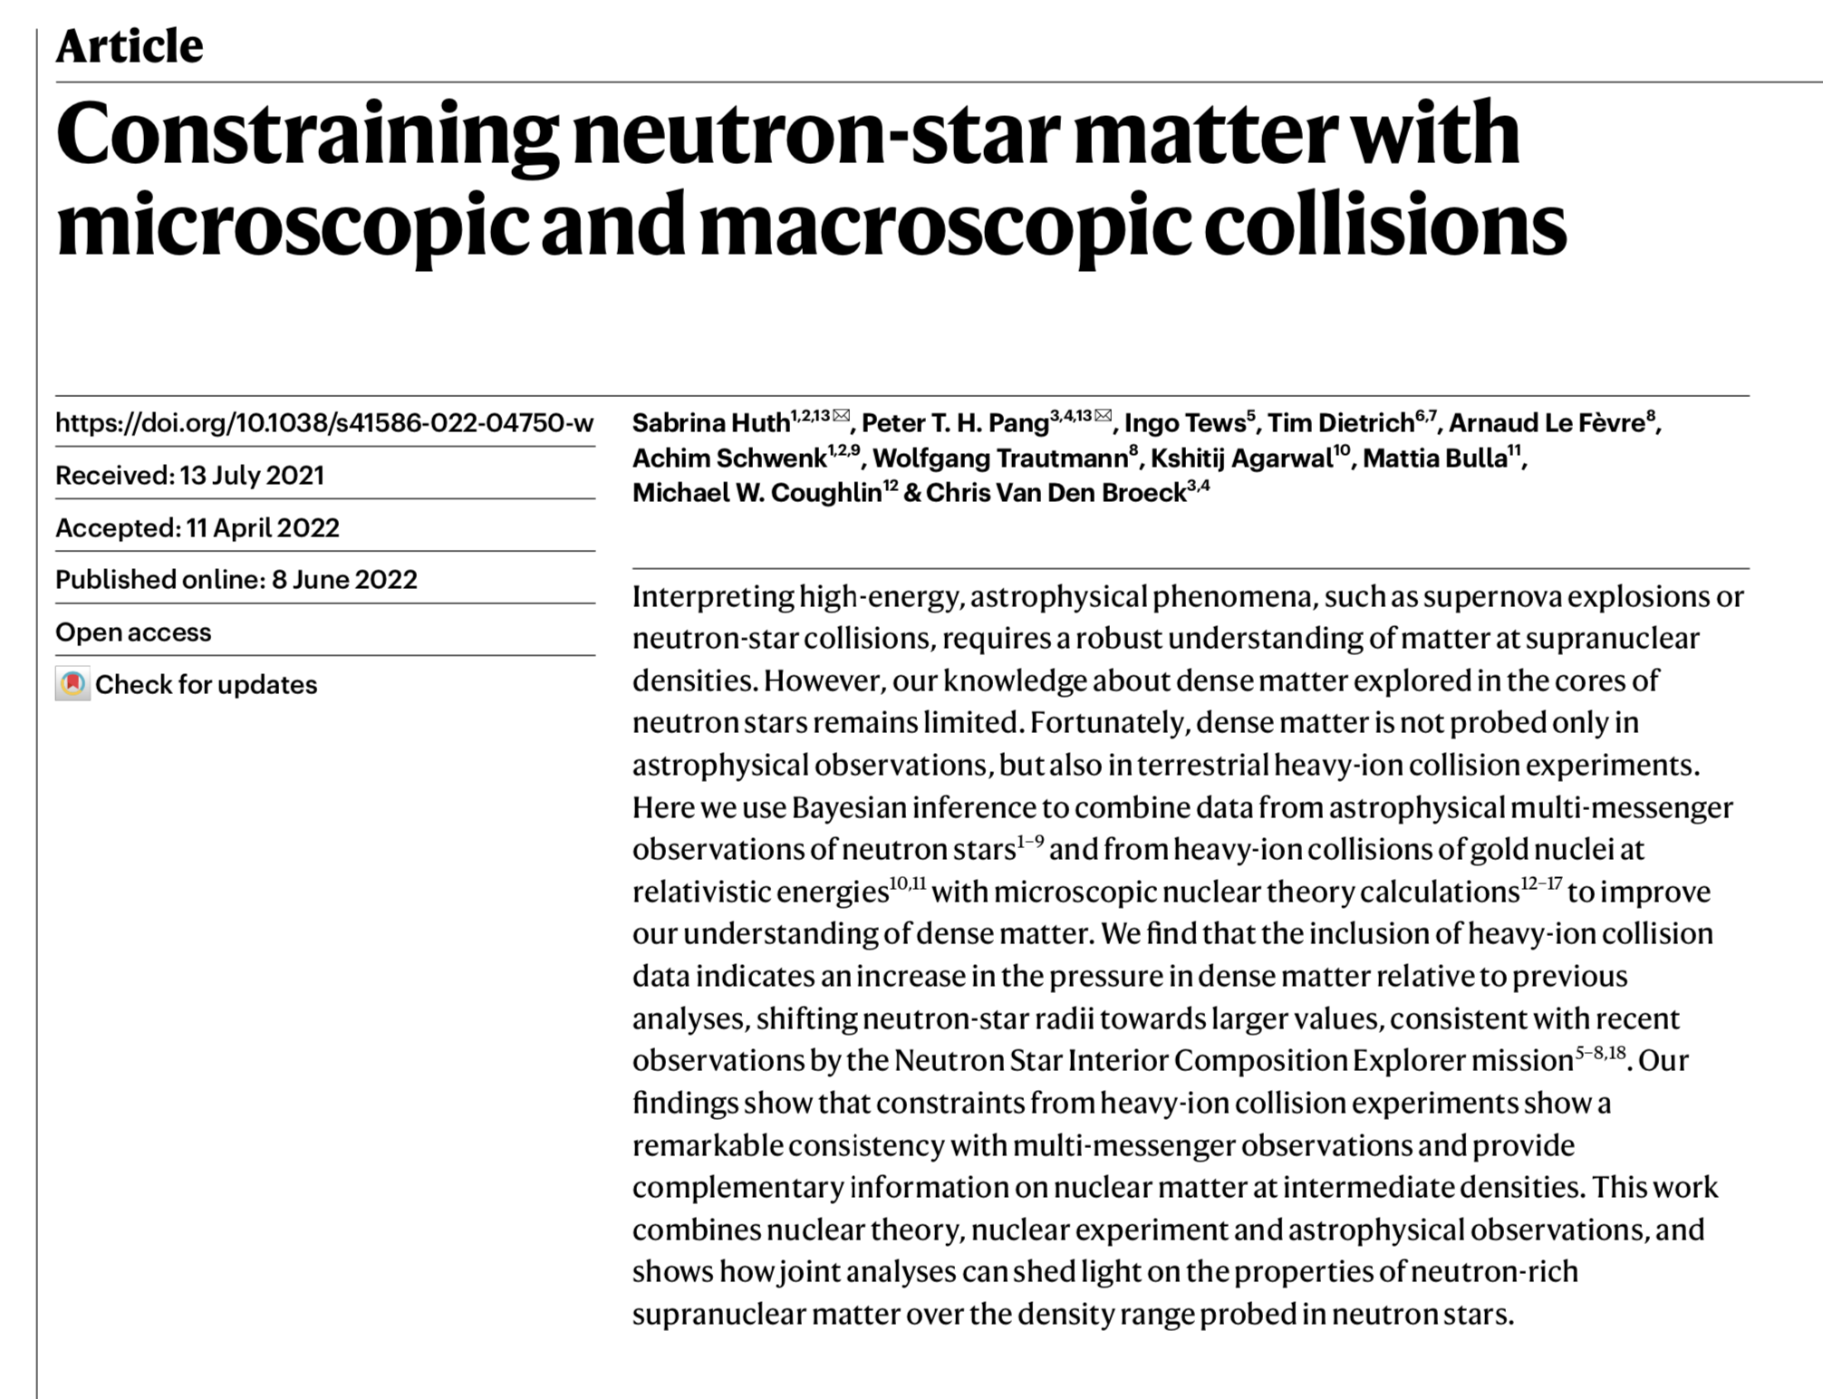
Highlights from past year
Advanced Virgo + (Phase 1 completed): Strong hardware contribution from Nikhef, i.e. filter cavity for frequency dependent squeezing.
Nikhef became third member of the European Gravitational Observatory (EGO), next to INFN and CNRS
Final O3 analyses published.
ETpathfinder came really to life!
National Growth funds approved (42+870 MEuro for ET), LISA roadmap proposal approved, ENW-XL@Utrecht for nuclear matter, next Virgo consortium grant submitted … awaiting outcome.

Slide 11
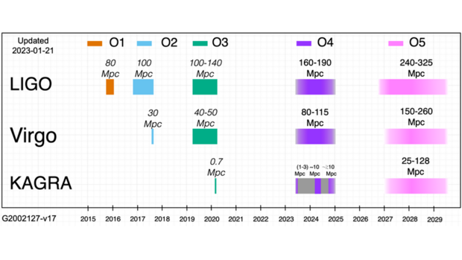
Looking forward towards the next 12+ months
O4 to starting very soon. Run extended from 12 to 18 months on request of astronomy community.
Expect many hundreds of signals!
In parallel preparation for upgrades between O4 and O5 will ramp up.
LISA hardware (see presentation from detector group) and also DA preparations underway.
Thinking about Virgo beyond 2030 has started (Nissanke co-chair of this effort).
ETpathfinder coming into full swing …
… and many other activities

Slide 12
END

