Slide 1
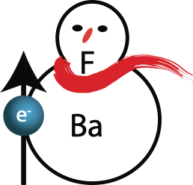
The eEDM program
Table-Top Particle Physics
Hendrick Bethlem, Anastasia Borschevsky, Steven Hoekstra (PL), Steve Jones, Rob Timmermans, Wim Ubachs, Jordy de Vries, Lorenz Willmann
UvA
Dutch National Institute for (astro)Particle Physics

Slide 2
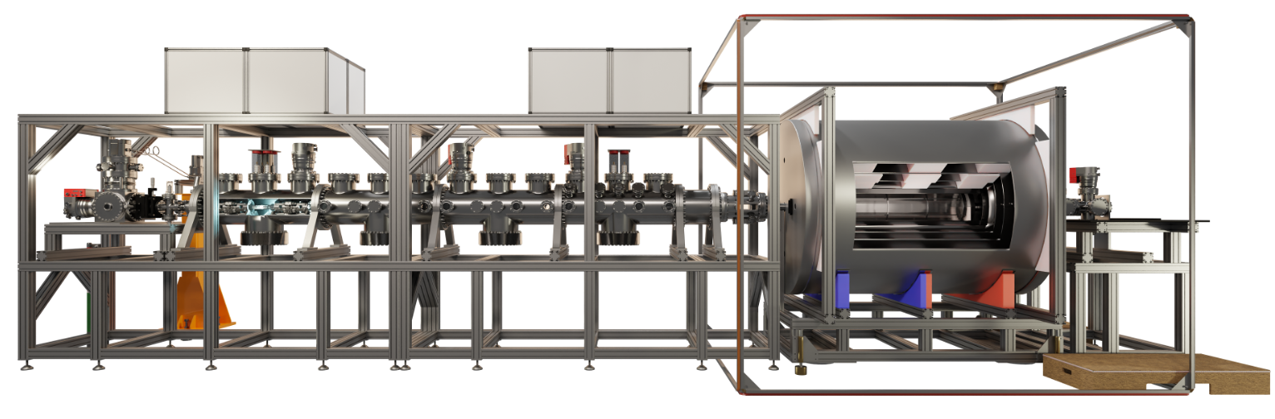
The eEDM program
Table-Top Particle Physics
Use molecular enhancement to probe the electron’s electric dipole moment
Symmetry-violating properties of fundamental particles may add minuscule but measurable shifts to the energies of molecular states
Probe physics beyond the Standard Model of particle physics
Pulsed
Molecular
Beam

Slide 3
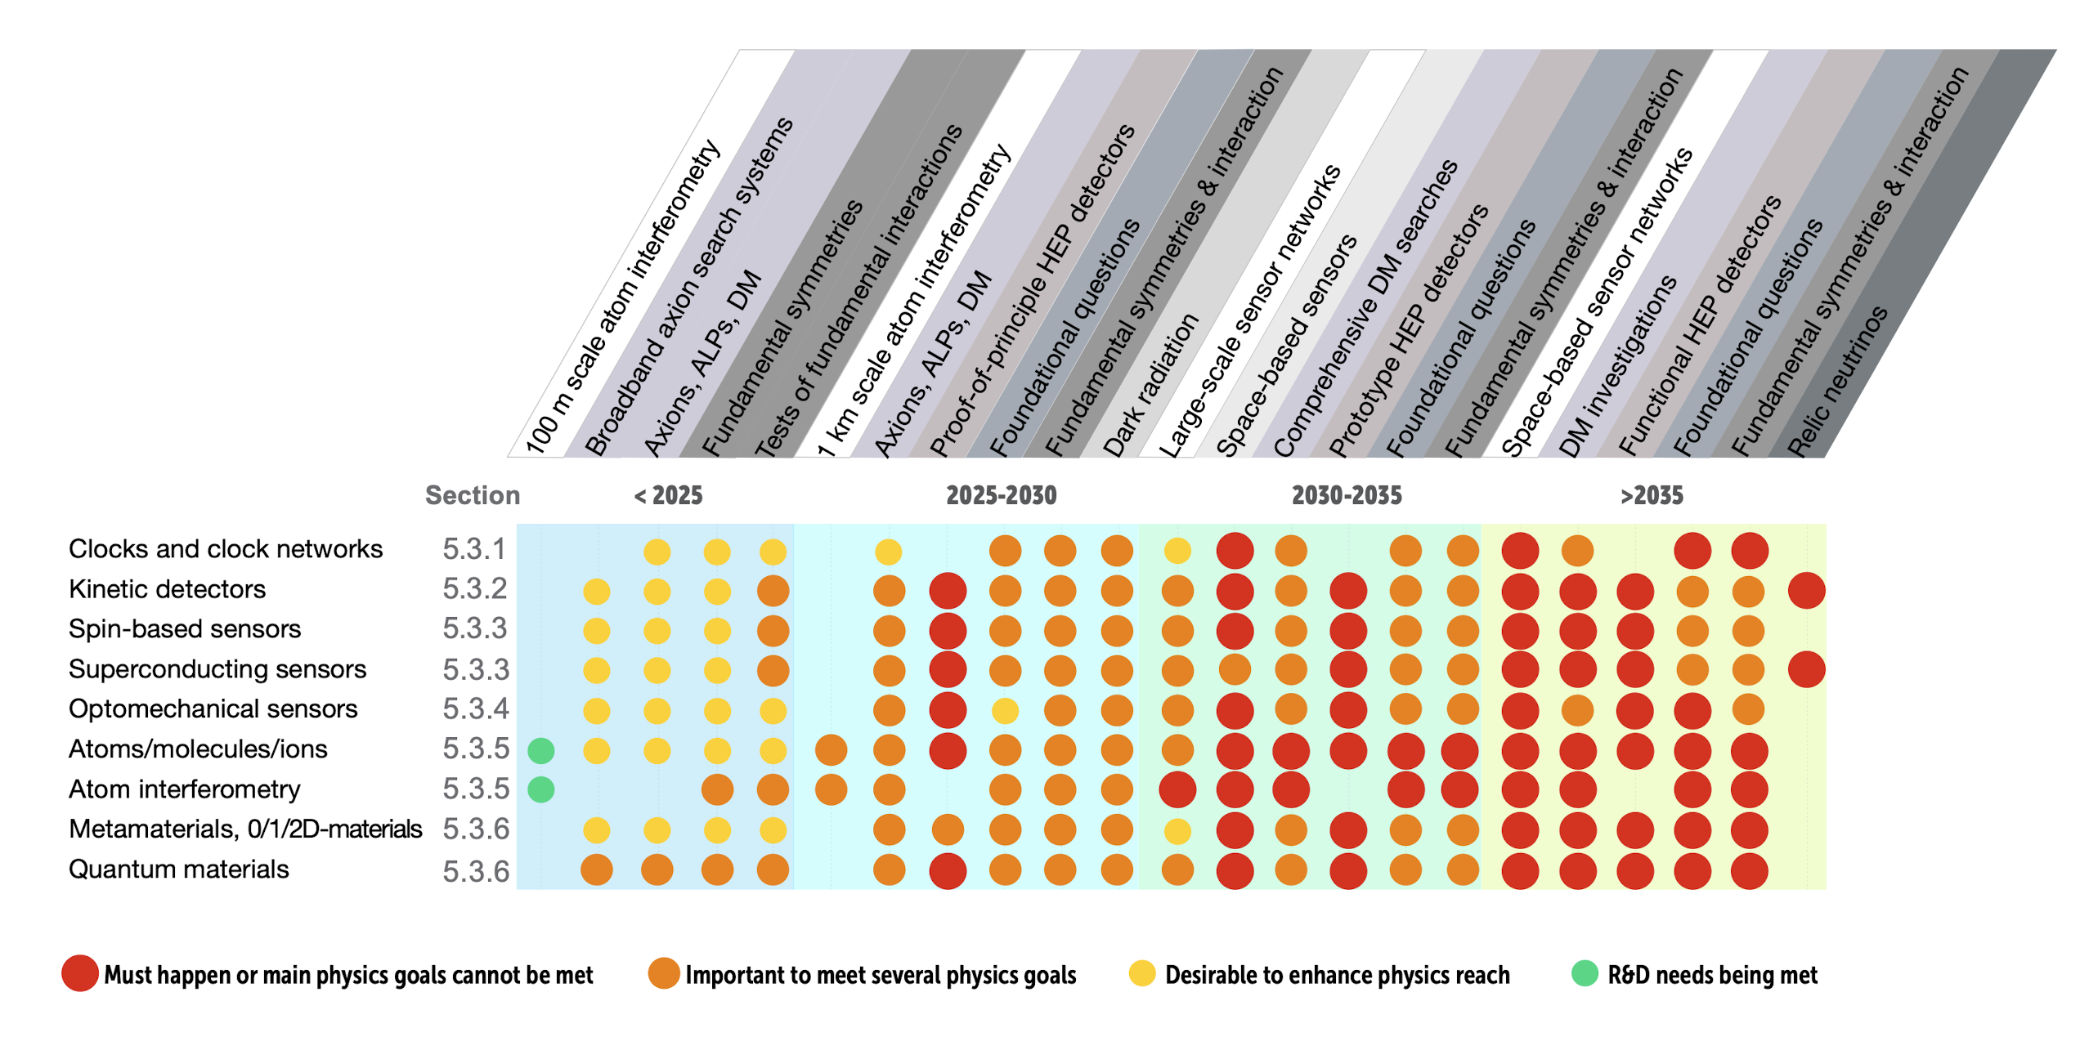
Context
ECFA detector R&D Roadmap - RDq: Quantum and Emerging Technologies
Precision experiments using atoms, ions and molecules are part of larger framework of low-energy table-top particle physics
Impact recognised, rapidly growing field, requires investments now
Nikhef can play a significant role!
2021 ECFA DETECTOR
R&D ROADMAP

Slide 4
Status: people and funding
Funding
First NWO program came to an end
Successful with ENW-XL (2.7 M€), M2 (700 k€) and VICI (1.5 M€) grants
Mostly for PhD students and postdocs, limited investment in equipment
Staff changes
Jordy de Vries (UvA) joined: particle physics theory
Steve Jones (VSI Groningen) joined: antihydrogen precision table-top particle physics
Klaus Jungmann retired
PhD students - transition to a next generation
(3 finished, 4 will finish this year, 1 ongoing, 4 new hires, 6 open positions)

Slide 5
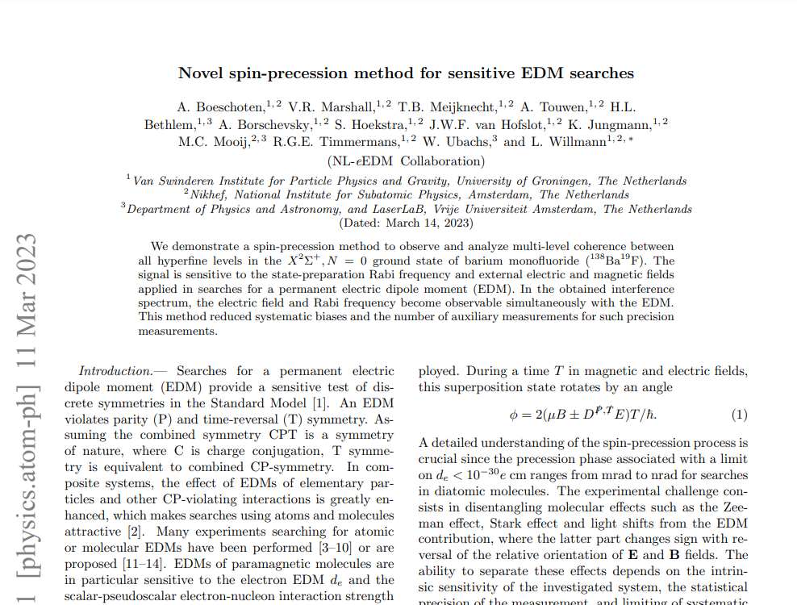
Status: the experiment
Two fronts
Spin-precession measurements
All key elements in place
600 m/s BaF molecular beam
First measurements successfully done, key publication submitted
Bright and slow beam
Intense cryogenic 200 m/s beam operational, meets all specifications
Some hardware setbacks: laser issues, high-voltage electronics. All resolved now - but shows crucial role of technical support for this in-house experiment
Last year
Next year
Larger datasets -> first eEDM limit
Demonstrate control of systematics
Combine with transverse laser cooling (all systems currently operational)
Quantify and optimise brightness of 200 m/s beam
Demonstrate 30 m/s BaF beam

Slide 6
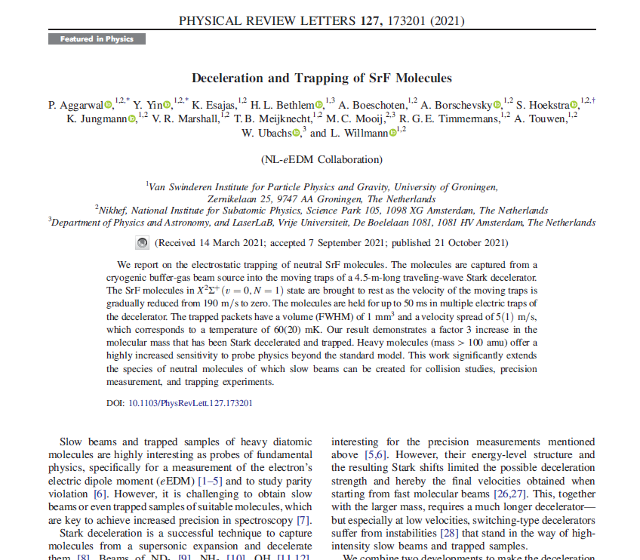
Status: the experiment
Two fronts
Spin-precession measurements
All key elements in place
600 m/s BaF molecular beam
First measurements successfully done, key publication submitted
Bright and slow beam
Intense cryogenic 200 m/s beam operational, meets all specifications
Some hardware setbacks: laser issues, high-voltage electronics. All resolved now - but shows crucial role of technical support for this in-house experiment
Last year
Next year
Larger datasets -> first eEDM limit
Demonstrate control of systematics
Combine with transverse laser cooling (all systems currently operational)
Quantify and optimise brightness of 200 m/s beam
Demonstrate 30 m/s BaF beam

Slide 7
Status: the experiment
Two fronts
Spin-precession measurements
All key elements in place
600 m/s BaF molecular beam
First measurements successfully done, key publication submitted
Bright and slow beam
Intense cryogenic 200 m/s beam operational, meets all specifications
Some hardware setbacks: laser issues, high-voltage electronics. All resolved now - but shows crucial role of technical support for this in-house experiment
Last year
Next year
Larger datasets -> first eEDM limit
Demonstrate control of systematics
Combine with transverse laser cooling (all systems currently operational)
Quantify and optimise brightness of 200 m/s beam
Demonstrate 30 m/s BaF beam

Slide 8
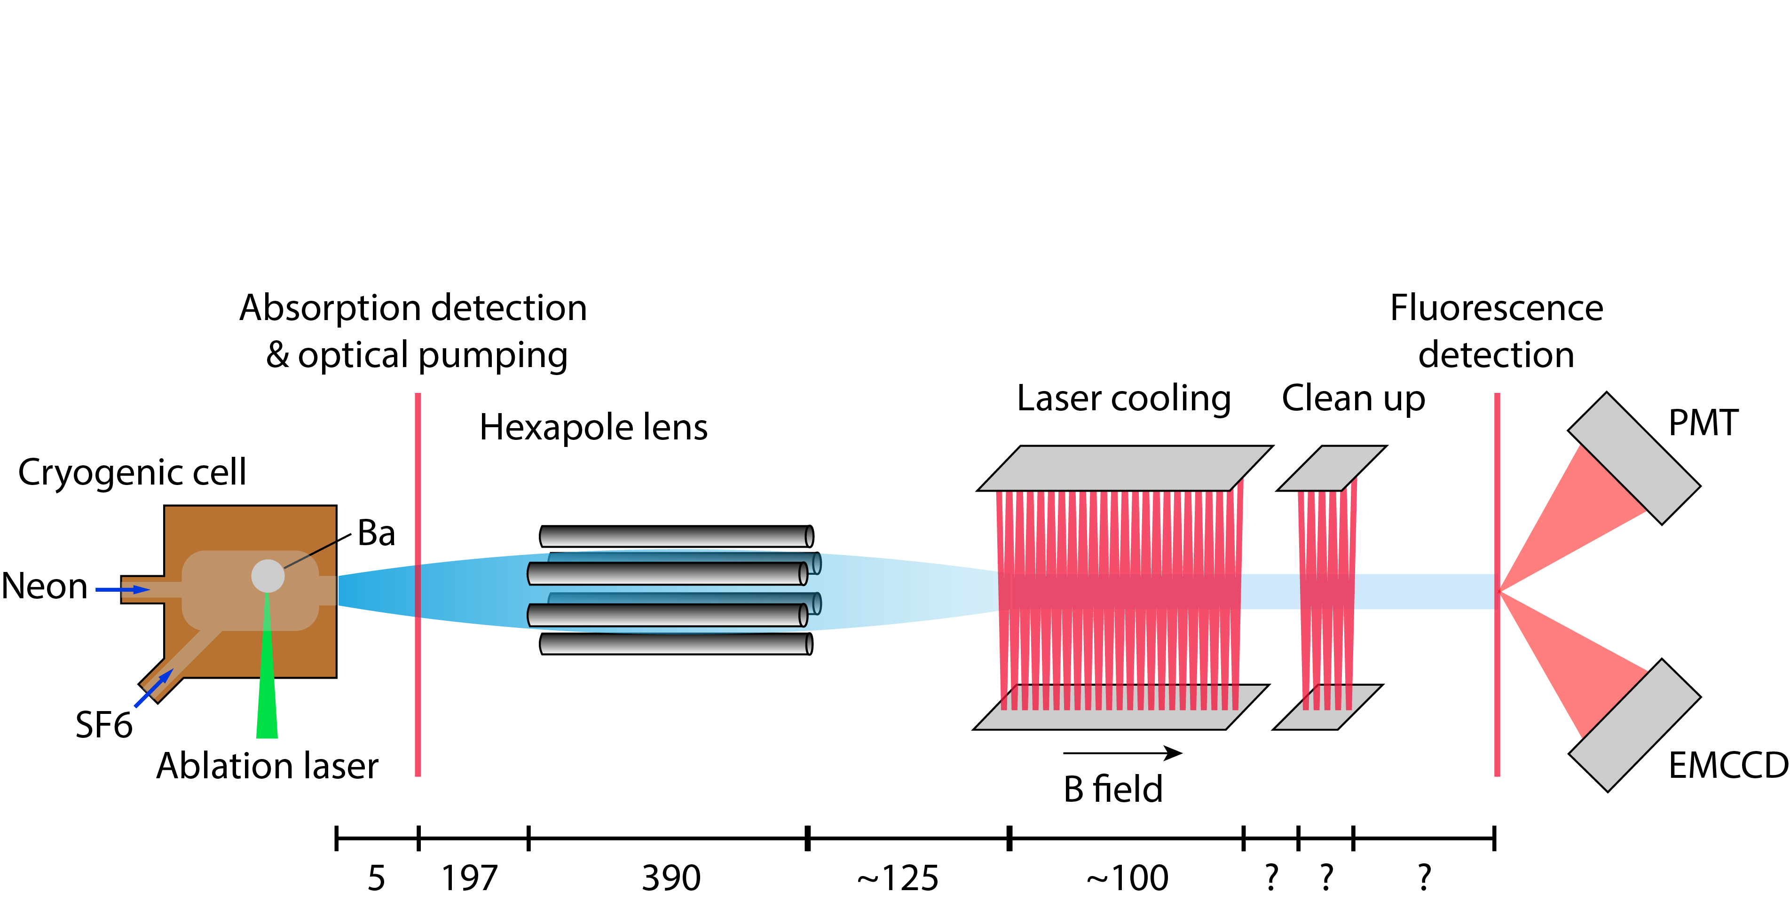
Status: the experiment
Two fronts
Spin-precession measurements
All key elements in place
600 m/s BaF molecular beam
First measurements successfully done, key publication submitted
Bright and slow beam
Intense cryogenic 200 m/s beam operational, meets all specifications
Some hardware setbacks: laser issues, high-voltage electronics. All resolved now - but shows crucial role of technical support for this in-house experiment
Last year
Next year
Larger datasets -> first eEDM limit
Demonstrate control of systematics
Combine with transverse laser cooling (all systems currently operational)
Quantify and optimise brightness of 200 m/s beam
Demonstrate 30 m/s BaF beam

Slide 9
Status: preparing for a move
Merge the two fronts
Move to new lab space
New building for faculty of science and engineering in Groningen
Make use of this deadline: key moment to implement spin-precession measurement of 200 m/s BaF molecules
Will take time and resources
Q2 2024

Slide 10
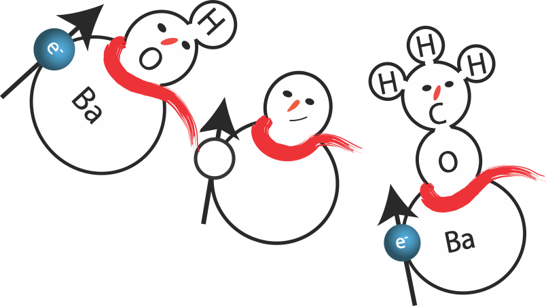
Status: theory
Two fronts
Effective field theories
Rob Timmermans, Jordy de Vries
Make more connections between eEDM and high-energy observables through effective field theories
Ab-initio quantum structure
Anastasia Borschevsky
Enhancement factors, state lifetimes, behaviour in external fields, and discovery of even better molecules for future experiments

Slide 11
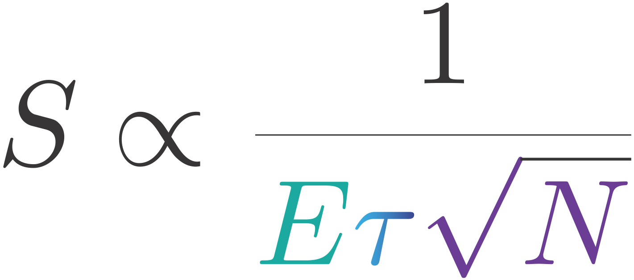
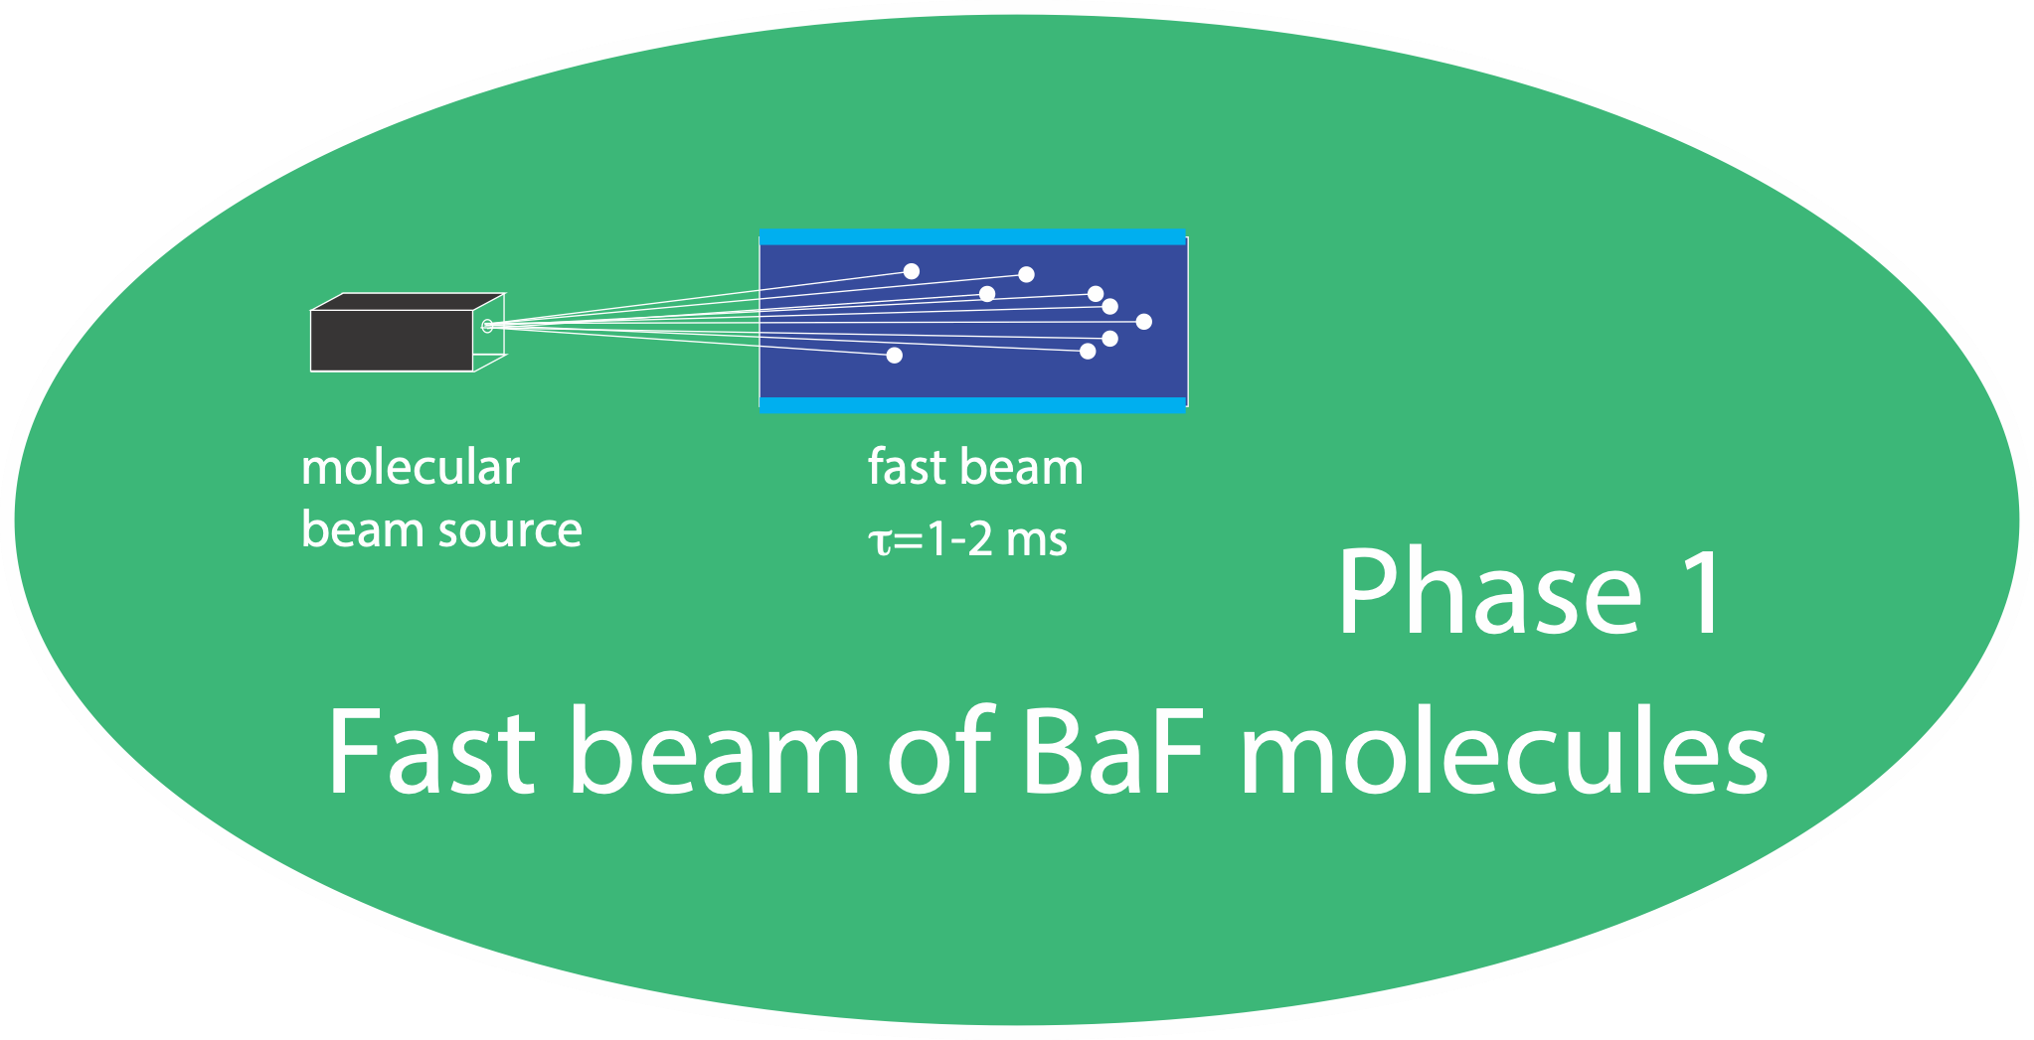
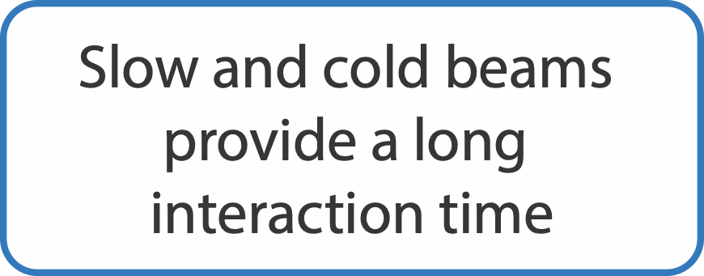
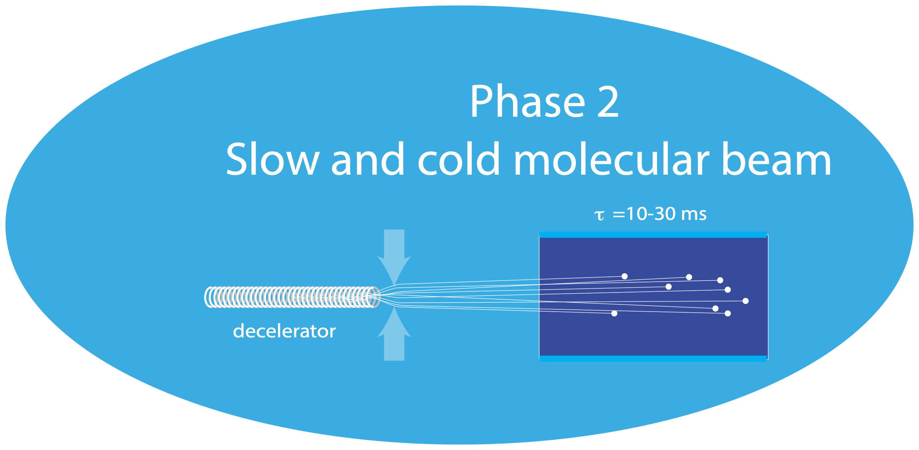
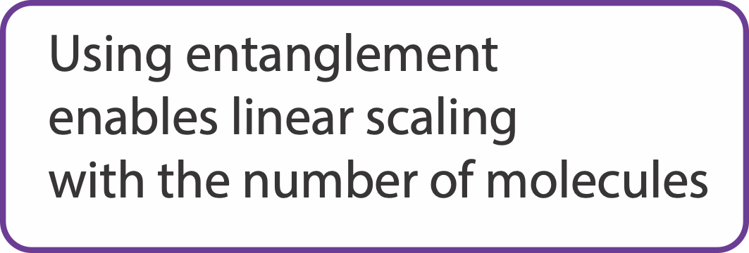
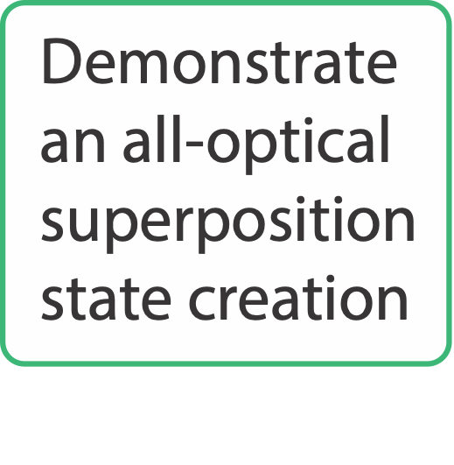
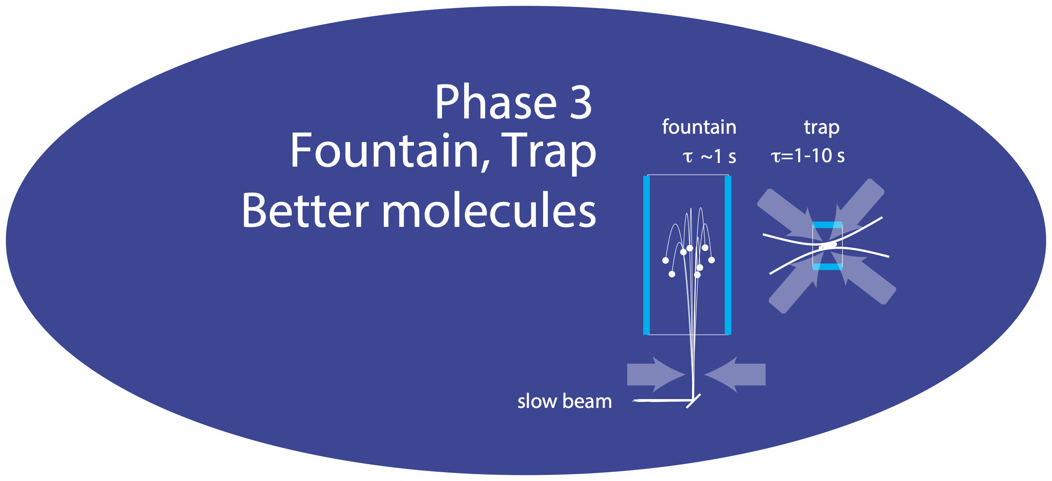
The VISTA for our program
Looking further ahead
Current best limit: 4$×{10}^{−30}e.cm (Roussy et al.arXiv:2212.11841)$
2017-2023
NWO program
$$3×{10}^{−28}e.cm$$
2023-2028
ENW-XL
$$3×{10}^{−30}e.cm$$
2023-2028
ENW-XL, M2 and VICI
$$1×{10}^{−31}e.cm$$
2025-2035
$$1×{10}^{−32}e.cm$$

Slide 12
Key points
eEDM: table-top particle-physics, within growing field
Nikhef inhouse experiment
Unique experimental infrastructure combined with strong theory component
Funding situation currently excellent
Mainly for junior scientists
Technical support of experiment remains crucial
Clear future plans
Plan move to new lab well to minimise delays

