Slide 1
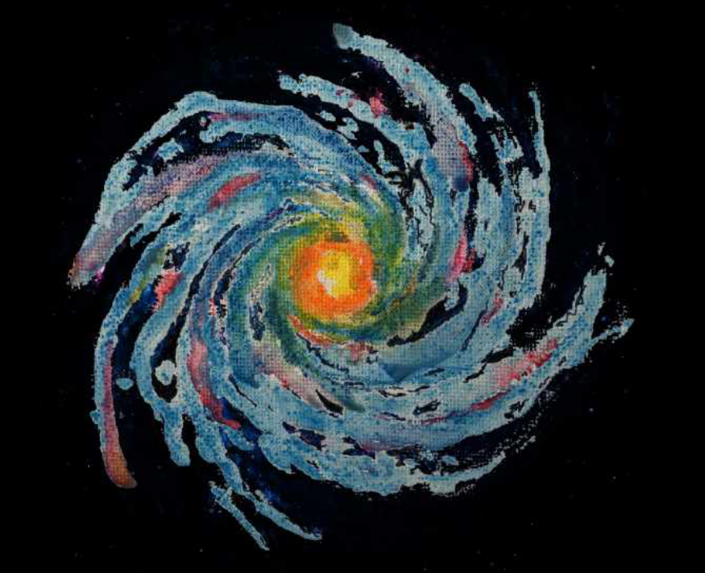
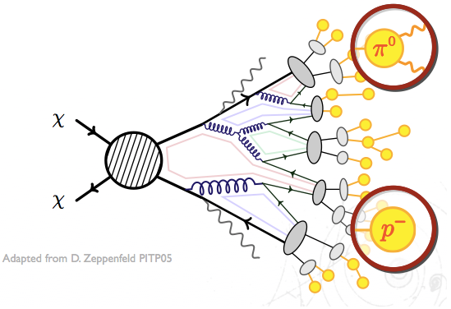
Pedro de la Torre Luque
pedro.delatorreluque@fysik.su.se
CR anti-nuclei predictions and their detectability in the next years
χ
q
q
χ
Celebrating 10 years of GRAPPA – 3/07/2023

Slide 2
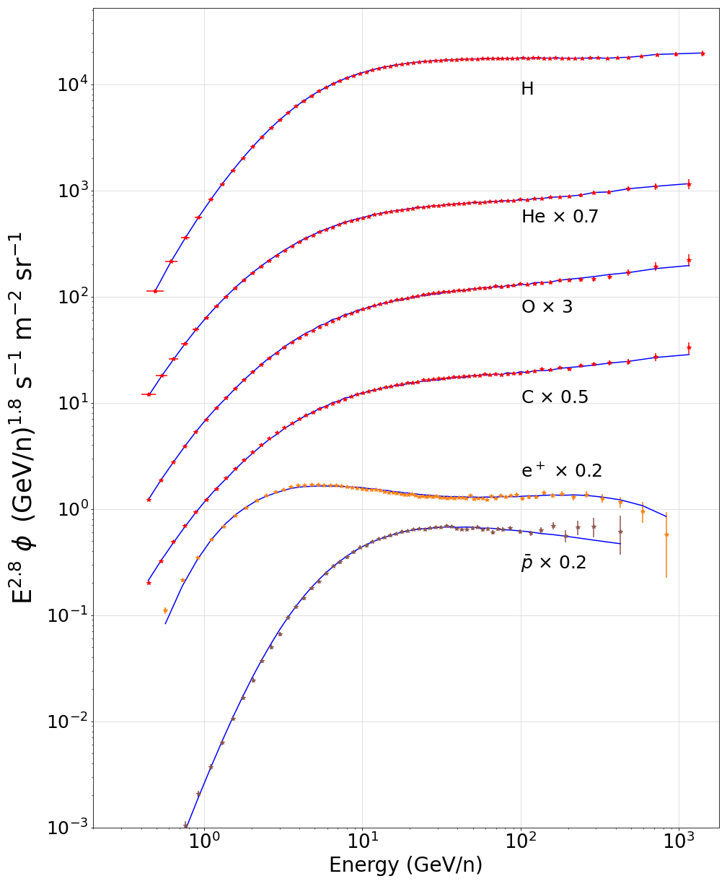
Potential of antiparticles to reveal the existence of BSM physics
Flux of CR nuclei and antiparticles (data from AMS-02)
High precision data for the fluxes of CR nuclei allow us to accurately model the production of CR antiparticles and uncertainties related.
The antiproton spectrum allows us to strongly constrain the existence of BSM physics due to the expected low production and uncertainty in their modelling.
Specially, well motivated WIMPs ($M_{χ}\sim O(100 GeV)$) are expected to leave imprints in the GeV energy region.
$$CR$$

Slide 3
Potential of antiparticles to reveal the existence of BSM physics
Flux of CR nuclei and antiparticles (data from AMS-02)
High precision data for the fluxes of CR nuclei allow us to accurately model the production of CR antiparticles and uncertainties related.
The antiproton spectrum allows us to strongly constrain the existence of BSM physics due to the expected low production and uncertainty in their modelling.
Specially, well motivated WIMPs ($M_{χ}\sim O(100 GeV)$) are expected to leave imprints in the GeV energy region.
$$CR$$
χ
q
χ
q

Slide 4
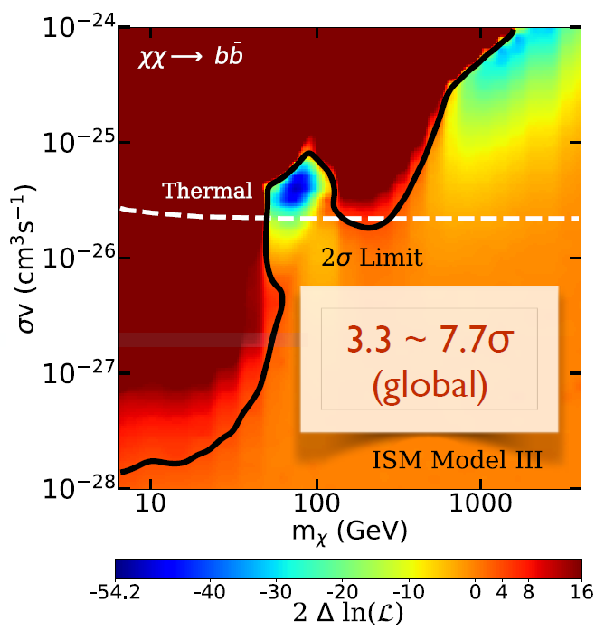
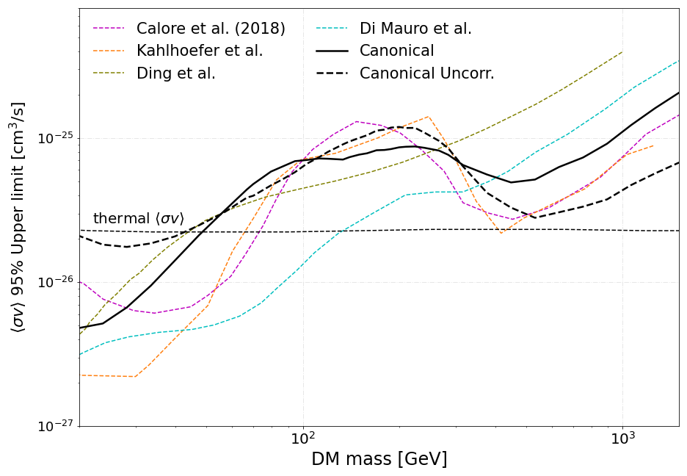
Dark matter bounds from antiproton analyses
Hooper, Cholis, Linden 2019
No excess found in the latest p analyses
Detailed DM searches found different sources of uncertainties difficult to avoid in our current studies: Cross sections, AMS-02 correlated errors, diffusion process …
(bb channel)
P.D.L. et al, in preparation
Notes:
Leaving clear that is not easy at all to identify DM signals in the antiproton spectrum

Slide 5
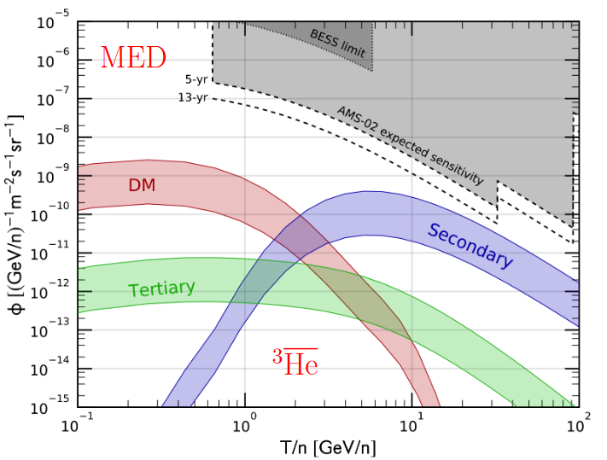
The window to prove (or disprove) many possible astrophysical excesses
Anti-nuclei as the dark matter smoking gun
For kinematical reasons, the production of anti-nuclei from CR interactions is not important at energies below the GeV, offering a clear way to spot the production of anti-nuclei from dark matter (at least for masses below ~hundreds of GeV)
Secondary anti-nuclei produced from homologous interactions as for p, but highly suppressed (due to coalescence)!
M. Korsmeier+ (2018) PRD97, 103011

Slide 6
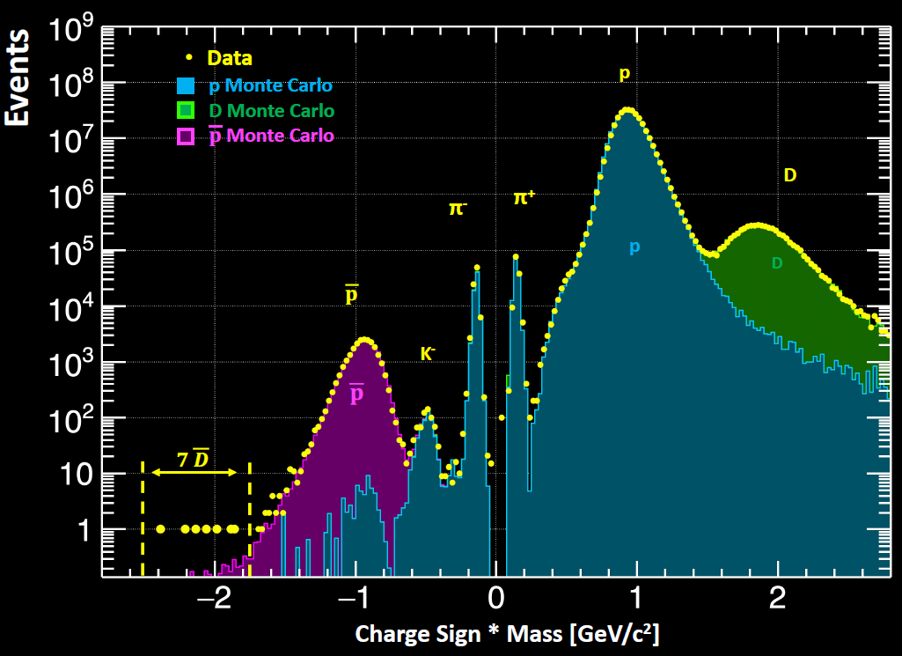
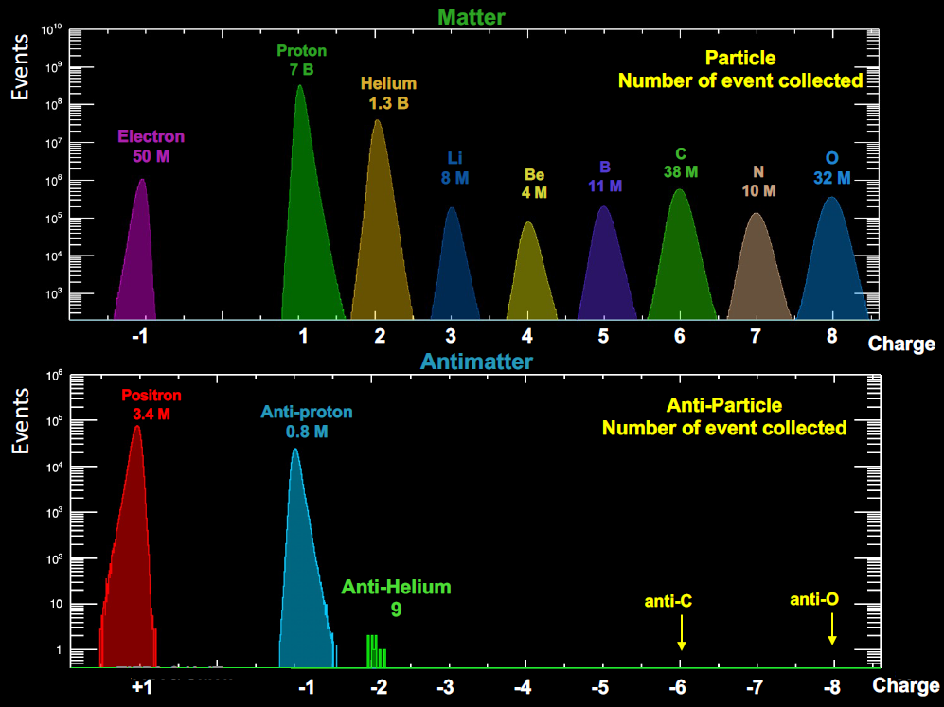
ANTI-NUCLEI: AMS-02 mass-charge spectra
Paolo Zuccon MIAPP 2021

Slide 7
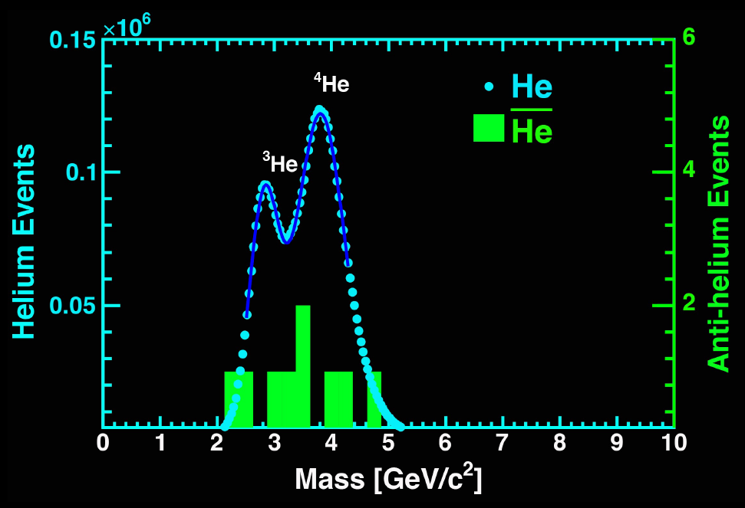
ANTI-NUCLEI: AMS-02 mass-charge spectra
Paolo Zuccon MIAPP 2021

Slide 8
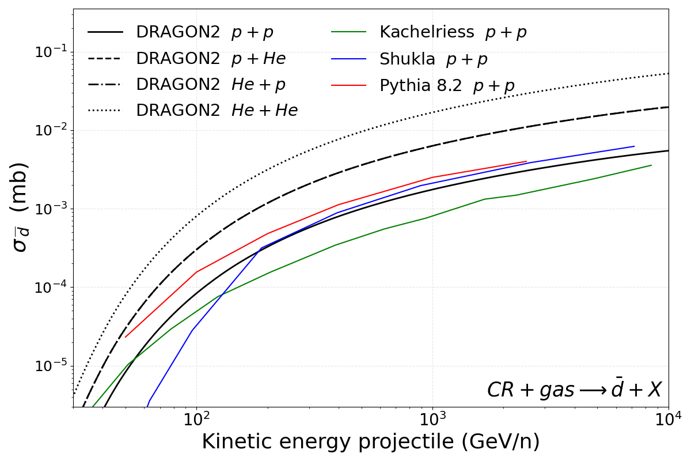
Propagation setup
Propagation code: github.com/tospines/Customised-DRAGON-versions/Custom_DRAGON2_v2-Antinuclei/
Implementation of anti-nuclei dark matter and secondary production in DRAGON2
Cross sections derived from analytical coalescence model. Using fits of antiproton (antineutron) production from Winkler, JCAP 02, 048 (2017)
DM spectrum at production derived from Pythia 8.2 simulating a neutral colorless resonance. Space and momentum (p_{c}) conditions for coalescence. Also including production from anti-hyperons
Inelastic cross sections and tertiary production computed extrapolating antiproton parametrizations
P.D.L. et al, in preparation

Slide 9
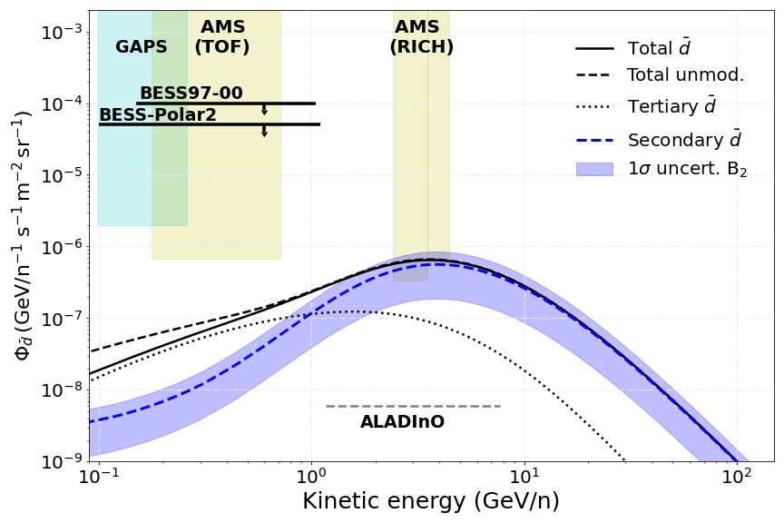
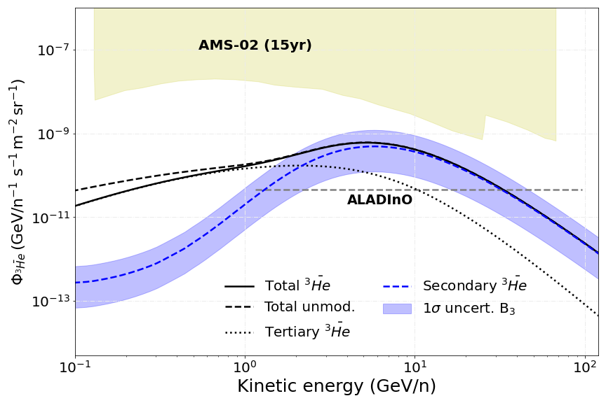
Astrophysical production
$$CR$$
CR + ISM → He, d
Can we explain the AMS-02 measurements without invoking any exotic source?
Main uncertainty is the coalescence parameter, the rest of uncertainties are under ~10%
We expect to have measurements of the d flux in the next years!! But nothing about He till ALADInO or AMS-100 (foreseen to 2039)
P.D.L. et al, in preparation

Slide 10
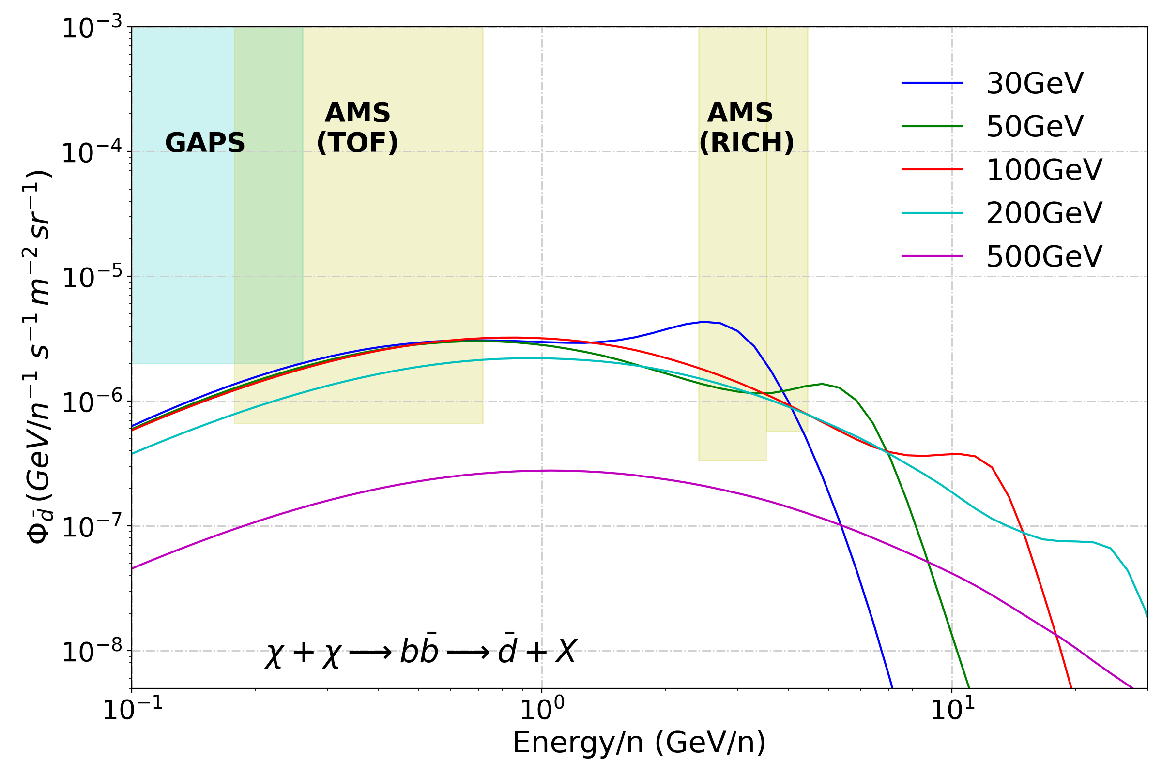
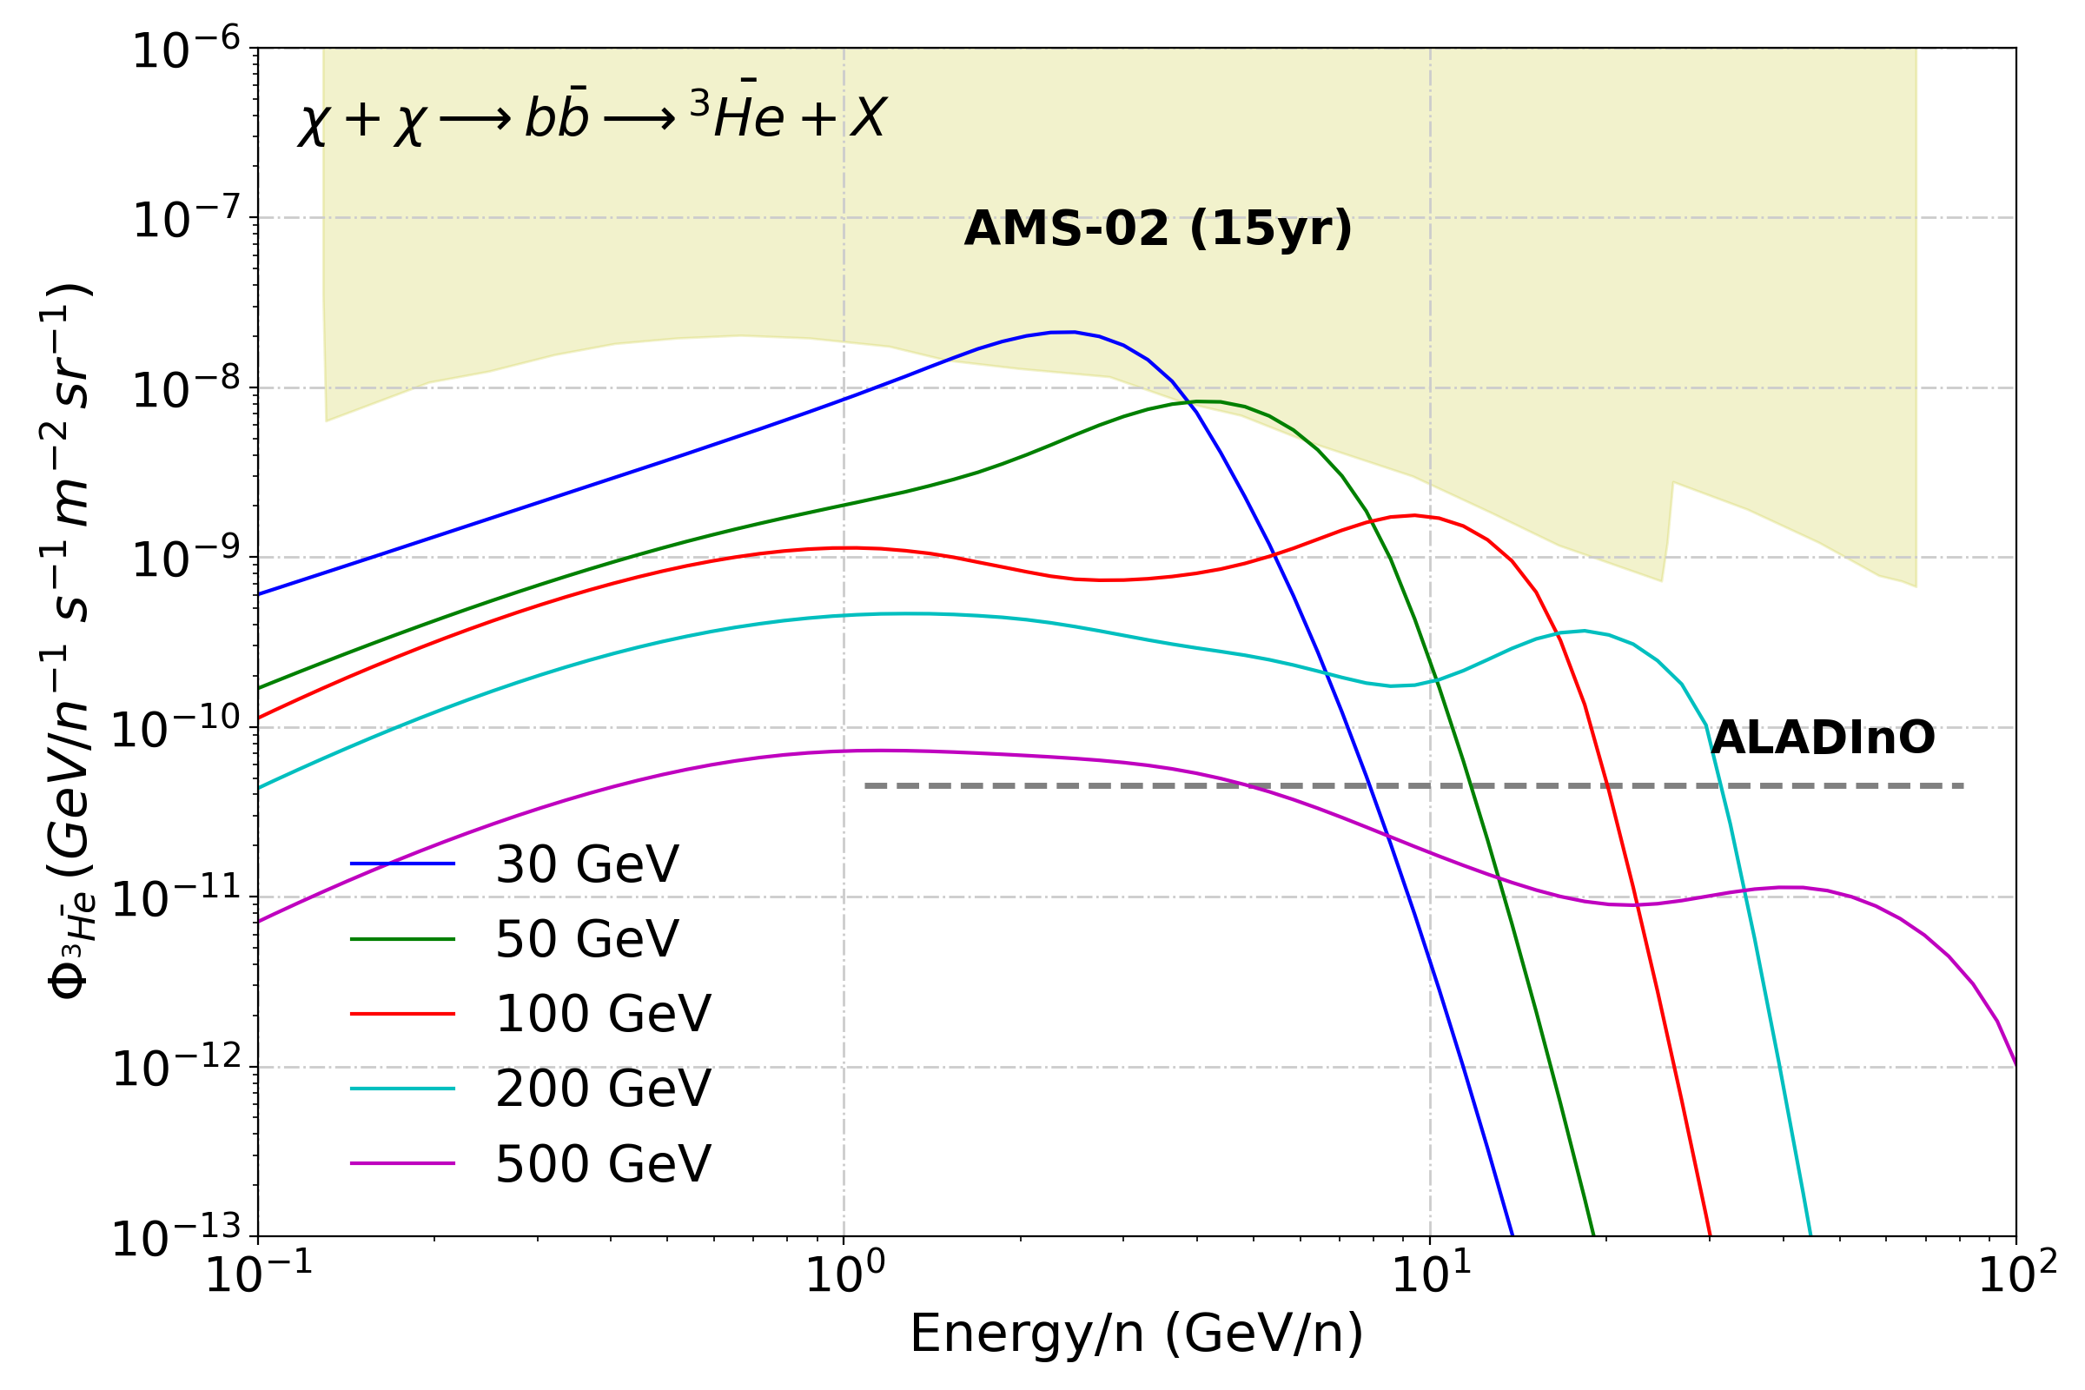
DM production: Upper Limits
q
χ
He, d
q
χ
Maximal antinuclei flux allowed from our antiproton bounds. Uncertainties in the coalescence momentum can hardly explain the detection of O(1) antihelium-3 event by AMS-02, but are unable to explain any detection of antihelium-4 by AMS-02…
P.D.L. et al, in preparation

Slide 11
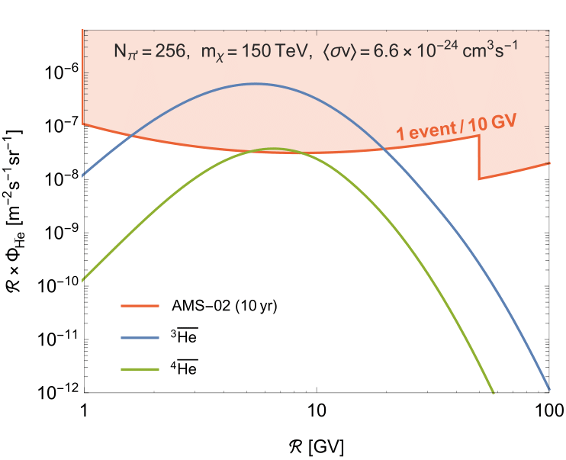
How to explain the AMS-02 He detection?
Winkler et al 2211.00025
Our standard predictions do not explain total He events and foreseen a ratio He-4/He-3 of ∼ 1/1000
Two main models proposed so far: Galactic anti-clouds (Poulin et al. 1808.08961) (see also 2304.04623)
Would produce much more He-4 than He-3 QCD-Like Dark sector (Winkler, PDL, Linden 2211.00025)
Can explain AMS-02 detections, but needs to
be explored further

Slide 12
A solution: QCD-Like Dark sector
Winkler, PDL, Linden ArXiv:2211.00025
The observation of antihelium-4 is much harder to explain because standard models predict a production ratio ∼ 1/1000
A strongly coupled dark sector can produce a “dark parton shower”, generating high multiplicity of “dark pions”. These would subsequently decay into SM quarks through, e.g., the Higgs or top portals, triggering a hadronic shower.
Simulated with Pythia as
This could have escaped detection at LHC and it offers a pathway to look for excesses in the ditop channel

Slide 13
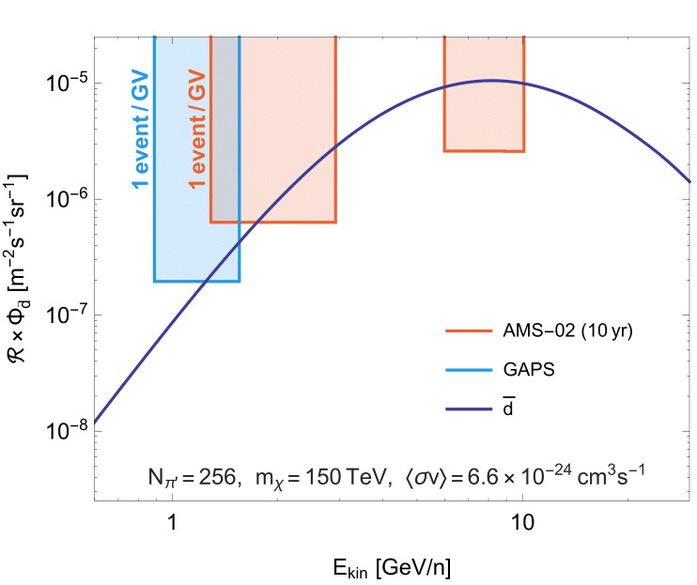
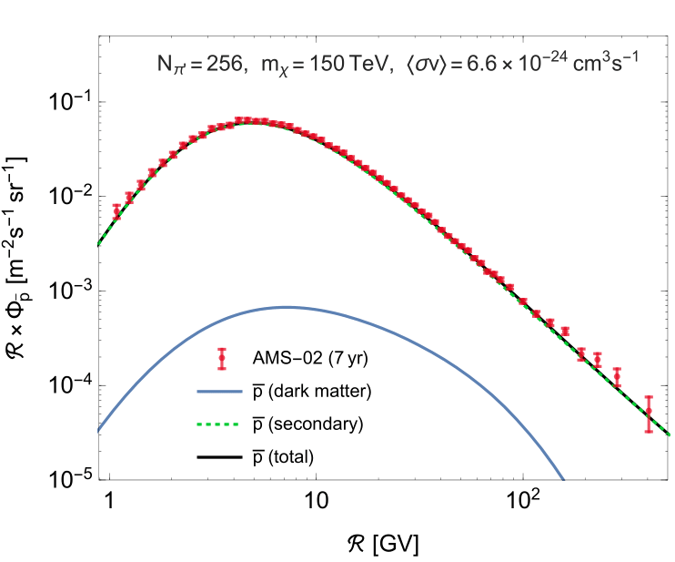
QCD-Like Dark sector
From factorized formula: $N_{A}∝{\left(N_{p}\right)}^{A}$

Slide 14
Conclusions
CR anti-nuclei predictions and their detectability in the next years
Anti-nuclei are a very promising channel to study signals from dark matter and constrain our current WIMP models – At reach in the next decade!
The secondary production of anti-deuteron is already detectable by AMS-02 (need to refine experimental analysis of the events detected)
Exciting preliminary detection of anti-helium seems to challenge our models… WIMP production seems insufficient… need of invoking exotic scenarios
QCD-like dark sector can be a viable solution and testable in accelerators!
Pedro de la Torre Luque – 3/07/2023
pedro.delatorreluque@fysik.su.se

Slide 15
BACK UP

Slide 16
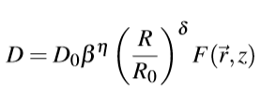
The propagation of CRs – Diffusion equation
The basic idea is that primary particles are accelerated in astrophysical sources (namely SNRs) and propagate throughout the Galaxy during millions of years, due to scattering with plasma waves. Occasionally, they interact with gas and produce secondary nuclei through spallation.
$$Dpp ∝\frac{p2 VA2}{D}$$

Slide 17
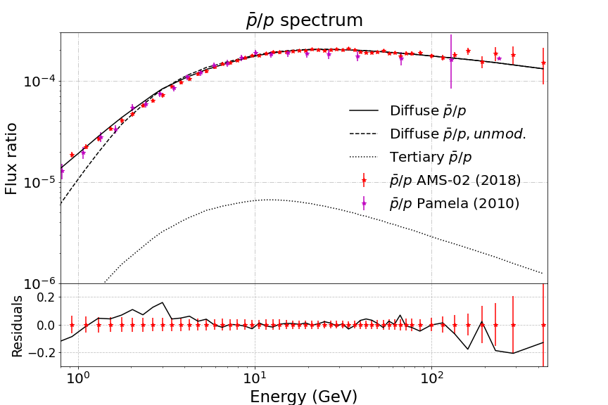
Potential of antiparticles to reveal the existence of BSM physics
Flux of CR nuclei and antiparticles (data from AMS-02)
p + p → p + p + p + p (High energy protons produce lower energy antiprotons)
$$CR$$
Secondary:
Tertiary:
χ
q
χ
q

Slide 18
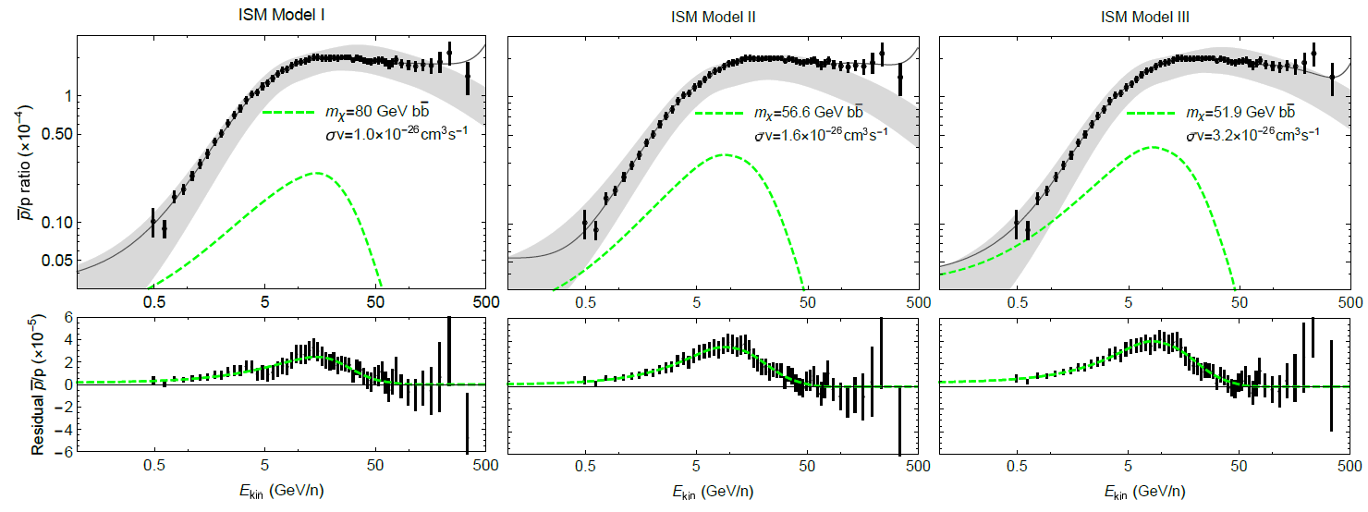
Antiproton excess – A DM signal?
$$CR$$
Several studies claimed the possibility of an excess of data over the predicted flux at around 10-20 GeV, which can be the signature of dark matter annihilating or decaying into antiprotons
p_{CR} + p_{ISM} → p
χ + χ → p
Cholis et al PRD 99, 103026

Slide 19
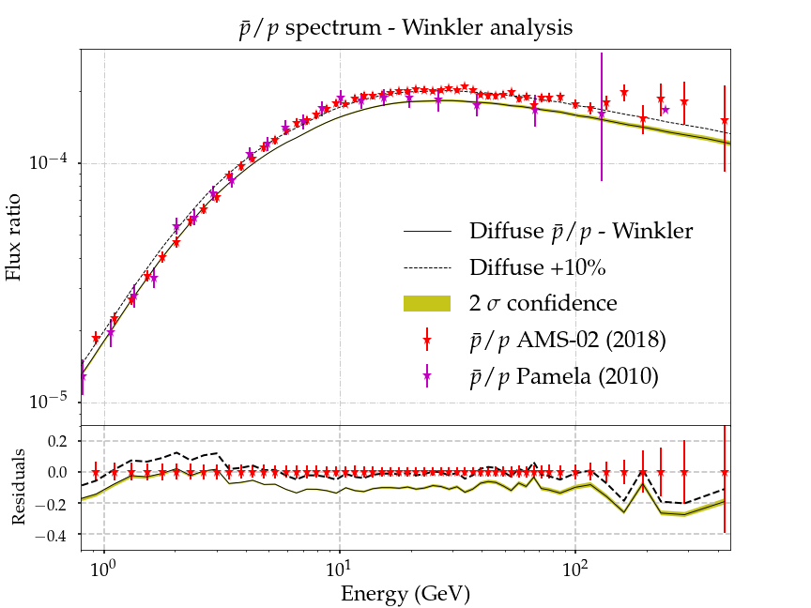
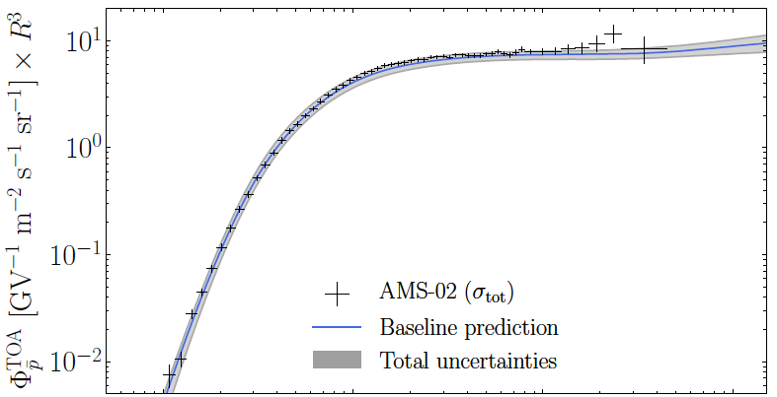
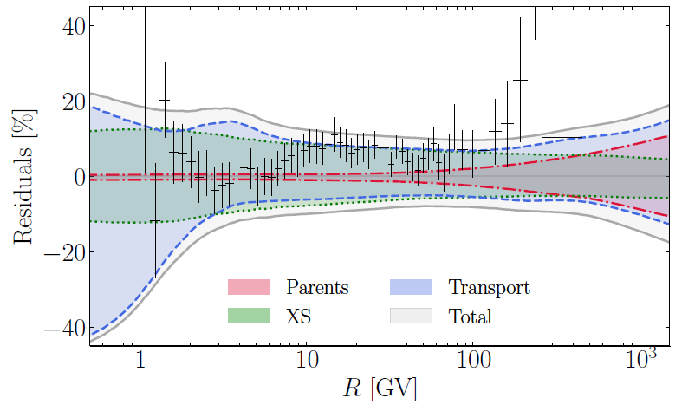
Antiproton excess – A DM signal?
$$CR$$
Further investigations revealed that the p spectrum is totally compatible with the rest of CRs, without any need of dark matter. Cross sections uncertainties and AMS-02 correlated errors are crucial
p_{CR} + p_{ISM} → p
χ + χ → p
P.D.L. JCAP 11 (2021) 018
P.D.L. JCAP 11 (2021) 018
Boudaud+ PRR 2, 023022 (2020)

Slide 20
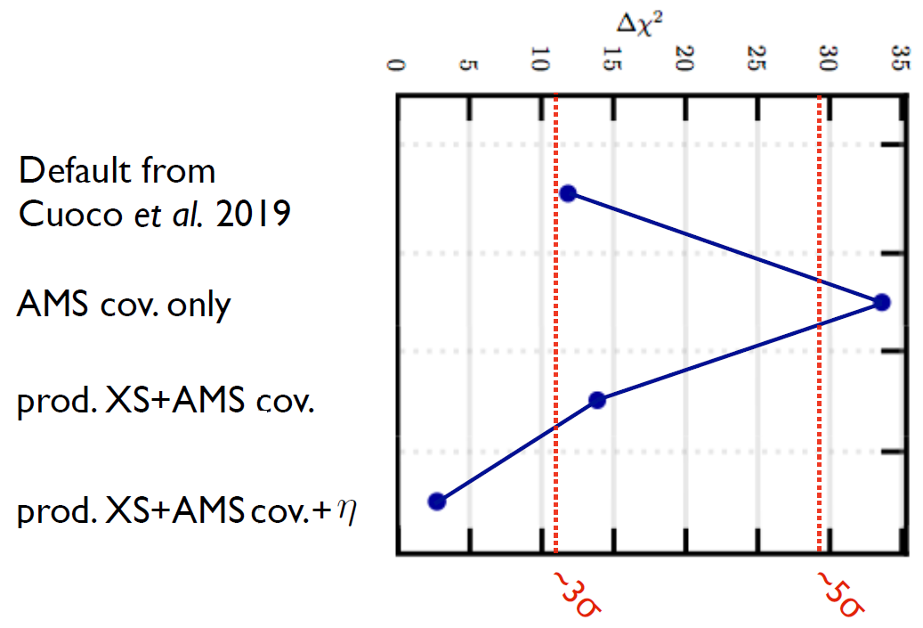
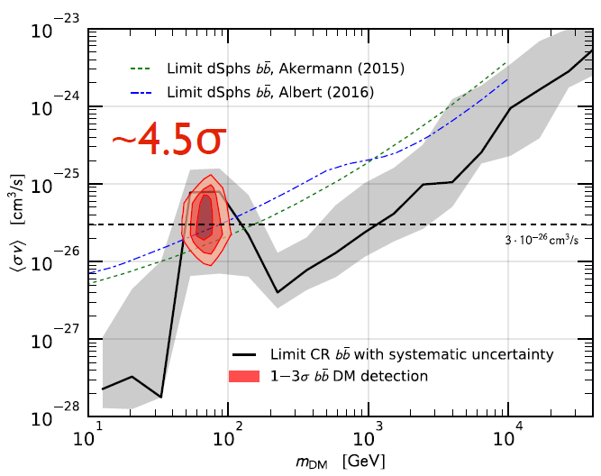
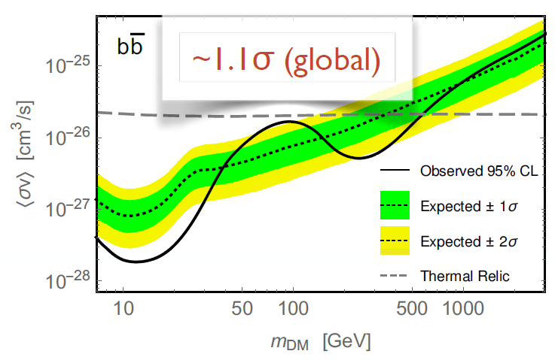
Antiproton excesses – The spectral excess
$$CR$$
All analysis coincided in the position of the excess, but not in its significance… again, the astrophysical uncertainties were not completely understood (and they aren’t yet!)
p_{CR} + p_{ISM} → p
χ + χ → p
Hooper, Cholis, Linden 2019
Jan Heisig MIAPP 2021
Cuoco, Kramer, Korsmeir 2017
Reinert, Winkler 2018
$$D(E)\sim D0βηEδ$$
20

Slide 21
Antiproton excesses – The grammage excess
Diff. coeff. predicted by the flux-ratios of B, Be and Li underpredicts the antiproton flux by a 10-20%→ Grammage tension
Energy spectrum of antiprotons is easily reproduced simultaneously with B, Be and Li
P.D.L. JCAP 11 (2021) 018
P.D.L. JCAP 11 (2021) 018
Conclusion: Cross sections uncertainties affect very significantly our predictions and can explain the excess
Notes:
How should the cross sections be modified (deformed) from their actual state?

Slide 22
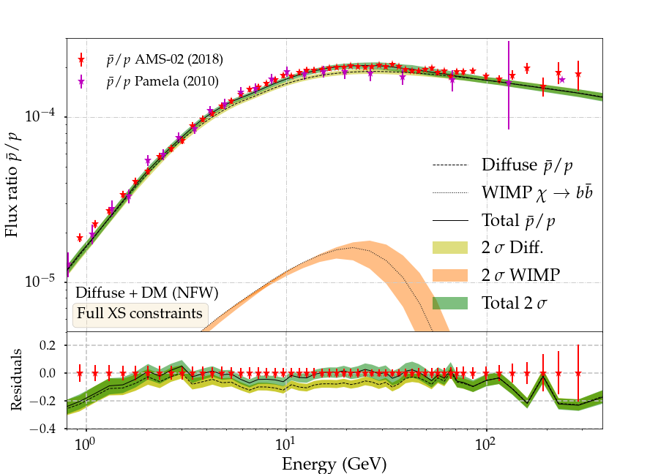
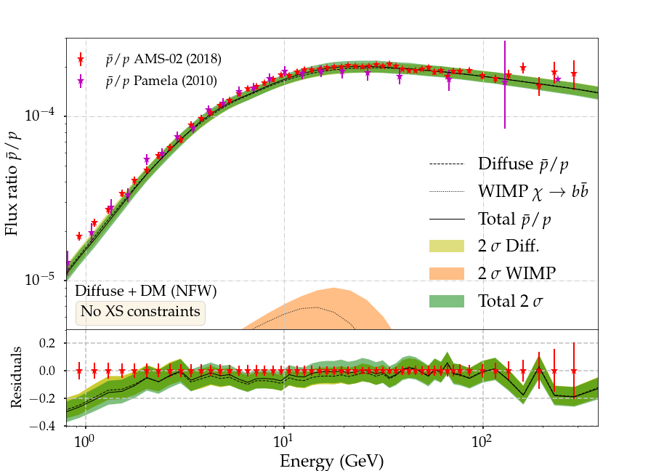
Search for DM features in the antiproton spectrum
Combination of B, Be and Li to determine prop. Params
Cross-section (XS) normalizations as nuisance parameters
Two modifications of XS prior constraints:
- No constraints - Penalty factor same as for B (Full cons.)
B/C, B/O, Be/C, Be/O, Ap/p (Prop. parameters)
¹⁰Be/⁹Be, ¹⁰Be/Be (H), Li/B
No statistical evidence in any analysis (0.6 < σ < 1.1)
P.D.L. et al, in preparation
Mχ ~ 160 GeV
<σv> ~ 2.7·10²⁶ cm³/s
Mχ ~ 107 GeV
<σv> ~ 0.7·10²⁶ cm³/s

Slide 23
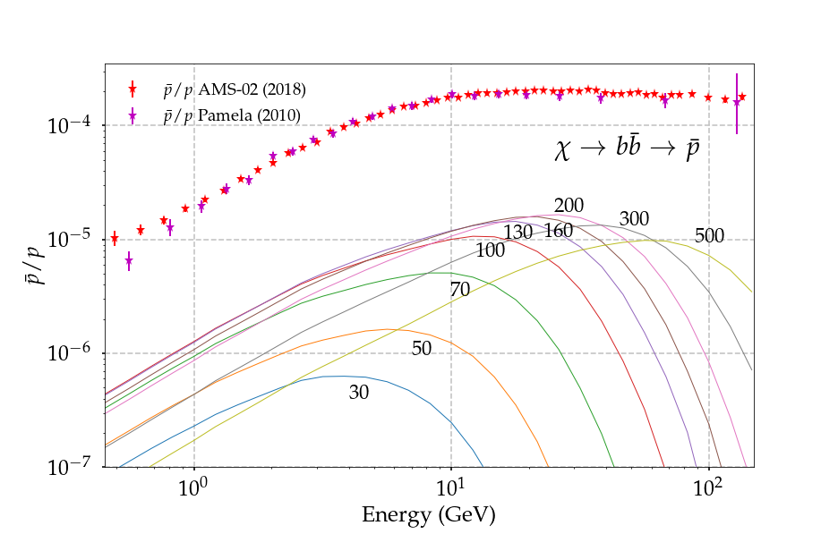
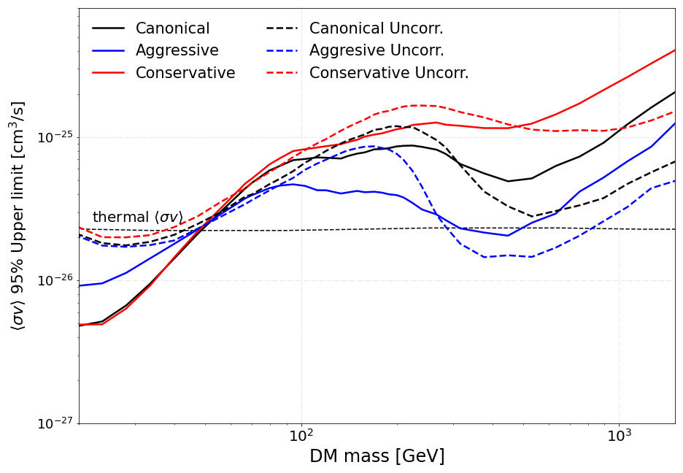
Dark matter bounds from antiproton combined analyses
No hints for WIMP signals in recent analyses…
P.D.L. et al, in preparation
These analyses can rule out the thermal relic cross-section for WIMP masses below ~50 GeV
Tension with the GCE!!
However, we are constrained to the classical model of production of antiprotons

Slide 24
Dark matter bounds from antiproton combined analyses
No hints for WIMP signals in recent analyses…
P.D.L. et al, in preparation
These analyses can rule out the thermal relic cross-section for WIMP masses below ~50 GeV
Tension with the GCE!!
However, we are constrained to the classical model of production of antiprotons

Slide 25
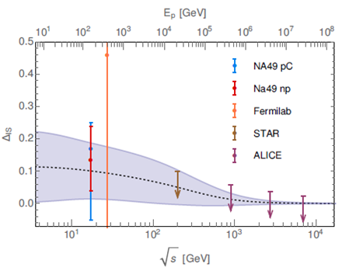
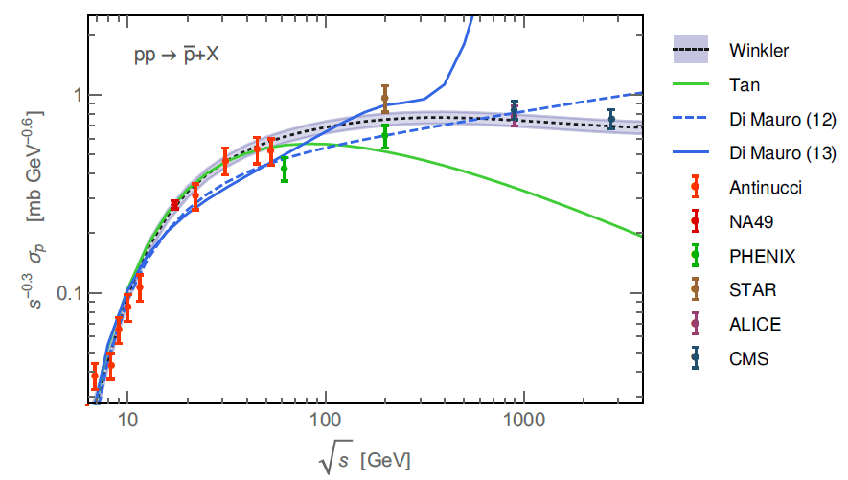
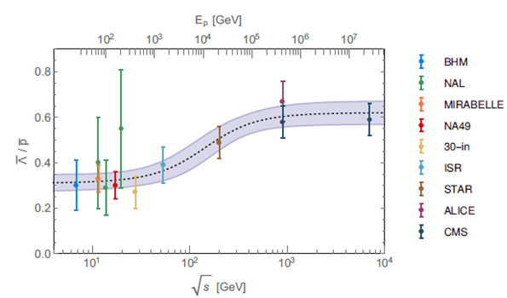
Antiproton cross sections
$·(2+ ΔIS+2$ $Δ$_{Λ})
Kappl & Winkler, 2019 ; arXiv:1408.0299
A. Reinert, M. W. Winkler, 2017 ; arXiv:1712.00002
25

Slide 26
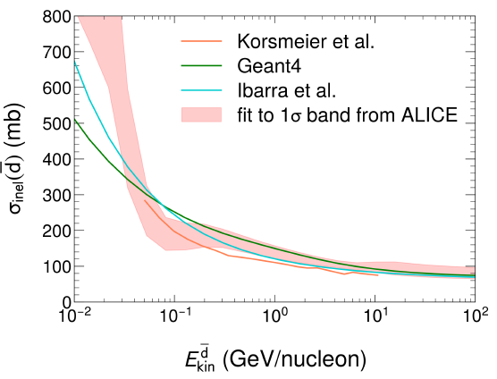
Propagation setup
Propagation code: github.com/tospines/Customised-DRAGON-versions/Custom_DRAGON2_v2-Antinuclei/
Implementation of anti-nuclei dark matter and secondary production in DRAGON2
Cross sections derived from analytical coalescence model. Using fits of antiproton (antineutron) production from Winkler, JCAP 02, 048 (2017)
DM spectrum at production derived from Pythia 8.2 simulating a neutral colorless resonance. Space and momentum (p_{c}) conditions for coalescence. Also including production from anti-hyperons
Inelastic cross sections and tertiary production computed extrapolating antiproton parametrizations
Šerkšnytė et al PRD 105, 083021 (2022)

Slide 27
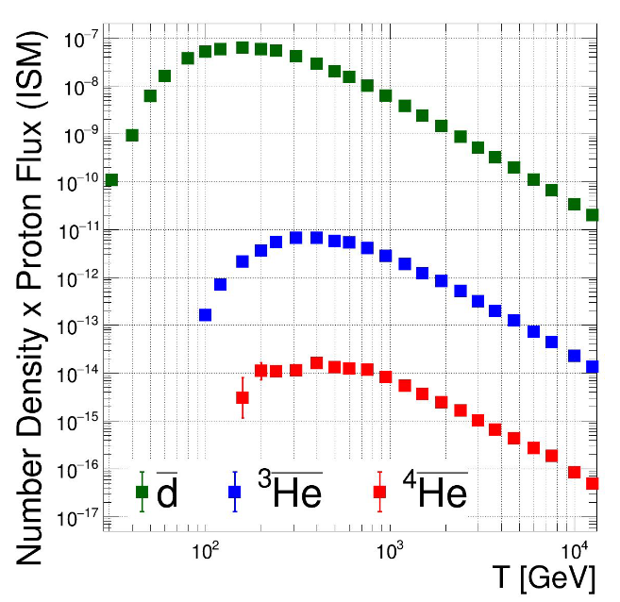
Potential of anti-nuclei to reveal the existence of BSM physics
Flux of CR nuclei and anti-nuclei (data from AMS-02)
P + p → p + p + p + ap + ap + an
$$CR$$
Shuckla, MIAPP 2021

Slide 28
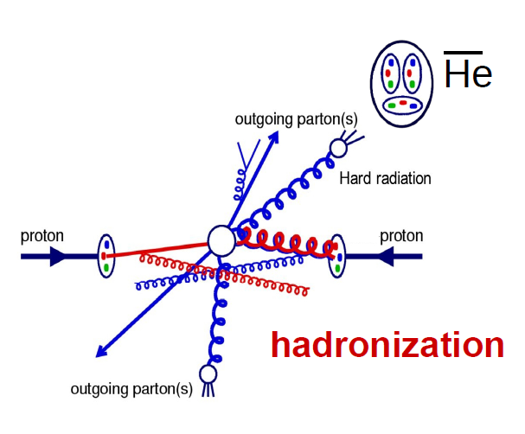
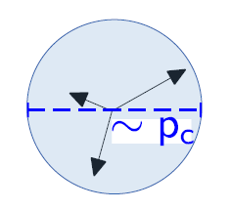
Formation of anti-nuclei
Simplest coalescence model: Factorised coalescence
Antineutrons and antiprotons are produced uncorrelated
Coalescence parameter can be approximated from the coalescence momentum, p₀
(anti)nucleons with low relative momentum merge to form (anti)nuclei
Anti-D $\left|∆p\right|<p0$
Anti-He

Slide 29
Formation of anti-nuclei: Coalescence
Secondary anti-nucleons are produced from homologous interactions as for p. These must coalesce in order to form an anti-nucleus, which hugely suppressed their production!
Simplest coalescence model: Factorised coalescence

Slide 30
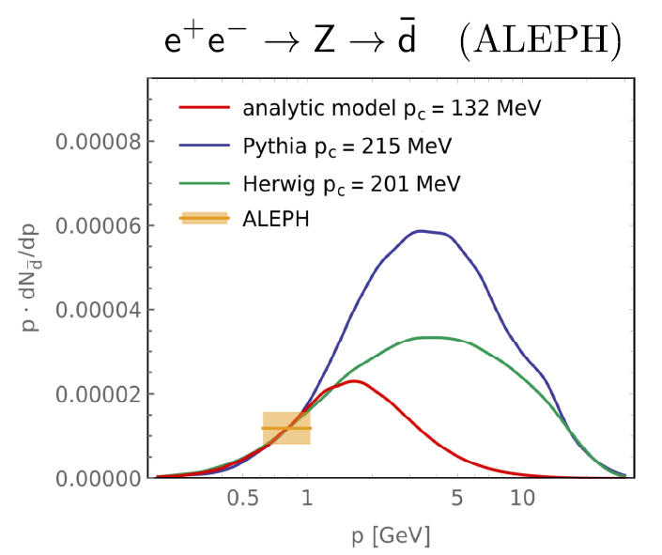
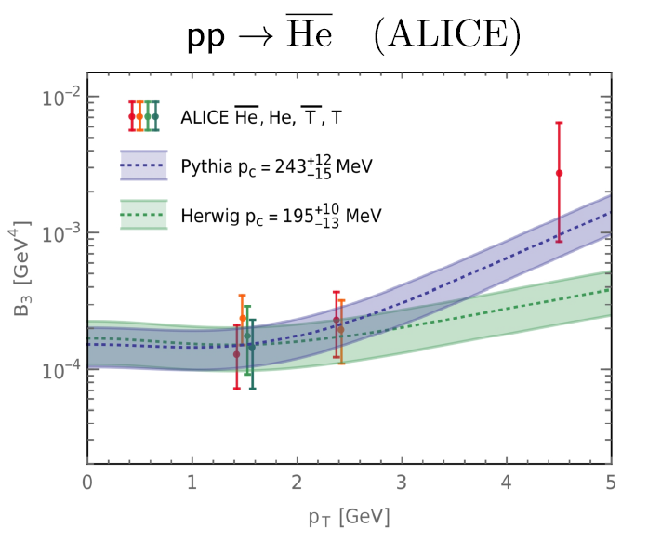
Formation of anti-nuclei
Coalescence parameter may depend on many kinematical parameters, including the size of the projectile and target
Martin Winkler, MIAPP 2021

Slide 31
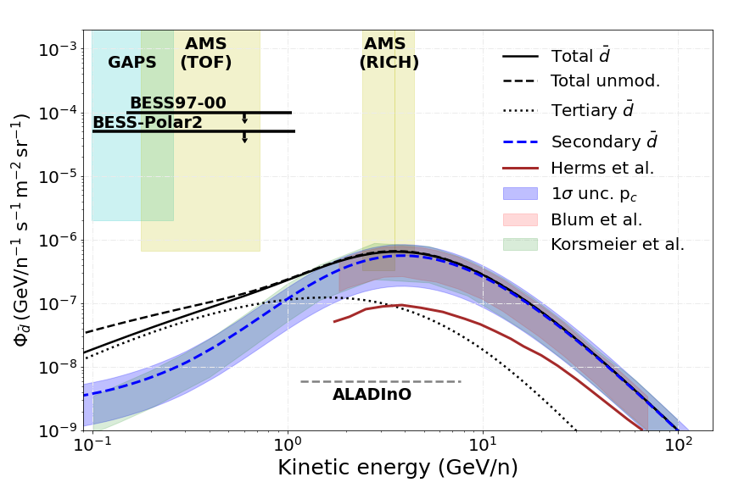
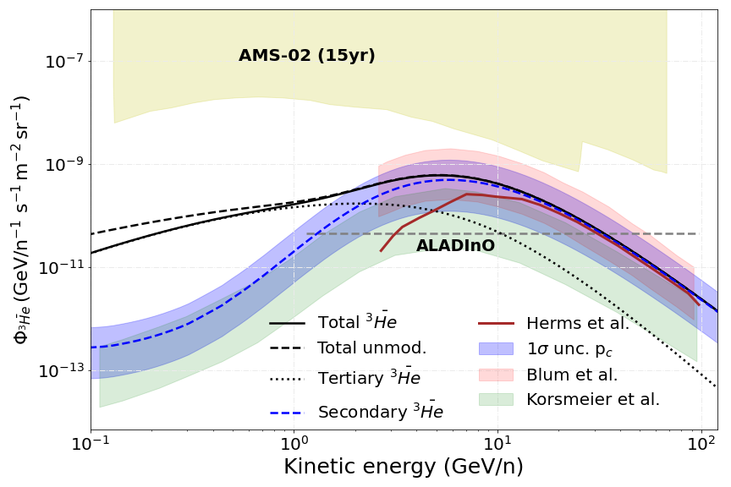
Astrophysical production
$$CR$$
CR + ISM → He, d
Can we explain the AMS-02 measurements without invoking any exotic source?
Main uncertainty is the coalescence parameter, the rest of uncertainties are under ~10%
We expect to have measurements of the d flux in the next years!! But nothing about He till ALADInO or AMS-100 (foreseen to 2039)
P.D.L. et al, in preparation

Slide 32
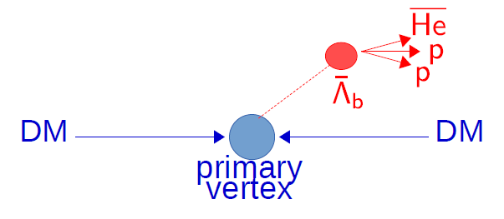
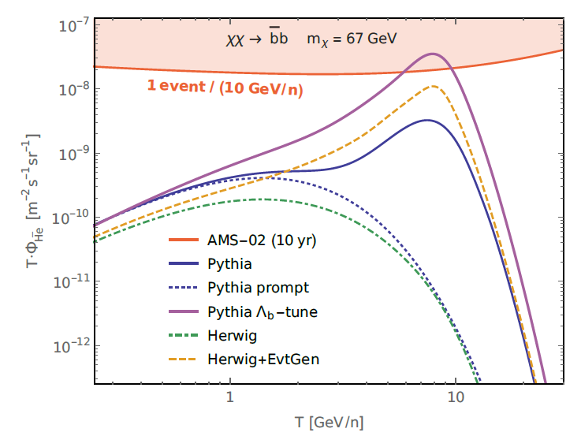
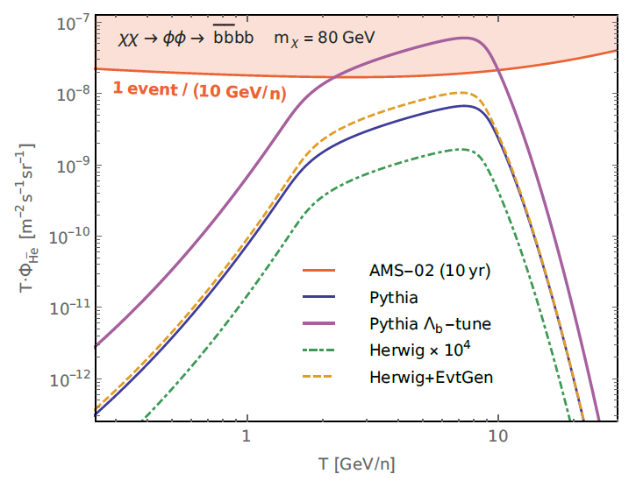
Boosting the dark matter signal
Λ_{b} production is a very important source of anti-helium, even able to explain the events reported by AMS-02, although not yet well constrained
Winkler, Linden (2021) PRL 136, 101101

Slide 33
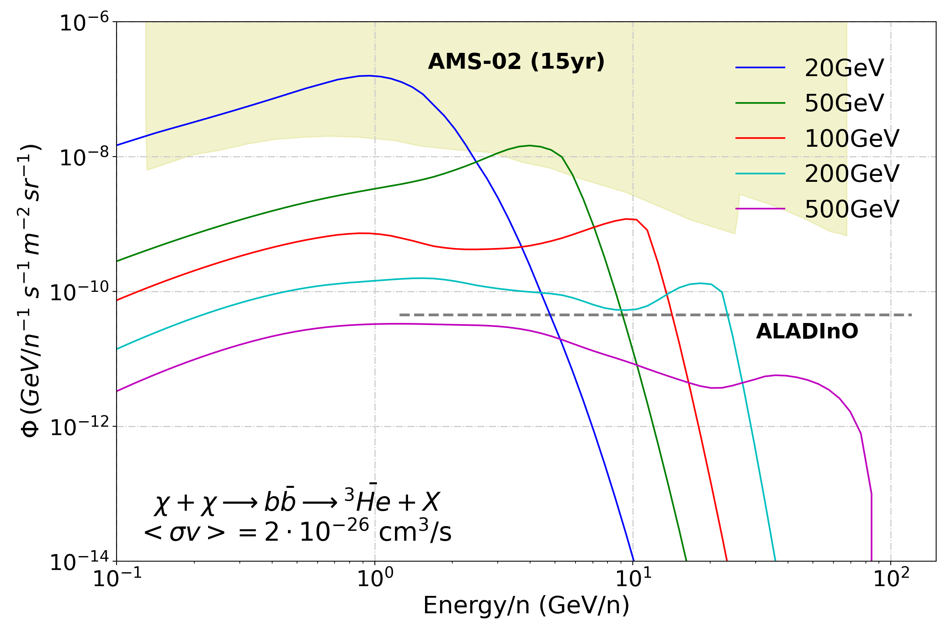
The window to prove (or disprove) the WIMP paradigm
Dark matter production
χ
q
He, d
q
χ
P.D.L. et al, in preparation
PPPC – M. Cirelli tables:
http://www.marcocirelli.net/PPPC4DMID.html

Slide 34
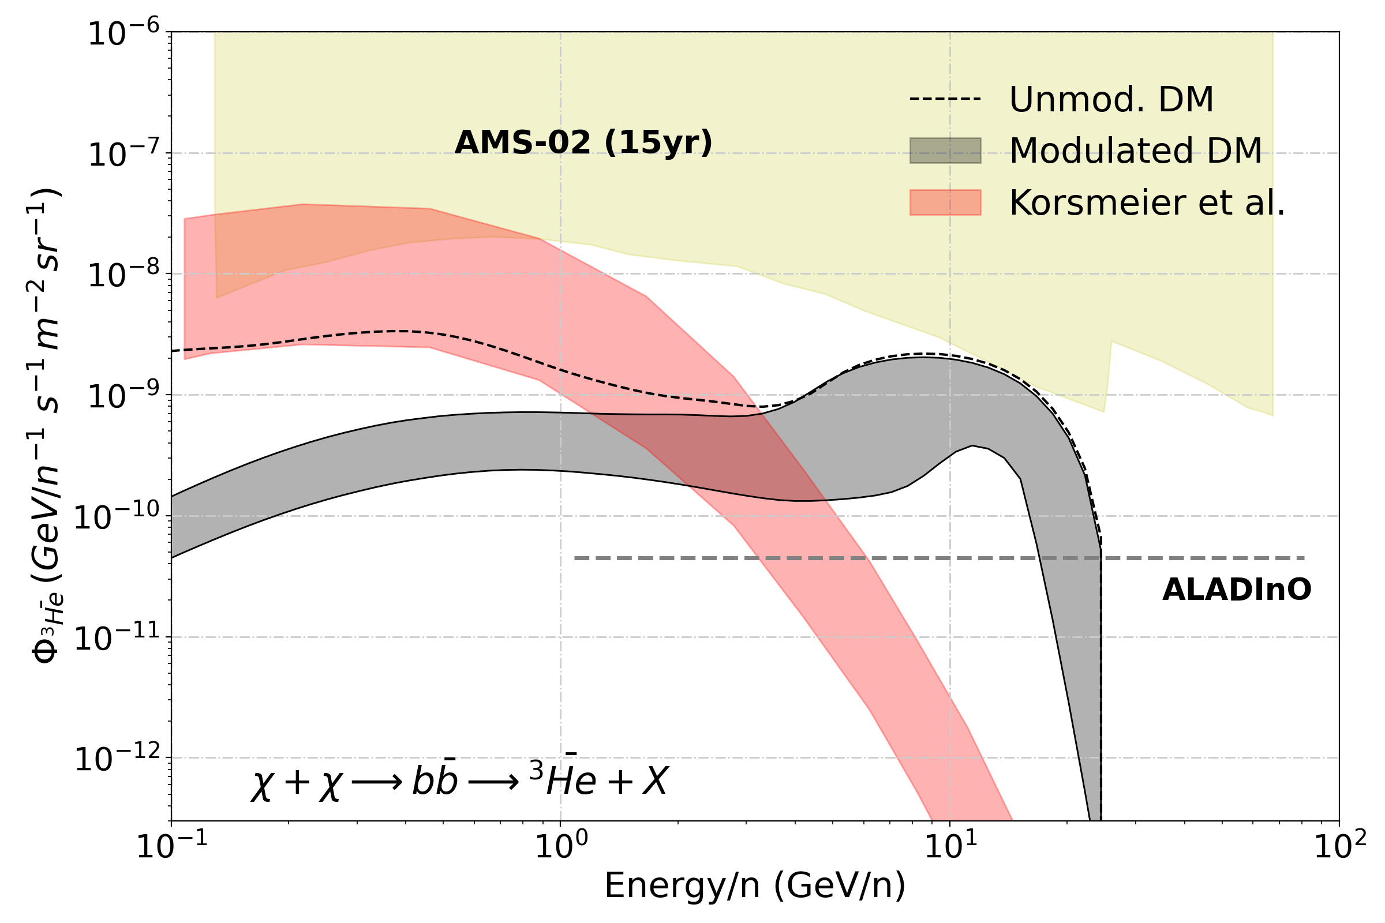
Dark matter production
χ
q
He, d
q
χ
Estimations of the expected flux from DM hints have changed significantly over the last years. The measurement of anti-deuteron events by GAPS or the TOF (AMS-02) will certainly evidence exotic mechanisms of production of these particles
P.D.L. et al, in preparation

Slide 35
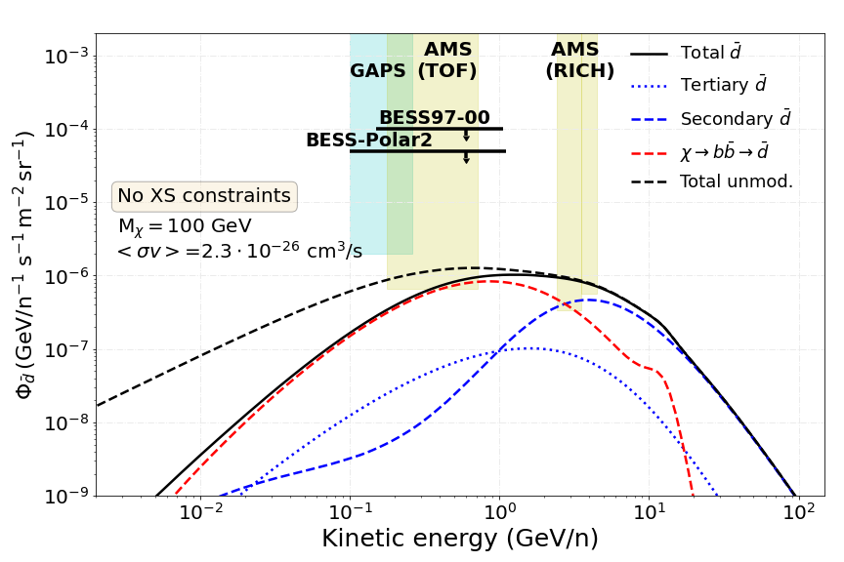
Anti-nuclei as the dark matter smoking gun
P.D.L. et al, in preparation
Shuckla, MIAPP 2021
Detected anti-D events possibly explained, but impossible to explain more anti-He events!

Slide 36
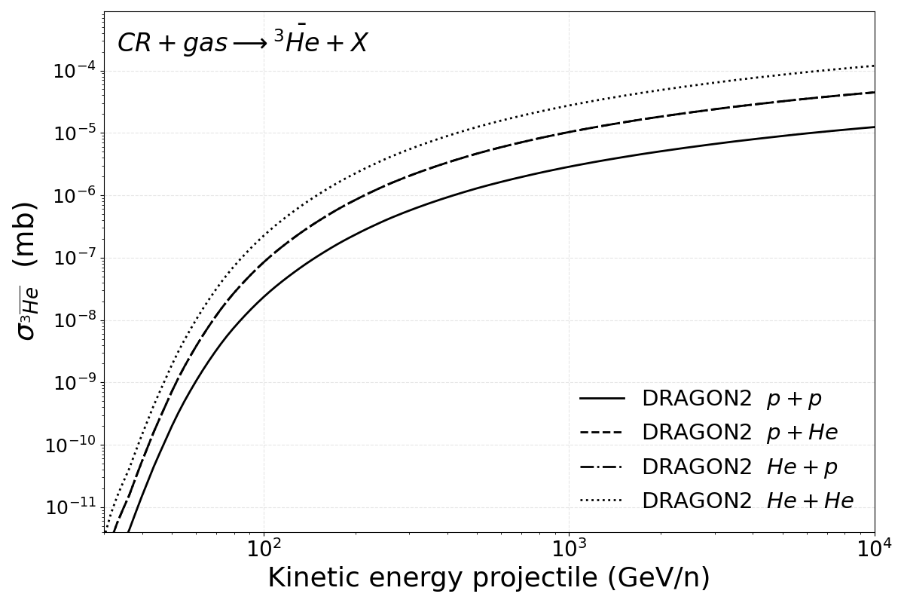
New antinuclei cross sections!
Derived analytically using the factorized coalescence model model from the Winkler (2017) cross sections for antiprotons. Coalescence momentum adjusted to reproduce ALICE p+p data!

Slide 37
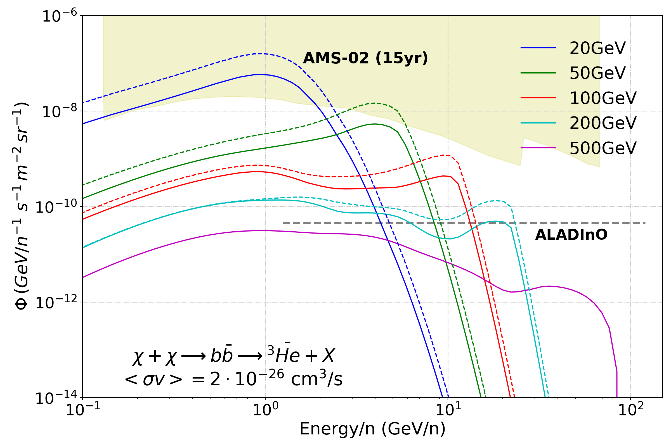
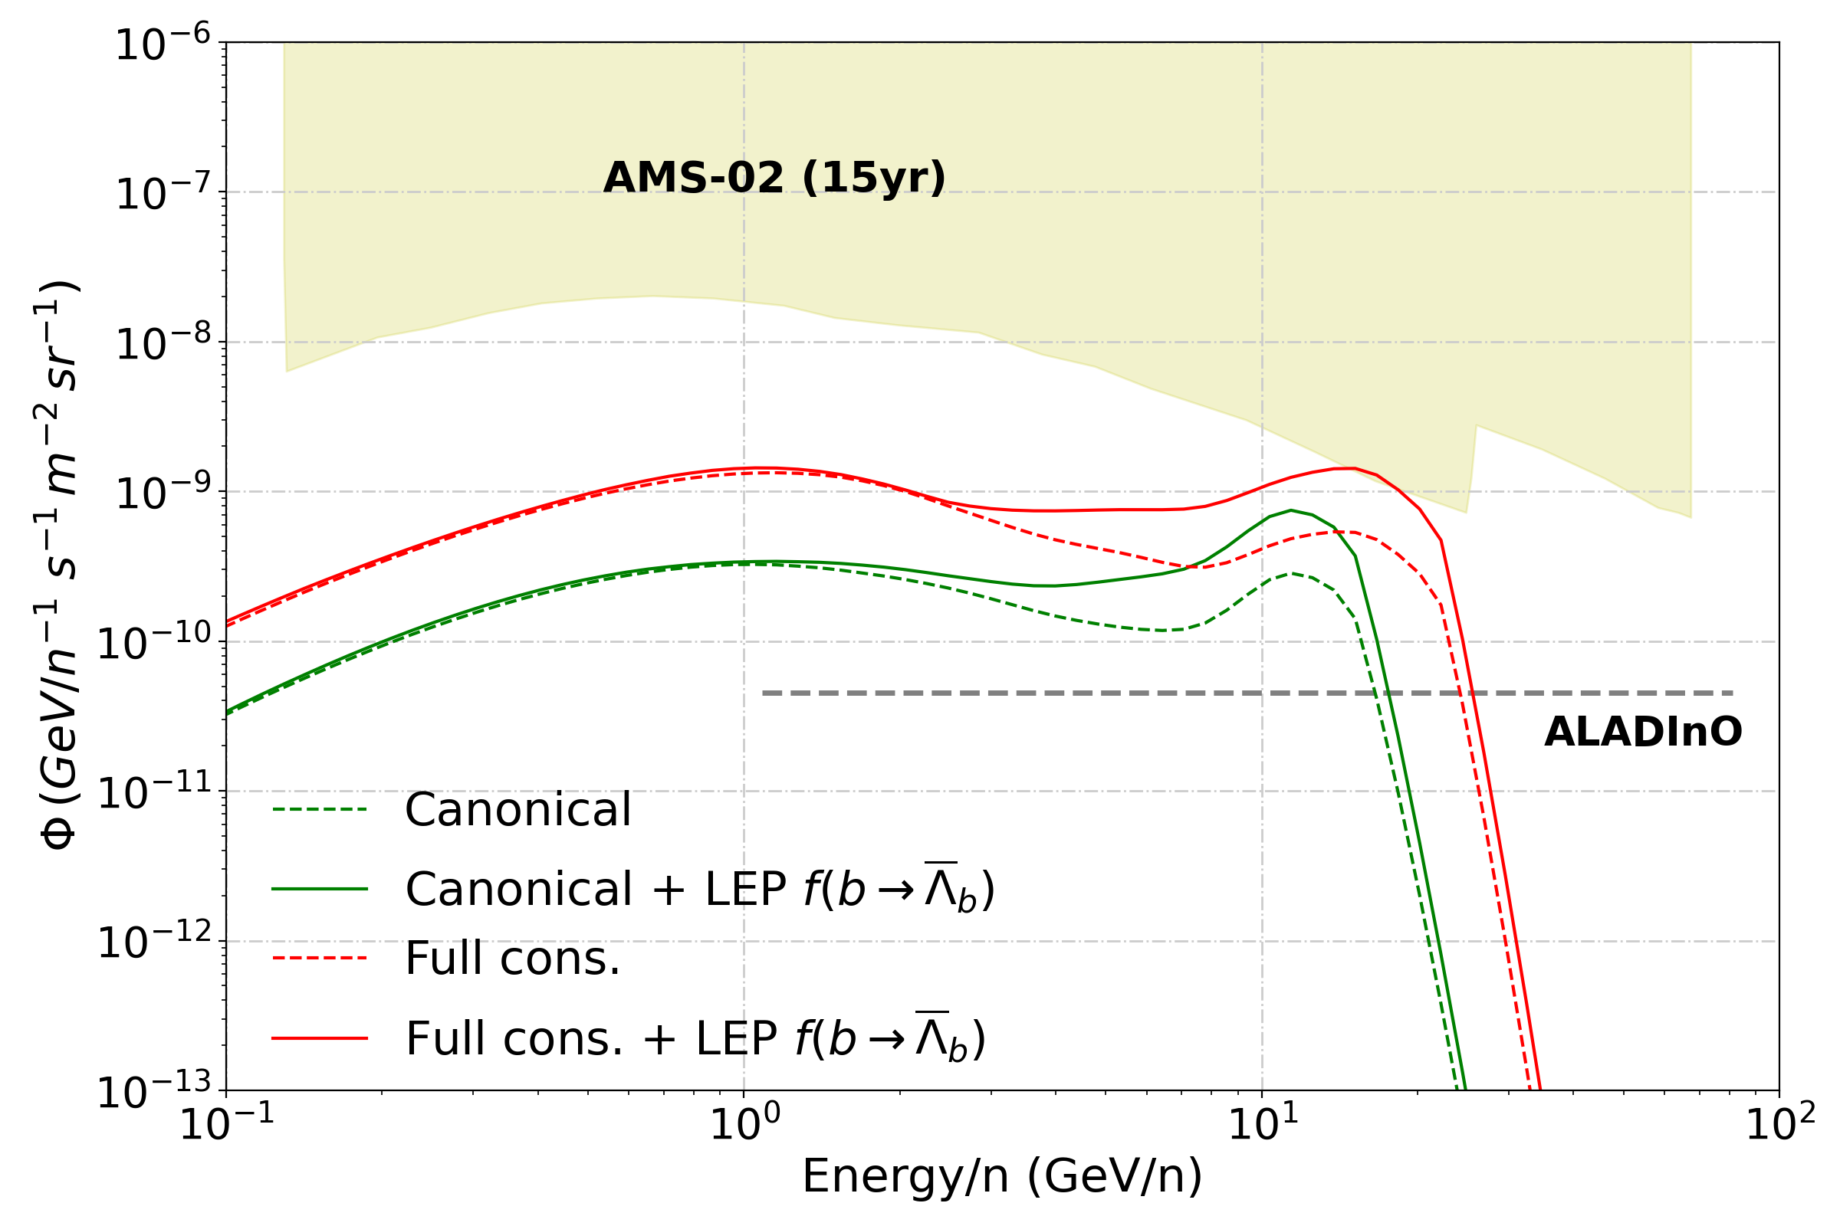
LEP correction vs plain Pythia

Slide 38
How to avoid current uncertainties and improve our models!?
Better description of the distribution of gas density
Refined and more complete description of solar modulation
More measurements of cross sections of production of secondary CRs (B, Be, Li) at energies above a few GeV/n
Cross sections measurements for the production of antiprotons from He (and heavier nuclei) collisions and broader energy range for p-p collisions
Improvement on the description of coalescence by nuclear codes such as Pythia, motivated by the latest measurements by ALICE and other experiments
Publication of AMS-02 upper limits and covariance matrices (correlated errorbars)
Description of the propagation of CRs beyond the spatially-constant scenario

