Slide 1
To a LepCol module for TimePix 3 Very first stage of development
Ideas of Harry and Fred
NIKHEF
LepCol meeting Nikhef
May 23, 2016

Slide 2
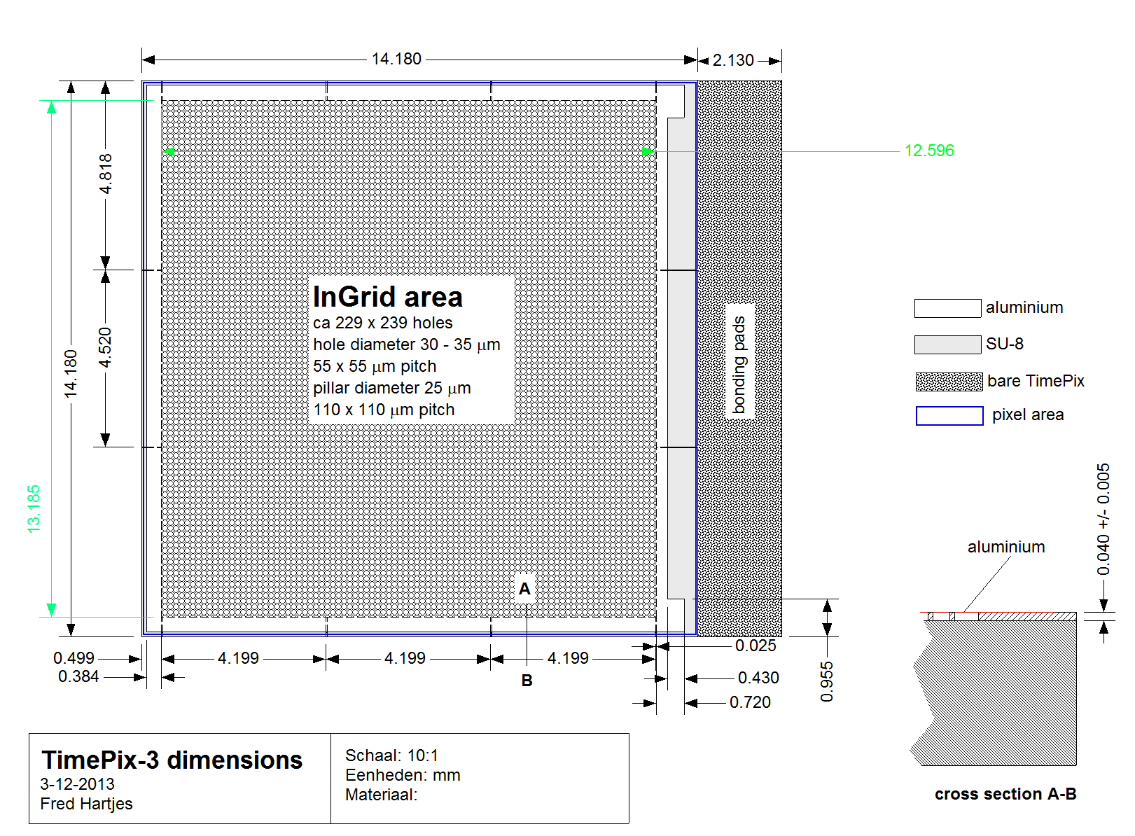
InGrid on TimePix 3 chip

Slide 3
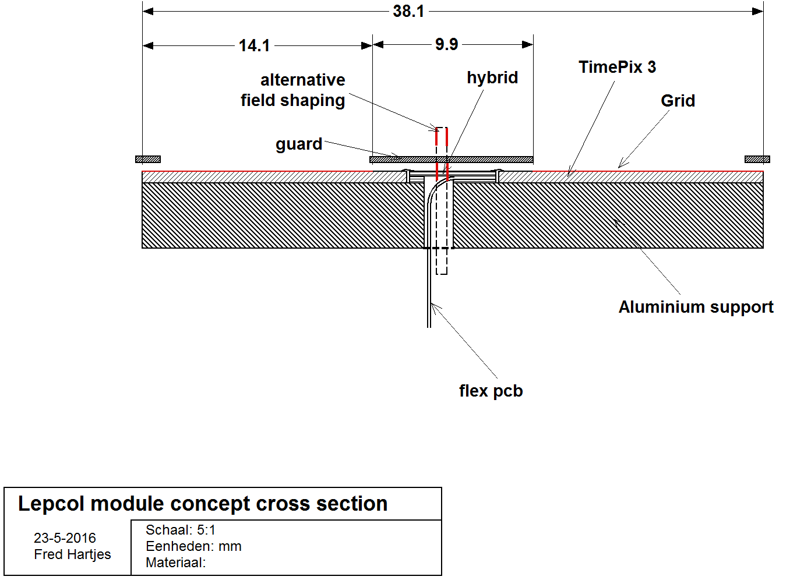
Concept of Lepcol TPC module
Based on TimePix 3

Slide 4
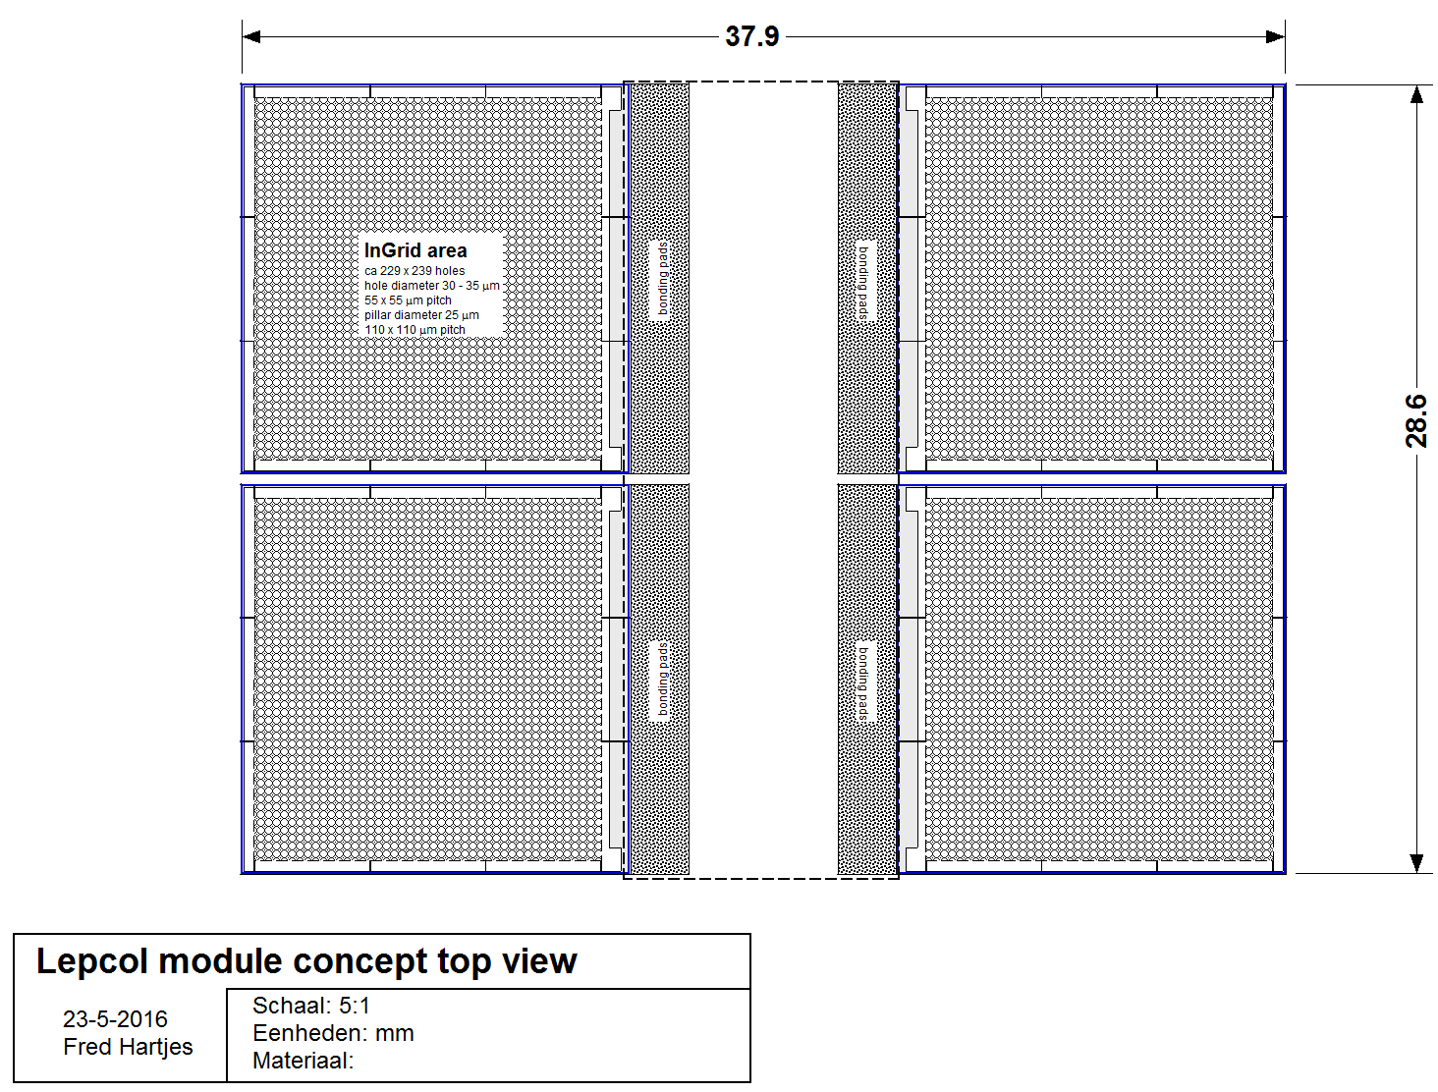
LepCol module top view
How many chips per module?
Minimum two
Not practical
Four may be optimal at the present stage of development
Six?
Eight?

Slide 5
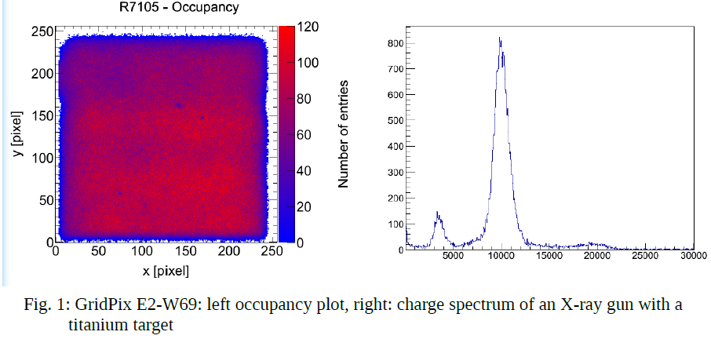
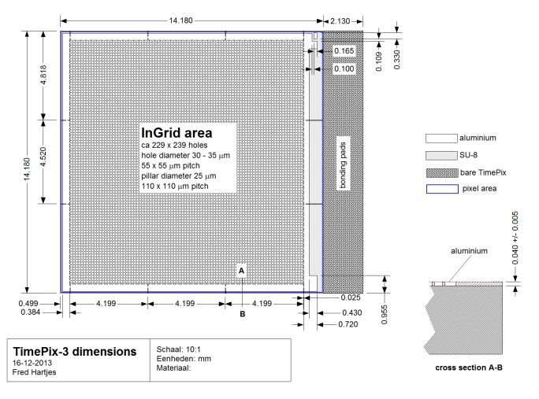
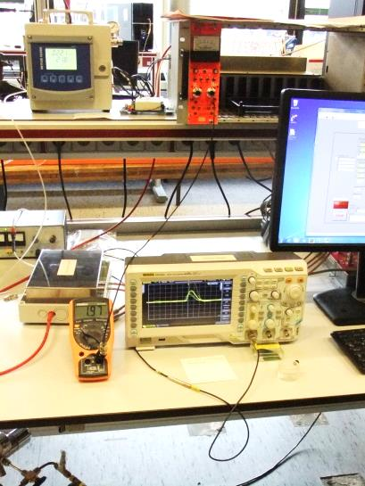
A few words on InGrid on TPX3 developent
Recently a production of InGrid on a TPX1 wafer in Bonn has been very successful
IZM-7
Chips can have very high gas gain
Sustain sparking without any problems
Are defect free excellent uniformity
Yevgen now preparing a production on a TPX3 wafer
Plan B: mounting a dedicated Micromegas foil on a protected TPX3 chip
Practical identical to InGrid
Foils due to arrive
Spark tests at Nikhef going on
Silicon substrates
Broken TPX3 chips

Slide 6
Summary
It is too early to define a project for assembling a LepCol TPC
Start with a small building block first
A more or less square module block of 4 may be most practical to use as a building block for a LepCol TPC
RO scheme of TPX3 completely different from that of TPX1
Complete redesign of the module needed
Design almost completely driven by RO electronics
Hydrid PCB, flex etc
How to make connections to outer world?
Cooling is not really an issue
Water cooling (vacuum driven) most practical in this stage of development
Field shaping at chip edges crucial
Several options
Field shaping planes
Vertical strips with different potentials

