Slide 1
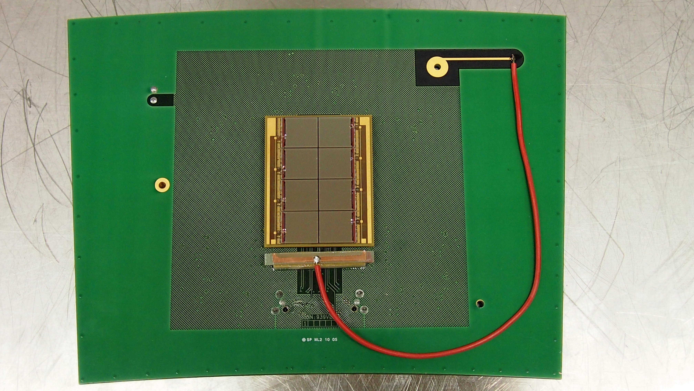
ILC Highlight Nikhef Octopuce grid pix
Chip (1x1) 14 x 14 mm
Octopuce (2x4) 28 x 56
Module (100)

Slide 2
Testbeam DESY performance
Module 1 is in great shape
320 V and 1 T
all
100 μm
Resolution 100 μm per hit. (ExB) Deformations at the edges of the board are under control and systematics per chip less than 20 μm. This is good enough for a TPC. We need now to build a 100 chip module.

