Slide 1
Noise runs
The goal of the noise run is to verify the stability of the DAQ and to mask new noisy channels before data taking.
Noise runs have run number 1111.
A Run procedure:
cd /localstore2/TPX3/DATA/LOGFILES
// first remove old noise run always 1111
rm -f /localstore2/TPX3/DATA/*I*/Run1111/*
// run command for 10 secs data (is enough)
Tpx3daq_concentrator -s "" -i 1 -p 2 -m -t 10
// produce arawana_daqlog_20230216_152142.txt
// and .dat files in /localstore2/TPX3/DATA/LINK0 LINK1/ TIMESTAMP/
Details in the log file show that right thresholds were put and at the end of the run read back. See e.g. arawana*EIC*.log

Slide 2
Noise runs
B Ntuple production start a new terminal (cannot mix the setups for ntuple production and A run/ B analysis):
cd /home/gastpx3
source init_laser_setup_software.sh
you are in /localstore/TPX3/laser_setup_software
// run the ntuple production
./make_concentrator_tree -r 1111 -l 0 > testNoise_0.l &
./make_concentrator_tree -r 1111 -l 1 > testNoise_1.l &
// produces /localstore2/TPX3/ROOT/run1111_0.root and run1111_1.root
//main code
// make_concentrator_tree.cpp make_concentrator_tree.h
// you can redo make make_concentrator_tree
//

Slide 3
Noise runs
C Analyse Ntuple start a new terminal (cannot mix the setups for ntuple production and A run/ B analysis):
cd /home/gastpx3
cd /localstore/TPX3/laser_setup_software
root -l
> .L MaskAndTrim.C++
> MaskAndTrim t
> t.LoopM()
edit MaskAndTrim.h to run on both concentrators
name = "/localstore2/TPX3/ROOT/run1111_0.root";
name = "/localstore2/TPX3/ROOT/run1111_1.root";
// this code masks pixels and updates all the W0030_G03_trimdacs.txt files
In order to use the new trimdacs: cp -rf W*.txt /localstore/TPX3/localCONFIGS/Module/EIC/.
Then redo A take noise data, B make ntuple, C analyse and mask pixels

Slide 4
Diagnostics from Noise runs
Often one needs two iterations for masking
One can see DAQ problems in the running (e.g. time outs etc.)
The analysis can show not so apparent problems
High ToT values indicate a badly running chip
A high rate 200 hits/ pixel with almost all channels firing
Action: do a spidr reset and take a new noise run
It is likely that the the current setting of the masks is fine and only a few pixels get noisy in the testbeam in US.

Slide 5
Diagnostics from Noise runs
Example of noise runs with dac offset of 50 counts
/localstore2/TPX3/DATA/LOGFILES/arawana*EIC50.txt
B) Corresponding ntuples
/localstore2/TPX3/ROOT/run1111EIC50_0.root
/localstore2/TPX3/ROOT/run1111EIC50_1.root
C) Output of the mask and trim
/localstore/TPX3/laser_setup_software/logfileMaskAndTrim.log
Typically we have 1-10 hits per pixel in 10 seconds.
For a window of 1 μs it means 0.1-10 hits per event. This is a very acceptable noise rate. The noise can be easily removed by at ToT cut at 8 counts (time 25 nsec).

Slide 6
Diagnostics from Noise runs
In test at Nikhef chip 30 was not in the readout.
I never succeeded to get chip 30 in the readout.
In the DESY test beam we did after many retries.
*** Often chip 31 had (ALARM message for ToT) problems.
After a few restarts of the SPIDRs it worked fine.

Slide 7
Diagnostics from Noise/source run
C) In case the detector is fully on with gas and HV one can take a source and take a noise run for a 10-100 seconds
One can measure the ToT per chip and this is VERY VERY revealing. It shows the full functioning of the detector
The mean ToT should be similar for all chips
see next slides from May 2021
The recipe is simple: take a noise run and make the ntuple and use the tree for making plots of the mean ToT (in units of 25 ns).

Slide 8
New Gas envelop
Old gas box
New gas box
May 2021: https://indico.nikhef.nl/event/3124/
Mean ToT
Concentrator 0 chip nr

Slide 9
New Gas envelop
Old gas box
New gas box
May 2021: https://indico.nikhef.nl/event/3124/
Mean ToT
Concentrator 1 chip nr

Slide 10
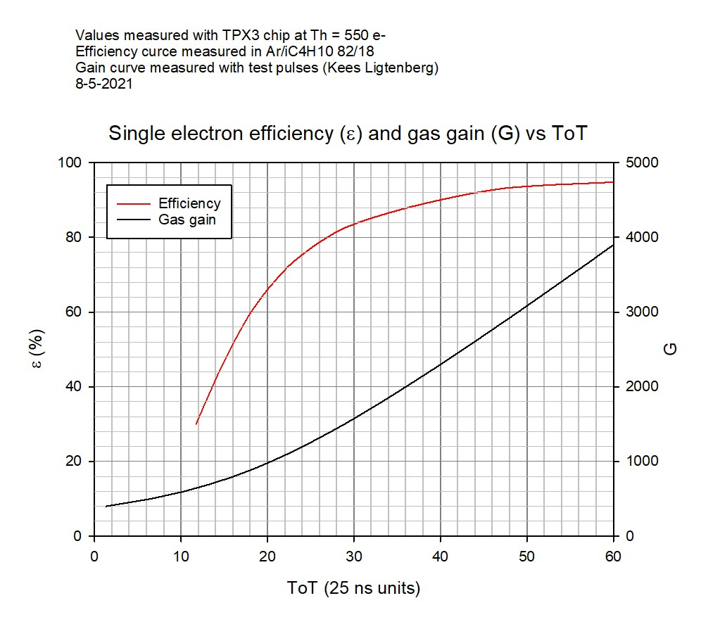
Calibration curve ToT gas gain

