Slide 1
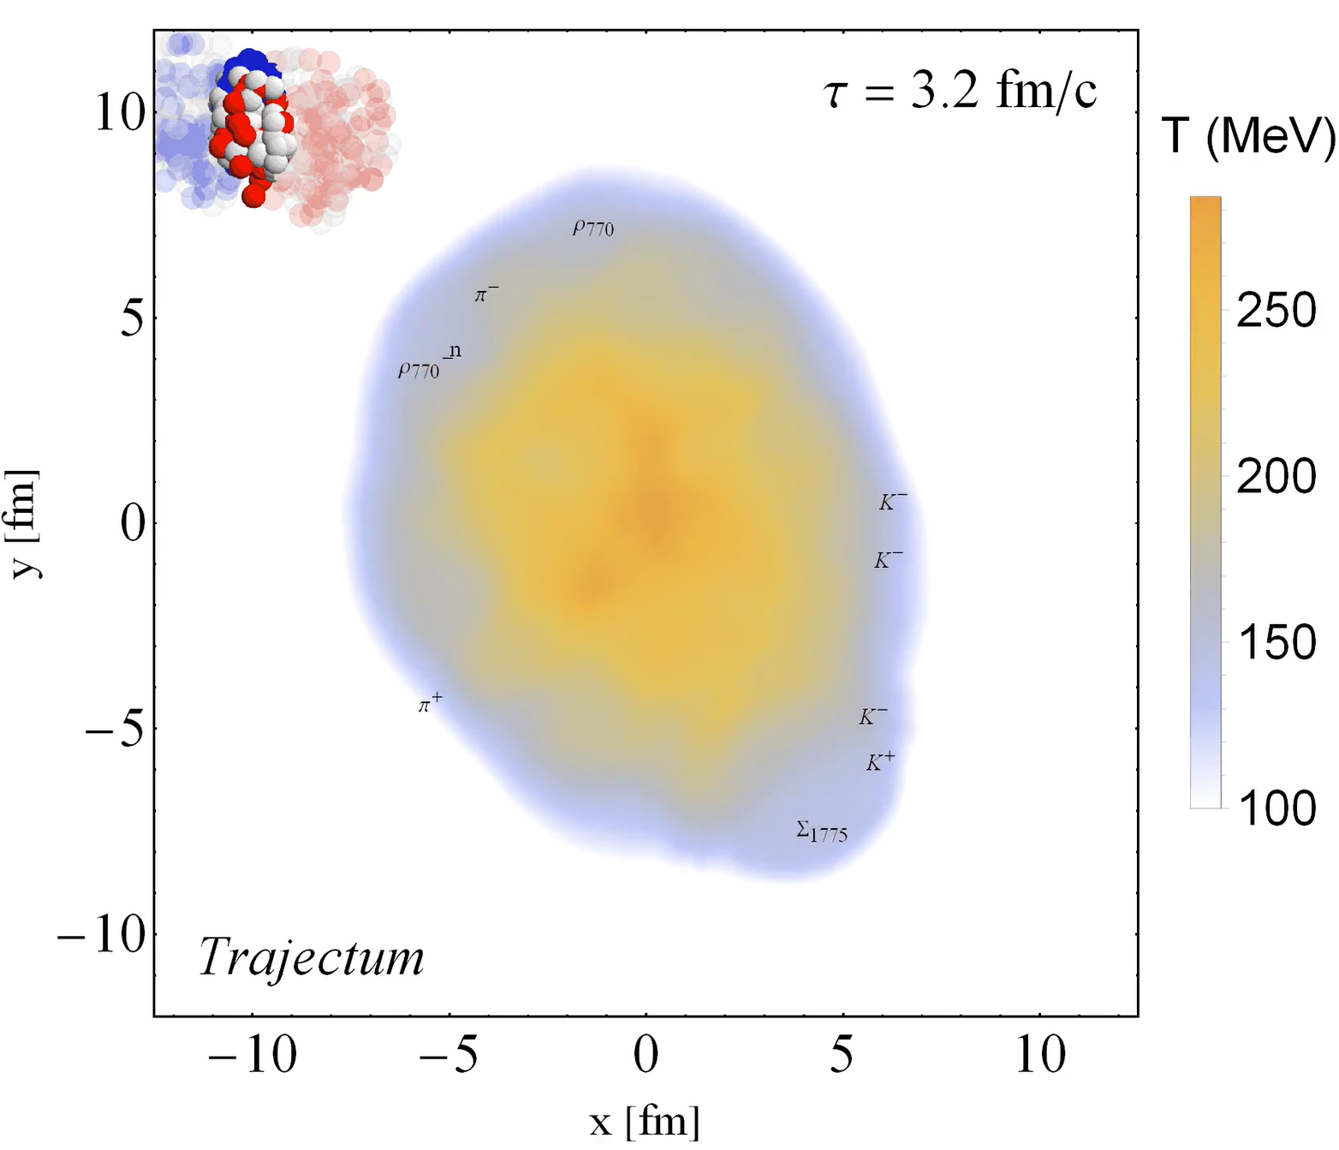
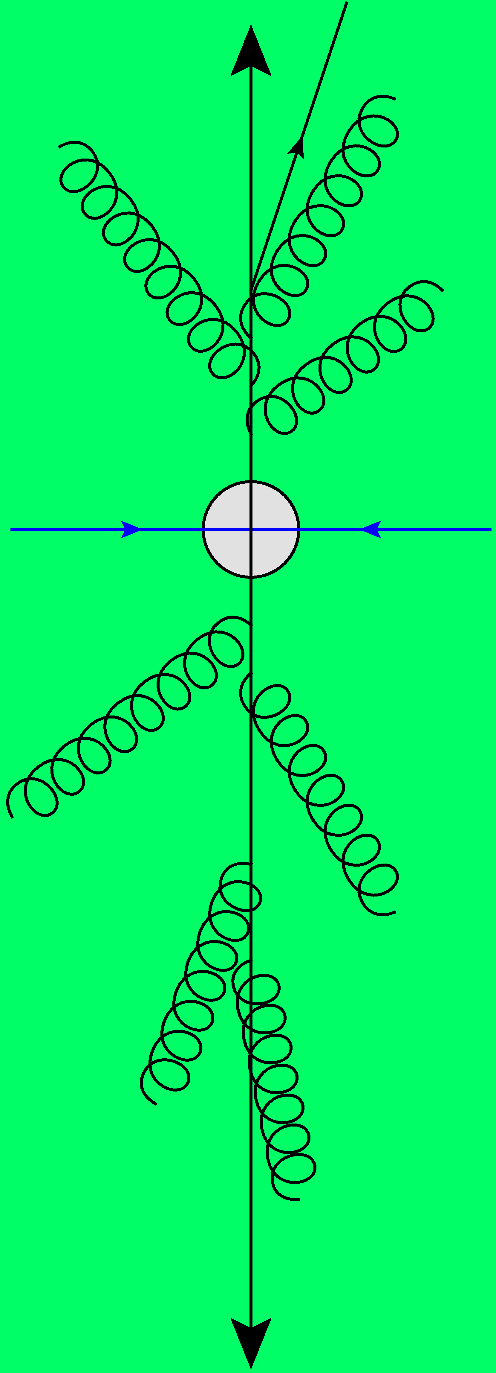
A theory perspective on heavy ion collisions
Many body physics in the hottest droplet on earth
Wilke van der Schee
Topical lectures, NIKHEF
7 June 2023

Slide 2
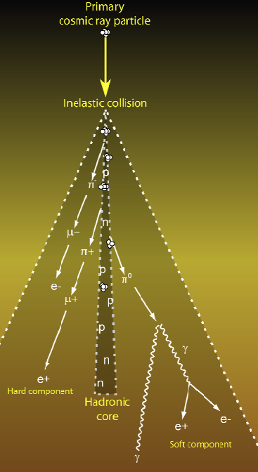
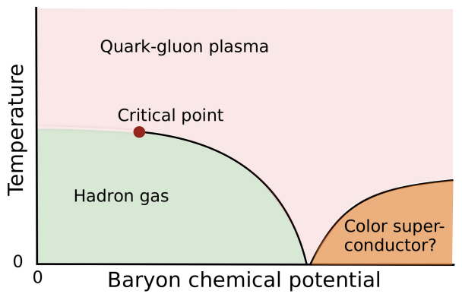
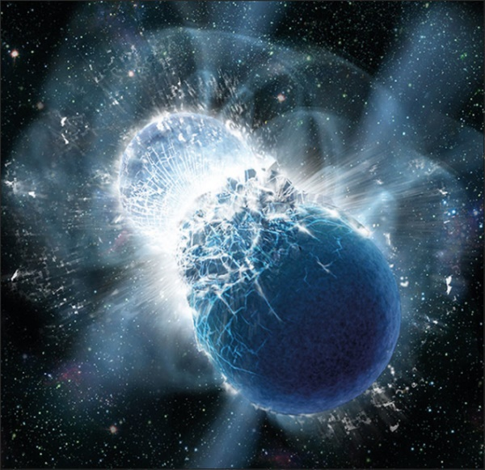
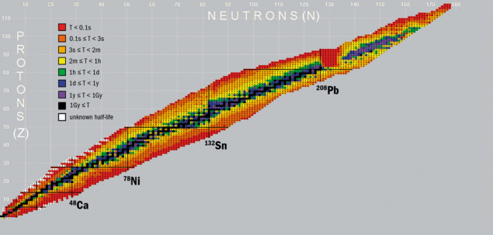
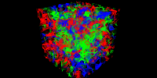
The scope of QCD
Particle showers
Quark-gluon plasma
?
Neutron star (mergers)
Nuclear structure
Lattice QCD
https://cerncourier.com/a/exploring-nuclei-at-the-limits/, https://cerncourier.com/a/neutron-star-mergers-create-heaviest-elements/

Slide 3
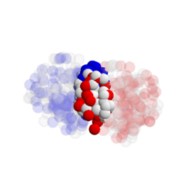
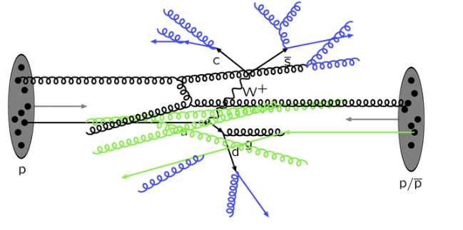
Wilke van der Schee, CERN/Utrecht
QCD at collider energies
Vacuum (`pp collisions’)
Collectivity (`pbpb collisions’)
Dominated by a few `hard’ scatterings
Typical framework:
Parton distribution functions (PDFs)
Hard scattering matrix elements
Parton showering and fragmentation
Relatively low particle production (~100)
Up to 2000 nucleon-nucleon collisions
Gluon density so high they thermalise
Hydrodynamics is important (viscosity etc)
Freeze-out into locally thermal spectra
Also `hard’ processes: hard probes
Up to 30.000 particles produced

Slide 4
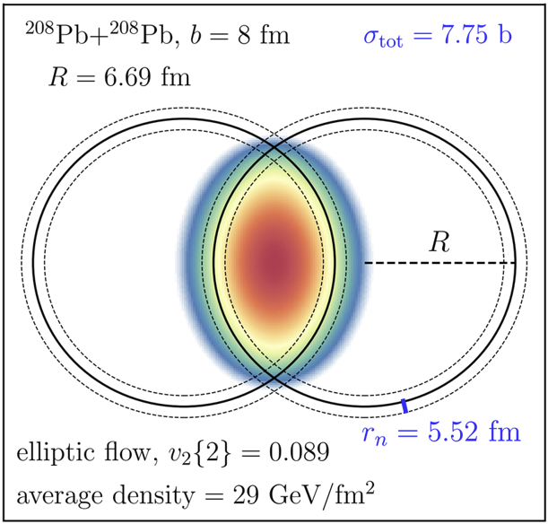
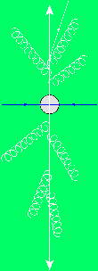
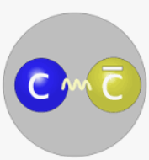
Wilke van der Schee, CERN/Utrecht
Heavy ion collisions – a window into strongly coupled matter
Soft (`collective effects’)
hard (`rare processes / probes’)
Spectra come from a thermal plasma
Can be more precise:
Radial flow boosts mean <p_{T}>
Anisotropy induces `elliptic flow’
Sensitive to shear/bulk viscosities
Study of quark-gluon plasma (QGP)
High p_{T} partons (jets)
Charateristically lose energy to QGP
Electroweak bosons (W/Z/γ)
Colourless: traverse QGP unmodified
Production modified by nPDF effects (cold)
Quarkonium, such as J/Ψ melting in QGP
J/Ψ can also be formed by charm recombination

Slide 5
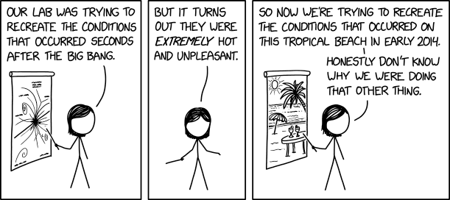
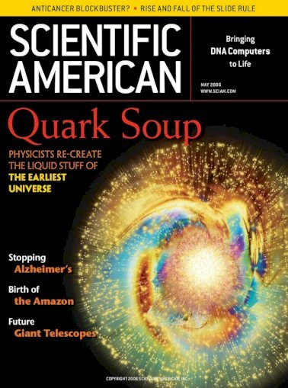
Quark-Gluon Plasma
16 fm
Colliding heavy nuclei (Pb, Au) at high energies
Lorentz gamma factor up to 2500 (LHC) or 100 (RHIC)
Hottest fluid:
10¹² K
Smallest fluid:
~ 2 fm living 10⁻²³ s
Most perfect/strange:
η/s ~ 0.08
Most vortical fluid:
ω ~ 10²²/s

Slide 6
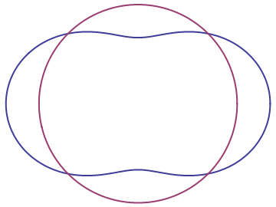
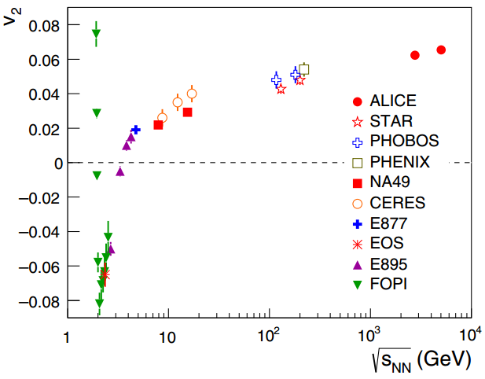
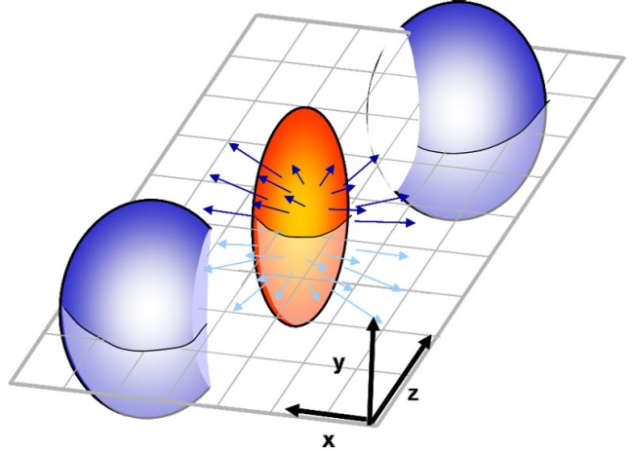
Elliptic flow: v₂, QGP is interesting
How anisotropic is the final state?
Ideal gas/weak coupling
Perfect fluid/strong coupling
K. Aamodt et al, Anisotropic Flow of Charged Particles in Pb-Pb Collisions at √s_{NN}=5.02 TeV (2016)

Slide 7
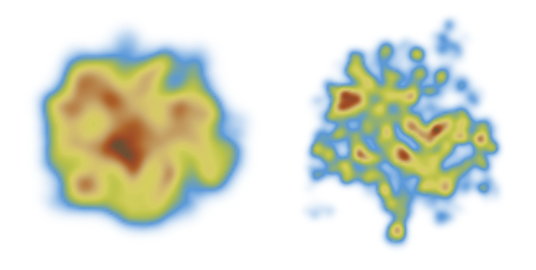
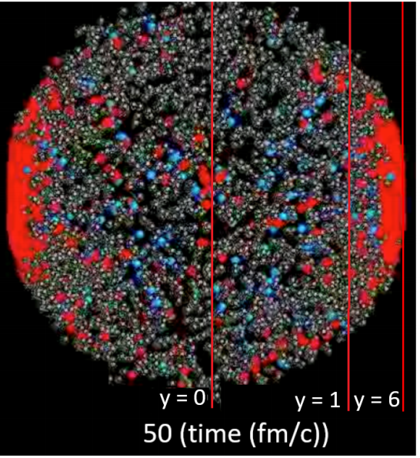
Standard model of heavy ion collisions
Wilke van der Schee, CERN/Utrecht
(# parameters)
Trajectum
Initial stage (11)
Viscous hydrodynamics (9)
Subnucleonic structure? (8)
Non-thermal flow? (2) with hydrodynamised initial stage
Fluctuations? (1)
Shear viscosity (4)
Bulk viscosity (3)
Second order transports: 2
Cascade of hadrons (1)
Jonah Bernhard, Scott Moreland and Steffen Bass, Bayesian estimation of the specific shear and bulk viscosity of quark–gluon plasma (2019)
Govert Nijs, WS, Umut Gursoy and Raimond Snellings, A Bayesian analysis of Heavy Ion Collisions with Trajectum (2020)

Slide 8
Hydrodynamics: first and second order
Relativistic version of Navier-Stokes for conformal hydrodynamics:
Depends on energy density ε and fluid velocity u (4 degrees of freedom).
Evolution equations: (conservation)
Transport/EOS: P(ε) (Equation of State), shear viscosity η and second order terms
For non-conformal hydro one gets more terms, including bulk viscosity. Rotation Ω usually small
with `spatial’ projection
R. Loganayagam, Entropy Current in Conformal Hydrodynamics (2008)
Notes:
Finite number of transport coefficients

Slide 9
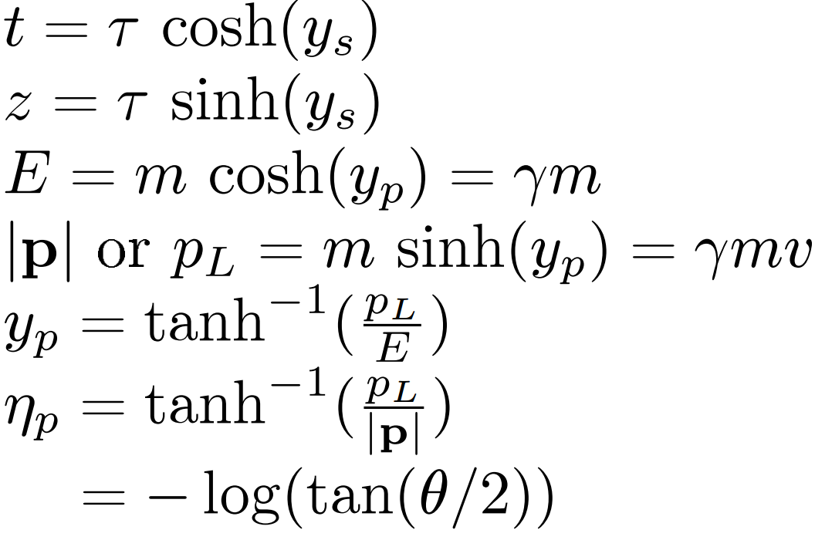
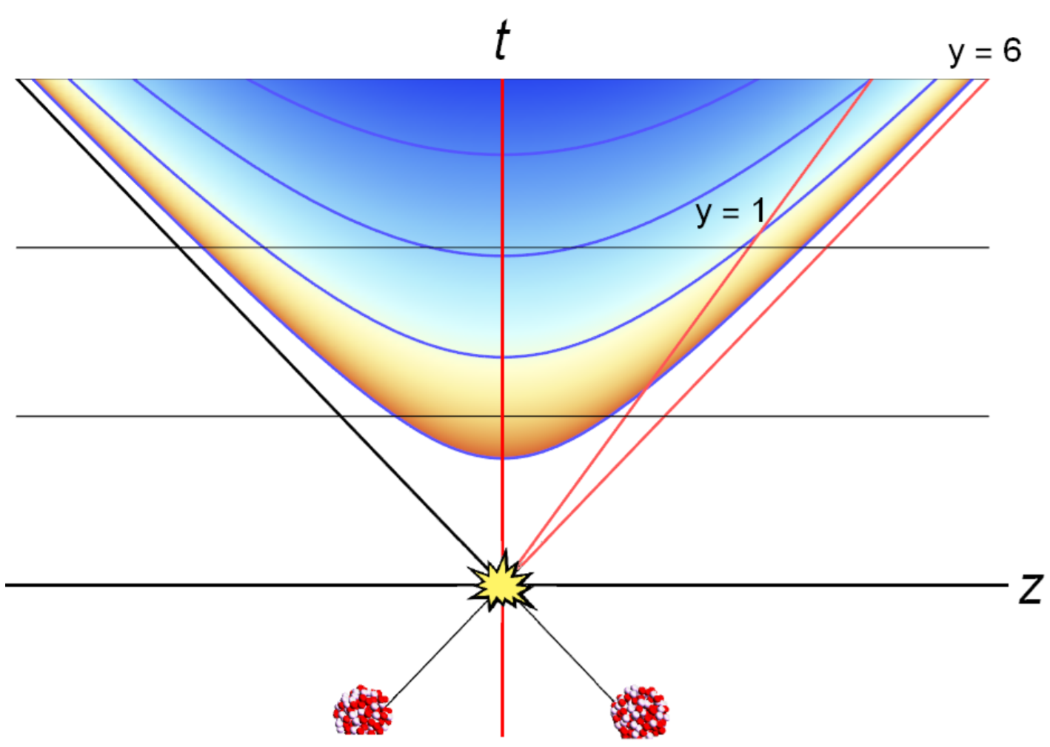
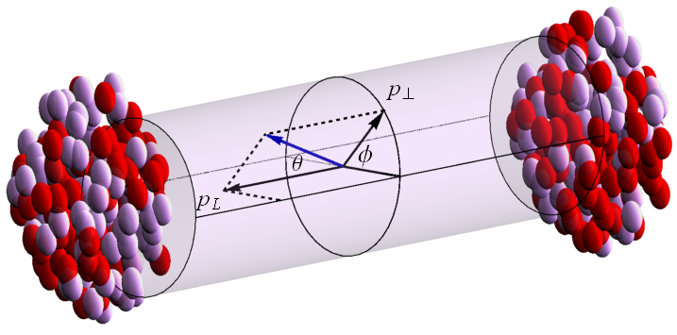
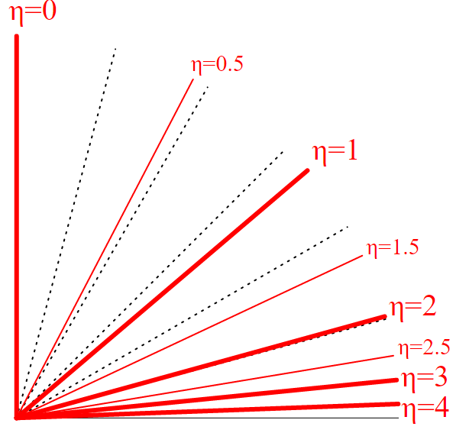
(pseudo)rapidity
Transverse and longitudinal dynamics
Note distinction between space and momentum rapidity
Boost invariance: no y-dependence Bjorken symmetry, simplest model for expanding plasma
Exercise: ALICE measures up to η=5.1, 4cm from beam, how big is the detector?

Slide 10
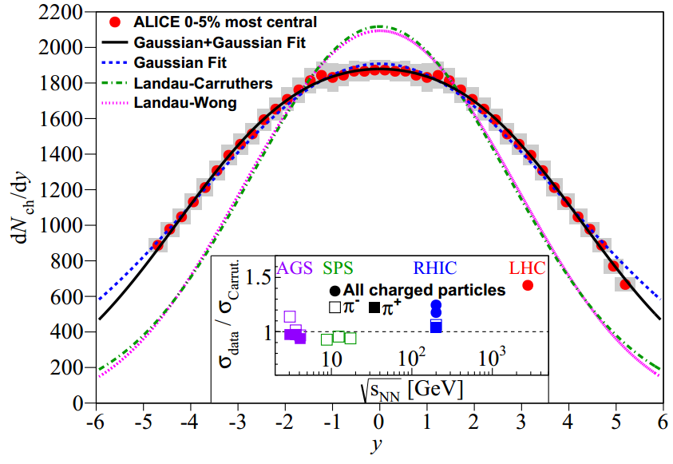
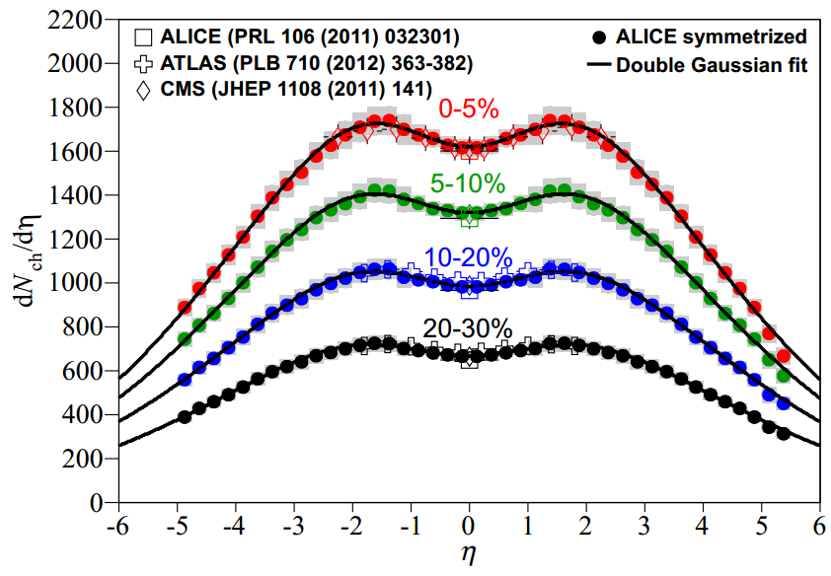
Rapidity versus pseudo-rapidity
Wilke van der Schee, MIT
Longitudinal particle spectrum
No real boost invariance: rapidity dependence Gaussian width (~ 2 at RHIC, ~3 at LHC), with Jacobian depending on mass
Theorists prefer y, experimentalists η
ALICE, Centrality dependence of the pseudorapidity distribution for charged particles in Pb–Pb collisions at √s_{NN} = 2.76 TeV (2013)

Slide 11
Many different kinds of observables
Wilke van der Schee, CERN/Utrecht
Total cross section
Spectra as a function of:
Centrality
Transverse momentum (p_{T})
Particle identification (PID): pions, kaons, protons, lambdas, etc …
Anisotropic flow, like v₂
Again as a function of centrality, p_{T} and PID
Higher orders (up to v₁₀)
More complicated observables
Correlations among observables above, as a function again of centrality
Event plane angles and their correlations, etc
Notes:
Parameters influence observables in complex and non-linear way
Global analysis needed
Run on design points + emulate
MCMC with Bayes theorem and over 500 datapoints
Verify that high probability parameter set works well with other observables
Similar to gravitational waves with for instance waveform determines correlation between distance and inclination

Slide 12
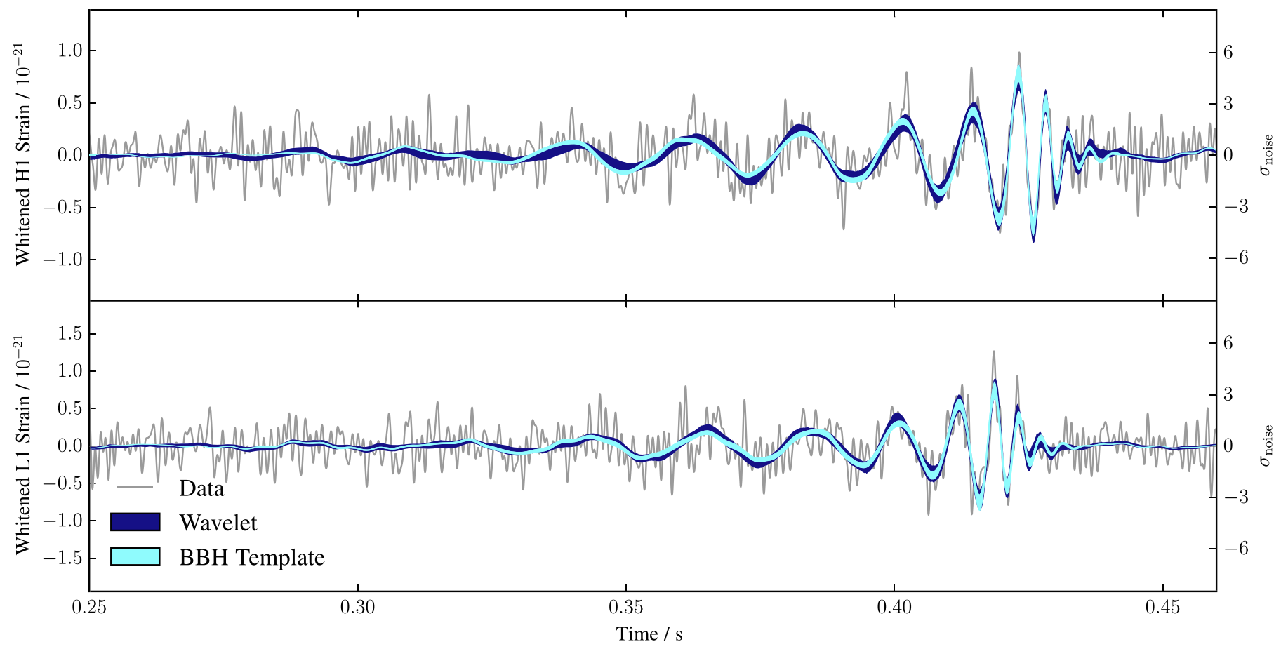
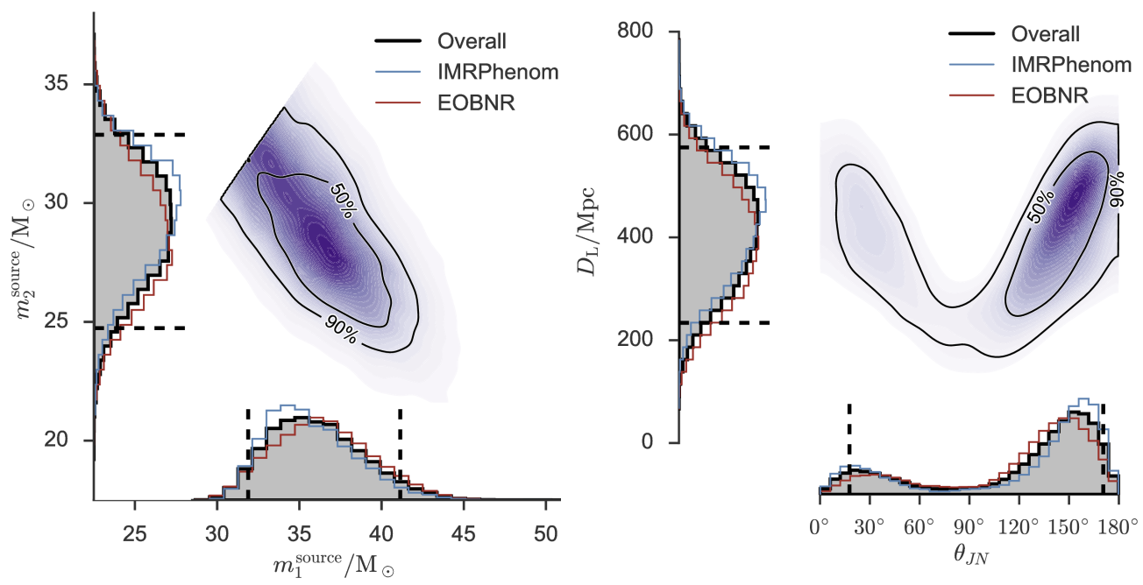
Performing a global analysis
Wilke van der Schee, CERN/Utrecht
Bayes theorem:
Same technique: gravitational waves
Model depends on parameters non-linearly
Run model on 1200 `design’ points
Use an emulator for any point in parameter space (GP)
Markov Chain Monte Carlo
653 data points
Obtain posterior probability density of parameters
EMCEE code (`hammer of mcmc’)
Compare posterior with data
Can include high statistics run
LIGO, Properties of the Binary Black Hole Merger GW150914 (2016)
https://emcee.readthedocs.io/en/stable/
Notes:
Parameters influence observables in complex and non-linear way
Global analysis needed
Run on design points + emulate
MCMC with Bayes theorem and over 500 datapoints
Verify that high probability parameter set works well with other observables
Similar to gravitational waves with for instance waveform determines correlation between distance and inclination

Slide 13
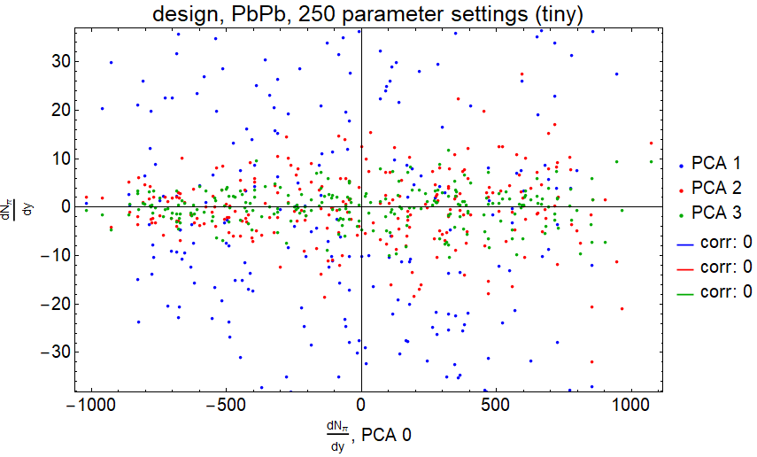
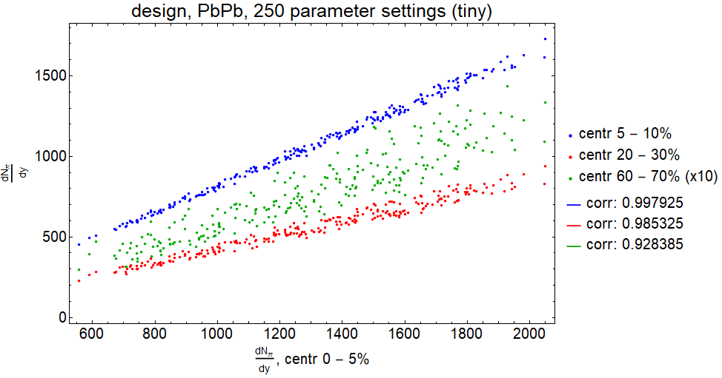
Analysing the model: correlations
Wilke van der Schee, CERN
Bayes theorem:
Many observables, but they are (often) highly correlated
PCA analysis: linear transformation among observables
Orders d.o.f. in decreasing variance; removes correlations
An example: pion multiplicity in 4 different centrality bins
Less correlation between central and peripheral (0.928)
Notes:
Two lines, gravity to the strong force,
Mergers and intractable problems by exploiting Maldacena’s

Slide 14
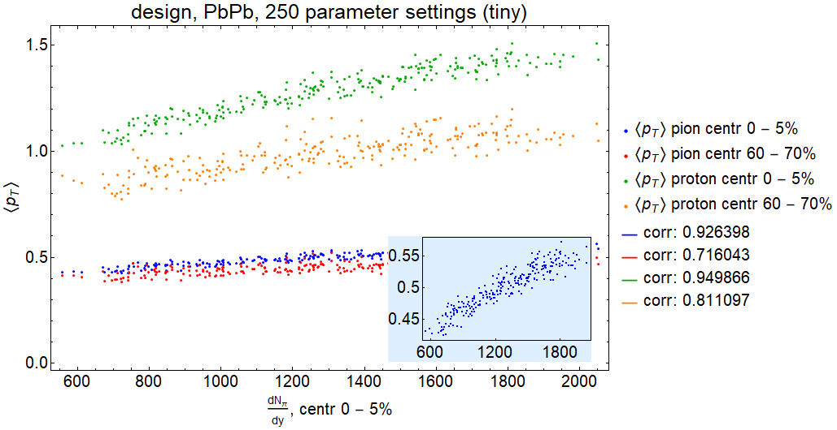
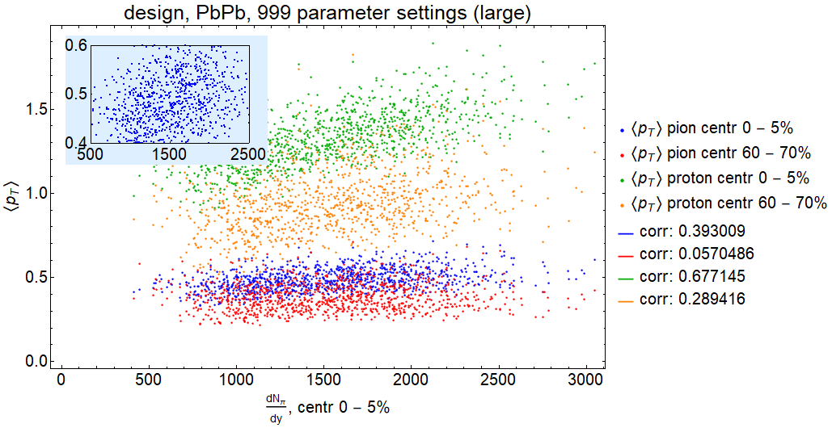
Analysing the model: correlations
Wilke van der Schee, CERN
`Tiny’ mean pion and proton p_{T} still correlated with pion multiplicity
Even the hardly varying pion pT
Much more complicated for a large dataset
Quite natural: bulk viscosity compete norm, etc
Still blue quite striking: central pion p_{T} versus central pion multiplicity
Notes:
Two lines, gravity to the strong force,
Mergers and intractable problems by exploiting Maldacena’s

Slide 15
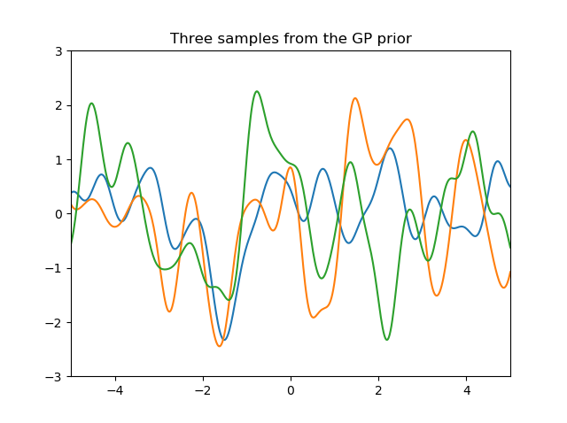
Design points are not enough: emulate rest
Wilke van der Schee, CERN
Emulation using Gaussian Processes
Non-parametric: finds (Bayesian) probability over distribution of functions f(x)
Uses prior + observations (e.g. 250 design points)
Prior kernel defines function similarity versus distance in x-space; standard:
Length term + noise term (uncorrelated): hyperparameters
If independent of x: long length scale
f: n points that are `given’
f*: m points we like to estimate
K: correlation between points
L = 1/M ² = 0.1
Carl Rasmussen and Christopher Williams, Gaussian Processes for Machine Learning (2006)
Katherine Bailey, https://katbailey.github.io/post/gaussian-processes-for-dummies/ + Python Sci-kit

Slide 16
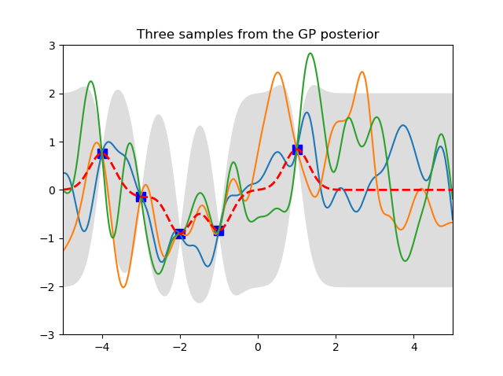
Design points are not enough: emulate rest
Wilke van der Schee, CERN
Emulation using Gaussian Processes
Add training data f; compute Bayesian posterior distribution for f*:
GP work for any dimension ☺
Hyperparameters need to be optimised (‘training’ the emulator)
L = 1/M ² = 0.1
Carl Rasmussen and Christopher Williams, Gaussian Processes for Machine Learning (2006)
Katherine Bailey, https://katbailey.github.io/post/gaussian-processes-for-dummies/ + Python Sci-kit
Notes:
Two lines, gravity to the strong force,
Mergers and intractable problems by exploiting Maldacena’s

Slide 17
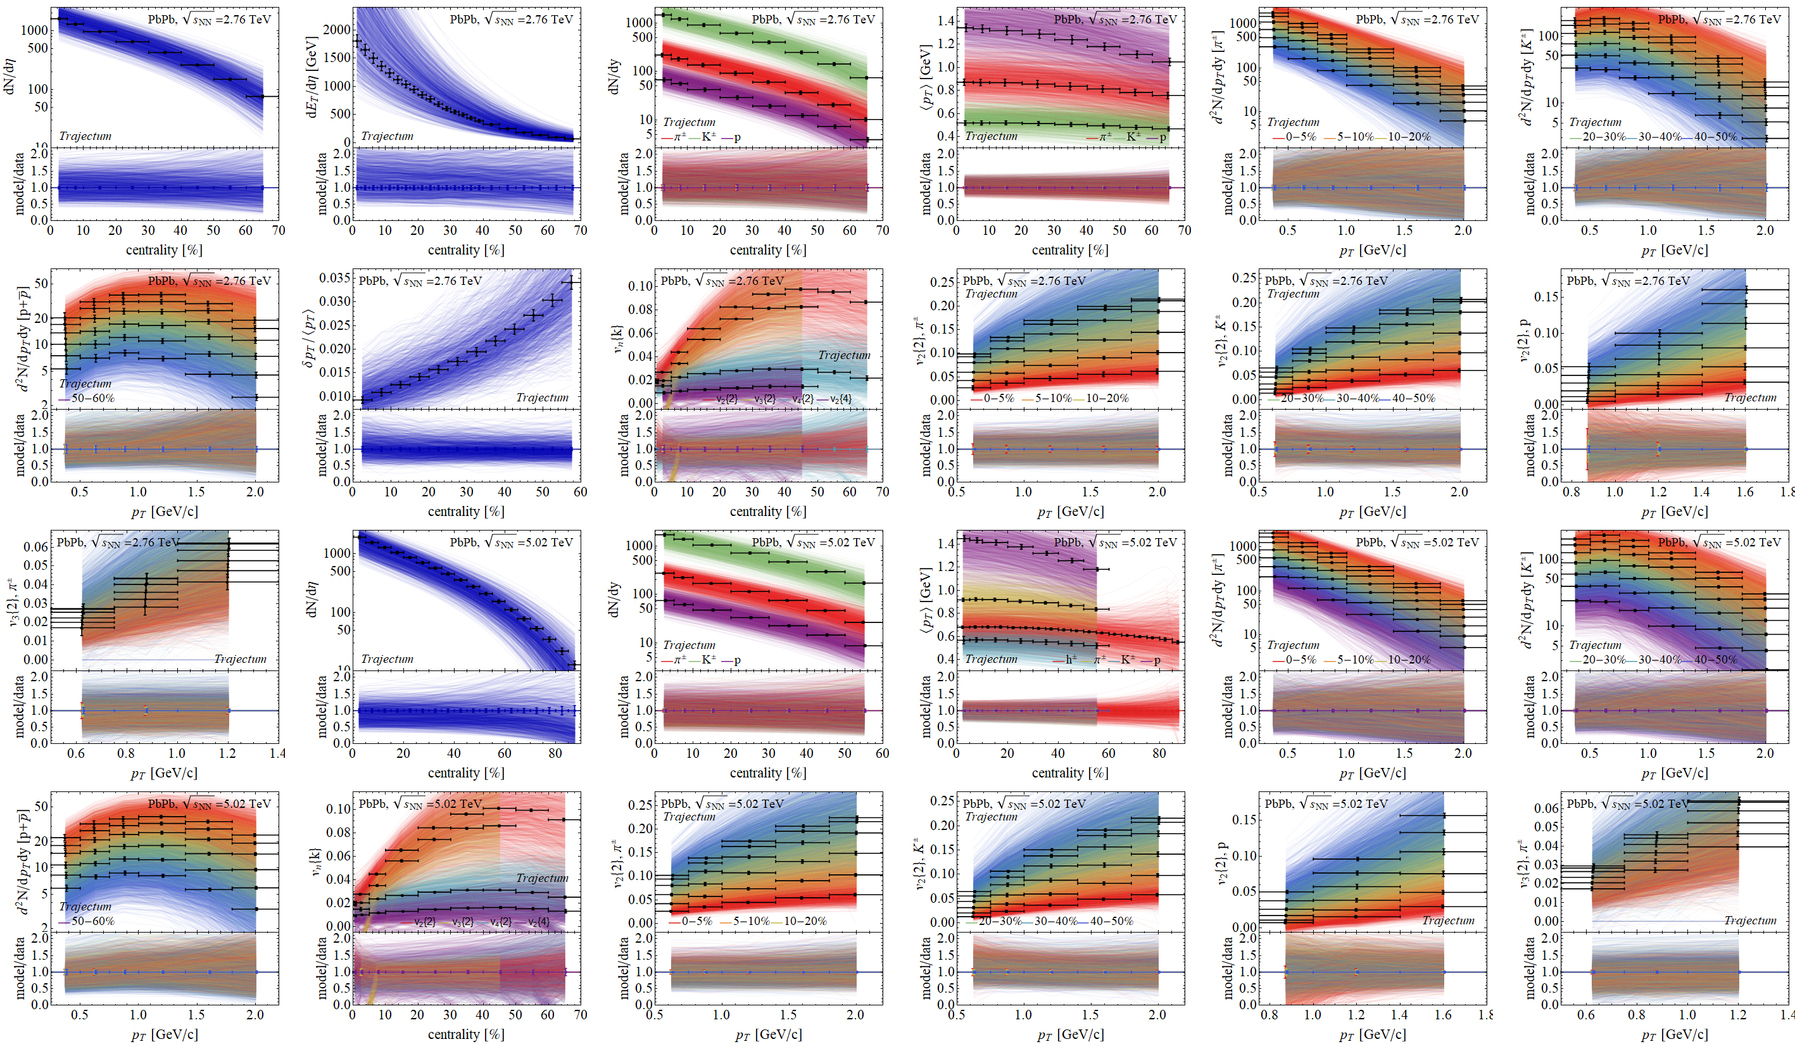
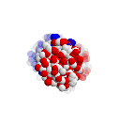
Experimental observables: a wealth of data
Prior

Slide 18
Experimental observables: a wealth of data
Posterior

Slide 19
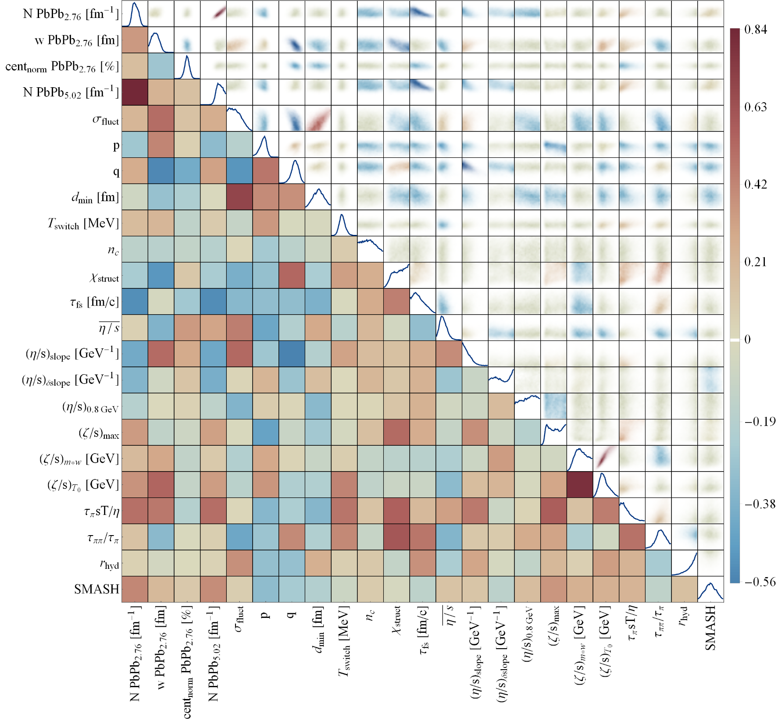
Full posterior distributions
Wilke van der Schee, CERN/Utrecht
Some parameters better constrained than others
Correlations add important information, e.g. width constrained much more accurately if q parameter is known

Slide 20
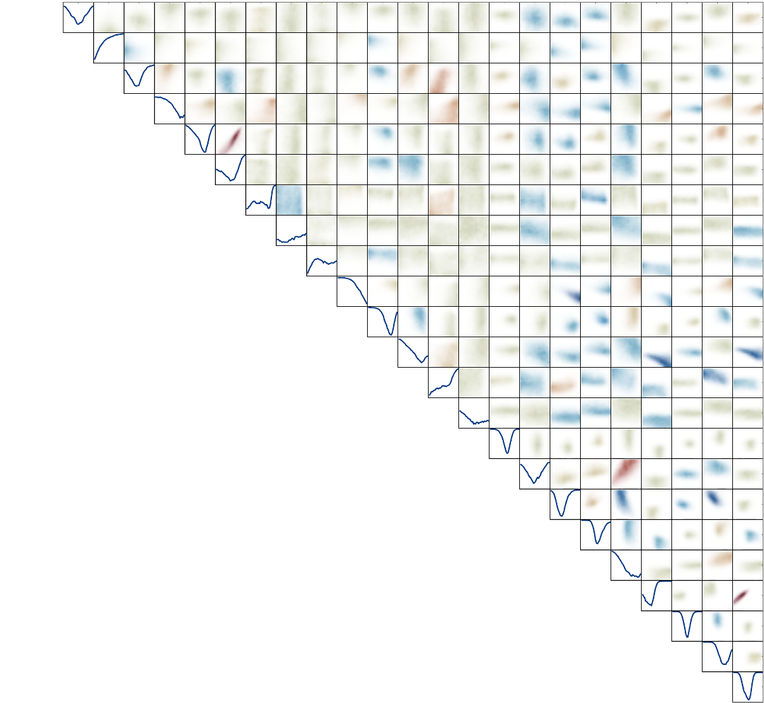
Discussion
Exciting progress using global analyses
Heavy ion collisions towards percent level precision
Wealth of data, most of it understood within hydrodynamic framework
Many things left out:
Hard probes, jets, jet-hydro interaction
Flavoured particles (strange, charm, beauty..) and their characteristics
Parton distribution functions and their nuclear modifications
Exciting topics in `small’ systems (p-Pb, OO …): hydro at its limit
Interaction with nuclear structure (oxygen, neutron skin of lead…)
`Special’ observables such as ultracentral collisions (highest 0.01%)

Slide 21
Back-up

Slide 22
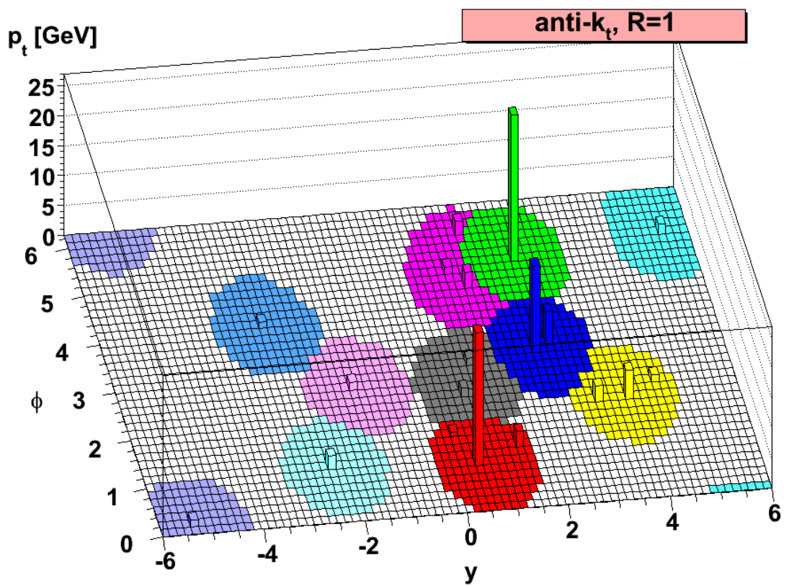
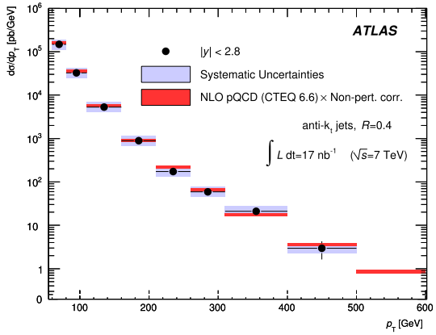
Jet spectra
Clustering algorithm: anti-k_{T}
Clusters around hard cores:
Matteo Cacciari, Gavin P. Salam and Gregory Soyez, The anti-k_{t} jet clustering algorithm (2008)

Slide 23
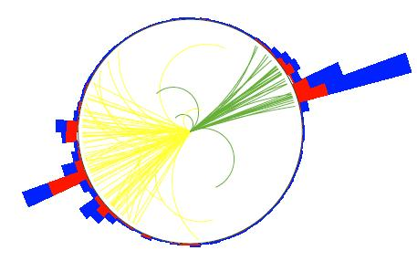
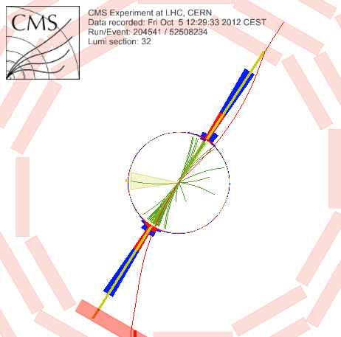
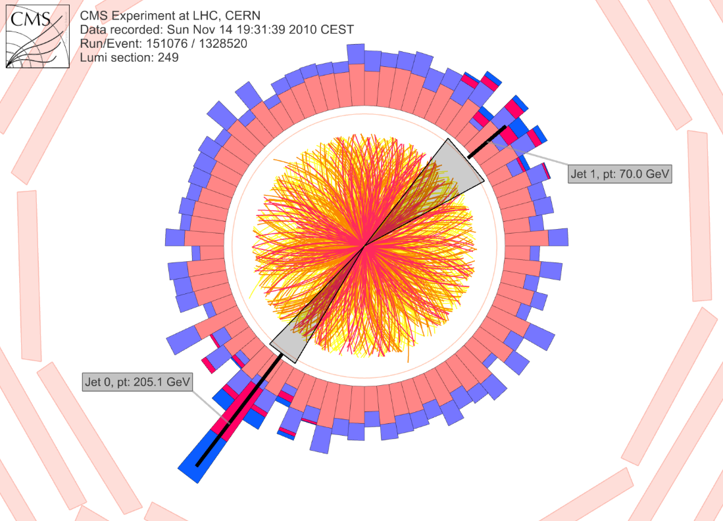
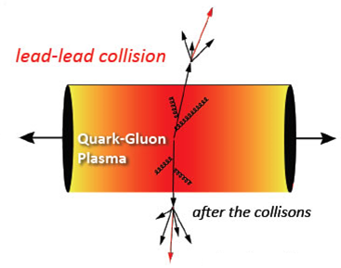
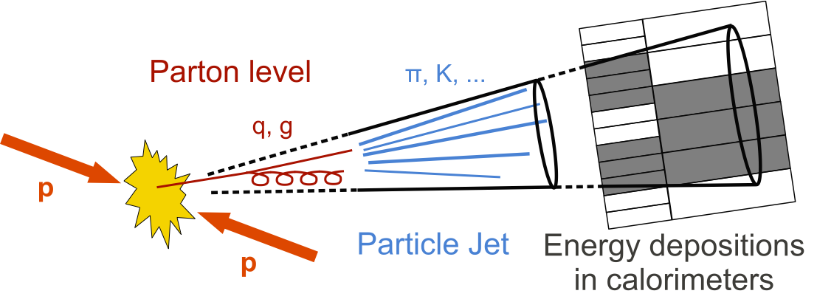
Jets in QGP
?
CMS PAPER EXO-12-059
Notes:
Many states + linearized

Slide 24
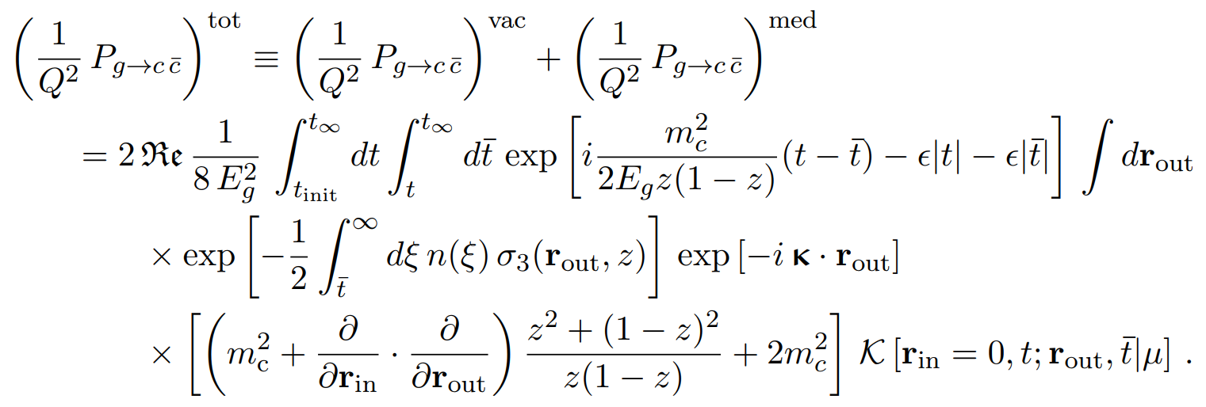
Heavy flavour theoretically
Aleksas, Jasmine, Maximilian, Sohyun, Urs, Wilke and Gian Michele (ALICE)
Medium modified splitting function after scattering with N medium constituents
Depends on density n(ξ); medium modified propagator K, cross section σ₃
Two characteristics:
amplitude (yield)
transverse momentum κ (broadening)
Aleksas, Jasmine, Maximilian, Sohyun, Urs, Wilke and Gian Michele, The medium-modified g → cc¯ splitting function in the BDMPS-Z formalism (2022)

Slide 25
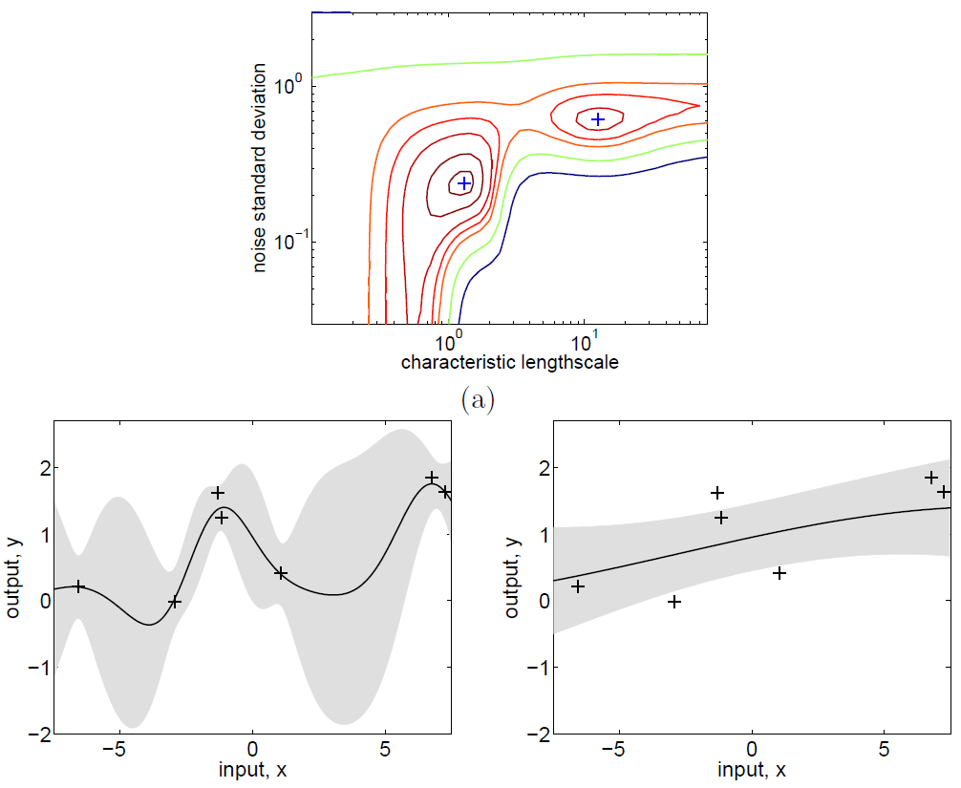
Design points are not enough: emulate rest
Wilke van der Schee, CERN
Training the emulator with training data: determine hyperparameters
Find l to maximise chance of finding training data
Log likelihood, marginalise over functions f:
First term fits data; second penalizes complexity
Prefer left fit:
Carl Rasmussen and Christopher Williams, Gaussian Processes for Machine Learning (2006, page 116)
Notes:
Two lines, gravity to the strong force,
Mergers and intractable problems by exploiting Maldacena’s

Slide 26
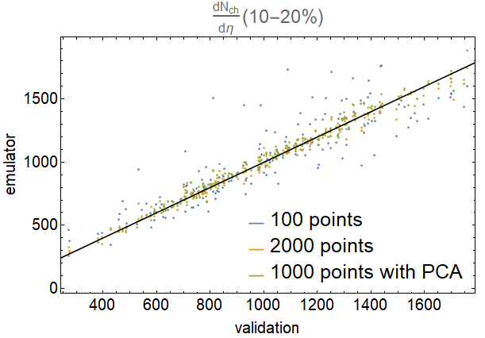
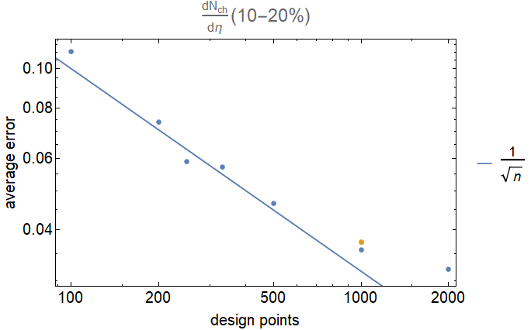
Does it really work? Validate!
Wilke van der Schee, CERN
Emulator gives (statistical) error: in principle sufficient
Nevertheless, validate with O(10%) extra validation points
Example: dN_{ch}/dη for 10-20% centrality, large dataset:
Notes:
Two lines, gravity to the strong force,
Mergers and intractable problems by exploiting Maldacena’s

Slide 27
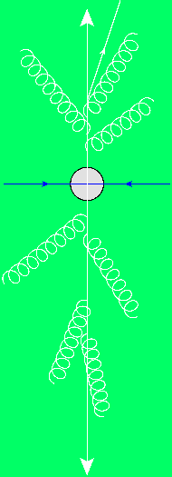
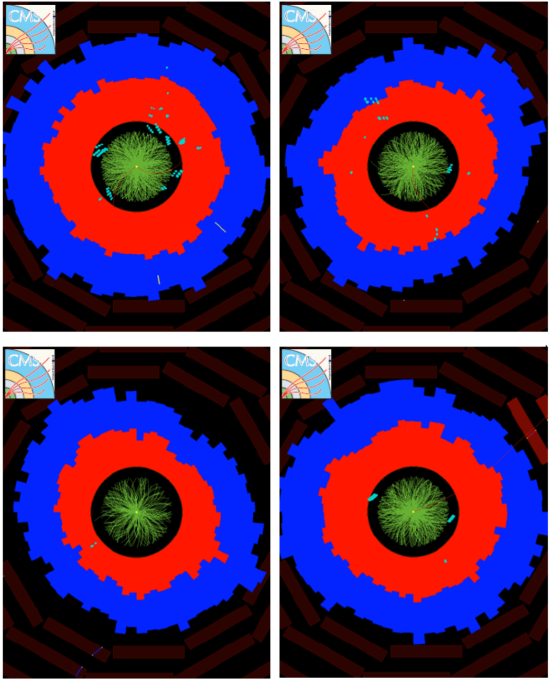
Quark-gluon plasma is strongly coupled
Wilke van der Schee, CERN/Utrecht
1. Initial stage - QGP - hadronic phase
2. Anisotropic/elliptic flow (v₂)
Small viscosity: strong coupling
φ
3. Jet energy loss in dijet pair
Wit Busza, Krishna Rajagopal and WS, Heavy Ion Collisions: The Big Picture, and the Big Questions (2018)
Notes:
Quick intro HIC
Historically: Weak coupling: slow thermalization and larger viscosity
Review: now notice anisotropic flow

Slide 28
Energy + viscosities + experiment
Ten different probable parameter settings →
Centrality →

Slide 29
Design parameter-observable correlations:
Wilke van der Schee, CERN/Utrecht

Slide 30
The shape of nuclei
Benjamin Bally, James Daniel Brandenburg, Giuliano Giacalone, Ulrich Heinz, Shengli Huang, Jiangoyng Jia, Dean Lee, Yen-Jie Lee, Wei Li, Constantin Loizides, Matthew Luzum, Govert Nijs, Jacquelyn Noronha-Hostler, Mateusz Ploskon, WS, Bjoern Schenke, Chun Shen, Vittorio Somà, Anthony Timmins, Zhangbu Xu and You Zhou
Imaging the initial condition of heavy-ion collisions and nuclear structure across the nuclide chart (2022)

Slide 31
Wilke van der Schee, CERN/Utrecht
Neutron star mergers are just big heavy ion collisions, right?
Neutron stars
Heavy ion collisions
Driven by gravity / general relativity
Large baryon density
Zero to low temperature (~50 MeV)
Dynamics is 3+1 dimensional
Shear viscosity due to (numerical) turbulence
Cools down ‘slowly’ by neutrinos
Harmonics probe sturdiness
Gravity can be ignored (very) safely
Small baryon density
High temperature (up to 500 MeV)
Dynamics is 2+1+1 dimensional
Large gradients, ‘real’ viscosity is important
Cools down quickly by expansion, no neutrinos
Harmonics probe spatial anisotropy

