Slide 1
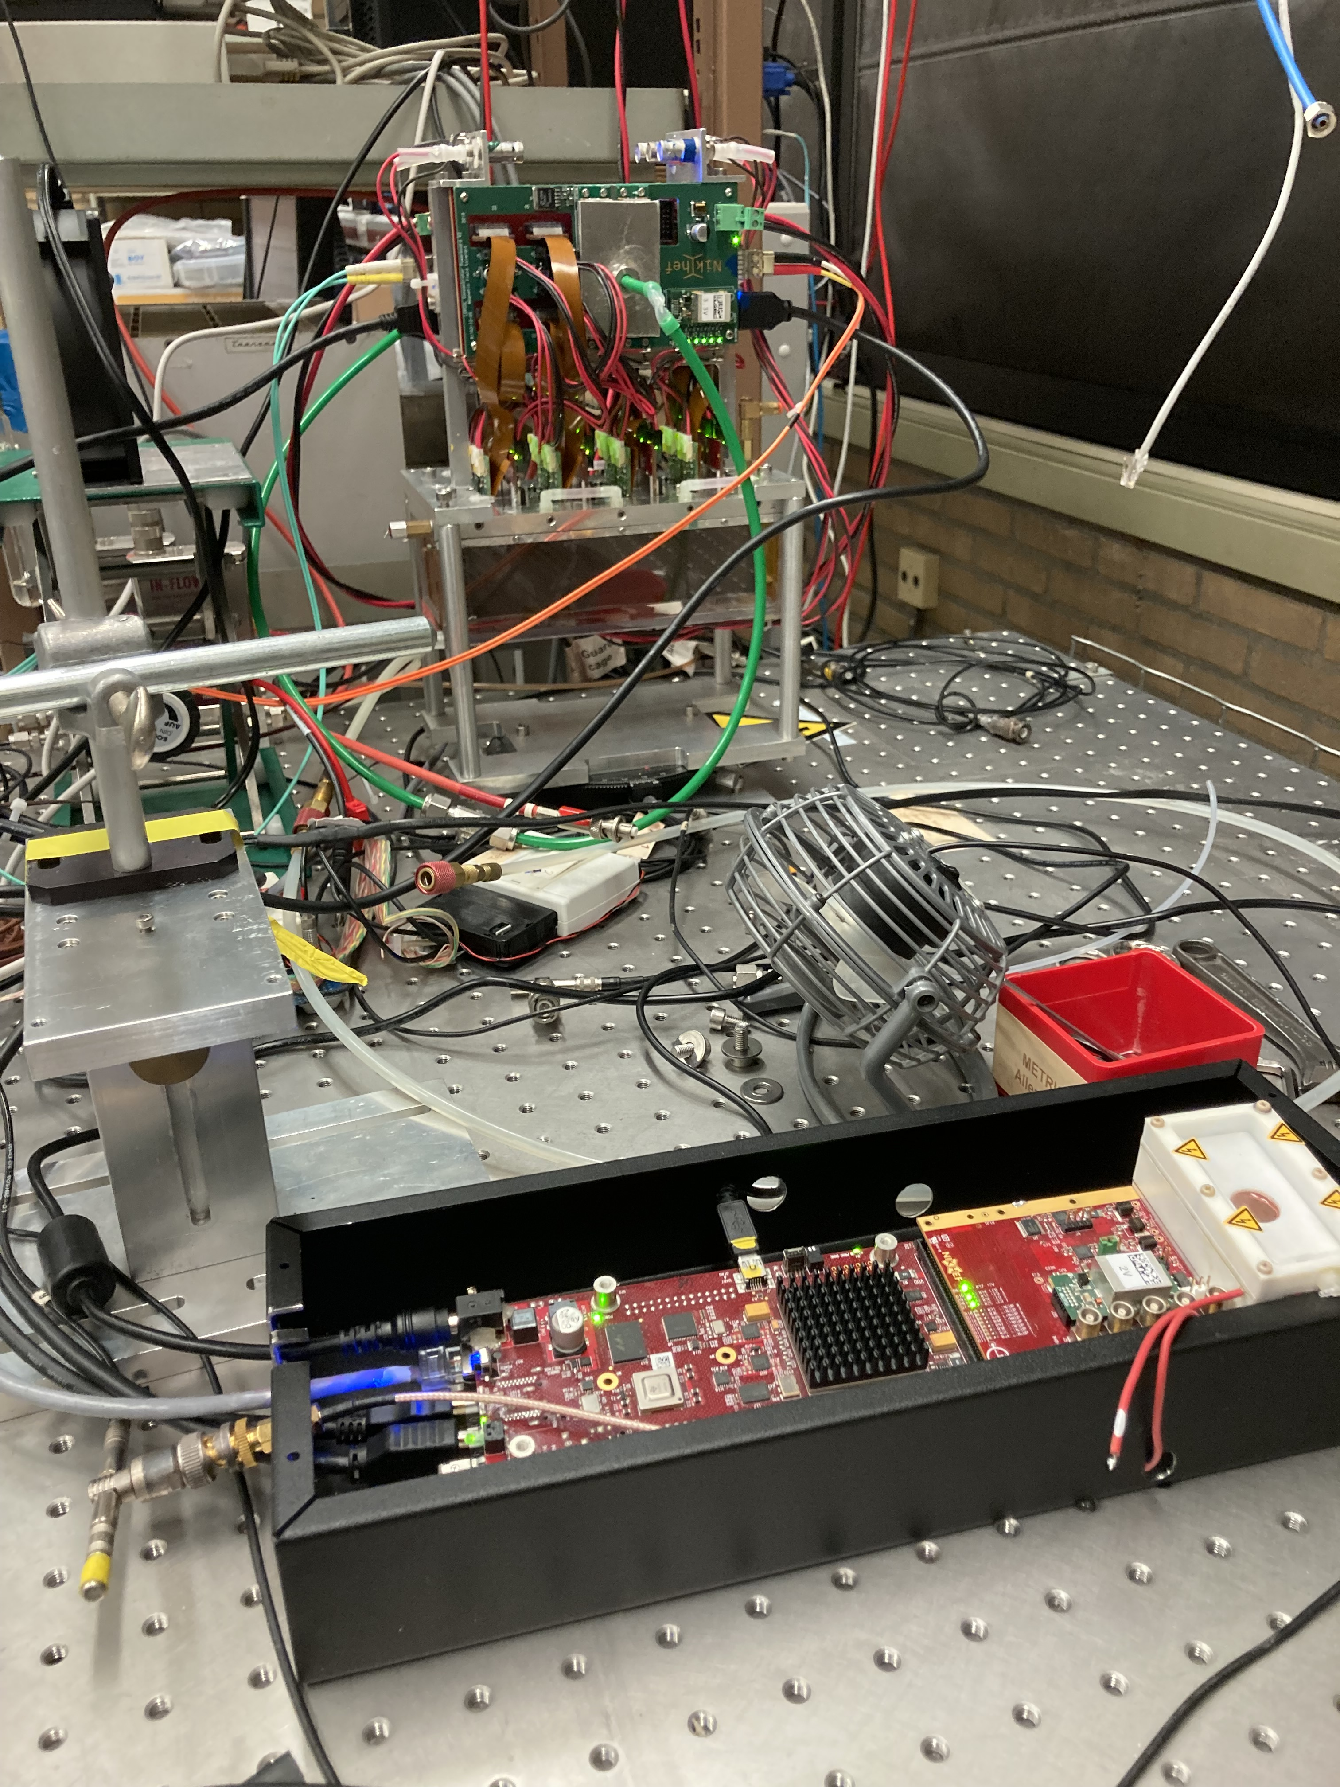
Repairing the Module in Bonn
On 25-26-27 January Fred and I will go to Bonn.
There are two goals:
Repair of the module in Bonn. Chip 11 has a short. See next slide for geometry. The quad with chips 28-31 has a low efficiency and low ToT. Can this be fixed/improved?
Take the module with the DAQ to Nikhef to prepare for shipping to the US. The idea is to test the DAQ, pack the detector and send it.

Slide 2
Geometry of the 8 quad module
The offline geometry follows this picure and has 0,0 in the lower bottom corner and x runs upwards
The x laser (indicated with the arrow) starts scanning at high offline x values
x local = off line x
off line x = - x (laser)
x local
y local

Slide 3
Summary of repair work in Bonn
Looked at the quad with low ToT; HV is well connected. Question is whether this correlated to the mean threshold per chip.
Took off the box with entrance and exit windows that was used for the DESY test beam. To protect the detector for shipping we put on the laser set up box after cutting the wires (without field cage).
We also dismounted the field cage; and the guard wires that are connected to the cage. This means that in the US the guard wires should be redesigned in put on with the end plate and guard if the end plate.
Chip 11 had a short. After removing the L shaped guard and resoldering and connecting to the grid the short was gone. Further visual inspection with the microscope showed that the HV wire and the bond wire were very close; Fred pushed the wires away from each other.

Slide 4
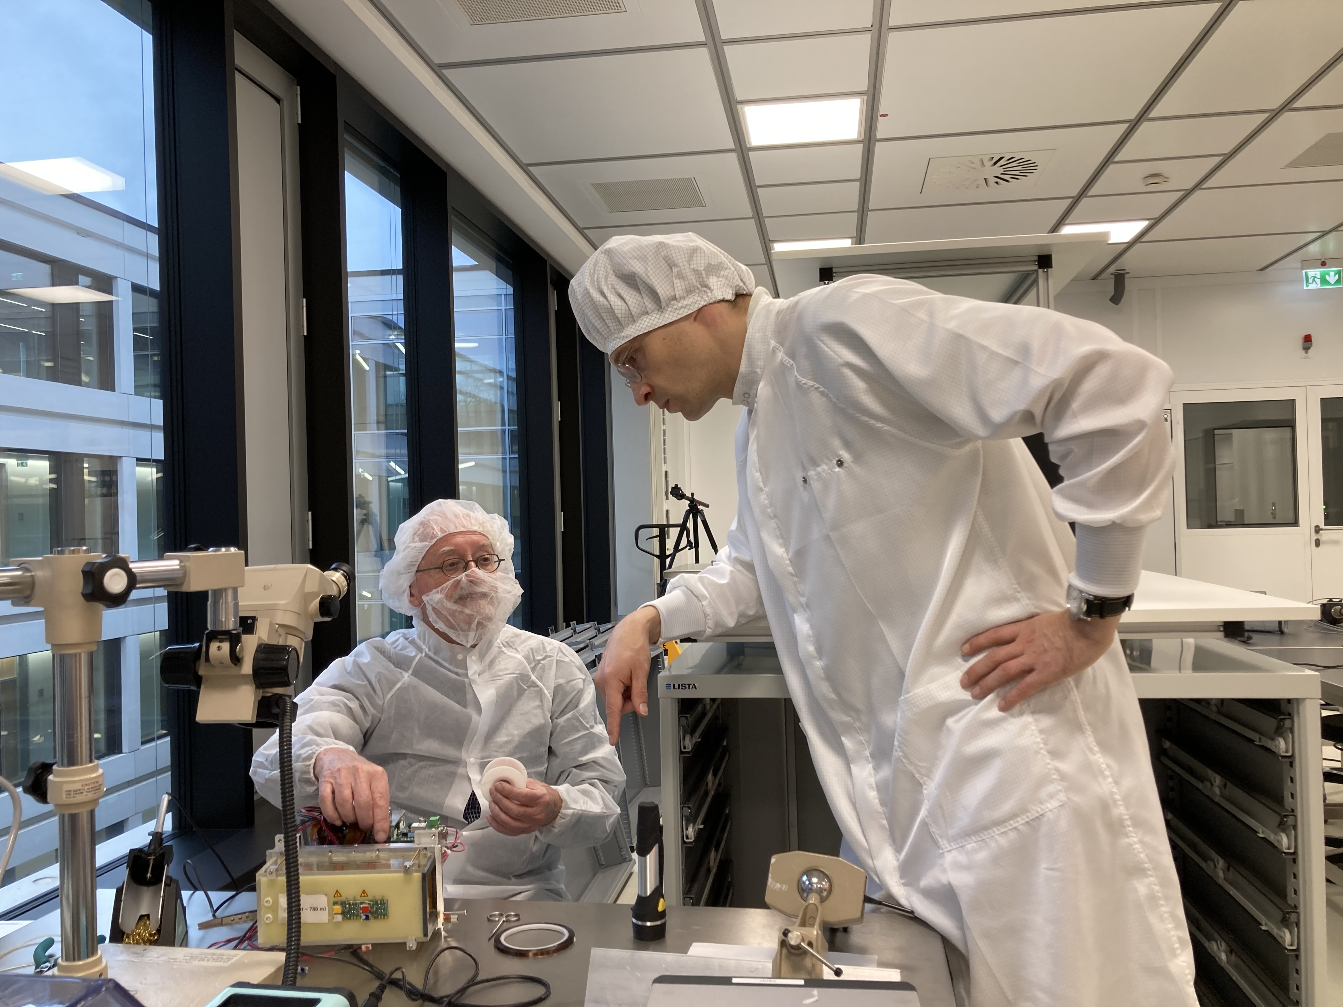
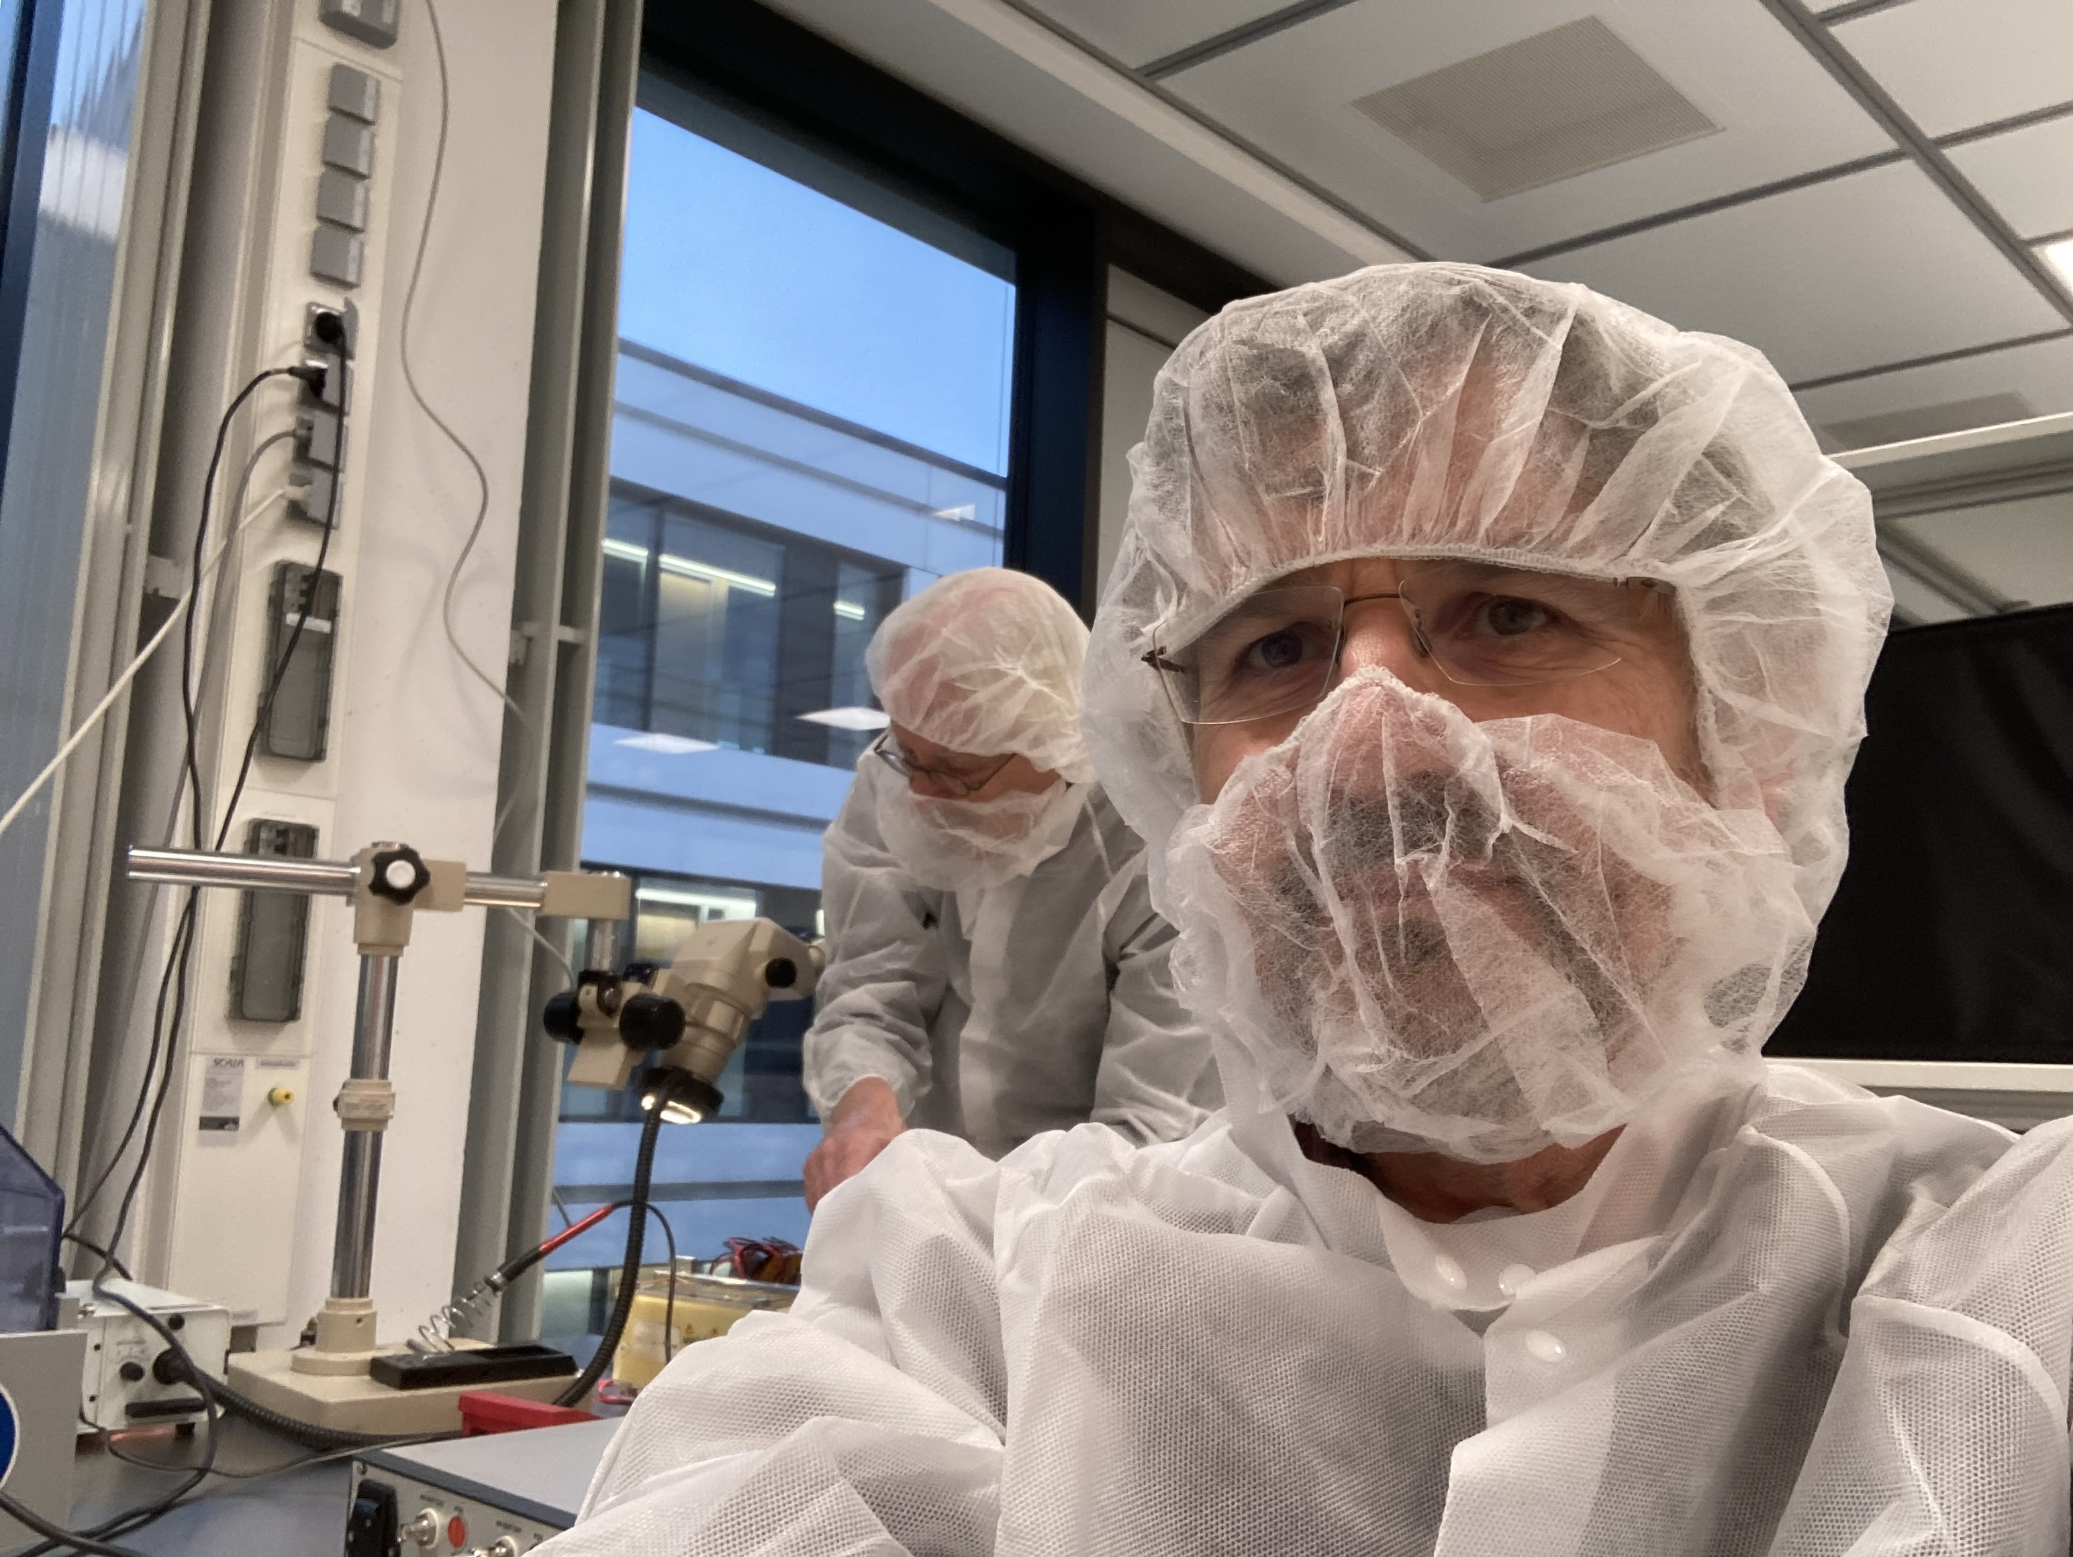
Pictures of repair work in Bonn

Slide 5
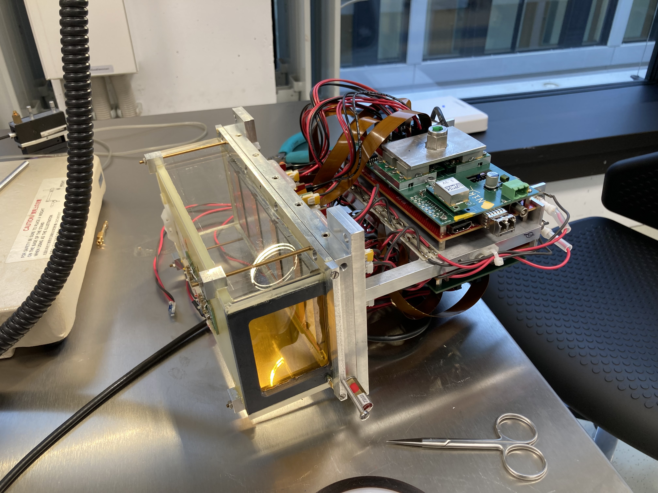
Pictures of repair work in Bonn
At the start

Slide 6
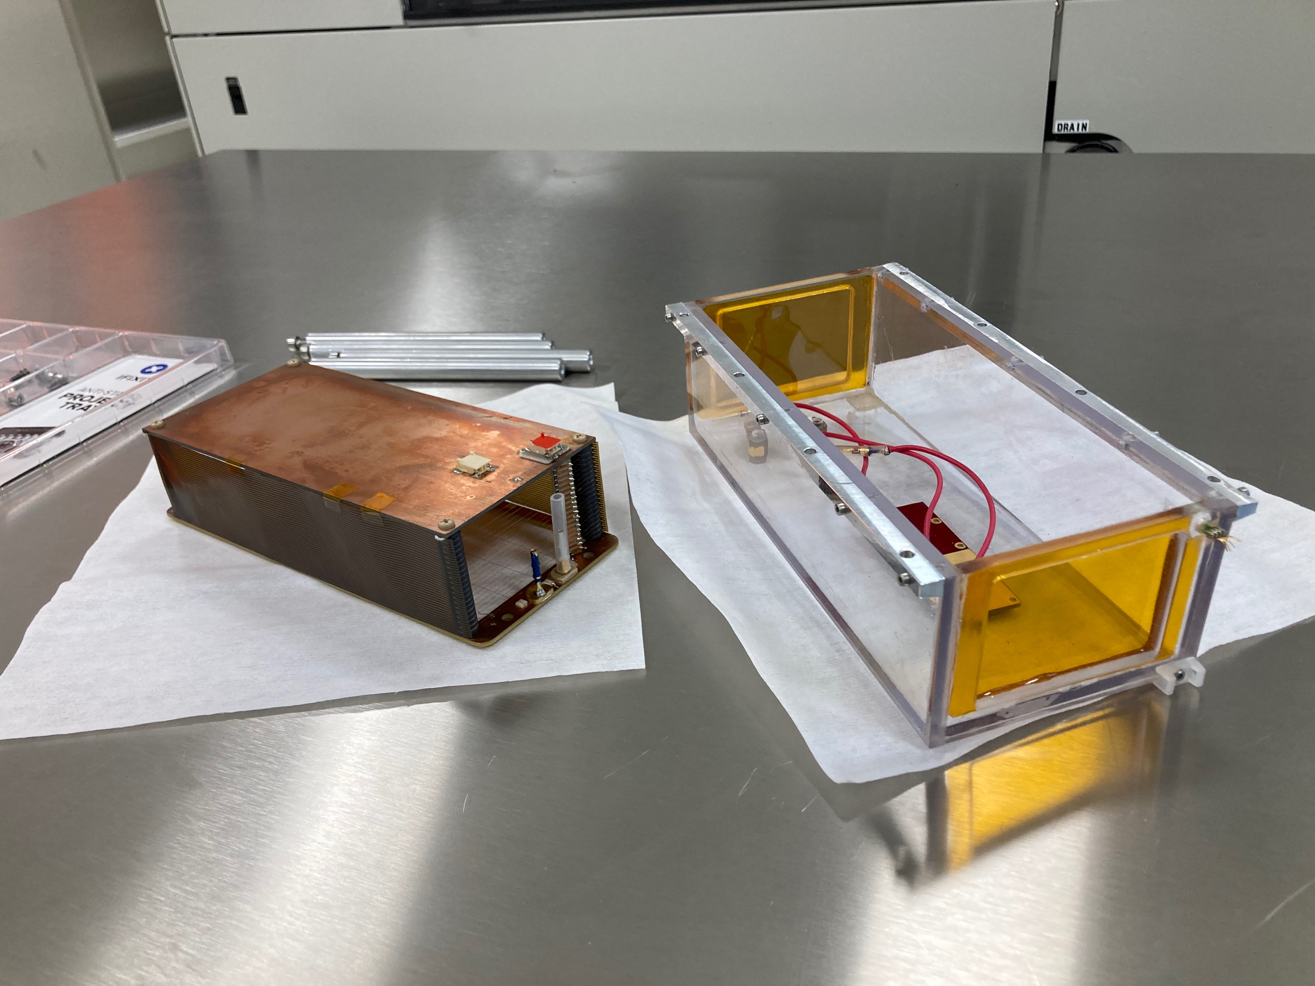
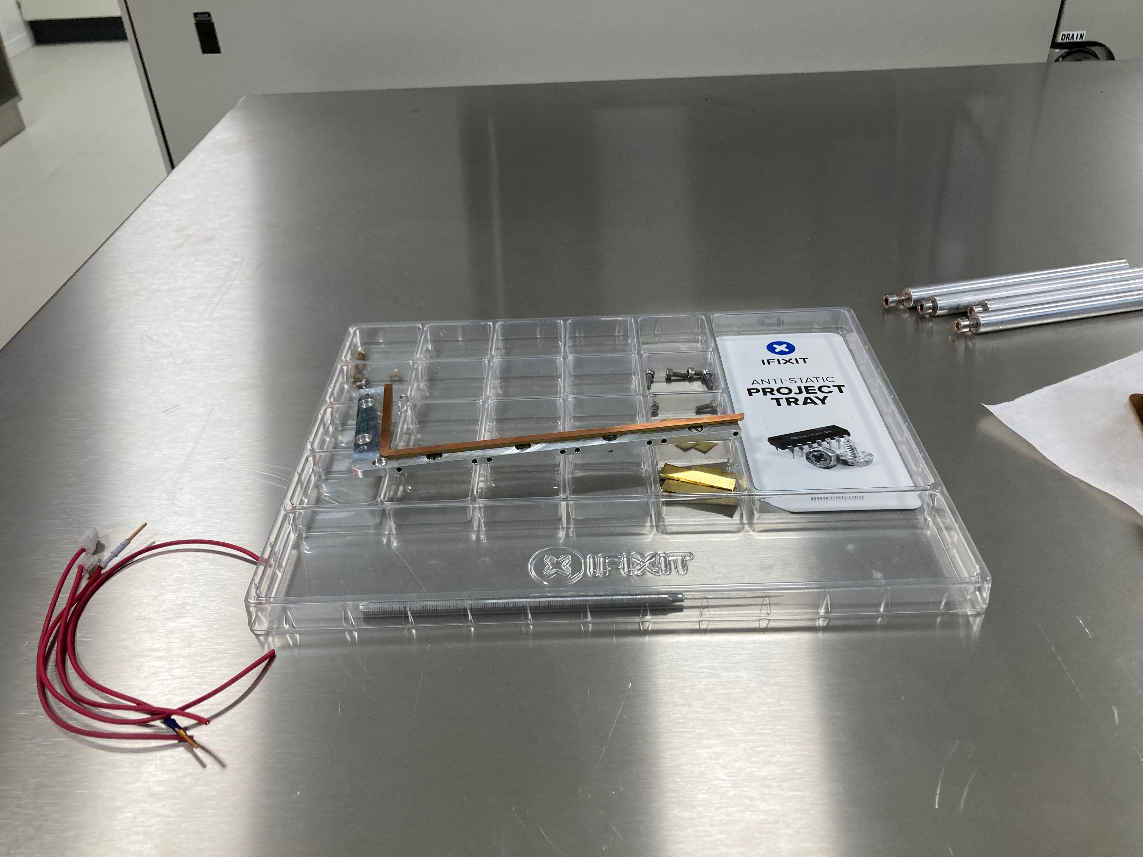
Pictures of repair work in Bonn
Taking off the (testbeam) box and field cage and L shaped part

Slide 7
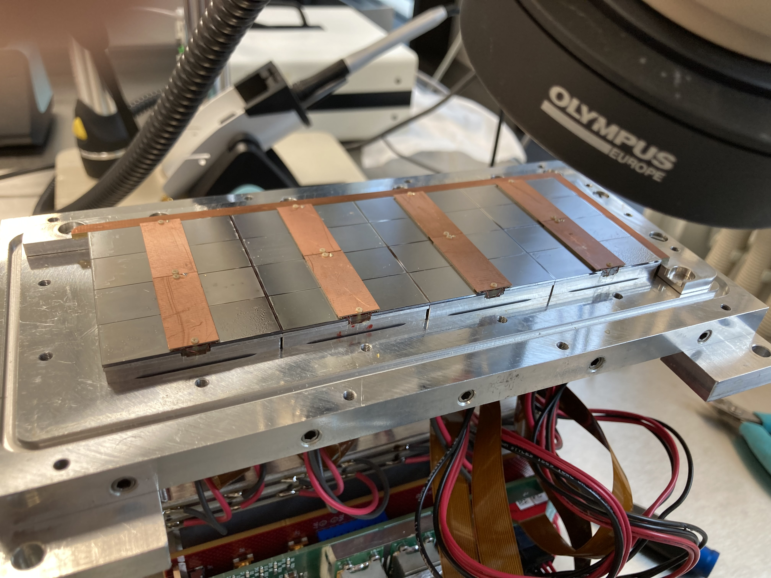
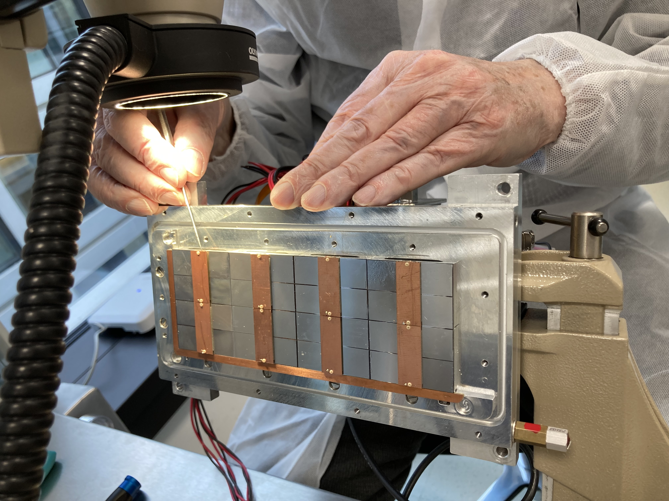
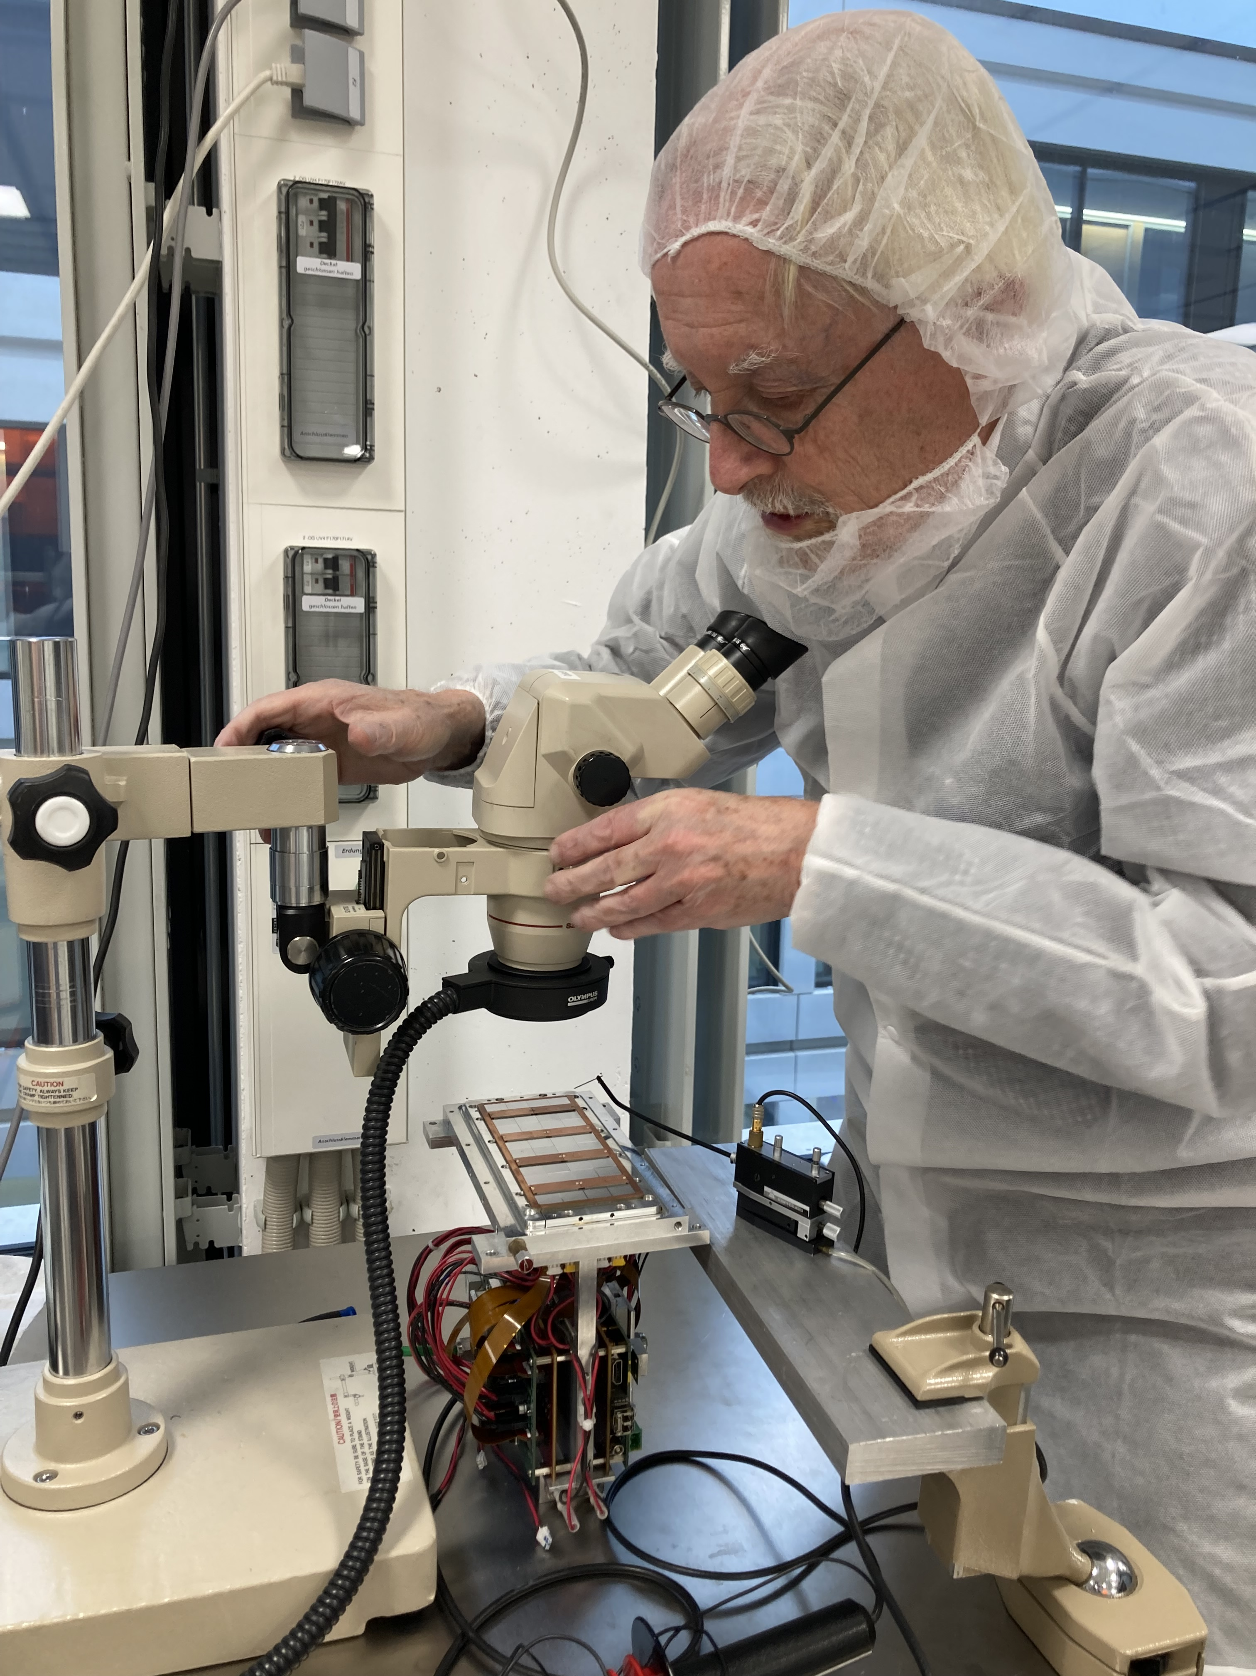
Pictures of repair work in Bonn

Slide 8
Measurements of all chips in Bonn
About 50 V was put on the grid and the voltage on all grids of the individual chips were probed measured
Concentrator 0 or D
chip | 10 | 9 | 2 | 1 | 11 | 14 | 8 | 13 | 3 | 6 | 0 | 5 | 15 | 12 | 7 | 4
V | 45.6 | 46.5 | 46.3 | 46.6 | 46.3 | 46.7 | 46.4 | 46.6 | 46.4 | 46.3 | 46.5 | 46.5 | 45.5 | 46.6 | 46.5 | 46.6
Concentrator 1 or E numbered also as chip nrs 16-31 (16+chip#)
chip | 6 | 5 | 14 | 13 | 7 | 2 | 4 | 1 | 15 | 10 | 12 | 9 | 3 | 0 | 11 | 8
V | 46.4 | 46.5 | 46.5 | 46.4 | 46.4 | 46.5 | 46.5 | 46.4 | 46.3 | 46.5 | 46.4 | 46.4 | 44.6 | 46.4 | 46.5 | 46.5
Conclusion all chips work properly no shorts

Slide 9
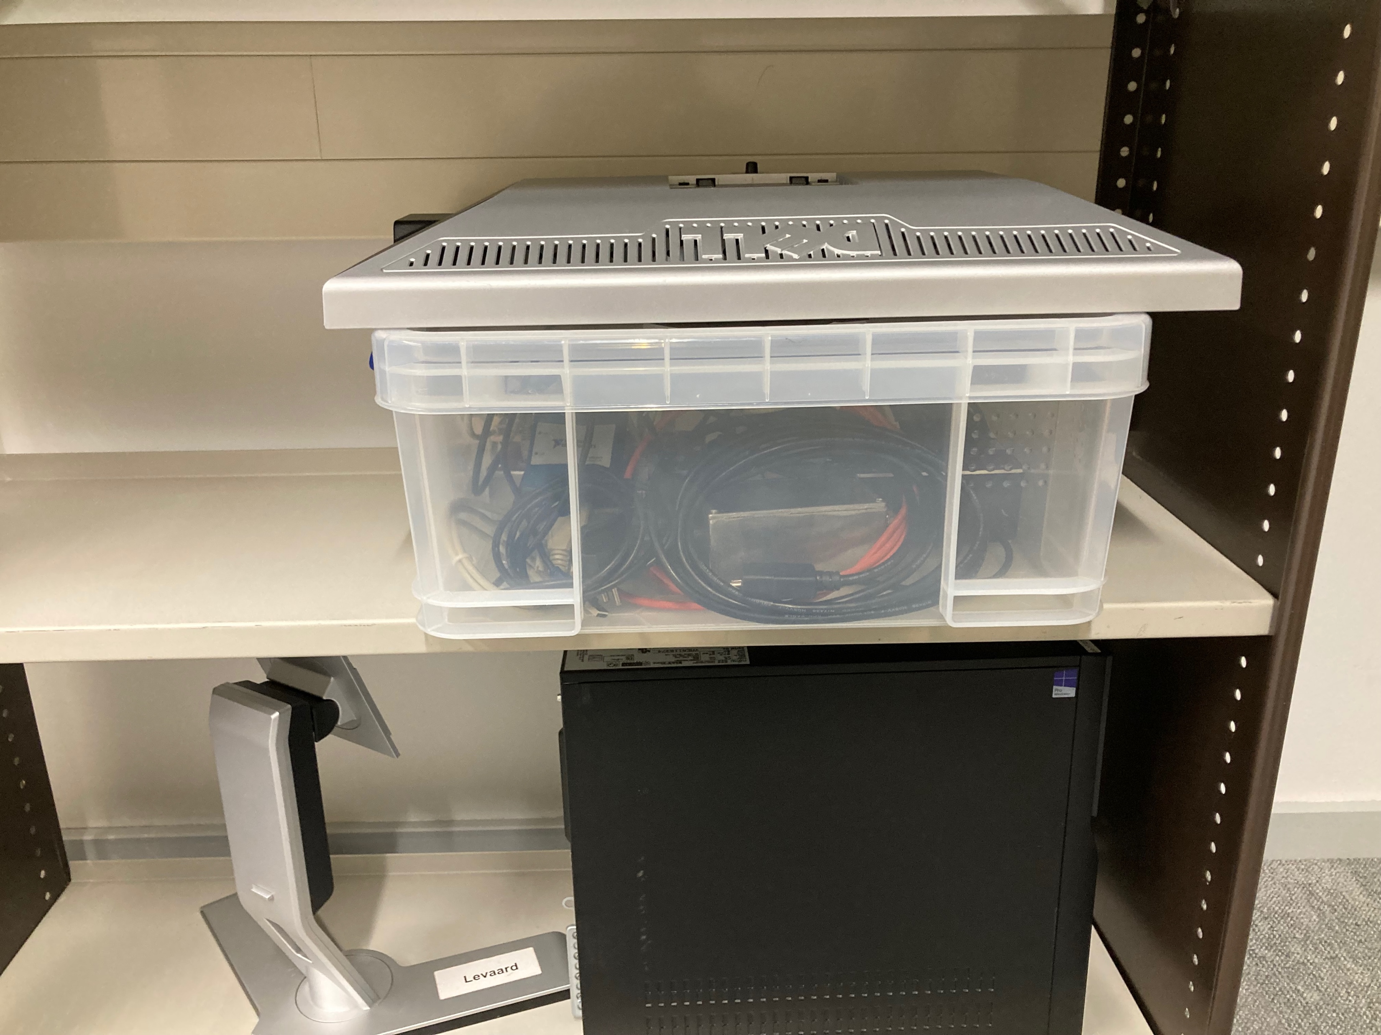
At Nikhef after arrival
Prepared for the US
Levaart Lsow Controls and Mini HV distribution system

Slide 10
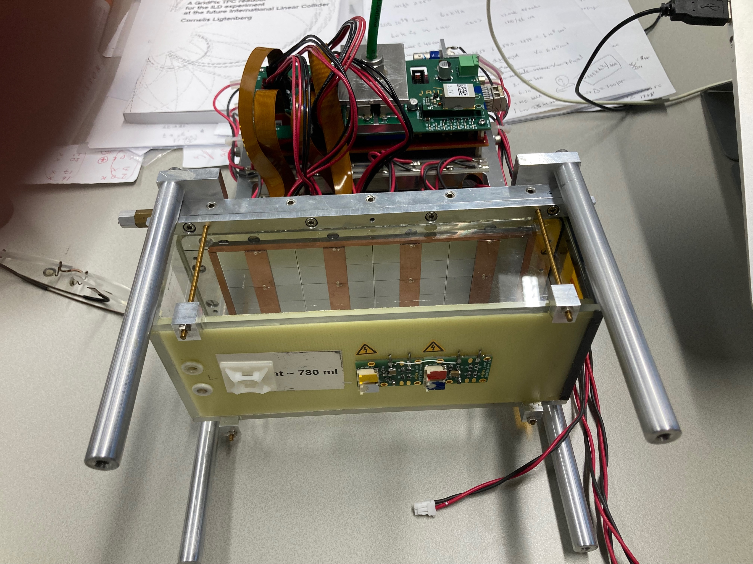
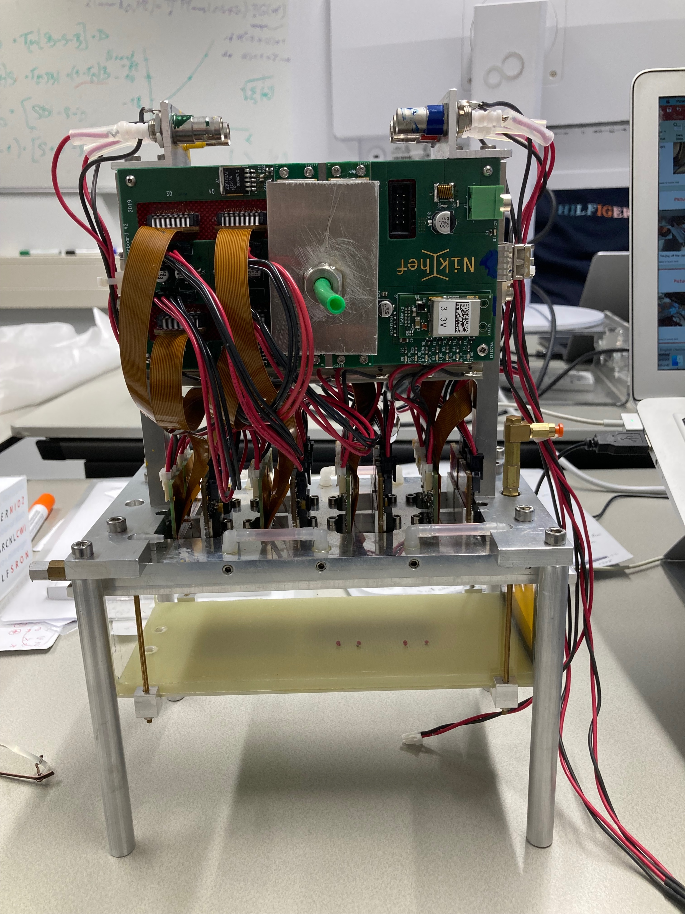
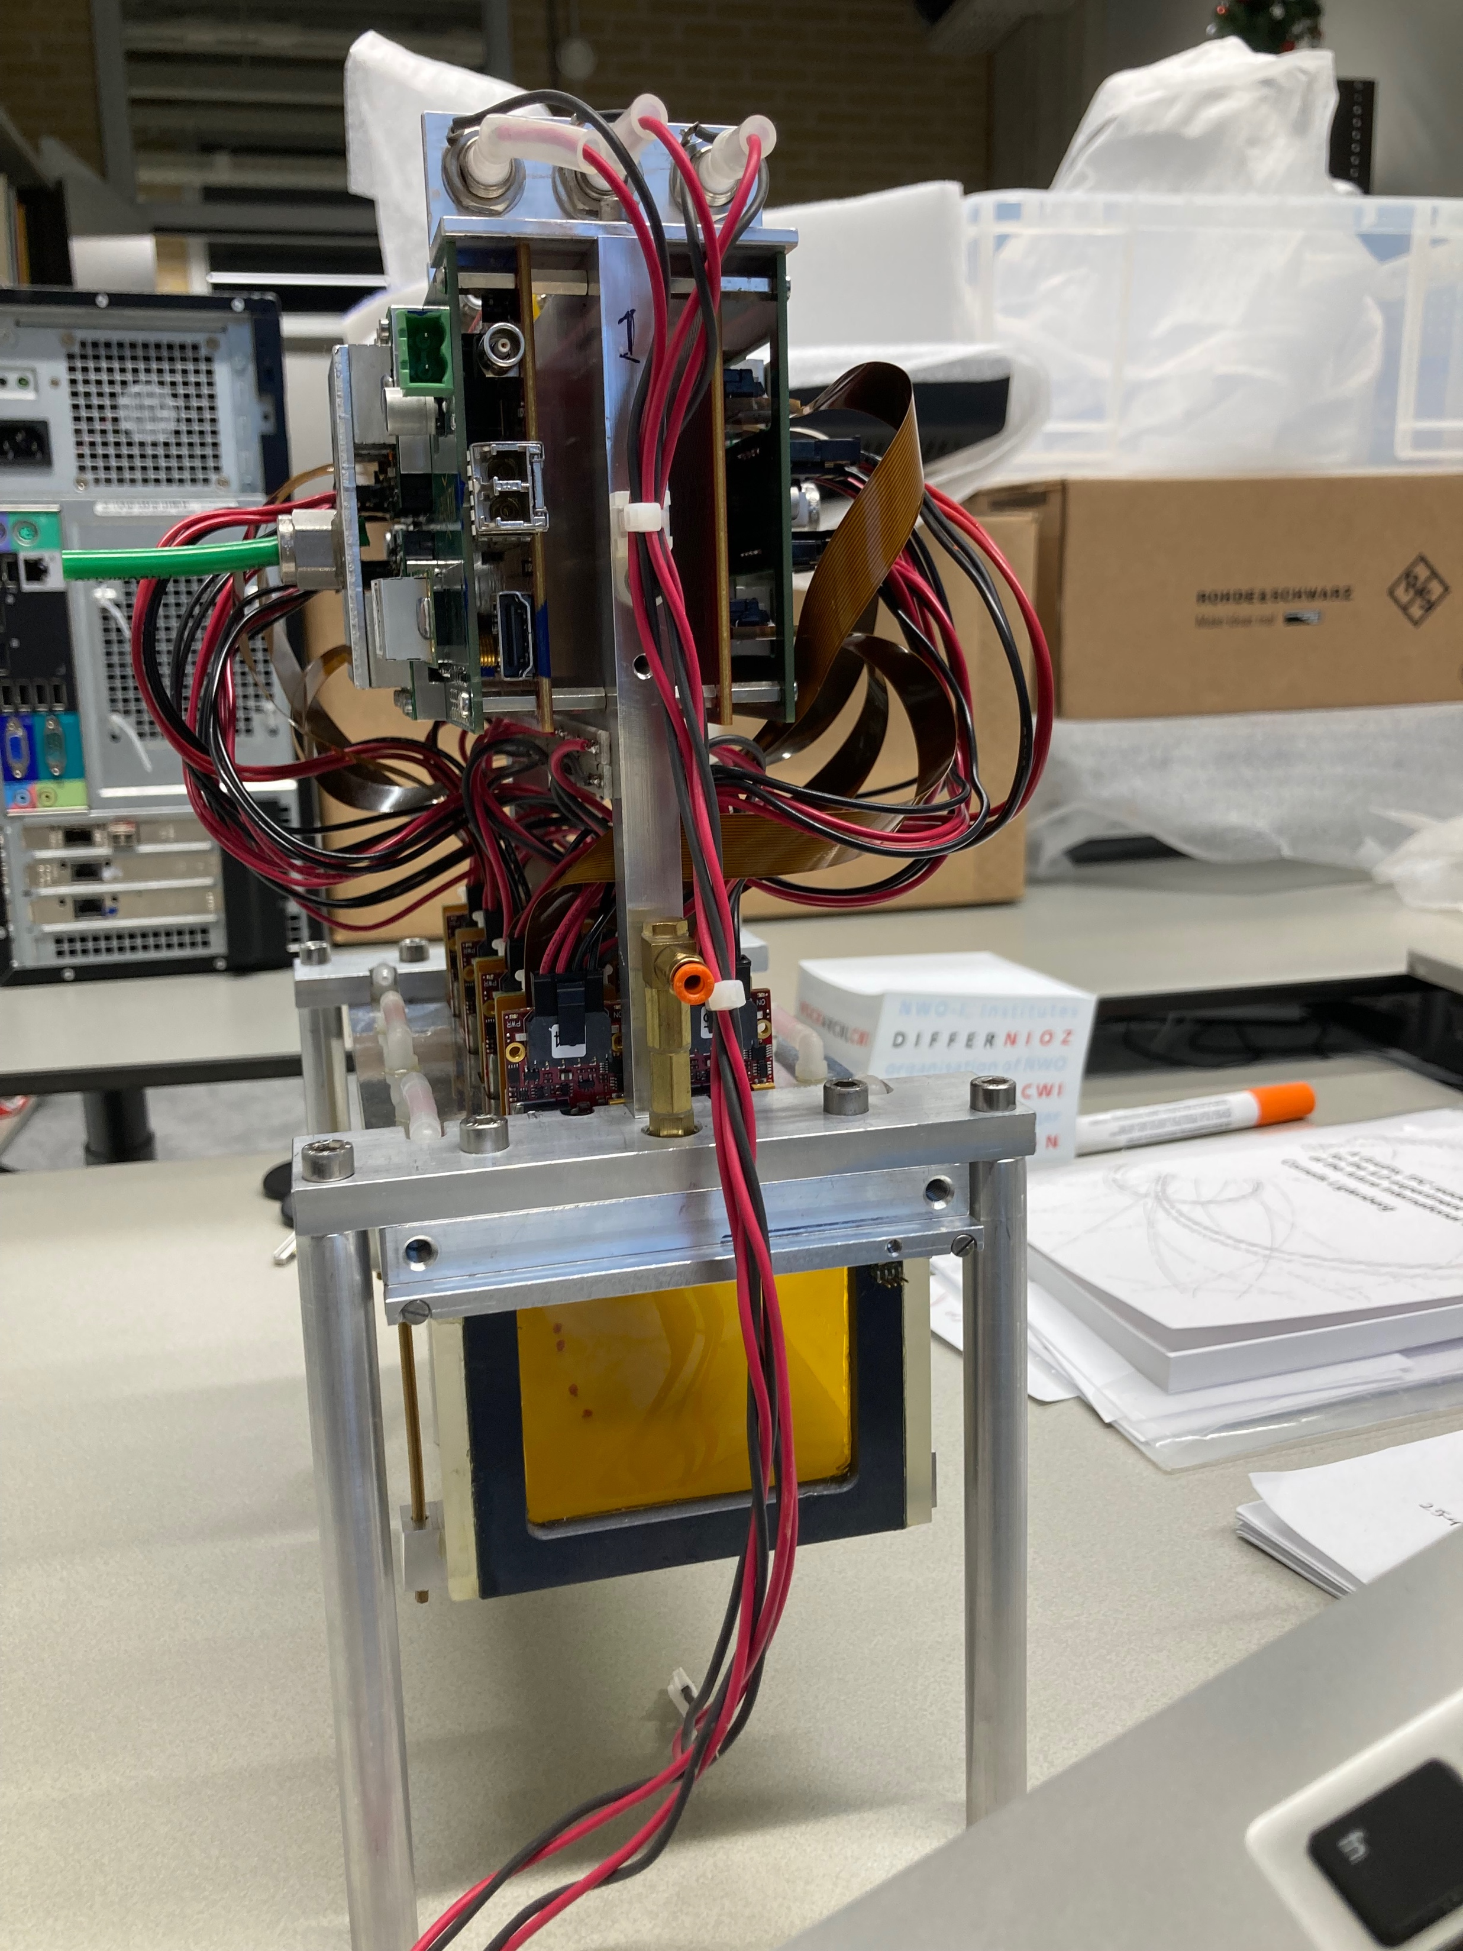
At Nikhef after arrival
Module protected by laser box with quads and concentrators

Slide 11
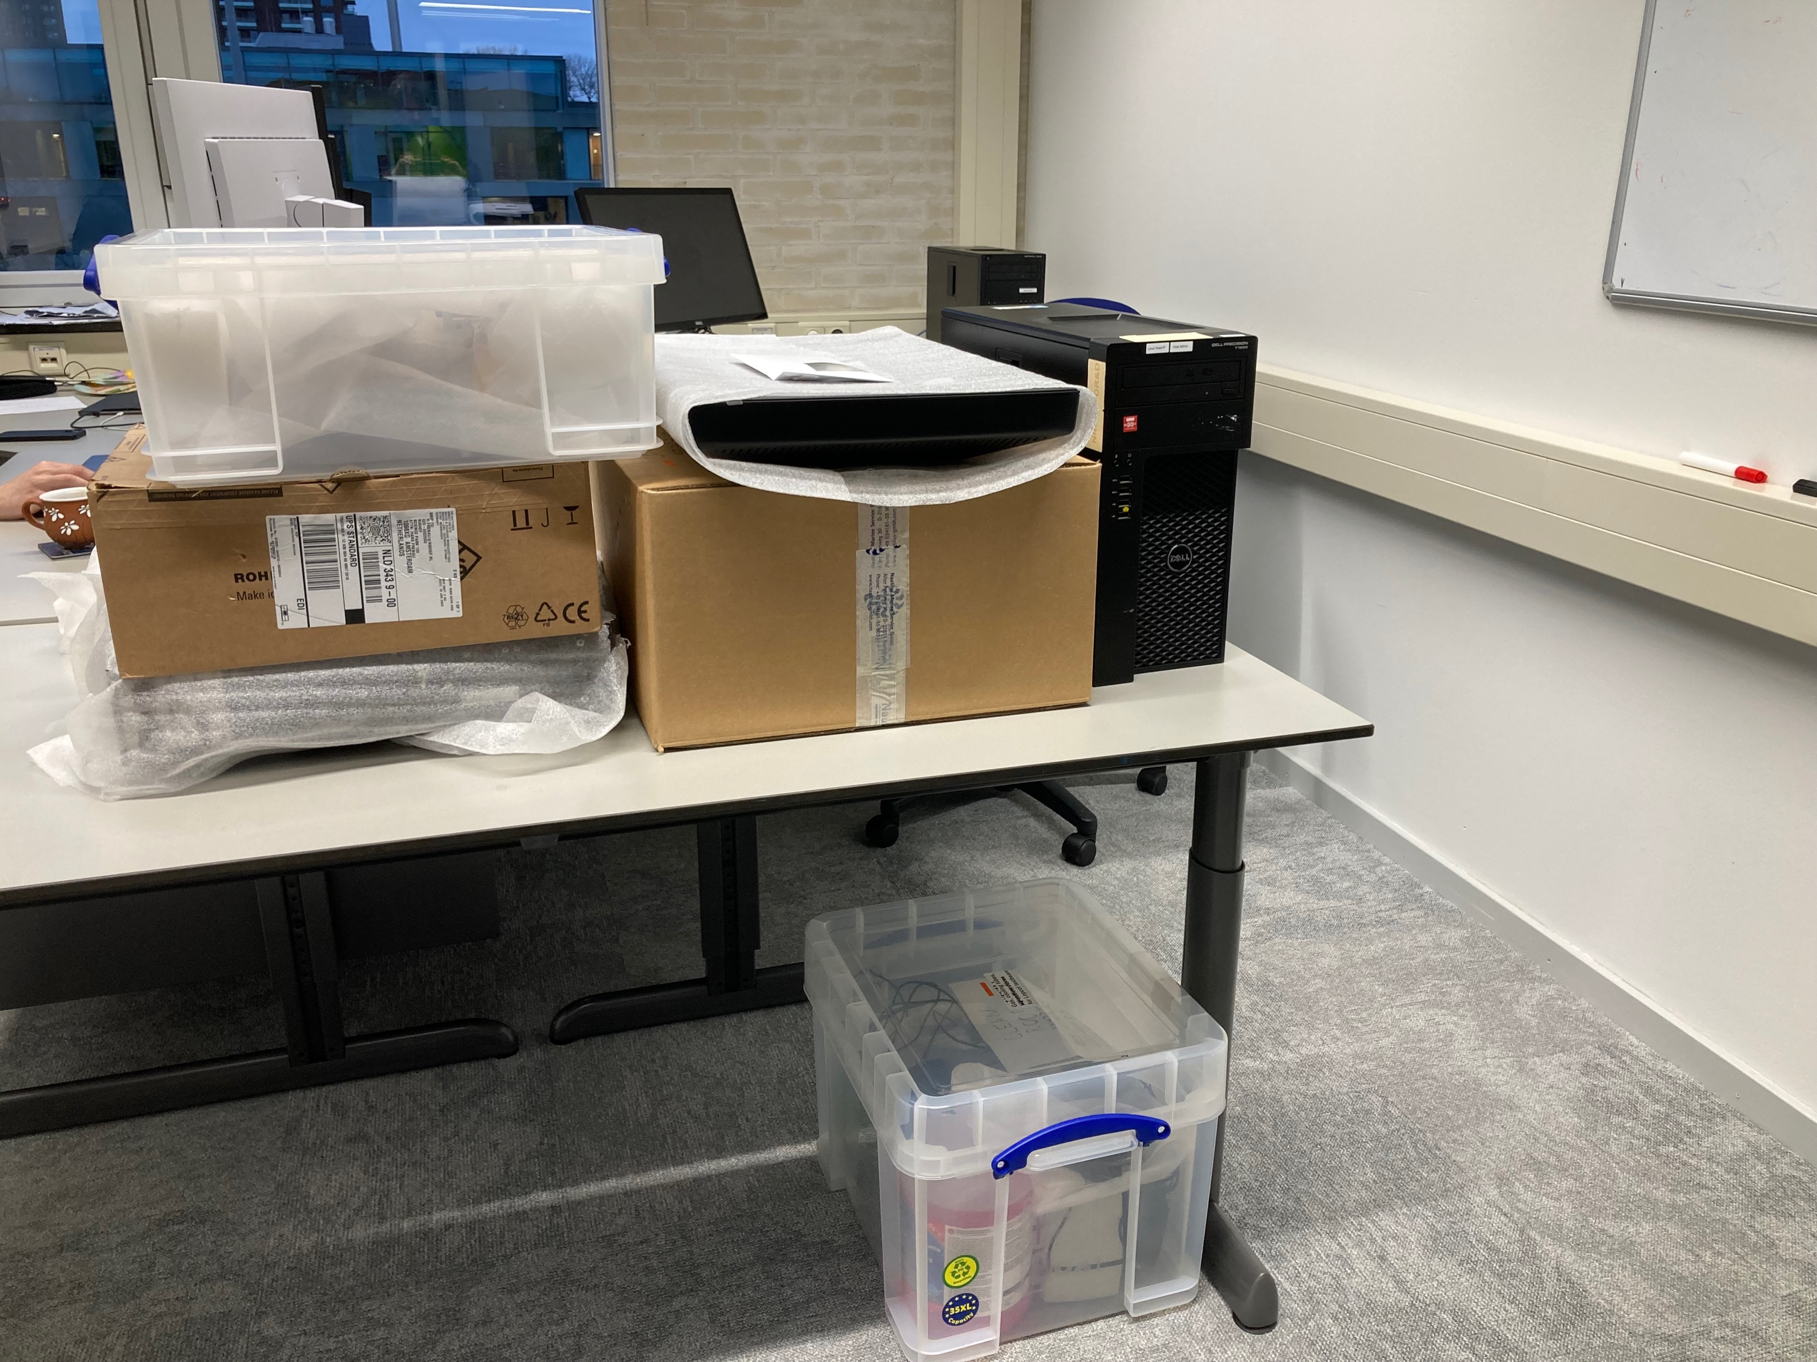
At Nikhef after arrival
DAQ sytem
In boxes with ARAWANA daq computer, SPIDRs, cables and on the floor a box with cooling pump with fluids
To be set up and tested at Nikhef

