Slide 1





R&D for a Pixelated Time Projection Chamber
Yevgen Bilevych, Klaus Desch, Harry van der Graaf, Fred Hartjes, Jochen Kaminski, Peter Kluit, Naomi van der Kolk,
Cornelis Ligtenberg,
Gerhard Raven, and
Jan Timmermans
LCTPC workshop

Slide 2
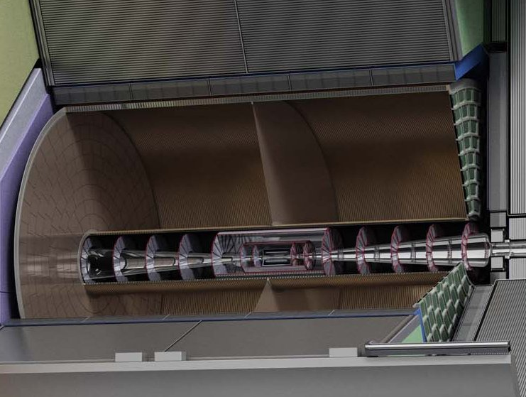



Pixel TPC
(Octopuce)
(TimePix1) TPX3 chip Quad Module TPC plane
(2007-14) 2017 2018 2019

Slide 3
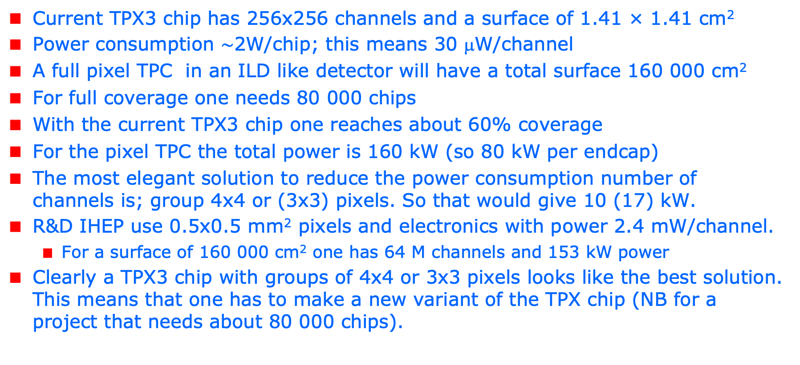
R&D topics: power consumption
Current TPX3 chip has 256x256 channels and a surface of 1.41 × 1.41 cm²
Power consumption $\sim$2W/chip; this means 30 μW/channel
A full pixel TPC in an ILD like detector will have a total surface 160 000 cm²
For full coverage one needs 80 000 chips
With the current TPX3 chip one reaches about 60% coverage
For the pixel TPC the total power is 160 kW (so 80 kW per endcap)
The most elegant solution to reduce the power consumption number of channels is; group 4x4 or (3x3) pixels. So that would give 10 (17) kW.
R&D IHEP use 0.5x0.5 mm² pixels and electronics with power 2.4 mW/channel.
  For a surface of 160 000 cm² one has 64 M channels and 153 kW power
Clearly a TPX3 chip with groups of 4x4 or 3x3 pixels looks like the best solution. This means that one has to make a new variant of the TPX chip (NB for a project that needs about 80 000 chips).

Slide 4
R&D: power consumption and double grid
The idea of a TPX3 chip with groups of 4x4 or 3x3 pixels is the following:
  One would keep the grid with the standard 55μm x 55μm
  The thing to change in the TPX3 chip is to collect the signals from 16 or 9 pixels and reduce the number of channels (amplifiers etc.)
  The post-processing steps to put a protective layer and a Grid on top of the TPX3 chip would remain identical
Note that we still have a digital TPC (with multi hit capacity) and measurement of ToT and time of arrival
I will check this idea with the designers of the TPX3 chip @ Nikhef whether this could work and would bring down the power consumption by a factor 16 or 9
The resolution from the pixels size will become 64 (47) μm per electron.
This will not compromise the spatial resolution because the diffusion (even at 4 T) is still dominant.
It could be useful (in view of Alice procedure to correct for distortions) to measure and digitize the current of the grid of the individual chips
Another R&D topic to start in the lab is to develop the post-processing procedure to make a double grid structure in order to reduce the ion back flow

