Slide 1
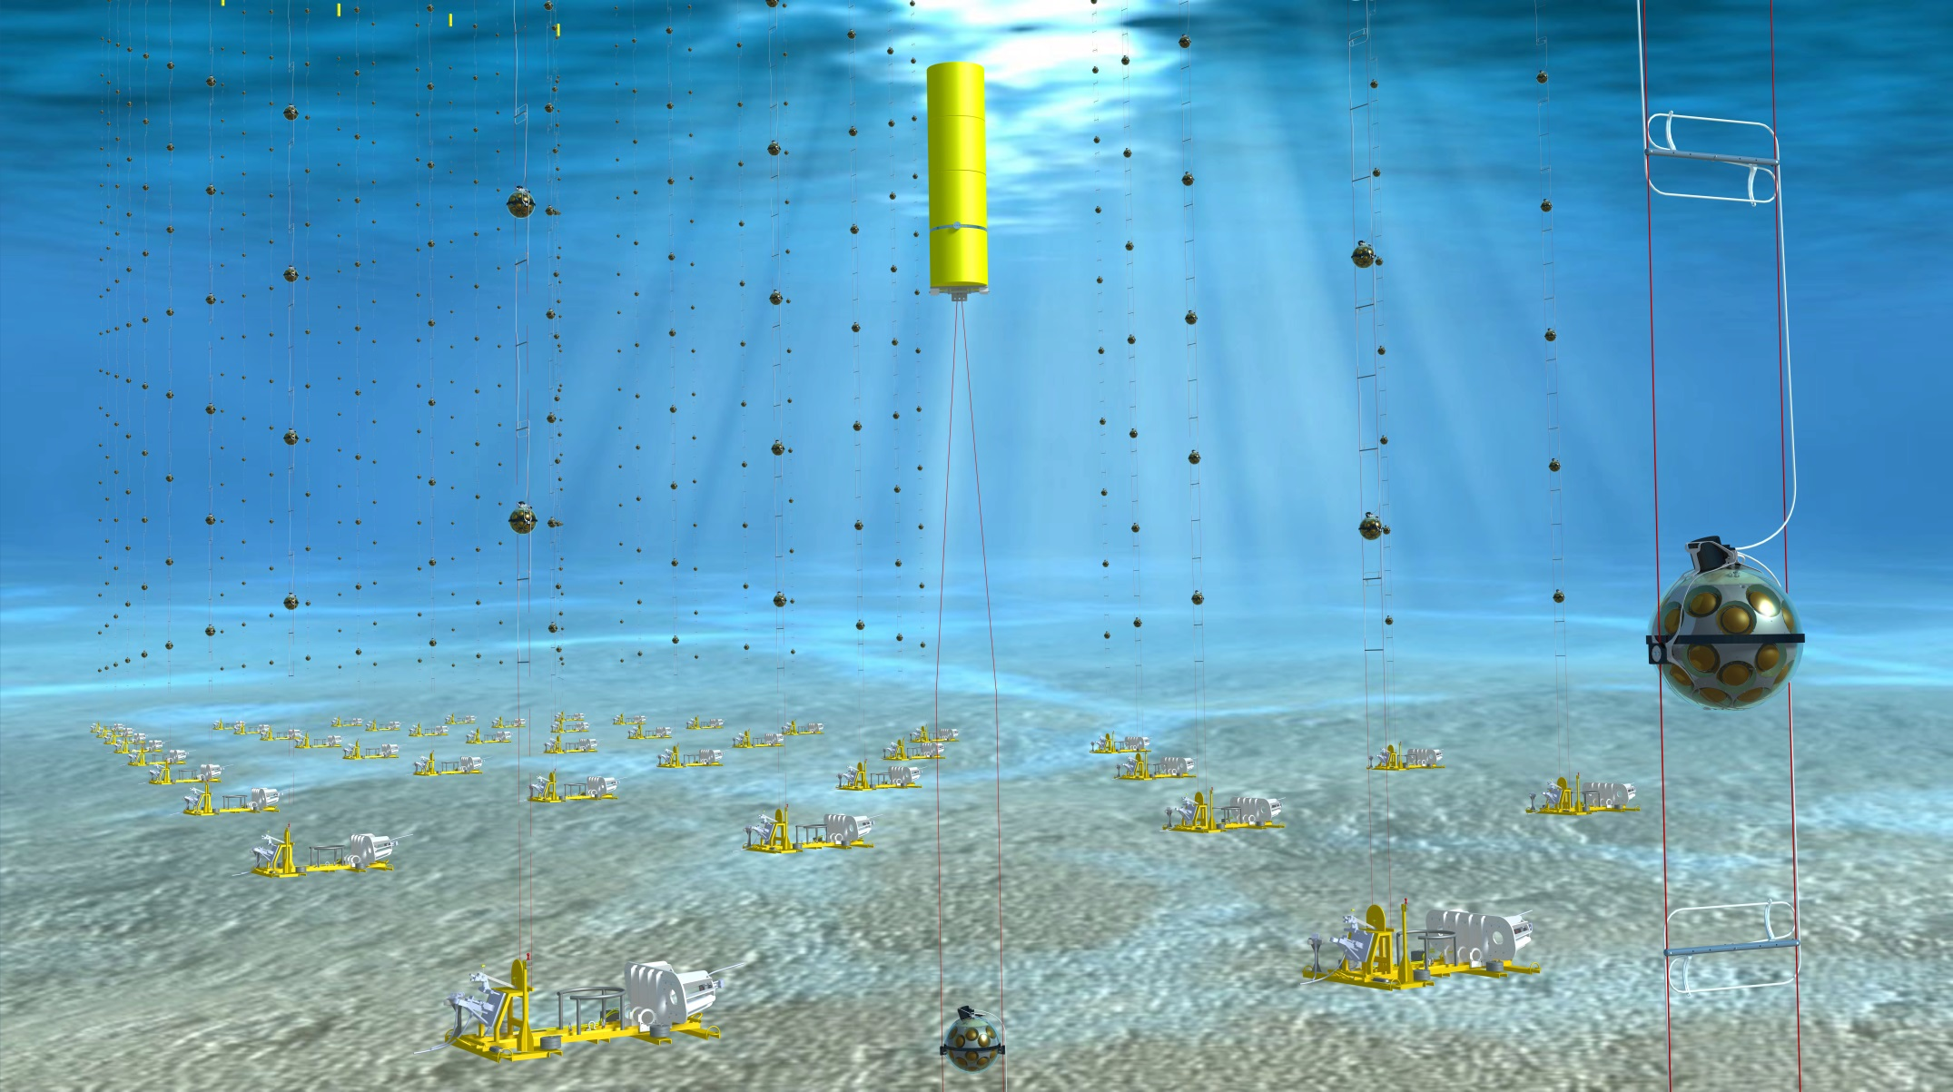
KM3NeT mechanics at Nikhef

Slide 2
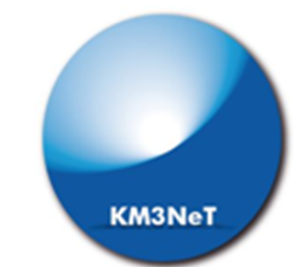
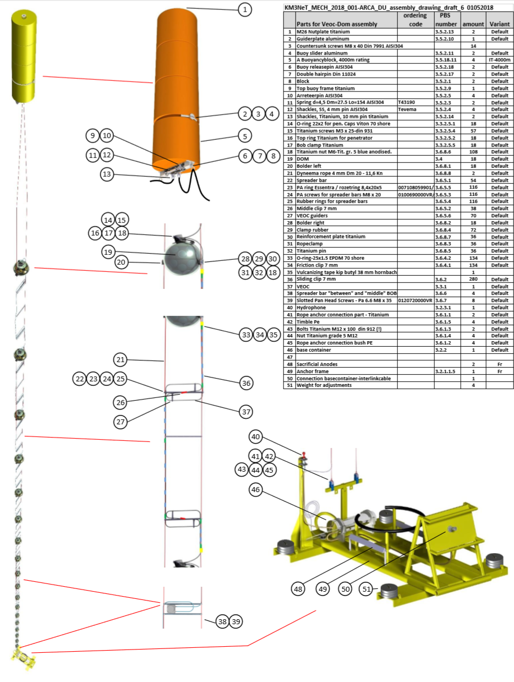
ARCA
The DUs are designed to have minimal hydrodynamic drag and each host 18 DOMs in ARCA as well as in ORCA.
The ARCA DU is about 700 m height, starting 68 m from the sea floor and spaced 37 m apart in the vertical direction. Additional spreader bars are added in between the DOMs to maintain the ropes parallel and prevent the DU from rotating.
Attached to the ropes is the vertical electro-optical cable, a pressure balanced, oil-filled, PE tube that contains two copper wires for the power transmission (400 VDC) and 18 optical fibers for the data transmission. At each DOM two power conductors and a single fibers are branched out via the breakout box which also contains a DC/DC converter (400 V to 12 V). The power conductors and optical fibers enter the DOMs via a titanium penetrator. The detection unit stays vertical by the buoyancy of the DOMs and in addition some extra buoyancy of the top buoy.

Slide 3
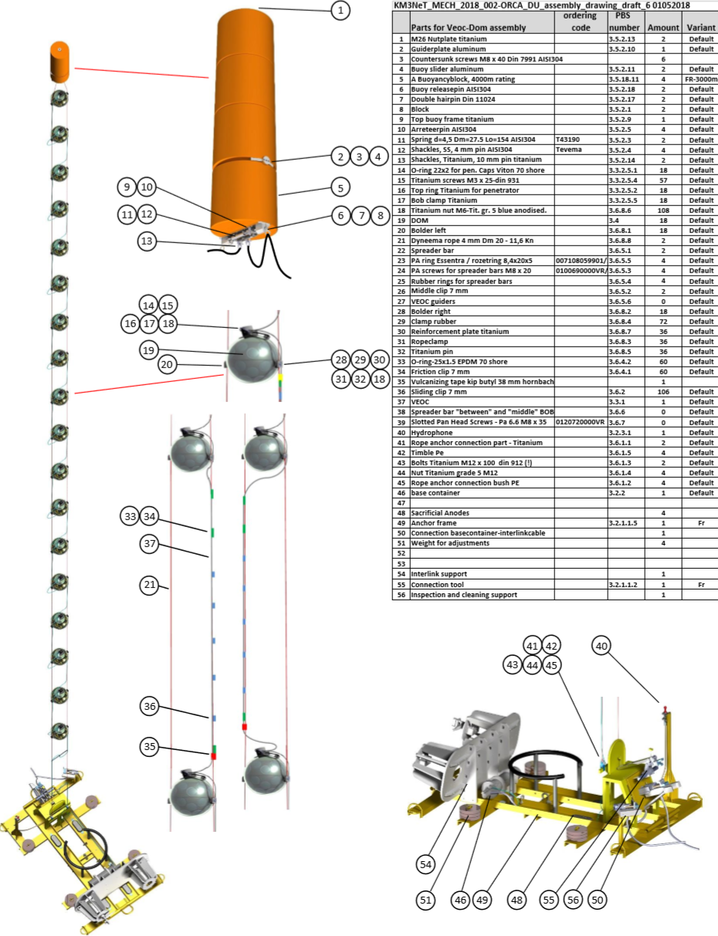
ORCA
For ORCA, each string is 200 m in height with DOMs spaced 9 m apart in the vertical direction, starting at about 29 m from the sea floor.
Each DU comprises two 4 mm parallel Dyneema ropes to which the DOMs are attached. The detection unit is held at the seafloor with an anchor connected to the ropes.

Slide 4
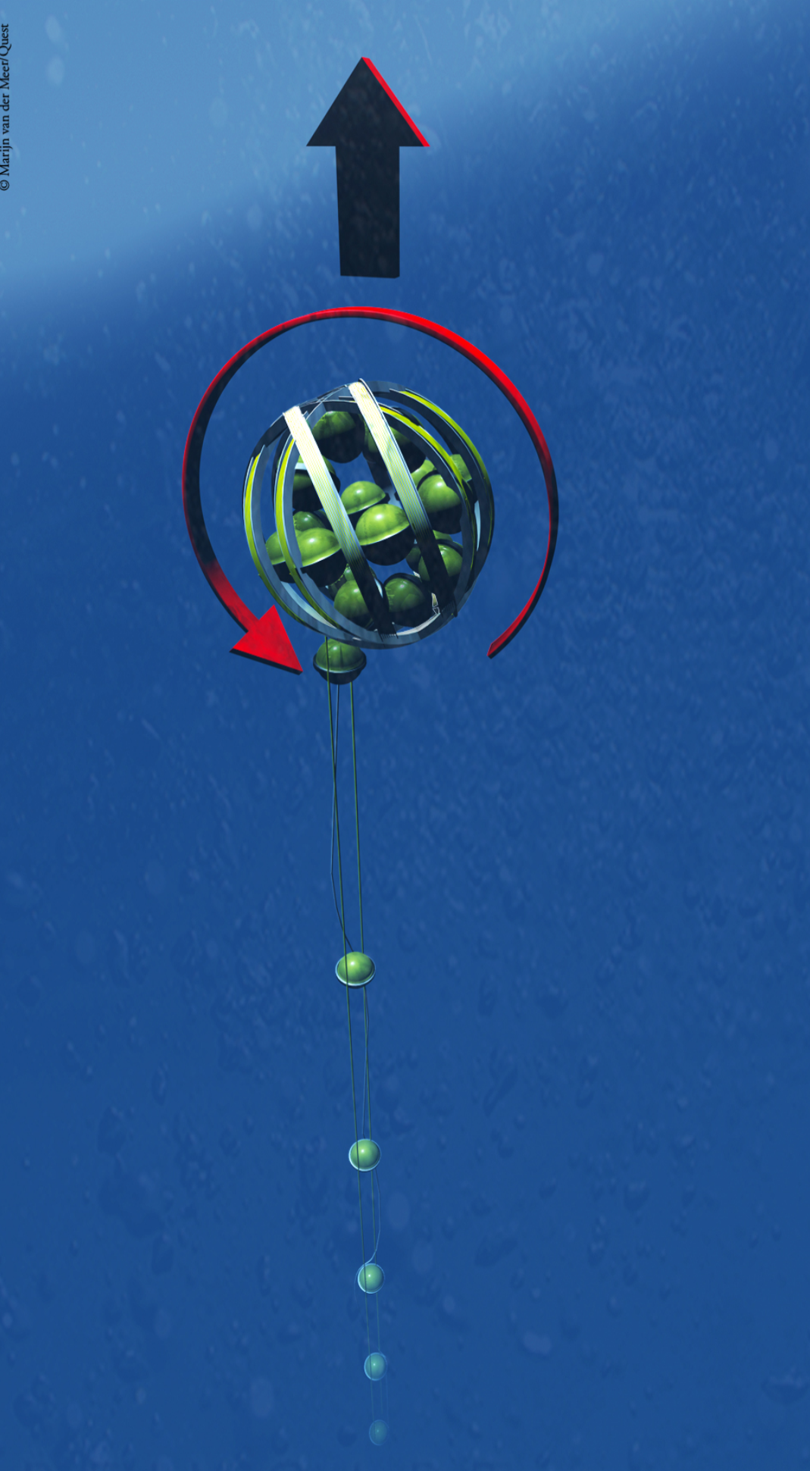
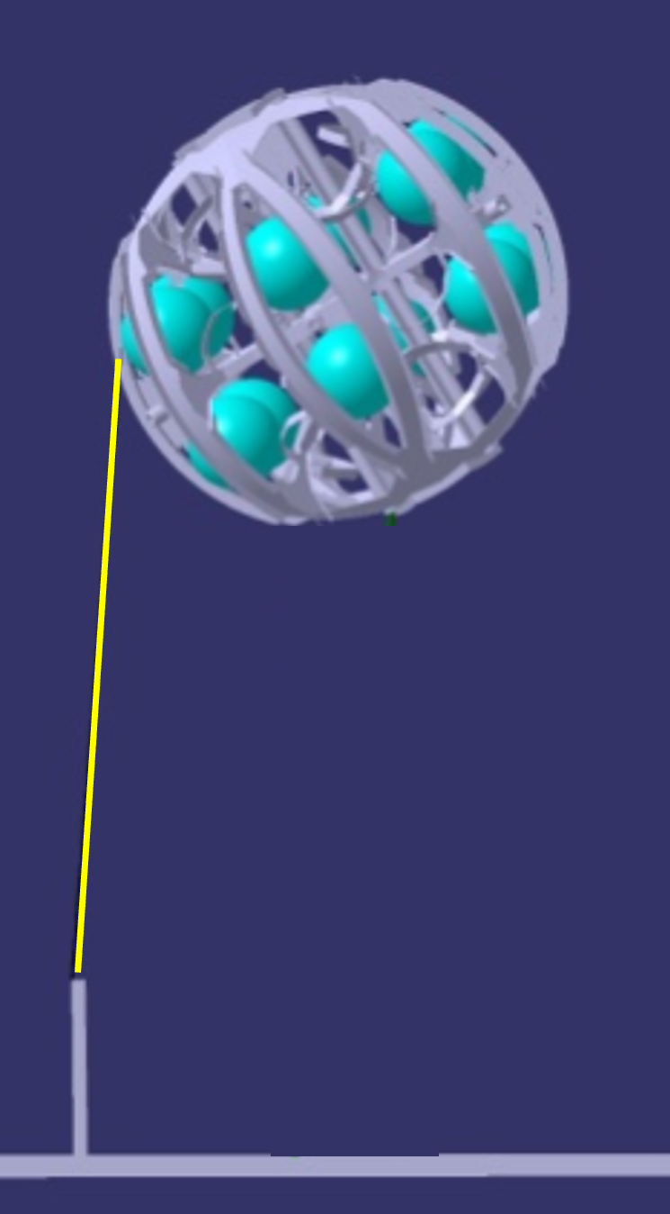
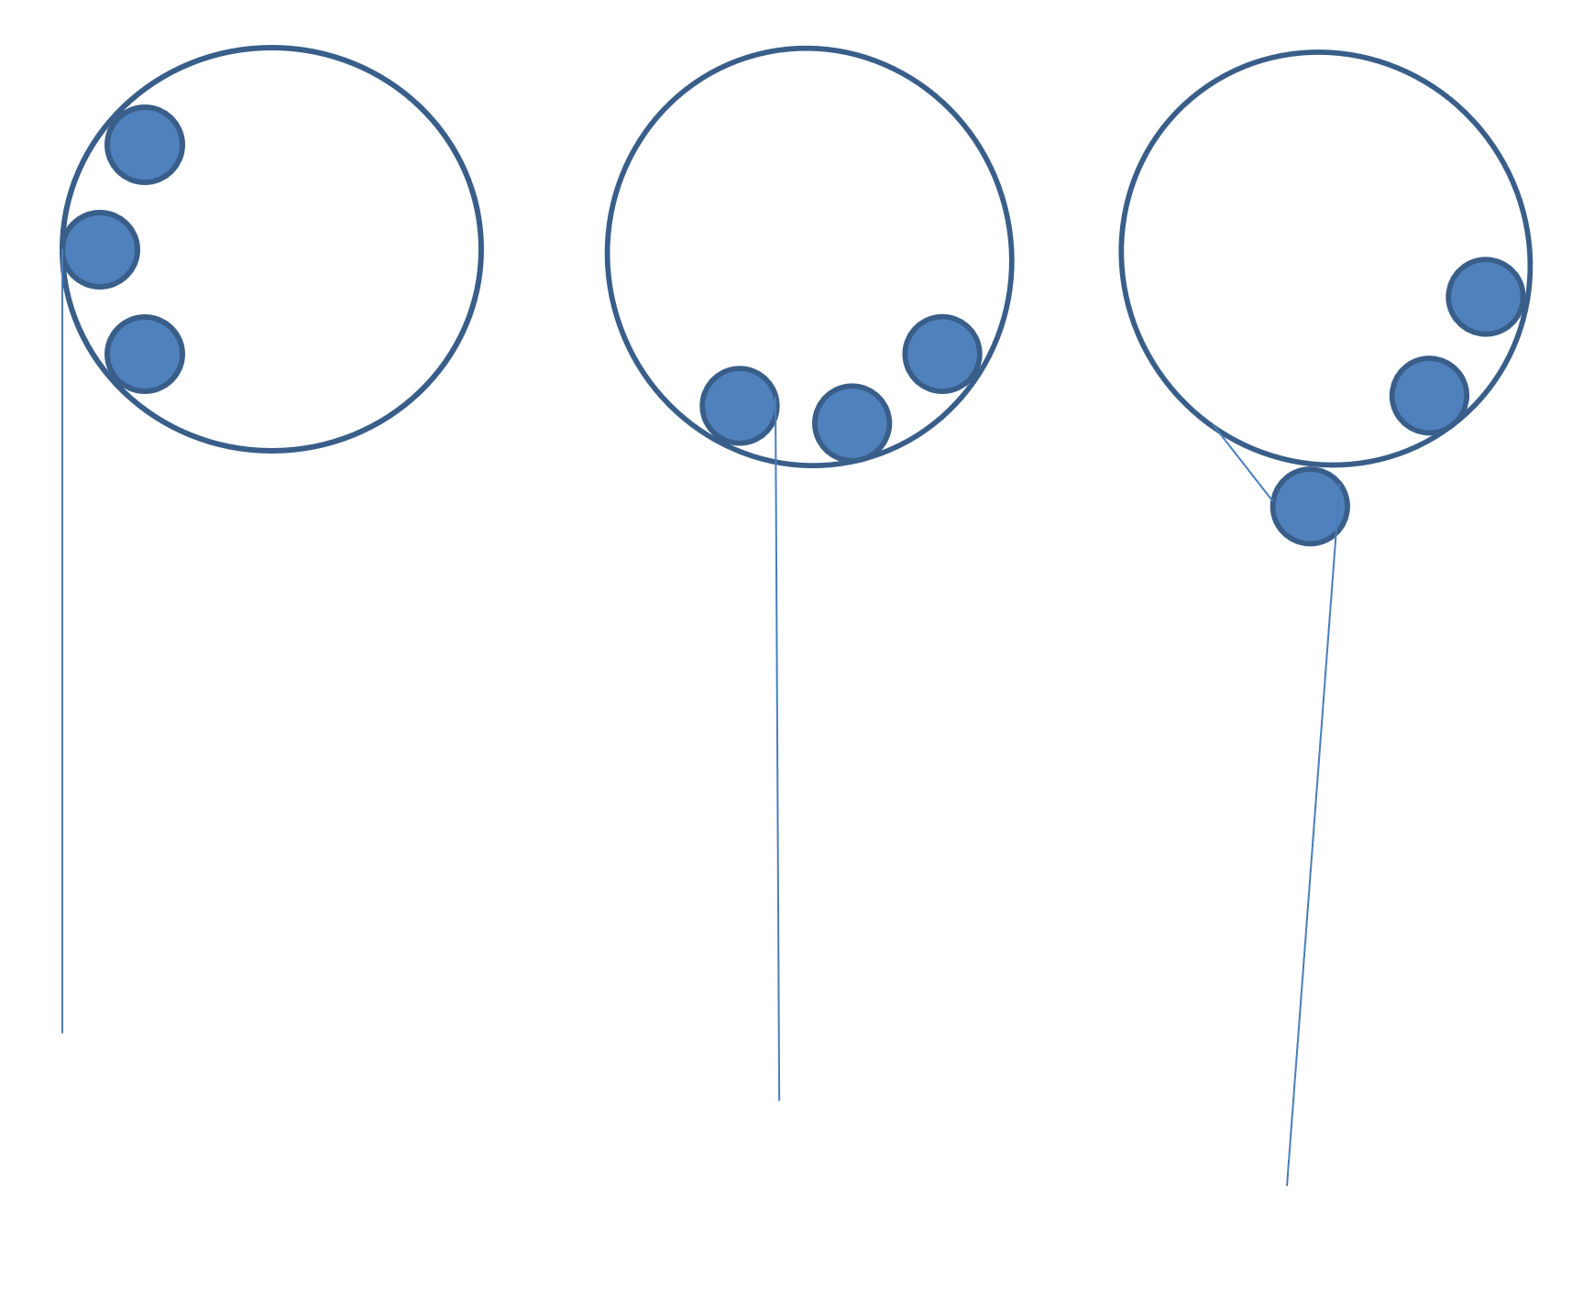
LOM-basics
A ROV is used to connect the interlink cable from the base of a DU to a junction box.
Once the connection to the DU has been verified onshore, the ROV removes the hook from the LOM.
Thereafter the ROV activates another release below the LOM and the LOM starts to rise to the surface due to its positive buoyancy while rotating and releasing the DOM’s which can be retracted with an approximate 800 N force from the LOM by the two vertical ropes connected to the anchor.
As a last step the top-buoy is released from the LOM and the LOM surfaces freely, at surfacing it is recovered by the ship.
The Start at the anchor;
The sequence;

Slide 5
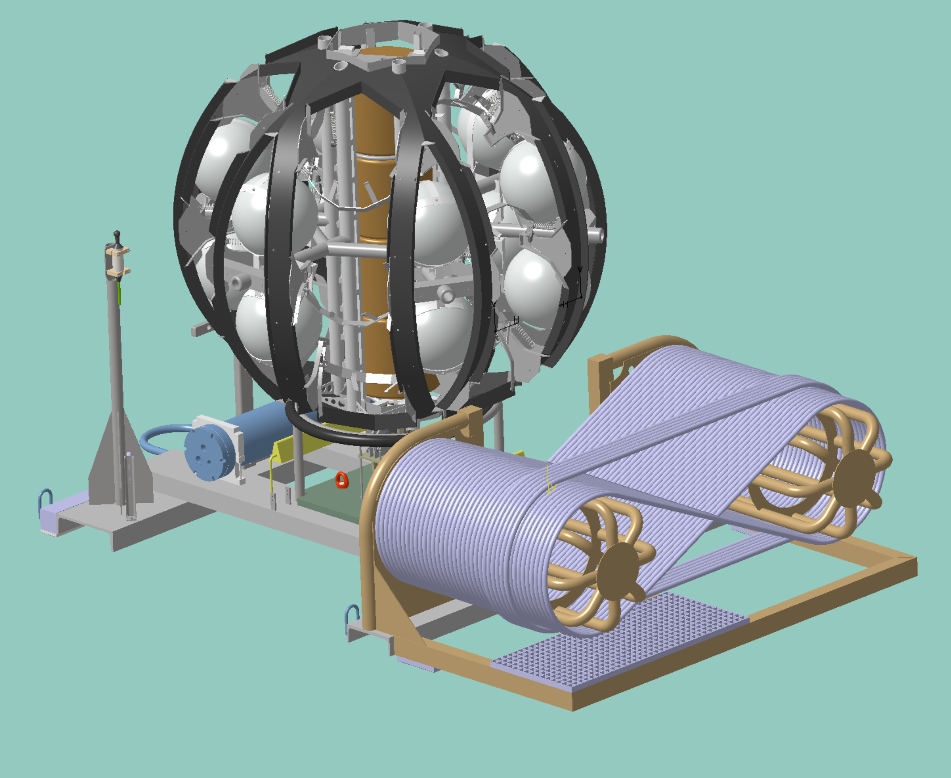
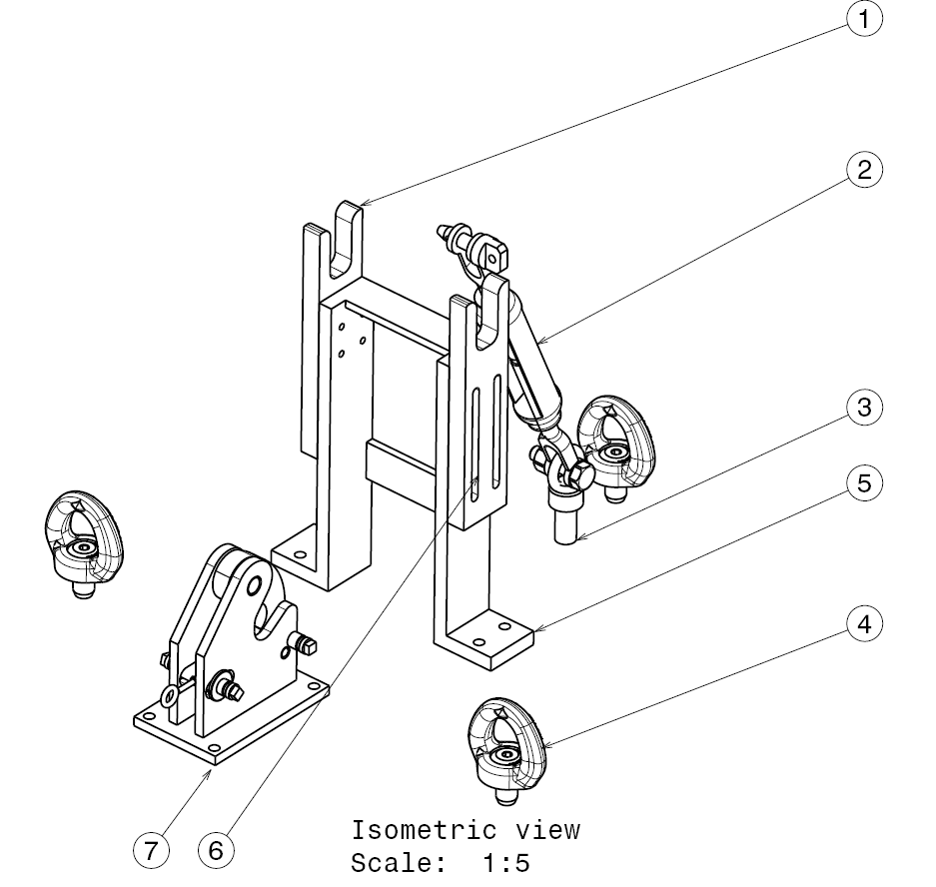
New anchor, to be implemented this year;
Main goal is to obtain an optimal balance in the anchor during descending to the seabed, calculating the influence of the weight at both ends of the hoisting cable. (be aware the balance in that case is not optimal in air)
The additional cable weight at one side of the anchor leads to a significant change of design to regain balance in the anchor.
For this reason also the base container is moved towards the rope fixation point.
A calculation is done to also take into account the difference of drag in vertical direction during descending. (the longest cable generates quite some extra (non central) drag due to the horizontal surface of the cable, approximately 60 kgf at 0,5m/s ).
The mounting points for extra balancing weight are left out since we can only calculate the balance during descending, the balance is expected to be good enough as calculated, there is no possibility to check the angle during descending.
Rope fixation, anodes, slider pads and LOM-seat are unchanged.
Central LOM fixation and unfurl system changed to the ORCA
adjusting design.
Fixation for hydrophone and LBL are simplified.
The cable in the picture is 240 m, also a bit longer is no issue.
Sytem to release the LOM;

Slide 6
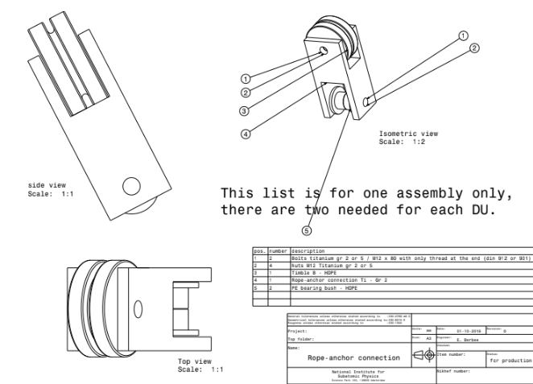
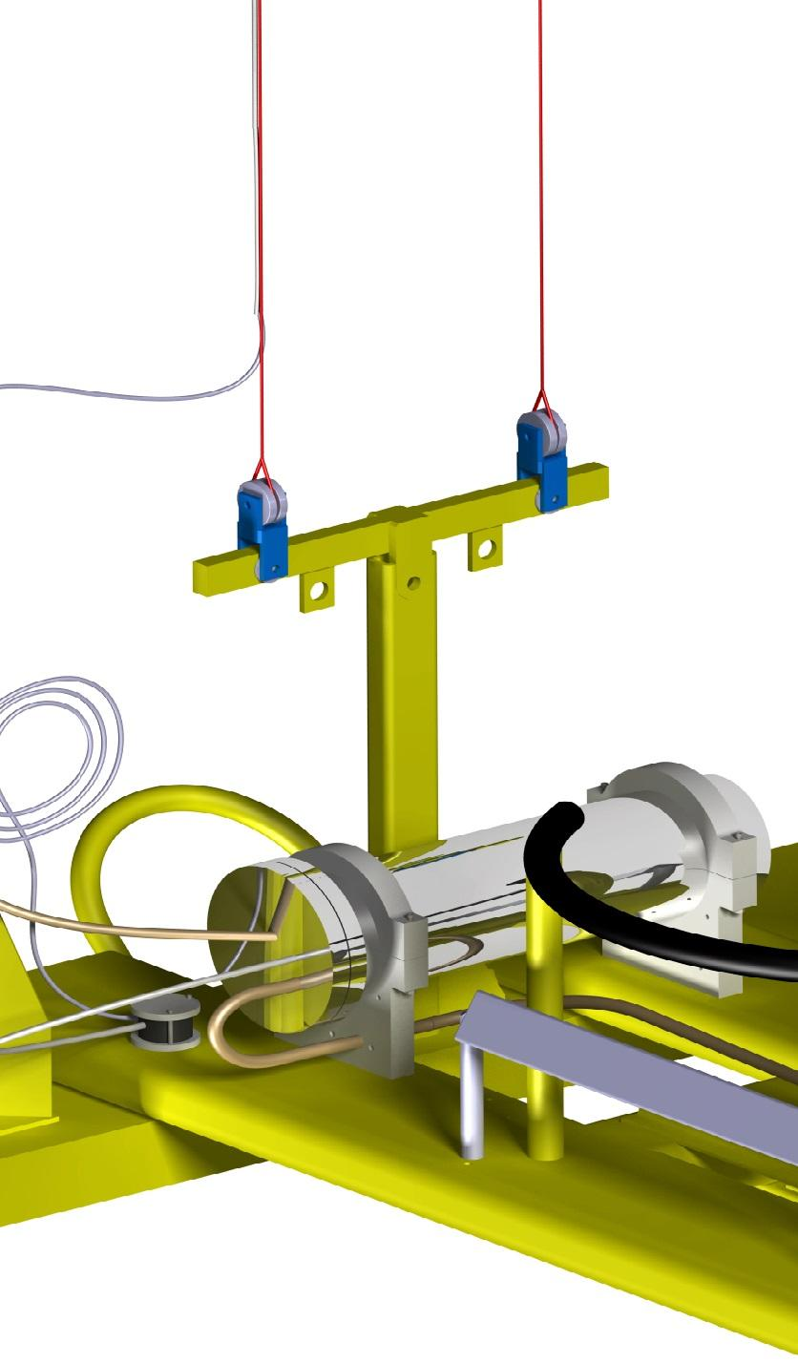
Rope-anchor connection.
The connection is designed to avoid any force or friction on the Dyneema ropes during movement. After mounting the ropes can freely move in all possible directions.
The rope end, the splice, is fitted around a “PE wheel” which we call Timble which again can rotate around its M12 titanium bolt.

Slide 7
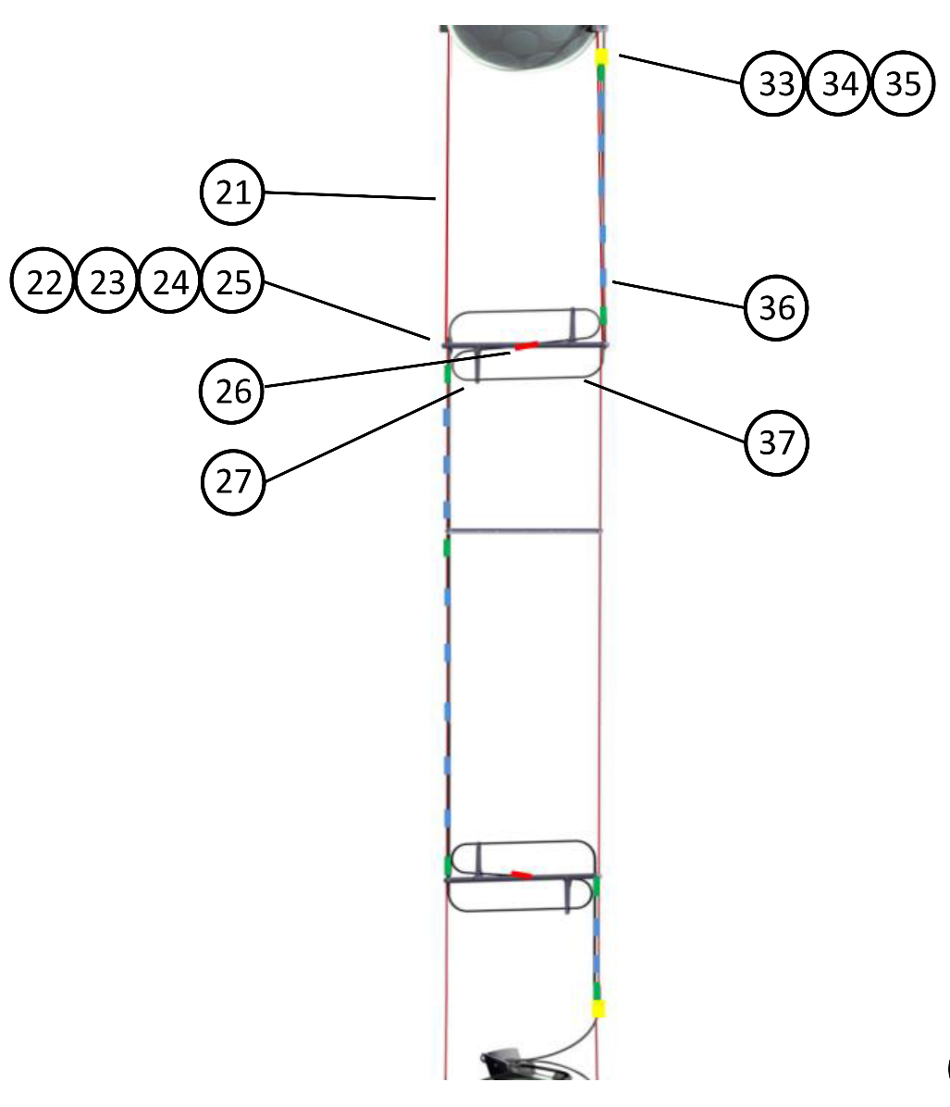
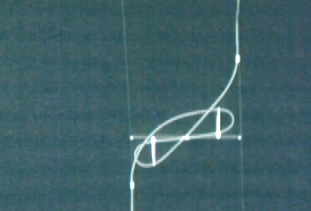
VEOC guiding and secure system ARCA.
The VEOC part between two DOMs has a length of 40 m. The length of the ropes between two DOMs is 37 m on average.
Between each two DOMs there are three spreader bars (22) at which the VEOC forms two loops that are kept in place by VEOC guiders (27). Any force will (partly) retract these loops from the guiders. The friction clip is designed to slide along the rope but to fix on the VEOC, the picture shows that this will give way to accommodate extra length of VEOC. The slider clips are mounted for further guiding of the VEOC.
Loops in this case are not completely used.
Here more extra length is used, but still not completely.

Slide 8
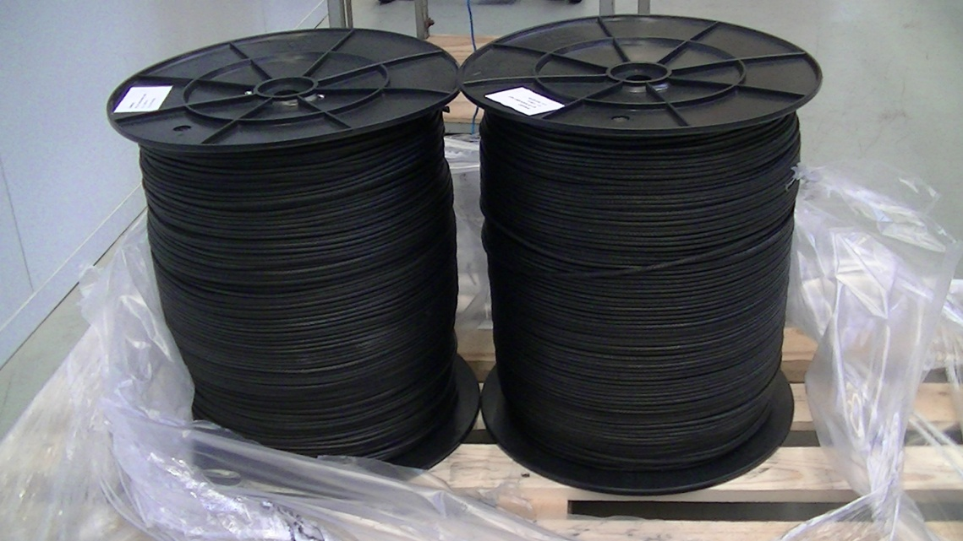
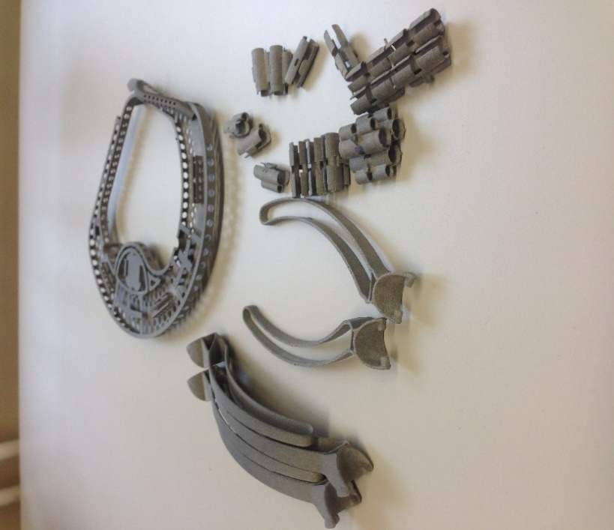
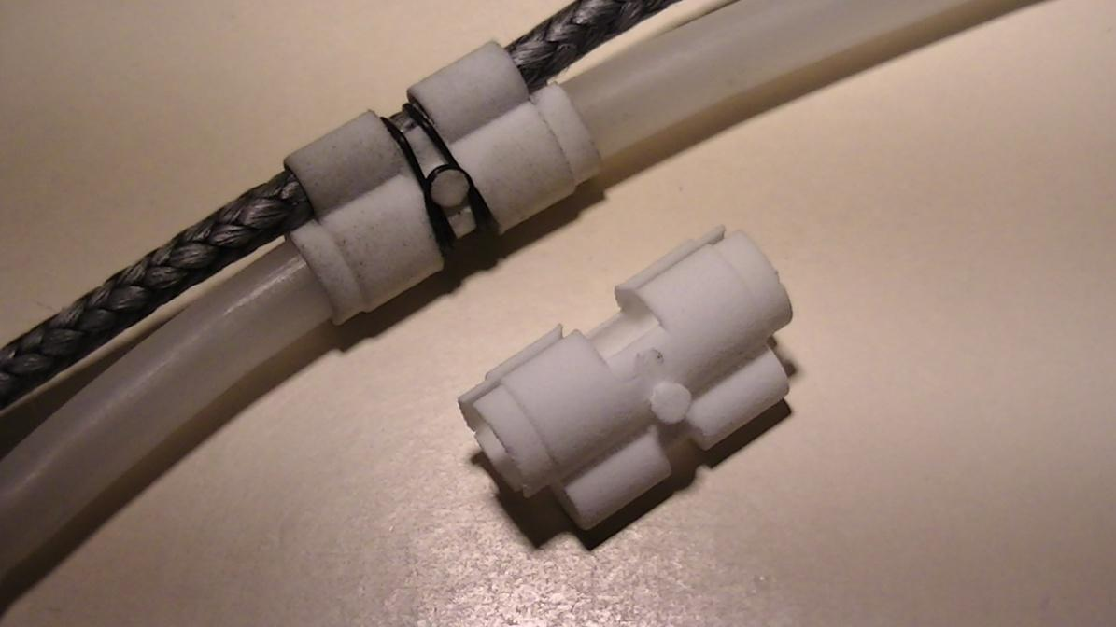
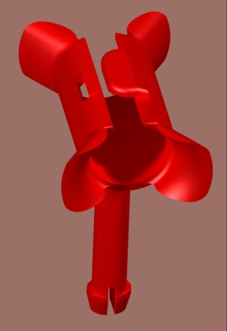
After delivery the pre-stressed ropes (1500 m on one reel) are stretched once more to obtain a “ready to use” set of 750 m stretched and marked ropes as in the procedure.
Various 3D-printed parts
The friction-clip is a clip meant to fix the VEOC at points where the VEOC has to slide with friction along the ropes, preventing it to freely move.
The sliding clip is meant to freely let the VEOC slide along the ropes without friction. The part itself is clamped onto the rope, the VEOC slides through.
It is 3-D printed in Polyamide and has a lock to securely fix the VEOC to the rope without friction.
Centre-clip, with round exit preventing the VEOC from nicking

Slide 9
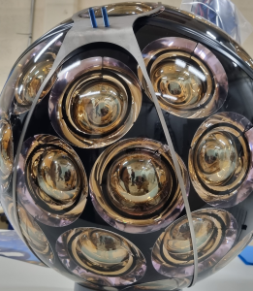
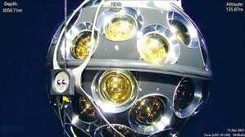
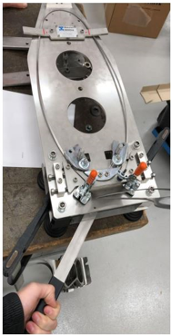
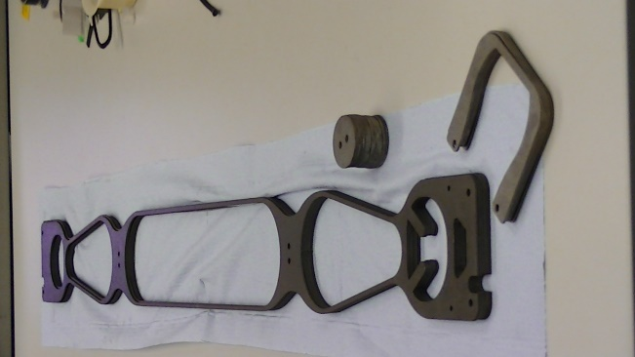
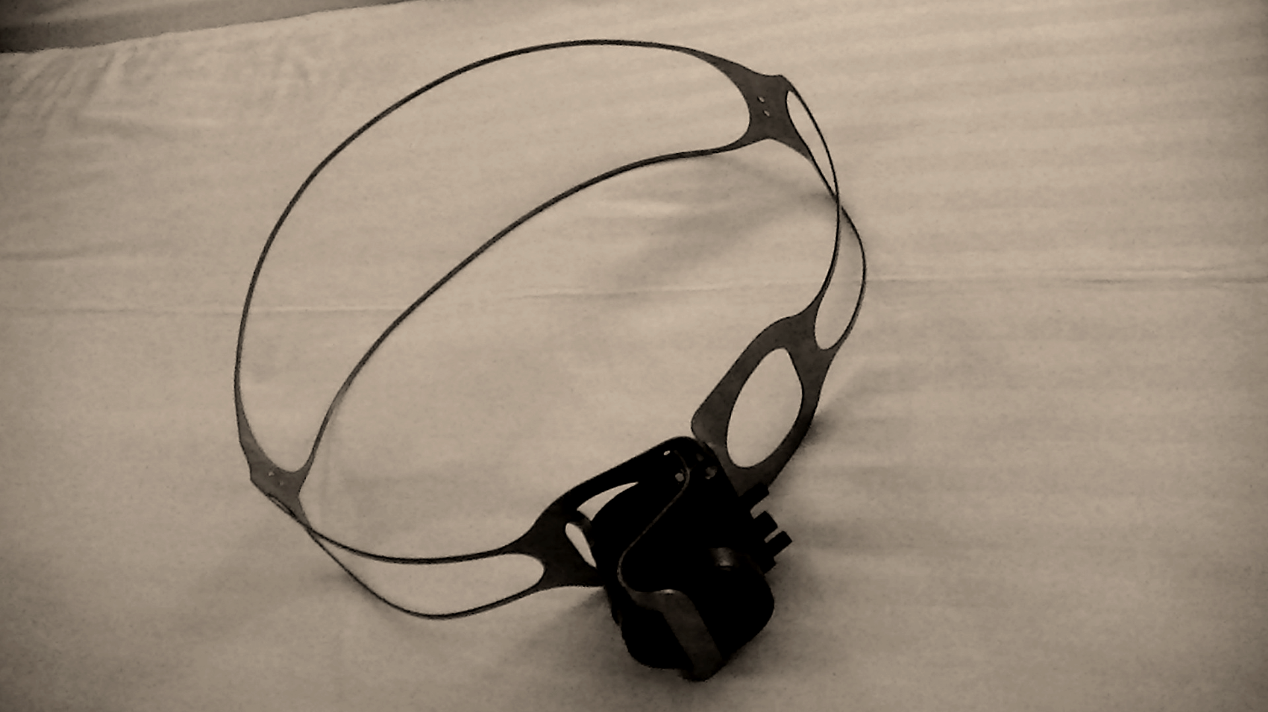
DOM collar
Bottom and sideview when mounted on a DOM.
The clamping force to fix the two hemispheres in place is approximately 8000N, provided by the two small spokes passing the bottom side. The design gives only approximately 2 % of shadowing.
Titanium collar with breakout box mounted.
Lasercut titanium Gr5 collars before bending
The last bending-step, with the bending-tool

Slide 10
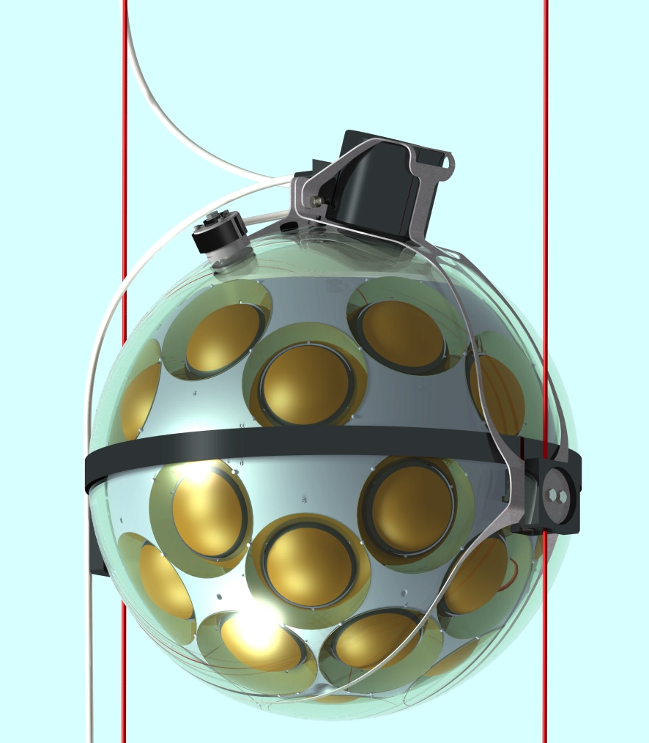
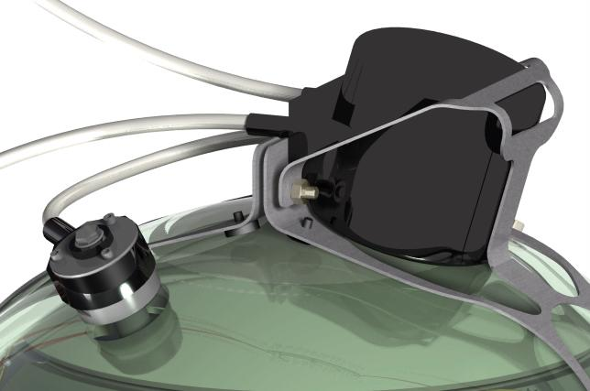
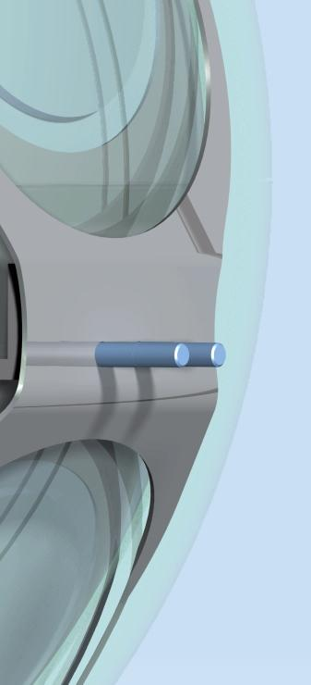
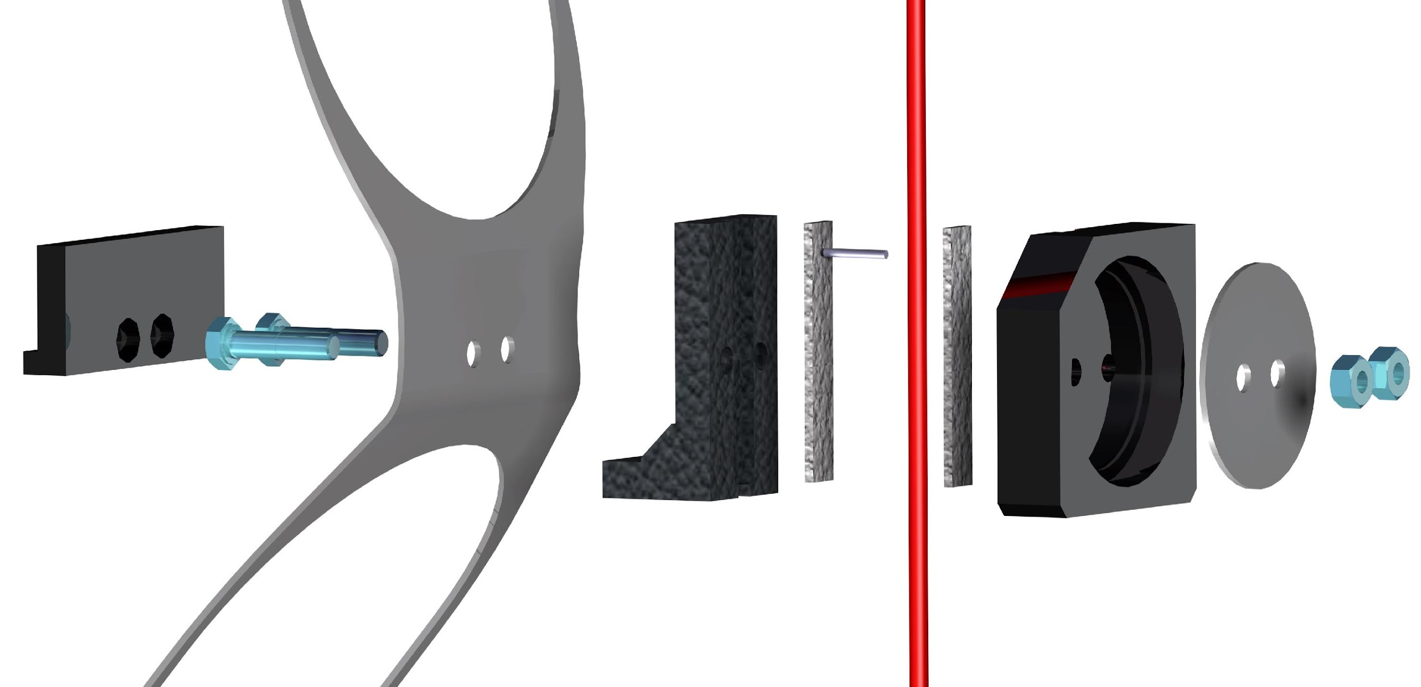
The mechanical connections of the VEOC to a DOM.
The DOM-fixation consists of an assembly of parts that clamp the DOM to the Dyneema ropes. The ropes are clamped between two rubber parts that provide the necessary friction between ropes and PE parts and also protect the ropes.
A Titanium reinforcement plate is added to provide enough stiffness, preventing the PE-parts that clamp the ropes from deforming. The force is provided by two M6 bolts and nuts.
Tests showed this design provides a friction of approximately 1400 N to each rope while the maximum needed is 400 N each. Nevertheless an extra 2 mm titanium pin is pierced through the rope to prevent it from slipping through, even in extreme situations (like a deployment!)
The mechanical connection of the VEOC to the DOMs is obtained by first feeding an optical fibre and the two copper wires through the BEOC in the BOB.
Thereafter the VEOC-penetrator cap is mounted on the DOM penetrator with an O-ring and 3 titanium screws and a titanium ring to press the cap evenly.
After testing the optical and electrical continuity as well as its leak-tightness, the BOB is filled with oil and mounted on the DOM by means of the BOB-clamp and two titanium nuts.

Slide 11
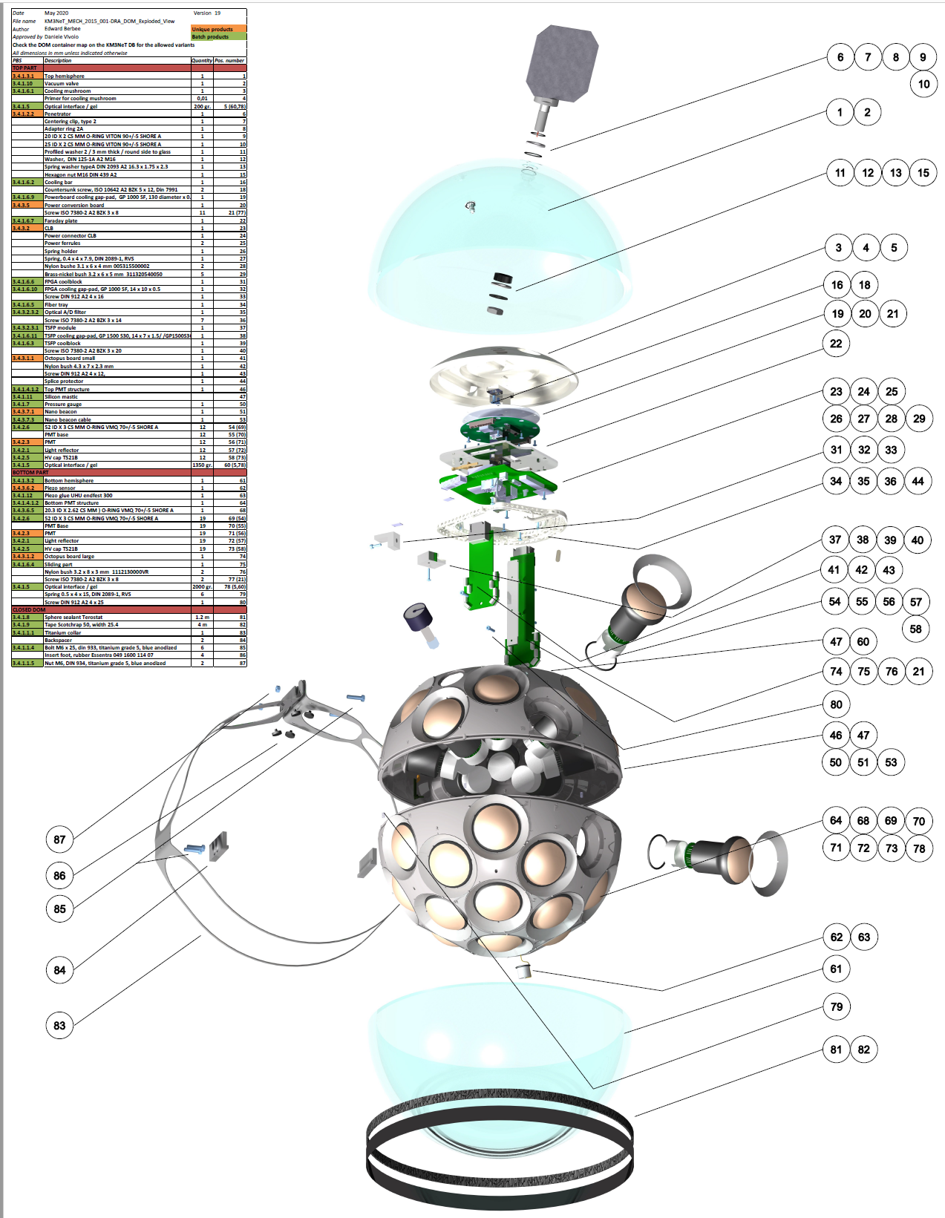
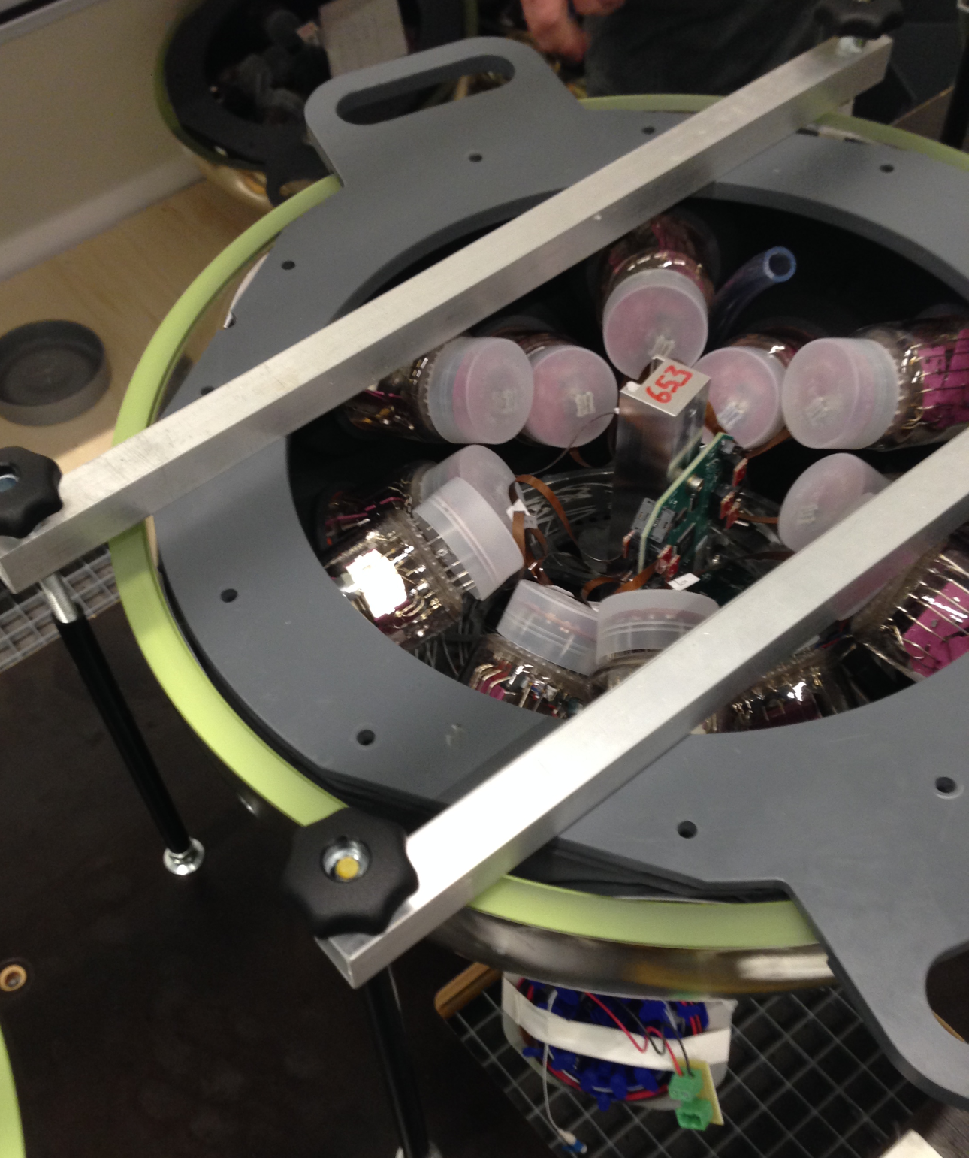
Filling tube; from here the space between the glass and the PMT support structure is filled with a transparent gel.

Slide 12
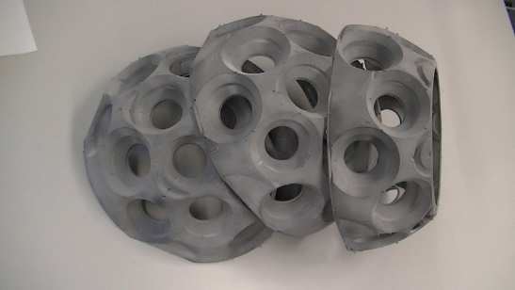
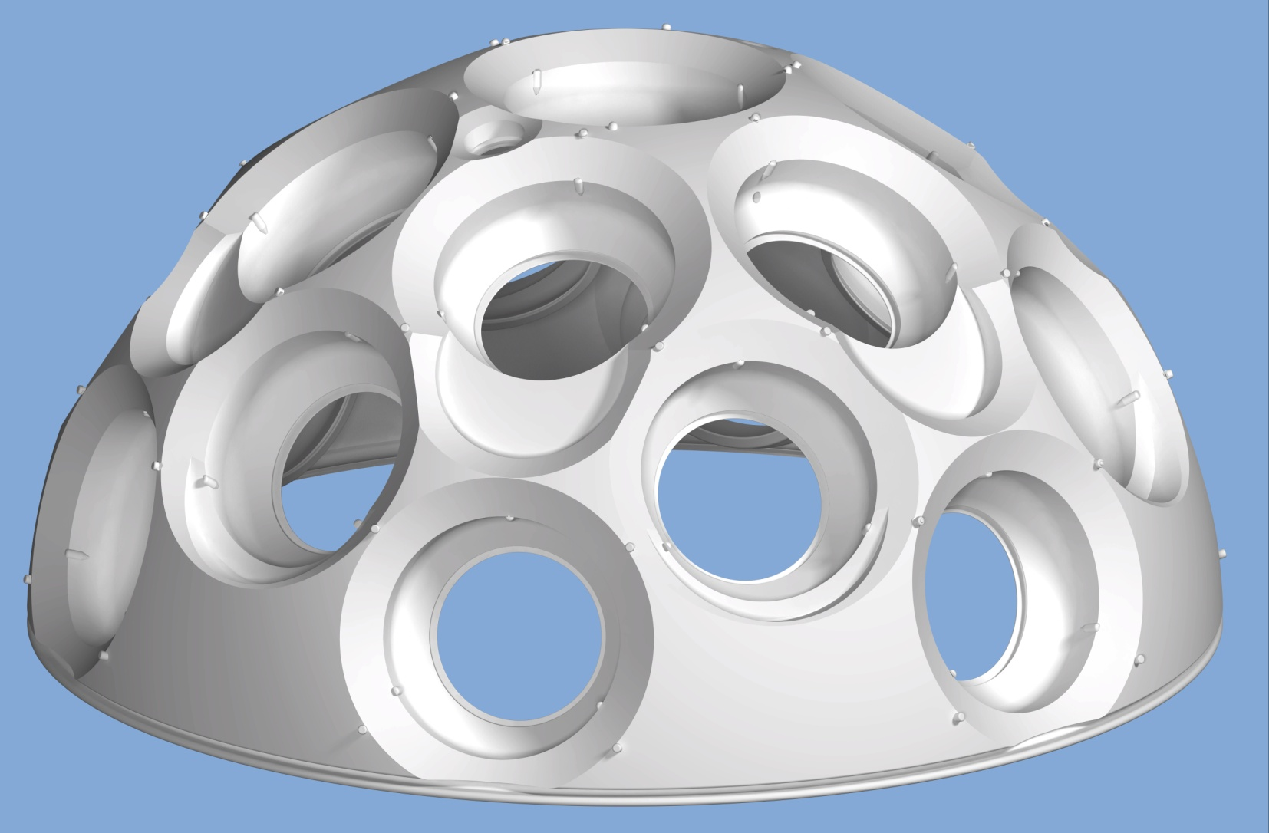
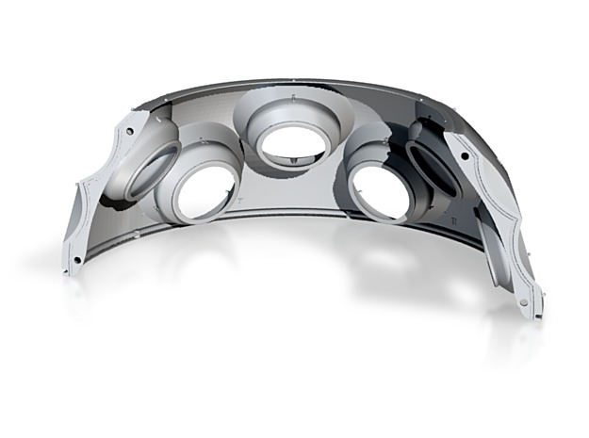
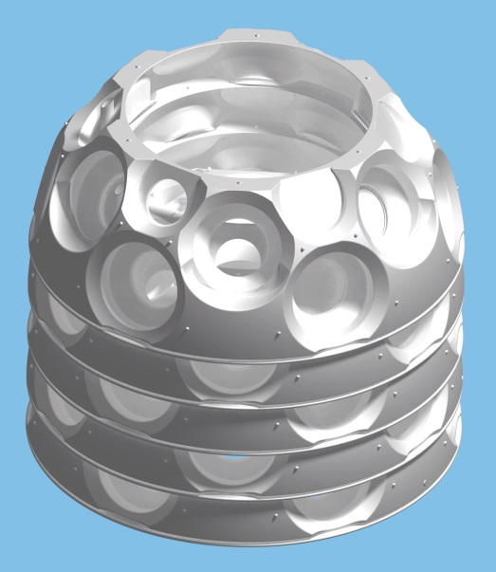
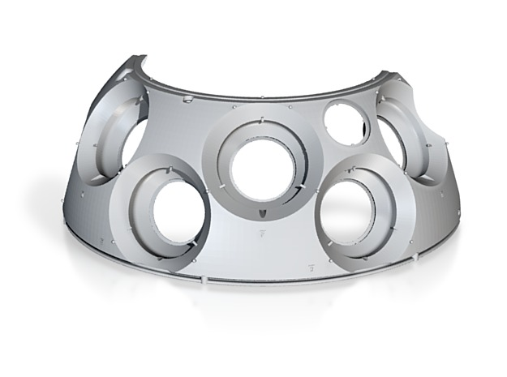
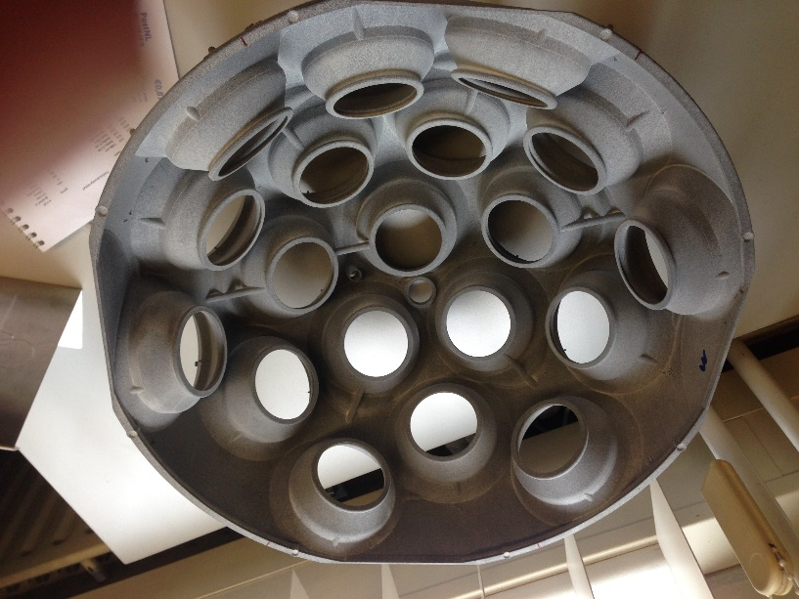
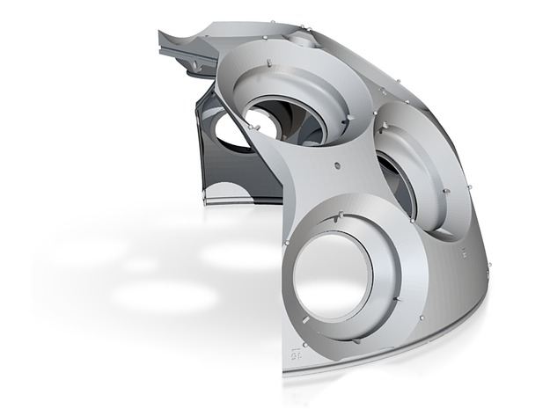
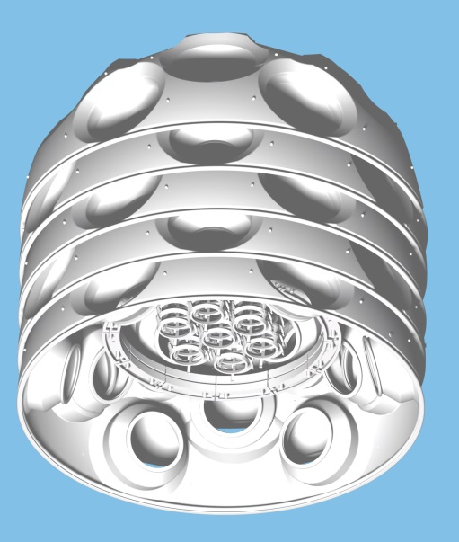
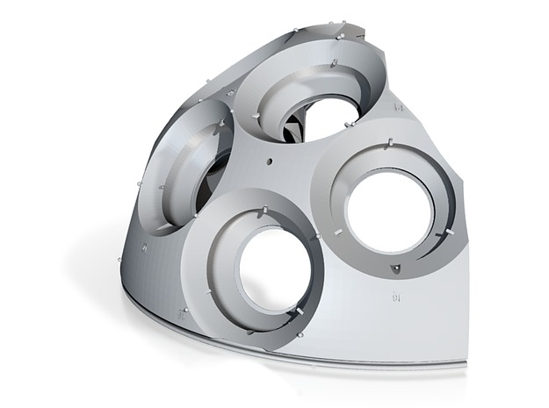
PMT-supports; many versions where designed, changes where made for many reasons
-Stackable for better pricing.
-Stackable combined with all small parts
-4 sides cut off to fit a HP printer.
-Cutouts to stack more dense.
-Same, also stackable.
-Quarters to fit more in a batch.
-Changed PMT’s.
-Another approximate 30 reasons.
-

Slide 13
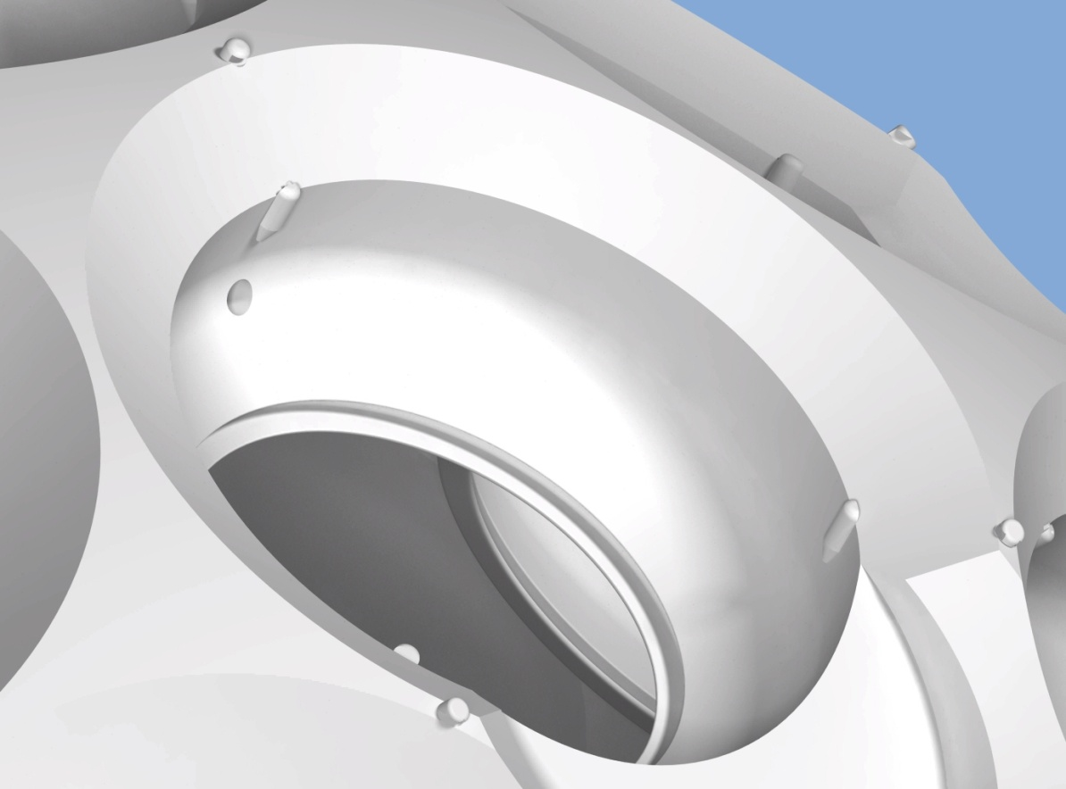
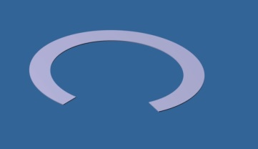
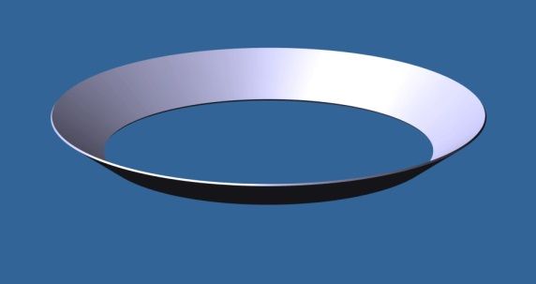
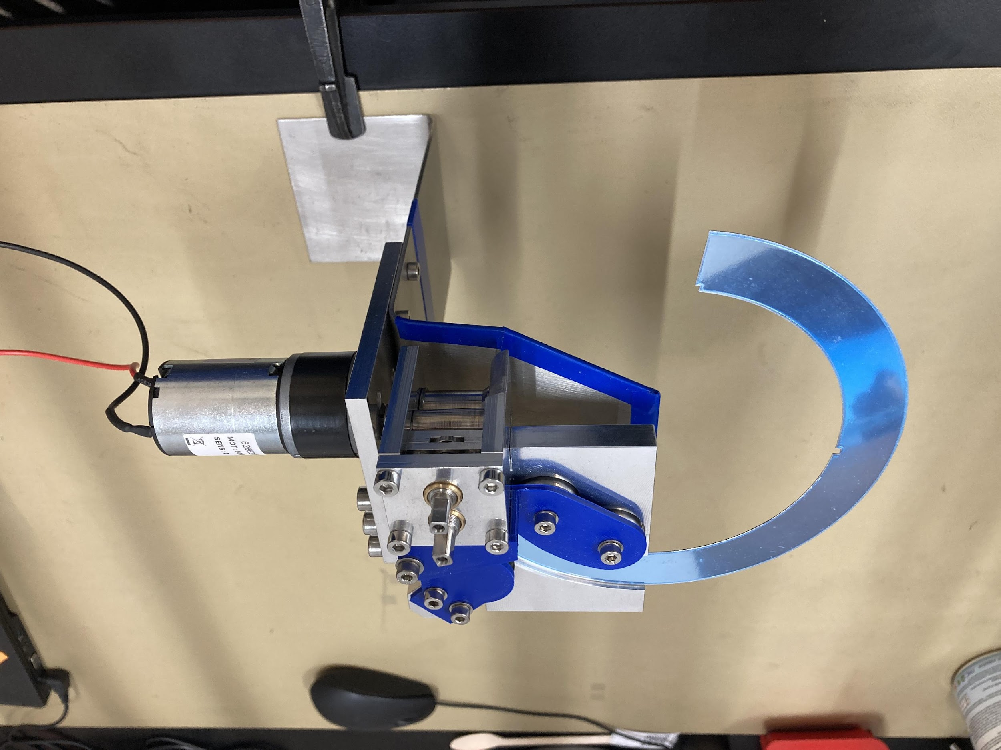
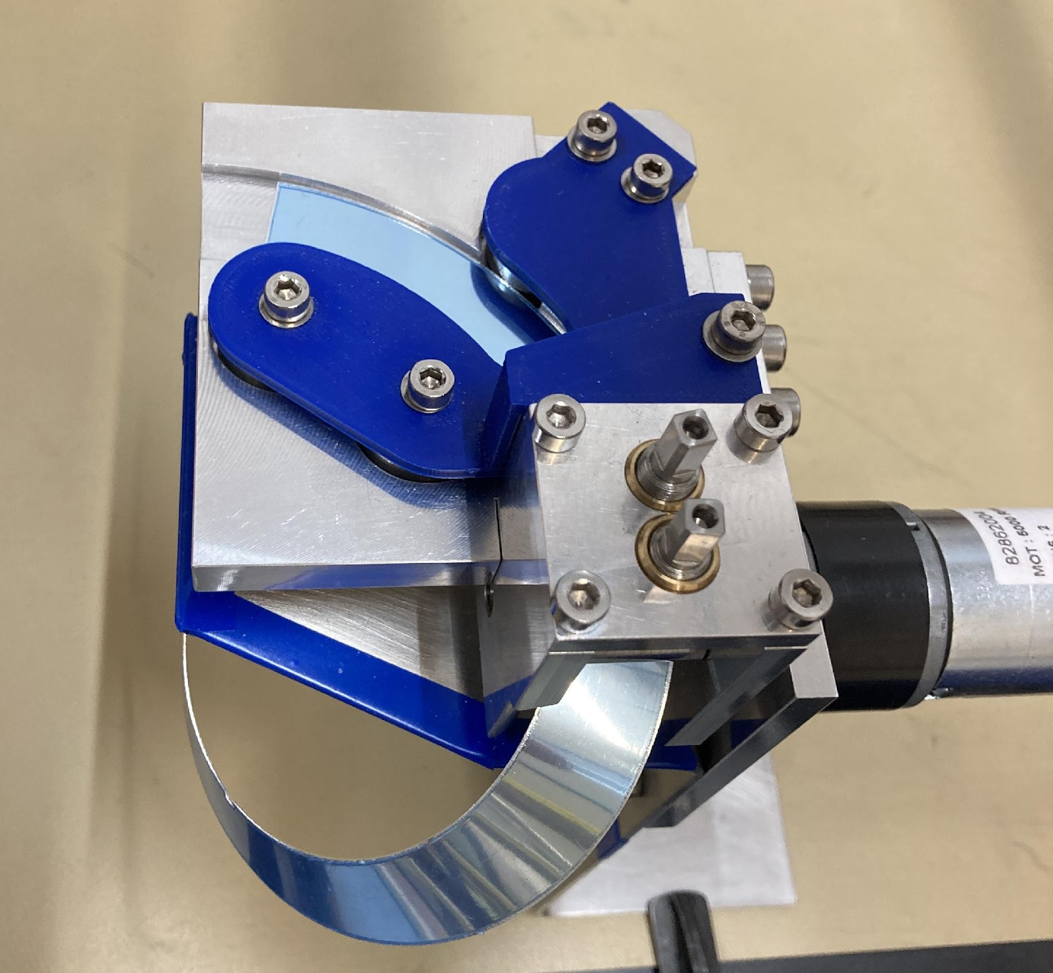
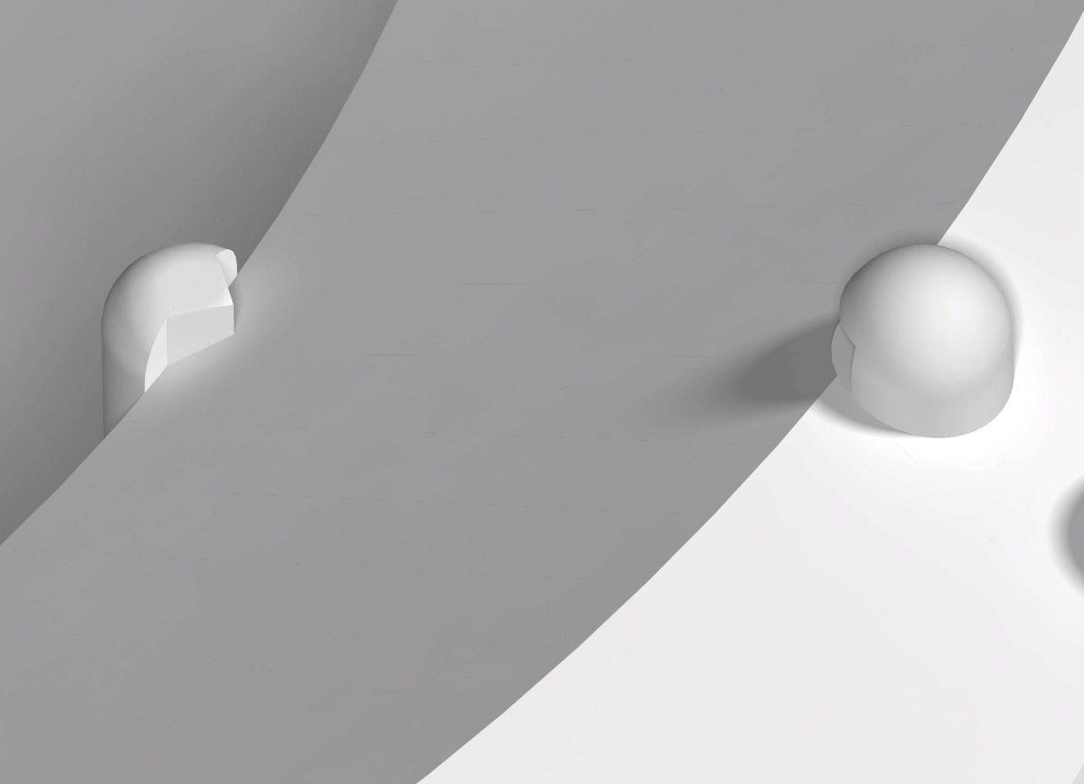
Fitting the reflectorring;
A tool “rolls” the funnel-form in the flat ring
Three PMT-clamping parts, combined with clamping the reflector ring.
Fixing point for
the reflector ring.
Nice homogenous reflectors in 3 seconds!

Slide 14
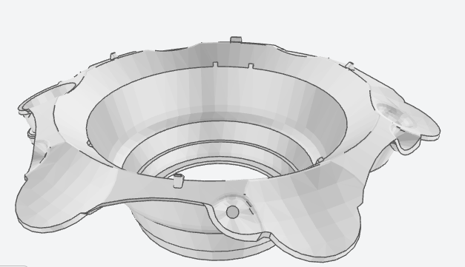
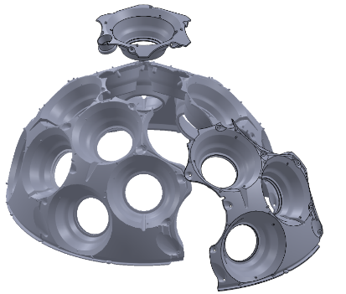
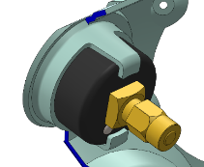
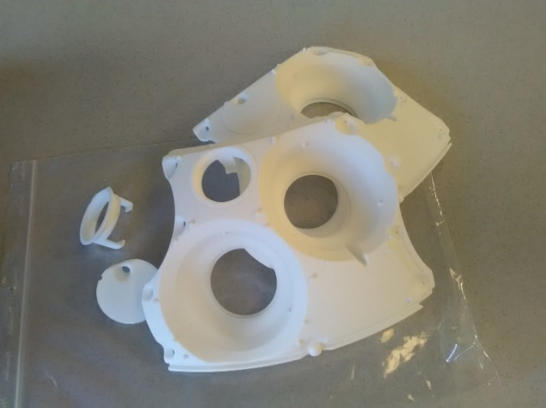
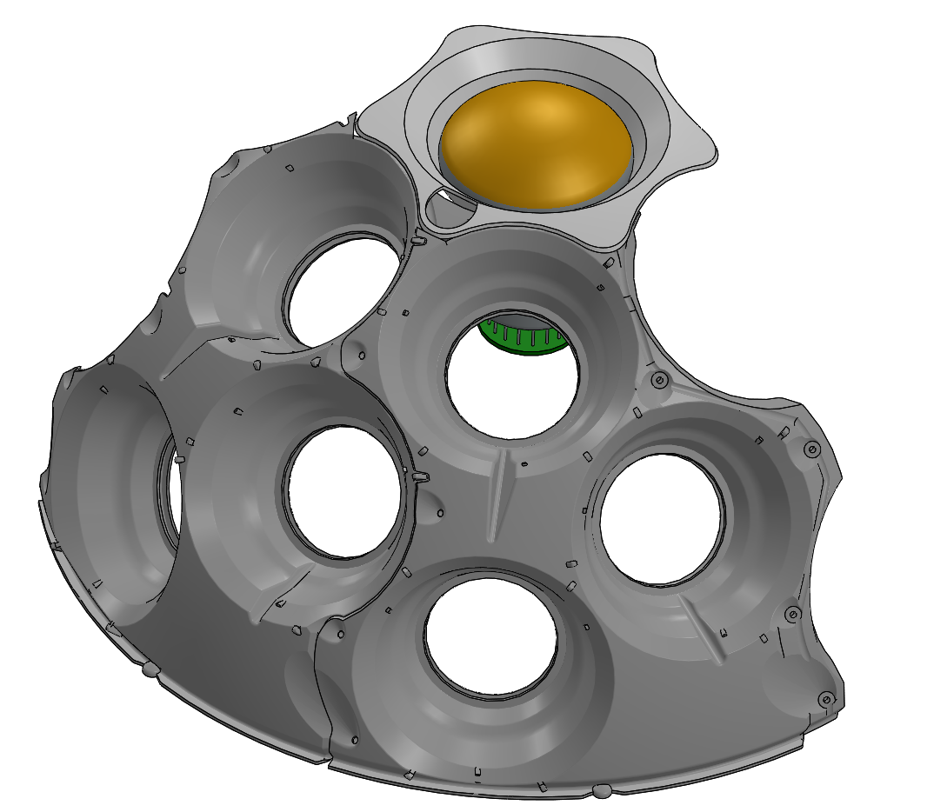
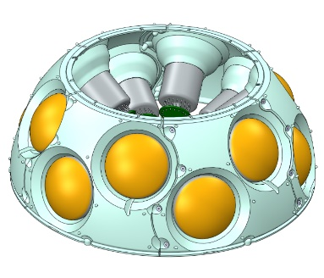
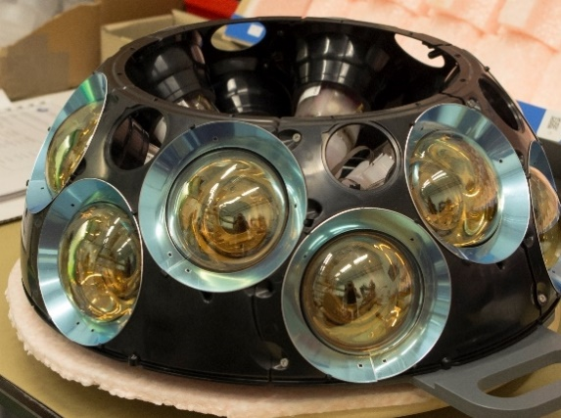
Injection molding Support structures
Paul Dijkstra, researcher at the Professorship for Polymer Engineering Windesheim in Zwolle made it possible to mould the PMT-support structure. He redesigned the Top-support to make it ready for injection molding. It was therefore divided in 6 equal parts which thereafter are assembled (all external!) For the pressure gauge, the pouring tube and the Nano beacon a solution is implemented.
The different inserts for pressure
gauge, nano-beacon, gel tube-connection and blanks.
Six separate parts
form a Top-support.
For the bottom support;
Six identical parts + one central part
Possibly the piezo hole must be separately milled

Slide 15
Why 3D-printing as well as injection molding?
Designing and producing the mould takes more than a year, therefore the top supports (the first ones developed) had to be combined with the printed bottoms -an extra complication-
New form injection molded with U-seal
New form 3-D printed, to be used with O-ring.
On the left the new seal, better capable of sealing PMT’s with slightly different dimensions, therefore less depending on accurate PMT dimensions (Design-change is much less flexible in injection molding!)

Slide 16
The Mold;
Complicated mechanics, cooling and eject mechanisms which are now producing the parts, this one is for the top-supports.

Slide 17
Top buoy assembly
The DU top buoy is necessary to keep the Du straight up within specification;
Within 100 m at 0.15 m/s Sea current in ARCA which is measured to be the maximum current at Capo-Passero where ARCA will be installed. With the current design the deviation is limited to approximately 40 m.
In ORCA the maximum top-deviation is 25 m at 0.3 m/s Sea current which is the maximum current at the Toulon site where ORCA will be installed. With the current design the deviation is limited to approximately 14 m.
The rest of the parts are for the release of the buoy at the end of the unfurling. The guider plate (2) is the mounting device for the two buoy sliders (4) which let the Buoy slide out of the LOM smoothly and are clamped in the LOM until they are pulled out by the ropes which are fixed to the anchor on the seabed. This LOM has two spring release clamps which clamp the sliders with a total force of approximately 800 N.
At the bottom of the buoy frame a “pre-release” system is mounted. Since the main release system can only hold back approximately 800 N this second release prevents the buoy from breaking loose during the LOM rotation or transport.
The system consists of two buoy release pins (6) which are tensioned by springs (11). Fixed to the ropes there are two hairpins (7) which block the release pins from retracting. When all DOMs are subsequently released from the LOM, the ropes will tension and the “safety” hairpins will be pulled out, now the release pins can be retracted by their springs. The small rope-ends will tension again and the buoy is retracted from the LOM.

Slide 18
Motril (Portugal) tests 2014 / 2015
First deployment-tests done with the NIOZ ship; the Pelagia, dummy DU’s (dummy) where deployed repeatedly while in the harbor the rest of the crew prepared the next one.

Slide 19
Cabling to go overboard first
Underway to the site
Hosting a DU overboard
Almost there

Slide 20
Putting overboard the first two DU’s.
ROV, two great teams of tree people on board available 24/7
Waiting for the LOM to be near the Marilene to hoist in.

