Slide 1
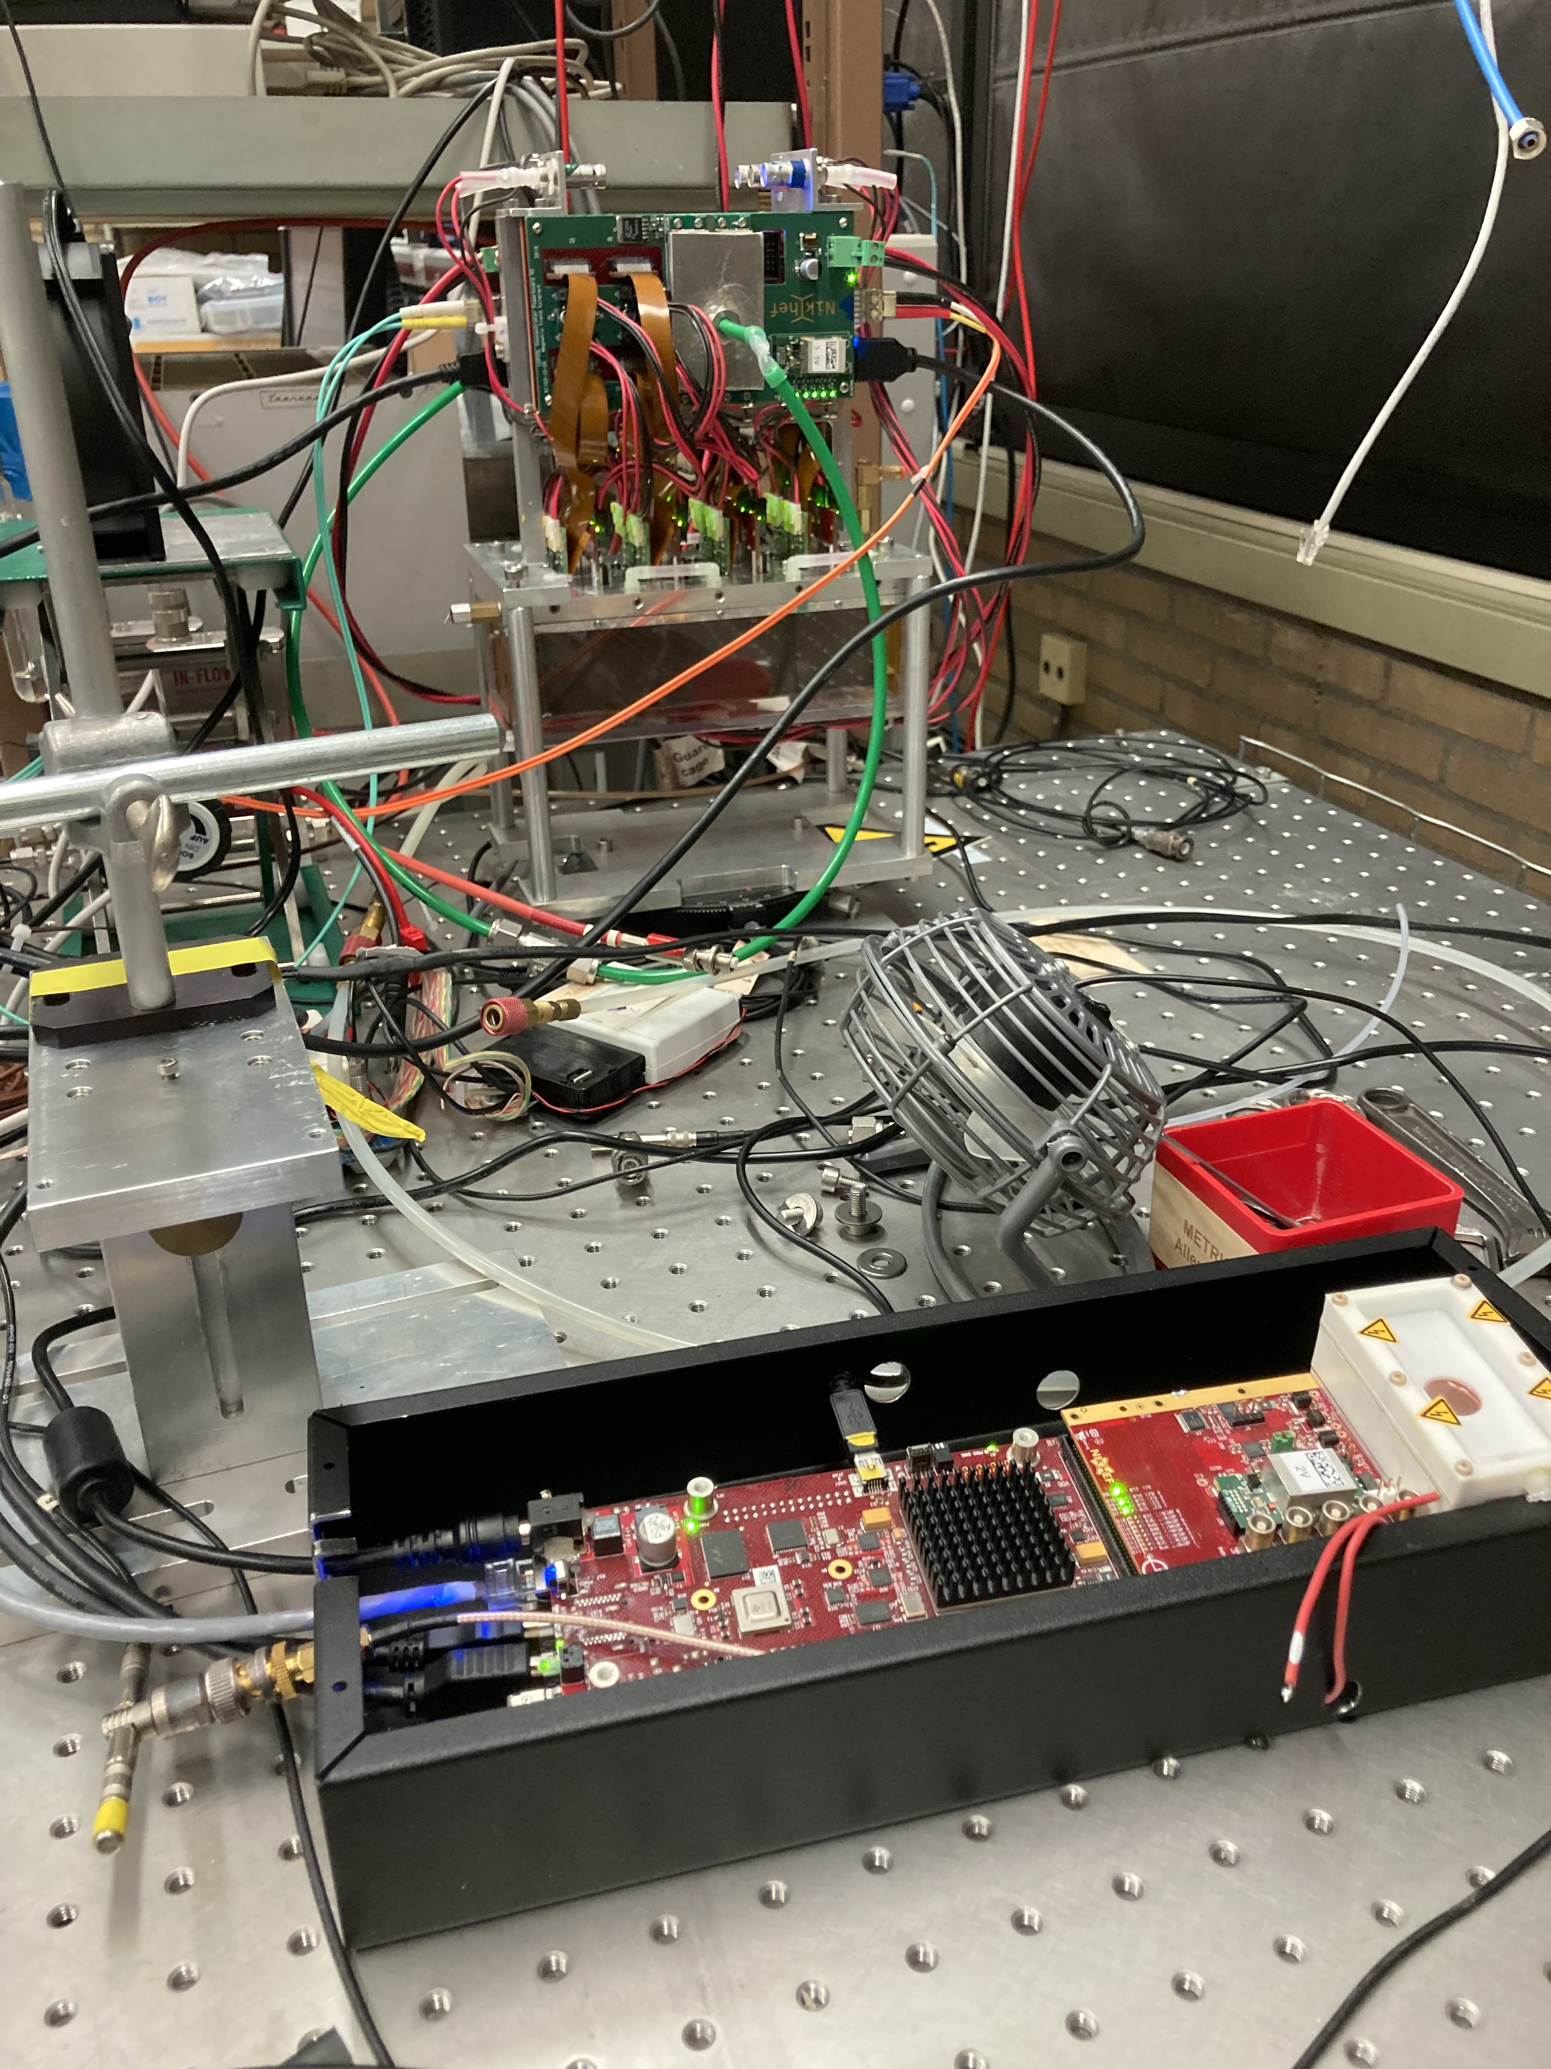
Repairing the Module in Bonn
On 25-26-27 January Fred and I will go to Bonn.
There are two goals:
Repair of the module in Bonn. Chip 11 has a short. See next slide for geometry. The quad with chips 28-31 has a low efficiency and low ToT. Can this be fixed/improved?
Take the module with the DAQ to Nikhef to prepare for shipping to the US. The idea is to test the DAQ, pack the detector and send it.

Slide 2
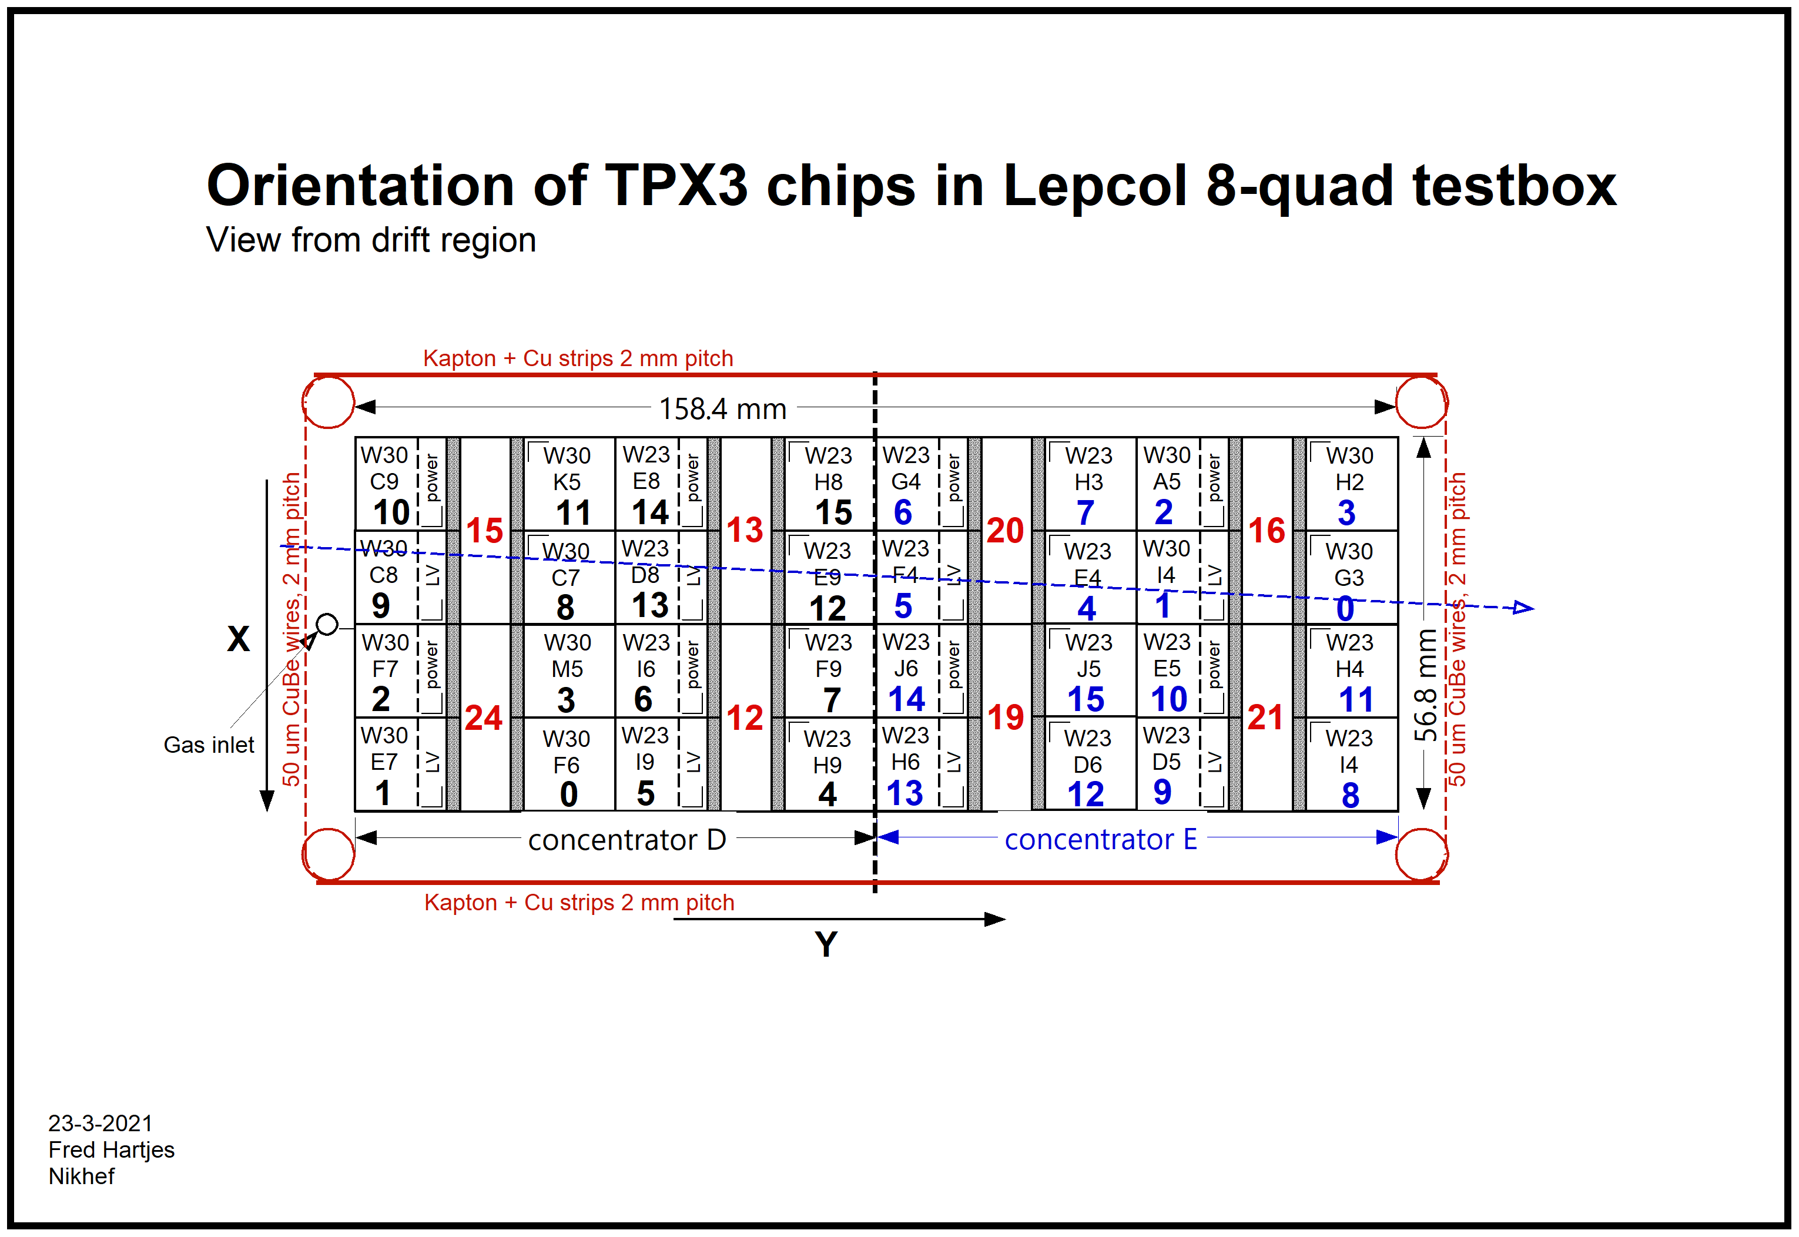
Geometry of the 8 quad module
The offline geometry follows this picure and has 0,0 in the lower bottom corner and x runs upwards
The x laser (indicated with the arrow) starts scanning at high offline x values
x local = off line x
off line x = - x (laser)
x local
y local

Slide 3
Repairing the Module in Bonn
To repair the module we need
Bring the test beam quad (incl support) to to Bonn
Access to a clean room and tooling (that is in one of the white boxes)
Microscope, ISEG voltage supply, vacuum probe
…..
The module is in one of the red labelled boxes. The tools in other equipment (see pictures in Transfer_Bonn.pptx).

Slide 4
Transfer of the module plus DAQ to Nikhef
The following equipment should be transferred
The module with support frame
DAQ computer Arawana including cables screen etc.
The module SPDR board plus cables and charger
The Time stamp SPDR plus charger; with an attached ‘dummy’ TPX3 chip to it
Low voltage supply (?)
Detector cooling:
  ventilators to cool the multiplexers and SPDRs.
  Liquid cooling fluid with pump and tubes.
……

Slide 5
Next slide a block diagram of the DESY testbeam setup (slide 6)
The DAQ system is in the upper half of the diagram controlled by Arawana
In the middle is the HV and Slow Control system controlled by Levaard
The lower part is for the Mimosa Telescope
For the EIC experiment we will test the DAQ (upper half) part and ship it to the US excluding the cooling system.
Mockup test setup: https://indico.nikhef.nl/event/3124/ NewGasEnvelopAndMockup.pptx
https://indico.nikhef.nl/event/3151/ MockupJune.pptx
DESY testbeam information https://indico.nikhef.nl/event/3158/

