Slide 1
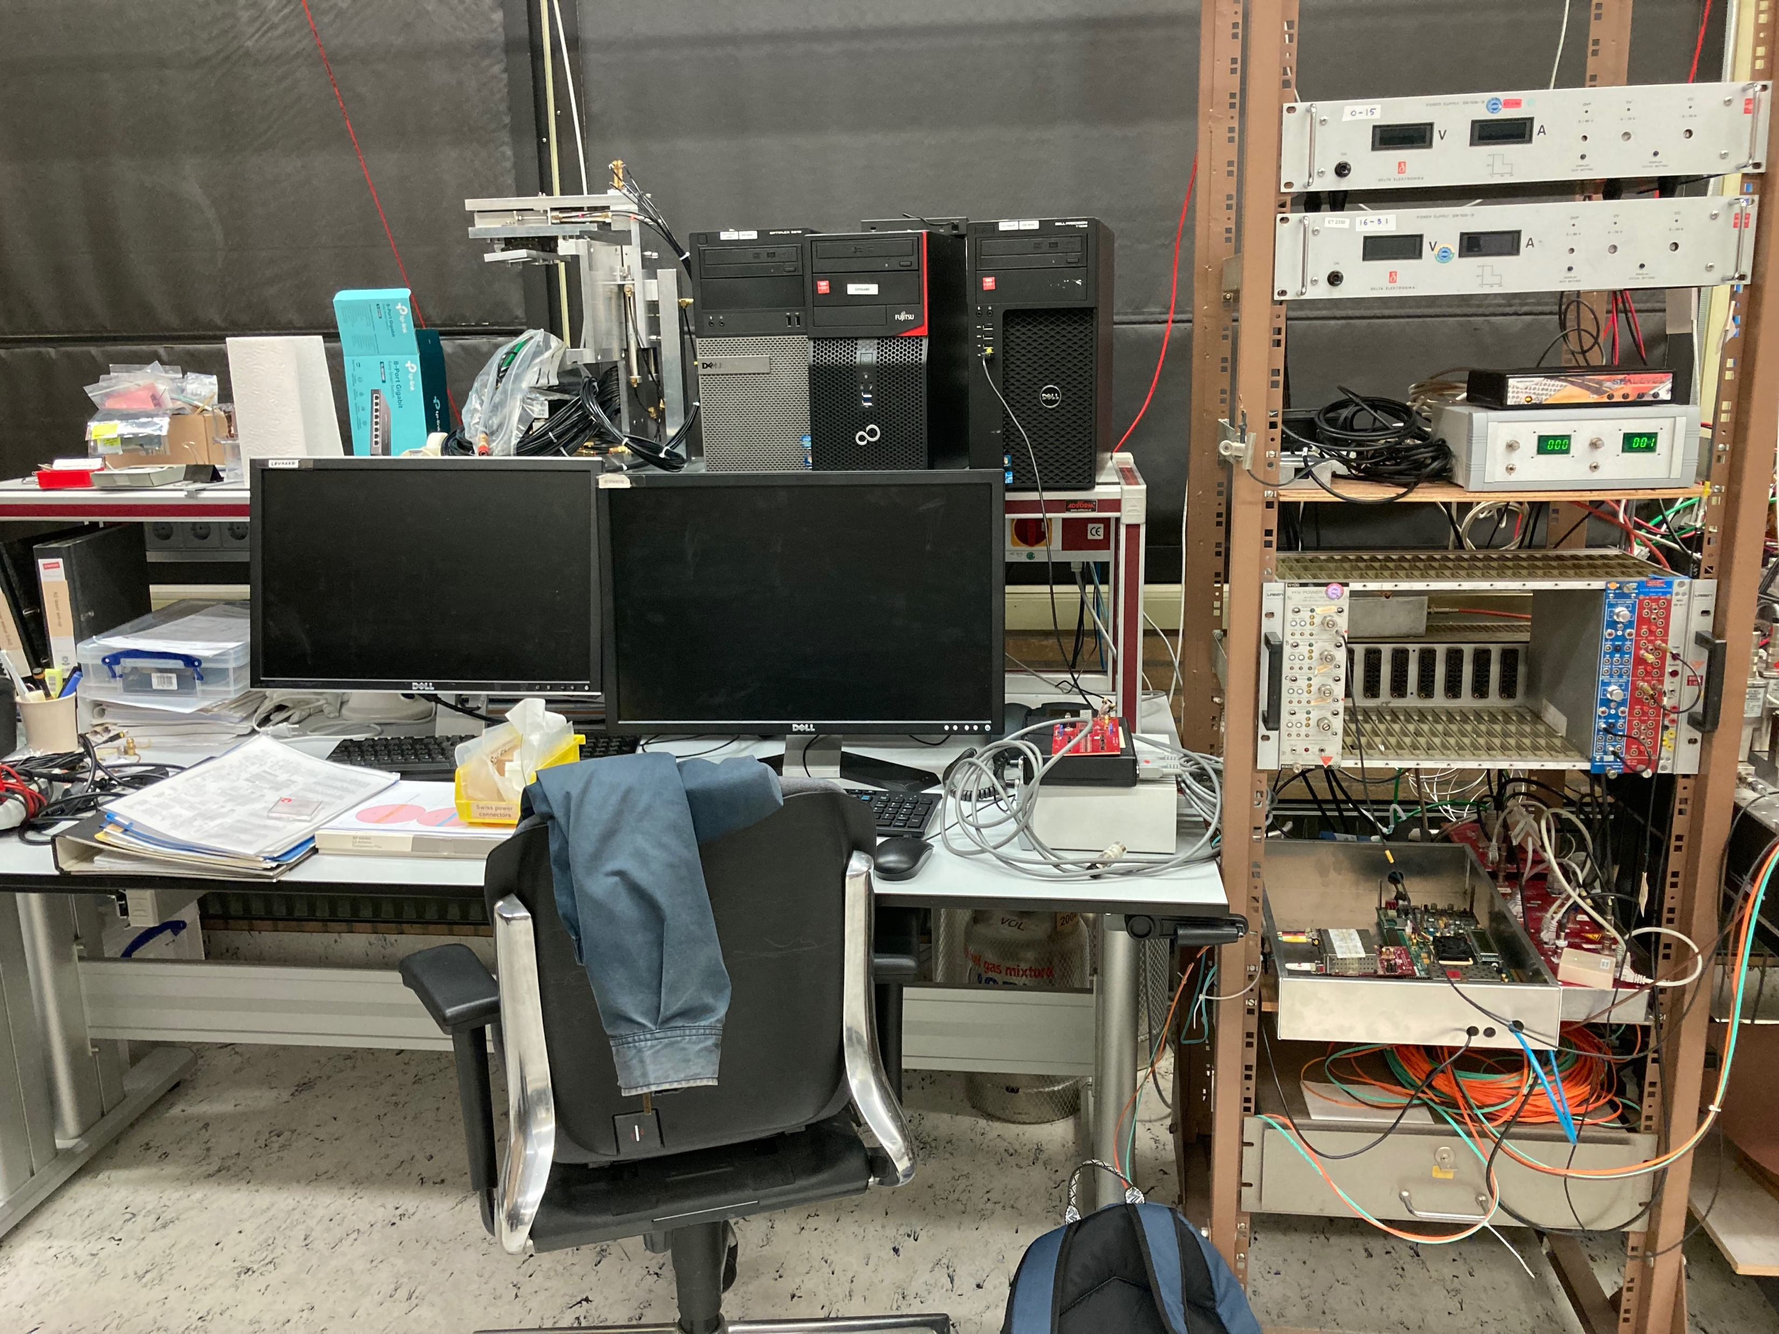
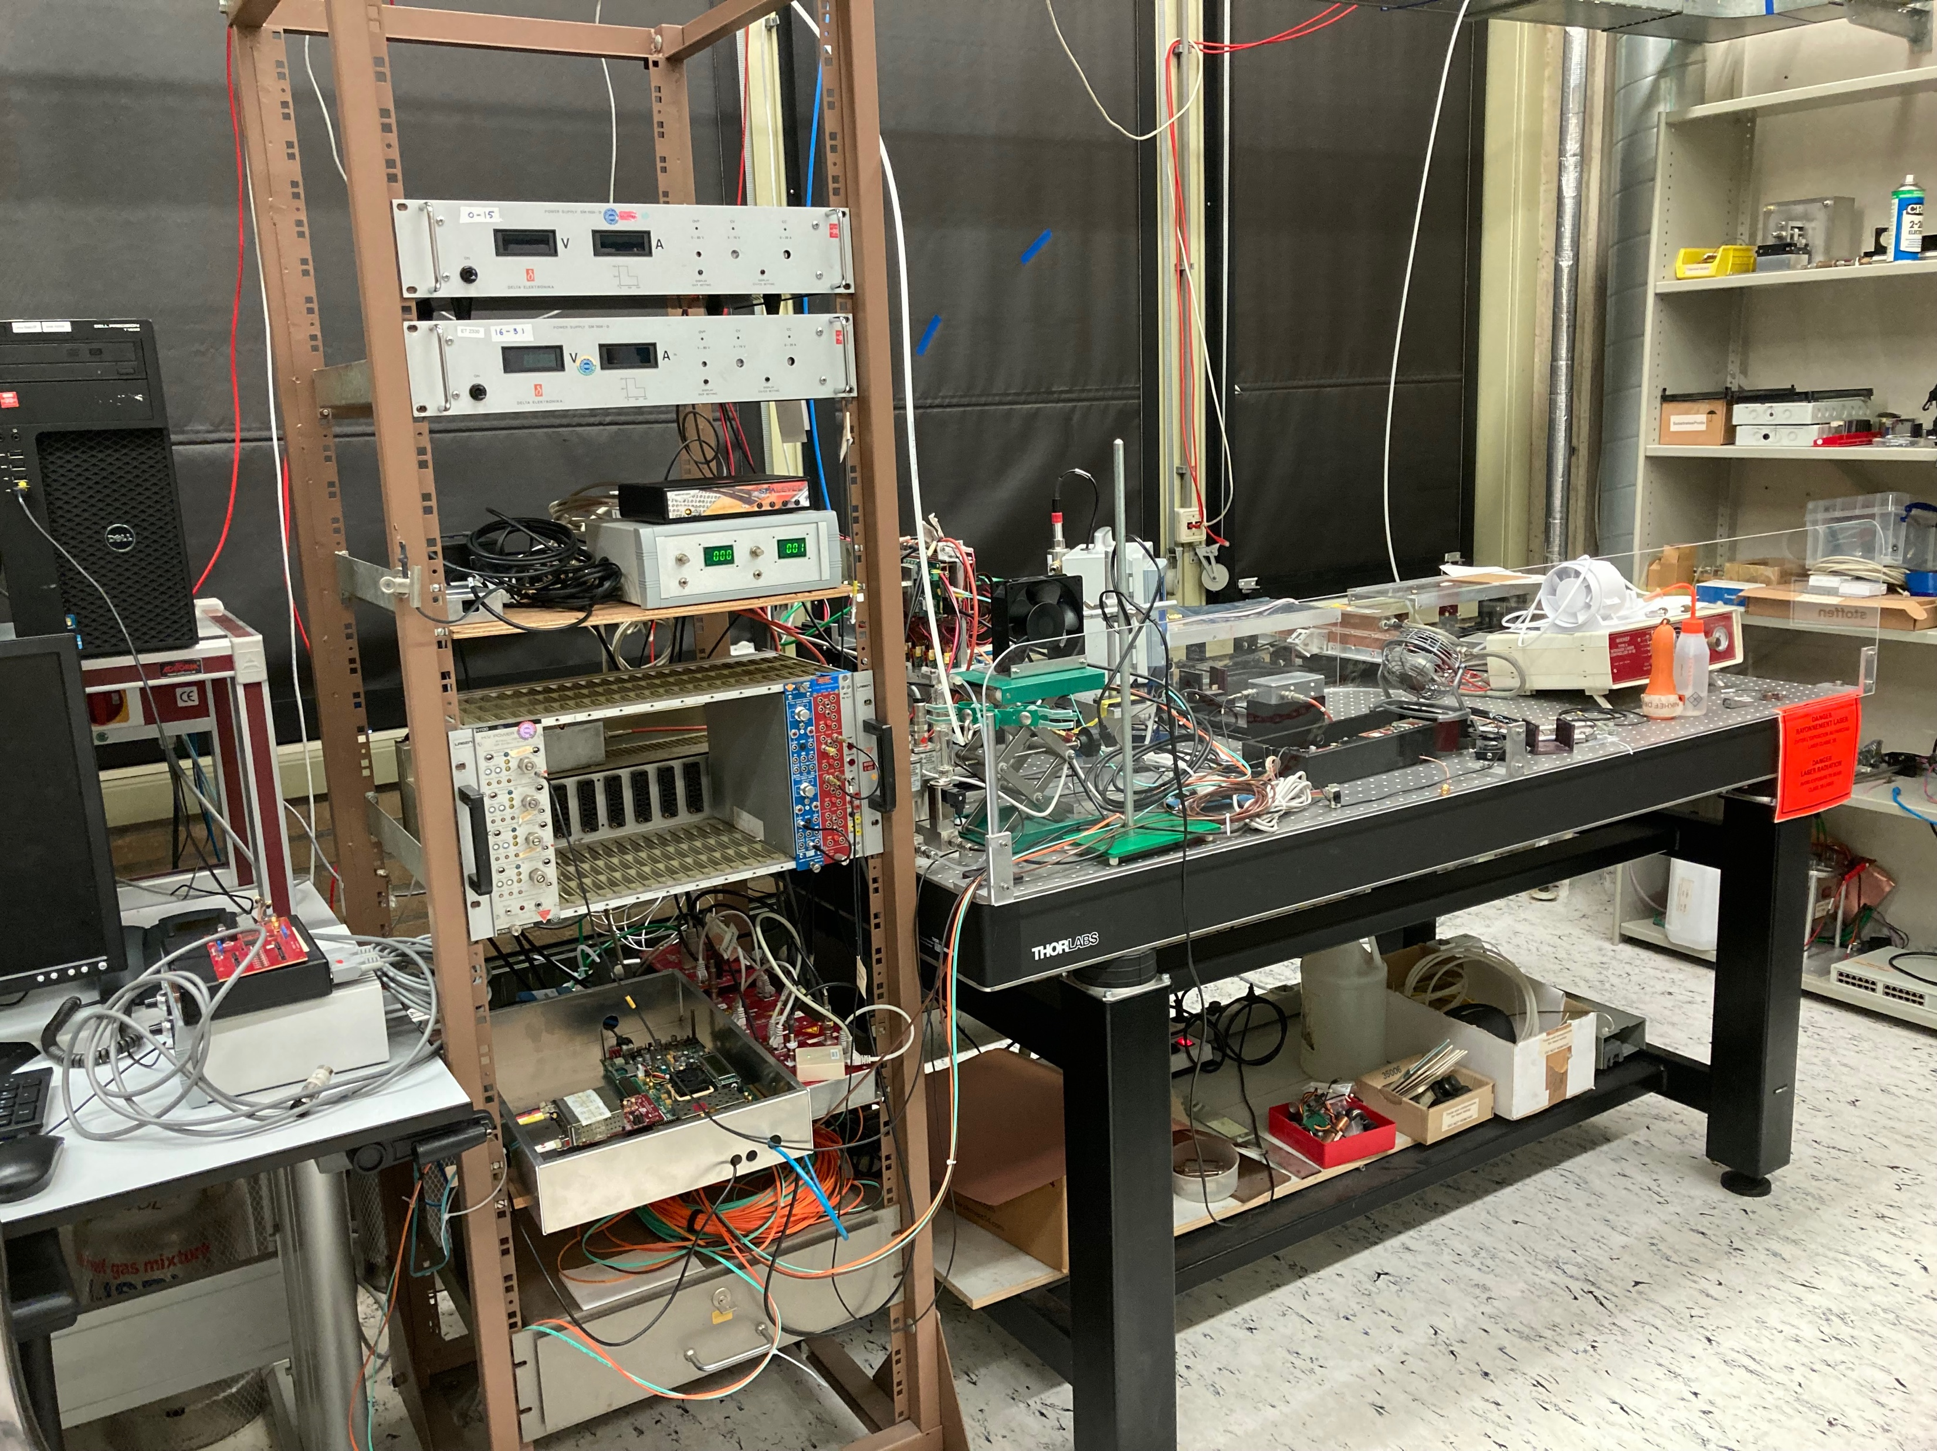
Laser setup photo’s
https://www.nikhef.nl/pub/services/biblio/theses_pdf/thesis_F_Hartjes.pdf
Optical table 90 x 180 cm

Slide 2
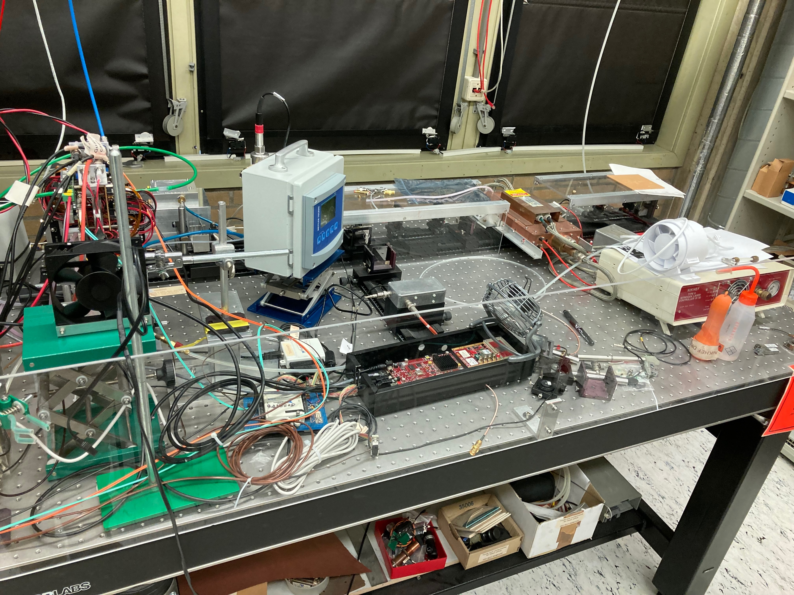
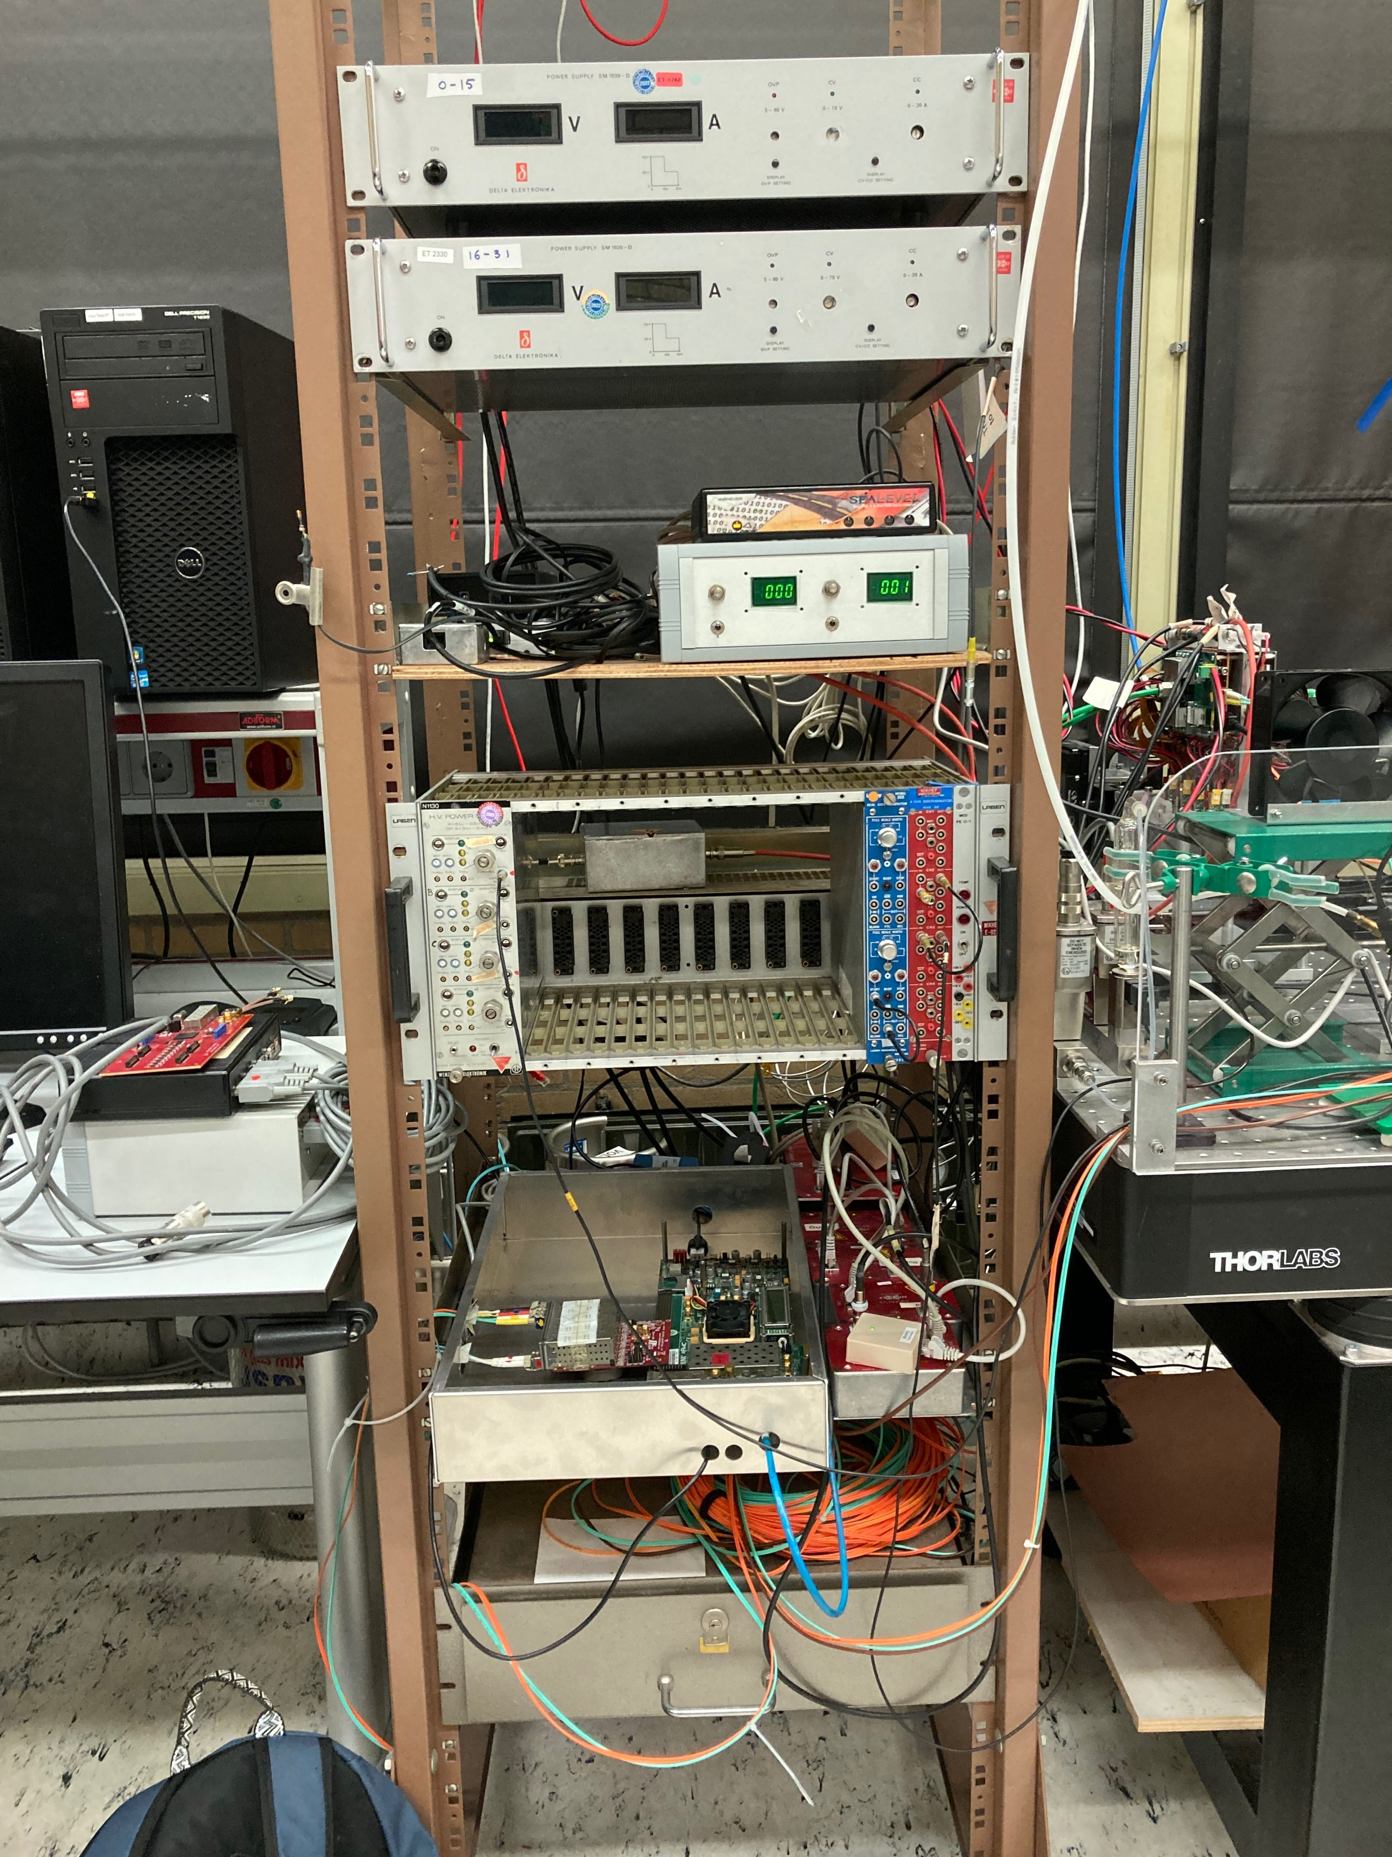
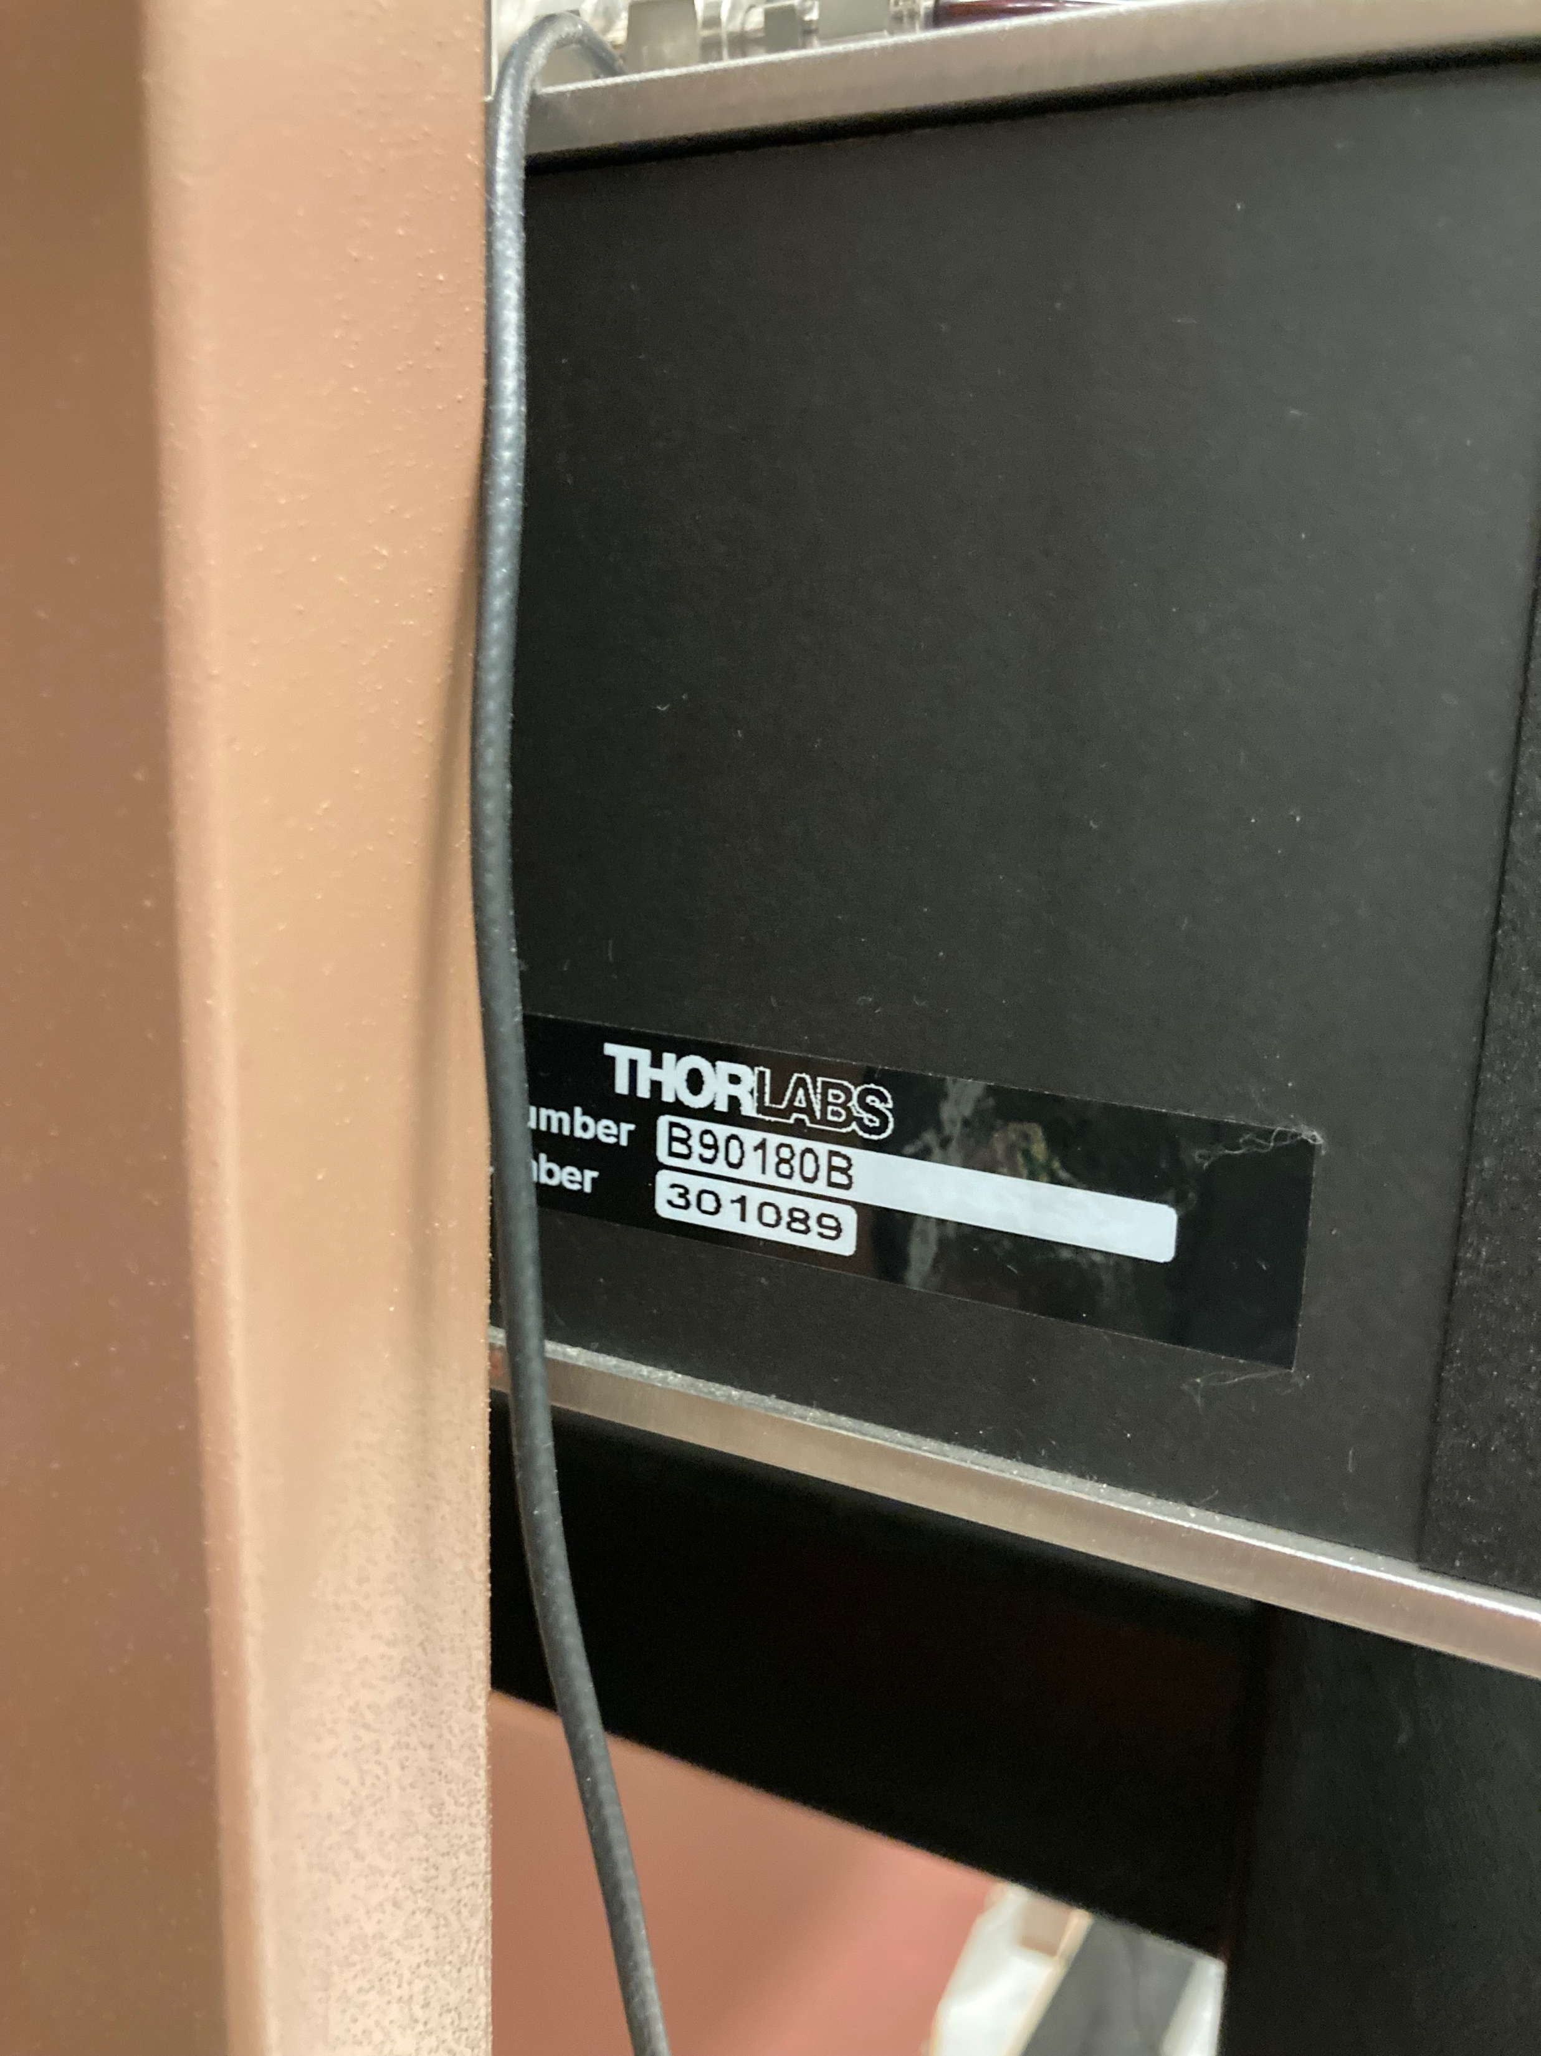
Laser setup photo’s

Slide 3
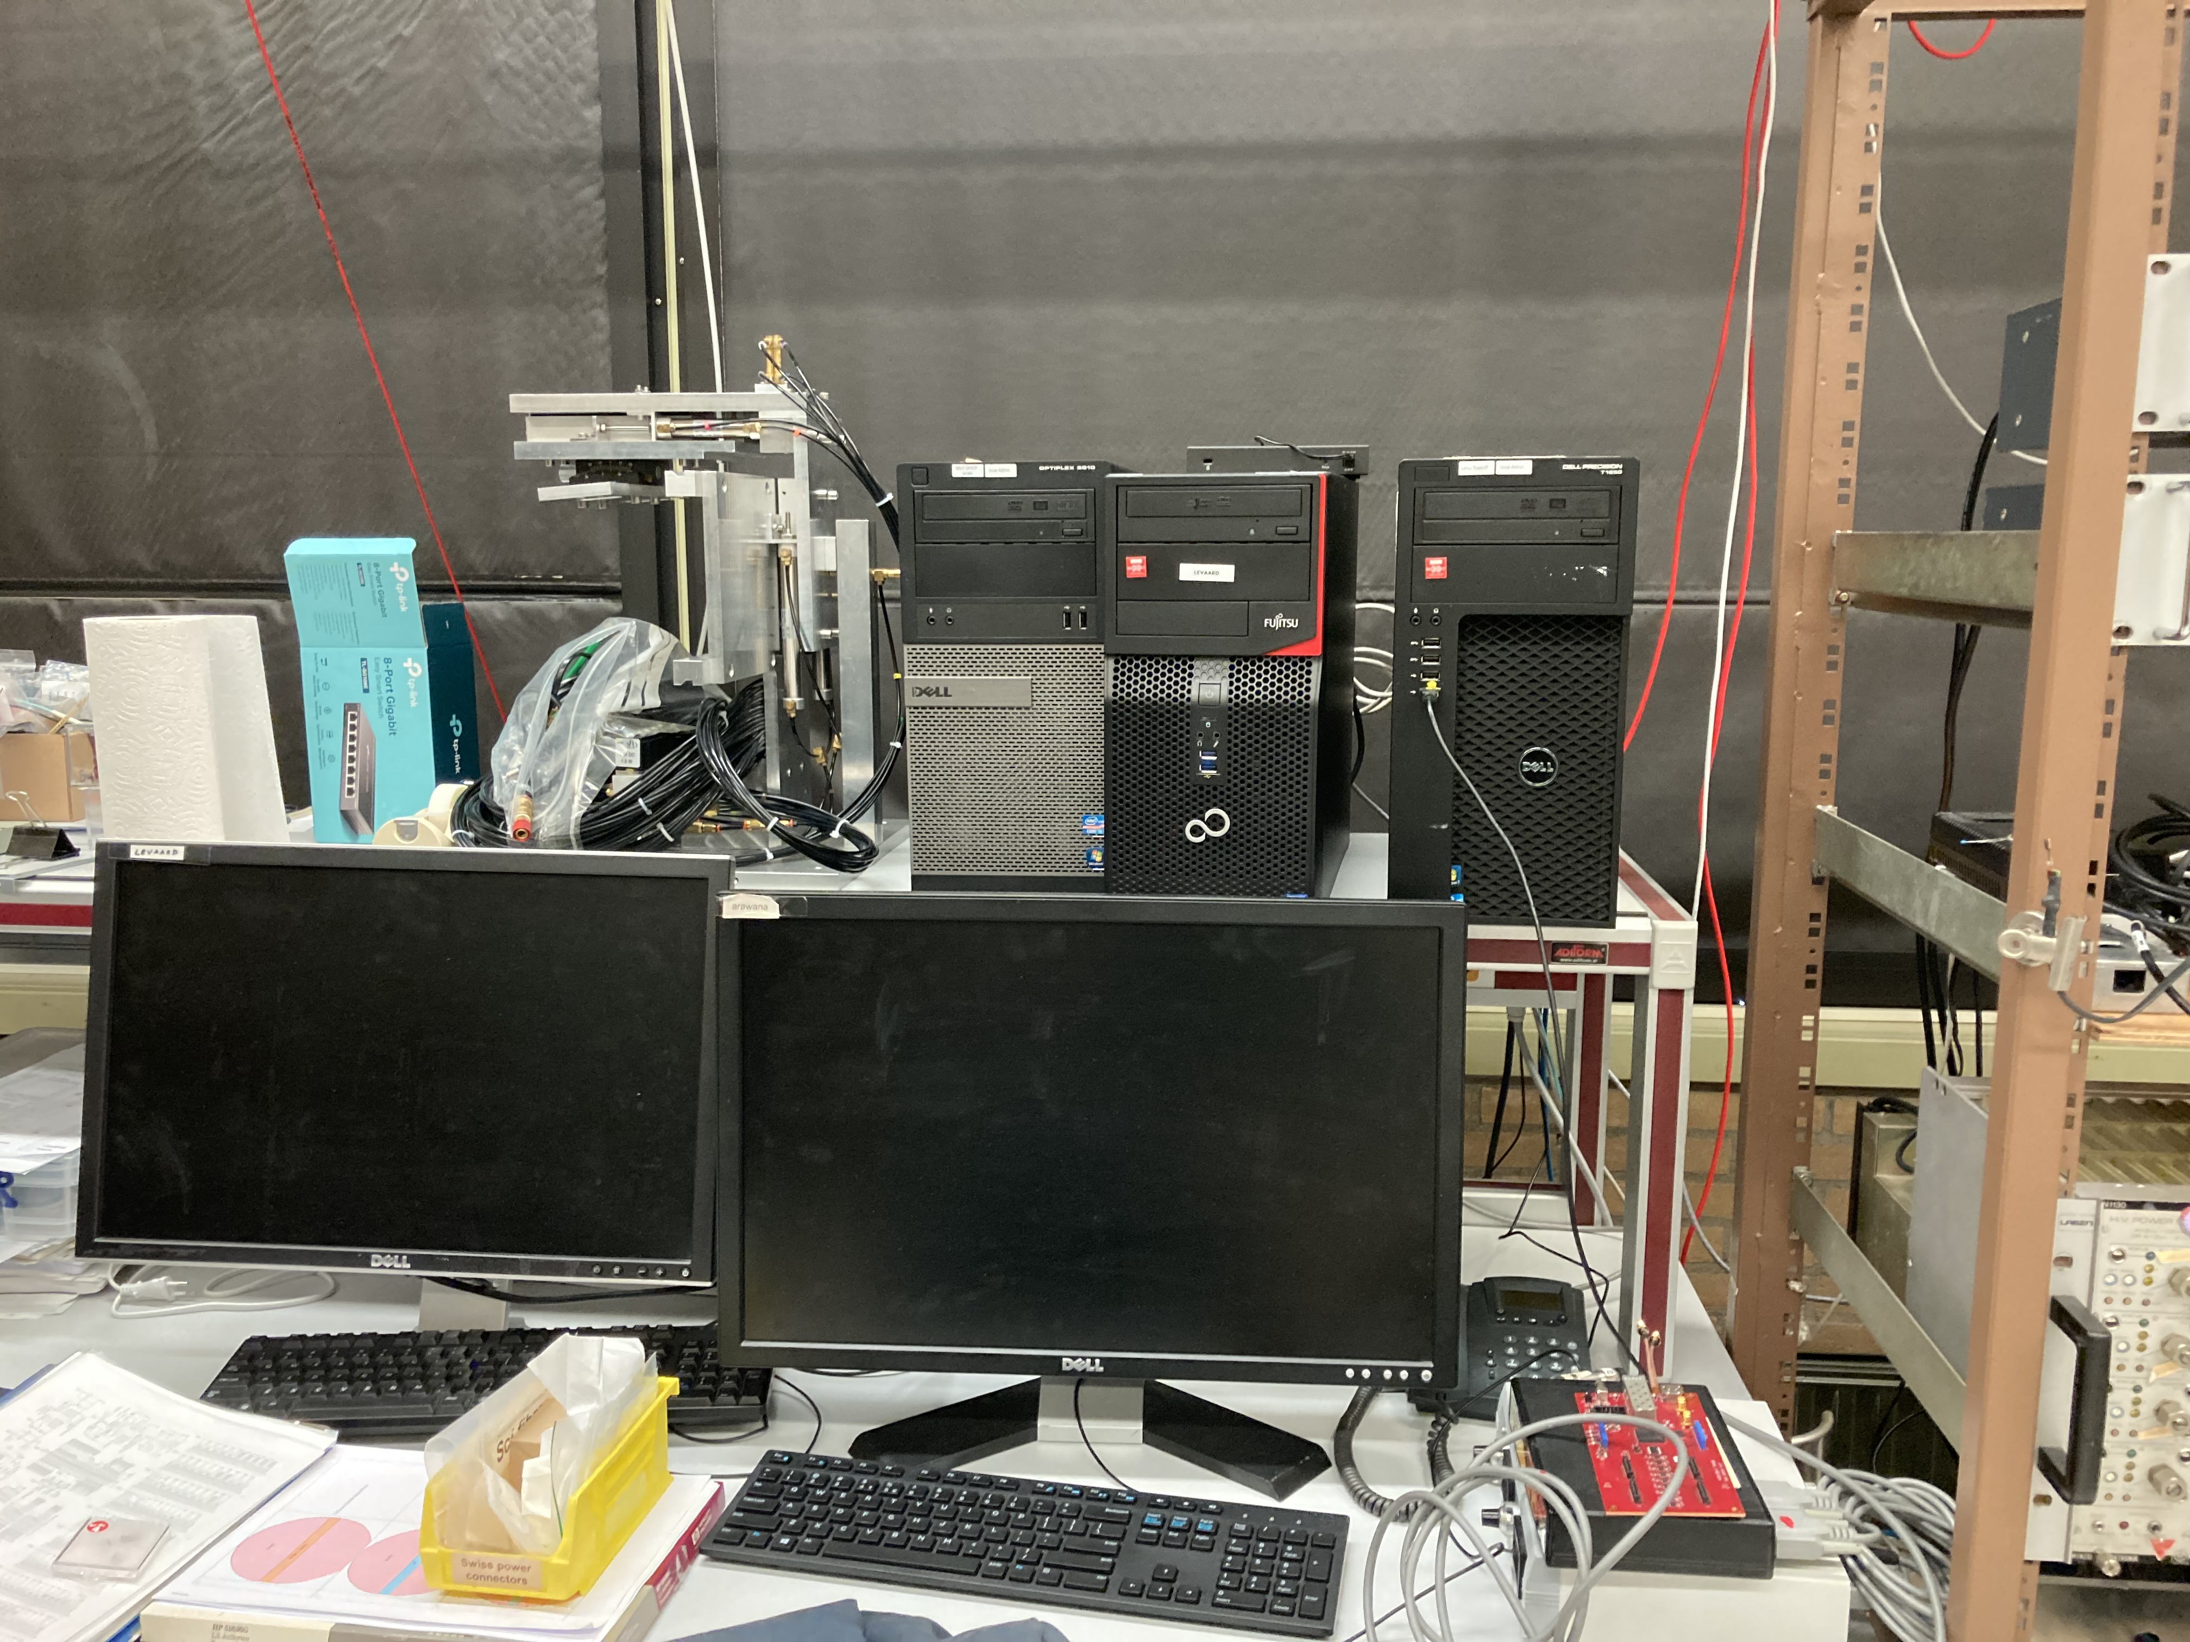
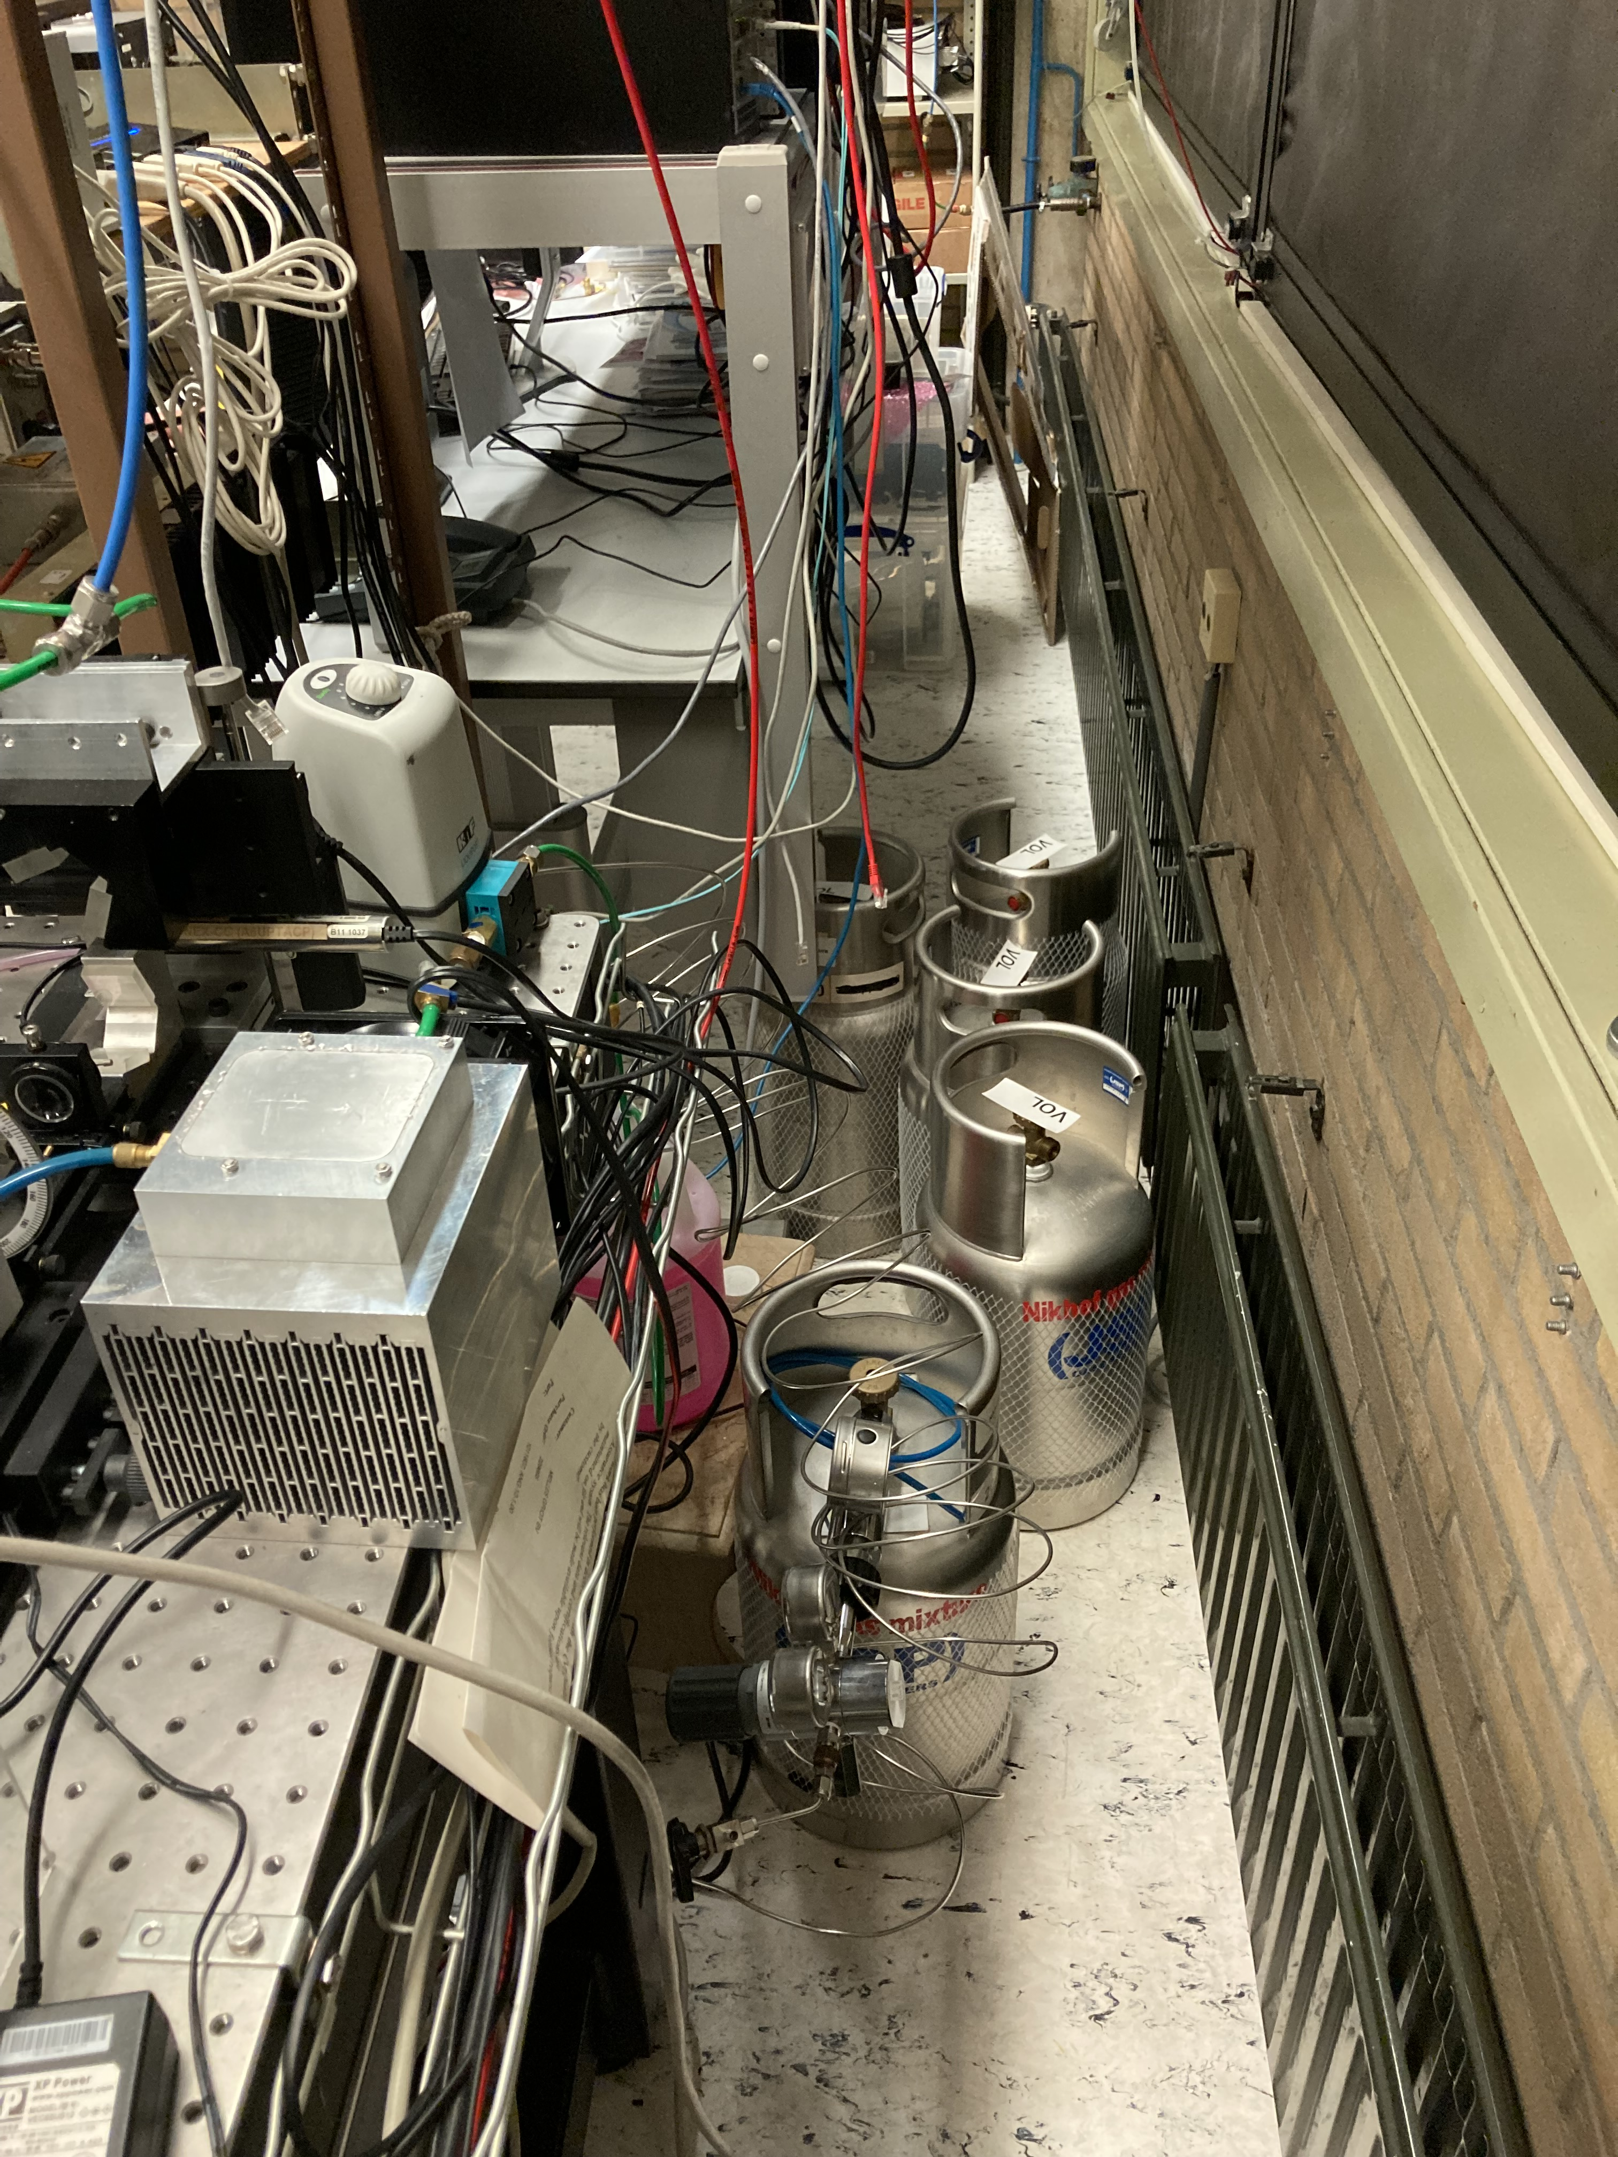
Laser setup photo’s
Back side Optical table: gas

