Slide 1
Analysis of the 2014 Octopuce Pixel TPC Test Beam data Deformations
Peter Kluit, Jan Timmermans
prepared 17 March 2016

Slide 2
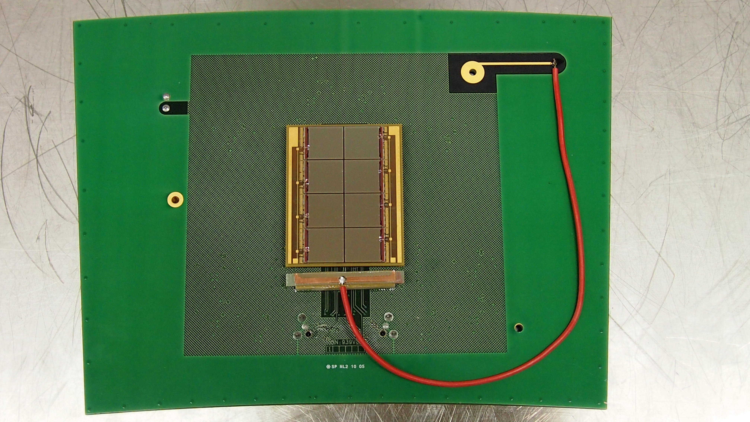
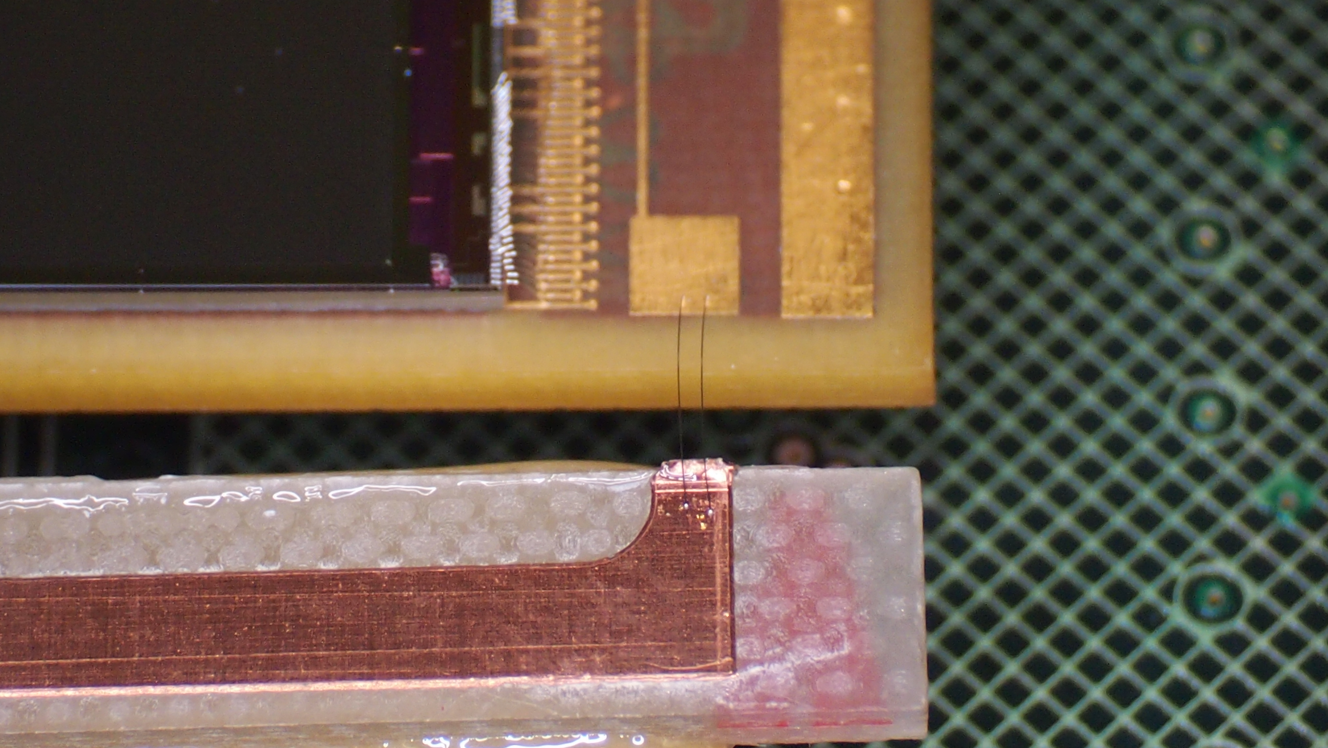
Layout Octopuce

Slide 3
300 V data residiual map
Module 2 has deformations left top and right bottom but smaller than for 320 V
Module 1 has deformations left top

Slide 4
320 V data residuals map
Module 2 has more deformations than@ 300 V
Module 1 is in great shape
Chips
5 6 7 8
1 2 3 4

Slide 5
320 V data deformations x
Very small deformations in Module 1 vs x
Large fitted deformations in Module at low and high x

Slide 6
320 V data deformations y
Deformations vs y are small

Slide 7
320 V data raw hit map
In the Raw hit maps the edges show the deformations

Slide 8
320 V data raw hit map
Between the chips we see 2 times 7 pixels dead zone coming from the dike
Module 1 Module 2
Module 1 is OK
Module 2 deformations occur on Octopuce edges. A large dead zone is created at low x and low y at high x and high y
Module 1 why hits y > 512-7 (beyond dike)
Module 2 Edges x = 33 x = 993 y= 22 y = 494
Half height Edges x = 38 x = 989 y= 30 y = 486

Slide 9
300 V data residiual map
Module 2 has deformations left top and right bottom but smaller than for 320 V
Module 1 has deformations left top

Slide 10
300 V data deformation x

Slide 11
300 V data

Slide 12
300 V data raw hit map

Slide 13
300 V data
Module 1 Module 2
Between the chips we see 2 times 7 pixels dead zone coming from the dike
Module 1 is OK except chip 5 low x high y
Module 2 deformations occur on Octopuce edges. A large dead zone is created at low x and low y at high x and high y
Module 2 Edges x = 26 x = 1000 y= 11 y = 502
Half height Edges x = 30 x = 994 y= 20 y = 495

Slide 14
All data: Fitted deformations
300 V Module 1
300 V Module 2 320 V Module 2
320 V was a good working point for Module 1
For Module 2 no data was taken at a lower voltage:
NB: 280-270 V would have been better

Slide 15
Origin of the field deformations
-380 V
Guard PCB 1.6 mm
4.25 mm above grid
-357 V
< 12 mm >
∧
2.65 mm
∨
A mismatch on the Guard-Grid Voltages will result that the drifting are moved “outside/inside” the grid. In y there is an additional potential to bring the HV to the chip. In x this is not present.
Grid @ 50 μm -300 -320 V
y bonds
<2 mm>
Chip 700 μm height
Grid HV for y
< 4.5 mm >

Slide 16
Field and the edges
V | xlow | xup | ylow | yup
320 | 38 | -35 | 30 | -16
300 | 30 | -30 | 20 | -17
Optimal HV will give ±10 pixels
E.g. 30-10 pixels implies a shift of 20 pixels or 1.1 mm

Slide 17
Conclusions
The origin of the deformations has been found: electrical field deformations (incl ExB):
Module 1 has to be run with a Guard Voltage at 320 V
As slight mistune of the Guard Voltage of 20 V results already in 0.2 mm deformation at the chip edge (active zone that starts after dike).
Module 2 was not ran at an optimal Voltage and has deformations up to 1 mm for 300 V (320V makes it worse).
Chips far from the Octopuce boundaries (“in the middle”) suffer less from the distortions. The distortions have been measured on data.
The field distortions can also be observed in the raw hit map.
The edges get shifted and the effective sensitive area changes. An optimal HV on the Guard will give ±10 pixels.
E.g. 30-10 pixels implies a shift of 20 pixels or 1.1 mm
A design of a TPC module should be done including the Efield calculations at the edges of chips and module boundaries.
Also the impact of mechanical uncertainties (e.g. up 1 mm shifts in vertical or horizontal plane) should be evaluated.
This should result in a robust design with minimal distortions.

