Slide 1

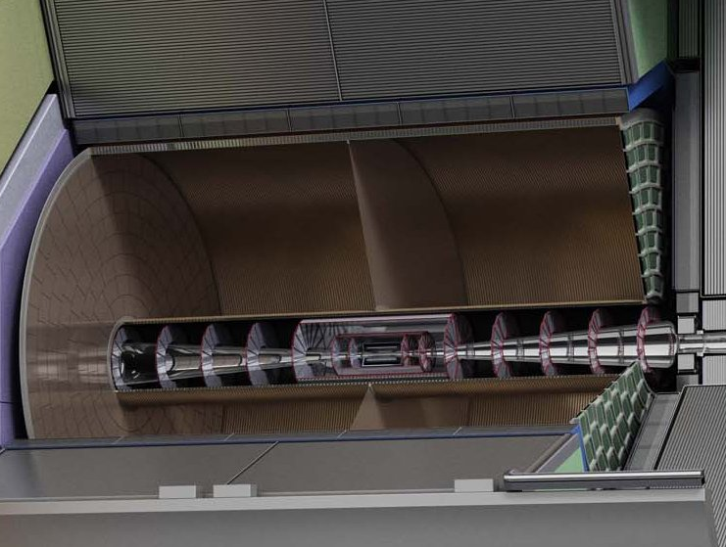

Performance of an ILD-like detector at CEPC or FCCee
Peter Kluit (Nikhef)
CEPC workshop 28 October 2022

Slide 2


ILD concept detector
Optimized for ILC
Large radius detector
B field 3.5 T
TPC central tracker
Surrounded by Silicon trackers
Inner: VTX-SIT
Outer: SET
SET

Slide 3
ILD-like detector at CEPC
In ILD discussions are ongoing to shape a the long term strategy of ILD
See e.g. Talk Paul Colas @ CEPC workshop on ILD strategy
This opens the possibility to study an ILD-like detector at other colliders such as CEPC or FCCee. This is now in the start up phase. This means that no common proposal for an ILD-inspired detector - that is agreed and dicusssed out by the ILD management and members – exists yet.
Currently only first ideas of individuals are being discussed.
Some of the key questions are:
(How) Can one operate a TPC in an ILD-like detector at other colliders
  What are the critical issues?
What is the tracking detector performance?

Slide 4

ILD TPC requirements
The R&D on a TPC for a Linear Collider is done in the LCTPC collaboration

Slide 5
TPC R&D questions
In LCTPC three – now mature - read out technologies are developed:
See VCI 2020 slides Kaminski
GEMs with pad readout
Resistive Micro Megas with pad readout
Pixels using a integrated grid on top of a pixel chip (TPX3)
For running at the Z several questions were raised:
Can a TPC reconstruct the events?
  The TPC total drift time is about 30 μs
  This means that there is on average 2 event / TPC readout cycle
  Pixels YES: The excellent time resolution: time stamping of tracks < 1.2 ns allows to resolve and reconstruct the events. No occupancy problem at low radii.
  Pads ?: The current pad size might be too large and occupancy might be an issue

Slide 6
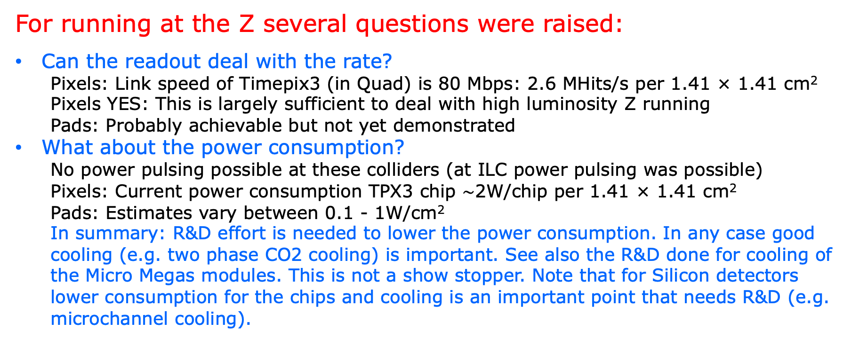
TPC R&D questions
For running at the Z several questions were raised:
Can the readout deal with the rate?
  Pixels: Link speed of Timepix3 (in Quad) is 80 Mbps: 2.6 MHits/s per 1.41 × 1.41 cm²
  Pixels YES: This is largely sufficient to deal with high luminosity Z running
  Pads: Probably achievable but not yet demonstrated
What about the power consumption?
  No power pulsing possible at these colliders (at ILC power pulsing was possible)
  Pixels: Current power consumption TPX3 chip $\sim$2W/chip per 1.41 × 1.41 cm²
  Pads: Estimates vary between 0.1 - 1W/cm²
  In summary: R&D effort is needed to lower the power consumption. In any case good cooling (e.g. two phase CO2 cooling) is important. See also the R&D done for cooling of the Micro Megas modules. This is not a show stopper. Note that for Silicon detectors lower consumption for the chips and cooling is an important point that needs R&D (e.g. microchannel cooling).

Slide 7
TPC R&D questions
For running at the Z several questions were raised:
Can one limit the track distortions due to Ion Back Flow (IBF) in a TPC?
  YES: one can limit the IBF for different readout options
  Pixels: Use of a GridPix with a double Grid will limit the IBF*Gain to 0.6
  A device like this was already made with the TimePix chip
  The idea needs to be tested for the TPX3.
  Further R&D on the chip processing is needed.
  Micromegas: For this technology a double MicroMegas mesh is an option
  GEMs: At IHEP a MicroMegas mesh was put on top of a GEM to reduce the IBF*Gain to 1
  In summary: the way forward is clear but R&D is needed to realize a stable reliable device.

Slide 8
Tracking performance ILD-like detector
For running at the Z questions on the tracking performance were raised:
What is the tracking performance of an ILD-like detector?
  What is the momentum resolution?
    VTX-SIT-TPC-SET all detectors
    TPC only
Due to the Ion Back Flow and the primary ionization of the particles produced at the Z pole there will be charge in the TPC volume, that distorts the drift of the primary electrons. Assuming that for the read out a technology with IBF*Gain = 1 is achieved.
What is the momentum resolution in the presence of TPC distortions?
  For all detectors and TPC only

Slide 9
Tracking performance ILD-like detector
Perform simulation studies for an ILD-like detector at CEPC/FCCee
Starting point is the ILD (detector) as optimized for ILC B = 3.5 T
Large detector with VTX SIT TPC SET with nominal resolutions
Study momentum resolution for high p tracks where multiple scattering in the material can be neglected
  Compare performance for full ILD tracking with TPC only B = 3.5 T
  What is the performance of the detector including TPC distortions?
  What is the performance of an ILD-like detector at B = 2 T?

Slide 10

ILD geometry and performance
Some basic numbers for the ILD detector (units mm)
// VTX (mm)
double VTX1 = 16.;
double VTX2 = 37.;
double VTX3 = 58.;
double resolution_VTX = 0.004;
// SIT
double SIT1 = 153.;
double SIT2 = 303.;
double resolution_SIT = 0.010;
// SET
double SET1 = 1773.;
double SET2 = 1776.;
double resolution_SET = 0.010;
// TPC
double rInner = 329.; //
double rOuter = 1770.; //
double zMax = 2350.; // half length
double resolution_TPC = 0.1; // per point in total 220 points
arXiv:1912.04601
ILD Full simulation muon momentum resolution
ILD σ(1/p_{T}) $≈$ 2 x 10⁻⁵ GeV ⁻¹

Slide 11
ILD geometry and performance
A simulation program generates hits on a straight line track in the B field
This gives 3+2 (VTX+SIT)+220 (TPC)+2 (SET) points along a track
The hits are smeared using the specified resolution (see slide 9)
Note that no multiple scattering is included
Finally, a helix is fitted to the hits using per point errors
The curvature 1/p is a free parameter in the fit.
Two fits are performed:
  One through all hits giving 1/p for full ILD (VTX-SIT-TPC-SET)
  One fit gives 1/p TPC through the TPC hits only

Slide 12
ILD performance at B=3.5 T
Simulations are in the barrel region θ=90 degrees at B=3.5 T
ILD σ(1/p_{T}) = 2.3 x 10⁻⁵ GeV ⁻¹
TPC σ(1/p_{T}) = 8.2 x 10⁻⁵ GeV ⁻¹
The silicon tracking improves the TPC tracking and dominates the momentum resolution

Slide 13
Distortions and ILD performance
The impact of distortions* in the TPC on ILD tracking
The distortions from Ion Back Flow – assuming IBF*Gain=1 - were calculated/presented by Ganjour/Schwemmling and have to be scaled up by a factor of 16.7 to correspond to a Luminosity of 200 10³⁴ cm⁻² s⁻¹
(see summary LCTPC WP meeting 370)
The distortion rotates the track in φ due to the ExB term. It affects the curvature measurement. This term is pretty constant for a 2 or a 3.5 T field.
At θ = 90 degrees the drift distance and the distortions are maximal.
Only distortions* from Z decays;
other (machine) backgrounds not simulated

Slide 14
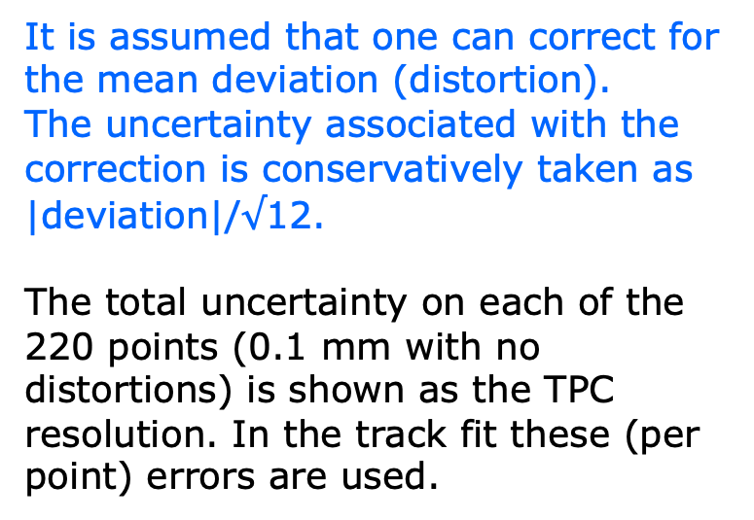
ILD performance at B=3.5 T
The impact of deformations* in the TPC on the tracking
It is assumed that one can correct for the mean deviation (distortion).
The uncertainty associated with the correction is conservatively taken as |deviation|/$√$12.
The total uncertainty on each of the 220 points (0.1 mm with no distortions) is shown as the TPC resolution. In the track fit these (per point) errors are used.
Distortions from -340 till 100 μm

Slide 15
ILD performance at B=3.5 T
Simulations including deformations* B=3.5 T (θ =90 degrees)
In red the results for no deformations
ILD σ(1/p_{T}) = 2.34 (2.30) 10⁻⁵ GeV ⁻¹
TPC σ(1/p_{T}) = 9.1 (8.2) 10⁻⁵ GeV ⁻¹
One observes a tiny worsening for the full ILD tracking and about 10% worsening of the TPC only momentum resolution

Slide 16
ILD’ performance at B=2 T
ILD-like detector same layout with B=2 T (θ=90 degrees)
NB: TPC resolution goes from 100 to 150 μm per point due to increased the diffusion
ILD σ(1/p_{T}) = 4.9 x 10⁻⁵ GeV ⁻¹
TPC σ(1/p_{T}) = 2.1 x 10⁻⁴ GeV ⁻¹
Due to the lower B field the momentum resolution is worse than at ILC (3.5 T).
Note that this is a factor 5 better than the ALEPH TPC at B=1.5 T
σ(1/p_{T}) = 1.2 x 10⁻³ GeV ⁻¹

Slide 17
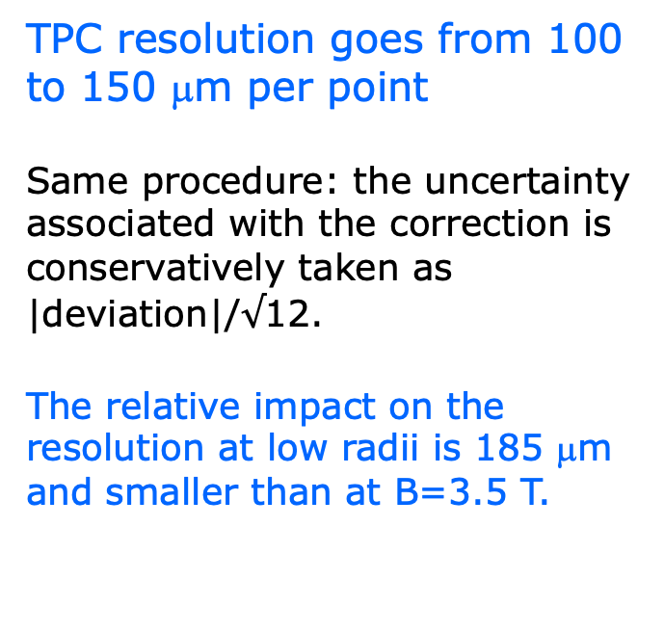
ILD’ performance at 2 T
ILD-like detector with deformations* B=2 T (θ=90 degrees)
TPC resolution goes from 100 to 150 μm per point
Same procedure: the uncertainty associated with the correction is conservatively taken as |deviation|/$√$12.
The relative impact on the resolution at low radii is 185 μm and smaller than at B=3.5 T.
Deformations in the xy plane are the same as for 3.5 T

Slide 18
ILD’ performance at B=2 T
ILD-like detector including deformations* B=2 T (θ=90 degrees)
In red results for no deformations
ILD σ(1/p_{T}) = 4.9 (4.9) 10⁻⁵ GeV ⁻¹
TPC σ(1/p_{T}) = 2.2 (2.1) 10⁻⁴ GeV ⁻¹
It is clear that the momentum resolution is almost unaffected by TPC distortions

Slide 19
Summary for an ILD-like detector
q/p resolution GeV ⁻¹ | no distortions | with TPC distortions*
Full ILD B=3.5 T | 2.30 10⁻⁵ | 2.34 10⁻⁵
TPC only B=3.5 T | 8.2 10⁻⁵ | 9.1 10⁻⁵
Full ILD B=2 T | 4.9 10⁻⁵ | 4.9 10⁻⁵
TPC only B=2 T | 2.1 10⁻⁴ | 2.2 10⁻⁴
One can conclude that the distortions* – after correcting – have little impact on the momentum resolution of full ILD tracking (VTX-SIT-TPC-SET). Independent of the B field.
For the TPC only momentum resolution at 3.5 T a 10% degradation is observed. At a field of 2 T the impact of distortions on the TPC momentum resolution is pretty small.
Only distortions* from Z decays; other (machine) backgrounds not simulated.

Slide 20
Conclusions for an ILD-like detector
If one constructs a TPC with an Ion Back Flow times Gain factor of 1 – as assumed in these distortions* studies - and one integrates it in an ILD-like detector, one can achieve a momentum resolution that is sufficient for the various physics programmes (Z, W, Higgs or top).
Only distortions* from Z decays; other (machine) backgrounds not simulated.
In particular, if the detector operates at a field of 2 T (like at CEPC or FCCee), the TPC distortions – after correction - have a neglegible impact on the momentum resolution.
The advantages of the TPC – compared to a full silicon tracker - are a low(er) material budget, continuous tracking and measurement of the energy loss dE/dx.

