Slide 1
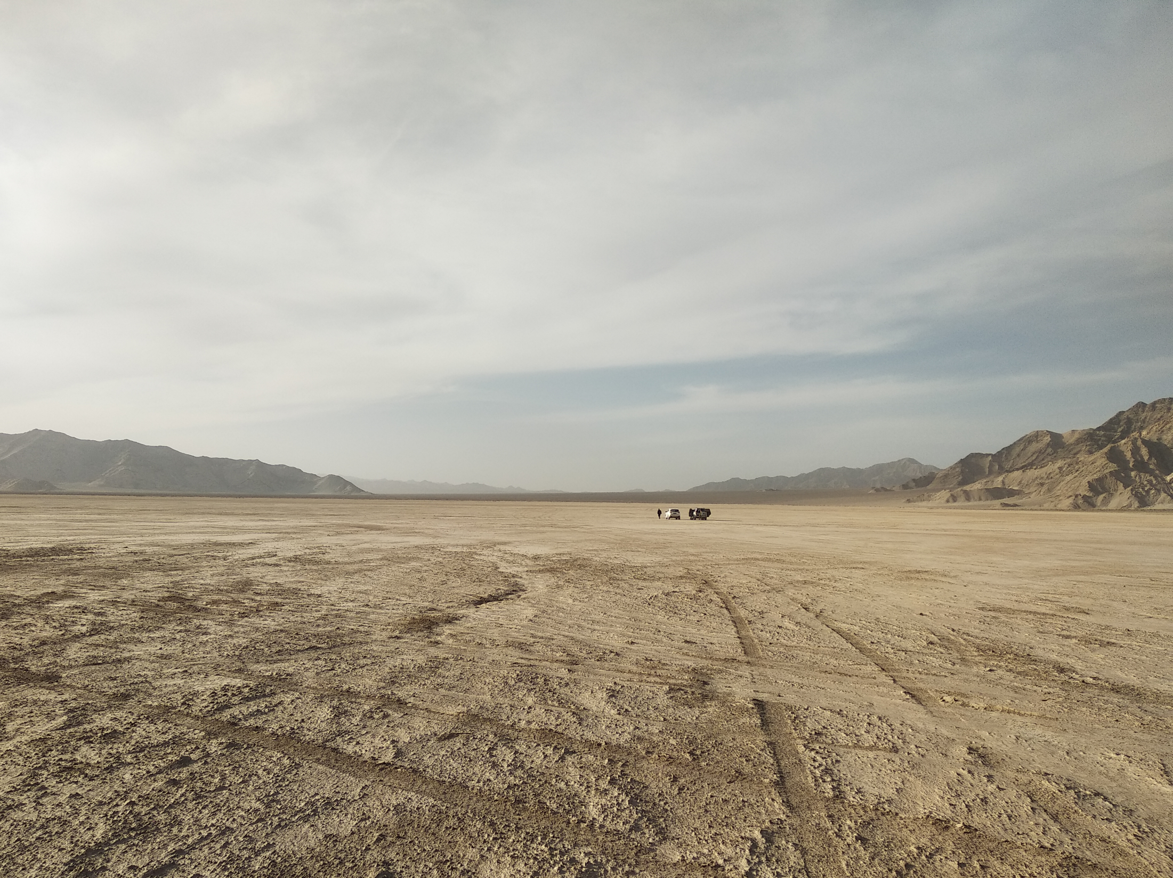

The giant Radio array for neutrino detection
http://grand.cnrs.fr/
LengHu, QingHai province, China
Candidate site for the GRANDProto300 setup

Slide 2
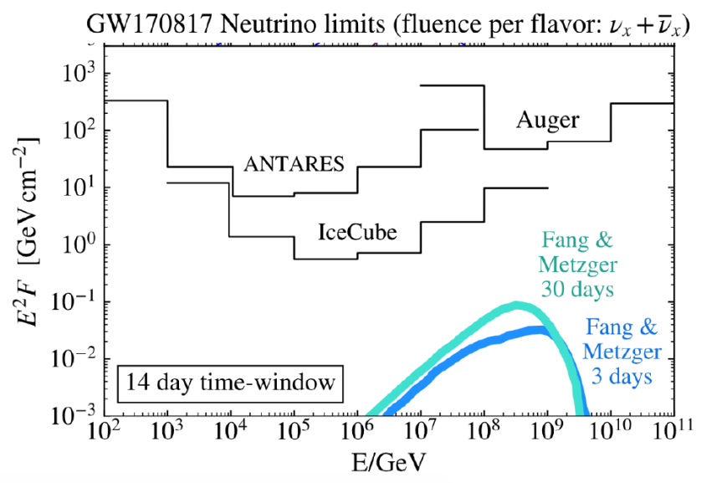
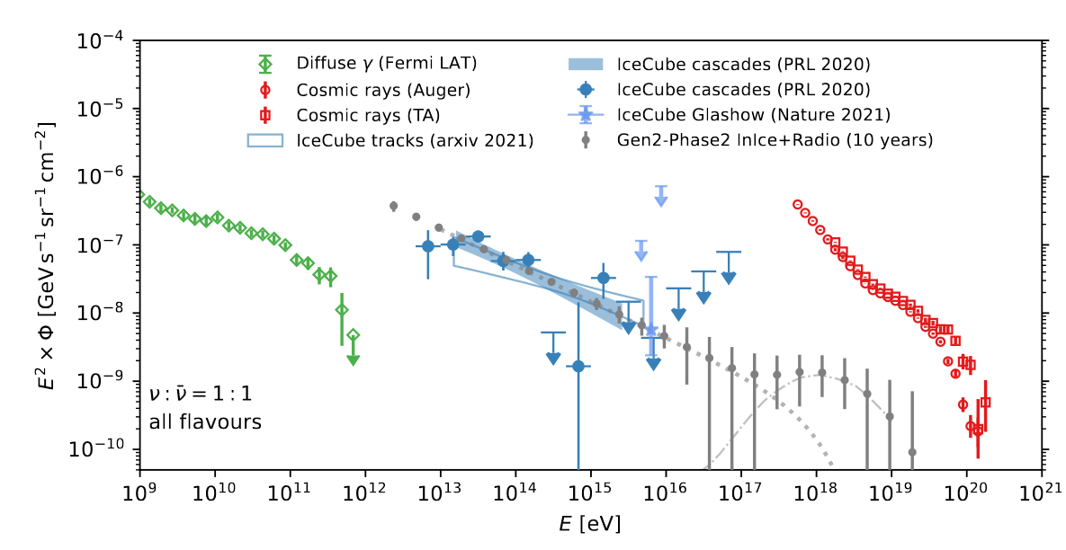
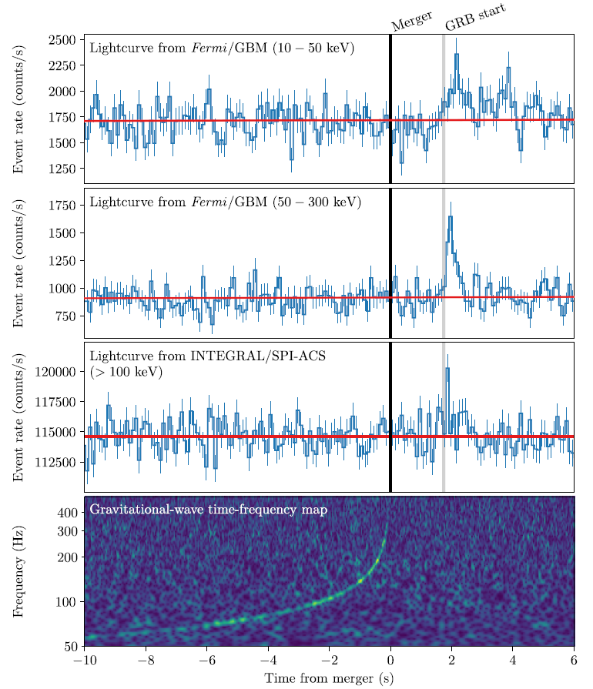

Why UHE neutrinos?
Clean probe of the Universe
E>10¹⁷eV neutrinos is uncharted territory
Direct link to highest energy CRs (5%/A of primary energy)
Transient multimessenger astronomy
What it would take:
Gain of factor ~100 in sensitivity
(10⁻¹⁰ GeV/cm²/s/sr)
Large FoV (~full sky)
Precise angular reconstruction (~0.1°)
Decent energy reconstruction (spectrum)
[2203.08096]

Slide 3
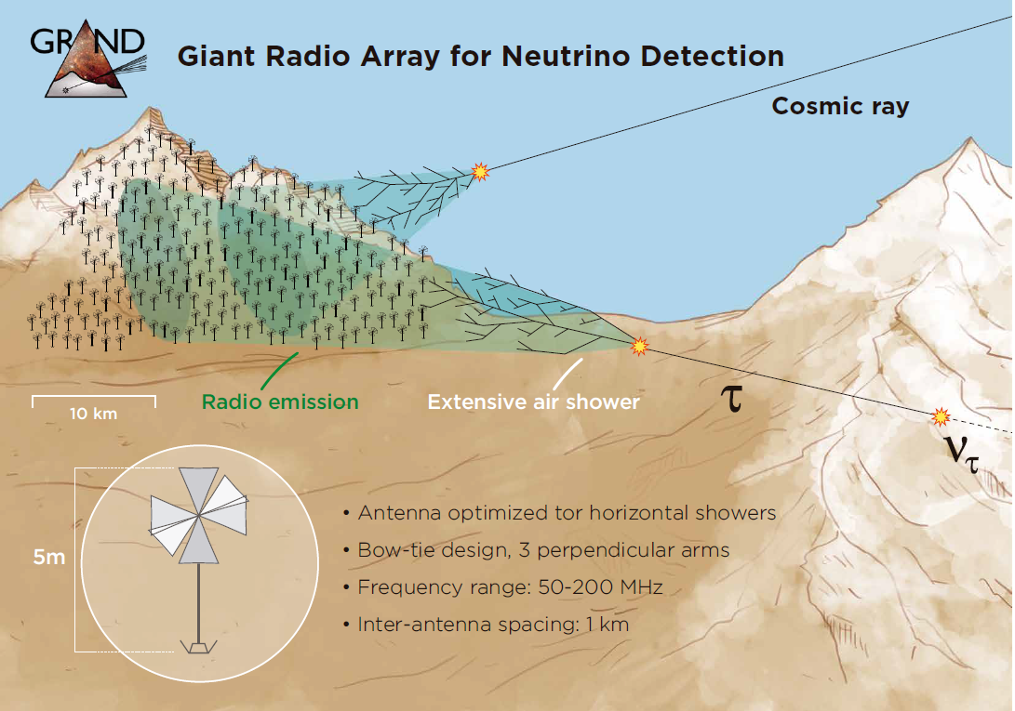
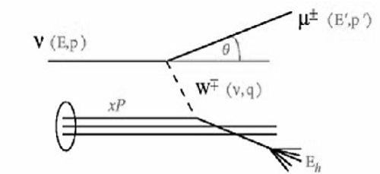
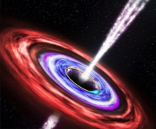
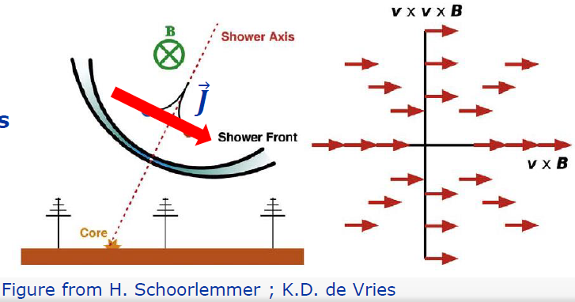
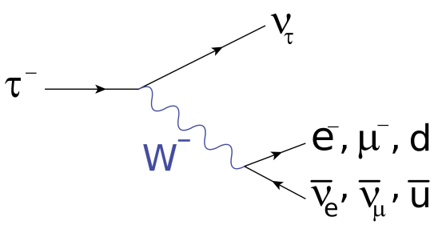
detection principle
τ±

Slide 4
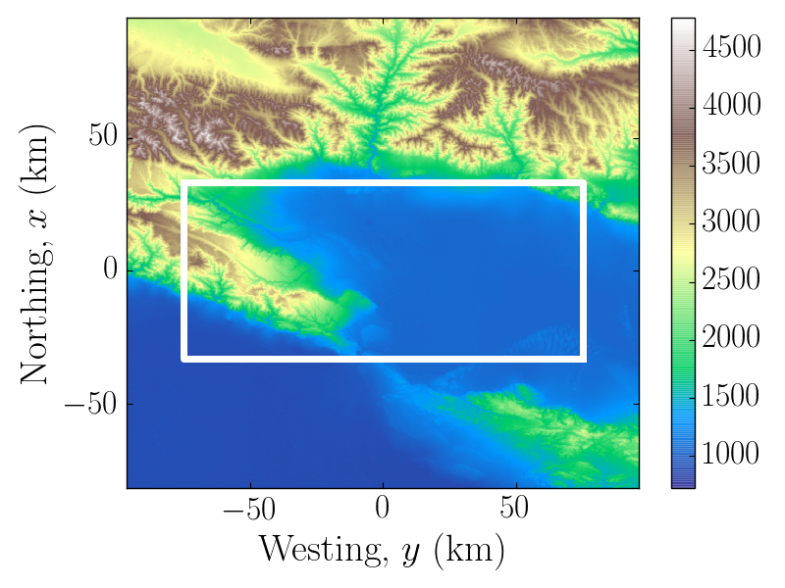
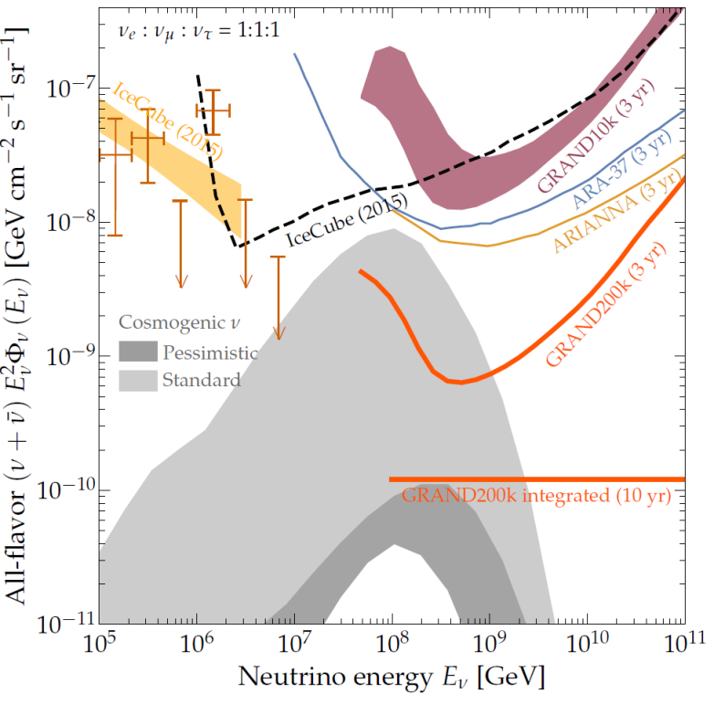
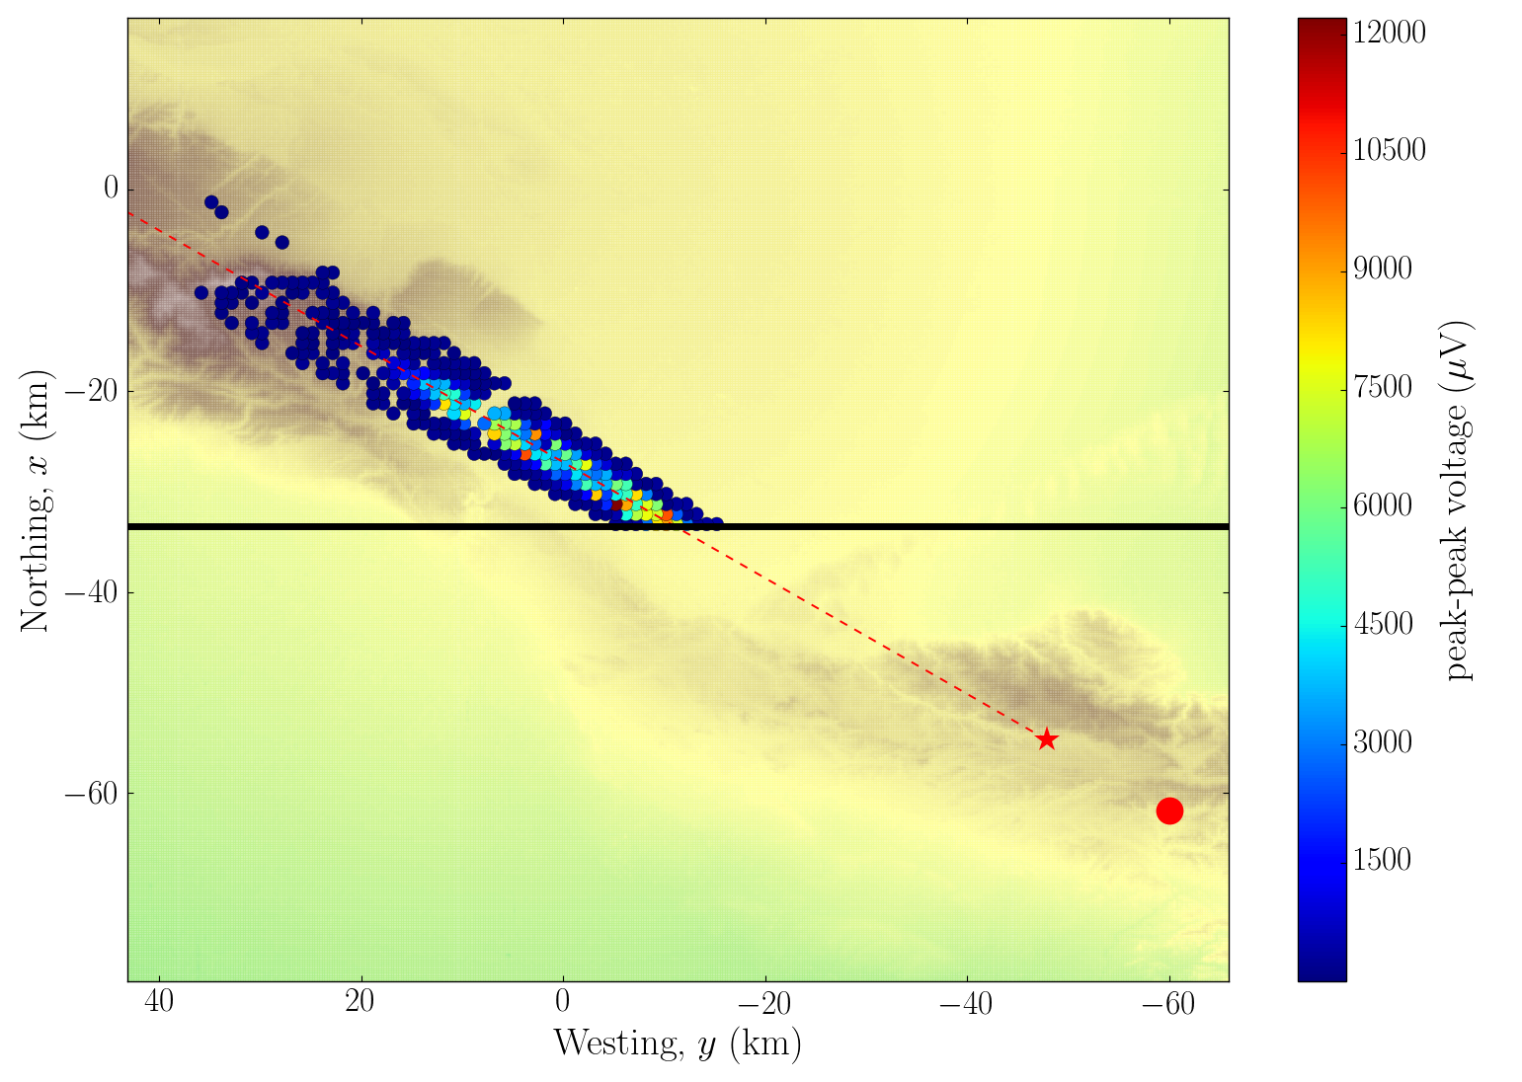

GRAND proposal
Sizable effort for end-to-end simulation
DANTON Niess & Martineau-Huynh 1810.01978
RadioMorphing
Zilles et al. 1811.01750, Chiche et al.
on a 10000 antennas hotspot (GRAND10k)
Sensitivity in IceCube2015 range.
Go for x20!! ➔ Network of o(20) subarrays of o(10000) antennas with sparse density (1/km²) at various favorable locations around the world (« hotspots »)
Sensitivity of full array good enough for GRAND to detect cosmogenic neutrinos for standard hypothesis
GRAND white paper
10 000km²
HotSpot1
A simulated neutrino event in a GRAND hotspot
E_{ν} = 2 10¹⁹eV; θ = 93°
Trigged antennas
τ decay
Not contractual!
ν CC interaction

Slide 5
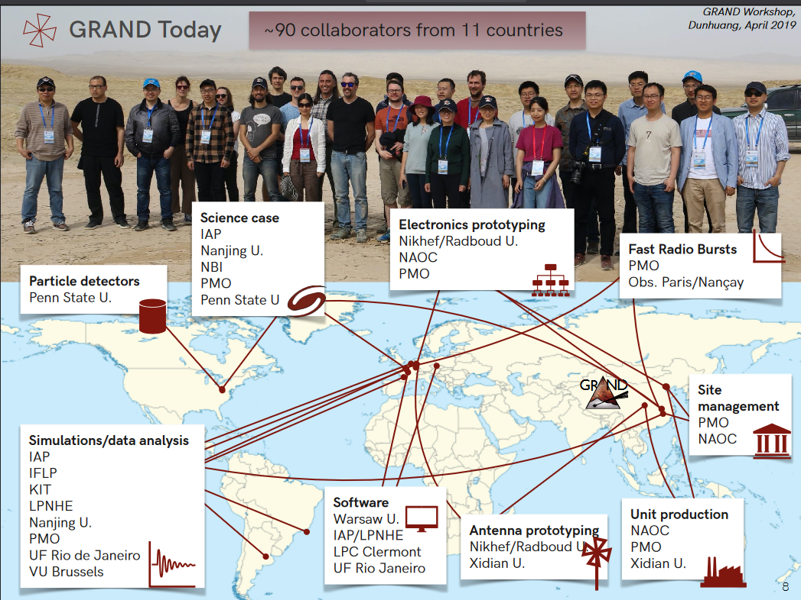

Slide 6

A staged approach with
self-standing pathfinders
GRANDProto300
GRAND10k
GRAND200k
2021
2028
203X
autonomous radio detection
of very inclined air-showers
1st GRAND sub-array
sensitive all-sky detector
cosmic rays 10^{16.5-18} eV
Galactic/extragalactic transition
gamma rays
muon problem
radio transients
discovery of EeV neutrinos for optimistic fluxes
radio transients (FRBs!)
1st EeV neutrino detection
and neutrino astronomy!
Goals
300 HorizonAntennas over 200 km²
Particle detectors
(a la HAWC/Auger)
Gansu or QingHai province, China
10,000 radio antennas over 10,000 km²
200,000 antennas over 200,000 km²
20 sub-arrays of 10k antennas
on different continents
Setup
~1.5 M€ ~4000€/unit
100 antennas already built
Budget for remaining parts secured (China)
300M€ in total
500€/unit
1500€/unit
~15 M€
host country
to be divided among participating countries
Budget

Slide 7
GRANDProto300
A validation for GRAND principles:
  Validate principle of autonomous radiodetection of inclined air showers with a 300 antenna-array over 200km²
  Determine performances for shower identification, reconstruction (direction, nature and energy)
A testbench for GRAND:
  Develop procedure for calibration & monitoring (time and amplitude). Evaluate ground effects.
  Testbench for trigger and data transfer for later stages.
A tool for physics
  Denser infill to reach energies down to 10^{16.5}eV
  Complemented by ground array for independent muon measurement
  ➔ Clean(er) measurement of composition & energy + larg stats in 10^{16.5}-10¹⁸eV

Slide 8
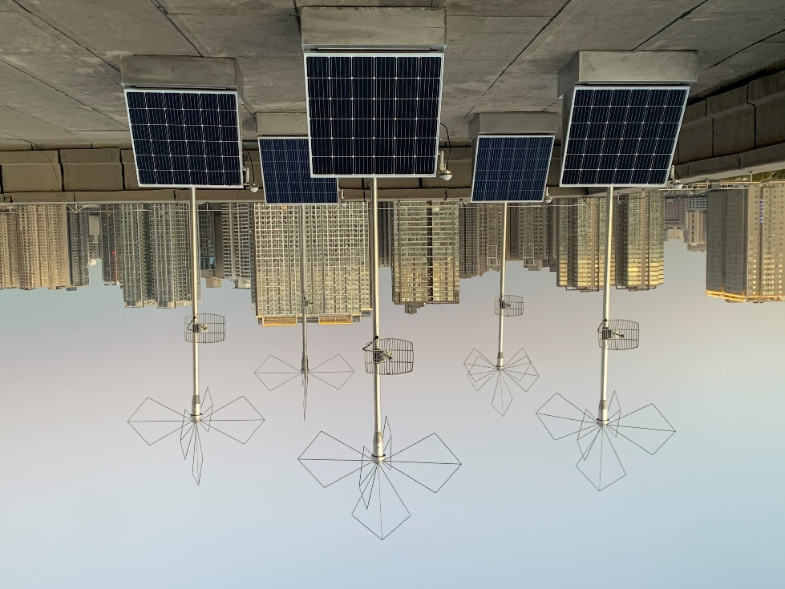
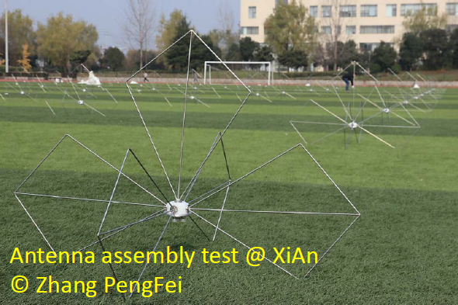
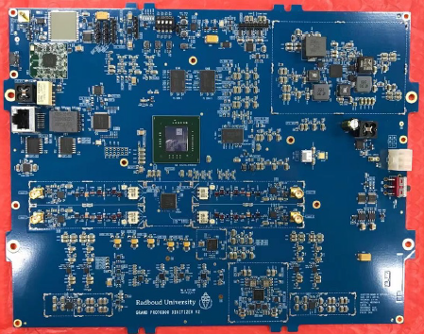
GRANDProto300 detector
2x65cm antenna arm (butterfly shape)
3 arms (X, Y, Z)
Atop a 3.5m pole
5 detection units
in test @ Xi’An
© Zhang PengFei
Front-End electronics
(dev: Nijmegen, prod: NAOC, tests: PMO)
30-230MHz analog filtering
500MS/s digitization
Xilinx Zync MPSoC (FPGA+2 CPUs+2 RT CPUs)
100 units now fully ready for deployment

Slide 9
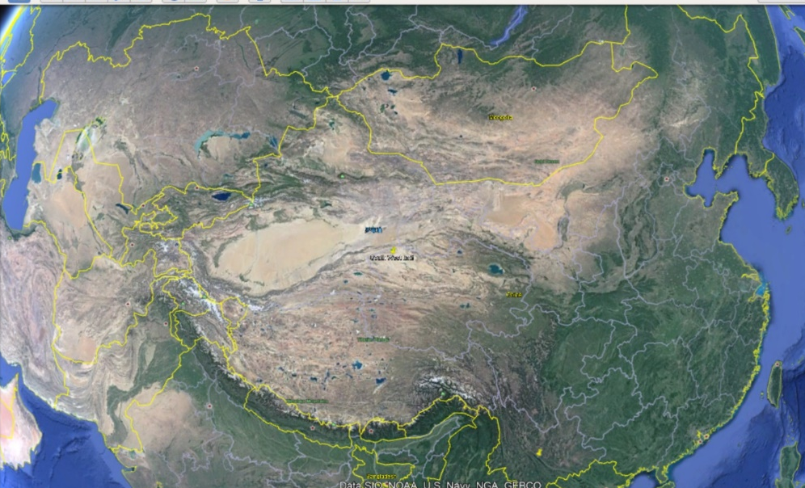
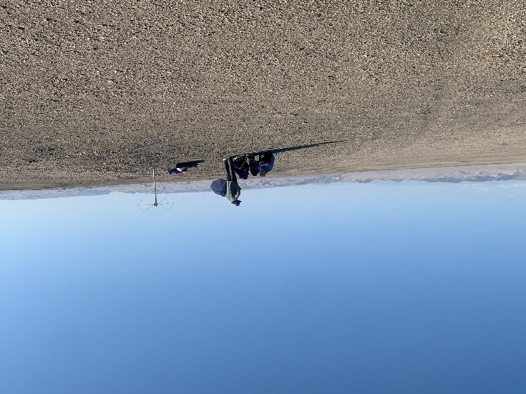
GRANDProto300 site (?)
Subei county, Gansu province:
  Remote mountain area in the Gobi desert
  Excellent radio background & topography ideal for deployment
  Within boundaries of a Nature Reserve
  Deployment approved, COVID issues
GP300 candidate site
41.3°N, 96.5°E

Slide 10
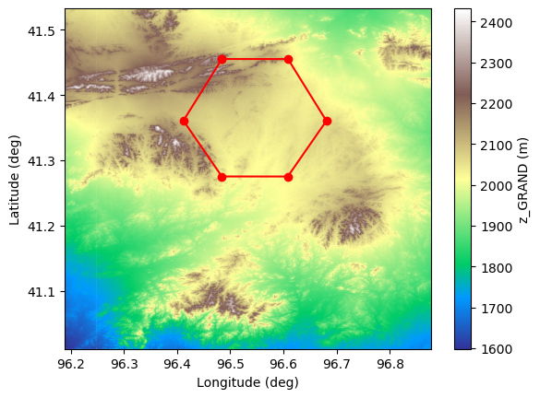
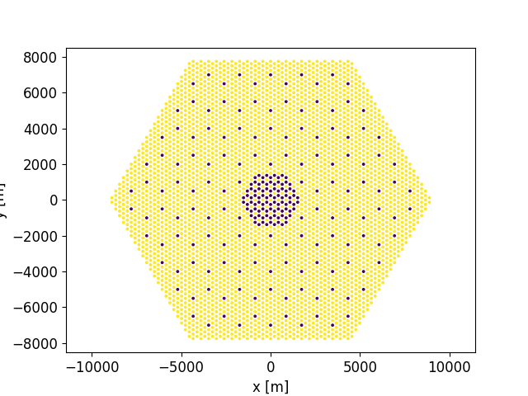
GRANDProto300 layout
hexagonal pattern with d = 850m
200 antennas ➔ 200 km²
Infill of ~100 antennas for improved sensitivity at lower energies
Detection efficiency
d
GP300:
10⁶ events/year in
10^{16.5} – 10¹⁸ eV energy range
With infill
A. Benoit-Levy, K. Kotera & M. Tueros
the GRAND collaboration, ICRC2019

Slide 11
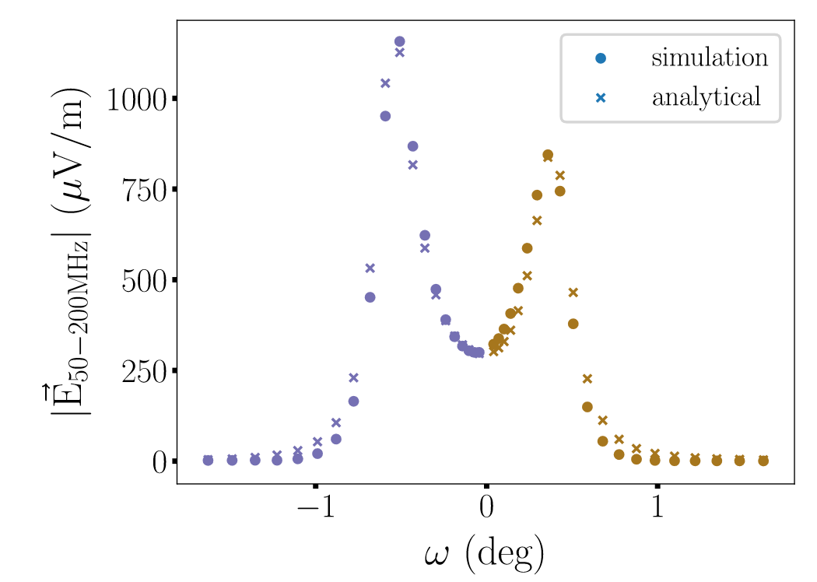
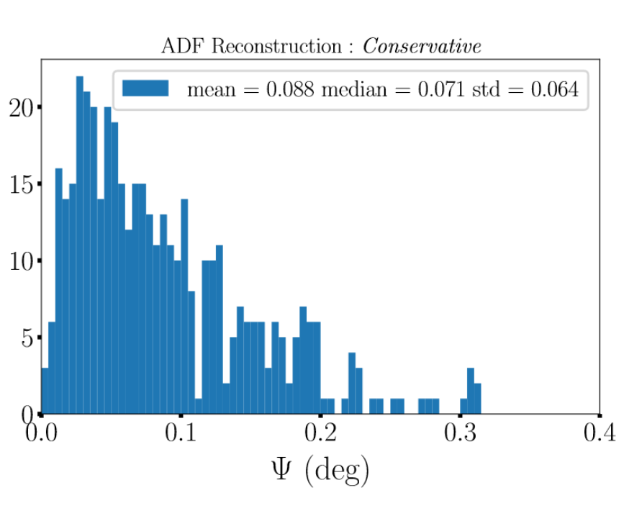
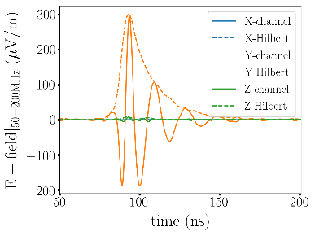
EVENT reconstruction & ANALYSIS
Analytical description of amplitude distribution
GP300 simulations
V. Decoene PhD
σ_{t} = 5ns
σ_{A}/A = 20%
Center of spherical fit of trigger times
⬄ radio emission source
V. Decoene PhD
ω
V. Decoene et al., submitted to Astropart Phys

Slide 12
Radio Interferometry
Schoorlemmer Carvalho jr,, Eur.Phys.J.C 81 (2021)

Slide 13
Long Lived Particles
Searches in horizontal air showers
Radio signal moves with speed of light in air
van Rens, masters thesis Radboud University 2022

Slide 14
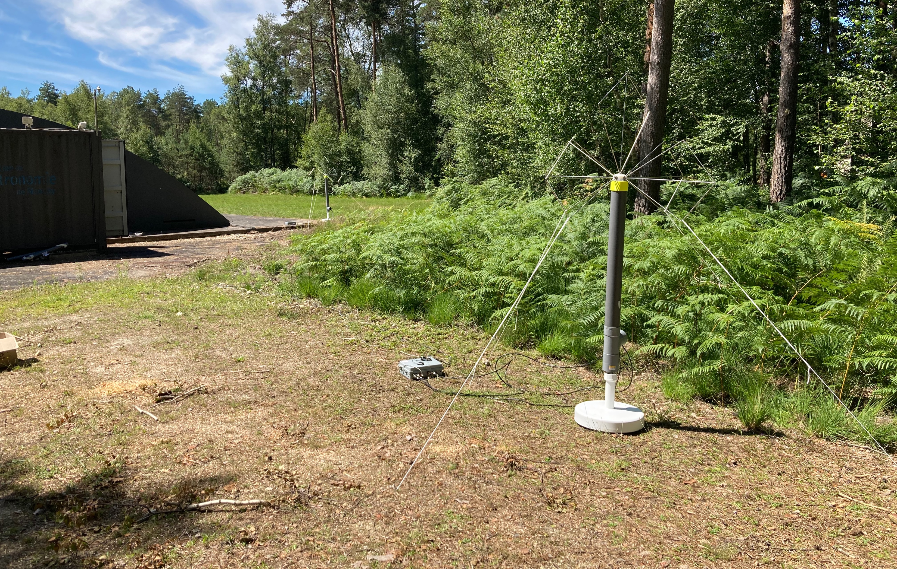
GRAND test setups
GRAND @ Nançay Radio Observatory
  A 4-units testbench in a clean radio environment (and a reasonable distance from our labs)
  Test trigger algorithms for First (and Second) Level Triggers.
  Also a tesbench for GP300 units
  Deployment started, commissioning first quarter 2023

Slide 15
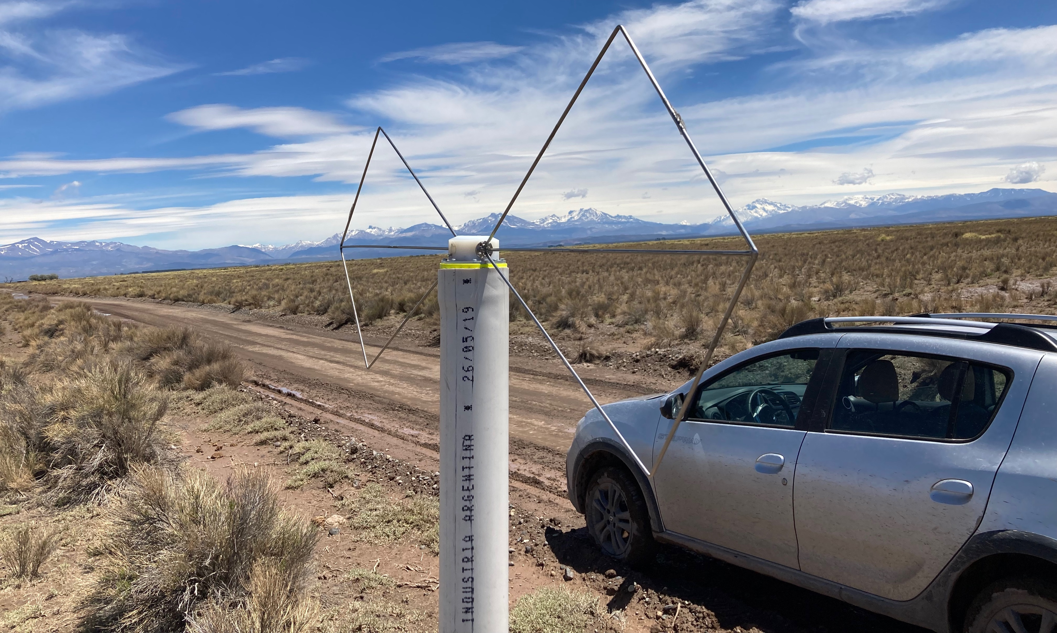
GRAND test setups
GRAND @ Pierre Auger Observatory
  Subarray of 10 GP300 units within Pierre Auger array
  Test GRAND units & trigger system in a different radio environment
  Cross calibration & analysis of Auger (radio) & GRAND data
  Site selection was done in November 2022, deployment will start in March 2023

Slide 16
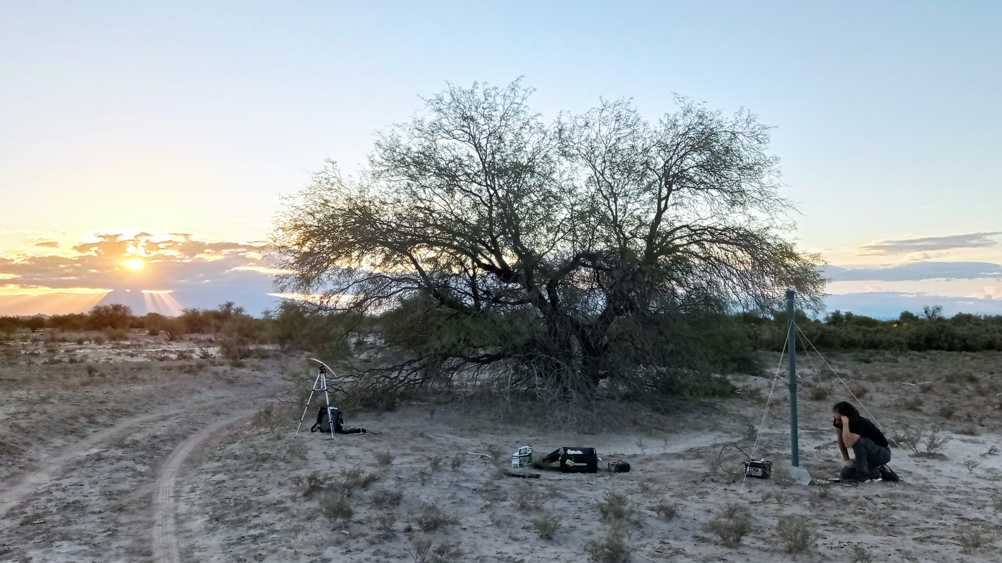
CONCLUSION
GRAND is an ambitious project to perform UHE multi-messenger astronomy (among other things) in the 2030s
A staged experimental approach was chosen by the collaboration, with GRANDProto300 as a demonstrator for the full-scale experiment
Deployment of GRANDProto300 was significantly affected by Covid… Now hoping for a positive outcome in the coming months.
In the meanwhile, vivid activity within the collaboration: hardware & software developments, deployment of alternative testbenches and analyses.

