Slide 1
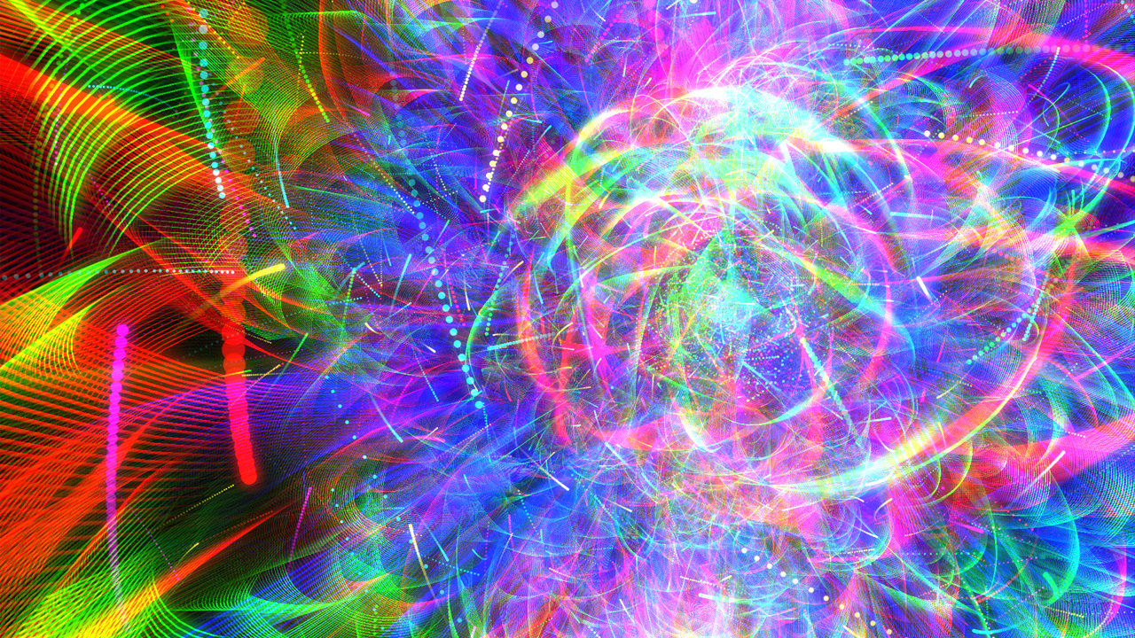
Bounds on light higgs in future electron positron colliders
Monika Kofarago, Lennaert Bel, Sander Breur, Boris Boom,
Chunhui Zhang, Birgit Stapf & Joris van Heijningen

Slide 2
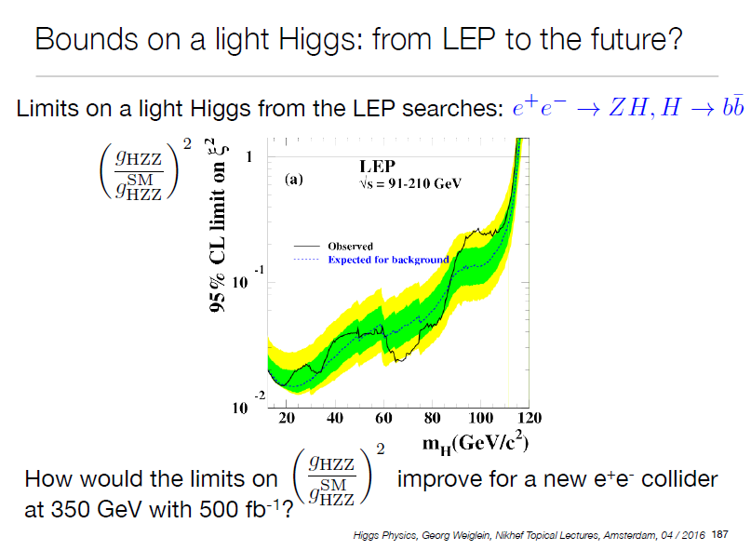
Bright or light future?
→ Need to understand how these limits were achieved!
→ Start with summary of LEP analysis

Slide 3
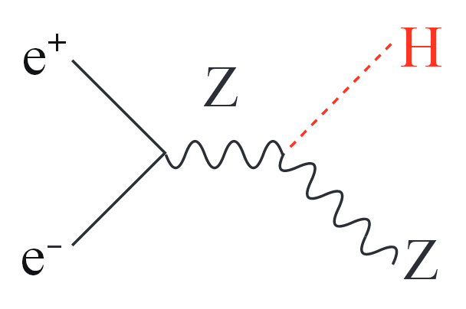
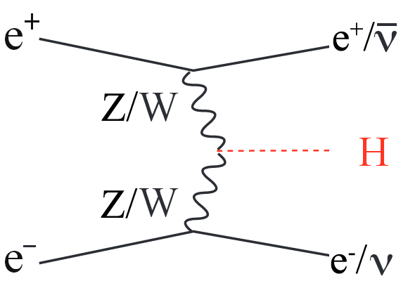
LEP Analysis Summary
Higgs search in 2461 pb⁻¹ of e⁺e⁻− collision data at centre-of-mass energies between 189 and 209 GeV (from 4 experiments combined)
In e⁺e⁻ - collisions the dominant Higgs production mode is Higgstrahlung, with a small contribution from vectorbosonfusion
+

Slide 4
LEP Analysis Summary
Relevant decay modes of the Higgs here:
  H → bb (74%)
  H → ττ (7%)
Studied channels:
  Four jets: bb + qq
  Missing energy: bb + νν
  Leptonic: bb + ll (both electrons and muons)
  Tauonic: bb + ττ and ττ + qq
For each channel bin the data according to reconstructed m_{H} and discriminating variable (combining event features)
→ For each bin perfom likelihood ratio test

Slide 5
Likelihoods
Q is likelihood ratio between fits with and without signal
–2 log Q represents signal significance
Equal to difference in χ² between fits in high-statistics limit

Slide 6
Higgs probability
For a given m_{H} consider the distribution of test statistic -2 ln(Q) ( „slice“ of the plot on previous slide) for background and background + signal hypothesis, plus measurement (vertical line)
→ integrate bkg from -∞ to measurement = incompatibility of the measurement with the bkg hypothesis
→ integrate sig+bkg from measurement to +∞ = compatibility of the measurement with the sig+ bkg hypothesis
From this caculate exclusion limits at 95% CL

Slide 7
Higgs probability
Resulting 95%-CL limits on coupling constant ratio between non-SM and SM value ( = ratio of cross sections)
Exclude with 95% certainty that a Higgs at given mass has higher coupling than corresponding point on black curve
Possible future experiments could improve the limits

Slide 8
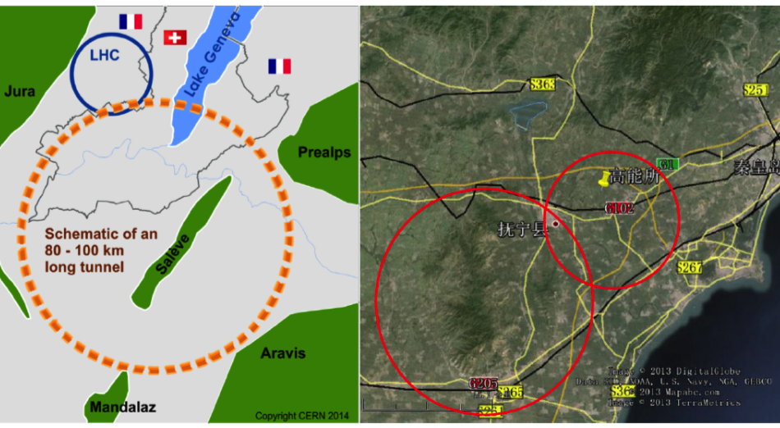
Circular future e⁺e⁻ colliders
CC-ee | FcEP
100 km (350 GeV) | 54 km (250 GeV)

Slide 9
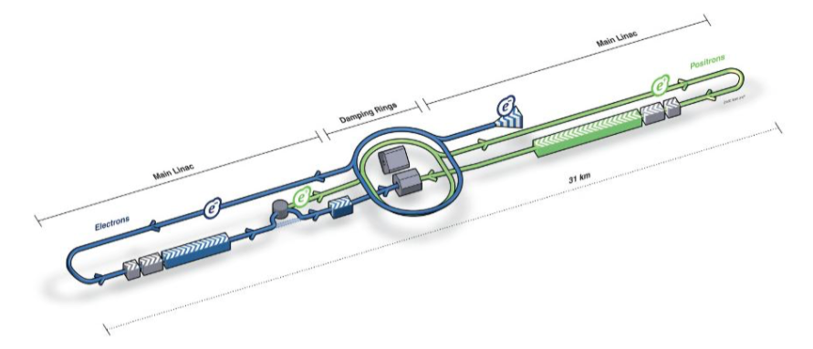
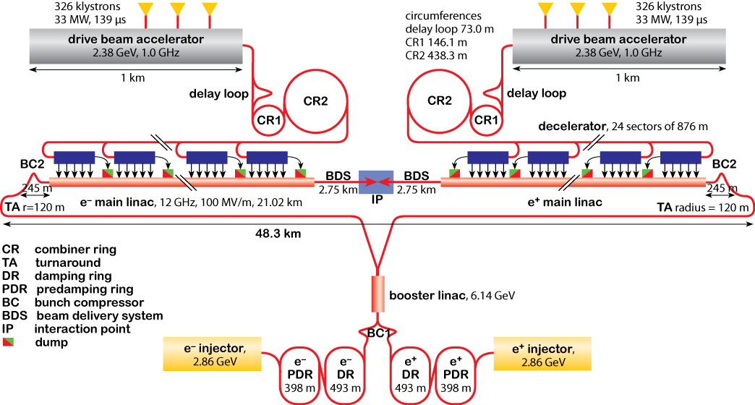
Linear future e⁺e⁻ colliders
ILC | CLiC
30 km (500 GeV) | 50 km (3 TeV)

Slide 10
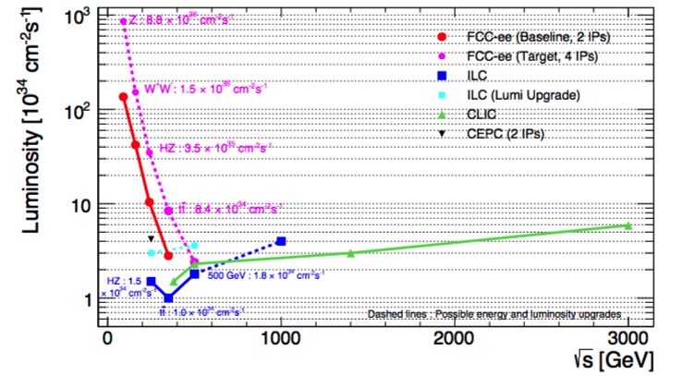
Luminosities and energies for e⁺e⁻
@ 350 GeV, 500 fb⁻¹ takes: - 580 (195) days with ILC (Lumi upgrade)
- 390 days with CLiC
- 195 (70) days with FCC-ee 2IP (4IP)
@ 250 GeV, 500 fb⁻¹ takes: - 145 days with FcEP

Slide 11
What changes in the new scenario?
Luminosity at LEP: 2.4 fb⁻¹
→ go up to 500 fb⁻¹
Center of mass energies at LEP: 91 – 210 GeV
→ go up to 350 GeV →σ_{H} will change! And so will the cross sections of the backgrounds (probably)
Both of these mean that the number of events N changes
→ In what way does the change affect the limits?
→ By what factor approximately does N change?
→ Can estimate how the limits would change

Slide 12
Does change in N change the limits?
Go back to the hypothesis test:
With increasing N ( = increasing S and B) the distributions will move away from each other
→ move is linear to N (see equation)
→ limit itself scales down with 1/N
Increasing N will also decrease the width of the bkg distribution
→ uncertainty bands shrink with √N/N

Slide 13
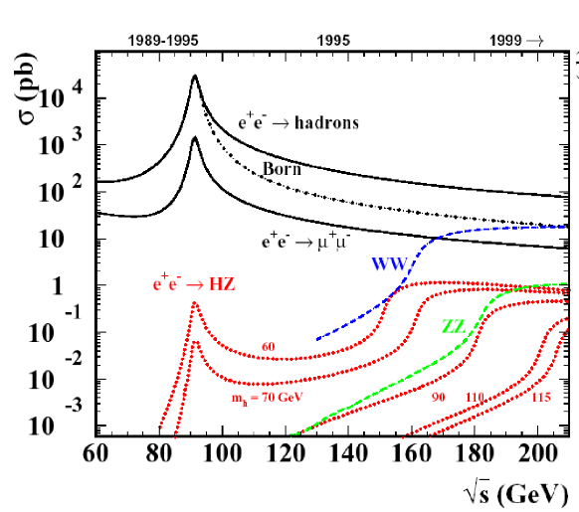
Does σ_{H} change with √s ?
For m_{H} ~ 110 GeV we have σ_{H} ~ 0.1 pb ~ 100 fb at the maximum LEP energies

Slide 14
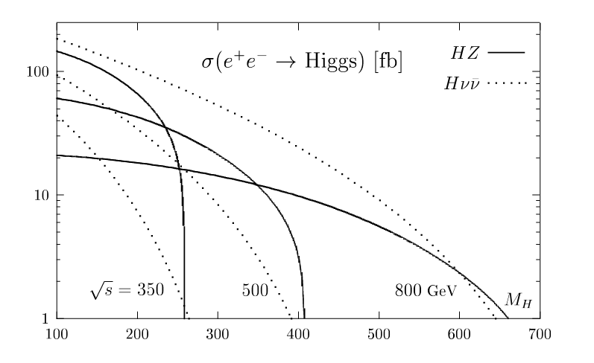
How does σ_{H} change with √s ?
At 350 GeV typically of the order of 100 fb in the low Higgs mass region
→ Assume 100 fb for both cases

Slide 15
What does 350 GeV/ 500 fb⁻¹ do?
Integrated luminosity dependence:
The number of events entering the analysis is: n = σ × L_{int}
LEP : n_{LEP} = 100 fb × 2.4 fb⁻¹
Proposed collider : n_{new} = 100 fb × 500 fb⁻¹
Scaling with the number of events:
−2 log Q ∼ n
95% CL limit on ξ² ∼ 1/n
Probability band ∼ √n/n
⇒ Qualitatively: shifting the CL limit down and shrinking the band around it
Energy dependence:
At 200 GeV the σ of Higgs production drops at ∼ 115 GeV/c2
At 350 GeV the σ of Higgs production drops at ∼ 200 GeV/c2
⇒ Qualitatively: stretching the Higgs mass axis

Slide 16
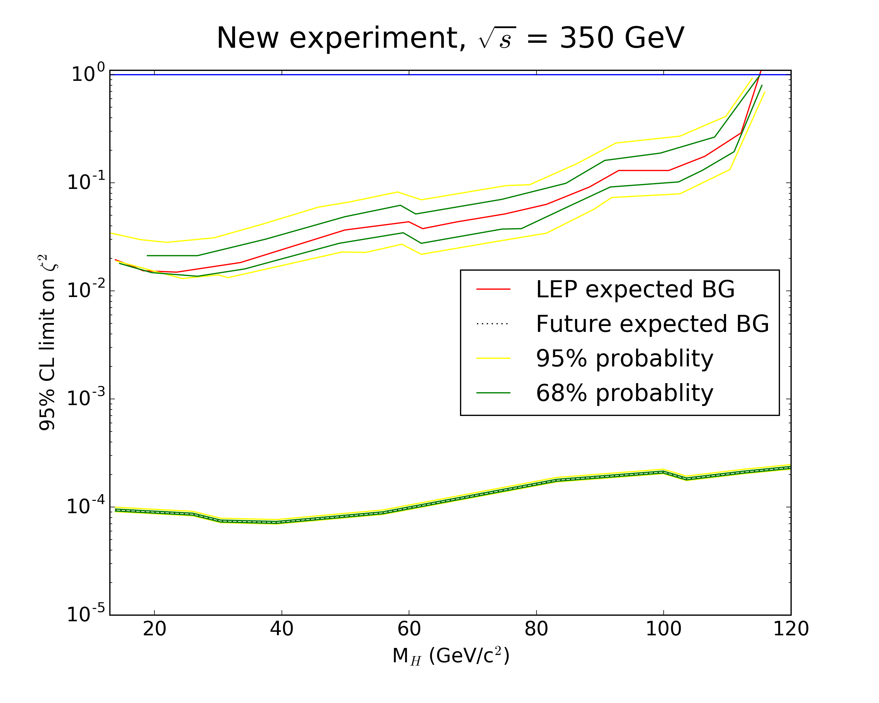
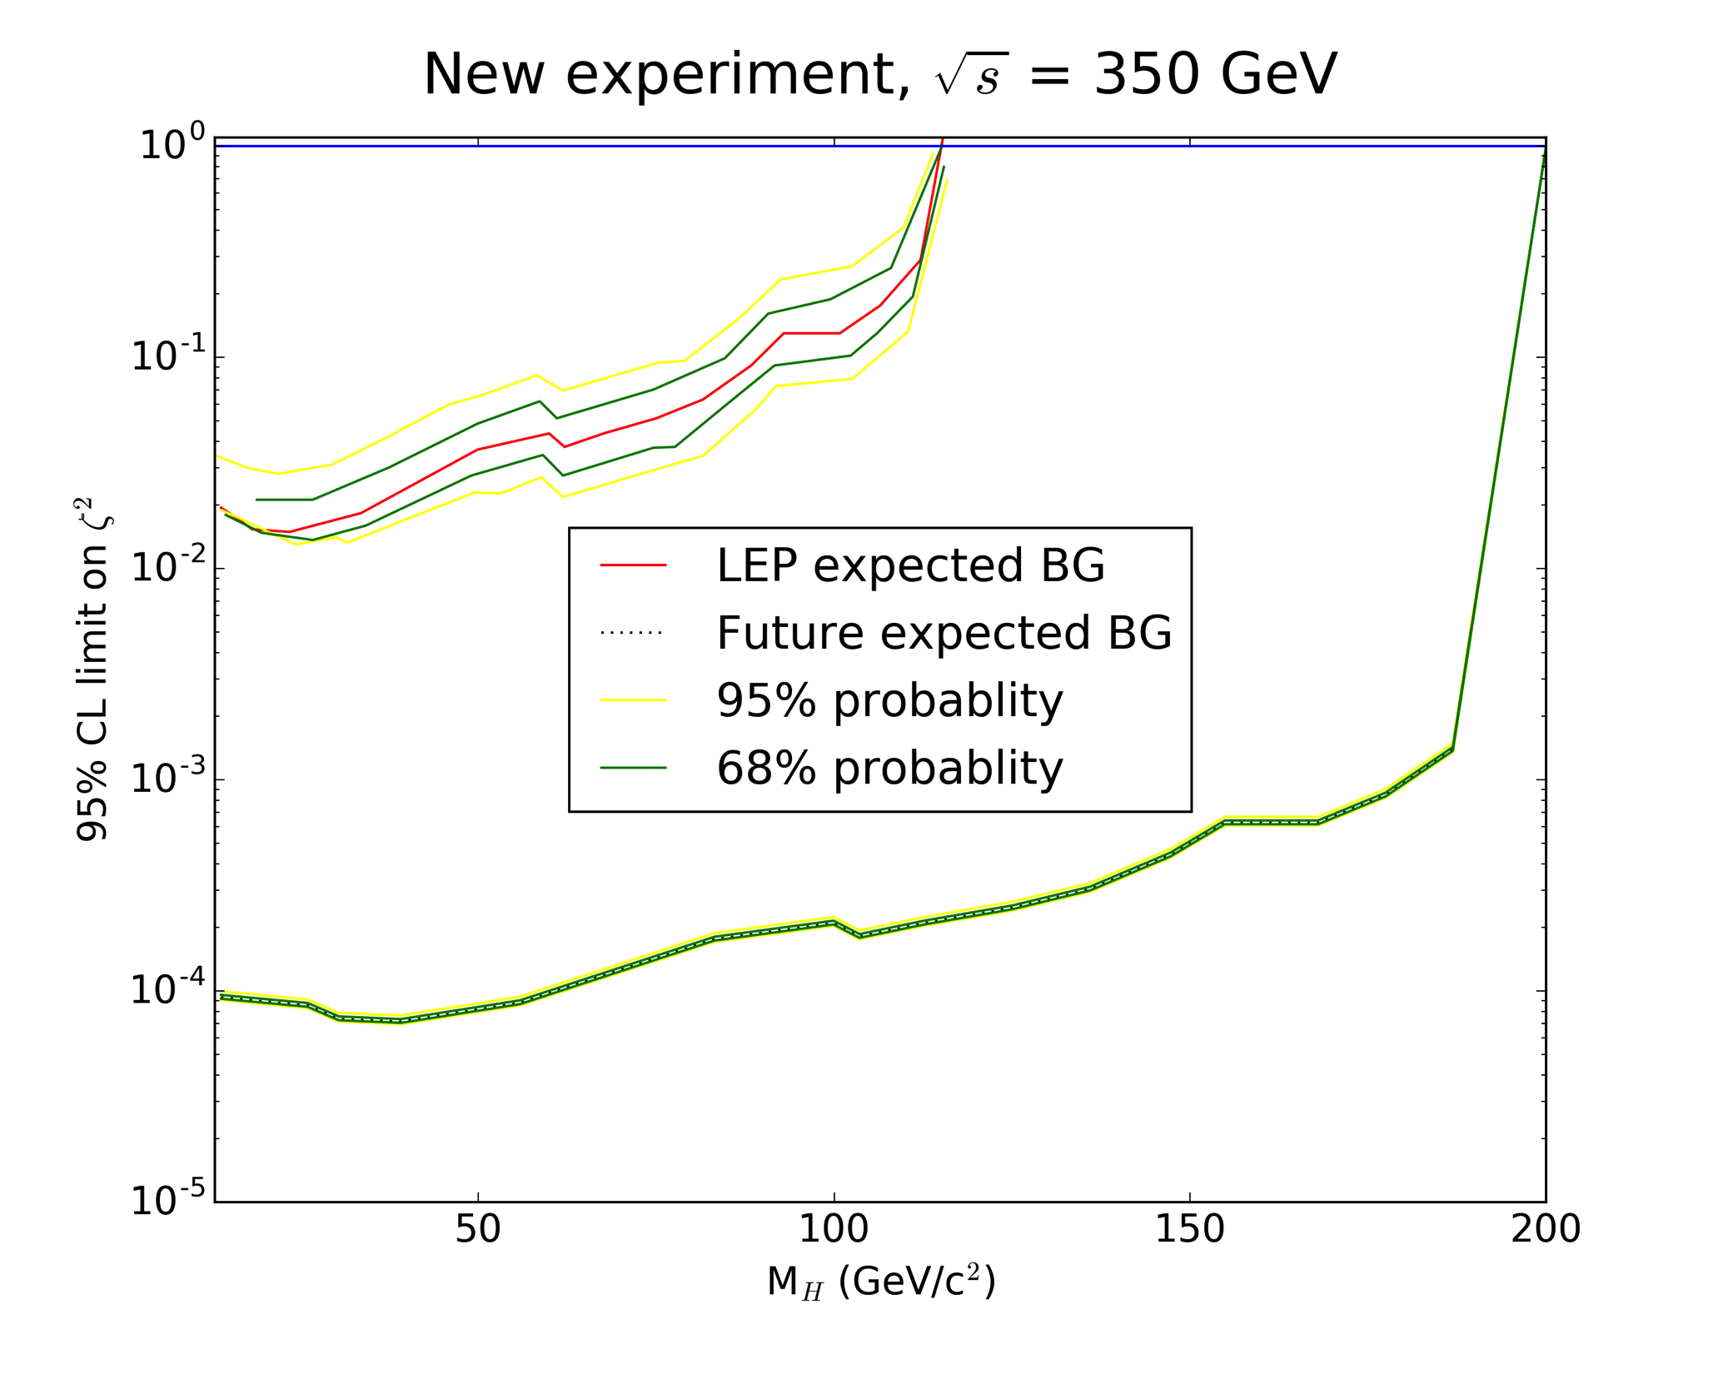
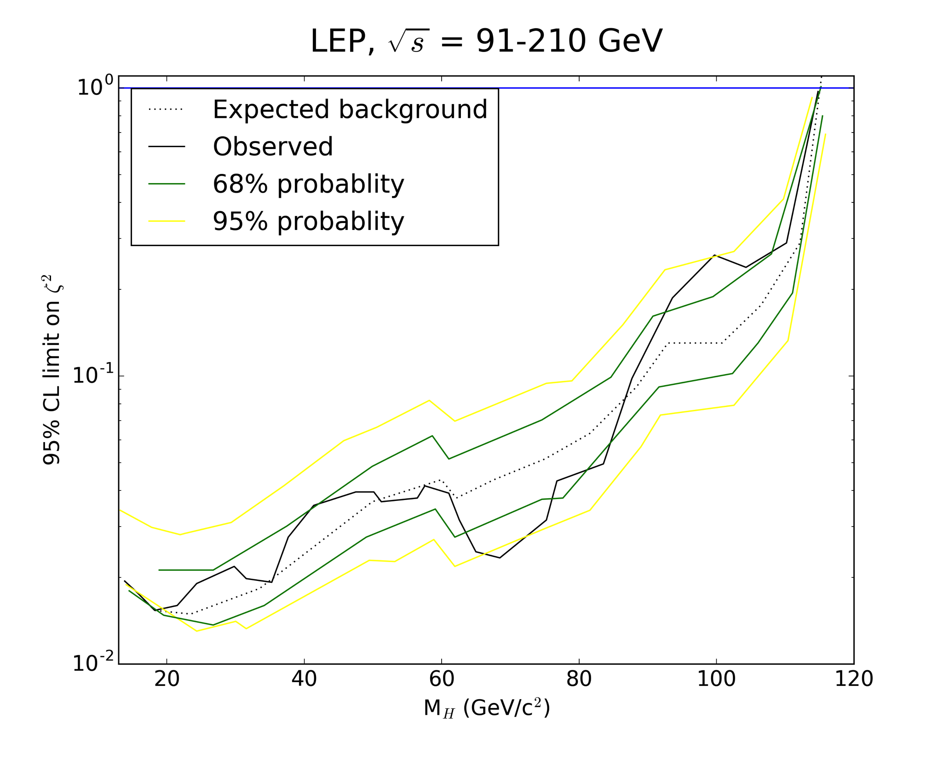
‘Stretching’ the plot

Slide 17

Building the next e⁺e⁻ collider gives us…
We find going to 350 GeV and 500 fb⁻¹ results in:
shifting the CL limit down and shrinking the band around it
stretching the Higgs mass axis
Future analysis improvements (mostly better bkg estimates):
include improved detector performance in MC simulations
include SM Higgs in analysis
new backgrounds will leak in and were ignored here
This is all provided we build the next e⁺e⁻ collider!

