Slide 1



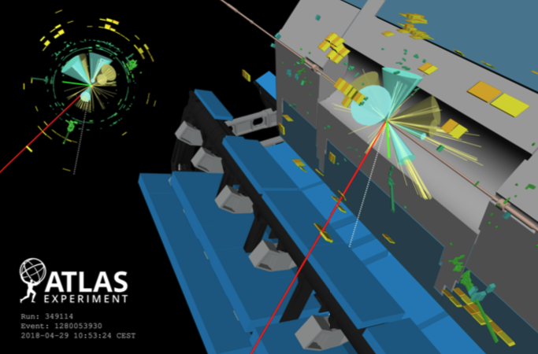
Top physics analysis
Search for four-top-quark
Sascha Caron, Clara Nellist, Polina Moskvitina
Nikhef Jamboree, Amsterdam, 16/05/2023

Slide 2
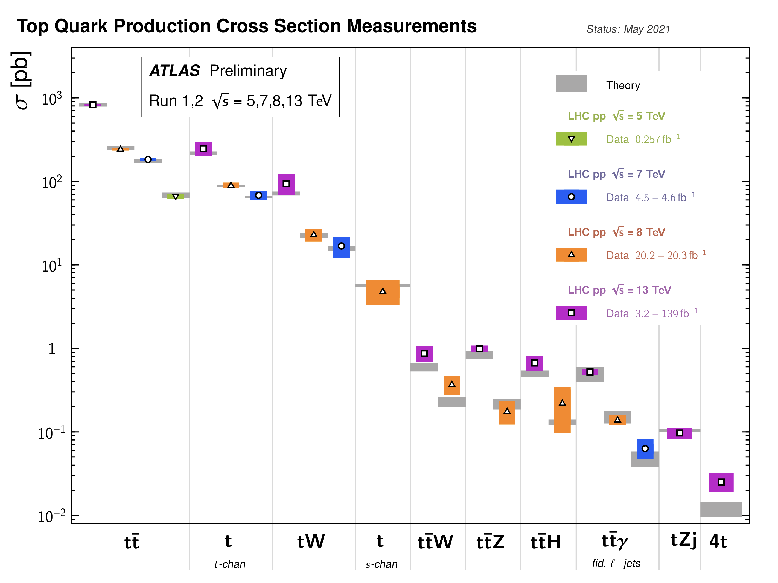

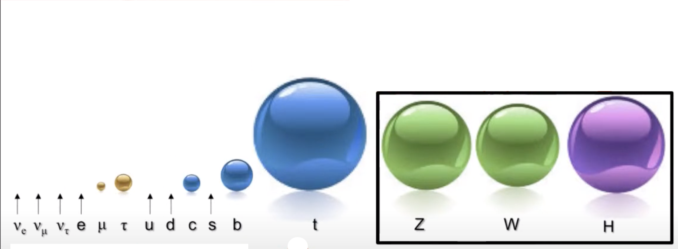
ATL-PHYS-PUB-2022-051
The top quark production at LHC
What are its properties?
Why so heavy?
How can the Higgs give mass to the top quark?
Multi-top (four-top, three-top)

Slide 3
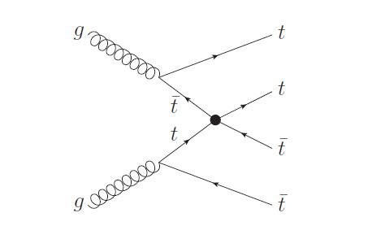
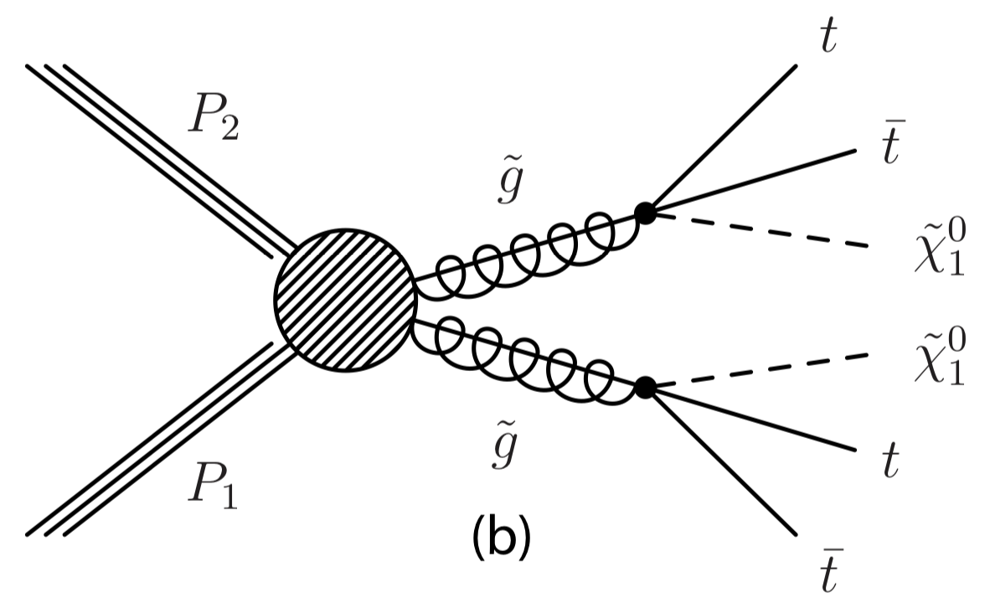
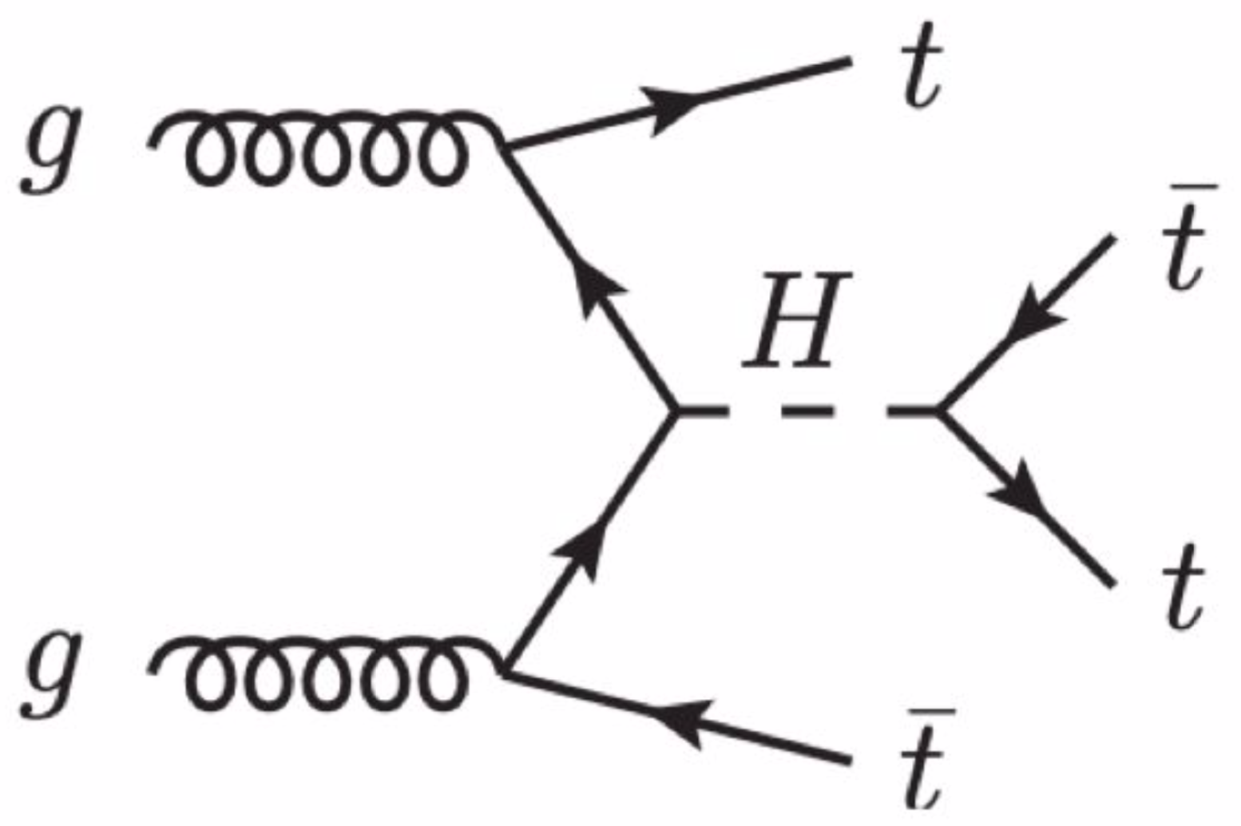
Exploring BSM
Contact Interaction
2HDM
SUSY (gluino/sgluino pair, ..,)
More likely to couple to new physics because of mass?

Slide 4
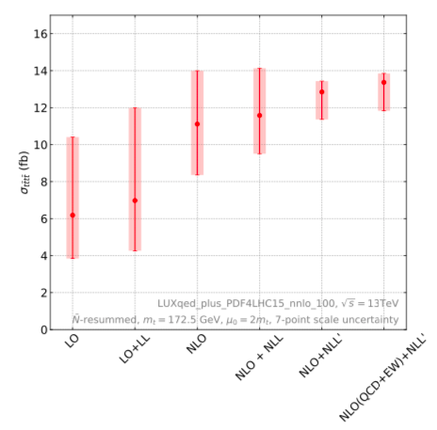
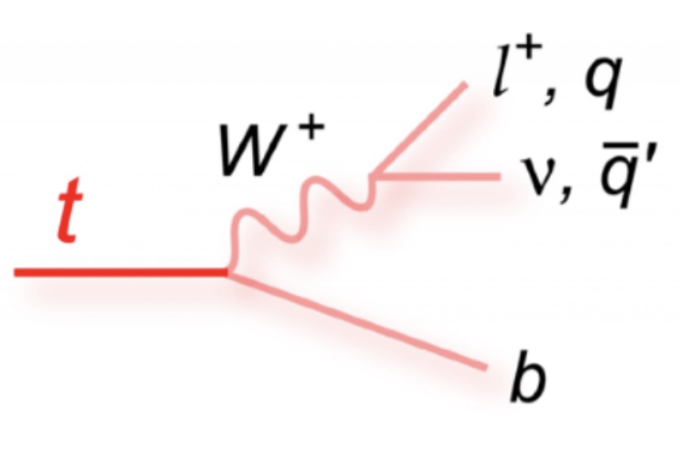
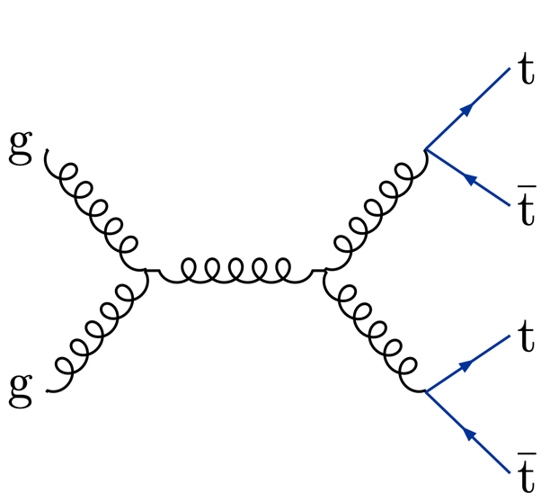
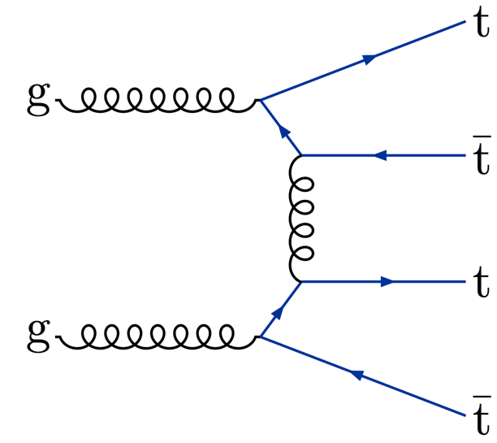

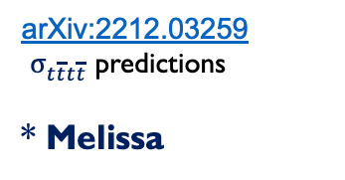
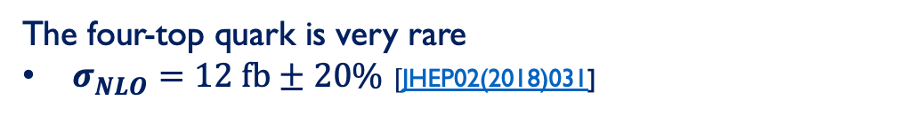
The four-top-quarks production at LHC
The four-top quark is very rare
$σ_{NLO}=12 fb±20\%$ $[$JHEP02(2018)031]
arXiv:2212.03259
$σ_{t\overline{t}t\overline{t}}$ predictions
* Melissa
Examples of Feynman diagrams for SM $t\overline{t}t\overline{t}$ production at leading order in QCD and via an off-shell Higgs boson mediator
The signal for 4-top events has not been discovered yet, but if the measurement is different to the SM, it would indicate physics beyond it

Slide 5
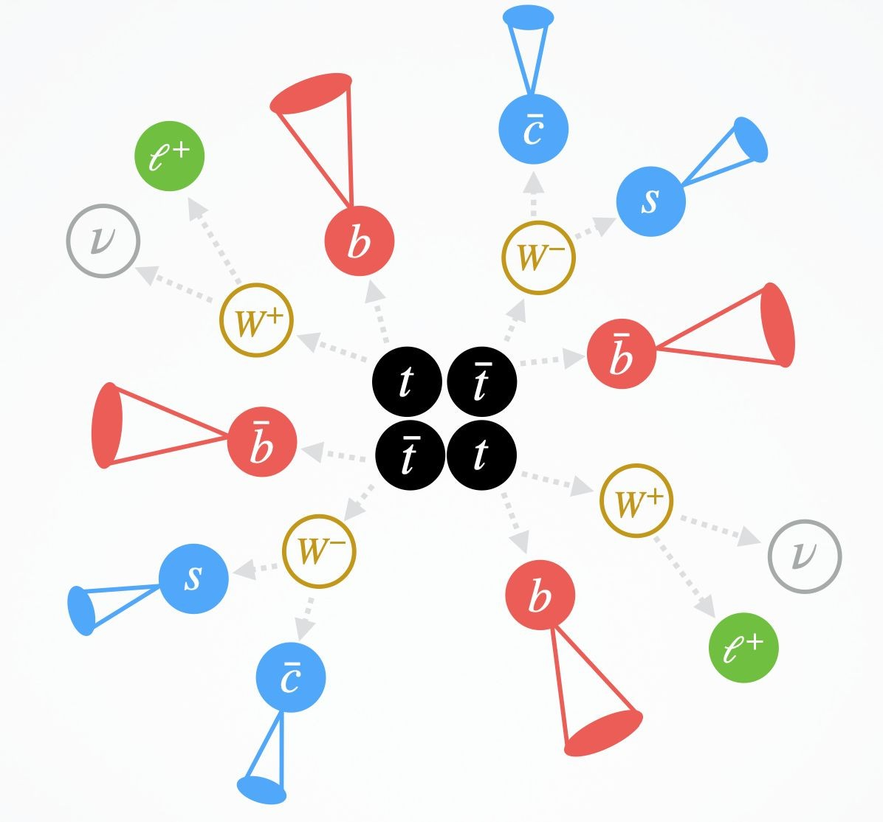
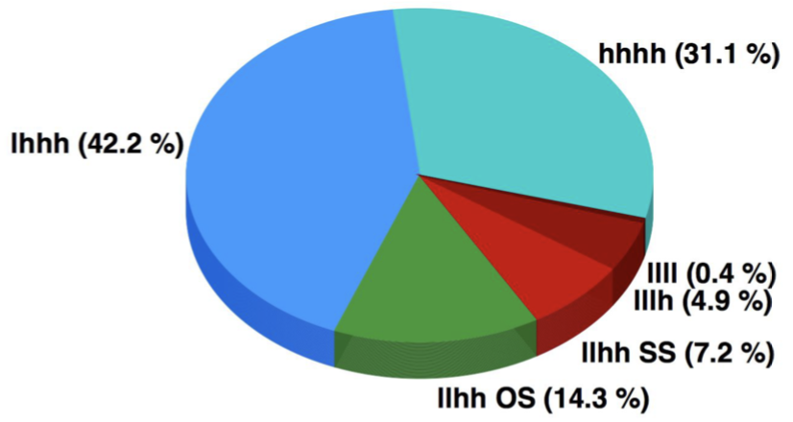
The four-top decays
2 leptons same-sign and 3 leptons (2LSS/3L)
13% branching ration
highest sensitivity – observation

Slide 6
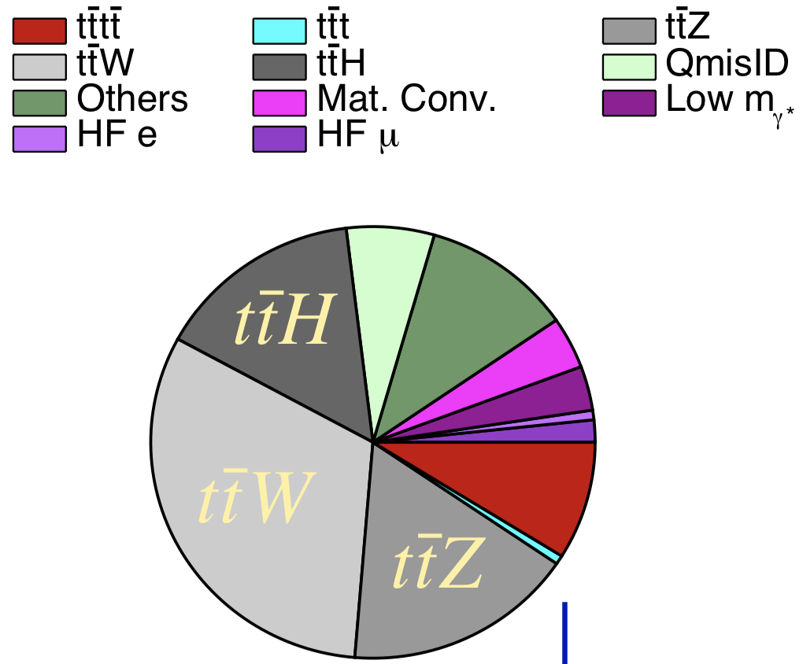
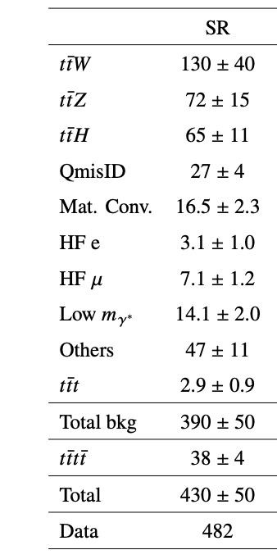

Background composition
Signal Region Composition
MVA allows to recover signal purity even with larger background
Novel MVA techniques bring improvement for S/B separation
$t\overline{t}t$ serves as important background given similar kinematics

Slide 7
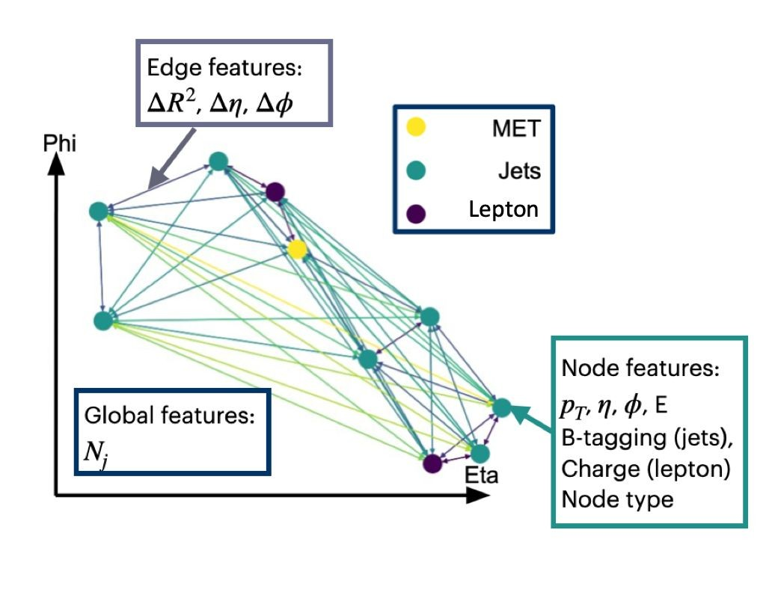
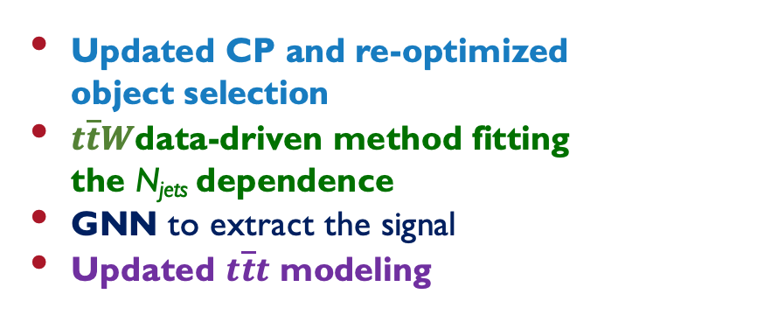

Main aspects of the analysis
Analysis strategies are based on the SM $t\overline{t}t\overline{t}$ evidence paper with several improvements
Updated CP and re-optimized object selection
$t\overline{t}W$data-driven method fitting the N_{jets} dependence
GNN to extract the signal
Updated $t\overline{t}t$ modeling
SR
Similar shape between
$t\overline{t}t\overline{t}$ and $t\overline{t}t$
Observed (exp.) significance :
GNN: 6.1 σ (4.3σ)
BDT: 6.0 σ (3.9σ)

Slide 8


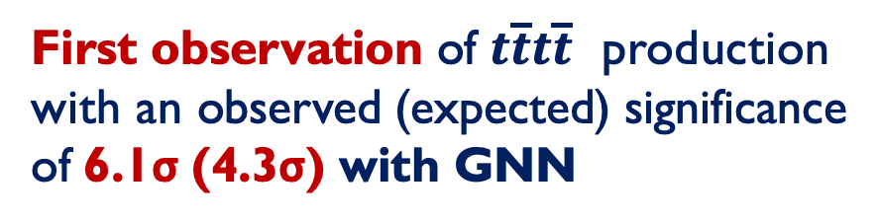


First observation of four-top production
First observation of $t\overline{t}t\overline{t}$ production with an observed (expected) significance of 6.1σ (4.3σ) with GNN
Likelihood distribution on $σ_{t\overline{t}t\overline{t}}$
$μ=1.9±0.4(stat){}_{−0.4}^{+0.7}{\left(syst\right)={1.9}_{−0.5}^{+0.8}}$
$σ_{t\overline{t}t\overline{t}}= {22.5}_{−4.3}^{+4.7}(stat){}_{−3.4}^{+4.6}{\left(syst\right) fb={22.5}_{−5.5}^{+6.6} fb}$
With BDT: 6.0σ (3.9σ)
  GNN gave 10% higher sensitivity compared with the best BDT methods!
* Consistent with the SM within 1.8 standard deviations and with previous ATLAS measurement of ${24}_{−6 }^{+7}$fb

Slide 9

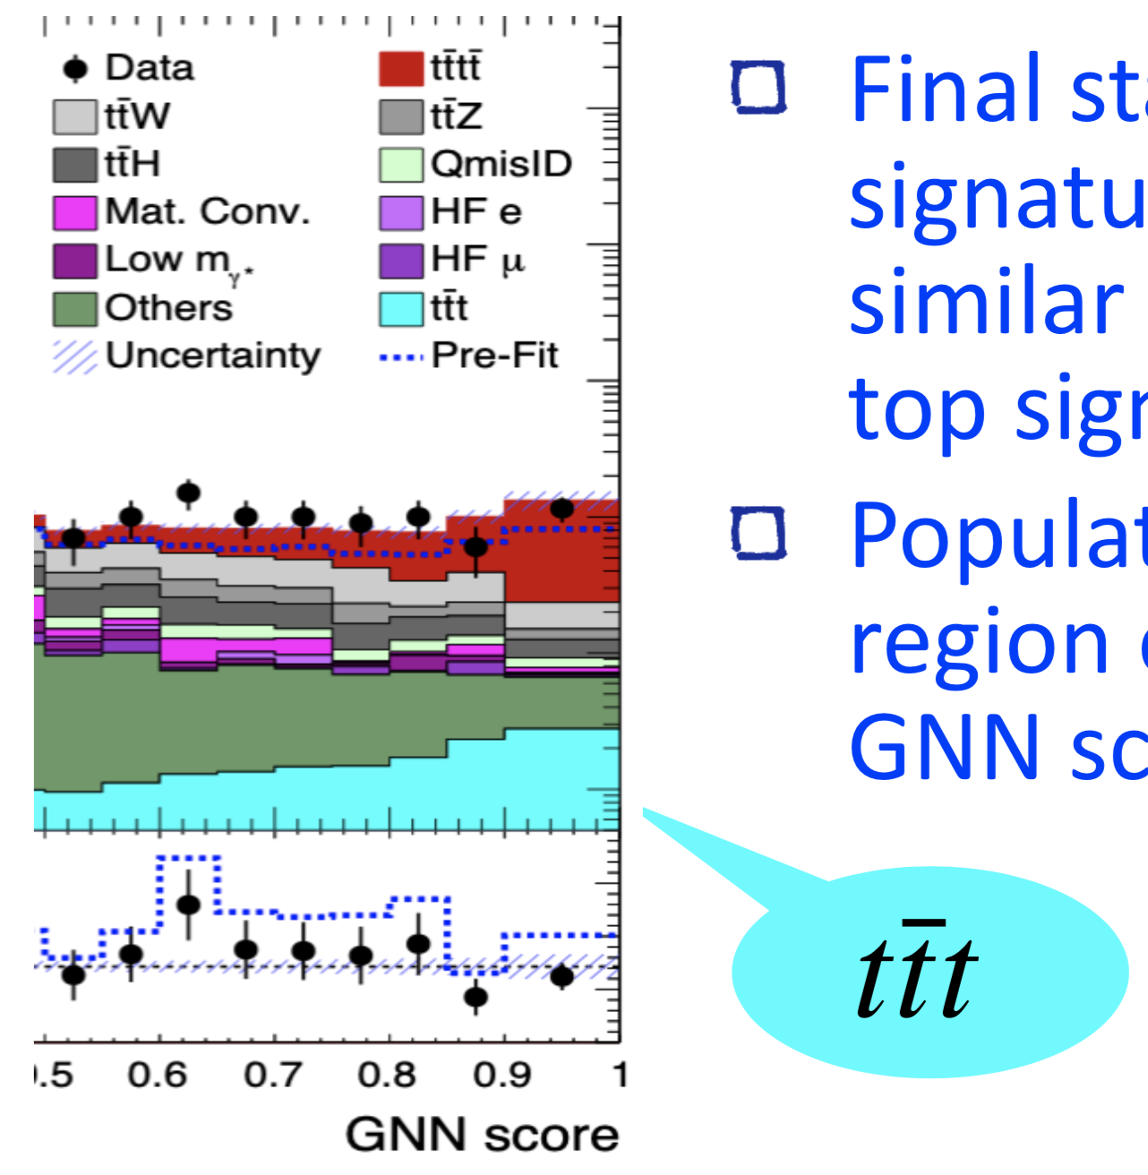
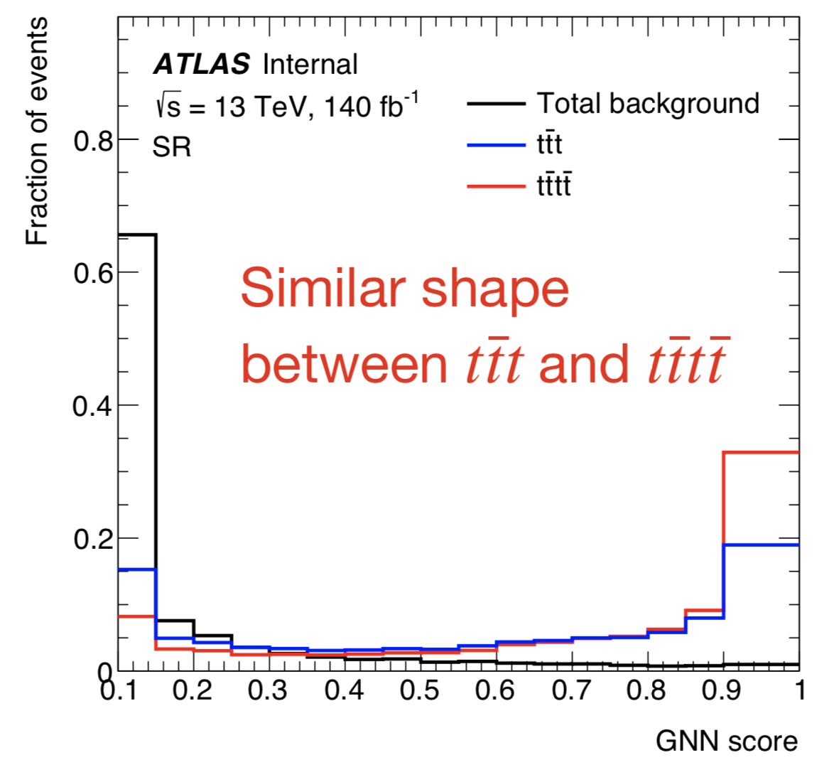
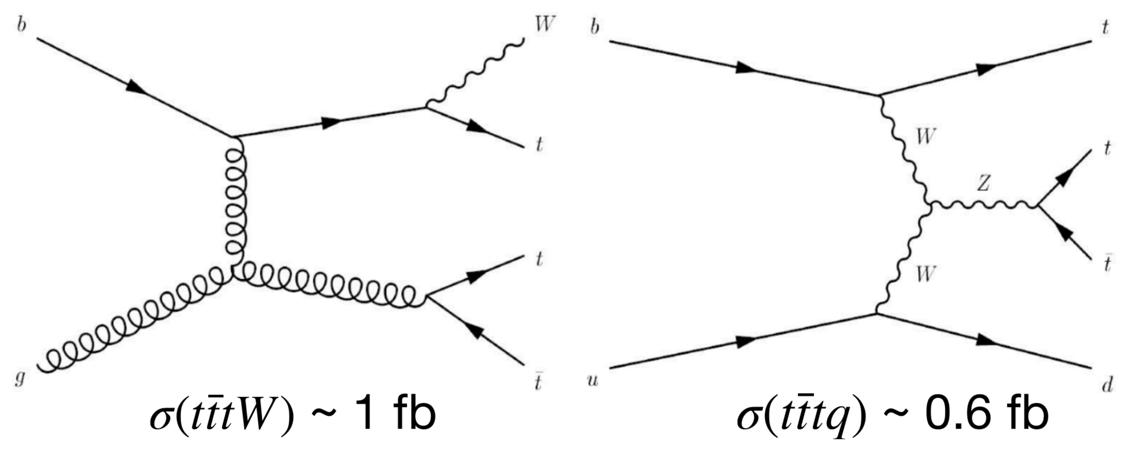
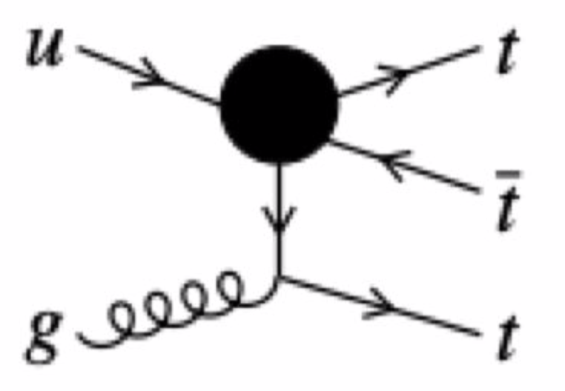

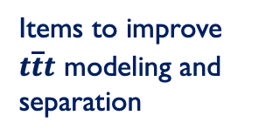
Four top as a path to three top
Hard to distinguish three and four top production
Cross section ~10 times smaller than the four top process
Similar shape between
$t\overline{t}t\overline{t}$ and $t\overline{t}t$
Final state signature is similar to four-top signal
Populates region of high GNN score
SM
BSM
Items to improve $t\overline{t}t$ modeling and separation

Slide 10
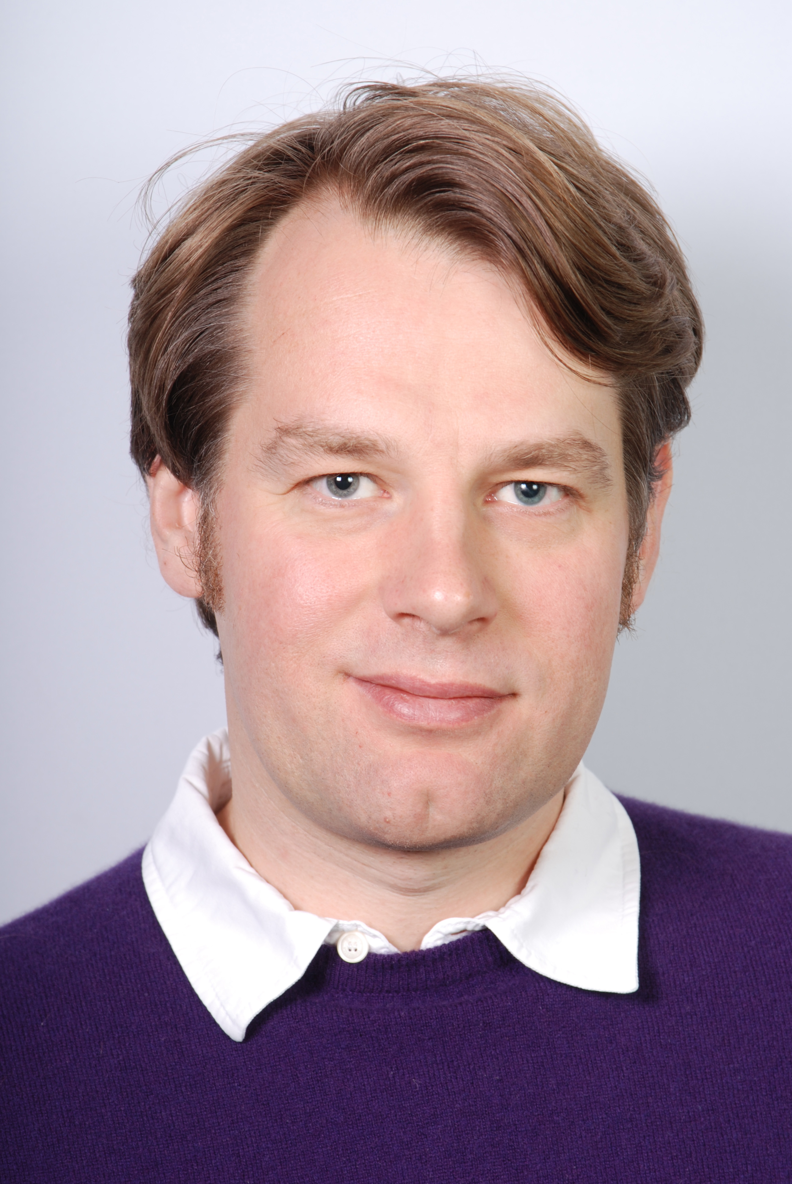



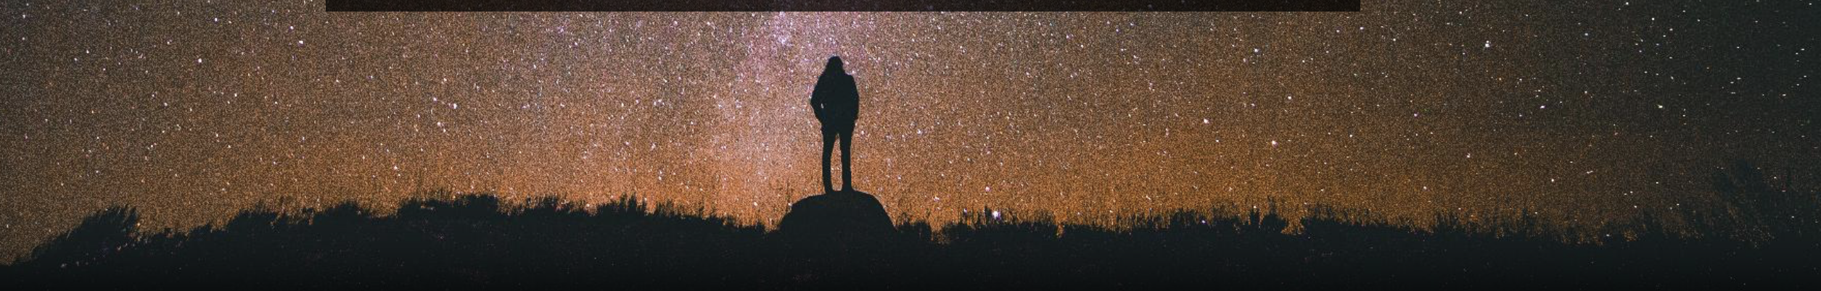
Our group outside ATLAS
From DarkMachines :
Sascha)
(Supervisor)
Polina
(PhD)
Zhongyi
(Postdoc)
Clara
(Co-supervisor)
Roberto Ruiz de Austri (Postdoc, IFIC)
Rob Verheyen (Postdoc, UCL)
We also looked at simulated data studies outside of ATLAS!
The question was: “What is the best network configuration to search for the four-top channel?”

Slide 11


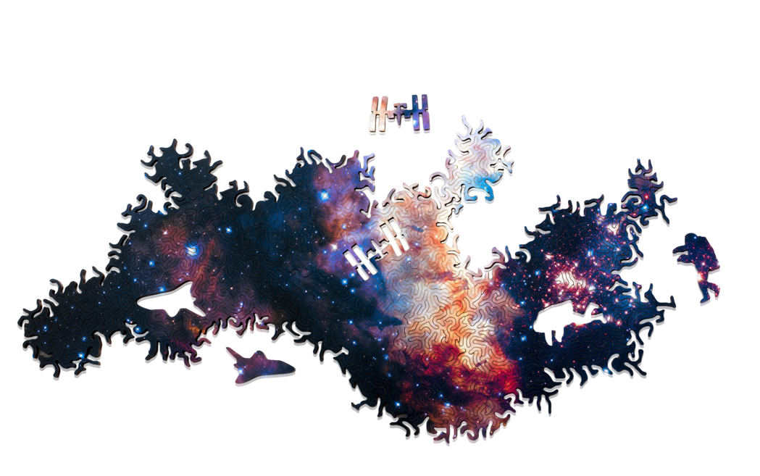
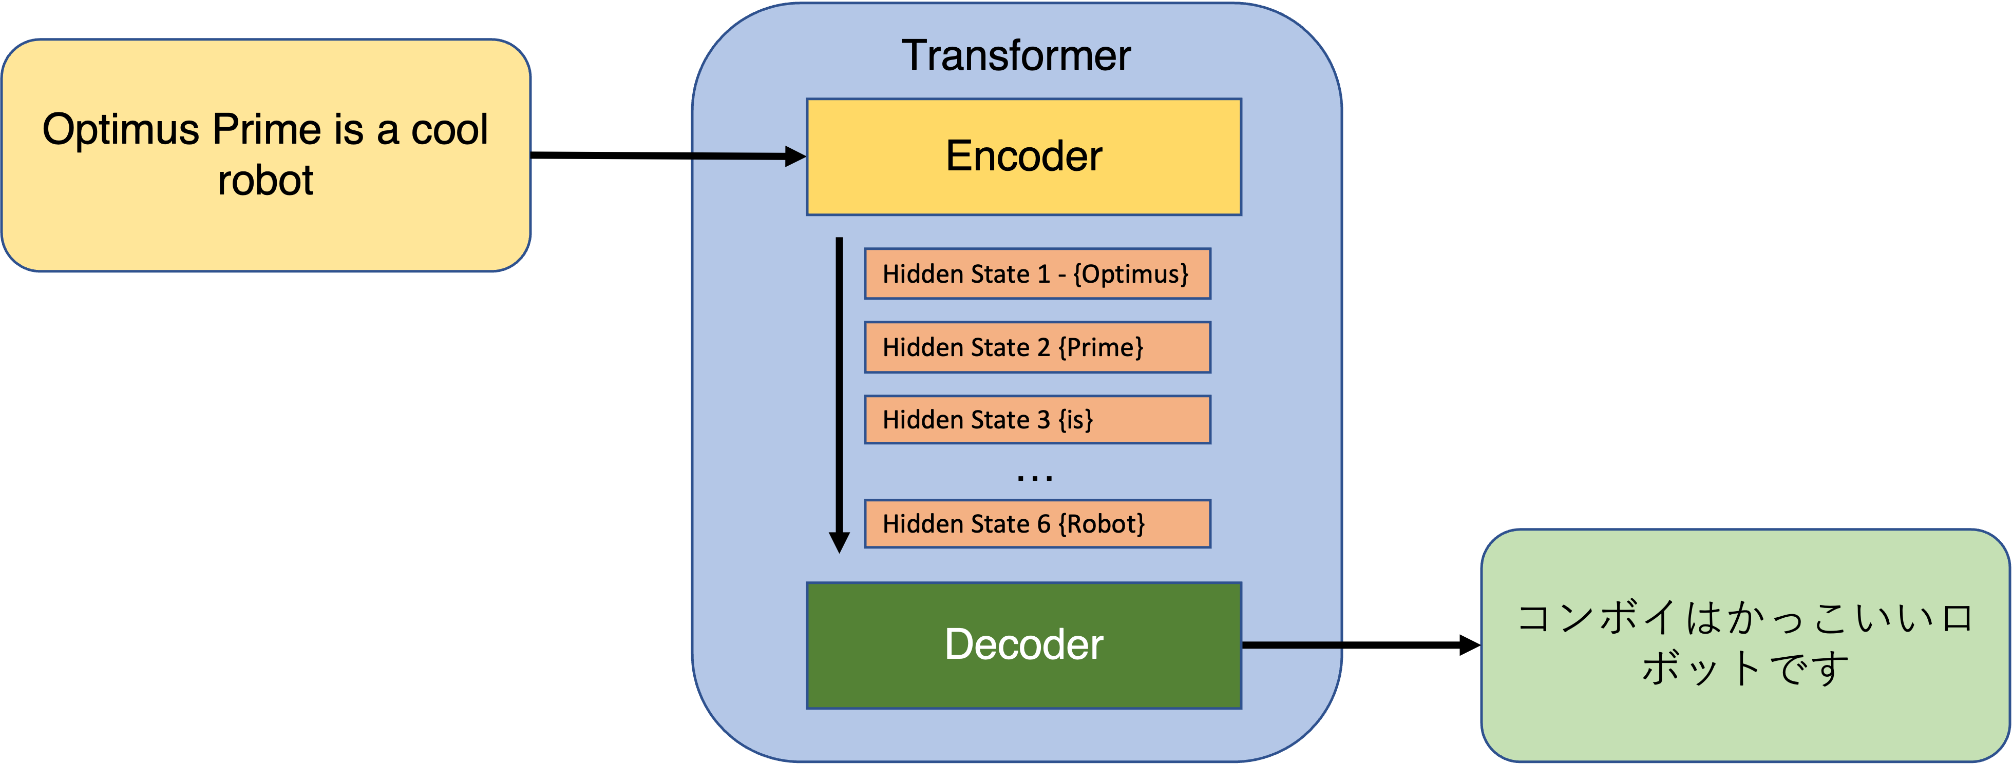
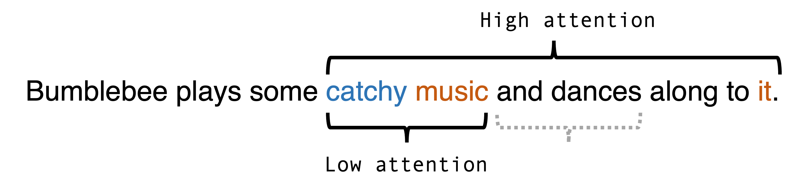
arXiv:2202.03772
Transformers
Idea
Sequence-to-sequence network that learns importance of elements with respect to others
+
Attention is All You Need!
arXiv:1706.03762
+
Pairwise features ($m_{ij}$, $∆ R_{ij}$, etc..)

Slide 12
arXiv:2211.05143
Results
X-axis – the signal efficiency
Y-axis – the background rejection
compared to the BDT
We can achieve a 50% higher background rejection FOR FREE by switching from BDT to Transformers (with pairwise features)
A plot with signal efficiency VS background rejection

Slide 13


We observed a significantly higher number of four-top events than expected within the Standard Model
[6.1 σ (4.3σ)]
Exact nature of the excess remains unknown
Is it actually four-top production??
Are there anomalies hidden in the four-top selection ??
Are there new physics in the four-top channel?
New physics beyond the SM (BSM) ….

Slide 14


Summary
Four-top observation! First time ever!
Background only hypothesis rejected with a significance of 6.1σ
Transformers are to be a capable tool when applied to particle collider problems!
Next steps: Investigating the excess of 3-top/4-top events and
Searching for Anomalies in ATLAS!!!

Slide 15

MAY THE TOPS BE WITH YOU
Thank you for your attention!

Slide 16
Backup

Slide 17
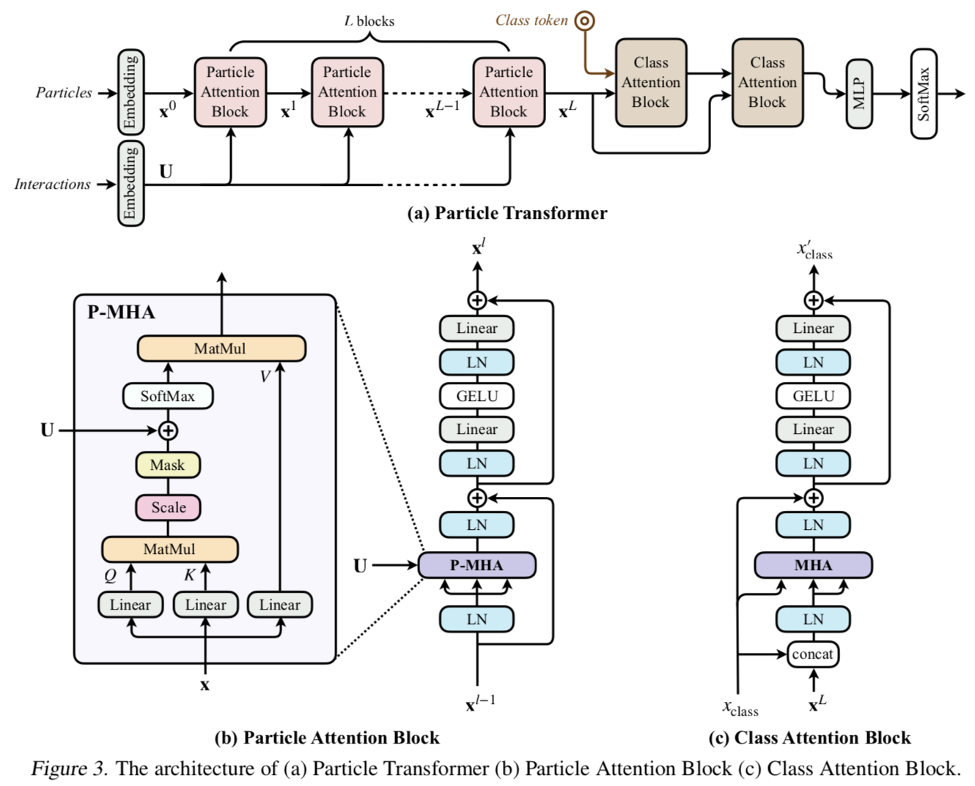
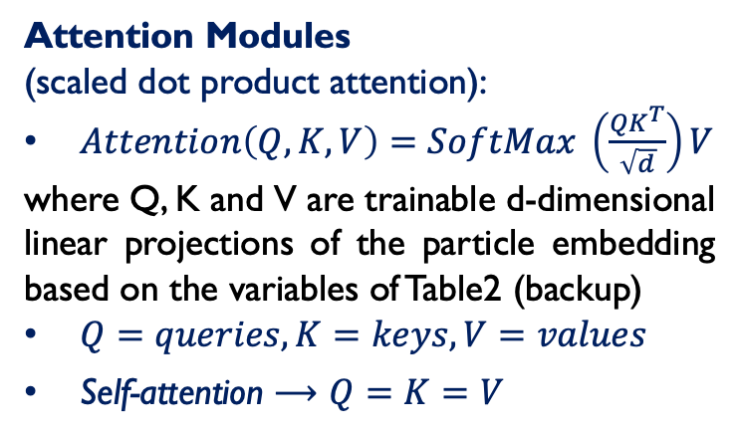
Transformers
arXiv:2202.03772
Idea
Sequence-to-sequence network that learns importance of elements with respect to others
Attention Modules
(scaled dot product attention):
$Attention\left(Q,K,V\right)=SoftMax \left(\frac{{QK}^{T}}{\sqrt{d}}\right)V$
where Q, K and V are trainable d-dimensional linear projections of the particle embedding based on the variables of Table2 (backup)
$Q=queries, K=keys, V=values$
Self-attention $⟶Q=K=V$
Attention is All You Need!
arXiv:1706.03762

Slide 18
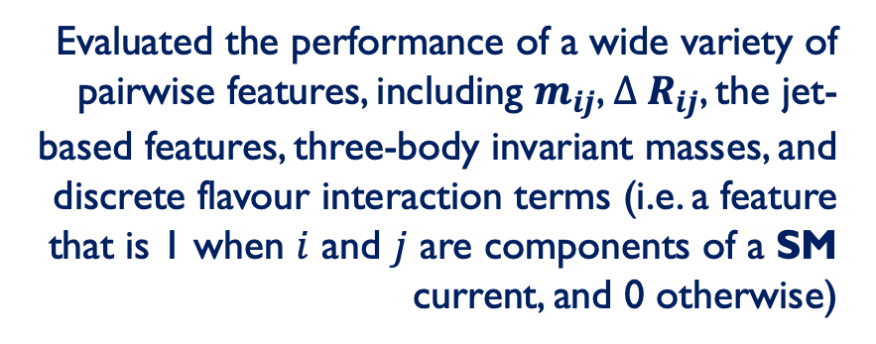
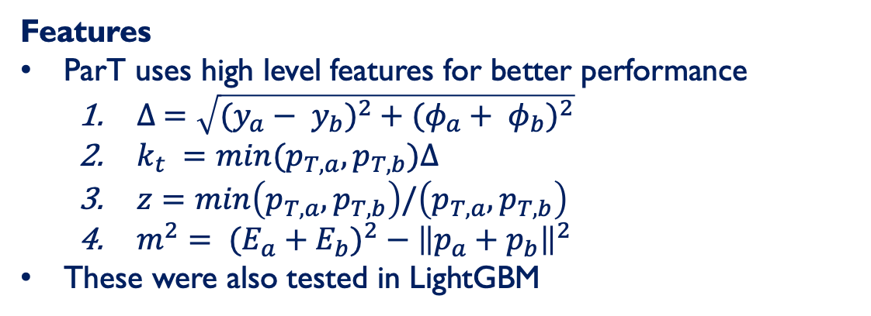
Adding Pairwise features
Include pairwise features in Particle Transformer through a trainable embedding $U_{ij}$ for particles $i$ and $j$, by replacing :
Attention Modules
$Attention\left(Q,K,V\right)=SoftMax \left(\frac{{QK}^{T}}{\sqrt{d}}\right)V$ $Attention\left(Q,K,T\right)=SoftMax \left(\frac{{QK}^{T}}{\sqrt{d}}+U\right)V$
arXiv:2202.03772
Features
ParT uses high level features for better performance
  $∆ =\sqrt{{(y_{a}− y_{b})}^{2} + {(φ_{a}+ φ_{b})}^{2}}$
  $k_{t} =min(p_{T,a},p_{T,b})∆$
  $z=min\left(p_{T,a},p_{T,b}\right)/\left(p_{T,a},p_{T,b}\right)$
  $m^{2}= {(E_{a}+E_{b})}^{2} − {\left\|p_{a}+p_{b}\right\|}^{2}$
These were also tested in LightGBM
Evaluated the performance of a wide variety of pairwise features, including $m_{ij}$, $∆ R_{ij}$, the jet-based features, three-body invariant masses, and discrete flavour interaction terms (i.e. a feature that is 1 when $i$ and $j$ are components of a SM current, and 0 otherwise)

Slide 19
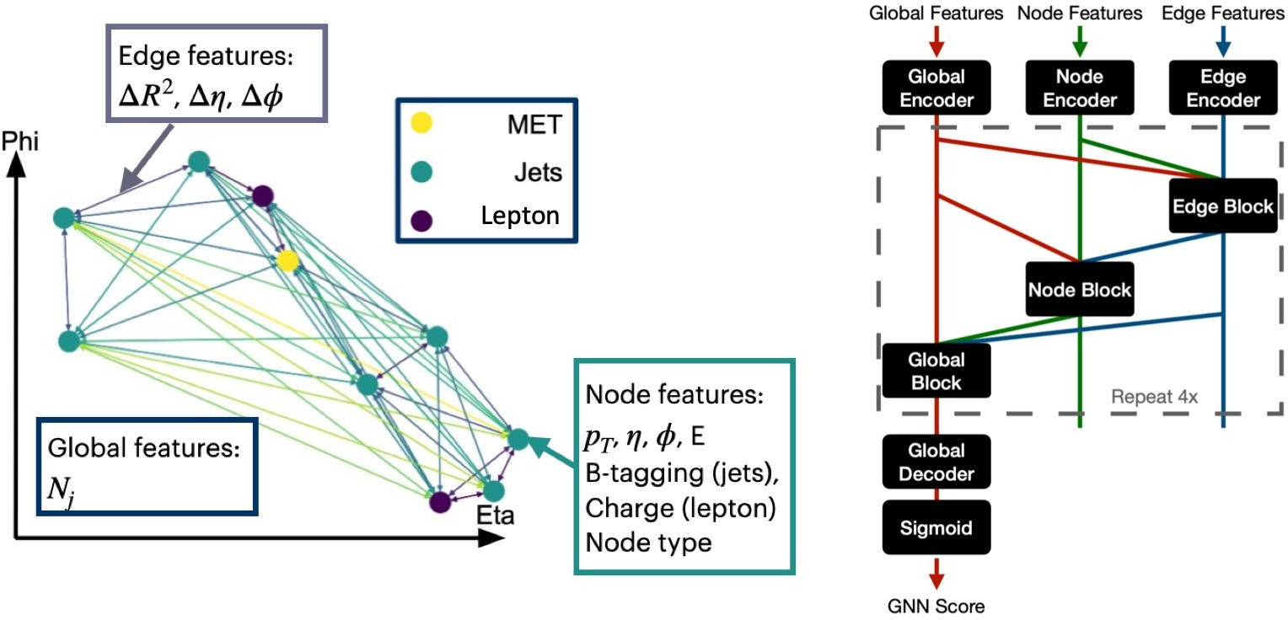
GNN multivariate analysis
The main challenge of the four-top signal extraction is the complicated final state
The Graphic Neural Network (GNN, arxiv:1806.01261) combines information about all objects (jets, leptons, MET) from an event into a graph, with node, edge and global properties
Message passing architecture allows network to learn complex features of the four-top process

Slide 20
The publication before the observation
Both ATLAS and CMS experiments had the combined measurements on four-top with ATLAS full Run-2 data
Both ATLAS/CMS experiments declared the evidence of the four-top, and re-optimized their analysis with the same Run2 data in 2LSS/3L channel for the observation

Slide 21
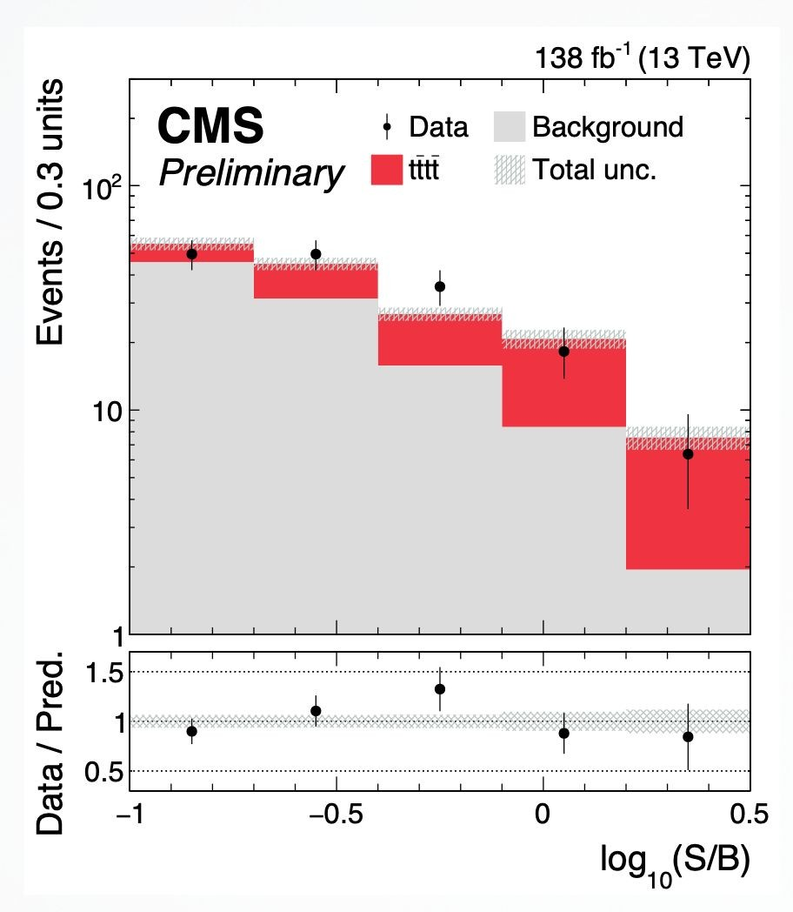
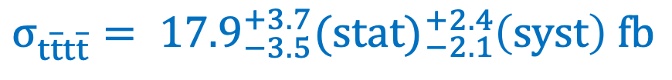

The CMS result (2LSS/3L/4L)
$$σ_{t\overline{t}t\overline{t}}= {17.9}_{−3.5}^{+3.7}(stat){}_{−2.1}^{+2.4}{\left(syst\right) fb}$$
$S_{t\overline{t}t\overline{t}}= 5.5 (4.9)σ$
Differences
CMS has a 4-lepton channel (tiny contribution), lepton channels are split, ATLAS merged 2LSS/3L channels
CMS is using multi-class BDT, ATLAS is using GNN
CMS merged three-top contribution with all the minor top productions
CMS used data-driven method to estimate the non-prompt (ttbar) backgrounds, ATLAS used MC ttbar, with profiled normalizations
CMS measures four-top, ttW and ttZ simultaneously, ATLAS measures four-top, ttW and non-prompt (ttbar) simultaneously

Slide 22
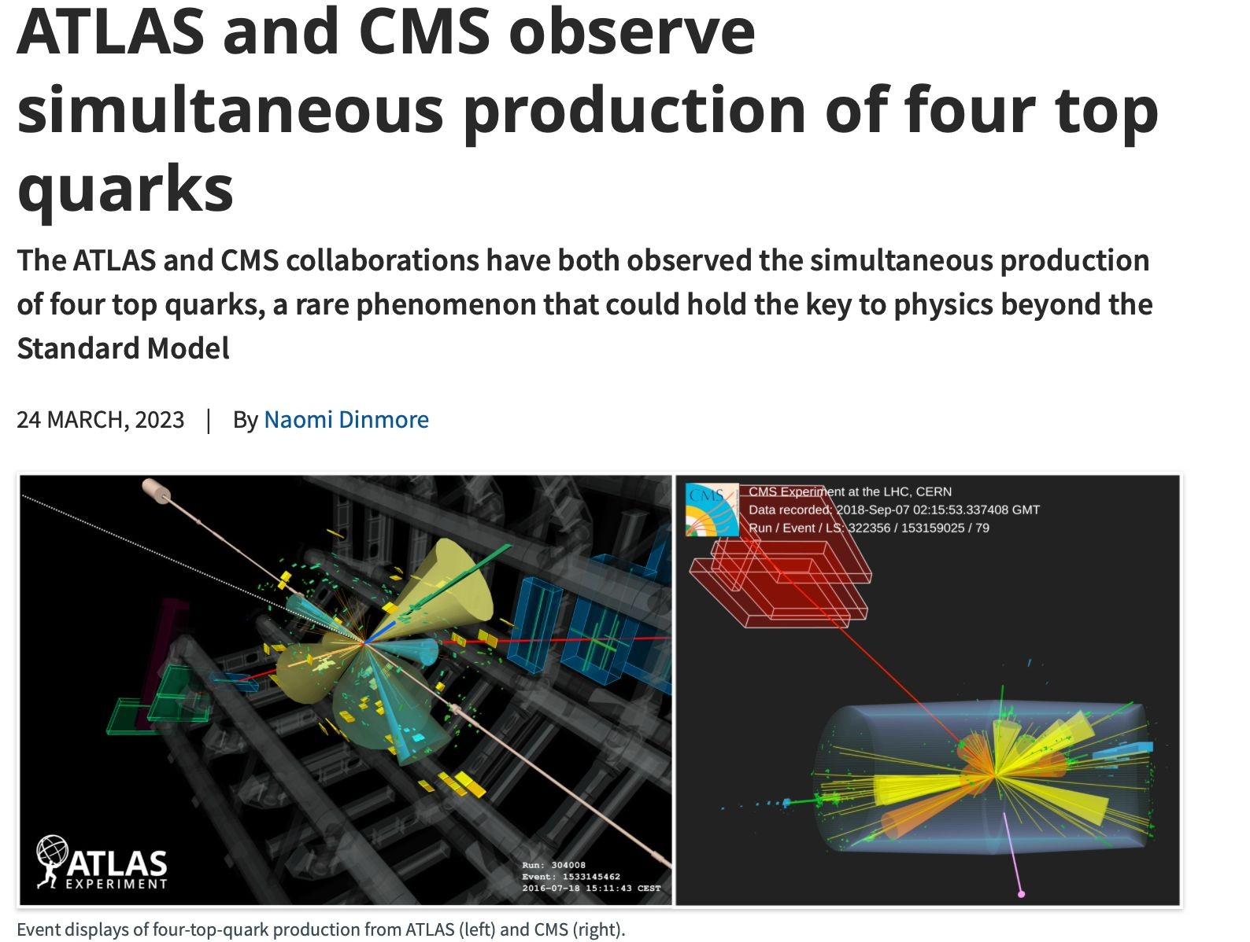
Papers
Four tops observed for the first time at CERN – The heaviest final state ever observed !!!
  The observations happened in 2LSS/3L channel only
  The interpretations are done with three-top measurements, top-Higgs Yukawa coupling and EFT parameters
All results are compatible with SM
ATLAS (EPJC, CERN-EP-2023-055)
CMS (CMS-PAS-TOP-22-013)
CERN news and briefing

