Slide 1
$H^{*}→WW$ Offshell and Total Width measurement
Bryan Kortman

Slide 2
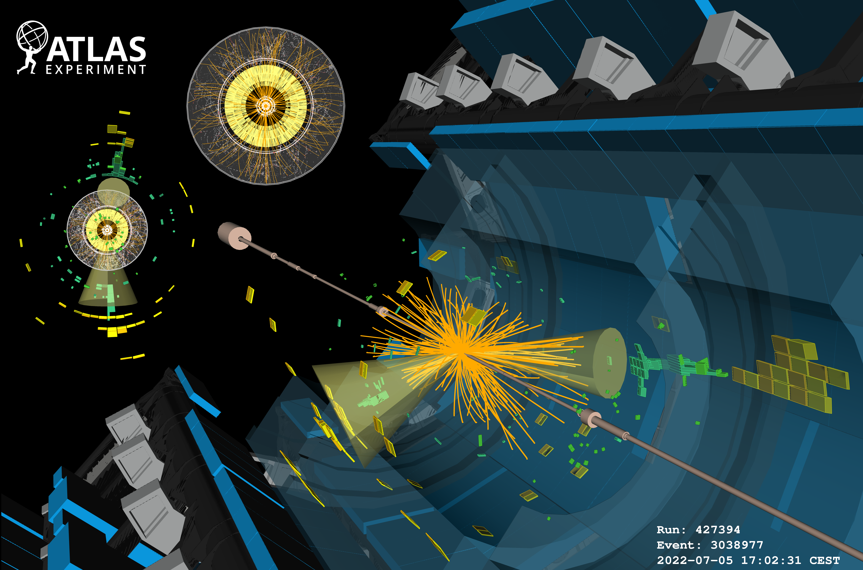
Reconstruction of proton-proton collisions
Run 3 just started with 13.6 TeV collision energy
The analysis in this talk uses Run 2 data
Objects
Charged particle tracks
Energy deposits
Electromagnetic
Hadronic
Reconstructed jets
Electrons, Muons, Jets, Missing Energy

Slide 3
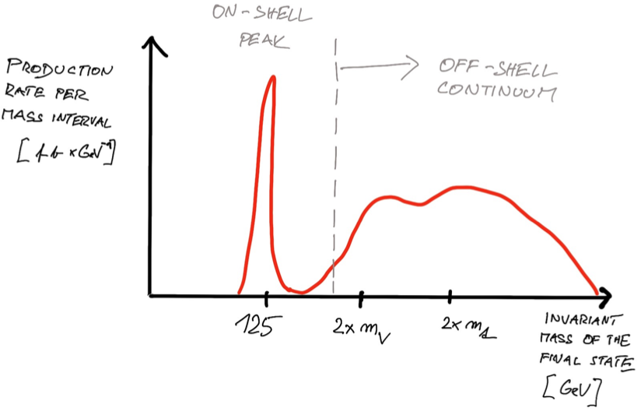
Higgs Resonance and Off-shell
Higgs couplings to massive states
On-shell Higgs production resonance occurring at $125GeV$
Higgs production extends into the Off-shell continuum
Top intermediate state
Higgs resonance
WW intermediate state
$$m_{H}>140GeV$$
Different side of the SM Higgs Boson
Constitutes $O(15\%)$ of the total $gg→H$ production!

Slide 4
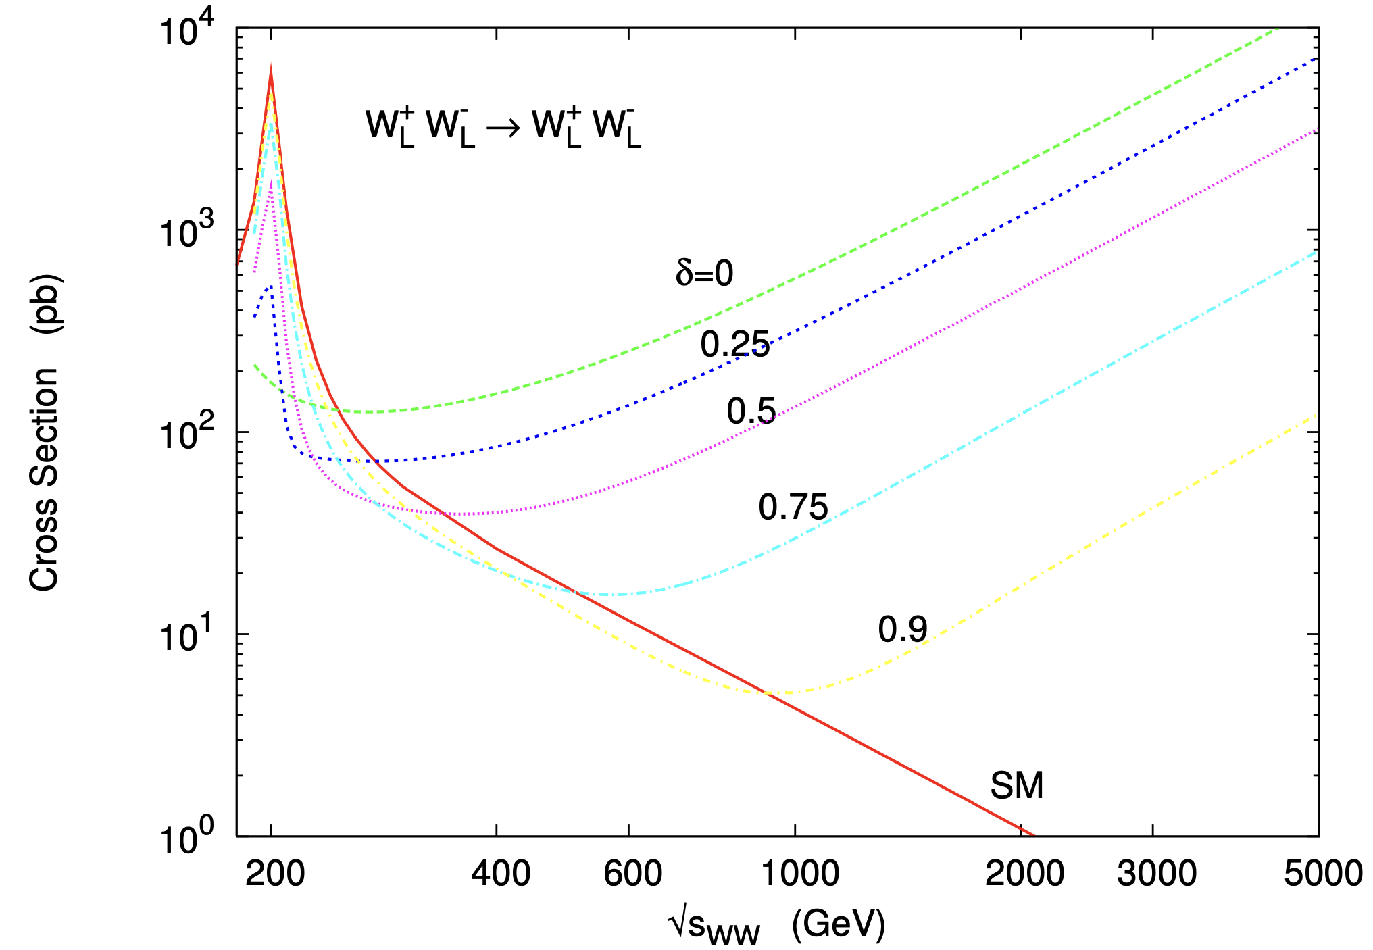
Motivation: Offshell couplings
[1] Bruni, Lucrezia Stella. "Polarized on Higgs?: Measurement of the Higgs couplings to polarized vector bosons." (2019).
To measure all the properties of the Higgs Boson, Off-shell measurements are crucial
non-SM Off-shell Higgs couplings cause WW scattering cross-sections to diverge
Off-shell Higgs interplay mediates this effect
$$\sqrt{δ}≡\frac{g_{HWW}}{g_{HWW}^{SM}}$$
Vector Boson
Fusion (VBF)
WW scattering cross sections as a function of center of mass energy for multiple Higgs to WW coupling hypotheses [1].

Slide 5
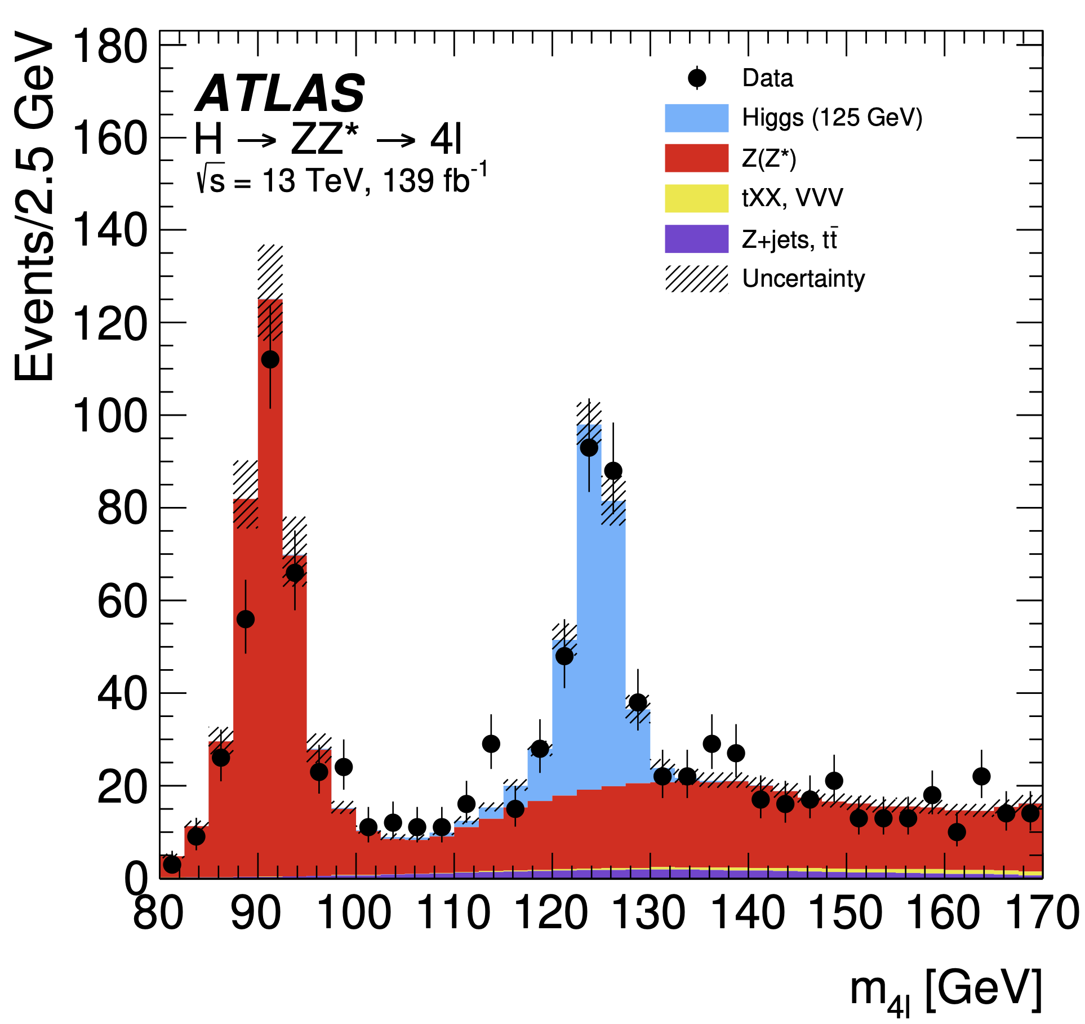
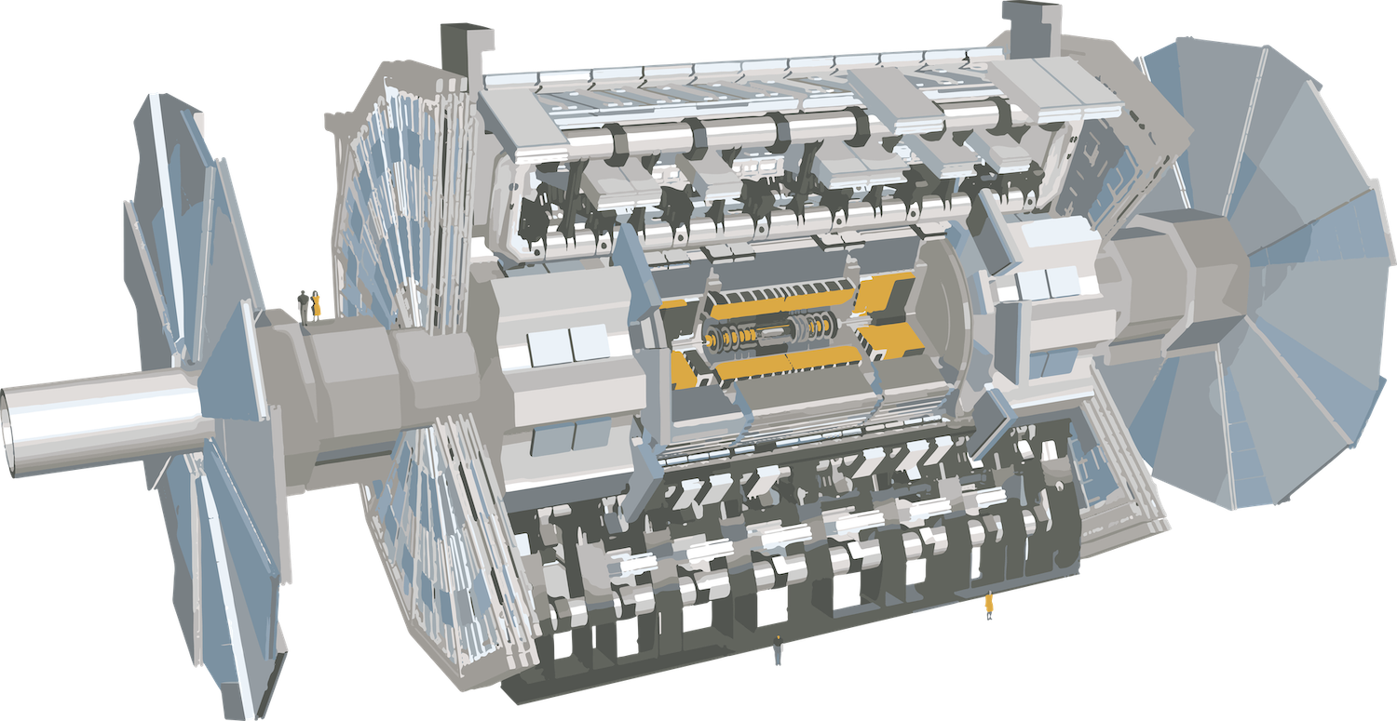
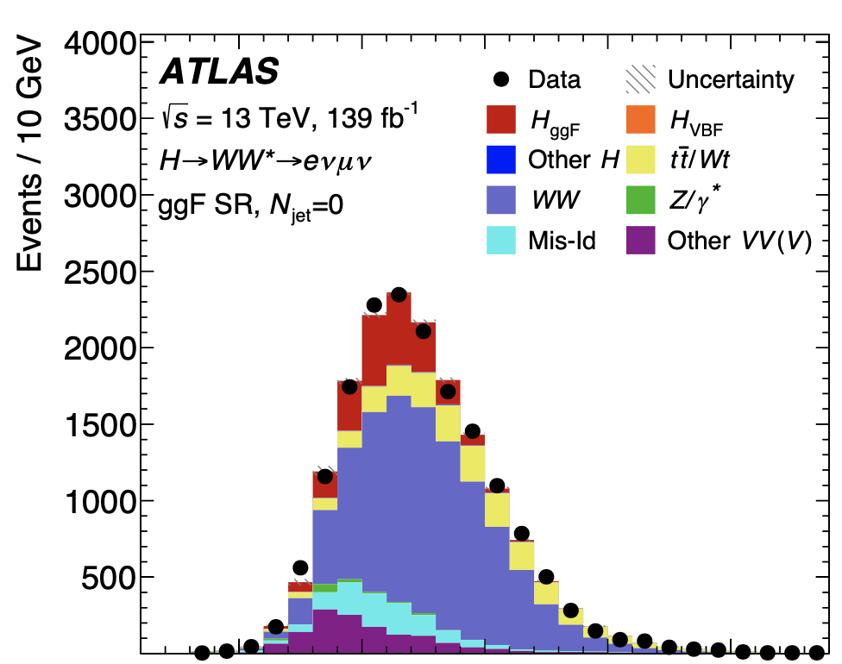
Directly measuring the Higgs decay rate?
Theory prediction: $Γ_{H}^{SM}≈4.1MeV$ $→$ too small for direct measurement
~ $GeV$
$$Γ_{H}^{tot}=\overset{V}{\underset{W,Z}{∑}}Γ^{H→VV}+\overset{q}{\underset{u,d,c,s,t,b}{∑}}Γ^{H→q\overline{q}}+\overset{l}{\underset{e,μ,τ}{∑}}Γ^{H→l\overline{l}}+...Γ^{H→NP}?$$
~ $MeV$
$$N_{events}$$
$$Γ_{H}^{tot}$$
We are about a factor 1000 short in energy resolution!
$$m_{H}$$
$$mass$$

Slide 6
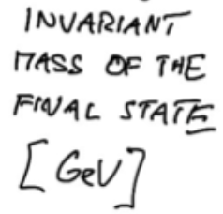
Using the ratio to off-shell and on-shell measurements
Indirect acces to the total decay rate
Divides out some systematic uncertainties
Motivation: measuring the Total Higgs Width
On-shell
$$σ_{i→H→f}∼\frac{g_{i}^{2}g_{f}^{2}}{m_{H}^{2}Γ_{H}^{2}}$$
Off-shell
$$σ_{i→H→f}∼\frac{g_{i}^{2}g_{f}^{2}}{(m_{f}^{2}-m_{H}^{2})^{2}}$$
Combination
$$\frac{σ_{i→H→f}^{offshell}}{σ_{i→H→f}^{onshell}}∝Γ_{H}$$

Slide 7
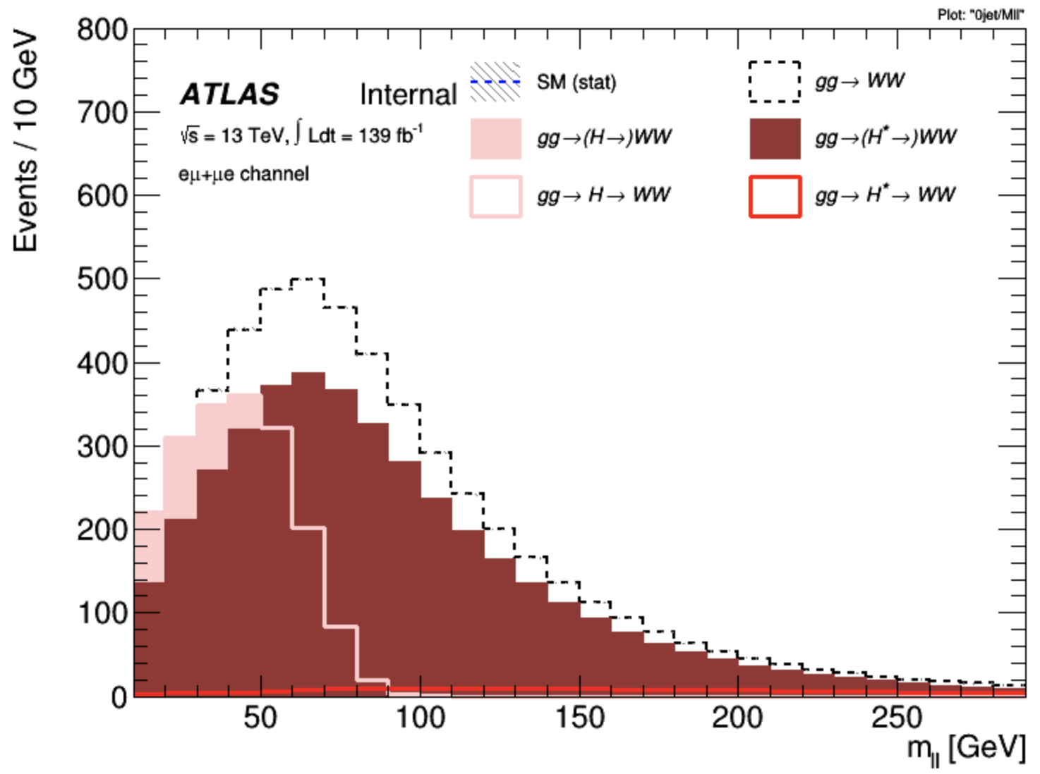
Destructive Interference
Higgs signal and $gg→WW$ background: Negative Interference occurs
Essentially measuring a deficit in $gg→WW$ events
~25 % less $gg→WW$ because of Offshell Higgs Signal
Signal + background
$$2$$
$$2$$
$$+$$
$$+$$
$$×$$
Interference < 0
actual Offshell Signal barely visible

Slide 8
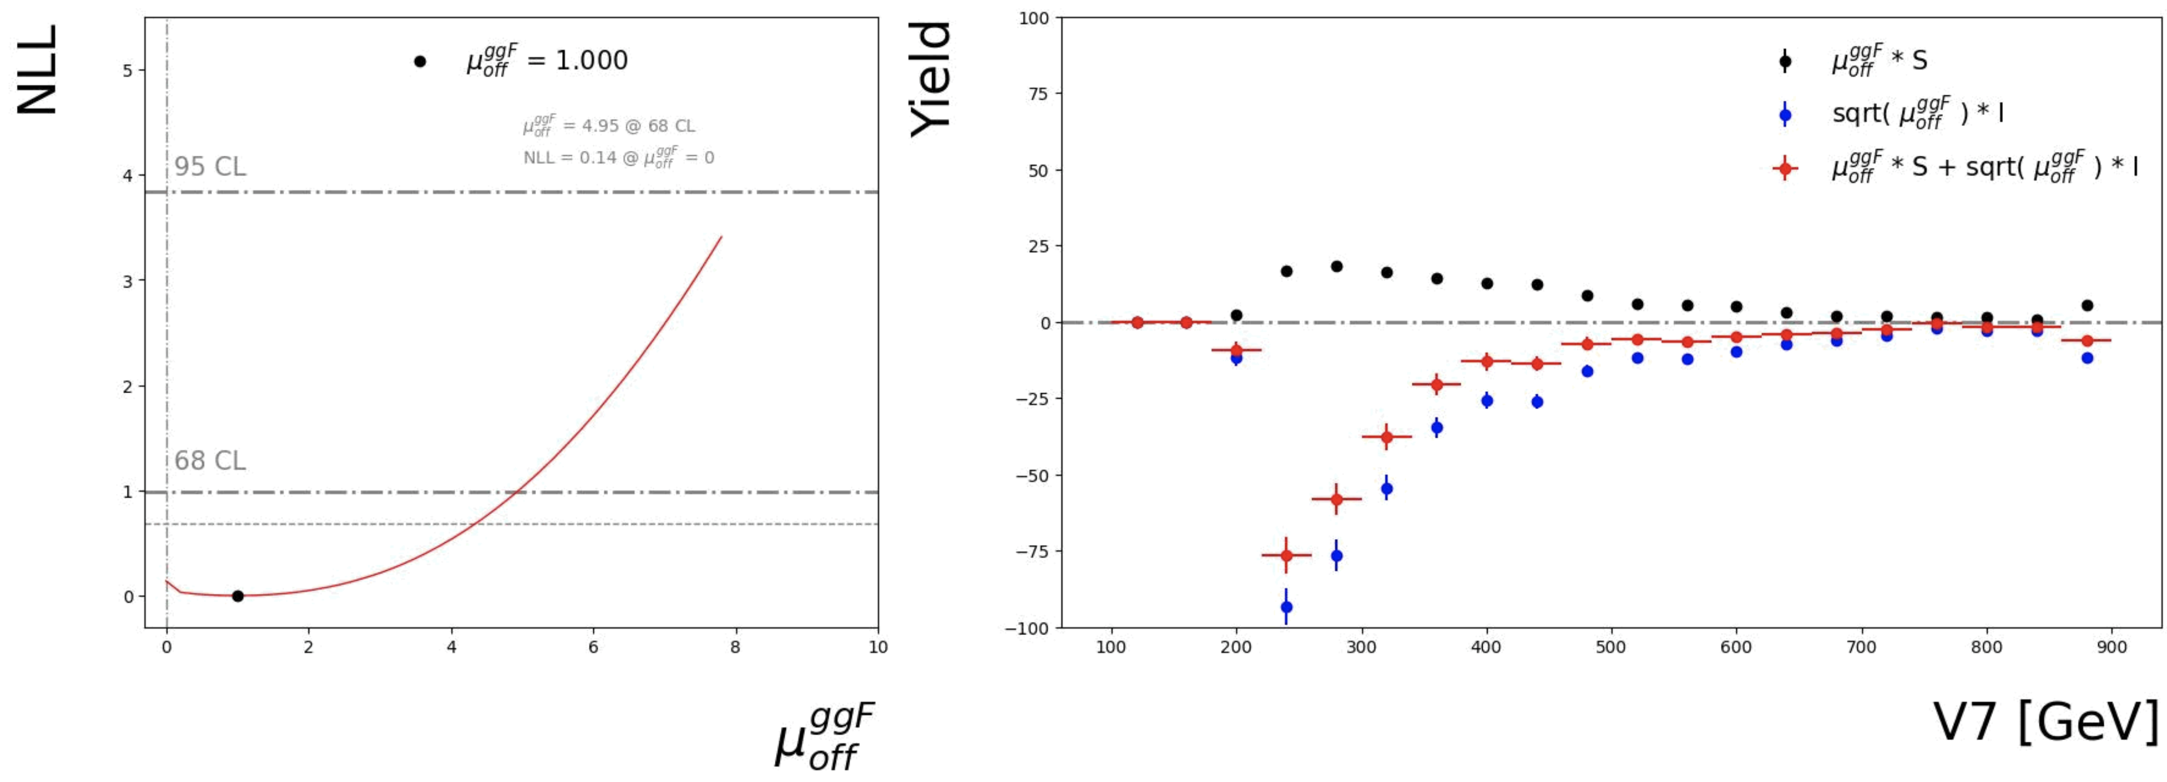
Signal definition: Effective signal contribution
Parametrise this effect using the Off-shell Higgs Signal strength $μ_{Off}^{ggF}∝Γ_{H}^{tot}$
$$σ_{gg→(H→)WW}=μ_{offshell}σ_{S}+σ_{B}+\sqrt{μ_{offshell}}σ_{I}$$
The effective contribution we observe
$$V7(m_{ll}+0.7⋅m_{T})[GeV]$$

Slide 9
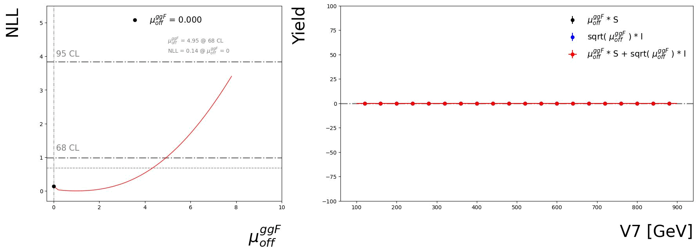
Signal definition: Interference and Signal
Take advantage of the shape as well as the normalisation
The effective contribution we observe
$$V7(m_{ll}+0.7⋅m_{T})[GeV]$$

Slide 10
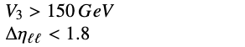
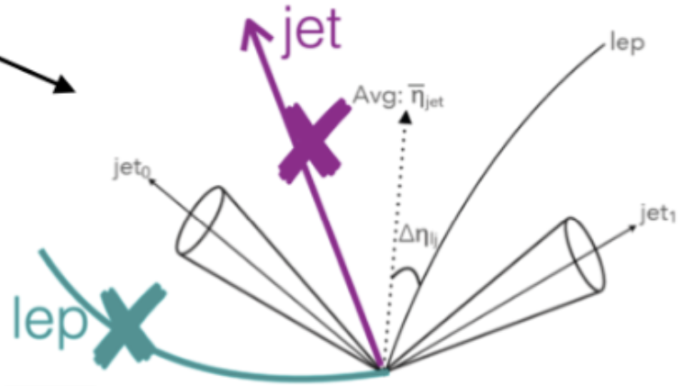
HWW Off-shell analysis: Topologies
6 signal regions, 3 production modes, 2 decay topologies
$WW→eνμν$ and $WW→eνeν/μνμν$
Gluon fusion
Gluon fusion + 1 jet
Vector boson fusion
CJV (Central-jet-veto)
OLV (outside-lepton-veto)
$$Δη_{ll}$$
$$ℓ^{+}$$
$$ℓ^{-}$$
$$Δϕ_{ll}$$
$$ℓ^{+}$$
$$ℓ^{-}$$
$$E_{T}^{miss}$$
$$E_{T}^{miss}$$

Slide 11
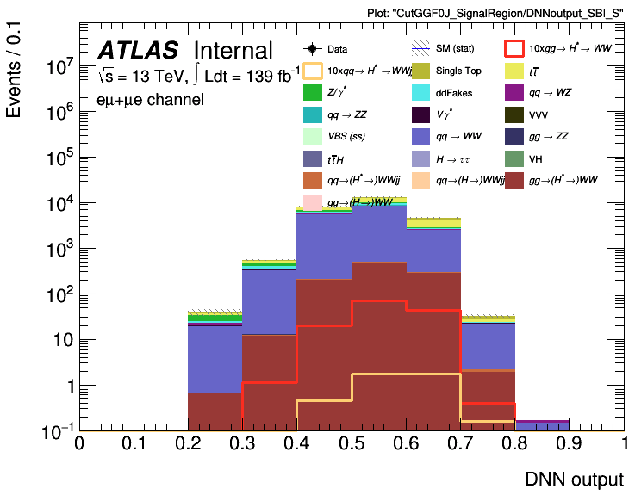
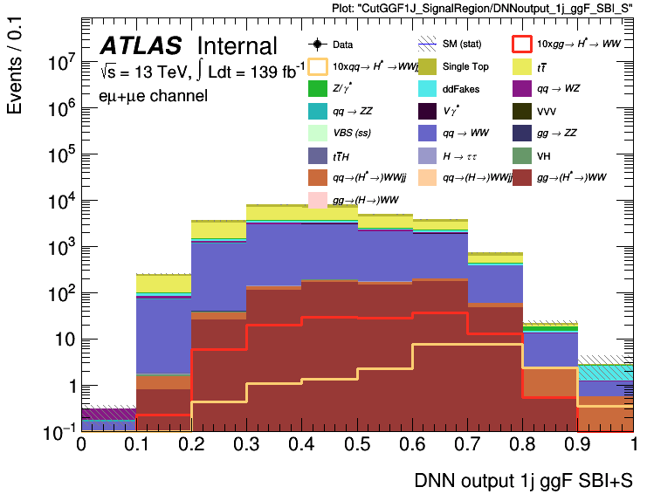
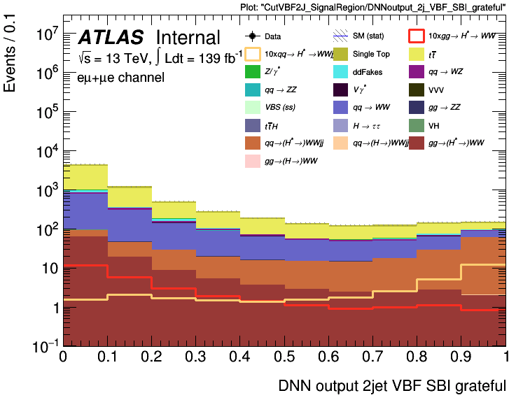
Signal extraction
First background defined:
Non-interfering background
3 Binary classifiers trained per channel and background composition
Train 1-Dimensional classifiers to pass all interfering Background, Signal and SBI
Discriminating against non interfering Background
Gluon fusion
Gluon fusion + 1 jet
Vector boson fusion

Slide 12
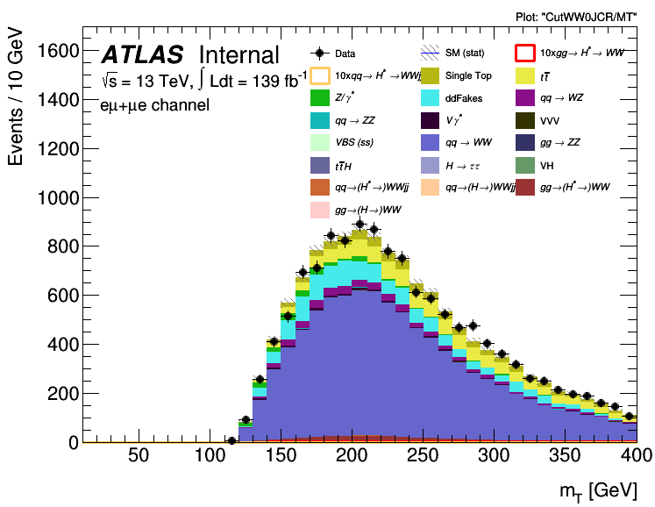
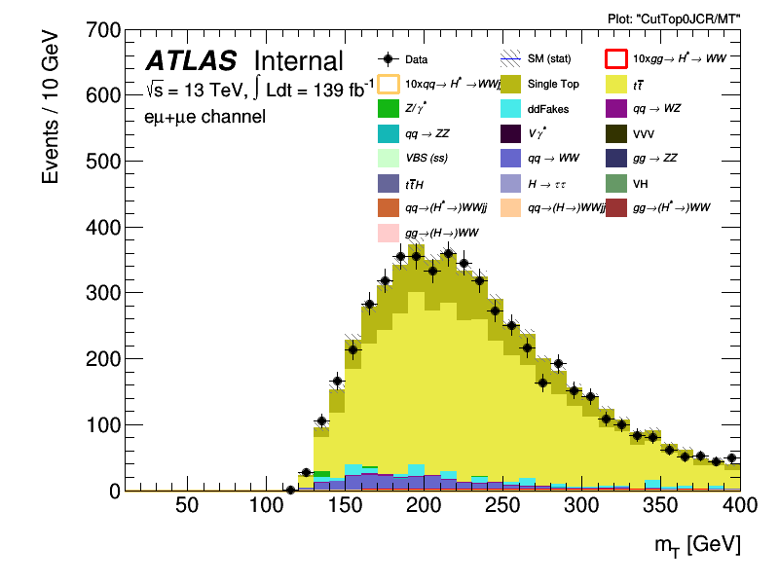
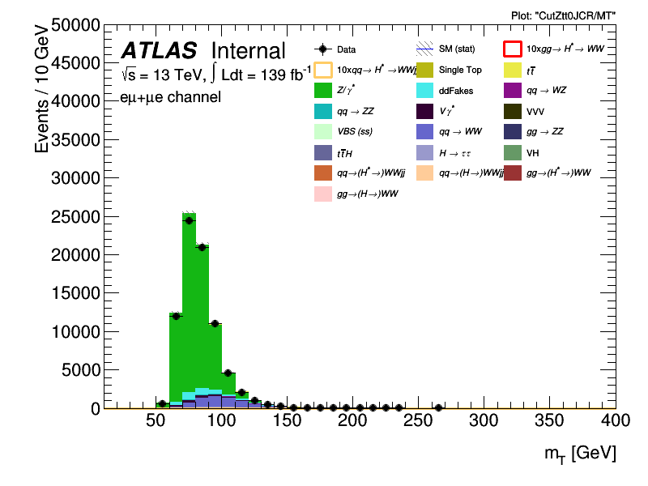
$H^{*}→WW$ Background modelling
WW, Top and Z+jets: normalisation contained by a dedicated control region
Crucial for this type of measurement
State-of-the-art higher order corrections applied in collaboration with theorists
Try to setup your Control region as close to the Signal region as possible
Normalisation factor extracted and applied to the Signal region
$qq→WW$ 0-jet
$p\overline{p}→t\overline{t}$ 0-jet
$p\overline{p}→Z→ττ$ 0-jet
High mass CR
High mass CR
On the Z-peak

Slide 13
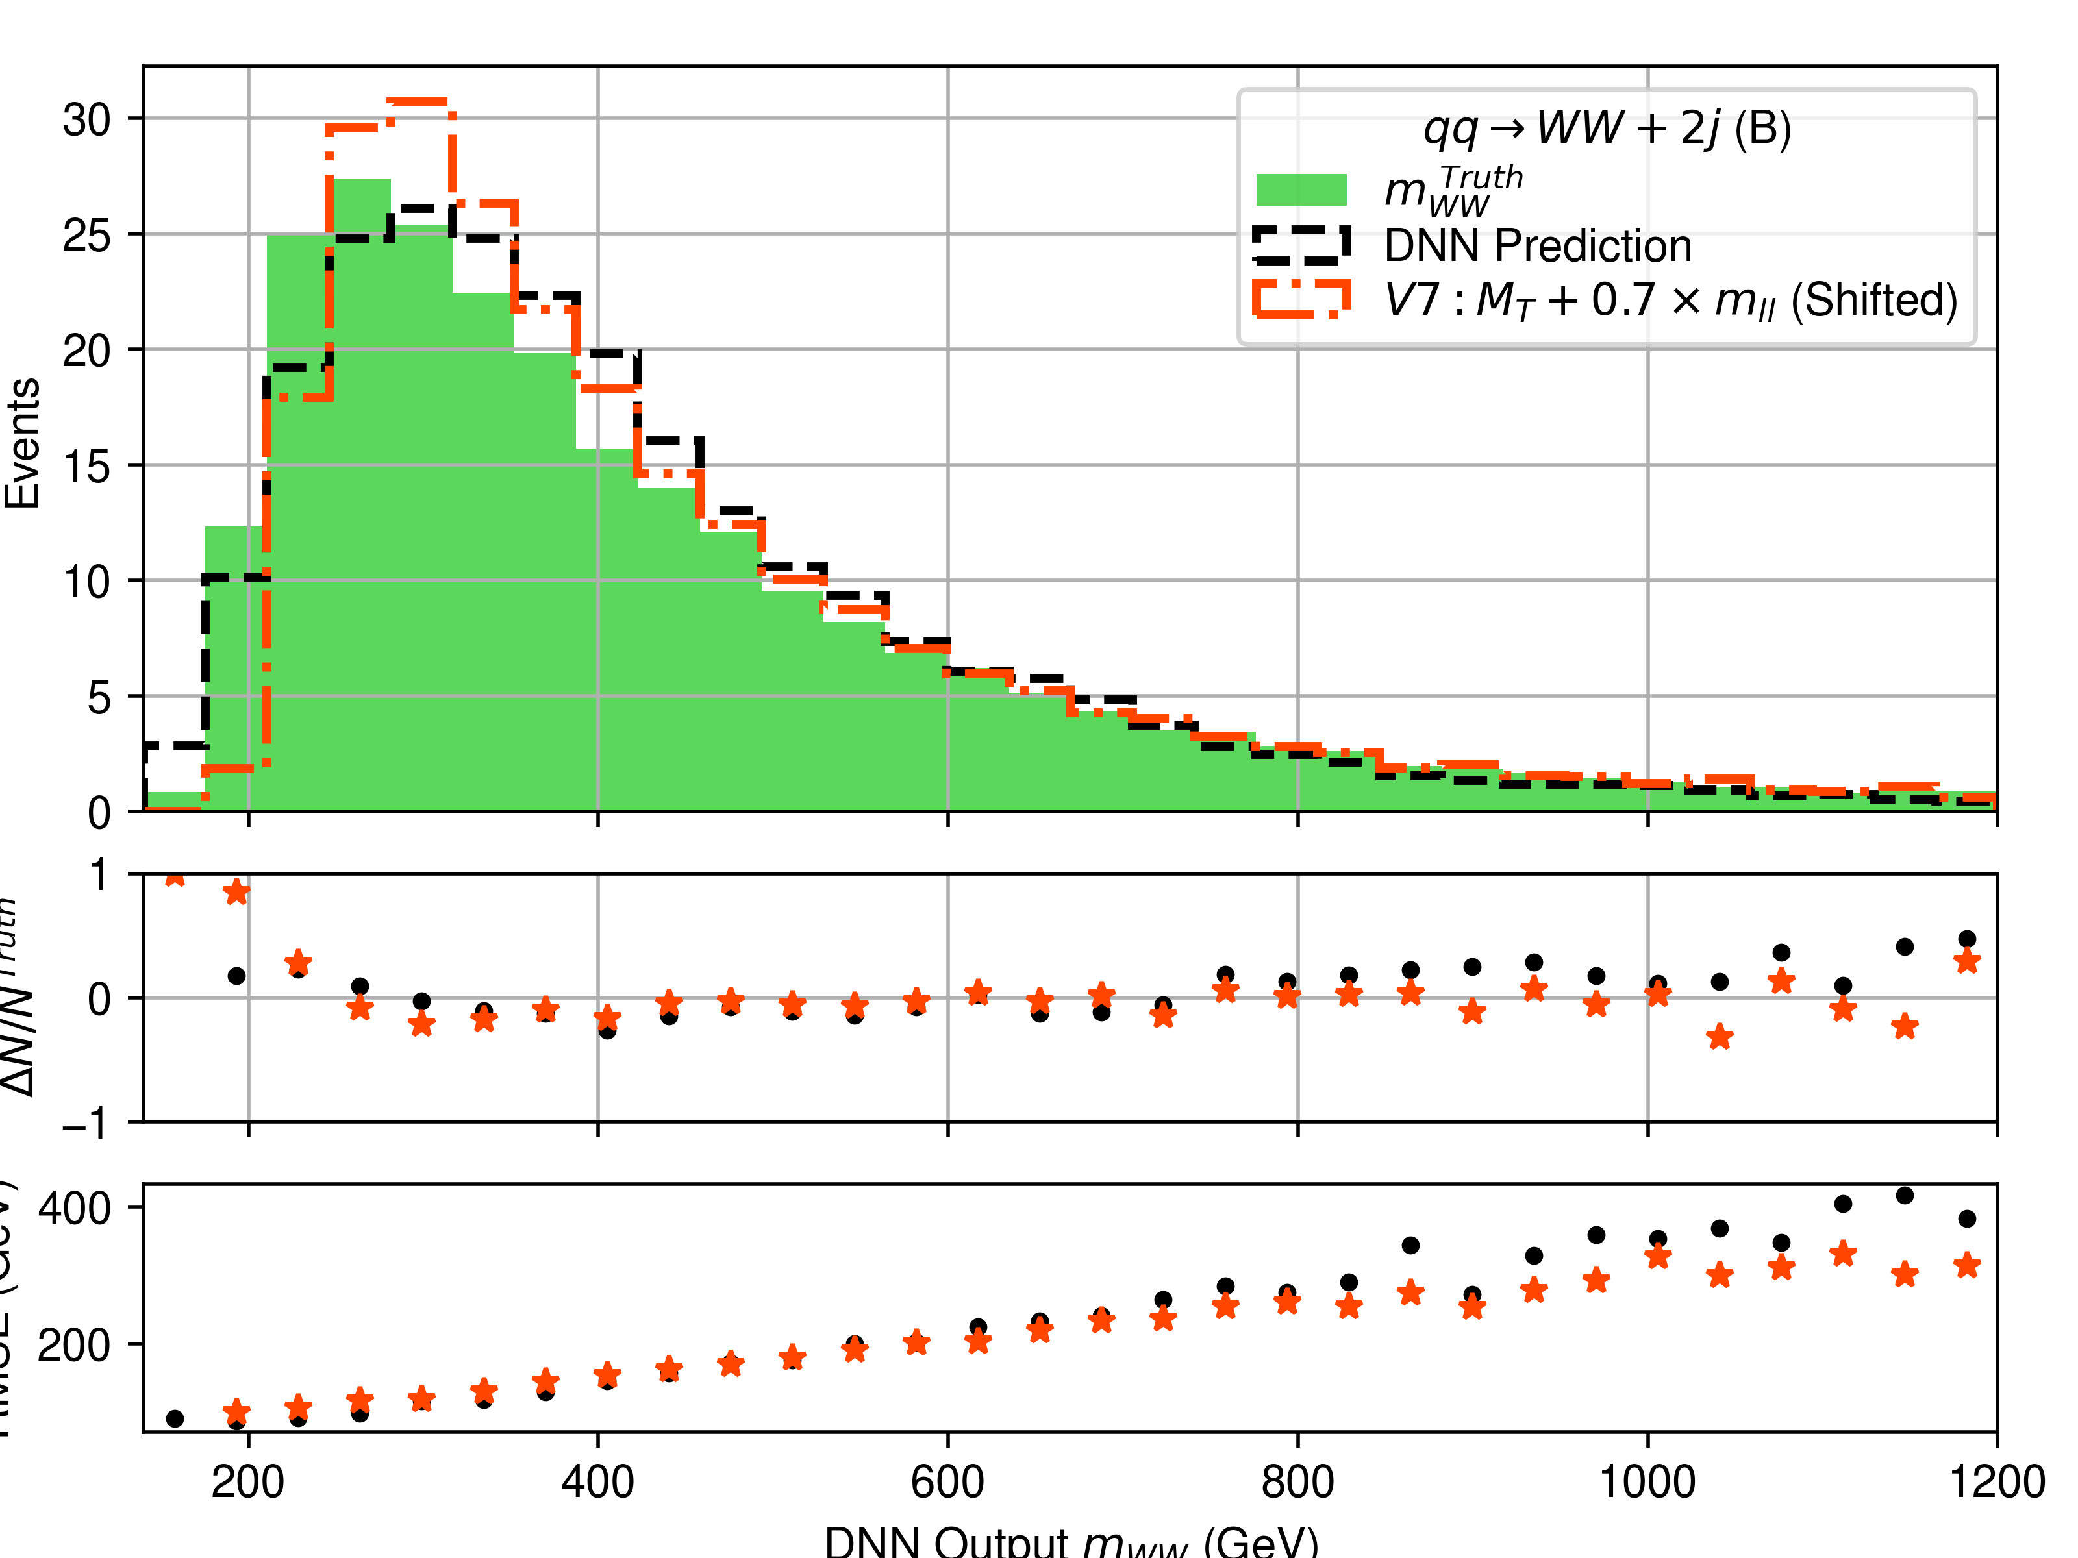
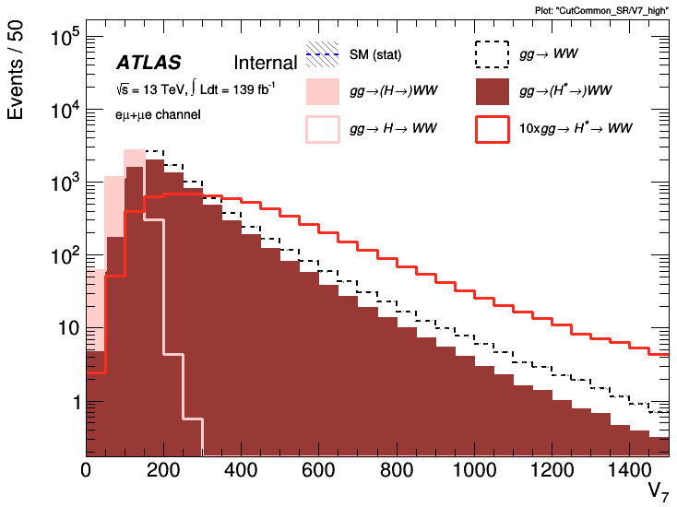
Signal extraction
Second type background defined:
Interfering background
$m_{WW}$ - proxy observable
$m_{WW}$ -regressor or V7
Allows for a natural separation off:
Onshell region
Interference dominated region
Signal dominated region
Observable defined as close to $m_{WW}$ as possible
Use as discriminant variable to separate interference and signal dominated regions
$$ΔN/N^{truth}$$
$$RMSE(GeV)$$
$$DNN-output/m_{WW}[GeV]$$

Slide 14
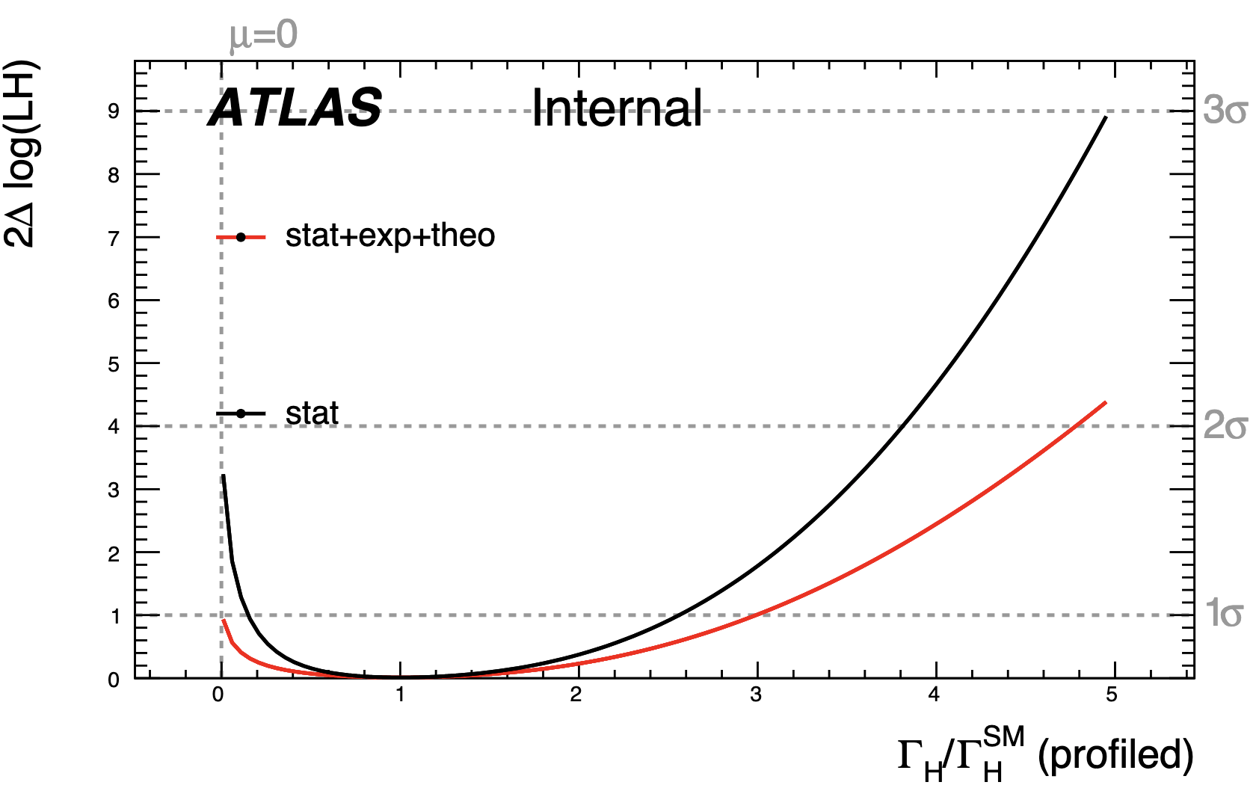
Total Higgs Width measurement
The $m_{WW}$-proxy and DNN output are unrolled
$WW→eνμν$ channel only!
Expect to set limits on the Offshell $H→WW$ Signal strength
$μ_{Off-shell}^{H→WW→eνμν}=1_{-0.97}^{+1.96}$ (stat+sys+theo)
When combining with On-shell $H→WW$
Current Expected sensitivity for the total Higgs width
$Γ_{H}^{tot}={4.1}_{-4.1}^{+12.3}MeV$ (stat+sys+theo)

Slide 15
Conclusion and Prospects
What researchers previously thought to be an inaccessible property of the Higgs is now being measured in Higgs to WW, ZZ and $γγ$ channels!
HWW Analysis strategy mostly developed by now using the different flavour channel
Results shown here only contain the $WW→eνμν$ channel.
$WW→eνeν/μνμν$ channel expected to add an extra 25% in sensitivity
More sensitivity improvements ongoing
Looking to combine results with the $H→ZZ$ Offshell which recently found first evidence for Offshell Higgs production at the ATLAS experiment.

Slide 16
Backup

Slide 17
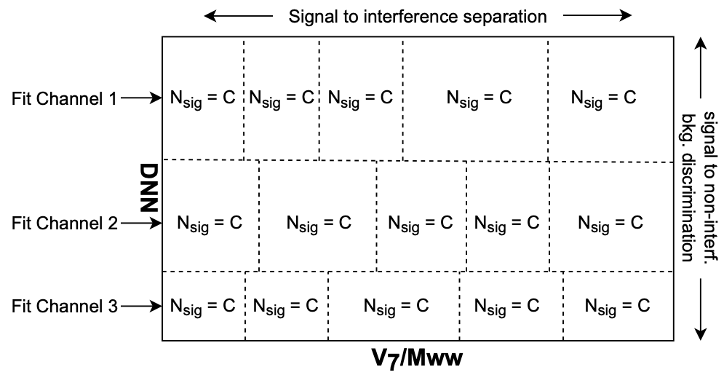
Signal extraction
3 DNN regions per channel, Providing:
$m_{WW}$-proxy observable with high S/B for High DNN output
Background enriched $m_{WW}$-proxy to be used as extra control region

Slide 18
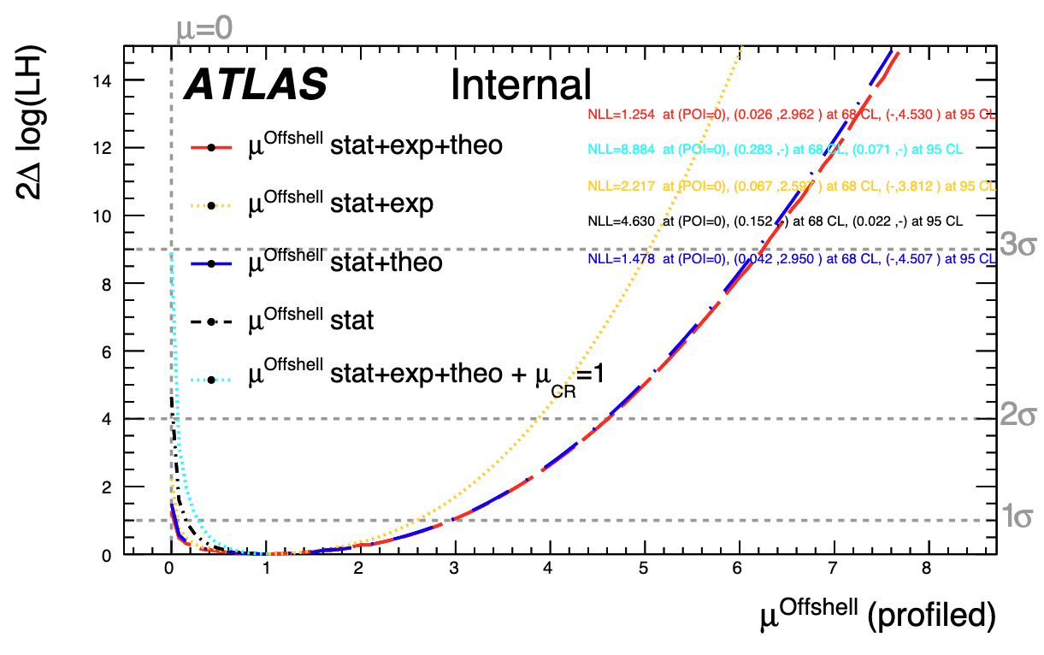

Slide 19
